Slide 1
R&D status of STCF ECAL readout electronics
Hanlin YU
On behalf of the STCF ECAL Working Group
the State Key Laboratory of Particle Detection and Electronics, University of Science and Technology of China
Hefei 230026, China
Notes:
Dear experts, students, hello everyone, my name is Yu Hanlin, from the University of Science and Technology of China, I am making this report on behalf of the STCF ECAL working group, and my report is entitled "R&D status of STCF ECAL readout electronics".
各位专家，领导，同学们，大家好，我叫于翰霖，来自中国科学技术大学，我代表STCF ECAL工作组为大家做此次报告，我的报告题目是STCF ECAL读出电子学研究进展。

Slide 2
Catalog
Background
Readout electronics design
Improvement for pile-up signals
Summary and prospect
Notes:
First, the background of STCF ECAL
首先介绍研究背景

Slide 3
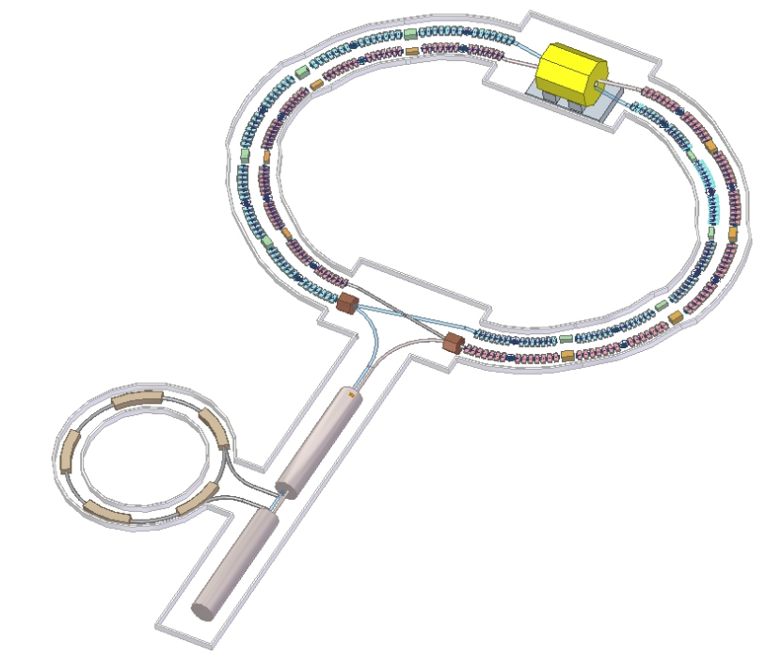
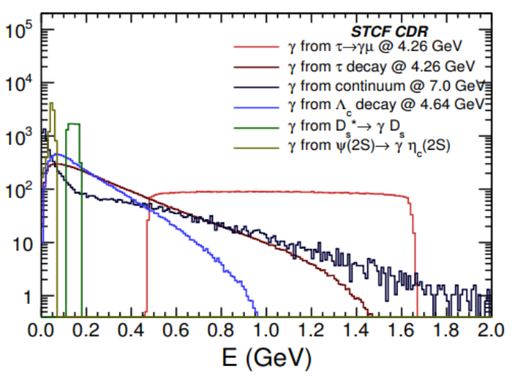
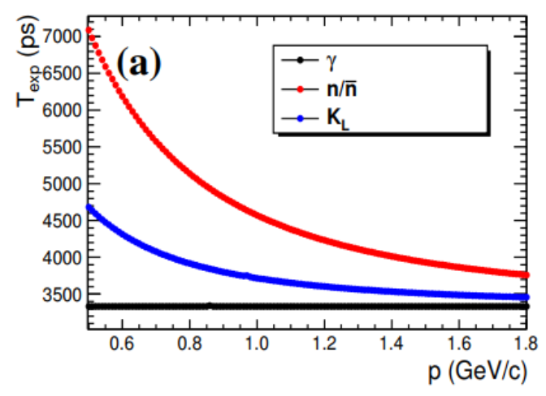

Background of STCF ECAL
Electromagnetic Calorimeter，ECAL
  Target particle: Terminal photon
  Core target: measurement of energy at high brightness
  Accessibility: Get information of Neutral hadrons
Super Tau Charm Facility，STCF
  Collision energy：2 – 7 GeV
  Collision brightness：$>0.5×{10}^{35}{cm}^{−2}s^{−1}$
  Fast response probe spectrometer
Photon energy distribution
Time-of-flight
Notes:
The Super Tau Charm Facility, stcf, which is a fast response probe spectrometer, its collision energy is 2 to 7 GeV（Giga electron volts）, collision brightness is over 0.5 times 10 to the power of 35 per squar centimeters per second. stcf Electromagnetic Calorimeter, ecal, its main target is the Terminal photon generated by the collision of positive and negative electrons, and the accurate measurement of photon energy under high collision brightness is the core task of ecal. In addition, since STCF is not designed with a hadron calorimeter, ECAL also needs to undertake the task of getting part of the information of neutral hadrons.
我国科学家提出的新一代高亮度陶粲对撞机被称为超级陶粲装置，stcf，其对撞能量为2到7个GeV，对撞亮度xxx，快响应探测谱仪，stcf的电磁量能器，ecal，其探测的主要目标是正负电子对撞产生的末态光子，精确测量高对撞亮度下的光子能量是ecal的核心任务 。此外，由于谱仪并未设计强子量能器，ecal还需承担部分中性强子的信息提取任务。

Slide 4
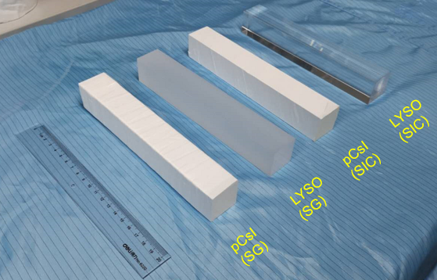
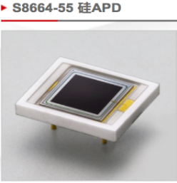
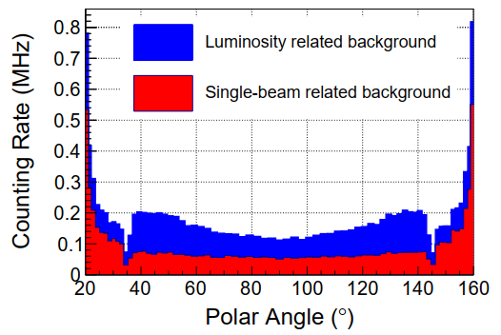
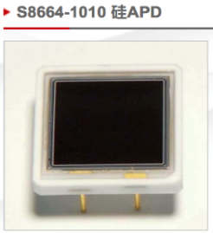
Background of STCF ECAL
Detection scheme at high collision brightness
  Pure CsI（pCsI）
    Short luminescence decay time
    Good radiation resistance
  Avalanche photodiode（APD）
    Internal gain
    Anti-magnetic field
    Large dynamic range
Challenge of readout electronics
  Low Noise
    <2.4𝑓𝐶(1𝑀𝑒𝑉)
  High Time Resolution
    <200 𝑝𝑠@2400𝑓𝐶(1𝐺𝑒𝑉), <1𝑛𝑠@240𝑓𝐶(100𝑀𝑒𝑉)
  High Sample Rate
    Up to ~MHz at EndCap
The hit event rate reaches the order of MHz
Notes:
Due to the need to achieve high energy and at high case rates, the STCF ECAL is designed based on fast scintillation crystals. Among them, Pure Cesium iodide was selected due to its short luminescence decay time and good radiation resistance. But its light yield is relatively low. So ECAL use avalanche photodiodes, which have internal gain and are not affected by magnetic fields. However, at the same time, it also has the disadvantages of large junction capacitance and leakage current.
Therefore, we need to design readout electronics for the detection unit composed of pCsI and APD.
The challenge of this design is to achieve high energy resolution and time resolution at high case rates by using a charge-sensitive preamplifier
由于需要在高事例率下实现较高的能量分辨率，stcf ecal设计为基于快闪烁晶体的全吸收型量能器。其中，pcsi由于其发光衰减时间短、抗辐照性能好等优点被选作为闪烁晶体。不足之处是其荧光产额相对较低。为弥补此差距，ECAL的光电器件采用具有内部增益且不受磁场影响到雪崩光电二极管，apd。但同时也具有结电容和漏电路偏大的不足。
因此，本课题的研究内容是对pCsI和APD组成的探测单元，进行读出电子学方案的设计。
STCF ECAL，读出电子学噪声达到1MeV以下，时间分辨率在1GeV达到200ps，在100MeV达到亚纳秒量级，本底事例率最高可以达到~MHz，本课题的挑战在于采用电荷灵敏读出方案实现在高事例率下获得高能量分辨率和高时间分辨率的电子学设计

Slide 5
Catalog
Background
Readout electronics design
Improvement for pile-up signals
Summary and prospect
Notes:
Next, we will introduce read-out electronics design
接下来介绍读出电子学设计

Slide 6
Energy Measurement
Readout electronics design based on CSA
  Architecture Description：
Important Points
  Noise : Large Junction capacitance (270pF) , Large leakage current(20nA)
  Dynamic Range : 2.4fC~7.2pC
Notes:
The architecture of readout electronics design mainly includes CSA, pole-zero cancellation circuit, drive circuit and digitization and signal processing module, energy information and time information are transmitted to the server.
Among them, the noise contribution of the system mainly comes from CSA, and the noise of this stage is analyzed theoretically.
本课题设计的读出电子学整体架构主要包括CSA、极零相消电路、驱动电路以及后续的数字化和数字处理部分，经过ADC数字化的信号进入FPGA经过算法处理提取出能量信息以及时间信息传输至服务器。
其中，该系统的噪声贡献主要来自于第一级电荷灵敏放大器，下面对该方案的噪声进行理论分析。

Slide 7
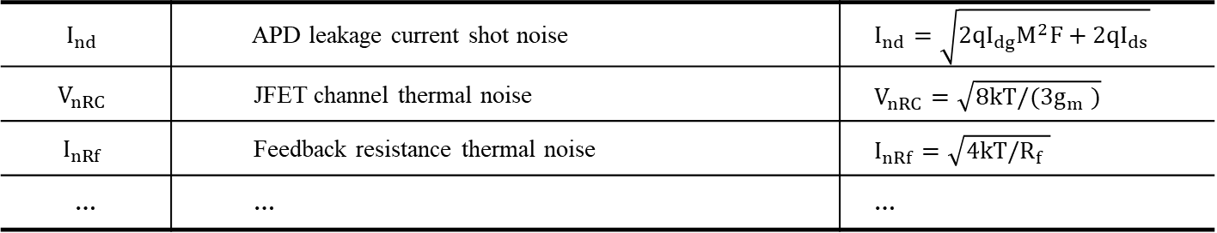
Energy Measurement
Noise Analysis of CSA
$$I_{nd}$$ | APD leakage current shot noise | $$I_{nd}=\sqrt{2qI_{dg}M^{2}F+2qI_{ds}}$$
$$V_{nRC}$$ | JFET channel thermal noise | $$V_{nRC}=\sqrt{8kT/(3g_{m} )}$$
$$I_{nRf}$$ | Feedback resistance thermal noise | $$I_{nRf}=\sqrt{4kT/R_{f} }$$
… | … | …
Notes:
The CSA structure with APD is shown in the figure on the left, and the noise model is shown in the figure on the right, which contains a total of 13 noise sources. Among them, the major contributors are the leakage current shot noise of APD, the channel thermal noise of JFET, and the thermal noise of feedback resistor.
本课题设计的包含APD的CSA放大结构如左图所示，右图是其对应的噪声模型，共包含13中噪声源。其中贡献较大的几项分别为APD的漏电流散粒噪声、JFET的沟道热噪声以及反馈电阻的热噪声等。

Slide 8

Energy Measurement
CSA noise simulation——After Shaping(RC²)
$$\sim 1/\sqrt{n}$$
270 pF
100 ns
Three JFETs in parallel can achieve lower noise
The shaping time ~ 100 ns
Notes:
the relationship between system noise and parameters is simulated according to the theoretical noise formula. The figure on the left shows the simulation results of system noise, detector capacitance, and number of JFETs. It can be seen that in the case of a large input capacitance, the total noise can be reduced by increasing the number of JFETs, and in the case of an APD with a junction capacitance of 270 picofarad, a better noise level can be achieved by using three JFETs in parallel. The figure on the right show noise reaches the minimum when the shaping time is around 100 ns, which meets the design requirements.
为了进一步确定JFET跨导以及成形时间的选择，本课题根据得到的理论噪声公式，对系统噪声与相关参数的关系进行了仿真。左图是系统噪声与探测器电容、JFET数量的仿真计算结果。可以看出，在输入电容较大的情况下，通过增加JFET数量来提高跨导，可以使总噪声按照$1/\sqrt{n}$的趋势进行降低；对于结电容270 pF的APD而言，采用三个JFET并联可以实现更好噪声水平。 右图是系统噪声与成形时间的仿真结果。随着成形时间的增大，总噪声呈现先减小后增大的趋势；当成形时间在100 ns附近时，总噪声达到最小。对应指标可以满足设计需求。

Slide 9
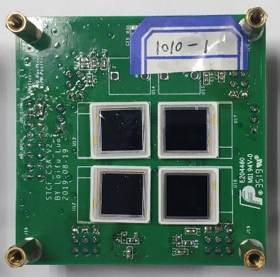
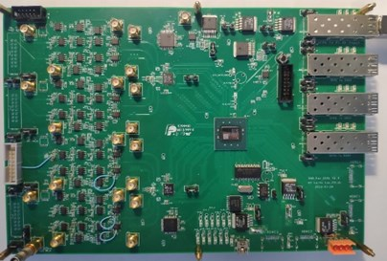
Energy Measurement
Noise actual measurements
APD
ADC
FPGA
The measured results are consistent with the simulation results

Slide 10
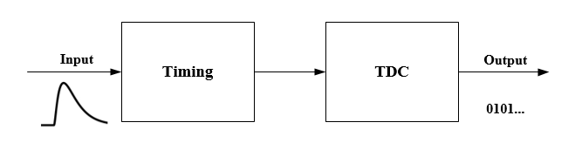
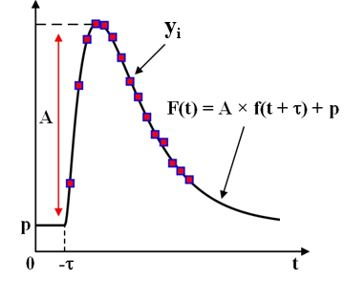
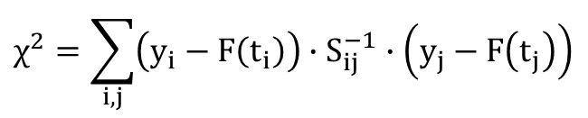
Time Measurement
Waveform Fitting
  Using ADC Sample Points
  Calculation process
Leading Edge Time Measurement Methods
$$χ^{2}=\sum_{i,j}{\left(y_{i}−F\left(t_{i}\right)\right)∙S_{ij}^{−1}∙\left(y_{j}−F\left(t_{j}\right)\right)}$$
Leading Edge Time Measurement
Quick edge – Fast Shaper
STCF ECAL Electronics
Energy Measurement – CSA
Notes:
The time measurement methods include leading edge timing, zero-crossing timing, constant ratio timing, etc.; however, these methods require fast signal edge for timing, that is, fast amplification circuit is required; however, STCF ECAL uses CSA circuit, which means the waveform is slow, so the waveform fitting method is used to get the time information. This method uses the known shape function to describe the sampling sequence of ADC, where the variable parameters are amplitude, time, and baseline. By calculating the chi-square between the sampling sequence and shape function , the time information can be obtained.
一般时间测量过程可分为定时与时间数字转换，其中常见的定时方法有前沿定时、过零定时、恒比定时等；但是这些方法要求用于定时的信号边沿快，即需要快放大电路；但为了获得高精度的能量信息，STCF ECAL读出电子学采用CSA对电流进行积分，波形较慢；因此采用波形拟合的方法对CSA的输出波形进行时间测量。该方法的基本原理，如右图所示，利用已知的形状函数f(t)来描述ADC的采样序列，其中可变化的参数有幅度A、时间τ、基线p。通过计算采样序列与F(t)之间的误差平方和，并平方和最小时，即可得到相应的参数信息。

Slide 11
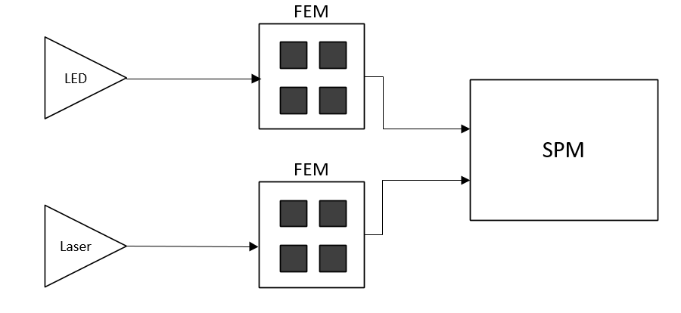
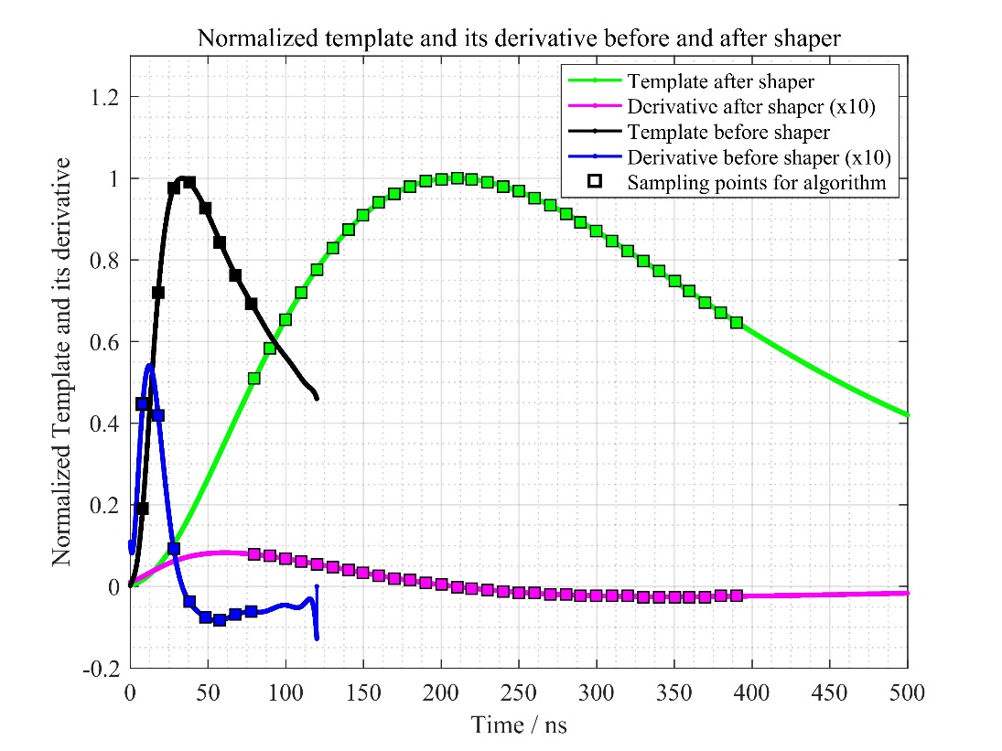
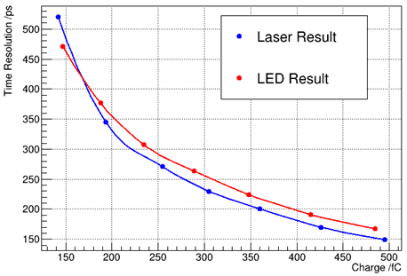

Time Measurement
Time Measurement Error Analysis
Result of LED&&Laser Test
$$σ_{t−n}= \frac{σ_{n}}{A\sqrt{∑{\left(f^{′}\left(t_{i}\right)\right)}^{2}}}$$
Sample Noise
Slope
After Shaping
Before Shaping
Notes:
According to the least squares theory, time resolution is proportional to the noise of the sampling point and inversely proportional to the derivative of the sampling sequence. The waveforms before and after shaping shown in the figure. It can be seen that the slope of the waveform before shaping is much larger than that after shaping. Therefore, the waveform fitting using the signal before shaping can obtain better time resolution. The figure on the right shows the time resolution curve as a function of energy from the actual measurement of LED and laser signals.
根据广义最小二乘理论，拟合时间τ的标准差与采样点噪声成正比，与采样序列的波形导数成负相关。由此可知，成形后的波形，其边沿较慢，波形斜率较小，因而噪声引入的时间误差较大。对于STCF ECAL在能量测量中采用的CSA与CR-RC2成形电路，其成形前后的归一化波形和对应的波形斜率如图所示。可以看出，成形前的波形斜率比成后的斜率大了5倍左右。所以采用成形前信号进行波形拟合，理论上可以得到更好的时间分辨。右侧图片为对led和laser信号进行实际测量得到的时间分辨随能量变化的曲线。

Slide 12
Catalog
Background
Readout electronics design
Improvement for pile-up signals
Summary and prospect
Notes:
Next, we will introduce read-out electronics design
接下来介绍读出电子学设计

Slide 13
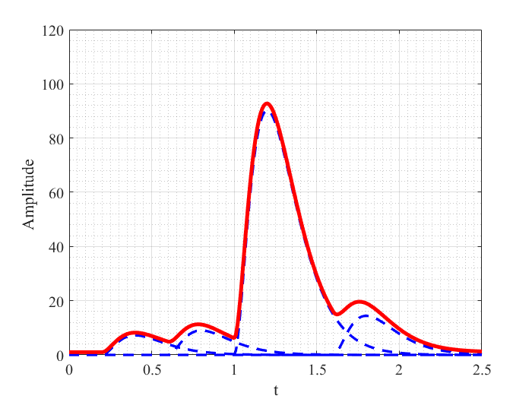
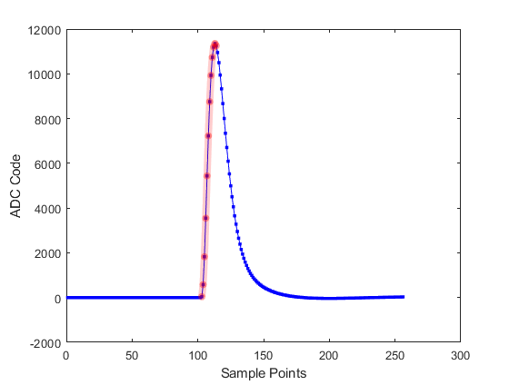
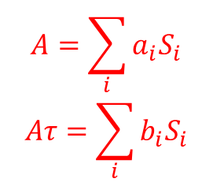
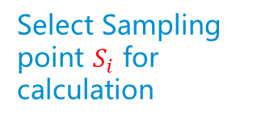
Processing of Pile-up signals
Challenge
  Waveform fitting algorithm && RC^{(n)} Filtering：Unable to handle high event rate pile-up Time&&amplitude extraction algorithm：Get time and energy information altogether
Select Sampling point $S_{i}$ for calculation
$$A=\sum_{i}{a_{i}S_{i}}$$
$$Aτ=\sum_{i}{b_{i}S_{i}}$$
Notes:
In the case of the high case rate mentioned above, it is difficult to deal with the pile-up waveform by using the waveform fitting method and RC filtering, so we use an algorithm that can extract time and energy information with few resources at the same time, and the algorithm only needs one calculation to obtain the information we need, and we use this algorithm to process the sampling points and processing pile-up signals.
在上述的高事例率情况下，可能会出现堆积现象，使用波形拟合方法和RC滤波难以对这种高事例率情况下的波形堆积进行处理，因此我们采用了一种可以用比较少的资源同时提取出高精确度的时间和能量信息的算法，该算法只需要一次计算即可得到我们需要的信息，我们使用该算法对采样点进行处理并依次扣除堆积信号。

Slide 14
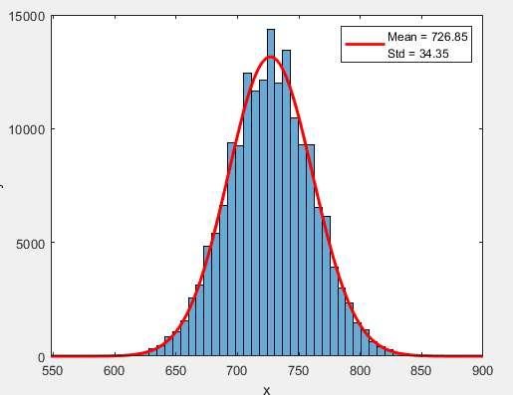
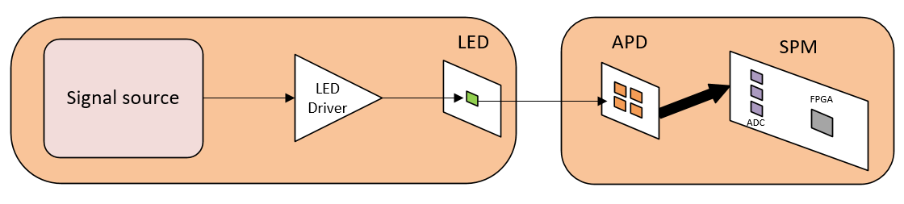
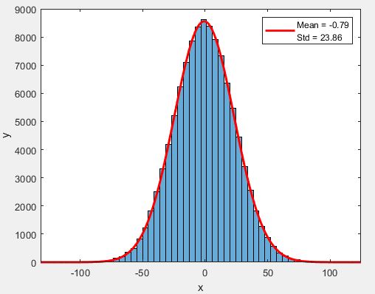
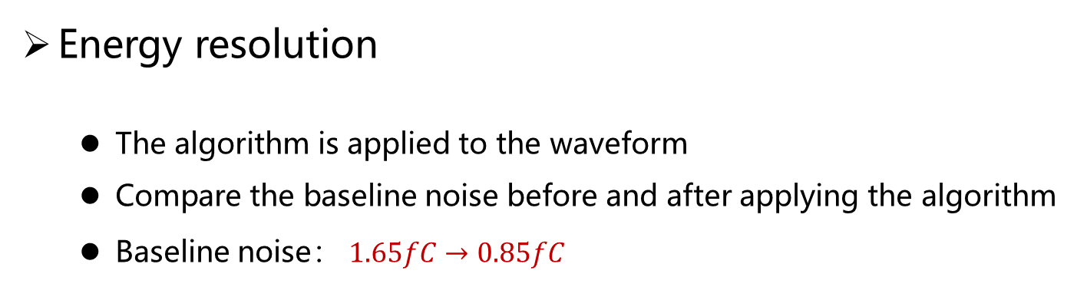
Processing of Pile-up signals
Sigma=1.65fC
Energy resolution
  The algorithm is applied to the waveform
  Compare the baseline noise before and after applying the algorithm
  Baseline noise： $1.65fC→0.85fC$
Sigma=0.85fC

Slide 15
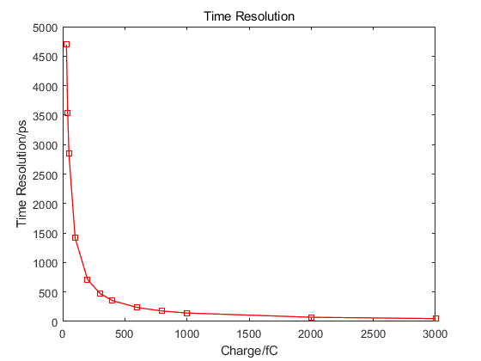
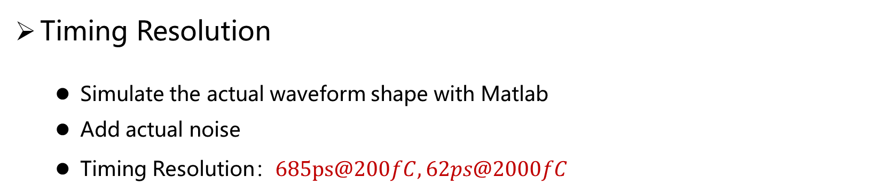
Processing of Pile-up signals
Timing Resolution
  Simulate the actual waveform shape with Matlab
  Add actual noise
  Timing Resolution：$685ps@200fC, 62ps@2000fC$
The time resolution meets the requirements
685ps@200fC
62ps@2000fC
142ps@1000fC
Notes:
In order to verify the time resolution of the algorithm, we use the actual waveform shape adding actual noise to simulate, the figure shows the time resolution as a function of energy, it can be seen that The time resolution meets the requirements
为了验证该算法的时间测量效果，我们采用实际波形形状进行建模仿真，使用实际波形拟合得到的解析式添加实际测量得到的噪声，使用算法得到的定时精度曲线如图所示，可以看到在。。。

Slide 16
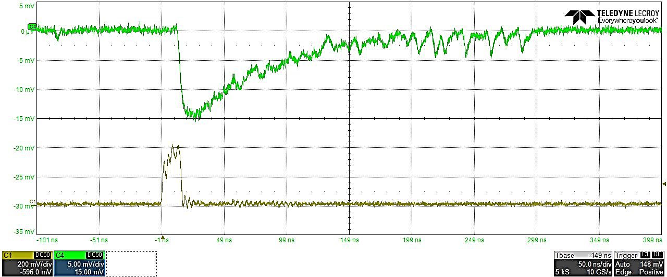
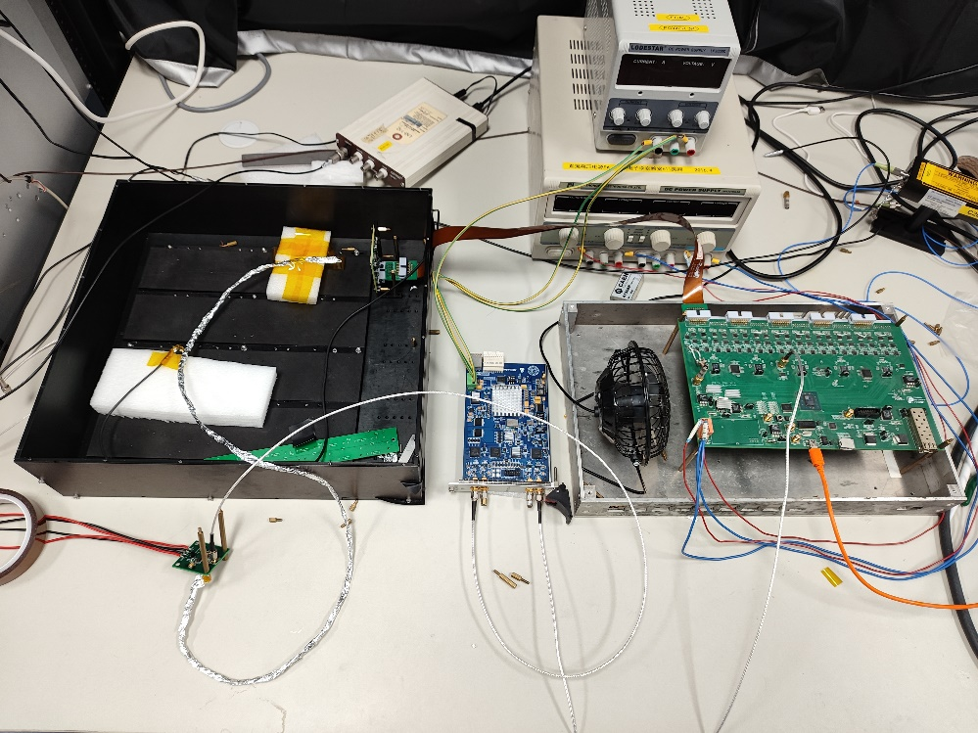
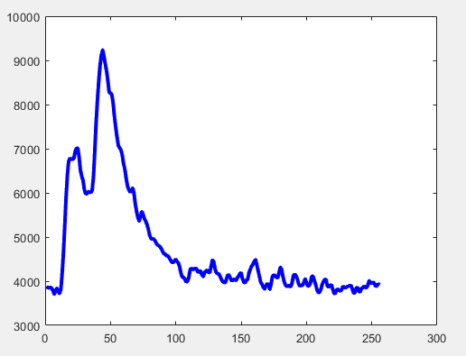
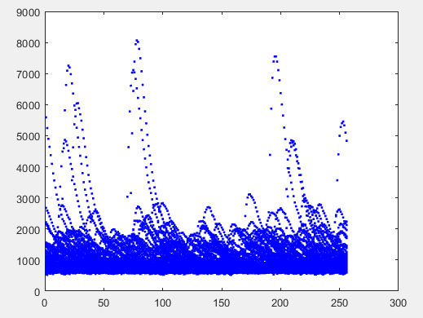
Background signal simulation platform
LEDs are driven to emit light using a DAC controlled by FPGA and collected by an APD to simulate the background signals
The shape of the LED drive voltage and the shape of the LED output light signal
LED
Power
Single
Multi
Wire
FEM
SPM
DAC
LED Driver
Single and multiple waveforms plotted together using DAC-driven LEDs to simulate background signals
Notes:
we use the LED and DAC module to build a background signal simulation platform, and use the FPGA to control the DAC module to generate random pulse signals that meet the energy distribution and time distribution of the background signals, which is used to drive the LED to generate an optical signal similar to the response of pCsI to simulate the background case.
为了验证对于本底信号的处理效果，我们使用LED以及DAC模块搭建了一套本底信号模拟验证平台，使用FPGA控制DAC模块产生满足本底事例能量分布和时间分布的随机脉冲信号用于驱动LED产生与pCsI的响应类似的光信号以模拟本底事例。

Slide 17
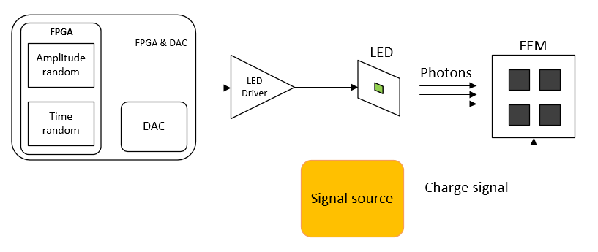
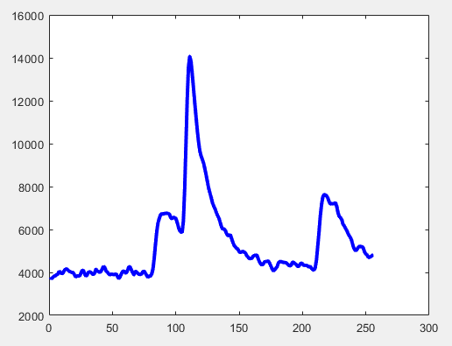
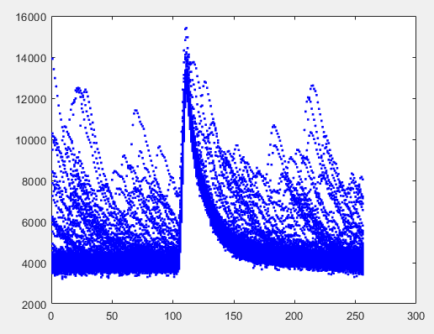
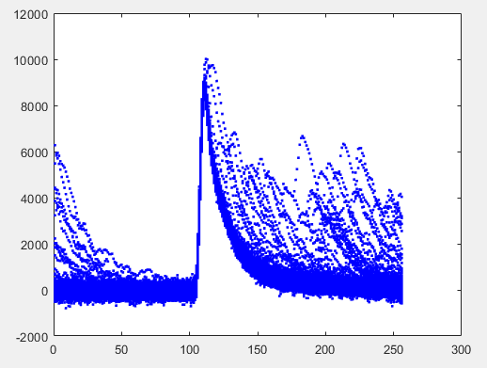
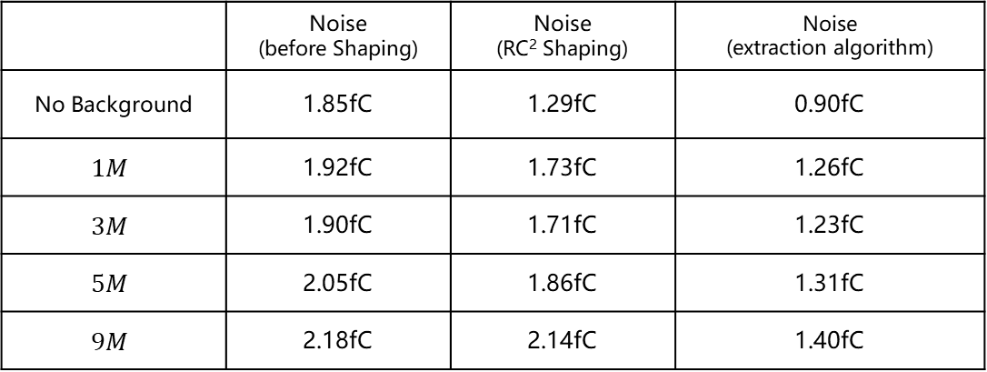
Processing of Pile-up signals
Single
Multi
DAC&&LED → Background Signal
Charge signal → Event Signal
 | Noise (before Shaping) | Noise (RC² Shaping) | Noise (extraction algorithm)
No Background | 1.85fC | 1.29fC | 0.90fC
$$1M$$ | 1.92fC | 1.73fC | 1.26fC
$$3M$$ | 1.90fC | 1.71fC | 1.23fC
$$5M$$ | 2.05fC | 1.86fC | 1.31fC
$$9M$$ | 2.18fC | 2.14fC | 1.40fC
Notes:
We use LED to simulate the background signal, use a signal source to simulate the event signal, and use the above algorithm deal with the pile-up signals to ,and calculate the energy resolution of the event signal, compare this method with RC filtering, the results are shown in the chart, the results obtained by this algorithm are previously better than RC filtering.
我们使用上文提到的平台进行测试，使用led模拟本底信号，使用信号源输入电信号来模拟事例信号，并使用上述算法扣除产生堆积的信号排除堆积信号对于事例信号的干扰，并计算出事例信号的能量涨落，并将这种方法与RC2滤波进行对比，结果如图表所示，这种算法得到的结果明显优于RC滤波。

Slide 18
Readout Electronics Prototype
PXI Chassis
Prototype electronics
  Crystal arrays
  Distributed, modular
SFP Fiber
Flex Board
Notes:
Prototype electronics is distributed and modular, designed for the crystal arrays, including the front-end electronics module FEM, the back-end signal processing module SPM, and the data acquisition module DAQ, SPM and DAQ are designed and placed in the PXI chassis
原型电子学针对晶体阵列，按照分布式、模块化的设计思路，设计完成后包含直接与晶体连接的前端电子学模块FEM，后端信号处理模块SPM，以及数据汇总模块DAQ，SPM和DAQ均被设计放到PXI机箱中，下面分别对FEM和SPM进行介绍。

Slide 19
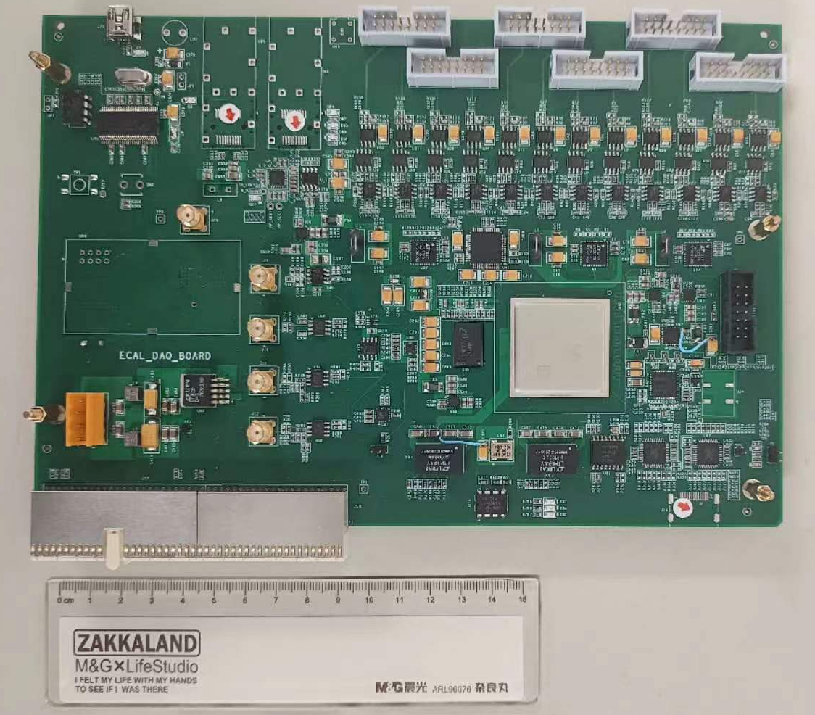
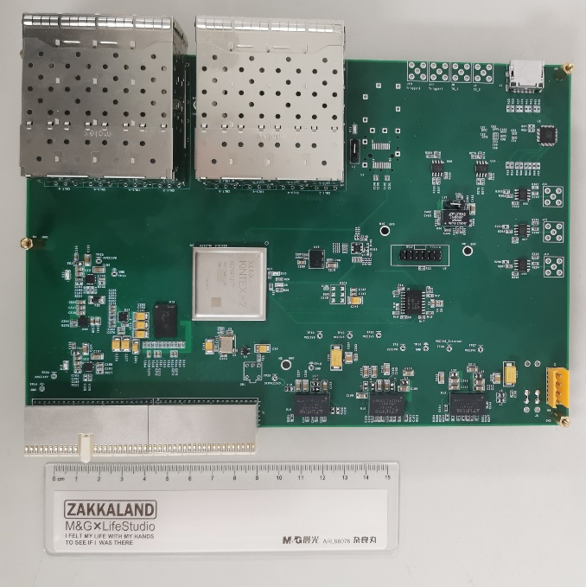
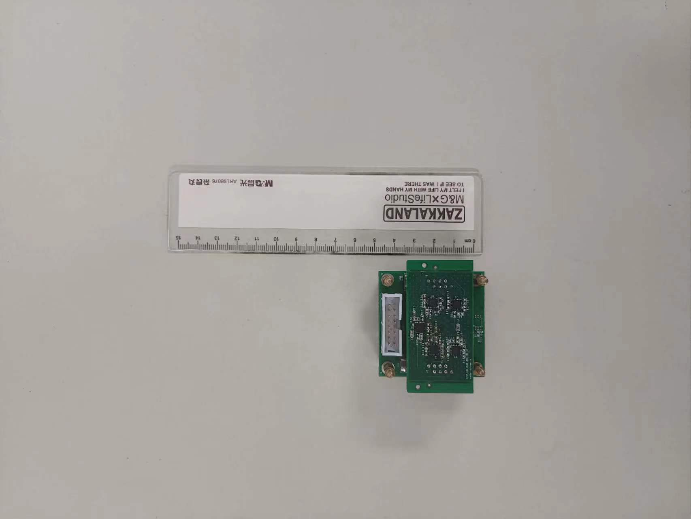
Readout Electronics Prototype
Front-End Module(FEM)
  Double Layer
  4 APD-CSA Channel
  High && Low Gain
Signal Processing Module(SPM)
  Control and Config FEM
  Receive Data from FEM
  Analog Digitization
  Extract Energy&&Time information
Data Acquisition Module(DAQ)
  Distribute the system clock
  Receive Data from SPM
  Data Packaging
  Communicate with outer systems
Notes:
FEM主要集成4片APD和4路对应的CSA。4路CSA输出信号经过极零相消、和模拟求和后，通过一路驱动运放传输至后端，FEM使用双层结构更高效的利用空间，包含高低增益以适应更高的动态范围。
SPM主要功能是接收FEM的信号，进行波形数字化，并对其进行信息提取。
DAQ向SPM分发系统时钟，并将SPM的数据收集打包，并负责与外部系统连接。

Slide 20
Catalog
Background
Readout electronics design
Improvement for pile-up signals
Summary and prospect
Notes:
最后是总结与展望

Slide 21
Summary and Prospect
Summary
  Completed the key technical research of readout electronics
  The timing resolution and energy resolution meet the design requirements
  In the background signal simulation experiment, the processing algorithm for the pile-up signal is verified
Prospect
  Complete the real-time processing in FPGA
  Complete the design of the readout electronics prototype
Notes:
未来我们计划继续完善堆积处理算法并应用在FPGA中实现实时处理，并且完成读出电子学原型机的设计，电子学原型机主要包括三个模块，信息提取模块用于汇总前端模块的模拟信号并提取能量和时间信息，数据汇总模块用于汇总信息提取模块的数据，所有模块均按照PXI机械结构设计，可以插入PXI机箱中，由机箱供电。

Slide 22
Thank You !
Notes:
感谢各位专家，领导，同学的倾听，我的报告到此结束，谢谢大家！

Slide 23
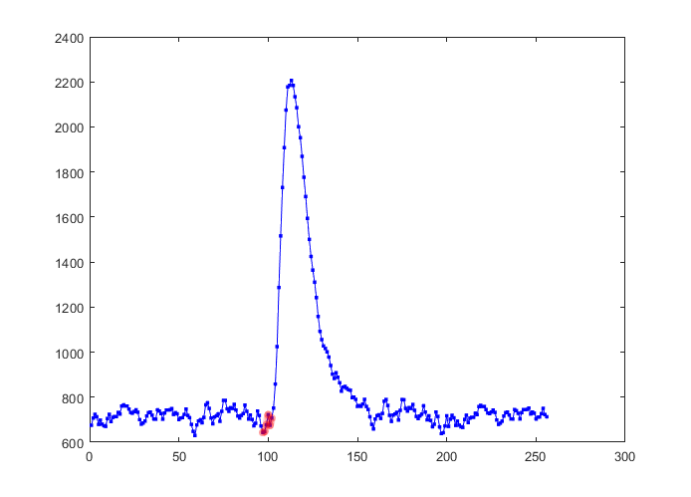
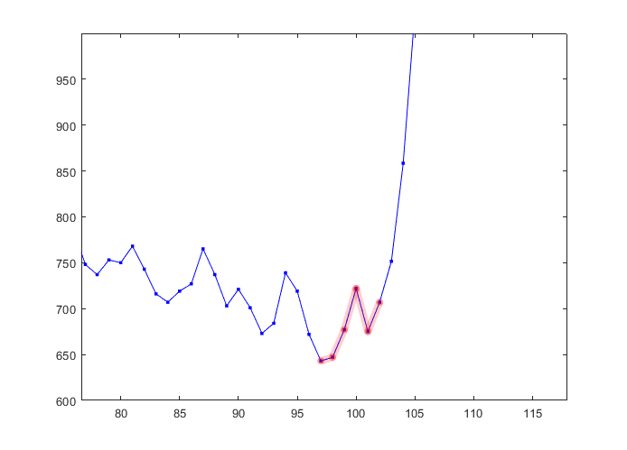
Backup
By algorithm to each point of the entire waveform, an energy sequence and a time offset sequence can be obtained, and only when the time offset is within a certain range, the point is considered to be the position of the case signal.
Sample Point | A/Code | τ/ps
97 | 876 | 23984
98 | 1117 | 20187
99 | 1309 | 14851
100 | 1433 | 7951
101 | 1479 | -695
102 | 1454 | -11198
Notes:
还有一个问题是如何寻找在一个时间窗内的事例位置

Slide 24
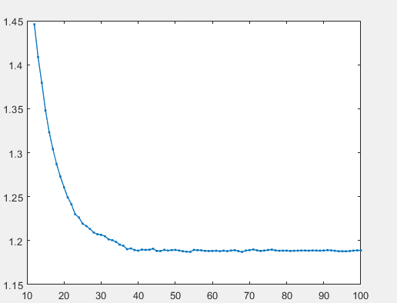
Backup
Noise(fC)
When the original nose is 2.1 fC, the optimal filtering algorithm is used to calculate the processed charge fluctuation as shown in the figure above by using sampling points of different lengths
Points

