Slide 1
Vertex fit and Kinematic fit Algorithm
Liang Yan
Fudan University

Slide 2
Outline
Introduction
Algorithm
Current Status and Limits
Global fits
Summary
Reference:
R. Frühwirth, Nucl. Instrum. Methods A 262 (1987) 444-450
W.D. Hulsbergen, Nucl. Instrum. Methods A 552 (2005) 566–575
Belle-II analysis software Group, Nucl. Instrum. Methods A 976 (2020) 164269
G. Guennebaud, B. Jacob, et al., Eigen v3, URL http://eigen.tuxfamily.org.

Slide 3
Introduction

Slide 4
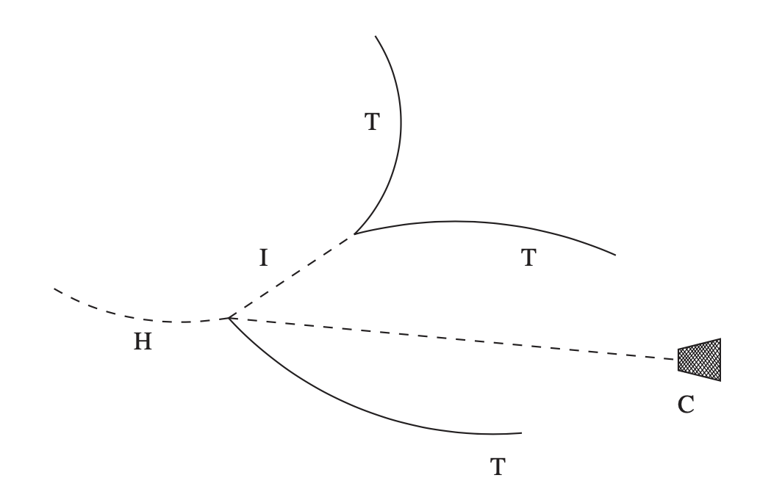
What is Vertex Fitting and Kinematic Fitting
The mathematic process of improving the measurements according to the physics laws in the interaction and decay of the particles.
For example: In the decays, the final particles should come from the common decay point (vertex fitting), the momentum of the final states equals to initial state (kinematic fitting).
Physical requirements are provided through constraints in the form of an equation: each track for 2 constraints (vertex fitting), four-momentum conversation for 4 constraints (kinematic fitting).
Figure from NIMA, 552, (2005)

Slide 5
Algorithm

Slide 6
Least-squares fit
The constraints are expressed as χ² contribution, a function of the parameters, denoted by the vector x
The solution to the fit is the value of x that minimizes the total χ²
Standard least-squares method
Kalman filter method

Slide 7
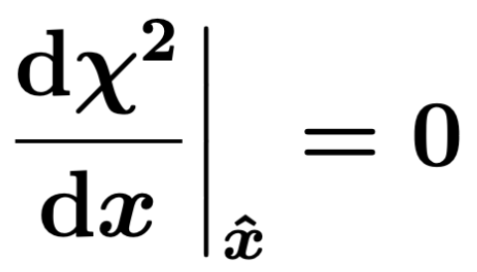
Method of least squares

Slide 8
Matrix notation

Slide 9
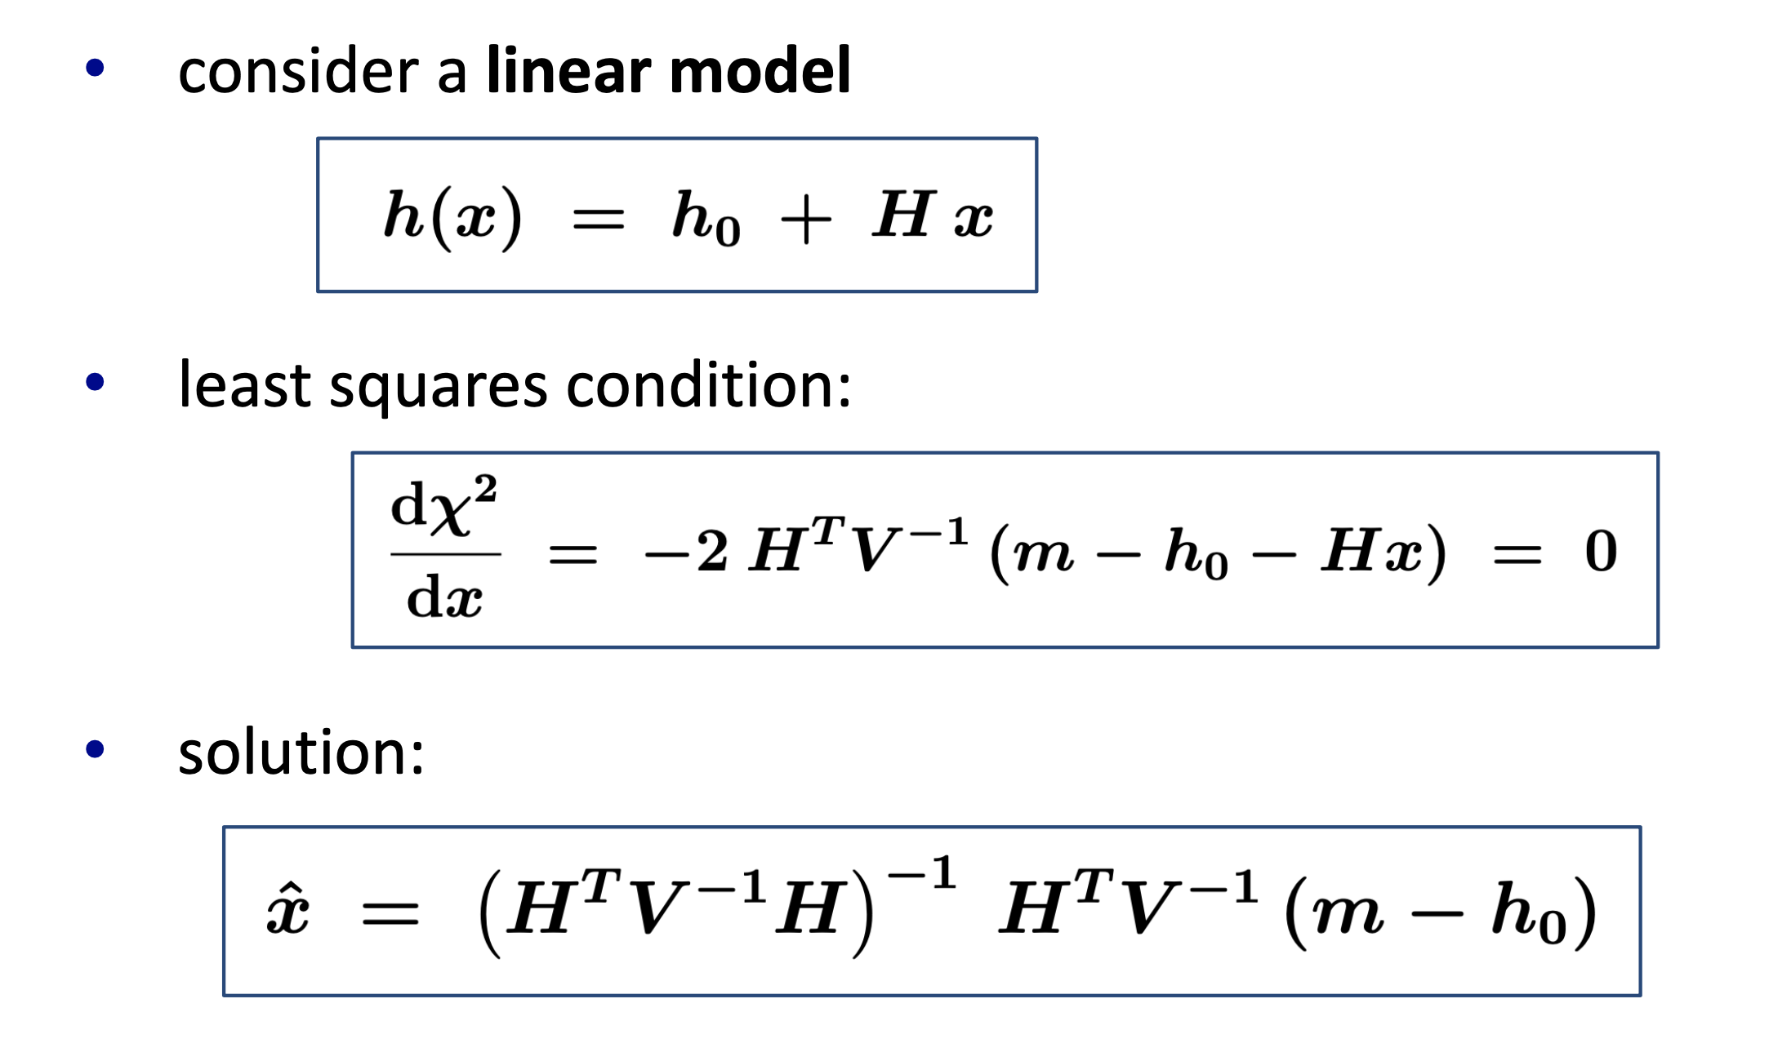
Linear least squares estimator
Linear least squares estimator
(LSE)

Slide 10
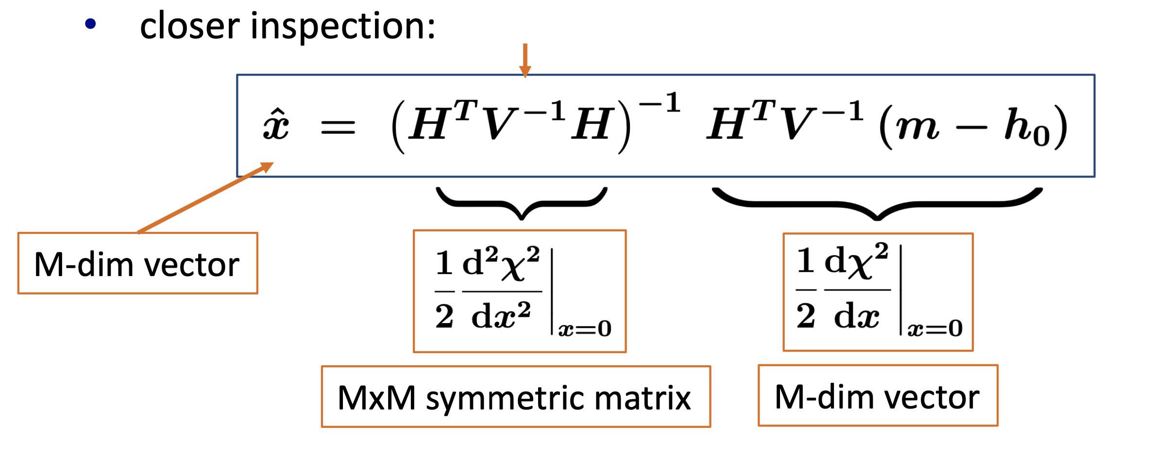
Linear least squares estimator

Slide 11
Non-linear models: Newton-Raphson

Slide 12
Kalman filter method (progressive fit)

Slide 13
Kalman filter

Slide 14
Kalman filter
the χ² contribution of the constraint m_{k} is given by the χ² contribution of the prediction

Slide 15
Covariance matrix in the Kalman filter

Slide 16
χ² and degree of freedom

Slide 17
Current Status and Limits

Slide 18
Vertex and Kinematic Fit in BESIII and STCF
$$\left({x \atop \begin{aligned}y \\ z \\ Px \\ Py \\ Pz \\ E\end{aligned}}\right)$$
WTrackParameter Class is defined in Vertex and Kinematic Fit.
The measured values with uncertainties construct the χ² values.
The exact constraints are included with Lagrange Multiplier in χ².
WTrackParameter
Those parameters are calculated with uncertainties before Vertex and Kinematic Fit.
$$χ^{2}=\left(W −W_{0}\right)V_{W}^{−1}\left(W −W_{0}\right)$$
+$2λ^{T}g_{T}(W)$

Slide 19
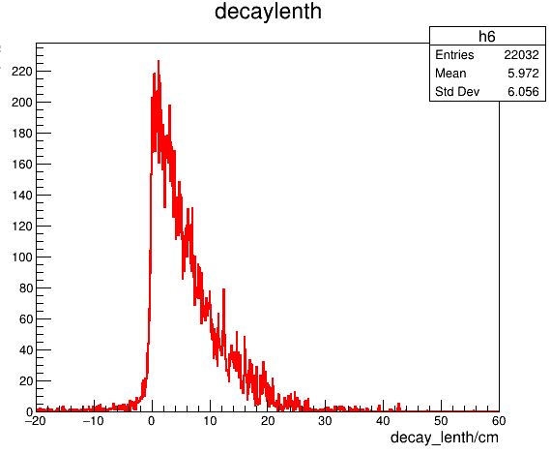
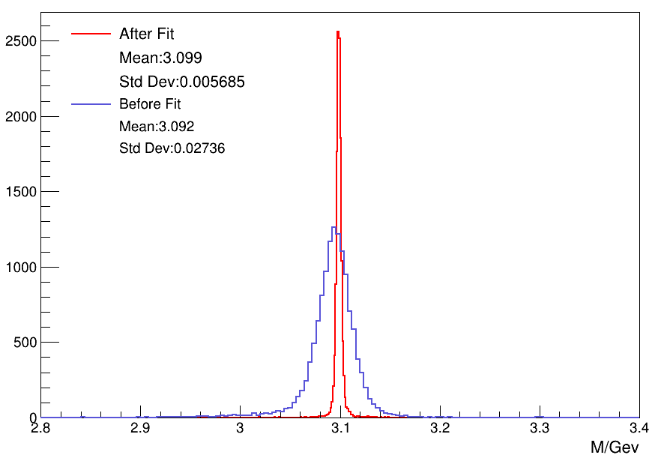
Vertex and Kinematic Fit in BESIII and STCF
Vertex Fit and Kinematic Fit have been widely used in IP estimation, long-live particle decays, mass constraints, four-momentum constraints, and so on.
The missing particle information could be considered, and various requirements could be implemented in Kinematic Fit
BESIII and STCF shared the same algorithm in Vertex Fit and Kinematic Fit, and achieved similar performance.
Decay length
$$J/ψ→Λ\overline{Λ}$$
$ψ\left(3686\right)→π^{+}π^{−}J/ψ$ $→π^{+}π^{− }e^{+}e^{−}$

Slide 20
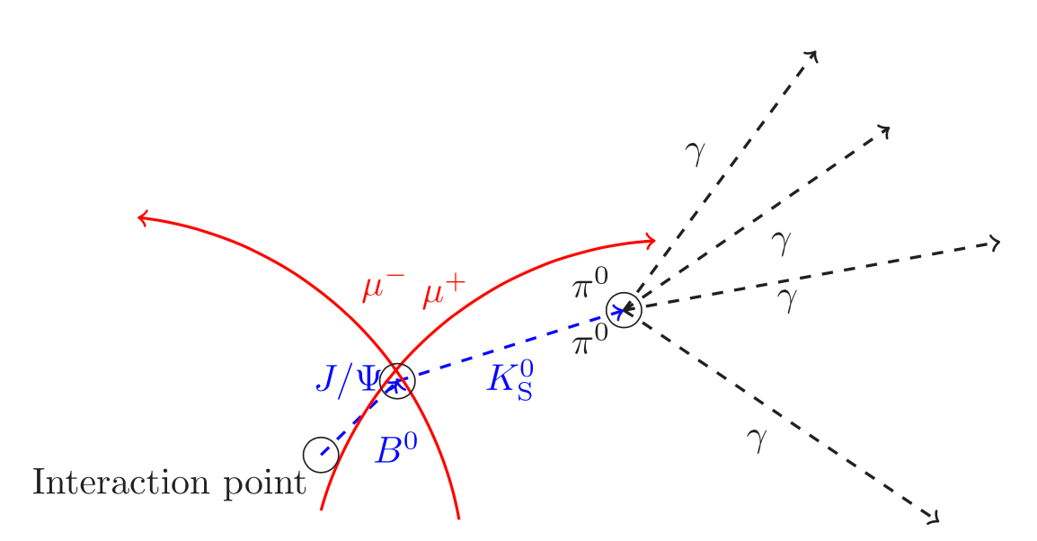
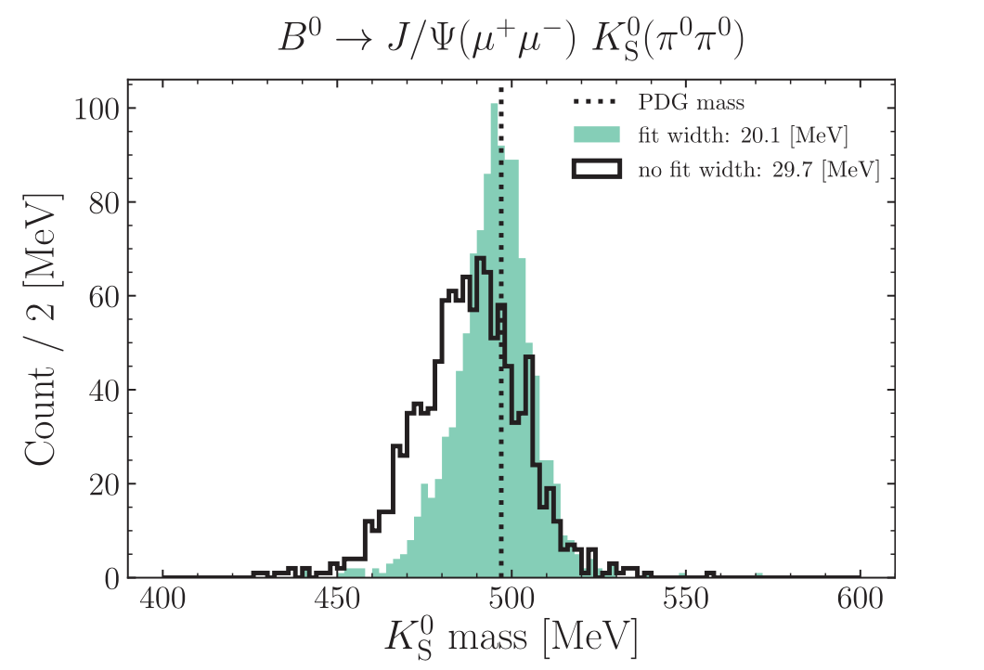
Limits: Leaf by Leaf
In high-energy physics experiments, researchers typically trace the decay process starting from the final state and work backward to identify intermediate metastable states. This approach helps in understanding the sequence of events leading to the final observed particles or states.
These reconstructed final state particles are then used as inputs for further analysis, helping to reconstruct the properties and paths of intermediate composite particles.
Disadvantage: constraints that are upstream of a decay vertex do not contribute to the knowledge of the parameters of the vertex.
Figure from Belle-II

Slide 21
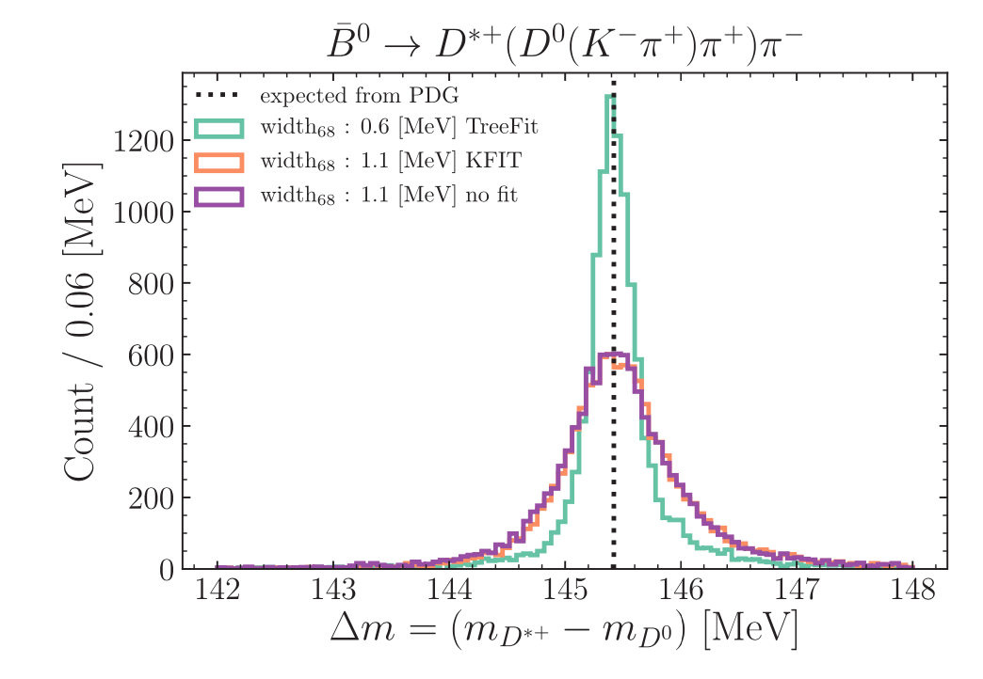
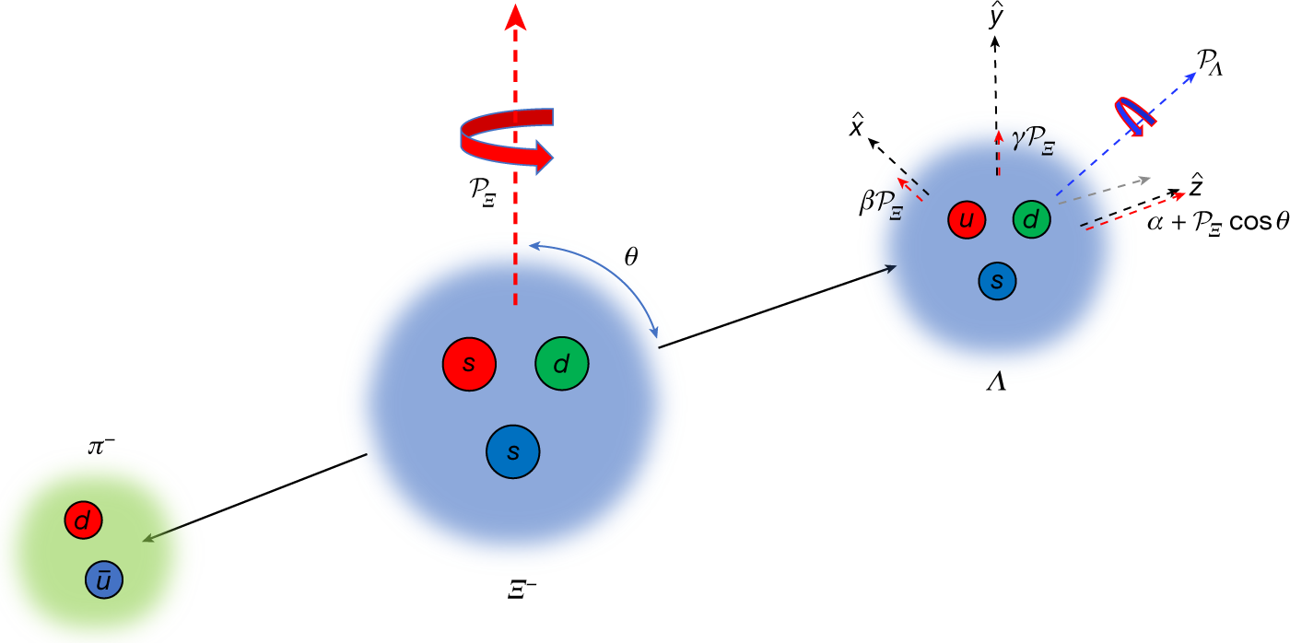
Other examples
The update of Lambda could not impact the proton and pion.
Improve the precision of hyperon parameter measurements.
Not only Kinematics fitting and vertex fitting are separated, but also the process with continuous decay vertices are separated.

Slide 22
Global fit

Slide 23
Decay Tree Fitter
Fits the whole decay tree at once. Vertices, known masses, measured tracks & neutrals and beam/target measurement (4C) are included as constraints. The common approach is the χ² fit with Lagrange multipliers.
->Very large parameter space and large matrices have to be inverted!
Solution: Kalman Filter approach
Calculation of χ² is linearized
Each constraint to the fit enters as one separate, scalar term
Measurements are constraints and are treated similar to, e.g. four-momentum conservations

Slide 24
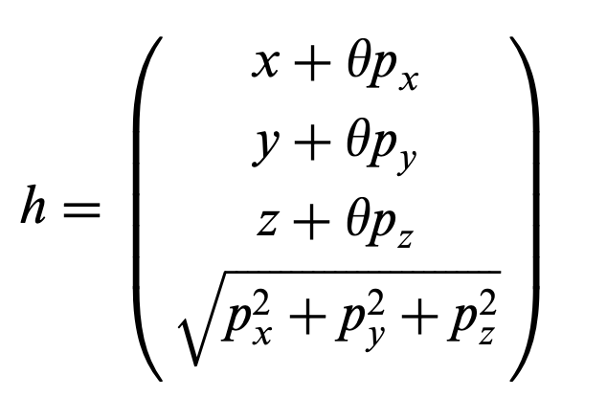
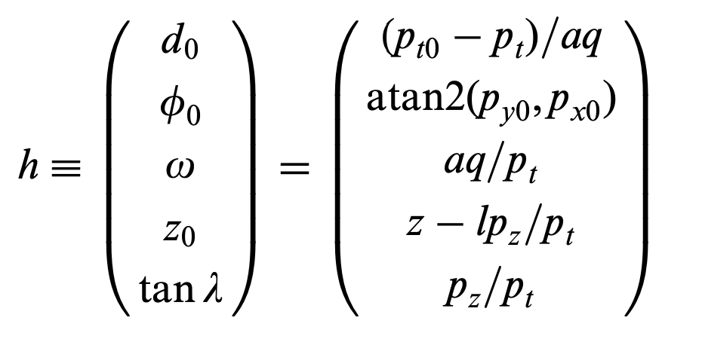
Constraints
Tracks
Photons
In principle, θ can be added to the photon parameter list and extracted from the fit. Since this parameter is not very interesting, it is preferable to eliminate it.

Slide 25
From Ralf Kliemt @ PANDA

Slide 26
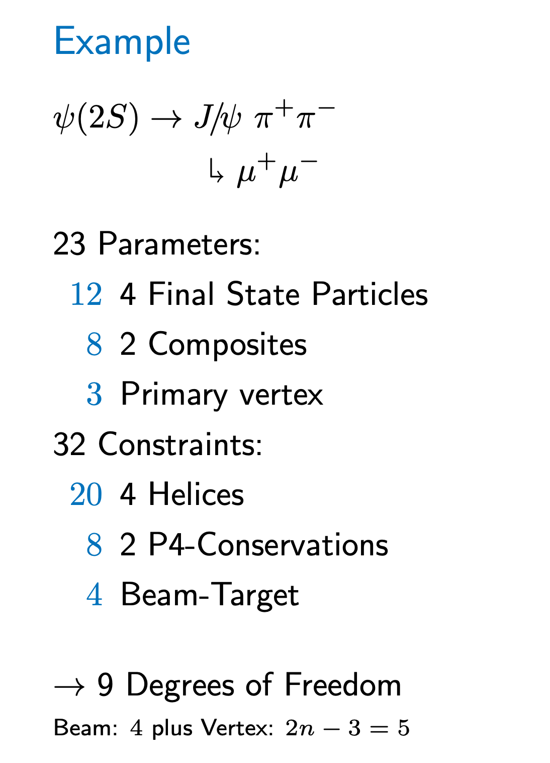
From Ralf Kliemt @ PANDA

Slide 27
Eigen
Eigen is a C++ template library for linear algebra: matrices, vectors, numerical solvers, and related algorithms.
Figure from NIMA, 976, (2020)
Eigen doesn't have any dependencies other than the C++ standard library.

Slide 28
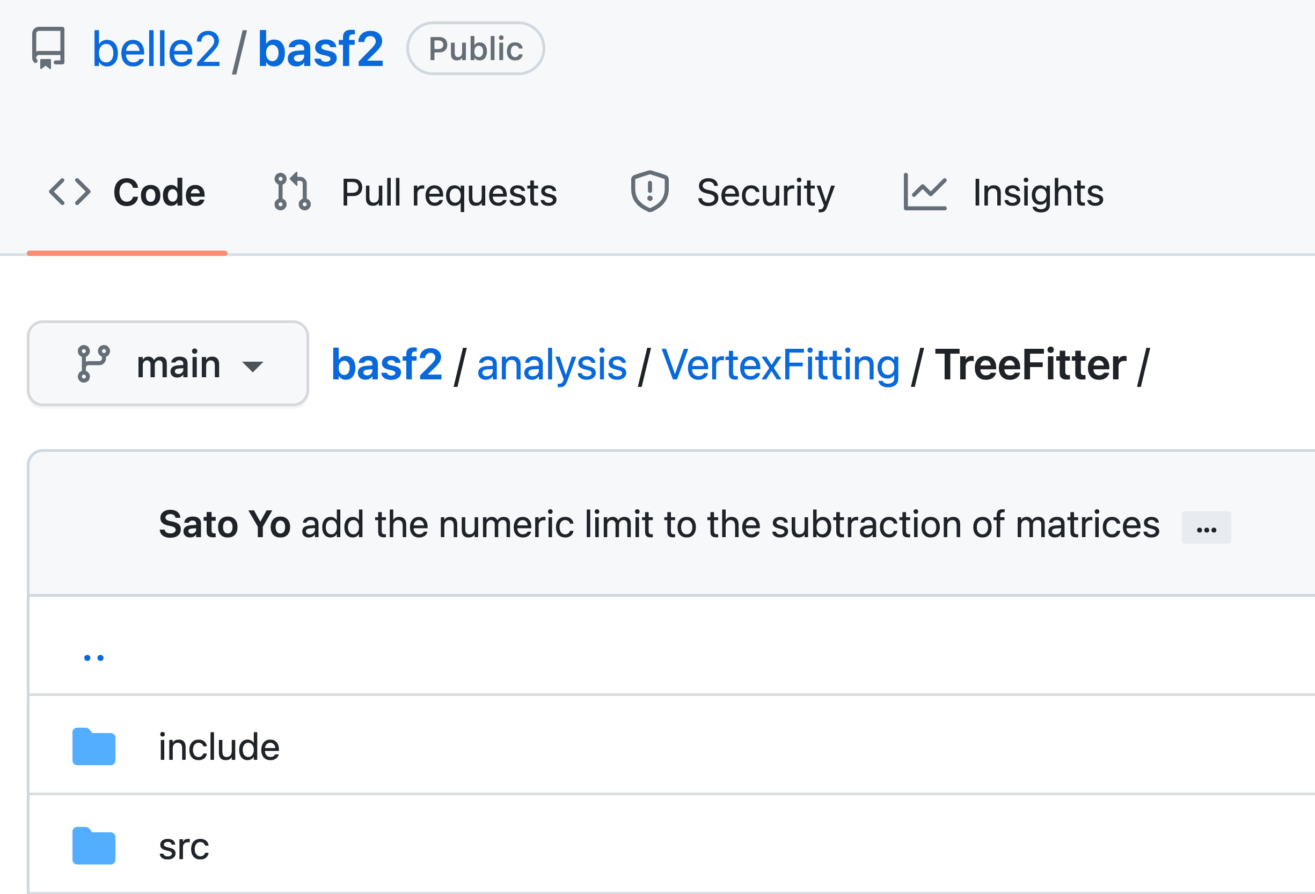
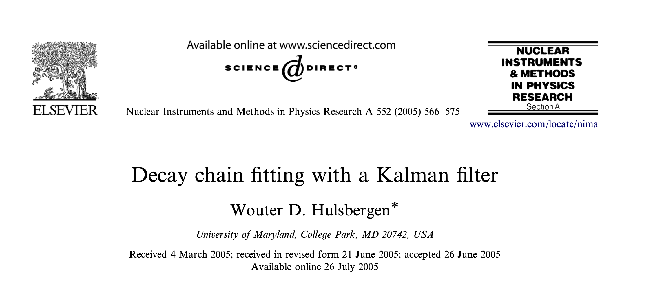
Existing Decay Tree Fitter
BaBar have a Tree Fitter, written by W. Hulsbergen.
LHCb, PANDA and Belle II have similar Tree Fitter.
Belle II code is shared (Github)

Slide 29
Future plans in STCF
Introduce the Global fit method in the STCF software framework.
1. BELLE-II software migration
Using the process $ψ\left(2S\right)→π^{+}π^{−}J/{ψ→π^{+}π^{−}e^{+}e^{−}}$ as an example.
Using Service to connect BELLE-II Vertex fit and STCF data types
ParticleLoader, ParticleCombiner, TreeFitter —>Service
2. Combine Vertex and kinematic fit based on the BESIII package
Redesign the calculation process for the chi-square value.
Develop the new WTrackparameter Class.
Using Eigen to optimize the matrix calculation.

Slide 30
Summary
Kalman filter method has been implemented in vertex fitting and kinematic fitting in BESIII and STCF software.
Leaf by Leaf fit method could deal with most of the vertex and kinematic problems.
Global fit is useful in cascade decay, especially long-life particles and missing particles.
Eigen and Kalman filter could save the Global fit costs, which will be used in STCF.

