Slide 1
GlobalPID Algorithms Based on Machine Learning for STCF
Yuncong Zhai, Zhipeng Yao,Teng li, Xingtao Huang Shandong University 2024.01.17

Slide 2
Introduction
Identification For Charged Particles
目录
Identification For Neutral Particles
CONTENTS
GlobalPID Software
Summary

Slide 3
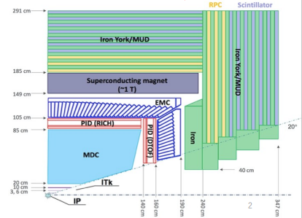
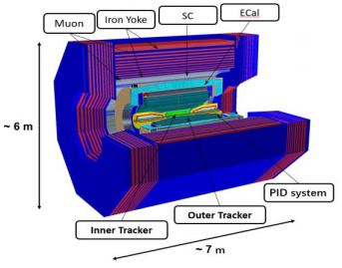
Introduction
The Super Tau Charm Facility (STCF) is an important option for China's future accelerator-based particle physics large-scale scientific facility.
Damp ring
65 m
Linear accelerator
400 m
Storage ring
800 m
Detector
Schematic layout of the STCF detector concept
Parameters of STCF
Physics Objectives
Rich physics with c quark and $τ$ leptons
Non-perturbed strong interaction and new exotic hadronic states
Studying flavor physics and CP violation physics
Searching for new physics
$E_{cm}=$ 2-7 GeV ,
L $=\text{0.5}\text{×}\text{10}\text{35} \text{cm}\text{−2} \text{s}\text{−1}$
Circumference: Double-ring, 600-800 m
Crossing angle: 2×30mrad

Slide 4
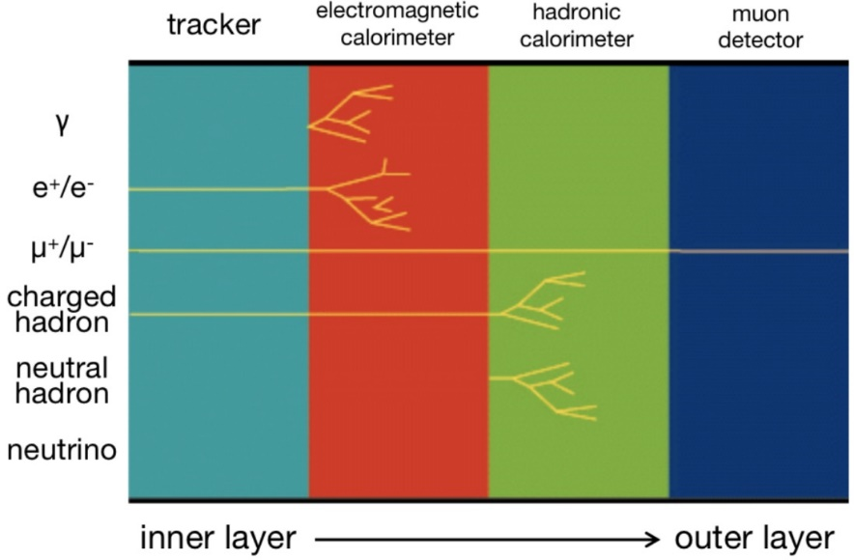
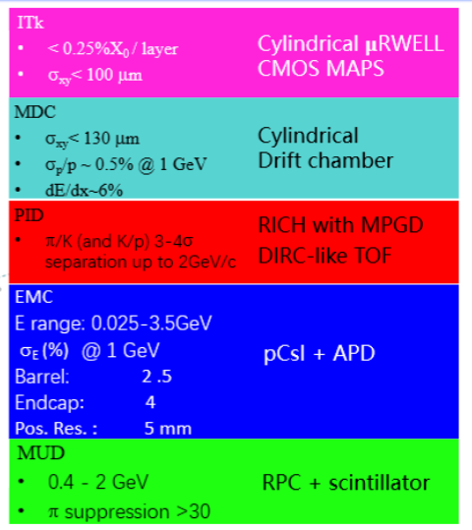
Introduction
Particle identification (PID) is one of the most important and commonly used tools for the physics analysis in STCF.
The PID algorithm performance is crutial for exploiting the potential of STCF detectors.
π/K (K/p) 3-4$σ$ $\text{separation} \text{up} \text{to}\text{ 2}\text{Gev}\text{/}\text{c}$
𝜇/𝜋 up to 2Gev/c, 𝜋 suppression ~ 3%
Good discrimination power for γ/n/$K_{L}^{0}$
Better particle identification usually requires the combination of information from multiple sub-detectors.
Single sub-detector is often sub-optimal
Usually difficult for traditional PID algorithms to combine all sub-detectors

Slide 5
Introduction
The data-driven machine learning (ML) has provided a powerful toolbox for PID.
Advantage: Extracting effective information from large amounts of interrelate data
Widely applied and opening up new possibilities in high-energy physics experiments.
Achieved outstanding results in the field of PID.
LHCb、BelleII、CMS and ALICE …….
Main methods : Boosted Decision Tree (BDT) and Neural Networks (NN)
Innovated and developed a Global Particle Identification (GlobalPID) software algorithm based on the ML techniques.
Achieve optimal PID performance
To boost the progress of physics analysis work
Targeting at particle identification problem at the STCF experiment
Exploration the physical potential

Slide 6
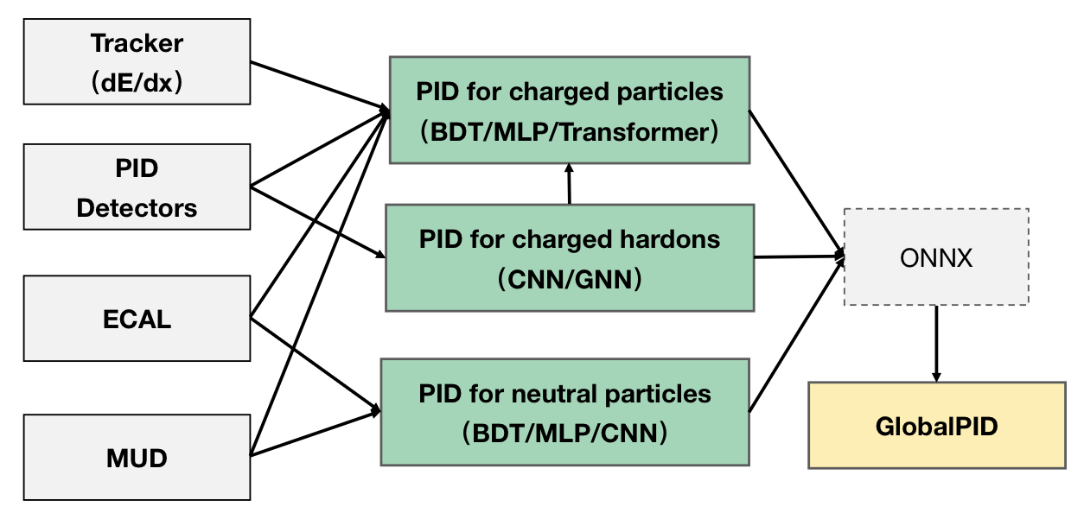
Introduction
Identification of charged particles (e/μ/π/K/p)
Combine all sub-detectors reconstruction information
Taking BDT (based on XGBoost) as a baseline model
Other ML algorithms tested as well :
MLP, SVM,Transformer …..
Charged hadrons discrimination
e.g. DTOF raw information: The hit position and time of Cherenkov photons on the sensor
Based on classical convolutional neural network (CNN) on PID detectors
Improve hadron discrimination power
As the input for charged particleID
Neutral particle (γ/K_{L}⁰/n) identification
Fully utilize energy deposition, time response within the ECAL and MUD hit pattern
A convolutional neural network is developed for neutral particle identification

Slide 7
Identification For Charged Particles
Ⅰ

Slide 8
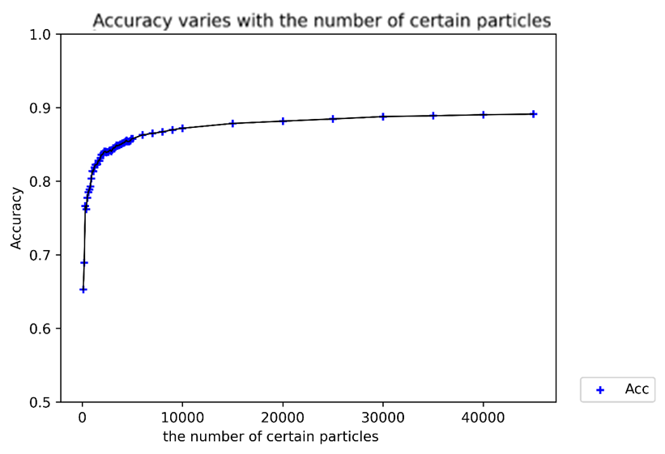
Data Sample
The quality of the data samples
High statistics
large momentum and angle coverage
Data production
Based on OSCAR simulation and reconstruction
MC single charged track using ParticleGun
50000 tracks for each type (e±, μ±, π±, K±, p±)
p∈(0.2, 2.4 )Gev/c, 𝜃∈(20$°$, 160$°$)，phi = 0°
Pre-processing
Flatten momentum and θ spectrum to avoid bias due to p/θ distribution
Train:Validation:Test = 8:1:1
Accuracy varies with the number of traing tracks

Slide 9
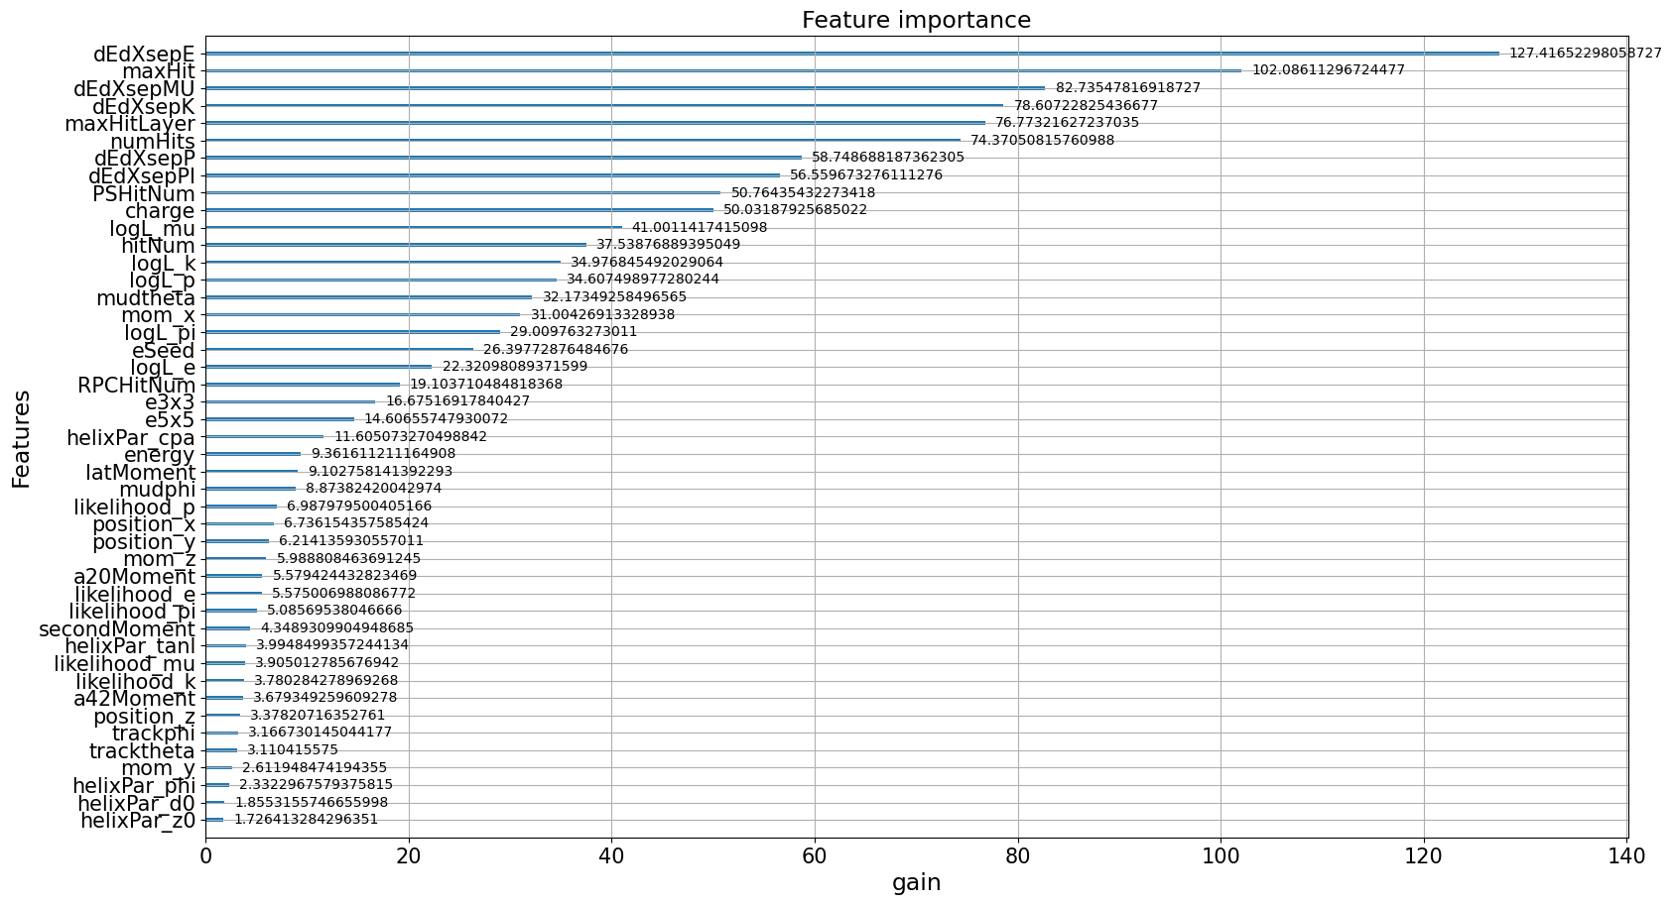
Training and Tuning : Feature Selection
Selecting a subset of the most informative features from large amount of interrelated sub-detectors information can help stabilize the model training process
Tracker/dEdx/RICH/DTOF/ECAL/MUD reconstructed variables have been collected
45 features are kept, feature importance distribution of the features is obtained (Full list of variables please see backup slides)

Slide 10
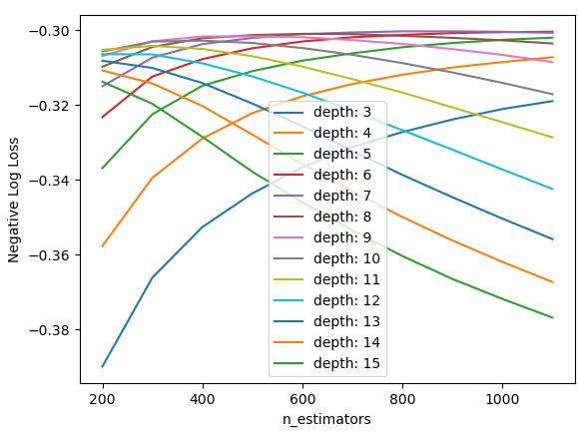
Training and Tuning : Optimal Hyperparameters
Target: automated optimization of BDT hyperparameters
Reduce manual intervention and time costs
Improve model efficiency and reliability
Optimal hyperparameters are obtained based on GridSearchCV
Selected hyperparameters
max_depth: 7
n_estimators: 800
Tunning of hyper-parameters
Discrimination power between charged particles are used as criteria
Search range of max_depth: [200,1200]
Search range of n_estimators: [3,15]
Best:(7,800)

Slide 11
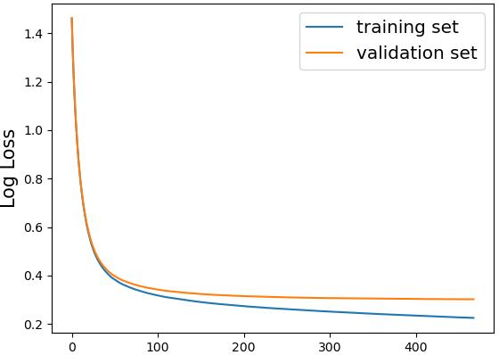
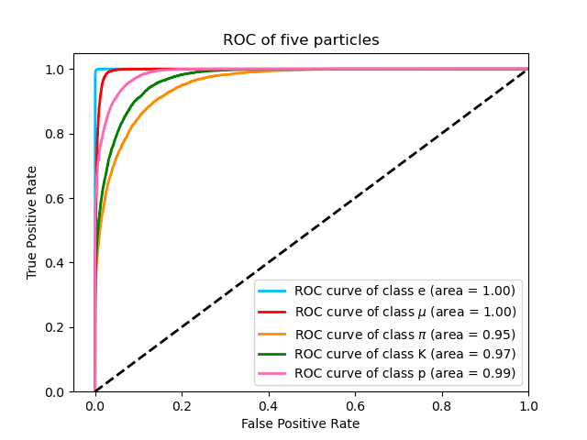
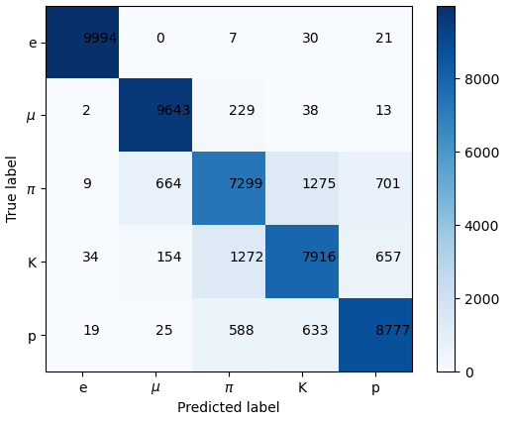
Performance
BDT model(based on XGBoost) is trained and optimized to discriminate (e, μ, π, k, P)
Preliminary results have been obtained
Good performance for leptons
Hadron performance is sub-optimal at the moment. Expecting better performance with updated PID reconstruction algorithms
Learning curve
The receiver operating characteristic curve (ROC curve)
Confusion matrix

Slide 12
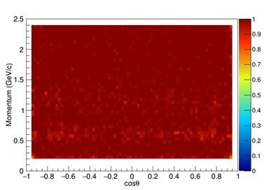
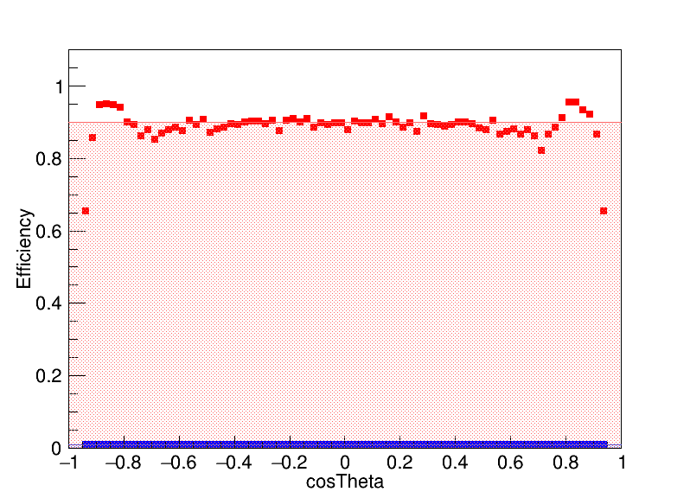
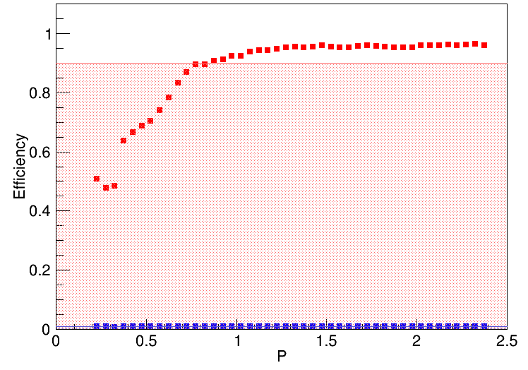
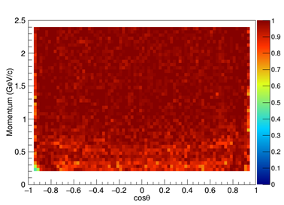
Performance
e(Five Particles Identification)
Charged Particle Identification Performance In GlobalPID (preliminary)
Signal efficiency : $\frac{The number of signal selected correctly}{The total number of signal}$
Particle discrimination performance in different PID modes：All(e/μ/π/K/p),π/K/p,π/K,e/π/K,μ/π
𝜇(Five Particles Identification)
0.9
0.9
$π^{+}$（$μ$/$π$）
$π^{+}$（$μ$/$π$）
0.01
0.01
The signal efficiency and background misidentification rate(no more than 1%) for$π$ at different momentum and angles.
The signal efficiency for e and 𝜇

Slide 13
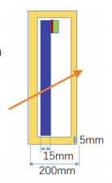
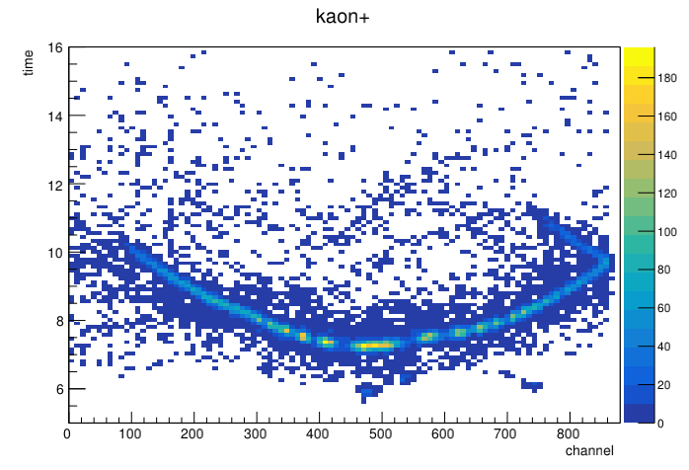
STCF DTOF based on classical convolutional neural network π/k discrimination
Zhipeng Yao
The DTOF is located on the end cap of the STCF PID system and is based on an total internal reflection Cherenkov time-of-flight detector.
Using the hit position and time of Cherenkov photons on the photomultiplier tube, a two-dimensional pixel map is constructed and a convolutional neural network is developed for π/k discrimination, further enhancing the PID performance of the DTOF.
k π
The darker areas in the image indicate a higher probability of Cherenkov photons being detected at the corresponding channel at the given time. The overall image represents the topological structure of Cherenkov photons produced by different particles.

Slide 14
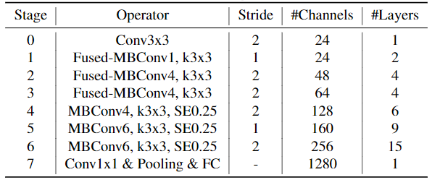
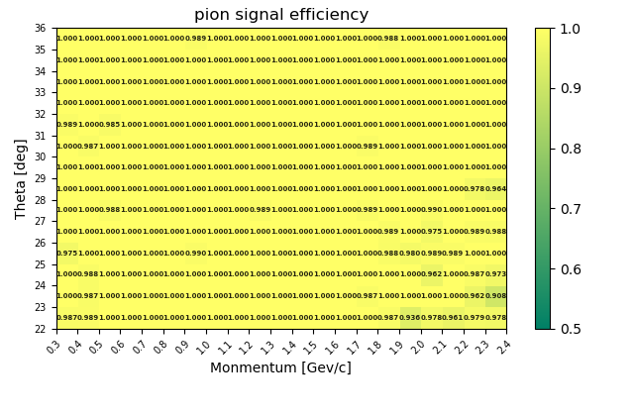
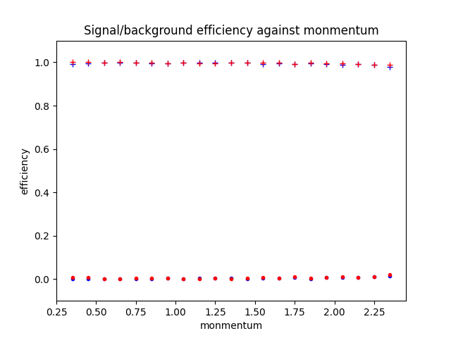
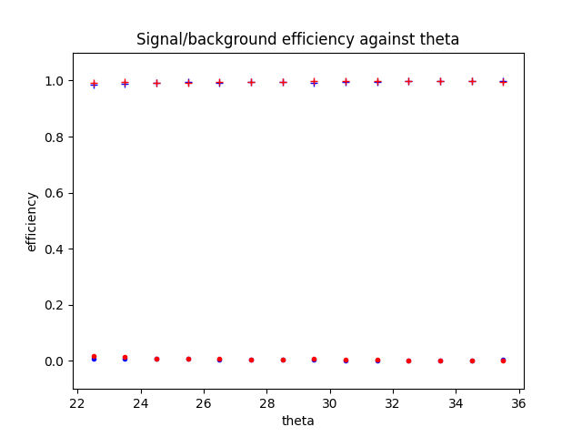
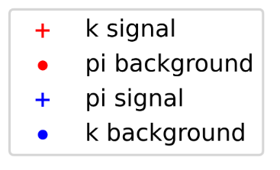
STCF DTOF based on classical convolutional neural network π/k discrimination
Zhipeng Yao
model : EfficientNetV2-S Accuracy = 99.46%
Using EfficientNetV2-S as the baseline model and optimizing
Training:Adding momentum and position information of particle hits in the DTOF outside of the fully connected layers
The signal efficiency and background misidentification rate for pions/kaons at different momentum and angles.
The signal efficiency for pions (the background no more than 3%)

Slide 15
Identification For Neutral Particles
Ⅱ

Slide 16
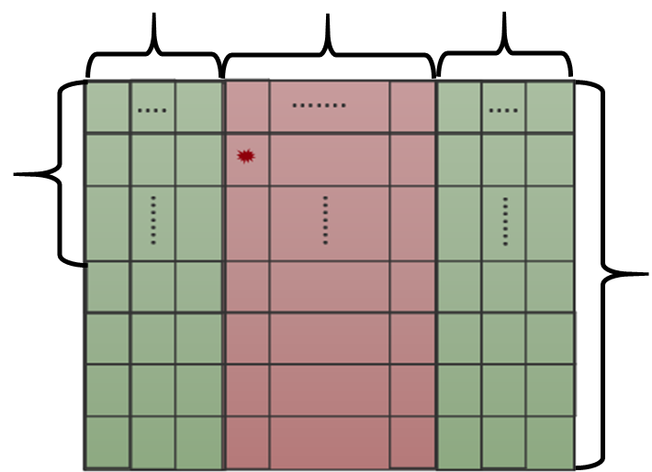
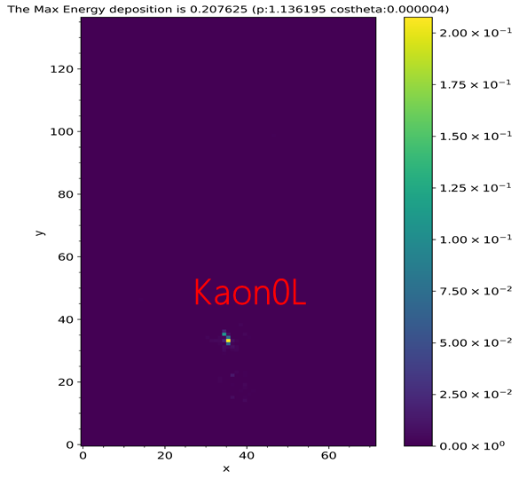
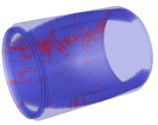
Data Sample
10 Left endcap
51 Barrel
10 Right endcap
Energy deposition pixel map（71*136）：
X-coordinate ：Position information
Left endcap / Right endcap（0-9/61-70）
Barrel（10-60）
Y-coordinate：CrystalID
Value：Energy deposition inside the crystal
132
136
Energy deposition pixel map
Neutral Particle Data Sample：
γ/K_{L}/n
Generated by ParticleGun
100,000(Each type)
$\text{P}∈（\text{0}\text{，}\text{2.0}\text{）}$Gev/c,$θ=90°,φ=0°$
Energy Deposition in ECAL
Energy Deposition for $K_{L}^{0}$

Slide 17
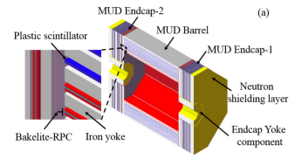
CNN
MUD Information
The initial implementation of a global neutral particle discriminator based on CNN
CNN consists of alternating convolutional and pooling layers, ending with fully connected layers
Convolutional Layer: Use convolutional kernels to extract new hidden features
Pooling Layer: Reduce data dimensionality, prevent overfitting, and reduce resource usage
Fully Connected Layer：Add MUD information in the future

Slide 18
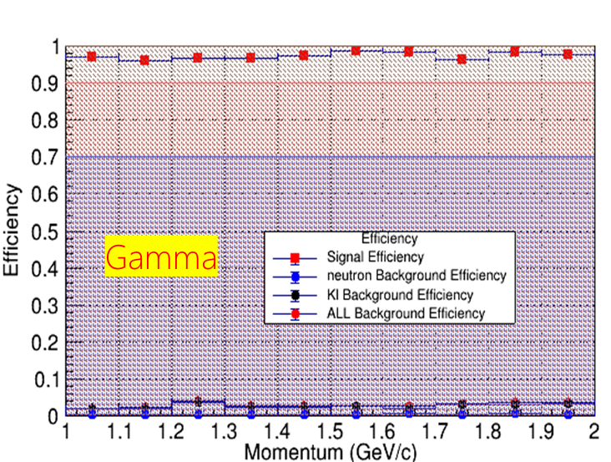
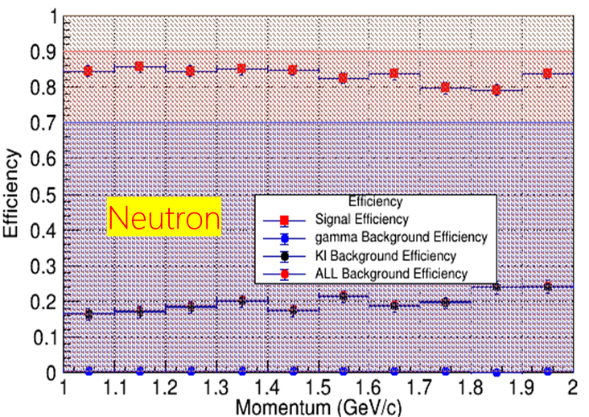
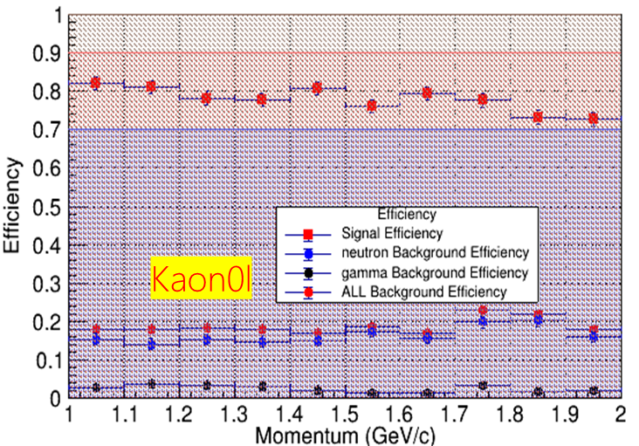
Performance
Analyzing the energy deposition distribution in ECAL (preliminary)
Neutron:
Signal efficiency is controlled to be above 80%.
Background misidentification ~20%，mainly for KL
Gamma:
Good photon discrimination performance
Signal efficiency > 90%
K_{L}:
Signal efficiency >70%
Background misidentification ~20%，mainly for Neutron
The neutron and K_{L} identification capability still needs improvement

Slide 19
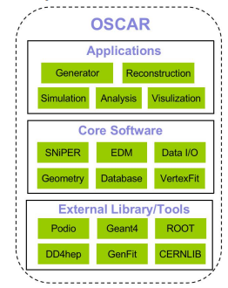
GlobalPID Software
The BDT model and GlobalPID algorithm have been integrated into OSCAR software and is available for analysis and research.
GlobalPID
For the identification of charged particles
Pre-trained model is integrated, and made transparent to users
Based on C-API of XGBoost, Provided simple interface and user manual for users
Development of the ML-based software packages for hadron and neutron particle identification.
The GlobalPID packages integration : All the software packages will be transferred into the ONNX framework.

Slide 20
Summary
To fully exploit the performance of the STCF detector, a novel GlobalPID algorithm based on machine learning is developing.
Based on a data-driven method, BDT is used as a baseline to discriminate charged particles at STCF.
Extract features from many correlated variables(integrating all sub-detector information)
Provides charged particle identification performance in different PID modes
Drive the fast simulation work
Integrate PID system information and use CNN to achieve hadron discrimination.
A global neutral particle identifier based on CNN is initially implemented.
Preliminary results for the identification of charged and neutral particles have been obtained, but need to be further checked and validated.
The GlobalPID software package has been completed for charged particles identification and is available for analysis and research.
More study is needed to do:
Add time response and MUD information to neutral particle identification
Further study the variables used for PID
Try other machine learning techniques
Upgradation and result verification for GlobalPID software package

Slide 21
THANKS

Slide 22
Backup

Slide 23
Backup 1
Gkklhcbchic2Zero_1.root
Features
||-------------------------------------|特征量信息|------------------------------|说明|
ReconstructinParticle ‘charge’ 重建粒子的电荷
‘momentum.x’
‘momentum.y’ 粒子在xyz方向上的动量
‘momentum.z’
RecRICHLikelihood ‘likelihood_e’ 该粒子假设为电子的可能性
‘likelihood_mu’ 该粒子假设为muon的可能性
‘likelihood_k’ 该粒子假设为kaon的可能性
‘likelihood_pi’ 该粒子假设为kaon的可能性
‘likelihood_p’ 该粒子假设为proton的可能性
DTOFPid ‘logL_e’ 粒子分别在五种粒子假设下的可能性
'logL_mu'
'logL_pi'
'logL_k'
'logL_p'
TrackerRecTrack ‘helixPar_d0’
‘helixPar_phi’
‘helixPar_cpa’
‘helixPar_z0’
‘helixPar_tanl’
||-----------------------------------|特征量信息|---------------------------|说明|
DEDX 'dEdXsepE/MU/PI/K/P' 基于五种粒子假设下的chi2值
RecECALShower ‘numHits’ 在ECAL里的击中数目
‘energy’, 重建粒子的能量
‘eSeed’ 种子的能量
‘e3x3’ 3*3晶体内的能量沉积
‘e5x5’ 5*5晶体内的能量沉积
‘position.x’ Shower的x坐标
‘position.y’ Shower的y坐标
‘position.z’ Shower的z坐标
‘secondMoment ’ 二阶矩阵
‘LateralMoment ’ 横向矩阵
‘ZernikeMoment{2,0}‘ Zernike2*0矩阵
‘ZernikeMoment{4,2}’ Zernike4*2矩阵
MUDTrack ‘theta’ 在极方向上的夹角
‘phi’ 在xy平面上的夹角
‘hitNum’ 在u子探测器里的击中数
‘RPCHitNum’ 在电阻板室（RPC）中的击中
‘PSHitNum’ 在塑料闪烁体探测器上的击中
‘maxHit’ 有最大击中数所在层的击中数
‘maxHitLayer’ 有最多击中数目的层数

Slide 24
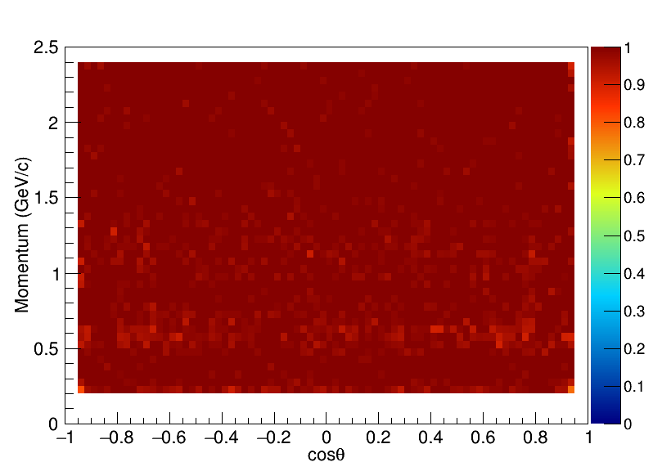
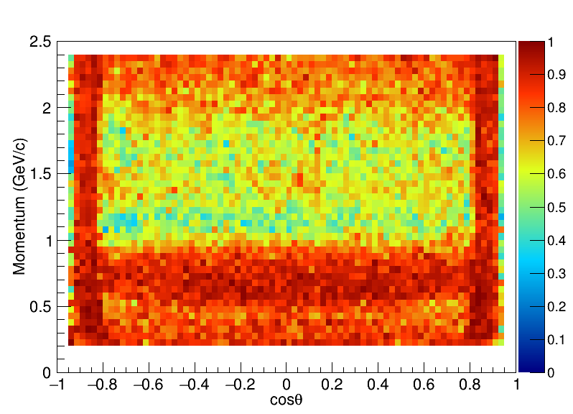
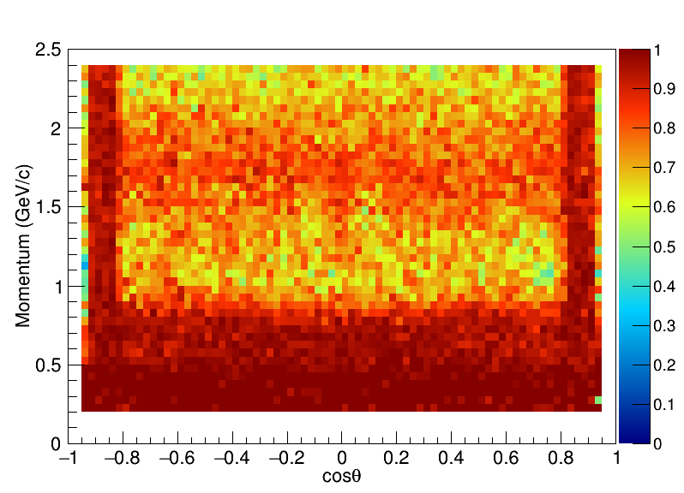
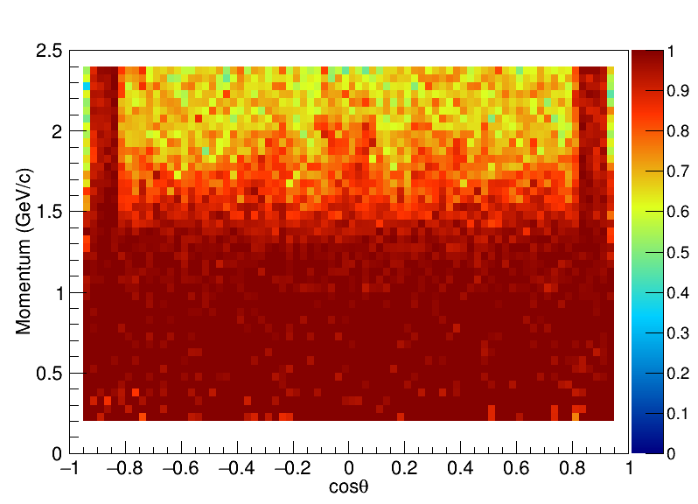
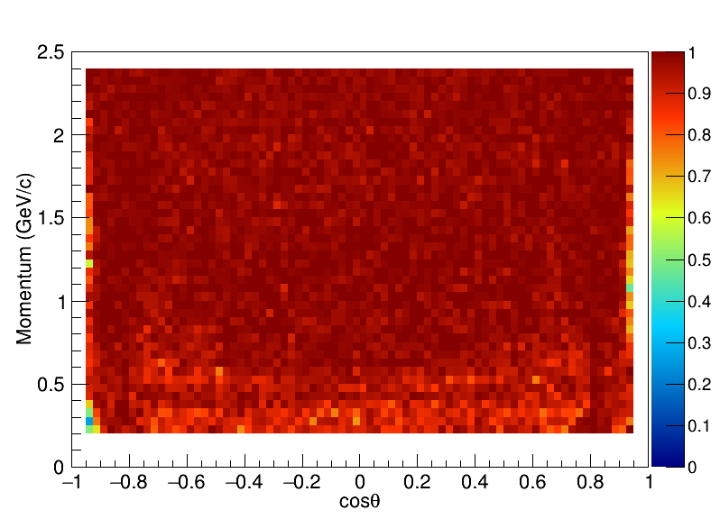
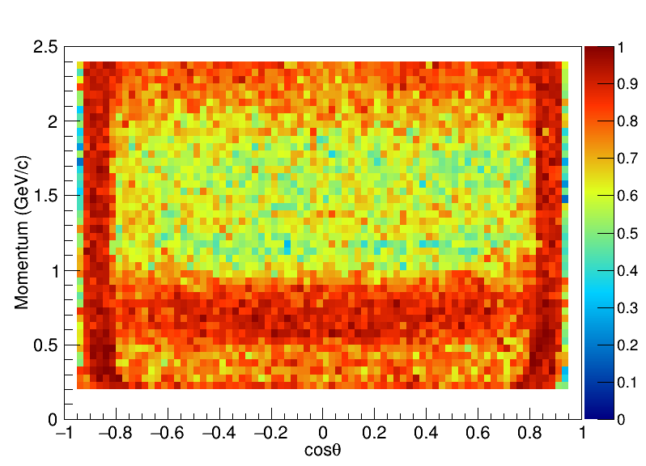
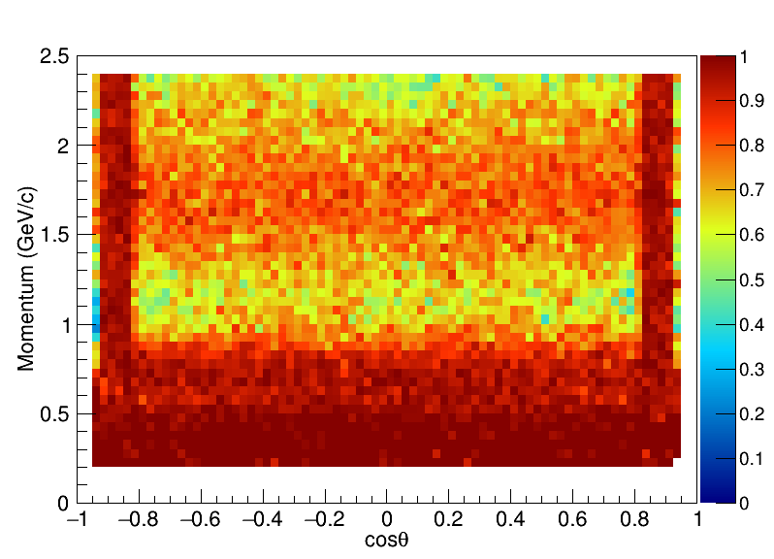
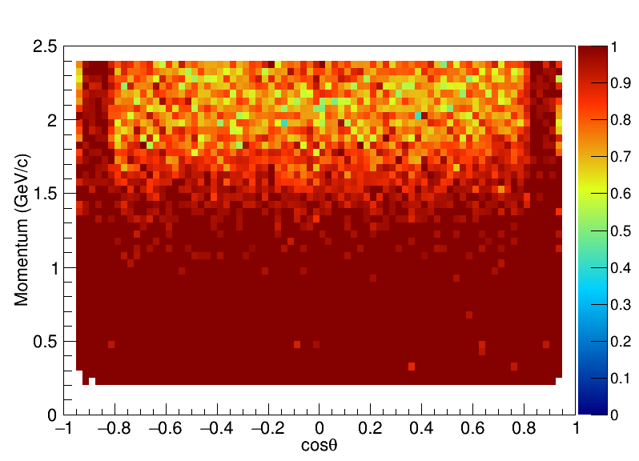
Backup 2
Gkklhcbchic2Zero_1.root
Efficiency distribution
E-
Mu-
Pi-
K-
P-
E+
Mu+
Pi+
K+
P+

Slide 25
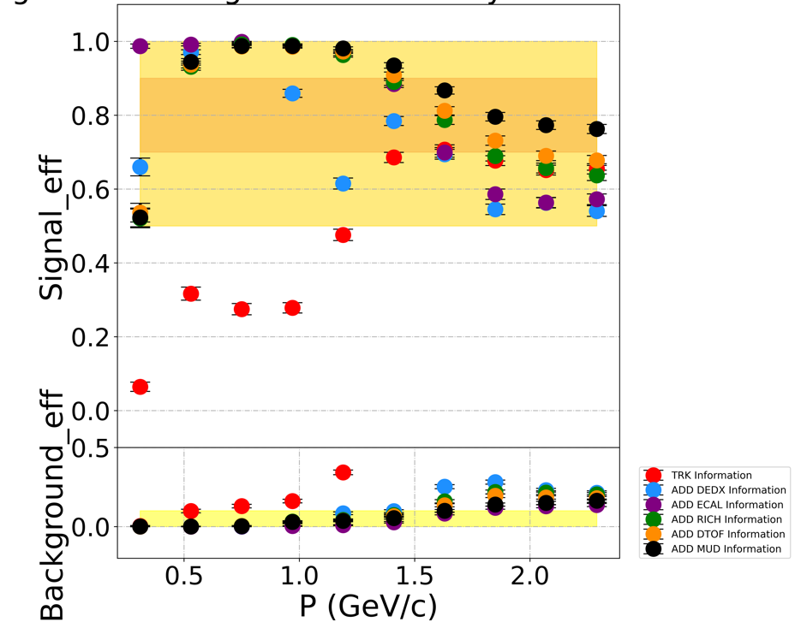
Backup 3
Gkklhcbchic2Zero_1.root
The signal efficiency of Proton

Slide 26
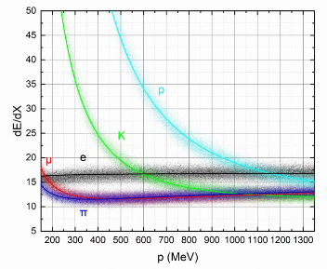
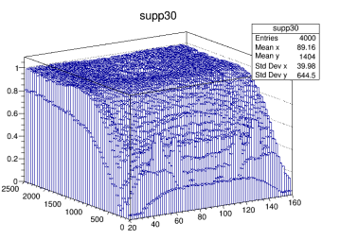
Backup 4
Gkklhcbchic2Zero_1.root
DE/dx Sepa.
MUD Sepa.

Slide 27
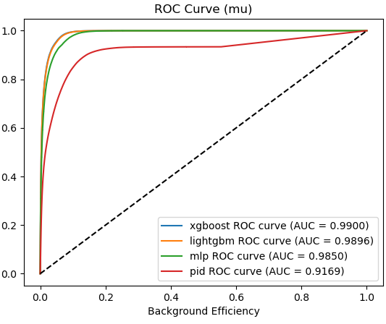
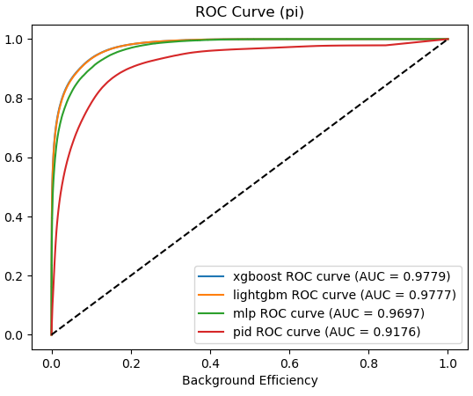
Backup 5
Gkklhcbchic2Zero_1.root
Based on the selected features, various models are studied and tested:
Boosted decision tree based on XGBoost and LightGBM
Deep neural network
Support vector machine
Model optimization is based on a combination of grid search and bayasian optimization
BDT (XGBoost) is chosen given its performance and tranparency
max depth: 7
n estimators: 400

