Slide 1

DIRC-like Time-of-flight Detector (DTOF) under the Offline Software of Super Tau-Charm Facility
The 2024 International Workshop on Future Tau Charm Facilities
Yutong Feng^{[1,2]}, Binbin Qi^{[1,2]}, Zekun Jia^{[1,2]}, Cong Geng^{[3]}, Wenhui Tian^{[3]}
[1] University of Science and Technology of China
[2] State Key Laboratory of Particle Detection and Electronics
[3] Sun Yat-sen University
On behalf of the STCF DTOF-software working group
Jan 17, 2024, Hefei
fengyutong@mail.ustc.edu.cn

Slide 2
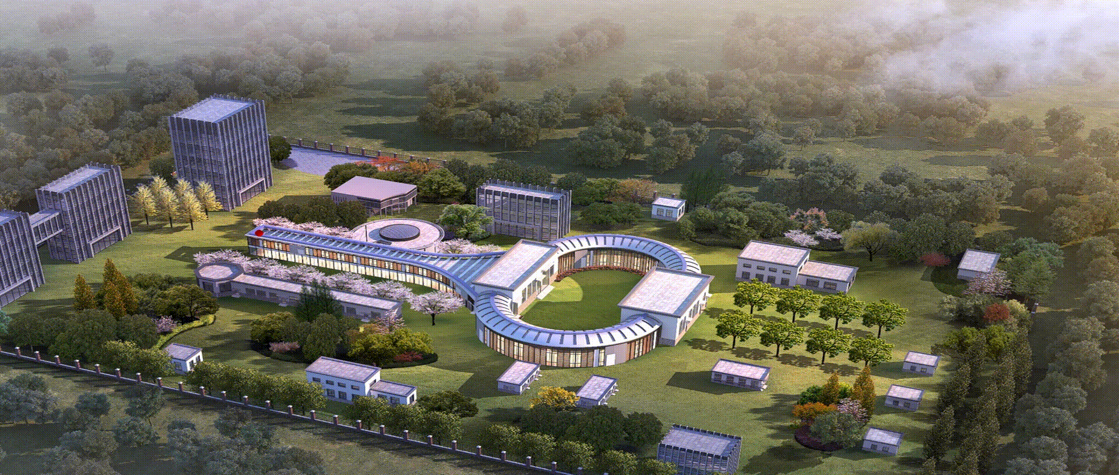
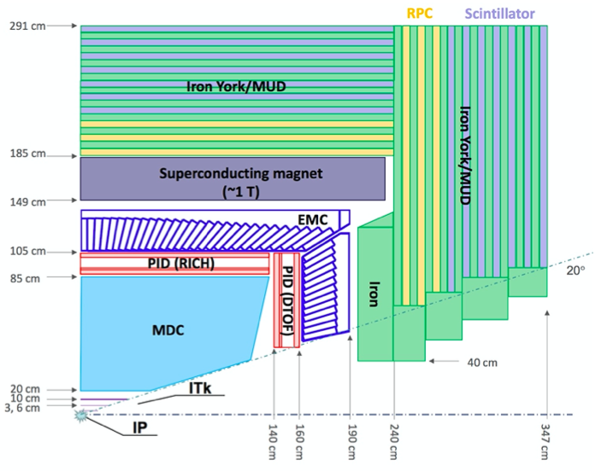
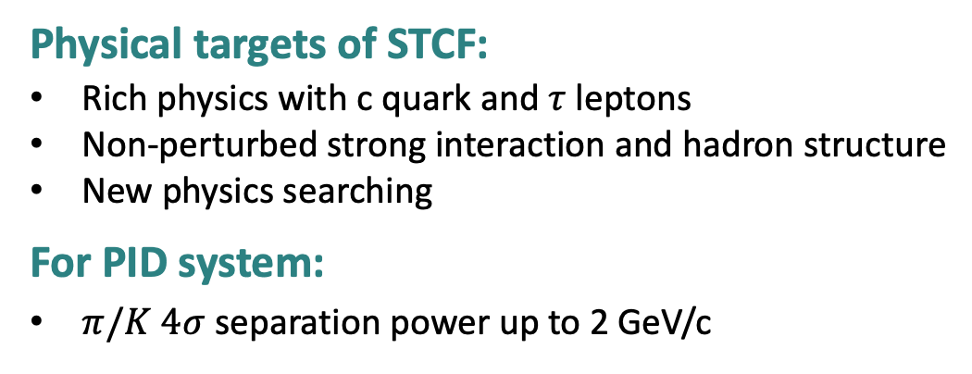
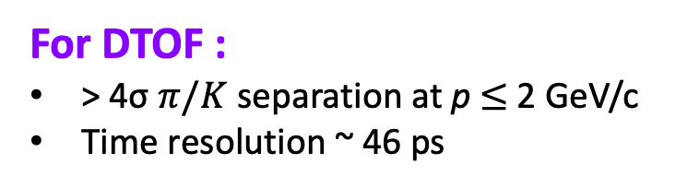
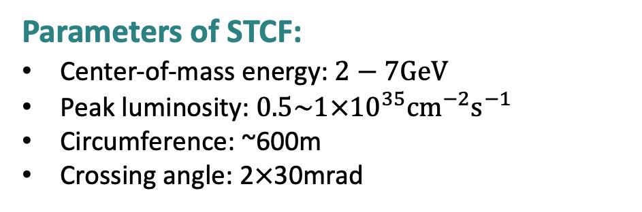
Super Tau-Charm Facility
Linac
Storage ring
Parameters of STCF:
Center-of-mass energy: $2−7GeV$
Peak luminosity: $0.5\sim 1×{{10}^{35}cm}^{−2}s^{−1}$
Circumference: ~600m
Crossing angle: 2$×$30mrad
Detector spectrometer
Physical targets of STCF:
Rich physics with c quark and $τ$ leptons
Non-perturbed strong interaction and hadron structure
New physics searching
For PID system:
$π/K 4σ$ separation power up to 2 GeV/c
For DTOF :
> 4σ $π/K$ separation at p $≤$ 2 GeV/c
Time resolution ~ 46 ps
Notes:
STCF is the next version electron-positron colldier being developed in China, which has a wider energy region from 2-7 GeV and an integrated luminosity 50~100 times higher than BES.
It can allow for more comprehensive physics studies of particle composition, and the deep structure of the matter, as following items.
This plot shows the specific internal structure of the detector. DTOF is the PID detector located on the endcap.
To support the rich physics research, the PID system need to have over 4sigma for pion and kaon separaton power up to 2 GeV momentum.
And the DTOF under the this offline software of STCF can satisfy this performance requirement well. And the time resolution of DTOF is about 46 picosecond.

Slide 3
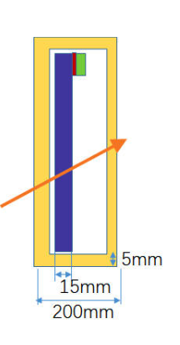
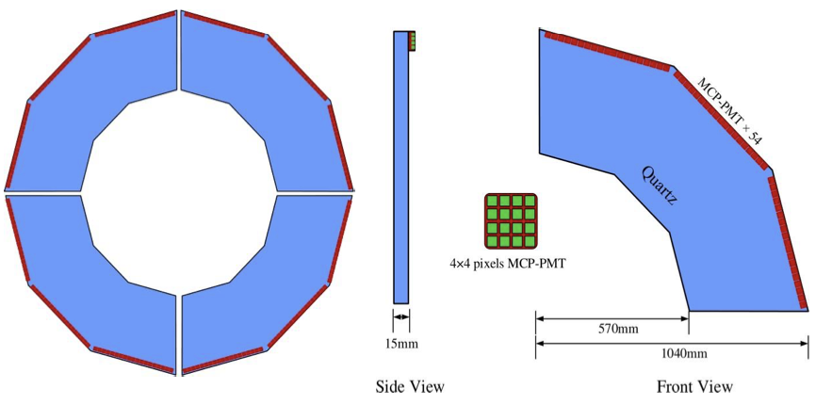
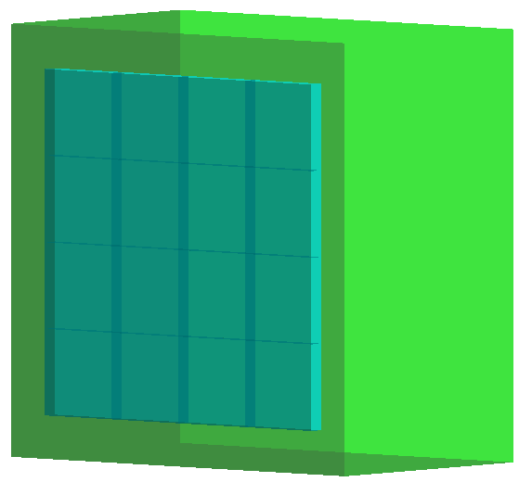
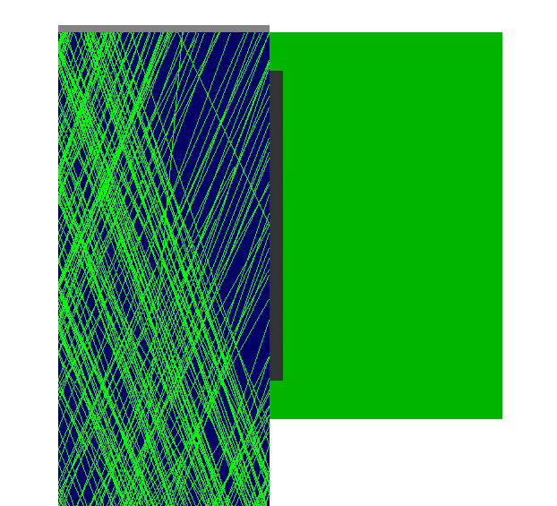
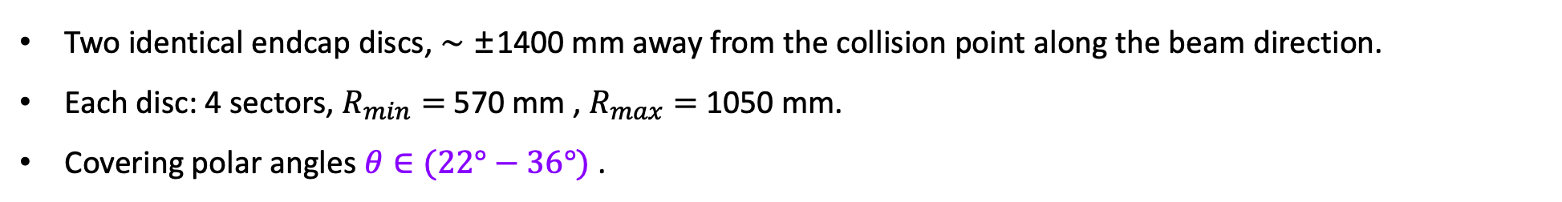



DTOF Geometry Configuration
Two identical endcap discs, ∼ ±1400 mm away from the collision point along the beam direction.
Each disc: 4 sectors, $R_{min}=$ 570 mm , $R_{max}=$ 1050 mm.
Covering polar angles $θ∈(22°−36°)$ .
$$4×4 anodes$$
$$5.5×5.5 mm^{2}$$
$$18 MCP−PMTs$$
Notes:
This page show the geometry configuration of DTOF.
DTOF consists of two identical endcap discs positioned at 1400 millimeter away from the collision point along the bean direction.
Each disc has 4 sectors with the detailed parameters as following two figures.
It can cover the polar angles theta from 22 to 36 degrees.
The third plot shows its side profile.
We used a 4 by 4 anodes MCP-PMT to detect the signal chrenkov photons. And used the time-over-threshold method to read the time information.
In cases of multiple hits in the same channel, only the hit time of the earliest hit can be saved.

Slide 4
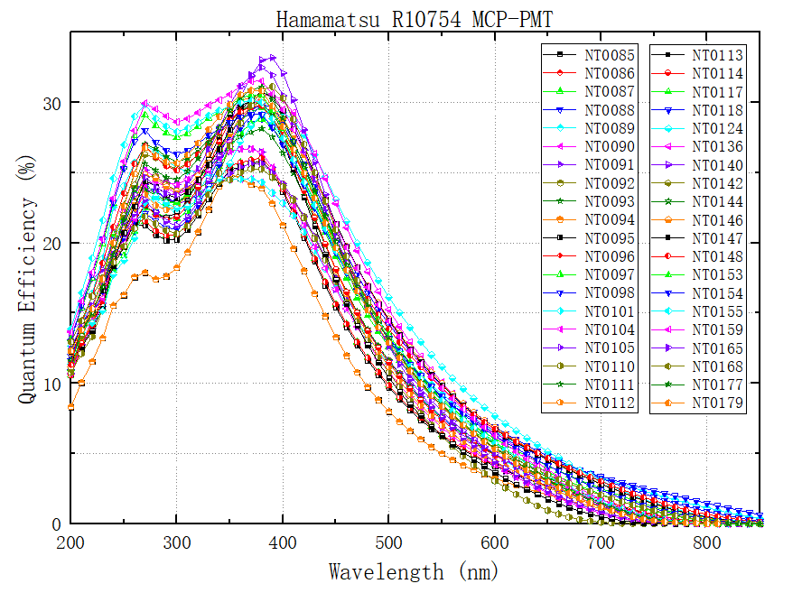
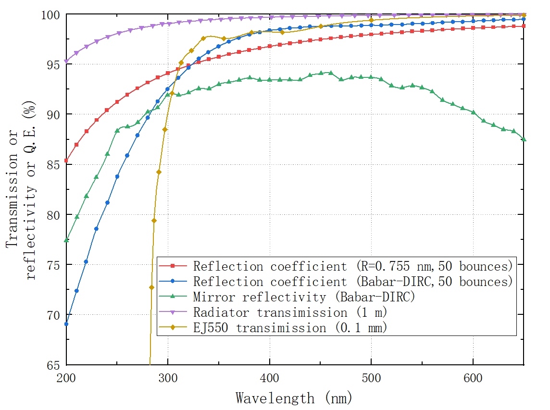
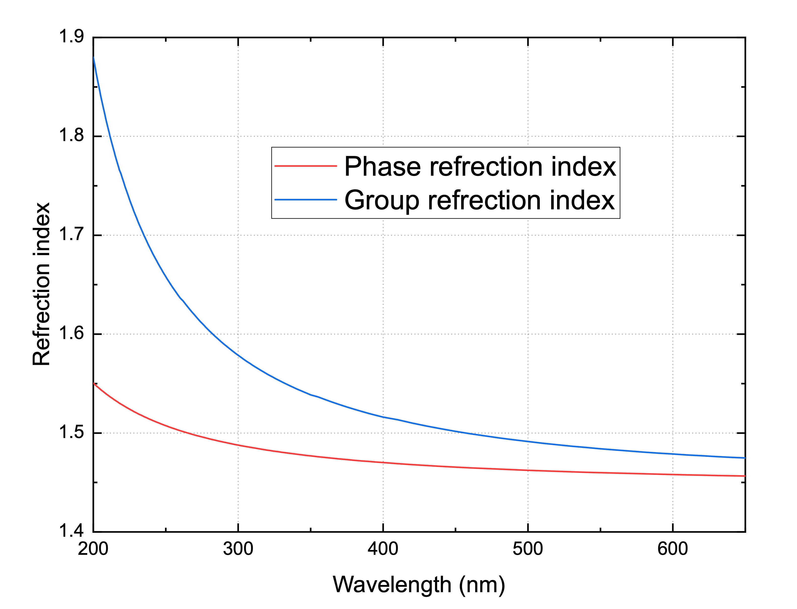
DTOF Simulation
Optical Parameters
Optical parameters used in DTOF simulation.

Slide 5
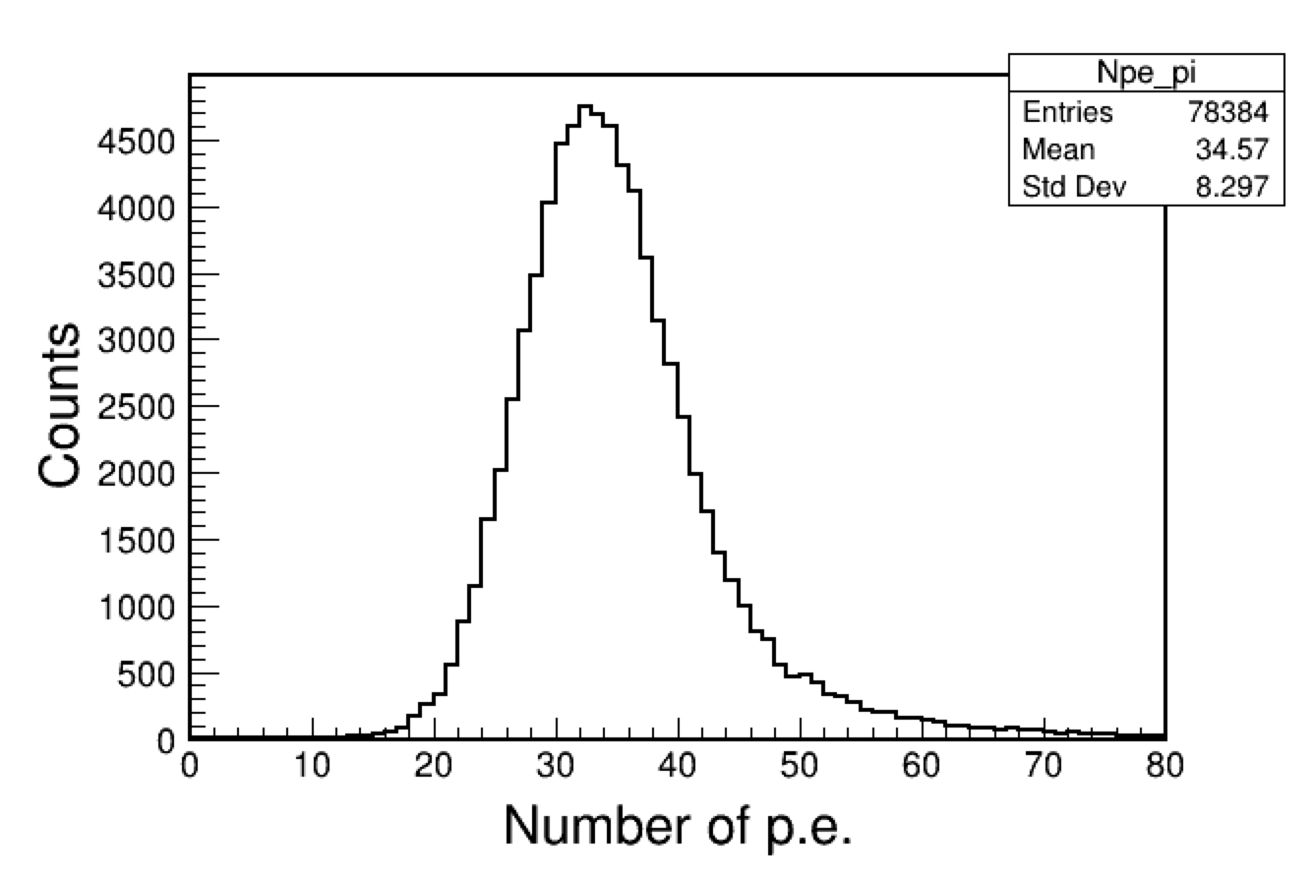
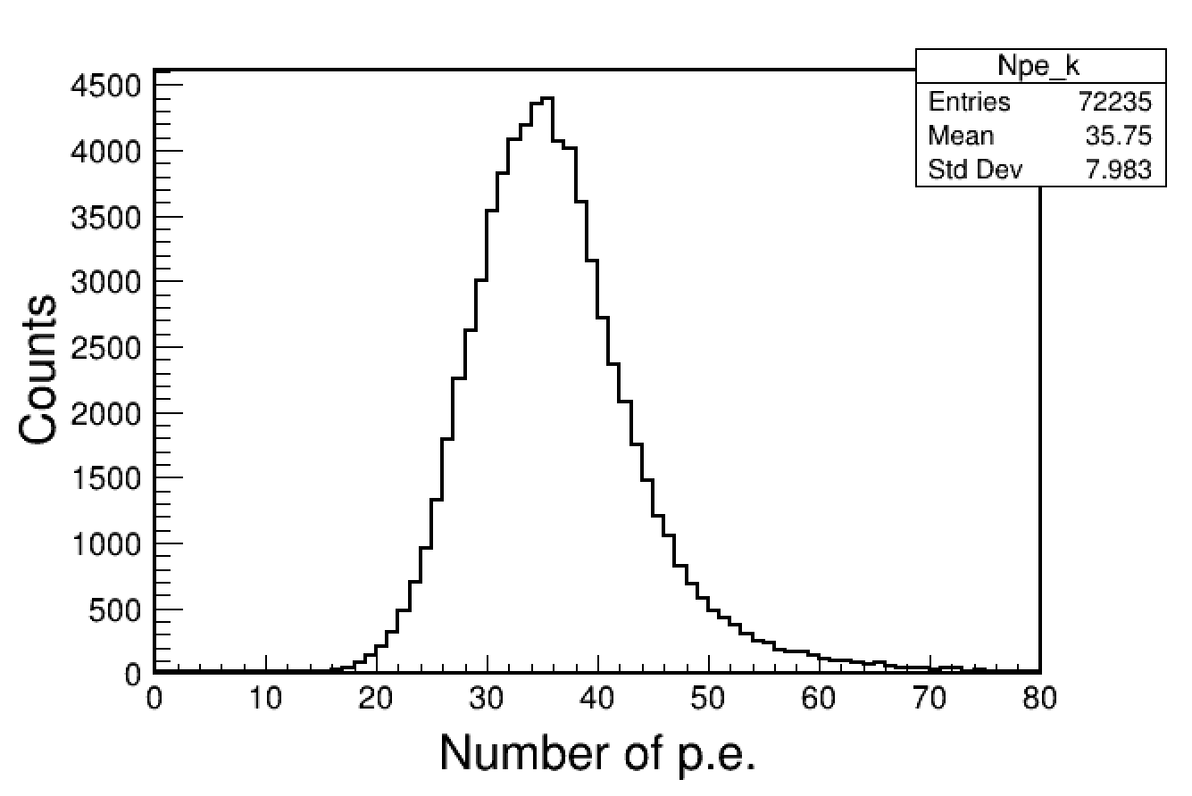
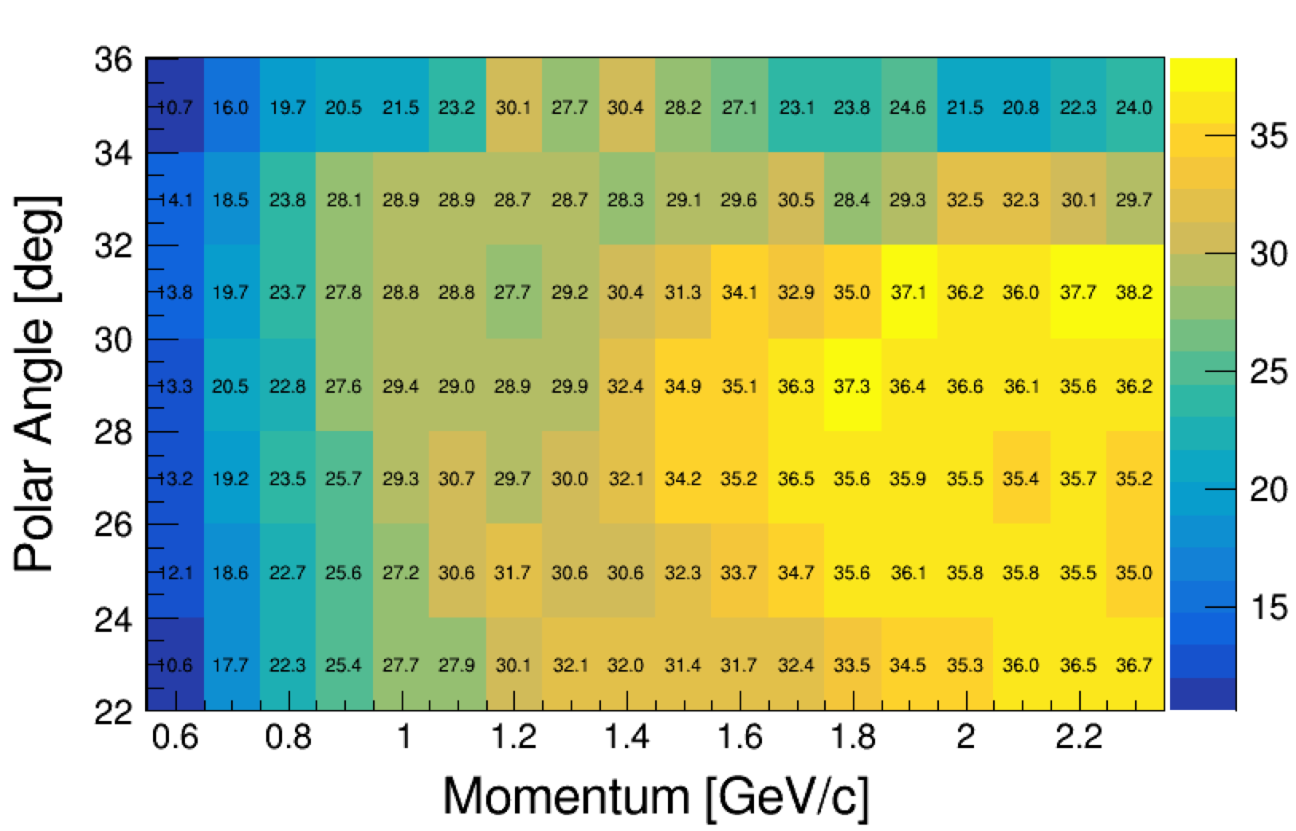



DTOF Simulation
Photon Yield
$π$ Sample
K Sample
$$p=2.0GeV$$
$$θ=25°$$
$$p=2.0GeV$$
$$θ=25°$$
Notes:
Effective photon yields used in the following reconstruction

Slide 6
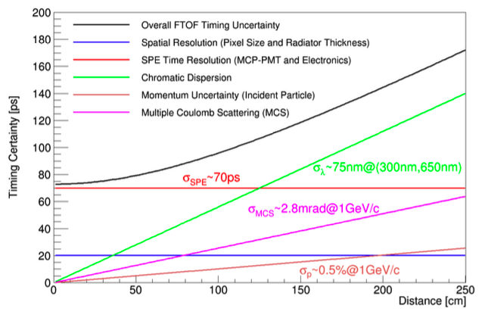
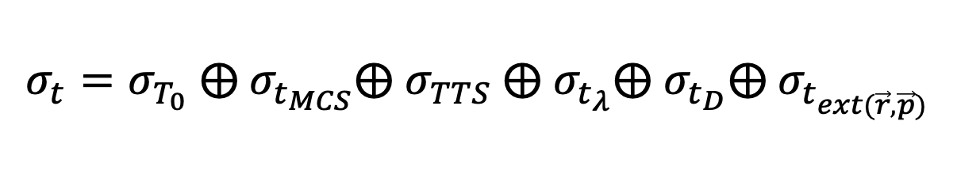


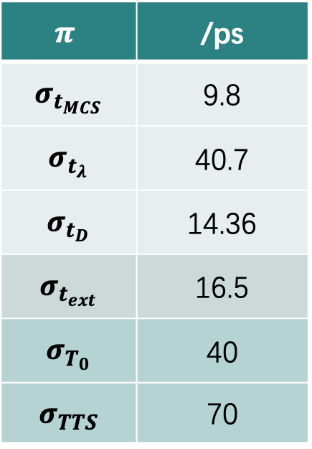
DTOF Reconstruction
Single Timing Uncertainties
$$σ_{t}=σ_{T_{0}} ⨁{ σ}_{t_{MCS}}⨁ σ_{TTS} ⨁{ σ}_{t_{λ}}⨁{ σ}_{t_{D}}⨁{ σ}_{t_{ext(\vec{r}, \vec{p})}}$$
OSCAR ～95.7 ps
$⊕σ_{T_{0}}⊕σ_{ext}\sim$ 94 ps
$Distance=\sqrt{ΔX^{2}+ΔY^{2}}=$ 63.5 cm ~ 83 ps
$$π$$ | /ps
$$σ_{t_{MCS}}$$ | 9.8
$$σ_{t_{λ}}$$ | 40.7
$$σ_{t_{D}}$$ | 14.36
$$σ_{t_{ext}}$$ | 16.5
$$σ_{T_{0}}$$ | 40
$$σ_{TTS}$$ | 70
B. Qi et al 2021 JINST 16 P08021
Notes:
There is the single timing uncertainties in DTOF reconstruction.
It consists of these six parts: the uncertainty from the starting time of an event, the mutiple Compton scattering of the charged tracks, the transit time spread of the MCP-PMT, the dispersion of the lignt, the geometry width of the quartz, and from the extrapolation algorithm of the charged tracks.
Uner the offline software frame, the uncertainties from these parts are estimated as this table.
Finally, the total single timing uncertainty is evalueated as about 95.7 pico second.
In this paper, they estimated this timing uncertainty by analytical mathematical calculation, and at same momentum and polar angle, it predict this uncertainty as 94ps, which is essentially consistent.

Slide 7
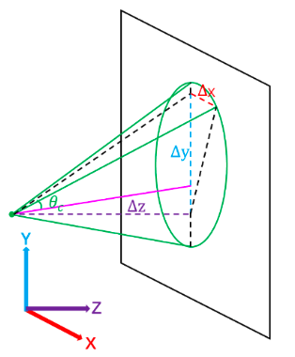
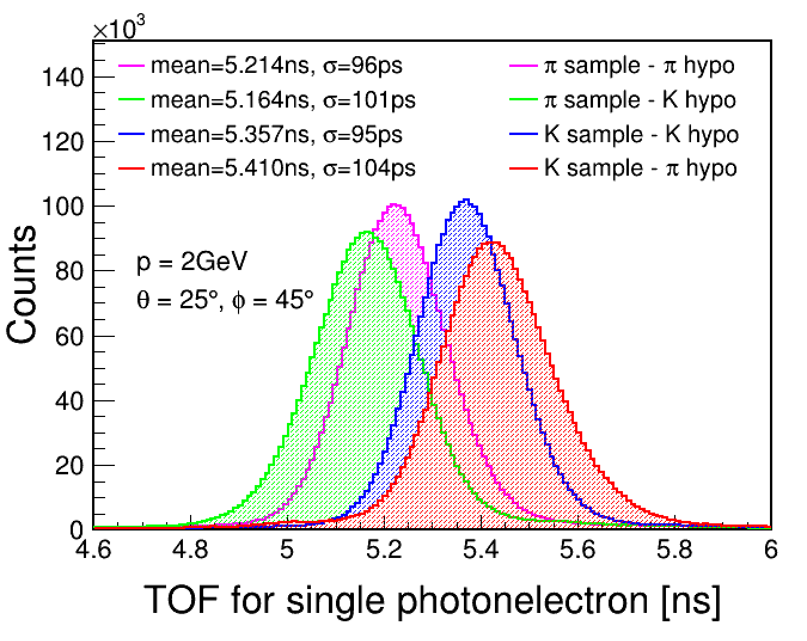

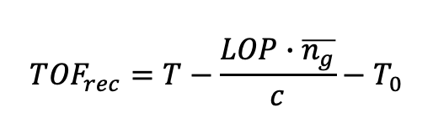


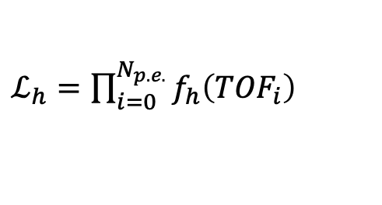

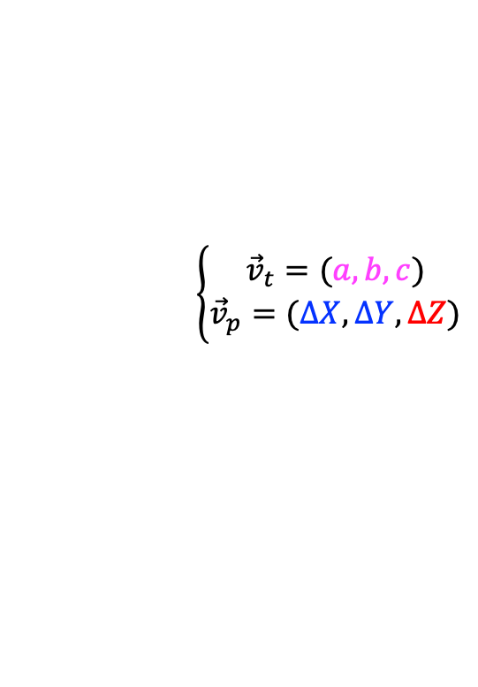


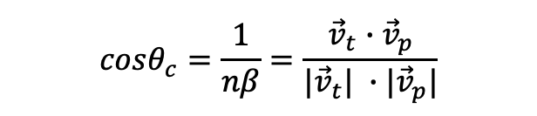
DTOF Reconstruction
Likelihood Method for PID – Timing Method
TOF Reconstruction
Likelihood construction
$$cosθ_{c}=\frac{1}{nβ}=\frac{{\vec{v}}_{t}∙{\vec{v}}_{p}}{|{\vec{v}}_{t}| ∙|{\vec{v}}_{p}|}$$
$$\left\{\begin{aligned}{\vec{v}}_{t}=(a,b, c) \\ {\vec{v}}_{p}=(ΔX, ΔY, ΔZ)\end{aligned}\right.$$
$ℒ_{h}=\prod_{i=0}^{N_{p.e.}}{f_{h}\left({TOF}_{i}\right)}$
signal
bkg
$${TOF}_{rec}=T−\frac{LOP∙\overline{n_{g}}}{c}−T_{0}$$
$$f_{h}\left(t\right)=Gaus\left(TOF_{rec}| TOF_{hypo}, σ\right)+0.05$$
$$LOP=\sqrt{ΔX^{2}+ΔY^{2}+ΔZ^{2}}$$
$$⟹$$
where $TOF_{hypo}=\frac{LOF}{cβ_{hypo}}$
Detection point
Photon direction
In xoy $(ΔX, ΔY)$
$$ΔZ$$
Trk
$${\vec{v}}_{t}=(a,b,c)$$
z
Notes:
We used likelihood method to perform the PID.
The first method is to construct the likelihood distribution of the TOF of the charged particle.
As we all know, the theta between Cherenkov photon and it mother charged particle should stratify this function.
Because the Cherenkov photon will be uniformly generated in the quartz, we assume that these Cherenkov photons are generated from the point where the particle passes through the center of the quartz, and combine the position, momentum information of the particle at this point and the hit position of the photon together to calculate the propagation length of the photon in z-axis, which is demoted as delta Z.
By this way, we can obtain the whole propagation length of the Cerenkov photon, and used this length to calculate the reconstructed TOF of the mother charged track.
By the extrapolation algrothim, we can estimate the TOF under different particle hyposis, and assume the TOF obey the distribution as this functon. The signal is distribed by a Gaussian fuction, and this constant is the bkg.
At the same time, the particle has the different momentum information at different particle hyposis, so we can reconstruct the TOF of a partile under the different particle sort phyposis as this plot.

Slide 8
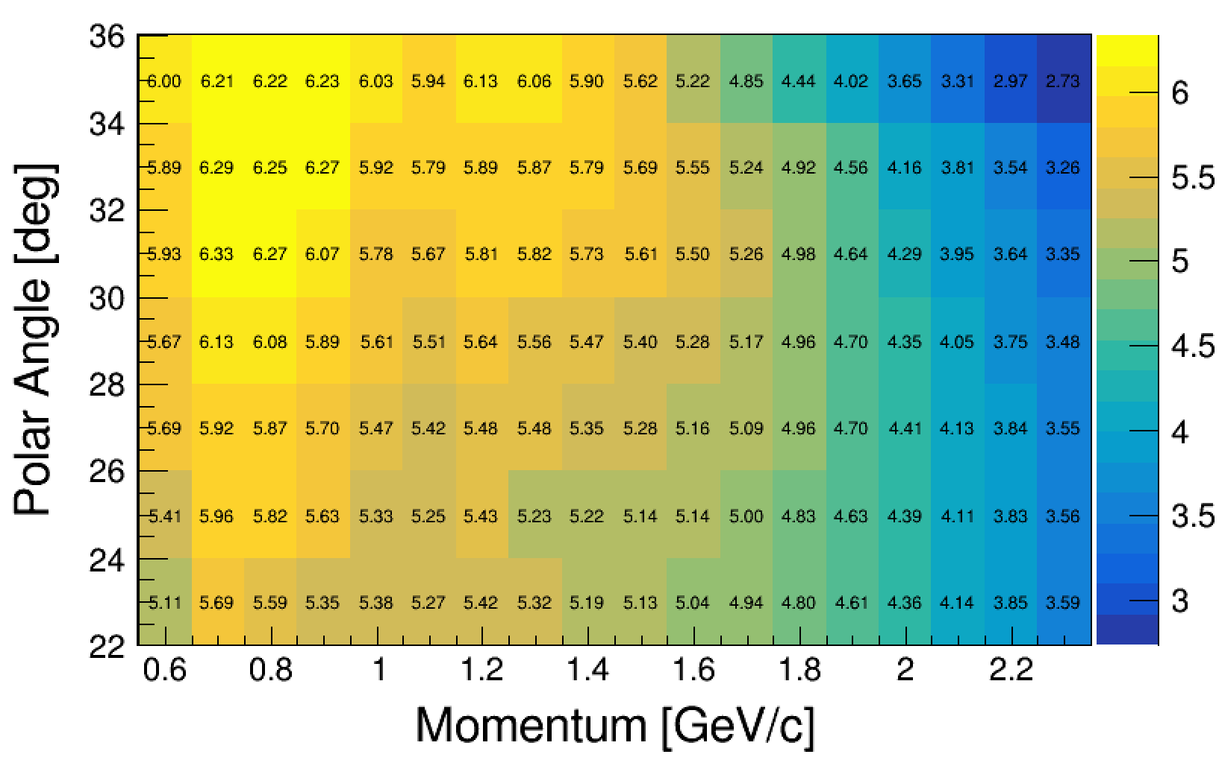
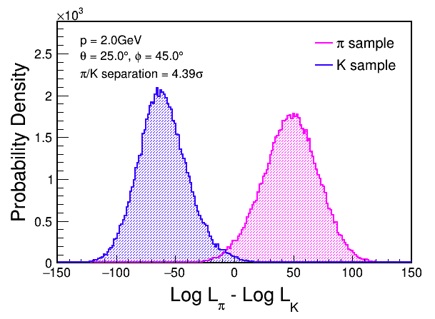

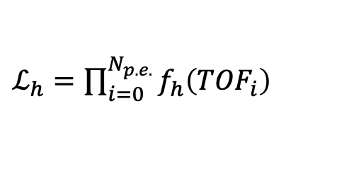
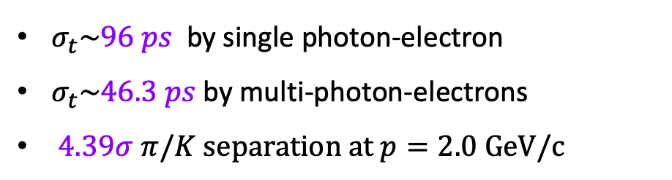
DTOF Reconstruction
Likelihood Method for PID – Timing Method
Performance
$ℒ_{h}=\prod_{i=0}^{N_{p.e.}}{f_{h}\left({TOF}_{i}\right)}$
$π/K$ separation power in different $\left(\left|\vec{p}\right|, θ\right)$ :
$σ_{t}\sim 96 ps$ by single photon-electron
$σ_{t}\sim 46.3 ps$ by multi-photon-electrons
$4.39σ π/K separation at p=2.0 GeV/c$
8
Notes:
Then we can calculate the likelihood value of the particle under the different particle sort hyposis, and such as this plot, we can obatain 4.4 sigma separation between the pi and kaon by using there likelihood deviation between differen hyposis.
We call this likelihood distribution of TOF as Timing method, and the performance of the pi k separation at different polar angle and different momentum can found at this plot.

Slide 9
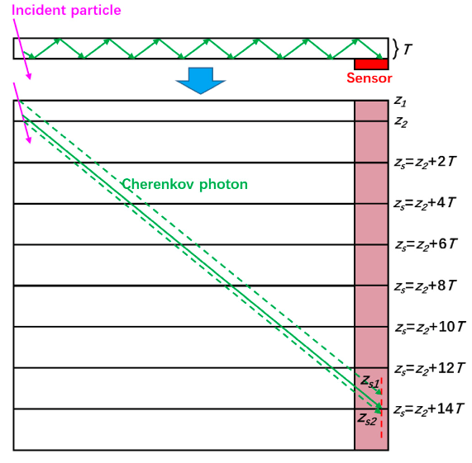
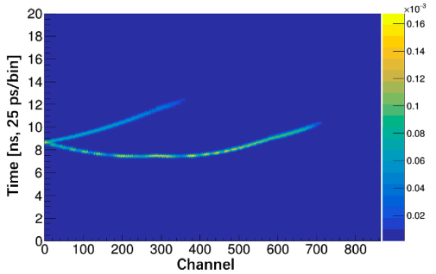



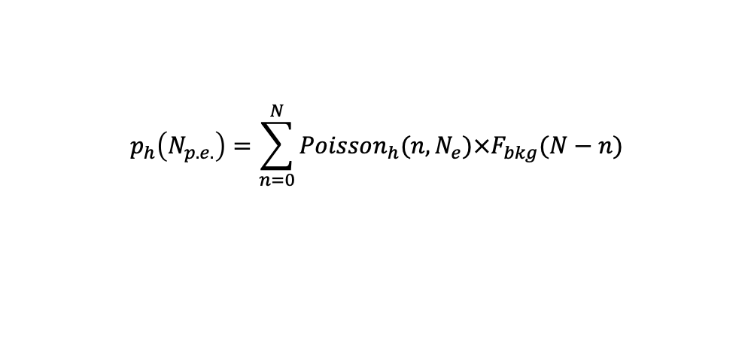

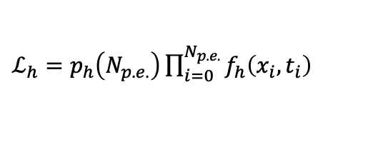

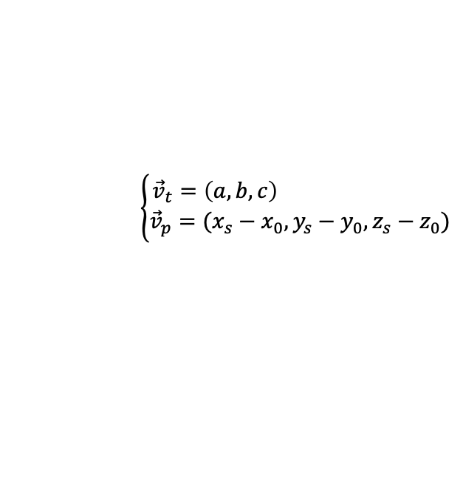
DTOF Reconstruction
Likelihood Method for PID – Imaging Method
Photon TOA v.s. $(x_{s}, y_{s})$ Reconstruction
Likelihood construction
$$cosθ_{c}=\frac{1}{nβ}=\frac{{\vec{v}}_{t}∙{\vec{v}}_{p}}{|{\vec{v}}_{t}| ∙|{\vec{v}}_{p}|}$$
$$\left\{\begin{aligned}{\vec{v}}_{t}=\left(a,b, c\right) \\ {\vec{v}}_{p}=(x_{s}−x_{0}, y_{s}−y_{0}, z_{s}−z_{0})\end{aligned}\right.$$
$ℒ_{h}=p_{h}\left(N_{p.e.}\right)\prod_{i=0}^{N_{p.e.}}{f_{h}\left(x_{i},t_{i}\right)}$
$$p_{h}\left(N_{p.e.}\right)=\sum_{n=0}^{N}{Poisson_{h}(n, N_{e})×F_{bkg}(N−n)}$$
$$z_{s}=z_{2}+2mT$$
$$\left(x_{s}, y_{s}\right)⟹z_{e}, φ_{c}⟹TOA=TOF+\frac{ΔLOF_{e}}{βc}+TOP$$
$f_{h}\left(x,t\right)=S_{h}(x, t)+const_{bkg}$
$S_{h}(x, t)$ is the signal P.D.F. with a weight of $N_{p.e.}$
z
9
Notes:
We have also constructed a two dimentional probability density function of the hit time and the hit position of the Cerenkov photon, which is called imaging method.
We also used this Cerenkov angle function to construct the relationship between the photon and the information of the charged particle at photon’s generated point.
This vt is the momentum of track, and the vp is the momumtum of the photon, where the x0,y0,z0 is the photon generated point, which we need to solved.
The following plot show the unfolded photon reflection spectrum, and from this plot. Z1 and z2 is two interfaces of the quartz.
We can found that if the photon can hit the MCP_PMT, its the deviation between the hit position in zxis and the z2 should statisfy the even multiple of the quartz thickness, and its final hit position should located in the red region at this plot which symbolize the sensor.
So, under the above fuction, we can obtain the position of the real generated point of the photon, and based on this, we can calculate the floght time of the charged track from the IP position to the photon generated point, and the propogation time of the photon to obtain the photon hit time.
Finally, we can construct a lielihood distribution as this Func.
The first part is the lielihood distribution to describe the photon yield of the track under different hyposis.
The second part, fh is the two dimesion PDF of the photon hit position and the hit time we discussed before.

Slide 10
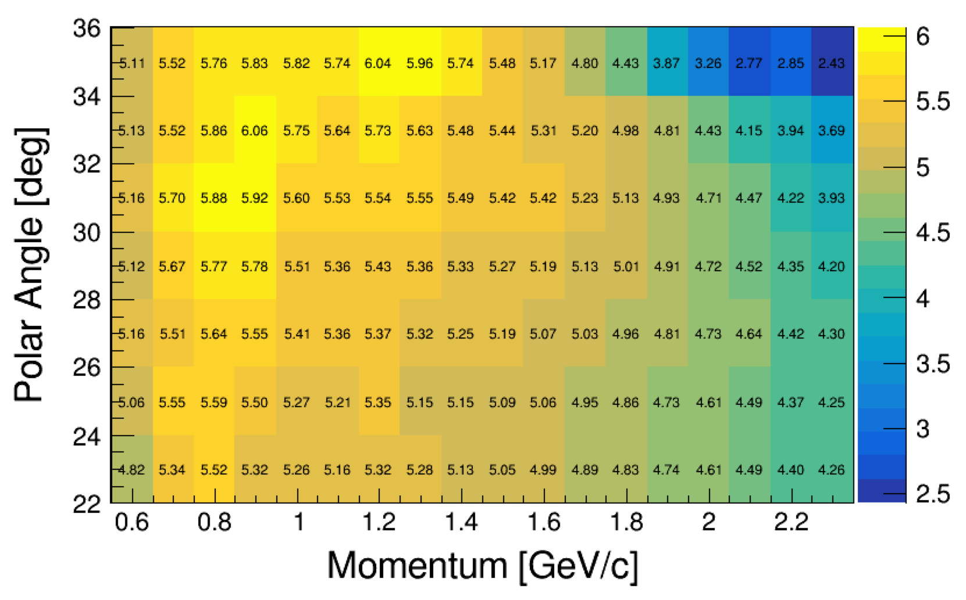
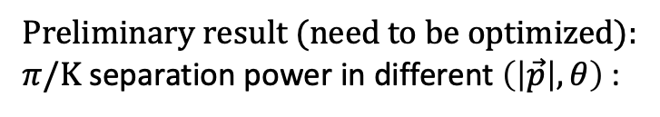
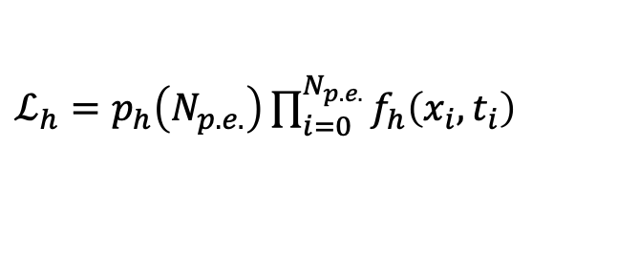
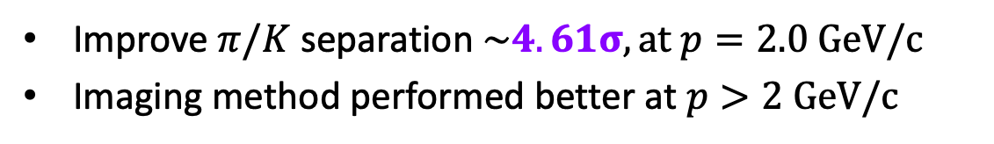
DTOF Reconstruction
Likelihood Method for PID – Imaging Method
Performance
$ℒ_{h}=p_{h}\left(N_{p.e.}\right)\prod_{i=0}^{N_{p.e.}}{f_{h}\left(x_{i},t_{i}\right)}$
Preliminary result (need to be optimized):
$π/K$ separation power in different $\left(\left|\vec{p}\right|, θ\right)$ :
Improve $π/K$ separation $\sim 4.61σ, at p=2.0 GeV/c$
Imaging method performed better at $p>2 GeV/c$

Slide 11
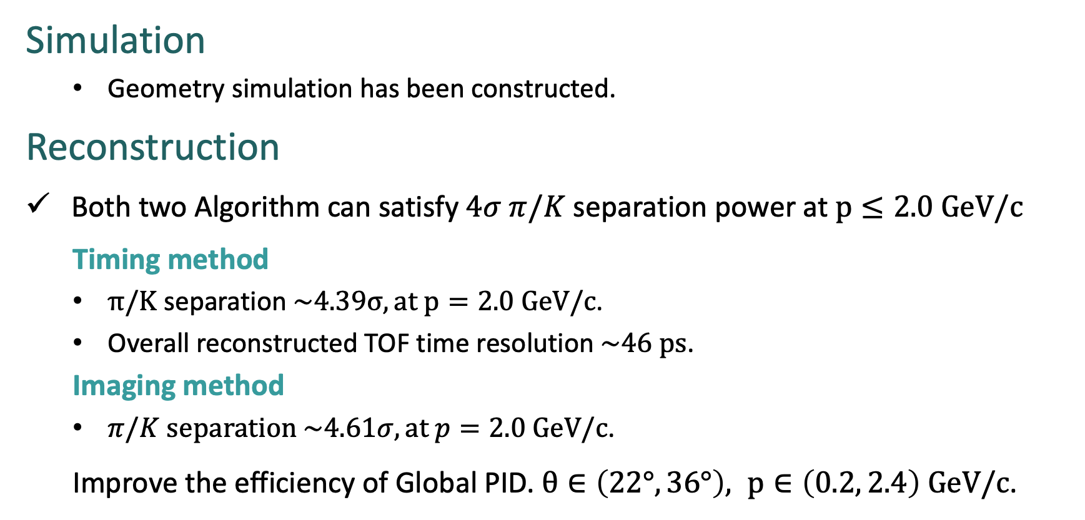
Summary
The Simulation & Reconstruction software of DTOF has been established based on OSCAR:
Simulation
  Geometry simulation has been constructed.
Reconstruction
Both two Algorithm can satisfy $4σ π/K$ separation power at $p≤2.0 GeV/c$
  Timing method
  $π/K$ separation $\sim 4.39σ, at p=2.0 GeV/c$.
  Overall reconstructed TOF time resolution $\sim 46 ps$.
  Imaging method
  $π/K$ separation $\sim 4.61σ, at p=2.0 GeV/c$.
  Improve the efficiency of Global PID. $θ∈\left(22°, 36°\right), p∈\left(0.2, 2.4\right) GeV/c$.
Thank you!

Slide 12
BackUp

Slide 13
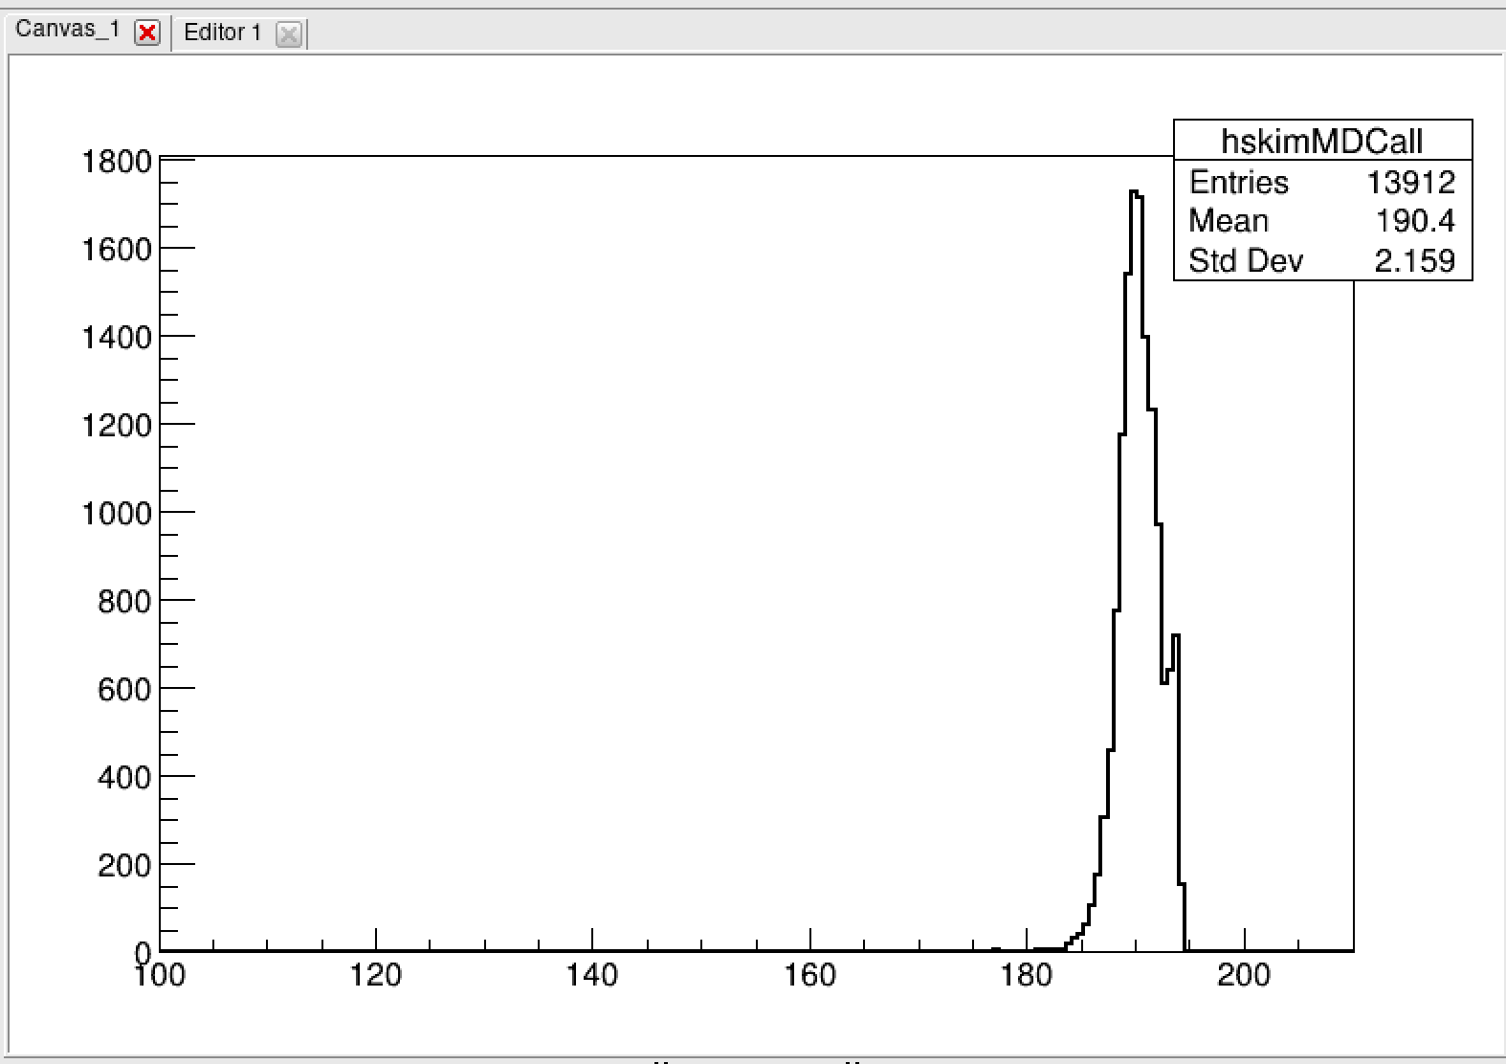
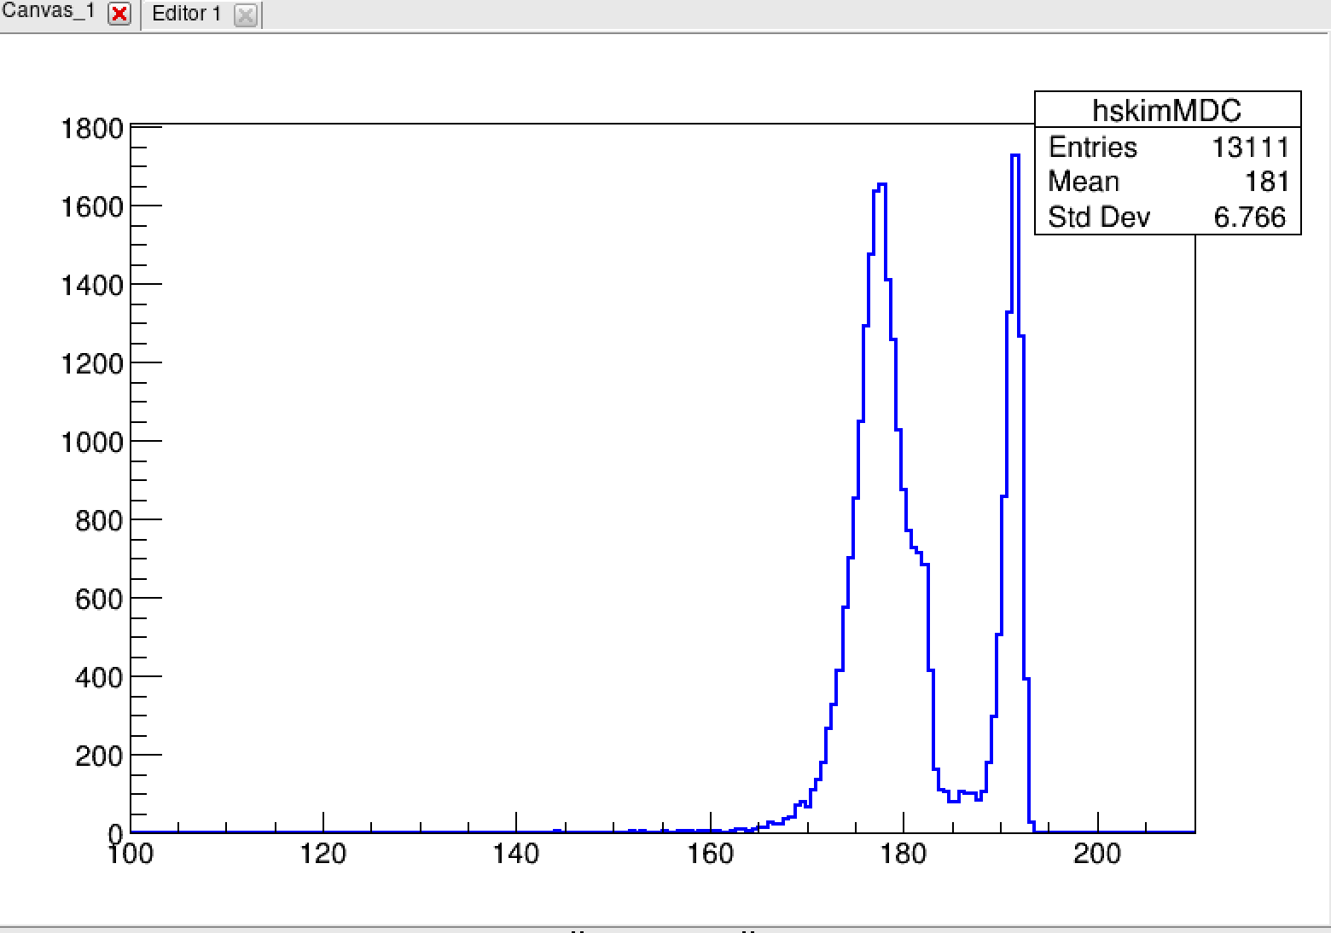
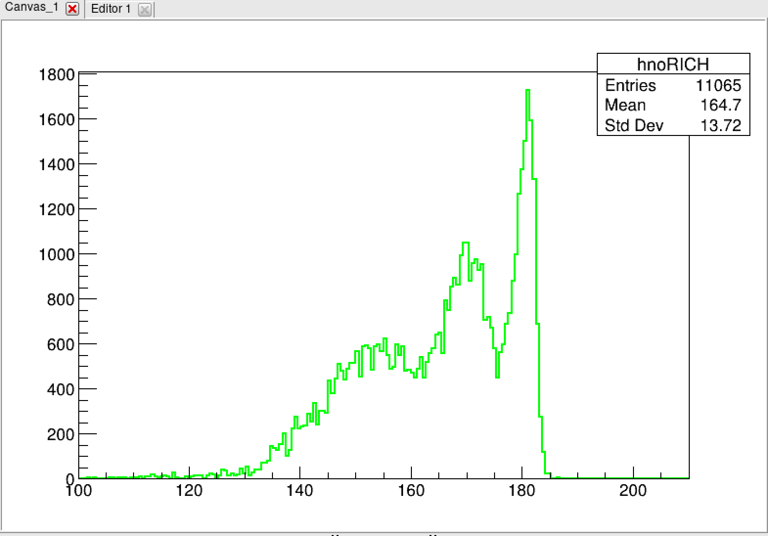
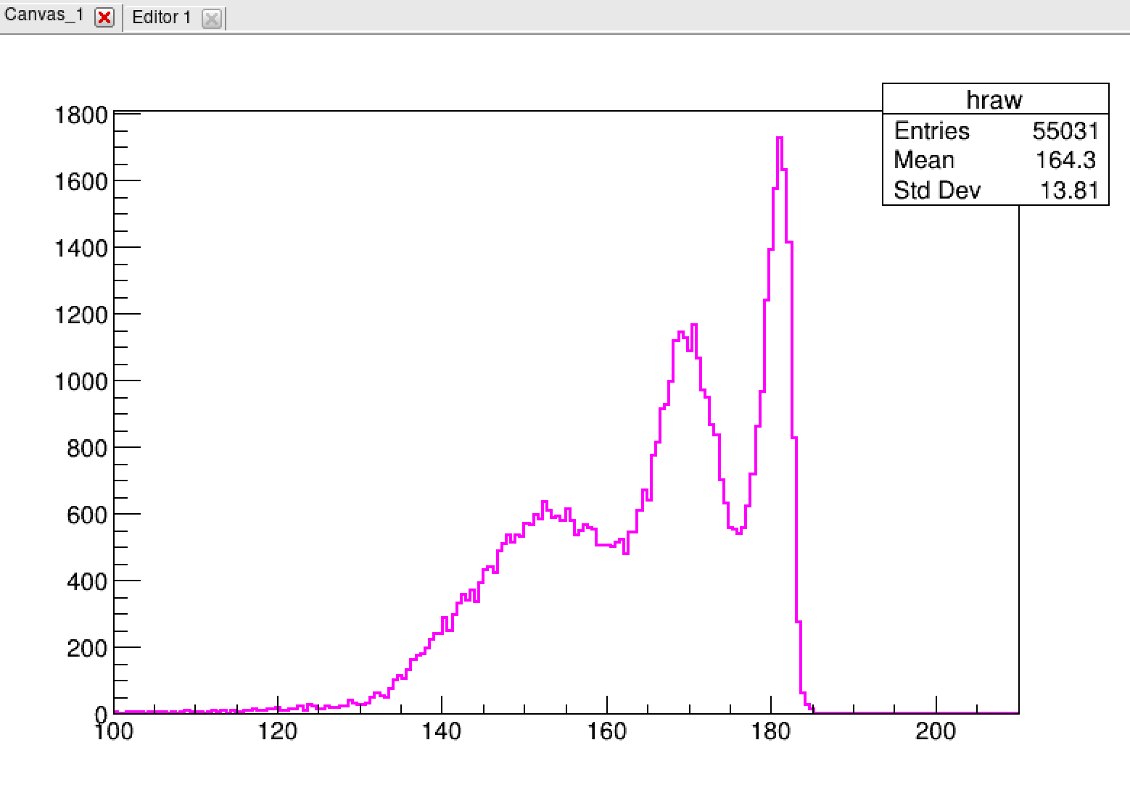
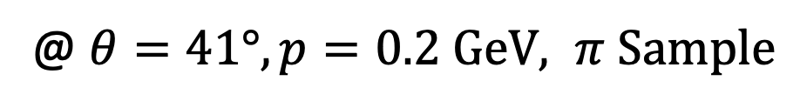
BackUp
@ $θ=41°, p=0.2 GeV, π Sample$
Delete the Rich,
Skim the barrier of MDC
(both endcap & barrel)
Delete the Rich,
Skim the barrier of MDC
(only barrel)
Delete the Rich
With whole Geometry

