Slide 1
RICH Simulation and Reconstruction Algorithm
Binlong Wang Huibin Zhang Qian Liu
Qingyuan Huang Shiping Chen Wenqian Huang
University of Chinese Academy of Sciences
FTCF2024，Hefei

Slide 2
Contents
Introduction
DLL Algorithm
StandAlone Simulation
Work in OSCAR
Conclusion

Slide 3
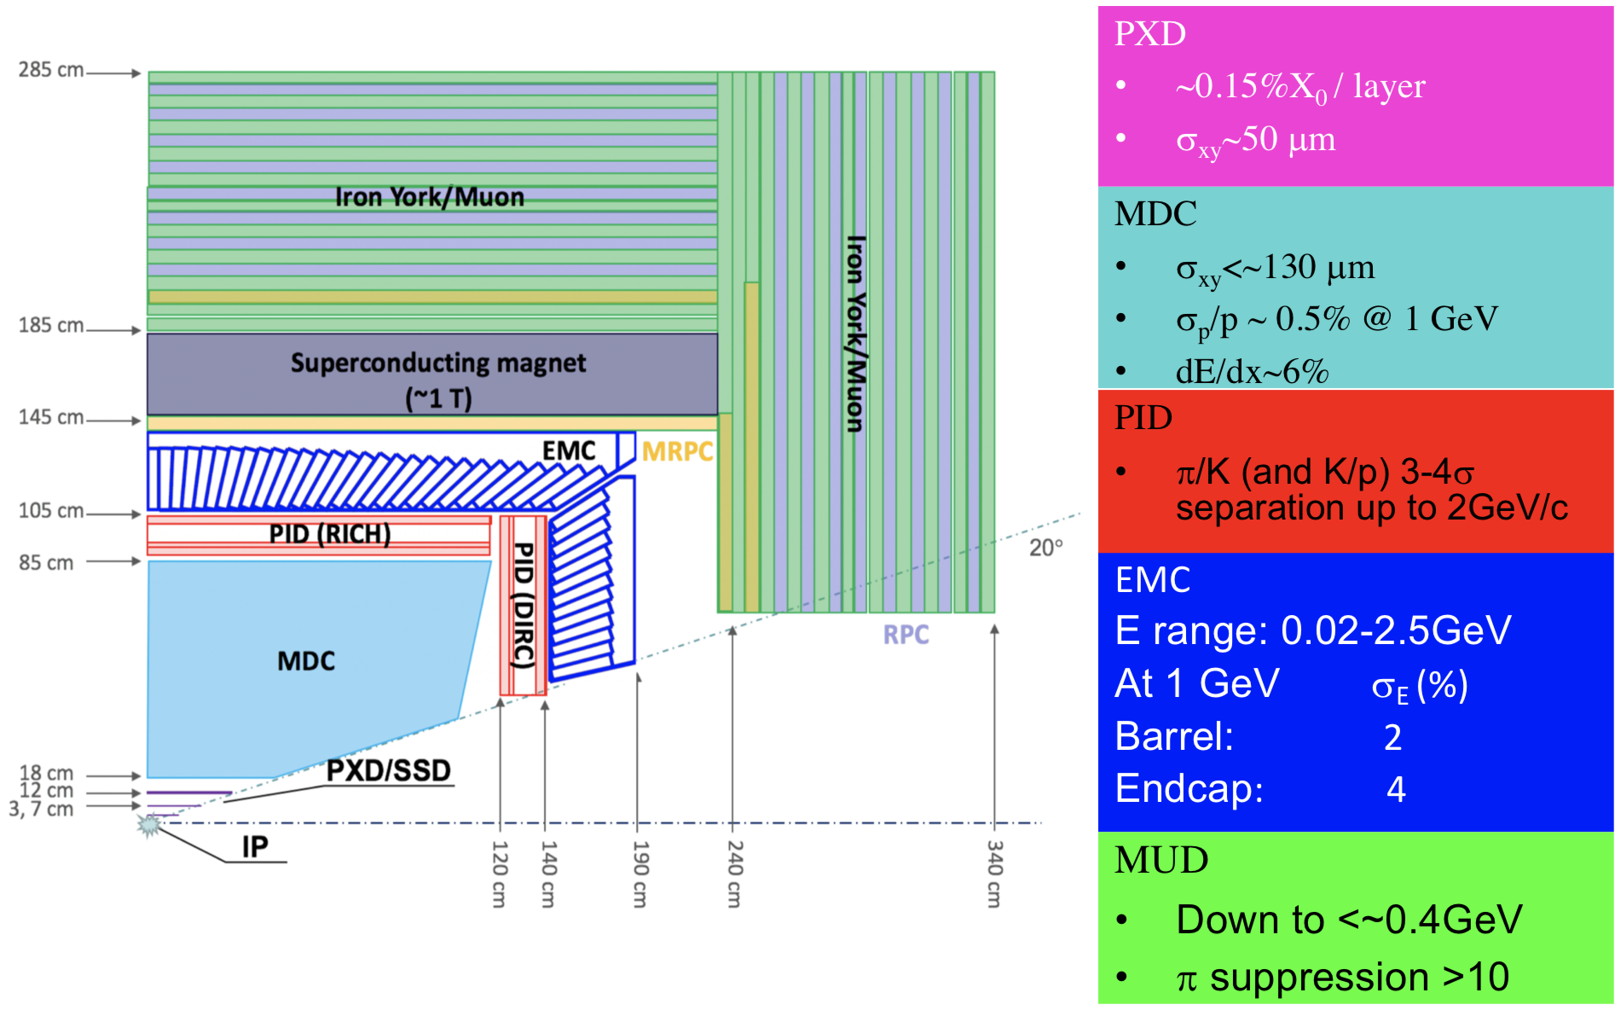
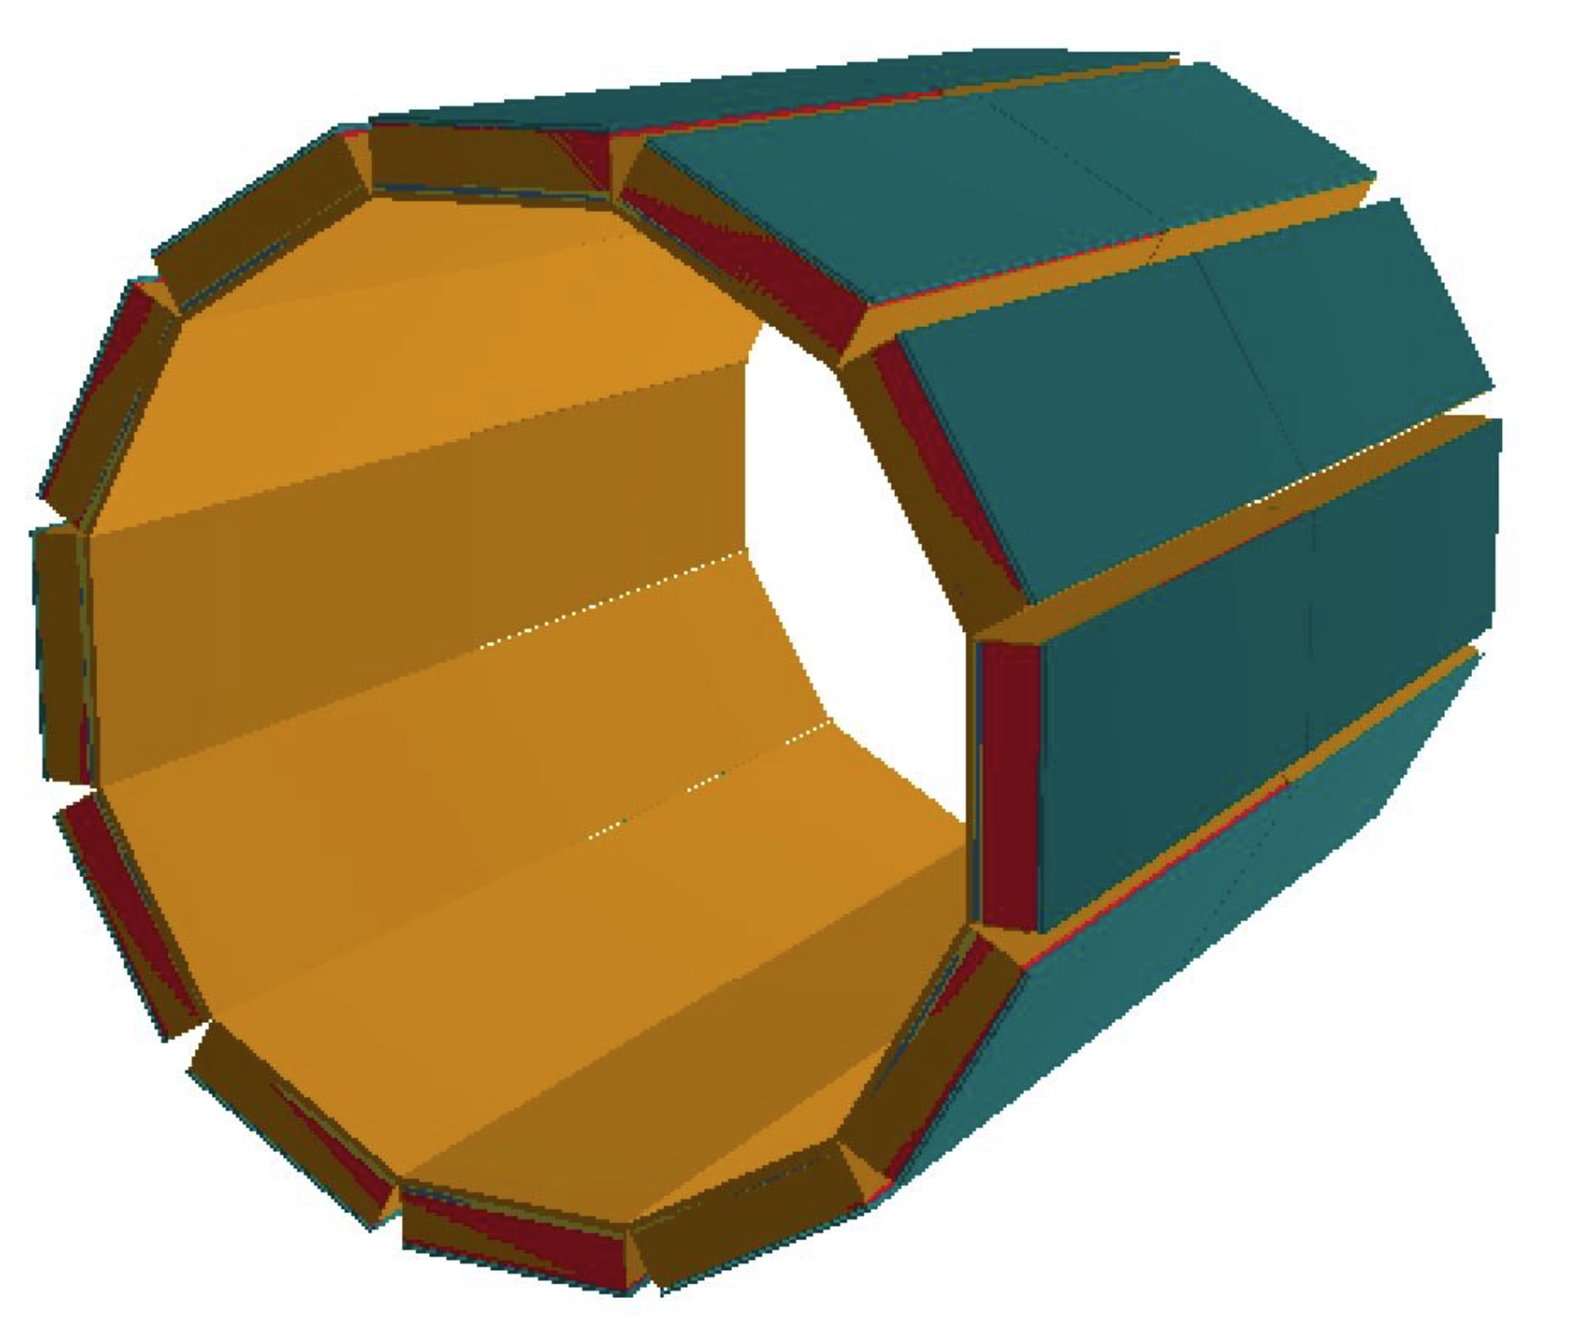
RICH in STCF
PIDB, 12 modules
located between MDC and EMC

Slide 4
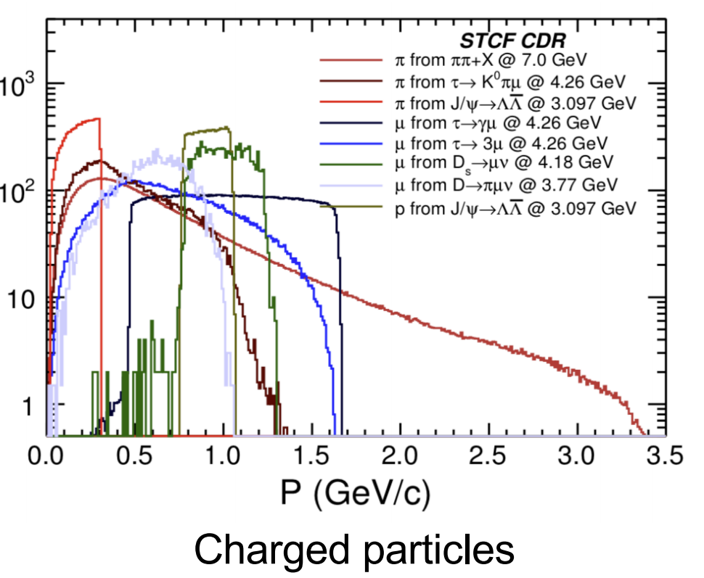
PID Requirements
Wide range of momentum distribution
$E_{cm}$ being up to 7 GeV , PID up to 2GeV
Low momentum region (< 0.6 GeV/c) covered by dE/dx measurement
Cherenkov-based technology
Compact (< 20 cm) and limited material budget (< 0.3 $X0$)
difficult to find optical focusing method
Large solenoid angle coverage

Slide 5
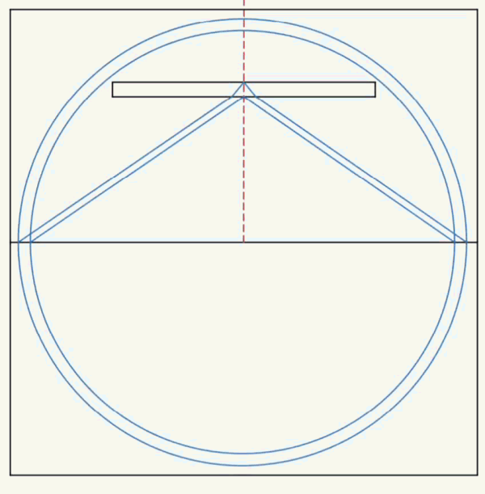
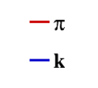
Hit on anode
~10 photonelectron
Cherenkov distribution
Deformed distribution in different kinematic regions
Cherenkov Ring with seperated branches in some cases
liquid Radiator
Quartz
Anode
θ=90°
2GeV/c
θ=45°
2GeV/c
Cherenkov dist.
Anode

Slide 6
Delta-Log-Likelihood Algorithm
For each partical hypothesis h , log-likelihood defined as
$$ln{ ℒ}_{h}=\sum_{pixel}{ln⁡[ Poisson(N_{i}, dis{t_{i,h}^{Chkv}}_{ }+dist_{i}^{bg})]}$$
$N_{i}$ :photoelectron number received by anode pixel i
$dis{t_{i,h}^{Chkv}}_{ }$:photoelectron number expected to received by anode pixel i for particle hypothesis h
$dist_{i}^{bg}$ :background photonelectron number expected to received by anode pixel i
do $π/K$ seperation by figure out delta-log-likelihood
$$DLL_{πK}=\ln{ℒ_{π}}−\ln{ℒ_{K}}$$
$dis{t_{h}^{Chkv}}_{ }$and $dist^{bg}$ generated offline
To speed up the program , only pixels with $dis{t_{i,h}^{Chkv}}_{ }≠0$ included in calculation

Slide 7
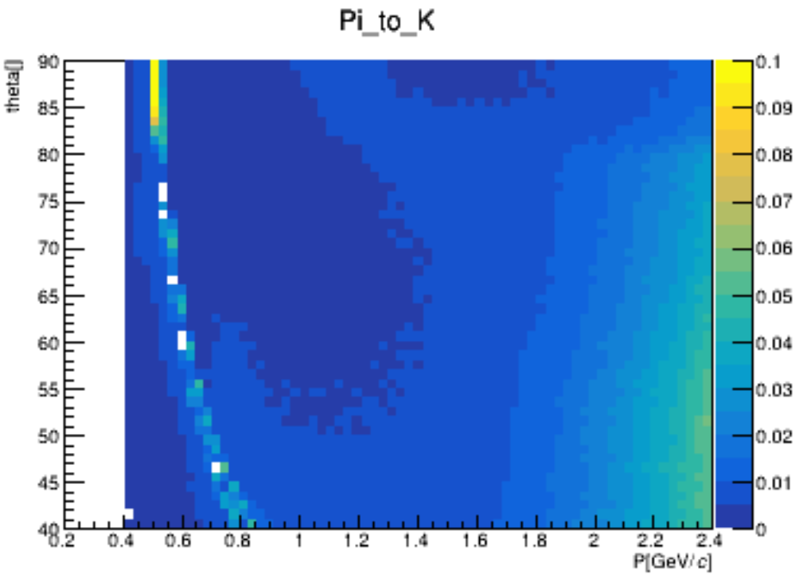
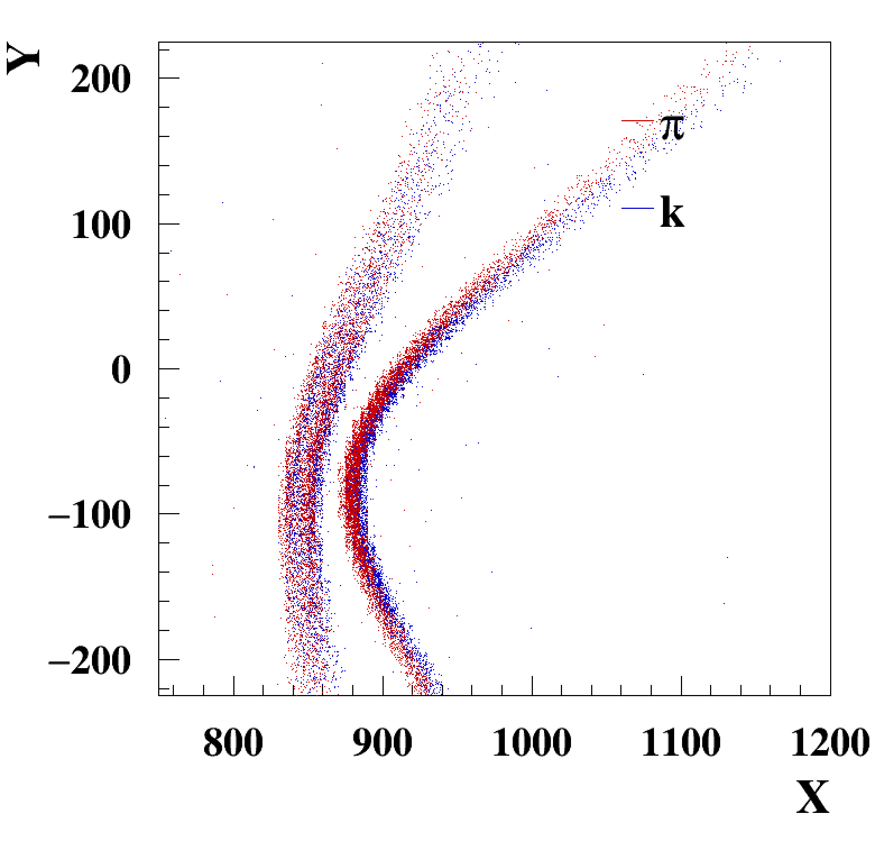
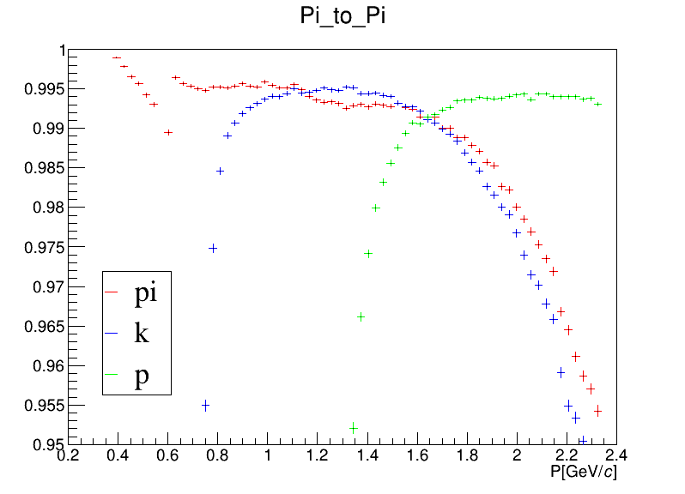
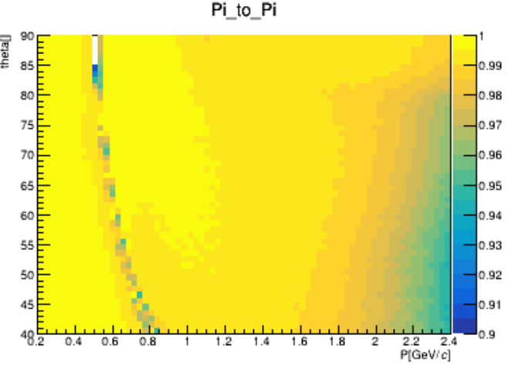
Standalone Simulation
In geant4
$P∈\left[0.2, 2.4\right]$GeV/c , $θ∈\left[40, 90\right]$deg, $φ=0°$
Background level: 10⁻³ hit / (pixel · time window)
$π/K$ mis-ID rate < 1% , $π, K, p$ PID efficiency > 98% mostly
Deformed Cherenkov distribution makes PID performance worse
$$θ$$
$$P[GeV/c]$$
$$θ$$
θ=45°
2GeV/c
$$π$$
$$K$$
$$p$$
θ=60°
$$P[GeV/c]$$

Slide 8
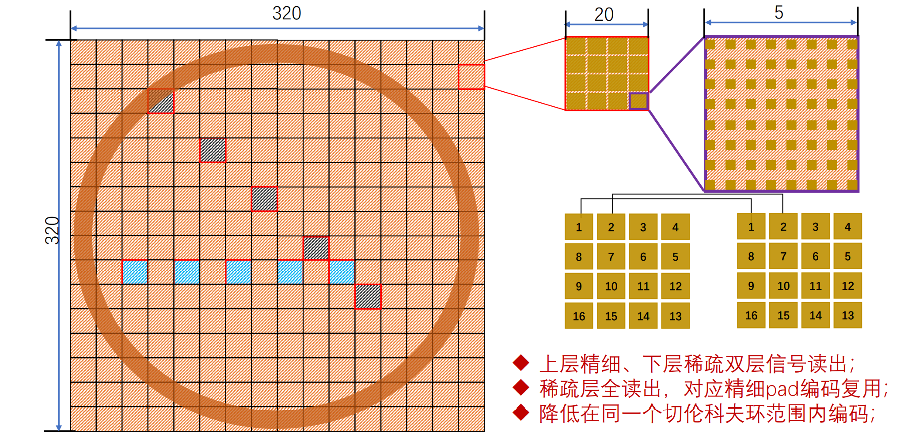
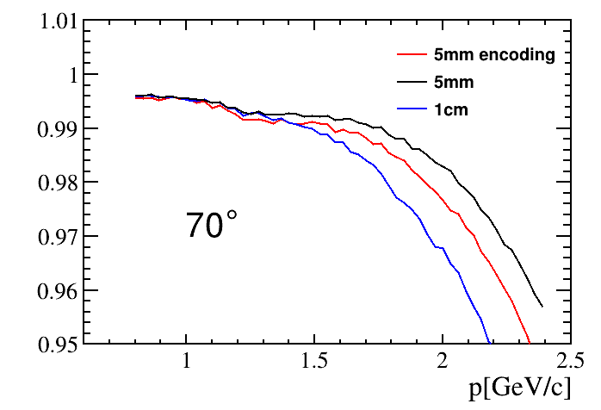
Encoding Readout in Standalone Simulation
Normal anode readout:
Granularity: $5×5$mm²
43200 pixels $×$ 12 modules
too many channels, expensive
Granularity: $10×10$mm²
Low PID efficiency @ 2GeV/c
Encoding anode readout:
Granularity remains $5×5$mm²
Specific pixels share same electronic channels,
decode the fired pattern to locate hit position
~20% Front end electronics $←$ less cost
PID efficiency remain 98％ mostly @ 10⁻³ background level
θ=
Notes:
做下图为与束流夹角为70度情况下模拟给出π、k、p中π鉴别成功的概率；含1.35^-3的本底。

Slide 9
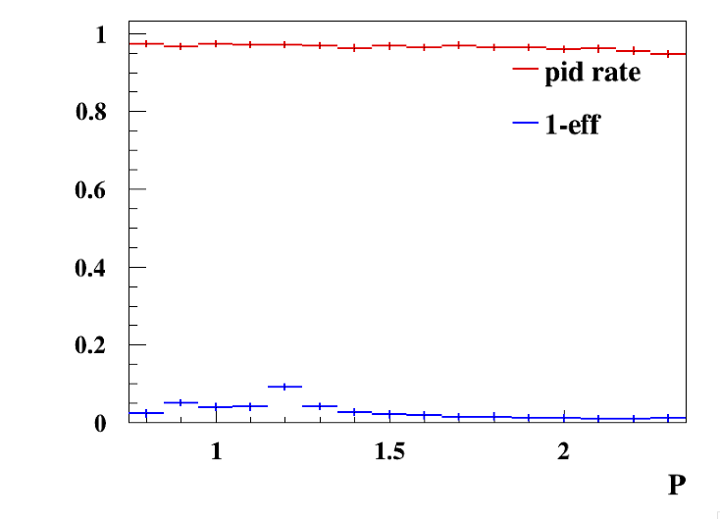
Migration to OSCAR
Standalone simulation:
Generate Cherenkov distribution in geant4
Cherenkov distribution in part of kinematic region
98% $π/K$ separation
OSCAR:
Generate Cherenkov distribution database by numerical calculation
faster than geant4 simulation
same result
Database: ~7M Cherenkov distribution image for different particles
$θ∈\left[{40}^{∘}, {140}^{∘}\right], φ∈\left[−{15}^{∘}, {15}^{∘}\right], p∈\left[0.2, 2.4\right]GeV/c$
> 96％$π/K$ separation
use RecExtTrack to improve PID performance
translate or interpolate Cherenkov distribution

Slide 10
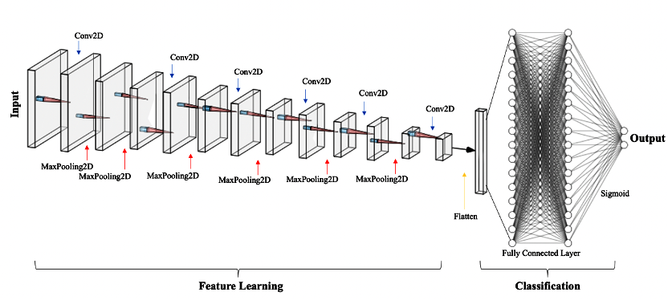
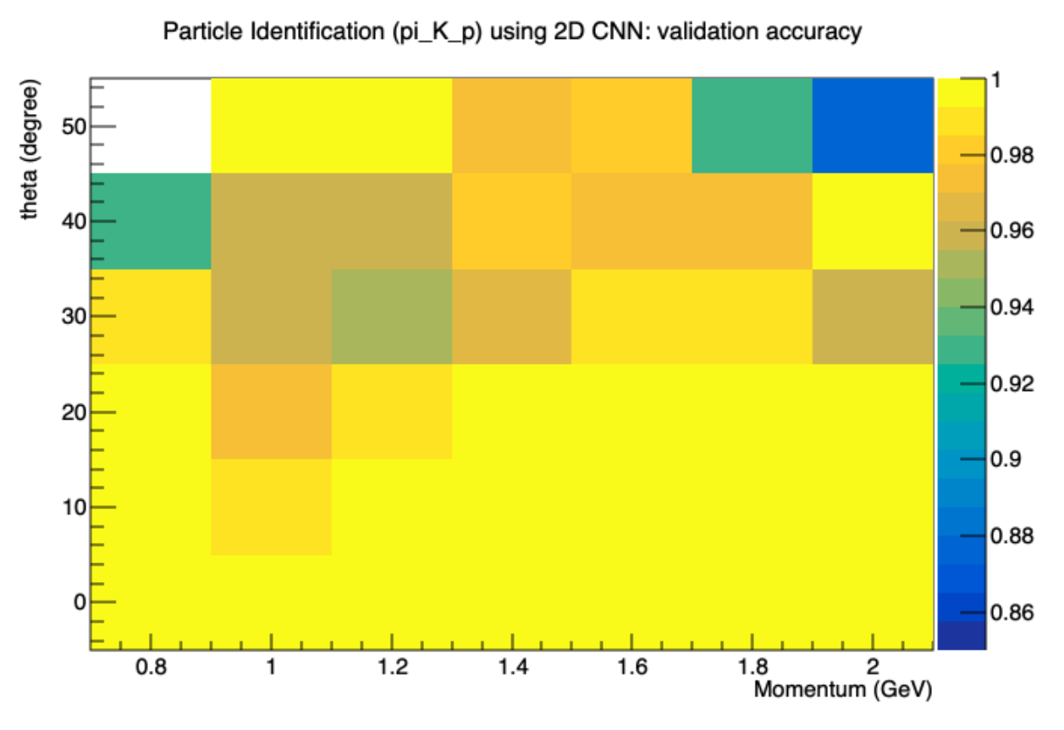
Convolutional Neural Networks
Disadvantages of DLL algorithm
Slow calculation:
Frequently database access
Too many Poisson likelihood calculated
Data-MC agreement is highly required
Kaon hit
Pion hit
CNN used
Pro
PID efficiency ~ similar level of likelihood method.
Highly accelerate the execution time to 1evt/2ms (1 2080Ti).
Con
Only take fixed-size images , lack of track information

Slide 11
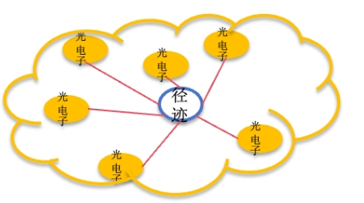
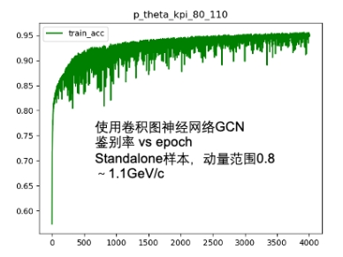
Graph Neural Networks
> 95％ when the training sample size > 4000

Slide 12
Conclusion
RICH satisfy STCF PID requirement: 98％ $π/K$ separation @ 2GeV/c
Algorithm | Expected PID efficiency | Note
DLL (standalone) | >98% | Need Cherenkov distribution as database Uniform distribution background
DLL (OSCAR) | >96% | Attempt to use RecExtTrack to improve PID performance
CNN | ～99% | Large memory consumption Unable to use track information
GNN |  | Start a trail
Future Plan:
optimize DLL algorithm
More simulation under OSCAR framework
Continue to work on neural network algorithm

Slide 13
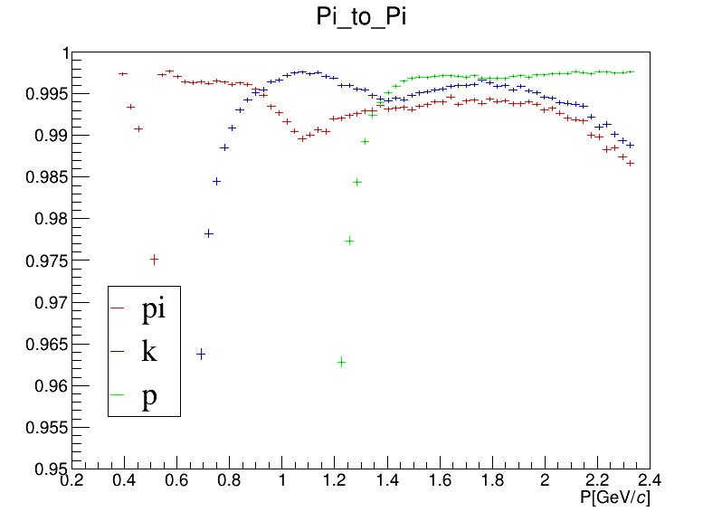
Backup
$$π$$
$$π$$
$$K$$
$$K$$
$$p$$
$$p$$
θ=90°
θ=60°

Slide 14
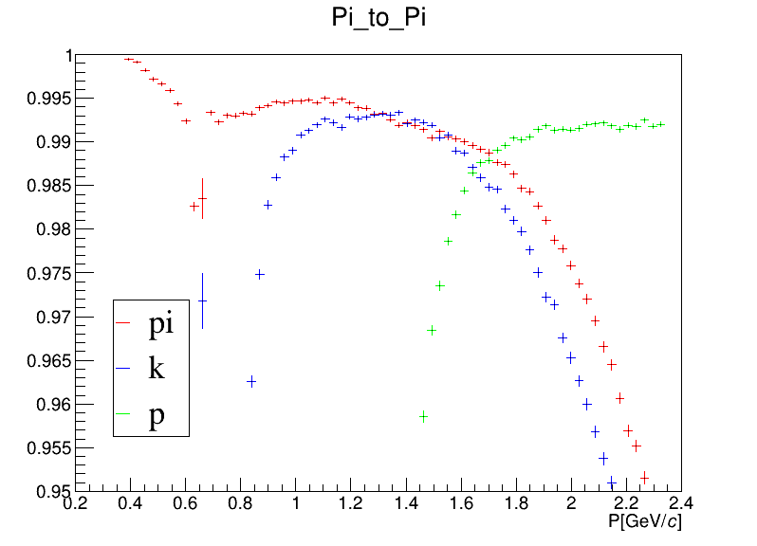
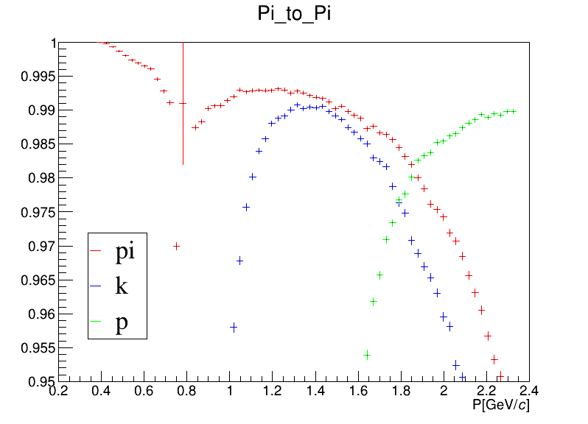
Backup
$$π$$
$$π$$
$$K$$
$$K$$
$$p$$
$$p$$
θ=50°
θ=40°
PID efficience decrease with the Cherenkov Ring deformed

