Slide 1
MILLICHARGED PARTICLES AT SCTF/STCF
[2208.03377]
D. Kalashnikov^{a,b}, D. Gorbunov^{a,b}, P. Pakhlov^{c,d}, T. Uglov^{c} ªINR RAS, ^{b}MIPT, ^{c}LPI, ^{d}HSE

Slide 2
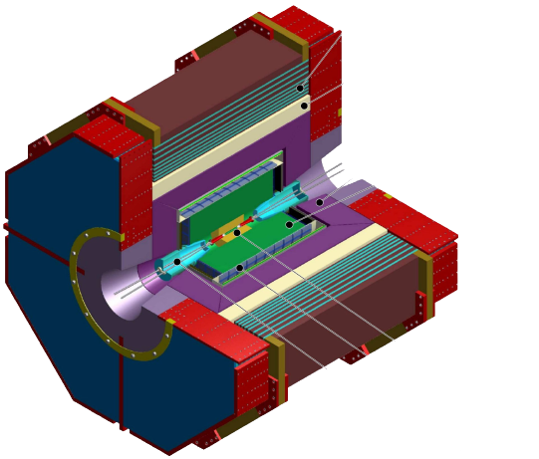
MILLICHARGED PARTICLES Super Tau-Charm Factory
$e^{+}e^{−}$ - collider
$$\sqrt{s}, GeV$$ | $$L, {fb}^{−1}$$
3.097 | 300
3.554 | 50
3.686 | 150
3.770 | 300
4.110 | 100
4.650 | 100
$$+$$
Scan over collision energies with 10 MeV step and 1/fb
1
Kalashnikov Dmitry FTCF2024 16.01.2024

Slide 3
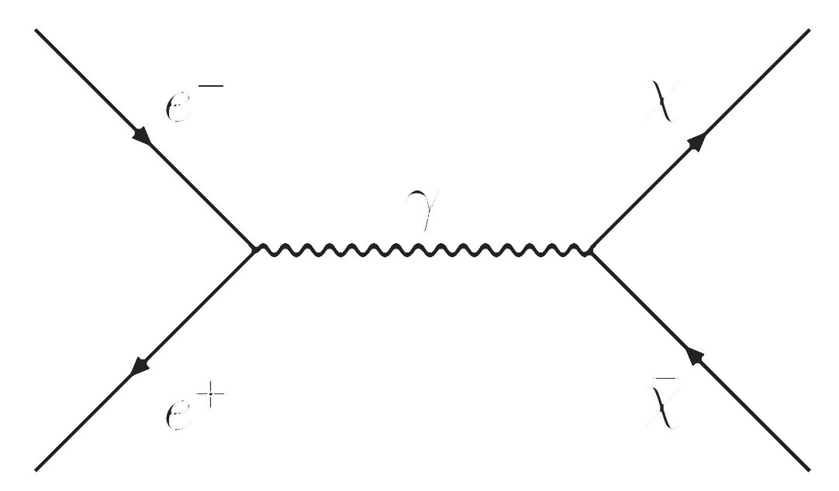
MILLICHARGED PARTICLES Model
$$ℒ=\text{ϵ}e A_{μ}\overline{χ}γ^{μ}χ , \text{ϵ}=\frac{Q_{χ}}{e}$$
2
Kalashnikov Dmitry FTCF2024 16.01.2024

Slide 4
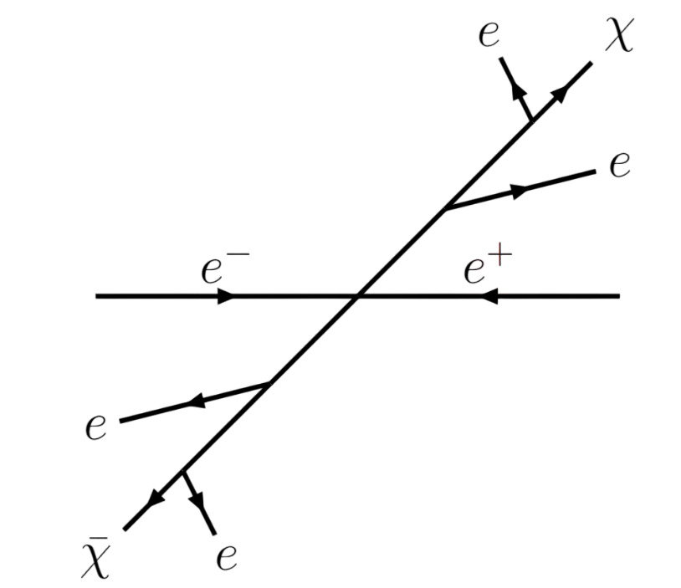
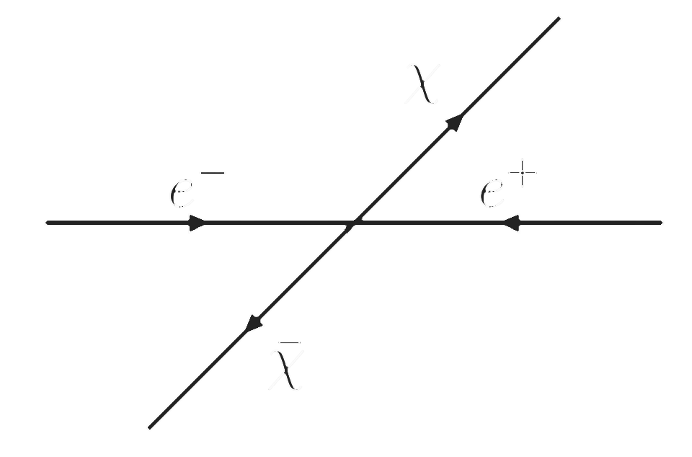
MILLICHARGED PARTICLES Signal for direct searches
Detector
Detector
Energy loss
δ-electrons
3
Kalashnikov Dmitry FTCF2024 16.01.2024

Slide 5
MILLICHARGED PARTICLES Energy loss
$$N(δx)=\frac{ρK}{2}\frac{Z}{A}δx×\frac{{\text{ϵ}}^{2}}{β^{2}}×\int_{I}^{T_{max}}{dT}\frac{1−β^{2}T/T_{max}}{T^{2}}$$
$$m_{χ}≫m_{e}$$
$$N(δx)=\frac{ρK}{2}\frac{Z}{A}δx×\frac{{\text{ϵ}}^{2}}{β^{2}}×\left(\frac{1}{I}−\frac{1}{T_{max}}\right)$$
$$β≪1$$
$$T_{max}=2m_{e}β^{2}$$
$$N(δx)=0.5×\left(\frac{δx}{1cm}\right){\left(\frac{ε}{1.8∙{10}^{−3}}\right)}^{2}{\left(\frac{{10}^{−2}}{β}\right)}^{2}$$
Gas: propane
4
Kalashnikov Dmitry FTCF2024 16.01.2024

Slide 6
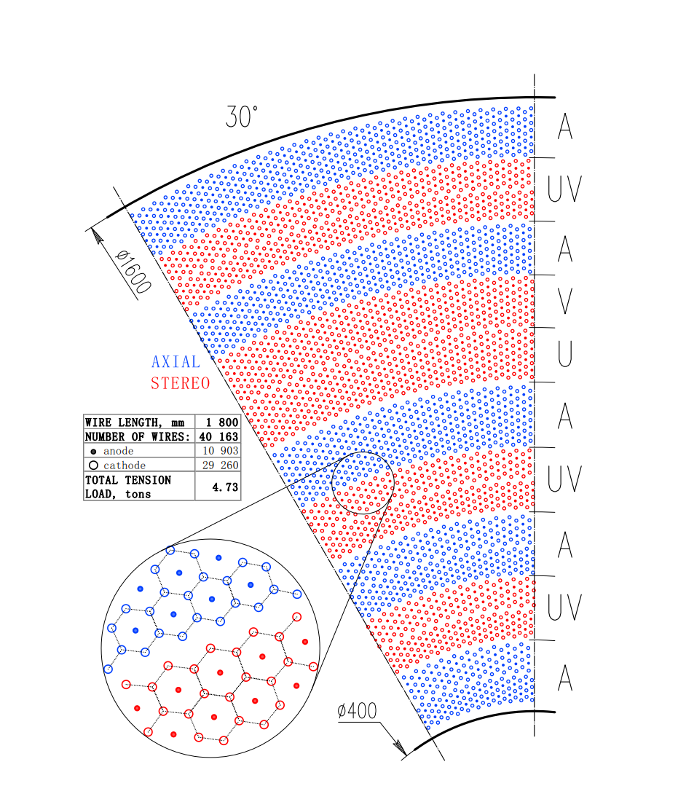
MILLICHARGED PARTICLES Number of hits
Drift Chamber consist of 41 sense layers, $n_{c}=41$
Cell size $≈1 cm ⇒N(1 cm)$
Probability to lighten up more than $n_{0}$ cells is:
$$P_{s}\left(n_{0},N\right)=\sum_{n=n_{0}}^{2n_{c}}{\left[\begin{aligned}{\left(e^{−N}\right)}^{2n_{c}−n}× \\ {\left(1−e^{−N}\right)}^{n}× \\ \frac{2n_{c}!}{n!\left(2n_{c}−n\right)!}\end{aligned}\right]}$$
5
Kalashnikov Dmitry FTCF2024 16.01.2024

Slide 7
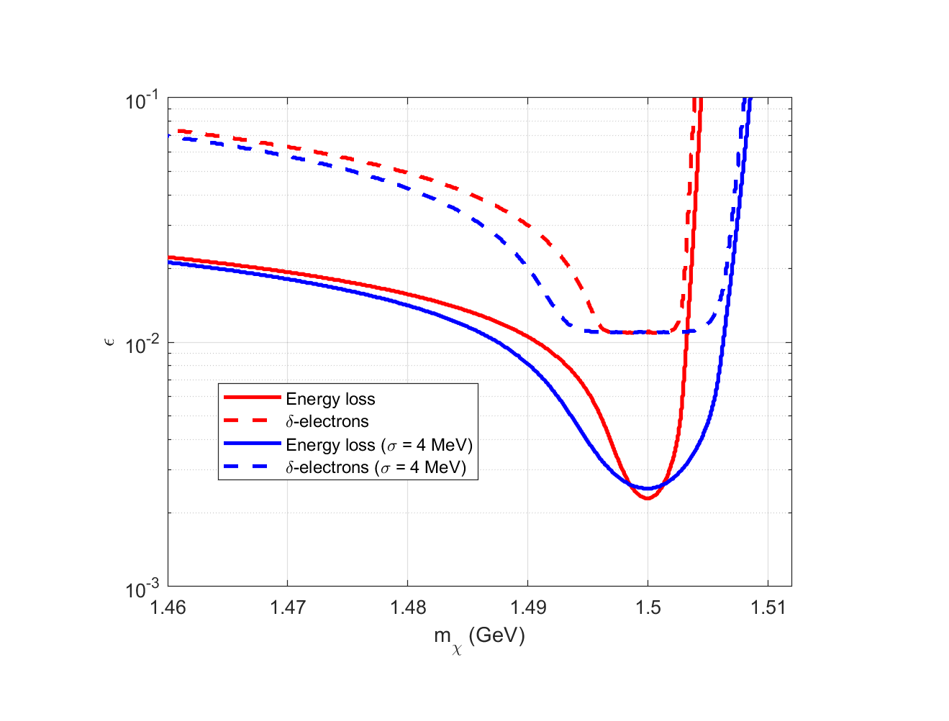
MILLICHARGED PARTICLES Non-monochromatic energy
$$\frac{dL}{d\sqrt{s}}=\frac{L_{0}}{\sqrt{2π}σ}×exp\left(−\frac{{\left(\sqrt{s}−\sqrt{s_{0}}\right)}^{2}}{2σ^{2}}\right)$$
$$σ=\sqrt{2}×0.01\% \frac{\sqrt{s}}{2}$$
6
Kalashnikov Dmitry FTCF2024 16.01.2024

Slide 8
MILLICHARGED PARTICLES
Energy loss
Detector
$$σ\left(e^{+}e^{−}→χ\overline{χ}\right)=\frac{2πα^{2}ε^{2}β}{s}$$
$$N\left(\sqrt{s_{0}}\right)=\int{\begin{aligned}d\sqrt{s}×\frac{dL}{d\sqrt{s}}×σ\left(e^{+}e^{−}→χ\overline{χ}\right)× \\ P_{s}\left(n_{0},N\right)\end{aligned}}$$
7
Kalashnikov Dmitry FTCF2024 16.01.2024

Slide 9
MILLICHARGED PARTICLES δ-electrons
$$\frac{{d^{2}N}_{δ}}{dx dT_{e}}=\frac{ρK}{2}\frac{Z}{A}×\frac{{\text{ϵ}}^{2}}{β^{2}}×\frac{F(T_{e})}{{T_{e}}^{2}}$$
Detector
$$F(T_{e})≈1$$
$$T_{e}>T_{min}=1 keV$$
$$N_{δ}=\frac{ρK}{2}\frac{Z}{A}×\frac{{\text{ϵ}}^{2}}{β^{2}}×L\left(\frac{1}{T_{min}}−\frac{1}{T_{e}}\right)$$
8
Kalashnikov Dmitry FTCF2024 16.01.2024

Slide 10
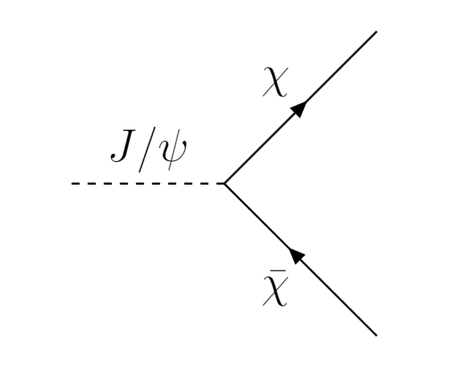
MILLICHARGED PARTICLES $J/ψ$ decays
$$N=N_{J/ψ}×ε^{2}×{Br}_{χ\overline{χ}}×P_{s}\left(n_{0},N\right)$$
$${Br}_{χ\overline{χ}}={Br}_{μμ}\frac{\sqrt{1−4m_{χ}^{2}/m_{J/ψ}^{2}}\left(1+2m_{χ}^{2}/m_{J/ψ}^{2}\right)}{\sqrt{1−4m_{μ}^{2}/m_{J/ψ}^{2}}\left(1+2m_{μ}^{2}/m_{J/ψ}^{2}\right)}$$
9
Kalashnikov Dmitry FTCF2024 16.01.2024

Slide 11
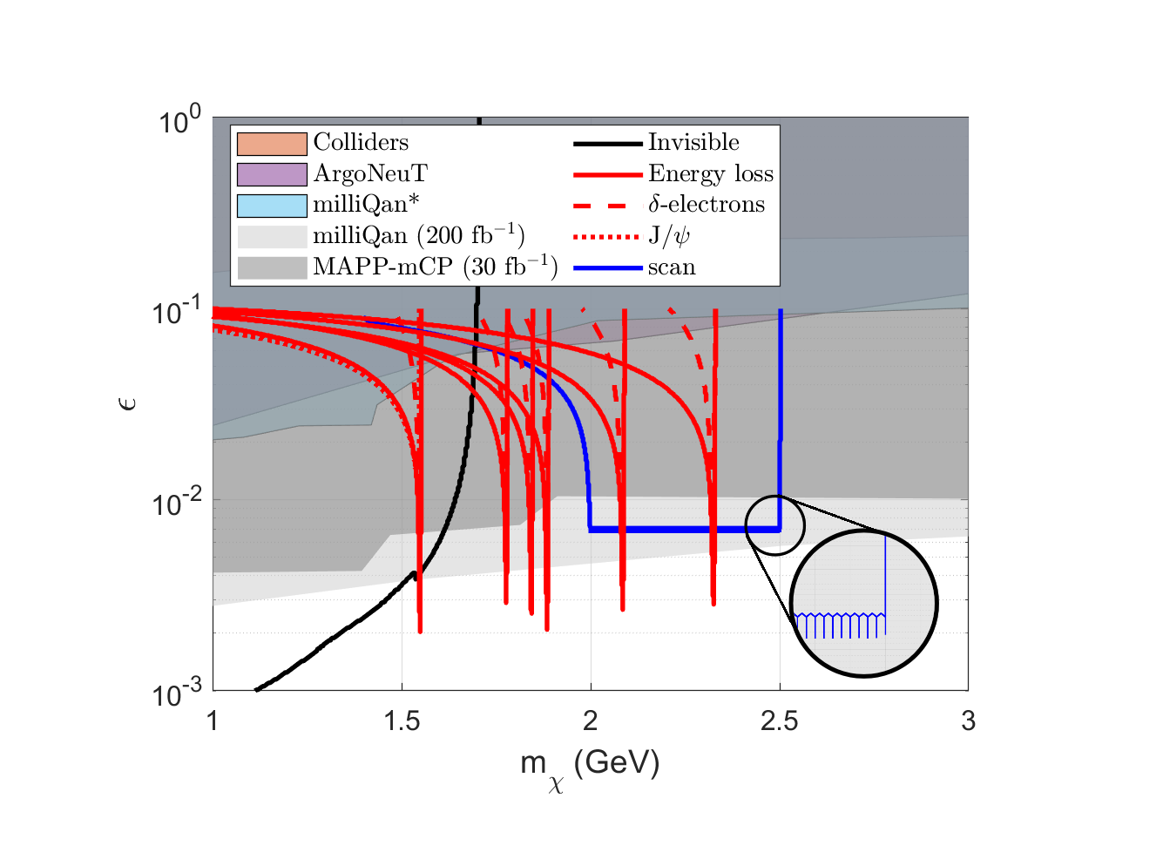
MILLICHARGED PARTICLES
10
Kalashnikov Dmitry FTCF2024 16.01.2024

Slide 12
MILLICHARGED PARTICLES AT SUPER CHARM-TAU FACTORY
Contacts: kalashnikov.d@phystech.edu
This work is supported by RSF grant № 21-12-00379

Slide 13
MILLICHARGED PARTICLES Larmor radius
$$r≈97 cm\left(\frac{1 T}{B}\right)×\left(\frac{m_{χ}}{1 GeV}\right)\left(\frac{β}{ε}\right)$$
$$r>20 cm$$
Kalashnikov Dmitry FTCF2024 16.01.2024

Slide 14
MILLICHARGED PARTICLES Number of hits
$$P_{b}\left(n_{0} \right)=\sum_{n=n_{0}}^{2n_{c}}{\left[\begin{aligned}{\left(1−0.05\right)}^{2n_{c}−n}× \\ {\left(0.05\right)}^{n}× \\ \frac{2n_{c}!}{n!\left(2n_{c}−n\right)!}\end{aligned}\right]}$$
$$n_{0}>29, n_{0}=30$$
Kalashnikov Dmitry FTCF2024 16.01.2024

Slide 15
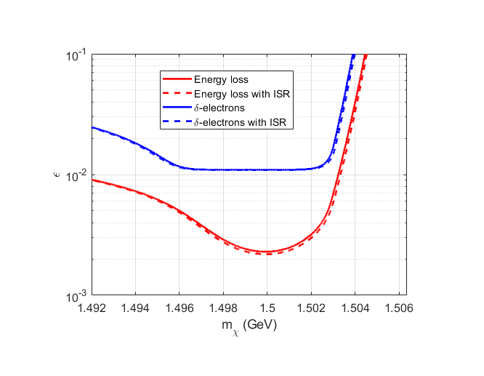
MILLICHARGED PARTICLES Initial State Radiation
$$σ_{corr}=\int_{0}^{x_{max}}{σ\left(\left(1−x\right)s\right)}H\left(x,s\right)dx$$
$$E_{γ}<25 MeV$$
O. Nicrosini, Luca Trentadue. Phys.Lett.B 196 (1987), 551
Kalashnikov Dmitry FTCF2024 16.01.2024

