Slide 1


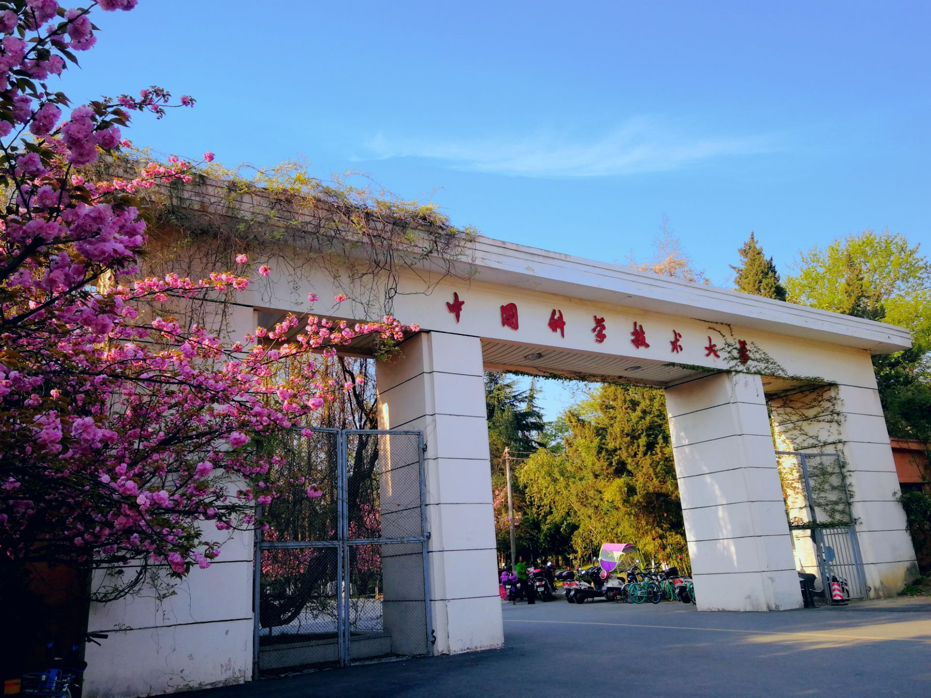
Trigger System R&D in Super Tau-Charm Facility
Zhujun Fang
State Key Laboratory of Particle Detection and Electronics
University of Science and Technology of China
On behalf of STCF Trigger Working Group
17/1/2024

Slide 2
Outline
STCF overview and requirement for trigger system
STCF trigger system preliminary design
L1-level trigger algorithm R&D
L1-level FPGA-based hardware platform R&D
Summary

Slide 3
Outline
STCF overview and requirement for trigger system
STCF trigger system preliminary design
L1-level trigger algorithm R&D
L1-level FPGA-based hardware platform R&D
Summary

Slide 4
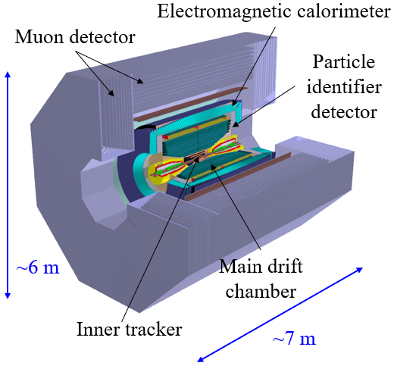
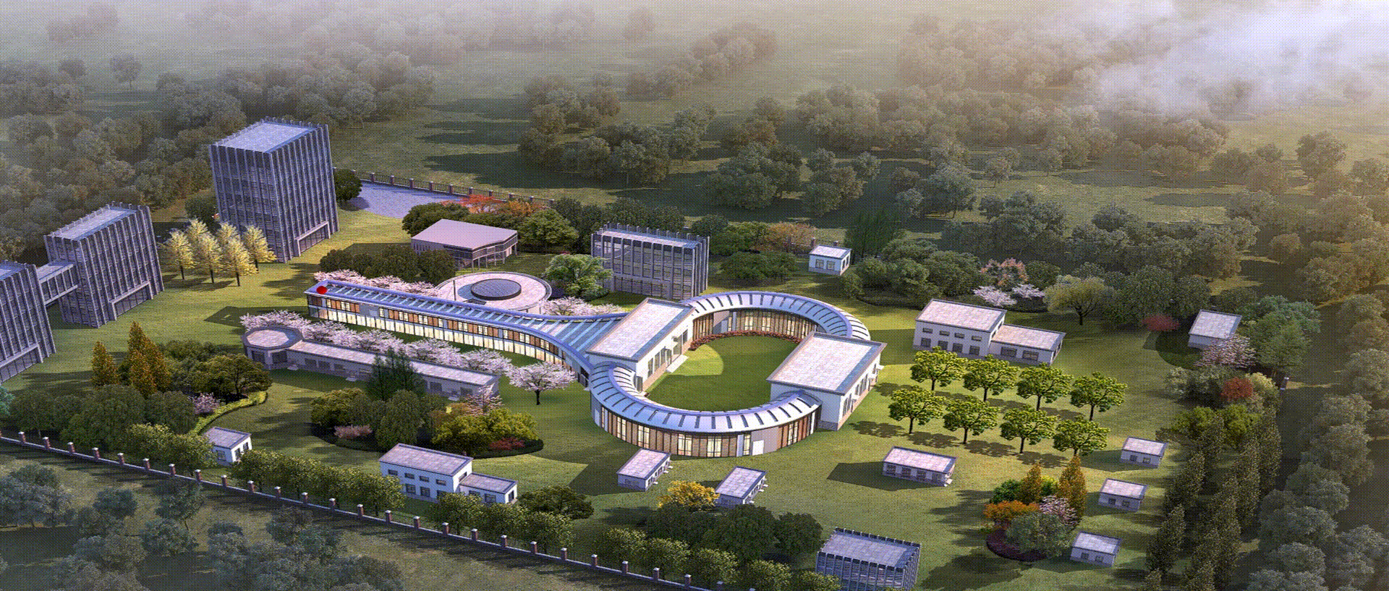
STCF overview
Super Tau-Charm Facility:
A new generation of high-luminosity electron-positron collider
Center-of-mass energy: 2-7 GeV
Peak luminosity: >0.5×10³⁵ cm⁻²s⁻¹ at 4 GeV
Collision data: more than 1 ab⁻¹/y
With potential to further increase luminosity and beam polarization
100 m damping ring
400 m linear accelerator
800 m storage ring
Detector spectrometer

Slide 5
Requirements for trigger system
Requirements for trigger system in STCF
High trigger rate (~ 1 MHz)
Low latency
Very high physics event trigger efficiency (>99%)
Good background suppression capability
Distinguish of multi-physics events in 1 trigger window
High luminosity in STCF synchronous generates:
High physics event rate: over 400 kHz
Large data size: over 200 GB/s raw data
High background: ~ 400 kHz/channel in MDC
~ 1 MHz/channel in ECAL
Trigger system:
Identifying physics events from massive background
Reducing the pressure in data acquisition and transmission
Maintain the long-term stable operation of experiment

Slide 6
Outline
STCF overview and requirement for trigger system
STCF trigger system preliminary design
L1-level trigger algorithm R&D
L1-level FPGA-based hardware platform R&D
Summary

Slide 7
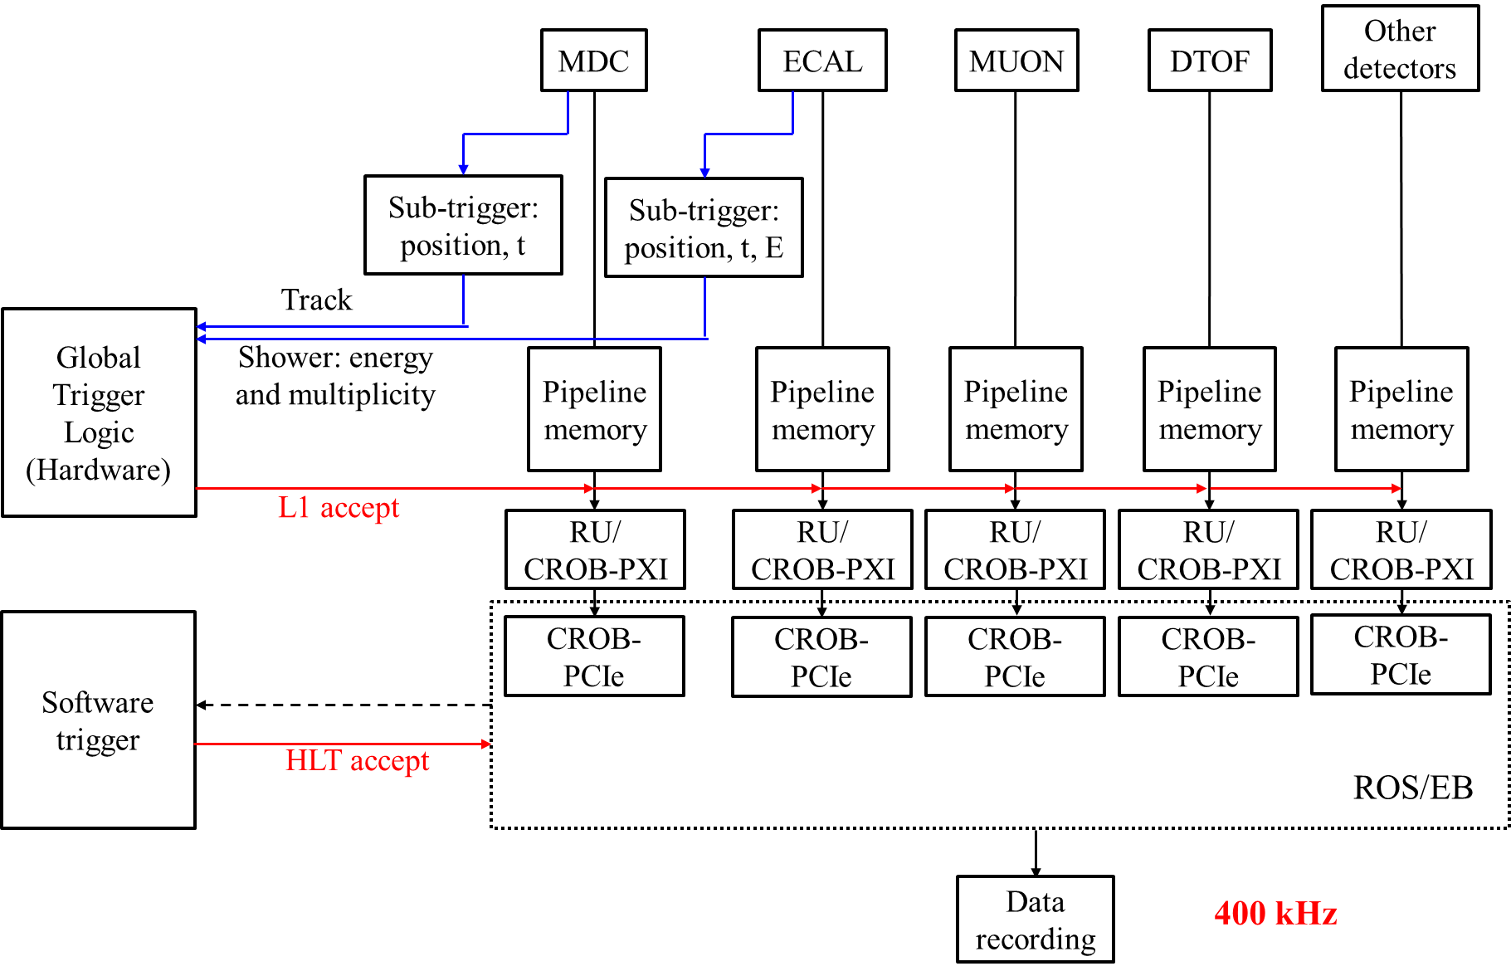
STCF trigger system preliminary design
Two-stage trigger system:
L1-level Trigger:
Identifying physics events window
Based on FPGA platform
Latency ~ 5 μs
High Level Trigger (HLT):
Suppressing backgrounds in each time window
Based on server cluster

Slide 8
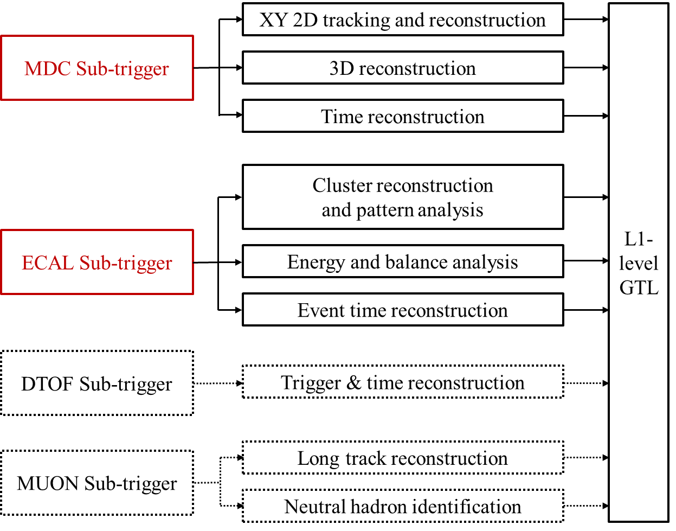
Preliminary design of L1-level trigger
ITK: high background
MDC: key tracking detector
RICH: complex Cherenkov ring reconstruction
DTOF: auxiliary in Endcap
ECAL: key calorimeter, fast response
MUON: auxiliary for μ/π/n/K_{L}

Slide 9
Outline
STCF overview and requirement for trigger system
STCF trigger system preliminary design
L1-level trigger algorithm R&D
L1-level FPGA-based hardware platform R&D
Summary

Slide 10
STCF MDC design
Baseline design:
48 layers of small cell
8 superlayers
1,4,7,8 superlayers are axial layers
Region division:
Barrel: 33.4 deg – 90 deg
Endcap: 20 deg – 33.4 deg
33.4 deg
20 deg

Slide 11
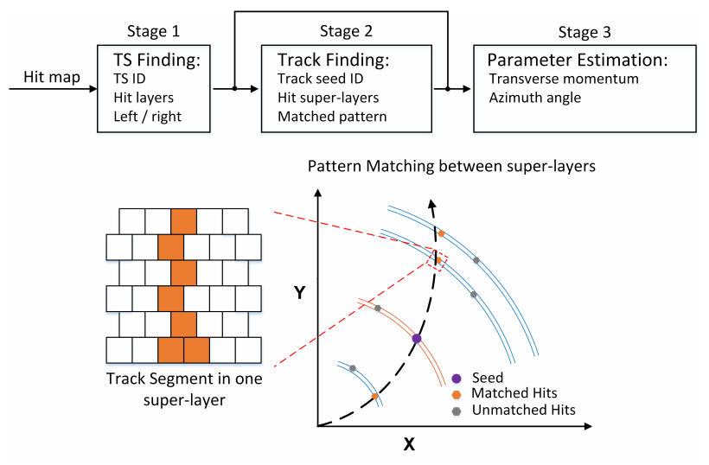
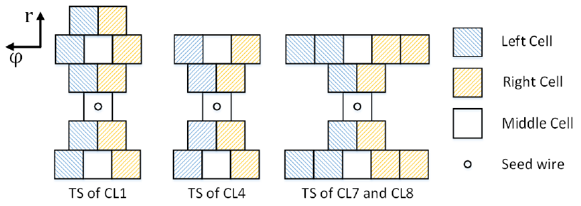
MDC sub-trigger R&D
XY 2D tracking and reconstruction
Track segment (TS) pattern configuration
3 types of TS module
Un-identification of high-p_{t} track in Endcap
3 hits tracking as a complement to 4 hits tracking
Further optimization is needed
Short track tagging
Un-reconstructed short track will be sent to GTL with related TS information
Suppressing long track background
Distinguish of cross tracks

Slide 12
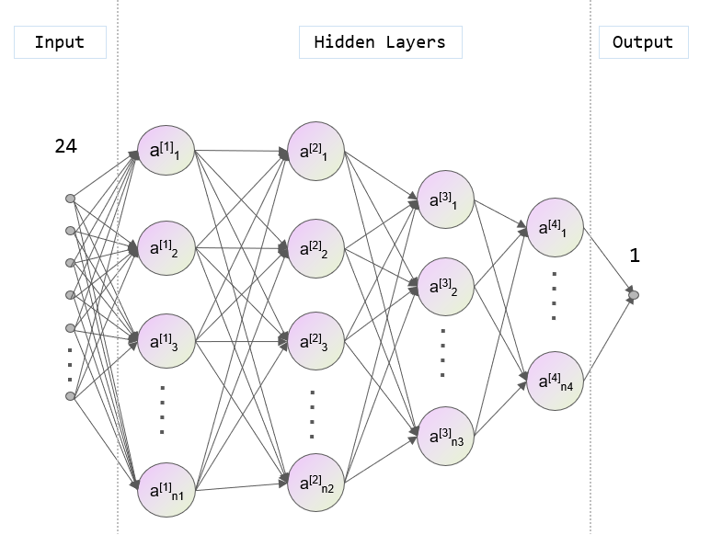
MDC sub-trigger R&D
3D reconstruction
Multi-layer fully connected neural network (MLP)
Input: Track segment numbers and TDC timing for 8 superlayers
Output: Reconstructed Z-position in various p_{t} regions

Slide 13
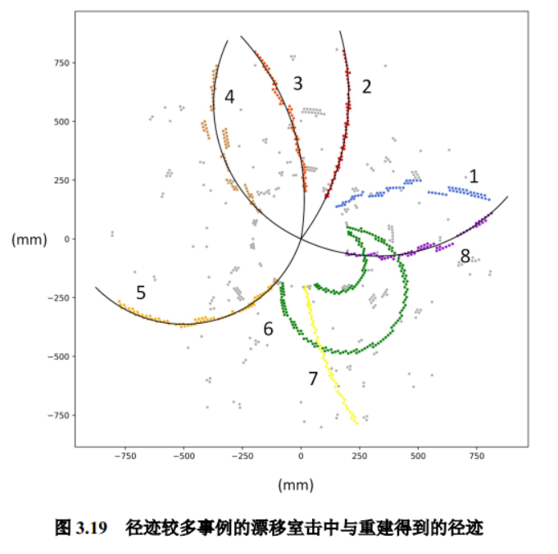
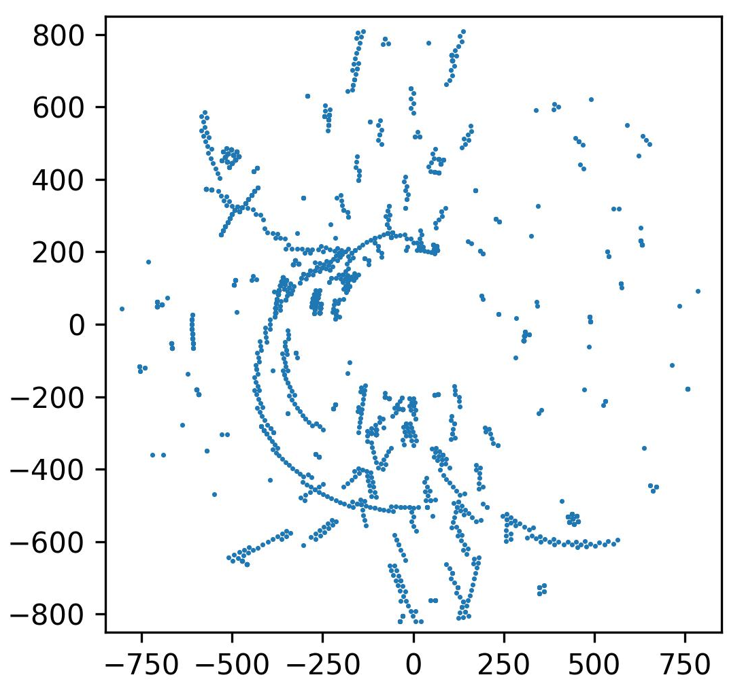
MDC sub-trigger performance
MDC tracking efficiency to typical charged physics processes
Trigger: N_{tracking} ≥ 2，N_{rec} ≥ 1
Typical good reconstructed and puzzle events
Relationship between track p_{t} and σ_{Z}
mm
mm

Slide 14
STCF ECAL design
Baseline design:
Barrel: 51 circles of pCsI crystal
Endcap (each): 10 circles of pCsI crystal
Trigger Cell (TC) setting:
Barrel (4×4 or 3×4):
51 circles × 132 crystal
429 TC in total
Each Endcap (3×5 or 4×5):
10 circles
  3 circles × 85 crystal => 3×5 divided
  3 circles × 105 crystal => 3×5 divided
  4 circles × 130 crystal => 4×5 divided
64 TC in total

Slide 15
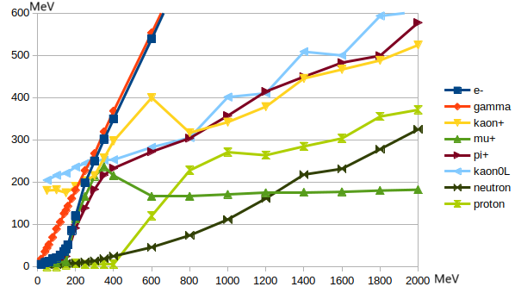
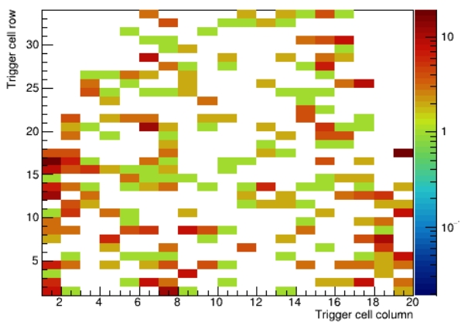
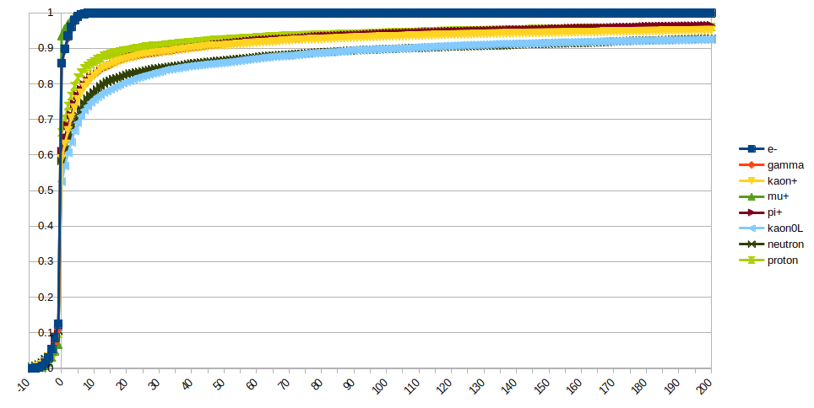
ECAL sub-trigger R&D
Single particle ECAL response:
Background level simulation:
1 μs time window for trigger
1 MeV TC signal threshold
Deposit energy V.S. momentum
ECAL background TC response distribution
Ratio
Time V.S. energy collection ratio
Time (ns)

Slide 16
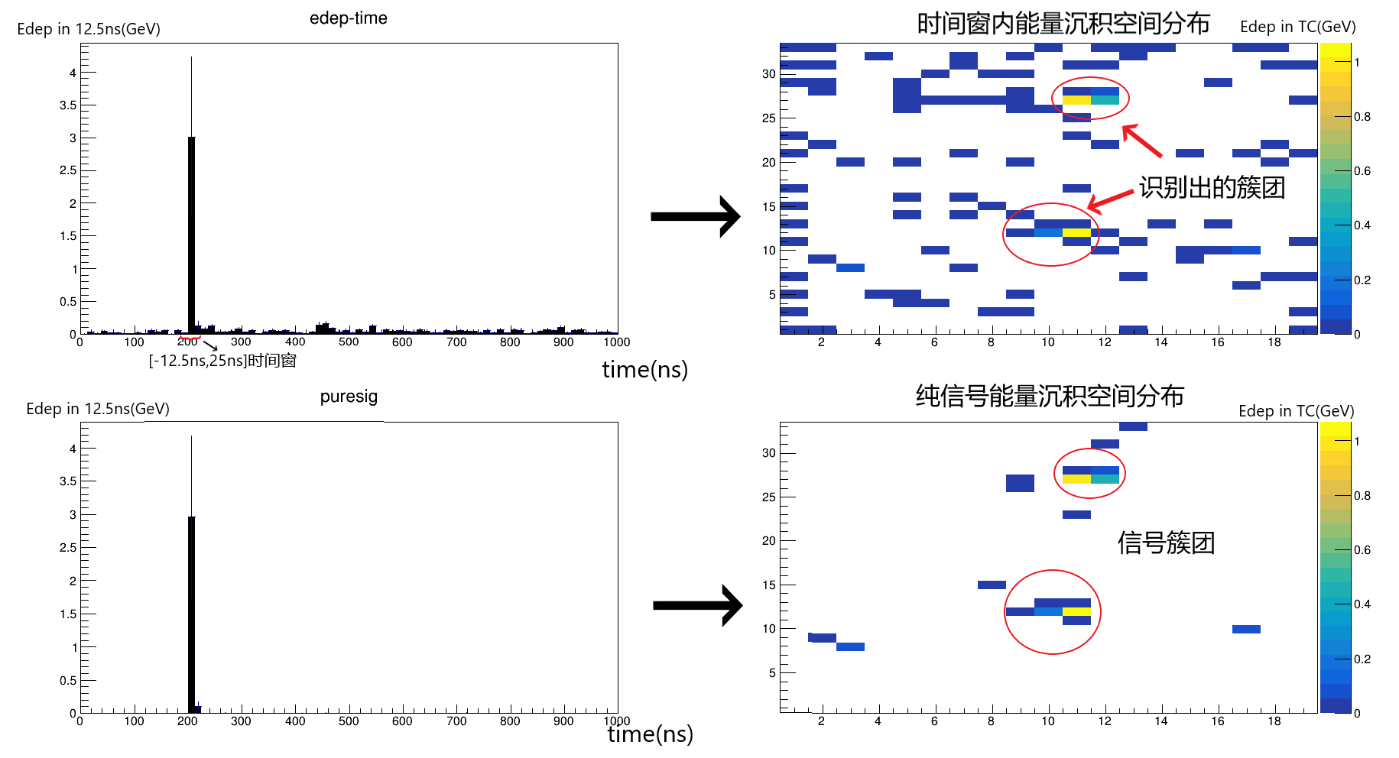
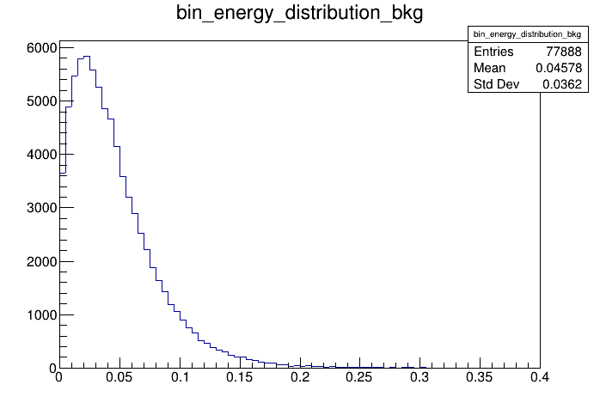
ECAL sub-trigger R&D
Basic parameters setting:
T-Q map bin width: 12.5 ns
S/B threshold: 210 MeV
Cluster energy threshold: 35 MeV
Cluster reconstruction:
Limit time window by T-Q map
Find the rec. cluster in TC map
Signal mixed with background
Background energy distribution in each 12.5 ns bin
Rec. cluster
Counts
Time window
Pure signal
Sig/bkg distinguish threshold
Signal cluster
Bkg energy in ECAL (GeV)

Slide 17
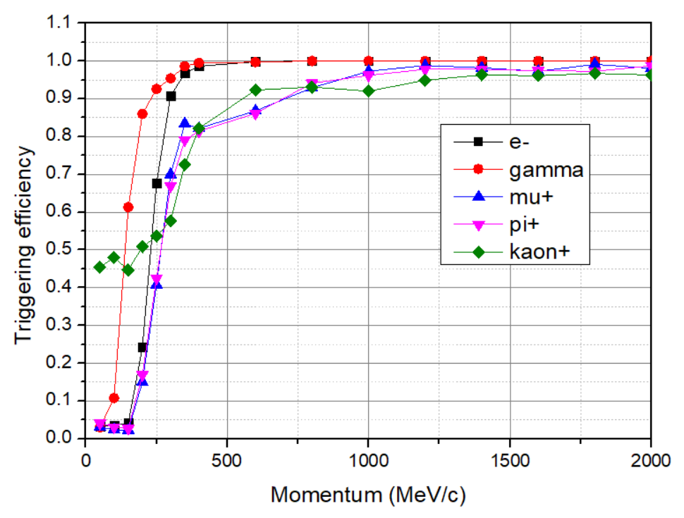
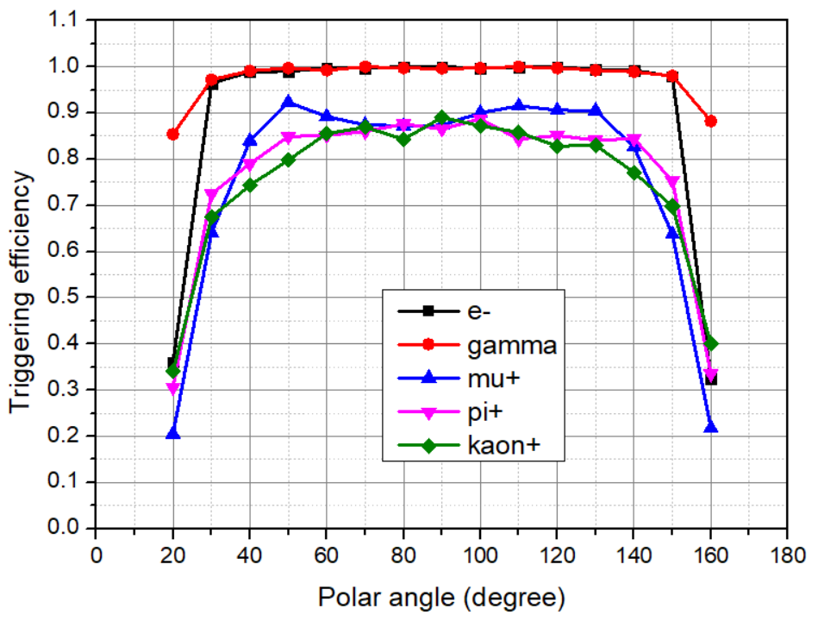
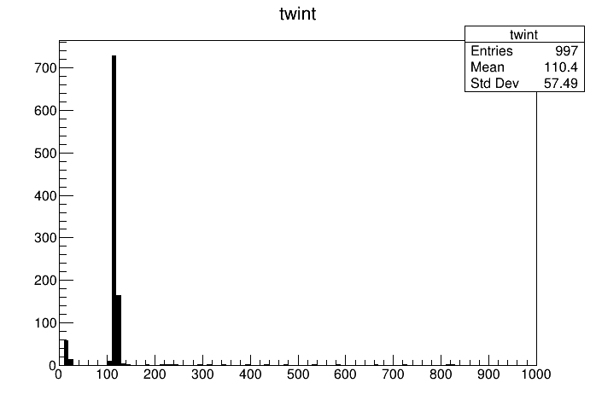
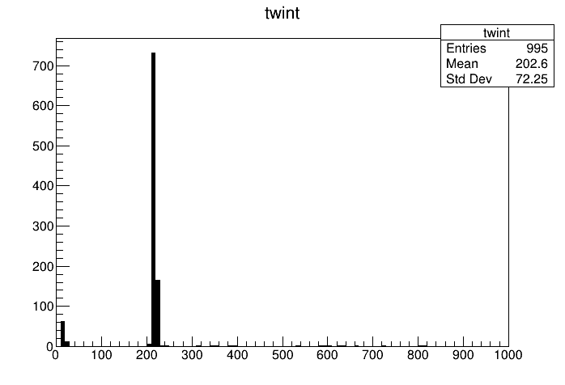
ECAL sub-trigger performance
Single particle trigger efficiency
ECAL trigger efficiency to typical charged physics reaction
Reaction | J/ψ->ee | J/ψ->mumu | charm_meson physics | Hyperon physics | τ-pair
Filter | N≥2 | N≥2 | N≥3 | N≥3 | N≥2
Efficiency | 99.40% | 98.20% | 98.70% | 95.60% | 98.50%
Polar angle = 90 deg
Distinguish of multi-physics events in 1 trigger window
Counts
Counts
p= 400 MeV/c
MC truth: 100 ns
MC truth: 200 ns
Time (ns)
Time (ns)

Slide 18
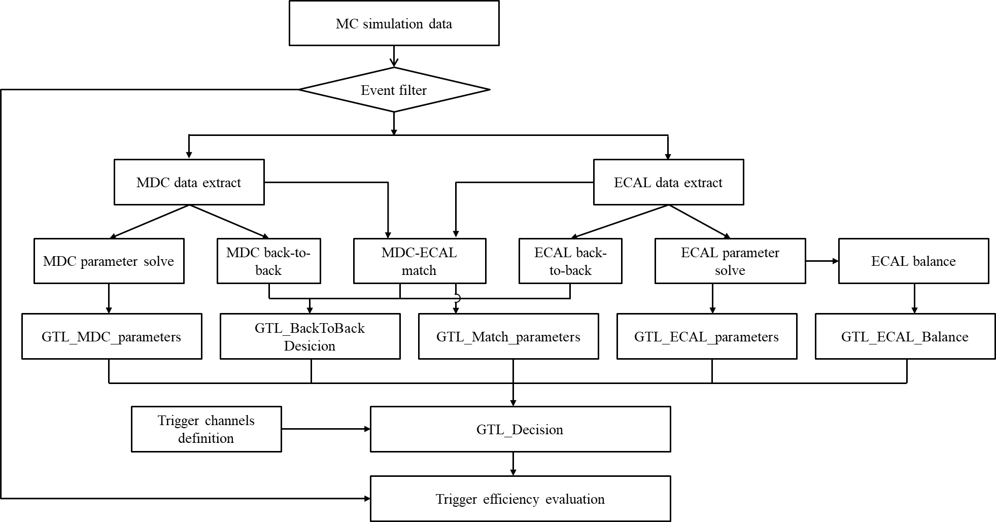
L1-level GTL R&D
GTL logic framework design
GTL algorithm realization & optimization
Trigger table design
L1-level trigger performance evaluation

Slide 19
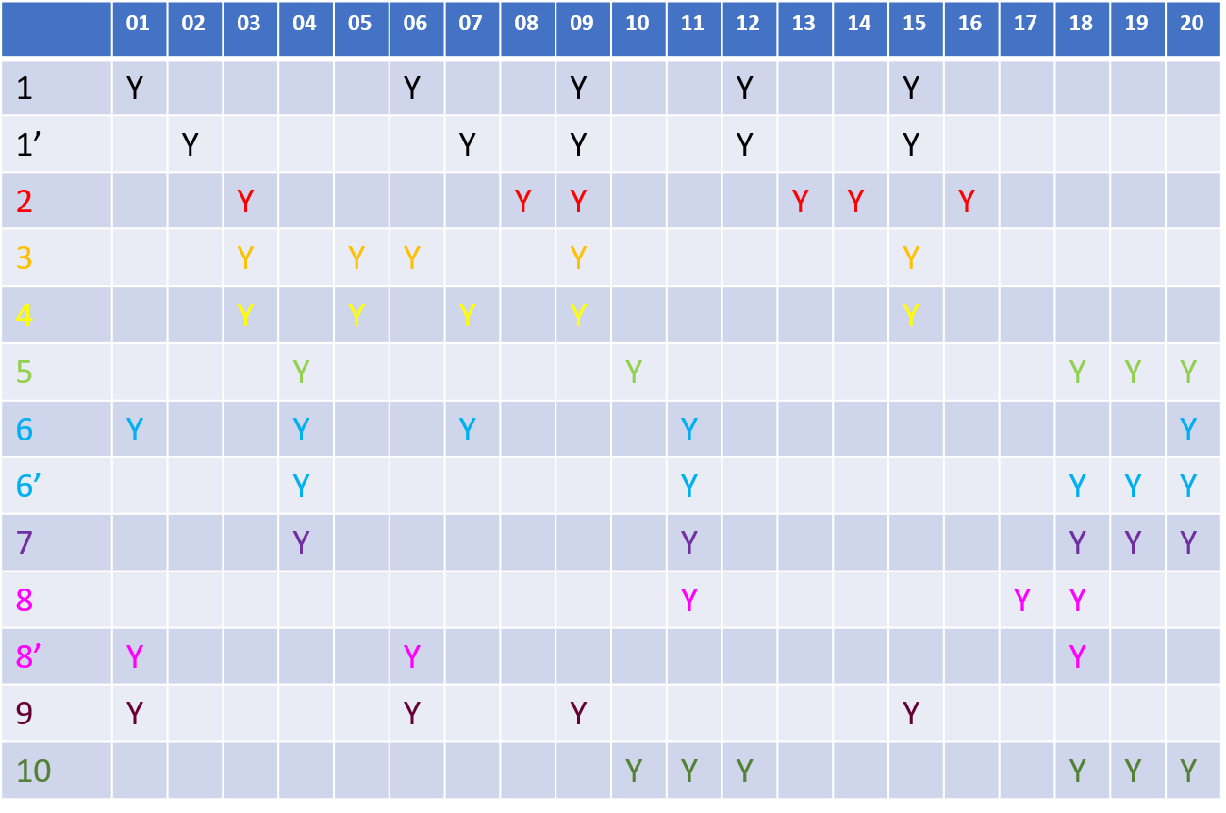
Preliminary trigger table
Trigger table
Cover 7 types of physics events of interest and typical background (RBB…)
Having 20 trigger parameters and 13 trigger channel
Trigger channel merge is planed in next step
Key parameters
MDC: Track No./(p_{t})
EMC: E_{th1,2,3}/Cluster No./Balance
Match: back-to-back/Track No.
Un-match: TS & TC

Slide 20
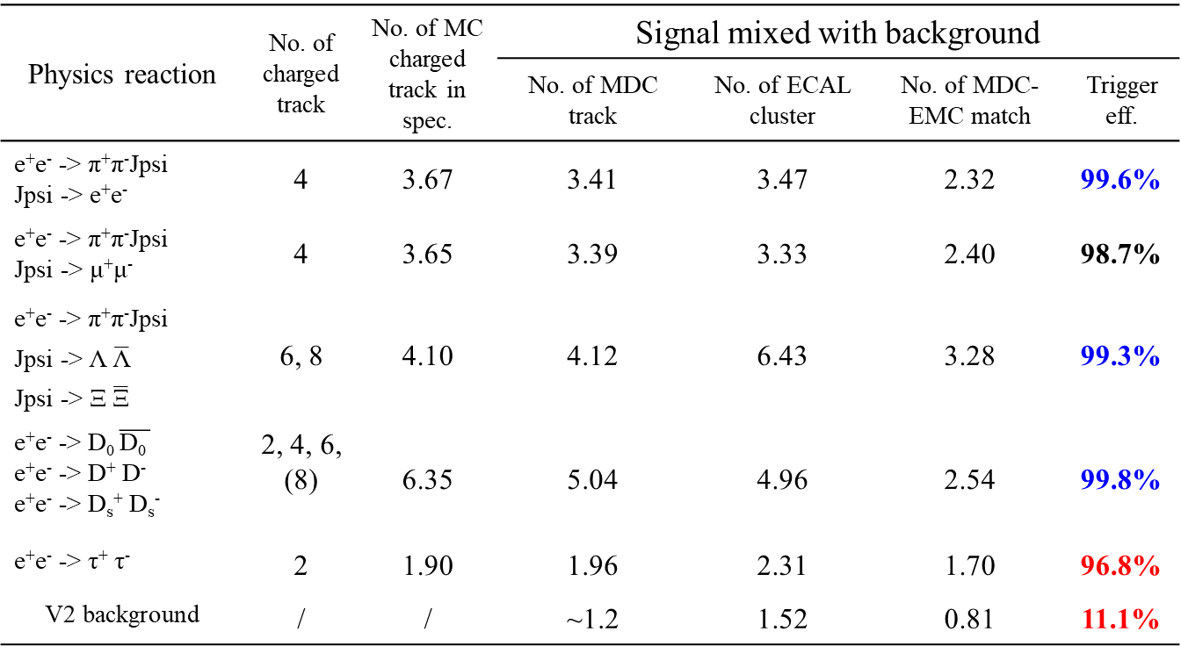
L1-level trigger performance
L1-level trigger efficiency to typical charged physics reaction
Physics reaction | No. of charged track | No. of MC charged track in spec. | Signal mixed with background
反应类型 | 带电末态数 | 进入谱仪带电径迹 | No. of MDC track | No. of ECAL cluster | No. of MDC-EMC match | Trigger eff.
e⁺e⁻ -> π⁺π⁻Jpsi Jpsi -> e⁺e⁻ | 4 | 3.67 | 3.41 | 3.47 | 2.32 | 99.6%
e⁺e⁻ -> π⁺π⁻Jpsi Jpsi -> μ⁺μ⁻ | 4 | 3.65 | 3.39 | 3.33 | 2.40 | 98.7%
e⁺e⁻ -> π⁺π⁻Jpsi Jpsi -> Λ $\overline{\text{Λ}}$ Jpsi -> Ξ $\overline{\text{Ξ}}$ | 6, 8 | 4.10 | 4.12 | 6.43 | 3.28 | 99.3%
e⁺e⁻ -> D₀ $\overline{\text{D}\text{0 }}$ e⁺e⁻ -> D⁺ D⁻ e⁺e⁻ -> D_{s}⁺ D_{s}⁻ | 2, 4, 6, (8) | 6.35 | 5.04 | 4.96 | 2.54 | 99.8%
e⁺e⁻ -> τ⁺ τ⁻ | 2 | 1.90 | 1.96 | 2.31 | 1.70 | 96.8%
V2 background | / | / | ~1.2 | 1.52 | 0.81 | 11.1%
Key points
High background pass rate
MDC-Endcap efficiency improving
GTL-neutral particle identifying and utilization
Processing of 2-particle final state reactions

Slide 21
Outline
STCF overview and requirement for trigger system
STCF trigger system preliminary design
L1-level trigger algorithm R&D
L1-level FPGA-based hardware platform R&D
Summary

Slide 22
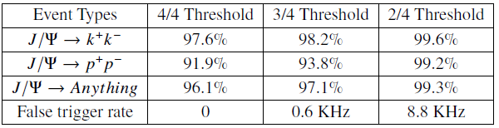
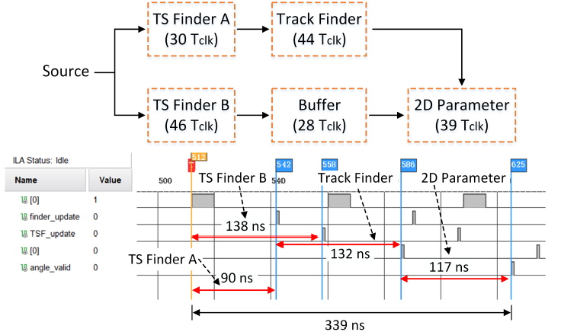
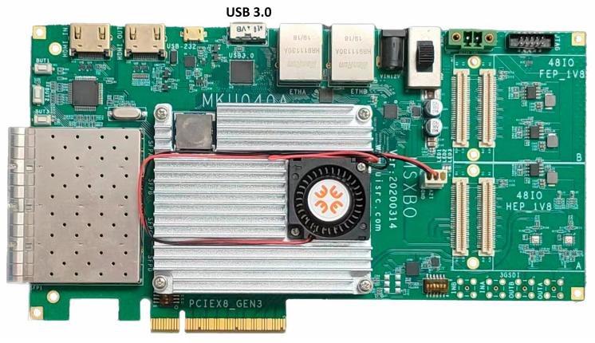
FPGA-based evaluation board test
Track segment trigger efficiency in FPGA evaluation board
The MDC sub-trigger 2D algorithm is tested on a FPGA-based evaluation board.
Latency measured in FPGA evaluation board
Evaluation board equipped with an XCKU060-FFVA 1156-2 FPGA

Slide 23
L1-level trigger prototype design
Simulation data generator: 1 server & 12 PCIe
MDC sub-trigger: 3×CROB-ST，1×CROB-LTU
ECAL sub-trigger: 1×CROB-ST，1×CROB-LTU
GTL: 1×CROB-GTU，1×Fan-out

Slide 24
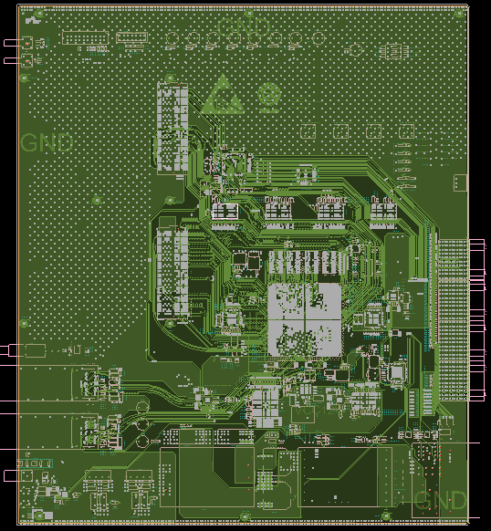
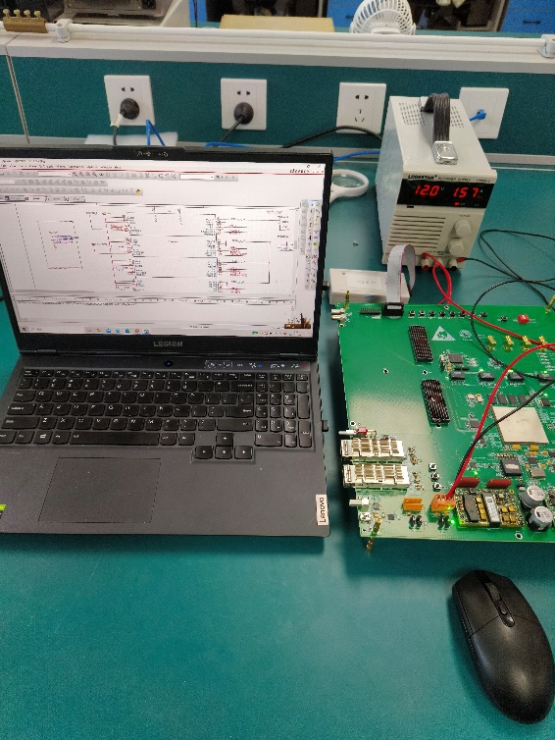
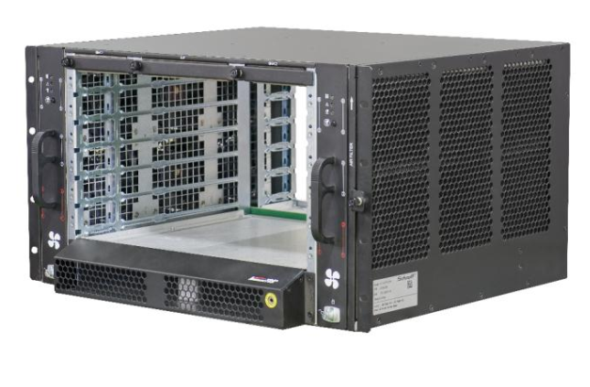
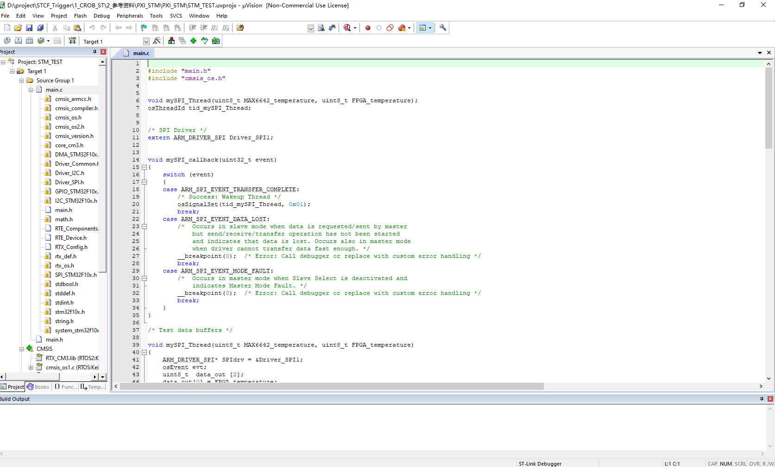
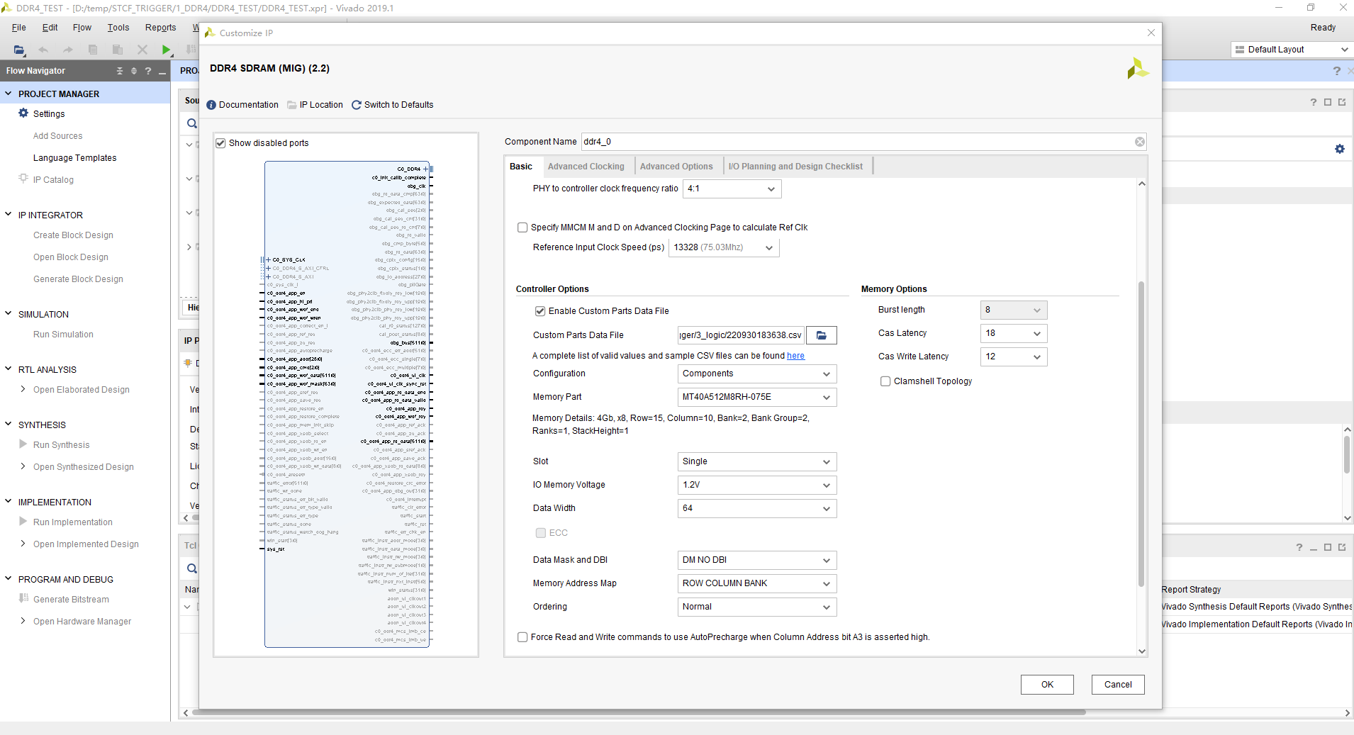
FPGA-based hardware platform R&D
Function module design of CROB-LTU board
CROB-LTU board
CROB-LTU board test
ATCA 6U chassis
Notes:
确定FPGA、DDR4、FMC+选型设计
研制第一版CROB-LTU板卡
CROB-LTU板卡测试

Slide 25
Outline
STCF overview and requirement for trigger system
STCF trigger system preliminary design
L1-level trigger algorithm R&D
L1-level FPGA-based hardware platform R&D
Summary

Slide 26
Summary
The preliminary design of STCF trigger system is illustrated:
Trigger logic & framework
MDC sub-trigger algorithm
ECAL sub-trigger algorithm
Key performance parameters simulation & test:
Trigger efficiency to typical charged physics channel: 99% (2-particle final state reactions 96%)
Background trigger rate: 11.1% (~ 110 kHz)
MDC 2D algorithm latency: 350 ns
Future work:
Background suppression
Algorithm & trigger table optimization
HLT R&D
GTL design and algorithm
Trigger prototype design
CROB-LTU board design

Slide 27
Thanks for your attention!

Slide 28
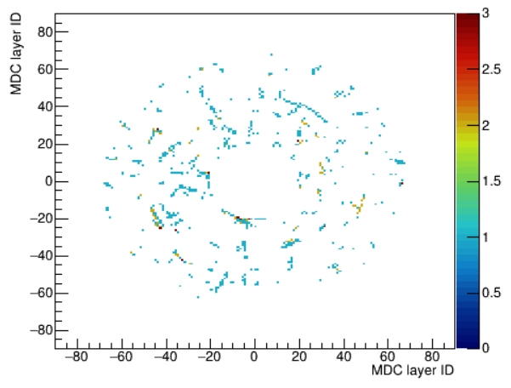
Back up
MDC and ECAL background
MDC background distribution in 1 sampling window
ECAL background distribution in 1 sampling window
Count
Count

Slide 29
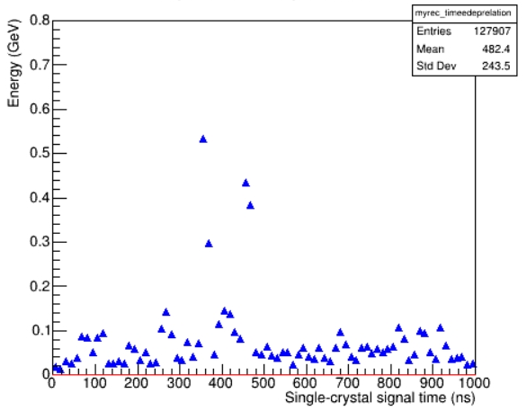
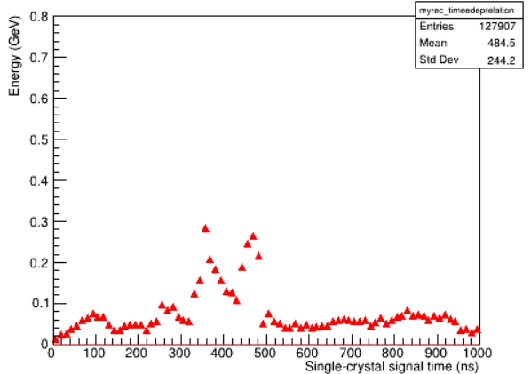
Back up
ECAL online time resolution contributions
Time V.S. deposit energy in whole EMC
Time V.S. deposit energy in whole EMC
σ_{t} = 5 ns
σ_{t} = 20 ns

Slide 30
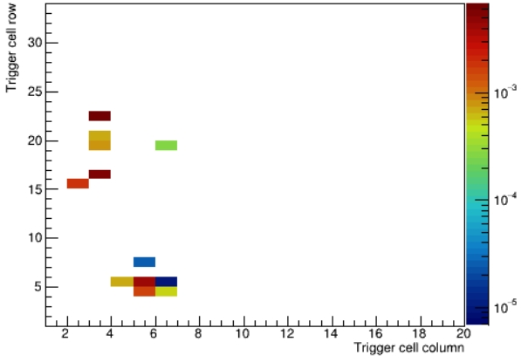
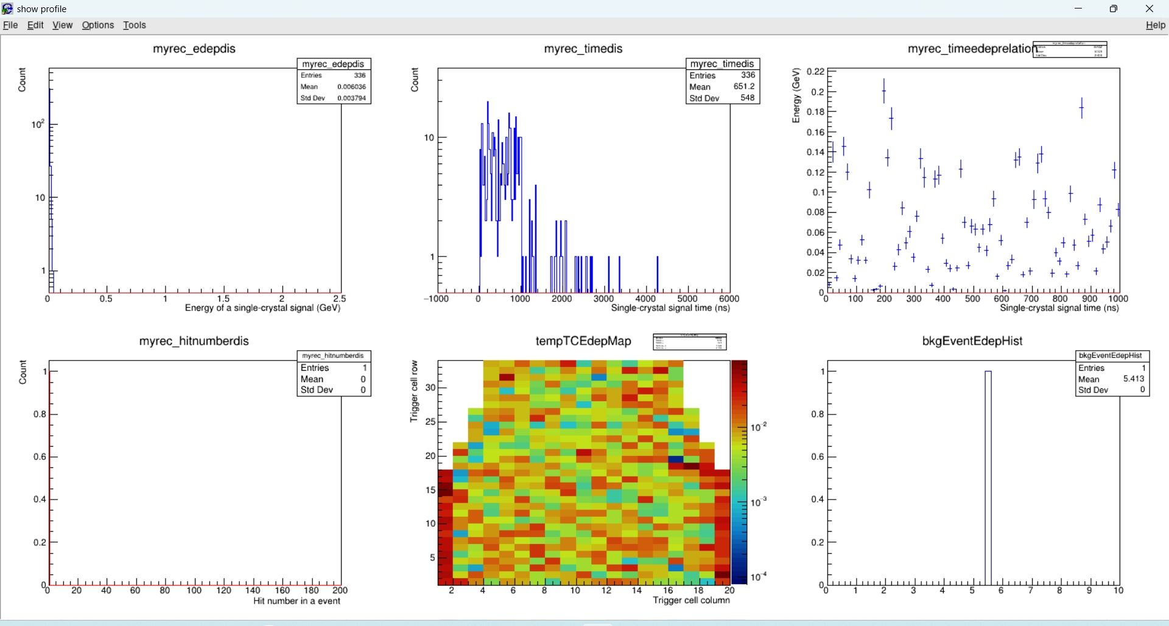
Back up
ECAL response to low energy deposition event
Signal distribution
Signal and background distribution
Time V.S. deposit energy in whole EMC
GeV
GeV

Slide 31
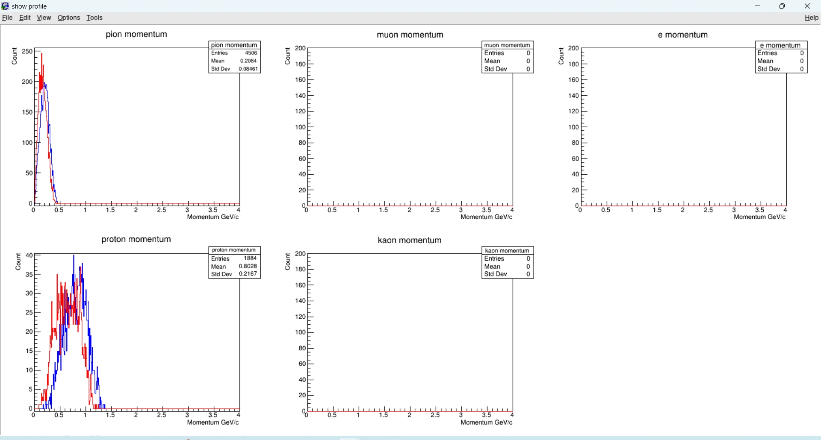
Back up
Transverse momentum of final state particle in hyperon physics

Slide 32
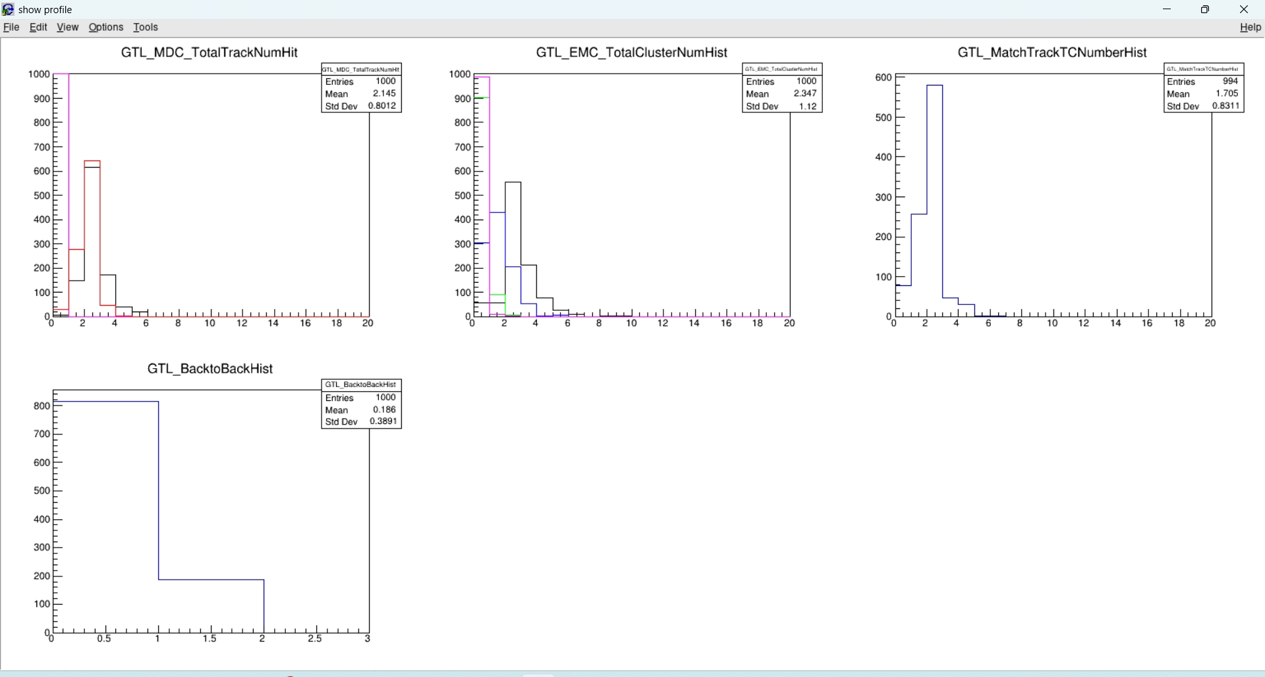
Back up
Detected final state particle distribution in tau-pair physics events

Slide 33
Other detectors
MDC
ECAL
MUON
Sub-trigger:
position, t
Sub-trigger: position, t, E
Track
Global Trigger
Logic
(Hardware)
Shower: energy and multiplicity
Pipeline memory
Pipeline memory
Pipeline memory
Pipeline memory
L1 accept
RU/
CROB-PXI
RU/
CROB-PXI
RU/
CROB-PXI
RU/
CROB-PXI
Software trigger
CROB-PCIe
CROB-PCIe
CROB-PCIe
CROB-PCIe
HLT accept
ROS/EB
Data recording
400 kHz

Slide 34
Other detectors
MDC
ECAL
MUON
DTOF
Sub-trigger:
position, t
Sub-trigger: position, t, E
Track
Global Trigger
Logic
(Hardware)
Shower: energy and multiplicity
Pipeline memory
Pipeline memory
Pipeline memory
Pipeline memory
Pipeline memory
L1 accept
RU/
CROB-PXI
RU/
CROB-PXI
RU/
CROB-PXI
RU/
CROB-PXI
RU/
CROB-PXI
Software trigger
CROB-PCIe
CROB-PCIe
CROB-PCIe
CROB-PCIe
CROB-PCIe
HLT accept
ROS/EB
Data recording
400 kHz

Slide 35
XY 2D tracking and reconstruction
L1-level GTL
MDC Sub-trigger
3D reconstruction
Time reconstruction
Cluster reconstruction
and pattern analysis
ECAL Sub-trigger
Energy and balance analysis
Event time reconstruction
DTOF Sub-trigger
Trigger & time reconstruction
MUON Sub-trigger
Long track reconstruction
Neutral hadron identification

Slide 36
MC simulation data
Event filter
MDC data extract
ECAL data extract
MDC parameter solve
MDC back-to-back
MDC-ECAL match
ECAL back-to-back
ECAL parameter solve
ECAL balance
GTL_MDC_parameters
GTL_BackToBack Desicion
GTL_Match_parameters
GTL_ECAL_parameters
GTL_ECAL_Balance
Trigger channels definition
GTL_Decision
Trigger efficiency evaluation

