Slide 1
STCF RICH PIDB progress
Speaker: Jiaming Li
On behalf of STCF RICH PIDB Group
University of Science and Technology of China
University of Chinese Academy of Sciences
2024.01.16
Notes:
I am honor to present the progress of the STCF RICH PIDB group here. My name is Jiaming Li on behalf of STCF RICH PIDB group.

Slide 2
Outline
1、Physical requirements for STCF PIDB
2、RICH PIDB detector design
3、RICH PIDB readout electronics design
4、Conclusion
2
Notes:
My presentation consists of 4 parts. Physical requirements for STCF PIDB, the design of the detector and the readout electronics. And then the conclusion is given.

Slide 3
Outline
1、Physical requirements for STCF PIDB
2、RICH PIDB detector design
3、RICH PIDB readout electronics design
4、Conclusion
Notes:
First is the physical requirements for the STCF PIDB.

Slide 4
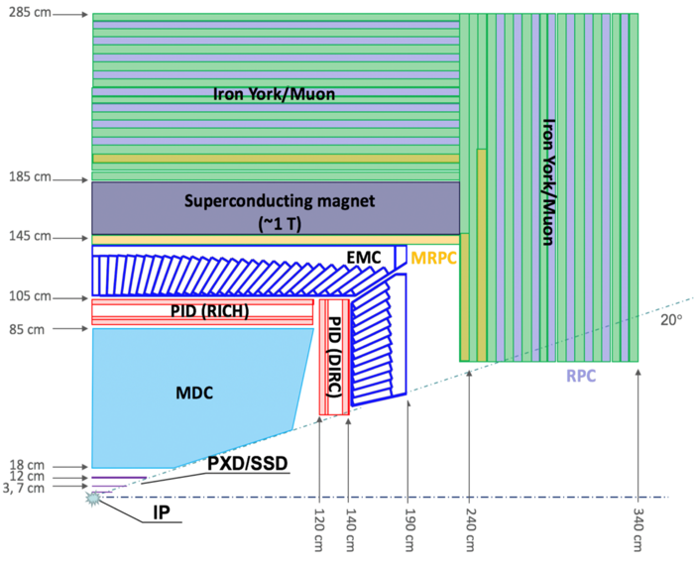
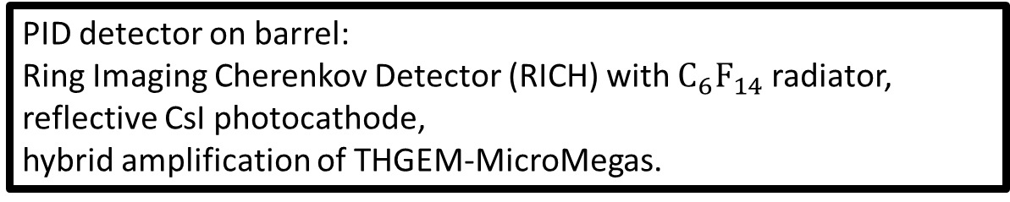
PIDB RICH Detector
Expansion plan after the BESIII facility
Center-of-mass energy extend to 2~7 GeV, luminosity up to 100 times (0.5~1×10³⁵ cm⁻² s⁻¹)
High event, background rate & large dynamic range vs high PID ratio
PID detector on barrel:
Ring Imaging Cherenkov Detector (RICH) with $C_{6}F_{14}$ radiator,
reflective CsI photocathode,
hybrid amplification of THGEM-MicroMegas.
Notes:
Super Tau-charm facility is an expansion plan after the BESIII facility. It is designed to operate in a center-of-mass energy range from 2 to 7 giga electron-volt with a peak luminosity of 0.5 × 1035 cm−2s−1 or higher. Such a high luminosity will allow the STCF to produce much more data samples. However，it also pose the challenge of high event rate and high background rate.
Moreover, considering of the space limit, the Ring Imaging Cherenkov Detector detector is chosen as the barrel part of the particle identification detector. The RICH detector consists of C_6 F_14 radiator, reflective CsI photocathode, hybrid amplification of THGEM-MicroMegas.

Slide 5
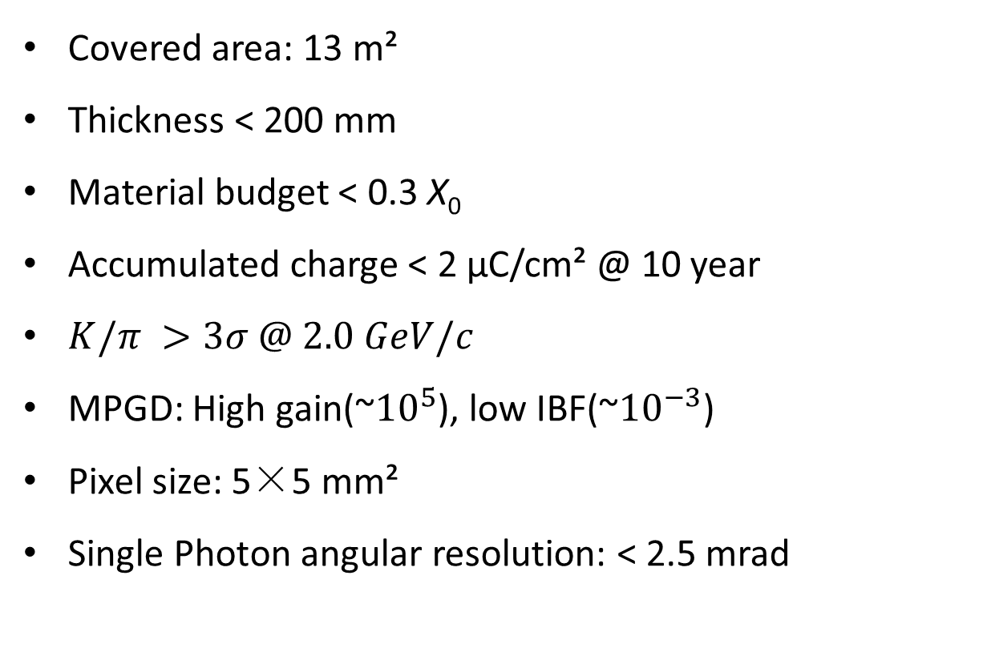
Technical Specification
Covered area: 13 m²
Thickness < 200 mm
Material budget < 0.3 X₀
Accumulated charge < 2 μC/cm² @ 10 year
$K/π >3σ @ 2.0 GeV/c$
MPGD: High gain(~${10}^{5}$), low IBF(~${10}^{−3}$)
Pixel size: 5×5 mm²
Single Photon angular resolution: < 2.5 mrad
Notes:
The RICH detector needs to cover an area of 13 square meters. In order to leave space for the calorimeter and achieve a low material budget of less than 0.5X0 , the thickness should be less than 200 millimeters. The accumulated charge over 10 years is about 2 micro coloumb per square centimeters. The precise measurement of the collision fragmentation function requires a π/K separation larger than 3 sigma up to 2.0 GeV. The micro pattern gas detector used for the RICH detector needs to achieve a high gain of about 100k and low ion backflow of less than one thousandth. The pixel size is 5 millimeters by 5 millimeters. And the angular resolution of the
RICH detector is assumed to be better than 2.5 milli rad.

Slide 6
Outline
1、Physical requirements for STCF PIDB
2、RICH PIDB detector design
3、RICH PIDB readout electronics design
4、Conclusion
Notes:
In the second part, we will represent the design of the RICH PIDB detector.

Slide 7
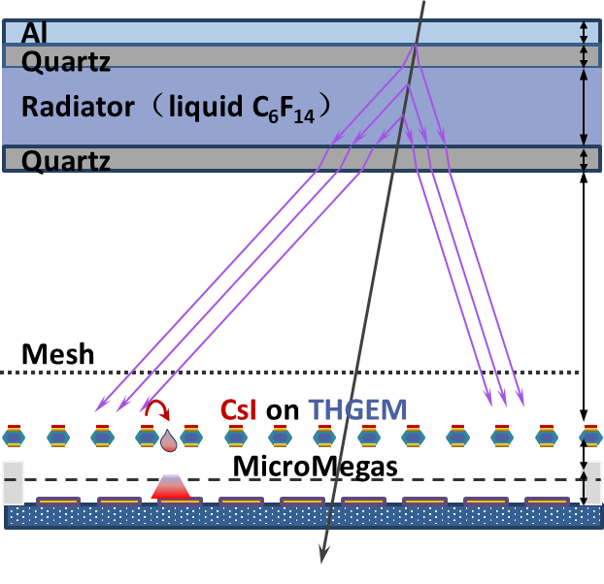
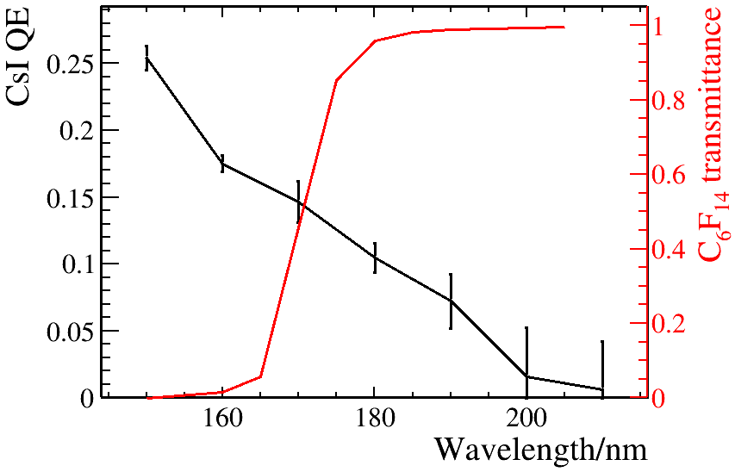
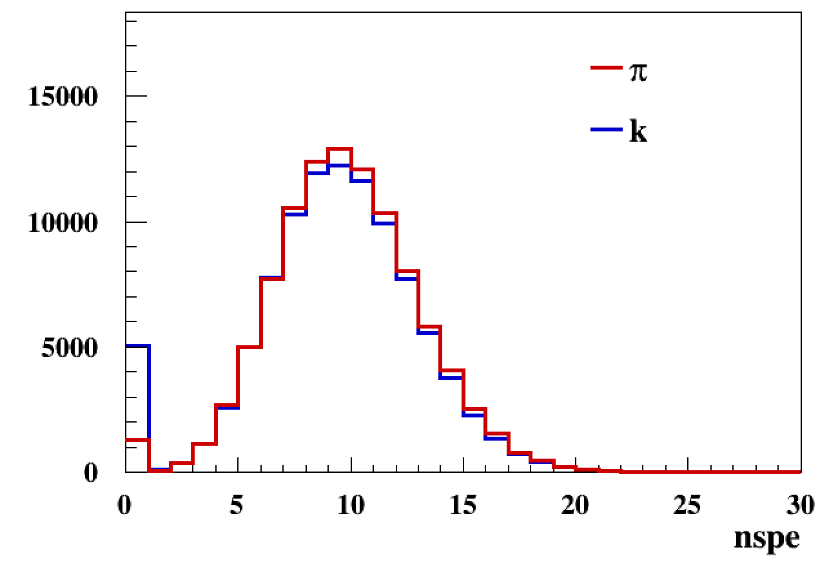
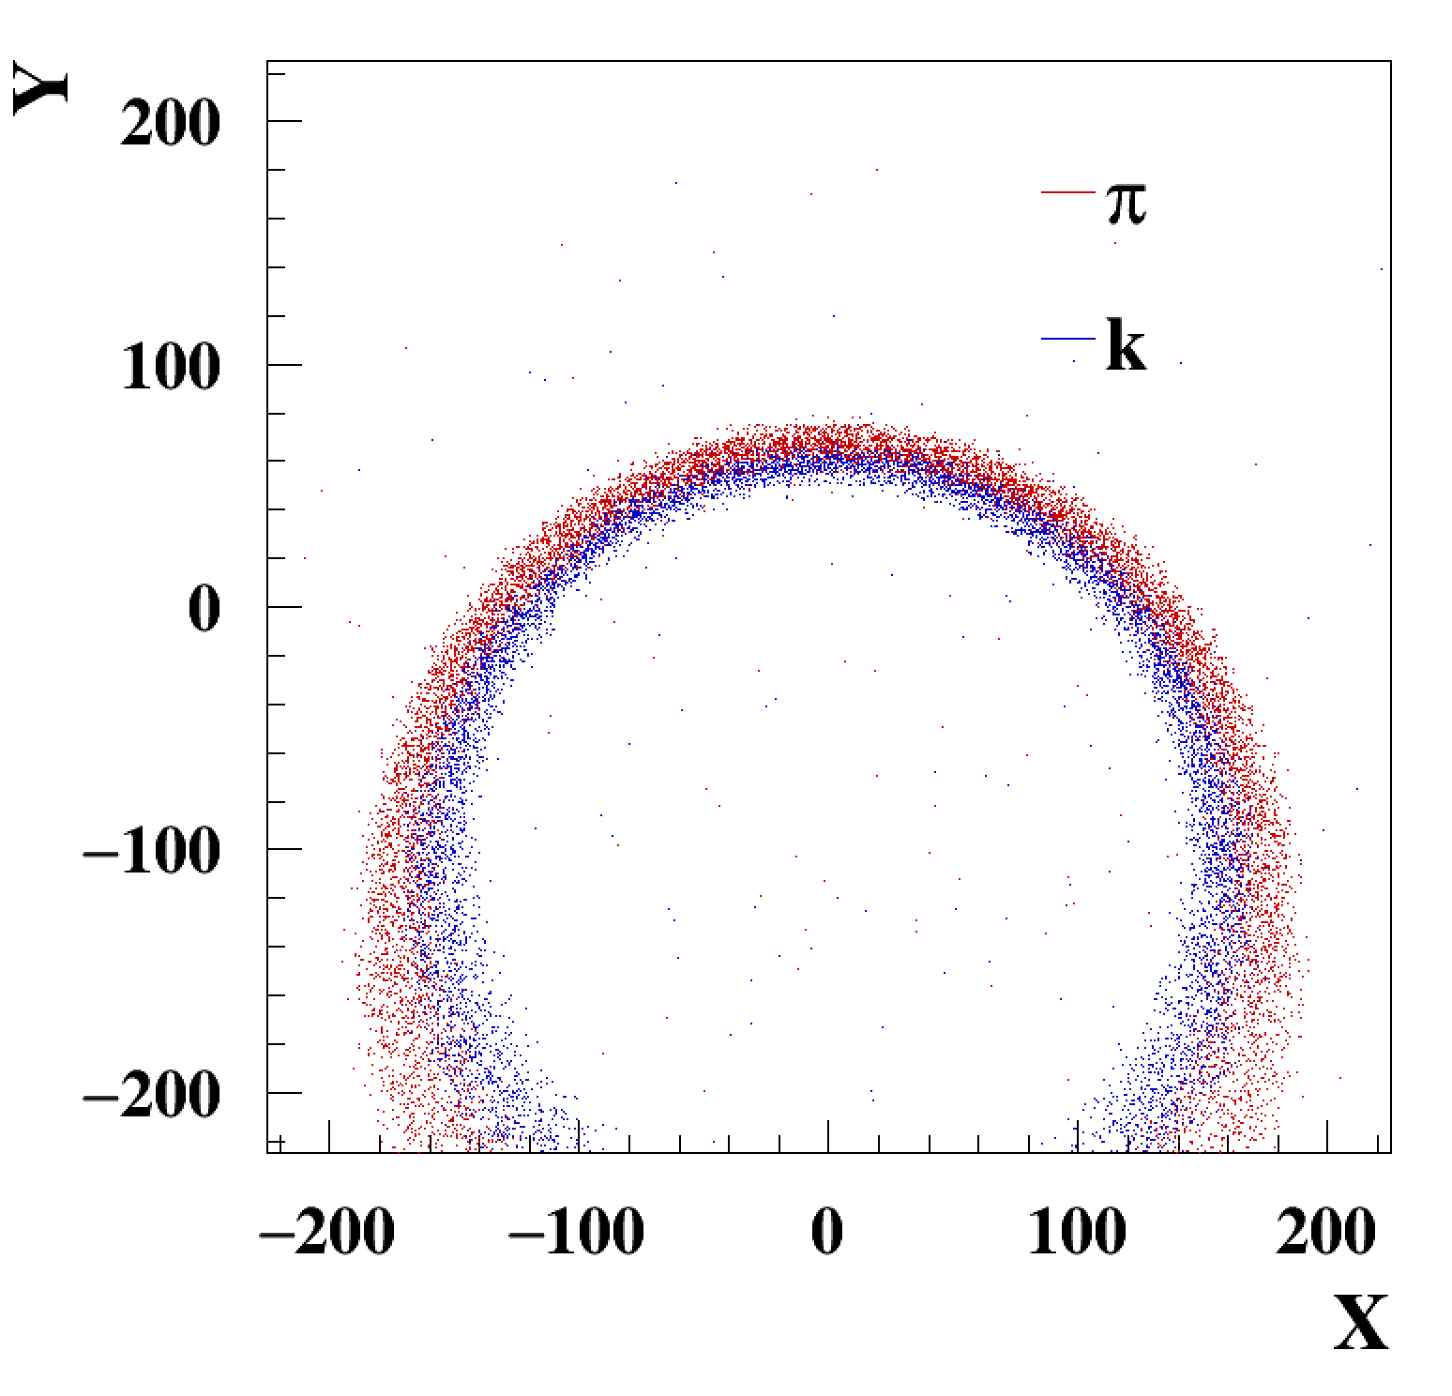
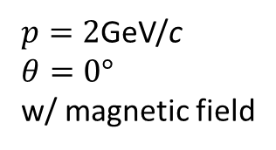
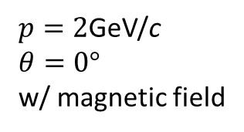
Performance of RICH
$p=2$GeV/c
$θ=0°$
w/ magnetic field
$p=2$GeV/c
$θ=0°$
w/ magnetic field
Notes:
Top left shows the structure of RICH detector: a charged particle goes through the radiator and emits the Cherenkov photons. The Cesium[ˈsiːziəm] Iodide[ˈaɪədaɪd] (CsI) convert the photons to photon-electrons and then amplified by thick-gem and micro-megas, collected by the anode.
(top right) The Cherenkov photons spread on a wide spectrum, but modulated by the quantum efficiency of Cesium Iodide and the transmittance of radiator, the sensitive wavelength of the RICH is 180nm, which is vacuum ultraviolet.
(bottom left) Considering all the efficiencies, including the QE, transmittance, the efficiencies during the electron transport, the number of PE collected in single event is around 10.
(bottom right) based on these PEs, we need to make a comparation to the Hitmap from the simulation. Different particles shows different hitmap and that’s how we make PID decision. The detailed algorithm will be shown in the RICH software report.

Slide 8
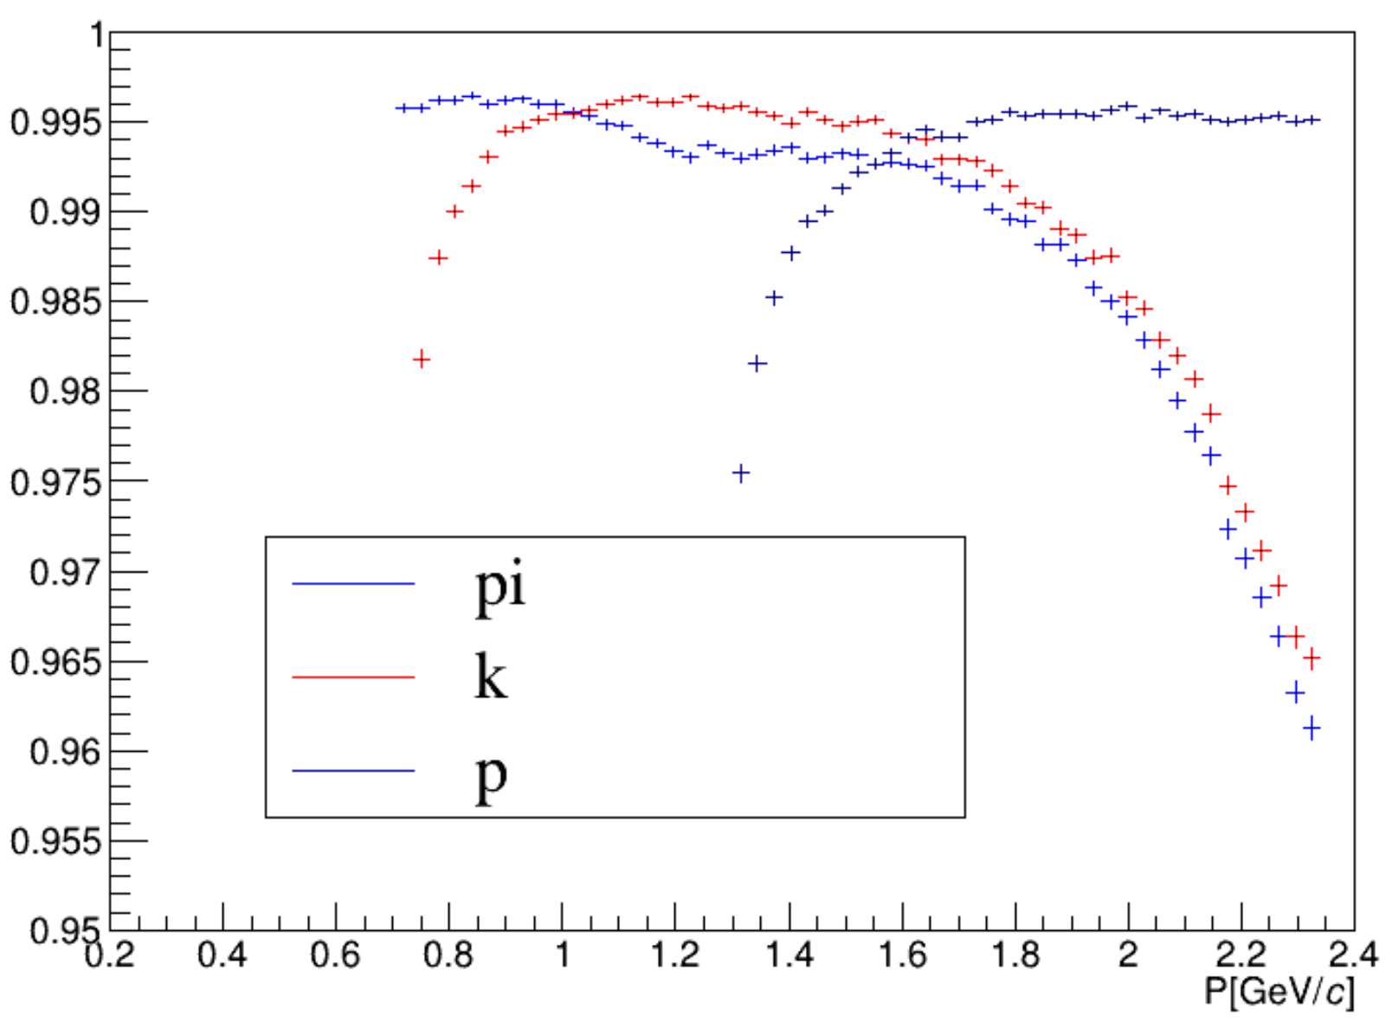
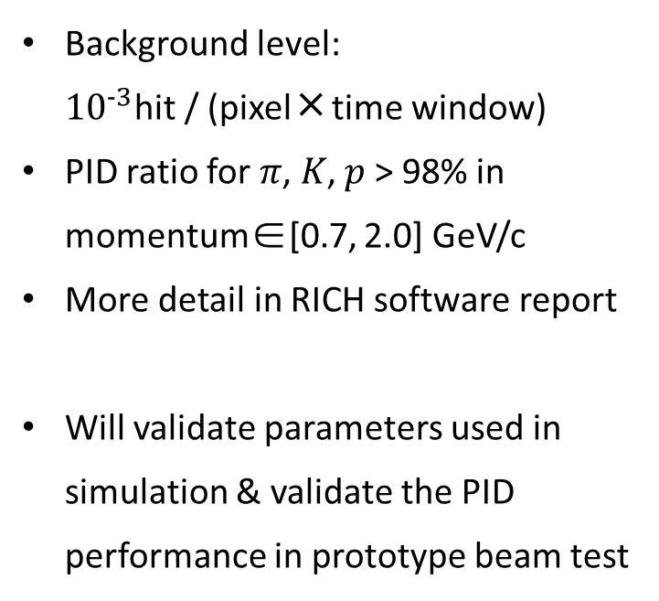



RICH performance in simulation
Background level:
${10}^{−3}$hit / (pixel ╳ time window)
PID ratio for 𝜋, 𝐾, 𝑝 > 98% in
momentum∈[0.7, 2.0] GeV/c
More detail in RICH software report
Will validate parameters used in simulation & validate the PID performance in prototype beam test
$$π$$
$$K$$
$$p$$
Notes:
And we also simulate the RICH performance. The background hit rate is about one thousandth per pixel and time window. The PID ratio requirement for the pai, K, p is better than 98 percent over a momentum range from 0.7 GeV to 2 GeV. More details of the simulation results will be also reported in the RICH software report. And we will validate the parameters used in simulation by test, and then validate the PID performance in prototype beam test.

Slide 9
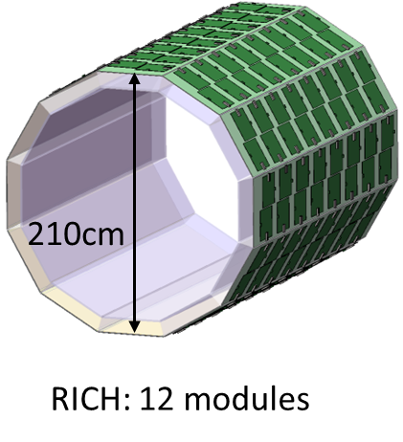
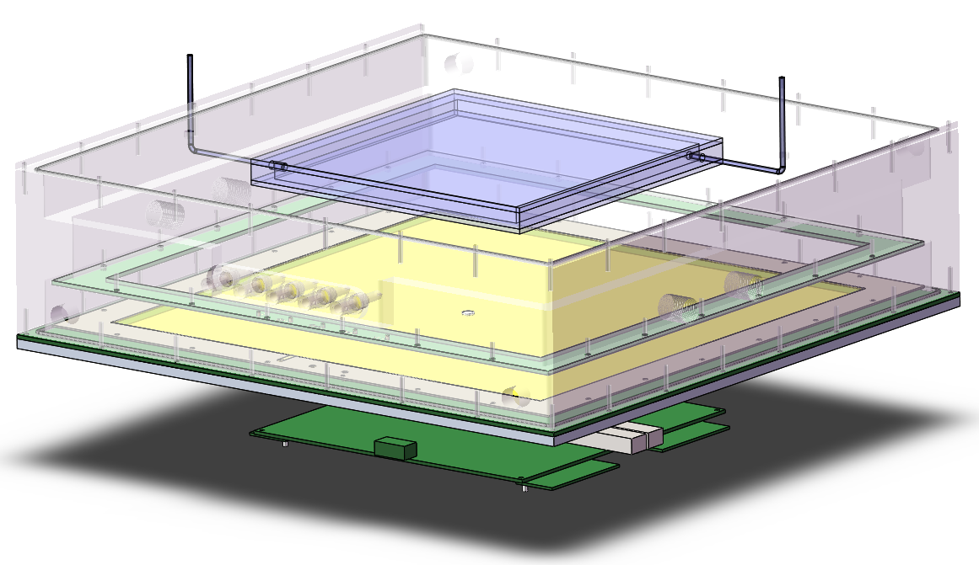
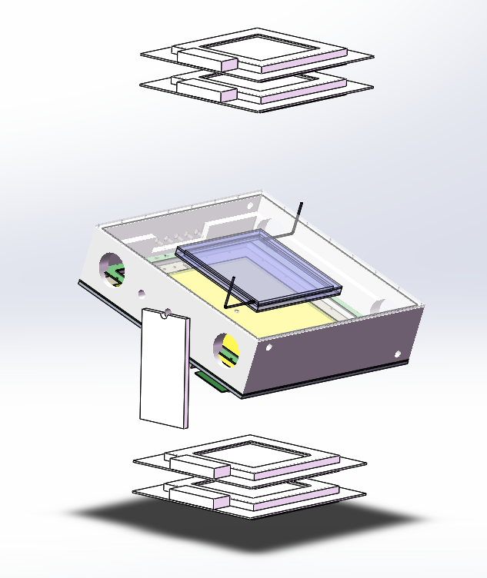
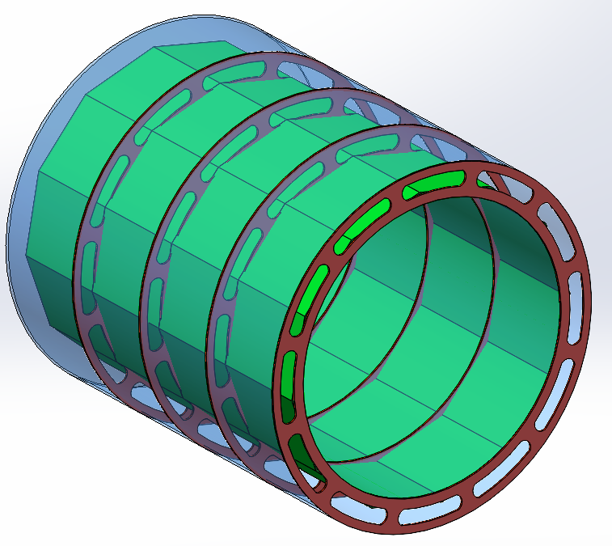
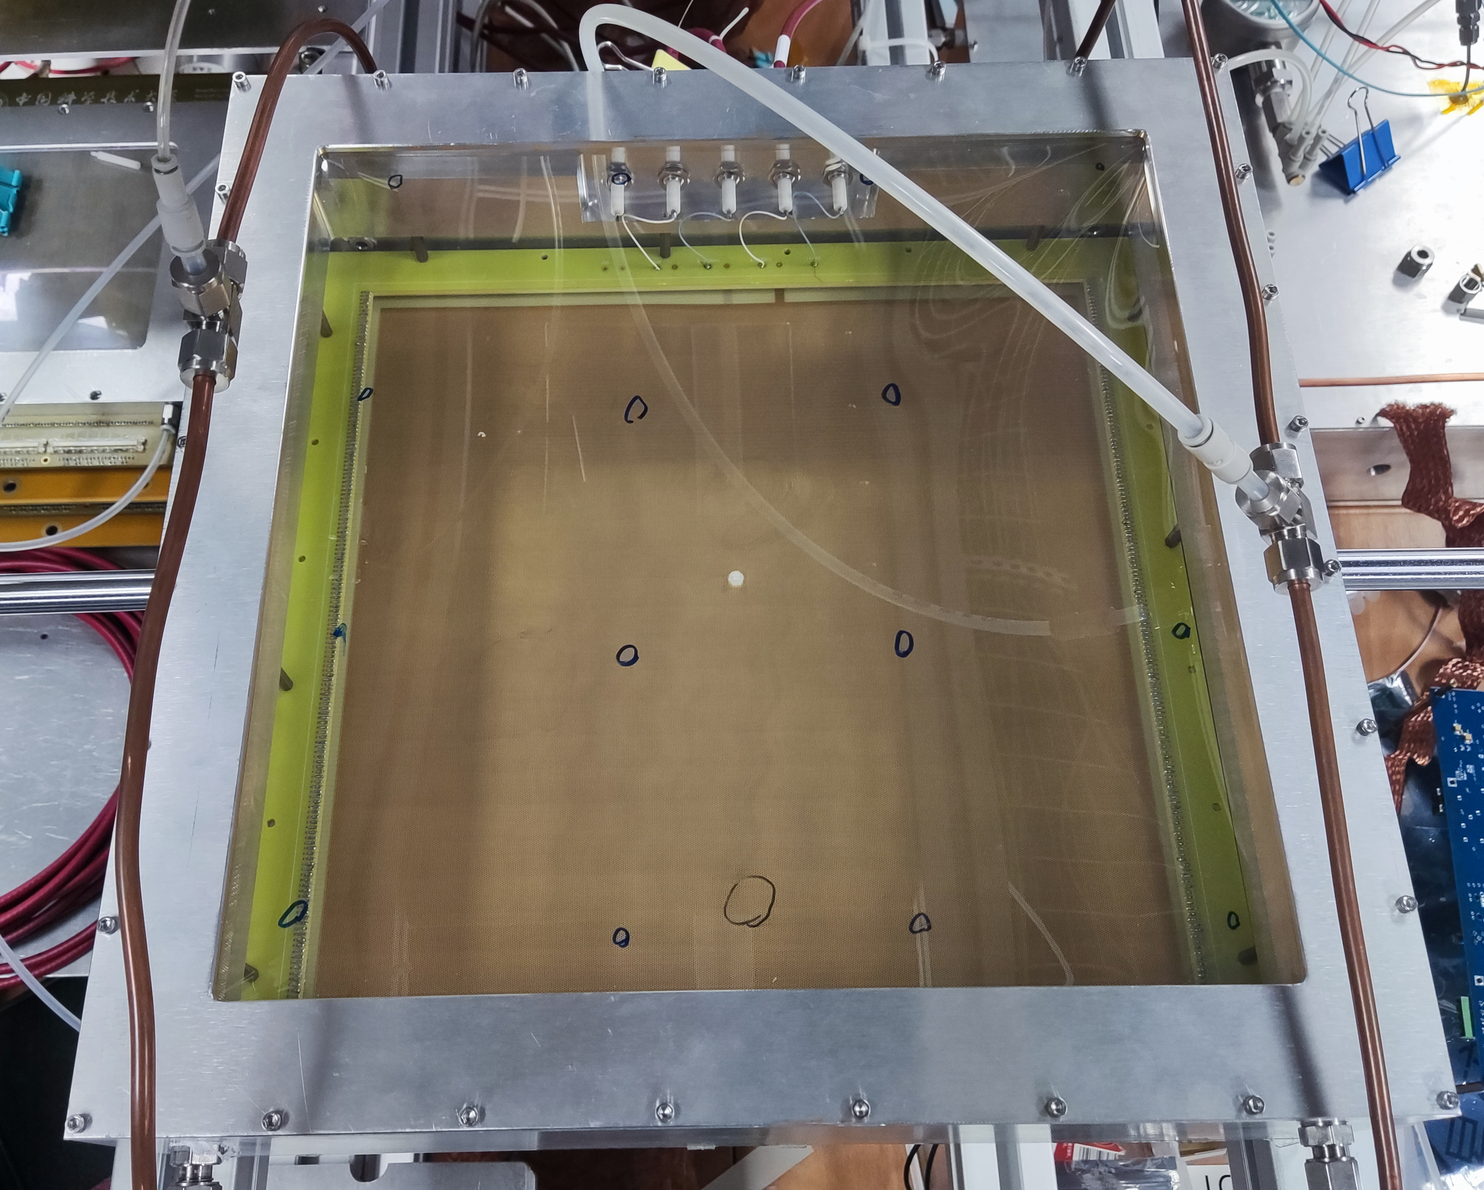
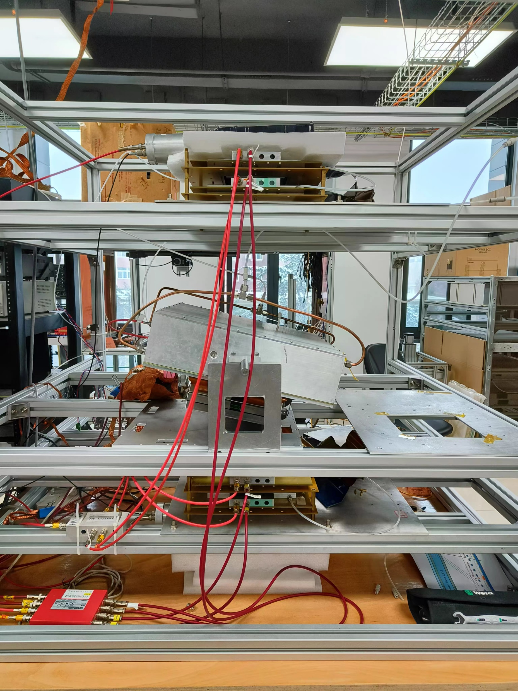
Structure of RICH Detector
Tracker system
RICH
Engineering prototype
Notes:
(Top left) The RICH detector consists of 12 modules, around the tracker. (bottom left) In order to increase the sensitive area, the cylinder anode with continuous radiator is also under study.
(top middle) to study the performance of RICH, we built up an engineering prototype. This is the Liquid radiator container, connected to the purification device. This is the mesh. This is the Cesium Iodide coated THGEM, the size of which is 32 centimeters by 32 centimeters. This is the micromegas and the size of the anode is 5 millimeters by 5 millimeters. The front end readout electronics is install directly behind the detector. This prototype is now running on a cosmic ray test system, with a fast trigger and tracker system.

Slide 10
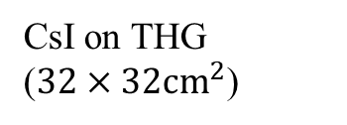
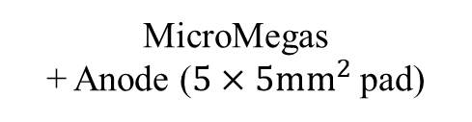
Structure of RICH Detector
Liquid radiator container, connected to the purification device
Mesh
CsI on THGEM
($32×32{cm}^{2}$)
MicroMegas
+ Anode ($5×5mm^{2}$ pad)
AGET / RICH ASIC FEE

Slide 11
Build the Prototype
Radiator purification
Coating CsI photocathode on THGEM on large area, QE test
THGEM-MicroMegas: gain and uniformity
AGET-based readout electronics
Custom ASIC-based readout electronics
On going: Test of encoding anode
On going: Cosmic ray test system
Preparing the beam test
Notes:
We will follow these steps to build the prototype.

Slide 12
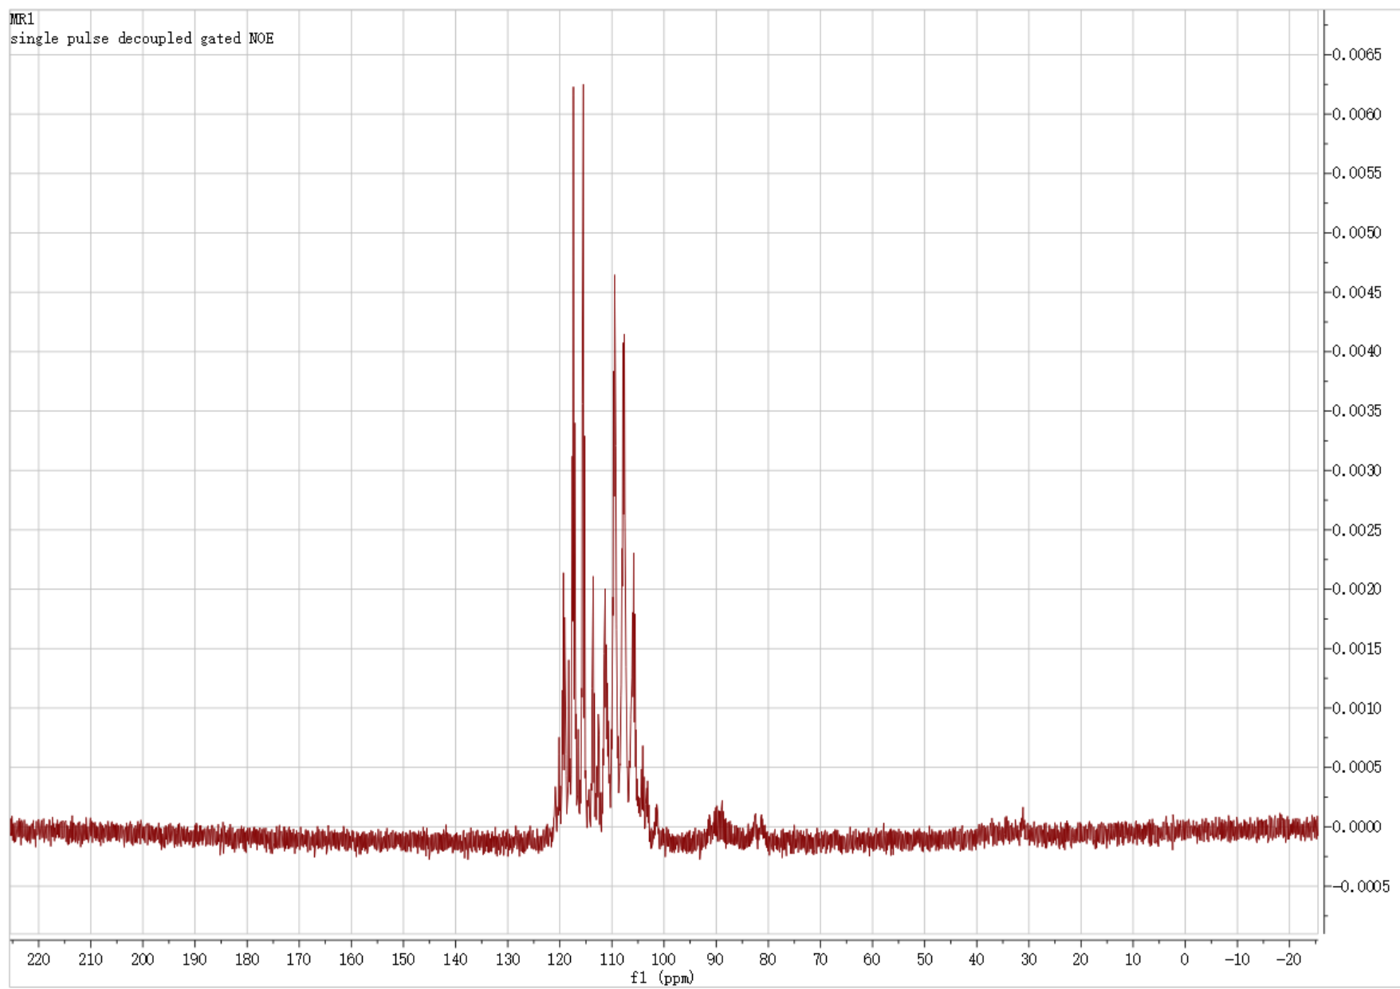
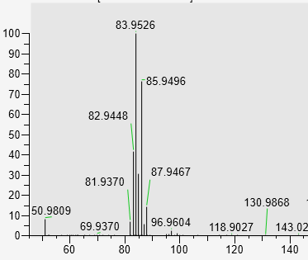
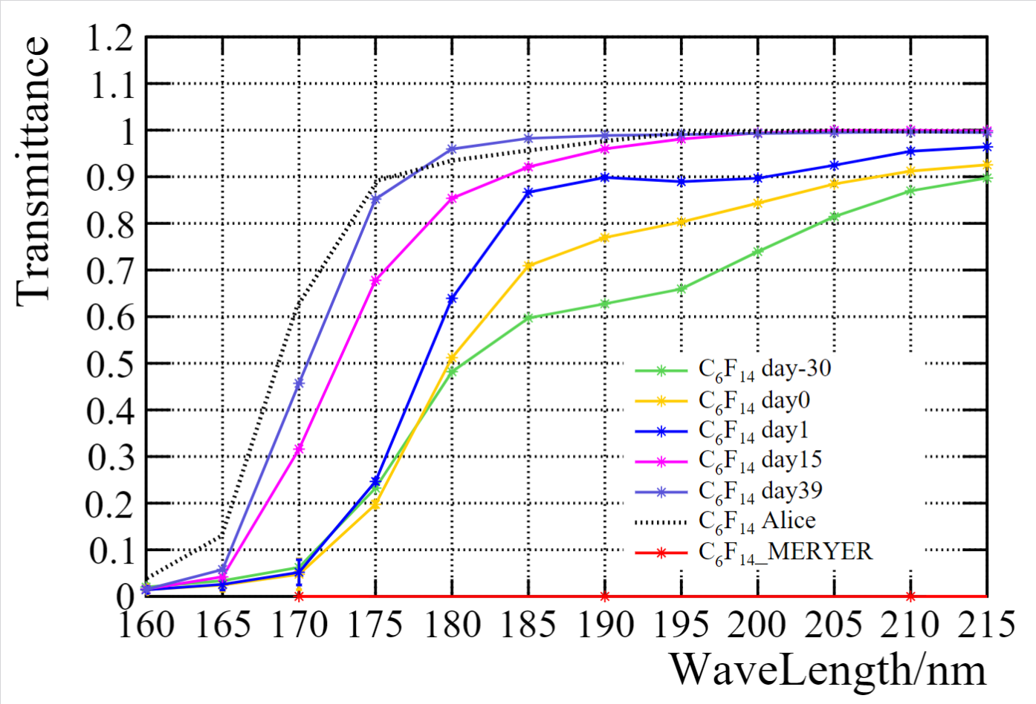
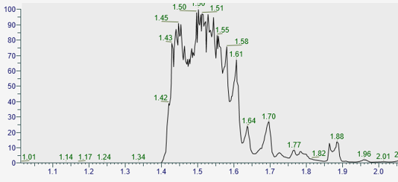
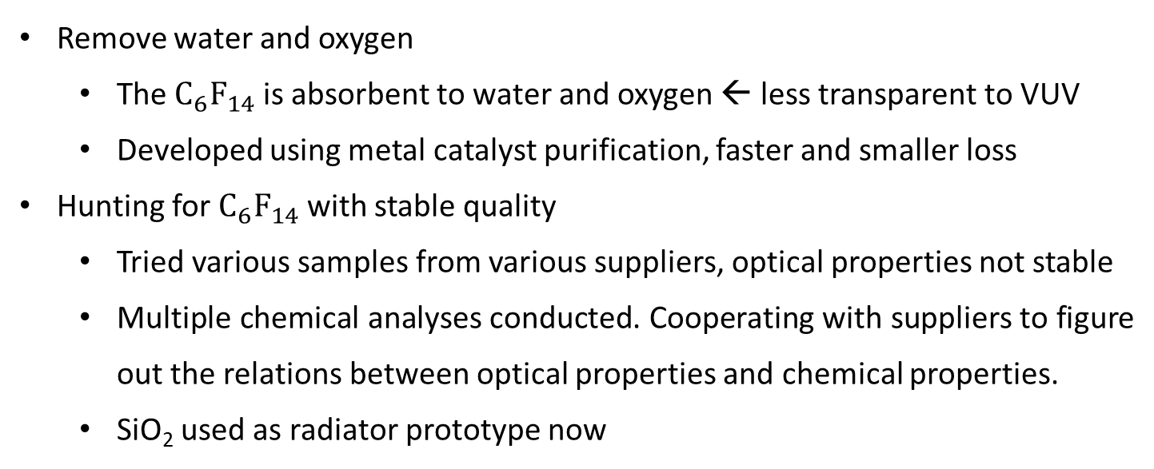
Radiator Purification
Remove water and oxygen
  The $C_{6}F_{14}$ is absorbent to water and oxygen ← less transparent to VUV
  Developed using metal catalyst purification, faster and smaller loss
Hunting for $C_{6}F_{14}$with stable quality
  Tried various samples from various suppliers, optical properties not stable
  Multiple chemical analyses conducted. Cooperating with suppliers to figure out the relations between optical properties and chemical properties.
  SiO₂ used as radiator prototype now
NMR spectrum
mass spectrum
chromatogram

Slide 13
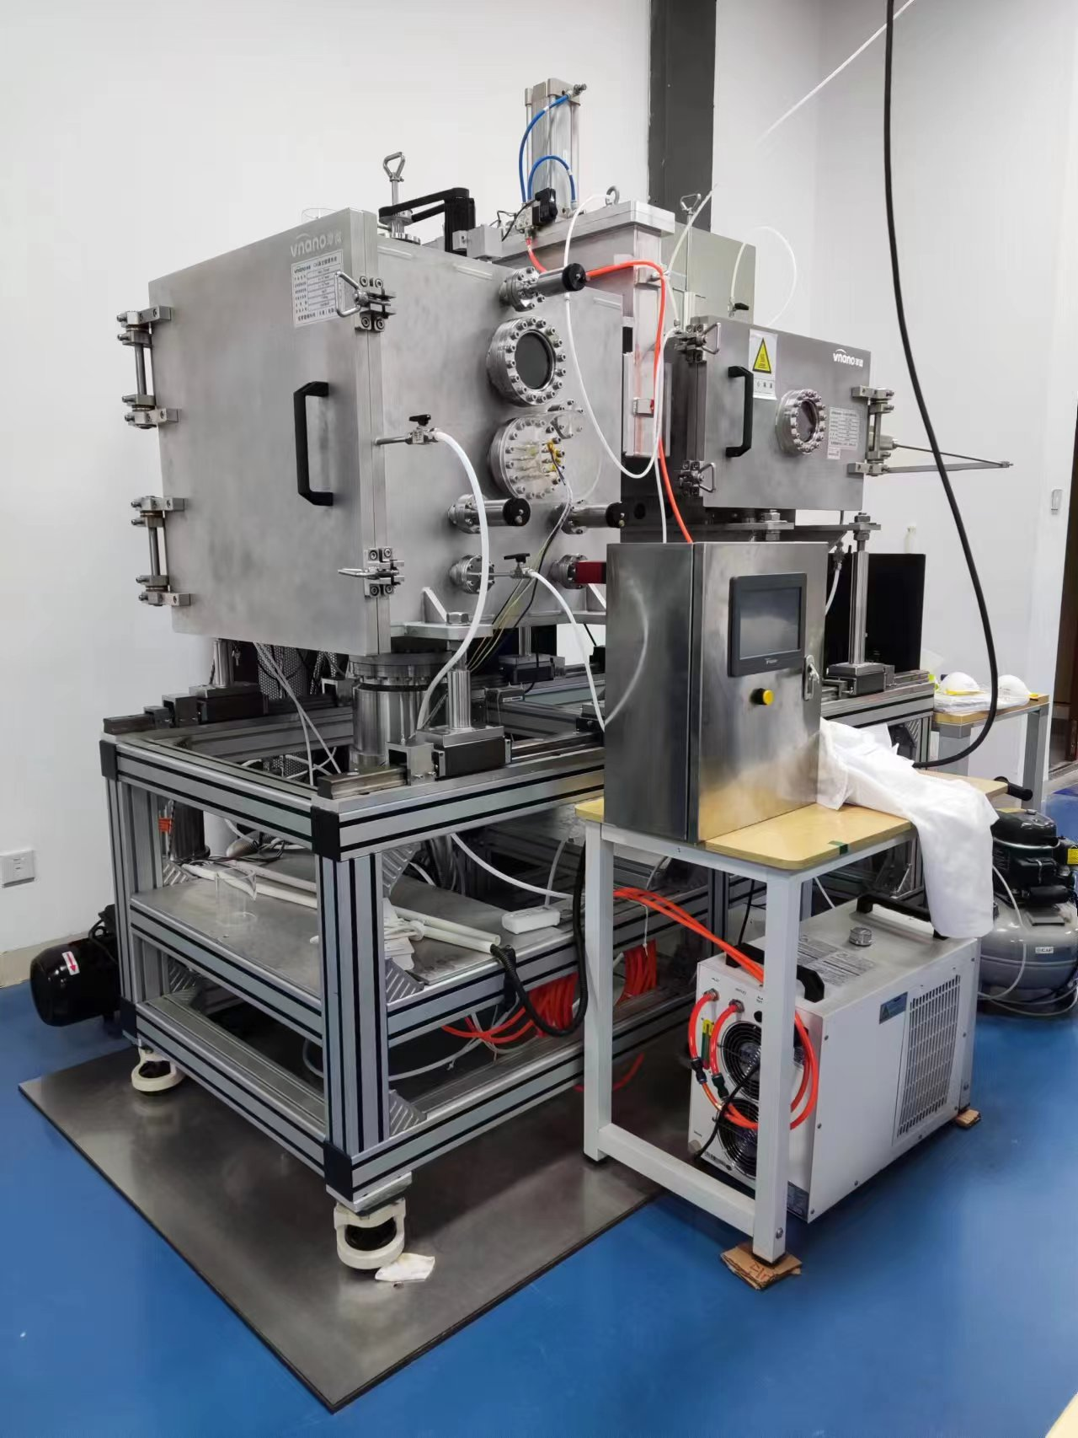
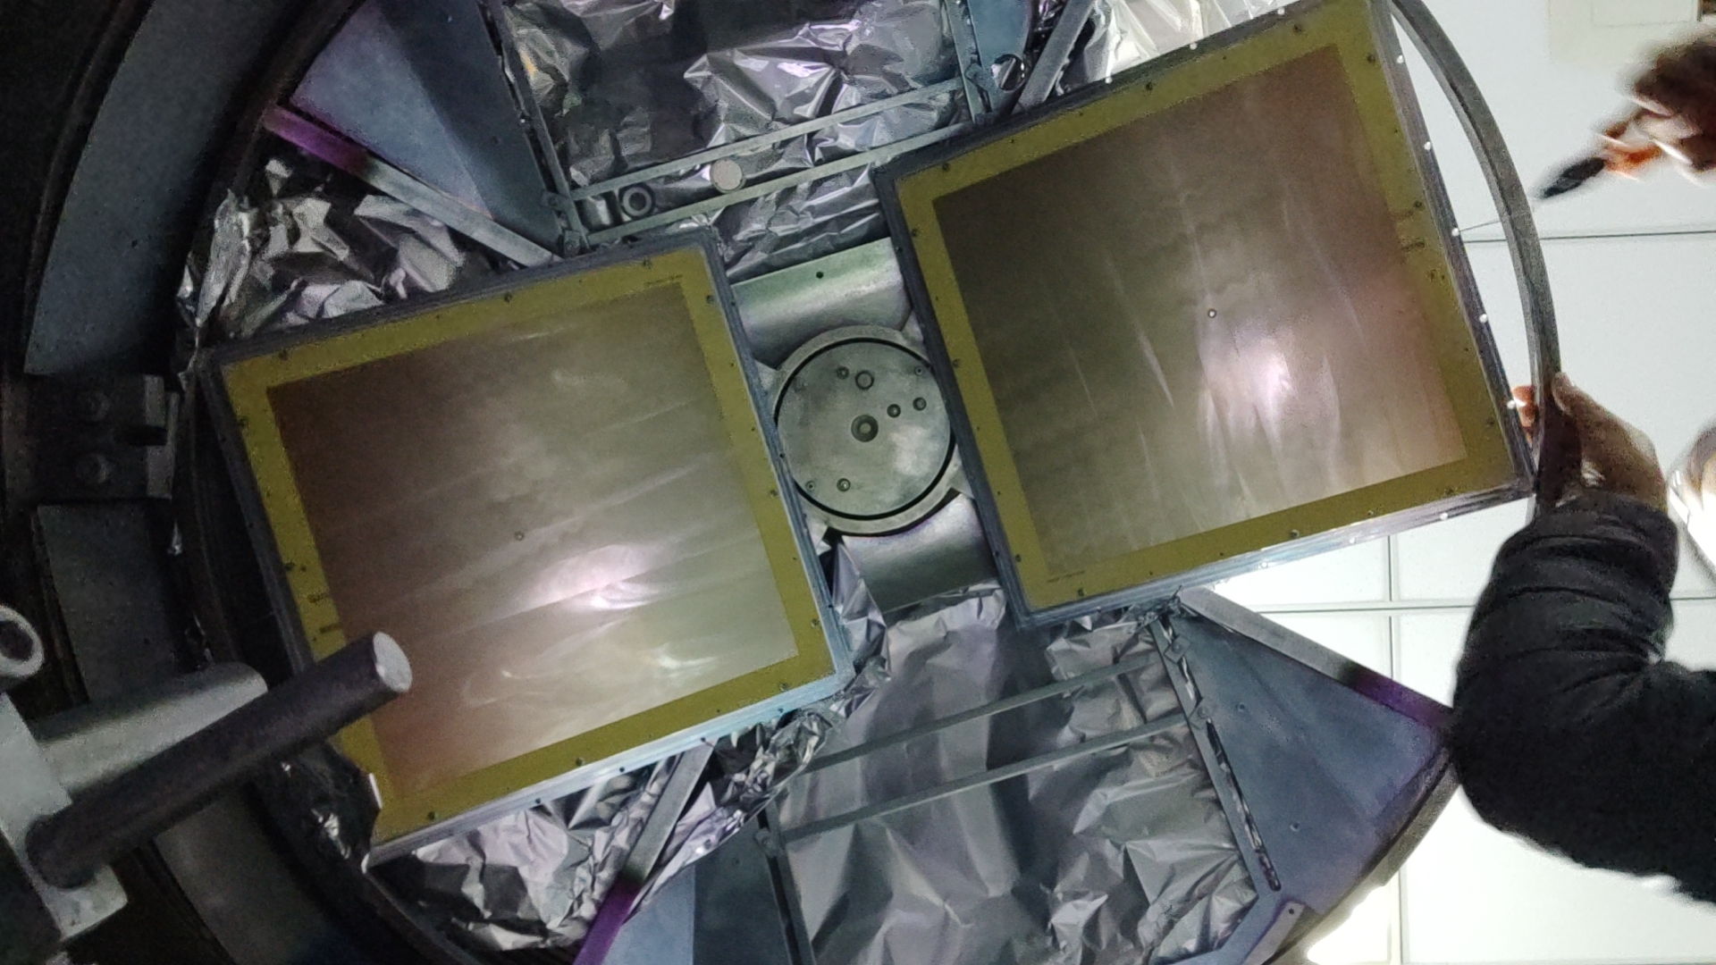
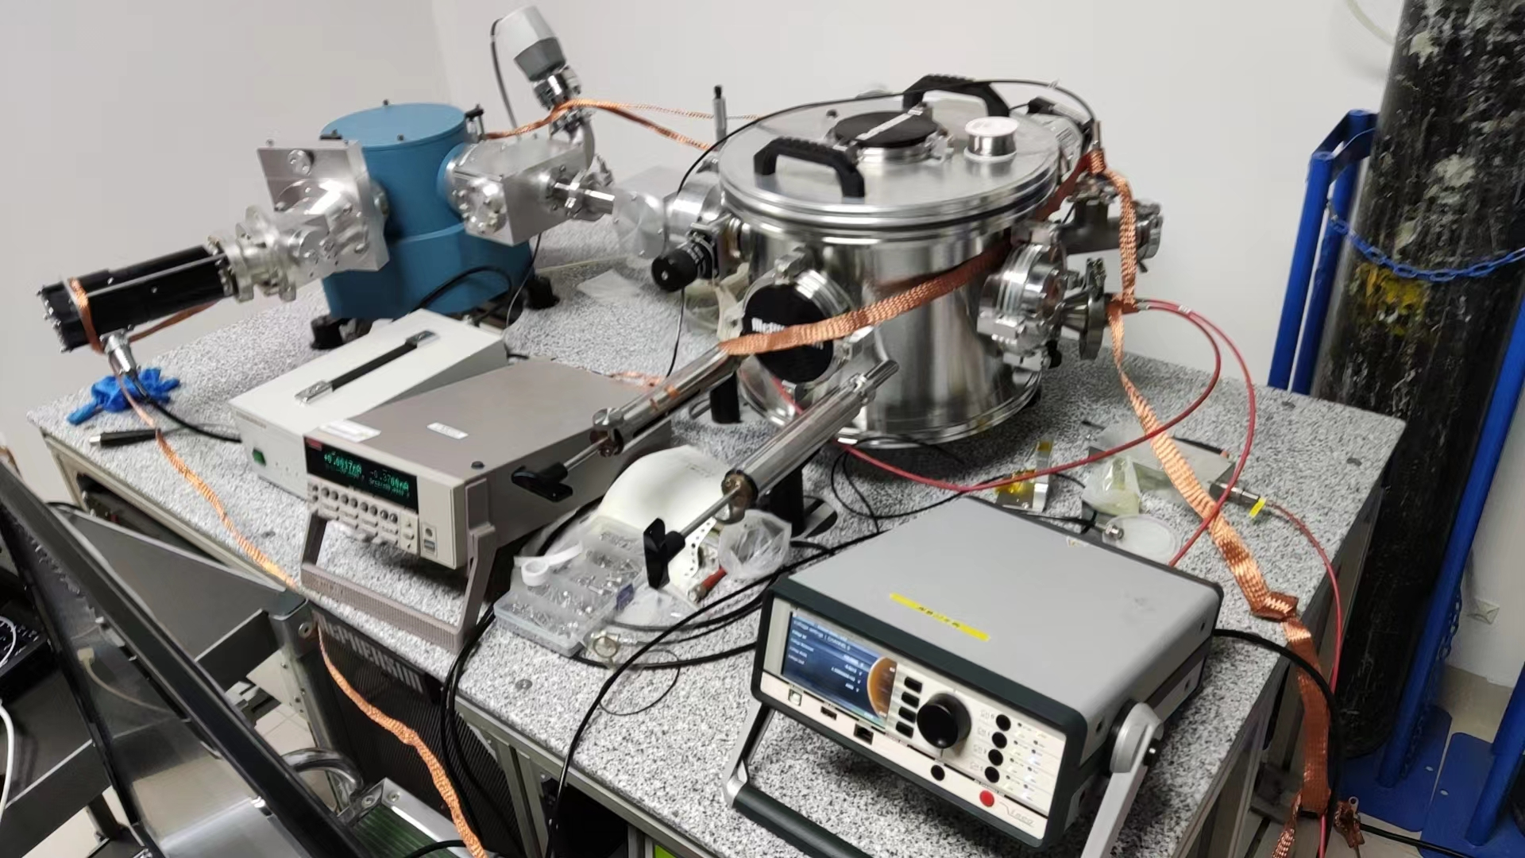
Coating CsI Photocathode on THGEM
Build the large area coating system & cooperate with Anhui Institute of Optics and Fine Mechanics, Chinese Academy of Sciences.
Build the QE & radiator transmittance measurement system.
Notes:
右上图：our vacuum coating system, can coat the CsI on one THGEM at a time. The bottom shows the coating system at Anhui Institute of Optics and Fine Mechanics. There we have larger container to coat 2 or 4 THGEMs at a time. The bottom left shows the vacuum test system for QE and transmittance, with 氘灯 (deuterium [dju:'tiəriəm] lamp) to get vuv with wavelength from 140 to 240nm. The results are shown in the middle

Slide 14
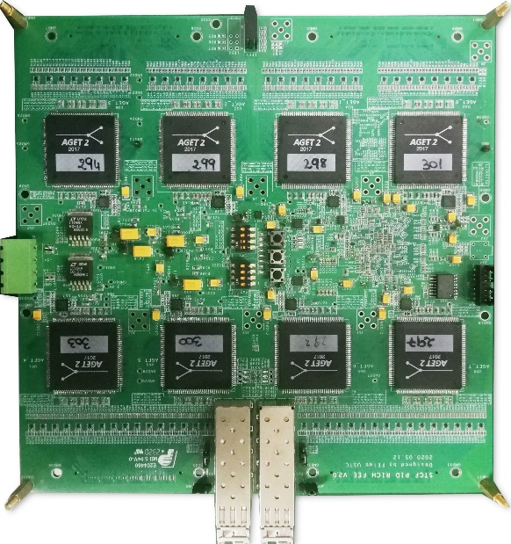
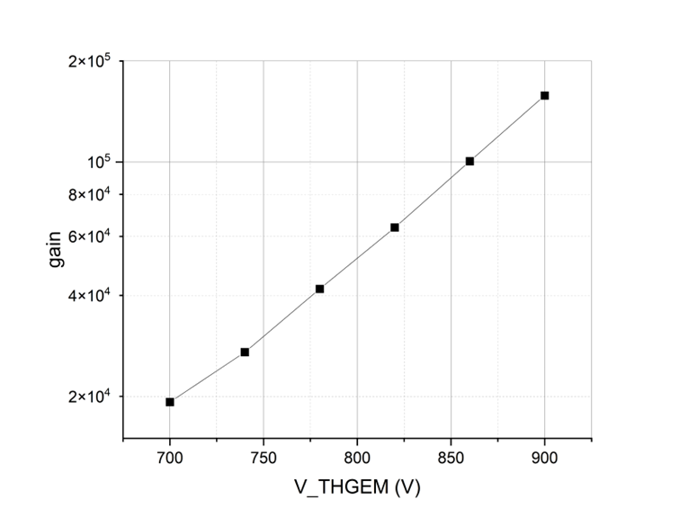
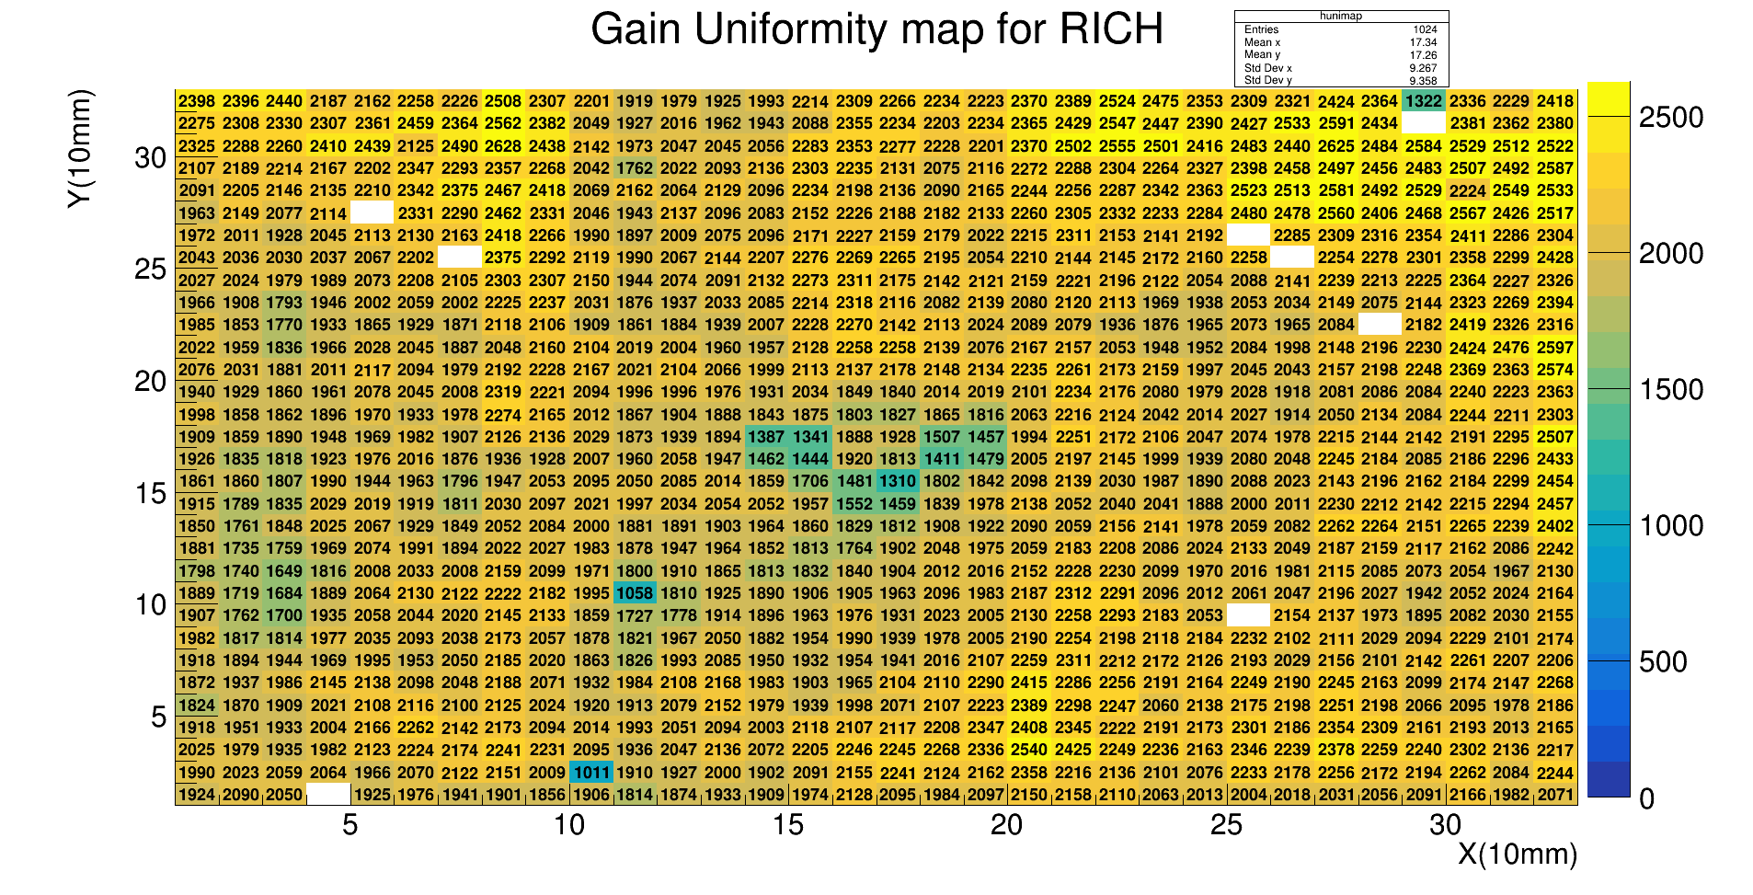
Gain & Uniformity
Test with THGEM-MicroMegas and AGET-based readout electronics.
Mesh
7.6 mm
0.4 mm
2mm
～0.1 mm
Gain
Uniformity 8% @ gain~1.6×10⁴
Notes:
The THGEM-MicroMegas detector is also tested with the AGET-based readout electronics. With a voltage of about 900 V, the gain can reach 160k. And the gain uniformity is better than 8 percent.

Slide 15
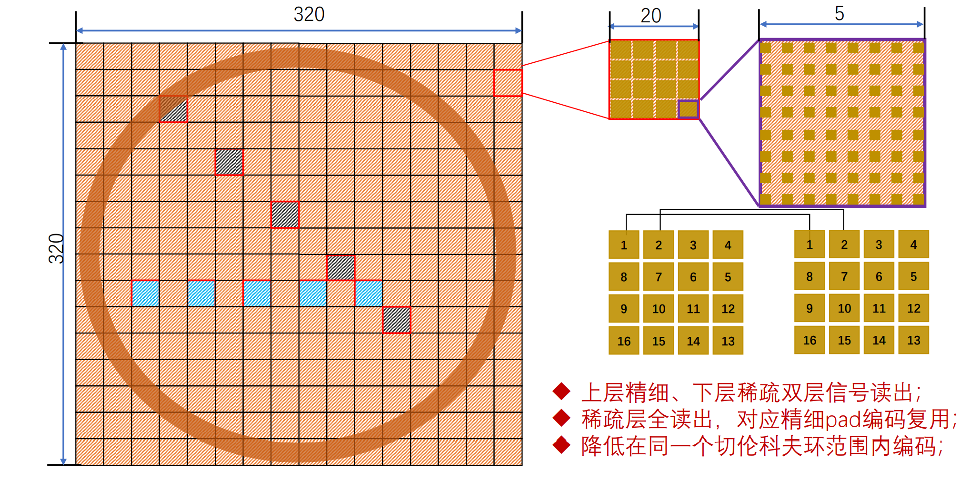
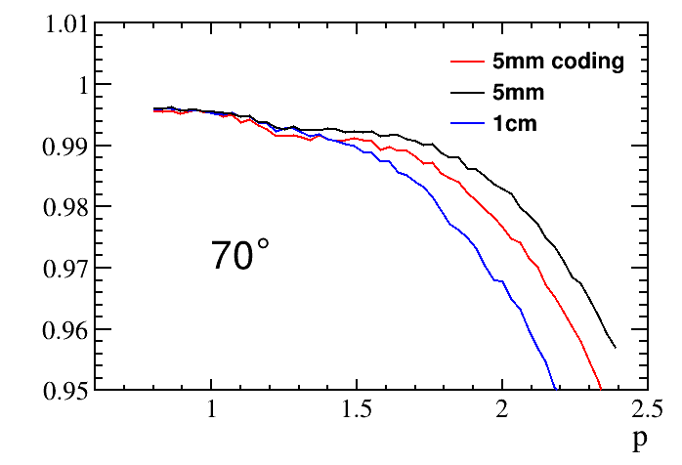
Encoding anode
The encoding anode method is proposed to reduce the number of readout channels to 1/5.
Connect and read out the anode by a special geometric rule (encoding) and determine the hit position by the firing mode (decoding).
Dual-layer readout for the resistive anode, with a large top pixel corresponding to 16 small bottom pixels (5 mm ╳ 5 mm), and the small pixels are encoded.
θ=
Notes:
The encoding anode method is proposed to reduce the number of readout channels to 1/5. Connect and read out the anode by a special geometric rule (encoding) and determine the hit position by the firing mode (decoding). Dual-layer readout for the resistive anode, with a large top pixel (2 centimeters by 2 centimeters) corresponding to 16 small bottom pixels, and the small pixels are encoded. The PID performance is similar to the full readout of the pad size of 5 mm ╳ 5 mm, while the channel number can be reduced to 1/5. And the PID performance is better than the full readout of the pad size of 1 cm ╳ 1 cm with the same number of channels.

Slide 16
Outline
1、Physical requirements for STCF PIDB
2、RICH PIDB detector design
3、RICH PIDB readout electronics design
4、Conclusion

Slide 17
PIDB Readout Electronics
The RICH PIDB detector consists of 12 identical block modules, each with 43,200 readout channels when using the 5×5 mm² readout pads.
The readout electronics are located directly behind the detector to avoid a large number of long readout cables.
Each block module is divided into 12 FEEs along the beam direction, each with 3600 channels of integration.
Conceptual design of the RICH PIDB readout electronics
Notes:
The RICH PIDB detector consists of 12 rectangular modules. Each module is 2.4 meters long and 45 centimeters wide. With a typical readout pixel size of 5 millimeters by 5 millimeters, each module has 43,200 readout channels. Considering the radial height limitation and the quality of the readout signal, it makes sense to install the front-end readout electronics directly behind the detector. In order to improve the yield and maintainability of the installation, the electronics are divided into 12 sub-modules along the beam direction. Each module is 20 centimeters long and is responsible for 3,600 channels. The data is then cached and transferred to the readout unit through high-speed optical fibers.

Slide 18
PIDB Readout Electronics
Challenges posed to readout
electronics:
High density
Large number of channels
High resolution
Short dead time
  Requirements for the readout electronics
 | Requirement
Charge measurement range | 48 fC
Equivalent noise charge (ENC) | 0.5 fC @ 20 pF C_{in}
Time resolution | ≤ 1 ns @ 16 fC @ 20 pF C_{in}
Total redout channels | ~ 518,400 (can be reduced with encoding anode)
Dead time | < 66 μs/channel
Signal processing chain of the readout electronics
Notes:
With a pixel size of 5 millimeters by 5 millimeters and a total area of 12 square meters, the readout electronics face the challenge of high density and a large number of readout channels. Meanwhile, the average charge of the signal is about 16 femto couloub, requiring low-noise readout electronics to ensure high detection efficiency and good time resolution. In addition, the high luminosity of STCF also requires readout electronics with a short dead time. The ASICs in current large-scale physical experiments cannot fully meet the above requirements. Therefore, it is necessary to design a suitable ASIC that meets all the requirements.

Slide 19
PIDB Front-end ASIC Prototype
The prototype ASIC integrates 32 channels, including analog processing circuits and analog-to-digital conversion (ADC) circuits.
Compatible with both external trigger mode and triggerless mode.
All outputs are digital, can be directly connected to the digital data processing ASIC.
Block diagram of the prototype ASIC
Notes:
In the prototype ASIC, we integrate 32 channels of analog processing circuits and analog-to-digital converters on a single chip. Each channel has an independent discriminator and DAC, making the chip compatible with both external trigger and triggerless readout modes. In triggerless readout mode, when the input signal crosses the threshold, the switched capacitor array stops and the sample points are sent to the ADC for digitization. Taking advantage of the all-digital output of the chip, this prototype ASIC can be directly connected to the digital data processing ASICs, reducing the complexity of the front-end electronics, and is suitable for the high-density readout requirements of STCF RICH.

Slide 20
PIDB Front-end ASIC Prototype
Since the digital waveform data can be further processed by digital filters, a CR-(RC)² semi-Gaussian shaper is selected.
A characteristics table based on the BSIM3v3 model is created to optimize the transfer function and ENC better.
ENC optimization
Schematic of the analog processing circuit
Notes:
The average output charge from the detector is 16 fC with a charge collection time of about 100 nanoseconds, so the maximum current is only a few hundred nanoamperes. Therefore, a charge sensitive amplifier is used as the input stage to achieve low noise amplification. This prototype ASIC outputs digital waveforms that can be further processed by a digital filter, so a second-order semi-Gaussian shaper is used in the analog circuit to save power and area consumption. Considering the complex device characteristics in deep submicron processes, we created a MOSFET characteristic table by simulation in the initial design step, and then the appropriate device parameters can be solved and optimized quickly.

Slide 21
PIDB Front-end ASIC Prototype
Higher sampling rate to extract more information from the waveform.
Lower power consumption for high density and low cooling requirements.
Effective signal duration only accounts for about 1% of the total time.
Switched Capacitor Array (SCA) + ADC
(ADC in suspend mode without valid signal)
Working sequence of the digitization circuit
Block diagram of the digitizing circuit
Notes:
As for the analog-to-digital conversion circuit, we hope to increase the sampling rate to obtain more waveform information, while minimizing its power consumption to reduce cooling requirements. Considering that the waveform duration is only sub-microseconds and the average interval between signals is hundreds of microseconds, the effective signal duration only accounts for about 1 percent of the total time. Therefore, we separate the sampling circuit from the digitizing circuit to achieve both high sampling rate and low power consumption at the same time. When there is no signal, only the sampling circuit is in operation, while the digitizing circuit is in standby. Only after an effective waveform is sampled will the Wilkinson ADC circuit be activated for waveform digitization.

Slide 22
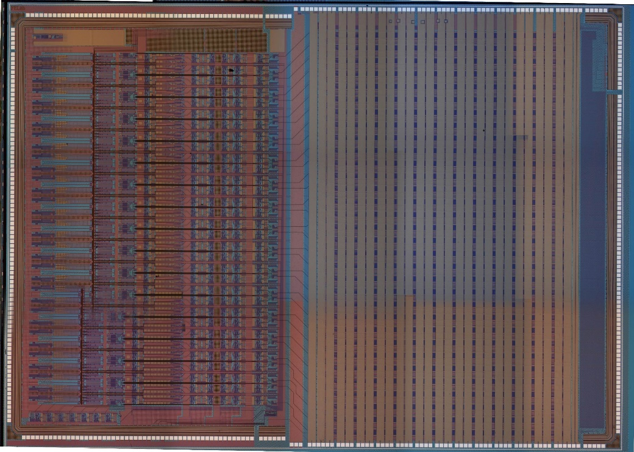
PIDB Front-end ASIC Prototype
This 32-channel mixed-signal ASIC is fabricated in the 180 nm CMOS process with a die size of 10,005 μm×6,168 μm.
Approaches to reducing crosstalk between sensitive front-end and digital circuits:
  Place the noisy digital circuits in the deep Nwell.
  Use Dcap cell as filler during digital implementation to reduce the power ripple.
  Isolate the ESD loop between digital IO and analog IO.
Analog
processing
circuit
SCA
+
ADC
Cross-sectional view of the deep Nwell
Photograph of the fabricated chip
Notes:
The prototype ASIC is fabricated in a 180-nanometer CMOS process with a die size of 10 millimeters by 6 millimeters, including 32 channels of analog processing circuit and digitization circuit. Due to the sensitivity of the analog processing circuit, we made some optimizations in the layout design to reduce the crosstalk caused by the digital circuit. For example, the noisy digital circuits are placed in the deep N-well to reduce crosstalk through the substrate. In the digital circuit implementation, Dcap cells were used as fillers to reduce power ripple. As for the IO pads, the ESD loop between the analog and digital parts was cut off for isolation.

Slide 23
PIDB Front-end ASIC Prototype
Output waveforms are sampled and digitized by 128 independent cells, the mismatch between cells results in different codes for the same input.
This mismatch is a form of fixed pattern noise that can be corrected by sampling the baseline waveforms and generating the DC correction data.
Output waveform is similar under different input charges, with a gain of 15.2 code/fC and an INL of 0.92%.
Pre DC calibration waveforms
of 6 fC charge signals
Post DC calibration waveforms
of 6 fC charge signals
Output waveforms
versus input charge
Notes:
The Wilkinson ADC digitizes the waveform in parallel. Each sample point is sent to an independent unit for digitization. Therefore, due to manufacturing mismatch, fixed pattern deviations may be introduced between different units, resulting in different output codes for the same sampled voltage. However, this difference is caused by the manufacturing process, and can be easily corrected by digitizing the same baseline repeatedly and generating the DC correction data for one time. The left figure is the measured waveform before correction, and there are many spikes in the signal. The middle figure shows the waveforms after DC correction, resulting in a cleaner waveform. The right figure shows the output waveform versus input charge after correction, with a gain of 15.2 codes per fento-coulomb and an integral nonlinearity of 0.92 percent.

Slide 24
PIDB Front-end ASIC Prototype
ENC at the discriminator input affects the lower limit of the threshold setting and then the detection efficiency in triggerless mode.
Measured ENC ≈ 627 e + 18.8 e/pF
With a threshold greater than 1.2 fC, the noise hit frequency for a single channel is a few Hz.
ENC at discriminator input
versus input capacitance
Frequency of noise hit versus threshold
Notes:
As for the single photon electron (SPE), the charge collected by a single channel follows a Polya distribution. In order to achieve high detection efficiency with the noise hit at a few Hz, the ENC at the discriminator input should be low enough. Based on the S-curve method, we measured the ENC versus the input capacitance. The ENC is about 600 electrons without input capacitance and the noise slope is about 18 electrons per picofarad. In particular, with the input capacitance of 20 picofarad, the ENC is better than 0.2 fento-coulomb, meeting the requirement. At the same time, we also tested the relationship between the noise hit frequency and the threshold. The noise hit frequency can be reduced to only a few hertz with a threshold higher than 1.2 fento-coulomb.

Slide 25
PIDB Front-end ASIC Prototype
Time resolution is tested for various input charges at 20-pF input capacitance.
Constant Fraction Discriminators (CFD) and 2-point linear fit are used for time calculation.
Digital filter and waveform fitting methods will be further investigated to improve the time resolution.
Time resolution
versus input charge
Timing extraction algorithm used for the digital waveform
Notes:
We use a digital constant ratio timing method for the time resolution test with the threshold set to 50 percent of the amplitude. And linear fitting is performed on the two points around the intersection point to obtain a more precious time information. After DC correction and simple filtering, the time resolution is better than 1 nanosecond when the input charge is larger than 16 fento-coulomb, meeting the requirements. In the next step, we will further study time extraction algorithms based on digital filtering and waveform fitting to improve the time resolution.

Slide 26
PIDB Front-end ASIC Prototype
The step voltage waveform is used as the input signal to test the counting rate capability.
The gain remains almost the same and the readout efficiency maintains 100% up to 15 kHz repetition rate for a single channel, meeting the requirement.
Step voltage waveform
used for the dead time test
Measured output rate versus
input rate for a single channel
Gain variation with input rate
Notes:
Finally, we performed a dead time test on the ASIC. We used an arbitrary waveform generator in series with a voltage-to-current conversion capacitor to inject charges into the ASIC. When using a normal square wave, two signals of opposite polarity are injected, which cannot test the effect of pile-up. Therefore, we used the stepped signal shown in the left figure to repeatedly inject signals of the same polarity. We then adjusted the interval between the two steps to change the counting rates of the input signals. Test results show that from sparse events to 15 kHz counting rates, the gain remains the same and the readout efficiency maintains 100 percent, indicating that the dead time is less than 66 microseconds.

Slide 27
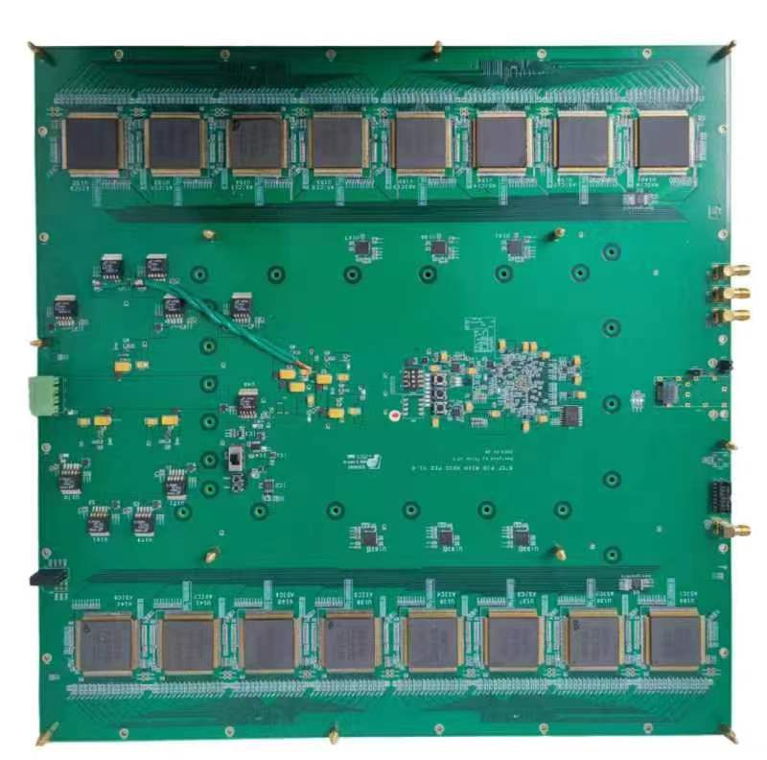
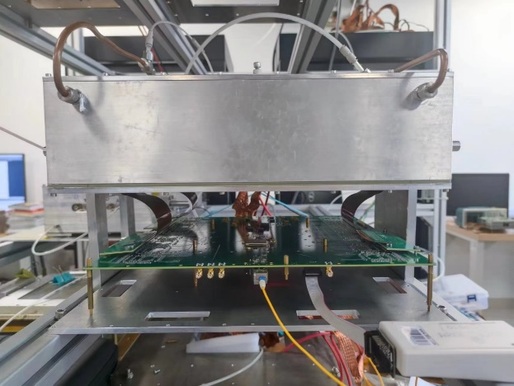
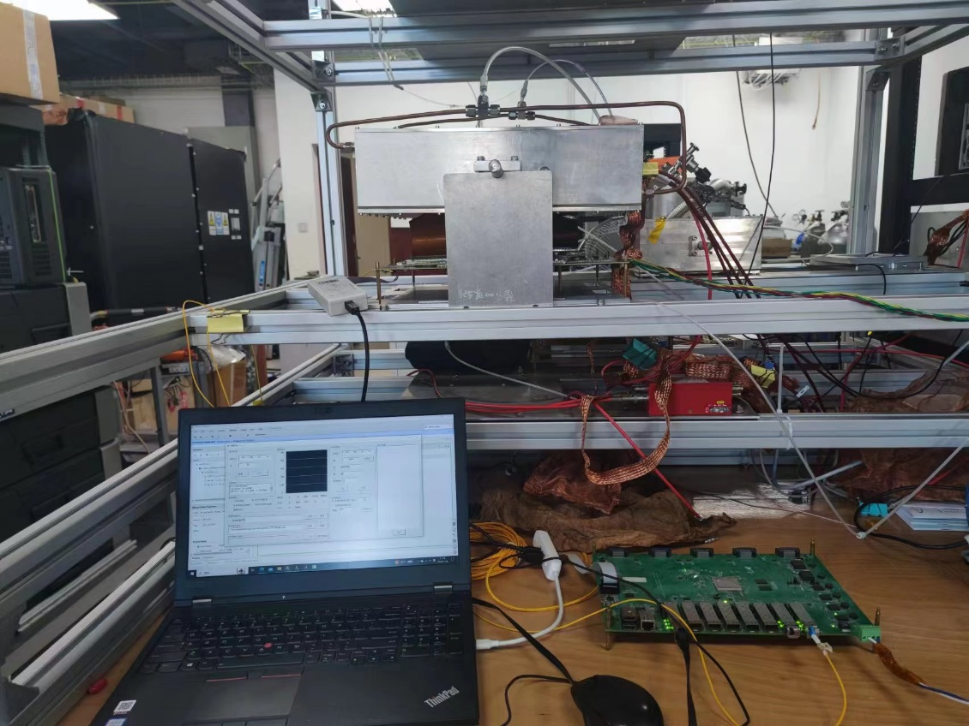
PIDB FEE Functional Verification
Based on the 32-channel prototype ASIC, a 512-channel FEE prototype was designed.
Layout of the 512-channel FEE prototype
Photograph of the FEE prototype
Functional verification and energy spectrum test with ⁵⁵Fe are completed.
RICH detector
RICH & FEE
FEE prototype
Data trans-
mission board
PC
Experimental setup for energy spectrum testing
⁵⁵Fe spectrum
Notes:
We have also completed the prototype design of readout electronics based on this 32-channel prototype ASIC. A single board contains 16 prototype chips, achieving a readout of 512 channels. The functionalities of the readout electronics have been validated and an energy spectrum test has been performed with the RICH detector prototype. The measured energy spectrum is similar to that of the AGET-based readout electronics, while the prototype ASIC can support a higher counting rate.

Slide 28
Outline
1、Physical requirements for STCF PIDB
2、RICH PIDB detector design
3、RICH PIDB readout electronics design
4、Conclusion

Slide 29
Conclusion
Use THGEM-MicroMegas based RICH as barrel PID detector.
Estimated PID ratio for 𝜋, 𝐾, 𝑝 > 98% in momentum ∈ [0.7, 2.0] GeV/c.
Developed the AGET-based readout electronics and custom ASIC-based prototype readout electronics.
Engineering prototype setup, running the cosmic ray test.
Ongoing:
Hunting for C₆F₁₄ with stable quality.
Optimize the process to improve the QE of CsI.
Preparing for the beam test.
Develop the 64-channel custom ASIC.
Notes:
The MPGD-based RICH detector will be used as the barrel part of the STCF particle identification detector, and the PID efficiency is expected to be better than 98% through simulation and optimization.
As for the detector, we have completed the radiator purification, CsI photocathode coating on large area THGEM, QE test, gain and uniformity testing of the THGEM-MicroMegas.
As for the readout electronics, we have developed the AGET-based readout electronics and custom ASIC-based prototype readout electronics.
The next step is to set up the cosmic ray test system and prepare for the beam test, meanwhile the 64-channel custom ASIC is also under development.

Slide 30
Thanks!

