Slide 1



Bunch-by-Bunch 3D Position Measurement
at SSRF
Yimei Zhou¹, Yongbin Leng^{1,2} , Xingyi Xu¹, Fangzhou Chen¹, Xing Yang¹ , Hongshuang Wang¹
1, Shanghai Synchrotron Radiation Facility, SARI, CAS
2, University of Science and Technology of China
FTCF2024, USTC, Hefei, 17 January 2024
Notes:
Good afternoon. It is a great pleasure for me to be here at this meeting. Today, I will discuss "Bunch-by-Bunch Three-dimensional Position Measurement at the Shanghai Synchrotron Radiation Facility."

Slide 2
Outline
  Motivation: why do we need bunch-by-bunch diagnostics
  HOTCAP: a general solution for 3D BYB position measurement
  Application: what we can do with this tool
  Summary
Notes:
My presentation is divided into three parts.
Initially, I will discuss the motivation behind the need for bunch-by-bunch diagnostics.
Subsequently, I will introduce a software package named HOTCAP, designed for 3D bunch-by-bunch position measurements.
Lastly, I will demonstrate an application of this tool in studying the beam-loading effect.

Slide 3
Why bunch by bunch diagnostics ?
Notes:
Let's address the first question: "Why is bunch-by-bunch diagnostics necessary?"

Slide 4
Why bunch-by-bunch diagnostics
For
accelerator physicists
For
machine operators
For
BI engineers
For
low emittance storage ring
Single bunch (bunch-by-bunch) behaves more ‘like’ a macro particle compared to a bunch train (turn-by-turn).
Employing BYB observations for validating theories or developing new ones is more logical.
Robust toolkit to monitor, capture, and predict instability events (beam loss).
Aids in optimizing operational modes, including filling patterns, tuning, injection parameters, etc.
Analyzing the raw beam signal at a BYB rate, rather than a filtered signal at an 'under sampling rate,' is more accurate.
Bunch-by-bunch diagnostics represent a significant advancement towards ideal diagnostics.
BYB tools are invaluable during commissioning and for a thorough understanding of the machine during operation.
Transient stages such as injection must be recorded and analyzed to enhance machine performance.
Notes:
Firstly, for accelerator physicists,
a single bunch behaves more like a macro particle compared to a bunch train. Therefore, employing bunch-by-bunch observations for validating theories or developing new ones is more logical.
Secondly, for machine operators,
it serves as a robust toolkit to monitor, capture, and predict instability events.
It also aids in optimizing operational modes, including filling patterns, tuning, injection parameters, etc.
For beam instrumentation (BI) engineers,
analyzing the raw beam signal at a bunch-by-bunch rate, rather than a filtered signal at an 'under sampling rate,' is more accurate.
Moreover, bunch-by-bunch diagnostics represent a significant advancement towards ideal diagnostics.
Lastly, for low emittance storage rings,
bunch-by-bunch (BYB) tools are invaluable during commissioning and for a thorough understanding of the machine during operation.
Additionally, transient stages such as injection must be recorded and analyzed to enhance machine performance.

Slide 5
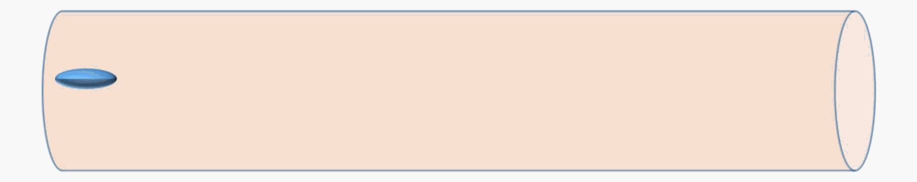
What bunch-by-bunch observation do we need?
In the simplest case
Assume:
Bunching beam
Gaussian distribution in the three-dimensional space
Six spatial parameters
(x, y, z, σx, σy, σz)
=
+
an independent bunch
Charge
(Q)
6-dimensional bunch-by-bunch diagnostic system
Notes:
The second question is, “What bunch-by-bunch observation do we need?”
Assuming the bunching beam follows a Gaussian distribution in three-dimensional space, the bunch position, size, phase, and length will vary as it moves, as depicted in the animation.
Hence, our ultimate objective is to establish a 6-dimensional bunch-by-bunch diagnostic system.

Slide 6
Why focus on injection transient stage
Dedicated machine study
Monitor Injection transient stage
Change machine parameters, compare the measured value with the expected value
Retrieve dynamic information from stored bunches and refilled bunch behavior
(Ideal experiment for beam instability study, Require dedicated machine study time)
(frequently observe during SSRF user runs)
Betatron Damping oscillation
Synchrotron Damping oscillation
← mismatch of kickers, also injector and storage ring
← mismatch of injector and storage ring
Refilled bunch
Stored bunch
Refilled bunch
Stored bunch
Refilled charge / Qr
Betatron amplitude / Ar
Synchrotron amplitude / zm
Synchrotron damping time / τ
Initial position in phase space / ϕ0
Stored charge / Qs
Transverse tune / νx, νy
Betatron amplitude / As
Betatron damping time / Lx
Notes:
Moreover, we concentrate on monitoring the injection transient stage, as it is frequently observed during SSRF user runs, unlike dedicated machine studies.
Through this, we can retrieve dynamic information from stored bunches and refilled bunch behavior by observing betatron and synchrotron damping oscillations. This method is instrumental in evaluating the mismatch between the injector and the storage ring.

Slide 7
How to do precise 3D position measurement
  A software package（HOTCAP）
  High speed Oscilloscope based Three-dimensional bunch Charge And Position measurement system
Notes:
Moving on to the second part, I will explain how we conduct precise 3D position measurements.
I will present our HOTCAP software package, the High-speed Oscilloscope-based Three-dimensional bunch Charge And Position measurement system.

Slide 8
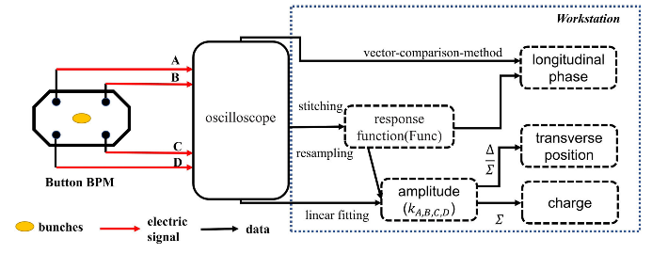
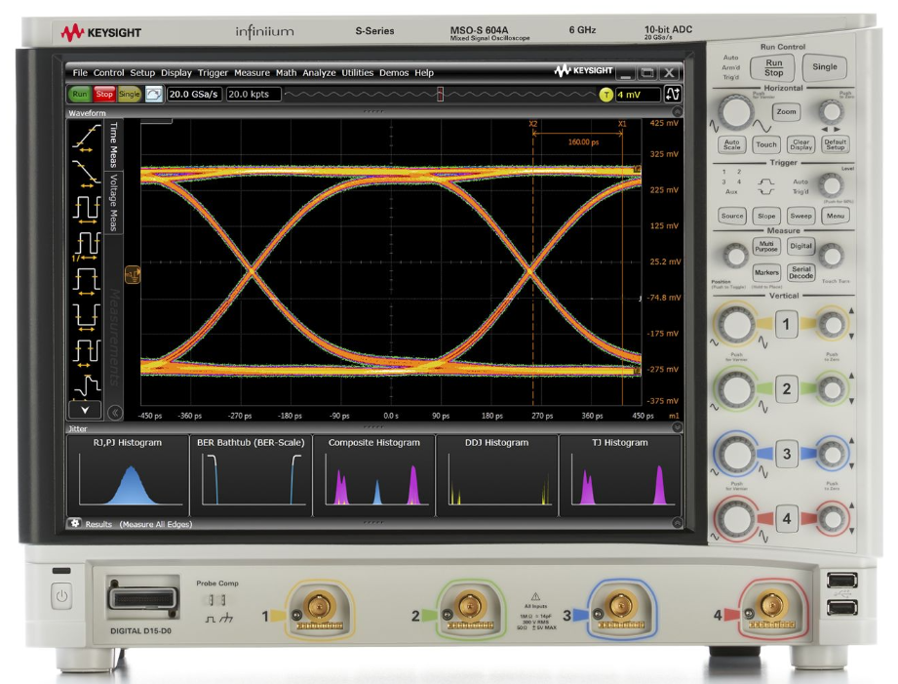
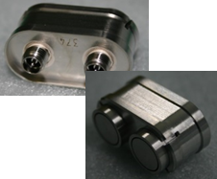

HOTCAP: System Framework
Source:
Hardware:
Data processing:
Keysight MSOS604A
Sampling rate | 10 GS/s
Bandwidth | 4.2 GHz
ENOB | 10 bit
Memory depth | 103 M/channel
Button BPM
Correlation coefficient-based methods
Construction of ultra-high time-resolved response functions
Extraction of 3D position information
Longitudinal phase
$$V_{b}(t)=\frac{−Z}{βc}∙\frac{t−t_{0}}{σ^{2}}∙I(t)∙F(δ,θ)$$
Charge
Transverse position
Xingyi Xu,Yongbin Leng,* Yimei Zhou, Bo Gao, Jian Chen, and Shanshan Cao，Bunch-by-bunch three-dimensional position and charge measurement in a storage ring，PRAB 24, 032802 (2021)
https://github.com/xuxingyi/HOTCAP
Notes:
This slide illustrates the HOTCAP system framework.
The electrical signal is sourced directly from the button BPM and captured by an oscilloscope with a high sampling rate and bandwidth.
The data is then processed by the HOTCAP software package.

Slide 9
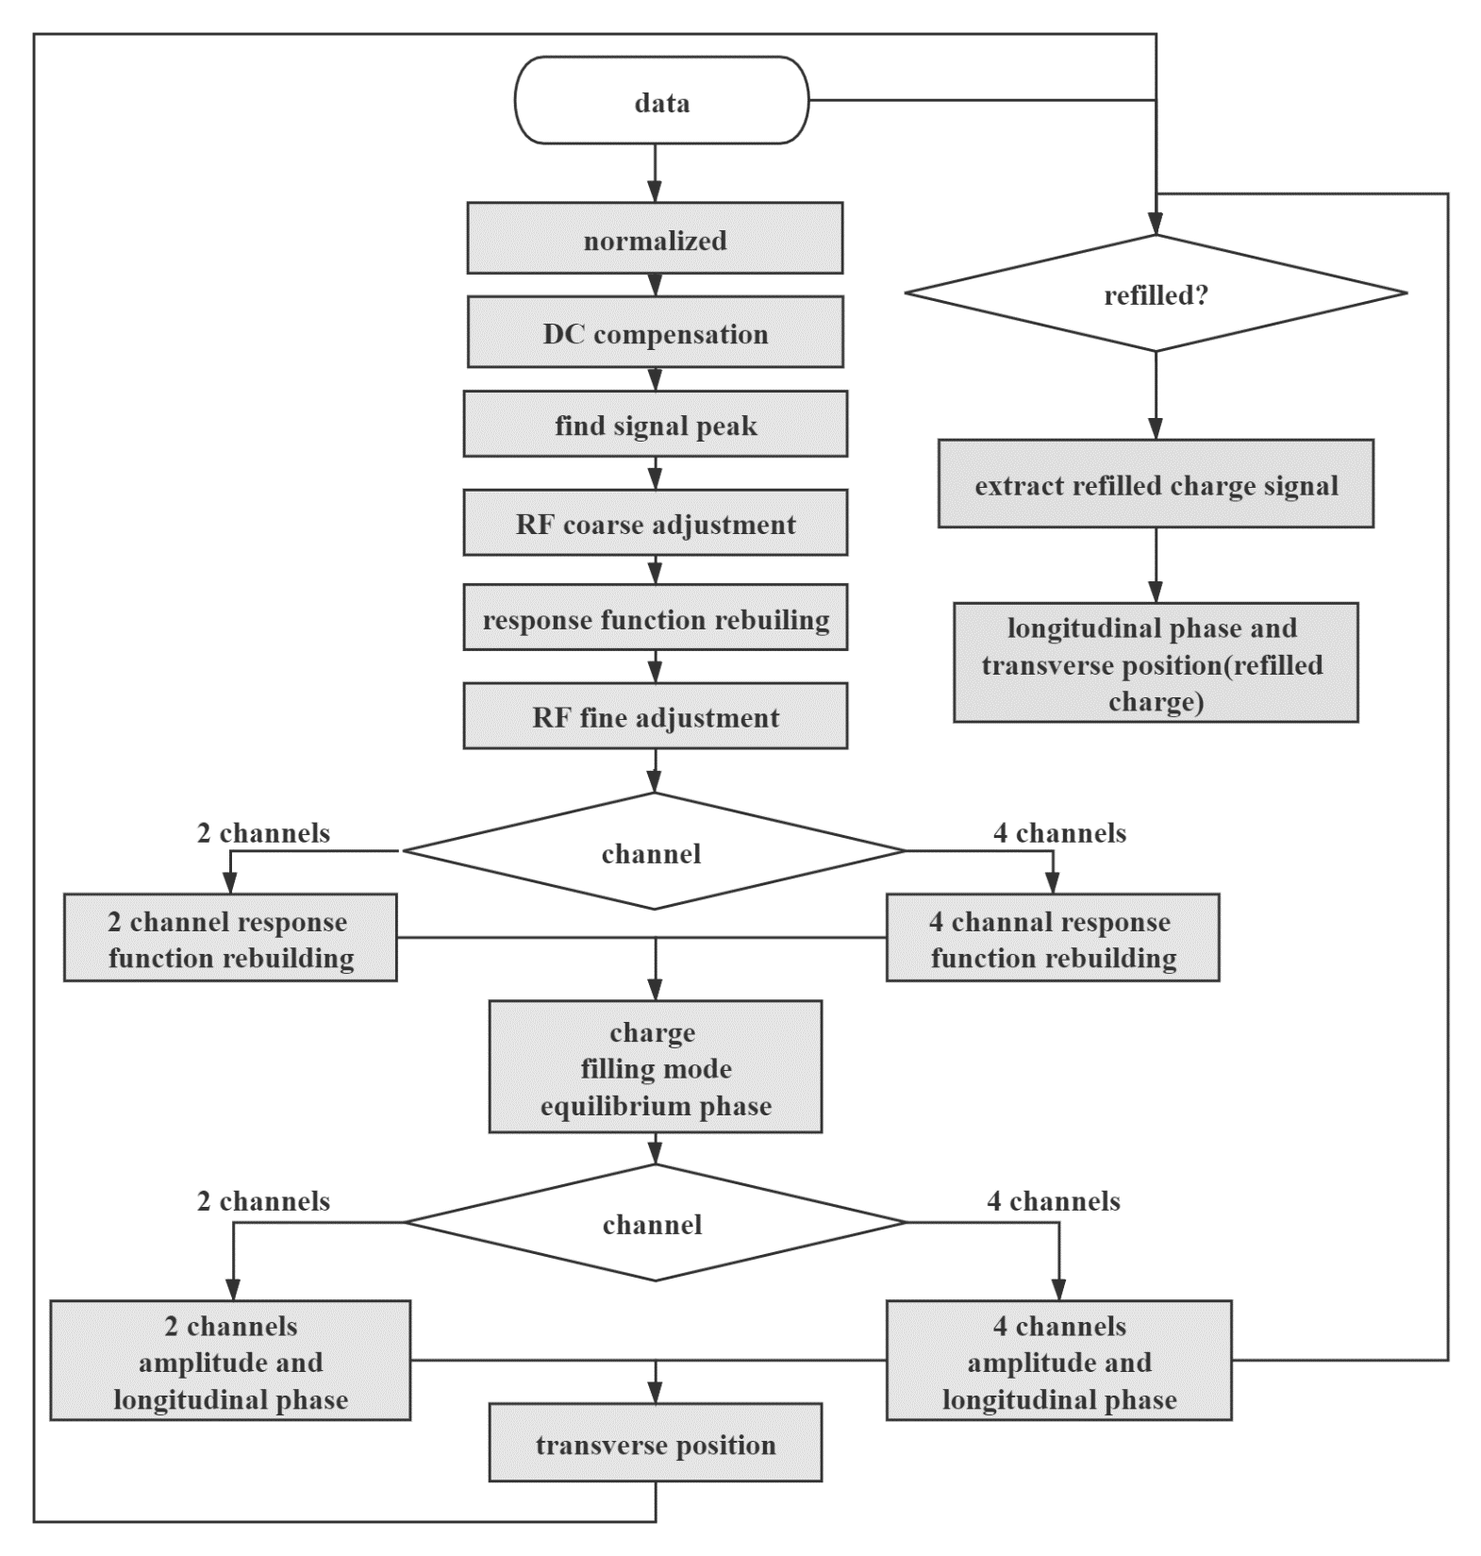

Signal processing flow
Pre-process
  Normalization
  DC compensation
  signal initial peak finding
  RF frequency coarse
  fine adjustment
The response function reconstruction
  multi-turn data splicing
  window smoothing
The phase and position extracting
  the longitudinal phase
    sliding cross correlation method
  the transverse position
    difference ratio
    linear fitting
The refilled charge signal extracting method
increase
in speed
by
Notes:
The calculation module is the cornerstone of the HOTCAP, handling nearly all signal preprocessing and bunch parameter extraction tasks.
The signal processing flow, depicted on the right, includes core algorithms such as the longitudinal phase extraction method based on cross-correlation, the response function reconstruction method based on software resampling, and the refilled charge signal extraction method.

Slide 10
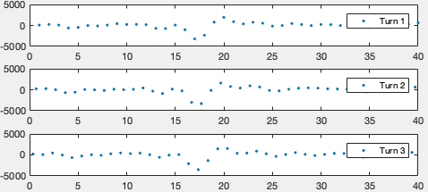


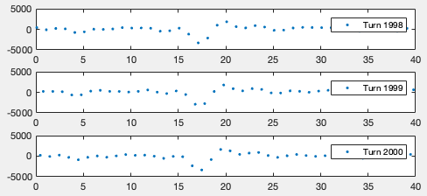


The response function reconstruction
:the revolution frequency
:the sampling frequency of the oscilloscope
Construct highly effective response function:
……
multi-turn data splicing
Window smoothing (low pass filtering)
Re-sampling at a very high rate ( step size 0.1ps)
40TS/s
10TS/s
10
Notes:
This slide presents the response function reconstruction.
It characterizes the signal pulse shape as the bunch passes through the BPM electrode, essentially the electrode and acquisition device's response to the bunch.
The method constructs a highly effective response function from multiple turns' raw data, using the fact the sampling frequency is not an integer multiple of the beam revolution frequency.
Specific steps include multi-turn data splicing，window smoothing and resampling at a very high rate.
After that we can use this response function to build a lookup table with a step size of 0.1ps.

Slide 11
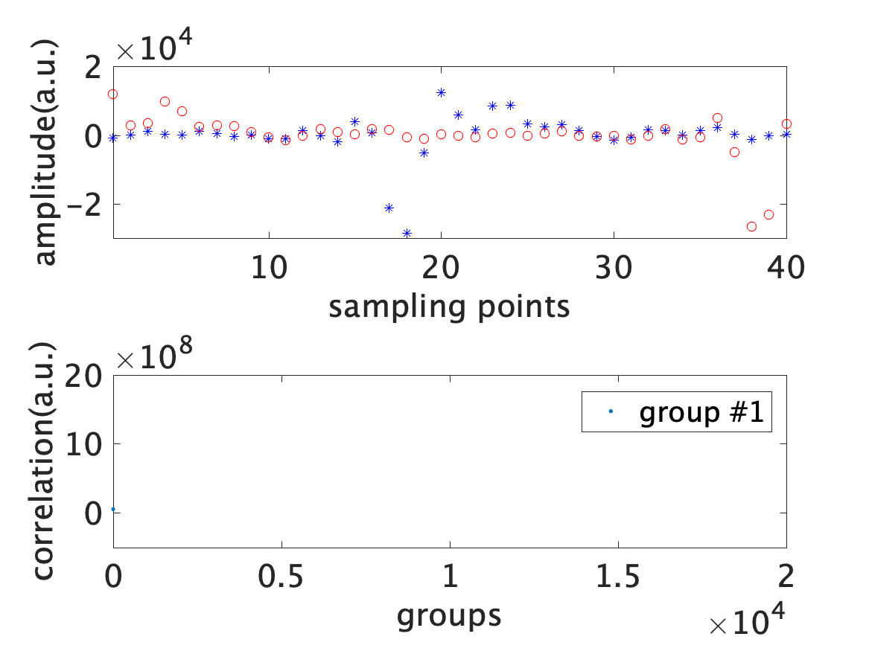
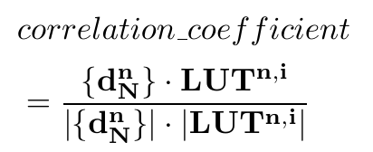
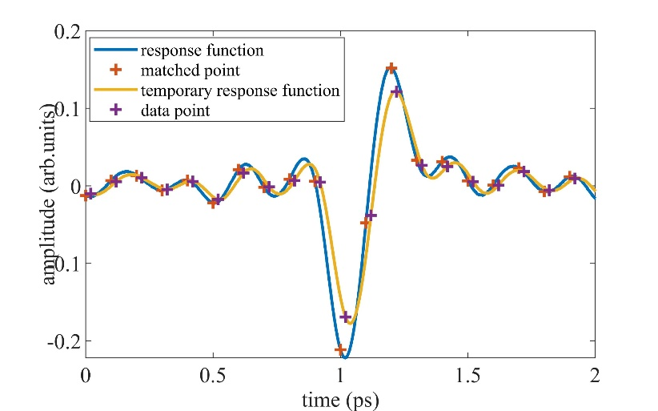
3D position information retrieval method
$−1≤$correlation$≤$1
perfect negative correlation
perfect positive correlation
Sliding cross-correlation method:
Sampling the response function
Calculate the correlation coefficient
Find maximum correlation coefficient
Obtain longitudinal phase
Notes:
The most crucial aspect of the HOTCAP package is the 3D position information retrieval method. It extracts the bunch-by-bunch longitudinal phase and transverse position.
The longitudinal phase extraction employs the sliding cross-correlation method, involving sampling the response function, calculating the correlation coefficient, finding the maximum correlation coefficient, and obtaining the longitudinal phase.

Slide 12
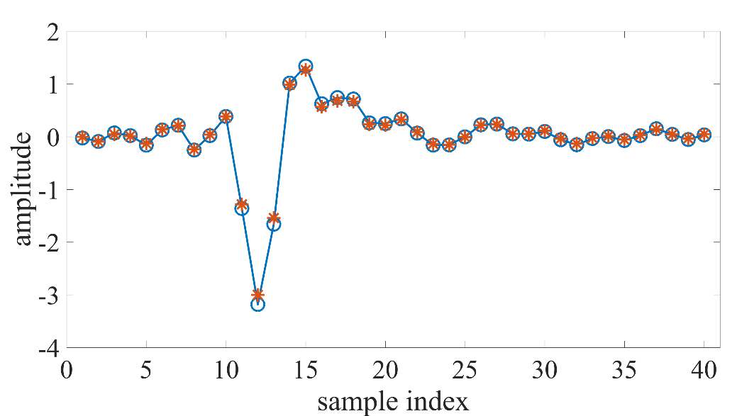
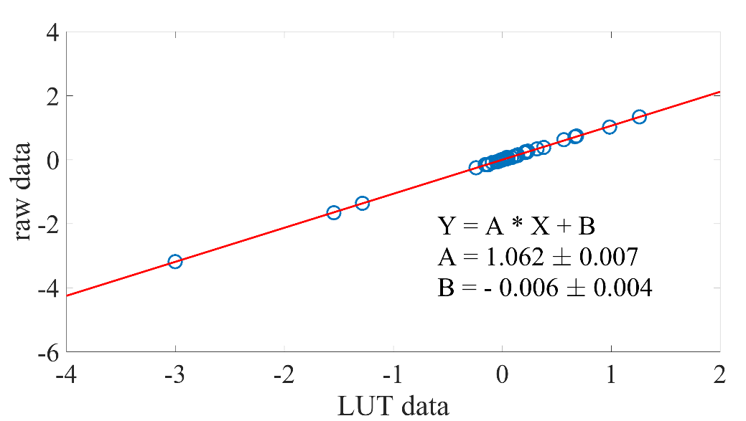
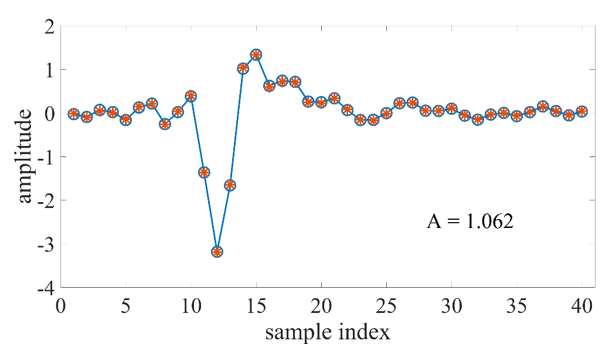
3D position information retrieval method
Linear fitting method:
By matching each bunch's phase for every turn to the response function lookup table, amplitude information is derived through linear fitting of the measured data against the lookup table data.
Transverse position is calculated using delta/sigma method.
Notes:
The signal amplitude is determined by a linear fitting method.
By matching each bunch's phase for every turn to the response function lookup table, amplitude information is derived through linear fitting of the measured data against the lookup table data.
Subsequently, the Transverse position is calculated using the delta/sigma method.

Slide 13
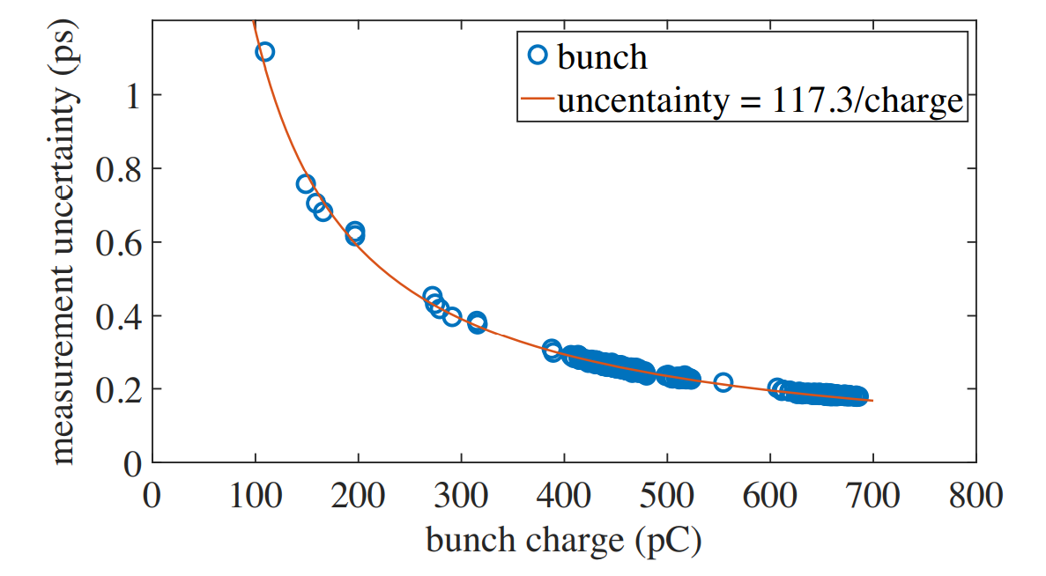
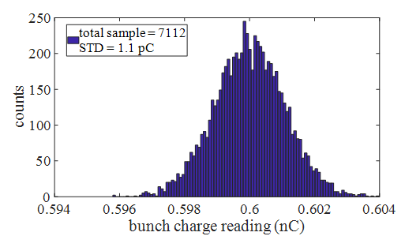
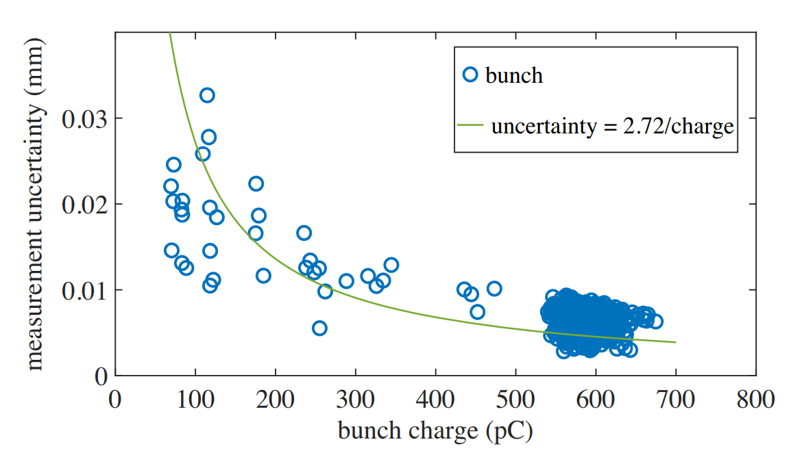
System performance
Data collected during user operation, uniform filling pattern
PCA method to evaluate transverse position and longitudinal phase measurement errors
Charge resolution: 0.2% (averaged charge reached 0.02%)
Phase resolution: 0.2ps @ 0.6nC
Position resolution: 5μm @ 0.6nC
<0.2ps @>0.6nC
Longitudinal phase measurement uncertainty with charge
<5µm @>0.6nC
Bunch-by-bunch charge resolution
Transverse position measurement uncertainty with charge
Notes:
This slide evaluates the system's performance. Data was collected during user operation with a uniform filling pattern. The PCA method was utilized to evaluate the transverse position and longitudinal phase measurement errors.
The results are as follows: charge resolution at 0.2%, phase resolution at 0.2ps, and position resolution under 5um.

Slide 14
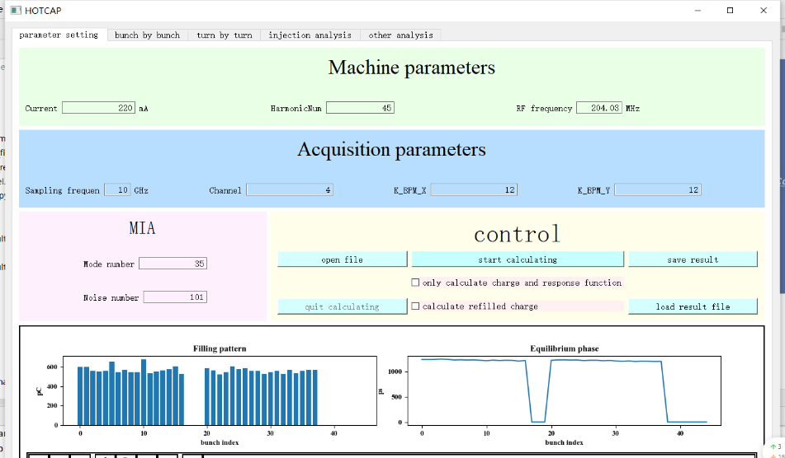
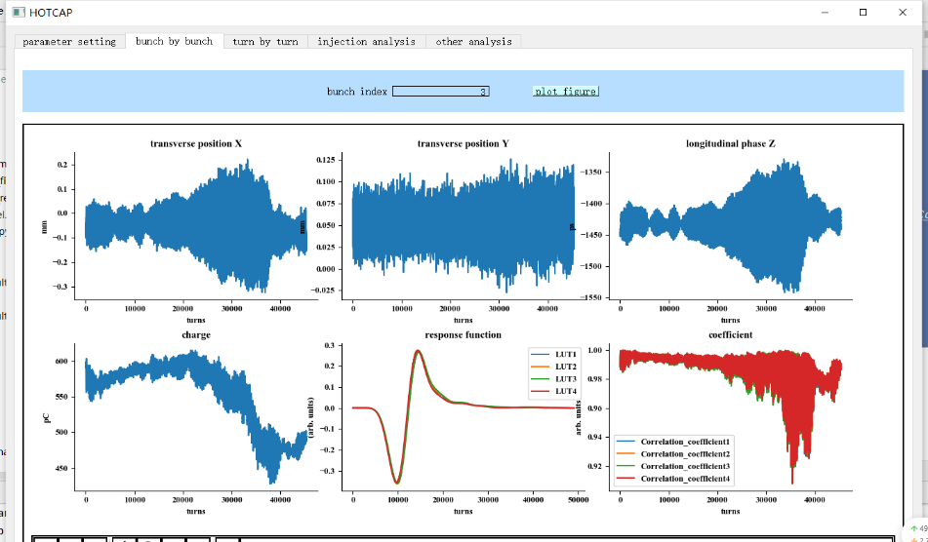
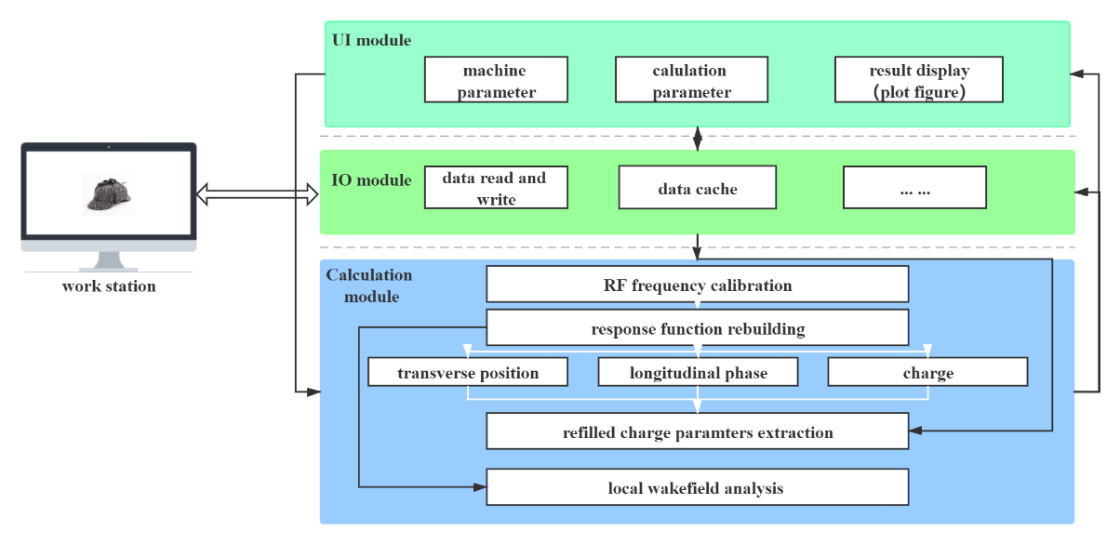
System functionality
High speed Oscilloscope based Three-dimesion bunch Charge And Position measurement system，HOTCAP
Composition: User Interface (UI) Module, Calculation Module, Input Output (IO) Module
  Input: Electrode signal by high-speed oscilloscope
  Output: 3D position results ( including stored bunches and refilled charges)
  Others: Injection analysis, Wakefield analysis…
Application: SSRF, HLS, BEPC
Architecture
https://github.com/xuxingyi/HOTCAP
Notes:
Displayed here is the HOTCAP user interface. It has been successfully implemented at SSRF, HLS, and BEPC. Interested parties can download it from the provided link.

Slide 15
System functionality: decaying cycle data
Charge (Q)、horizontal position (X)、vertical position (Y)、longitudinal position (phase)
Measurement result: 2D array (M X N) , M = bunch number, N = turn number
Example of longitudinal results:
Averaging each bunch
STD each bunch
Average of bunch FFT
FFT of bunch averaging
Notes:
After processing by the HOTCAP software package, the measurement results yield 2-dimensional arrays of bunch charge, horizontal position, vertical position, and longitudinal phase, where M represents the bunch number, and N represents the turn number.
Using the longitudinal results as an example, the turn-by-turn phase is illustrated in this figure. By averaging each bunch, we obtain the equilibrium phase, and by calculating the standard deviation (STD) of each bunch, we determine the phase noise. Additionally, by averaging the bunch Fast Fourier Transform (FFT), we can identify the synchrotron tune from the spectrum.

Slide 16
System functionality: decaying cycle data
2022.01.24，user operation
bunch charge（filling pattern） horizontal orbit (X0) horizontal orbit noise (Xstd) vertical orbit (Y0) vertical orbit noise (Ystd)
longitudinal position (Z0) synchrotron osc. amp spectrum of X spectrum of Y spectrum of Z
(synchrotron phase)
Notes:
Here, we display all the results obtained from one of the user operation datasets.

Slide 17
System functionality: decaying cycle data
Longitudinal phase shift of each bunch
Filling pattern
Longitudinal oscillation amplitude of each bunch
Notes:
From the averaging value of each bunch, we can compare the bunch-by-bunch phase shift and oscillation amplitude of each bunch under different conditions. For instance, we can compare the states when all insertion devices' gaps are open versus closed.

Slide 18
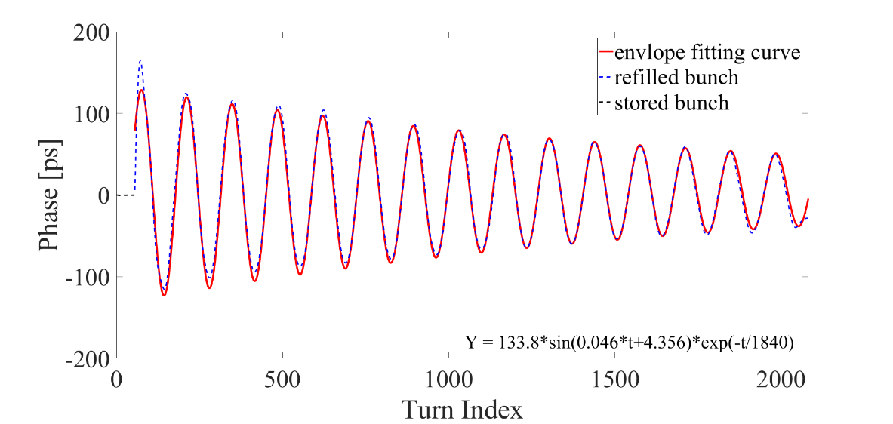
System functionality：injection cycle data
$$z_{d}=z_{m}sin⁡(ωt+φ_{0})∙e^{−\frac{t}{τ}}$$
Damping time
Maximum oscillation amplitude
Initial phase
$$α_{s}=\frac{1}{τ}$$
$$ω=\sqrt{Ω^{2}−α_{s}^{2}}$$
Horizontal Betatron oscillation of stored bunch
Synchrotron frequency (~0.0072)
Maximum oscillation amplitude
100ps~160ps
Vertical Betatron oscillation of stored bunch
Damping time
2.5ms~3ms
Fitting results of the refilled bunch
https://github.com/xuxingyi/HOTCAP
Notes:
Furthermore, from the turn-by-turn results of the injection process, we can observe betatron oscillation and synchrotron oscillation, and subsequently extract dynamic parameters from them.

Slide 19
Application: what we can do with this tool
Beam loading effect：harmonic cavity
Yimei Zhou¹, Xingyi Xu^{1,2}, Tianlong He³, Yongbin Leng^{2,3} ,Experimental Verification and Analysis of Beam Loading Effect Based on Precise Bunch-by-Bunch 3D Position Measurement, IBIC2022
Notes:
Next, I will present one of the applications of this tool, which is the study of harmonic cavity beam loading effects.

Slide 20
Phase shift modulation by beam impedance
HOTCAP system to record equilibrium acceleration phase within bunch train during various stages of SSRF user operation
Bunch equilibrium acceleration phase → a critical measurement data for assessing the beam loading effect
→ primarily derived from the correction of the beam wakefield (impedance)
For approximately uniform fill patterns：
  Before the harmonic cavity installation → impedance sources: Main cavity + IDs → phase shift ~ 1ps
  After the harmonic cavity (passive) installation → impedance sources: Main cavity + IDs + Harmonic cavity → phase shift ~ linear distribution
Main cavity + IDs
No harmonic cavity
Phase shift ~ 1ps
Main cavity + IDs
Harmonic cavity installed
Phase shift ~ 3ps
Main cavity + IDs
Harmonic cavity working
Phase shift ~ 10ps
Notes:
We utilized the HOTCAP system to record the equilibrium acceleration phase within the bunch train during various stages of SSRF user operation. The bunch equilibrium acceleration phase is a critical measurement for assessing the beam loading effect. It is primarily derived from the correction of the beam wakefield.
As illustrated in the figures,
Before the installation of the harmonic cavity, the phase shift within the bunch train is minimal, at only 1 ps.
However, after the installation of the harmonic cavity, the phase shift increases to 3 ps,
and during operation, it escalates to 10 ps and shows a linear distribution.
Thus, we can utilize this phase shift slope to gauge the beam loading effect.

Slide 21
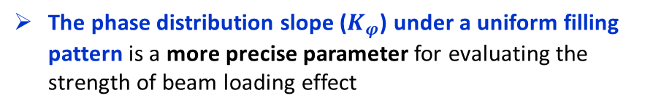
Phase shift modulation by filling patterns
Phase shift at the head and tail of the train
a common value used to evaluate the strength of beam loading effect
The phase distribution slope ($K_{φ}$) under a uniform filling pattern is a more precise parameter for evaluating the strength of beam loading effect
Phase distribution within the train under different filling patterns
  HOTCAP: measurement (blue circle)
  STABLE: simulation (red star)
Phase distribution within the bunch train correlates with the filling pattern.
Perfect agreement
Notes:
Additionally, simulations and measurements indicate that the phase distribution within the bunch train correlates with the filling pattern.
Consequently, the phase distribution slope under a uniform filling pattern is a more precise parameter for evaluating the strength of beam loading effect.

Slide 22
Phase shift modulation by total current
We have accumulated the equilibrium phase distributions within the bunch train under varying beam currents and calculated their respective phase slopes (K).
The change rate ($K_{φl}$) of the phase slopes at different beam currents.
Notes:
We have accumulated the equilibrium phase distributions within the bunch train under varying beam currents and calculated their respective phase slopes.
Subsequently, we can depict the change rate of the phase slopes at different beam currents.

Slide 23
Beam loading effect evaluation
The change rate ($K_{φl}$) of the phase slope at different beam currents under the same harmonic cavity parameters
The change rate varies for bunch trains with different numbers of bunches.
Larger filling gaps result in a higher change rate ($K_{φl}$), indicative of a more pronounced beam loading effect
300 bunches filled, gap = 420 buckets
500 bunches filled, gap = 220 buckets
Notes:
From these two figures, the change rate varies for bunch trains with different numbers of bunches.
Upon comparison, we ascertain that larger filling gaps result in a higher change rate, indicative of a more pronounced beam-loading effect.

Slide 24
Synchrotron frequency shift w/o harmonic cavity
the harmonic cavity detuned far from working frequency
the synchrotron frequency is linearly related to the beam current, and the change rate is -0.87Hz/mA
synchrotron frequency differences can be distinguished at the order of Hz
Notes:
Alternatively, we have also extracted the synchrotron frequency and damping time of the longitudinal oscillation during the injection process using the HOTCAP software package.
We then compare their variations with beam currents before and after the harmonic cavity's operation.
Here, we observe that the change rate of the synchrotron frequency is 0.87 when the harmonic cavity is detuned.

Slide 25
Synchrotron frequency shift with harmonic cavity
the harmonic cavity is operational
the synchrotron frequency is linearly related to the beam current, and the change rate is -8.06Hz/mA ( ~ $×10$)
Judgement : the harmonic cavity is still far from the best working condition (under-stretch for beam)
Notes:
However, once the harmonic cavity is operational, the change rate soars to 8.06, approximately tenfold the previous rate.

Slide 26
Damping time
the harmonic cavity is detuned: the longitudinal damping time remains independent of the beam currents
the harmonic cavity is operational: the longitudinal damping time exhibits a linear relationship
potential well distortion due to harmonic cavity→ synchrotron frequency spread increased → Landau damping
The change rate of damping time can be used to evaluate the performance of the harmonic cavity.
Notes:
This slide illustrates the change rate of the damping time.
When the harmonic cavity is operational, it exhibits a linear relationship.
Conversely, when the harmonic cavity is detuned, it remains independent of the beam currents.

Slide 27
Summary
Notes:
In summary, let's recap the key points.

Slide 28
Summary
Bunch-by-bunch diagnostics are invaluable, particularly for low-emittance storage rings.
To date, 3D position measurement based on a high-speed oscilloscope has demonstrated superior performance. A general software package (HOTCAP) was developed to process the bunch signals and extract bunch parameters including 3D position and charge. (https://github.com/xuxingyi/HOTCAP)
This software package does not require special acquisition equipment and is not constrained by the accelerator's state. The software package can be broadly applicable to nearly all electron ring accelerators.
Simultaneous measurement of the parameters of each bunch helps to diagnose the beam state and to obtain the machine state by correlation analysis.

Slide 29
Thanks for your attention
zhouym@sari.ac.cn

