Slide 1
Dalian Institute of Chemical Physics, CAS
Cavity-based Beam Diagnostics for High Quality Linacs
Speaker：Qian Wang
17/01/2024

Slide 2
Overview
1 Introduction
2 Theoretical Basis
3 Design Scheme and Laws
4 Cavity Bunch Length Monitor
5 Beam Experiments
6 Summary

Slide 3
Overview
1 Introduction
2 Theoretical Basis
3 Design Scheme and Laws
4 Cavity Bunch Length Monitor
5 Beam Experiments
6 Summary

Slide 4
Introduction
Beam Diagnostics System
Beam diagnostics is an essential part of any accelerator. It is the ’organ of sense’ showing the properties and the behavior of the beam.
For STCF, real time measurement and feedback of beam parameters (bunch charge, beam position, bunch length, energy spread, etc.) are crucial for accelerator stability and brightness.

Slide 5
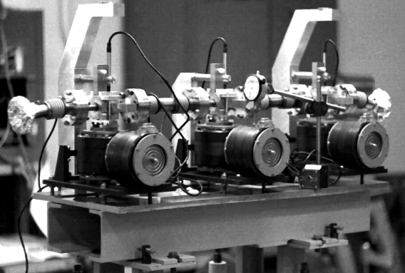
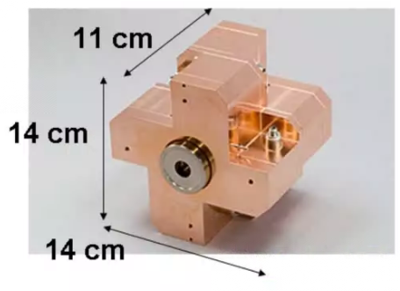
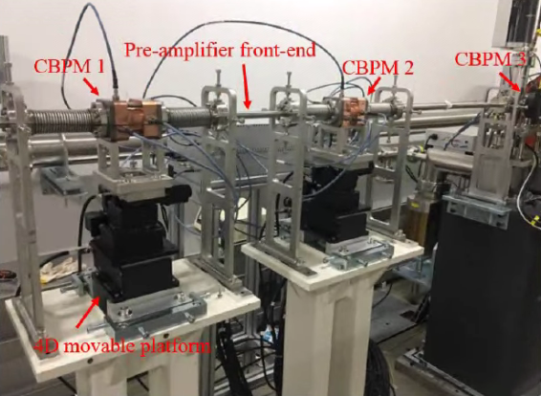
Introduction
Cavity-based Beam Diagnostics
Since the Stanford Two-mile Linac installed the cavity monitors in the 1966, after decades of evolution, cavity monitors are now widely equipped in international mainstream accelerators and colliders.
Cavity in Chalk River Laboratories, 1979
Cavity in ATF/BNL, 1999
Cavity in ATF2-ILC, 2008
Cavities in SXFEL, 2019

Slide 6
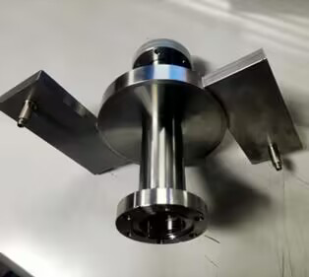
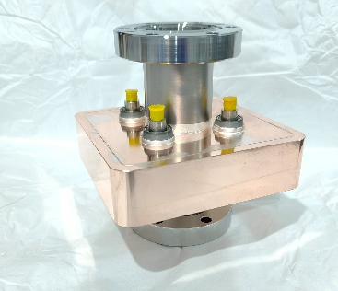
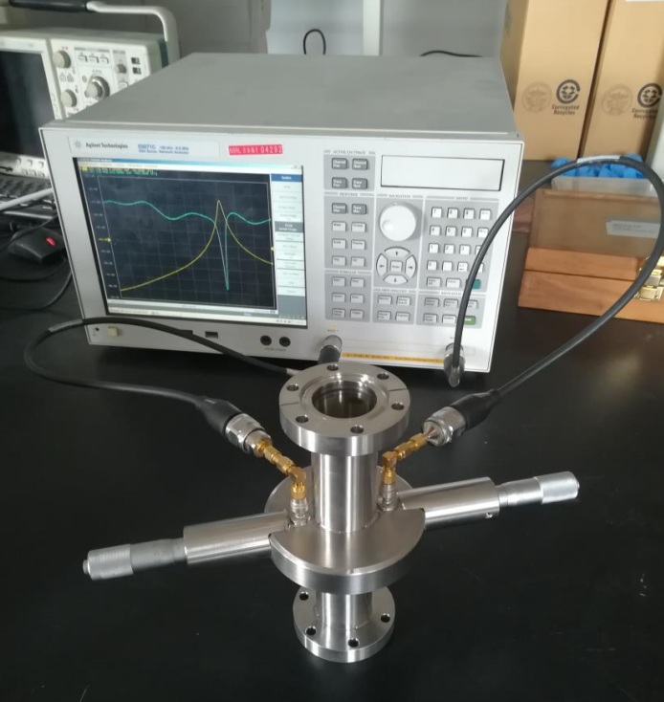
Introduction
Cavity-based Beam Diagnostics
According to eigenmodes within cavity excited by the beam, various beam parameters can be obtained.
Advantages
Nondestructive
High SNR and better resolution
High performance-price ratio
Multipurpose

Slide 7
Overview
1 Introduction
2 Theoretical Basis
3 Design Scheme and Laws
4 Cavity Bunch Length Monitor
5 Beam Experiments
6 Summary

Slide 8
Theoretical Basis
Cavity Signal
While passing through the cavity, the bunch will excite different eigenmodes. The signal amplitude of an eigenmode can be written as
q : Bunch charge
$V_{0}=2k_{n}q\int_{−T}^{T}{f\left(t\right)exp⁡(iω_{n}t)dt}$
k_{n} : Loss factor
$$k_{n}=\frac{1}{4}ω_{n}\left(R/Q_{0}\right)$$
Depend on the eigenmodes
Integral of longitudinal distribution
For Gaussian it will be
$$e^{−\frac{ω_{n}^{2}σ_{τ}^{2}}{2}}$$

Slide 9
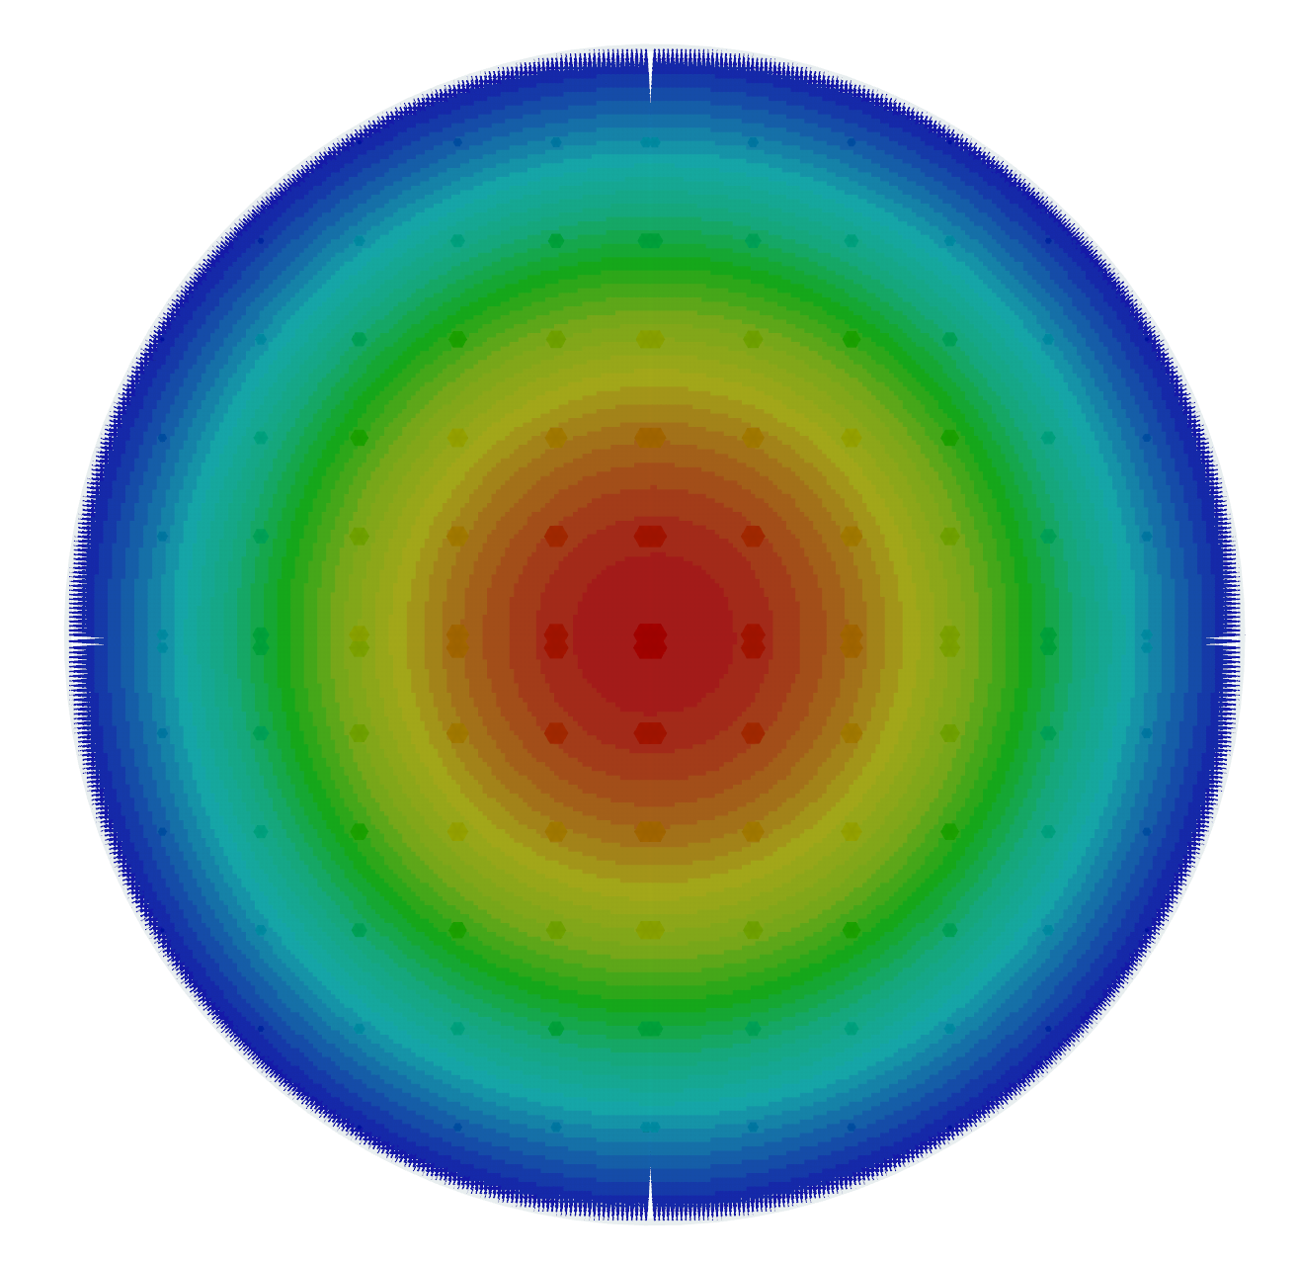
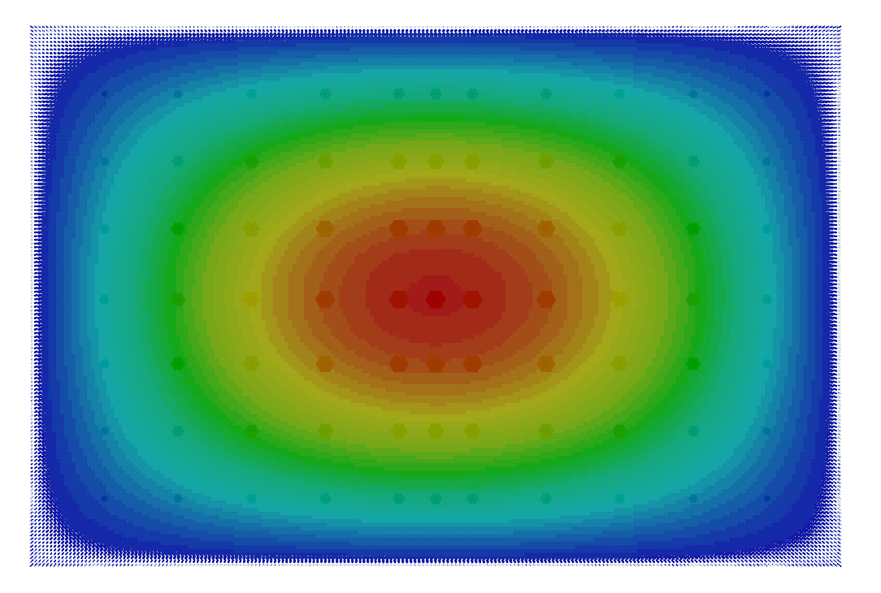
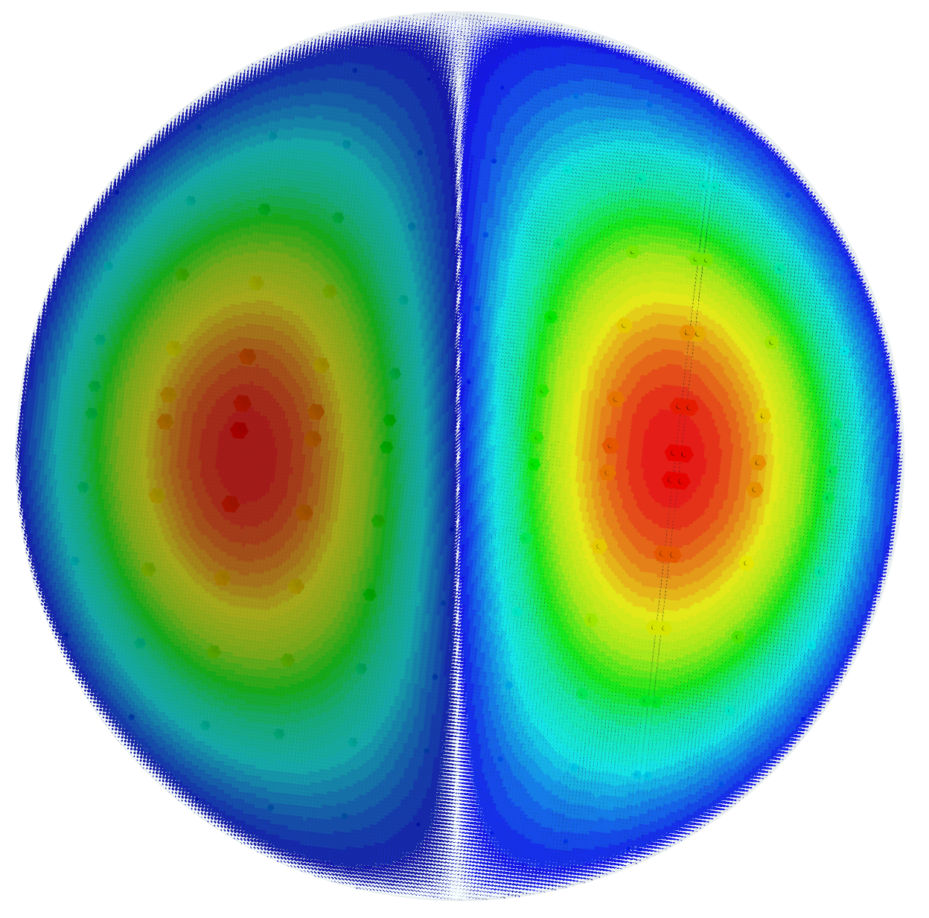
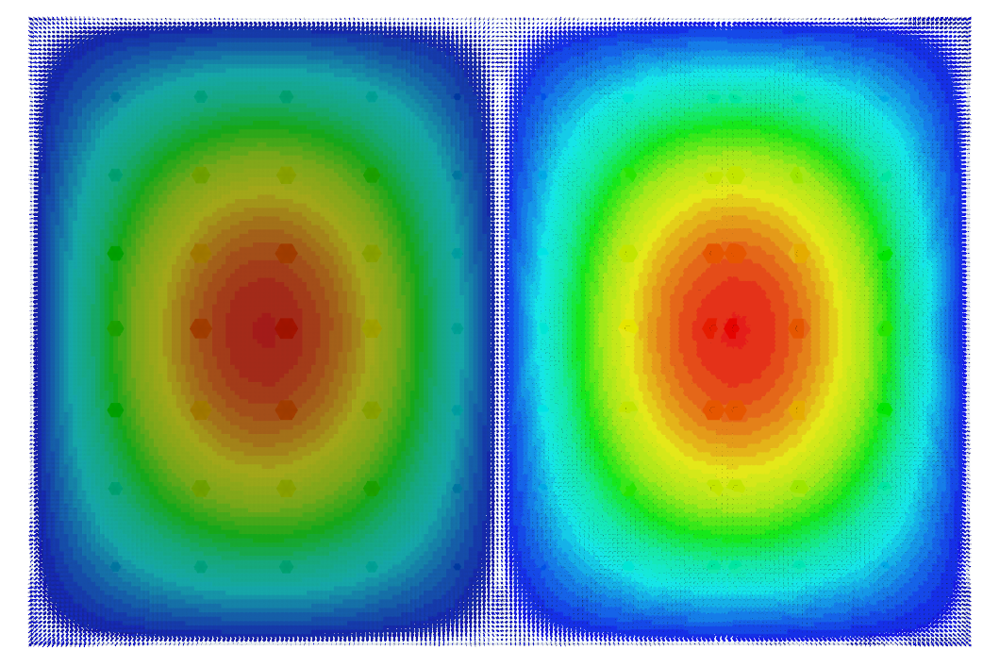
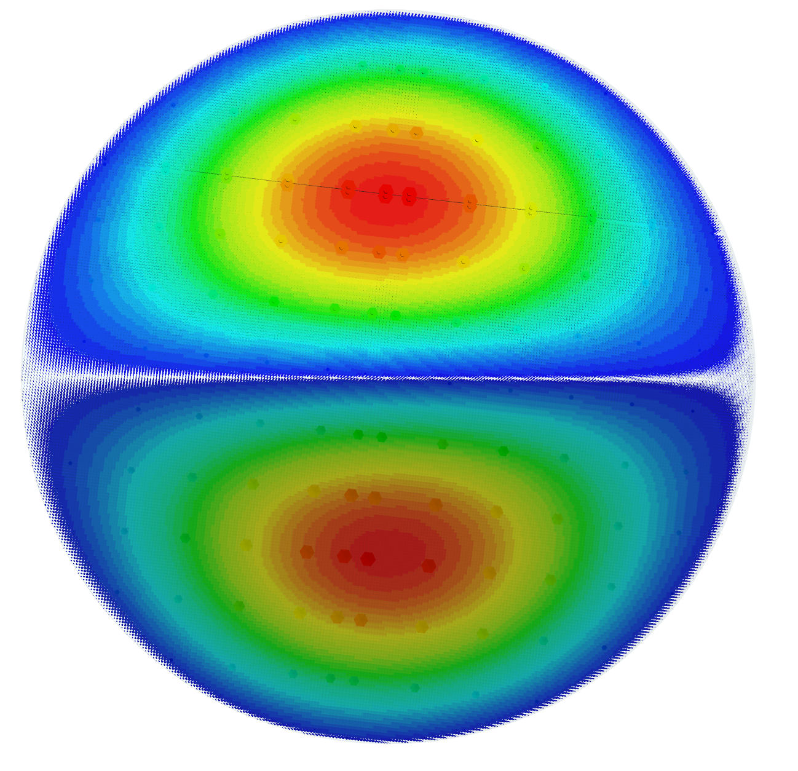
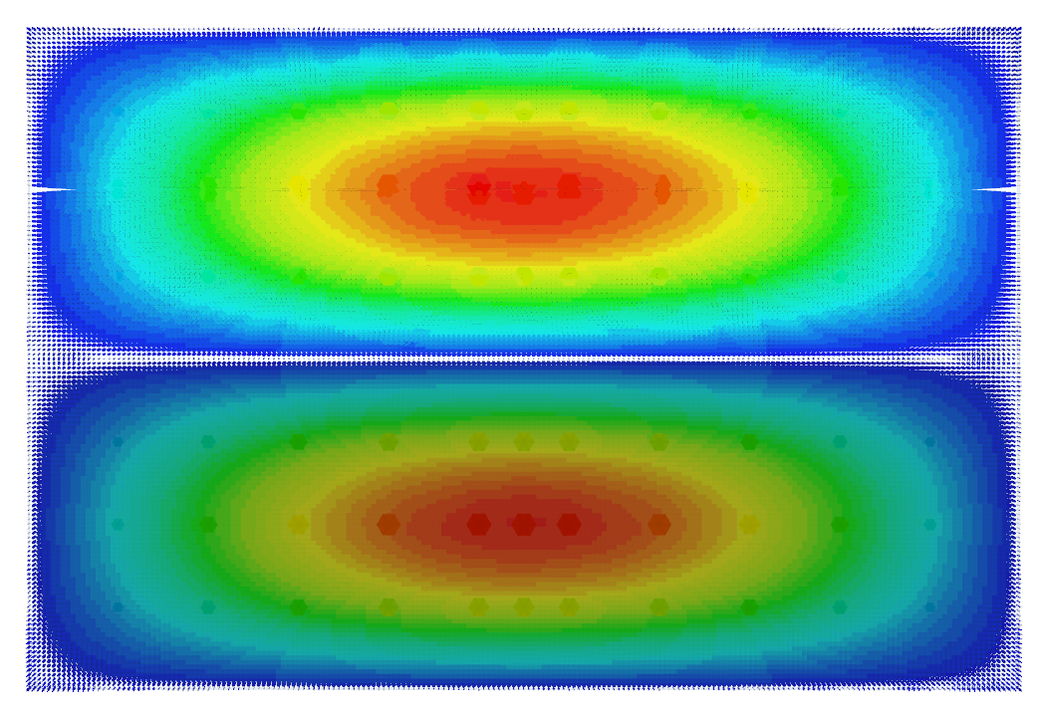
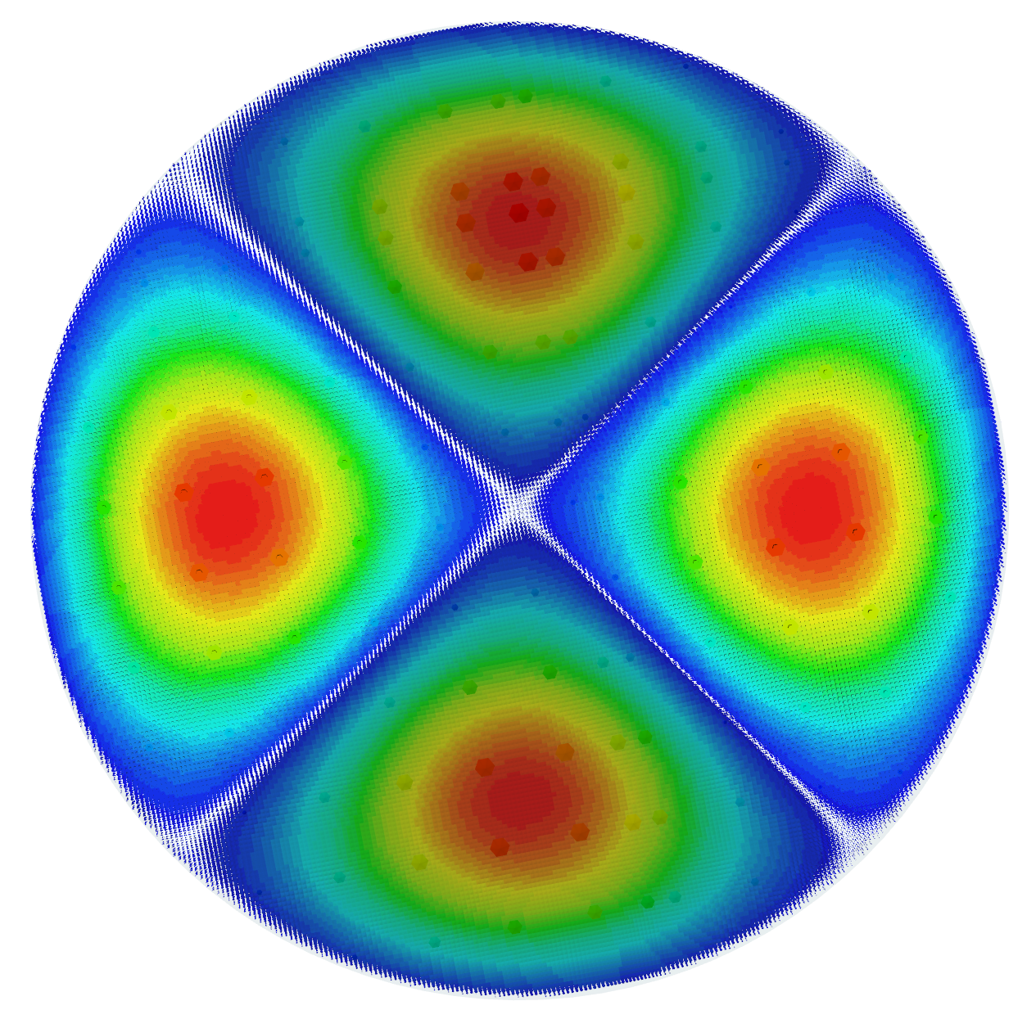
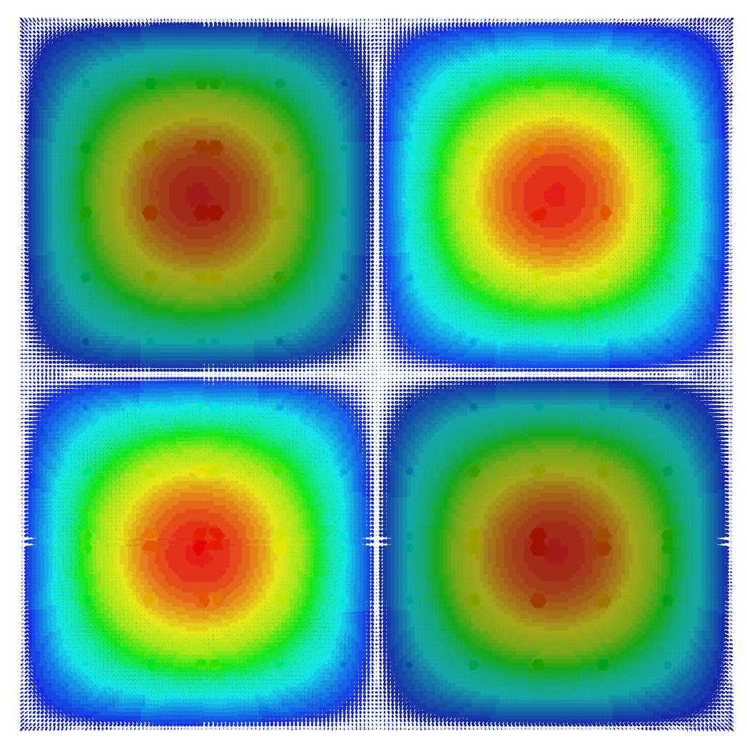
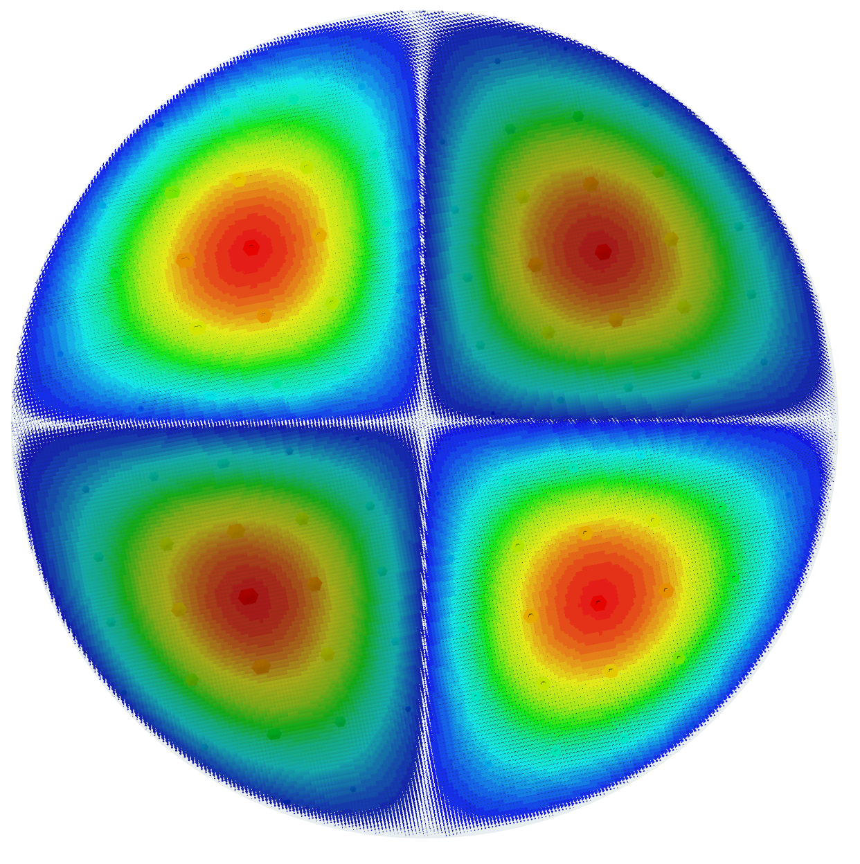
Theoretical Basis
Eigenmodes
Pillbox |  | Rectangular Cavity |  | Feature | Relevant Beam Parameters
Eigenmodes | Electric Field | Eigenmodes | Electric Field | Feature | Relevant Beam Parameters
TM₀₁₀ |  | TM₁₁₀ |  | Monopole modes | Bunch length Bunch charge
TM₁₁₀ |  | TM₂₁₀ |  | Dipole modes | Beam position x
TM₁₁₀ (degeneracy) |  | TM₁₂₀ |  | Dipole modes | Beam position y
TM₂₁₀ |  | TM₂₂₀-tilted |  | Quadrupole modes | Emittance, energy spread
TM₂₁₀ (degeneracy) |  | TM₂₂₀-upright |  | Quadrupole modes | Transverse coupling

Slide 10
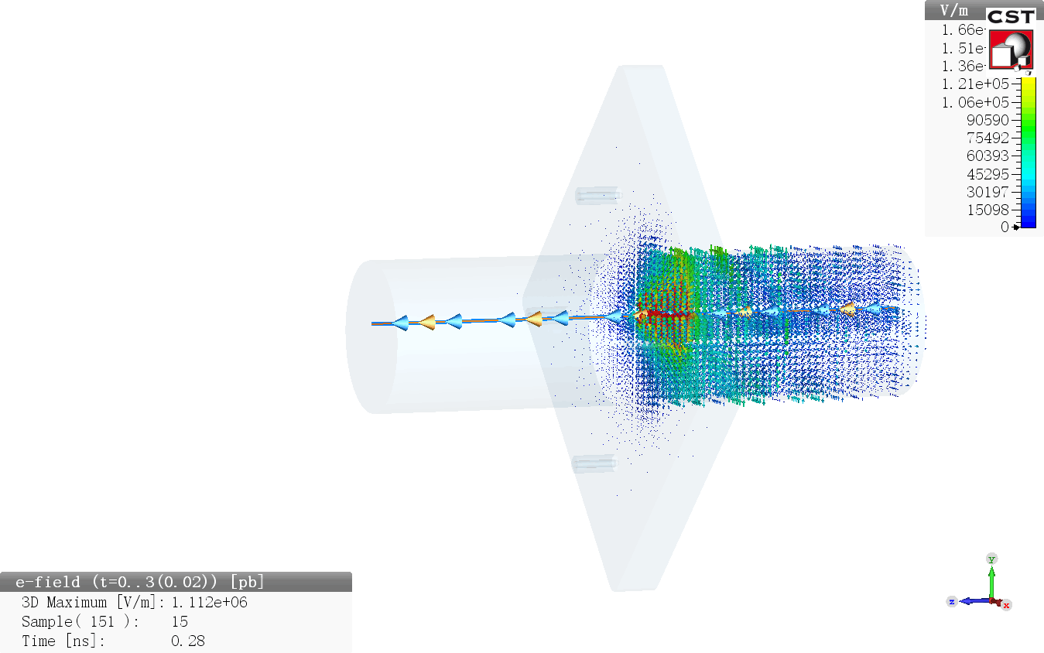
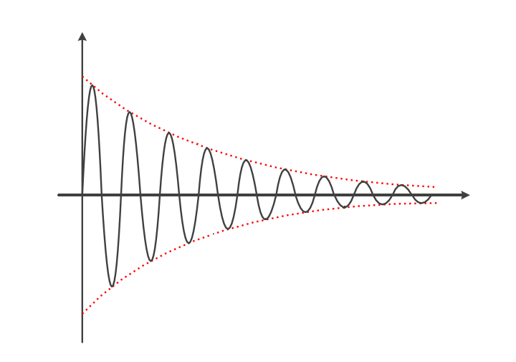
Theoretical Basis
Output Signal
The output signal is a sine decay function
$$V_{out}=V_{0}\sin\left(ω_{n}t+φ\right)e^{−t/τ}$$
τ : Decay time constant
Depend on the Q Factor of the eigenmode
V_{out}
t

Slide 11
Overview
1 Introduction
2 Theoretical Basis
3 Design Scheme and Laws
4 Cavity Bunch Length Monitor
5 Beam Experiments
6 Summary

Slide 12
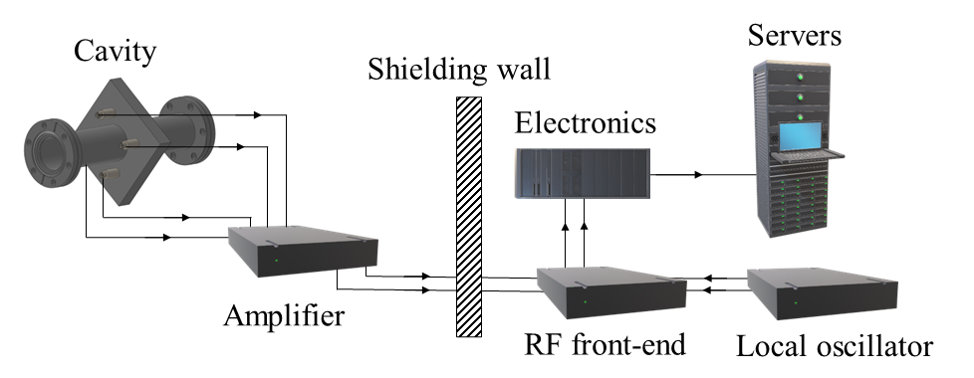
Design Scheme and Laws
System Layout
Extract the amplitude and phase of the signal
IF
RF
LO
Filtering
Down-conversion
Adjustable gain
Overcome transmission attenuation

Slide 13
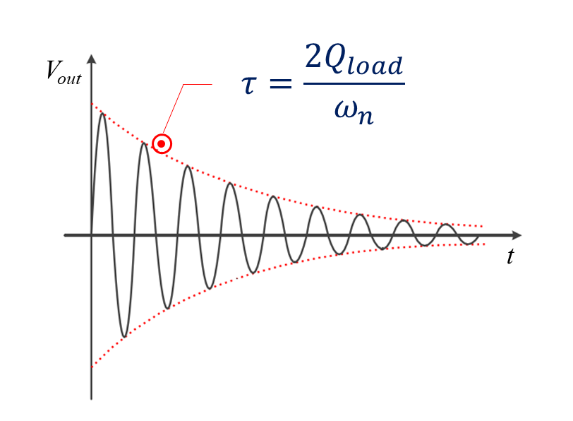
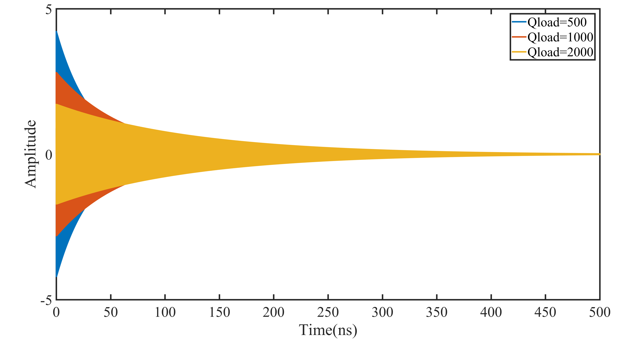
Design Scheme and Laws
Quality Factor of the Cavity
Definition
High-Q
Low amplitude
Last for a long time
Low-Q
High amplitude
Last for a short time
$$Q_{load}=\frac{1}{Q_{0}}+\frac{1}{Q_{ext}}=\frac{ω_{n}W}{P_{wall}+P_{out}}$$

Slide 14
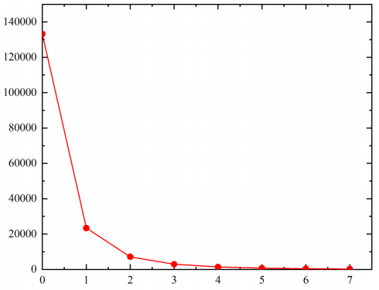
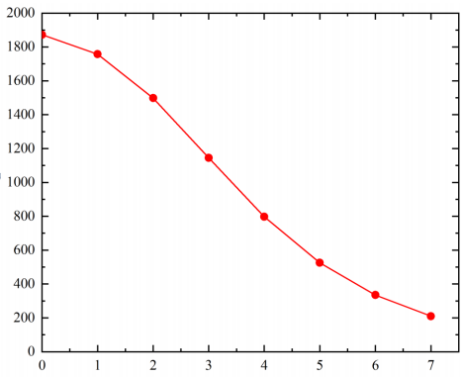
Design Scheme and Laws
Factors Affecting the Q Factor
Material
With the same cavity structure, the cavity made of Copper can reach to a higher Q_{load} than the cavity made of Stainless steel (SUS304 or SUS316).
Coupler
The insertion depth and position of the Feedthrough can affect P_{out}, and then affect Q Factor.
Cavity shape
Increase the dimension of the beam direction can obtain a higher Q_{load}.
Q_{ext} VS insertion depth of the Feedthrough
Q_{load} VS insertion depth of the Feedthrough

Slide 15
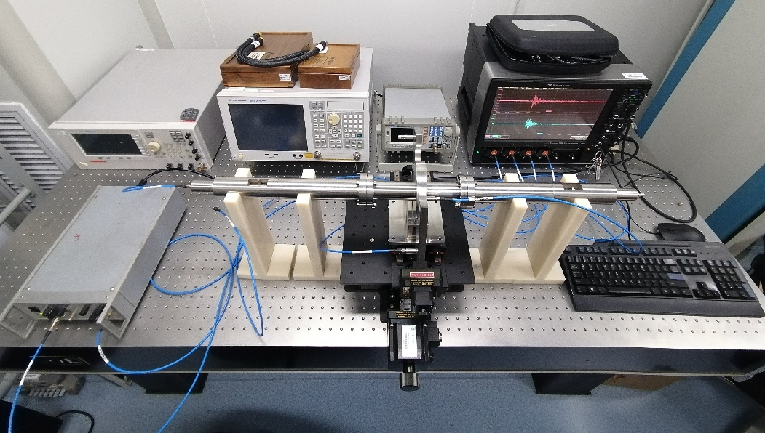
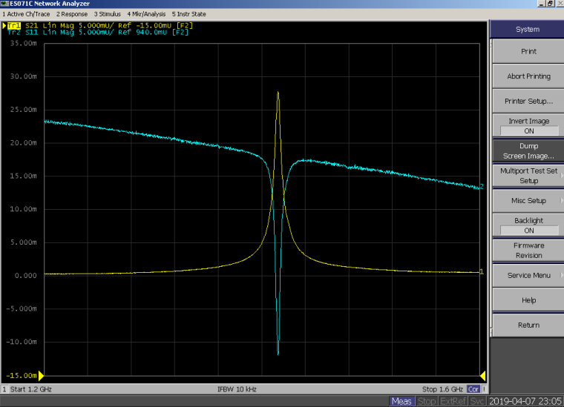
Design Scheme and Laws
Offline Testing
S-Parameter
Use vector network analyzer to obtain the Operating frequency, Bandwidth, and Quality factor.
Wire method (antenna method)
Use electric signal replaced beam as excitation source.

Slide 16
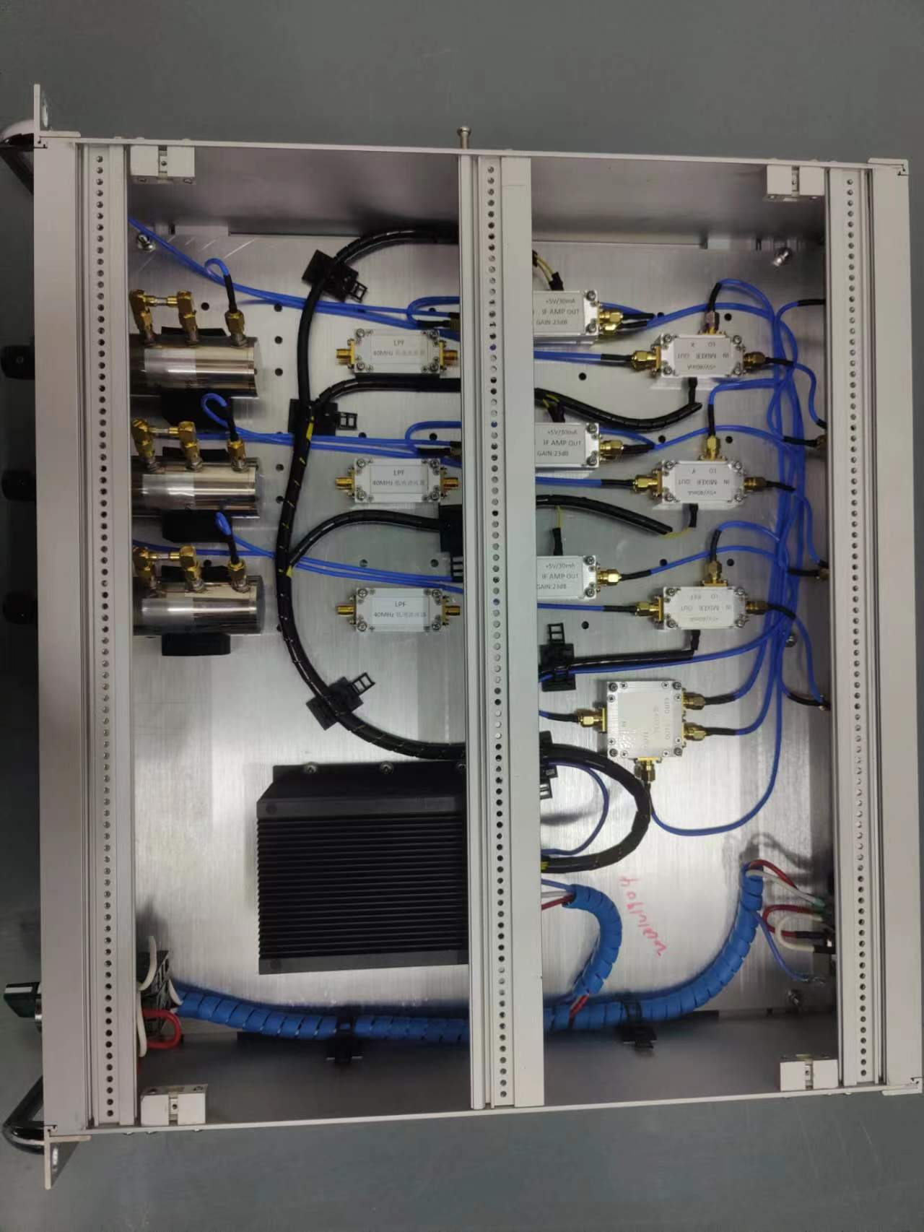
Design Scheme and Laws
RF Front-end
Filtering
Match with the frequency and bandwidth of the Cavity RF signal and IF.
Down-conversion
After down-conversion, the intermediate frequency (IF) is very low and easy to process.
Adjustable gain
Match with ADC.
RF front-end for Cavity BPM in Dalian coherent light source

Slide 17
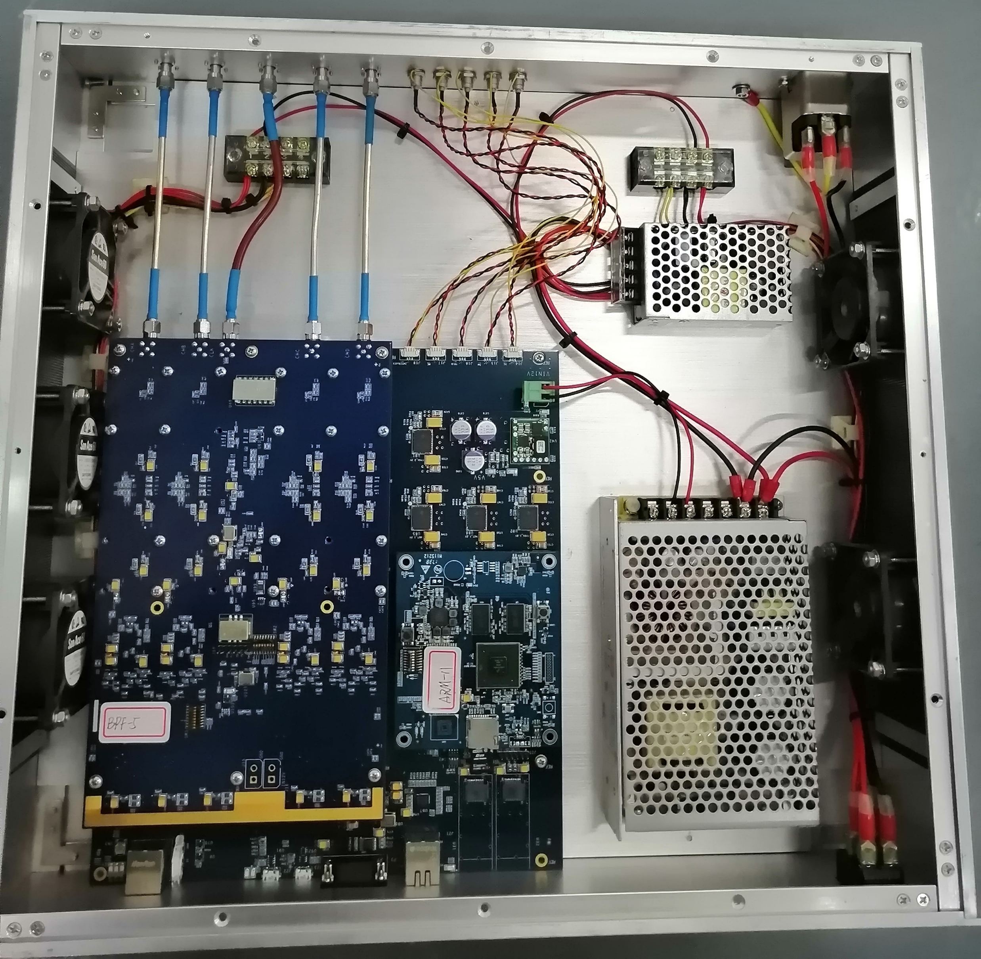
Design Scheme and Laws
Electronics
ADC
The sampling clock of ADC needs to be phase-locked with the LO.
FPGA
FFT or IQ demodulation algorithms can be used to extract amplitude and phase.
Electronics for Cavity BPM in Dalian coherent light source

Slide 18
Overview
1 Introduction
2 Theoretical Basis
3 Design Scheme and Laws
4 Cavity Bunch Length Monitor
5 Beam Experiments
6 Summary

Slide 19
Cavity Bunch Length Monitor
Principle
By using the frequency components on the spectrum, the bunch length can be inferred in reverse.
For Gaussian bunch, At least two frequency components are required to construct the beam spectrum.
If the bunch is not Gaussian distribution, the calculation results will not differ significantly.

Slide 20
Cavity Bunch Length Monitor
Cavity Design
Structure
Instead of the traditional two-cavity method, the two eigenmodes generated in a single cavity are used for measurement.
Eigenmodes
TM010 mode working at 2.38 GHz
TM020 mode working at 4.76 GHz
Coupler
Feedthrough probes (Port1 and Port2) are used for TM010 mode coupling, and waveguides (Port3 and Port4) are used for TM020 mode coupling.

Slide 21
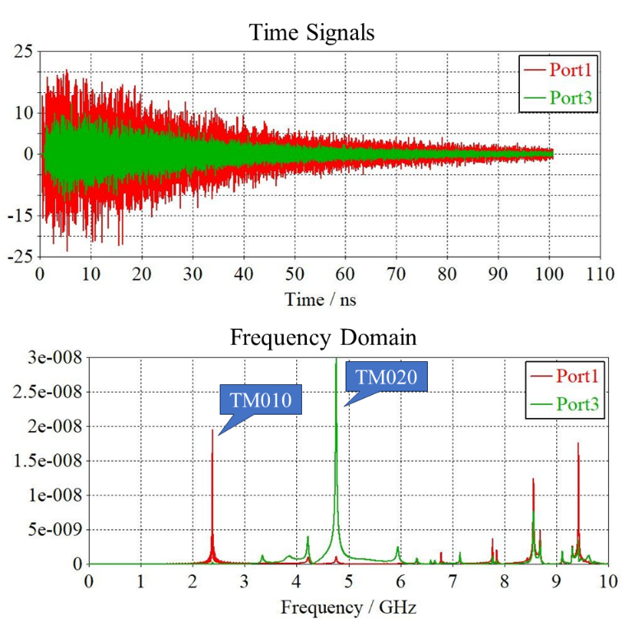
Cavity Bunch Length Monitor
Simulation
Set up a virtual beam in CST for wakefield simulation.
It can be seen that all required eigenmodes have been excited and coupled out.

Slide 22
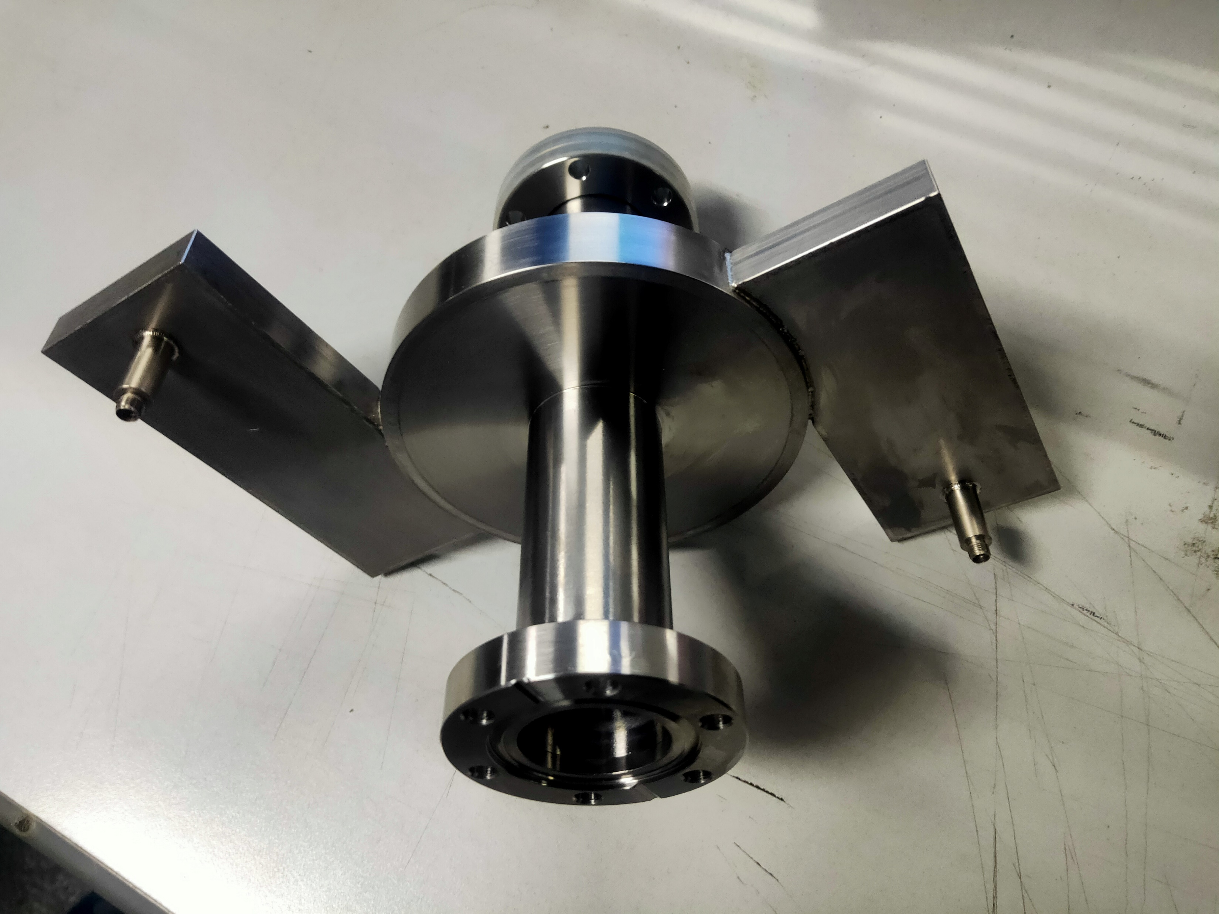
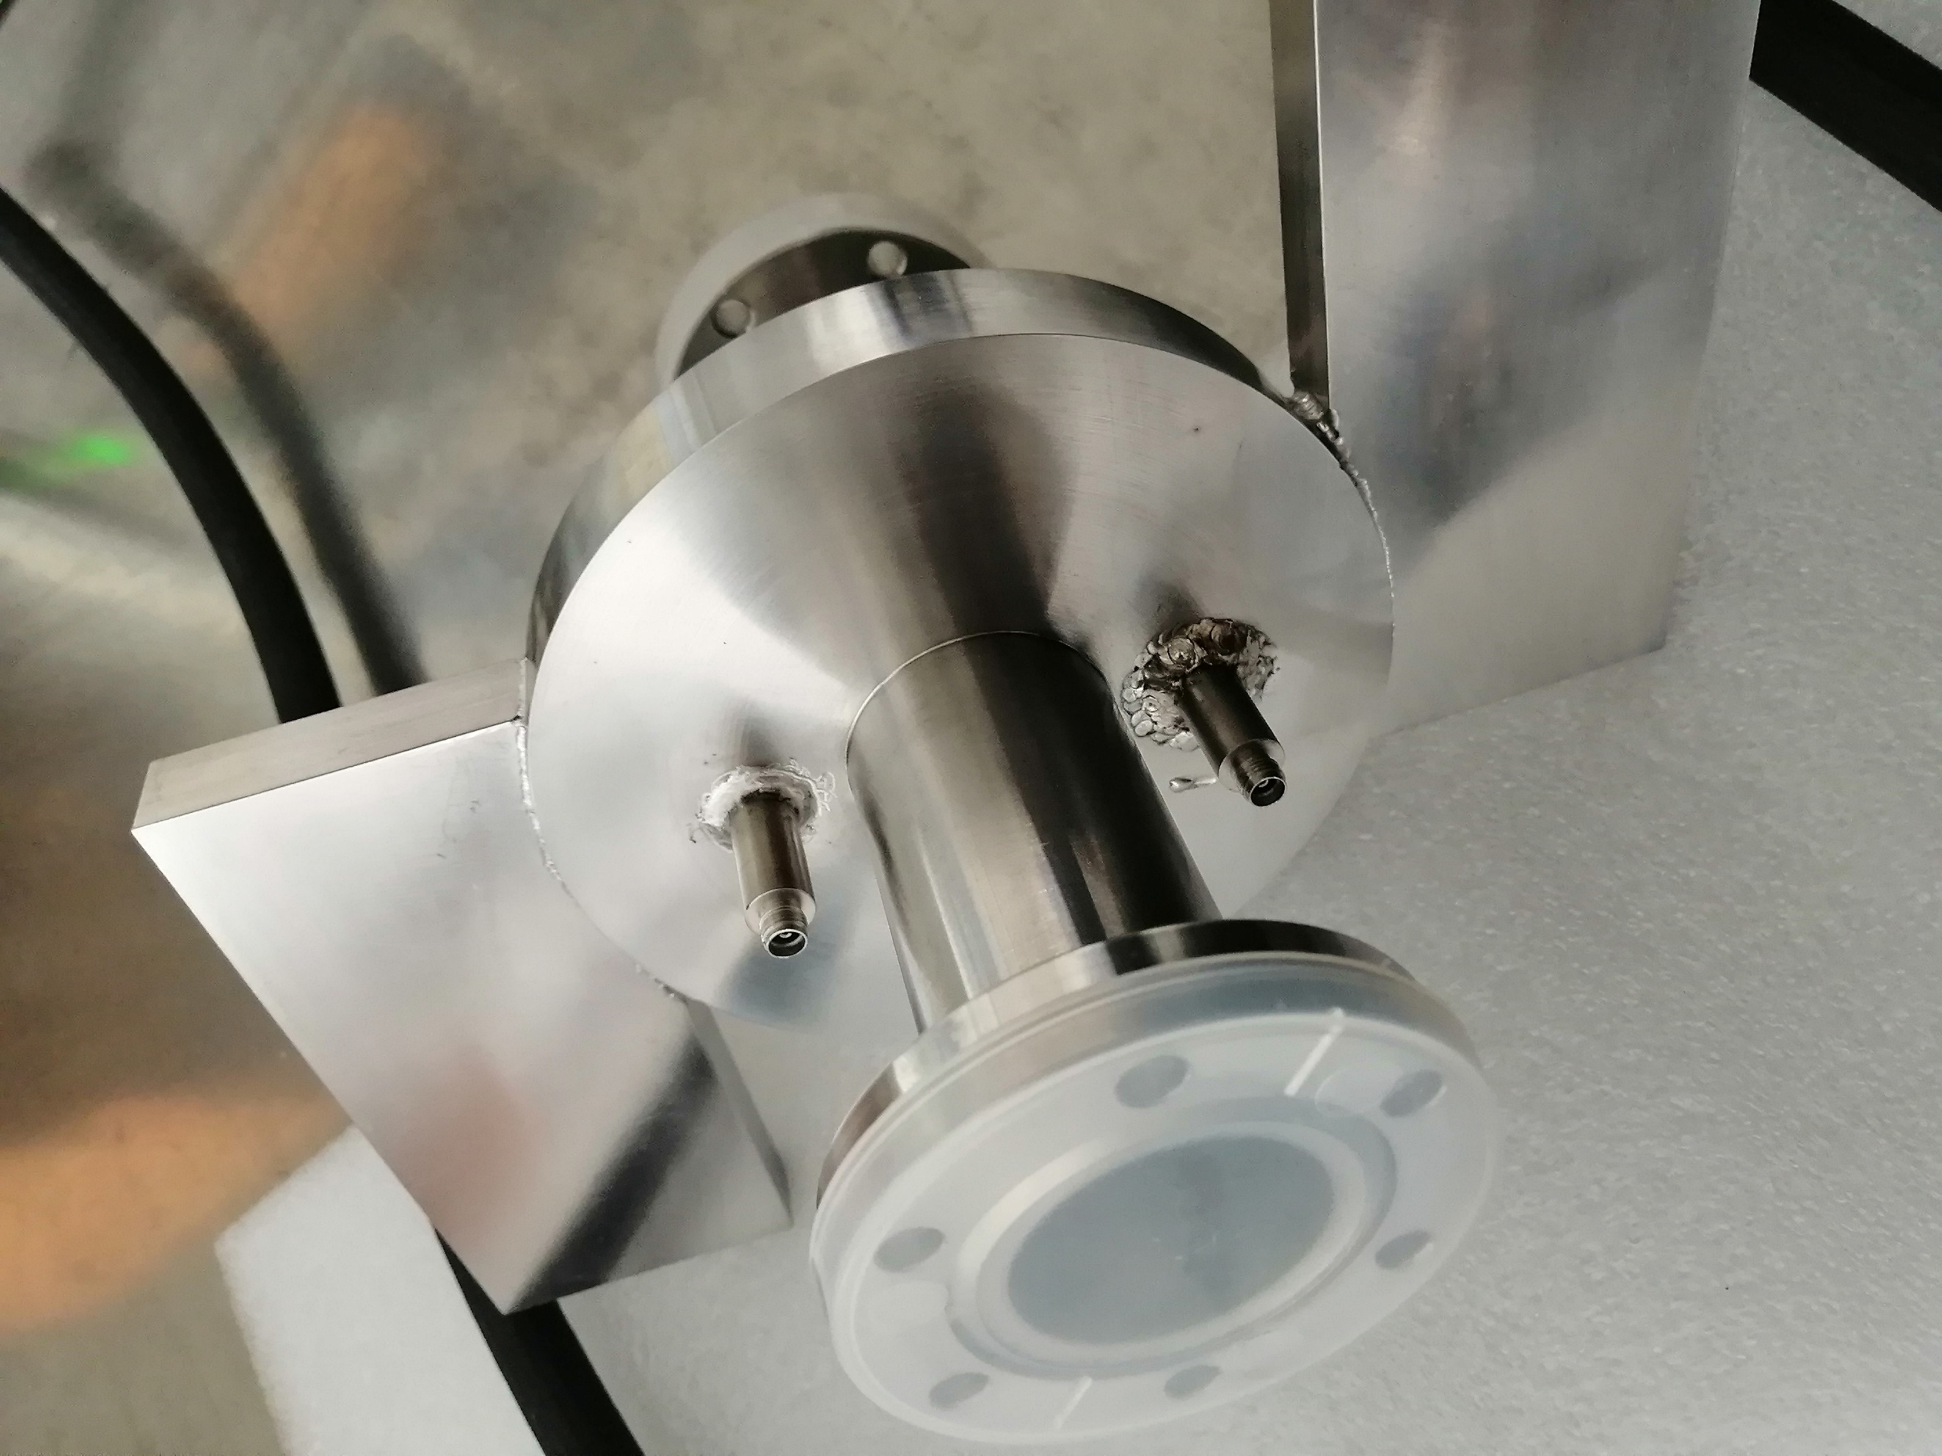
Cavity Bunch Length Monitor
Machining
The cavity is made of stainless steel and has a single-sided wall thickness of 3 mm
Longitudinal length (flange to flange) is 200 mm
Feedthrough
Waveguide
Beam pipeline

Slide 23
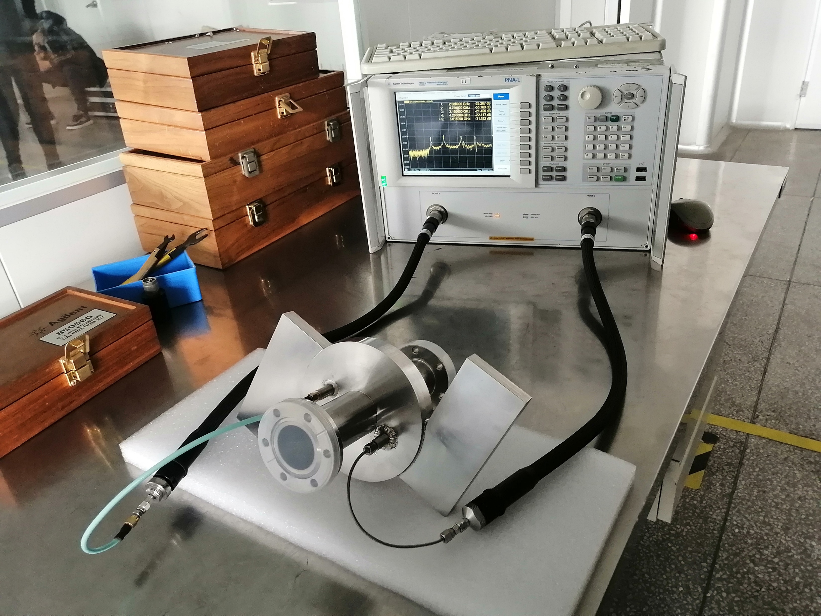
Cavity Bunch Length Monitor
Offline Testing ---- S-parameter
Vector network analyzer is used for S-parameter measurement
The actual frequency and bandwidth have been obtained.

Slide 24
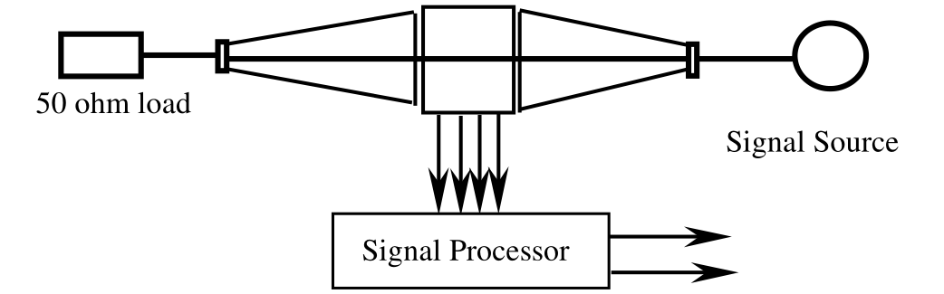
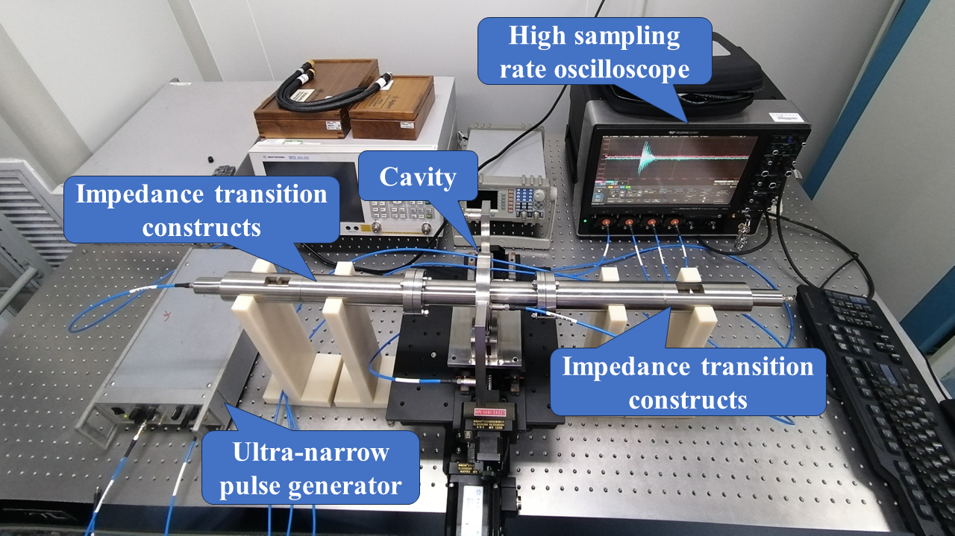
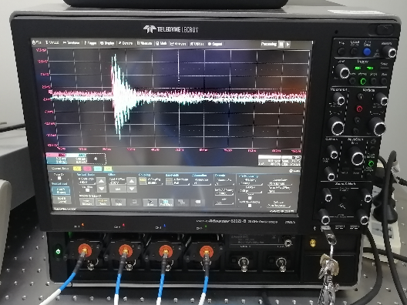
Cavity Bunch Length Monitor
Offline Testing ---- Wire Method
Performance analysis is carried out by using electric pulses to excite the cavity
Cavity

Slide 25
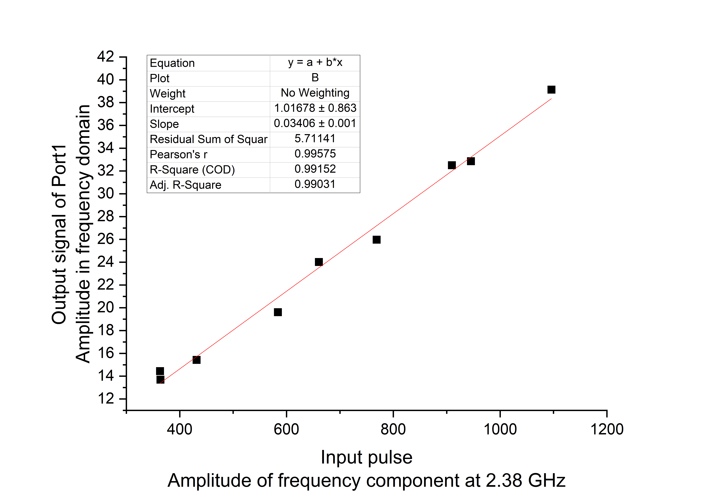
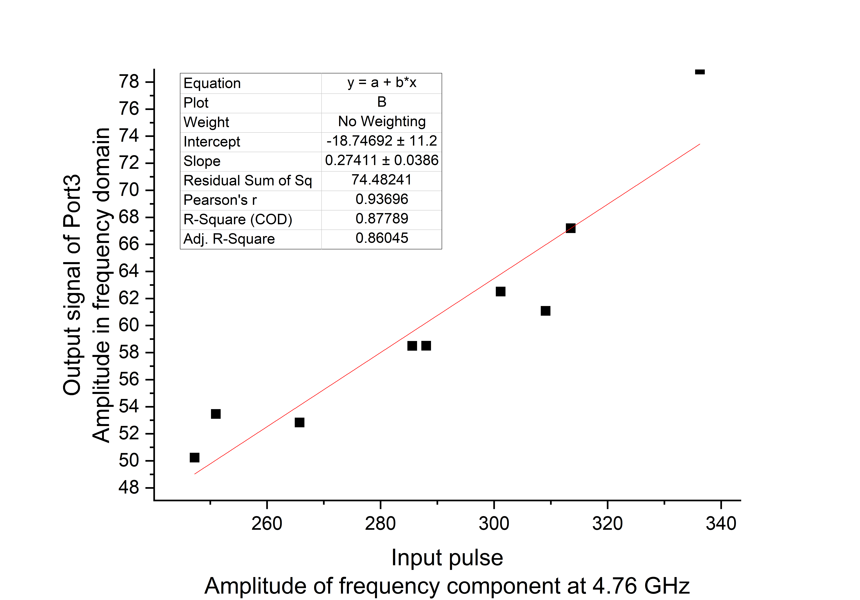
Cavity Bunch Length Monitor
Offline Testing ---- Wire Method
Adjust the input pulse width to simulate the change in bunch length, and obtain the relationship between the amplitude of the output signal and the input signal.
It can be seen that there is a clear linear relationship between the output signal and the input pulse frequency components.

Slide 26
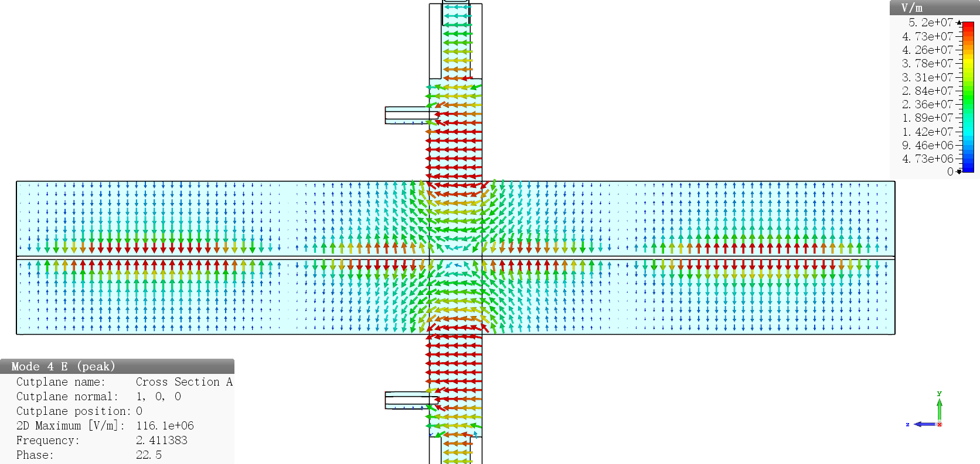
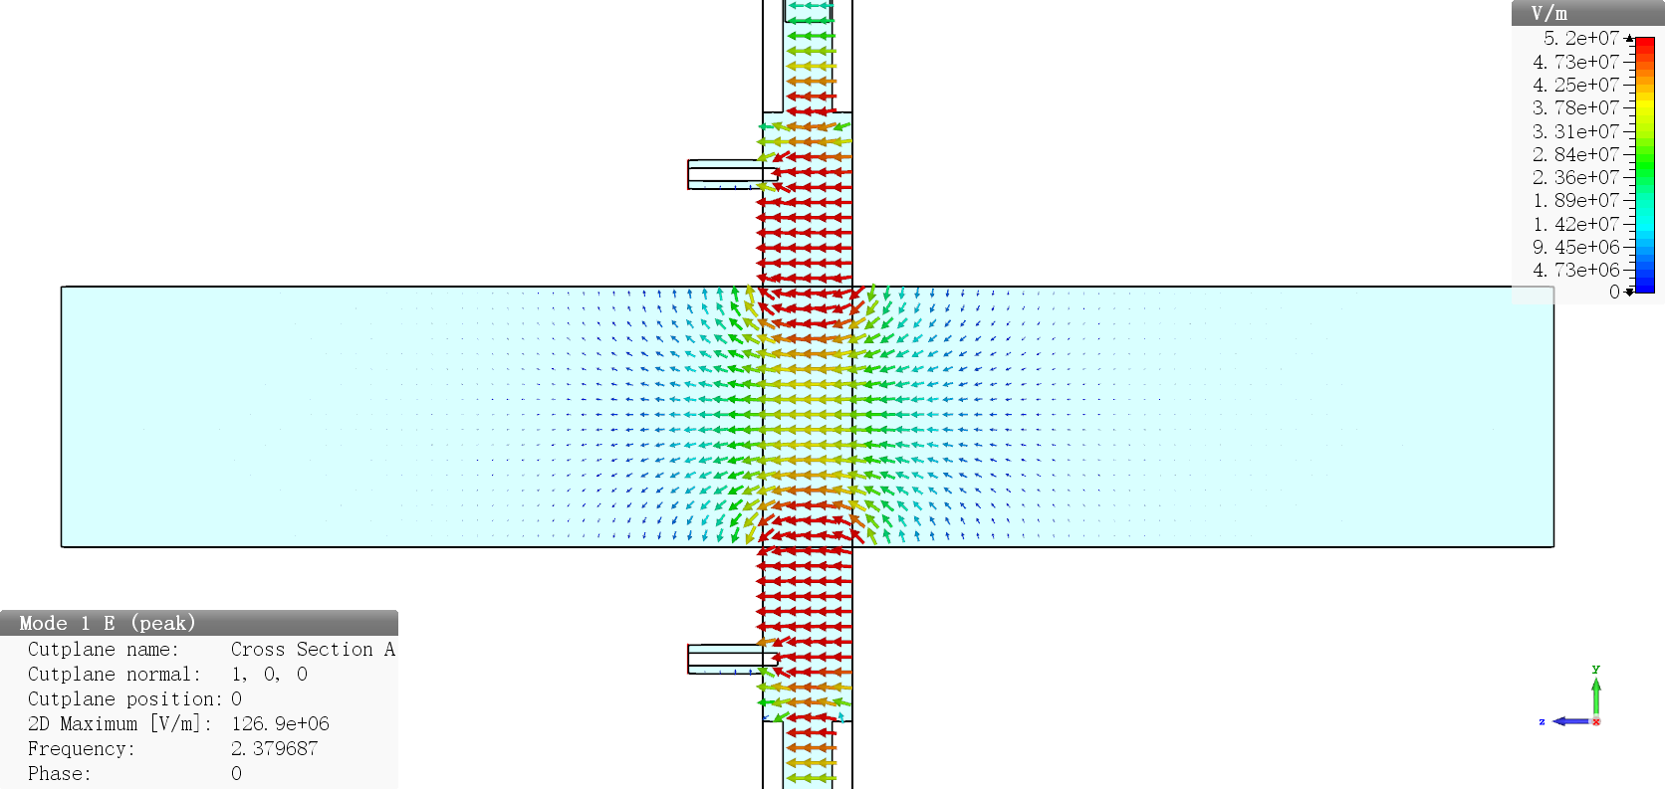
Cavity Bunch Length Monitor
Offline Testing ---- Wire Method
This testing proves that the specific frequency components of the beam pulse can be extracted through the cavity. This cavity can be used for bunch length measurement.
In online operation, due to the lack of wire, the eigenmodes inside the cavity hardly leaks out from the tube, so the sensitivity during online testing will be better than offline testing.

Slide 27
Overview
1 Introduction
2 Theoretical Basis
3 Design Scheme and Laws
4 Cavity Bunch Length Monitor
5 Beam Experiments
6 Summary

Slide 28
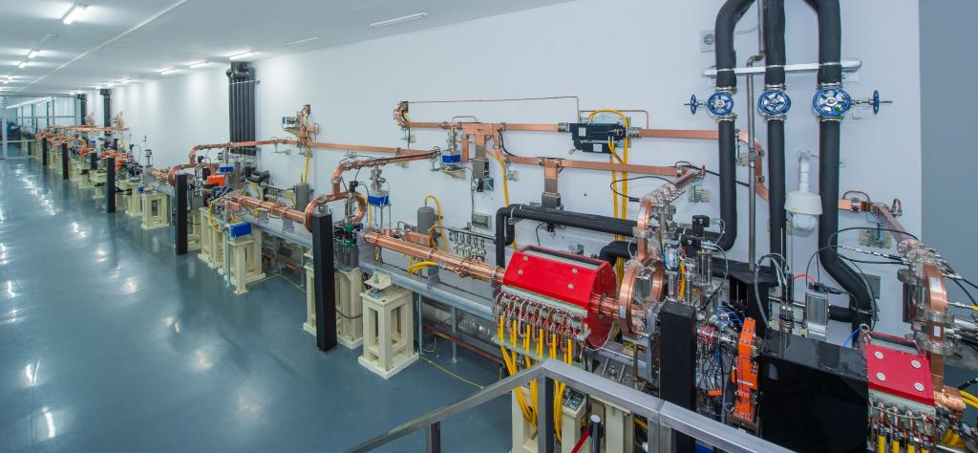
Beam Experiments
Dalian Coherent Light Source (DCLS)
The main body of DCLS is a FEL facility in the extreme ultraviolet. The entire accelerator is 96 meters long and can accelerate the electron beam to 300 MeV. The key parameters are similar to the Linac of STCF.
Parameter | Value
Energy (MeV) | 300
Energy spread (ems) | < 0.20 %
Normalized emittance（mm·mrad, rms） | ≤ 2.0
Bunch length (ps) | ≤ 2.0
Bunch charge (nC) | 0.5
Repetition rate (Hz) (single bunch) | 50

Slide 29
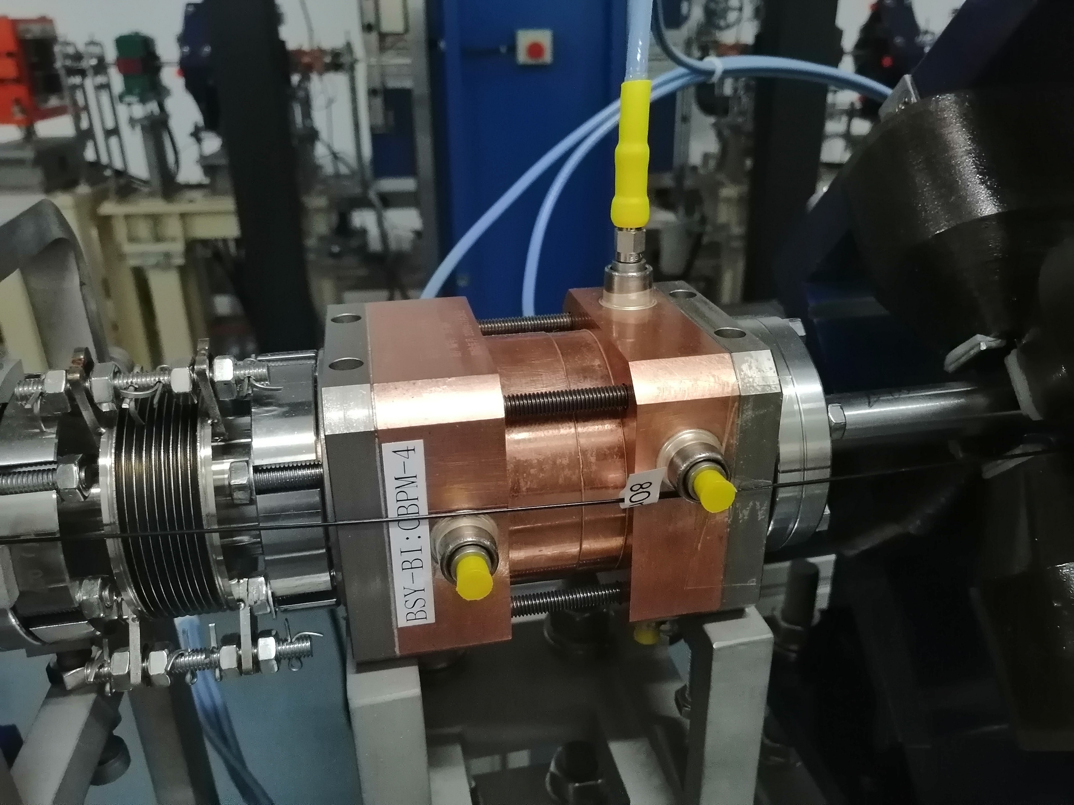
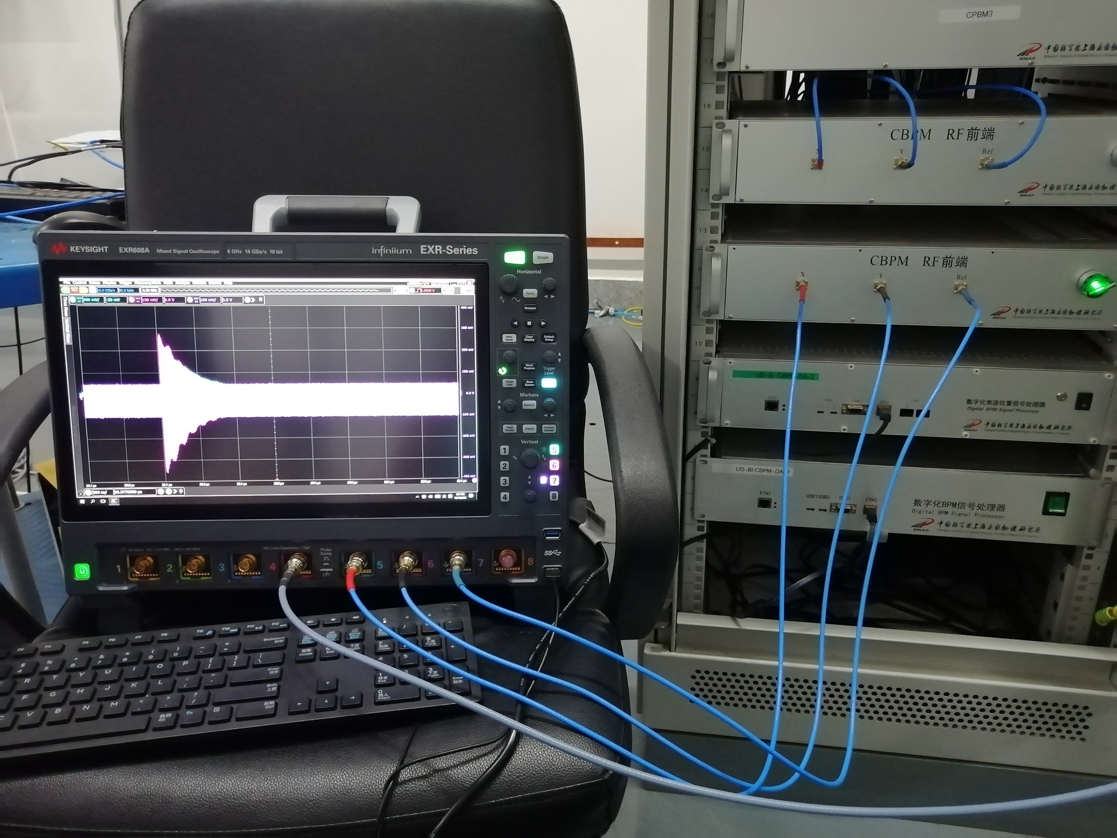
Beam Experiments
Output Signal of the Cavity in DCLS
Measure the output signal of the cavity using an oscilloscope and analyze the performance of the monitor.
Cavities in DCLS were designed by the beam diagnostics team of SXFEL.

Slide 30
Beam Experiments
Output Signal of the Cavity in DCLS
*Bunch charge is 265pC.
Signal | Eigenmodes | Frequency
Ref | TM010 | 4693 MHz
X | TM110-x | 4681 MHz
Y | TM110-y | 4689 MHz
TM010 mode
TM110-x mode

Slide 31
Beam Experiments
Output Signal of the Cavity in DCLS
Estimation of SNR based on the beam experiments
*The SNR is the result of evaluating the signal from output signal under the excitation of 300 bunches in 265pC.
*Signal X and Y was amplified inside the tunnel, while the Ref signal was not.
 |  | Frequency（MHz） | SNR (dB@0.5nC) | SNR(dB@1.5nC)
Ref (TM010 mode) | RF | 4693 | 47.1 | 56.6
 | IF | 500 | 46.8 | 56.4
X (TM110 mode) | RF | 4681 | 60.3 | 69.9
 | IF | 500 | 53.7 | 63.2
Y (TM110 mode) | RF | 4689 | 46.4 | 56.0
 | IF | 500 | 45.9 | 55.4

Slide 32
Beam Experiments
Performance of Cavity Monitors for STCF Linac
At 1.5nC, SNR of the cavity can reach over 55dB
For beam position measurements, the resolution will be better than 1μm@1.5nC
Parameter | Value
Energy (GeV) | 1.0~3.5
Bunch length (ps) | 3.3
Bunch charge (nC) | 1.5
Repetition rate (Hz) (single bunch) | 50
For bunch charge measurements, the relative resolution can reach to 0.07%
For bunch length measurements, the resolution will be better than 200fs@1.5nC

Slide 33
Overview
1 Introduction
2 Theoretical Basis
3 Design Scheme and Laws
4 Cavity Bunch Length Monitor
5 Beam Experiments
6 Summary

Slide 34
Summary
In this report, the cavity-based method and monitors for Linac are introduced.
Cavity-Based monitors have advantages such as high SNR and better resolution, and are therefore widely used in high quality Linas.
The design of the cavity monitors requires attention to key parameters, such as Q factor.
An example is given to illustrate the design and testing scheme of cavity monitors.
Based on the beam test results, it is inferred that using cavity monitors on STCF may achieve better resolutions.

Slide 35
Thanks for Your Attention！

