Slide 1

中国科学技术大学
STCF
University of Science and Technology of China
Injector and positron source of STCF in China
Ailin Zhang, Xin xu, Guoxi Pei，Youjin Yuan, Duan Gu et al.
17th January
The 2024 International Workshop on Future Tau Charm Facilities

Slide 2
Contents
STCF
The injector of STCF
The positron source of STCF
Future plan

Slide 3
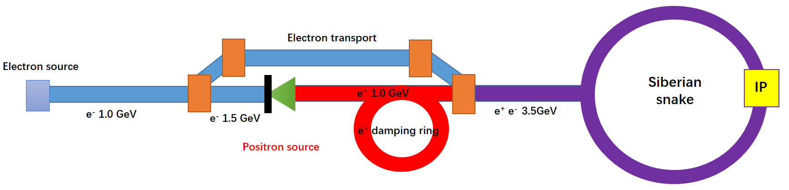
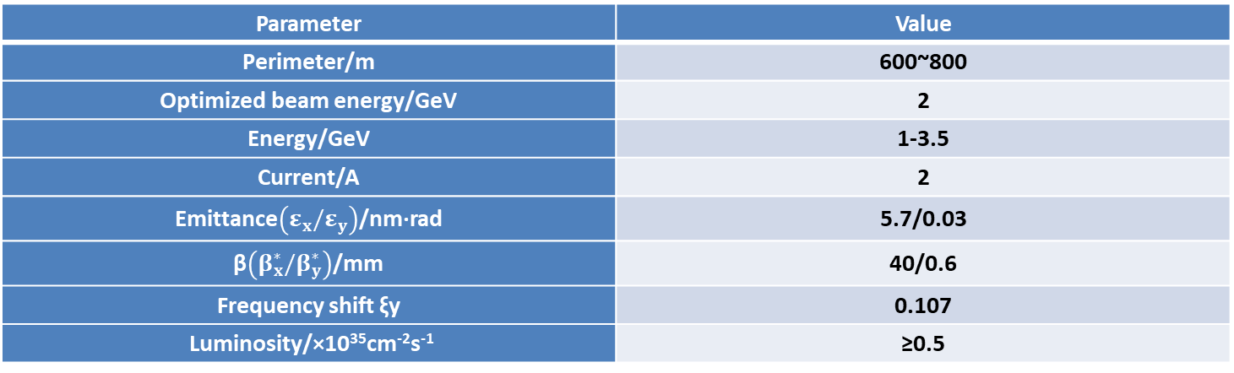
The Super Tau-Charm Facility in China
STCF
Parameter | Value
Perimeter/m | 600~800
Optimized beam energy/GeV | 2
Energy/GeV | 1-3.5
Current/A | 2
Emittance$\left(ε_{x}/ε_{y}\right)$/nm·rad | 5.7/0.03
β$\left({β_{x}^{∗}/β}_{y}^{∗}\right)$/mm | 40/0.6
Frequency shift ξy | 0.107
Luminosity/×10³⁵cm⁻²s⁻¹ | ≥0.5

Slide 4
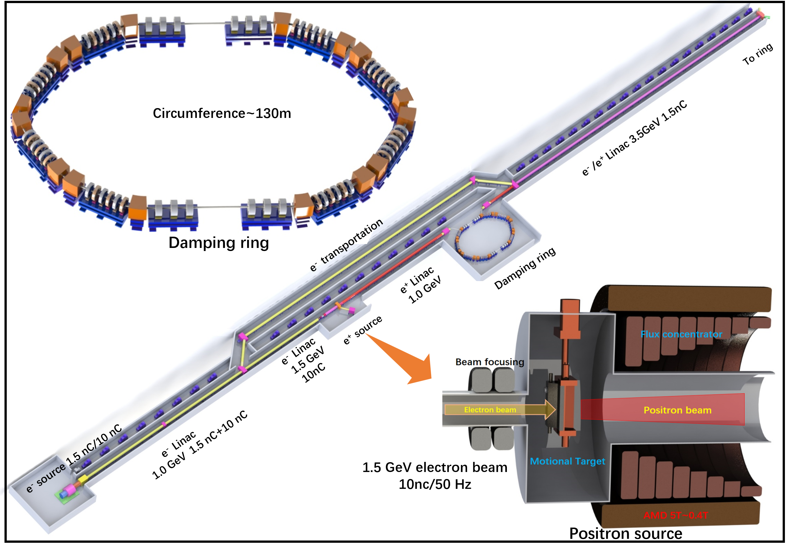
The injector of STCF
STCF

Slide 5
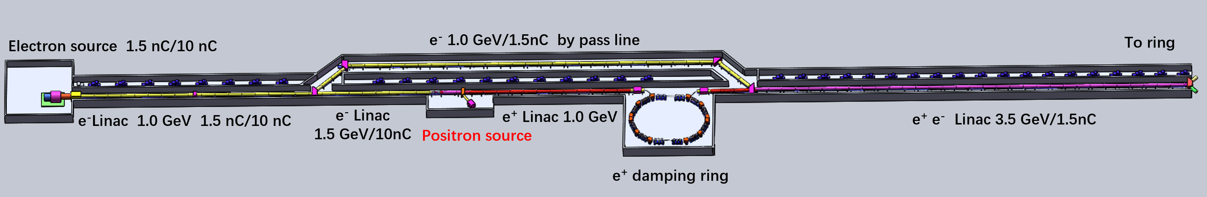
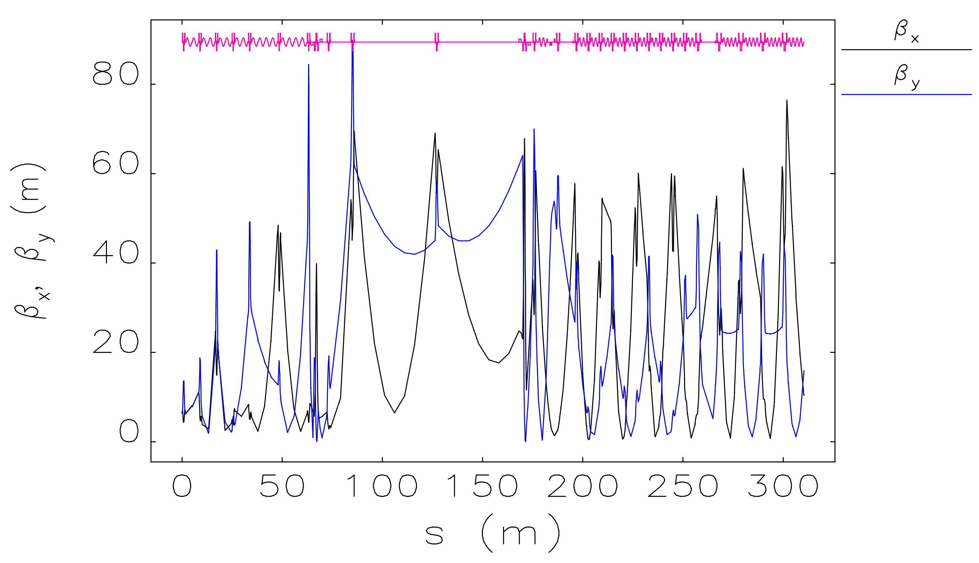
The electron beam line of STCF
STCF
Injector:
  e- linacs: 1.0 GeV, 1-1.5 GeV
  e+ linac: 1 GeV
  e+/e- linac: 1-3.5 GeV
  e+ target: @1.5 GeV
  Damping ring: 1 GeV, ~140 m
  e+/e- accumulator rings: 1 GeV,

Slide 6
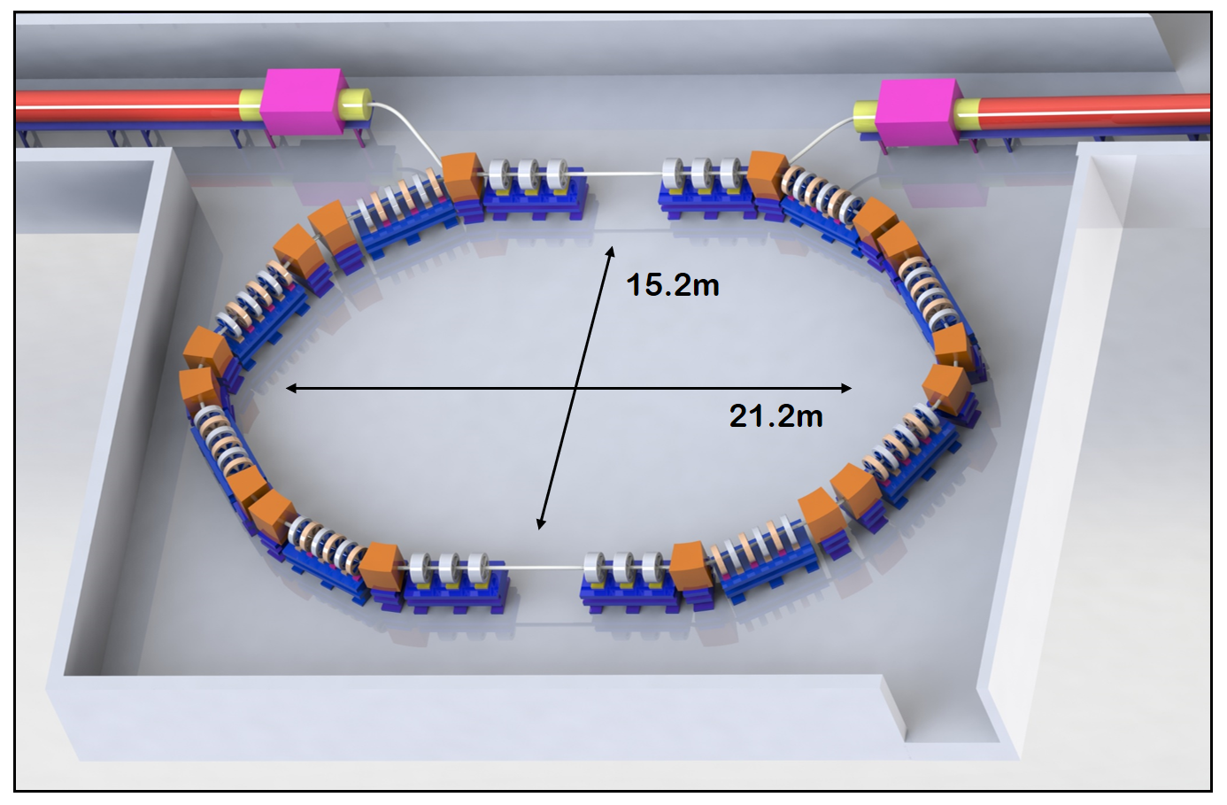
Damping ring
STCF
Parameter | Value
Energy | 1.0 GeV
Perimeter | ~130 mm
Repetition frequency | 50 Hz
Bending radius | 2.7 m
Dipole magnets，B₀ | 1.4 T
Momentum compression factor ，α_{c} | 0.076
U₀ | 35.8 keV
Damping time x/y/z | 12/12/6 ms
δ₀ | 0.05%
ε₀ | 287.4 mm·mrad
Bunch length | 7 mm
ε_{inj} | 2500 mm·mrad
ε_{ext x/y} | 704/471 mm·mrad
δ_{inj}/δ_{ext} | 0.3/0.06
Divergence of energy | 1%
f_{rf} | 650 MHz
V_{rf} | 1.8 Mv

Slide 7
Contents
STCF
The injector of STCF
The thermal research of single-crystal tungsten target
The new target design for positron

Slide 8
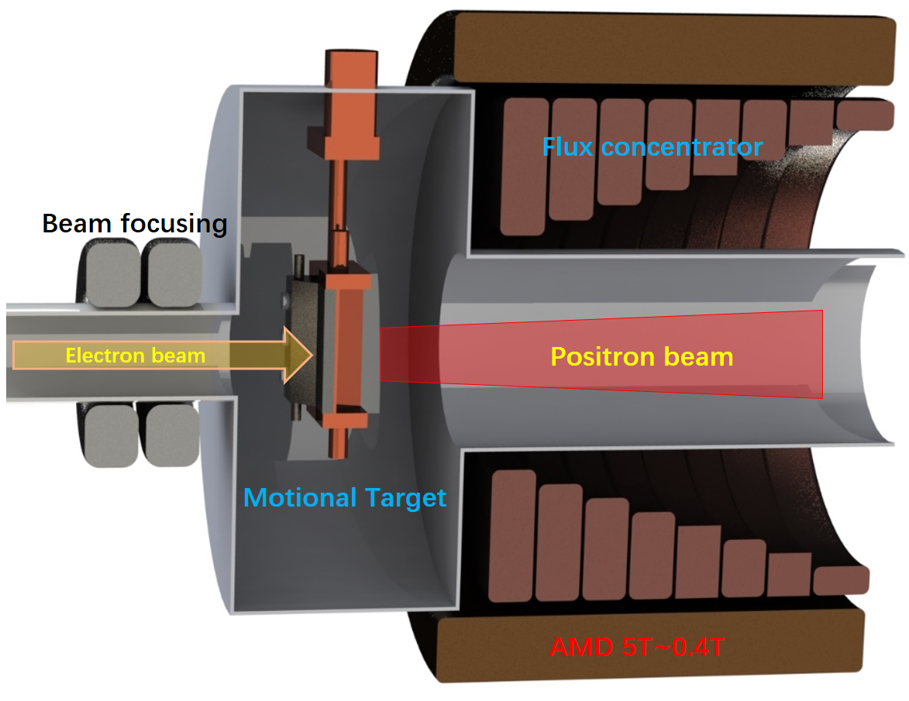
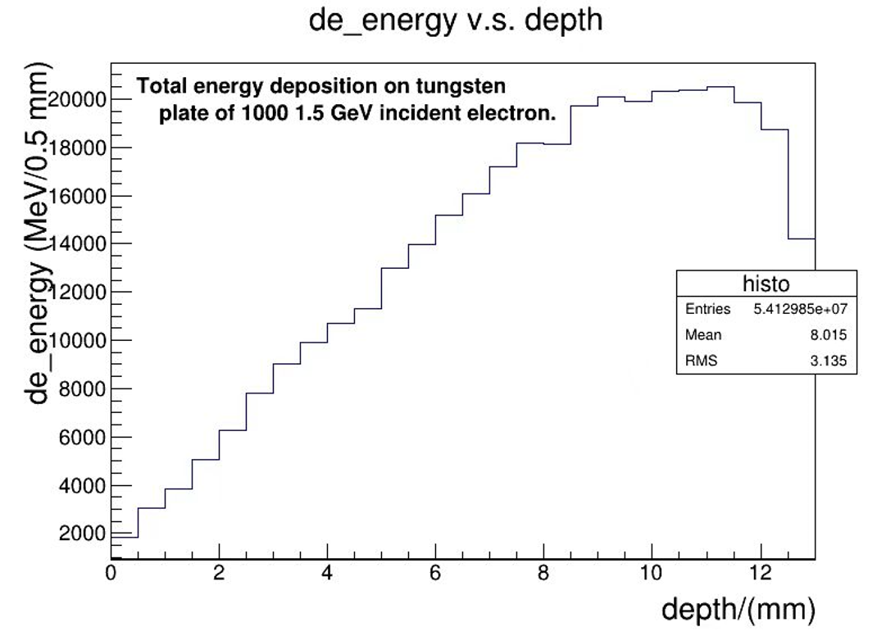
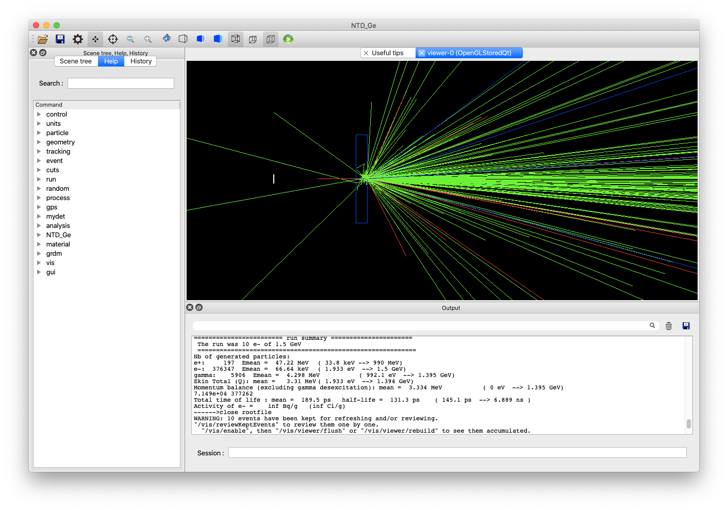
The positron production system
STCF
Parameter | Value
Electron bunch | 10 nC
Electron energy | 1.5 GeV
Rep. rate | 50 Hz
Deposited power | 750 W
Magnetic field | 5↘0.4
Target thickness | 13 mm
Target material | Tungsten
e⁺ yield | 0.15

Slide 9
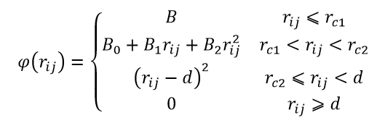
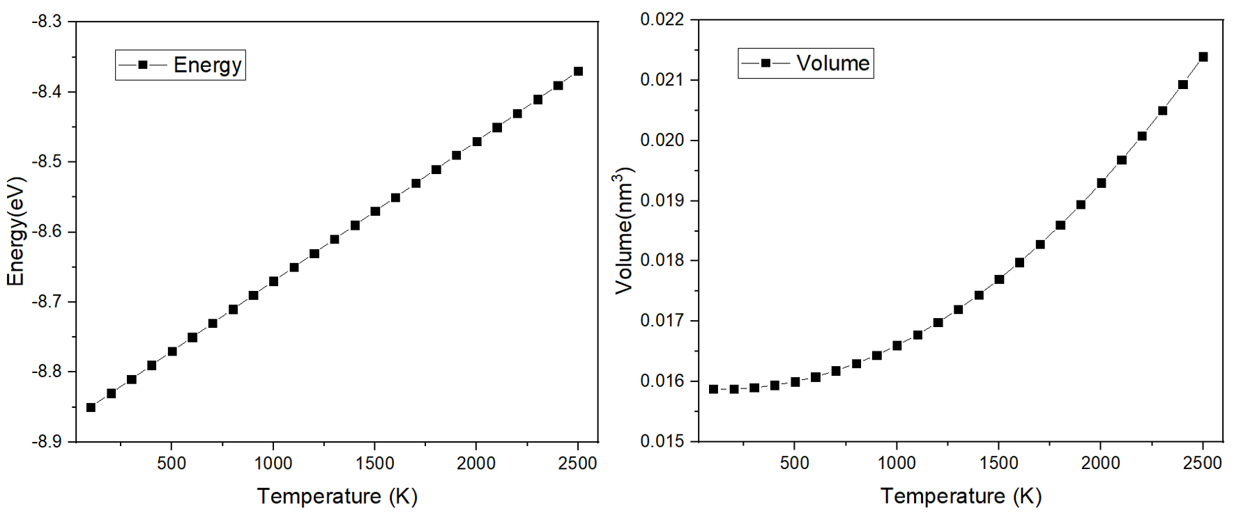
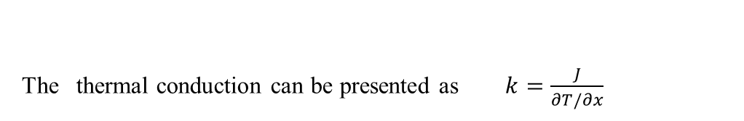
Thermal research on Positron target
STCF
The thermal conduction can be presented as $k=\frac{J}{∂T/∂x}$
E=E_{p}+E_{N}
The empirical N-body potential was used for tungsten by Finnis and Sinclair. In the F–S potential, the total potential energy of system is expressed as
The time averaged total energy of one tungsten atom (left) and the time averaged volume (right) as functions of temperature.
Notes:
Before the simulation, the equilibrium cell parameters should be calculated at different temperatures. The simulation cell consisted of 4×4×4 unit cells and the initial cell parameter of tungsten is 0.3165 nm. The third-order predictor–corrector algorithm was used to integrate the equations of motion, with a time step of 10⁻¹⁵ s. The vacuum pressure is setting to 10⁻⁵ Pa (experimental pressure).

Slide 10
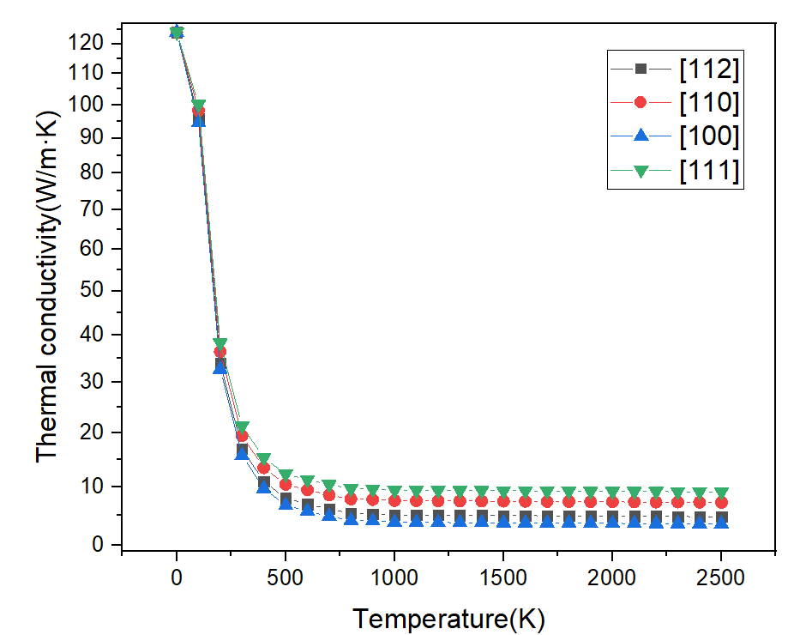
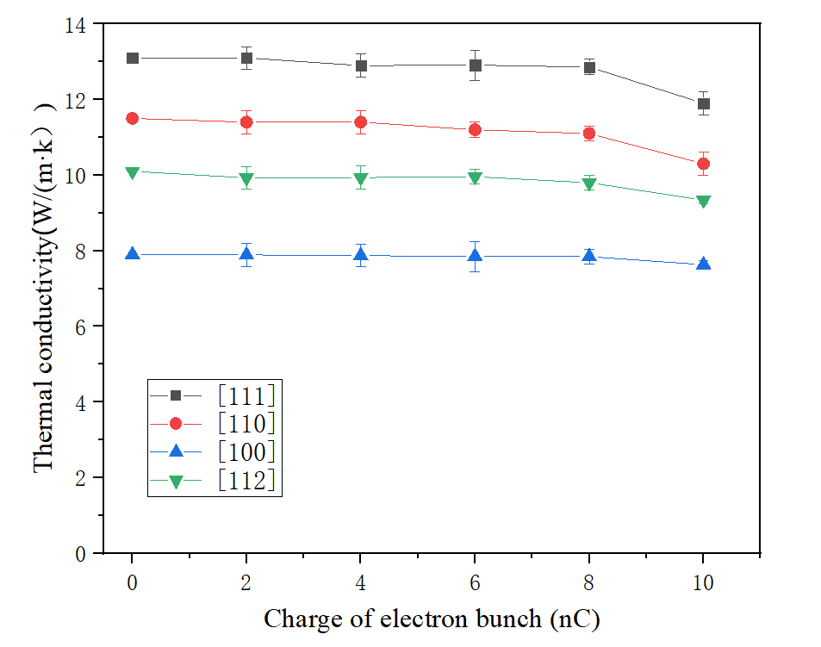
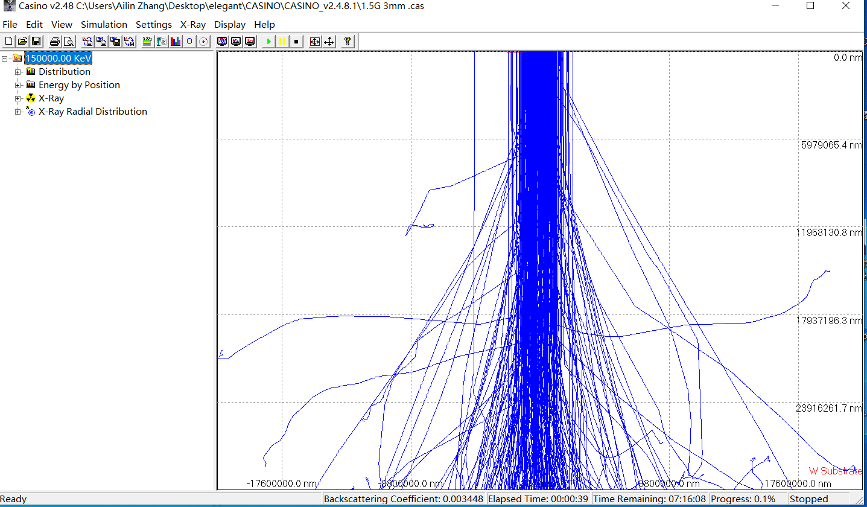
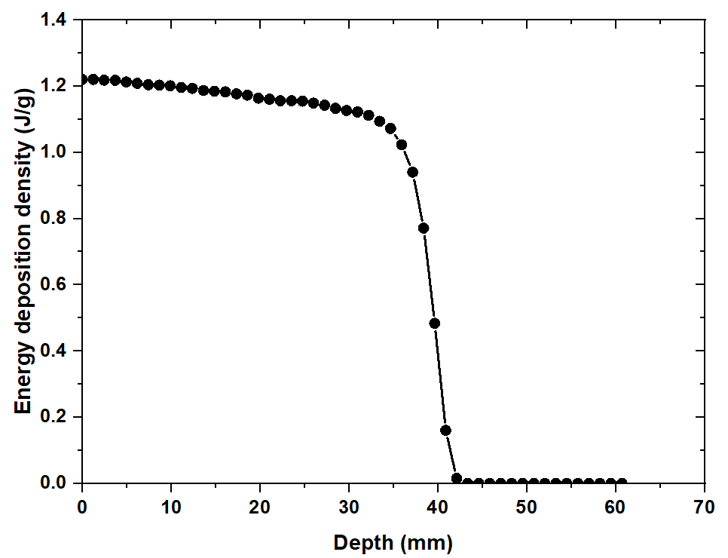
Thermal conductivity for different crystallographic orientation
STCF

Slide 11
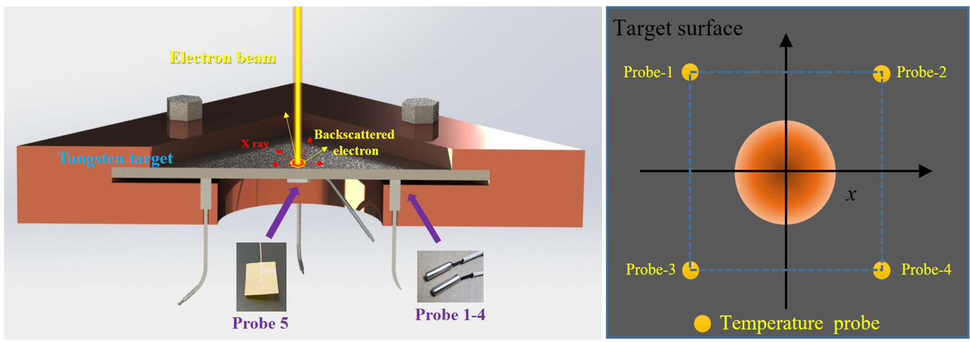
STCF
Thermal research of single crystal tungsten
Experimental setup of the electron beam target positron source（no water cooling）
Notes:
The experimental setup is shown in Fig.3, including electron beam, target, water cooling. The electron energy used for the bombardment experiment is 200 MeV, the thickness of tested tungsten target was 4 mm. Fig.4 showed the experiment result of electron beam bombardment without water cooling (10 nC (50 Hz)×250 pulses. It can be seen that the damage to the tungsten target is very serious in only 5 second electron beam bombardment.

Slide 12
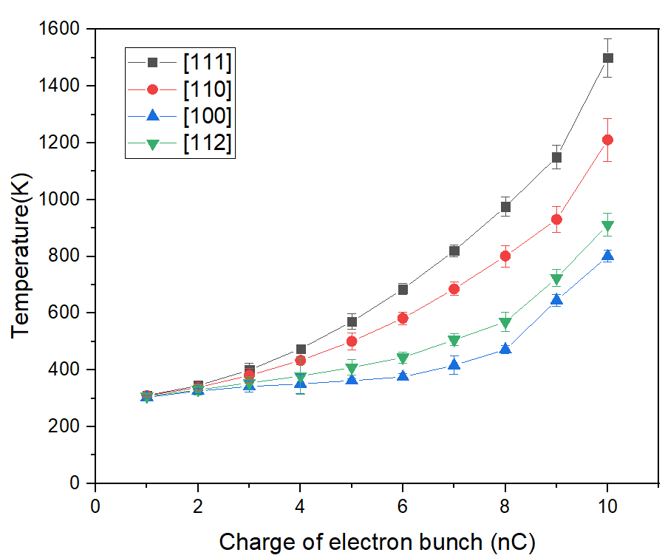
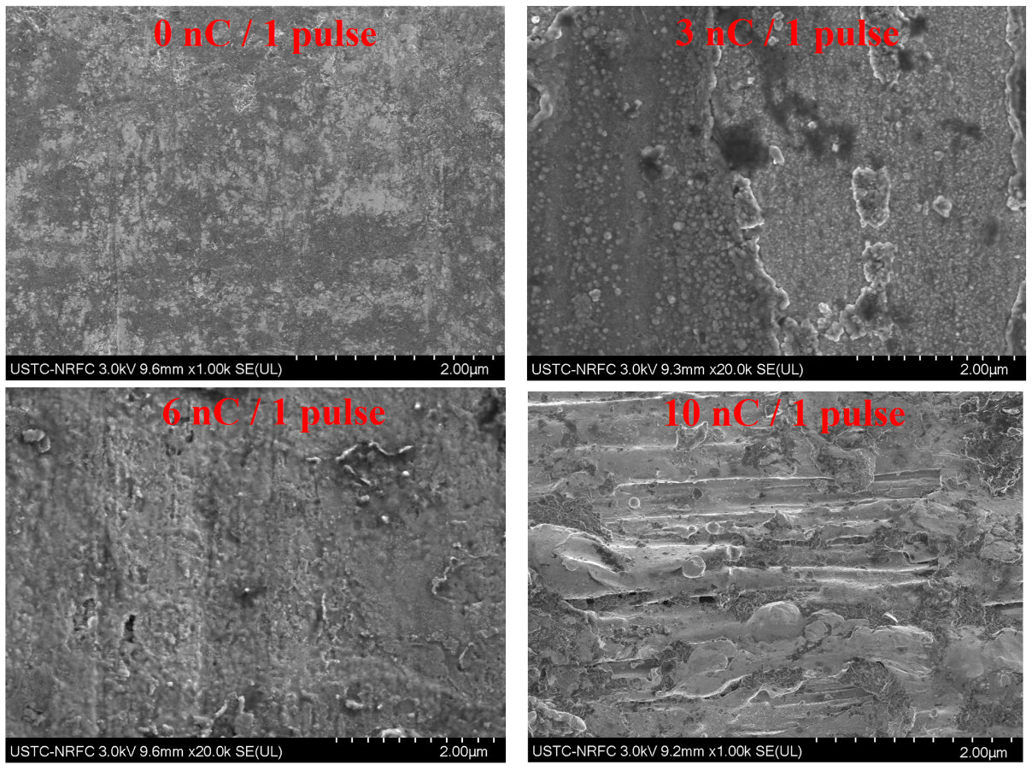
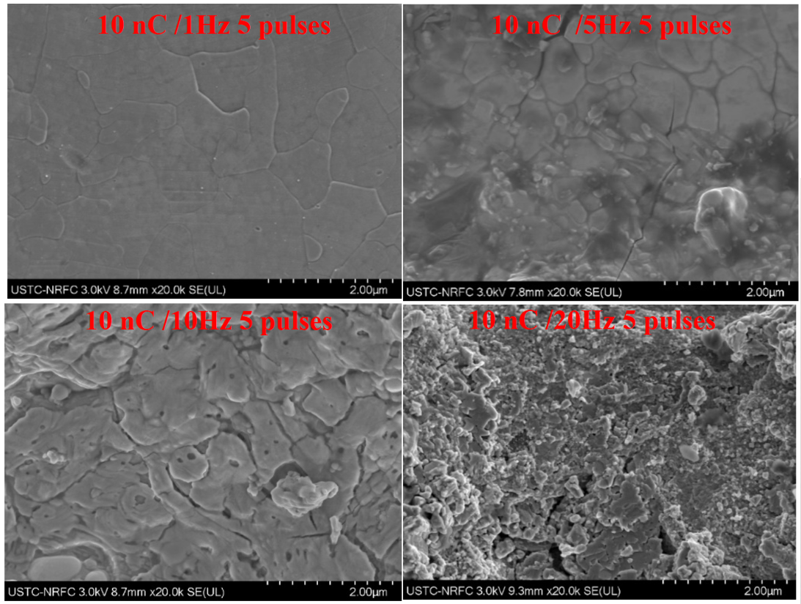
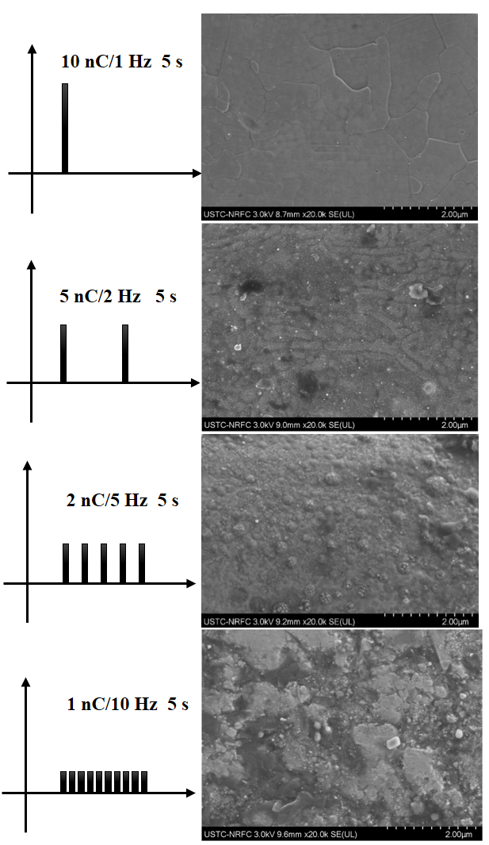
Thermal research of single crystal tungsten
STCF
The experimental results of thermal conductivity with different crystallographic orientations
Microscopic morphology of crystal tungsten target bombarded by single pulsed electron beams with different charges
Notes:
Fig. 7 shows the highest temperature detected at the No. 5 temperature probe when single-electron pulses with different charges bombard the crystal tungsten targets of different crystallographic orientations. Because of the limitations of experimental conditions, the maximum charge of the electron bunch can only reach 10 nC, and the electron energy is only 200 MeV. The thickness of the single-crystal tungsten target is 4 mm. There is no water cooling during electron bombardment. Obviously, it can be seen that the temperature in the [111] direction is the highest, which means that the thermal conductivity in the [111] direction is the highest. At low temperatures, the temperature difference between different crystal orientations is small, but the temperature difference becomes increasingly larger at high temperatures. For a 10 nC electron pulse, the temperature of [111] is 1500 K, while [100] is only 801 K. This law fits the simulation results of thermal conductivity in Fig. 5. First, a single pulsed electron beam was used to bombard the crystal tungsten target in the [111] crystallographic orientation. The energy of each pulse ranged from 0 to 10 nC. The SEM results are shown in Fig. 8. With increasing pulse charge, the surface damage of the crystal tungsten target became increasingly severe, but there was no apparent recrystallization phenomenon. Next, there is a multi-pulse experiment. To study the time characteristics of recrystallization, the charge of the electron pulse was fixed at 10 nC, and the total pulses were fixed at five. Then, electron bombardment experiments were conducted with different time intervals. The SEM results are shown as Fig. 10. The recrystallization phenomenon of 10 nC/1 Hz is obvious, and the surface after crystallization is also very smooth. There was also recrystallization at 10 nC/5 Hz, but obvious cracks appeared on the surface. The recrystallization at 10 nC/10 Hz is obvious, but too many surface cracks start to overlap. The surface at 10 nC/20 Hz was completely damaged, and there was no recrystallization. We carried out the 10 nC/50 Hz experiment, and recrystallization did not occur, as shown in Fig. 4, the target is completely damaged. Through a series of experiments, for a 10 nC pulse, as long as the pulse interval was more than 200 ms, the appearance of irregular recrystallization could be prevented, and the surface cracking phenomenon could also be suppressed. Studies from Ref [59] have also shown that the characteristic time of recrystallization for tungsten is also approximately 200 ms. For recrystallization, there are two necessary condition, firstly, sufficient time is required for recrystallization (200 ms); secondly, sufficient time interval between each recrystallization (200 ms). A pulsed electron beam with different pulse structures but the same power was used to bombard the crystal tungsten target to study what conditions recrystallization occurred. Fig. 9 shows the results of 4 kinds of pulse structures. All structures had the same bombardment time of 5 seconds. It can be seen from the SEM results that there was obvious recrystallization at a time structure of 10 nC/1 Hz, slight recrystallization at 5 nc/2 Hz, and no recrystallization at 2 nc/5 Hz and 1 nC/10 Hz. This series of experiments shows that the main factor of recrystallization is not the average power of the bombardment electron beam but the relatively strong instantaneous power.

Slide 13
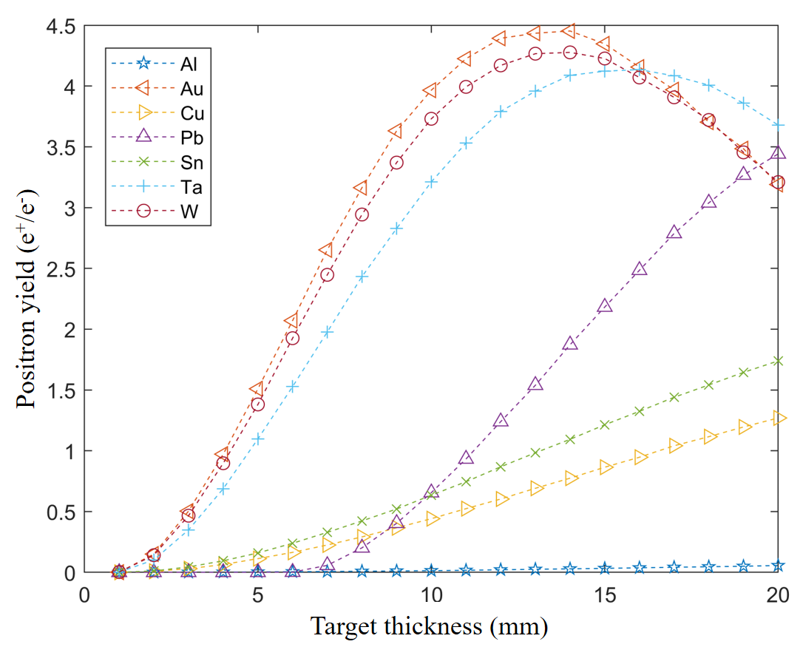
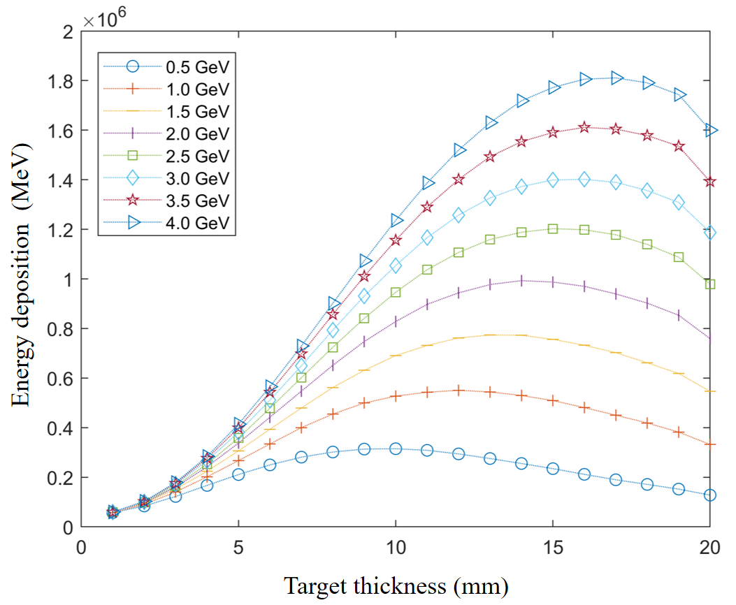
Study on the yield of positron sources
STCF
1.5 GeV electron beam bombardment
Simulation of tungsten target energy deposition

Slide 14
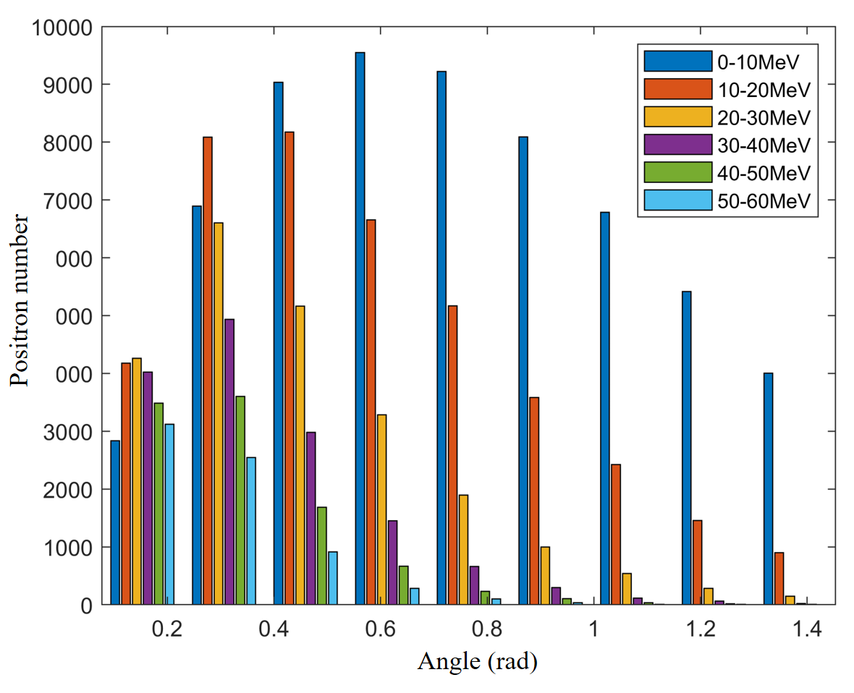
Energy dispersion and angle of STCF positron source
STCF
Simulation Results of Positron Angle and Energy Dispersion for 1.5 GeV Tungsten Target

Slide 15
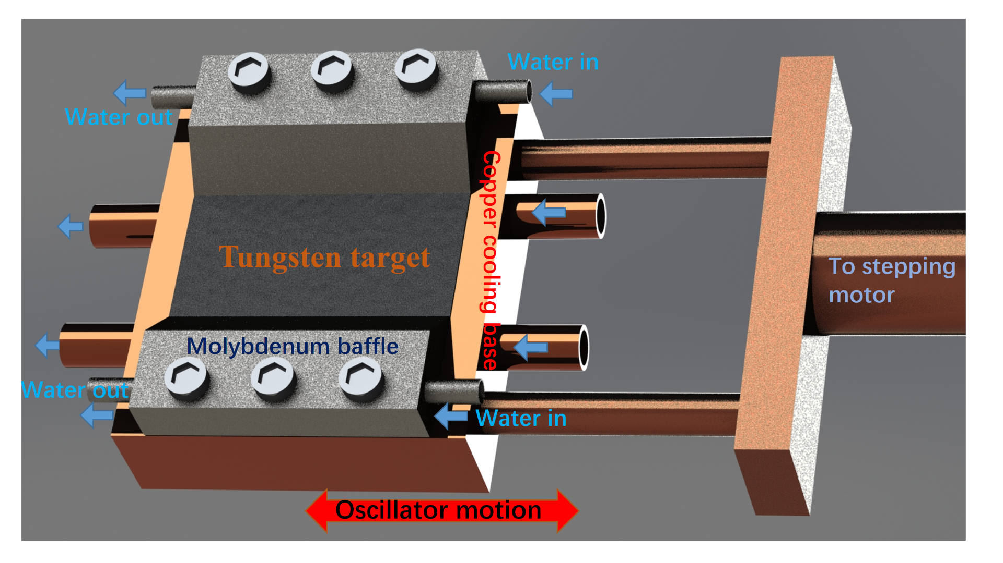
The motional target for positron production
STCF

Slide 16
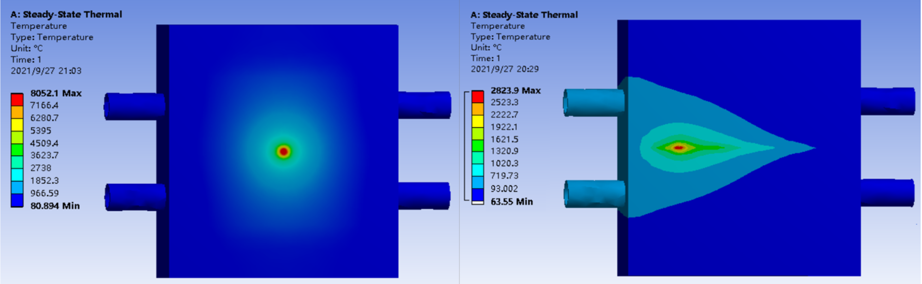
Thermal simulation for motional target
STCF
Simulation results of the static target (left) with strong water cooling and the motional target (right) with the same water cooling （20 nC/100 Hz）
Notes:
The results in Fig. 12 are simulated by ANSYS without considering the considerable changes in thermal conductivity at different crystallographic orientations and different temperatures. Therefore, we manually added the thermal conductivity results obtained in Fig. 7 to the engineering data in ANSYS and set up two new materials, [111] single crystal tungsten and [100] single crystal tungsten. When modeled the highest energy electron beam (30 nC/100 Hz 1.5 GeV) required for STCF in the future, the electron bunch is assumed to have a Gaussian distribution with a diameter of 4 mm. The temperature of the surface is shown in Fig. 13 when the [111] target is stationary. The temperature distribution is slightly sharper than the electron beam distribution, and the maximum temperature is 9067 °C which is higher than that obtained by ANSYS without considering the crystalline thermal conductivity (8051°C in left of Fig.12).

Slide 17
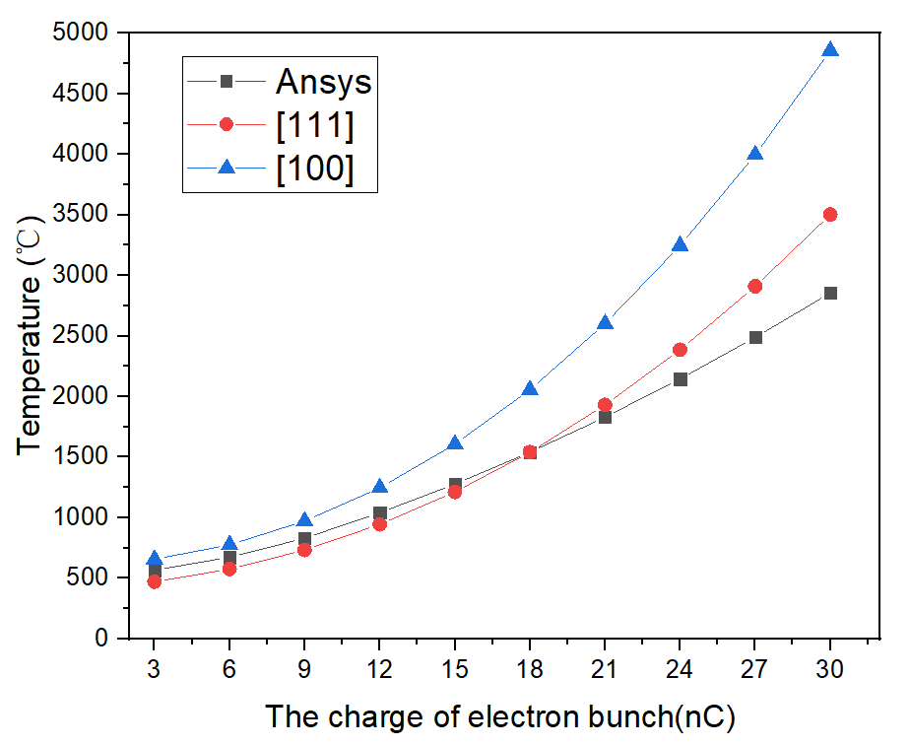
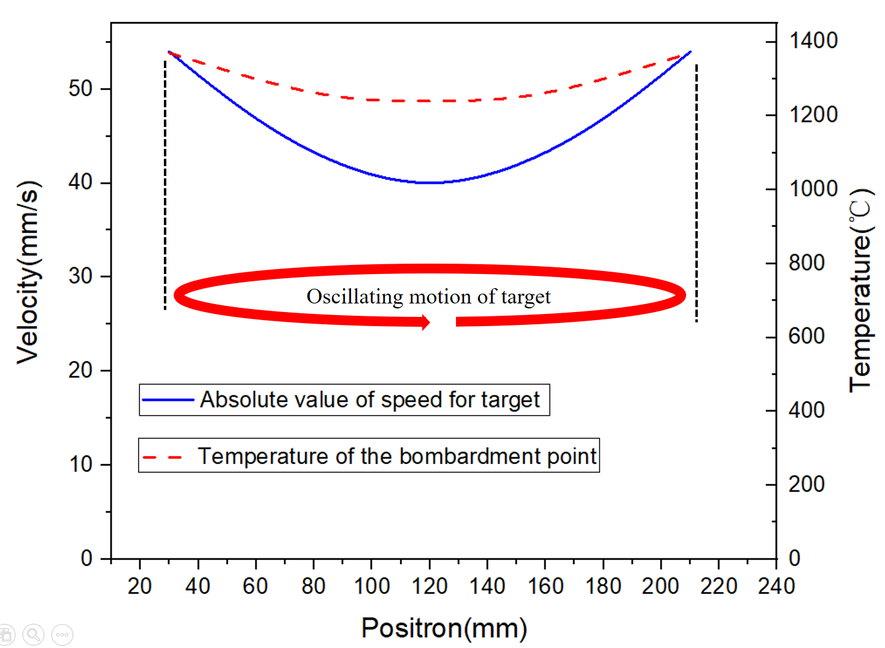

Optimization of Moving Target Movement Speed
STCF
The difference between thermal simulation results considering and not considering the influence of the crystallographic orientation on thermal conductivity of various electron bunch charge. The repetition frequency is fixed at 100 Hz, electron energy is fixed at 1.5 GeV. Positive triangle - the thermal conductivity comes from the molecular dynamics simulation of [100] crystallographic orientation. Round - the thermal conductivity comes from the molecular dynamics simulation of [111] crystallographic orientation. Square –the thermal conductivity comes from the Ansys database for tungsten.

Slide 18
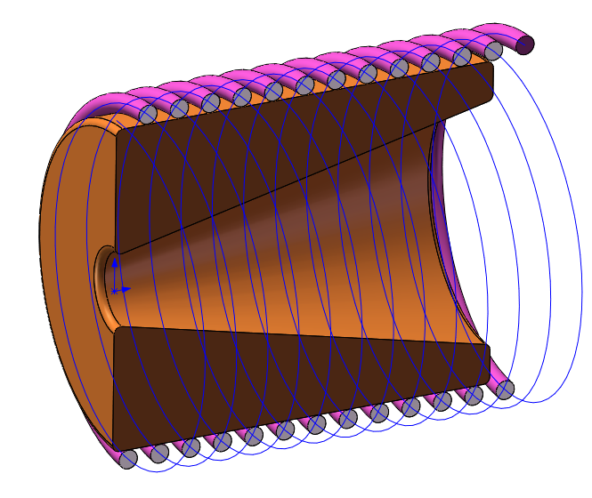
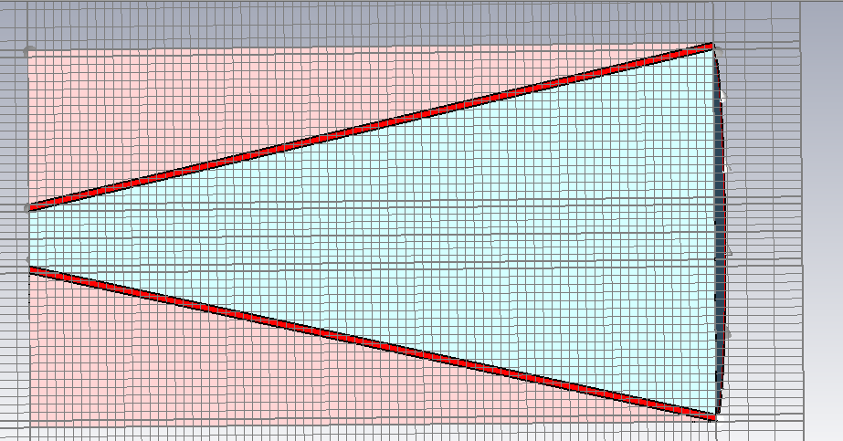
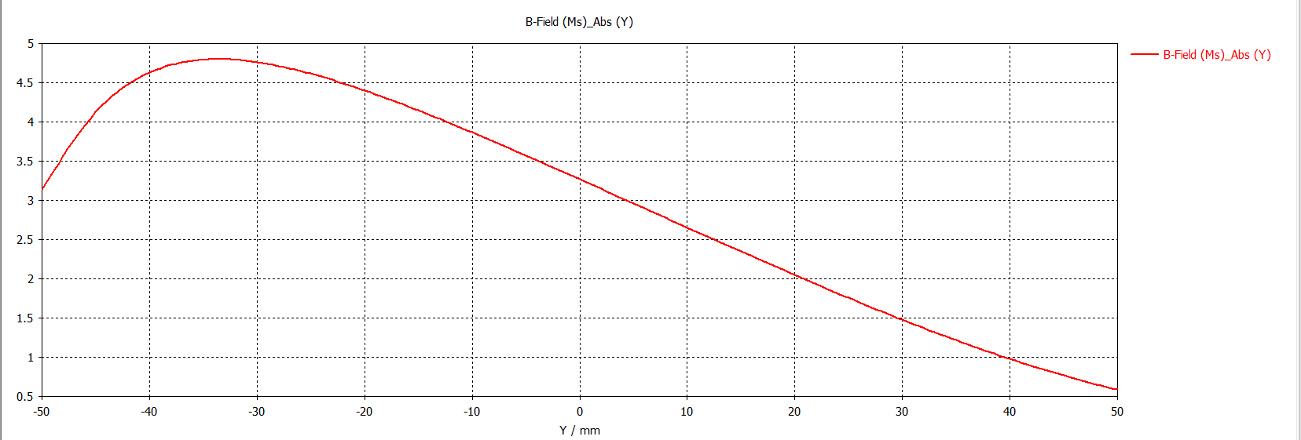
Adiabatic Matching Device(AMD) design
STCF
Flux concentrator coils
Magnetic field
AMD new coils
New magnetic field

Slide 19
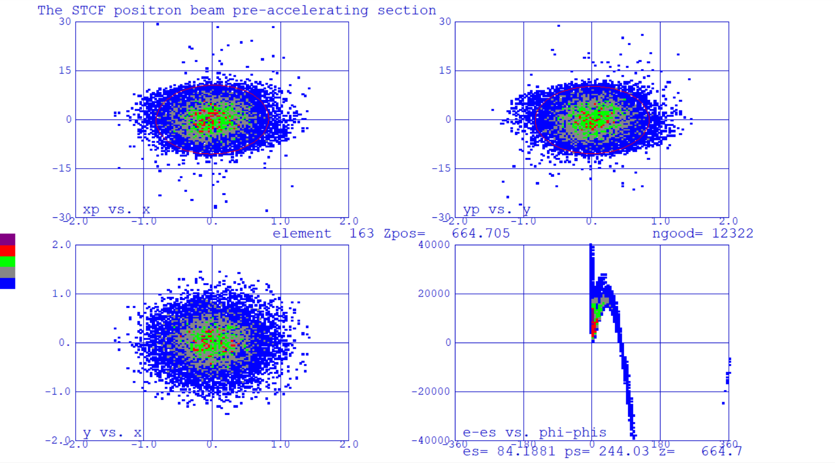
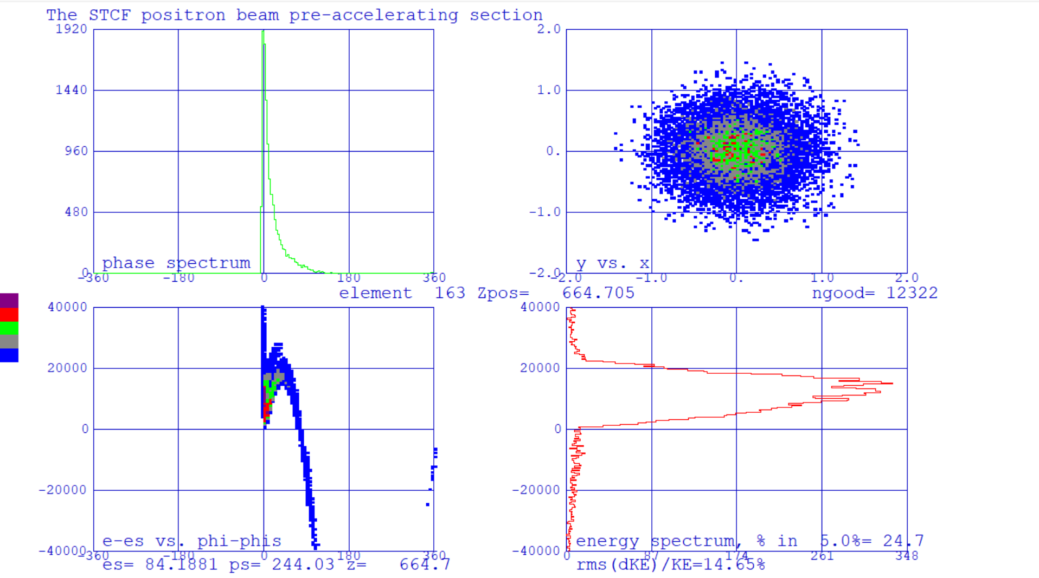
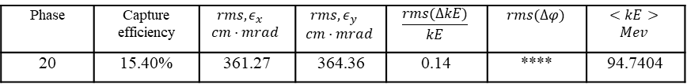
Positron pre-accelerating section
STCF
Phase | Capture efficiency | $$rms,ε_{x}$$ $$cm·mrad$$ | $$rms,ε_{y}$$ $$cm·mrad$$ | $$\frac{rms(∆kE)}{kE}$$ | $$rms(∆φ)$$ | $$<kE>$$ $$Mev$$
20 | 15.40% | 361.27 | 364.36 | 0.14 | **** | 94.7404

Slide 20
Conclusion
STCF
The preliminary layout design of the linear accelerator and the optical design of the Linac sections have been completed.
The optimization of the bypass-electron line is under way. The preliminary optical design of the damping ring has been completed, and the damping time and other parameters need to be optimized carefully in the future.
For the positron source, simulation optimization and design work have been carried out. The AMD design and collection efficiency of the positron were completed. The optical design of the positron beam capture system and the collection efficiency are still being optimized.

Slide 21
STCF
Thanks for your attention！

