Slide 1
Longitudinal beam dynamics and collective effects at the STCF collider rings
Linhao Zhang
2024/01/16
USTC, Hefei, China
The 2024 International Workshop on Future Tau Charm Facilities (FTCF2024)

Slide 2
Contents
Introduction
Longitudinal beam dynamics
Collective effects estimation
Summary

Slide 3
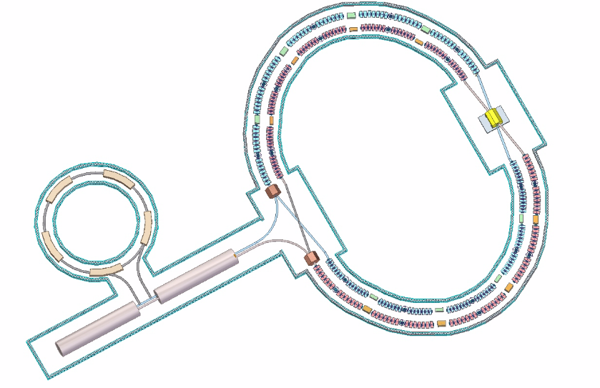
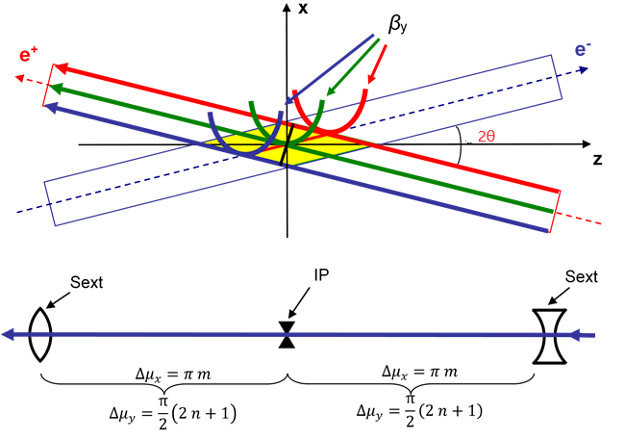
Introduction
STCF (Super Tau-Charm Facility), proposed in China, is a new-generation super high luminosity e+/e- collider in the low-energy region
Beam energy range 1—3.5 GeV (C.o.M energy 2—7 GeV) with optimum energy of 2 GeV
Luminosity aims at 5×10³⁴ cm⁻²s⁻¹ @2 GeV
50 times higher than BEPCII
Key parameters | Requirements
Beam energy | 1—3.5 GeV (Optimum energy 2 GeV)
Luminosity | ≥ 5×10³⁴ cm⁻²s⁻¹ @2 GeV
Ring circumference | 600—1000 m
$β_{y}^{∗}$ at IP | ≤ 1 mm
Crossing angle 2θ | ~60 mrad
Beam lifetime | ≥ 300 s
Collision scheme [1]
To achieve such high luminosity, a large Piwinski angle φ combined with the crab-waist collision scheme is adopted
Large φ makes interaction area length $L_{i}\sim {σ_{x}}/θ≈{σ_{z}}/φ$
$β_{y}^{∗}\sim {σ_{x}}/θ$ without hourglass effect
However, large φ introduces unwanted betatron and sychro-betatron beam-beam resonance
CRAB sextupole pairs with special phase advance and strength are innovatively used to suppress these resonance
$$φ=\frac{σ_{z}}{σ_{x}}tan⁡θ≈\frac{σ_{z}}{σ_{x}}θ$$
$$L_{i}$$
$$K2L=±\frac{1}{{θβ}_{y}^{∗}β_{y}}\sqrt{\frac{β_{x}^{∗}}{β_{x}}}$$
[1] P. Raimondi, D. Shatilov, M. Zobov, Proceedings of 2nd SuperB Workshop, Frascati, 2006

Slide 4
Introduction
However, the collision scheme will introduce a novel coherent beam-beam effect (coherent X-Z instability)[1], which imposes stringent constraints on the longitudinal beam dynamics
requiring the horizontal beam-beam parameter 𝜉_{x} to be much less than the synchrotron tune 𝜈_{z}, i.e. 𝜉_{x} << 𝜈_{z}
On the other hand, STCF beam properties: low energy, low emittance(~5nm), high current (~2A)
This means STCF faces significant beam collective effects
Most of which relies on longitudinal parameters (bunch length σ_{z}, energy spread σ_{δ}, synchrotron tune 𝜈_{z}, etc.)
The reason why we need to special design the STCF longitudinal beam dynamics
which involves transverse dynamics, beam-beam effects, and collective effects, etc., in order to search for possible optimal solutions.
[1] K. Ohmi, N. Kuroo, K. Oide, D. Zhou, and F. Zimmermann, PRL 119, 134801 (2017)

Slide 5
Contents
Introduction
Longitudinal beam dynamics
Collective effects estimation
Summary

Slide 6
Longitudinal dynamics design considerations
Luminosity (take 2 GeV as an example)
Beam energy 2 GeV →$γ$ = 3914.9
Beam current
I = 2A
Vertical beam-beam parameter：
$$ξ_{y}=\frac{r_{0}N_{b}}{2πγ}∙\frac{β_{y}^{∗}}{σ_{y}σ_{x}\sqrt{1+φ^{2}}}≈\frac{r_{0}N_{b}}{2πγ}∙\frac{β_{y}^{∗}}{σ_{y}σ_{z}θ}$$
$$L=\frac{γ}{2er_{e}}\frac{Iξ_{y}}{β_{y}^{∗}}H$$
$$φ=\frac{σ_{z}}{σ_{x}}tan⁡θ≈\frac{σ_{z}}{σ_{x}}θ≫1$$
Luminosity reduction factor due to Hourglass effect：
$$H=\frac{β_{y}^{∗}}{\sqrt{π}σ_{z_e}}exp⁡\left(\frac{β_{y}^{∗2}}{2σ_{z_e}^{2}}\right)K_{0}\left(\frac{β_{y}^{∗2}}{2σ_{z_e}^{2}}\right)$$
Electron charge:
e = 1.602 x 10⁻¹⁹ C
Classical electron radius:
r_{e} = 2.818 x 10⁻¹⁵ m
Lattice design
$$β_{y}^{∗}=0.6 mm$$
Effective bunch length $σ_{z_e}={σ_{z}}/φ$
K₀:0th order modified Bessel function
To achieve the high luminosity (≥ 0.5×10³⁵ cm⁻²s⁻¹) at 2 GeV, the beam current of 2 A and $β_{y}^{∗}$ of 0.6 mm are first chosen, which poses a limitation on $ξ_{y}$, and thus on $σ_{z}$
Note: Luminosity (almost) inversely proportional to $σ_{z}$ (since $ξ_{y}∝1/{σ_{z}}$)
Additionally, it is noted that the time resolution at the detector requires $σ_{z}$ not larger than 12 mm

Slide 7
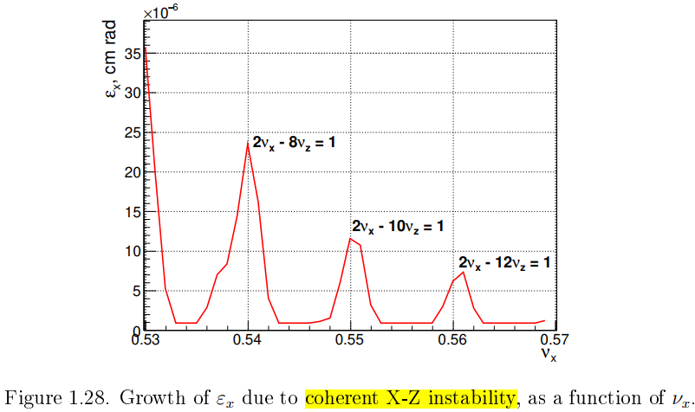
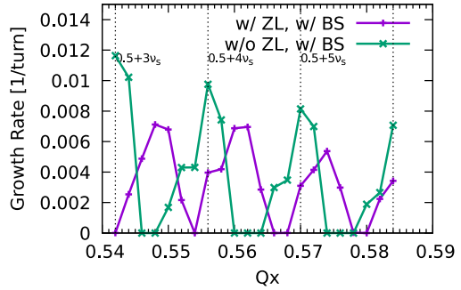
Longitudinal dynamics design considerations
Coherent X-Z instability
A newly discovered coherent beam-beam interaction under a large Piwinski angle using strong-strong beam-beam simulations
primarily leads to an increase in the horizontal emittance 𝜀_{x}
Considering the coupling between horizontal and vertical emittances, it eventually results in an increase in the vertical emittance 𝜀_{y} and a collapse of the luminosity
This instability cannot be suppressed through beam feedback systems, but can only be avoided through appropriate parameter optimization
Typically, a stringent requirement of 𝜉_{x} ≪ 𝜈_{z} is imposed to have wide region for the selection of working point without beam blow-up
In the case of STCF, 𝜈_{z}/𝜉_{x} ≥ 3 is expected.
SCTF case
CEPC case

Slide 8
Longitudinal dynamics design considerations
Lattice Design and Damping Wigglers
Lattice design is crucial for achieving high luminosity by achieving the required optical parameters at IP and by optimizing nonlinear dynamics aperture
Additionally, it defines the momentum compaction factor 𝛼_{p} and natural energy spread 𝜎_{δ} in the electron storage ring through synchrotron radiation integrals.
Damping wigglers are essential for STCF to control the damping time (30 ms) and to maintain beam emittance almost constant (~5 nm) throughout the entire energy range 1—3.5 GeV.
This inevitably increases the synchrotron radiation energy loss per turn
raising the demand for RF power
This also increases the natural energy spread
resulting in a proportional growth in bunch length
The lattice including damping wigglers has been designed for STCF at 2 GeV
These parameters (𝛼_{p} and 𝜎_{δ} ) are of importance in the longitudinal dynamics

Slide 9
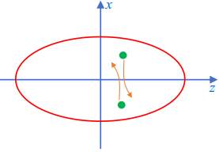
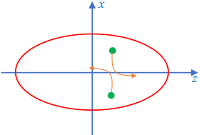
Longitudinal dynamics design considerations
Non-impedance-induced collective effects
Intrabeam scattering (IBS): multiple small-angle Coulomb scattering processes
not immediately cause particle loss in the bunch
but increase the equilibrium energy spread, bunch length, and transverse emittances
Touschek effect: single large-angle scattering processes
A large momentum deviation (beyond RF momentum acceptance or physical aperture)
thus limit the lifetime of the stored beam (i.e., the Touschek lifetime)
These two effects are directly related to the 6D phase-space size and thus associated with longitudinal parameters such as the bunch length
elegant and SAD codes can be used to calculate IBS and the Touschek lifetime
IBS
Touschek scattering
Impedance-induced single-bunch collective effects
bunch lengthening due to potential well distortion (PWD)
longitudinal microwave instability (LMWI)
transverse mode coupling instability (TMCI)
$${\left(\frac{σ_{z}}{σ_{z0}}\right)}^{3}−\frac{σ_{z}}{σ_{z0}}=\frac{I_{b}α_{p}}{4\sqrt{π}ν_{z}^{2}E/e}{\left(\frac{R}{σ_{z0}}\right)}^{3}Im{\left(\frac{Z_{∥}}{n}\right)}_{eff}$$
$$I_{b}^{mwi}=\frac{σ_{z}}{R}\frac{\sqrt{2π}α_{p}E/e}{{\left|Z_{∥}/n\right|}_{eff}}σ_{δ}^{2}$$
$$I_{b}^{tmci}=\frac{σ_{z}}{R}\frac{4\sqrt{π}ν_{z}E/e}{\left\langle β\right\rangle ⋅ImZ_{⊥}^{eff}}$$
Notes:
collective effects can be induced by beam itself and beam interaction with surroundings.

Slide 10
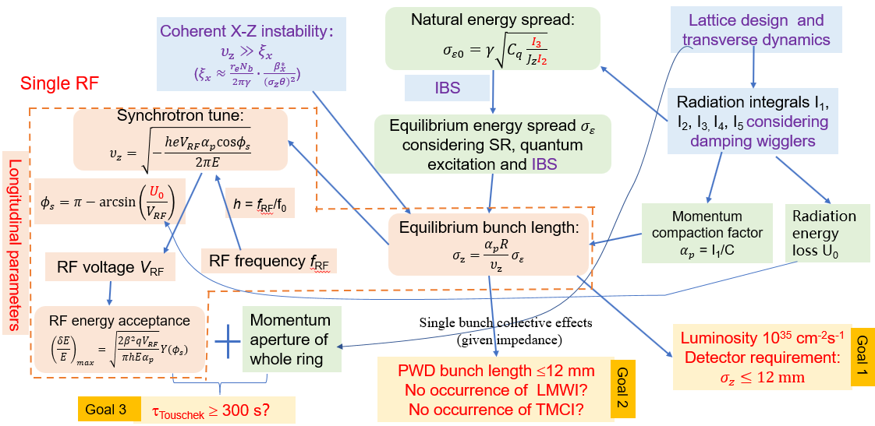
Longitudinal dynamics design
Longitudinal beam dynamics design for STCF requires iterative optimization considering transverse dynamics, beam-beam effects, and collective effects, in order to search for possible optimal solutions
Input constraints
Parameters defined by transverse dynamics
Longitudinal dynamics design
Optimization goals
Prioritize goal 1 (Luminosity) and goal 2 (single-bunch instability)
In fact, Touschek lifetime (Goal 3) relies heavily on the optimization of transverse nonlinear dynamics
This is considered highly challenging for STCF

Slide 11
Longitudinal dynamics design
Parameters | Units | STCF (wiggler+IBS) | STCF (wiggler+IBS)
Optimal beam energy, E | GeV | 2 | 2
Circumference, C | m | 616.76 | 616.76
Crossing angle, 2θ | mrad | 60 | 60
Relative gamma |  | 3913.9 | 3913.9
Revolution period, T₀ | ms | 2.057 | 2.057
Revolution frequency, f₀ | kHz | 486.08 | 486.08
Horizontal emittance, ε_{x} | nm | 5.77 | 5.66
Coupling, k |  | 0.50% | 0.50%
Vertical emittance, ε_{y} | pm | 28.85 | 28.85
Hor. beta function at IP, β_{x} | mm | 40 | 40
Ver. beta function at IP, β_{y} | mm | 0.6 | 0.6
Hor. beam size at IP, σ_{x} | μm | 15.19 | 15.05
Ver. beam size at IP, σ_{y} | μm | 0.132 | 0.130
Betatron tune, ν_{x}/ν_{y} |  | 31.552/24.572 | 31.552/24.572
Momentum compaction factor, α_{p} | 10⁻⁴ | 9.71 | 9.71
Energy spread, σ_{e} | 10⁻⁴ | 8.26 | 8.26
Beam current, I | A | 2 | 2
Bunch train gap |  | 0% | 0%
Number of bunches, n_{b} |  | 514 | 514
Single-bunch current, I_{b} | mA | 3.89 | 3.89
Particles per bunch, N_{b} | 10¹⁰ | 5.00 | 5.00
Single-bunch charge | nC | 8.01 | 8.01
Energy loss per turn, U₀ | keV | 286 | 286
damping time, τ_{x}/τ_{y}/τ_{z} | ms | 28.6/28.8/14.4 | 28.6/28.8/14.4
RF frequency, f_{RF} | MHz | 499.7 | 499.7
Harmonic number, h |  | 1028 | 1028
RF voltage, V_{RF} | MV | 1.2 | 0.85
Synchronous phase, f_{s} | deg | 166 | 160
Synchrotron tune, ν_{z} |  | 0.0096 | 0.0080
Natural bunch length, σ_{z} | mm | 8.18 | 9.81
RF bucket height, (ΔE/E)_{max} | % | 1.58 | 1.20
Piwinski angle, $φ_{Piw}$ | rad | 16.16 | 19.57
Hor. beam-beam parameter, ξ_{x} |  | 0.0038 | 0.0026
Ver. beam-beam parameter, ξ_{y} |  | 0.106 | 0.09
Equivalent bunch length, σ_{z_e} | mm | 0.51 | 0.50
Hour-glass factor, F_{h} |  | 0.8881 | 0.8896
Luminosity, L | cm⁻²s⁻¹ | 1.37E+35 | 1.15E+35
Touschek lifetime | s | >110 | >110
Single RF system, V_{RF}=1.2 MV, ν_{z}=0.0096, RF acceptance 1.58%
$σ_{z}=8.18 mm$， $ξ_{x}=0.0038→υ_{z}=2.5 ξ_{x}$
$ξ_{y}=0.106, L=1.37×{10}^{35} {cm}^{−2}s^{−1}$
$υ_{z}=2.5ξ_{x}$ doesn’t meet the requirement of coherent X-Z instability, possible mitigations:
1) Increase crossing angle 60 mrad → 80 mrad
$ξ_{x}=0.0021，υ_{z}=4.6 ξ_{x}$，$ξ_{y}=0.08, L=1.07×{10}^{35} {cm}^{−2}s^{−1}$
2) Modify lattice to increase $α_{p}$ and $σ_{δ}$
3) Reduce RF voltage 1.2 MV → 0.85 MV (RF acceptance 1.2%)
$σ_{z}=9.81mm$，ν_{z}=0.008, $ξ_{x}=0.0026→υ_{z}=3.1 ξ_{x}$
$ξ_{y}=0.090, L=1.15×{10}^{35} {cm}^{−2}s^{−1}$
The scheme adding a higher harmonic RF cavity to lengthen bunch is not considered here, since it will decrease $υ_{z}$ while lengthening bunch
more difficult to meet $υ_{z}≫ξ_{x}$
Need to negotiate with MDI group
All these measures need to be checked by beam-beam simulations

Slide 12
Single-harmonic RF system considerations
Define the number of RF cavities from radiation power loss
Synchrotron radiation power loss at 2 GeV is approximately 572 kW
If BEPCII-type superconducting cavities are used, 2 cavities are required (assuming the highest transmission power for input couplers is around 300 kW)
The number and power of BEPCII-type superconducting RF cavities required in the 1-3.5 GeV energy range need to be further determined after the completion of the parameter design in the entire energy range
RF voltage distribution:
At 2 GeV, the total RF voltage required for STCF is approximately 1.2 MV, so the voltage for a single cavity is around 0.6 MV
Since the maximum voltage for a single BEPCII-type superconducting cavity can reach up to 1.8 MV, the maximum voltage for the two cavities can reach 3.6 MV (currently only using 1.2 MV), providing sufficient voltage margin for bunch length adjustment
RF characteristics for the STCF: high power requirement, but not high total voltage
different from SuperKEKB RF system, which requires high power and high total RF voltage
Heavy beam loading

Slide 13
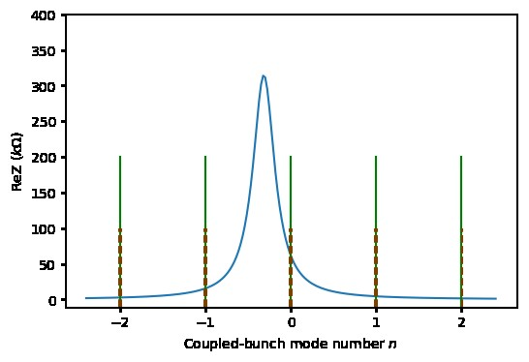
Beam loading driven by RF accelerating mode
In a storage ring, the RF cavity needs to be detuned to compensate for the reactive component of beam loading, so that the power input from the transmitter to the cavity is minimized
The optimal cavity detuning is:
Refer to BEPCII superconducting cavity
R_{s}/Q₀ | 95.4 | Ω
Q₀ | 10⁹
f_{r} | 499.7 | MHz
V_{c} | 0.6 | MV
For STCF at 2GeV, the optimal cavity detuning is -154.2kHz，about 32% of revolution frequency f₀(480.08kHz)
Coupled bunch instability growth rate:
$$f_{+}=f_{RF}+nf_{0}+f_{s}$$
excitation mode
damping mode
$$f_{−}=f_{RF}−nf_{0}−f_{s}$$
For n=-1 coupled bunch mode，τ=3.6ms，shorter than longitudinal radiation damping time 15ms
Longitudinal couple bunch instability driven by RF accelerating mode (-1 mode) for STCF requires RF feedback
-1 mode feedback system could refer to SuperKEKB or PEP-II
The cavity detuning for B factories is equal to or even greater than revolution frequency f₀, thus, longitudinal CBI caused by -1 mode is much severe than STCF

Slide 14
Contents
Introduction
Longitudinal beam dynamics
Collective effects estimation
Summary

Slide 15
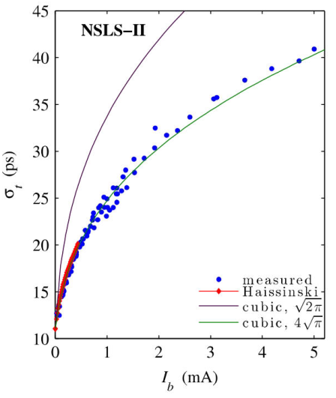
Impedance-induced single-bunch collective effects
Bunch lengthening due to potential well distortion (PWD)
Longitudinal microwave instability (LMWI)
$${\left(\frac{σ_{z}}{σ_{z0}}\right)}^{3}−\frac{σ_{z}}{σ_{z0}}=\frac{I_{b}α_{p}}{4\sqrt{π}ν_{z}^{2}E/e}{\left(\frac{R}{σ_{z0}}\right)}^{3}Im{\left(\frac{Z_{∥}}{n}\right)}_{eff}$$
Assuming $Im{\left({Z_{∥}}/n\right)}_{eff}$ =0.1 Ω (a typical value for modern storage rings)，then $σ_{z}=8.20mm→9.76mm$
Beneficial to 𝜉_{x} ≪ 𝜈_{z}
Note: coefficient is $4\sqrt{π}$, not $\sqrt{2π}$ [1,2]
$$υ_{z}=\frac{α_{p}R}{σ_{z}}σ_{ε}$$
$$ξ_{x}≈\frac{r_{e}N_{b}}{2πγ}∙\frac{β_{x}^{∗}}{{\left(σ_{z}θ\right)}^{2}}$$
[1] V. Smaluk, NIMA888, 22 (2018)
[2] D. Zhou, G. Mitsuka, T. Ishibashi, and K. Bane, arXiv:2309.00808 (2023)
Transverse mode coupling instability (TMCI)
$$I_{b}^{lmwi}=\frac{σ_{z}}{R}\frac{\sqrt{2π}α_{p}E/e}{{\left|Z_{∥}/n\right|}_{eff}}σ_{δ}^{2}$$
Assuming the imaginary part of the raw impedance dominates the effective impedance, i.e., ${\left|{Z_{∥}}/n\right|}_{eff}$ = 0.1 Ω, then $I_{b}^{mwi}=3.3 mA$，
Lower than the design single-bunch current 3.9mA！
Impedance optimization is a must!
Further parameter optimization is also necessary
$ImZ_{⊥}^{eff}=\frac{2R}{b^{2}}Im{\left(\frac{Z_{∥}}{n}\right)}_{eff}=13.96 kΩ/m$ (Panofsky-Wenzel theorem) with b =37.5 mm, $\left\langle β_{y}\right\rangle =42.5 m$, then $I_{b}^{tmci}=22.8 mA$, higher than the design single-bunch current 3.9mA
Ordinary vacuum chamber impedance will not cause TMCI
However, further study is needed to determine if the addition of special components, especially collimators, will induce TMCI.

Slide 16
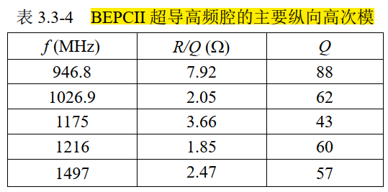
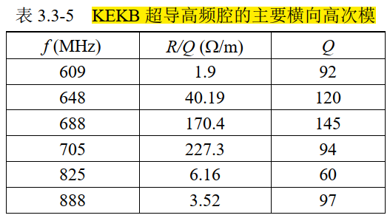
Impedance-induced coupled bunch instabilities
Longitudinal and transverse coupled-bunch instabilities induced by RF high order mode (HOM)
Assume that STCF adopts BEPCII superconducting cavity，the main longitudinal HOM and transverse HOM (refers to KEKB SC) are assessed below:
Growth rate:
$$\frac{1}{τ_{∥}}=\frac{n_{b}I_{b}α_{p}}{2(E/e)ν_{z}}fR_{s}$$
$$\frac{1}{τ_{⊥}}=\frac{n_{b}I_{b}f_{0}\left\langle β\right\rangle }{2E/e}R_{s}$$
2 cavities
R (Ω) | τ (ms)
697 | 15.0
127 | 75.8
157 | 53.6
111 | 73.2
141 | 46.8
R (Ω/m) | τ_{y} (ms)
175 | 275.9
4823 | 10.0
24708 | 1.95
21366 | 4.5
370 | 130.5
341 | 142.0
Longitudinal damping time 15ms
⇒ Synchrotron radiation can damp longitudinal CBI driven by RF HOM.
Transverse damping time 30 ms
Synchrotron radiation cannot damp transverse CBI driven by RF HOM.，
Transverse bunch-by-bunch feedback system is required

Slide 17
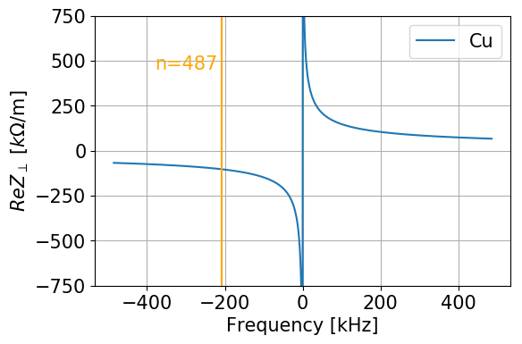
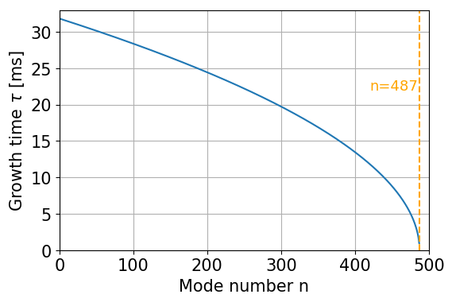
Impedance-induced coupled bunch instabilities
Transverse coupled-bunch instabilities induced by resistive-wall impedance
The image current induced by the relativistic beam on the walls of vacuum chamber with finite conductivity excites electromagnetic fields, acting on subsequent bunches, which can lead to development of instability
mainly caused by resonant peaks in the transverse wall impedance at low frequencies
Simple impedance model:
cylindrical vacuum chamber
$$\frac{1}{τ_{⊥}}=−\frac{\left\langle β\right\rangle ω_{0}n_{b}I_{b}}{4πE/e}\sum_{p=−∞}^{∞}{ReZ_{⊥rw}(ω_{pn})}$$
$$Z_{⊥rw}\left(ω\right)=(\operatorname{sgn}\left(ω\right)−i)\frac{L}{2π}\frac{Z_{0}δ_{z}\left(ω\right)}{b^{3}}$$
Growth rate:
The most dangerous mode is n=487, corresponding to an unstable growth time of 0.94 ms
Transverse bunch-by-bunch feedback system is required

Slide 18
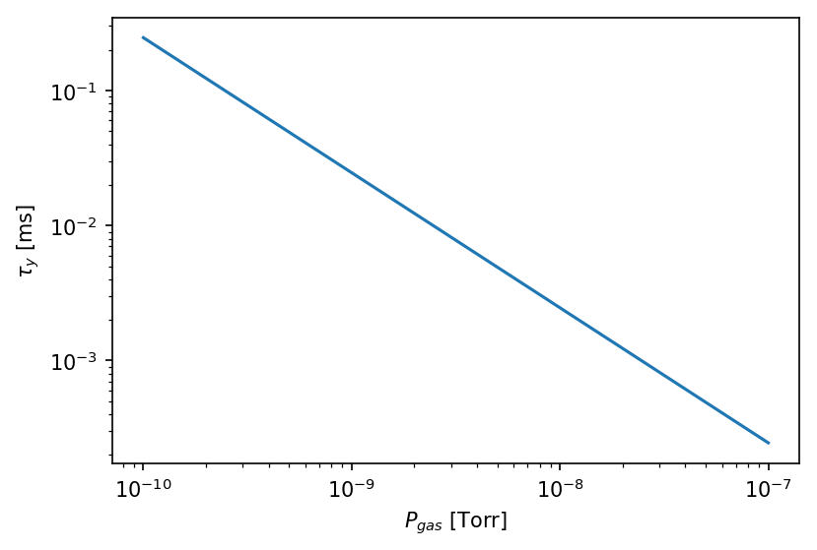
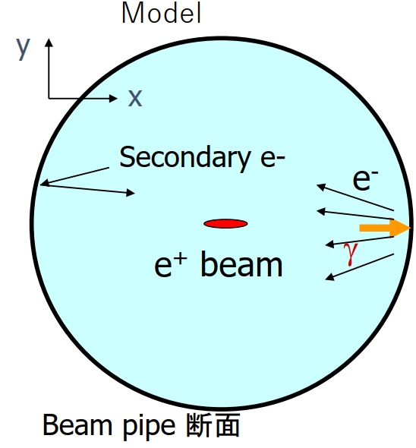
Two-beam collective instabilities
$$\frac{1}{τ_{c}}=5P_{gas}(Torr)\frac{\left\langle β_{y}\right\rangle N_{b}^{3/2}n_{b}^{2}r_{e}r_{p}^{1/2}L_{sep}^{1/2}c}{γσ_{y}^{3/2}{\left(σ_{x}+σ_{y}\right)}^{3/2}A_{i}^{1/2}}$$
Fast beam instability (electron storage ring)
Electron cloud effects (positron storage ring)
Particle factory type accelerators (with high current and small size) have high ion yield and oscillation frequency due to the beam-gas interaction, resulting in instability occurring in a single turn
Considering the spread of ion oscillation frequency, when the vacuum degree P_{gas} is 10⁻¹⁰ Torr, the instability growth time is about 0.2 ms!
Mitigation methods:
1) Transverse bunch-by-bunch feedback; 2) Large chromaticity
can cause coupled-bunch instability and single-bunch head tail instability
STCF(2GeV)
0.02
0.33
⇒ Electron clouds at STCF are more serious than BEPCII, PEPII, KEKB
Mitigation methods:
1) Antechamber beam pipe; 2) TiN coatings in vacuum chambers;
3) Solenoid fields in straight sections； 4) Clear electrode in beam pipe

Slide 19
Summary
STCF longitudinal dynamics at 2 GeV has been designed considering transverse dynamics, beam-beam effects and collective effects
Single harmonic RF with total voltage 1.2MV (or less) basically enough
Further iterative optimization is still needed, following the beam-beam simulations
Main collective effects for STCF at 2 GeV was preliminarily estimated without impedance model (or with simplest impedance model) based on the ideal theoretical formula
Detailed impedance models (or impedance budget) should be constructed
Further simulations with impedance models are needed to study the collective instabilities
Thanks for your attention!

