Slide 1
Status of beam-beam simulation for STCF
_{Sangya Li}
National Synchrotron Radiation Laboratory
University of Science and Technology of China

Slide 2
Previous work
Current work progress
Future work arrangement
Notes:
Iteration of parameter

Slide 3
1
Previous work
Notes:
Tipical structure

Slide 4
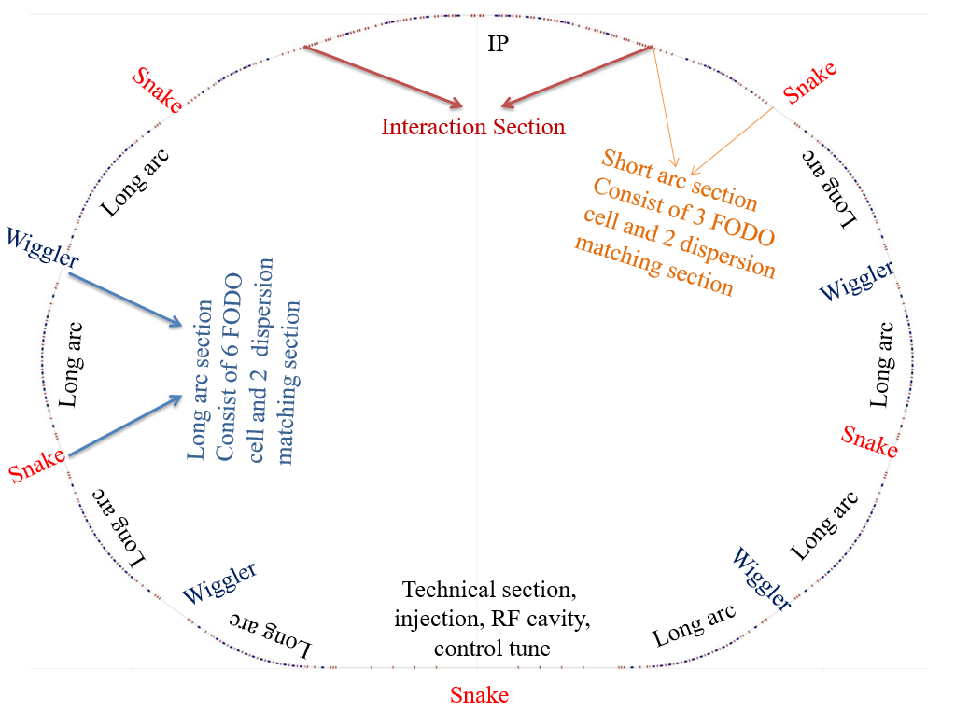
First edition lattice
Preliminary lattice design results (no nolinear)
parameters | values
Circumference /m | 707.258
Beam energy/GeV | 2*，1-3.5
Crossing angle (2θ)/mrad | 60
current/A | 1.5
$\left({β_{x}^{∗}/β}_{y}^{∗}\right)$/mm | 64.1/0.638
ε$\left(ε_{x}/ε_{y}\right)$/nm·rad | 2.85/0.0285
ν_{x}/ν_{y} | 30.523 / 28.538
chromaticity(C_{x}/C_{y}) | -95.291/-346.239
Momentum compaction factor | 1.237×10⁻³
Energy spread | 4.034×10⁻⁴
Energy loss per turn/keV | 78.4
(σ_{x}/σ_{y} )/μm | 13.61/1.39
$$ξ_{y}$$ | 0.04-0.06（estimate）
Hourglass factor | 0.8（estimate）
Luminosity/×10³⁵cm⁻²s⁻¹ | 0.63-0.95
Fig 1 Collider layout
From Q. Luo “STCF-ACC Accelerator concept introduction and summary”,2020.

Slide 5
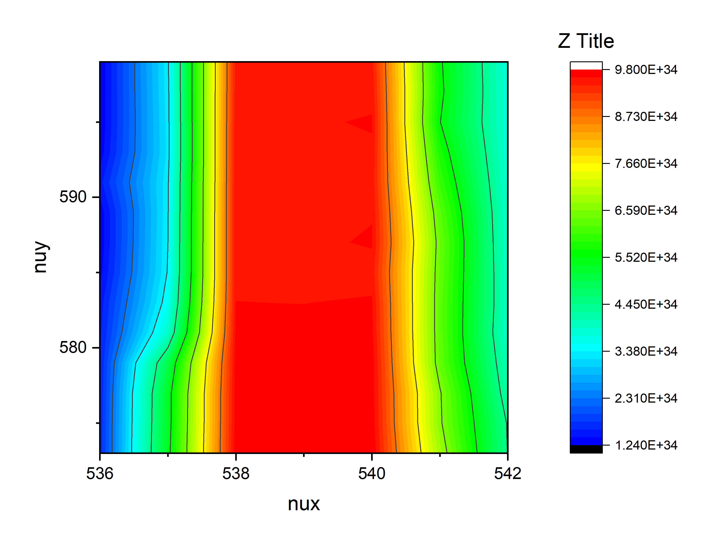
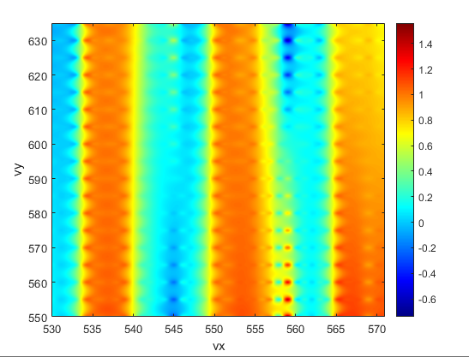
Second edition lattice
Adjustment of parameters
parameters | values
Circumference /m | 702
Beam energy/GeV | 2*，1-3.5
Crossing angle (2θ)/mrad | 60
current/A | 2
$\left({β_{x}^{∗}/β}_{y}^{∗}\right)$/mm | 90/0.6
ε$\left(ε_{x}/ε_{y}\right)$/nm·rad | 4.167/0.0208
ν_{x}/ν_{y} | 30.537 / 28.570
Momentum compaction factor | 7.20E-04
Energy spread | 7.19E-04
(σ_{x}/σ_{y} )/μm | 19.37/0.1117
$$ξ_{y}$$ | 0.08549
Hourglass factor | 0.9
Luminosity/×10³⁵cm⁻²s⁻¹ | 1.1
ξx ~0.005 ,Reducing betax(to 9cm) → ξx< 0.004
ξy increased by 1.22 times
Control nus~3xix to suppress X-Z instability
lum0: 0.9 → 1.34 ${ (10}^{35}\text{cm}\text{−2}\text{s}\text{−1}$）
Fig 2 luminosity chart changes from 2022 to 2023 (by IBB)
Notes:
The high brightness distribution region in nuy direction was obtained by tracking the size of the cluster and scanning the nuyIf xix~0.005 is too large, the blowup in the x direction is severe. Get a faster stable beam to get a higher brightness and achieve the damping time target: 36msTo get higher theoretical brightness. In the process of parameter iteration, the luminosity gradually increased longitudinal

Slide 6
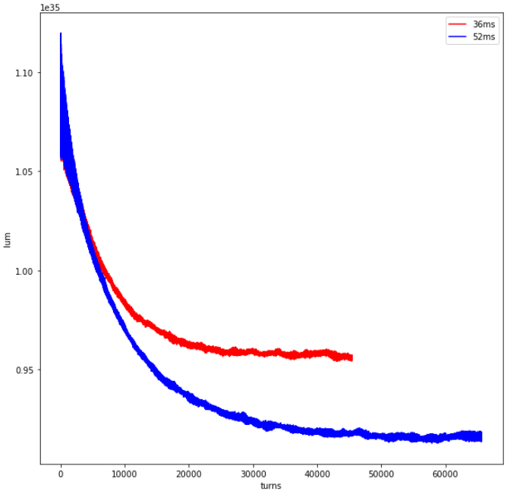
Design of wiggler
Add damping wiggler
damping time :
52ms → 36ms
(0.536,0.575,0.016)
 | damping time/ms | lum at 1dt | lum at 2dt | lum at 3dt
12000 | 24.68 | 10.1225 | 10.025 | 10.015
16000 | 32.91 | 9.895 | 9.81 | 9.7975
17500 | 35.99 | 9.8225 | 9.7225 | 9.725
18180 | 37.39 | 9.79 | 9.685 | 9.6925
20000 | 41.13 | 9.7 | 9.62 | 9.5925
25000 | 51.42 | 9.4925 | 9.3725 | /
design parameter of damping wiggler ：
Fig 3 The luminosity of different damping time

Slide 7
2
Current work progress
Notes:
Tipical structure

Slide 8
Third edition lattice
Parameters | Units | STCF
Optimal beam energy, E | GeV | 2
Circumference, C | m | 616.76
Crossing angle, 2θ | mrad | 60
Relative gamma |  | 3913.9
Revolution period, T₀ | μs | 2.057
Revolution frequency, f₀ | kHz | 486.08
Horizontal emittance, ε_{x} | nm | 4.47
Coupling, k |  | 0.50%
Vertical emittance, ε_{y} | pm | 22.35
Hor. beta function at IP, β_{x} | mm | 40
Ver. beta function at IP, β_{y} | mm | 0.6
Hor. beam size at IP, σ_{x} | μm | 13.37
Ver. beam size at IP, σ_{y} | μm | 0.116
Betatron tune, ν_{x}/ν_{y} |  | 31.552/24.572
Momentum compaction factor, α_{p} | 10⁻⁴ | 10.27
Energy spread, σ_{ε} | 10⁻⁴ | 8.77
Beam current, I | A | 2
Number of bunches, n_{b} |  | 512
Single-bunch current, I_{b} | mA | 3.91
Particles per bunch, N_{b} | 10¹⁰ | 5.02
Single-bunch charge | nC | 8.04
Energy loss per turn, U₀ | keV | 273
Hor. damping time, τ_{x} | ms | 30.14
Ver. damping time, τ_{y} | ms | 30.14
Long. damping time, τ_{z} | ms | 15.07
RF frequency, f_{RF} | MHz | 497.5
Harmonic number, h |  | 1024
RF voltage, V_{RF} | MV | 1.2
Synchronous phase, φ_{s} | deg | 167
Synchrotron tune, ν_{z} |  | 0.0099
Bunch length, σ_{z} | mm | 8.94
Natural bunch length, σ_{z} | mm | 8.94
RF bucket height, (ΔE/E)_{max} | % | 1.56
Piwinski angle, φ_{Piw} | rad | 20.06
Hor. beam-beam parameter, ξ_{x} |  | 0.0032
Ver. beam-beam parameter, ξ_{y} |  | 0.111
Equivalent bunch length, σ_{z_e} | mm | 0.45
Hour-glass factor, F_{h} |  | 0.9066
Luminosity, L | cm⁻²s⁻¹ | 1.45E+35
The important changes
Circumference 702 → 616.76 m
$β_{x}^{∗}$ 90 → 40 mm
$ε_{y}$ 20.8 → 22.35 pm
Momentum compaction factor
Energy spread
Natural bunch length
$ξ_{y}$ 0.0855 → 0.111
Input parameters parameters from lattice design also input parameters output parameters (use formula)
Notes:
the distance from the collision point and couples the transverse bunch size to the longitudinal position [16]. The hourglass eﬀect
arises when the transverse bunch size becomes comparable to the length of the bunch
With the same number of particles, the smaller the emittance, the higher the beam quality
Geometrically equal to the area of the elliptical phase diagram occupied by the beam in the phase space

Slide 9
The code
simulation
Weak-strong simulation
(strong)：single-macro particle model,beam has a fixed charge distribution
(weak) ：multi-macro particle model.
Current usage: IBB (WS), BBWS.
Strong-strong simulation
PIC strong-strong method
The macroparticle model is used for both bunch.
Head-tail instability
Current usage: IBB (SS), BBPS.
IBB, Y.Zhang , IHEP
BBWS, BBSP(BBSS) K. Ohmi ,KEK
Notes:
Advantages: The calculation is small (only equivalent to introducing one more nonlinear element). Disadvantages: not self-consistent, unable to simulate complex instability such as coupling impedance.
Current usage: IBB (WS), BBWS.
IBB supports mpi parallelism but does not use fit simplification, faster than BBWS
Disadvantages: large calculation, advantages: self-consistent, more accurate
Current usage: IBB (SS), BBPS.

Slide 10
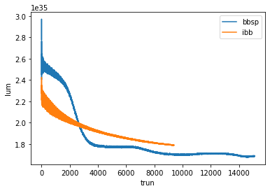
Simulation result
cross-verified
Far exceeding the target luminosity under the design parameters without considering the stability.
comparison of parameters | STCF (v3)
L (m) | 616.76
βy* | 0.6mm
peak luminosity | 1.4e35𝑐𝑚−2 𝑠 −1
ξx/ξy | 0.0038/0.106
νz | 0.0096
design bunch population | 5.02e10
σx /σy (μm) | 15.19/0.132
σz （mm） | 8.21(vs natural bunch length8.2)
Working point | (31.552,24.572)
Fig 4 The strong-strong simulation result of design working point with two kinds of code
Notes:
The strong-strong simulation with two kinds of code simulation is cross-verified, which far exceeds the target luminosity under the design parameters without considering the stability.

Slide 11
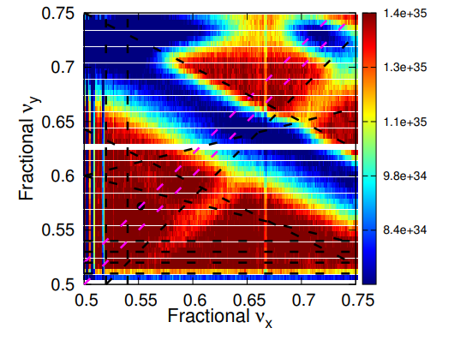
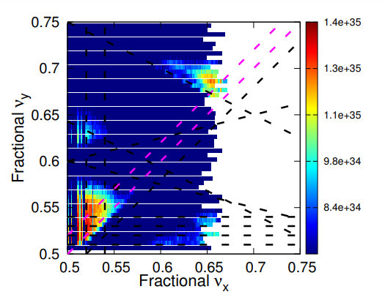
Simulation result
luminosity chart
The development of high luminosity interval:
In the process of parameter iteration, the luminosity gradually increased (2 figures above: luminosity chart changes from 2022 to 2023 years)
IBB:
22-23 v_{z}=0.016
2022 v_{z}=0.012
The scanning of luminosity for large area :
2 figures below: luminosity chart of the current parameter (version v3) , crossing Angle of 60 milliradians, with crab waist on (left) and off (right) , respectively .
BBWS:
CW ON
CW OFF
Notes:
The strong-strong simulation with two kinds of code simulation is cross-verified, which far exceeds the target brightness under the design parameters without considering the stability.

Slide 12
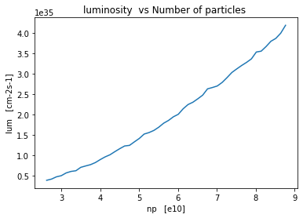
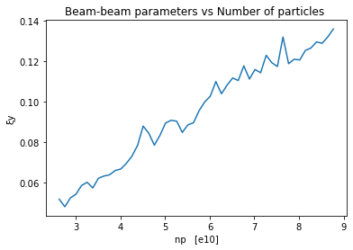
Simulation result
vs Number of particles
At the designed working point(0.552,0.572), the luminosity and beam-beam parameter increase almost smoothly with the increase of particle number, which has better robustness than other unstable working points.
Fig 5 Beam-beam simulation results for design working point. The final luminosity as functions of Np and the final beam-beam parameters as a function of bunch population (Np ) are summarized in left and right, respectively
Notes:
Since the STCF is designed to have a range from 1GEV to 3.5GEV, we will certainly be faced with different beam densities. We simply simulate the situation of different particle numbers to test the robustness of the operating point.

Slide 13
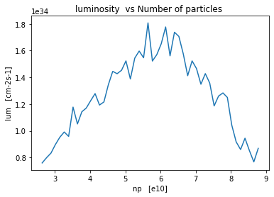
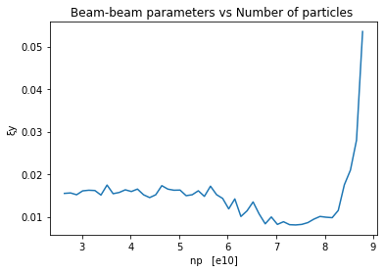
Simulation result
vs Number of particles
As a contrast, the result of working point(0.502,0.472), the luminosity and beam-beam parameter with the increase of particle number is not regular.
Fig 6 Beam-beam simulation results for unstable working point. The final luminosity as functions of Np and the final beam-beam parameters as a function of bunch population (Np ) are summarized in left and right, respectively

Slide 14
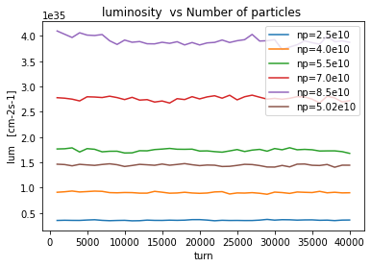
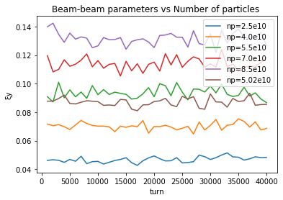
Simulation result
change with different number of particles
At the designed working point, denser bunches are less stable. But it's all stabilizing pretty quickly.
Fig 7 Weak-strong simulation results .The evolutions of the luminosity and beam-beam parameter for np= 2.5e10, 4.0e10, 5.02e10 (design), 5.5e10, 7.0e10 and 8.5e10, respectively

Slide 15
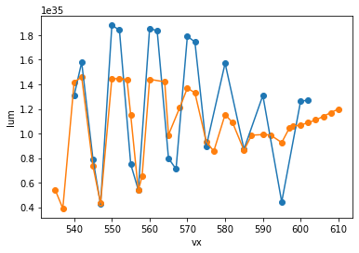
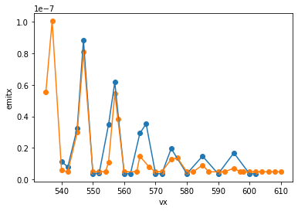
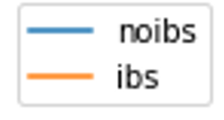
Simulation result
X-Z instability
However, under the current parameters, there is a less optimistic X-Z instability near the design operating point:
1.2vs
1.2vs
1vs
1vs
0.5
0.5+0.4vs
0.5
0.5+0.4vs
1.4vs
1.4vs
Fig 8 Beam-beam simulation results from IBB. The final luminosity and the final emittance as functions of vx (keep vy in designed 572) are summarized in left and right, respectively
Notes:
The coupling of transverse and longitudinal motion caused by large crossing angles reduces the region of stable operating points

Slide 16
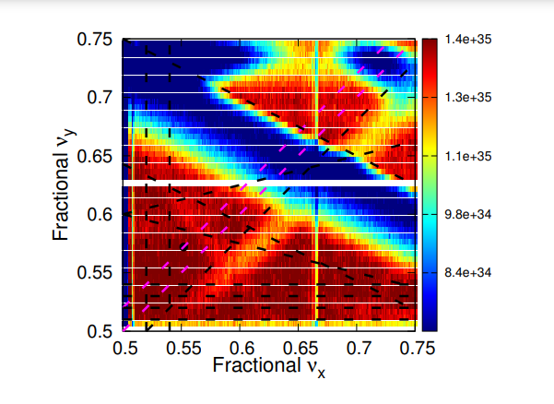
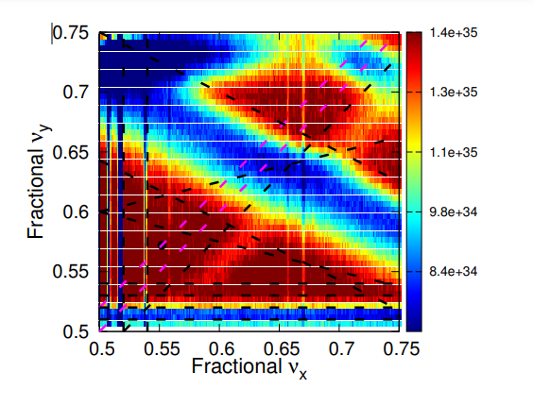
Simulation result
Adjustment of nus
Smaller nus narrow the resonance, more disturbance
Bigger nus widens the distance between vertical resonances
nus =0.005
nus=0.0099(design)
nus =0.02
Fig 9 The luminosity chart of current parameter (version v3) with the nus = 0.005 , 0.0099 (design) and 0.02
Notes:
tiny resonance

Slide 17
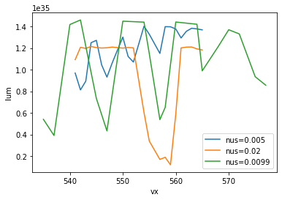
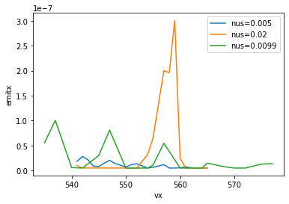
Simulation result
Adjustment of nus
The effect of this instability can be mitigated to a certain extent by adjusting nus :
Fig 10 Beam-beam simulation results from IBB. The final luminosity and the final emittance of nus = 0.005, 0.02 and 0.0099(design) as a function of vx (keep vy in designed 572) are summarized in left and right, respectively .
Notes:
The strong-strong simulation with two kinds of code simulation is cross-verified, which far exceeds the target luminosity under the design parameters without considering the stability.

Slide 18
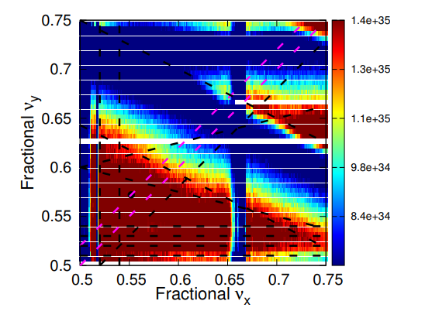
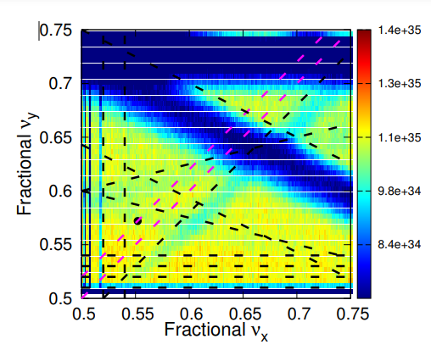
Simulation result
Adjustment of crossing angle
Smaller crossing angle higher luminosity.
18
2θ =0.04
2θ=0.06(design)
2θ =0.08
Fig 11 The luminosity chart of current parameter (version v3) with the crossing angle from 40 milliradians to 80 milliradians .
Notes:
The strong-strong simulation with two kinds of code simulation is cross-verified, which far exceeds the target luminosity under the design parameters without considering the stability.

Slide 19
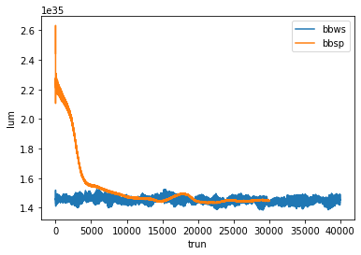
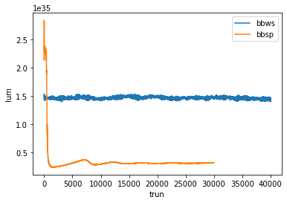
Simulation result
SS vs WS
The stable region of high luminosity is significantly reduced after the coherent instabilities are added in strong-strong simulation :
Fig 12 Beam-beam simulation results from BBWS vs BBSP. The design working point (552,572) on the left and WS working well point (546,545) on the right.
Notes:
The strong-strong simulation with two kinds of code simulation is cross-verified, which far exceeds the target luminosity under the design parameters without considering the stability.

Slide 20
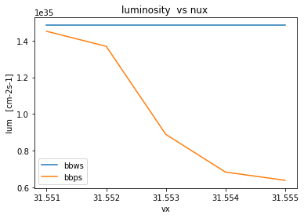
Simulation result
SS vs WS
The stable region of high luminosity is significantly reduced after the coherent instabilities are added in strong-strong simulation :
Fig 13 Beam-beam simulation results from BBWS vs BBSP. The design working point (552,572) on the left and WS working well point (546,545) on the right.
Notes:
The strong-strong simulation with two kinds of code simulation is cross-verified, which far exceeds the target luminosity under the design parameters without considering the stability.

Slide 21
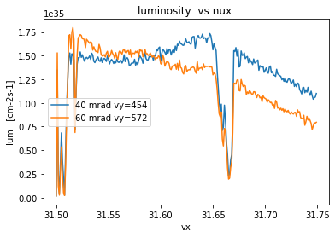
Simulation result
SS vs WS
Another example ,choose vy = 545,from 40 mrad:
Fig 14 Beam-beam simulation results from BBWS. 40 mrad luminosity chart (left), vs 60mrad (right)
Notes:
40 milliradians

Slide 22
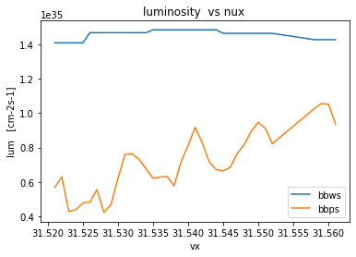
Simulation result
SS vs WS
The stable region of high luminosity is significantly reduced after the coherent instabilities are added in strong-strong simulation :
Fig 15 Beam-beam simulation results from BBWS and BBSP . The final luminosity as a function of vx (vy = 545, crossing angle = 40 mrad).
Notes:
The strong-strong simulation with two kinds of code simulation is cross-verified, which far exceeds the target luminosity under the design parameters without considering the stability.

Slide 23
3
Future work arrangement
Notes:
Tipical structure

Slide 24
Future work
Luminosity scan by strong-strong simulation.
Impedances model: Interplay of beam-beam, longitudinal and transverse impedances.
BBSP with GPU: Interplay of beam-beam and nonlinear lattices.

Slide 25
Thank You！

