Slide 1
Progress on lattice design study for STCF storage rings
Tao Liu
2024/01/16
Notes:
Good morning, every one. it’s my pleasure to be here. I’m Tao Liu. This presentation today will introduce the progress of lattice design study for STCF storage rings.

Slide 2
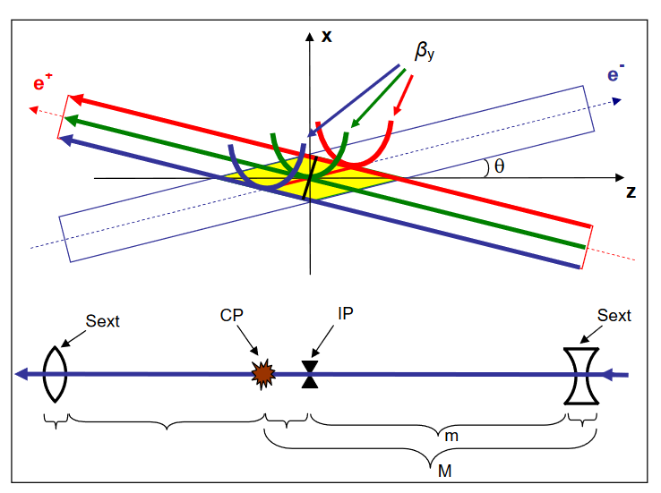
Crab waist scheme
Large piwinski angle
Large crossing angle(actually much smaller than 1)
Small horizontal beam size
Long bunches
Low beta functions at interaction point(IP)
$β_{y}$~1 mm
Crab sextupole pair
Sextupole pair with special phase advance and strengths
$$KΔL=±\frac{1}{θ}\frac{1}{β_{y}^{∗}β_{y}}\sqrt{\frac{β_{x}^{∗}}{β_{x}}}$$
$$\left(\begin{matrix}I & 0 \\ 0 & −I\end{matrix}\right)$$
Notes:
Crab waist is the one of the most important concept for the STCF, it enable us to increase the luminosity about 2 orders.
It consists of three steps:
Large, low beta and crab sextupoles.
Large piwinski angle is created with
Rotate the waist of beta function along the center trajectory of opposite beams,
Then most of the betatron and synchro-betatron resonance will be suppressed.
connected by $\left(\begin{matrix}I & 0 \\ 0 & −I\end{matrix}\right)$ with strengths of opposite signs
Second order geometric aberration cancellation

Slide 3
Design parameters for E=2.0 GeV
Parameters246 | Units | STCF
Optimal beam energy, E | GeV | 2
Circumference, C | m | 616.76
Crossing angle, $2θ$ | mrad | 60
Revolution period, T₀ | $$μs$$ | 2.057
Horizontal emittance, $ε_{x}$ | nm | 5.77
Coupling, k | % | 0.50
Beta function at IP, $β_{x}^{∗}/β_{y}^{∗}$ | mm | 40/0.6
Betatron tune, $ν_{x}/ν_{y}$ |  | 31.552/24.572
Momentum compaction factor, $α_{c}$ | 10⁻⁴ | 9.71
Energy spread, $σ_{e}$ | 10⁻⁴ | 8.26
Beam current, I | A | 2 | 1.34
Number of bunches, n_{b} |  | 514
Particles per bunch, N_{b} | 10¹⁰ | 5.02 | 3.35
Energy loss per turn, U₀ | keV | 286
Damping time, $τ_{x} / τ_{y} / τ_{z}$ | ms | 28.59 /28.77 /14.42
Harmonic number, h |  | 1028
RF voltage, V_{RF} | MV | 1.2 | 1.0
Synchrotron tune, $ν_{s}$ |  | 0.0096 | 0.0096
Bunch length, $σ_{z}$ | mm | 8.21 | 10
RF bucket height, ${\left(\frac{ΔE}{E}\right)}_{max}$ | % | 1.59 | 1.59
Piwinski angle, $Φ$ | rad | 16.21 | 17.81
Beam-beam parameter, ξ_{x}/ξ_{y} |  | 0.0038/0.106 | 0.0025/0.058
Hour-glass factor, F_{h} |  | 0.8881 | 0.888
Touschek lifetime $τ_{touschek}$ | s | 120 | 246
Luminosity, L | cm⁻²s⁻¹ | $$1.37×{10}^{35}$$ | $$5×{10}^{34}$$
Effects being considered
Maxwell nonlinear fringe field
Kinematical terms
Crab waist
IBS
Synchrotron radiation
Quantum excitation
Estimated
Notes:
Here is the parameters of the recent results., Where we have consider the effects including xxx

Slide 4
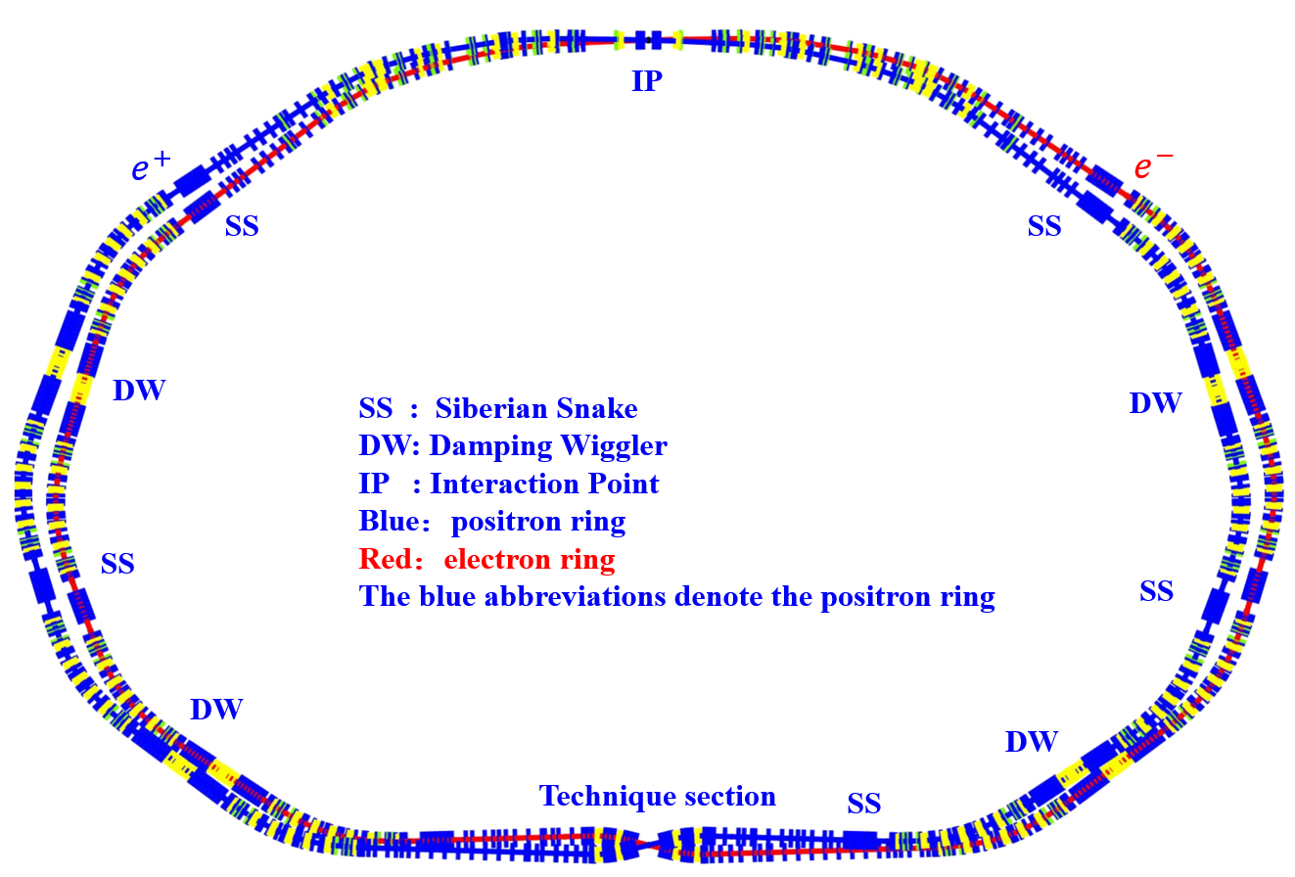
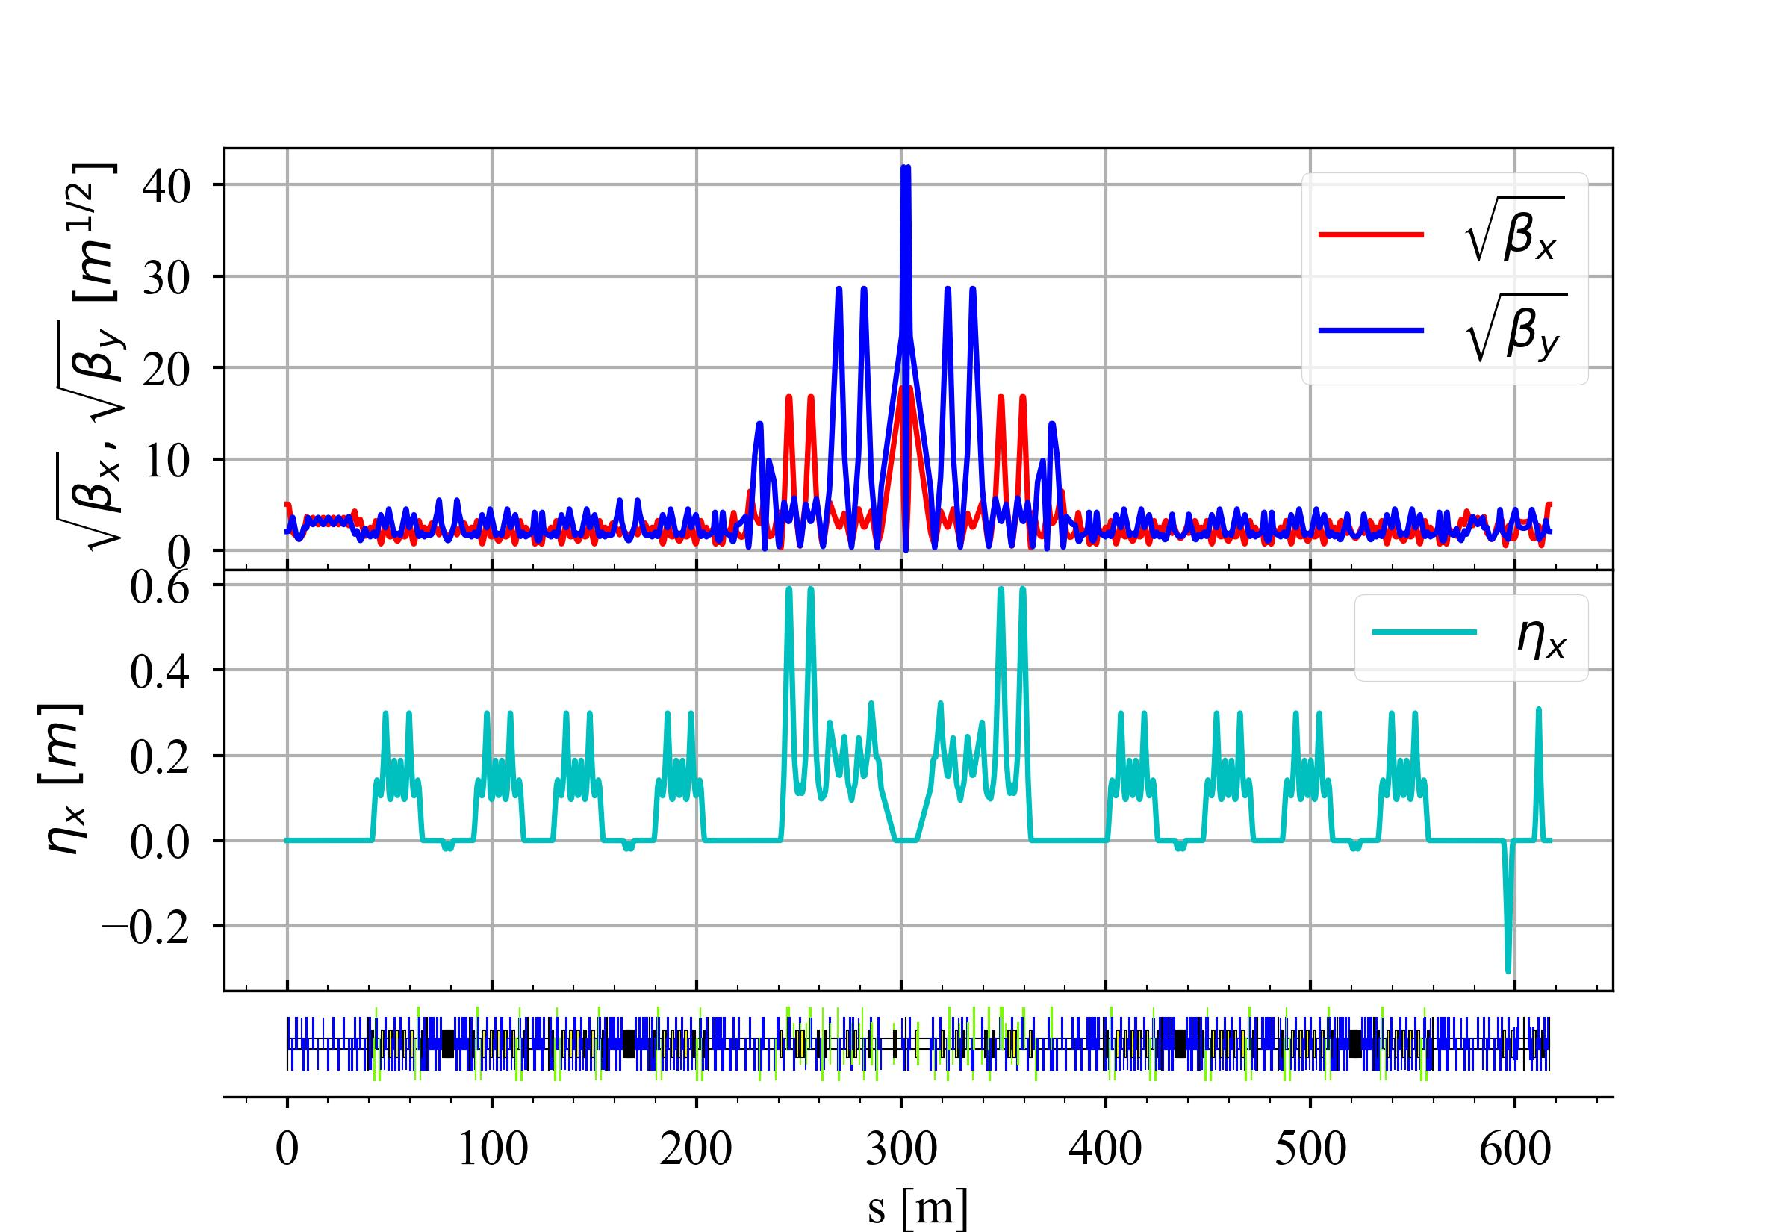
Lattice and layout
Each ring consists of:
8 arcs
5 SSs
4 damping wigglers
1 IR
1 Technique section.
Notes:
THIS PAGE show the lattice and layout of STCF, it consists of 8 arc sections, 5 Siberian snake, four damping wiggler , one interaction region and one technique sections. The electron and positron is symmetrical.

Slide 5
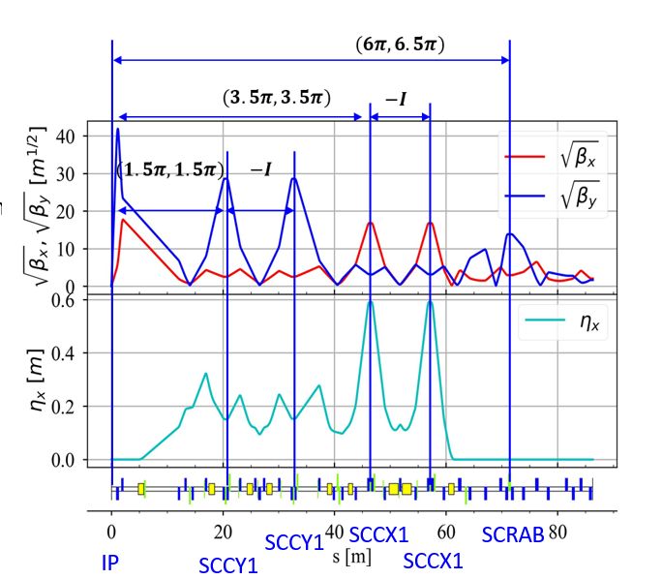
Optics design of Interaction Region(IR)
Low $β$ at IP and space for detector
Local chromaticity correction
To suppress the betatron and synchro-betatron resonance
Crab sextupoles
Important phase advances
Suppress the $β$ beating
SCCY1 to IP and SCCX1 to IP
Compensate geometric aberration
-I transfer matrix at CCY and CCX
Crabbed waist
crab sextupoles - SCRAB to IP
Optics functions at IP are optimized with longitudinal dynamics and beam-beam effect
High order chromaticity correction
Notes:
IR is the main source of nonlinearity,
Low $β$ at IP and necessary space for detector result in the large chromaticity at final doublet
Local chromaticity correction in vertical and horizontal at IR
To suppress the betatron and synchro-betatron resonance
Crab sextupoles
Important phase advances
Suppress the $β$ beating
From first vertical correction sextupole - SCCY1 to IP: 1.5$π$
From first horizontal correction sextupole - SCCX1 to IP 3.5$π$。
Compensate geometric aberration
-I transfer matrix at CCY and CCX
Crab-waist scheme
From crab sextupoles - SCRAB to IP: ($mπ, (n+1/2)π$)
Optics functions at IP are optimized with longitudinal dynamics and beam-beam effect

Slide 6
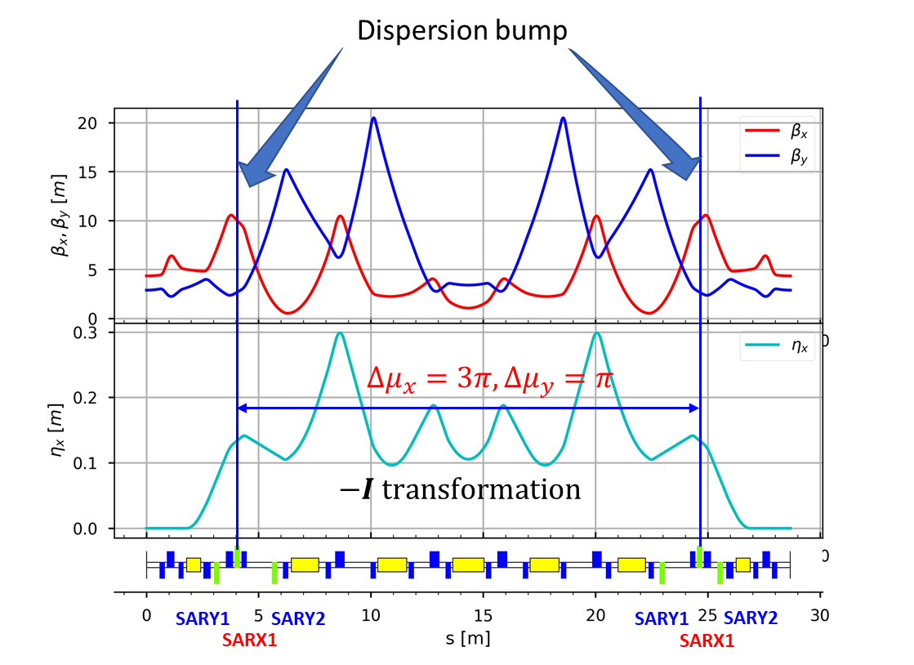
Optics design of Arc sections
Circumference of each collider ring ~ 800 m
Space reserved for SSs to polarize electron beams
8 insertion devices
Low emittance for small beam sizes
Effective chromaticity correction
Hybrid MBA
Typical hybrid-MBA :multi-bend, dispersion bumps
Notes:
To get better nonlinear dynamics, Effective chromaticity correction is required.
因为以上诸多要求，我们采用Hybrid-MBA结构，典型的hybrid-MBA结构就是多弯铁、dispersion bump。通过设置光学函数满足 –I传输矩阵，以便抵消高阶几何扰动。采用三组六极磁铁校正色品

Slide 7
Damping wiggler sections
Inner wiggler
Outer wiggler
Different length to separate the double rings.
Non-zero dispersion to adjust the emittance and damping times.
Notes:
This page shows the damping wiggler sections. It’s divided into inner wiggler and outer wiggler

Slide 8
Technique sections and Siberian snake
Technique section
Siberian Snake
RF
RF
Injection
Connect double rings
Install RF cavities
Inject beams
Phase tuning
Electron beam polarization
Reserve spaces
Notes:
This page shows the xxx. Technique section is also called Multi-functional section. It connects …,this is just a simplified structure.

Slide 9
Optimization strategies
Independent optimization for each section
High order chromaticity correction for IR
Touschek lifetime contribution optimization for arc with large dispersion and $β$ functions at IR
Connect all sections with the phase trombone*
Optimize the resonance driving terms(RDTs) with phase trombone, sextupoles and octupoles
Optimize dynamic aperture and touschek lifetime with the sextupoles and octupoles
Optimize dynamic aperture and touschek lifetime with the phase trombone, sextupoles and octupoles(TODO)
*Cai, Y, et al. 2022. Optimization of chromatic optics in the electron storage ring of the Electron-Ion Collider. Phys. Rev. Accel. Beams 25, 071001.
Notes:
After the optics design of these sections ,,we need to optimize the nonlinear dynamics of lattice. Here are some …

Slide 10
Optimization of DA and touschek lifetime
Directly optimize DA and touschek lifetime as objective functions using NSGAII with crab-on
Use 30 variables including the strengths of sextupoles and octupoles
DA is obtained by tracking particles 1000 turns in SAD code for optimization, while the results of following pages are tracked 10 000 turns

Slide 11
Result 1:optimization with reasonable strength range
Optimization with crab on, track particles with y=n*$σ_{y}$, x=n*$σ_{x}$ or py=n*$σ_{py}$, px=n*$σ_{px}$
Study the influence of crab sextupoles to dynamics
$σ_{s}=8.2 mm$ $, L=1.37×{10}^{35}cm^{−2}s^{−1}$
crab-on: $τ_{touschek}=114s$
crab-off: $τ_{touschek}=134s$
DA changes small for the lattice being optimized with crab on.

Slide 12
Result 2:optimization with wider strength range
Optimization with crab on, track particles with y=n*$σ_{y}$, x=n*$σ_{x}$ or py=n*$σ_{py}$, px=n*$σ_{px}$
Study the influence of crab sextupoles to dynamics
$σ_{s}=8.2 mm, L=1.37×{10}^{35}cm^{−2}s^{−1}$
crab-on: $τ_{touschek}=127s$
crab-off: $τ_{touschek}=174s$
DA changes for the large amplitude particles even if the lattice is optimized with crab on.

Slide 13
Comparation between the strengths of two results
SX3ORD1A for third order chromaticity correction*
Result 2
Result 1
Most of the strengths of result 2 are larger than that of result 1.
*Cai, Y et al., 2016. Analytical approach to chromatic correction in the final focus system of circular colliders. Phys. Rev. Accel. Beams 19, 111006

Slide 14
Summary
A preliminary lattice at 2 GeV
Following effects being considered:
Maxwellian nonlinear fringe field
Kinematical terms
Crab waist
IBS
Synchrotron radiation
Quantum excitation
Touschek lifetime are about 120 s for $1.37×{10}^{35}cm^{−2}s^{−1}$ and 240 s for for $5×{10}^{34}cm^{−2}s^{−1}$, but the goal is 300 s
Notes:
Let’s summarize above result.

Slide 15
Future work
Optimization of optics functions for local chromaticity correction
Better high order chromaticity correction at IR
Optics functions optimization at Crab sextupoles
Study of arc structures

Slide 16
Thank you for your attention!

