Slide 1
Plan for longitudinal polarization test at VEPP-4M
D.V. Dorokhova, E.B. Levichev and S.A. Nikitin
BINP SB RAS Novosibirsk
FTCF 2024 workshop
14-18 Nov 2024

Slide 2
Motivation
Concept of Siberian Snake at VEPP-4M
What to study
Proposal on required polarization manipulation in injection beam-line VEPP-3-VEPP-4
Structure of snake solenoid insert and its properties
Matching VEPP-4M optics with Siberian Snake insert
Our experience in spin manipulation in injection beam-line
Special experiment with obtaining longitudinal polarization without upgrading VEPP-4M
Minimum program

Slide 3
Motivation
Longitudinal polarization in Super C-Tau is based on Siberian snakes
The use of spin rotators based on SC solenoids is being considered to obtain longitudinal polarization in the CEPC super-collider project
The effect of radiation on polarization makes spin rotators in lepton colliders more complex in relation to the properties of similar devices used to cross spin resonances in ring accelerators of heavy particles
To date, only one example of the implementation of the “Siberian snake” on an electron storage ring is known - at energy of about 700 MeV on AmPS (Netherlands)
The VEPP-4 complex has unique capabilities and gained experience in accelerator experiments with polarized beams (booster-polarizer VEPP-3, resonant depolarization technique, spin resonance intersections, partial Siberian snake, Touschek polarimeter, laser polarimeter in combination with a system of scattered electrons)
Why not gain experience in creating and studying the properties of spin rotators in the form of solenoid on VEPP-4M for its use in future machines?

Slide 4
Siberian Snake to obtain longitudinal polarization at VEPP-4M
S.A. Nikitin and E.L. Saldin. Preprint INP 81-19, 1981
IP
VEPP-4M
Spin tune ν₀ =1/2 regardless of energy
VEPP-3
τ_{S-T} (VEPP-3)≈ 80 min
1.55 GeV
E=1.55 GeV
e⁺
Pulse solenoid
for spin matching
πν
e⁻
π-solenoid
Depolarization time at 1548 MeV: td=425 min
Po=75% , electron beam polarization degree at injection
<P>=Po*td/t*[1-exp(-t/td)]=66% average value for t=1.5 h
Due to the dispersion of spin rotation in the median plane around the guide field vector, quantum fluctuations lead to complete depolarization of the beam in a time that strongly depends on energy. The dependence factor is the Sokolov-Ternov radiative relaxation time. In the energy range VEPP-4 < 2 GeV it is high ~ 100 hours. Due to this, the lifetime of longitudinal polarization can reach a few hours.

Slide 5
What can and is important to study
Strong dependence of the longitudinal polarization lifetime on energy ( ∝ 1/Е⁷)
Depolarizing effect of betatron oscillations in comparison with calculations
Stability of longitudinal polarization in the field of a counter beam
The influence of transverse fields in the solenoid, arising due to orbital distortion, on polarization
Methods for measuring longitudinal polarization
…
Example of calculated influence of betatron oscillations on radiative kinetics of polarization in one of variants of Siberian Snake scheme at VEPP-4
τ_{d} [hour]
E [GeV]
Depolarization time vs beam energy at different radial
betatron tune. Dotted line - excluding betatron oscillations.

Slide 6
Two approaches to obtaining longitudinal polarization
“Capital”. Siberian Snake and injection of a polarized beam at an energy of 1.55 GeV. Expected polarization lifetime is several hours
“Special”. Obtaining longitudinal polarization with life-time of about 20 minutes without Snake and any modification of the existing complex due to the adiabatic transformation of transverse polarization into longitudinal polarization in the KEDR detector when using its field as a partial Siberian snake (to study methods for observing longitudinal polarization)

Slide 7
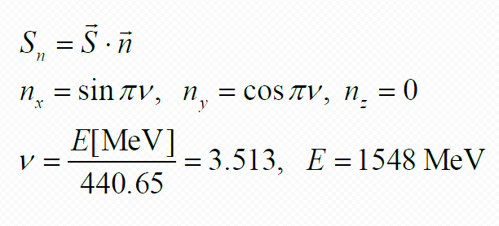
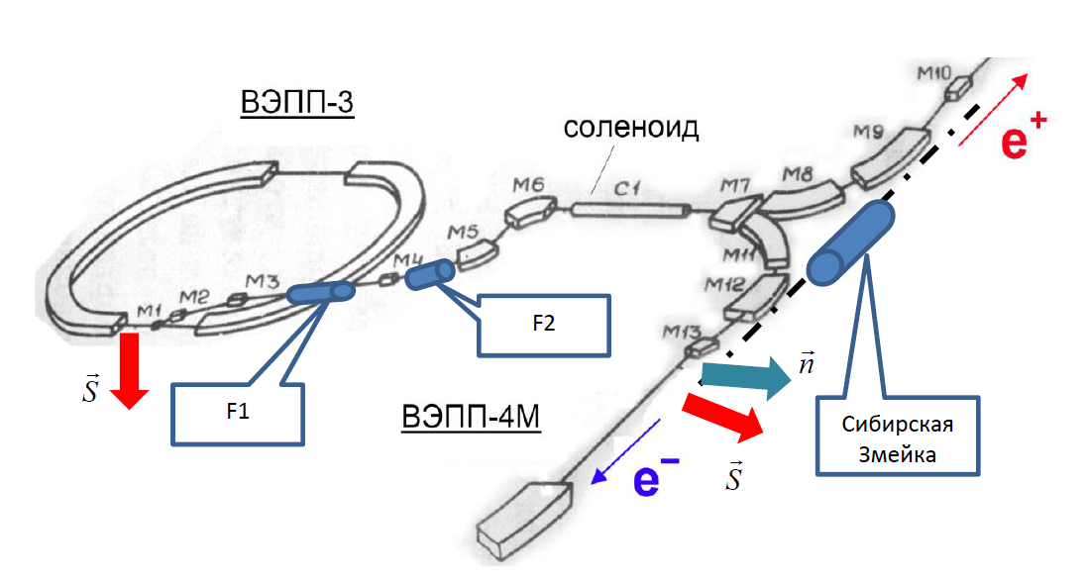
Pulse solenoids in injection beam-line at 1548 MeV
For the best matching of polarization vectors and spin-flip at the inlet, a scheme of two solenoids in the VEPP-3-VEPP-4M beam-line is proposed. You can limit yourself to one of them - F1. With one sign of
the F1 field, it will
provide a projection
S_{n}=-0.97 (first bunch
from VEPP-3).
Otherwise
S_{n} =+0.65
(second bunch)
Projection of the polarization of the injected beam onto on the equilibrium direction of polarization in VEPP-4M vs. spin rotation angles in pulse solenoids F1 and F2
E=1548 MeV
at inlet
Z
VEPP-3
available
solenoid
Y
X
F3
2nd e⁻
VEPP-4M
1st e⁻
VEPP-4M
Snake
F1 – angle in the solenoid between M3 and M4 (dgr)
F2 – angle in the solenoid between M4 and M5 (dgr)
Two signs of electron helicity in 3 options:
F₁=100°, F₂=0 → spin projection of 1-st bunch electrons S_{n}= - 0.97
F₁=80° , F₂=0 → spin projection of 2-nd bunch electrons S_{n}= + 0.65
F₁=120°, F₂=50° → spin projection of electrons of the second bunch S_{n}= + 0.85
no F2 needed

Slide 8
Optics of insert with Siberian Snake
Full insert length L_{total} = 532 cm, energy 1548 МэВ
The type of insert for localizing the betatron coupling is taken as a basis from: A.A. Zholents, V. N. Litvinenko. INP Preprint 81-80, 1981
The optics of the insert is equivalent to that of an empty section with a length equal to the length of the insert itself, but with an incursion
of the betatron phase by π in one of the directions.

Slide 9
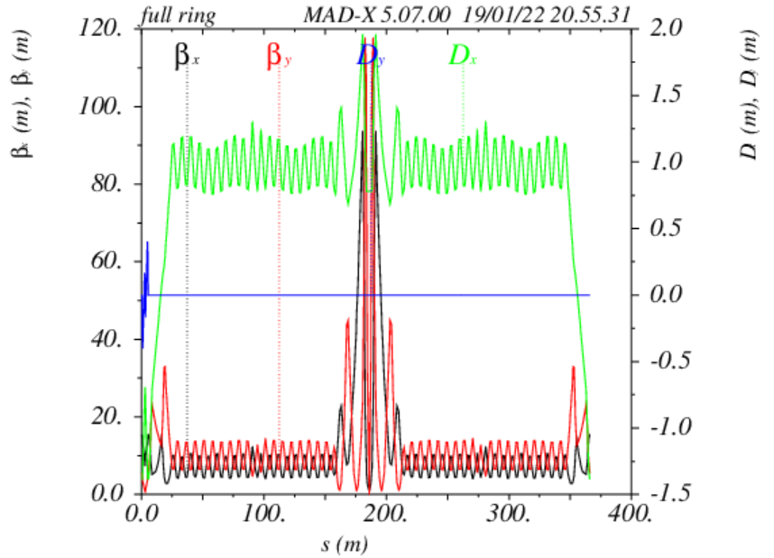
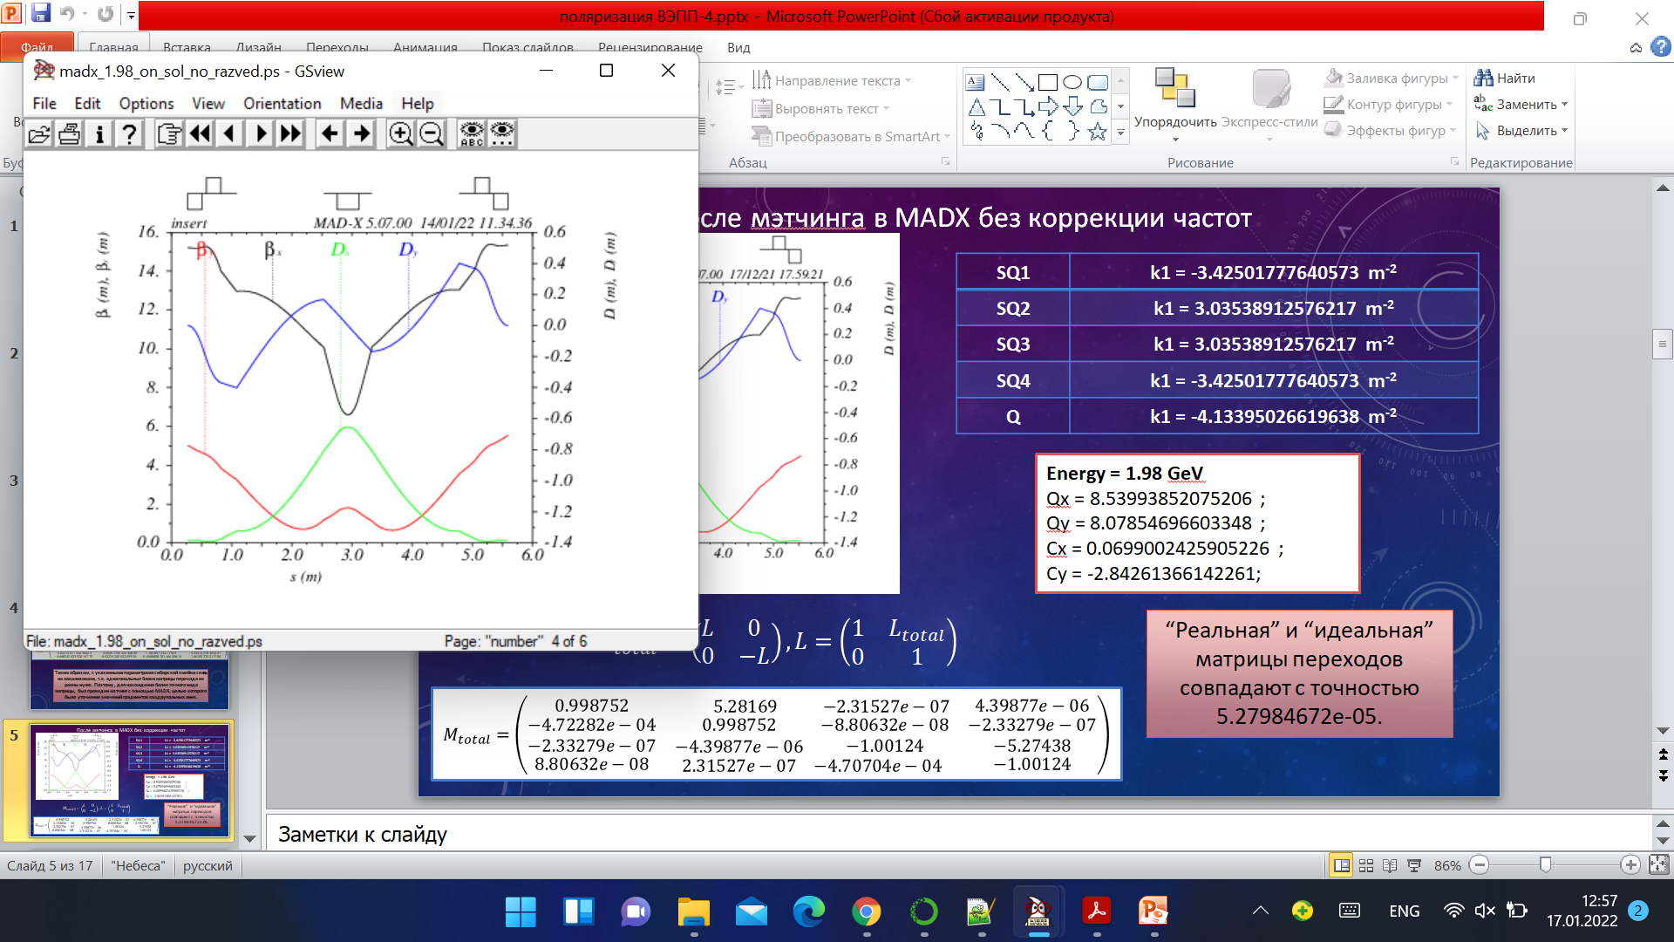
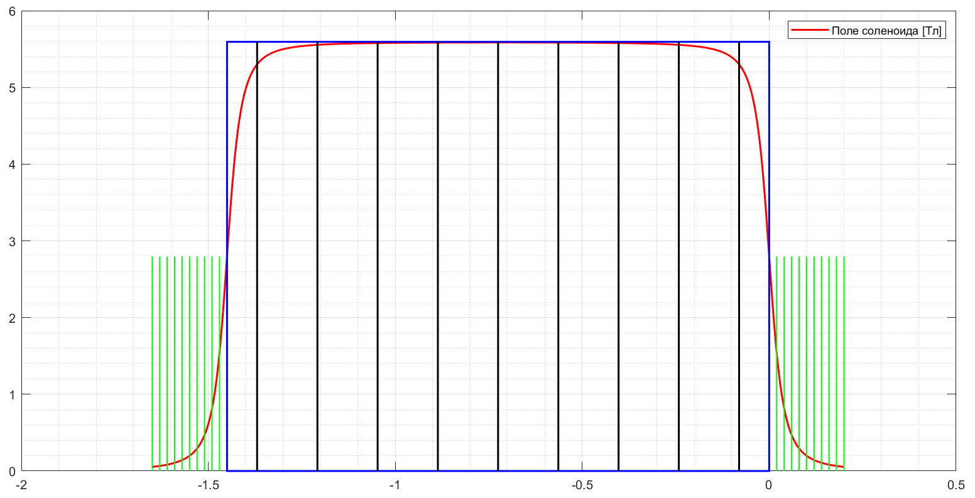

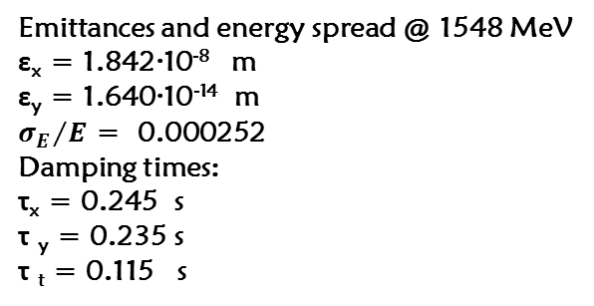
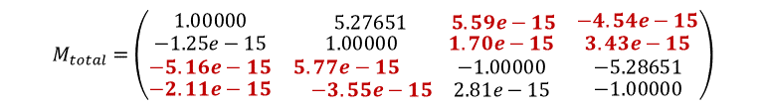

Matching VEPP-4M optics with Siberian snake
Tunes, chromaticity, IP
Qx = 8.539
Qy = 7.580
Cx = 1.236
Cy = -2.098
βx_IP = 0.894 [m];
βy_IP = 0.045 [m]
Local perturbation of optical functions at the insertion site
Emittances and energy spread @ 1548 MeV
ε_{x} = 1.842·10⁻⁸ m
ε_{y} = 1.640·10⁻¹⁴ m
${σ_{E}}/E$ = 0.000252
Damping times:
τ_{x} = 0.245 s
τ _{y} = 0.235 s
τ _{t} = 0.115 s
SS insertion
Distribution of solenoid field along its axis (L_{s}=145 m, radius 4 cm)
.
Matrix of insertion with length of $L_{total }$:
Матрица вставки с длиной $L_{total}$
$$M_{total}=\left(\begin{matrix}L & 0 \\ 0 & −L\end{matrix}\right), L=\left(\begin{matrix}1 & L_{total} \\ 0 & 1\end{matrix}\right)$$
Large phase shift and changes in chromaticity
are compensated by
magnetic correction in arcs
$$M_{total}=\left(\begin{matrix}1.00000 & \begin{matrix}5.27651 & 5.59e−15\end{matrix} & −4.54e−15 \\ \begin{matrix}−1.25e−15 \\ −5.16e−15\end{matrix} & \begin{matrix}\begin{matrix} 1.00000 \\ 5.77e−15\end{matrix} & \begin{matrix}1.70e−15 \\ −1.00000\end{matrix}\end{matrix} & \begin{matrix}3.43e−15 \\ −5.28651\end{matrix} \\ −2.11e−15 & \begin{matrix}−3.55e−15 & 2.81e−15\end{matrix} & −1.00000\end{matrix}\right)$$

Slide 10
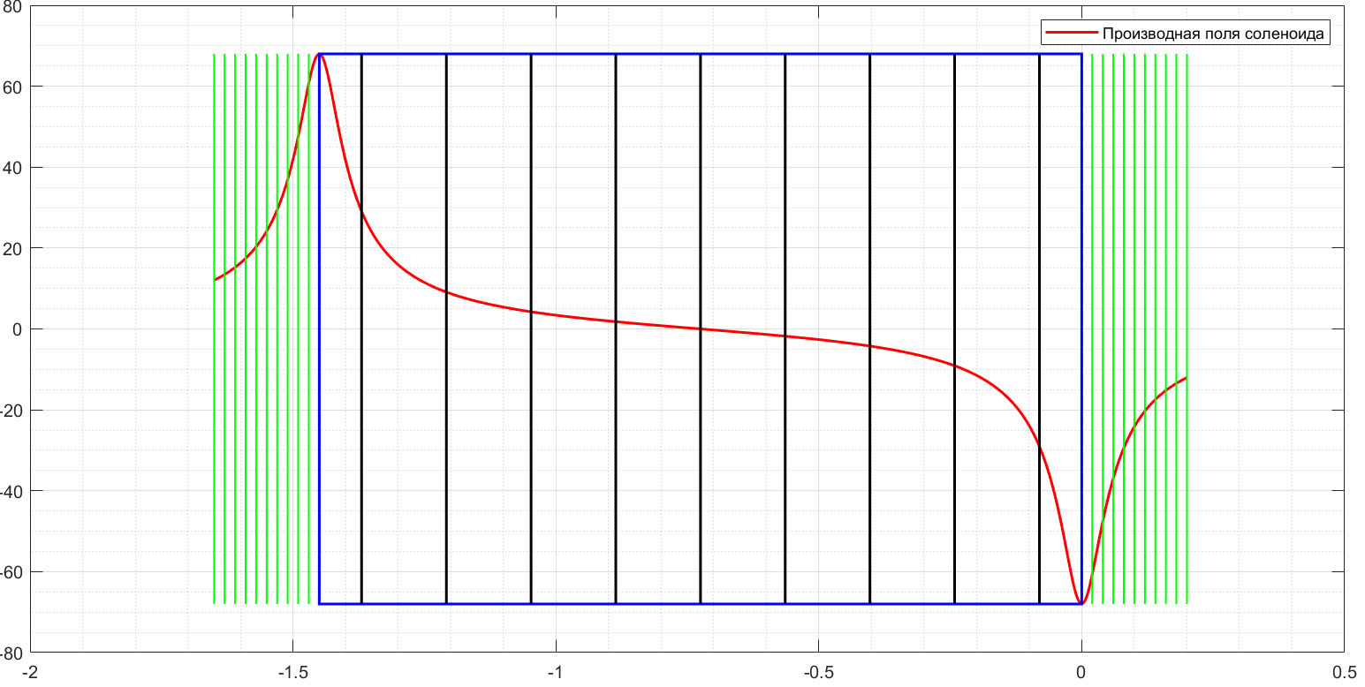
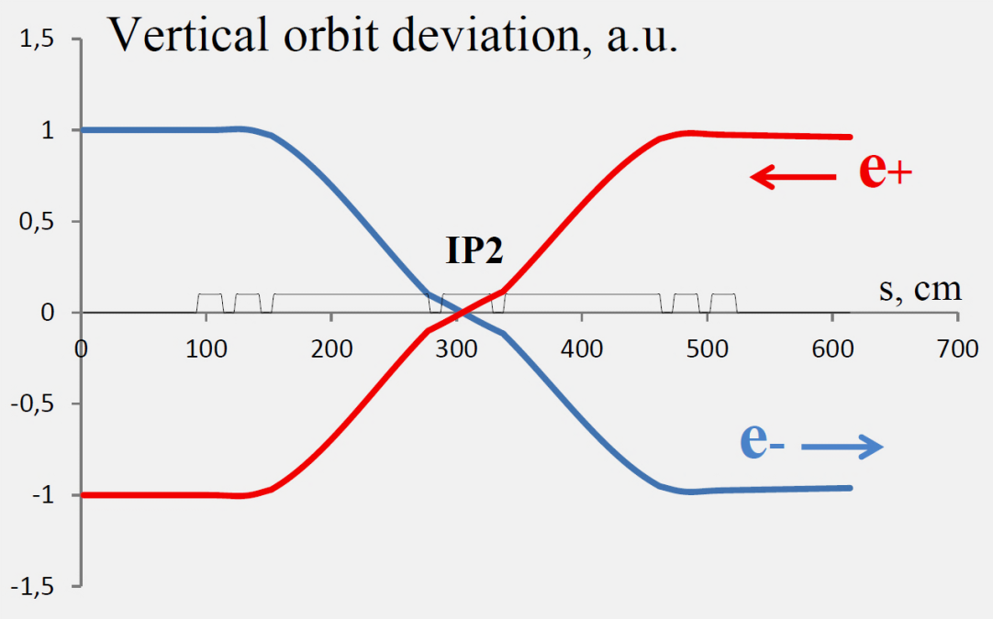
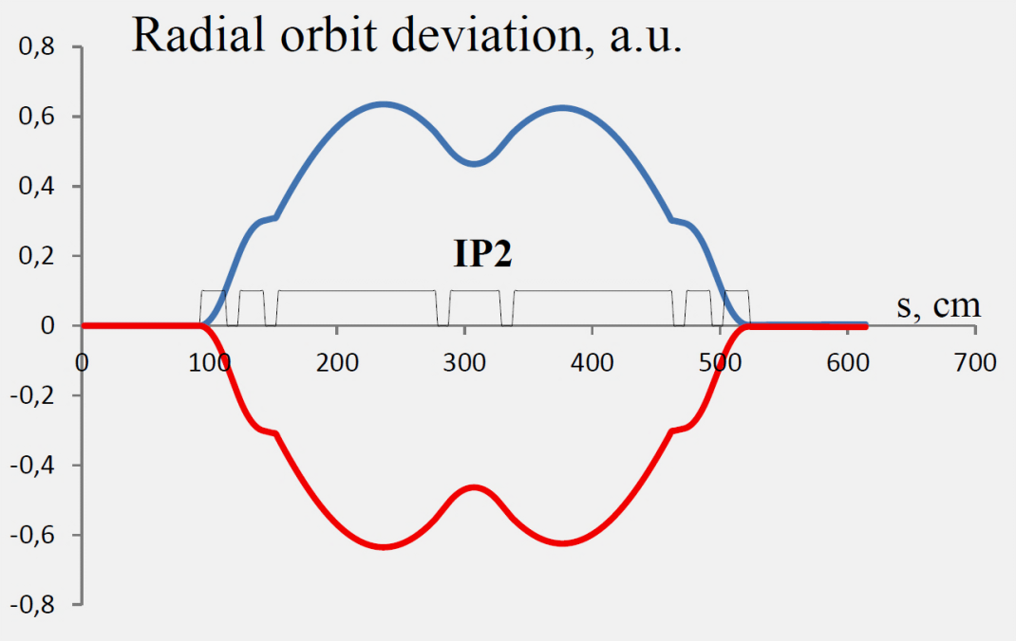
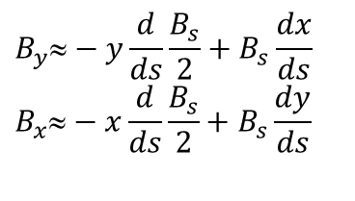
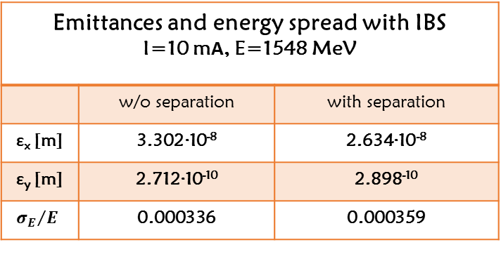
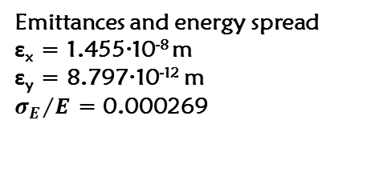
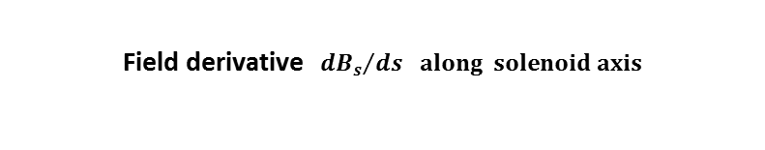
Taking into account separation of orbits at insert site and IBS
Orbit separation along insertion (at input ± 4 cm)
Transverse solenoid fields taking into account orbital deviation from solenoid axis:
Field derivative ${ dB_{s}}/{ds} ﷮ along solenoid axis$
$$B_{y}≈−y\frac{d}{ds}\frac{B_{s}}{2}+B_{s}\frac{dx}{ds}$$
$$B_{x}≈−x\frac{d}{ds}\frac{B_{s}}{2}+B_{s}\frac{dy}{ds}$$
w/o IBS
Emittances and energy spread
ε_{x} = 1.455·10⁻⁸ m
ε_{y} = 8.797·10⁻¹² m
${σ_{E}}/E$ = 0.000269
Emittances and energy spread with IBS I=10 mА, E=1548 MeV
 | w/o separation | with separation
ε_{x} [m] | 3.302·10⁻⁸ | 2.634·10⁻⁸
ε_{y} [m] | 2.712·10⁻¹⁰ | 2.898⁻¹⁰
$${σ_{E}}/E$$ | 0.000336 | 0.000359
Damping times
τ_{x} = 0.194 s
τ _{y} = 0.236 s
τ _{t} = 0.131 s

Slide 11
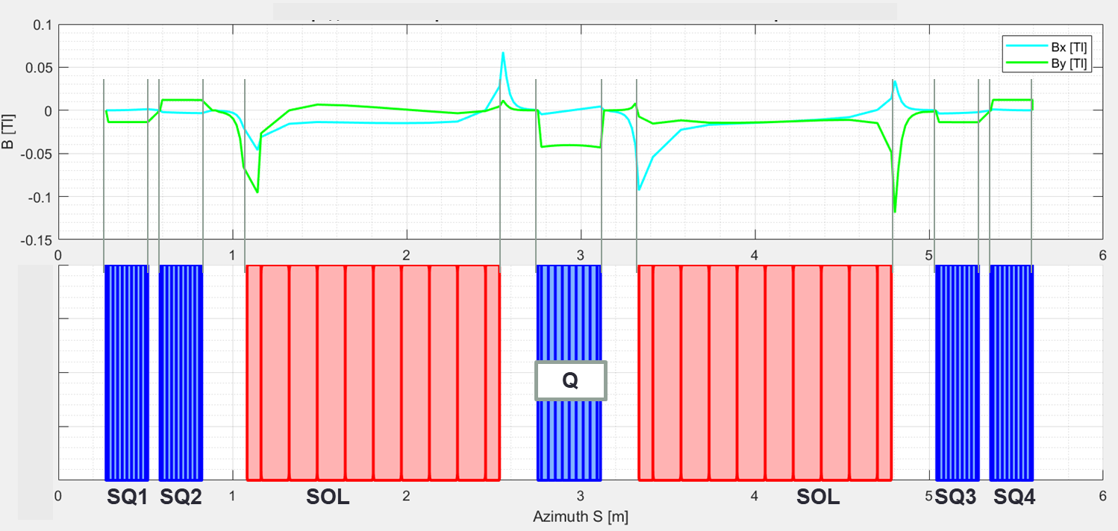
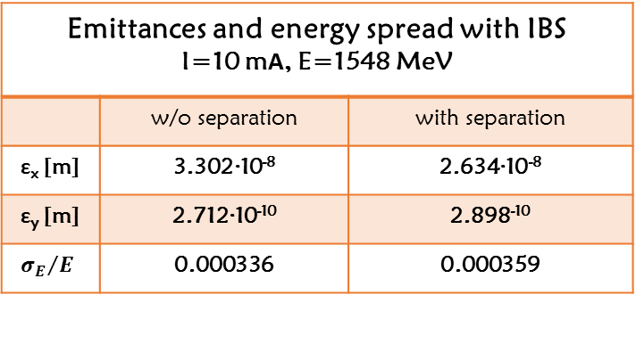
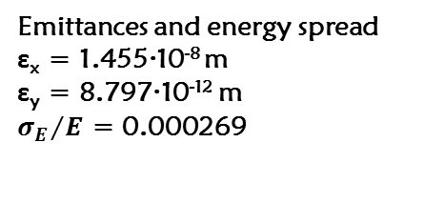
Taking into account separation of orbits at insertion site and IBS
Orbit separation along insertion (at input ± 4 cm)
Transverse solenoid fields taking into account orbital deviation from solenoid axis:
Transverse fields along the solenoid insertion$[Т]$
$$B_{y}≈−y\frac{d}{ds}\frac{B_{s}}{2}+B_{s}\frac{dx}{ds}$$
$$B_{x}≈−x\frac{d}{ds}\frac{B_{s}}{2}+B_{s}\frac{dy}{ds}$$
w/o IBS
Emittances and energy spread
ε_{x} = 1.455·10⁻⁸ m
ε_{y} = 8.797·10⁻¹² m
${σ_{E}}/E$ = 0.000269
Emittances and energy spread with IBS I=10 mА, E=1548 MeV
 | w/o separation | with separation
ε_{x} [m] | 3.302·10⁻⁸ | 2.634·10⁻⁸
ε_{y} [m] | 2.712·10⁻¹⁰ | 2.898⁻¹⁰
$${σ_{E}}/E$$ | 0.000336 | 0.000359
Damping times
τ_{x} = 0.194 s
τ _{y} = 0.236 s
τ _{t} = 0.131 s

Slide 12
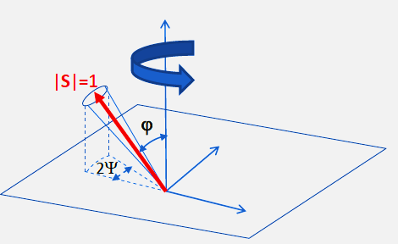
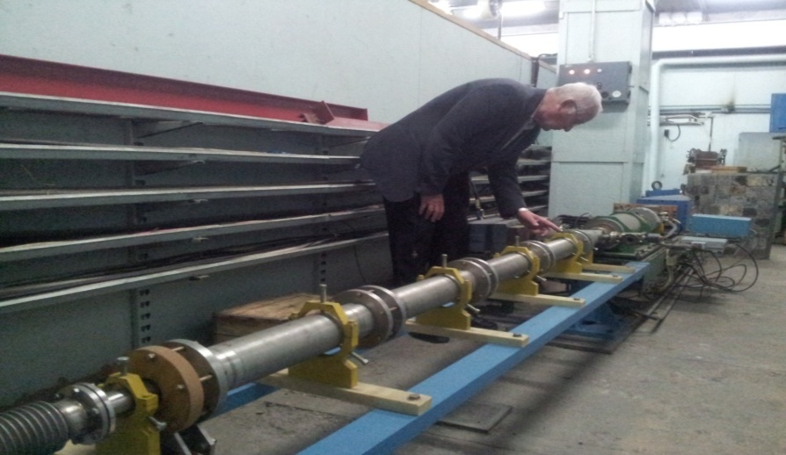
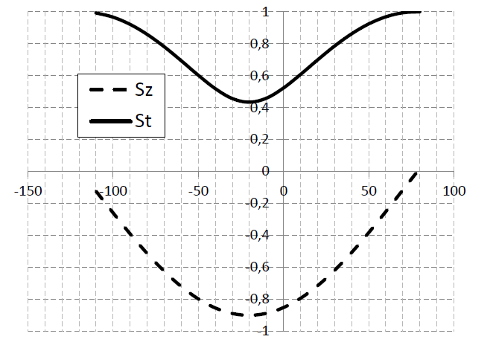
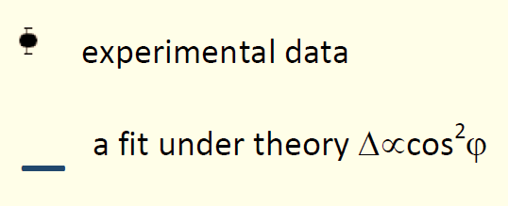
Injection experiment with different polarization inclination to guiding field
V.V. Kaminsky, V.A. Kiselev, E.B. Levichev, S.A. Nikitin, I.B. Nikolaev, P.A. Piminov, A.N. Zhuravlev
2Ψ=fan opening angle at injection
Pulsed solenoid in VEPP-3-VEPP-4M beam line
VEPP-3
Solenoid F3
VEPP-4M
E=1548 MeV
L=2 m, ∅50 mm, 300 turns, Hmax=2.5 Т,
Umax=3 kV, Imax=12 kA
Spin components at injection
Depolarization jump (%) in Touschek rate
vs. solenoid field
- - - S_{vert} = cos ϕ
___ S⊥ = sin ϕ
spin rotaIon angle
in solenoid F3 (dgr)
Although there are few measured points, their location suggests that $∆ ∝\cos^{2}φ$. This is compatible with the conclusion that the
experiment corresponds to the calculation of spin kinematics in the injection beam-line of complex 3D geometry. It is estimated that the initially narrow polarization fan spreads out over a time on the order of the radiative damping time due to the quadratic nonlinearity of the field (chromaticity correction system)

Slide 13
Adiabatic transformation of transverse polarization into longitudinal
Detuning from resonance ν=γa=3 vs energy
=any value
not too small
no solenoid
with
ν=γa=k
≈ 0.45 rad
H|| = H_{KEDR} =0.6 T
E=1320 MeV
≈ 20 min
Inject a transversely polarized beam from VEPP-3 at E=1500 MeV
Turn off anti-solenoids, turn on special skew-quad correction instead
Reduce energy to 1320 MeV (ν =3) at rate of ~ several MeV/s
Longitudinal polarization lifetime at 1320 MeV is about 20 minutes (Sokolov-Ternov polarization time is about 400 hours)
Measure longitudinal polarization by changing the intensity of Compton scattering when switching the sign of circular polarization polarization of laser photons and using a scattered electron detection system (both systems are active at VEPP-4M)
In addition, the fact of the presence of polarization can be checked with a Touschek polarimeter together with resonant depolarization
(by change in the ratio of the counting rates of Touschek electrons from polarized and unpolarized bunches)

Slide 14
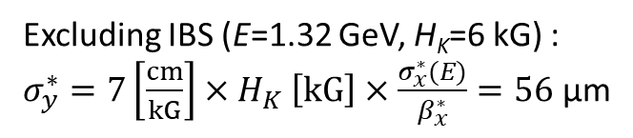
Coupling compensation for KEDR field with two skew quadrupoles
when transforming transverse polarization into longitudinal
View of normal modes of
transverse oscillations at
different distances from
center of KEDR
Vertical size [µm] in IP calculated and measured
by specific luminosity vs. KEDR field at 1.5 GeV
in “two skew quads” compensation scheme
OFF
KEDR field H_{K}= 0.6 Tesla.
Gradient/current in windings SQ±=±120 G/cm/14 A
is proportional to the field H_{K} and does not depend on energy
Excluding IBS (E=1.32 GeV, H_{K}=6 kG) :
$σ_{y}^{∗}=7\left[\frac{cm}{kG}\right]{×H}_{K}\left[kG\right]×\frac{σ_{x}^{∗}(E)}{β_{x}^{∗}}=56$ µm
Compensation for coupling introduced by the detector field provides better beam control during
acceleration/deceleration with anti-solenoids turned off. The scheme has been successfully used
to cross an integer spin resonance at 1763 MeV A.K. Barladyan et al., DOI:10.1103/PRAB 22.112604

Slide 15
Minimum program
Experiment on transforming transverse polarization into longitudinal. Test observation of longitudinal polarization
“Siberian snake” experiment:
- design and manufacture of two SC solenoids with an integral of at least 145 cm × 5.6 T;
5 “warm” quadrupoles (4 skew and one normal of approximately 3 kG/cm) and a vacuum chamber;
- development or selection of power sources for insert magnets;
- installation of the insert in the center of the technical straight section;
- manufacturing a pulse solenoid with a field integral of up to 5 T⋅m and its placement in the injection
beam-line between the bending magnets M3 and M4;
- in addition to it, transfer existing solenoid F3 (of 5 T⋅m ) to the place mentioned above to obtain a total
integral of 9.1 T m;
- conducting an experiment to obtain longitudinal polarization of electrons with helicity of two signs
(S_{n}=-0.97 and S_{n}=+0.65) at 1548 MeV;
- study of factors influencing the lifetime of longitudinal polarization
(energy, betatron oscillations, orbital distortions, colliding beam, IBS …);
- debugging methods for measuring the degree of longitudinal polarization
Thanks for attention!

Slide 16
Acknowledgement
Authors thank:
A. Blinov and A. Milshtein; V. Kiselev and O. Gordeev; A. Bomyagkov and S. Sinyatkin; N. Mezentsev; I. Nikolaev and V. Kaminsky for discussions
Thanks for attention!

