Slide 1
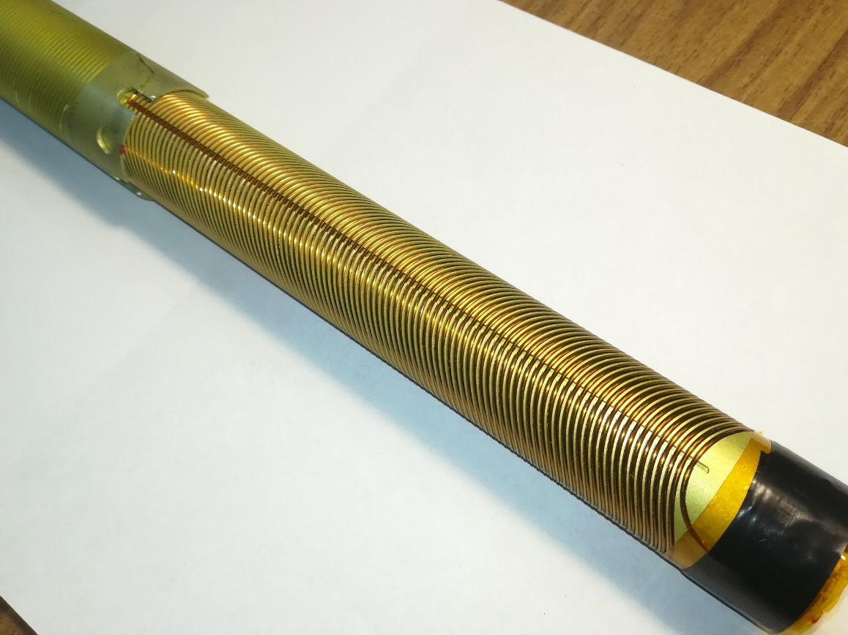
Superconducting CCT quadrupole test at Budker INP
Vitaliy Shkaruba
Budker INP, Novosibirsk
FTCF-2024, Hefei

Slide 2
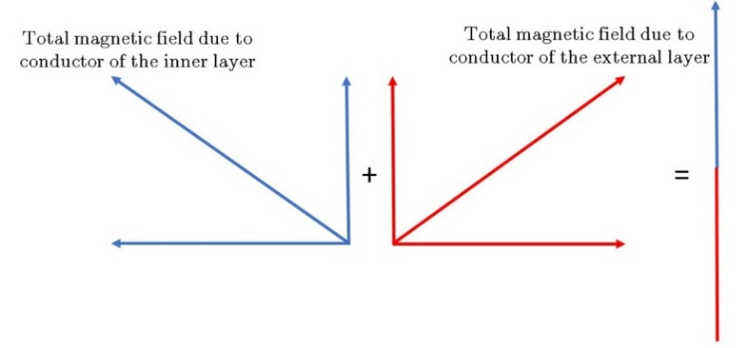
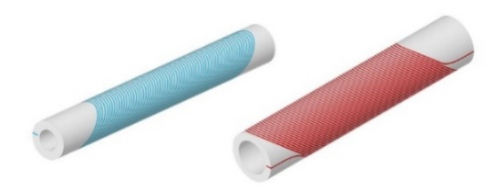
Superconducting CCT quadrupole
Motivation: Quadrupole lenses of final focus should have quite high value of the field gradient, the absence or minimum values of other multipole field components, and be enough compact to be placed in a small accessible space inside the detector. Superconducting lenses based on CCT technology meet these requirements well.
Used terminology:
CCT (Canted Cosine Theta)
DH (Double Helix)
TC (Tilted Solenoid)
Physical meaning: If the cable is wound around a pipe in the form of two oppositely inclined solenoids, then the trajectory of the turns is modulated by one sine period in the longitudinal direction. As a result, the axial field components of the solenoids field are compensated, and the transverse components are added up and create a purely dipole field.
Multipole components: If the turns of spiral will be modulated by two sine periods, then remains only a quadrupole field, if by three periods, then will be only a sextupole field, etc.
If you wind several windings with different sinusoidal modulations around each other it is possible get all the field components in one magnet at once.
But we will talk about quadrupole lenses only.
Gabriele Ceruti (“Mechanical Design of Curved Superconducting Magnet Cos-Theta and Canted-Cosine-Theta for a New Gantry for Hadron Therapy”), CERN
FTCF-2024, Hefei
2/15

Slide 3
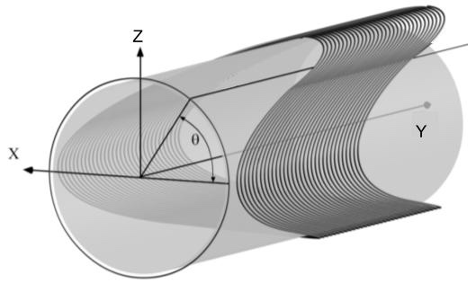
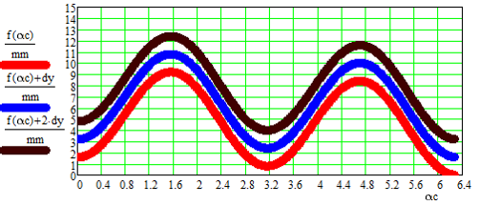
Superconducting CCT quadrupole
CCT quadrupole lens parameters: the lens FF concrete parameters are not finalized yet.
So we started from some intermediate variant for develop the manufacturing CCT technology:
Parameters of CCT quadrupole lens prototype:
Magnetic field gradient, T/m | 40
Internal winding diameter, mm | 29
Outer winding diameter, mm | 34
Modulation amplitude in the longitudinal direction, mm | +/- 4
Diameter of superconducting wire, mm | 0.92
Distance between turns, mm | 1.6
Number of turns per layer | 100
Lens length, mm | 160
The grooves for the wire are cut using these formulas:
$y\left(θ\right)=c ∙ (1−cos \left(n ∙ θ\right)) +dy ∙ \left(1−\frac{θ}{2π }\right)$
The shape of sinusoidal modulations for quadrupole lens with CCT technology
$$\left.x\left(θ\right)=a ∙ cos \left(θ\right), z\left(θ\right)=a ∙ sin{(}θ\right)$$
Where:
x,z – transverse coordinates of the cylinder,
y-longitudinal coordinate along the cylinder axis,
θ – angle of wire winding on the cylinder,
a – wire winding radius,
c – amplitude of wire winding in the longitudinal direction,
dy – wire winding pitch,
n – number of the multipole field component (n=2 for a quadrupole lens).
Three turns of groove are unfolded on the plane.
FTCF-2024, Hefei
3/15

Slide 4
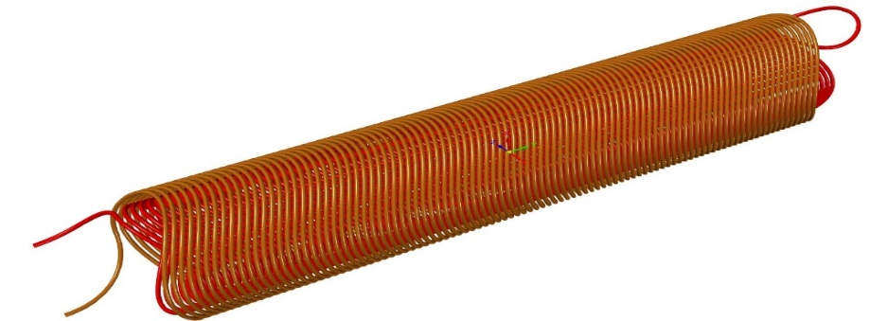
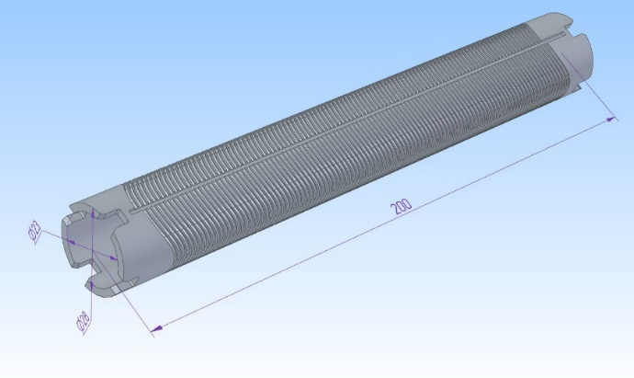
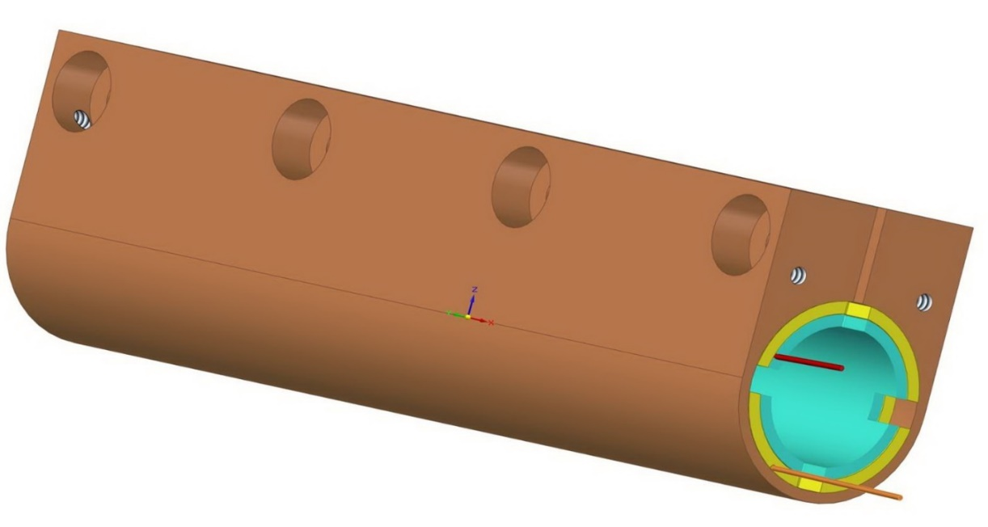
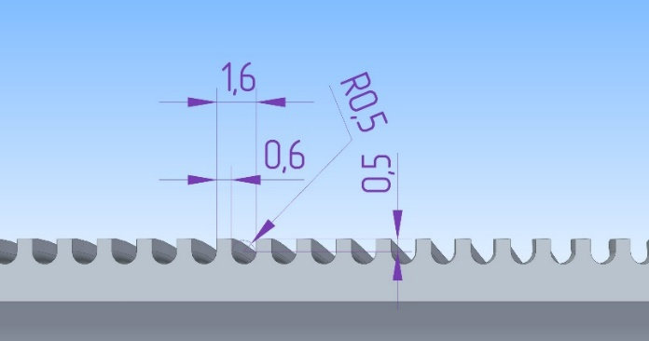
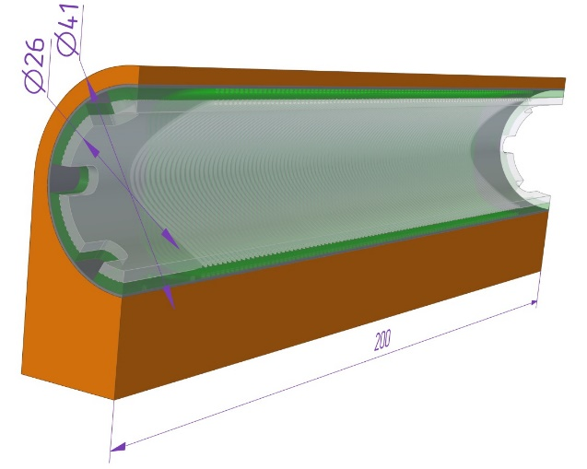
Superconducting CCT quadrupole
CCT quadrupole lens design:
The wire is wound into grooves on the surface of the inner cylinder and mechanically pressed by outer cylinder, which is continuously put on the inner cylinder during the winding process.
Then during of winding of outer cylinder, the coils are already pressed by an external mandrel. External mandrel made from copper for good thermo-conductivity because cooling will be inside of indirect cooling cryostat in vacuum.
The wire is wound continuously in one piece.
3-D model of winding turns
3-D model of two cylinders with winding
3-D Model of CCT quadrupole lens
3-D model of the finished CCT lens
The shape of winding groove
Sectional view of CCT lens design
FTCF-2024, Hefei
4/15

Slide 5
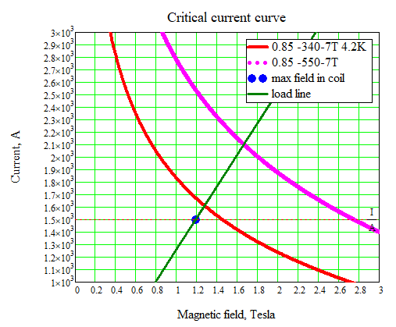
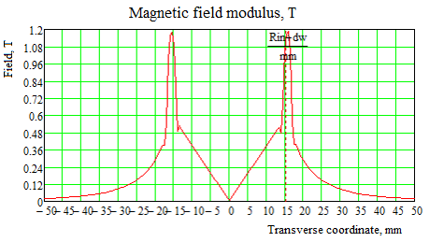
Superconducting CCT quadrupole
Superconducting winding design
It was choice between superconducting NbTi/Cu wire with critical current of 340 A or 550 A in a magnetic field of 7 T and temperature of 4.2 K. The wire with higher critical current is more rigid for bending (due to larger proportion of NbTi). But the wire with 550 A was selected due to critical current margin.
There is shows the position of the operating point (blue dot) at 1500A current relative to the critical lines of wire with current of 550A (red) and 340A (purple) at 7 Tesla. The gradient is 40 T/m at a current of 1500 A and max field of 1.2 T on the winding.
Transverse distribution of the magnetic field modulus in a quadrupole lens powered by a current of 1500 A is presented.
Parameters of superconducting wire:
Wire diameter without/with insulation, mm | 0,85/ 0,91
Proportion NbTi/Cu | 1,4
Critical current at 7 T and T=4.2K, A | 550
Position of the operating point (blue dot) at 1500A current relative to the critical lines of wire with current of 550A (red) and 340A (purple) at 7 T.
Transverse distribution of the magnetic field modulus in a quadrupole lens powered by a current of 1500 A
FTCF-2024, Hefei
5/15

Slide 6
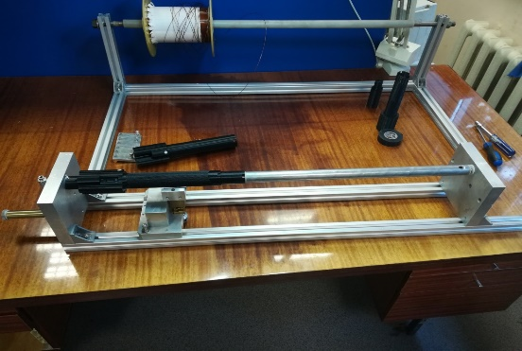
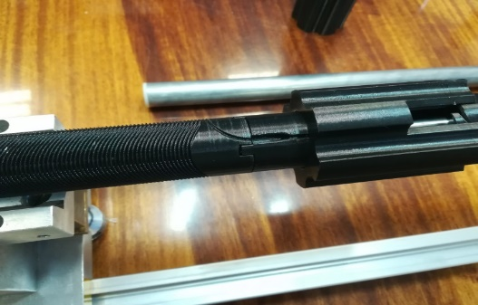
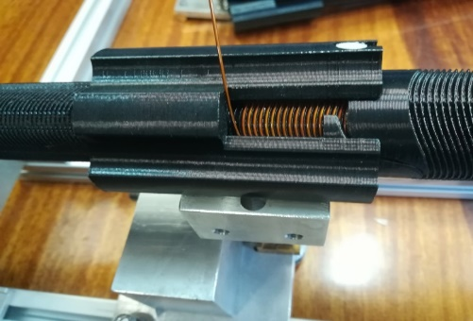
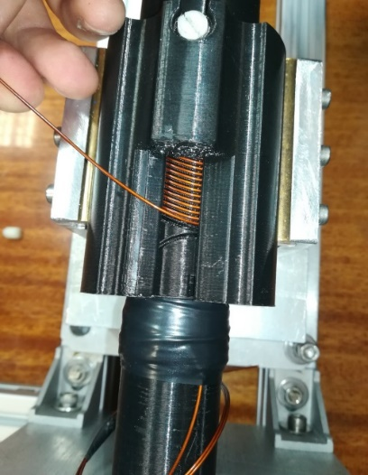
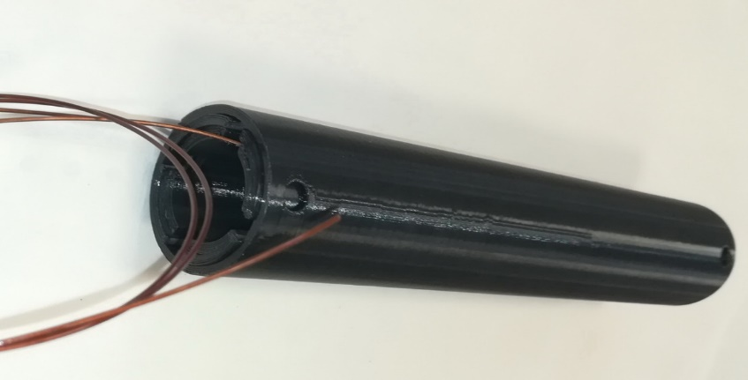
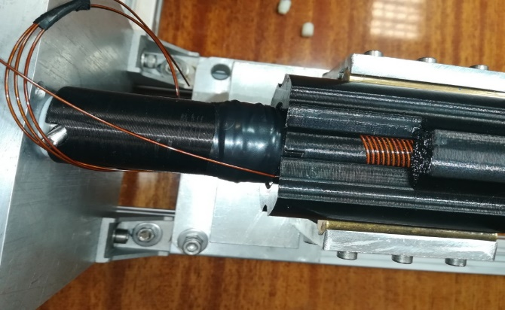
Superconducting CCT quadrupole
Develop manufacturing technology
To develop manufacturing technology of winding several prototypes were made from plastic using a 3-D printing.
It was made several test windings to improve the design of groove, auxiliary mandrels, the places for input, transition and output wire with taking into account its rigidity.
The winding of the first layer is hold in the grooves by the moved tube of the second layer. The turns of the second layer are held by the outer mandrel. Winding is continuous in one piece.
Mandrel for winding the first layer
First layer winding process
Stand for winding a prototype CCT lens
Process of transition to the second layer
Ready prototype of an CCT lens made of plastic
Second layer winding process
FTCF-2024, Hefei
6/15

Slide 7
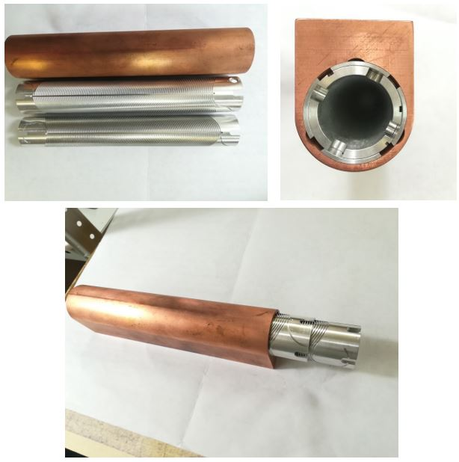
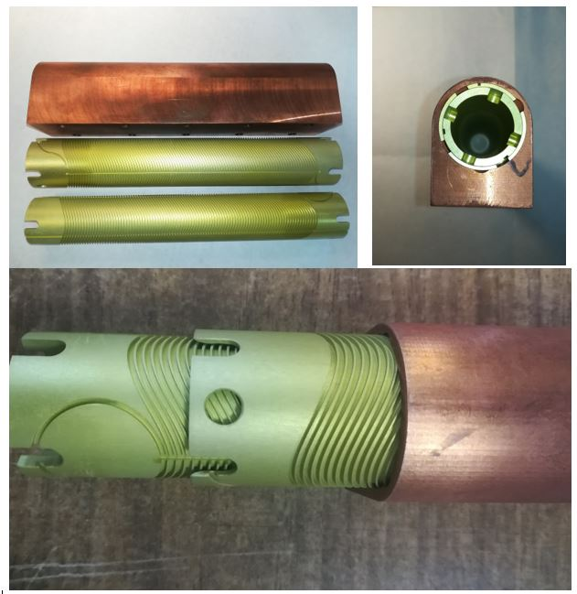
Superconducting CCT quadrupole
Manufacturing от CCT quadrupole
The lens parts were made of Al6063 alloy with high thermal conductivity for operation in an indirect cooled cryostat. Outer mandrel was made of copper.
The aluminum details were anodized with an insulating oxide layer of 7 microns.
Details for winding from Al6063 before anodization with insulating oxide layer.
Details for winding after anodization with insulating oxide layer (green color).
FTCF-2024, Hefei
7/15

Slide 8
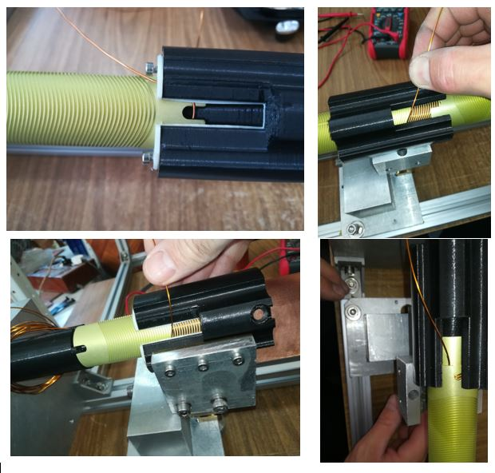
Superconducting CCT quadrupole
Manufacturing от CCT quadrupole
The process of winding the CCT quadrupole lens with superconducting Nb-Ti/Cu wire
FTCF-2024, Hefei
8/15

Slide 9
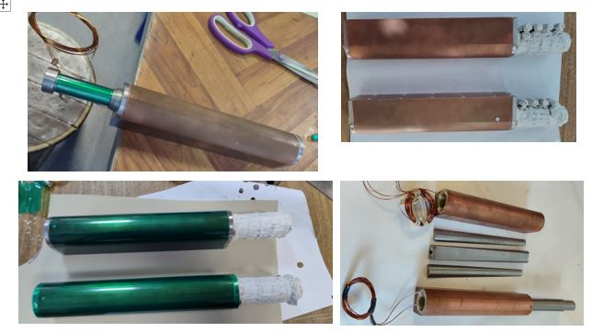
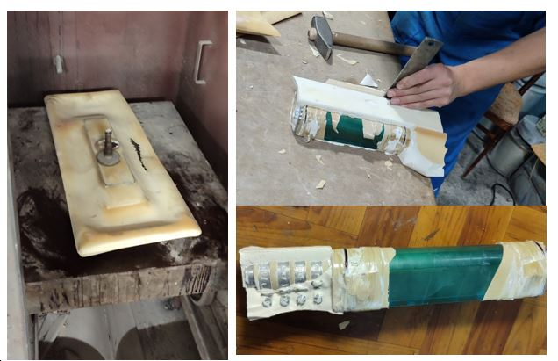
Superconducting CCT quadrupole
Manufacturing от CCT quadrupole
The dry-wound lens was impregnated with an epoxy compound with BN (boron nitride) filler (0.5 micron grain) using method in rubber bag at autoclave with 130 С and 15 bars.
There was a technological problem: the safety of the leads of superconducting wires about 1 m long and should not be broken.
The process of preparing a lens for impregnation with epoxy compound
The process of disassembling of one pair lenses after impregnation
FTCF-2024, Hefei
9/15

Slide 10
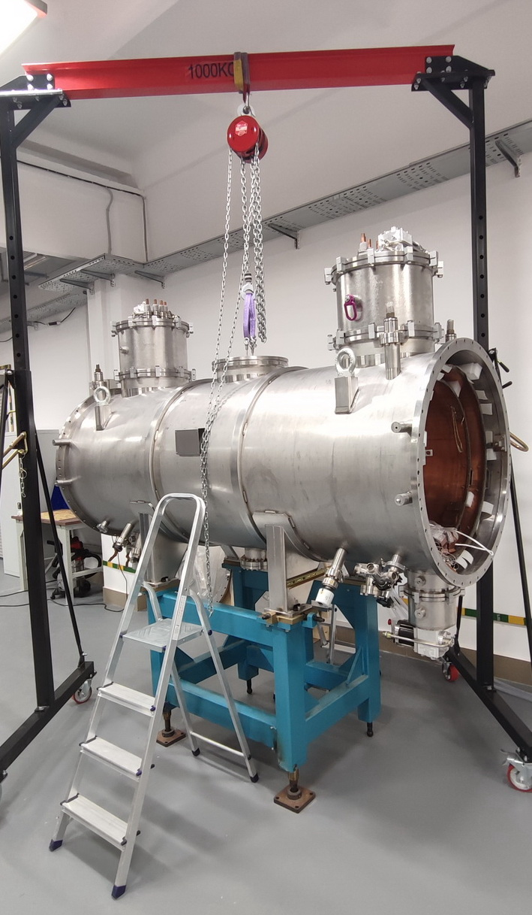
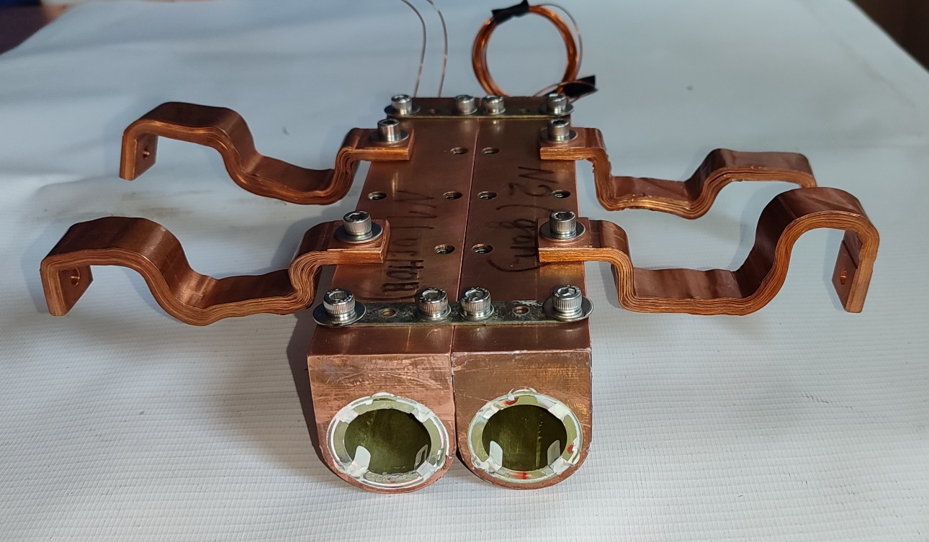
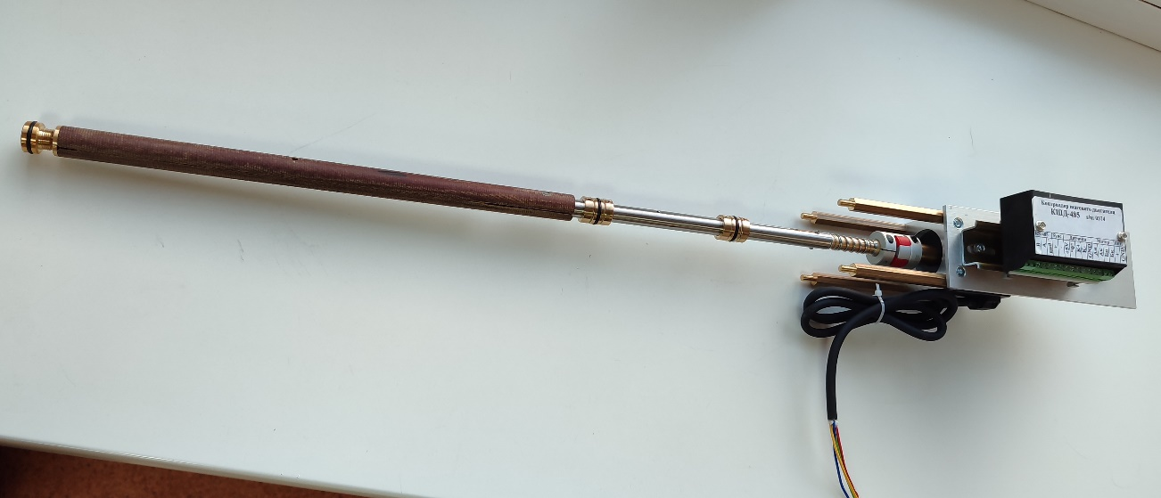
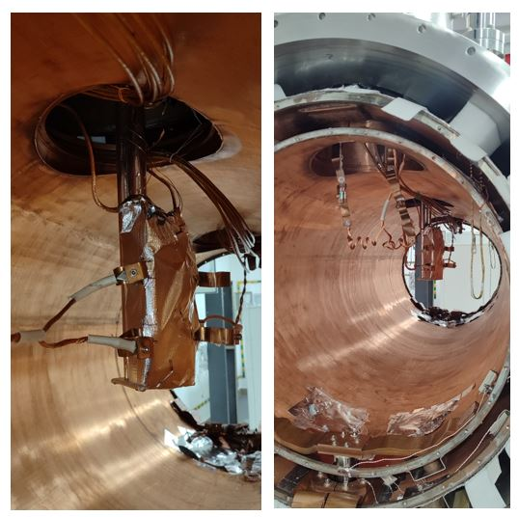
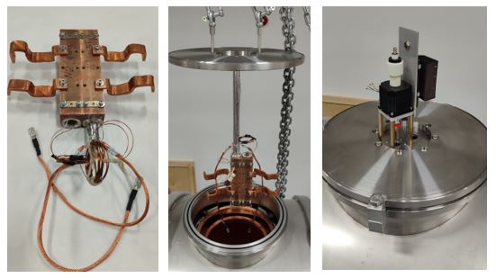
Superconducting CCT quadrupole
Cold testing of CCT quadrupole in indirect cooling cryostat
“Cold” tests of the CCT lens prototype were carried out in a “dry” cryostat with indirect cooling with cryocoolers through copper heat conductors in a vacuum.
The maximum current in the cryostat of 1600 A is provided by 4 Danfysik power supplies of 400 A each.
First step: only one lens is powered and measured.
Next step: both lenses will be connected in series to measure the effect of the magnetic field of each lens on each other.
Measuring frame with stepper motor
Indirect cooling cryostat at BINP
Quadrupole lens unit
The process of installing a quadrupole lens unit into indirect cooling cryostat
FTCF-2024, Hefei
10/15

Slide 11
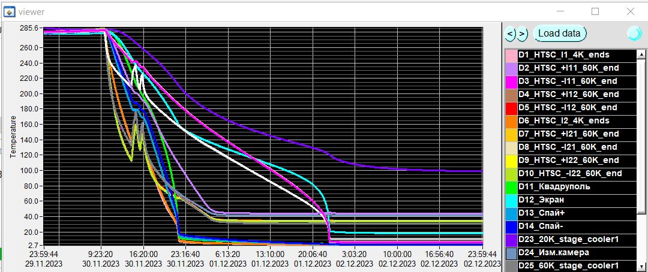
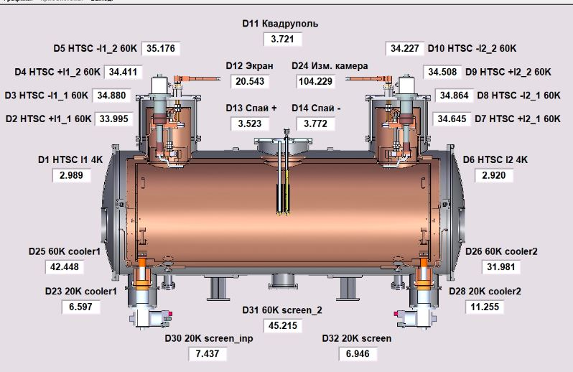
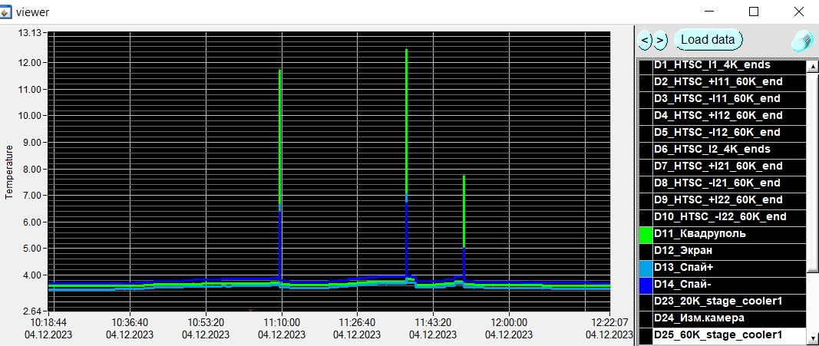
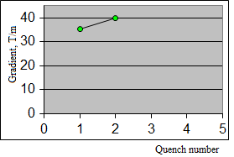
Superconducting CCT quadrupole
Cold testing of CCT quadrupole in indirect cooling cryostat
Cooling down of the quadrupole block took us 2 days. Minimum temperature 3.7 K.
It was two quenches. Max current was 1500 A (corresponding to a gradient of 40 T/m)
The process of cooling down of quadrupole in indirect cooling cryostat.
Temperature distribution in an indirect cooling cryostat
Training process of CCT quadrupole
date | time | I, А | Gradient Т/m
23.12.04 | 11:09 | 1324,2 | 35,31
 | 11:37 | 1499,1 | 39,98
Behavior of quadrupole temperature during quenching.
FTCF-2024, Hefei
11/15

Slide 12
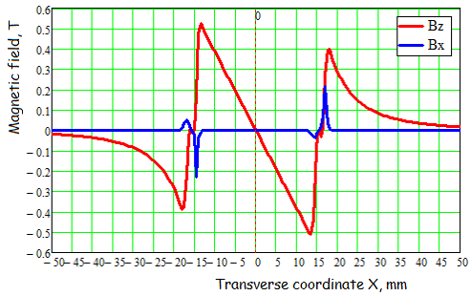
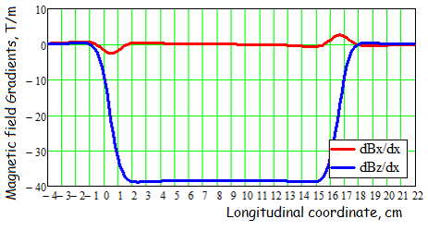
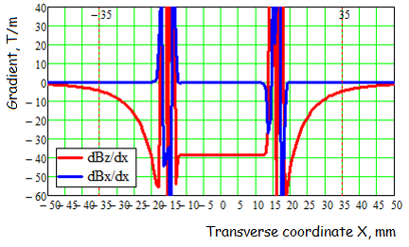
Superconducting CCT quadrupole
Magnetic field calculations for single lens
There is presented the magnetic field calculation for single quadrupole lens.
Biot-Savart's law was used to calculate the field distribution by summing the field contributions from short elements currents following the groove path.
Inside the lens aperture there is only a vertical field component Bz, which linearly depends on the transverse coordinate X and gradient dBz/dx component does not change in the lens aperture.
Dependency of Bx and Bz field component from transverse coordinate X
Distribution of field gradients dBx/dx and dBz/dx along longitudinal coordinate
Behavior of gradients dBx/dx and dBz/dx from transverse coordinate X
FTCF-2024, Hefei
12/15

Slide 13
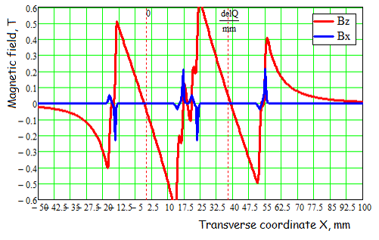
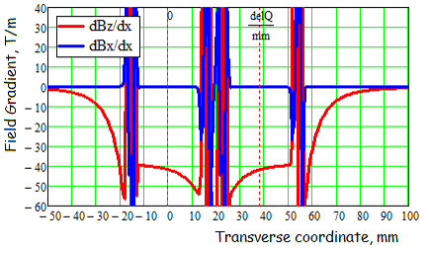
Superconducting CCT quadrupole
Magnetic field calculations for two powered lens
For magnetic field distribution of two powered lens: in the presence of second lens the Bz field component is depended not linearly from transvers coordinate X and field gradient is increased near neighboring lens.
This problem is recognized but its solution will not be discussed in this report.
Dependency of Bx and Bz field component from transverse coordinate X.
Red - the total field from two powered quadrupoles. The centers of the lenses are dotted.
Behavior of gradients dBx/dx и dBz/dx from transverse coordinate X with two powered quadrupoles.
FTCF-2024, Hefei
13/15

Slide 14
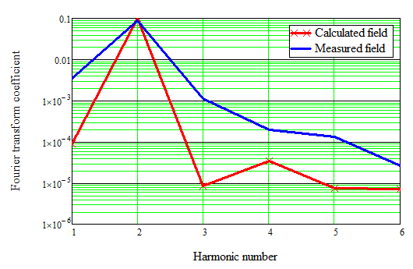
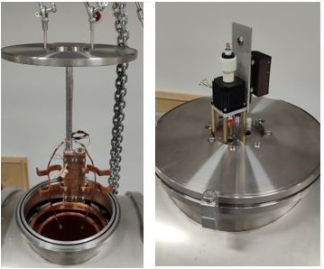
Superconducting CCT quadrupole
Magnetic field measurements of CCT lens using a rotating frame
Measurements of the magnetic field of single lens were carried out using a rotating frame system.
Field expansion coefficients in Fourier series of the measured signal: in addition to the main Second harmonic (corresponding to Quadrupole component), there is also a First harmonic (responsible for Dipole component) and Third harmonic (Sextupole). The amplitude of this additional harmonics is slightly higher than expected by calculations.
The presence of a dipole field can be explained by shifting between the axes of the measuring frame and the quadrupole lens. But slightly increased value of higher harmonics requires additional investigation.
These are only the first step and the measuring system and interpretation of measuring result will require some improvement.
2023.12.04
Calculated and measured field expansion coefficients in the Fourier series.
Measuring system with rotating frame
FTCF-2024, Hefei
14/15

Slide 15
Superconducting CCT quadrupole
Conclusions:
Using the prototype, a full technological cycle for manufacturing the FF CCT lens was developed, including the fabrication, winding, impregnation, etc.
Cold tests were carried out in a dry cryostat, including cooling to 3.7 K, powering by current of 1500 A, and field quenching. The winding remains safety during training.
The required gradient of 40 T/m was obtained.
Magnetic field measurements were carried out using a rotating frame.
Next step will be powering the both lenses connected in series to measure the effect of the magnetic field of each lens on each other.
Finding ways to suppress the influence of the magnetic field of lenses on each other.
Thank you for your attention
FTCF-2024, Hefei
15/15

