Slide 1
Touschek lifetime optimization at Super C-Tau factory in Novosibirsk
A. Bogomyagkov
BINP, Russia
The 2024 International Workshop on Future Tau Charm Facilities (FTCF2024)
University of Science and Technology of China (USTC), Hefei, China
14 – 18 January, 2024

Slide 2
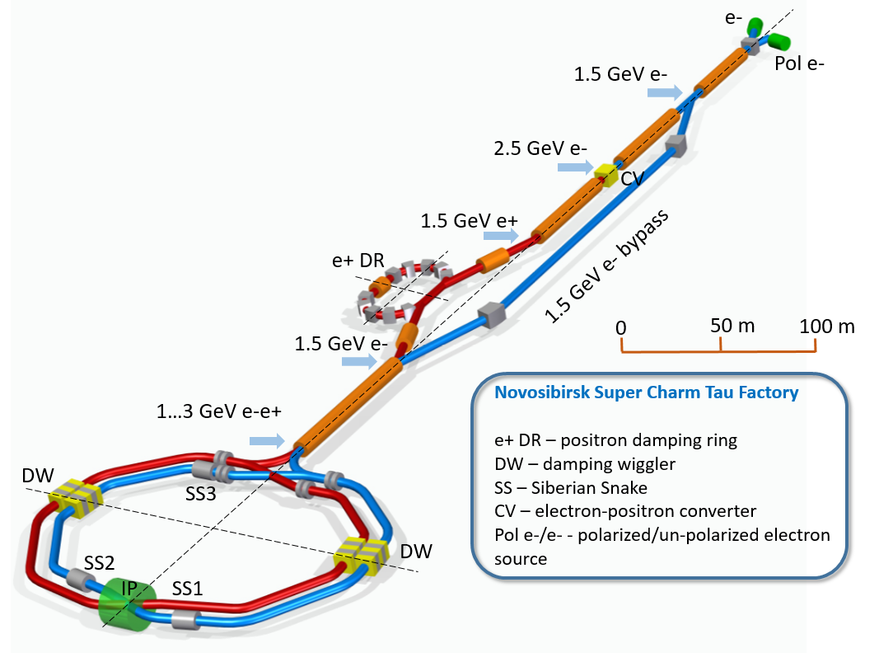
Facility overview
1.5 – 3.5 GeV e-e+

Slide 3
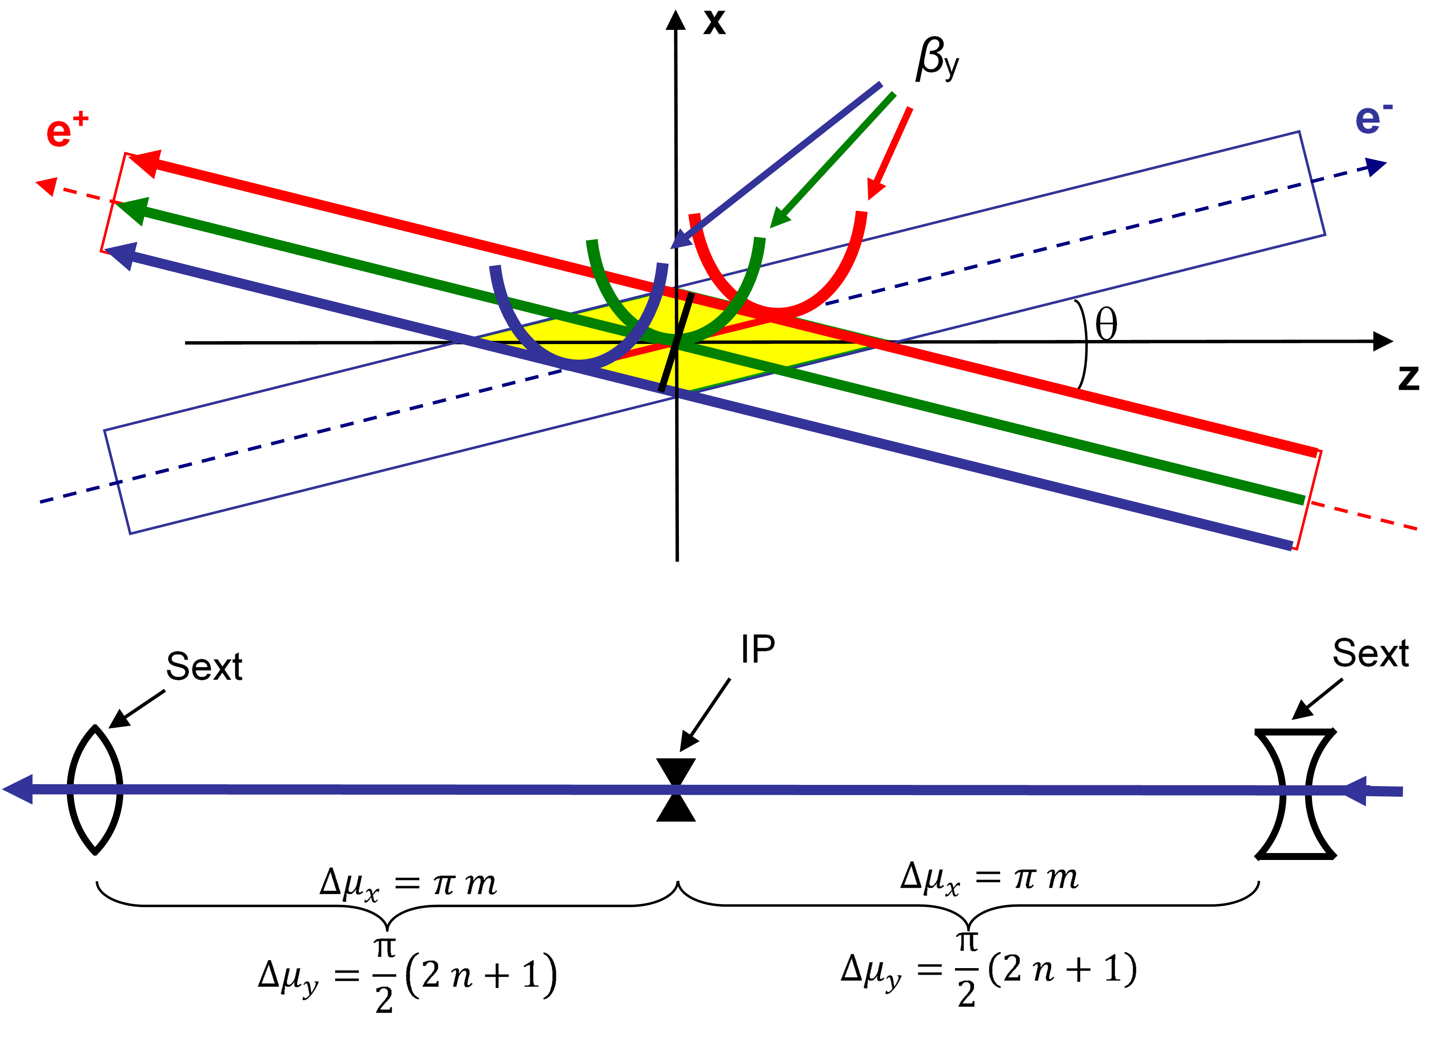
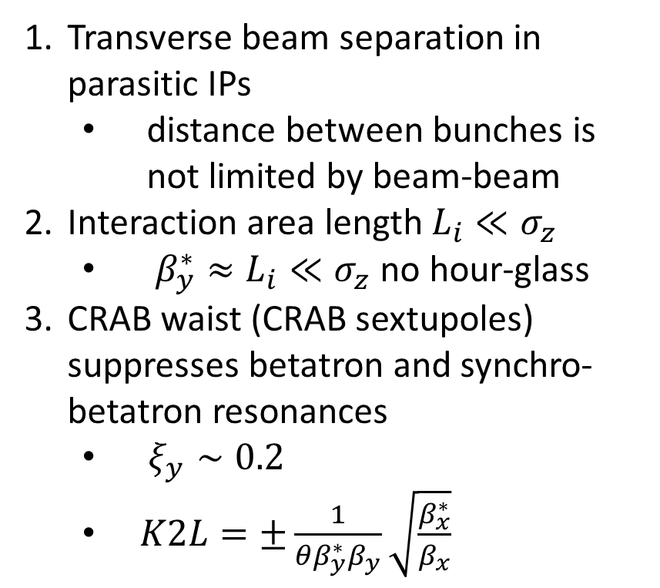
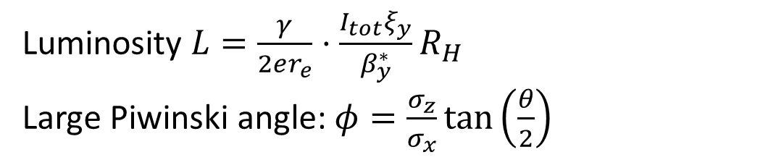
Crab waist (P.Raimondi 2006)
Luminosity $L=\frac{γ}{2er_{e}}⋅\frac{I_{tot}ξ_{y}}{β_{y}^{∗}}R_{H}$
Large Piwinski angle: $φ=\frac{σ_{z}}{σ_{x}}\tan\left(\frac{θ}{2}\right)$
Transverse beam separation in parasitic IPs
  distance between bunches is not limited by beam-beam
Interaction area length $L_{i}≪σ_{z}$
  $β_{y}^{∗}≈L_{i}≪σ_{z}$ no hour-glass
CRAB waist (CRAB sextupoles) suppresses betatron and synchro-betatron resonances
  $ξ_{y}∼0.2$
  $K2L=±\frac{1}{{θβ}_{y}^{∗}β_{y}}\sqrt{\frac{β_{x}^{∗}}{β_{x}}}$
x
+
-
e
L_{i}
e
θ
φ ∙σ_{x}
z
2σ_{z}
2σ_{x}
Notes:
mux=3pi*2, muy=2.5pi*2

Slide 4
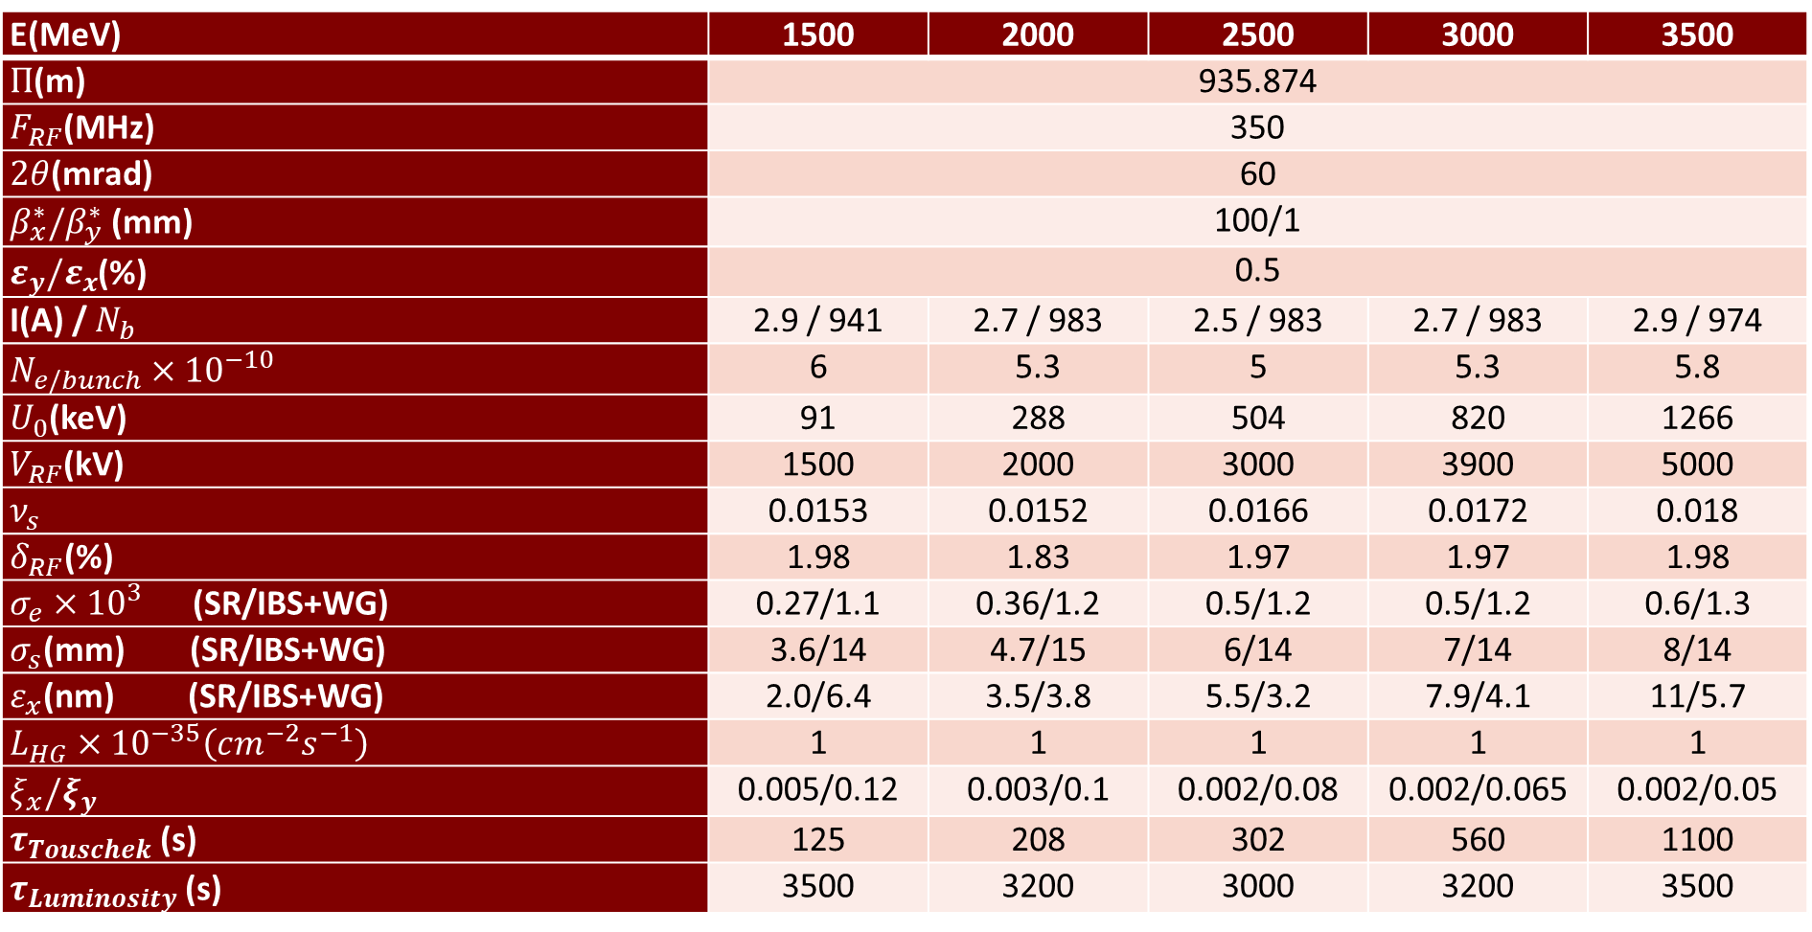



Design parameters for $ℒ=1×{10}^{35}$
E(MeV) | 1500 | 2000 | 2500 | 3000 | 3500
$Π$(m) | 935.874
$F_{RF}$(MHz) | 350
$2θ$(mrad) | 60
$β_{x}^{∗}/β_{y}^{∗}$ (mm) | 100/1
$ε_{y}/ε_{x}$(%) | 0.5
I(A) / $N_{b}$ | 2.9 / 941 | 2.7 / 983 | 2.5 / 983 | 2.7 / 983 | 2.9 / 974
$N_{e/bunch}×{10}^{−10}$ | 6 | 5.3 | 5 | 5.3 | 5.8
$U_{0}$(keV) | 91 | 288 | 504 | 820 | 1266
$V_{RF}$(kV) | 1500 | 2000 | 3000 | 3900 | 5000
$ν_{s}$ | 0.0153 | 0.0152 | 0.0166 | 0.0172 | 0.018
$δ_{RF}$(%) | 1.98 | 1.83 | 1.97 | 1.97 | 1.98
$σ_{e}×{10}^{3}$ (SR/IBS+WG) | 0.27/1.1 | 0.36/1.2 | 0.5/1.2 | 0.5/1.2 | 0.6/1.3
$σ_{s}$(mm) (SR/IBS+WG) | 3.6/14 | 4.7/15 | 6/14 | 7/14 | 8/14
$ε_{x}$(nm) (SR/IBS+WG) | 2.0/6.4 | 3.5/3.8 | 5.5/3.2 | 7.9/4.1 | 11/5.7
$L_{HG}×{10}^{−35}\left(cm^{−2}s^{−1}\right)$ | 1 | 1 | 1 | 1 | 1
$ξ_{x}/ξ_{y}$ | 0.005/0.12 | 0.003/0.1 | 0.002/0.08 | 0.002/0.065 | 0.002/0.05
$τ_{Touschek}$ (s) | 125 | 208 | 302 | 560 | 1100
$τ_{Luminosity}$ (s) | 3500 | 3200 | 3000 | 3200 | 3500
SuperKEKB 2020 $β_{y}^{∗}=0.8 mm$
PEPII: I(e+)=3.2 A PEPII
DAFNE : I(e-)=2.45A
SuperKEKB: $L=4.7×{10}^{34}$
Notes:
68_1, q=1093, I(e+)=3.2 A PEPII, I(e-)=2.45A DAFNE, L=2.1e34 KEKB

Slide 5
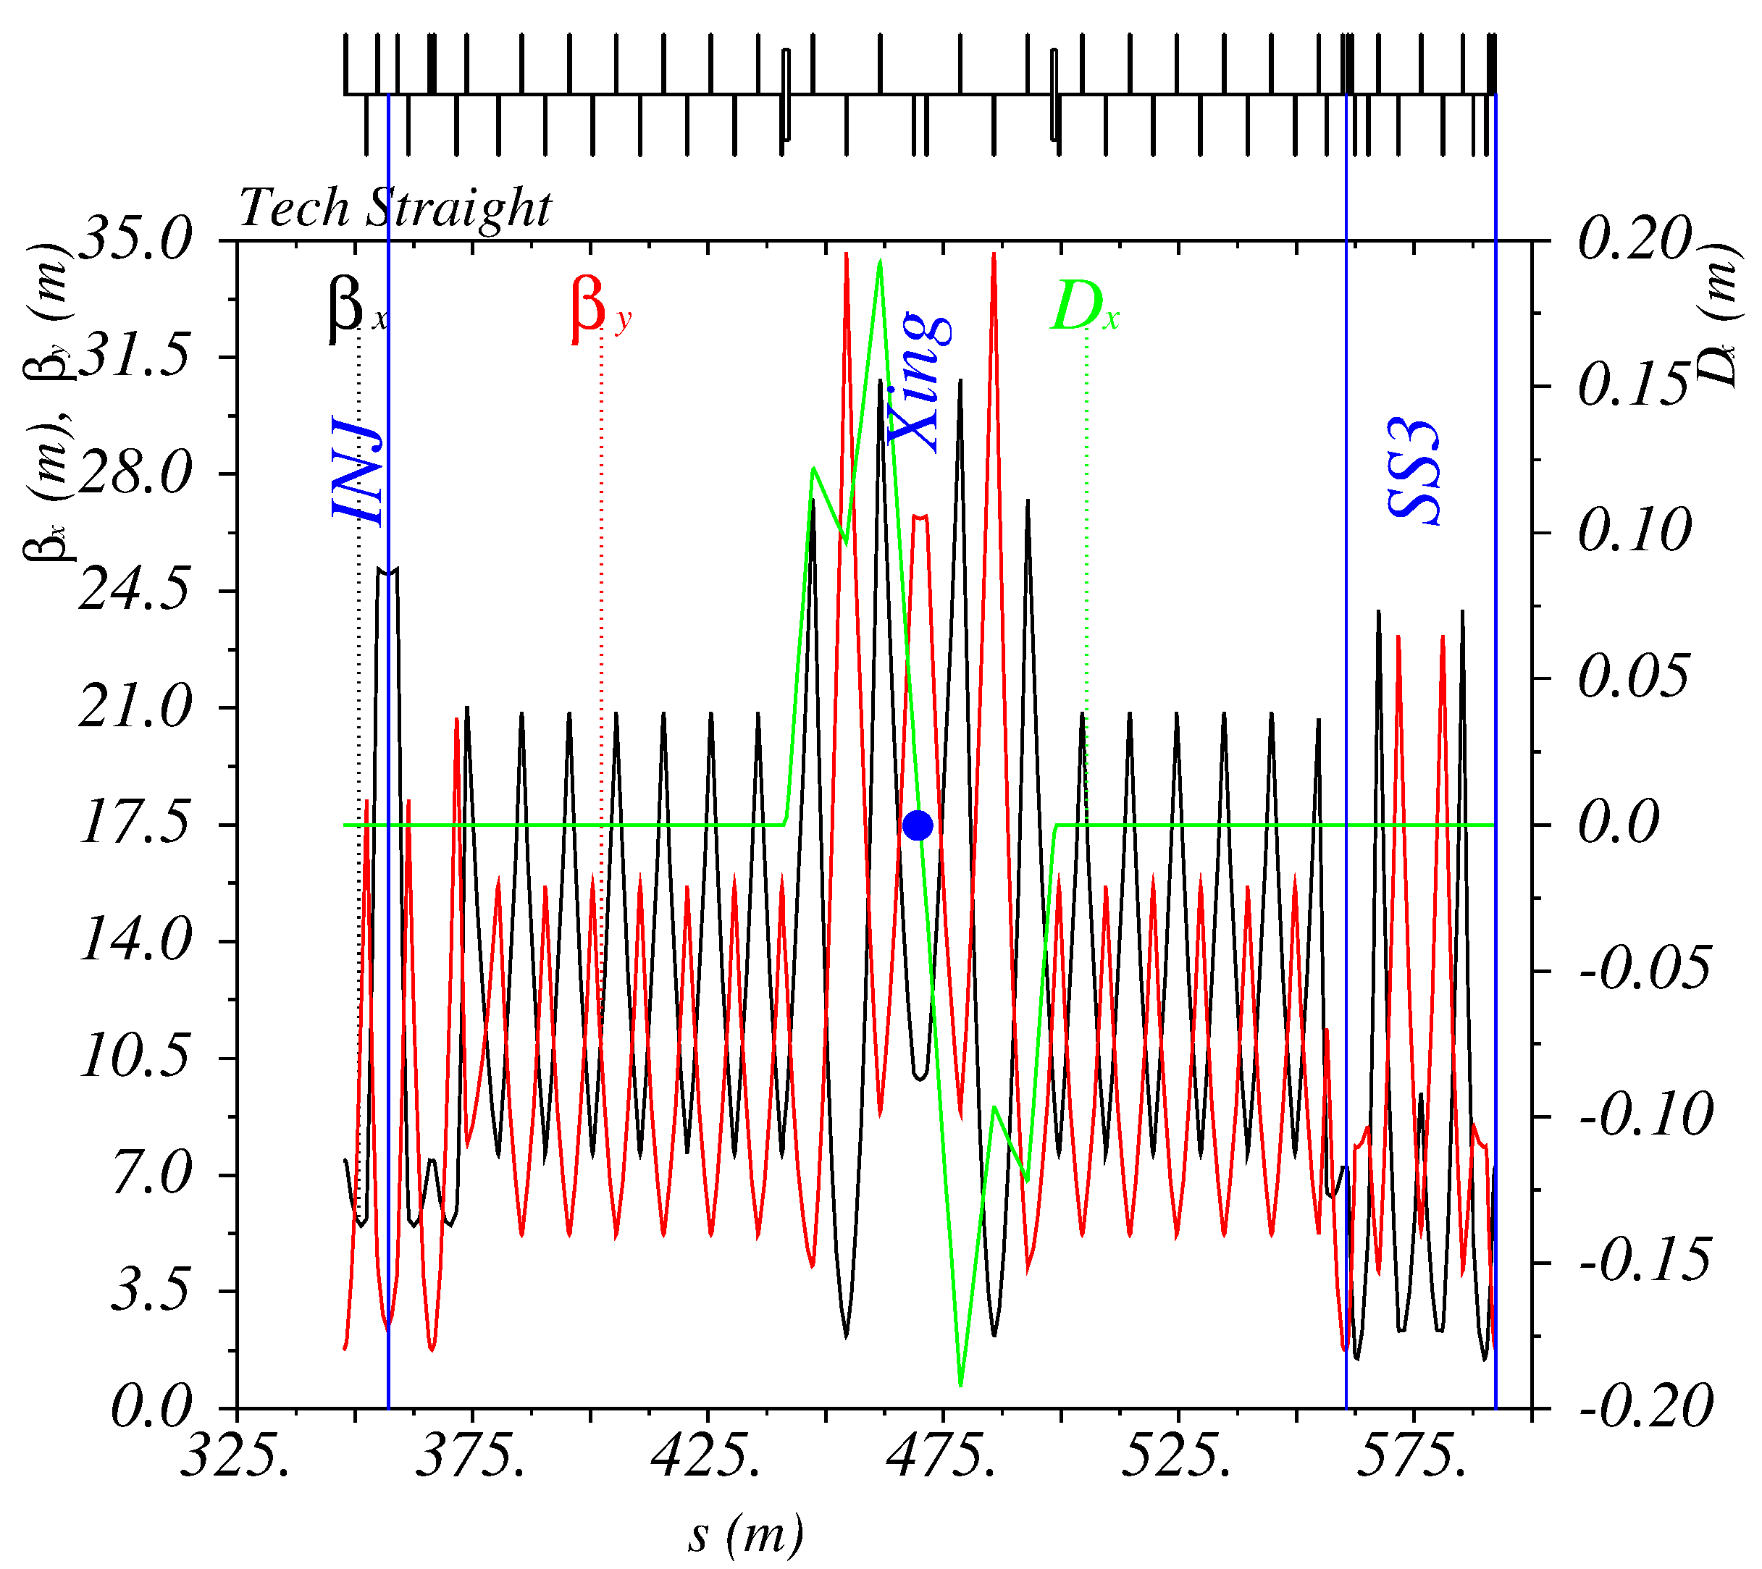
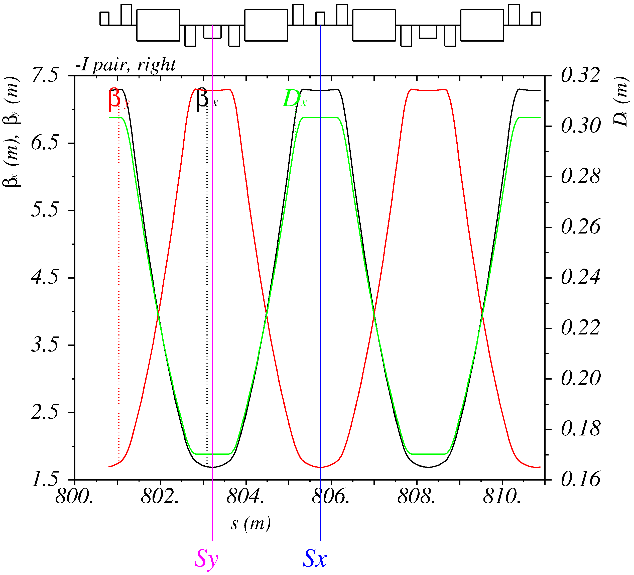
Straight and Arc sections
Straight
Arc: FODO 90° cells
Notes:
Arcs: 24 x and 24 y pairs of interleaved pairs of sextupoles

Slide 6
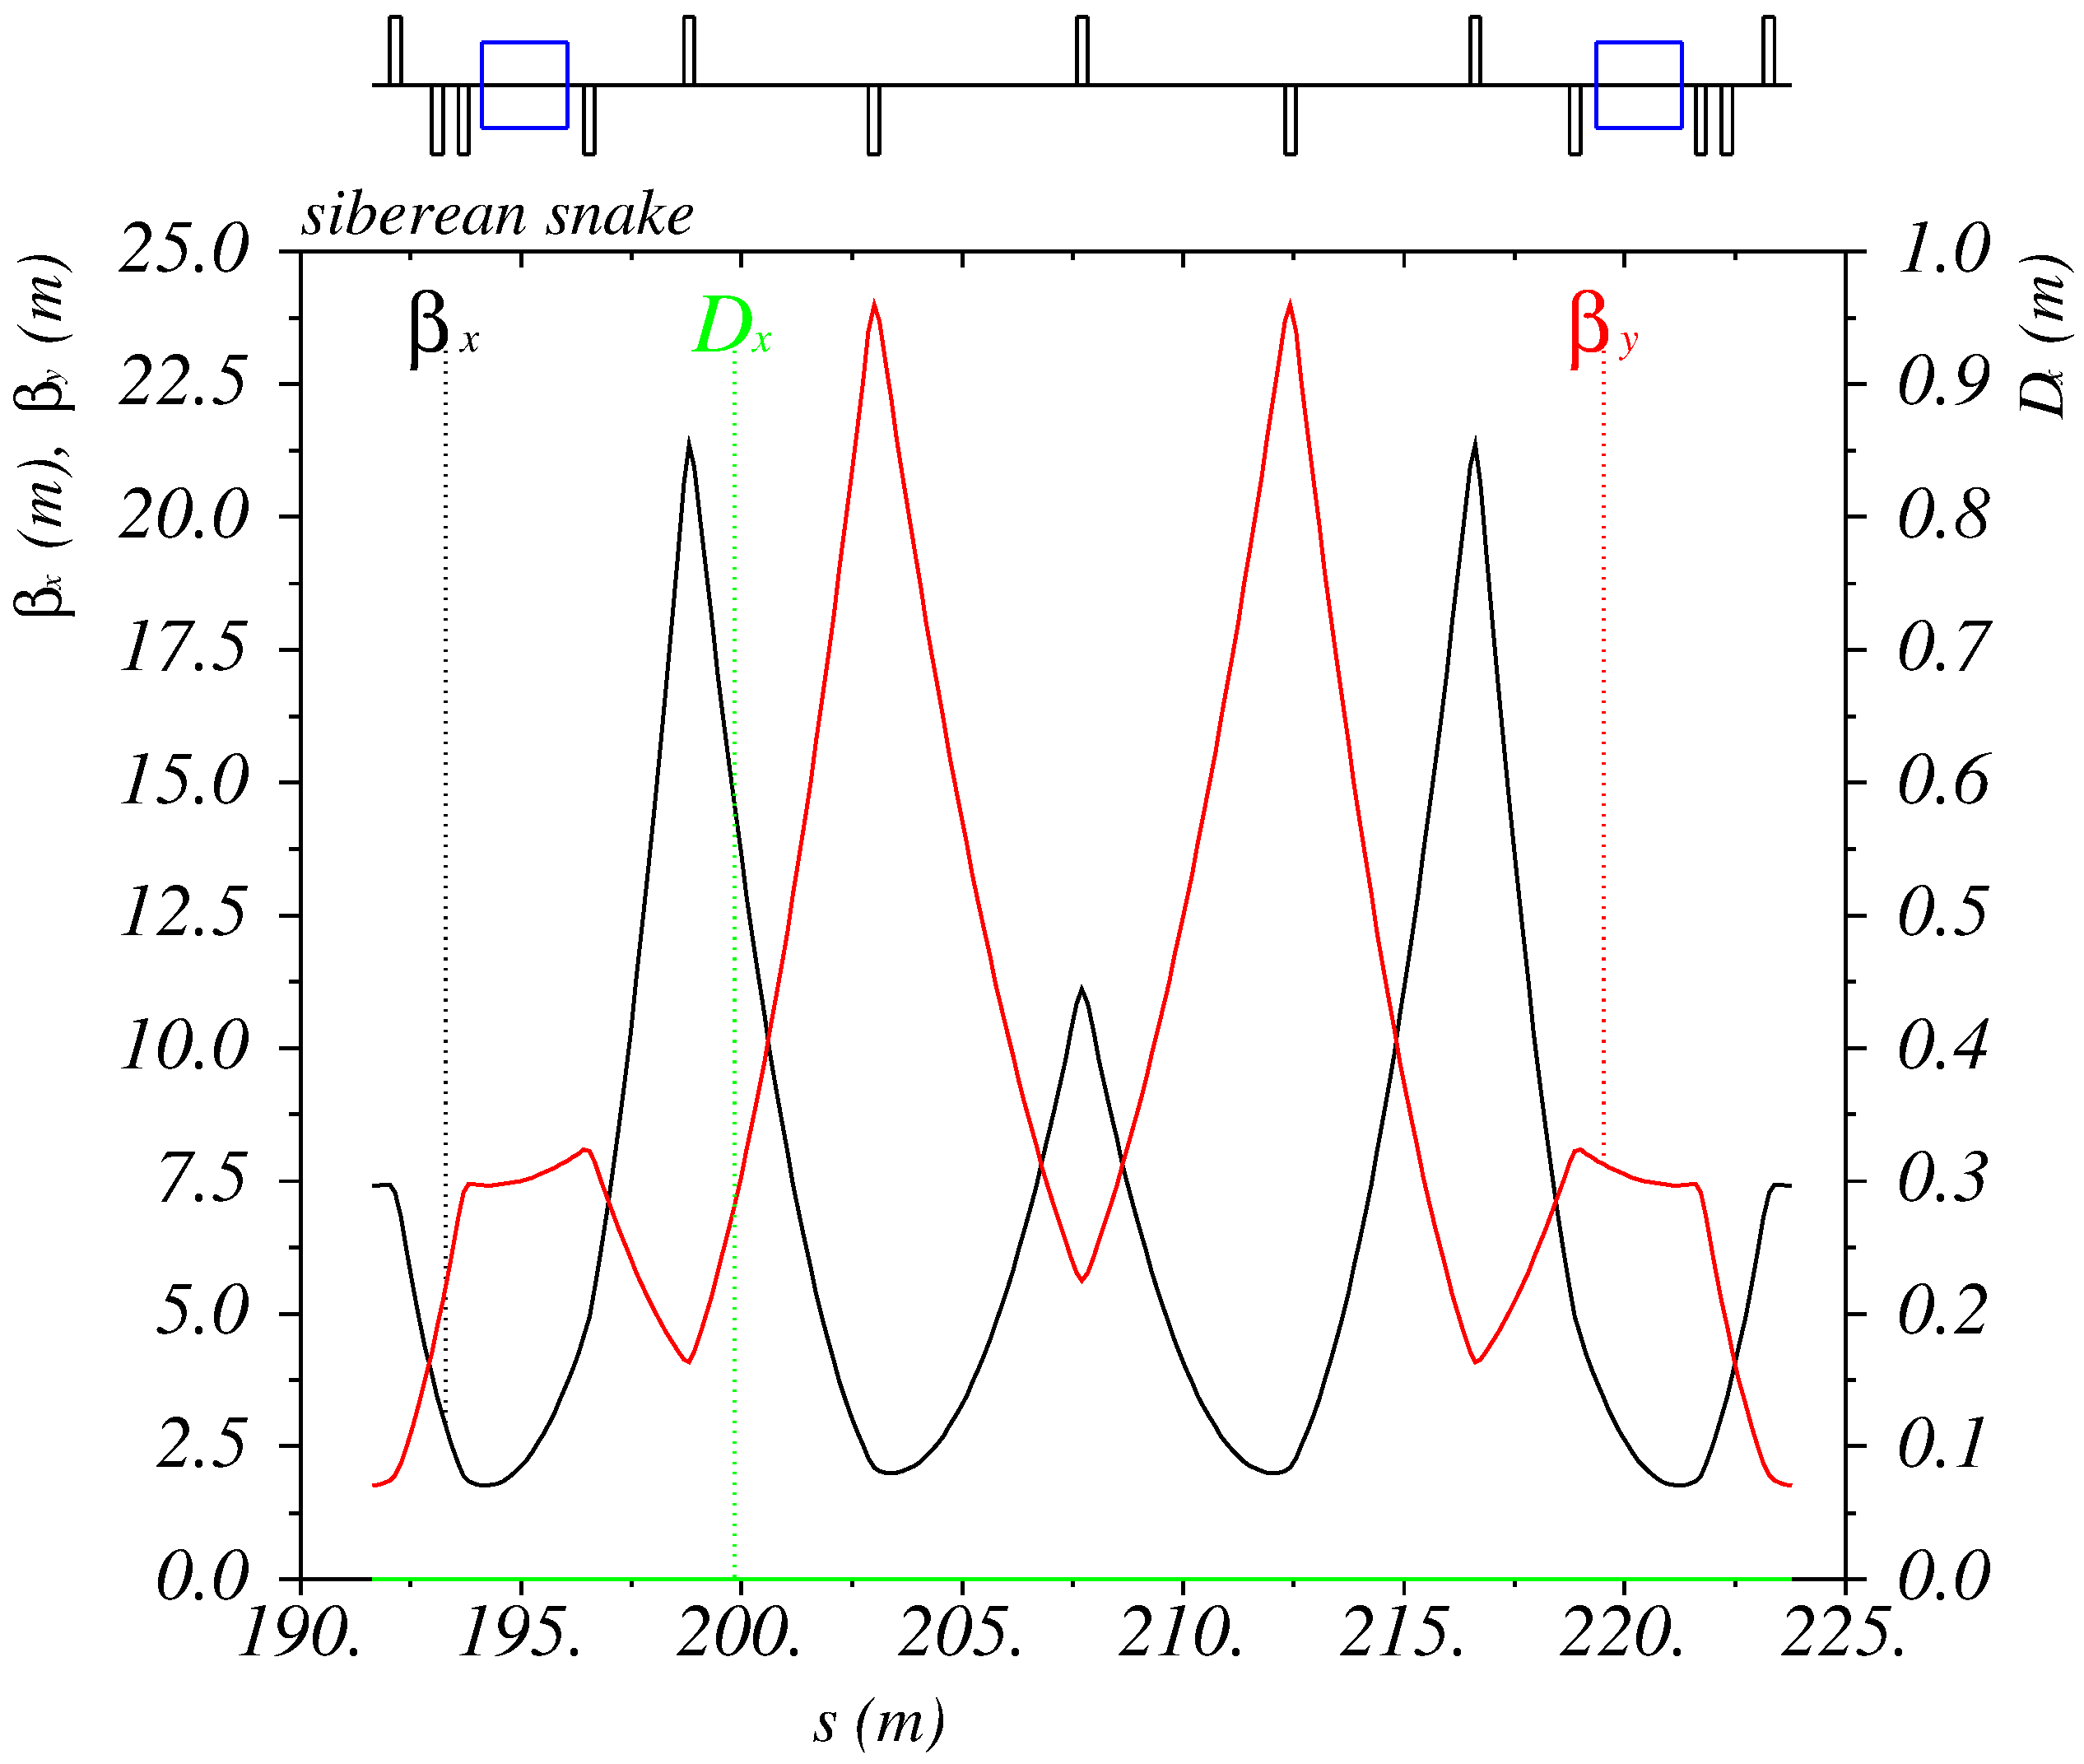
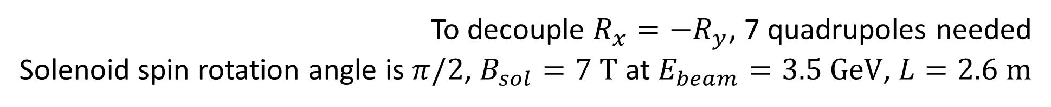
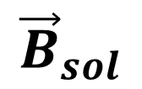
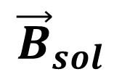
Siberian Snake
The goal is to provide longitudinal polarization at IP
$${\vec{B}}_{sol}$$
$${\vec{B}}_{sol}$$
120°
IP
SS2
SS1
120°
120°
SS3
To decouple $R_{x}=−R_{y}$, 7 quadrupoles needed
Solenoid spin rotation angle is $π/2$, $B_{sol}=7 \text{T}$ at $E_{beam}=3.5 \text{GeV}$, $L=2.6 \text{m}$
Notes:
The total length is 33 m, adding 100 m to circumference.

Slide 7
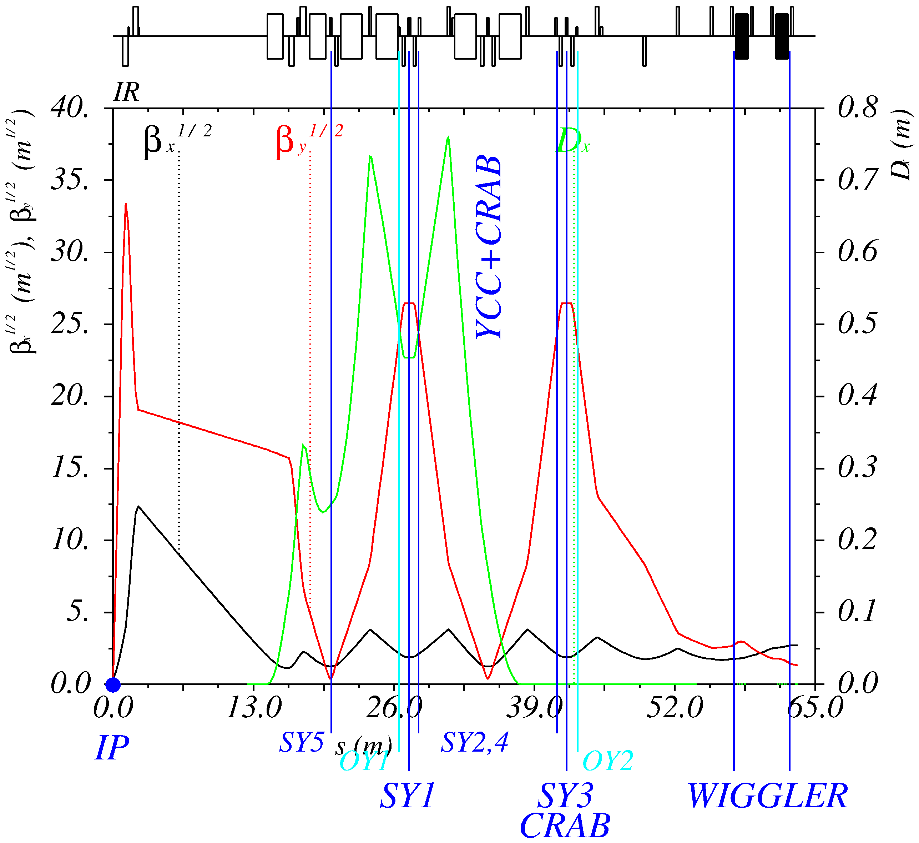
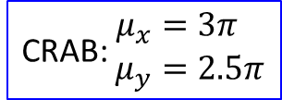
Interaction region 1
CRAB: $\begin{aligned}μ_{x}&=3π \\ μ_{y}&=2.5π\end{aligned}$
K.Oide FCC-ee
Notes:
54-1: crab at mux=3pi*2, muy=2.5pi*2, taux=0.3 s ->(wiggler) ->0.049 s

Slide 8
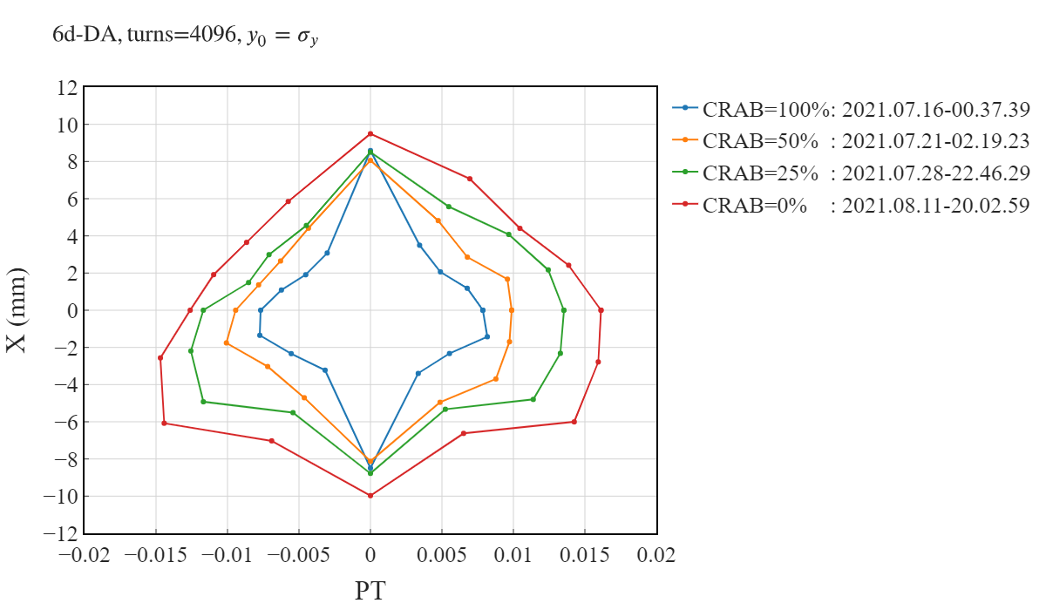
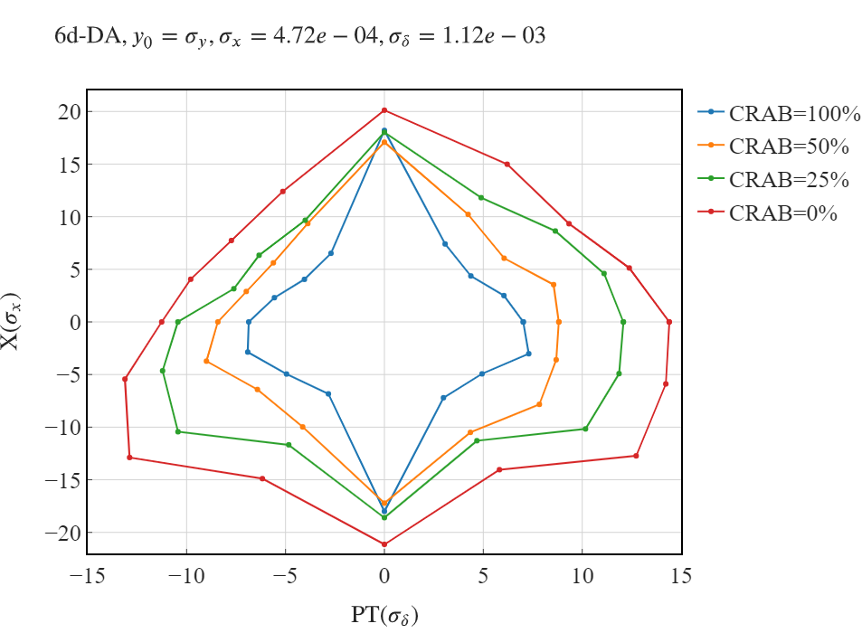
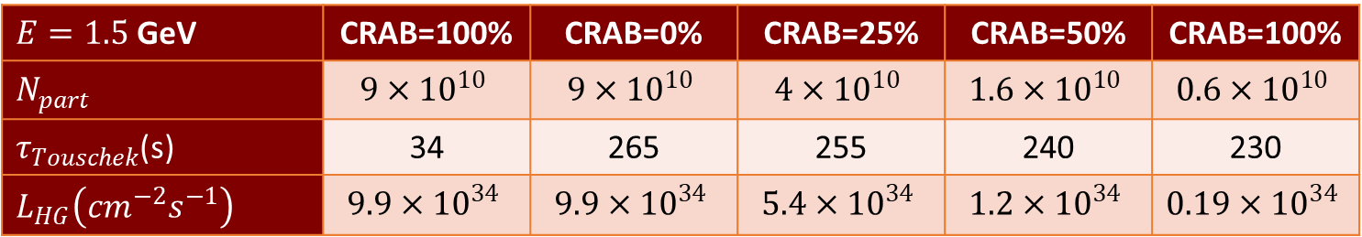
CRAB sextupole influence on 6d DA, E=1.5 ГэВ
$E=1.5$ GeV | CRAB=100% | CRAB=0% | CRAB=25% | CRAB=50% | CRAB=100%
$N_{part}$ | $$9×{10}^{10}$$ | $$9×{10}^{10}$$ | $$4×{10}^{10}$$ | $$1.6×{10}^{10}$$ | $$0.6×{10}^{10}$$
$τ_{Touschek}$(s) | 34 | 265 | 255 | 240 | 230
$L_{HG}\left(cm^{−2}s^{−1}\right)$ | $$9.9×{10}^{34}$$ | $$9.9×{10}^{34}$$ | $$5.4×{10}^{34}$$ | $$1.2×{10}^{34}$$ | $$0.19×{10}^{34}$$
Notes:
54_1, 2021.06.17-13.08.03_sextupole_chrom-14.str

Slide 9
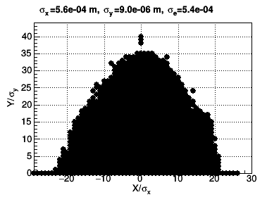
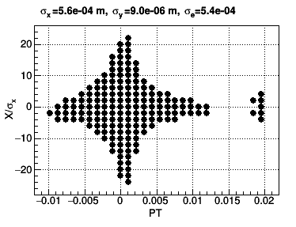
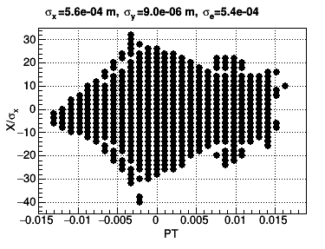
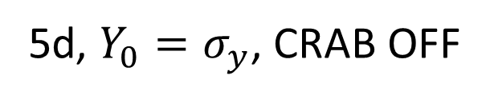
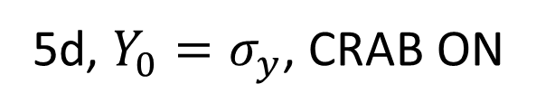
CRAB sextupole influence: 5d-DA
4d, on momentum
5d, ${Y_{0}=σ}_{y}$, CRAB ON
5d, ${Y_{0}=σ}_{y}$, CRAB OFF
Why do CRAB sextupoles reduce 5d DA?!
Notes:
49-5: 2020.10.11-22.59.05_sextupole_chrom-5.str

Slide 10
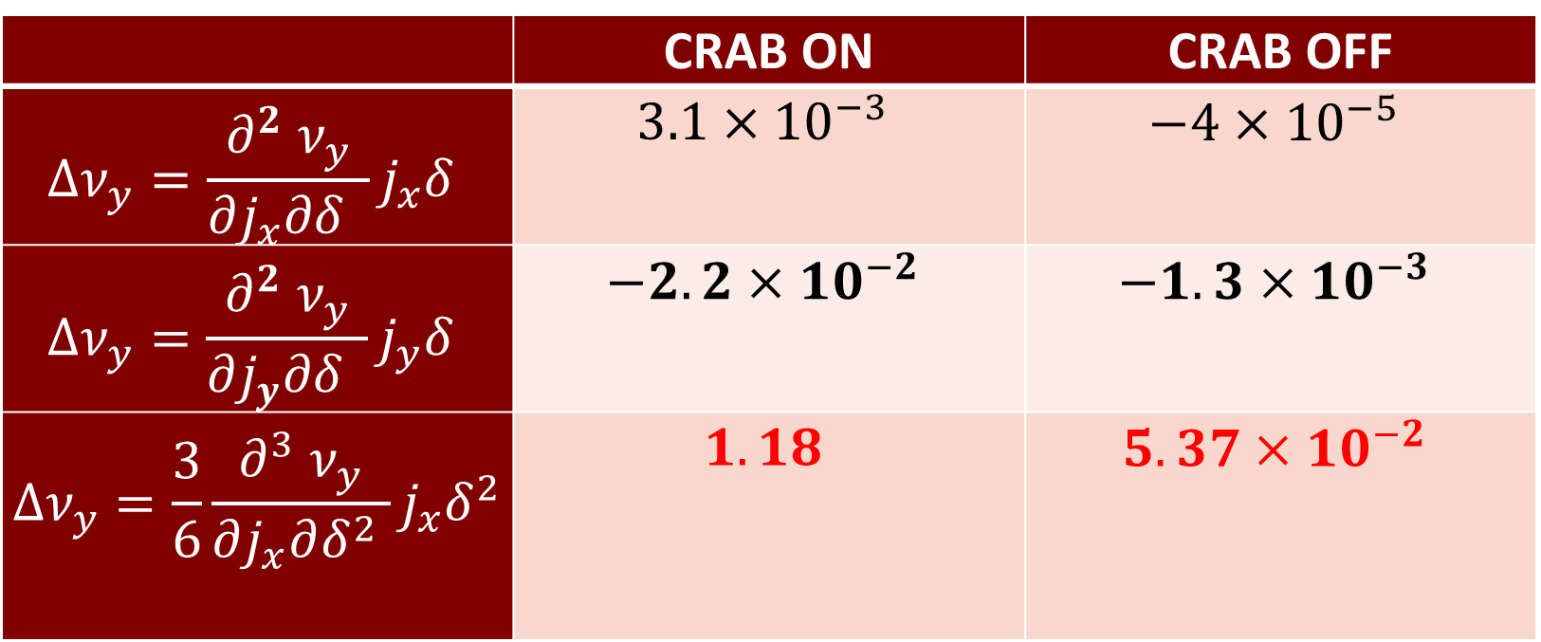

CRAB sextupole influence: detuning
 | CRAB ON | CRAB OFF
$$Δν_{y}=\frac{∂^{2} ν_{y}}{∂j_{x}∂δ }j_{x}δ$$ | $$3.1×{10}^{−3}$$ | $$−4×{10}^{−5}$$
$$Δν_{y}=\frac{∂^{2} ν_{y}}{∂j_{y}∂δ }j_{y}δ$$ | $$−2.2×{10}^{−2}$$ | $$−1.3×{10}^{−3}$$
$$Δν_{y}=\frac{3}{6}\frac{∂^{3} ν_{y}}{∂j_{x}∂δ^{2} }j_{x}δ^{2}$$ | $$1.18$$ | $$5.37×{10}^{−2}$$
$$x_{0}=10σ_{x}, y_{0}=15σ_{y}, δ=1.5\%$$
CRAB sextupoles introduces humongous chromatic detuning!
Notes:
49_5, call,file="../2020.10.11-22.59.05_sextupole_chrom-5.str";

Slide 11
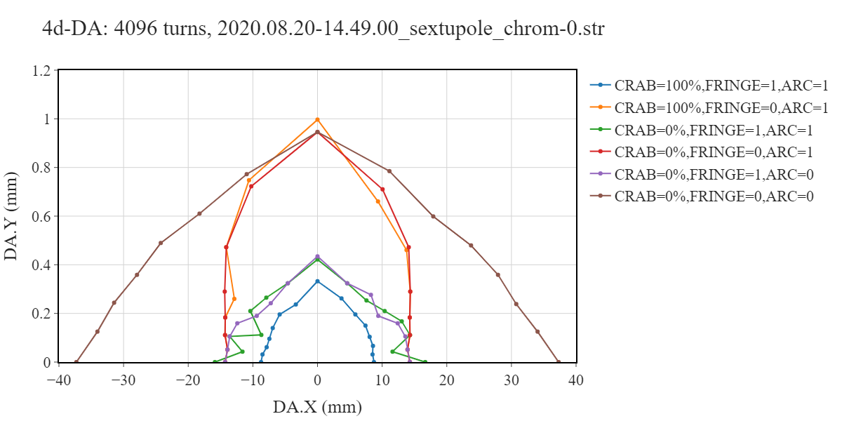
4d-DA study
4d DA is limited by CRAB sextupole and fringe fields and their interference
Notes:
49_6 (49_5), k2_lcrab = 24.2061222750197

Slide 12
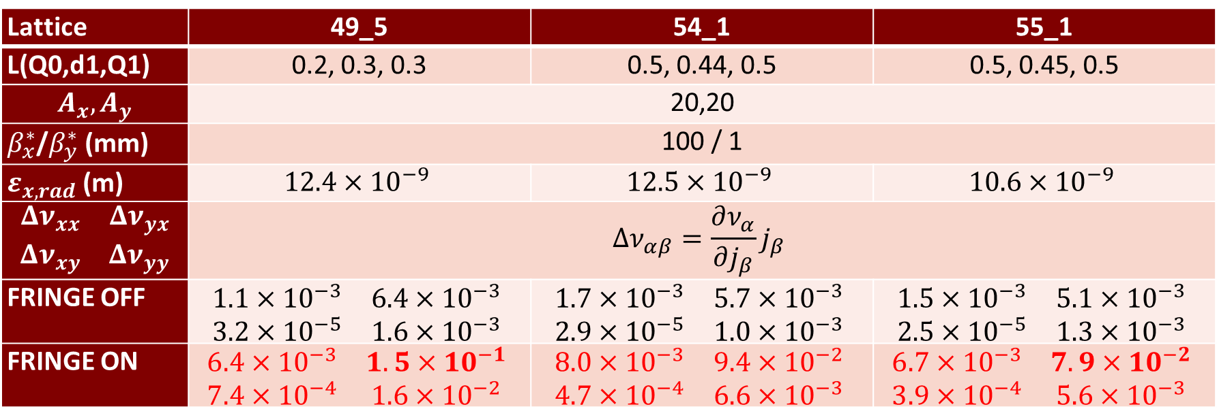
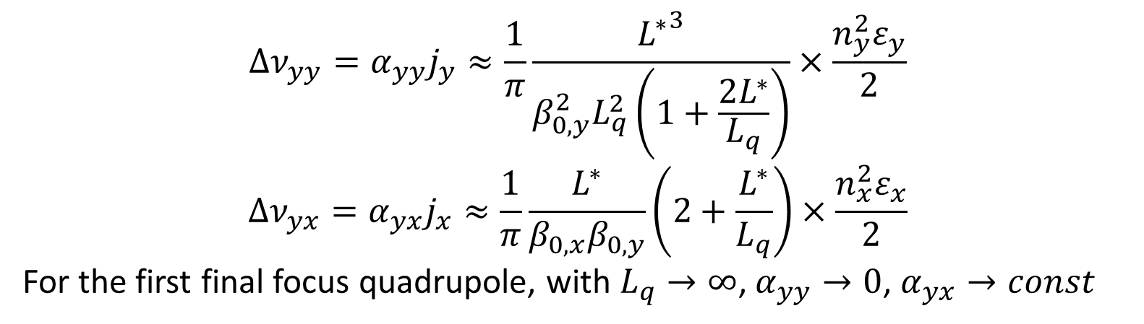
Optimization of the final doublet
$$Δν_{yy}=α_{yy}j_{y}≈\frac{1}{π}\frac{{L^{∗}}^{3}}{{β_{0,y}^{2}L}_{q}^{2}\left(1+\frac{2L^{∗}}{L_{q}}\right)}×\frac{n_{y}^{2}ε_{y}}{2}$$
$$Δν_{yx}=α_{yx}j_{x}≈\frac{1}{π}\frac{L^{∗}}{β_{0,x}β_{0,y}}\left(2+\frac{L^{∗}}{L_{q}}\right)×\frac{n_{x}^{2}ε_{x}}{2}$$
For the first final focus quadrupole, with $L_{q}→∞$, $α_{yy}→0$, $α_{yx}→const$
IP
L*
d1
Q0
Q1
Lattice | 49_5 | 54_1 | 55_1
L(Q0,d1,Q1) | 0.2, 0.3, 0.3 | 0.5, 0.44, 0.5 | 0.5, 0.45, 0.5
$$A_{x}, A_{y}$$ | 20,20
$β_{x}^{∗}$/$β_{y}^{∗}$(mm) | 100 / 1
$ε_{x, rad}$(m) | $$12.4×{10}^{−9}$$ | $$12.5×{10}^{−9}$$ | $$10.6×{10}^{−9}$$
$$\begin{matrix}Δν_{xx} & Δν_{yx} \\ Δν_{xy} & Δν_{yy}\end{matrix}$$ | $$Δν_{αβ}=\frac{∂ν_{α}}{∂j_{β}}j_{β}$$
FRINGE OFF | $$\begin{matrix}1.1×{10}^{−3} & 6.4×{10}^{−3} \\ 3.2×{10}^{−5} & 1.6×{10}^{−3}\end{matrix}$$ | $$\begin{matrix}1.7×{10}^{−3} & 5.7×{10}^{−3} \\ 2.9×{10}^{−5} & 1.0×{10}^{−3}\end{matrix}$$ | $$\begin{matrix}1.5×{10}^{−3} & 5.1×{10}^{−3} \\ 2.5×{10}^{−5} & 1.3×{10}^{−3}\end{matrix}$$
FRINGE ON | $$\begin{matrix}6.4×{10}^{−3} & 1.5×{10}^{−1} \\ 7.4×{10}^{−4} & 1.6×{10}^{−2}\end{matrix}$$ | $$\begin{matrix}8.0×{10}^{−3} & 9.4×{10}^{−2} \\ 4.7×{10}^{−4} & 6.6×{10}^{−3}\end{matrix}$$ | $$\begin{matrix}6.7×{10}^{−3} & 7.9×{10}^{−2} \\ 3.9×{10}^{−4} & 5.6×{10}^{−3}\end{matrix}$$
Notes:
call,file="../2020.10.11-22.59.05_sextupole_chrom-5.str";

Slide 13
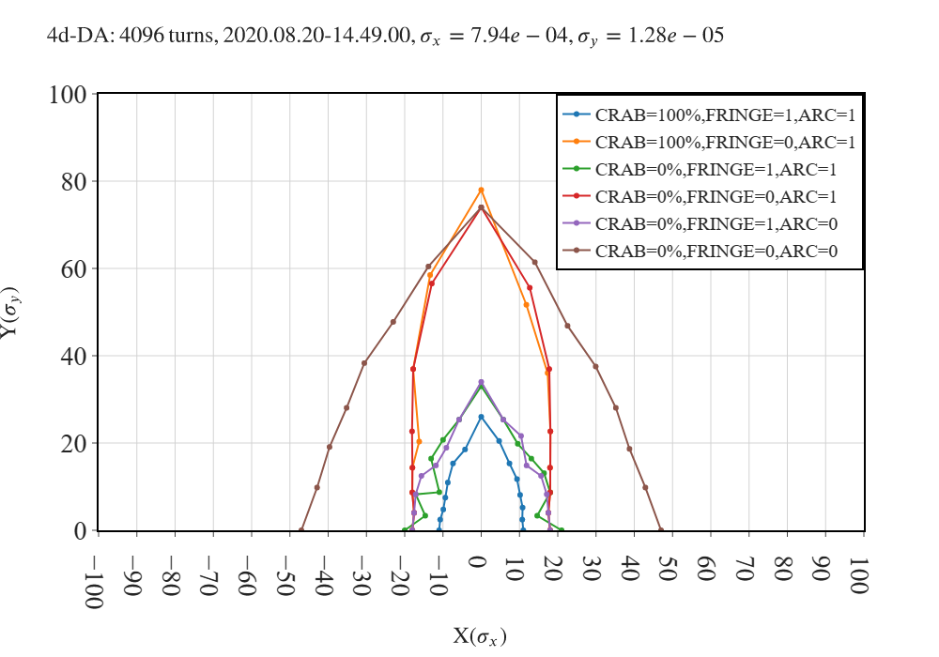
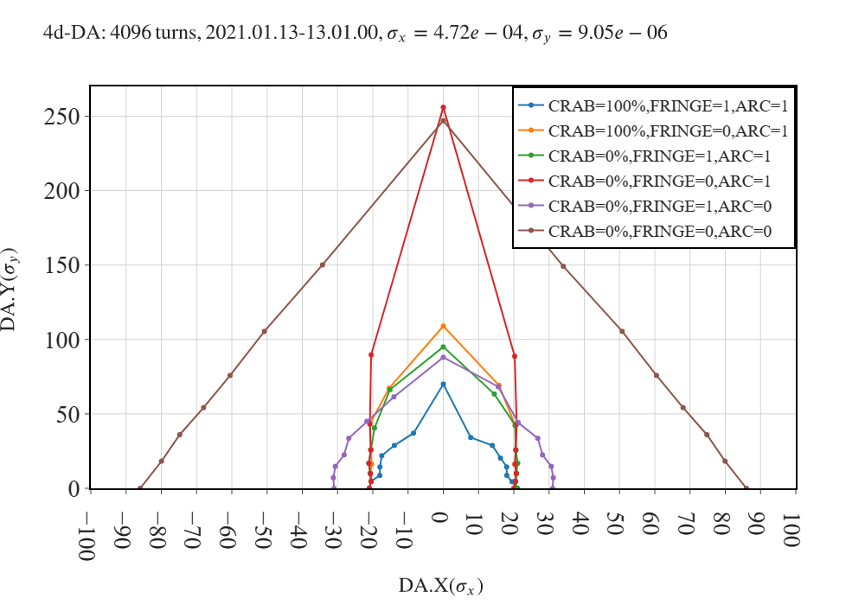
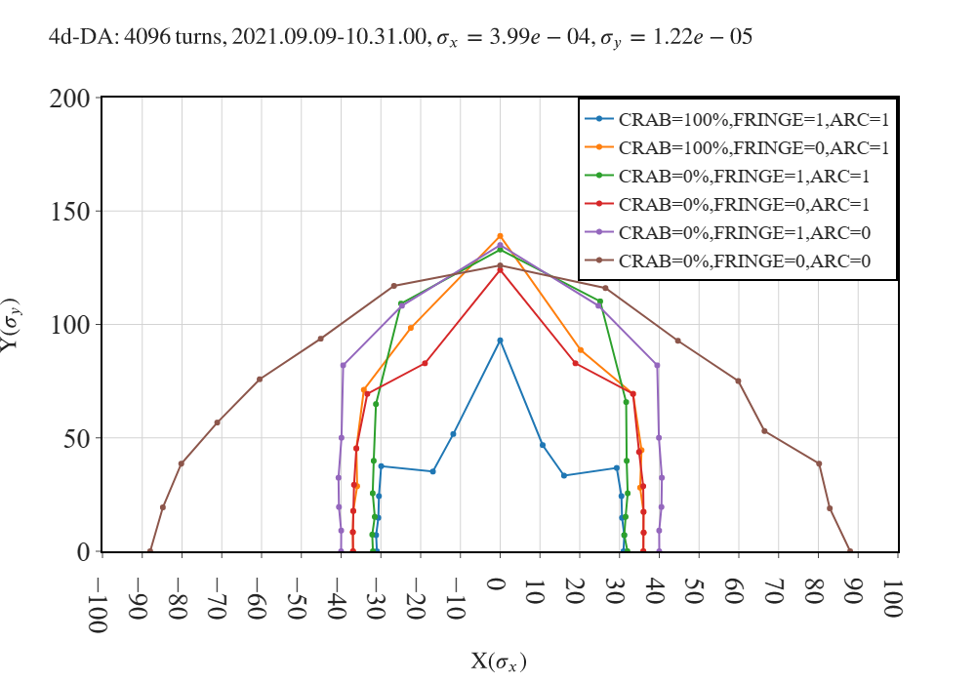
4d-DA: optimization
49_5
54_1
55_1
Notes:
49_6, k2_lcrab = 24.2061222750197; 54_1, k2_lcrab = 19.7885218159168; 55_1, k2_lcrab = 15.6466891406201

Slide 14
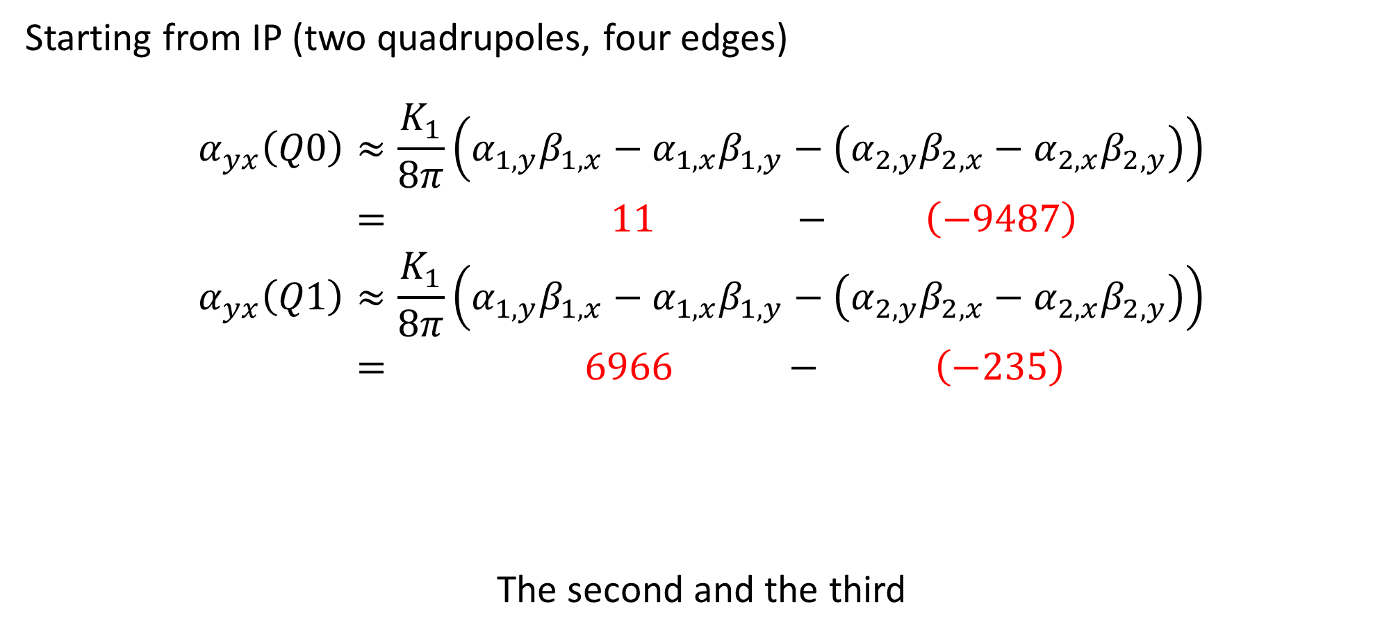
Which quad fringe is the strongest?
Starting from IP (two quadrupoles, four edges)
$$\begin{aligned}α_{yx}\left(Q0\right)&≈\frac{K_{1}}{8π}\left(α_{1,y}β_{1,x}−α_{1,x}β_{1,y}−\left(α_{2,y}β_{2,x}−α_{2,x}β_{2,y}\right)\right) \\ &= 11 − \left(−9487\right) \\ α_{yx}\left(Q1\right)&≈\frac{K_{1}}{8π}\left(α_{1,y}β_{1,x}−α_{1,x}β_{1,y}−\left(α_{2,y}β_{2,x}−α_{2,x}β_{2,y}\right)\right) \\ &= 6966 − \left(−235\right)\end{aligned}$$
The second and the third
First edge
from IP
Second edge from IP
IP
L*
d1
Q0
Q1
Notes:
54_1, the whole input

Slide 15
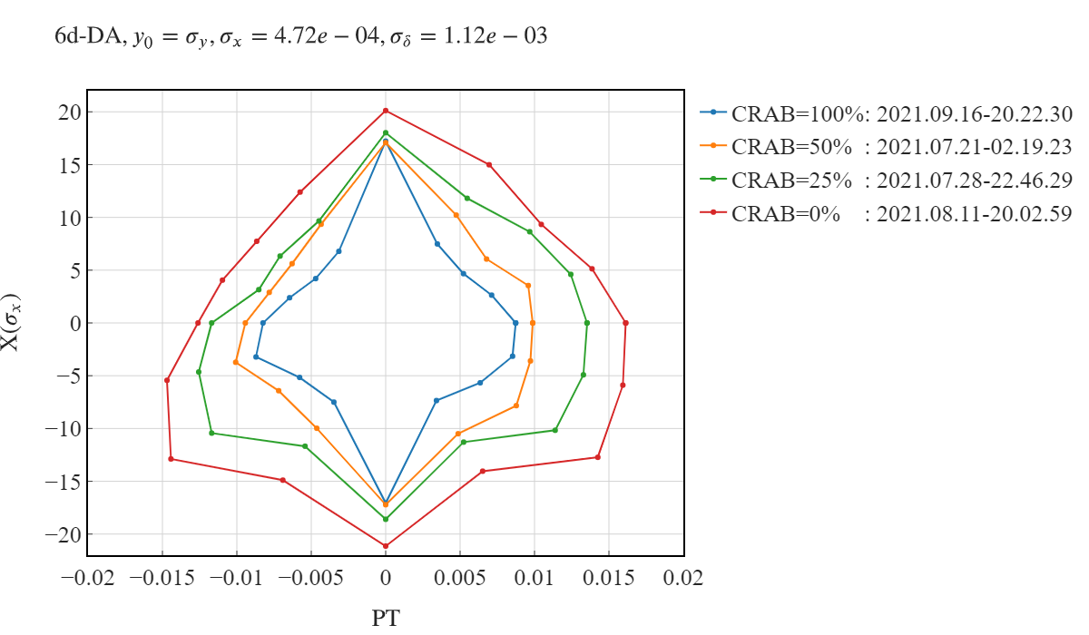
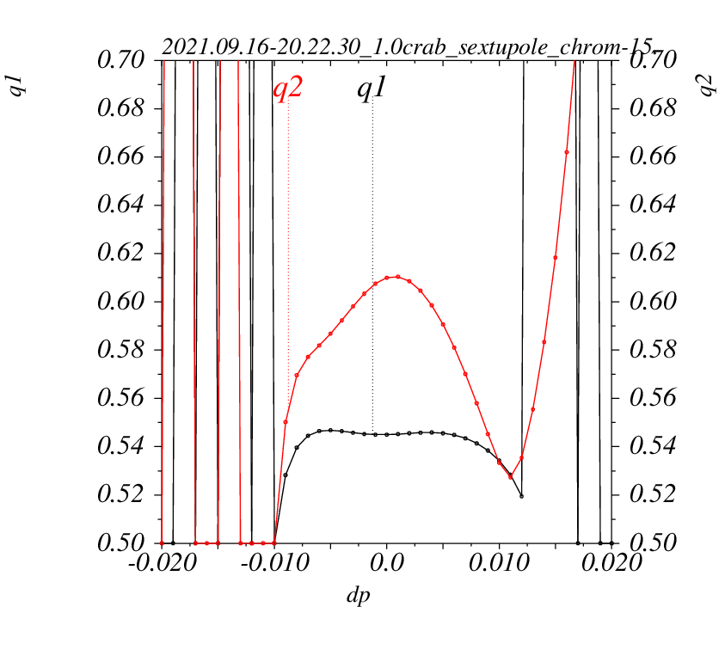
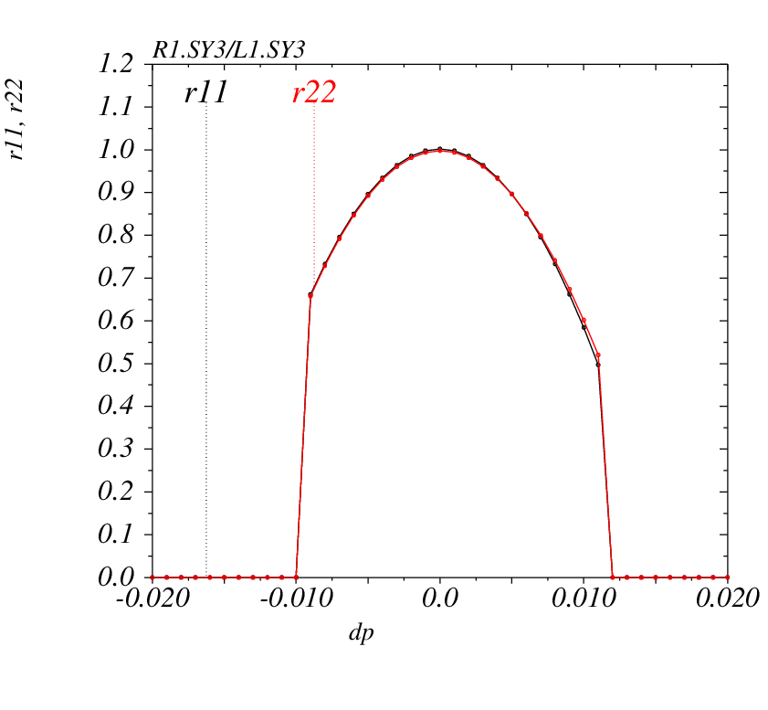
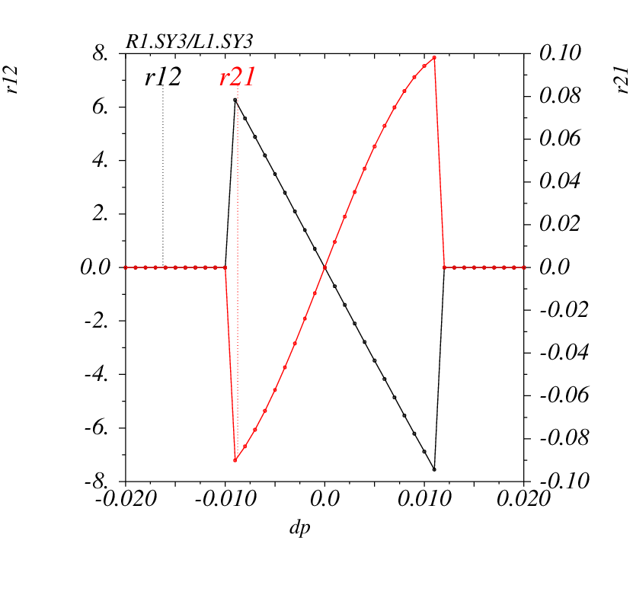
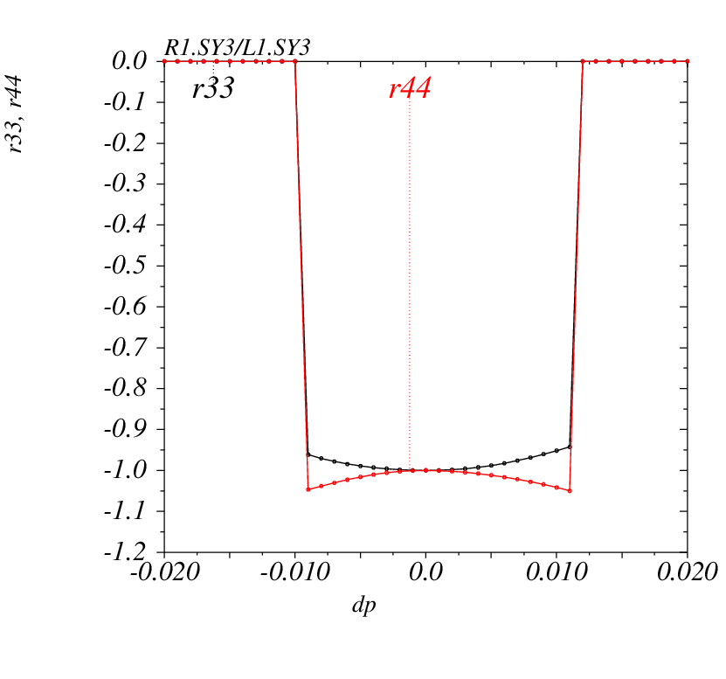
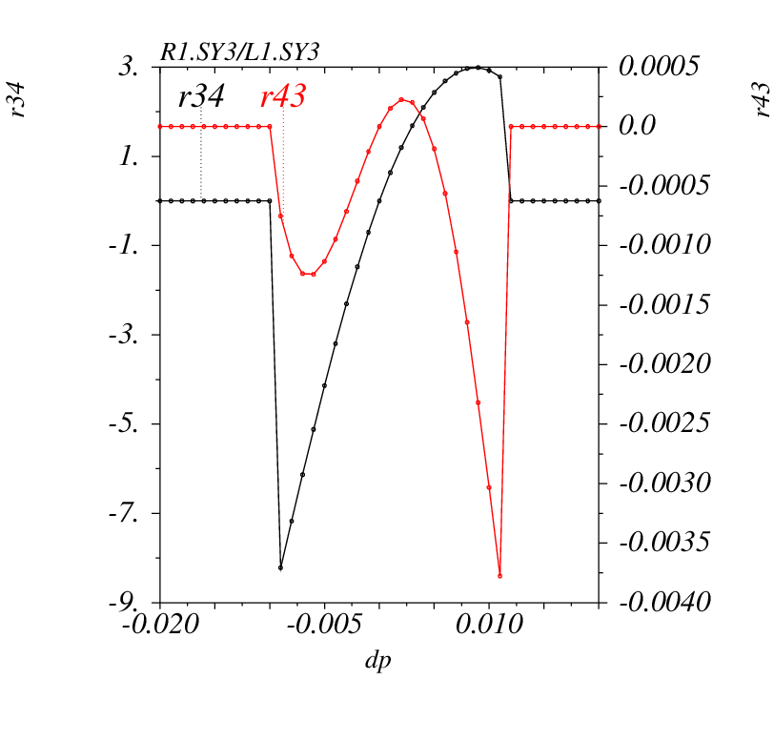
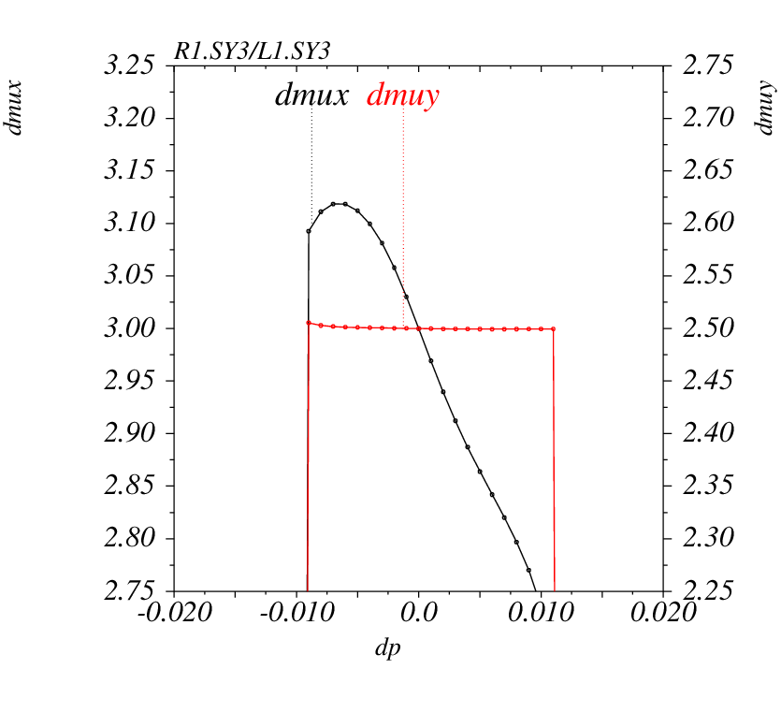
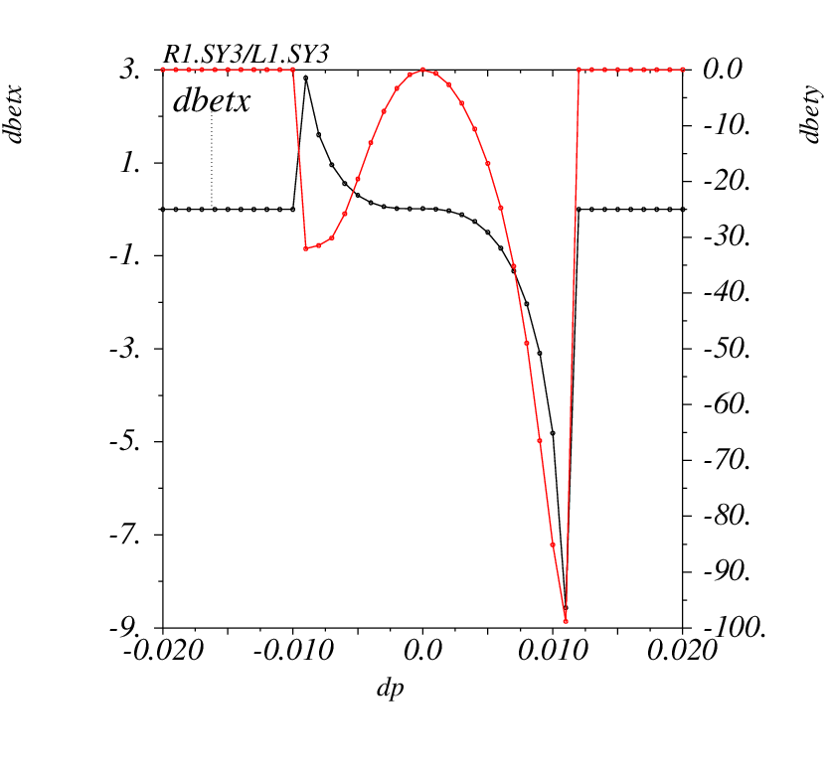
6d DA, no damping
CRAB=100%
Notes:
54_1, 2021.09.16-20.22.30_1.0crab_sextupole_chrom-15.str

Slide 16
Conclusion Interaction region 1
On momentum dynamic aperture is sufficient for injection and beam-beam effects
Off momentum dynamic aperture with CRAB ON is insufficient at 1.5-2.5 GeV to provide necessary Touschek lifetime
Optimization of final quadrupoles is possible

Slide 17
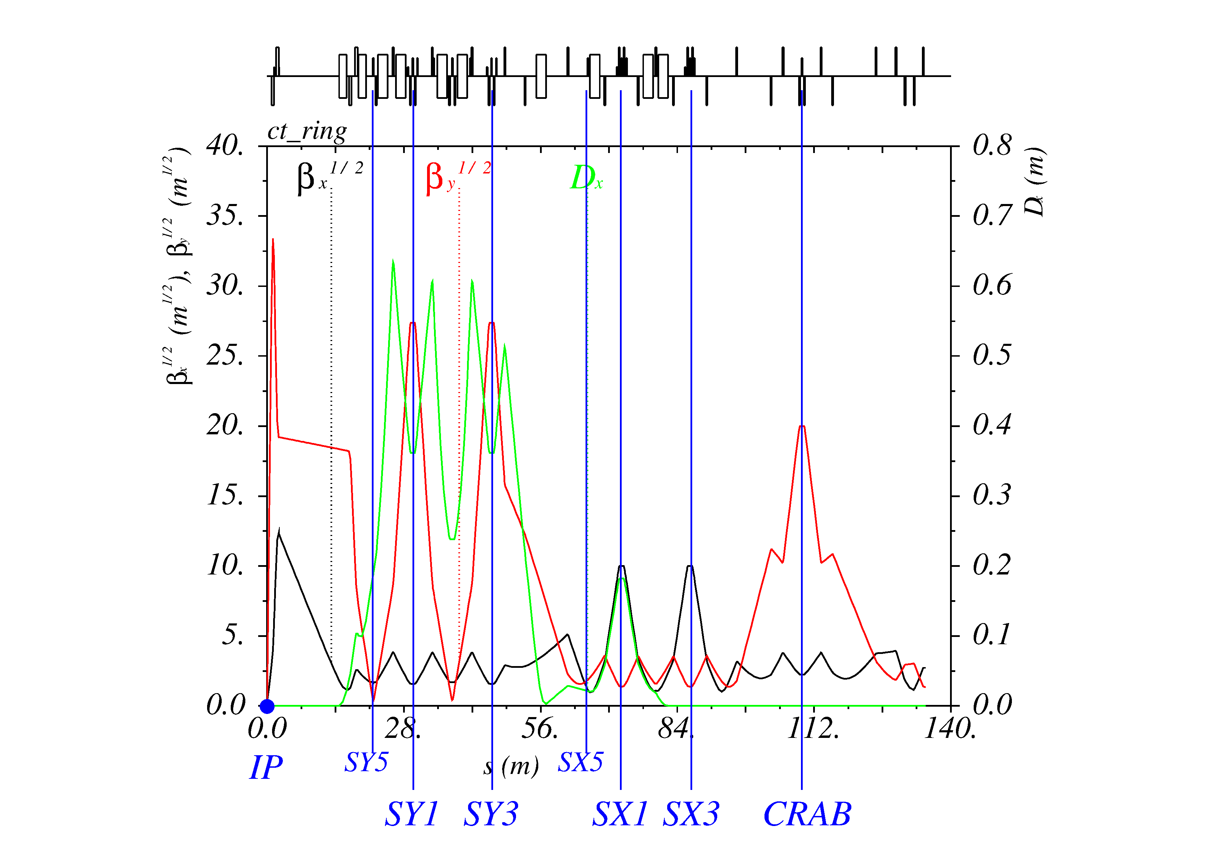
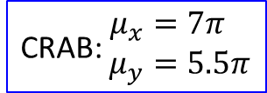
Interaction region 2 (CCY, CCX, CRAB)
CRAB: $\begin{aligned}μ_{x}&=7π \\ μ_{y}&=5.5π\end{aligned}$
Notes:
57-2

Slide 18
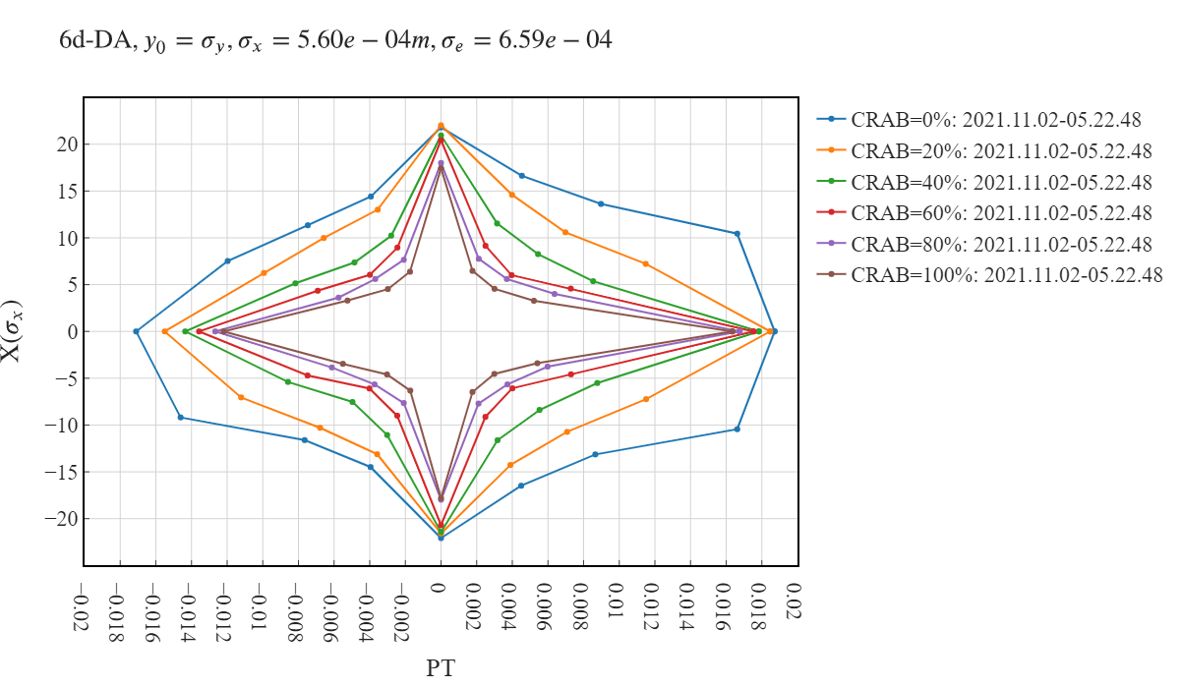
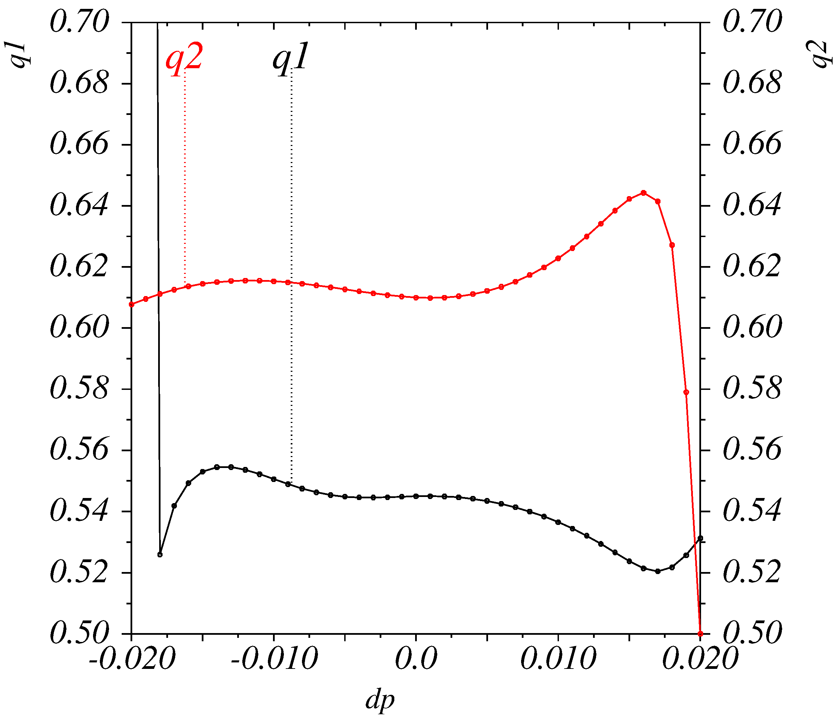
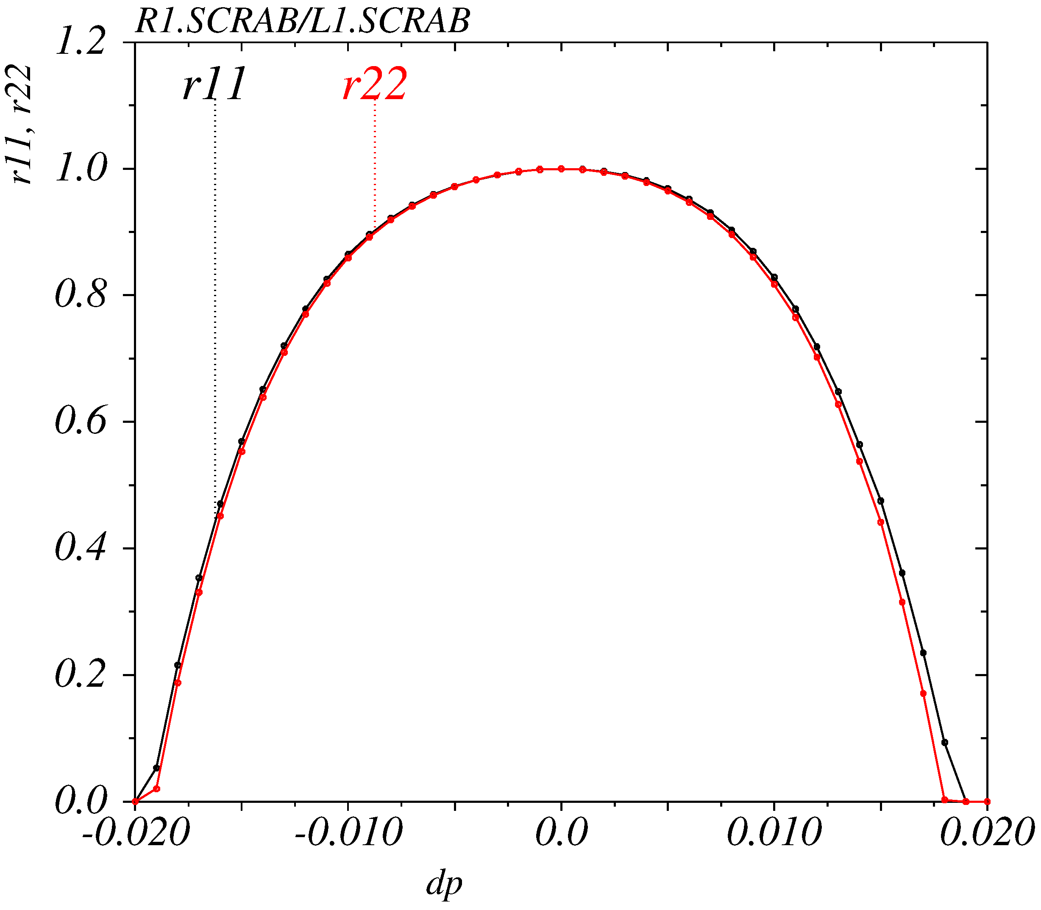
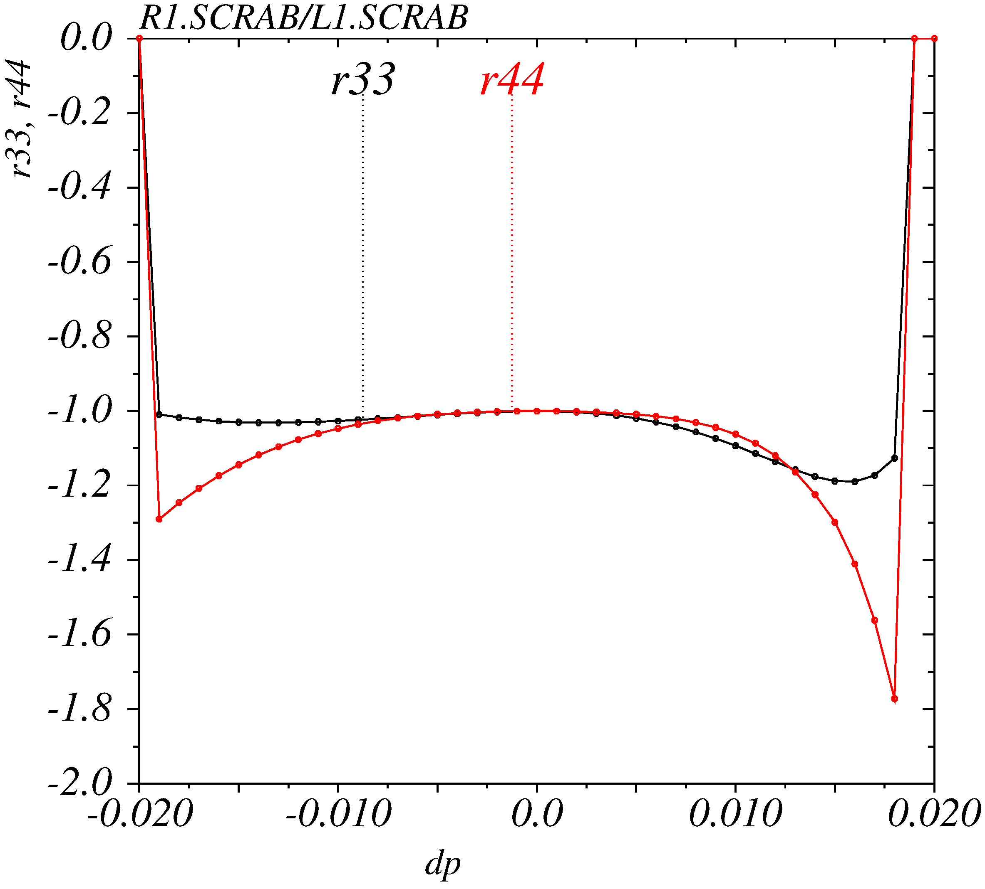
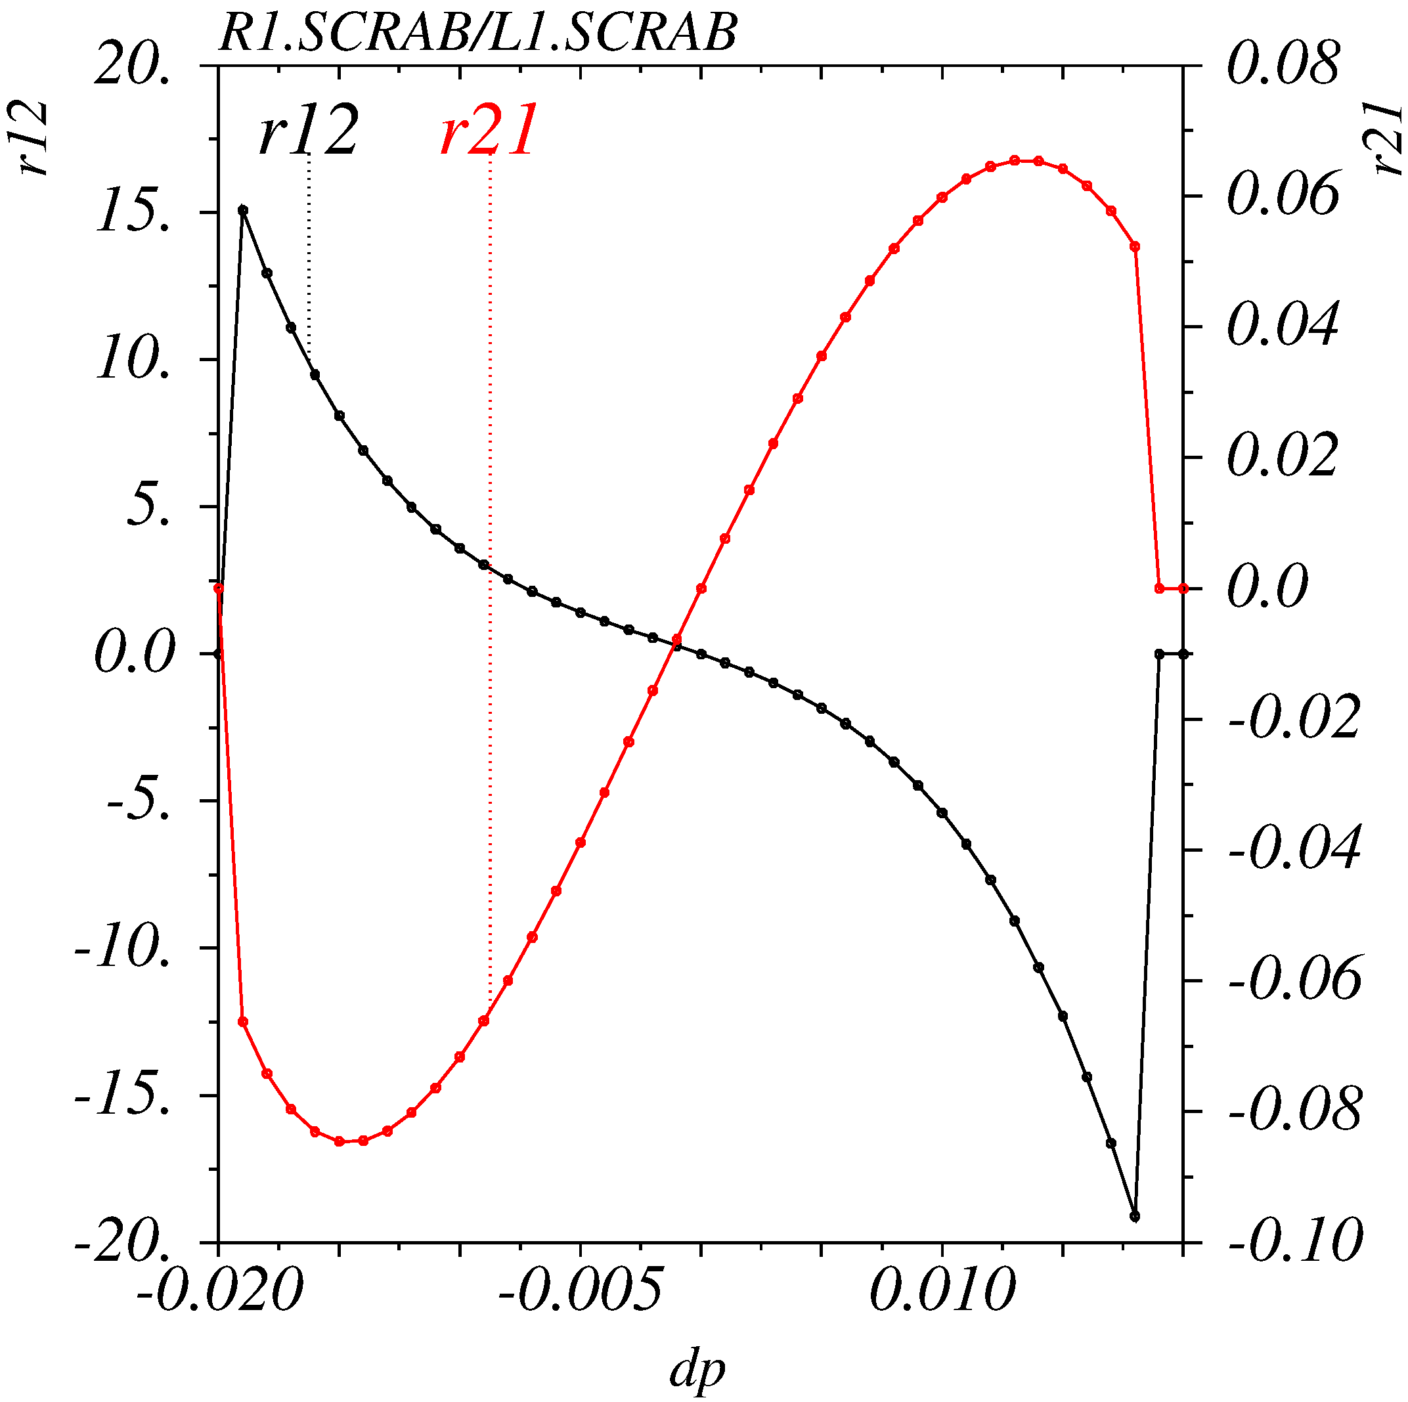
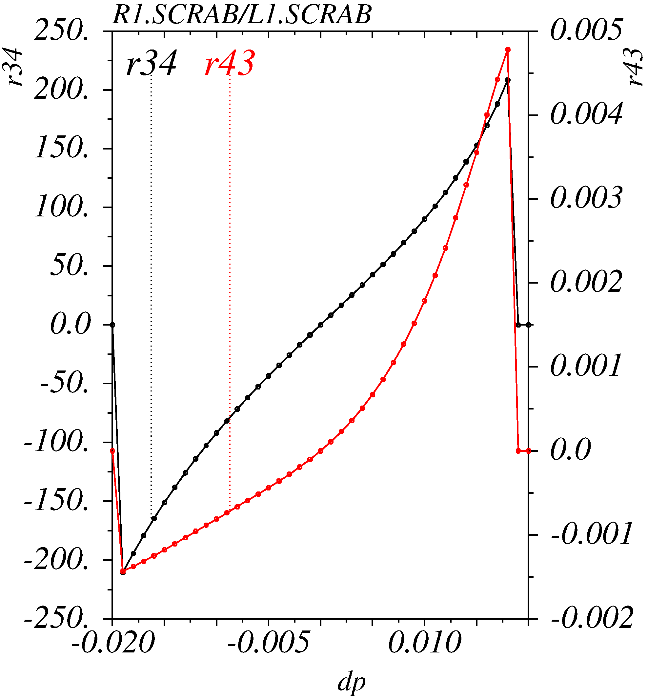
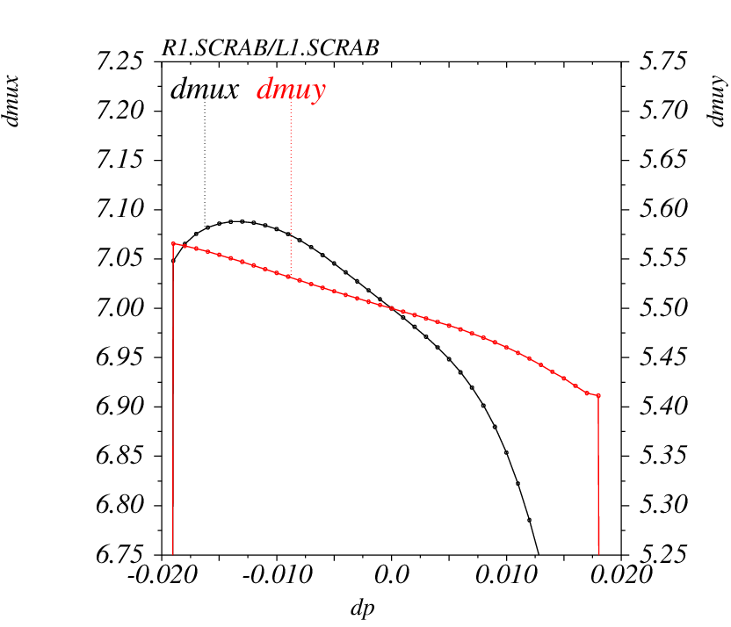
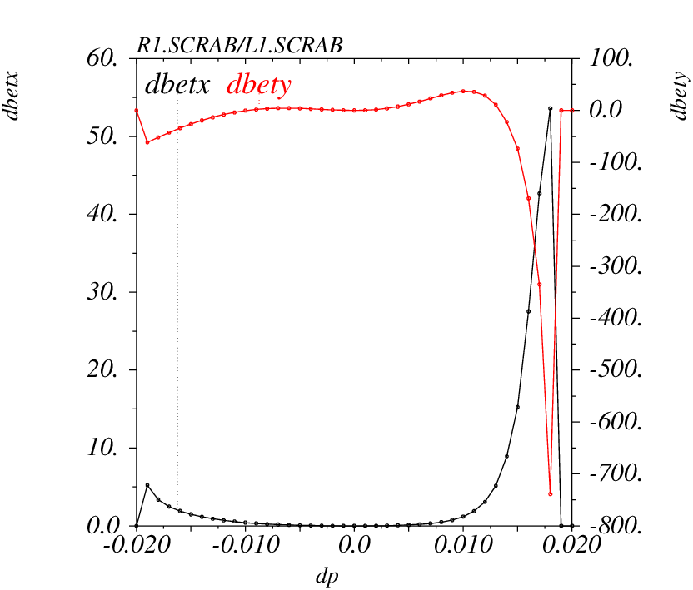
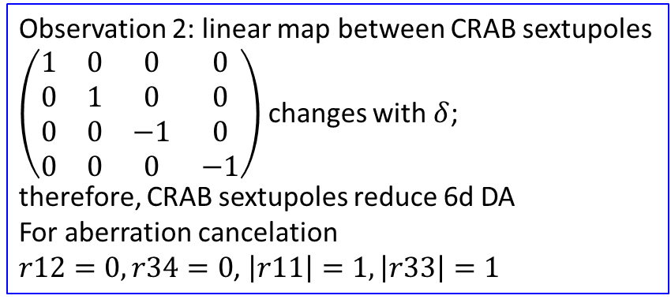
CRAB sextupole influence: 6d-DA
Observation 1:
addition of CCSX increased
energy aperture from
[-0.8;+1.1] to [-1.2;+1.6]
Observation 2: linear map between CRAB sextupoles
$\left(\begin{matrix}1 & 0 & 0 & 0 \\ 0 & 1 & 0 & 0 \\ 0 & 0 & −1 & 0 \\ 0 & 0 & 0 & −1\end{matrix}\right)$ changes with $δ$;
therefore, CRAB sextupoles reduce 6d DA
For aberration cancelation
$r12=0, r34=0$, $\left|r11\right|=1, \left|r33\right|=1$
Notes:
57-2: 2021.11.02-05.22.48_1.0crab_sextupole_chrom-4.str

Slide 19
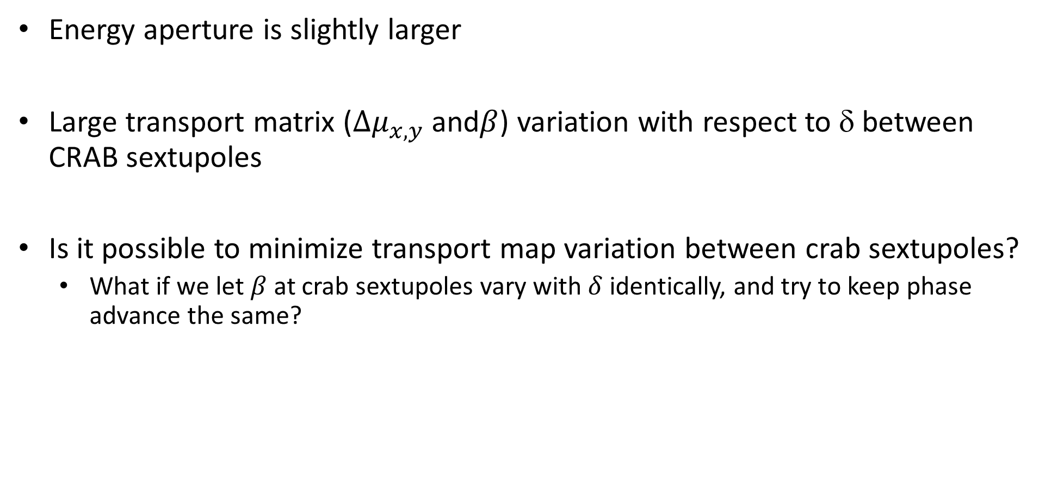
Conclusion Interaction region 2
Energy aperture is slightly larger
Large transport matrix ($Δμ_{x,y}$and$β$) variation with respect to δ between CRAB sextupoles
Is it possible to minimize transport map variation between crab sextupoles?
  What if we let $β$ at crab sextupoles vary with $δ$ identically, and try to keep phase advance the same?

Slide 20
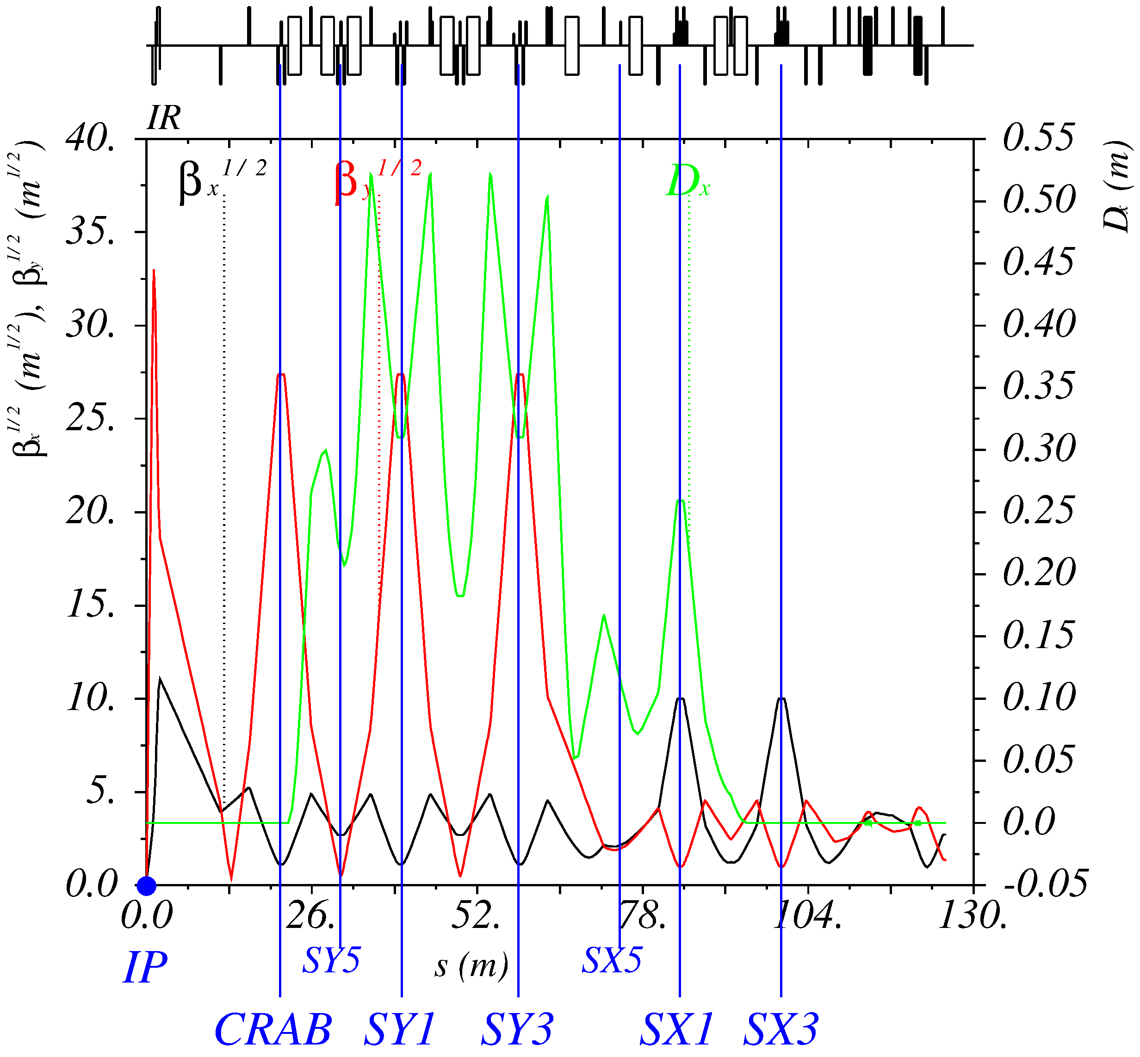


Interaction region 3
CRAB: $\begin{aligned}μ_{x}&=π \\ μ_{y}&=1.5π\end{aligned}$
Notes:
60

Slide 21




Map between CRAB sextupoles comarision
IR 2
Significantly smaller variation of r11, r22, r12, r21 with δ!
IR 3
Notes:
60, 2021.12.21-08.21.09_1.0crab_sextupole_chrom-3.str. 57-2: 2021.11.02-05.22.48_1.0crab_sextupole_chrom-4.str

Slide 22









Twiss functions between CRAB sextupoles
$β_{x}$ varies with δ identically at left and right CRAB sextupoles
$Δμ_{x}$ changes with δ by $+0.2$ and $−0.45$
Notes:
60, 2021.12.21-08.21.09_1.0crab_sextupole_chrom-3.str

Slide 23



6d DA for Interaction region 3
$E=1.5$ GeV | CRAB=100% | CRAB=60% | CRAB=0%
$N_{part}$ | $$9×{10}^{10}$$ | $$9×{10}^{10}$$ | $$9×{10}^{10}$$
$τ_{Touschek}$(s) | 63 | 126 | 280
$L_{HG}\left(cm^{−2}s^{−1}\right)$ | $$9.9×{10}^{34}$$
Why do CRAB sextupoles reduce 6d DA?!
Energy aperture
Interaction region 1: $±0.8\%$, $τ_{Touschek}=34$ s
Interaction region 2: $±1.2\%$
Interaction region 3: $±1.4\%$, $τ_{Touschek}=63$ s
Notes:
60, 2021.12.21-08.21.09_1.0crab_sextupole_chrom-3.str

Slide 24


Local momentum aperture (CRAB is ON)
$$δ\left(s\right)=\frac{R}{η\left(s\right)+\sqrt{ℋ\left(s\right)β\left(s\right)}}$$
Notes:
60, 2021.12.21-08.21.09_1.0crab_sextupole_chrom-3.str

Slide 25

Local momentum aperture (CRAB is OFF)
Why do CRAB sextupoles reduce 6d DA?!
$$δ\left(s\right)=\frac{R}{η\left(s\right)+\sqrt{ℋ\left(s\right)β\left(s\right)}}$$
Notes:
60, 2021.12.21-08.21.09_1.0crab_sextupole_chrom-3.str

Slide 26






6d scans of XY dynamic aperture
CRAB is ON
CRAB is OFF
$$δ= 0.0\%$$
$$δ=−1.0\%$$
Notes:
60: 2021.12.14-09.34.53_1.0crab_sextupole_chrom-4.str

Slide 27



6d scans: close-up XY aperture with $δ=−0.01$
Theory of distortion functions (new invariant action as a function of the old action) prediction agrees with tracking for $δ=−1\%$
DA: $R=\frac{\sqrt{2β_{x}}}{2(B_{+}−B_{−}−A_{+}+A_{−})}=−\text{1}\text{.}\text{54 }\text{m}\text{m}=−3.6σ_{x}$
Does not agree for $δ=0$. It means that at $δ=0$ DA is limited not by the 1st order sextupoles.
Off momentum distortion functions are created by CRAB sextupoles, and are 20 times larger than the rest of sextupoles
Notes:
60, 2021.12.14-09.34.53_1.0crab_sextupole_chrom-4.str

Slide 28



Touschek lifetime with CRAB ON and OFF at 2 GeV
$E=2.0$ GeV | CRAB OFF | CRAB ON
$$τ_{T}(s)$$ | $$480$$ | $$126$$
$$N_{p}({10}^{10})$$ | $$8$$ | $$8$$
$E=1.5$ GeV | CRAB OFF | CRAB ON
$$τ_{T}(s)$$ | $$280$$ | $$63$$
$$N_{p}({10}^{10})$$ | $$9$$ | $$9$$

Slide 29

Conclusion Interaction region 3
Placing CRAB sextupoles close to IP gave the largest energy aperture
  Interaction region 1: $±0.8\%$, $τ_{Touschek}=34$ s at 1.5 GeV
  Interaction region 2: $±1.2\%$
  Interaction region 3: $±1.4\%$, $τ_{Touschek}=63$ s at 1.5 GeV, the smallest variation of transport map ($Δμ_{x,y}$and $β$) with δ
But still not sufficient for Touschek lifetime at 1.5, 2 GeV with CRAB sextupole 100%, sufficient with CRAB sextupole OFF
Optimization of FF quadrupoles decreased fringe field effects
Strong 6d DA degradation with CRAB sextupole strength is explained by transport map variation with δ

Slide 30

Interaction region 4
Additional sextupoles in –I pairs
Four 90° cells
CRAB: $\begin{aligned}μ_{x}&=11π \\ μ_{y}&=10.5π \\ β_{x}&=2 m \\ β_{y}&=800 \text{m} \\ K2_{crab}&=−23.29 {\text{m}}^{−3}\end{aligned}$
Notes:
v. 68

Slide 31


Lattice and layout

Slide 32



6d DA for Interaction region 4
$E=1.5$ GeV | CRAB=100% | CRAB=60% | CRAB=0%
$N_{part}$ | $$6×{10}^{10}$$ | $$6×{10}^{10}$$ | $$6×{10}^{10}$$
$τ_{Touschek}$(s) | 125 | 104 | 118
$L_{HG}\left(cm^{−2}s^{−1}\right)$ | $$1×{10}^{35}$$
Sextupoles:
IR: 5(Y) + 8(X)
ARCS: 24(Y)+24(X)
Octupoles:
IR: 2(Y)+2(X)
Energy aperture
Interaction region 1: $±0.8\%$, $τ_{Touschek}=34$ s
Interaction region 2: $±1.2\%$
Interaction region 3: $±1.4\%$, $τ_{Touschek}=66$ s
Interaction region 4: $±1.1\%$, $τ_{Touschek}=125$ s
Notes:
68, 2022.10.08-19.03.53_1.0crab_sextupole_chrom-13.str

Slide 33

Design parameters for $τ_{Touschek}≥300 s$
E(MeV) | 1500 | 2000 | 2500 | 3000 | 3500
$Π$(m) | 935.874
$F_{RF}$(MHz) | 350
$2θ$(mrad) | 60
$β_{x}^{∗}/β_{y}^{∗}$ (mm) | 100/1
$ε_{y}/ε_{x}$(%) | 10 | 0.5 | 0.5 | 0.5 | 0.5
I(A) | 2.9 | 1.64 | 2.5 | 2.7 | 2.9
$N_{e/bunch}×{10}^{−10}$ | 6 | 3.25 | 5 | 5.3 | 5.8
$N_{b}$ / q | 941/1093 | 983/1093 | 983/1093 | 983/1093 | 974/1093
$U_{0}$(keV) / $V_{RF}$(kV) | 91 / 750 | 288 / 2000 | 504 / 3000 | 820 / 3900 | 1266 / 5000
$ν_{s}$ | 0.0108 | 0.0152 | 0.0166 | 0.0172 | 0.018
$δ_{RF}$(%) | 1.3 | 1.83 | 1.97 | 1.97 | 1.98
$σ_{e}×{10}^{3}$ (SR/IBS+WG) | 0.27/0.9 | 0.36/1.1 | 0.5/1.2 | 0.5/1.2 | 0.6/1.3
$σ_{s}$(mm) (SR/IBS+WG) | 3.6/17 | 4.7/15 | 6/14 | 7/14 | 8/14
$ε_{x}$(nm) (SR/IBS+WG) | 2.0/2.9 | 3.5/3.5 | 5.5/3.2 | 7.9/4.1 | 11/5.7
$L_{HG}×{10}^{−35}\left(cm^{−2}s^{−1}\right)$ | 0.29 | 0.4 | 1 | 1 | 1
$ξ_{x}/ξ_{y}$ | 0.003/0.03 | 0.002/0.06 | 0.002/0.08 | 0.002/0.065 | 0.002/0.05
$τ_{Touschek}$ (s) | 304 | 304 | 302 | 560 | 1100
$τ_{Luminosity}$ (s) | 12000 | 5000 | 3000 | 3200 | 3500
Notes:
68_1, q=1093, I(e+)=3.2 A PEPII, I(e-)=2.45A DAFNE, L=2.1e34 KEKB

Slide 34

Conclusion
Interaction region 4 gives the highest Touschek life time
  $E=1.5$ GeV, $τ_{Touschek}=125$s, $N_{part}=6.0×{10}^{10}$, $L_{HG}=1.0×{10}^{35}$ $cm^{−2}s^{−1}$
  $E=1.5$ GeV, $τ_{Touschek}=300$s, $N_{part}=1.4×{10}^{10}$, $L_{HG}=8.6×{10}^{33}$ $cm^{−2}s^{−1}$
Optimization of FF quadrupoles worked
Minimization of $ℋ$-invariant worked
Minimization of transport map variation between CRAB sextupoles worked

