Slide 1
Status of super charm tau factory design in BINP
A. Bogomyagkov
BINP, Russia
The 2024 International Workshop on Future Tau Charm Facilities (FTCF2024)
University of Science and Technology of China (USTC), Hefei, China
14 – 18 January, 2024

Slide 2
Crab waist (P.Raimondi 2006)
Luminosity $L=\frac{γ}{2er_{e}}⋅\frac{I_{tot}ξ_{y}}{β_{y}^{∗}}R_{H}$
Large Piwinski angle: $φ=\frac{σ_{z}}{σ_{x}}\tan\left(\frac{θ}{2}\right)$
Transverse beam separation in parasitic IPs
distance between bunches is not limited by beam-beam
Interaction area length $L_{i}≪σ_{z}$
$β_{y}^{∗}≈L_{i}≪σ_{z}$ no hour-glass
CRAB waist (CRAB sextupoles) suppresses betatron and synchro-betatron resonances
$ξ_{y}∼0.2$
$K2L=±\frac{1}{{θβ}_{y}^{∗}β_{y}}\sqrt{\frac{β_{x}^{∗}}{β_{x}}}$
x
+
-
e
L_{i}
e
θ
φ ∙σ_{x}
z
2σ_{z}
2σ_{x}
Notes:
mux=3pi*2, muy=2.5pi*2

Slide 3
Facility overview
1.5 – 3.5 GeV e-e+

Slide 4
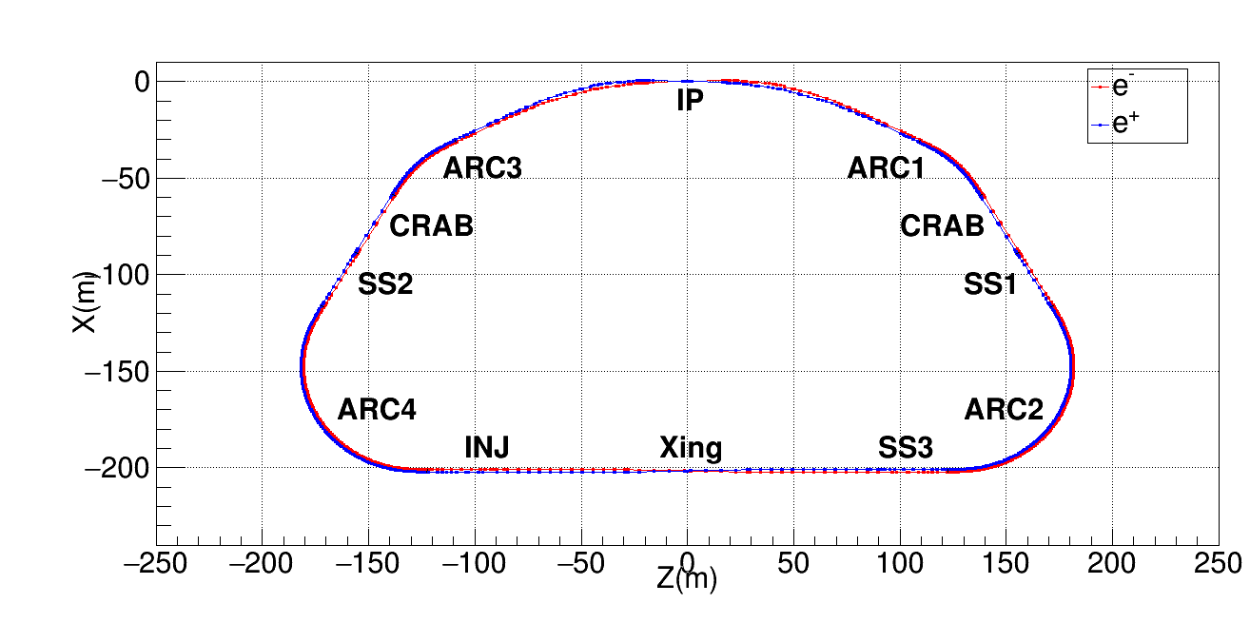
Lattice and layout
Notes:
v. 68

Slide 5
Interaction region
Additional sextupoles in –I pairs
Four 90° cells
CRAB: $\begin{aligned}μ_{x}&=11π \\ μ_{y}&=10.5π \\ β_{x}&=2 m \\ β_{y}&=800 \text{m} \\ K2_{crab}&=−23.29 {\text{m}}^{−3}\end{aligned}$
Notes:
v. 68

Slide 6
FF Trajectory at maximum emittance
Q0 pole field is -0.45116 T
R(Q0): x=0.0122306 m
R(Q0): y=0.0124814 m
Q1 pole field is 0.533268 T
R(Q1): x=0.0259444 m
R(Q1): y=0.0124814 m
Dx0=0.0290403 m
Dx1=0.059118 m
D0=0.9; //Drift, m
L0=0.5; //Length of Q0, m
D1=0.45; //Drift, m
L1=0.5; //Length of Q1, m
KQ0=-3.09613803321383; //Gradient of Q0, 1/m^2
KQ1=1.76057853542592; //Gradient of Q1, 1/m^2
Notes:
v. 68

Slide 7
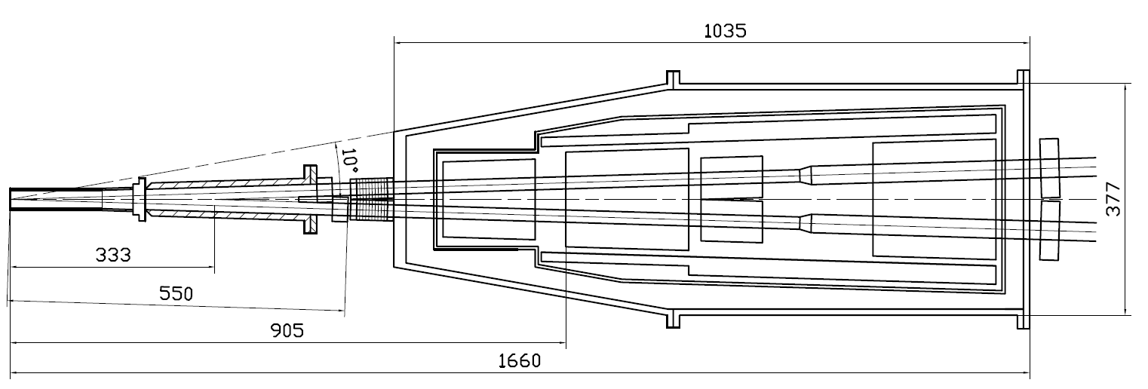
Machine-detector interface
Compensating solenoid
Gradients for 3.5 GeV
Be-tube ±150 mm,
∅30 mm, cooled
QD0, 500 mm
–36 Т/m
QF1, 500 mm
21 Т/m
Corr. coils
Screening solenoid
BPMs
Y-chamber,
cooled
BPMs
e+
IP
∅ 417
e-
L* =
FF vacuum chamber
Cryostat with FF magnets

Slide 8
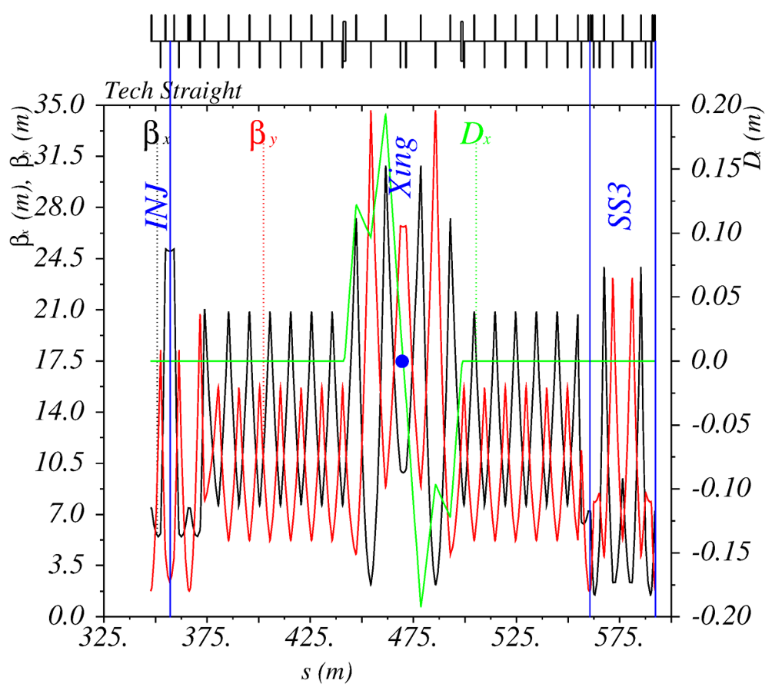
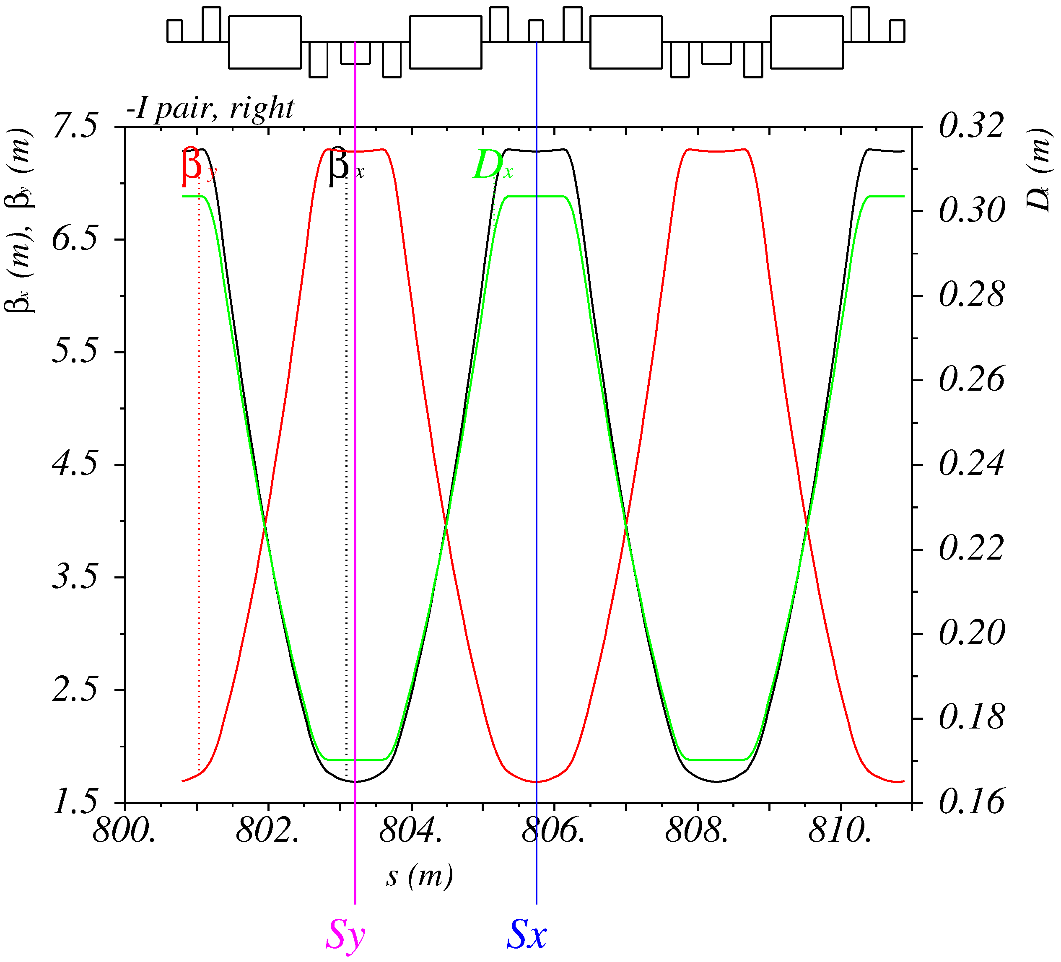
Straight and Arc sections
Straight
Arc: FODO 90° cells
Notes:
Arcs: 24 x and 24 y pairs of interleaved pairs of sextupoles

Slide 9
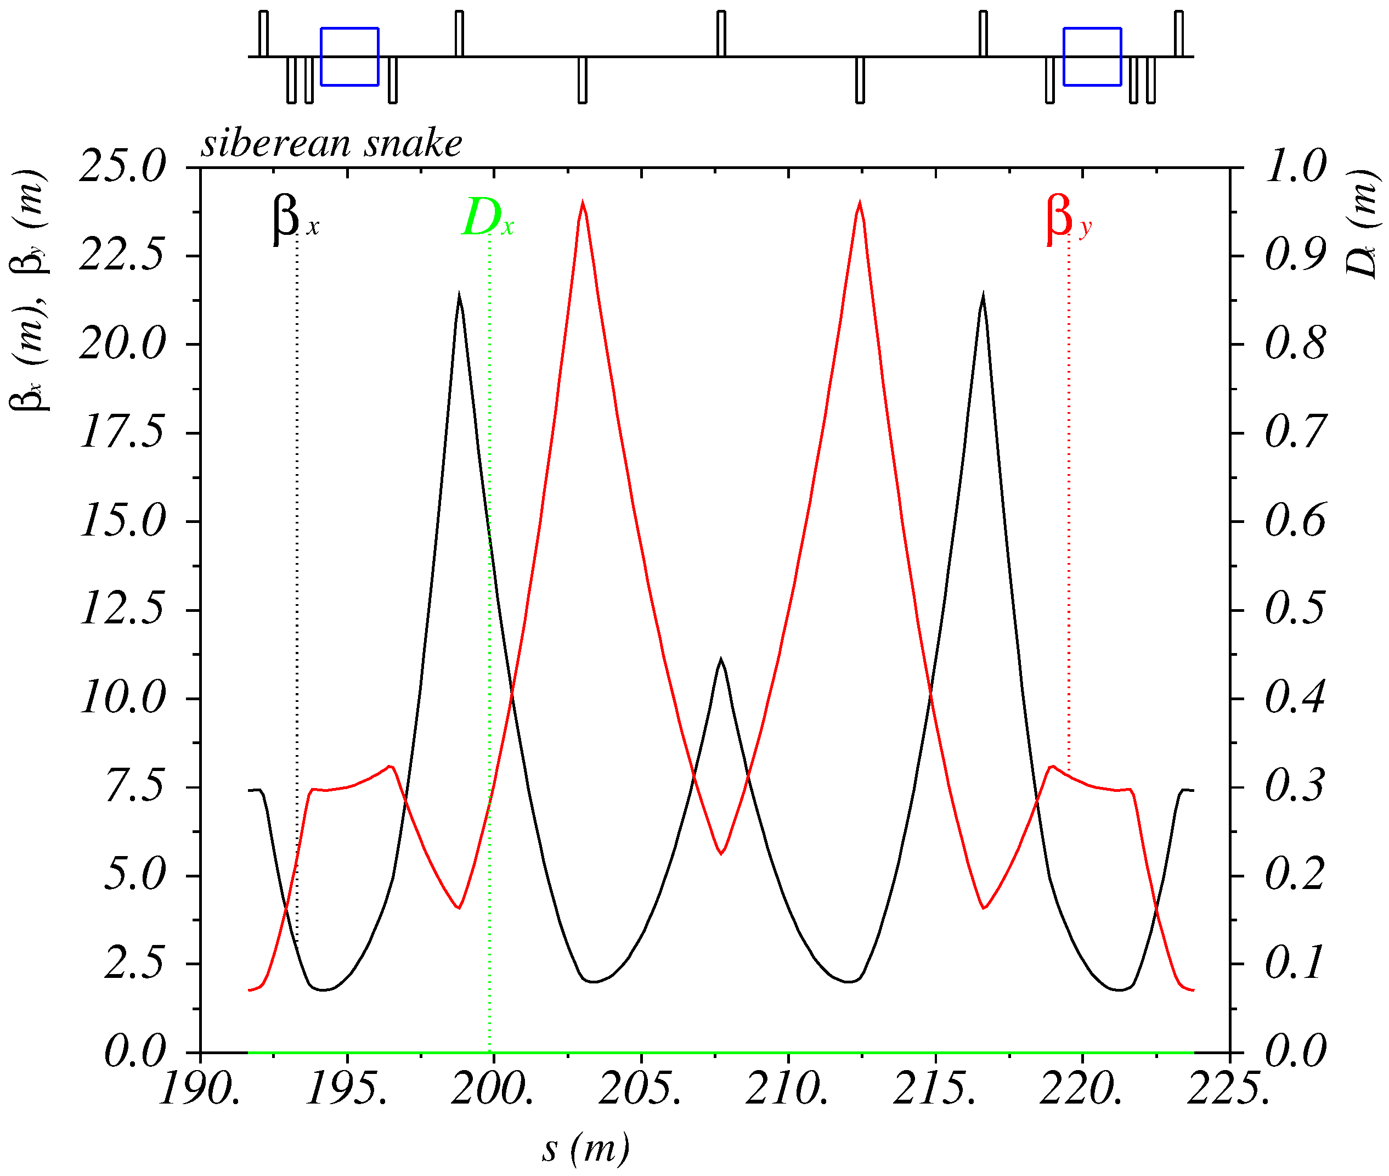
Siberian Snake
The goal is to provide longitudinal polarization at IP
$${\vec{B}}_{sol}$$
$${\vec{B}}_{sol}$$
120°
IP
SS2
SS1
120°
120°
SS3
To decouple $R_{x}=−R_{y}$, 7 quadrupoles needed
Solenoid spin rotation angle is $π/2$, $B_{sol}=7 \text{T}$ at $E_{beam}=3.5 \text{GeV}$, $L=2.6 \text{m}$
Notes:
The total length is 33 m, adding 100 m to circumference.

Slide 10
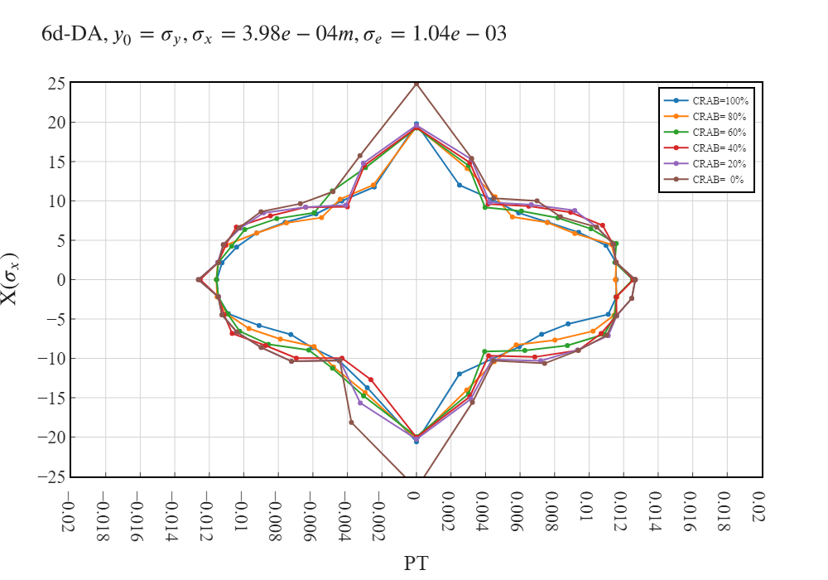
6d dynamic aperture
$E=1.5$ GeV | CRAB=100% | CRAB=60% | CRAB=0%
$N_{part}$ | $$6×{10}^{10}$$ | $$6×{10}^{10}$$ | $$6×{10}^{10}$$
$τ_{Touschek}$(s) | 125 | 104 | 118
$L_{HG}\left(cm^{−2}s^{−1}\right)$ | $$1×{10}^{35}$$
Sextupoles:
IR: 5(Y) + 8(X)
ARCS: 24(Y)+24(X)
Octupoles:
IR: 2(Y)+2(X)
Energy aperture: $±1.1\%$, $τ_{Touschek}=125$ s
Notes:
68, 2022.10.08-19.03.53_1.0crab_sextupole_chrom-13.str

Slide 11
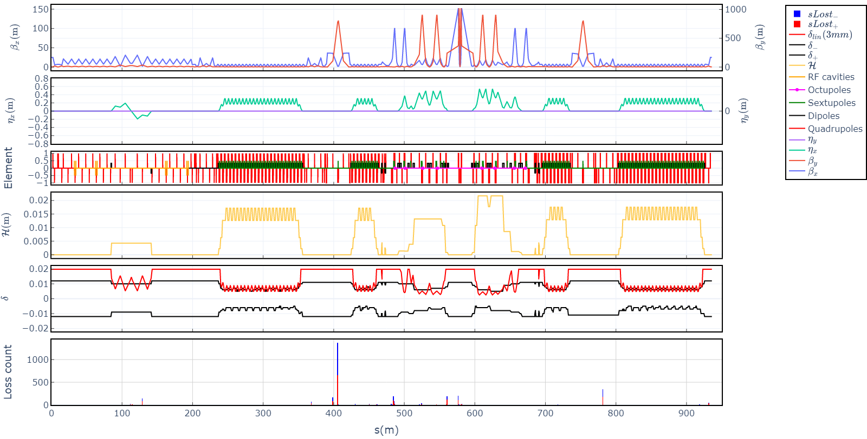
LMA
$$δ\left(s\right)=\frac{R}{η\left(s\right)+\sqrt{ℋ\left(s\right)β_{x}\left(s\right)}}$$
+1.1%
+0.6%
-0.6%
-1.1%

Slide 12
Design parameters for $ℒ=1×{10}^{35}$
E(MeV) | 1500 | 2000 | 2500 | 3000 | 3500
$Π$(m) | 935.874
$F_{RF}$(MHz) | 350
$2θ$(mrad) | 60
$β_{x}^{∗}/β_{y}^{∗}$ (mm) | 100/1
$ε_{y}/ε_{x}$(%) | 0.5
I(A) / $N_{b}$ | 2.9 | 2.7 | 2.5 | 2.7 | 2.9
$N_{e/bunch}×{10}^{−10}$ | 6 | 5.3 | 5 | 5.3 | 5.8
$N_{b}$ / q | 941/1093 | 983/1093 | 983/1093 | 983/1093 | 974/1093
$U_{0}$(keV) / $V_{RF}$(kV) | 91 / 1500 | 288 / 2000 | 504 / 3000 | 820 / 3900 | 1266 / 5000
$ν_{s}$ | 0.0153 | 0.0152 | 0.0166 | 0.0172 | 0.018
$δ_{RF}$(%) | 1.98 | 1.83 | 1.97 | 1.97 | 1.98
$σ_{e}×{10}^{3}$ (SR/IBS+WG) | 0.27/1.1 | 0.36/1.2 | 0.5/1.2 | 0.5/1.2 | 0.6/1.3
$σ_{s}$(mm) (SR/IBS+WG) | 3.6/14 | 4.7/15 | 6/14 | 7/14 | 8/14
$ε_{x}$(nm) (SR/IBS+WG) | 2.0/6.4 | 3.5/3.8 | 5.5/3.2 | 7.9/4.1 | 11/5.7
$L_{HG}×{10}^{−35}\left(cm^{−2}s^{−1}\right)$ | 1 | 1 | 1 | 1 | 1
$ξ_{x}/ξ_{y}$ | 0.005/0.12 | 0.003/0.1 | 0.002/0.08 | 0.002/0.065 | 0.002/0.05
$τ_{Touschek}$ (s) | 125 | 208 | 302 | 560 | 1100
$τ_{Luminosity}$ (s) | 3500 | 3200 | 3000 | 3200 | 3500
Notes:
68_1, q=1093, I(e+)=3.2 A PEPII, I(e-)=2.45A DAFNE, L=2.1e34 KEKB

Slide 13
Design parameters for $τ_{Touschek}≥300 s$
E(MeV) | 1500 | 2000 | 2500 | 3000 | 3500
$Π$(m) | 935.874
$F_{RF}$(MHz) | 350
$2θ$(mrad) | 60
$β_{x}^{∗}/β_{y}^{∗}$ (mm) | 100/1
$ε_{y}/ε_{x}$(%) | 10 | 0.5 | 0.5 | 0.5 | 0.5
I(A) | 2.9 | 1.64 | 2.5 | 2.7 | 2.9
$N_{e/bunch}×{10}^{−10}$ | 6 | 3.25 | 5 | 5.3 | 5.8
$N_{b}$ / q | 941/1093 | 983/1093 | 983/1093 | 983/1093 | 974/1093
$U_{0}$(keV) / $V_{RF}$(kV) | 91 / 750 | 288 / 2000 | 504 / 3000 | 820 / 3900 | 1266 / 5000
$ν_{s}$ | 0.0108 | 0.0152 | 0.0166 | 0.0172 | 0.018
$δ_{RF}$(%) | 1.3 | 1.83 | 1.97 | 1.97 | 1.98
$σ_{e}×{10}^{3}$ (SR/IBS+WG) | 0.27/0.9 | 0.36/1.1 | 0.5/1.2 | 0.5/1.2 | 0.6/1.3
$σ_{s}$(mm) (SR/IBS+WG) | 3.6/17 | 4.7/15 | 6/14 | 7/14 | 8/14
$ε_{x}$(nm) (SR/IBS+WG) | 2.0/2.9 | 3.5/3.5 | 5.5/3.2 | 7.9/4.1 | 11/5.7
$L_{HG}×{10}^{−35}\left(cm^{−2}s^{−1}\right)$ | 0.29 | 0.4 | 1 | 1 | 1
$ξ_{x}/ξ_{y}$ | 0.003/0.03 | 0.002/0.06 | 0.002/0.08 | 0.002/0.065 | 0.002/0.05
$τ_{Touschek}$ (s) | 304 | 304 | 302 | 560 | 1100
$τ_{Luminosity}$ (s) | 12000 | 5000 | 3000 | 3200 | 3500
Notes:
68_1, q=1093, I(e+)=3.2 A PEPII, I(e-)=2.45A DAFNE, L=2.1e34 KEKB

Slide 14
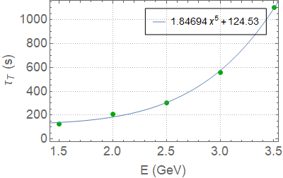
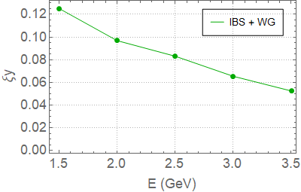
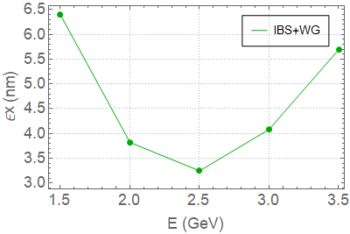
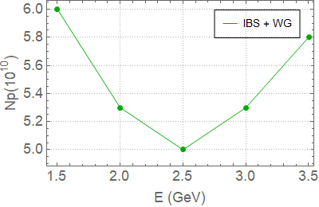
Summary for $L_{HG}\left(cm^{−2}s^{−1}\right)$=$1×{10}^{35}$

Slide 15
Conclusion
Present design gives the highest Touschek life time
$E=1.5$ GeV, $τ_{Touschek}=125$s, $N_{part}=6.0×{10}^{10}$, $L_{HG}=1.0×{10}^{35}$ $cm^{−2}s^{−1}$
$E=1.5$ GeV, $τ_{Touschek}=300$s, $N_{part}=1.4×{10}^{10}$, $L_{HG}=8.6×{10}^{33}$ $cm^{−2}s^{−1}$
$E=2.0$ GeV, $τ_{Touschek}=208$s, $N_{part}=5.3×{10}^{10}$, $L_{HG}=1.0×{10}^{35}$ $cm^{−2}s^{−1}$
$E=2.0$ GeV, $τ_{Touschek}=300$s, $N_{part}=3.25×{10}^{10}$, $L_{HG}=8.6×{10}^{33}$ $cm^{−2}s^{−1}$
$E=2.5$ GeV, $τ_{Touschek}=300$s, $N_{part}=5.0×{10}^{10}$, $L_{HG}=1.0×{10}^{35}$ $cm^{−2}s^{−1}$
$E=3.0$ GeV, $τ_{Touschek}=560$s, $N_{part}=5.3×{10}^{10}$, $L_{HG}=1.0×{10}^{33}$ $cm^{−2}s^{−1}$
$E=3.5$ GeV, $τ_{Touschek}=1100$s, $N_{part}=5.8×{10}^{10}$, $L_{HG}=1.0×{10}^{35}$ $cm^{−2}s^{−1}$

Slide 16
Extra slides

Slide 17
Design parameters for $ℒ=1×{10}^{35}$
E(MeV) | 1500 | 2000 | 2500 | 3000 | 3500
$Π$(m) | 935.874
$F_{RF}$(MHz) | 350
$2θ$(mrad) | 60
$β_{x}^{∗}/β_{y}^{∗}$ (mm) | 100/1
$ε_{y}/ε_{x}$(%) | 0.5
I(A) / $N_{b}$ | 2.9 / 941 | 2.7 / 983 | 2.5 / 983 | 2.7 / 983 | 2.9 / 974
$N_{e/bunch}×{10}^{−10}$ | 6 | 5.3 | 5 | 5.3 | 5.8
$U_{0}$(keV) | 91 | 288 | 504 | 820 | 1266
$V_{RF}$(kV) | 1500 | 2000 | 3000 | 3900 | 5000
$ν_{s}$ | 0.0153 | 0.0152 | 0.0166 | 0.0172 | 0.018
$δ_{RF}$(%) | 1.98 | 1.83 | 1.97 | 1.97 | 1.98
$σ_{e}×{10}^{3}$ (SR/IBS+WG) | 0.27/1.1 | 0.36/1.2 | 0.5/1.2 | 0.5/1.2 | 0.6/1.3
$σ_{s}$(mm) (SR/IBS+WG) | 3.6/14 | 4.7/15 | 6/14 | 7/14 | 8/14
$ε_{x}$(nm) (SR/IBS+WG) | 2.0/6.4 | 3.5/3.8 | 5.5/3.2 | 7.9/4.1 | 11/5.7
$L_{HG}×{10}^{−35}\left(cm^{−2}s^{−1}\right)$ | 1 | 1 | 1 | 1 | 1
$ξ_{x}/ξ_{y}$ | 0.005/0.12 | 0.003/0.1 | 0.002/0.08 | 0.002/0.065 | 0.002/0.05
$τ_{Touschek}$ (s) | 125 | 208 | 302 | 560 | 1100
$τ_{Luminosity}$ (s) | 3500 | 3200 | 3000 | 3200 | 3500
SuperKEKB 2020 $β_{y}^{∗}=0.8 mm$
PEPII: I(e+)=3.2 A PEPII
DAFNE : I(e-)=2.45A
SuperKEKB: $L=4.7×{10}^{34}$
Notes:
68_1, q=1093, I(e+)=3.2 A PEPII, I(e-)=2.45A DAFNE, L=2.1e34 KEKB

