Slide 1
Overview of the STCF accelerator
Jingyu Tang
On behalf of the accelerator team
FTCF2024, Jan. 14-18, 2024, Hefei

Slide 2
Topics
Design goals
Current accelerator design scheme and key parameters
Key challenges in accelerator physics and technologies
Organization of the STCF accelerator study
Financial resources and planning
Summary
Notes:
报告时间：25+5

Slide 3
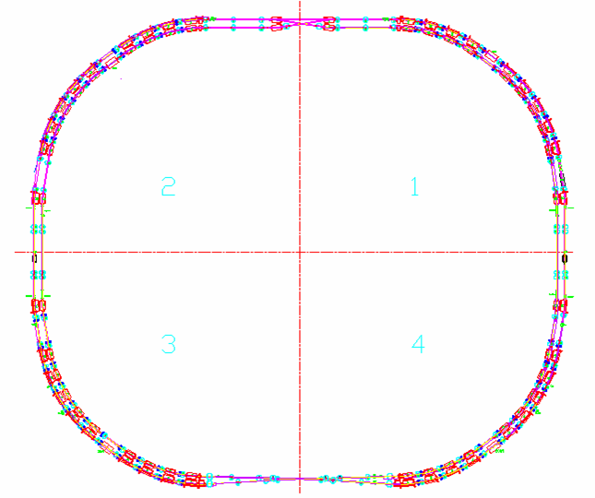
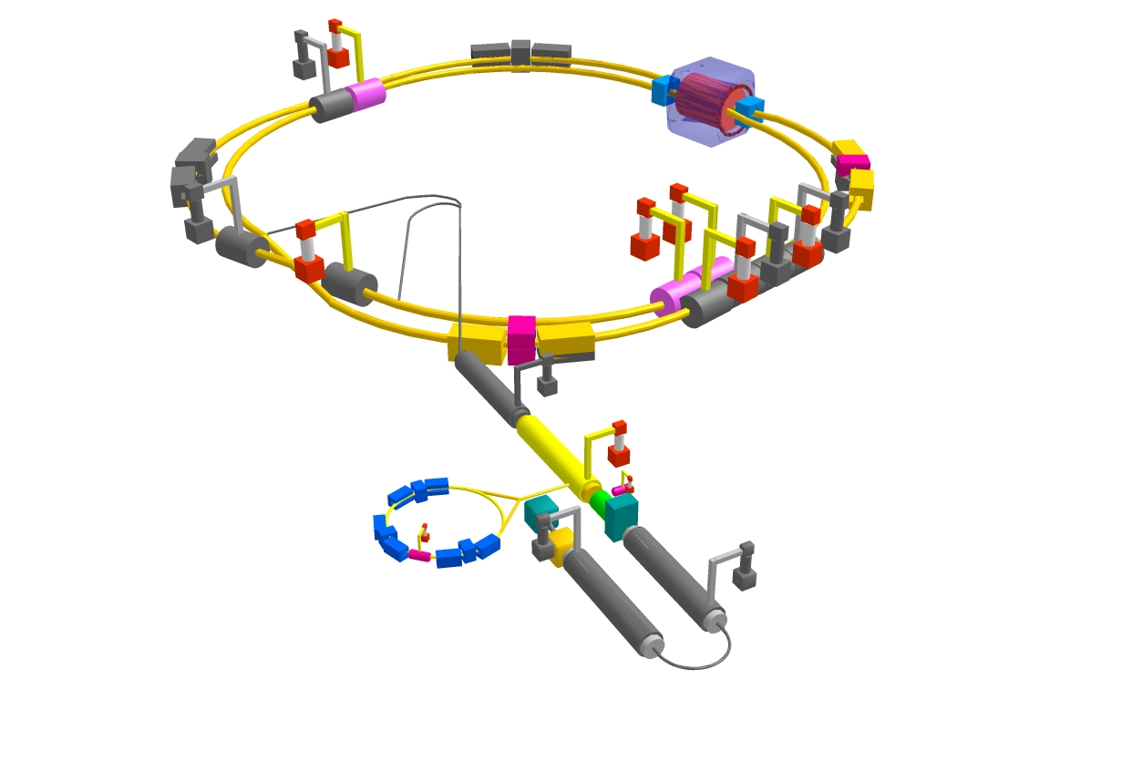
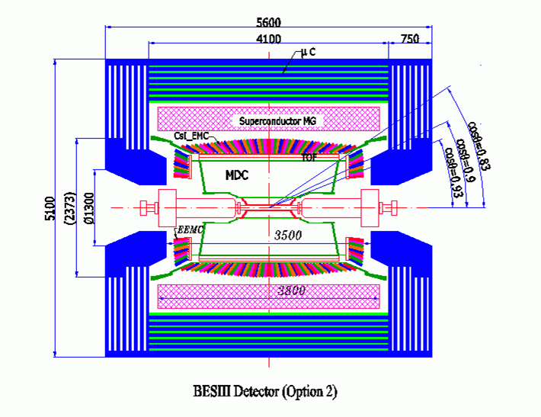
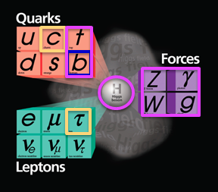
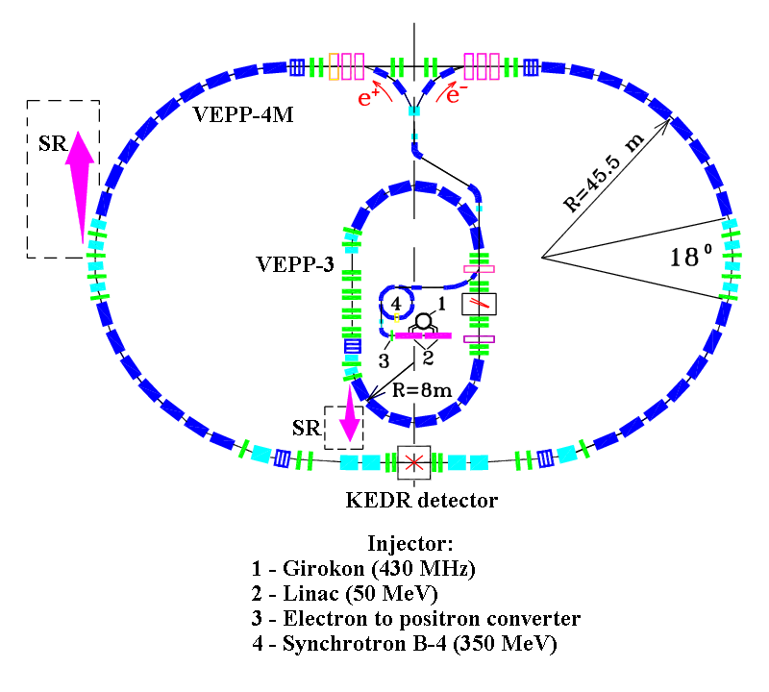

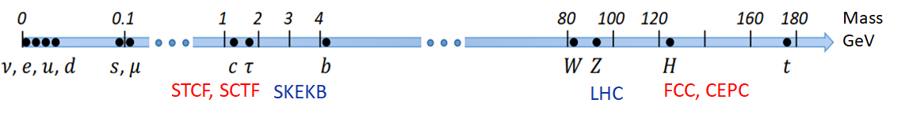
Particle physics at colliders: four operational colliders for energy frontier and intensity frontier in post-Higgs era
BEPC II, China
SuperKEKB, Japan
LHC,Europe
VEPP-4M, Russia
High-lumi frontier:
b physics and c physics
High-energy frontier:
Higgs physics

Slide 4
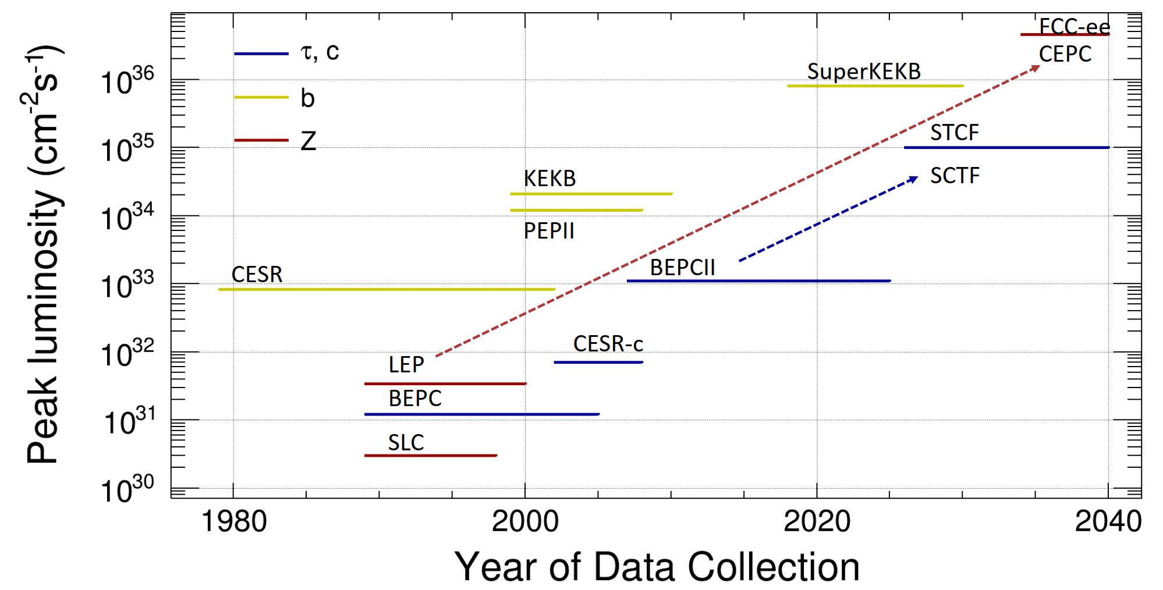
High-lumi e+/e- circular colliders
1st Generation
Single ring
2nd Generation
Double-ring
More bunches
Low β_{y}@IP
3rd Generation
Double-ring
Large Ib and crossing angle
Extremely low β_{y}@IP
Notes:
STCF(SCTF) is the natural facility of global HEP strategy
Super Tau Charm Facility is 𝑒+𝑒− collider, dedicated to precision study of properties of charm-quark, tau-lepton, study of strong interactions, search of BSM physics

Slide 5
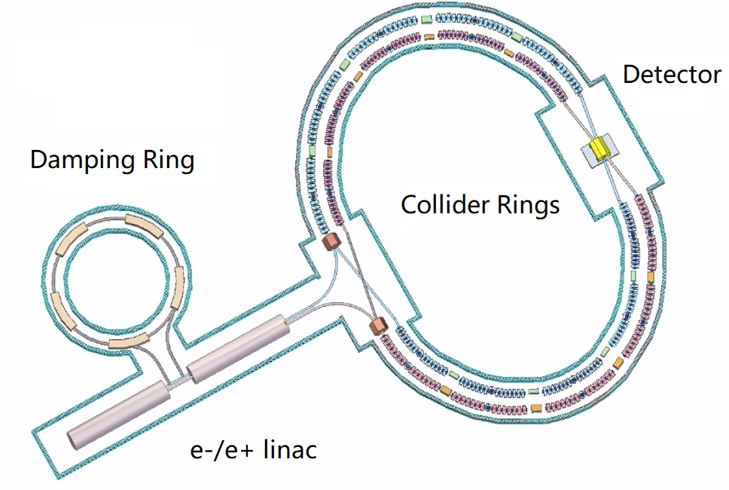
STCF Design Goals
Core design goal:
  CoM energy: 2-7 GeV
  Luminosity: >5×10³⁴ cm⁻²s⁻¹ @4GeV
  Upgrading potential: polarized beam, higher luminosity
Accelerator structure
  Double-ring collider:
  low emittance, high current, large Piwinski angle
  Injector: full-energy linac, e+ damping ring or accumulator, beam transport lines

Slide 6
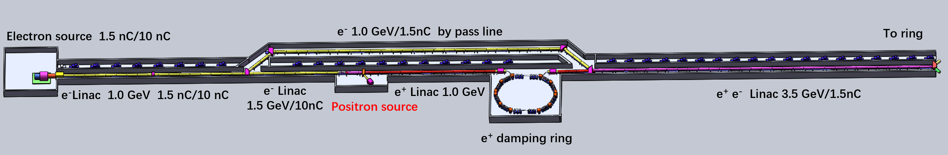
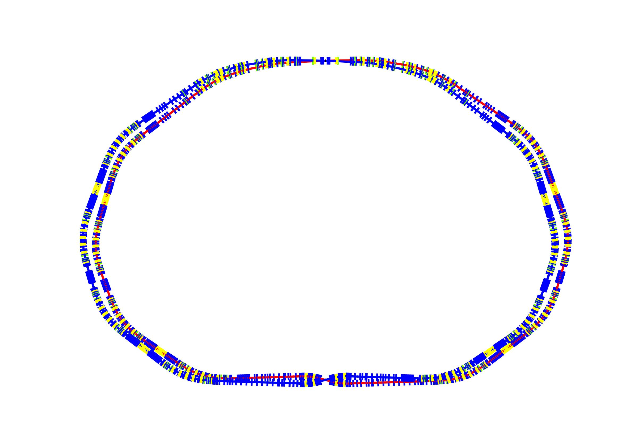
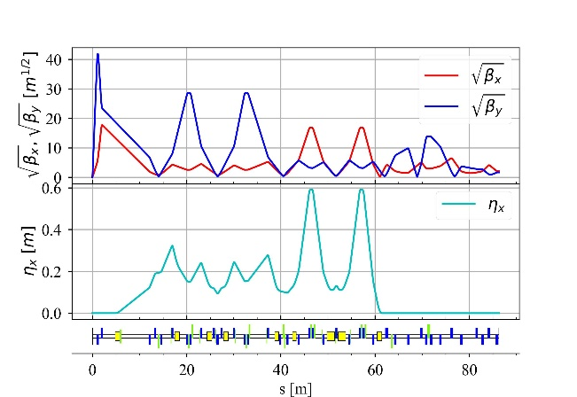
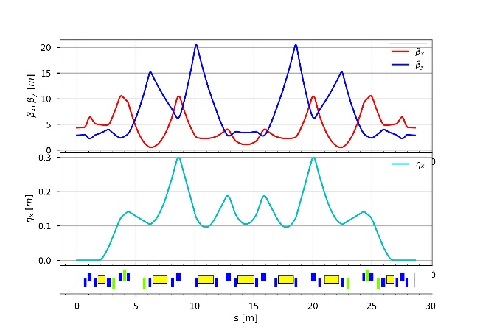
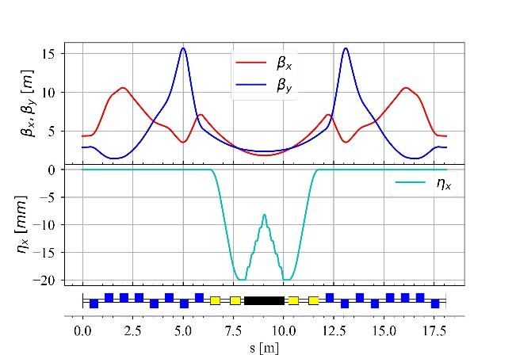
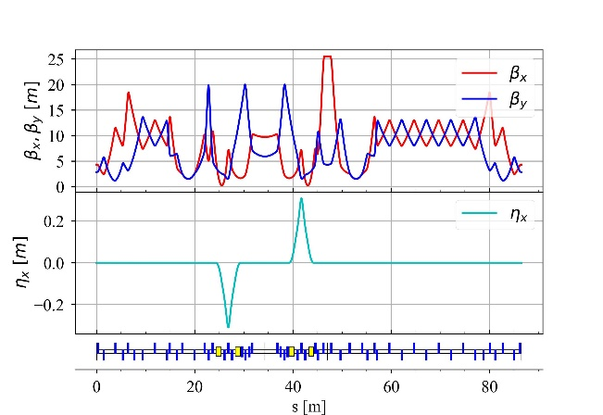
Current deign scheme and main parameters
Injector
Injector:
  e- linacs: 1.0 GeV, 1-1.5 GeV
  e+ linac: 1 GeV
  e+/e- linac: 1-3.5 GeV
  e+ target: @1.5 GeV
  Damping ring: 1 GeV, ~140 m
  e+/e- accumulator rings: 1 GeV, length? (alternative scheme)
  Total length: ~400 m (+100 m beam transp.
Half IR
ARC
Wiggler section
Comb.-funct. section
Collider ring lattice

Slide 7
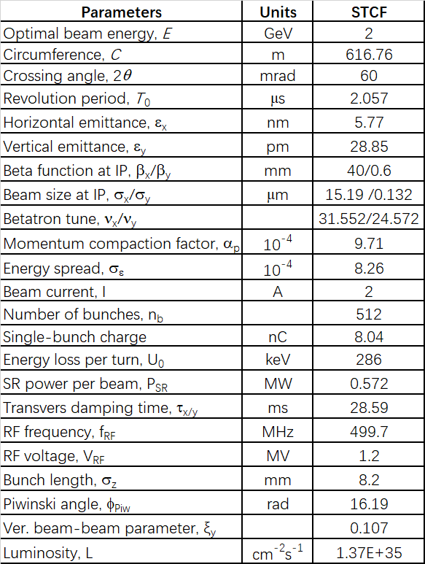
Collider rings:
  Injection energy: 1-3.5 GeV
  Optimal energy: 2 GeV
  Two injection schemes: off-axis, swap-out
  Circumference will be increased to about 800 m

Slide 8
Key challenges in accelerator physics and technologies

Slide 9
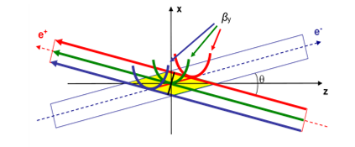
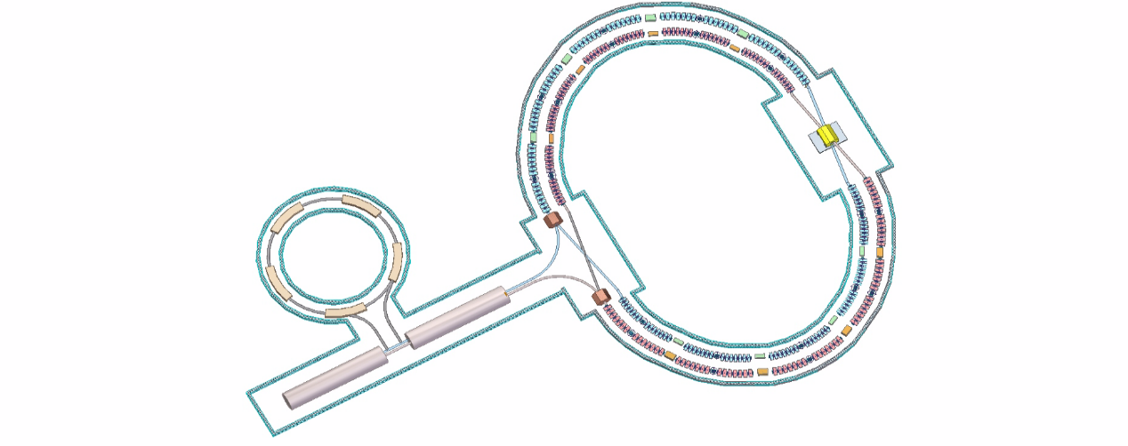
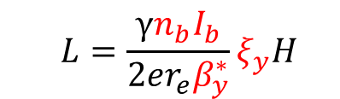
Key challenges on AP and technologies
Design goal: Super-high lumi., high-quality (high-current, low emittance) e+/e- beams collision (extremely low β*), stable operation
Great challenges: IR strong nonlinearity and collective effects; IR superconducting magnets
Collider Ring and IR AP design:
IP beam size (Y) nm scale, Crab-Waist, nonlinear compensation extremely difficult
IR Technologies:
SC magnets, MDI
  $$L=\frac{γn_{b}I_{b}}{2er_{e}β_{y}^{∗}}ξ_{y}H$$
Injection into CR (small DA): high I_{b} and low ε e+/e- sources
Other key technologies:
Ring RF, beam instrum. and control, beam injection…
Big Piwinski angle + Crab Waist

Slide 10
Key challenges on AP and technologies
No | Key design or tech | Prio. | Comments
1 | Collider ring AP design | A+ | Espec. IR, key to realize high-lumi
2 | IR SC magnets | A+ | Complex structure, high-field, tight space, less exp.
3 | Collider ring RF | A+ | High-power, deep-damped HOM, less exp.
4 | Injector AP design | A | Prov. high-qual. beams to CR, 2 injection schemes
5 | Collider beam instrum. | A | High-prec. and fast bunch meas., fast feedbacks
6 | Collider ring injection | A | ns-scale kickers for bunch swap-out injection
7 | Positron source | A | Low e- energy to generate e+ beam
8 | Collider ring vacuum | A- | High-current circ. beams, ultra-high vacuum for IR
9 | MDI | A- | Very tight space and complex mech. (acc. and det.)
10 | Electron source | A- | High-bunch charge photocathode e-gun
11 | Linac microwave | A- | Large-aper. S-band acc. struct., less exp, LLRF
12 | Linac power source | A- | High-power solid-state modulator

Slide 11
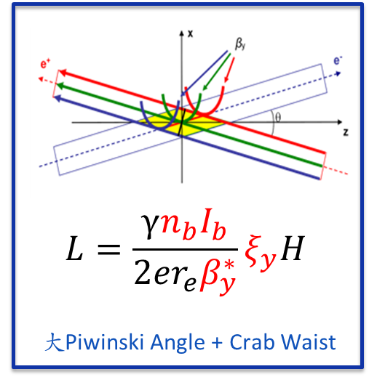
Key challenges (1) – CR AP design
A new-generation e+/e- collider
  How to attain two-order lumi. gain over the last-generation collider (BEPC-II)?
IR physics design
  The key and challenge for STCF accelerator
  New collision scheme: beam param (I_{b}, ε_{x} ; nm spot at IP), crossing angle, correlation with the B-B effect [Luminosity need]
  Special optics: Final Focus + Crab Waist (Telescope-Mini β, dispersion, phase advance) [Complexity]
  Strong nonlinearity: Local CC for extreme-low β, fringe-field, crab sextupoles ➔ very small DA and MA [very short beam lifetime]
  Complex MDI: SC magnets, vacuum, cryostat, beam monitors, interface with detector [Iterations]
➔Take advantage of a new machine, lessons from SuperKEKB ➔ better design

Slide 12
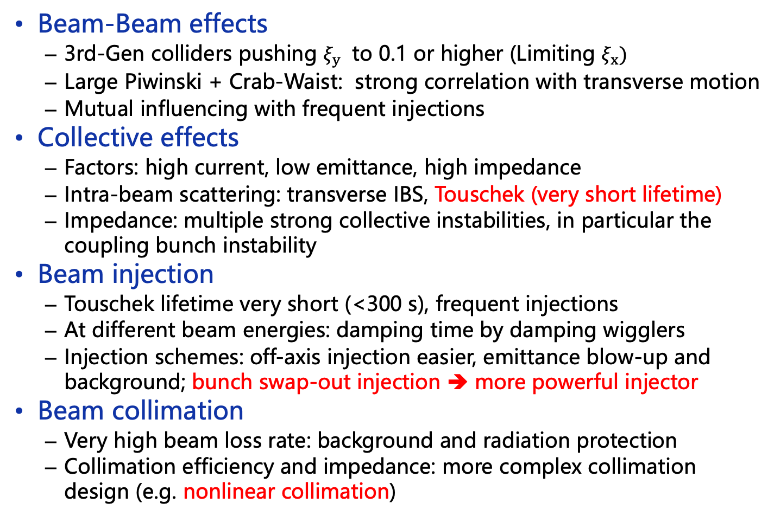
Other key problems in CR AP design
Beam-Beam effects
  3rd-Gen colliders pushing $ξ_{y}$ to 0.1 or higher (Limiting $ξ_{x})$
  Large Piwinski + Crab-Waist: strong correlation with transverse motion
  Mutual influencing with frequent injections
Collective effects
  Factors: high current, low emittance, high impedance
  Intra-beam scattering: transverse IBS, Touschek (very short lifetime)
  Impedance: multiple strong collective instabilities, in particular the coupling bunch instability
Beam injection
  Touschek lifetime very short (<300 s), frequent injections
  At different beam energies: damping time by damping wigglers
  Injection schemes: off-axis injection easier, emittance blow-up and background; bunch swap-out injection ➔ more powerful injector
Beam collimation
  Very high beam loss rate: background and radiation protection
  Collimation efficiency and impedance: more complex collimation design (e.g. nonlinear collimation)

Slide 13
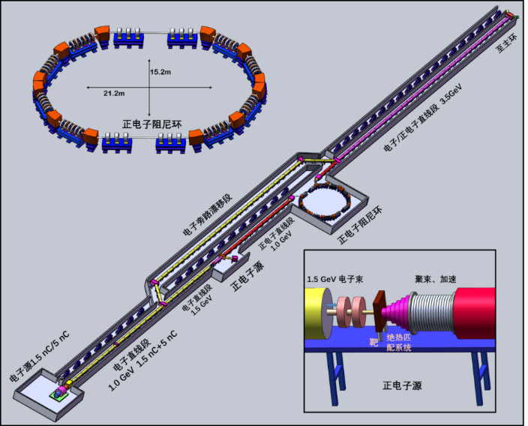
Key challenges (2) – Injector AP design
Injector providing e+/e- beams to CR
  Quality: energy spread, bunch charge, emittance, stability
  High frequency injections
Design difficulties
  Large energy range: 1-3.5 GeV, ε <20 nm
  High current: 1.5 nC (off-axis); 8-10 nC (swap)
  Depending on CR injection schemes:
  Off-axis: damping ring, key: e+ source
  Swap：e+/e- accumulator rings
  Low e-/e+ conversion: low e- energy (1.5 GeV) ➔ Higher current and low-emit e- beam, higher capture eff.
  High-charge, low-emit beam acceleration: wake-field effect
  Multiple bunches in AR: linac beam loading
  Two accum. rings (e+/e-): cost issue
➔Better design:
A new machine, utilizing design and technology from FEL and 4G light source linacs.

Slide 14
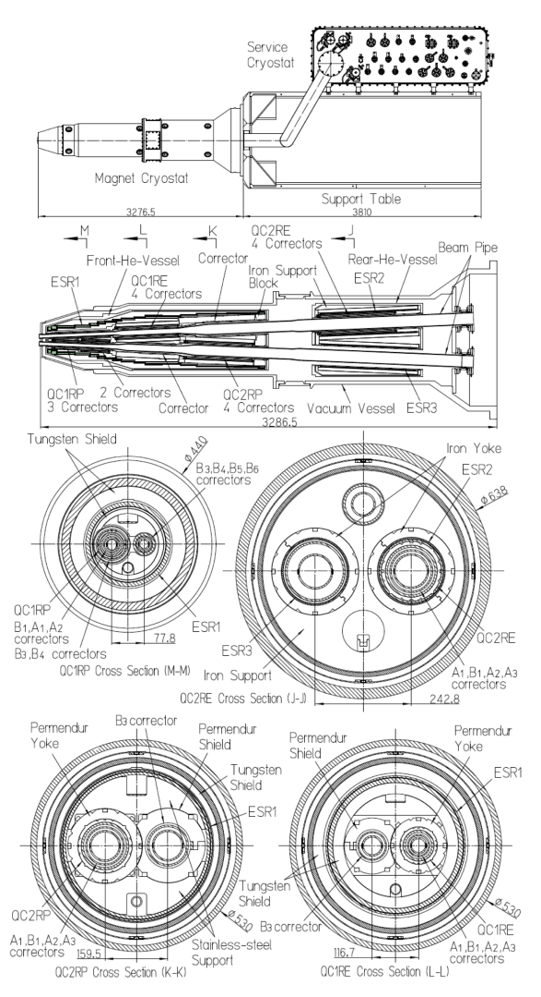
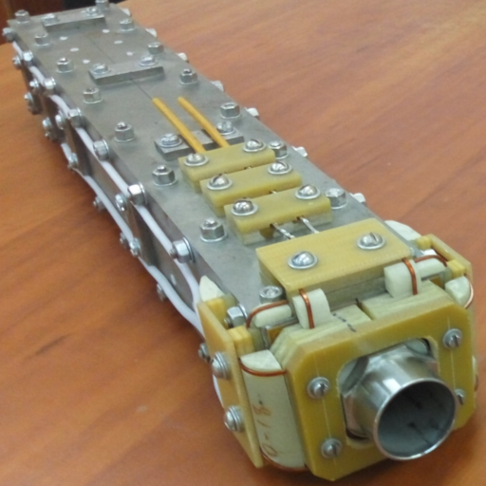
Key challenges (3) – IR SC magnets
IR SC magnets
  Technically very challenging, very few labs have experience
  Very tight space, complex and combined coils
  3rd-Gen e+/e- colliders even more difficult: twin-aperture, higher field gradient (~50 T/m)
  In China: IHEP built the first IR magnet for BEPC-II; some experience in other SC magnets
  STCF R&D: developing prototypes by steps, different technologies under consider. (BEPCII serpentine, CCT, cos2θ/DCT)
SuperKEKB considering to replace the magnets (Nb₃Sn)
BINP/SCTF
Prototype (CCT)
IHEP BEPCII-U

Slide 15
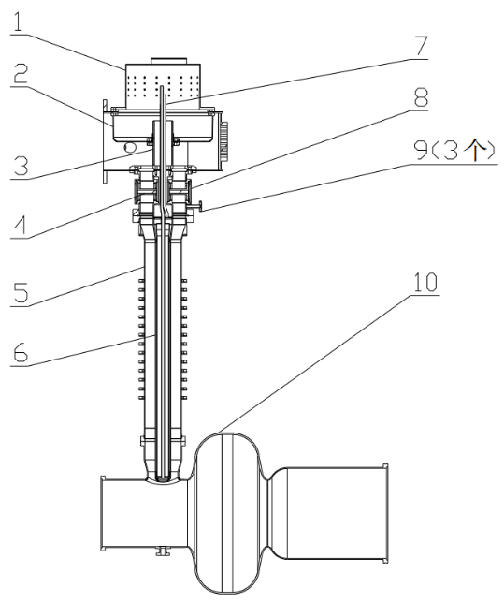
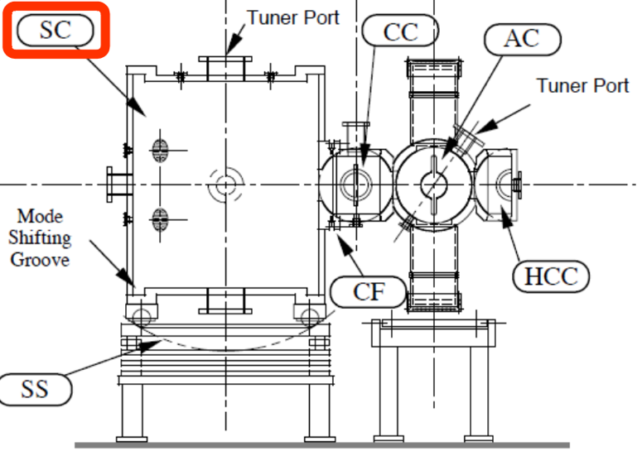
Key challenges (4) – Ring RF
RF for Collider rings
  High synchrotron radiation (2 Amperes): RF power and couplers
  HOM deep-damped: instabilities
  Large energy range (1-3.5 GeV): high V_{RF}
  Beam loading: at bunch swap-out injection
  Stability: more powerful LLRF
STCF RF considerations
  Comparing RT and SC cavities (RT cavity for DR)
  500-MHz HOM-d RF cavity: little exp. in China
  500-MHz SC cavity: more exp., but coupler≤150kW, STCF needing≥300kW
  R&D effort: high-power coupler for SC cavity, prototyping a RT cavity with HOM-d, LLRF
High-power coupler to SC cavity
RT cavity with HOM-d (KEK ARES type)

Slide 16
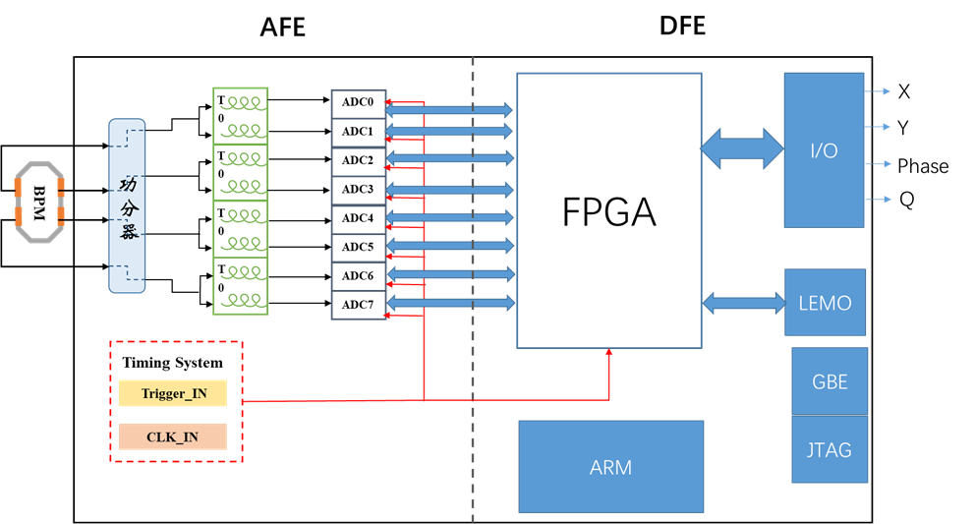
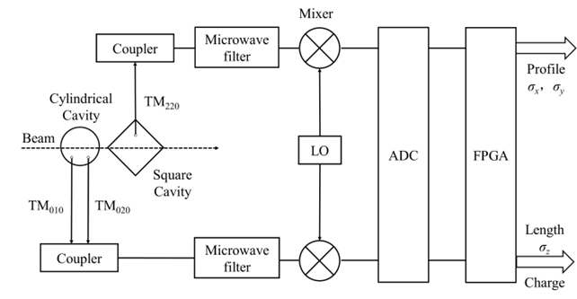
Key challenges (5) – Beam instrumentation
Requirements for beam instrum.
  CR precise bunch meas.: bunch-by-bunch 3D meas., trans. position res. <5 μm, long. phase res.<0.2 ps
  CR B-by-B fast feedback: coupled bunch inst.
  IP: orbit feedback
  Injector: bunch length and charge meas.
R&D efforts
  Bunch 3D meas.: probe, signal treat, electronics, S/N, integration
  B-by-B fast feedback: raising bandwidth, avoiding interference to single bunch
  Injector bunch length and charge meas.: cavity-based
  Prototypes: beam tests in different machines
Integrated board
for B-by-B 3D meas.
Cavity-based:
bunch length, charge and profile meas.

Slide 17
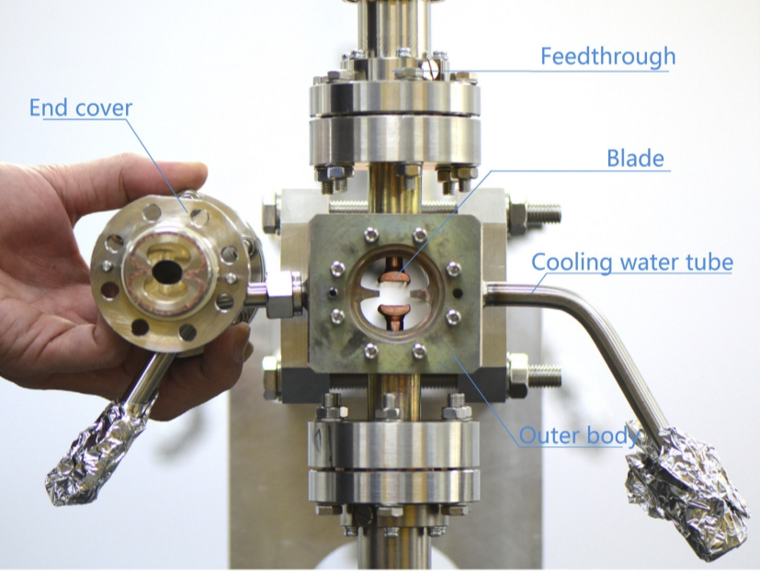
Key challenges (6) – Injection kickers
Injection kicker requirements
  Very short lifetime (<300 s): frequent injections
  Less influence to circulating beams (collision): small variations
  Very small DA: small off-axis injection
  Parallel study: off-axis injection and swap-out injection
R&D efforts
  High-rep (50 Hz), super fast kicker (bottom<4 ns)
  Concern: nonlinear kicker, thin-blade eddy-current septum
HEPS Strip-line kicker (8-10ns)
Multi-wire nonlinear kicker

Slide 18
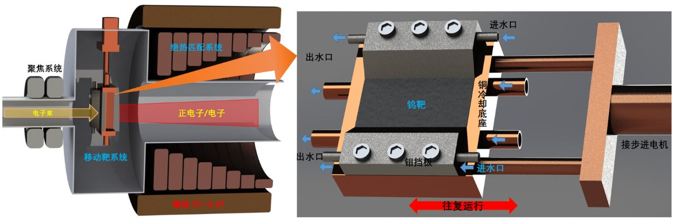
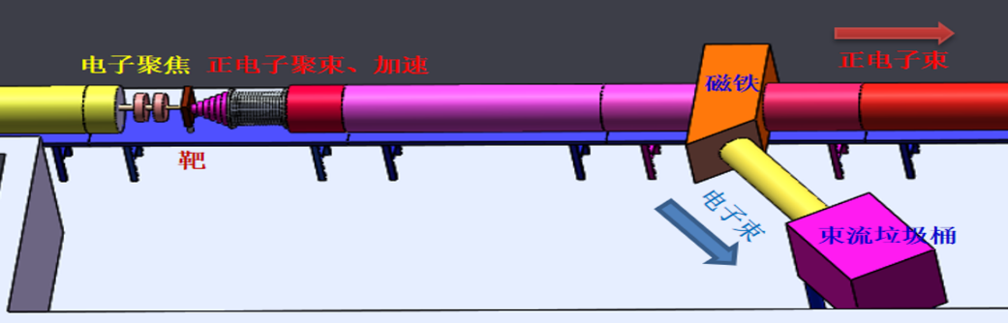
Key challenges (7) – Positron source
Requirements and challenges for positron source
  e+ beam: 1.5 nC per bunch
  Relatively low e- beam energy (1.5 GeV): low conversion eff.
  High rep. (50 Hz): heat deposit
  High capture eff.: strong magnetic horn, large-aper. accel. tubes
R&D efforts
  Prototype: e+ source (target, magnetic horn) and large-aper. accel. tube
  e+/e- beam test platform: accelerating e+ to 100 MeV (e-: 100 MeV)
  Exploring new type target: single crystal or amorphous tungsten
New reciprocating motion e+ target
e+/e- beams test platform

Slide 19
Electron-positron beams test platform
Test platform for supporting several injector R&Ds
  Electron source: mainly photocathode (also thermal e-gun)
  High-power solid-state modulator
  Positron target
  Magnetic horn
  Large-aperture S-band acceleration tube
  Beam diagnostic devices
Merge with HALF linac aging platform
Basic requirements
  Photocathode electron source
  100-MeV e- linac
  Positron target and magnetic horn
  100-MeV e+ linac
  Beam properties measurements, beam dumps

Slide 20
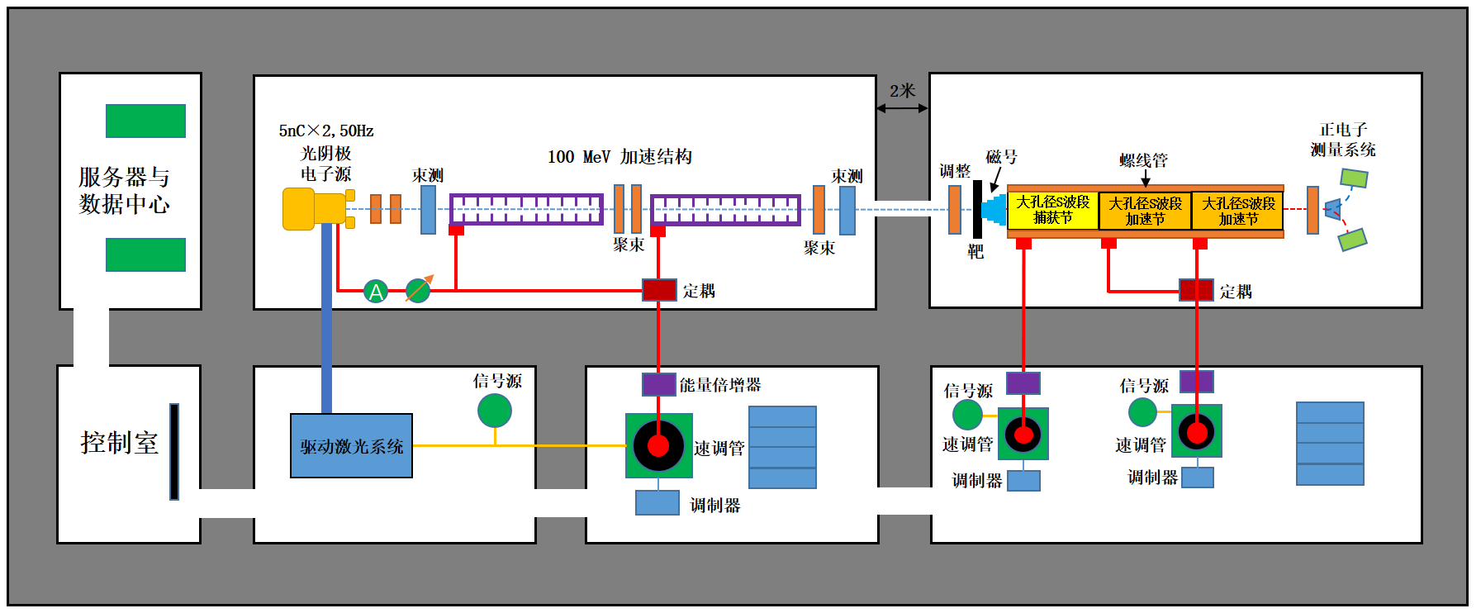
e- linac: 2* 6-m sections; e+ linac: 3 large-aper. accel. tubes
Located in the HALF accelerator test hall

Slide 21
Organization of the STCF accelerator study

Slide 22
From prelim. study phase to R&D phase
Preliminary study phase (from 2018 to mid 2023)
  Very limited manpower (a dozen, mostly: small-portion part-time, students, retired consultants): preliminary conceptual design on the STCF accelerator
  Lacking experience in colliders
  Supporting the STCF study project
Key R&D phase (since August 2023)
  National Synchrotron Radiation Laboratory (NSRL) fully engaged in, as the co-supporter of the STCF project
  NSRL is focusing on the constr. of HALF (a 4G synchrotron light source, 2023.5 to 2028.9), still limited manpower
  Domestic collaborations: 8 institutions (4 formerly, 4 individuals), contributing to half of current manpower
  About 90 persons, half are students, majority without experience in colliders

Slide 23
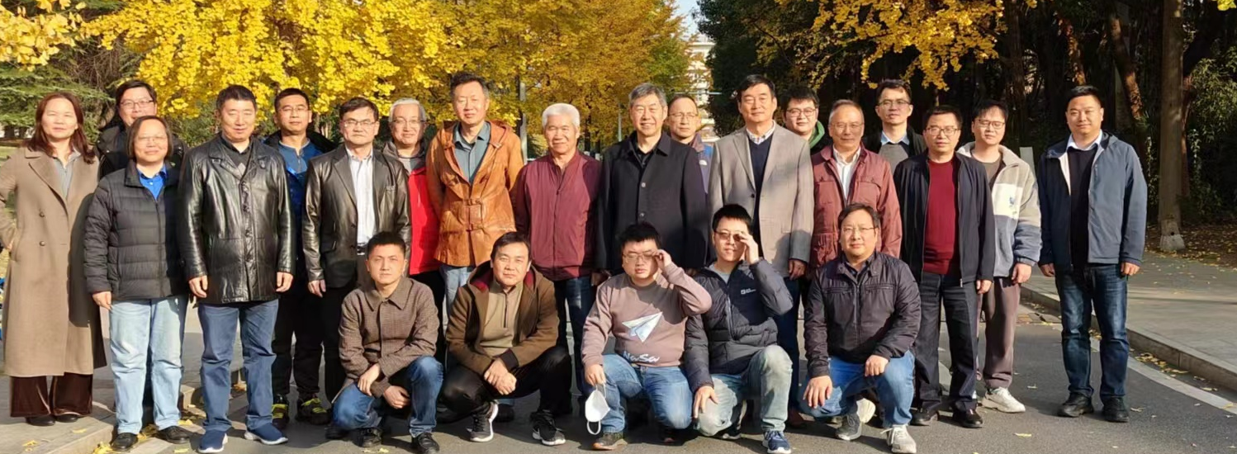
Accelerator Division
Accelerator Division
  Formed in August 2023
  15 under-systems established in Nov. 2023
  Regular meetings: weekly, bi-weekly, monthly
Objectives in 2023-2025
  Conceptual design report (first half 2025)
  Preliminary technical design report (end 2025)
  Key technology R&Ds (by steps)
Objectives beyond 2025
  Supporting STCF to bid national construction project: The Proposal of the STCF Project
  Technical design report
  Continuation and further key technical R&D

Slide 24
Financial resources for accelerator
Provincial STCF R&D project
  From 2023.1 to 2025.12
  Direct: total, 210M RMB; accelerator, 130M RMB
  Matching from USTC: total, 210M RMB
  On STCF accelerator design and R&D
MoST key research program
  From 2022.7 to 2027.6
  10.6M RMB
  On a few topics of STCF accelerator design and R&D
NSFC key research project
  From 2024.1 to 2027.12
  3.4M RMB
  On key accelerator physics problems in STCF collider rings

Slide 25
Summary
STCF accelerator goal is very challenging
STCF accelerator group laid a good base in preliminary research
Newly formed accelerator division will push forward the design and R&D studies (international standard)
Provincial and national financial resources to support the design and key technological R&Ds
STCF is a national project, several acc. institutions involved in the study
It is very important to collaborate with international labs, in particular, KEK and BINP
Thanks and welcome comments

Slide 26
Backup Slides

Slide 27
Lessons learnt from SuperKEKB
SuperKEKB
  Luminosity goal: 6×10³⁵ cm⁻²s⁻¹（KEKB: 2×10³⁴ cm⁻²s⁻¹）
  Current status: 4.7×10³⁴ cm⁻²s⁻¹
  Major problems found:
    Too short lifetime, frequent injections leading to high backgr.
    Severe instabilities (esp. LER), difficult to increase current
    Emittance blow-up, different factors, e.g. TMCI by collimators
    Difficult to ξy higher (current: <0.05, goal: 0.1)
    Sudden beam losses, leading to SC magnet quenches and collimator damage
    Only partial Crab-Waist collision
STCF countermeasures
  Layout and IR: fully exploiting 3rd collider features
  Injection: swap-out injection, better injector beam
  Collimators: better design, reducing background and impedance

