Slide 1
CEPC Sci-ECAL parameter analysis
Wang Jiaxuan

Slide 2
Data taking @SPS
ECAL Beam test: April 24 - May 4 at H2
MIP threshold scan：April 24 - April 25
for 10um-layer DAC+10
MIP position scan：April 26 - April 27
each channel ~ 4K counts
Data taking with two muon counters
mu- : 100GeV, 120GeV (>3M events)
pi- : 10, 15, 20, 30, 40, 50, 60, 70, 80, 100, 120GeV/c (>100K events each point)
350GeV/c
e- : 10, 20, 30, 40, 50, 60, 70, 80, 100, 120GeV/c (>100K events each point)
150, 200, 250GeV/c

Slide 3
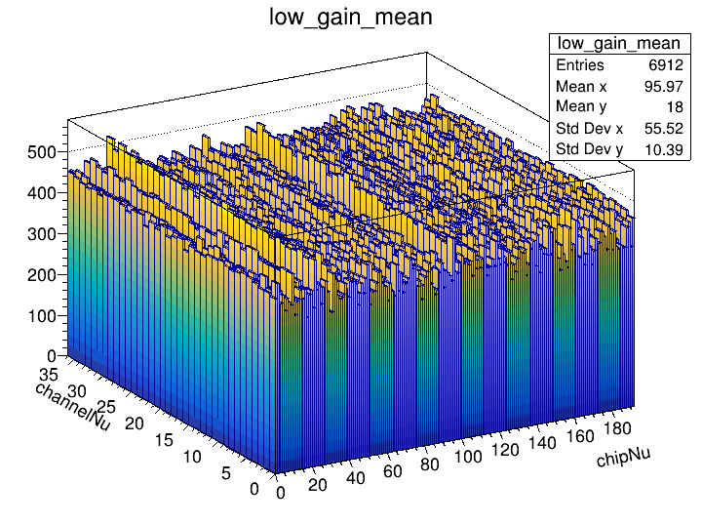
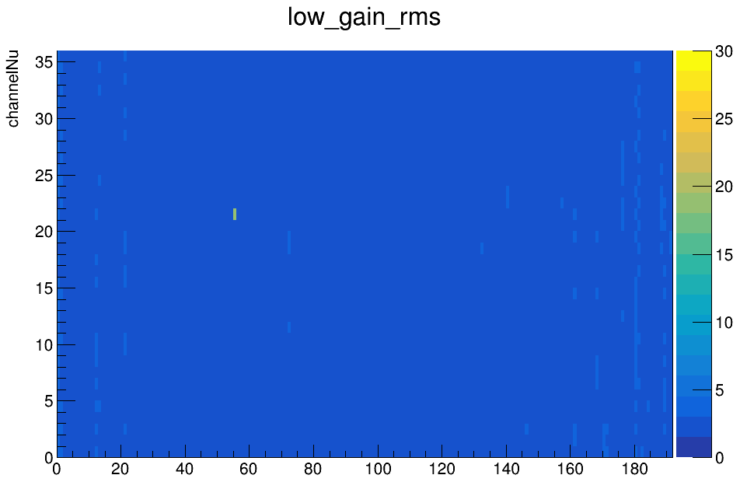
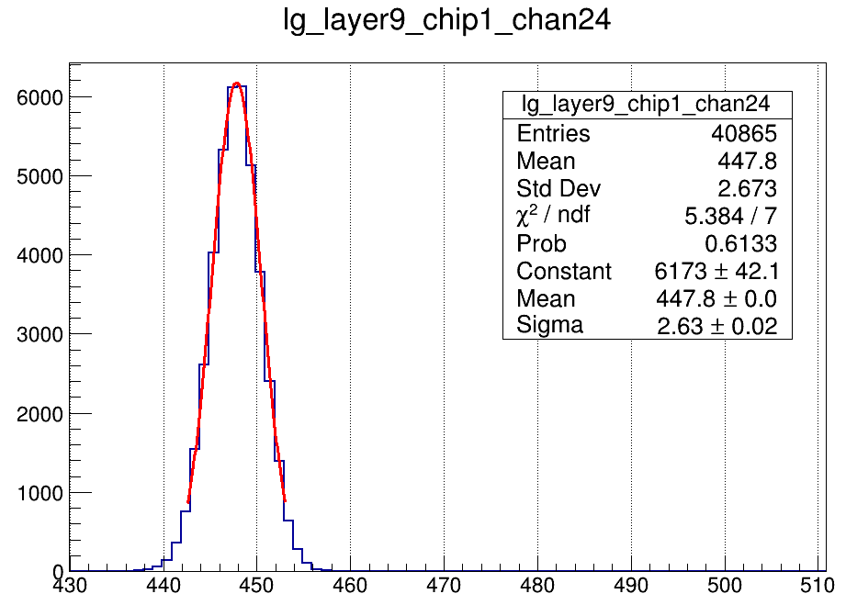
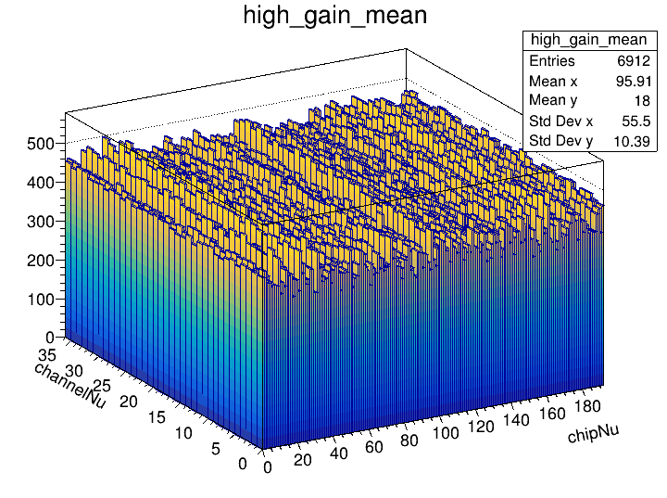
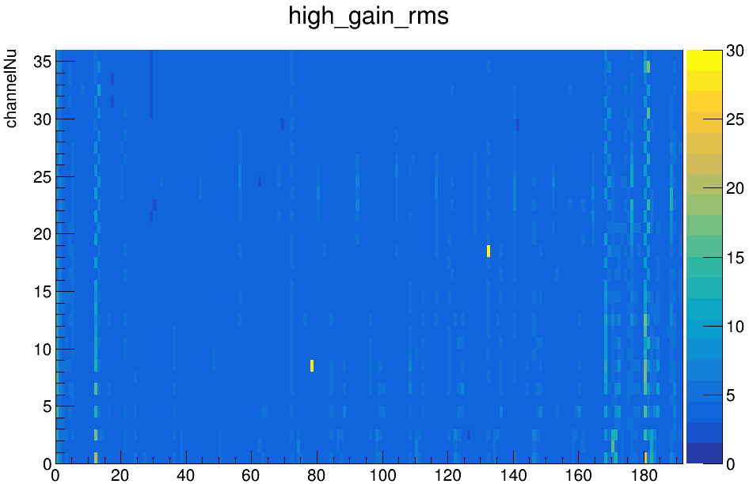
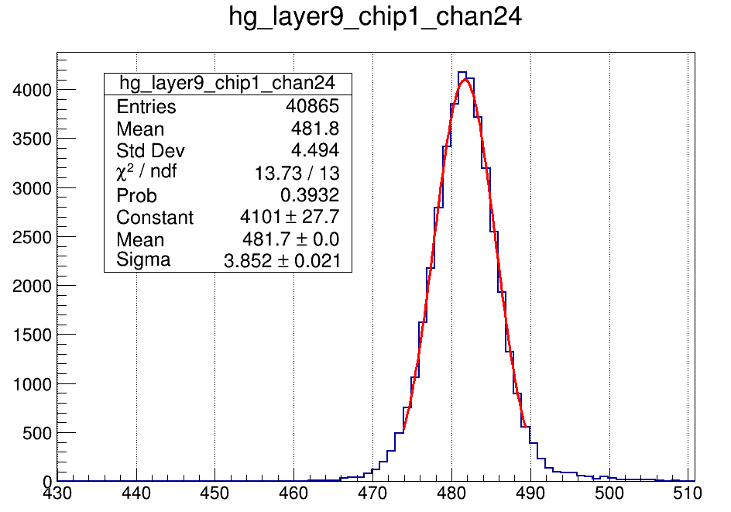
Pedestal

Slide 4
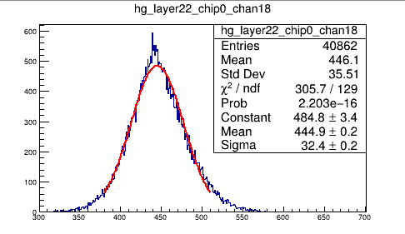
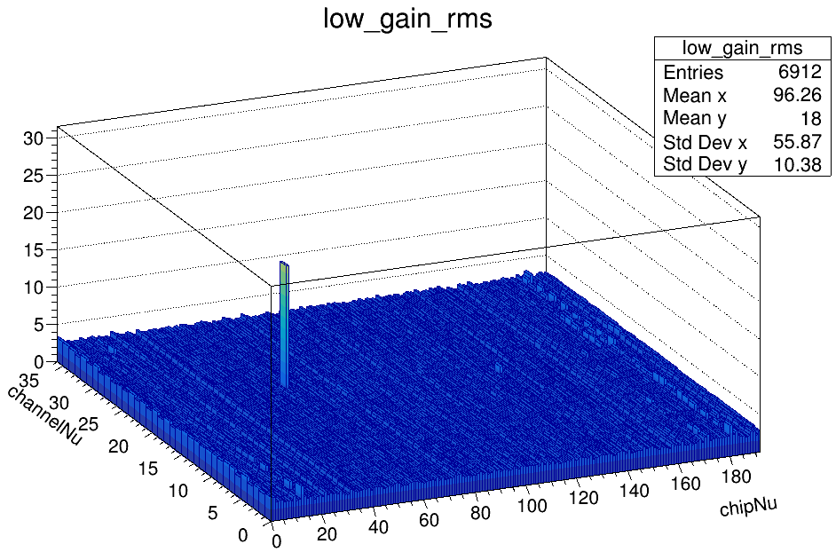
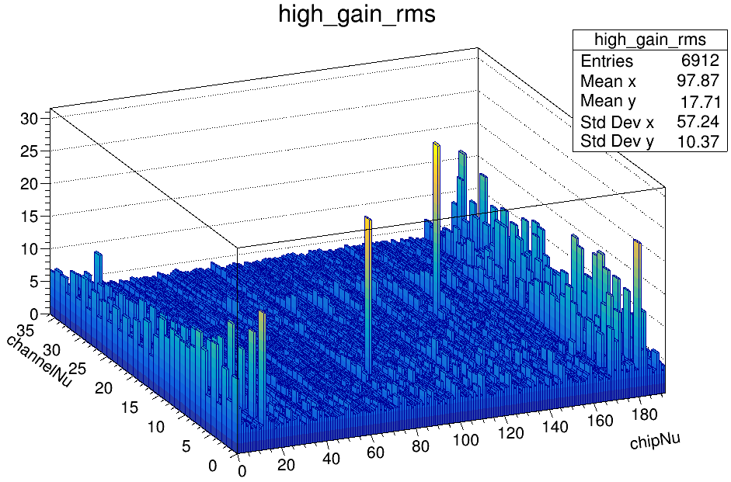
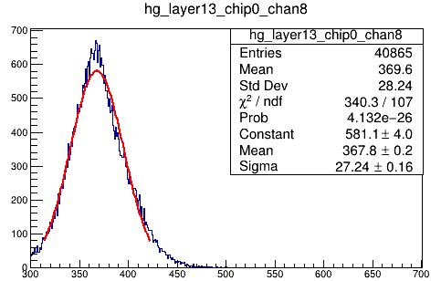
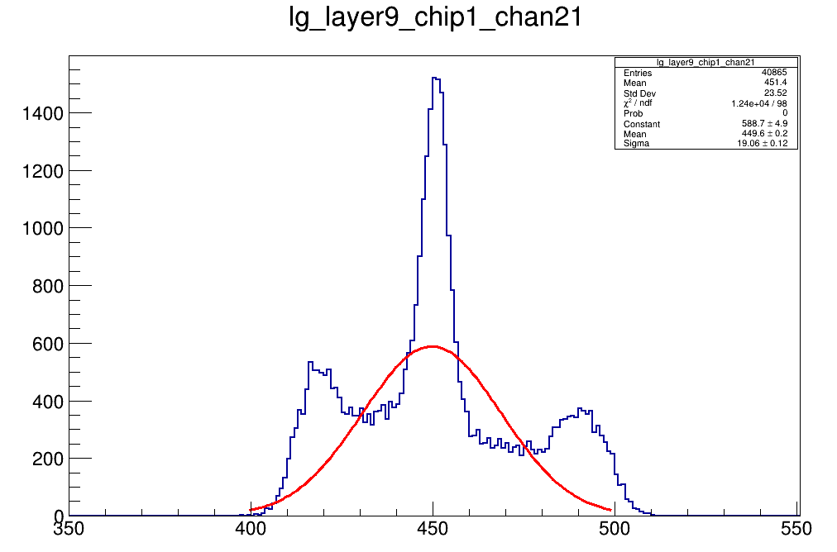
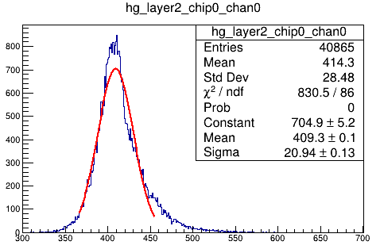
Pedestal - Abnormal Channel
layer9 chip1 channel21
layer22 chip0 channel18
layer13 chip0 channel8

Slide 5
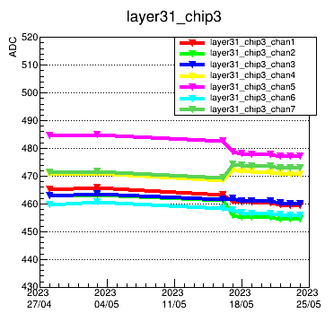
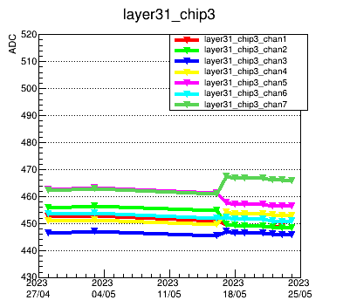
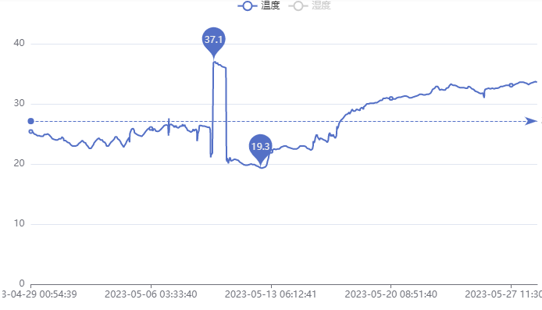
Pedestal stability
Not so many force-trigger mode pedestal files from SPS
Pedestal monitor
SPS PS
SPS PS
SPS PS
high-gain pedestal
low-gain
pedestal
temperatue
As for SPS and PS data, it shows pedestal quite stable respectively(1 ADC fluctuation @SPS)

Slide 6
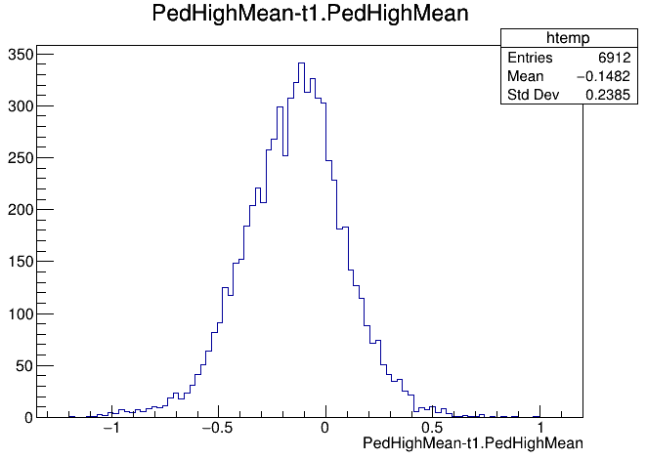
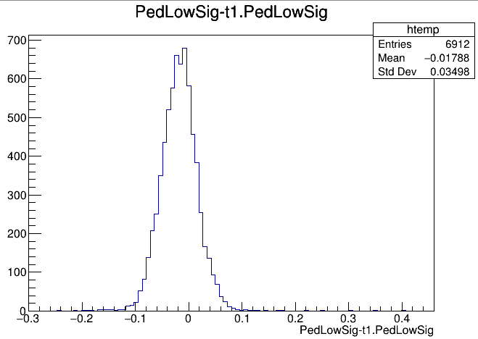
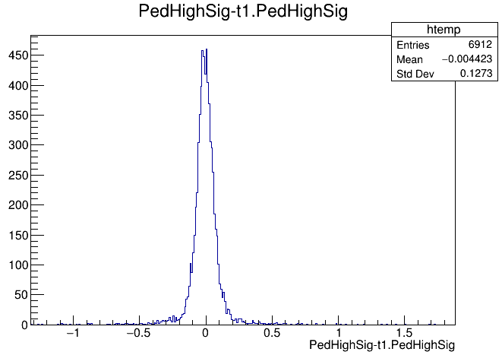
Pedestal stability @SPS
0428 and 0503 pedestal result difference
1ADC fluctuation

Slide 7
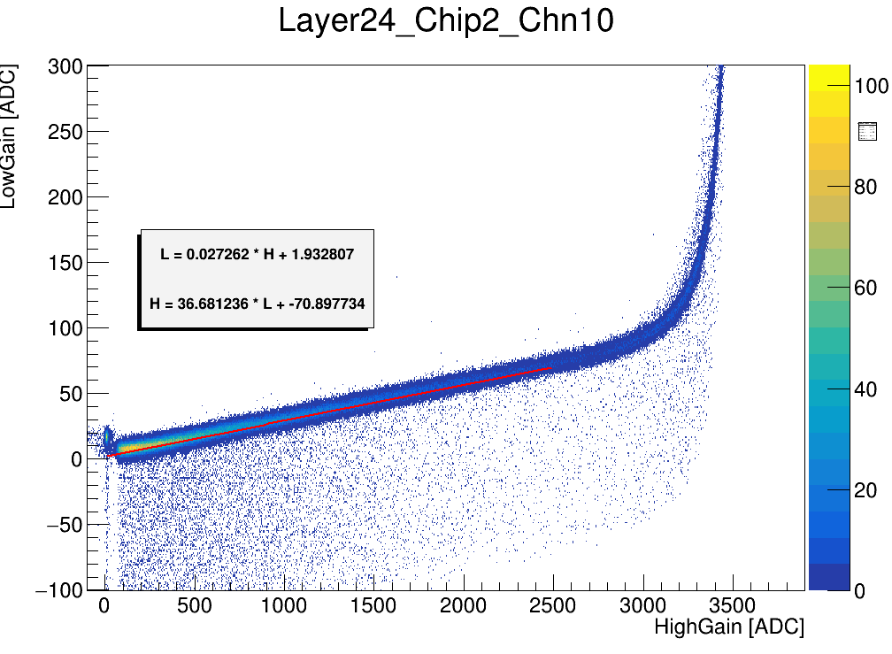
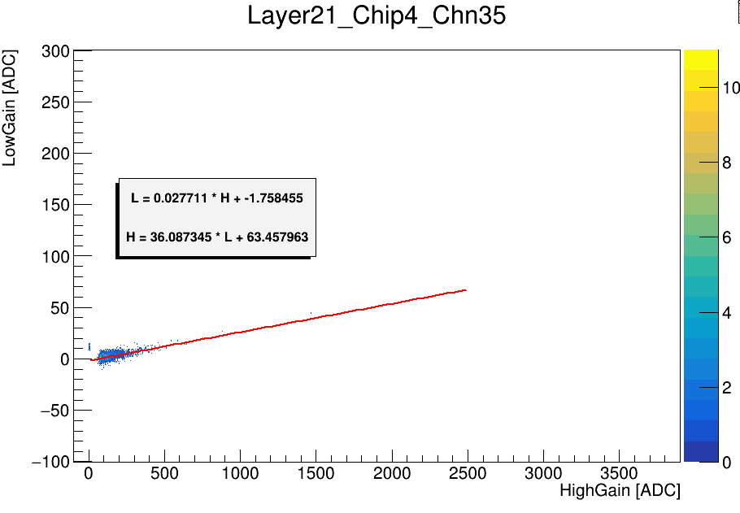
High-low gain calibration

Slide 8
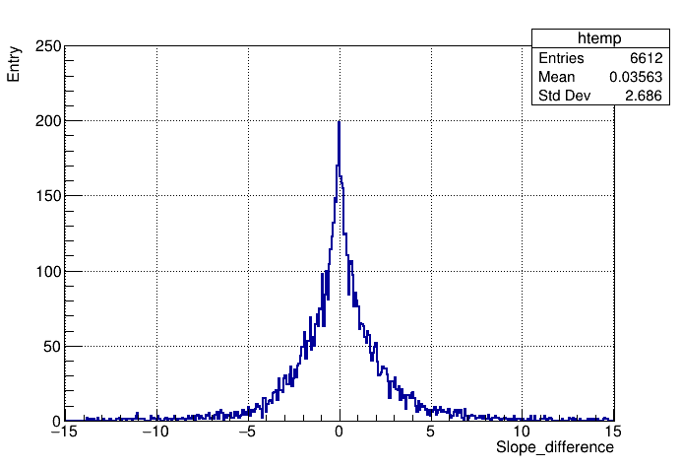
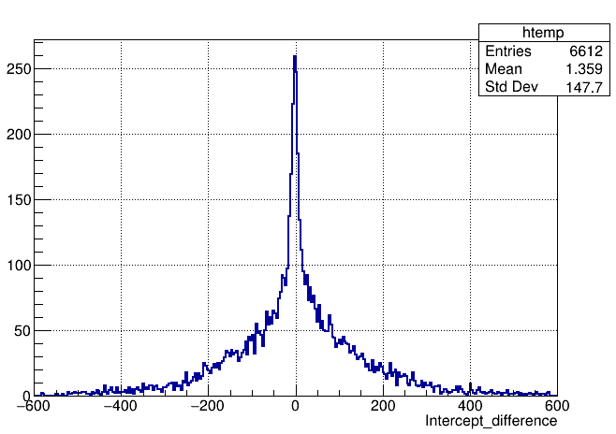
Ratio stability
0430 result – 0501 result

Slide 9
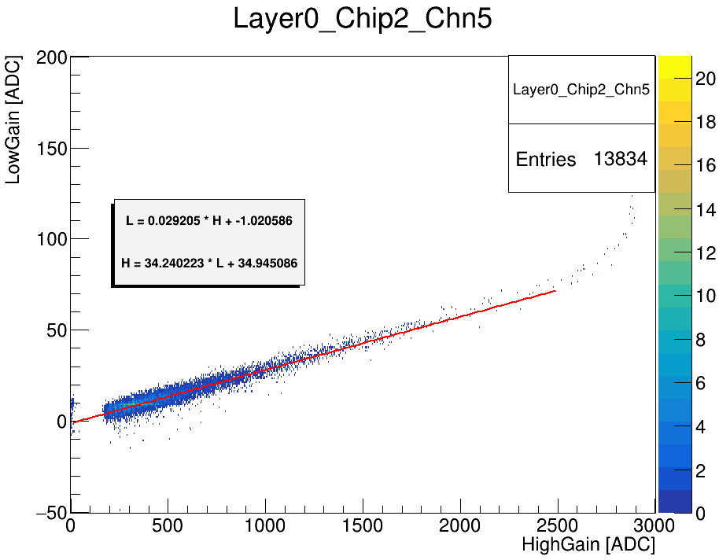
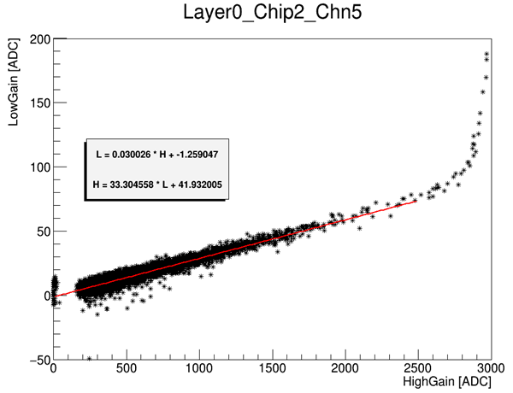
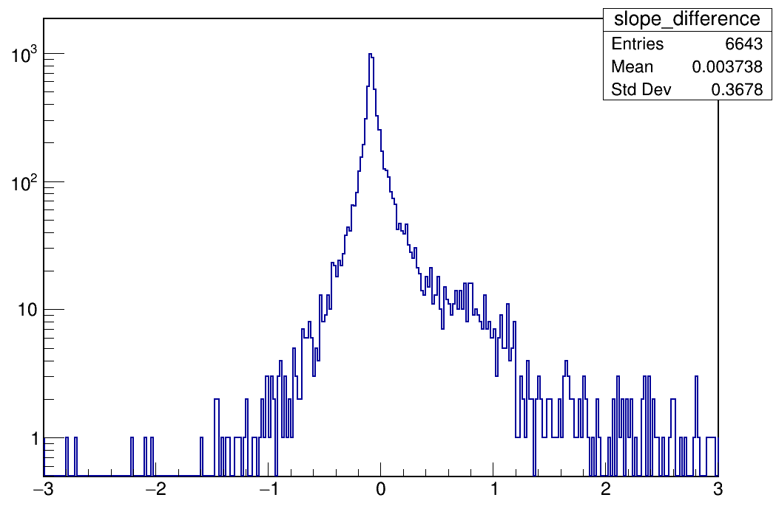
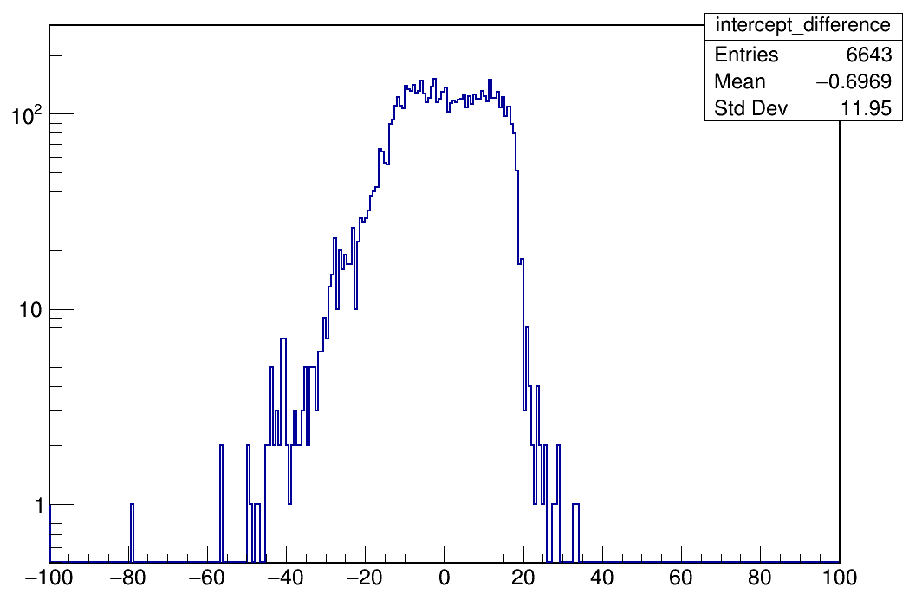
High-low gain ratio calibration : fit method
Bin and unbin fit
Bin width : 1*1
Scatter
Linear fit
Fit range: (300,x_max-600)
Slope difference
Intercept difference
Channel No
Channel No
residual
residual

Slide 10
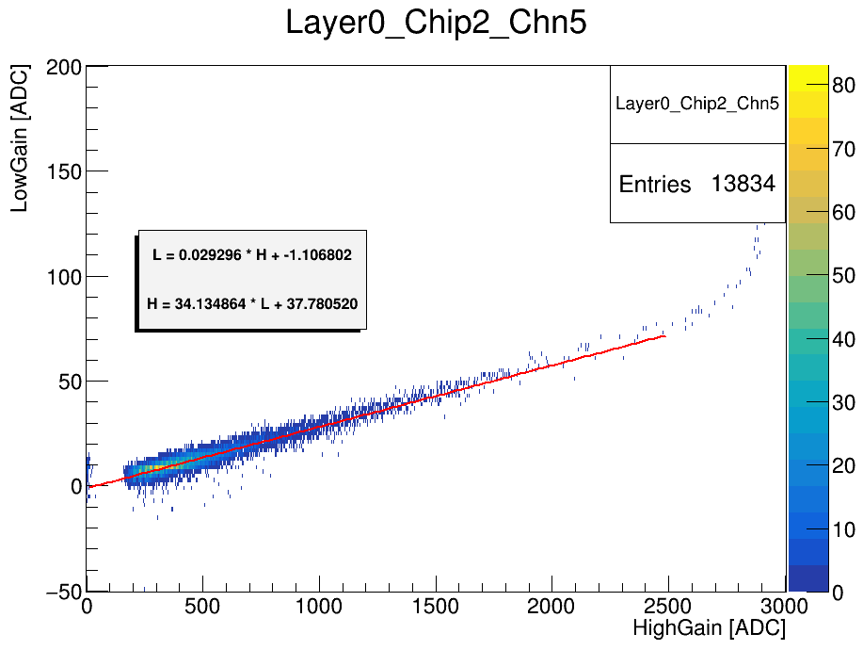
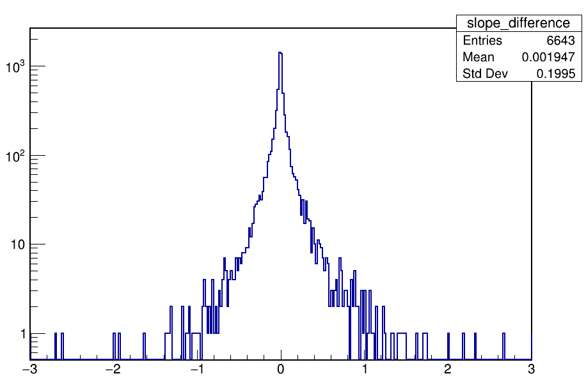
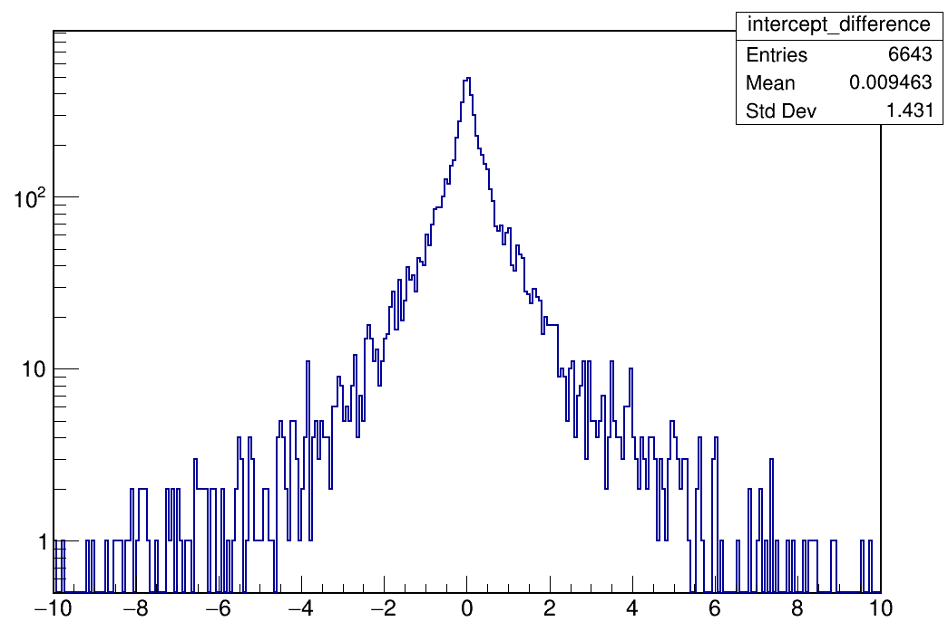
High-low gain ratio calibration : bin set
Different TH2 bin settings
Bin width : 1*1
Bin width : 4*2
Linear fit
Fit range: (300,x_max-600)
Slope difference
Intercept difference
Channel No
Channel No
residual
residual

Slide 11
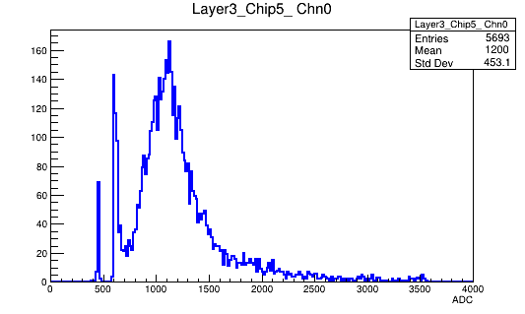
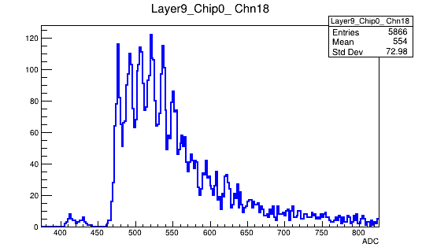
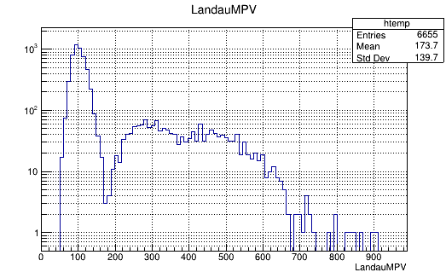
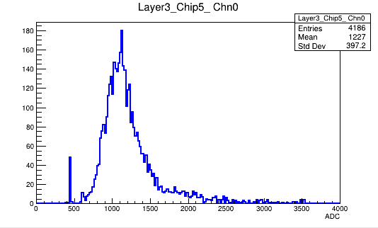
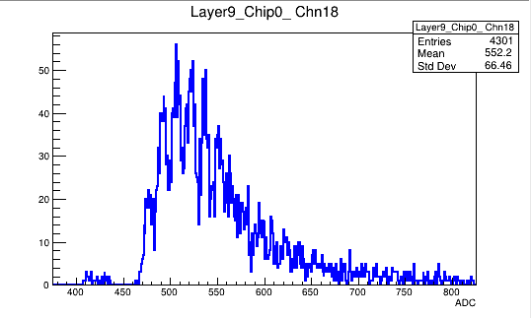
MIP calibration
With the cut according to muon track, noise get eliminated.
before
before
15um SiPM
10um SiPM
after
after
15um SiPM
10um SiPM

Slide 12
MIP statistics

Slide 13
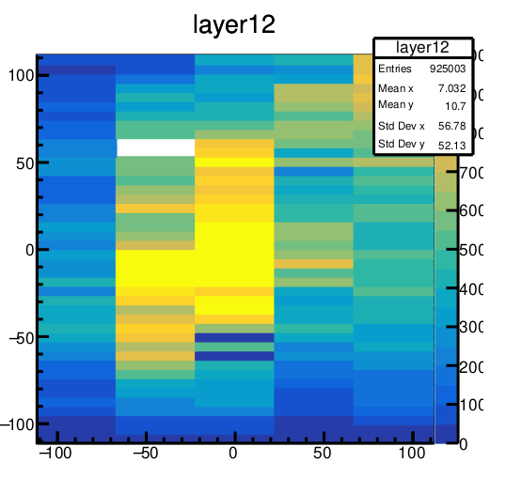
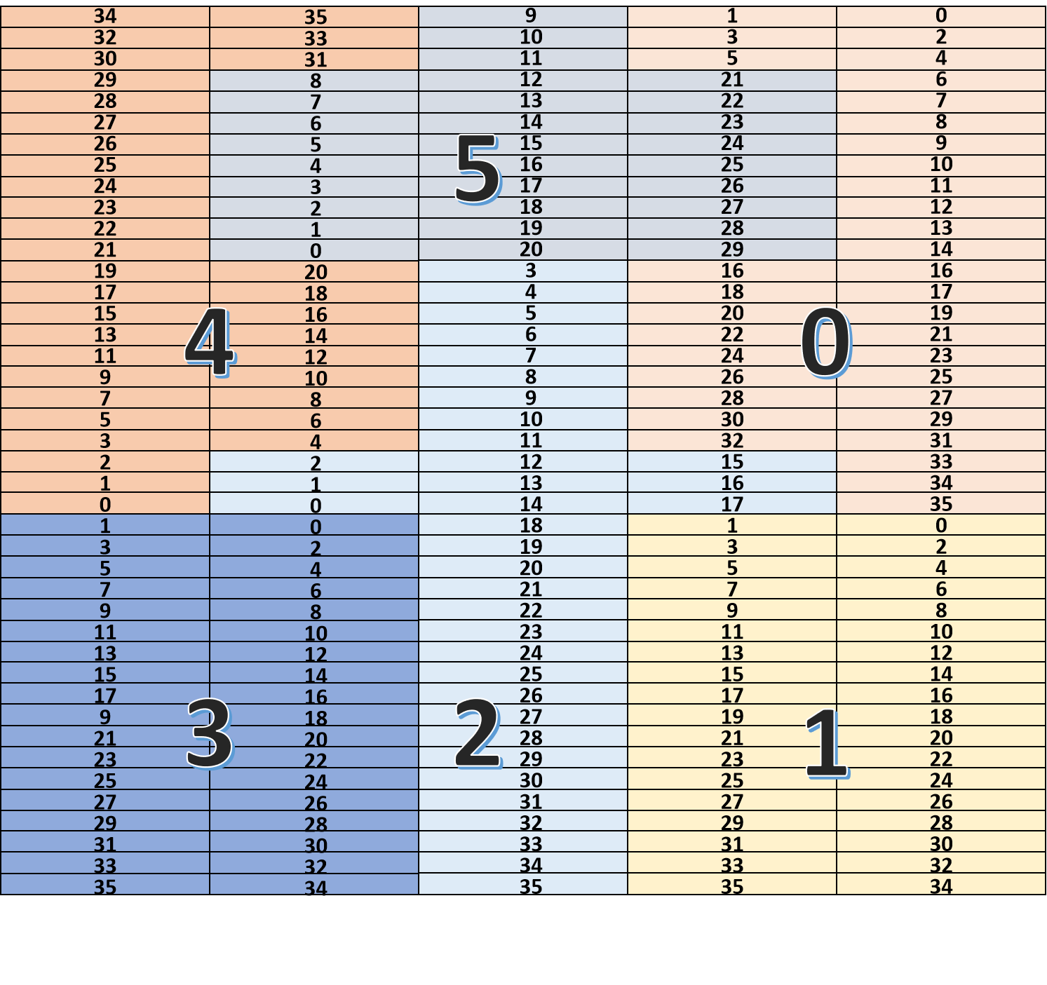
MIP statistics
Use SPS 100GeV/C muon- position scan data with auto gain mode(select threshold: 350)
Almost all channels from odd layers could be calibrated with adequate muon data. But for even layers, less than 500 hits for channels at bottom side.

Slide 14
MIP statistics

Slide 15
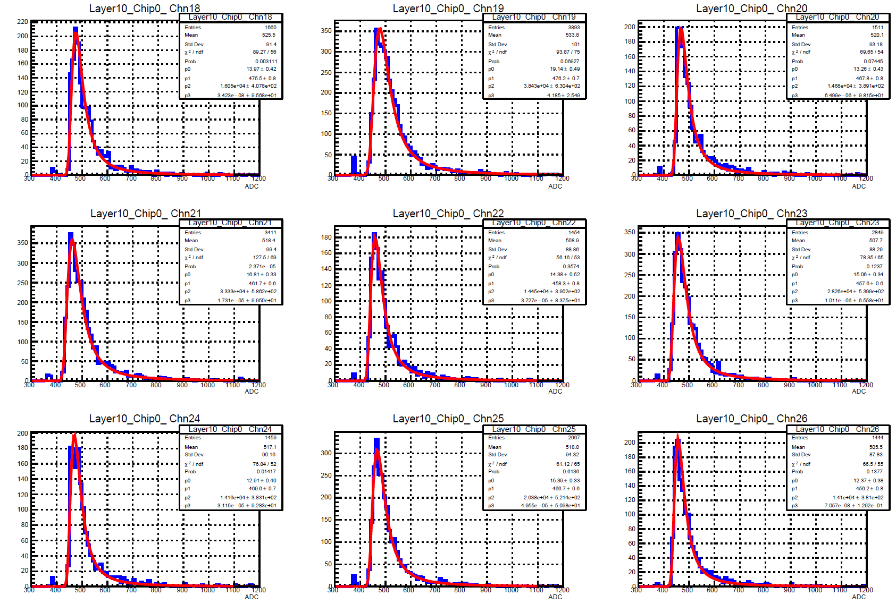
MIP spectrum
15um SiPM
10um SiPM

Slide 16
MIP abnormal channels
Those channels are on the edge of the prototype

Slide 17
Backup

Slide 18
Simulation settings update
Update MC geometry and material parameters
Geometry
Check prototype size in MC geometry
Superlayer structure
Material
Strip : G4_PLASTIC_SC_VINYLTOLUENE
Absorber : Cu-W alloy(15:85), density=16.32$g/{cm}^{3}$
PCB : FR4
Add More Detail(Film, hole)
Prototype layer | Size
Scintillator strip | 5mm*45mm*2*mm
PCB | 230mm*230mm*2mm
Absorber | 230mm*230mm*3.2mm
Superlayer structure:
scintillator-> PCB-> absorber-> PCB-> scintillator-> absorber

Slide 19
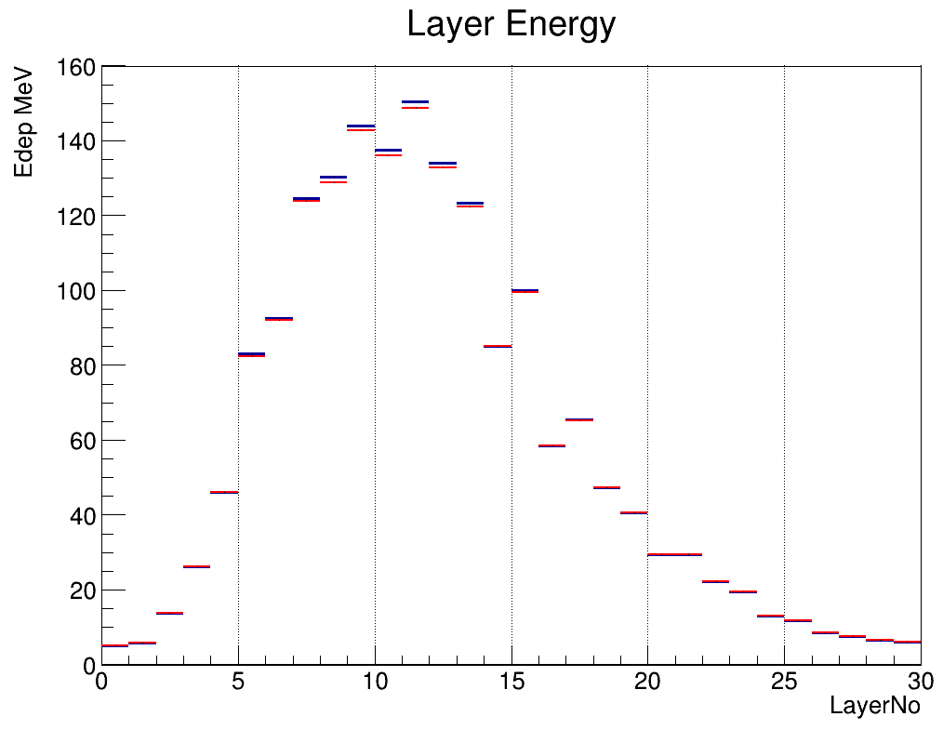
Energy reconstruction comparison
Scatter mean: 1778
sigma:102.9
TH2 bin1 mean: 1790
sigma: 105.1
TH2 bin2 mean: 1790
sigma: 105.1
Fit methods don’t affect energy reconstruction and resolution.

Slide 20
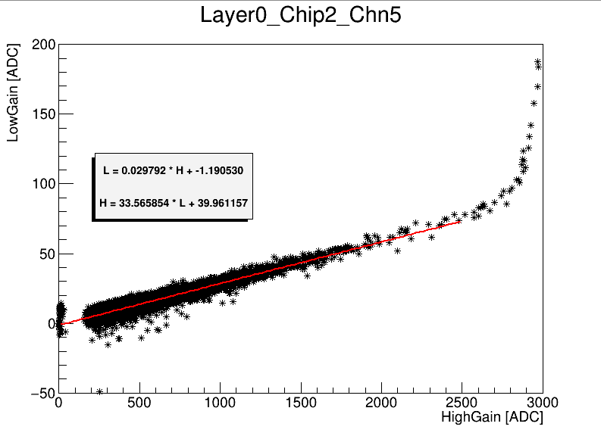
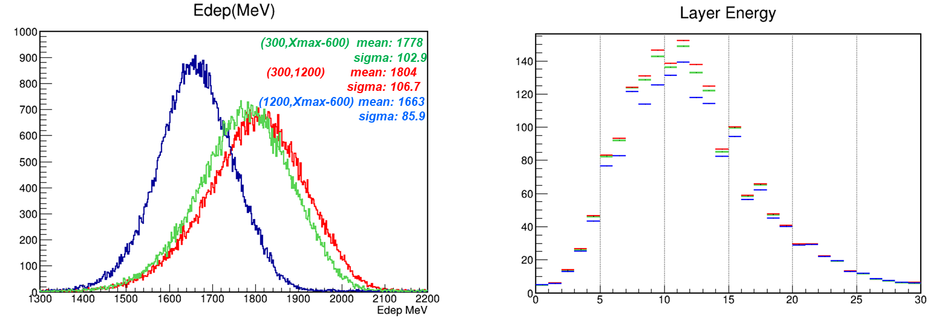
High-low gain ratio calibration
Fit range
(300,1200)
(1200,Xmax-600)
Fit range affect energy reconstruction and resolution.
Energy resolution ~10% improvement
Energy reconstruction ~ 8% decrease

Slide 21
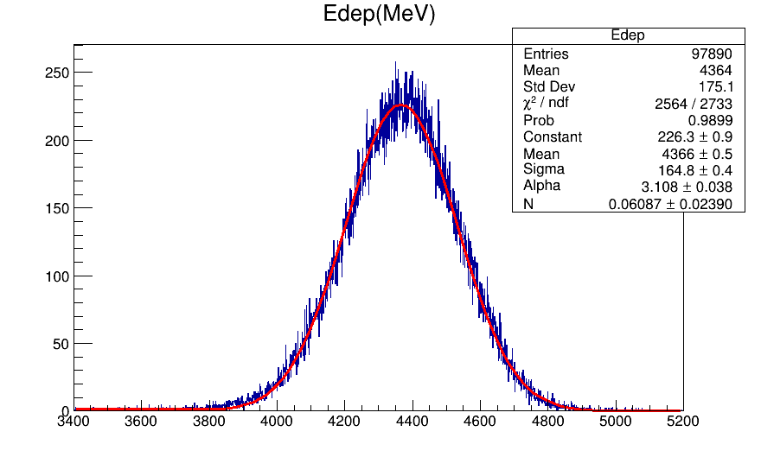
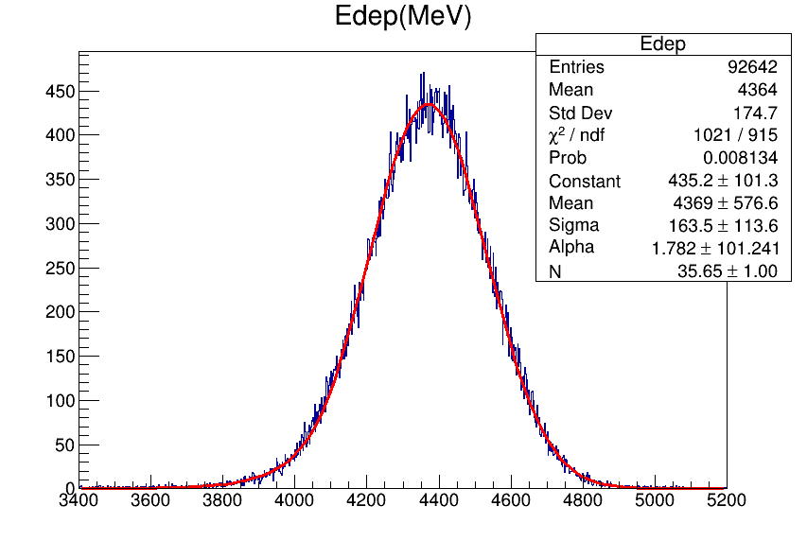
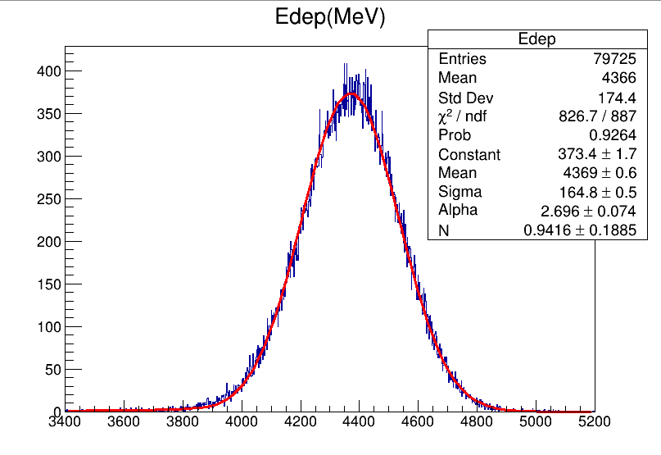
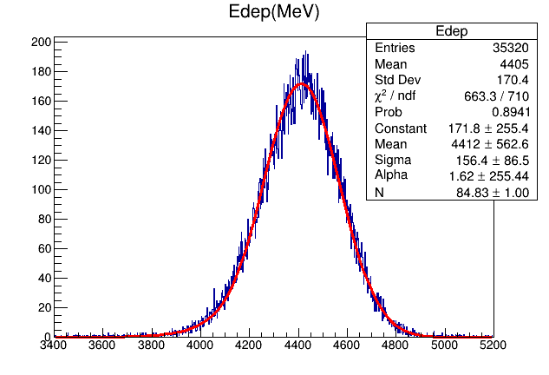
Event Selection
Considering leakage along X-Y plane and calibrated parameters, different hit position cuts are applied to all 100GeV electron events under hl-gain mode
Get mean position by calculating the average of the hit position in this layer
all
50*50 ${mm}^{2}$
Cut | Event | Percentage | sigma | mean
All | 97890 | 1 | 164.8 | 4366
50*50 | 92642 | 94.6% | 163.5 | 4369
30*30 | 79725 | 86.1% | 164.8 | 4369
15*15 | 35320 | 36.1% | 156.4 | 4412
MeV
MeV
30*30 ${mm}^{2}$
10*10 ${mm}^{2}$
MeV
MeV

Slide 22
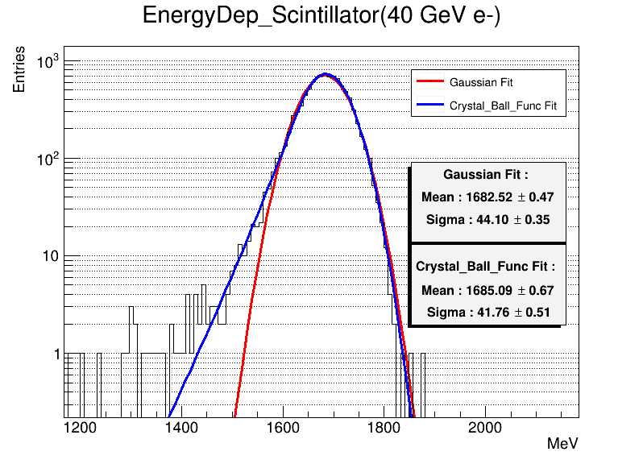
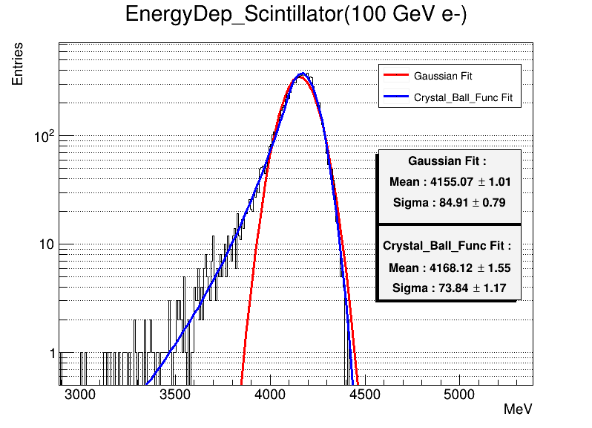
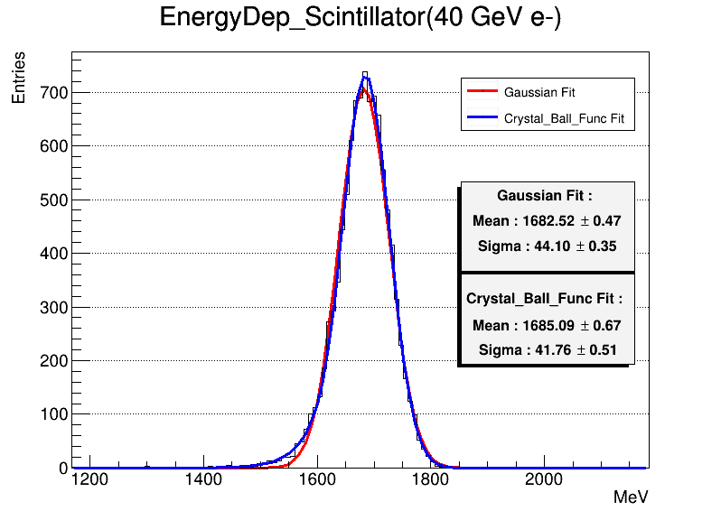
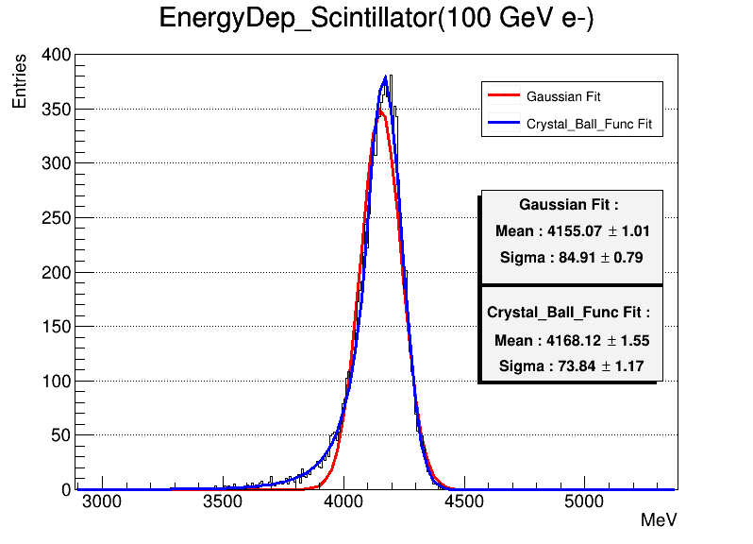
Fit Function
10000 simulation samples for 40GeV and 100GeV e-
Use crystal ball function instead of gaussian fit
Log scale
At relative low energy point, two fit methods have close mean and sigma,
For high energy electron, the crystal ball fit curve more approach the histogram.
Normal scale

Slide 23
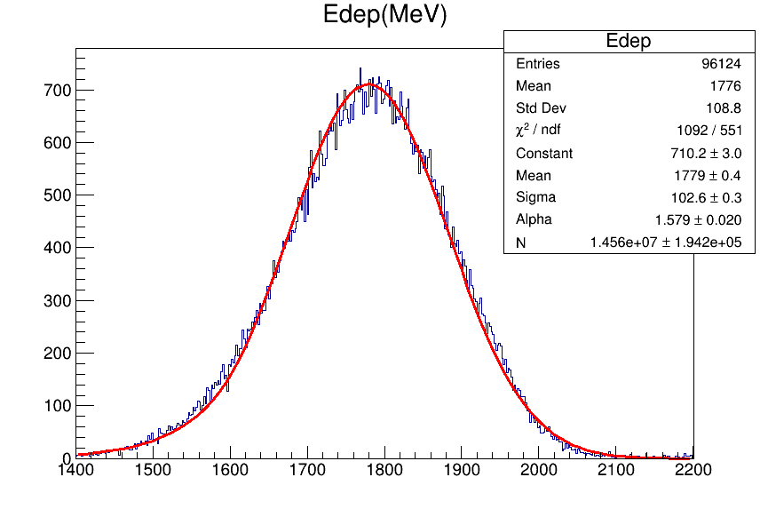
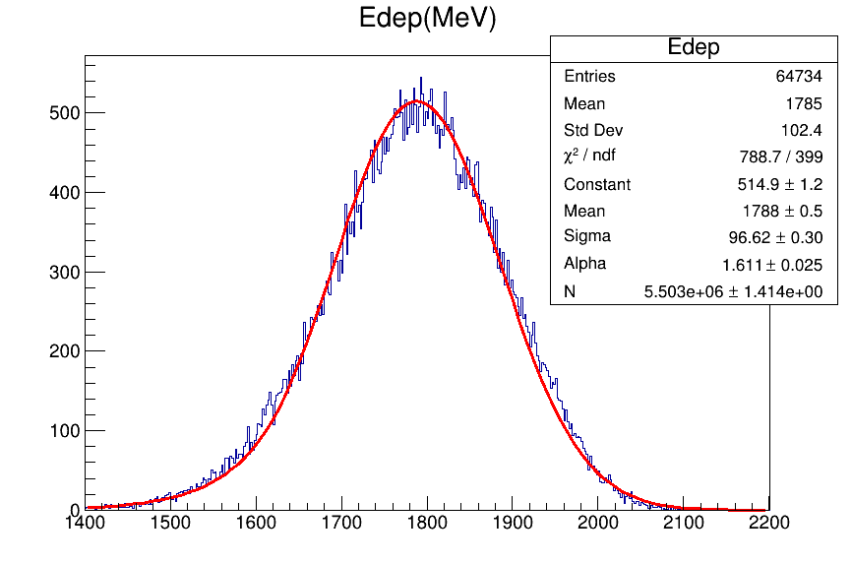
Hit No
40GeV
40GeV
40GeV
100GeV
100GeV
100GeV
%5 improvement

Slide 24
Energy Reconstruction
good energy linearity but energy resolution still need further analysis

Slide 25
2022 & 2023 data check
Same peak position on X axis.
In 2022 SPS beam data, it also shows oscillation.
Energy deposition of superlayer doesn’t show abnormal.

Slide 26
ECAL Channel Placement

