Slide 1
Stability analysis of AHCAL proformance
diao hongbin

Slide 2
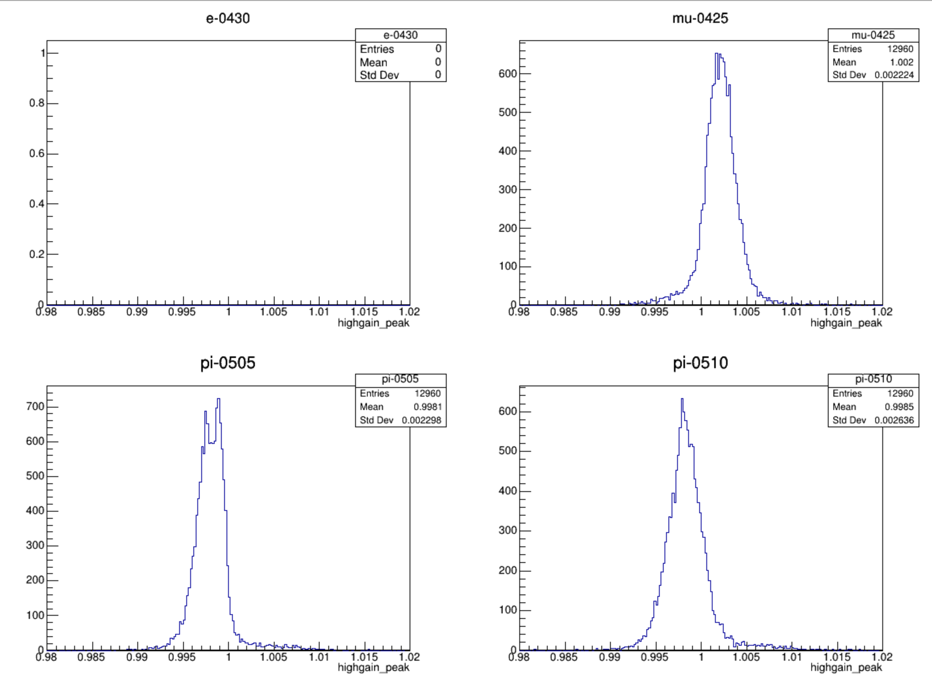
pedestal --highgain

Slide 3
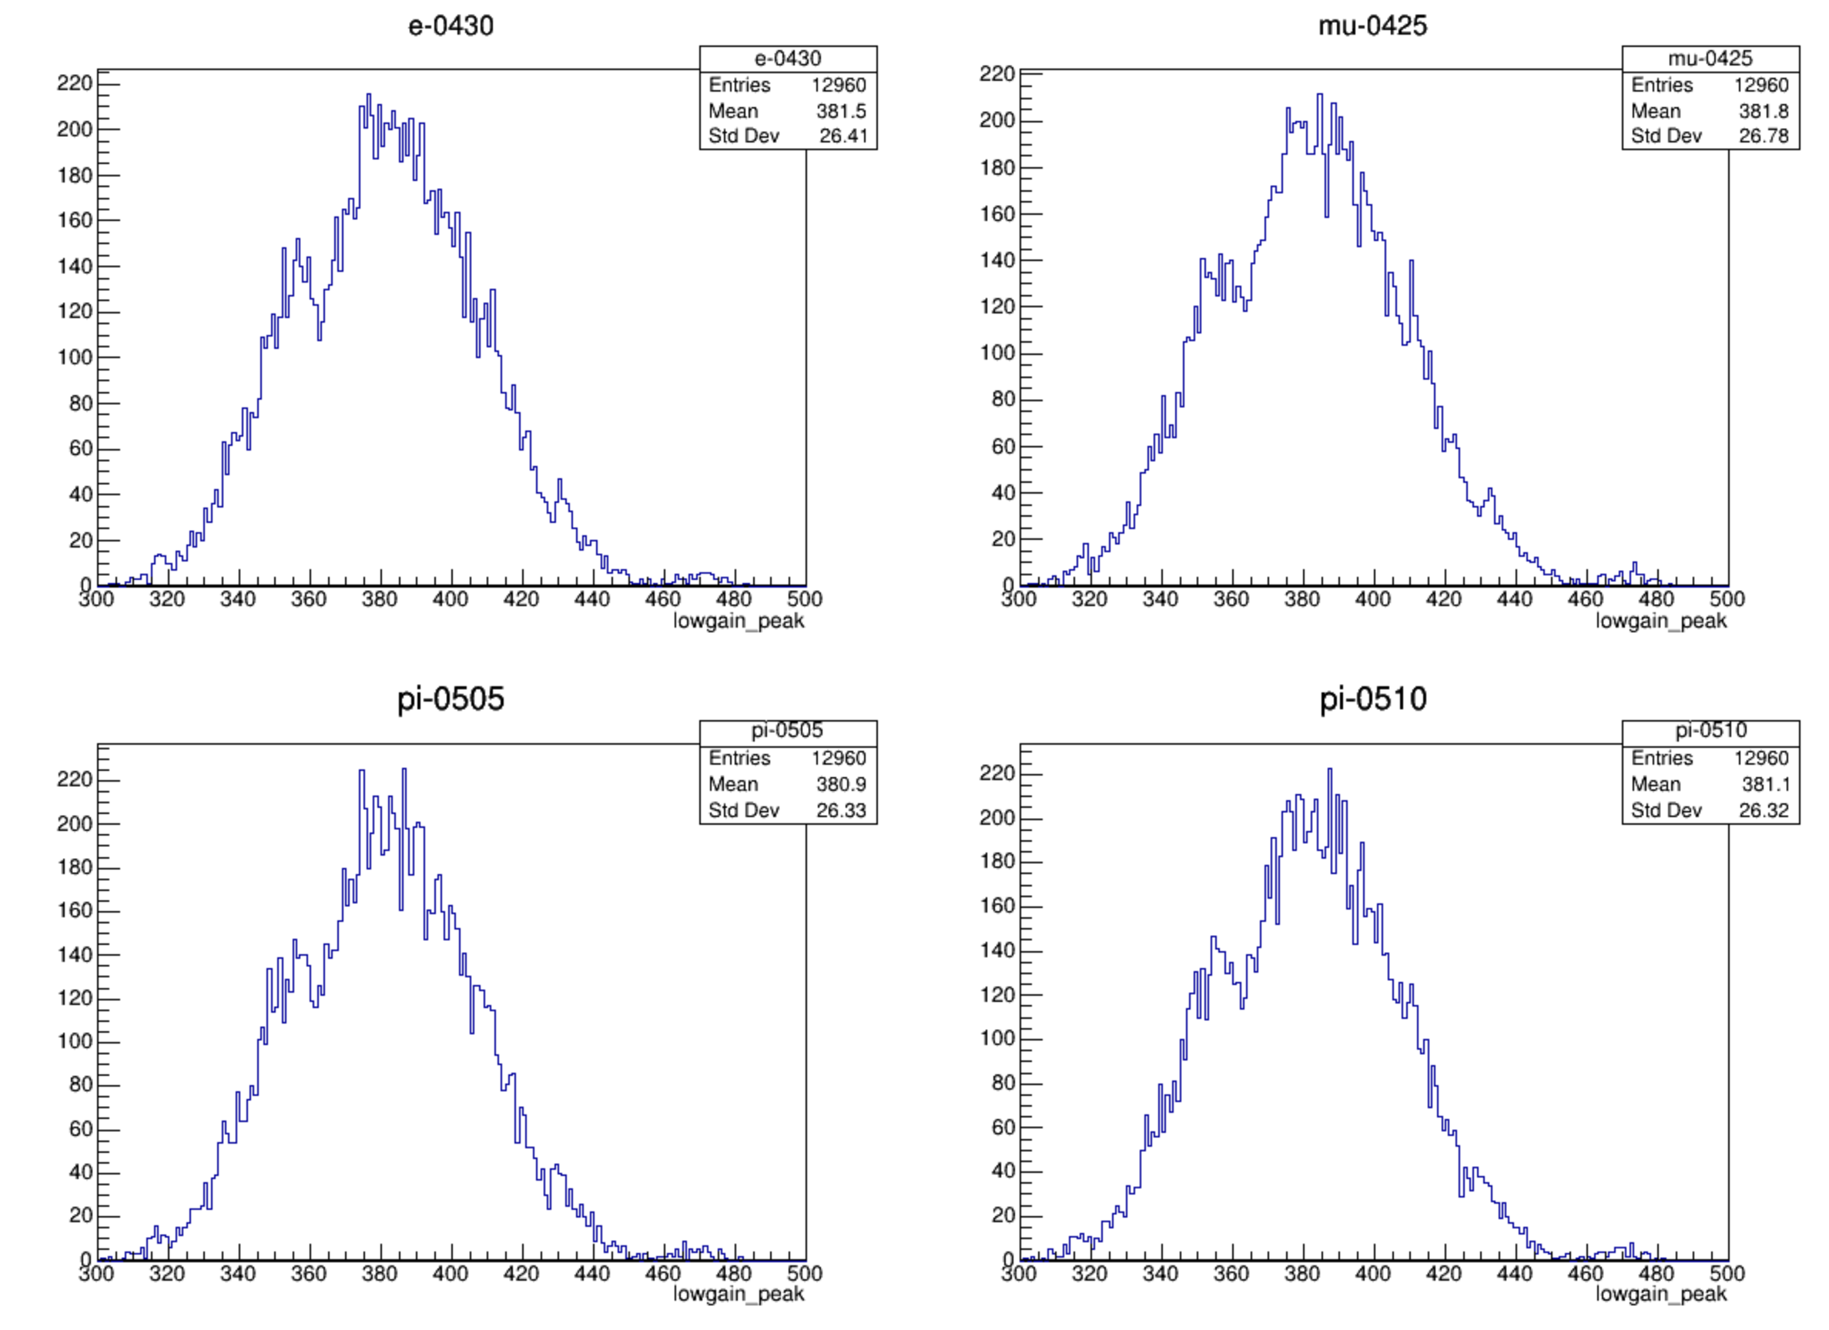
pedestal --lowgain

Slide 4
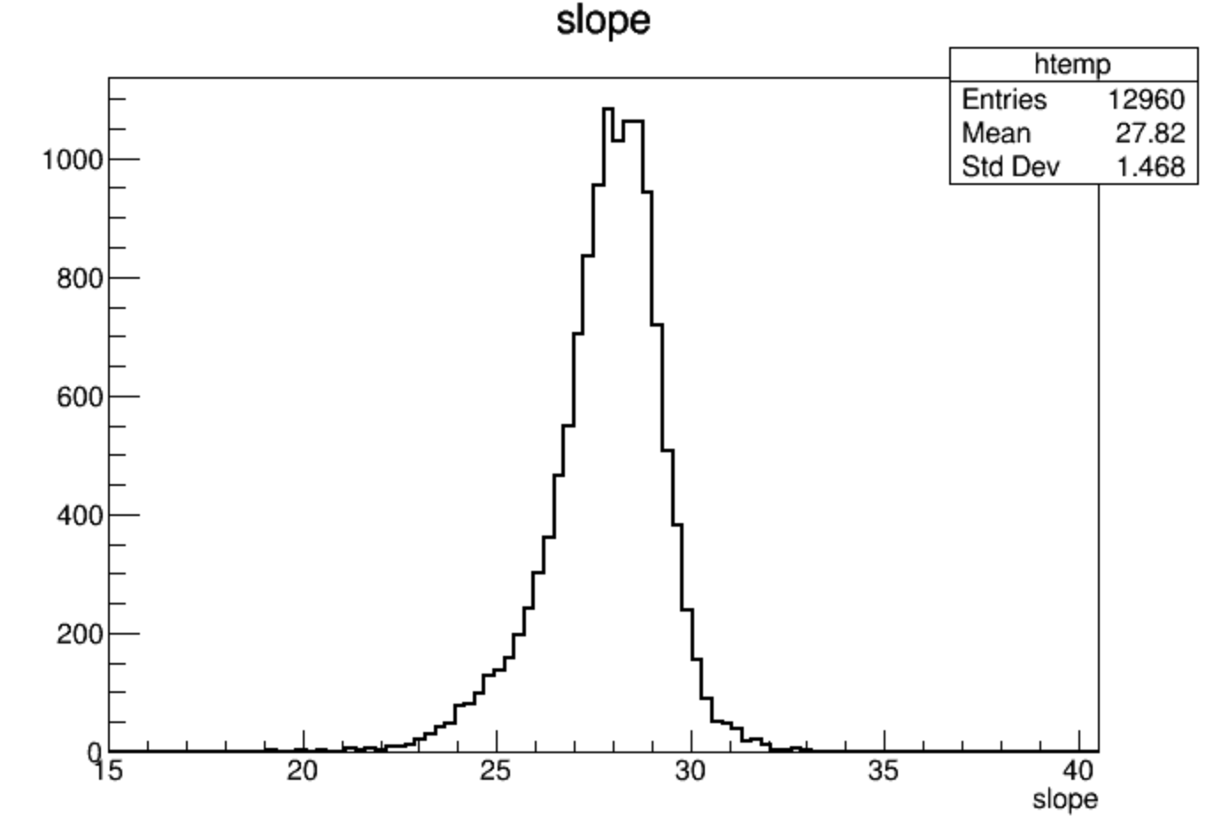
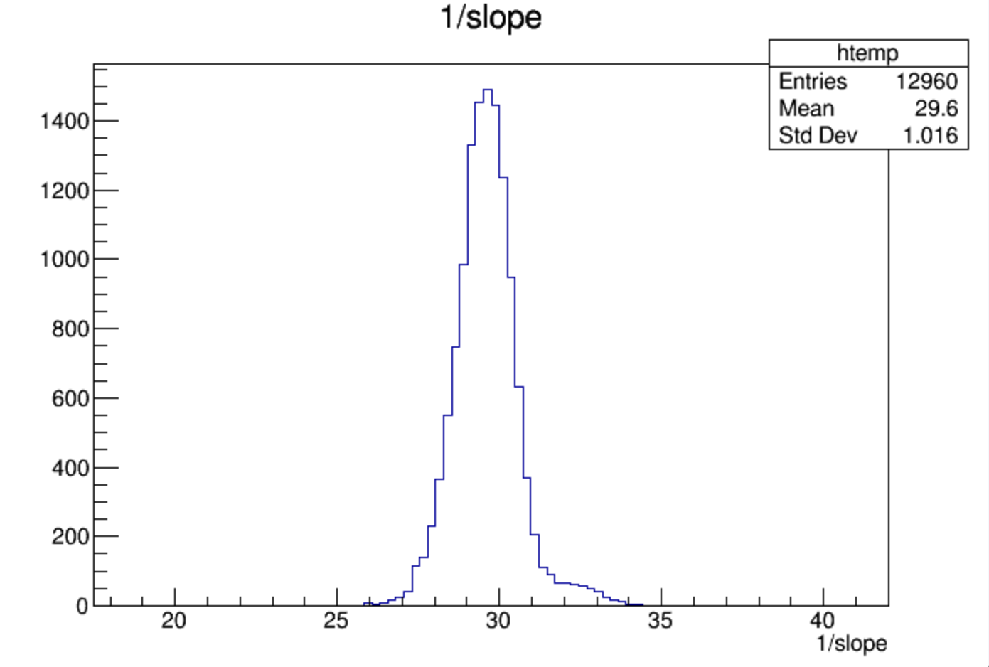
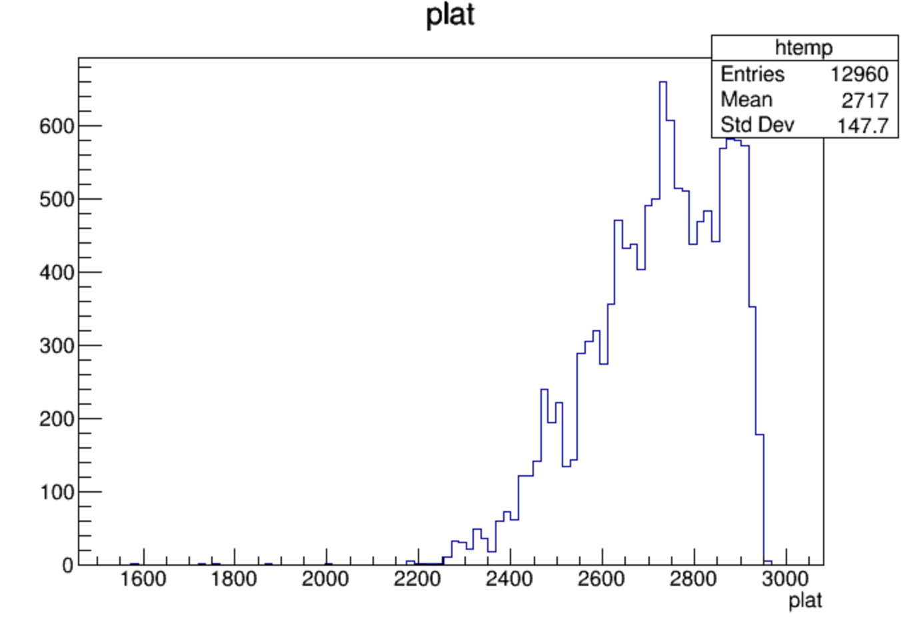
ratio
wang zhen provided
Pion_2023_V2
Pion_2023

Slide 5
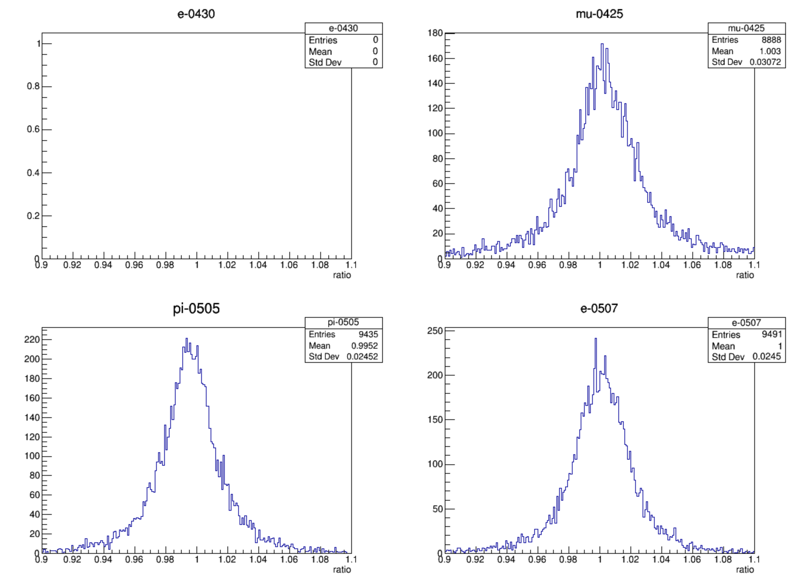
ratio
entries>100

Slide 6
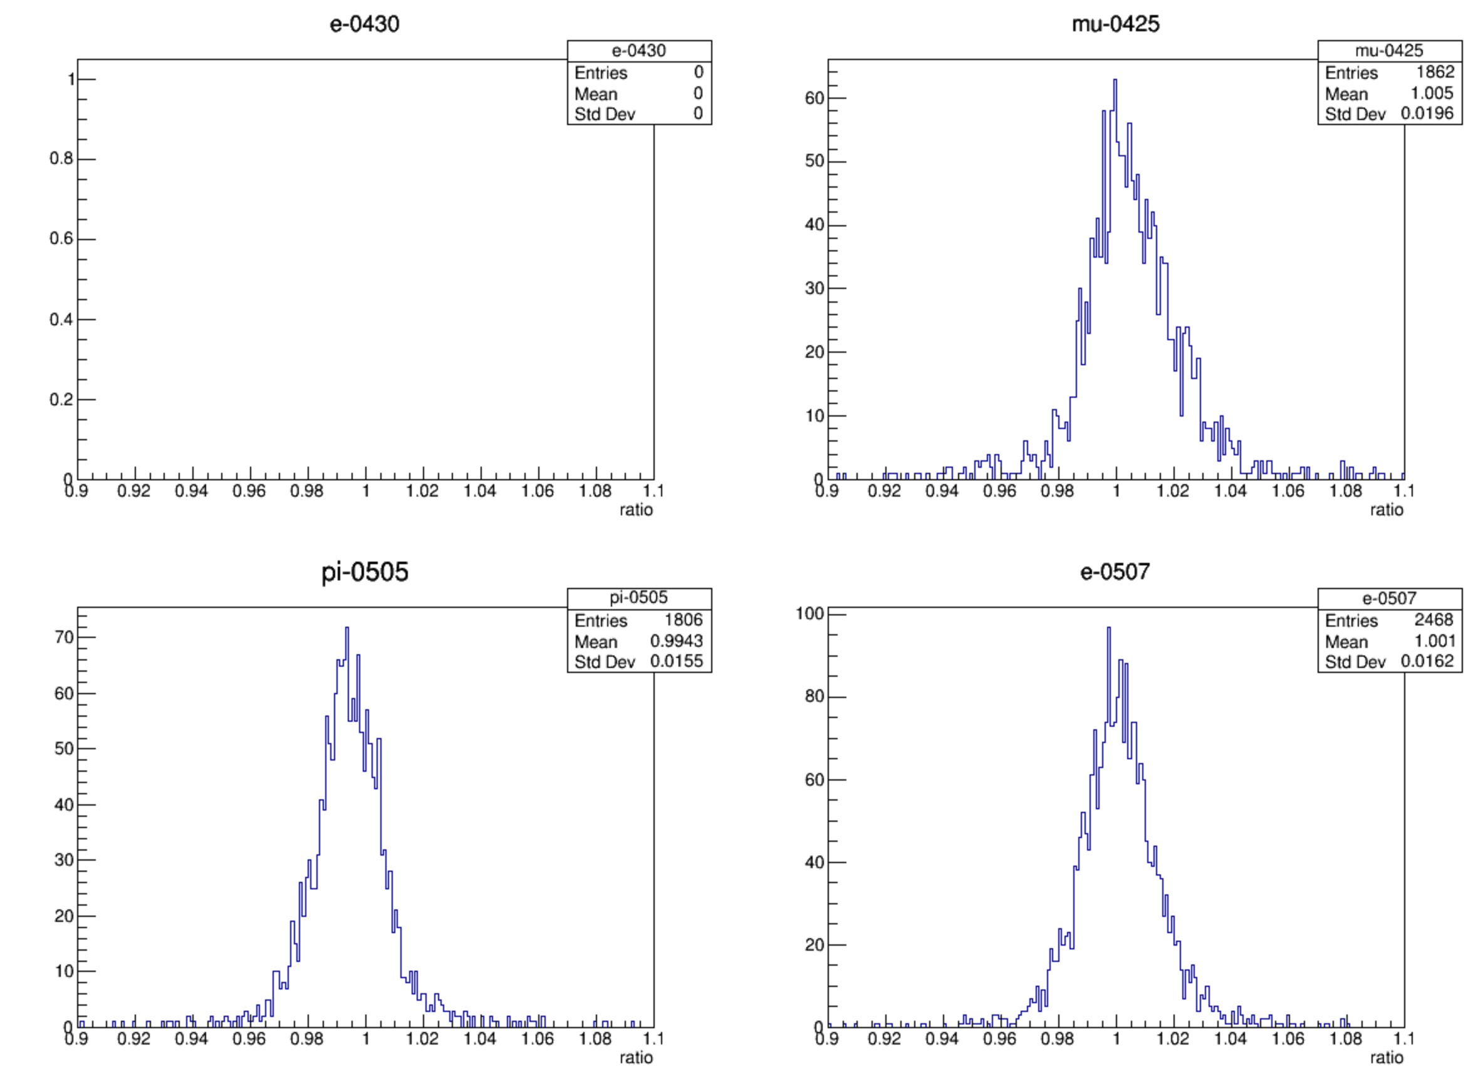
ratio
entries>1000

Slide 7
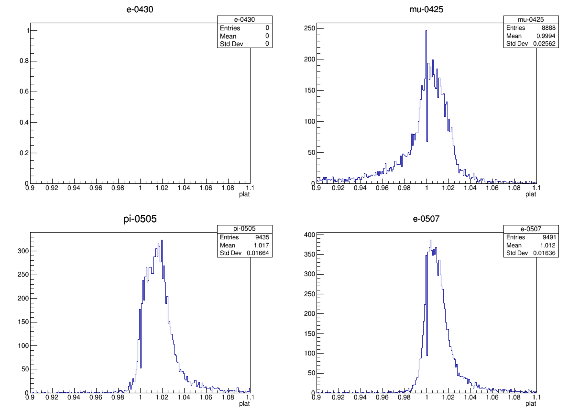
plat
entries>100

Slide 8
plat
entries>1000

Slide 9
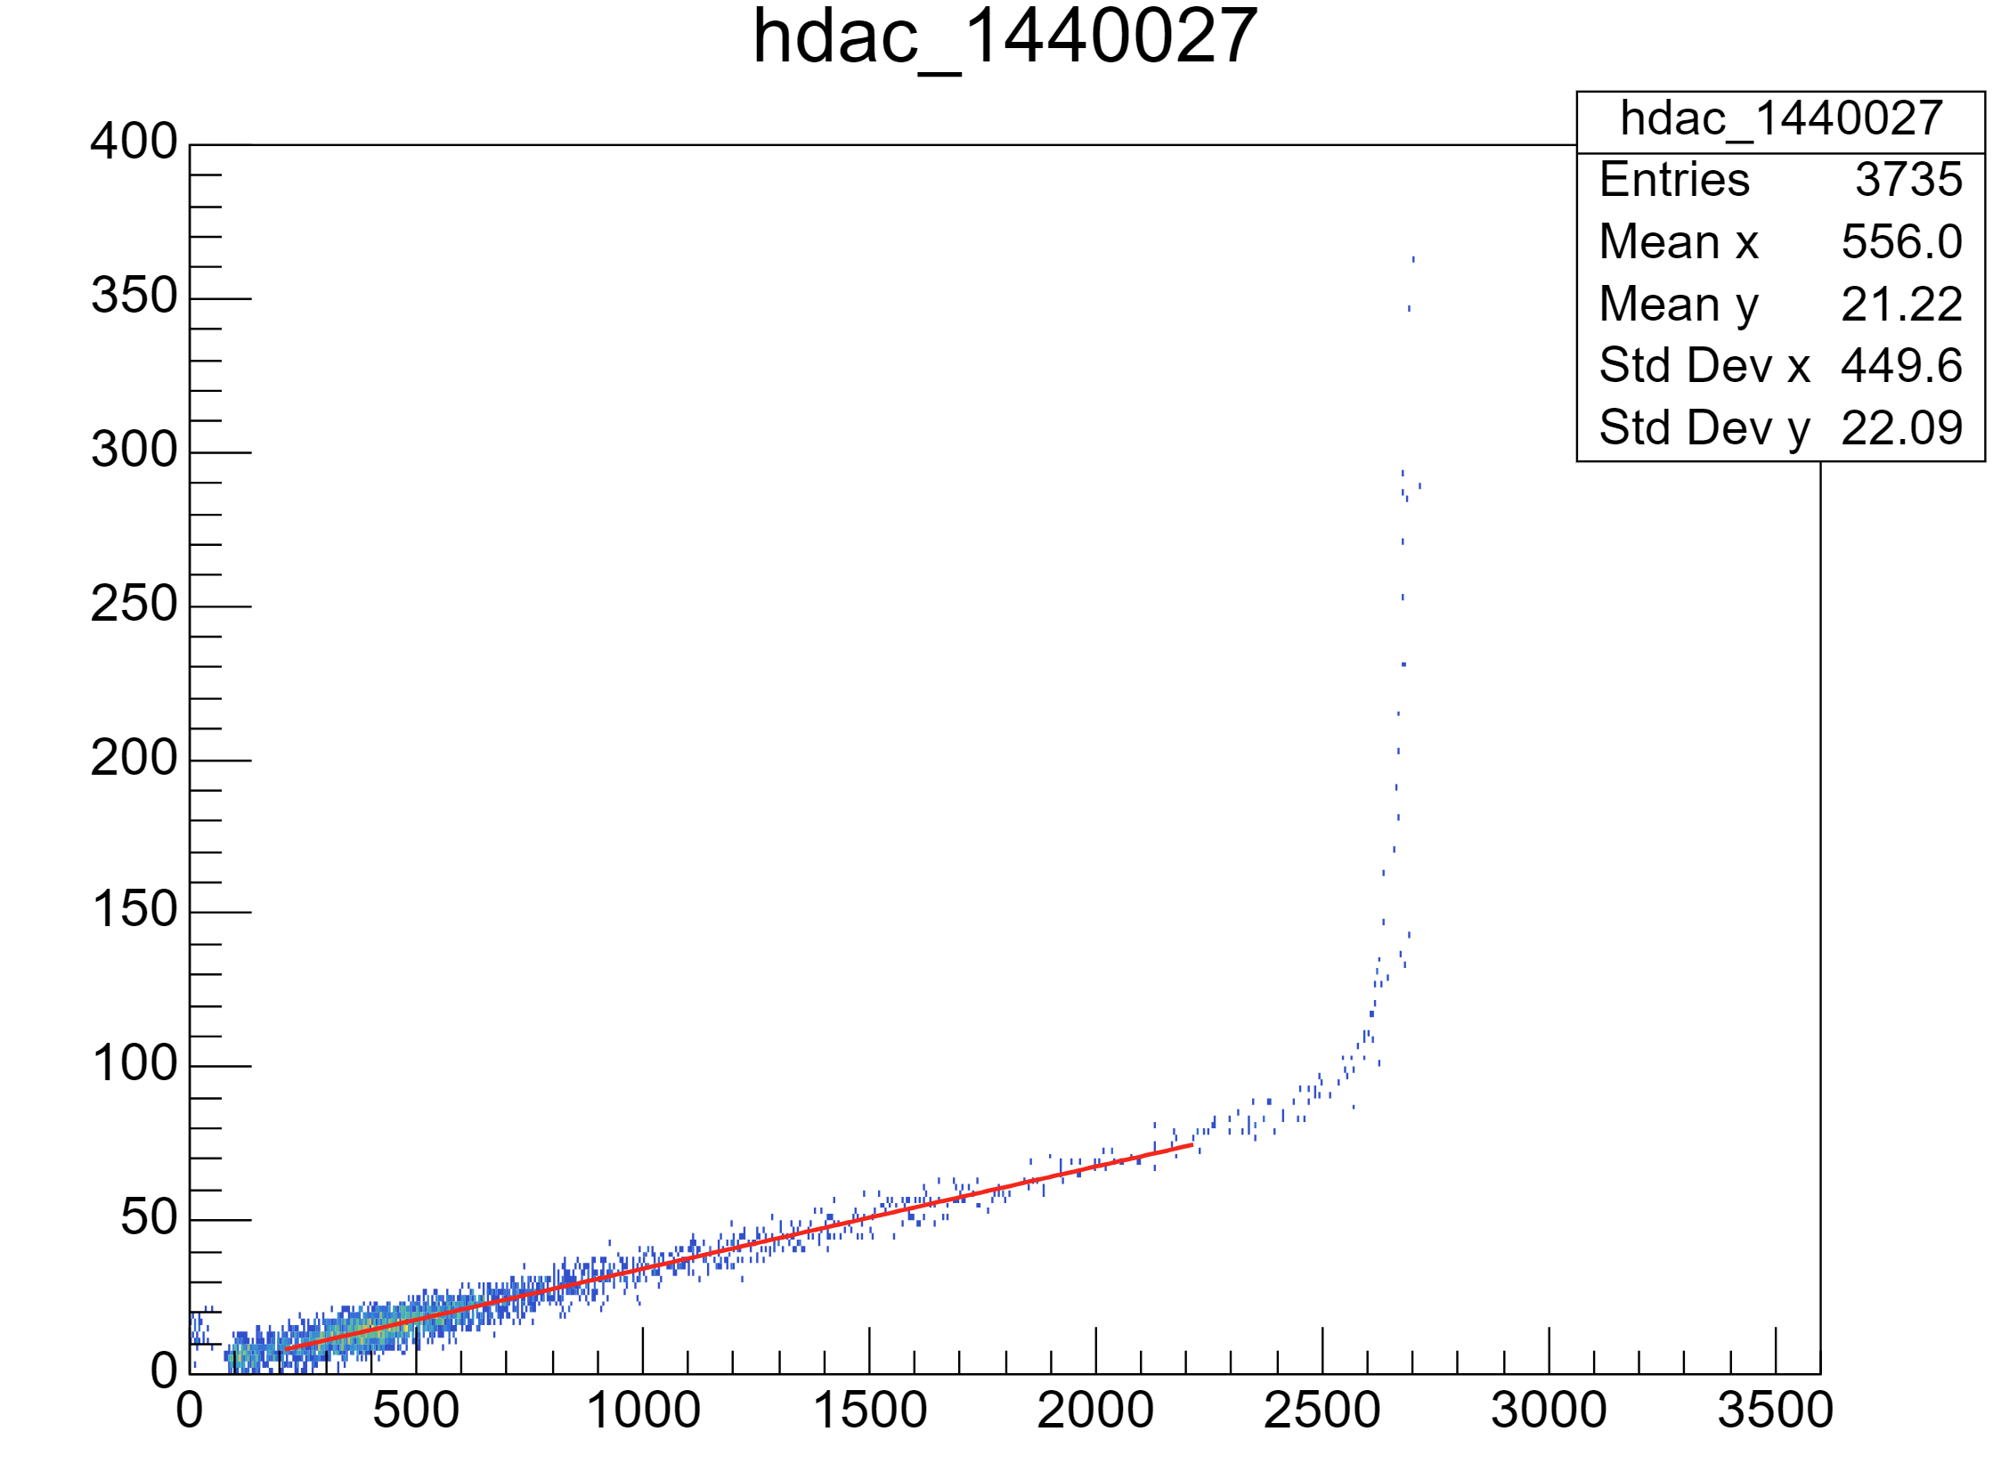
Run1-19/(7-9)
Run20-27

Slide 10
