Slide 1
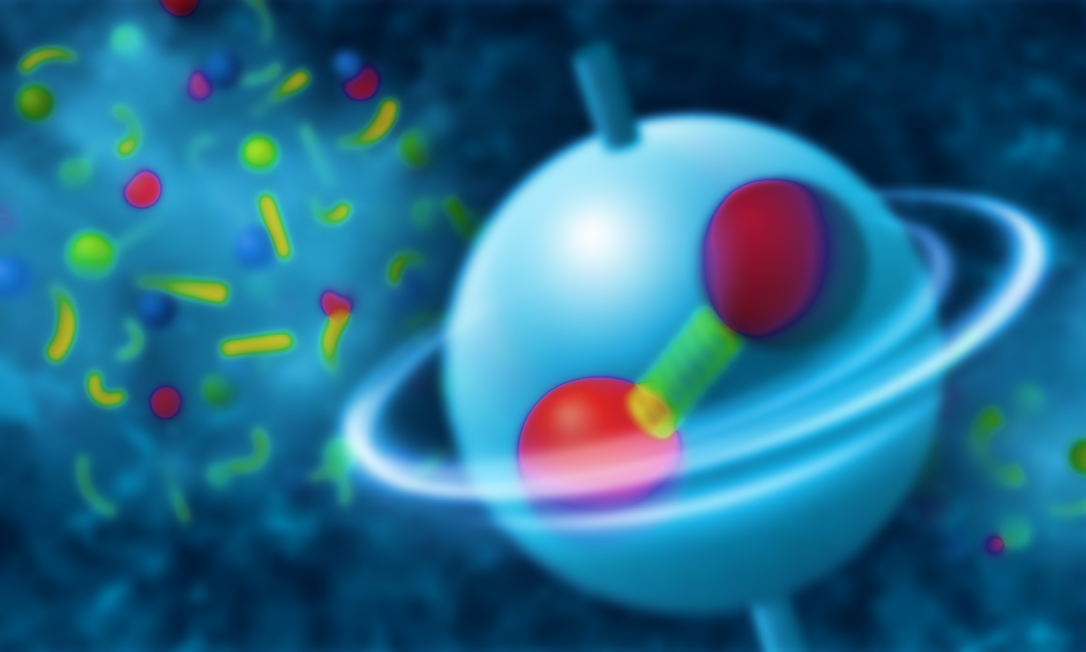
Spin alignment induced by the spin density fluctuation
Kun Xu @ USTC, Hefei
11/25/2023

Slide 2
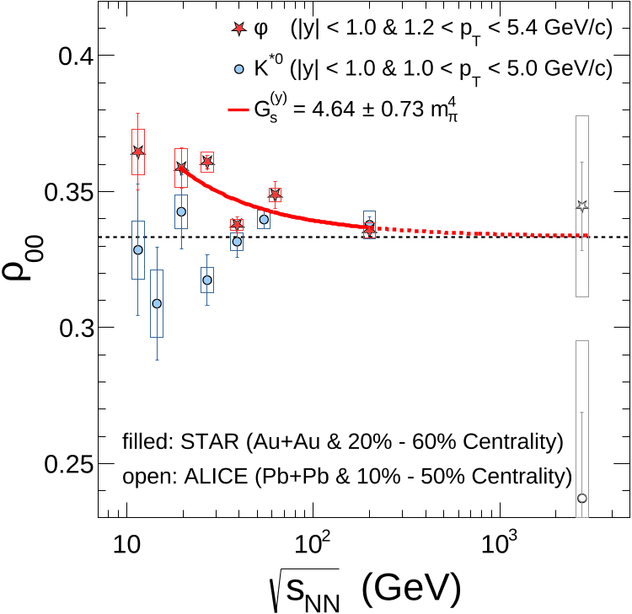
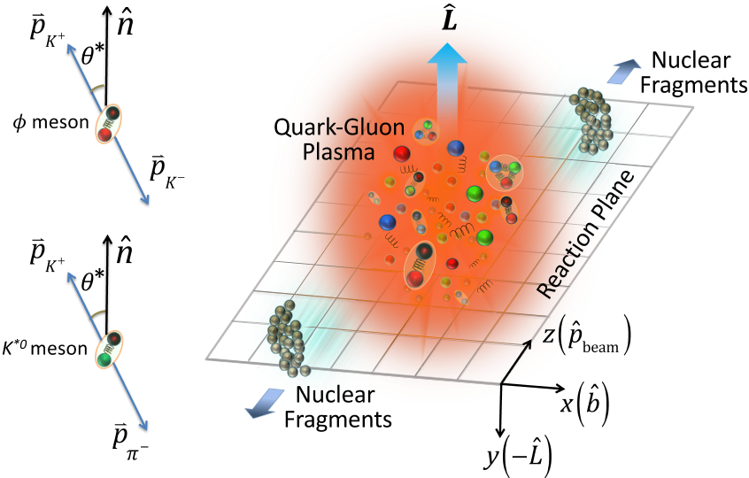
Spin alignment in Heavy Ion Collision
Rotation&Magnetic Field
STAR.
Nature 614 (2023) 7947, 244-248

Slide 3
From Prof. Qun Wang

Slide 4
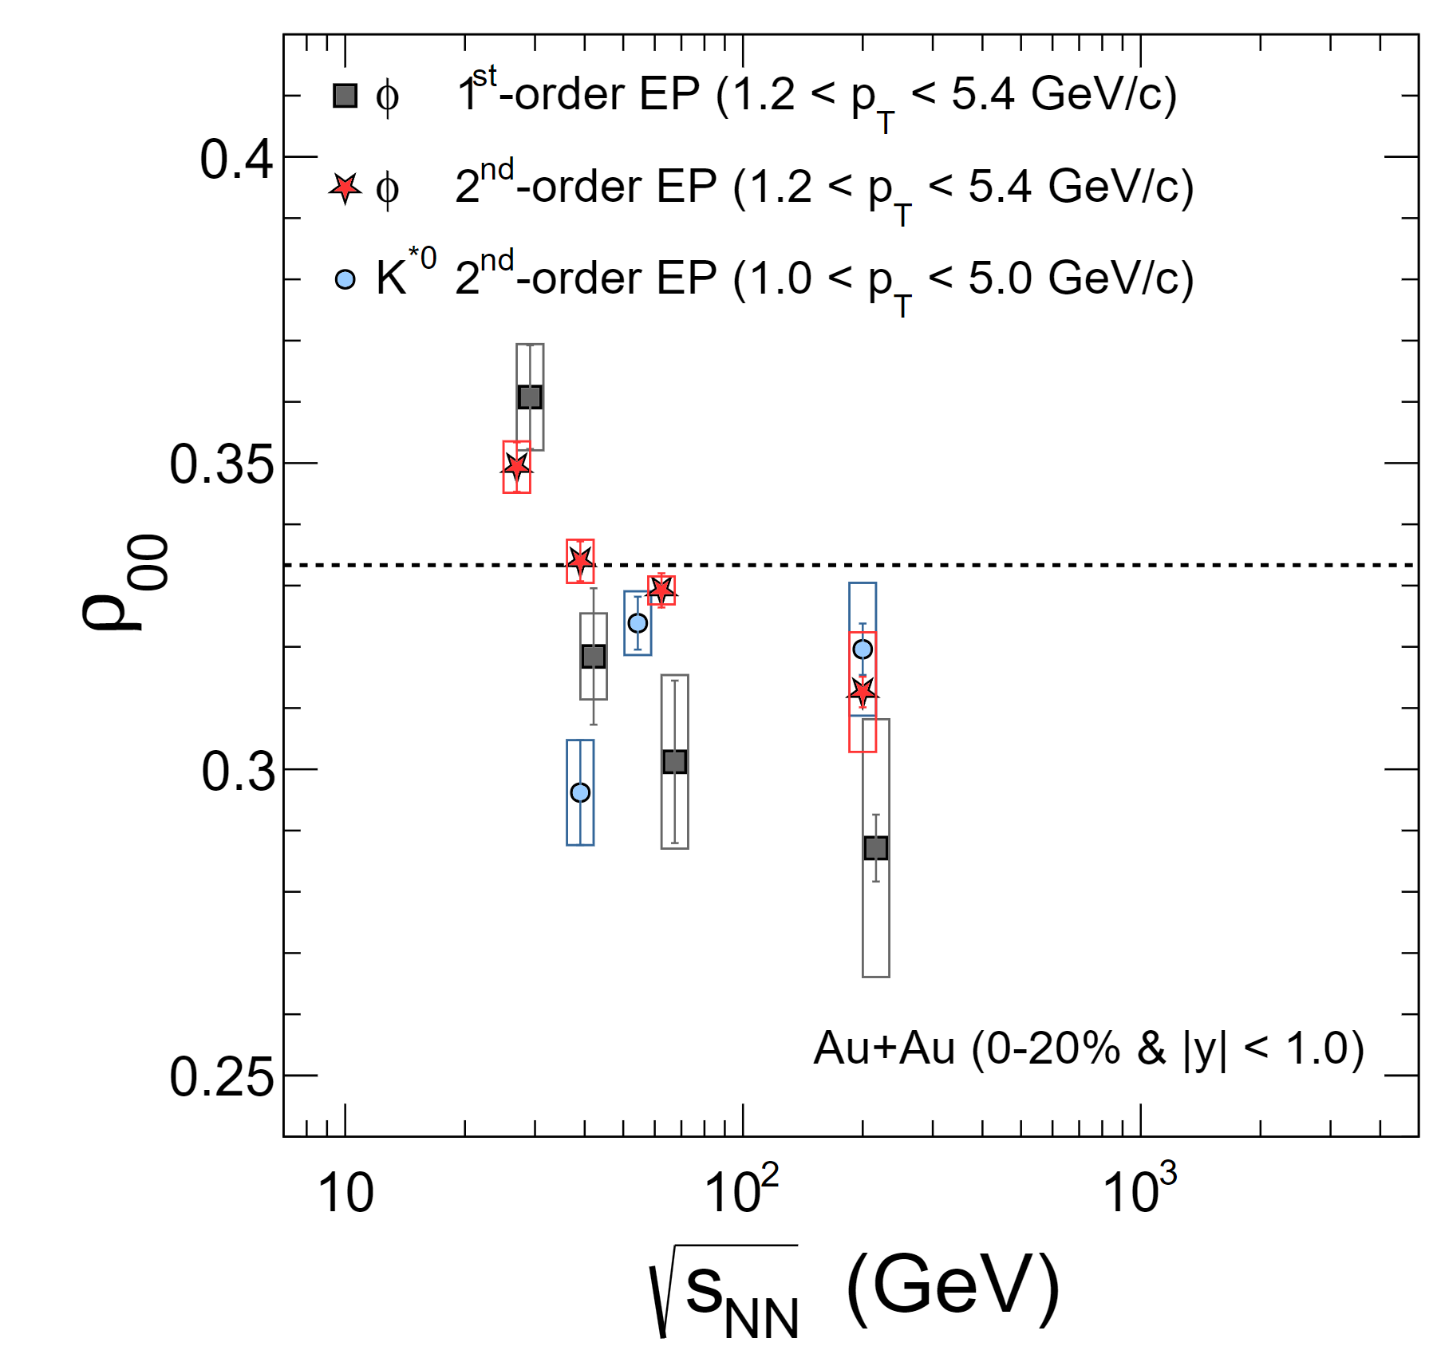
Any other possible mechanism?
Without any environment conditions, such as, rotation or magnetic field or…
Only the nature of QCD? Interaction of quarks
Rotation,
Magnetic field
…
No Rotation,
No Magnetic field
No net baryon
…

Slide 5
Axial-vector interaction | Tensor operator
$${(\overline{ψ}γ^{μ}γ^{5}ψ)}^{2}$$ | $${(\overline{ψ}{iγ}^{1}γ^{2}ψ)}^{2}$$
$$\int{d^{3}x\overline{ψ}(x)γ^{μ}γ^{5}ψ(x)}\sim N_{+}^{↑}−N_{+}^{↓}\text{+} N_{−}^{↑}−N_{−}^{↓}$$ | $$\int{d^{3}x\overline{ψ}\left(x\right)iγ^{1}γ^{2}ψ(x)}\sim N_{+}^{↑}−N_{+}^{↓}−(N_{−}^{↑}−N_{−}^{↓})$$
The number of spin-up minus the number of spin-down | The number of MM-up minus the number of MM-down
$$N_{+}^{↑}=\int{\frac{d^{3}p}{{(2π)}^{3}}\frac{Ep_{z}^{2}+mp_{⊥}^{2}}{E{\overset{⃑}{p}}^{2}}}$$ | $$N_{+}^{↑}=\int{\frac{d^{3}p}{{(2π)}^{3}}\frac{Ep_{⊥}^{2}+mp_{z}^{2}}{E{\overset{⃑}{p}}^{2}}}$$
Spin Polarization(SP) | Magnetic Moment Polarization(MMP)
Rotation | Magnetic Field

Slide 6
Lagrangian with a SP background
Dispersion relation:
$$ω^{2}={(\sqrt{m^{2}+p_{t}^{2}}−sa)}^{2}+p_{z}^{2}$$
$$ℒ=\overline{ψ}(i∂−m+aγ^{3}γ^{5})ψ$$
No dependence on quark or anti-quark
Zero momentum:
$$m^{′}=m−sa$$
If spin is same direction with the SP background, then lower energy;
If spin is opposite direction with the SP background, then higher energy;
The number(density) difference between spin-up and spin-down s quark

Slide 7
What happens to $φ$ meson?
Consider it in a constituent quark model:
$M_{φ}=$ $m_{s}+m_{\overline{s}}$
$$s=0$$
$$s=1$$
$$s=−1$$
Without SP background
With SP background
Mass splitting
$$m_{s}+m_{\overline{s}}$$
$$m_{s}+m_{\overline{s}}−2a$$
$$m_{s}+m_{\overline{s}}+2a$$
Distribution function:
$$f\left(M_{φ}\right)=\frac{1}{e^{\frac{\sqrt{{(M_{φ}+2sa)}^{2}+p^{2}}}{T}}−1}$$
This conclusion does not depend on the sign of SP background

Slide 8
$$ρ_{00}=\frac{N_{0}}{N_{0}+N_{1}+N_{−1}}$$
Spin alignment of $φ$
Where
$$N_{s}=\int{\frac{d^{3}p}{{\left(2π\right)}^{3}}}f\left(M_{φ}\right)≈\int{\frac{d^{3}p}{{\left(2π\right)}^{3}}}e^{−E_{φ}/T}$$
Assume $a≪M_{φ}$
$$M_{φ}≫T\sim 0.15GeV$$
The number change in denominator:
Spin alignment of $φ$ with SP background:
SP background lead to $ρ_{00}<1/3$
Similar with rotation

Slide 9
Lagrangian with a MMP background
Dispersion relation:
$$ℒ=\overline{ψ}(i∂−m+κiγ^{1}γ^{2})ψ$$
$$ω^{2}={(\sqrt{m^{2}+p_{z}^{2}}−sqκ)}^{2}+p_{t}^{2}$$
$q$: =1 for quark, =-1 for anti-quark
MM ~ $s × q$
$$s=0$$
$$s=0$$
$$s=1$$
$$s=−1$$
Without MMP background
With MMP background
$m_{s}+m_{\overline{s}}$ $−2κ$
$m_{s}+m_{\overline{s}}$ $+2κ$
Mass splitting
$m_{s}+m_{\overline{s}}$ $+2κ$
$m_{s}+m_{\overline{s}}$ $−2κ$
$$m_{s}+m_{\overline{s}}$$
$$m_{s}+m_{\overline{s}}$$
This conclusion does not
depend on the sign of MMP background
$$f\left(M_{φ}\right)=\frac{1}{e^{\frac{\sqrt{{(M_{φ}+2μκ)}^{2}+p^{2}}}{T}}−1}$$

Slide 10
Spin alignment of $φ$
$$ρ_{00}=\frac{N_{0}}{N_{0}+N_{1}+N_{−1}}$$
Where
$$N_{s}=\int{\frac{d^{3}p}{{\left(2π\right)}^{3}}}f\left(M_{φ}\right)≈\int{\frac{d^{3}p}{{\left(2π\right)}^{3}}}e^{−E_{φ}/T}$$
Assume $κ≪M_{φ}$
$$M_{φ}≫T\sim 0.15GeV$$
The number change in $N_{0}$:
Spin alignment of $φ$ with SP background:
MMP background lead to $ρ_{00}>1/3$
Similar to magnetic field

Slide 11
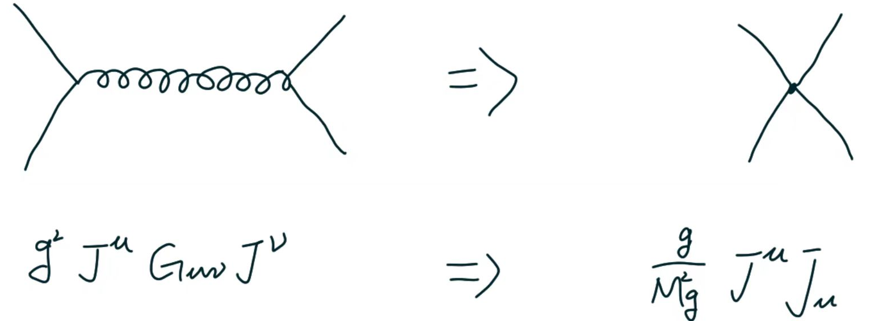
where is the background? axial-vector/tensor interaction
1. One-Gluon-Exchange(OGE)
Fierz transformation
2. Instanton induced interaction,
Non-interacting $I\overline{I}$ Gas
$I\overline{I}$-Molecule
Phys.Rev.D 51 (1995) 1267-1281

Slide 12
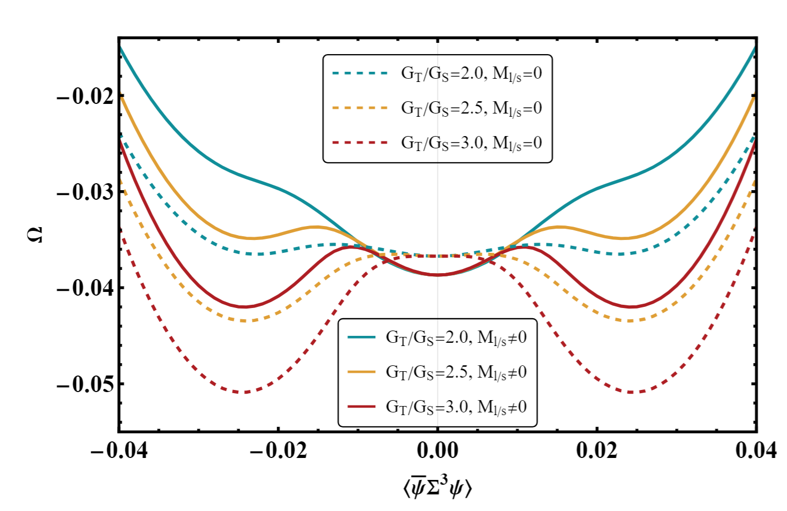
Condensate in Mean field?
Lagrangian with scalar and tensor interaction:
$$ℒ=\overline{ψ}\left(i∂−m\right)ψ+{G_{S}(\overline{ψ}ψ)}^{2}+{G_{T}(\overline{ψ}Σ^{3}ψ)}^{2}$$
Mean Field Approximation:
$$ℒ_{MFA}={−G_{T}\left\langle \overline{ψ}Σ^{3}ψ\right\rangle }^{2}{−G_{S}\left\langle \overline{ψ}ψ\right\rangle }^{2}$$
$+\overline{ψ}\left(i∂−M+2G_{T}\left\langle \overline{ψ}Σ^{3}ψ\right\rangle Σ^{3}\right)ψ$
Gap equation:
$$\frac{∂Ω}{∂\left\langle \overline{ψ}Σ^{3}ψ\right\rangle }=0, \frac{∂Ω}{∂\left\langle \overline{ψ}ψ\right\rangle }=0$$
No Mean Field Background!
No GLOBAL Background!
For $G_{T}≲2G_{S}$, $\left\langle \overline{ψ}Σ^{3}ψ\right\rangle =0$

Slide 13
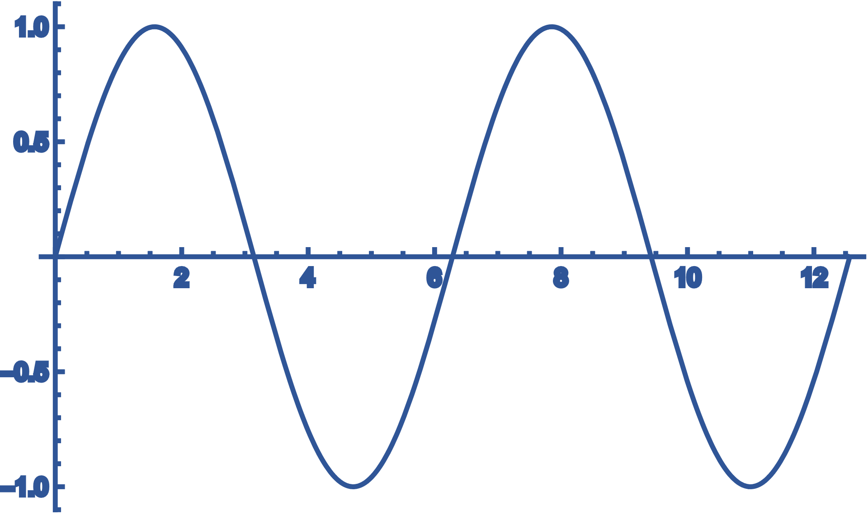
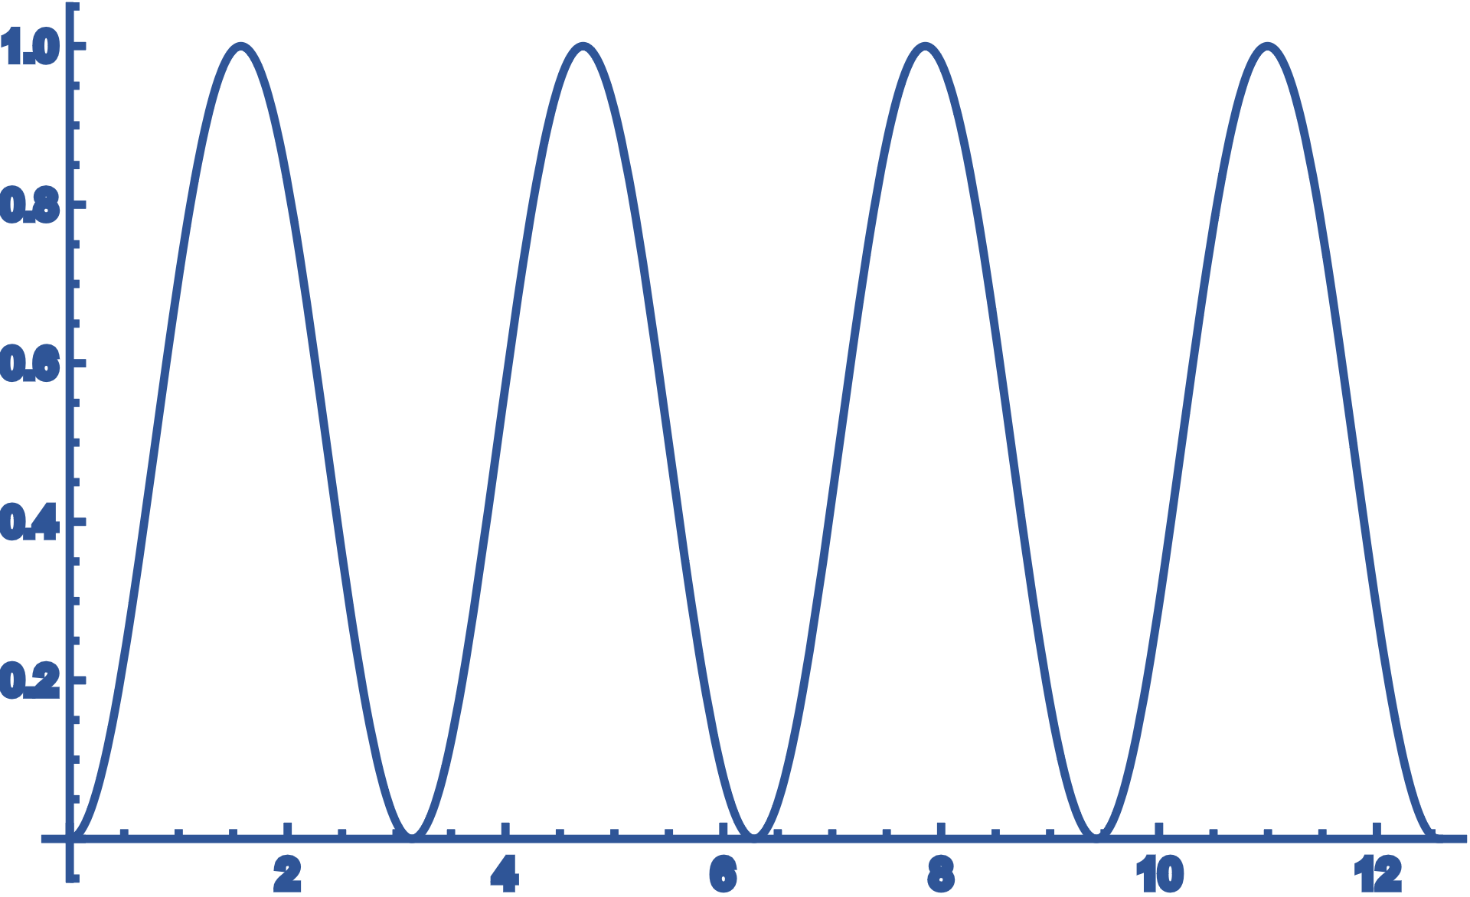
SP/MMP background lead to Spin Alignment;
Mean Field background is same sign globally.
The sign of background is of no matter;
Local background is enough!
Instead of MF, i.e., $\left\langle 𝒪\right\rangle =0$
We consider, $\left\langle 𝒪^{2}\right\rangle ≠0$
non-zero local background

Slide 14
Spin density fluctuation

Slide 15
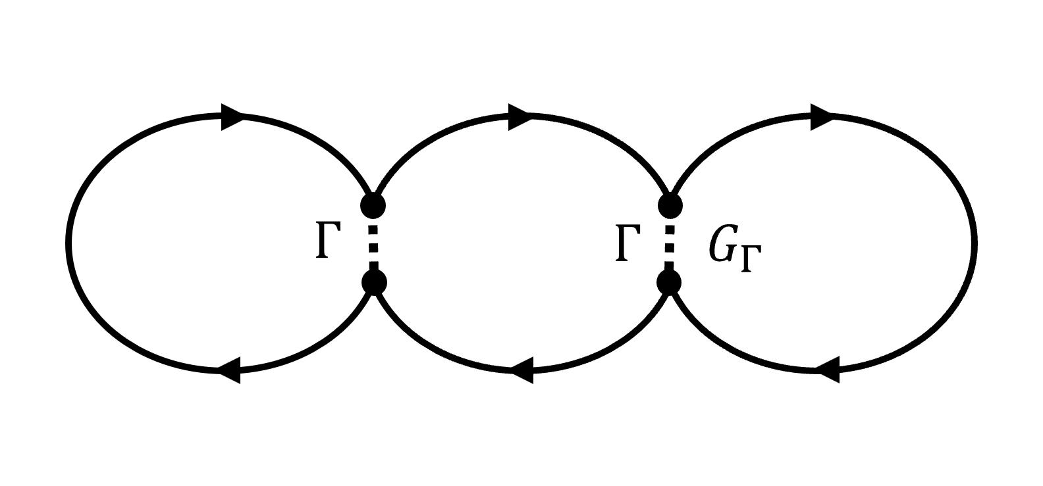
$$x$$
$$y$$

Slide 16
$$\sqrt{\left\langle ρ_{A}^{2}\right\rangle } \sim δN_{s}$$
Spin density fluctuation induced by 𝐼𝐼 ̅-Molecule lead to $ρ_{00}<1/3$ for $φ$

Slide 17
If the spin density fluctuations of s and d quarks are completely un-correlated, then there is no spin alignment of $K^{∗0}$.
In other words, s and d quarks have correlation.
In other other words, flavor-mixing interaction is expected.
$$K^{∗0}$$
OGE × Instanton √

Slide 18
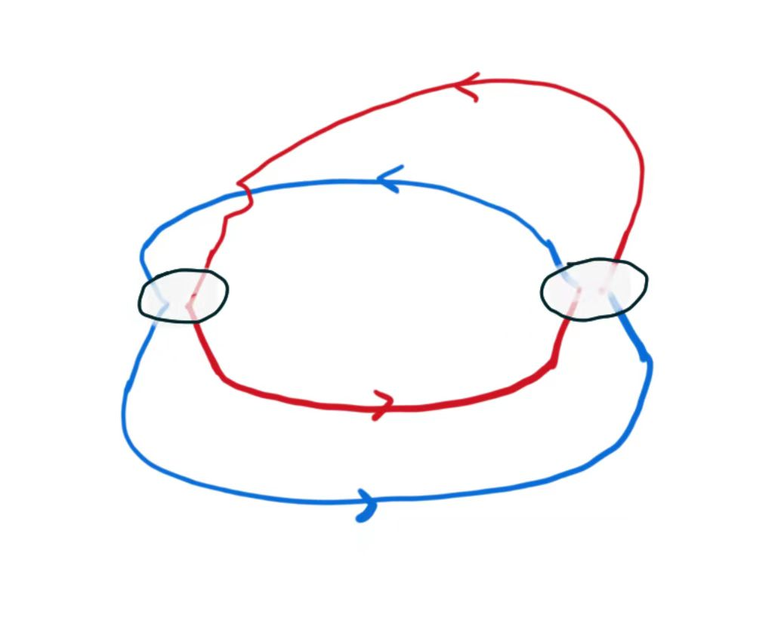
$$Γ$$
$$Γ$$
$$G_{Γ}$$
$$x$$
$$y$$
Correlation between spin density of s quark and d quark:
Not zero, obviously.
Sign is most important, which determines the direction of SP background of s and d quark.

Slide 19
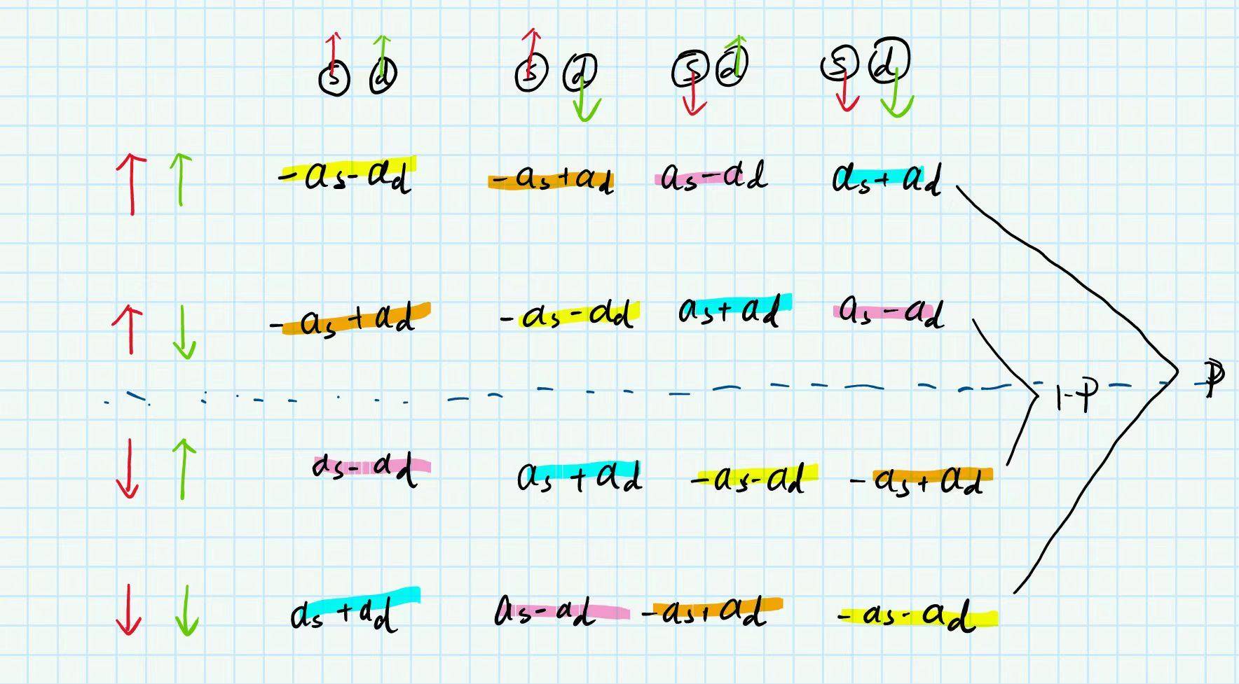
+
-

Slide 20
$$ρ_{00}=\frac{N_{0}}{N_{0}+N_{1}+N_{−1}}$$
$$f\left(M_{K},0\right)=\frac{1}{e^{\frac{\sqrt{{(M_{φ}−(|a_{s}−a_{d}|))}^{2}+p^{2}}}{T}}−1}$$
$$f\left(M_{K},1\right)=\frac{1}{e^{\frac{\sqrt{{(M_{φ}−(a_{s}+a_{d}))}^{2}+p^{2}}}{T}}−1}$$
$$f\left(M_{K},−1\right)=\frac{1}{e^{\frac{\sqrt{{(M_{φ}+(a_{s}+a_{d}))}^{2}+p^{2}}}{T}}−1}$$
$$ρ_{00}=\frac{1}{3}+A\left(a_{d}−a_{s}\right)−Ba_{d}a_{s}$$
有点复杂，还没算明白

Slide 21
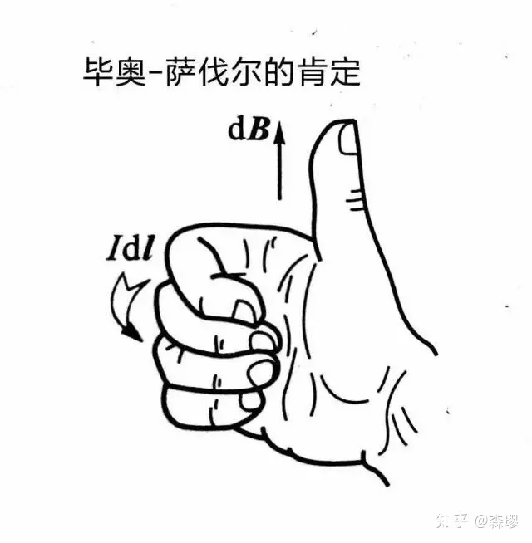
Low T: Non-interacting $I\overline{I}$ Gas
Low T-> tensor interaction-> $ρ_{00}>1/3$
High T: $I\overline{I}$-Molecule
High T-> AV interaction-> $ρ_{00}<1/3$

Slide 22
Thank you
SP induces $ρ_{00}<1/3$ for $φ$
MMP induces $ρ_{00}>1/3$ for $φ$
May induces $ρ_{00}<1/3$ for $K^{∗0}$
Instanton induced interactions are good! Could be the source of spin alignment!

Slide 23
Spin alignment of $K^{∗0}$
$${−a}_{s}−a_{d}$$
$${+a}_{s}+a_{d}$$
$${+a}_{s}−a_{d}$$
$${+a}_{s}−a_{d}$$
$${−a}_{s}+a_{d}$$
$${+a}_{s}−a_{d}$$
$${−a}_{s}−a_{d}$$
$${+a}_{s}+a_{d}$$

