Slide 1
$Bubble nucleation$ $$and gravitational wave from holography \\ in the probe approximation$$
Yidian Chen(陈亦点)
School of Physics, Hangzhou Normal University
Collaborators: Danning Li, Mei Huang
Based on JHEP 07 (2023) 225[arXiv: 2212.06591]
Nov. 25, 2023

Slide 2
Introduction
5D Setup, bounce solution and thin-wall approximation
III. Bubble expansion and bubble wall velocity
IV. Gravitational waves
V. Summary

Slide 3
I. Introduction

Slide 4
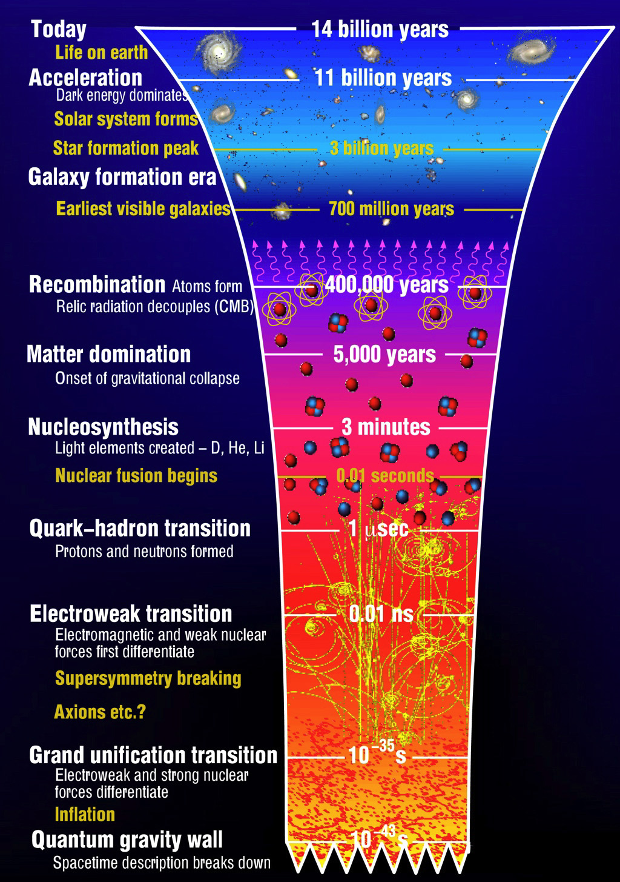
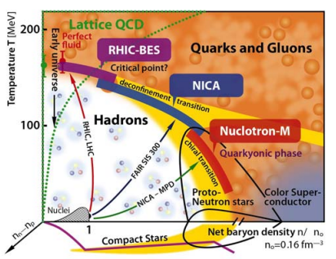
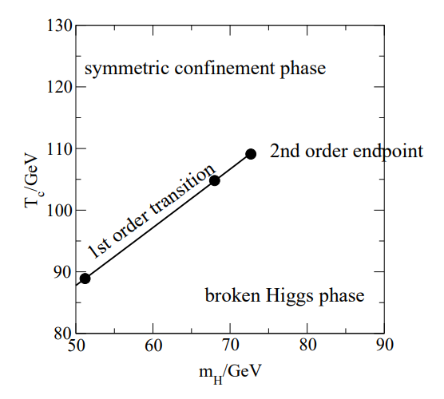
Cosmic phase transition

Slide 5
Baryon asymmetry puzzle
Sakharov conditions:
A.D. Sakharov, Pisma Zh. Eksp. Teor. Fiz.(1967)
1) Baryon number B violation.
2) C-symmetry and CP-symmetry violation.
3) Interactions out of thermal equilibrium.
First-Order Phase Transition
GWs, primordial magnetic field, primordial black holes, dark matter…

Slide 6
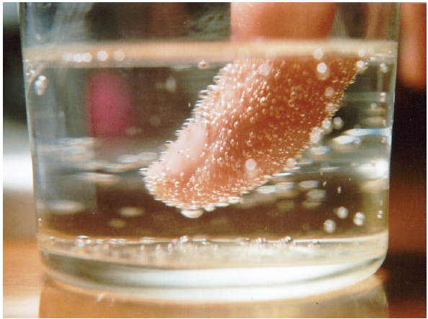
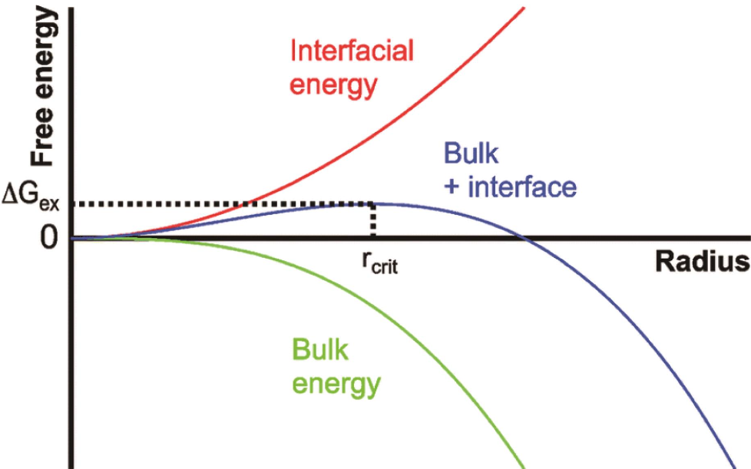
Nonequilibrium first-order transition
Classical Nucleation Theory

Slide 7
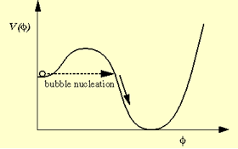
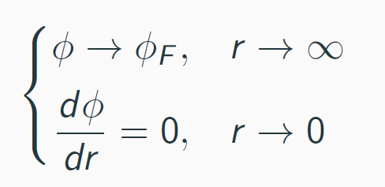
S. Coleman, Phys. Rev. D 15, 2929 (1977); ($T=0$)
A. D. Linde, Nucl. Phys. B216, 421 (1983). ($T≠0$)
Nonequilibrium first-order transition
Quantum Nucleation Theory
Bounce Solution
At sufficiently high temperatures, the least-action solution has O(3) symmetry [Linde, 1983]. The O(3)-symmetric bubble is governed by
J.I.Kapusta and C.Gale, Finite-temperature field theory: Principles and applications,
Cambridge University Press, 2011
with boundary conditions

Slide 8
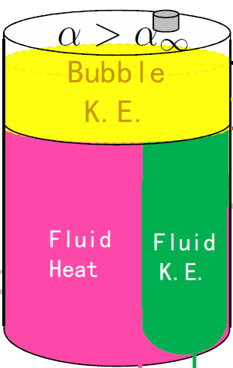
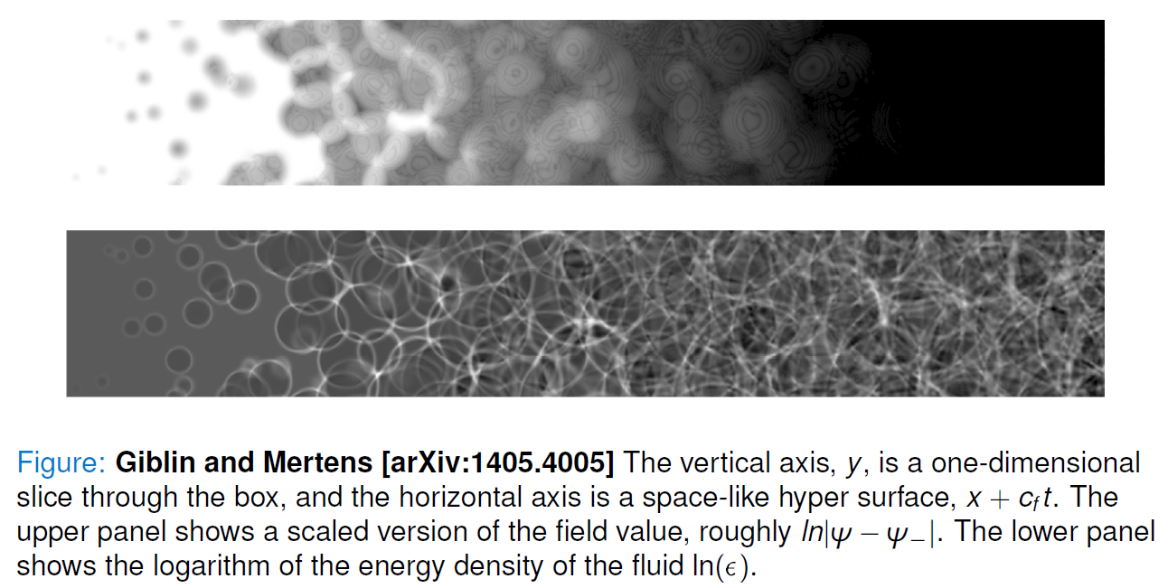
Stochastic gravitational waves

Slide 9
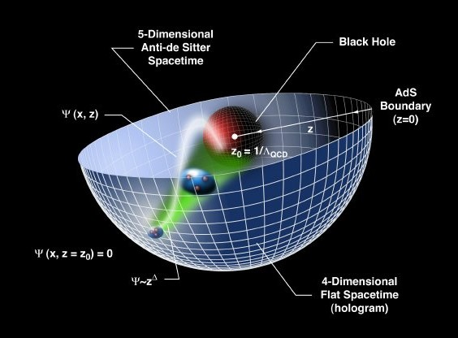
Holographic Dictionary: d-QFT/d+1-Gravity
AdS/CFT: original discovery of duality
relates gravity theories on anti-de Sitter spacetimes to conformal field theories
General Gauge/Gravity duality

Slide 10
Holographic dictionary
Boundary QFT Gravity
Local operator Field
conformal dimension $Δ$, p-form field $p$
$$z^{4−Δ}Φ_{0}\left(x\right)+z^{Δ}⟨𝒪(x)⟩ =Φ(x,r→0)$$
Strongly coupled Weakly coupled semi-classical

Slide 11
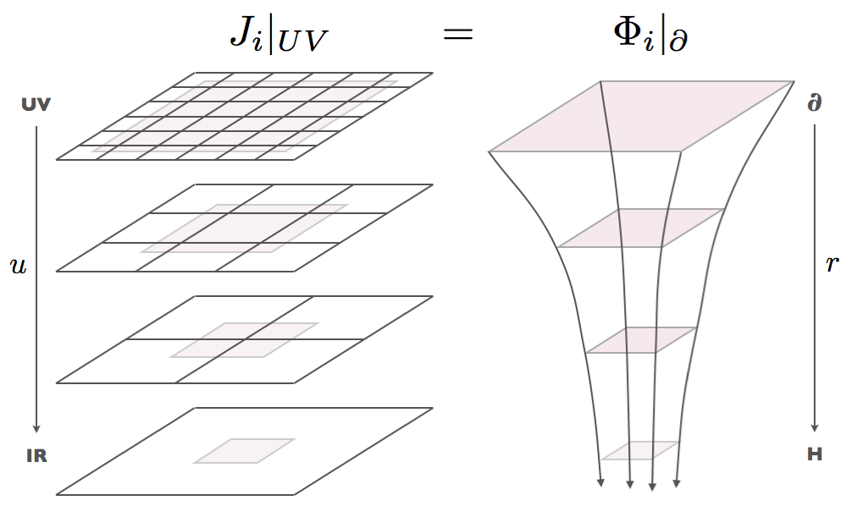
Holographic Duality & RG flow
QFT on lattice
RG scale
Coupling constant
Gravitational problem
Extra spatial dimension
Dynamical field
arXiv:1205.5180

Slide 12
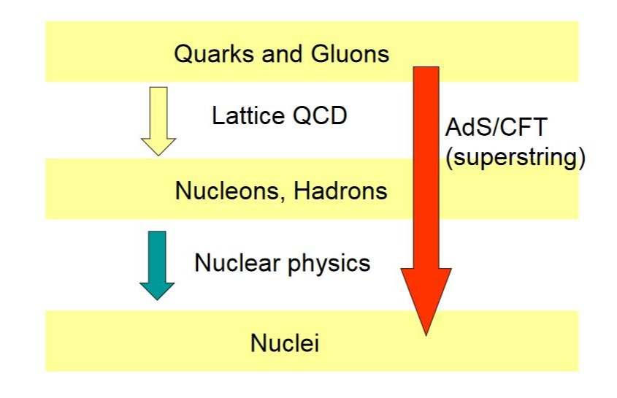
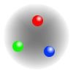
QCD
Effective field theories and models
FRG
DSE
QM, NJL, SM, HLS,
CHPT, NRQCD,
color flux tube,
Dual superconductor ……

Slide 13
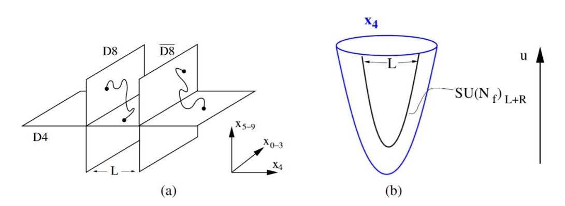
Top-down vs Bottom-up
Top-down：based on string theory and D-brane
D3-D7,
D4-D6,
D4-D8,
STU model
…
Bottom-up：from symmetry of QCD
hard-wall, soft-wall, Gubser model, improved holographic QCD, dynamical holographic QCD …
1) 5D effective action
2) IR cutoff or dilaton to realize confinement
Hadron spectra, chiral symmetry breaking & linear confinement, phase transitions, equation of state, transport properties

Slide 14
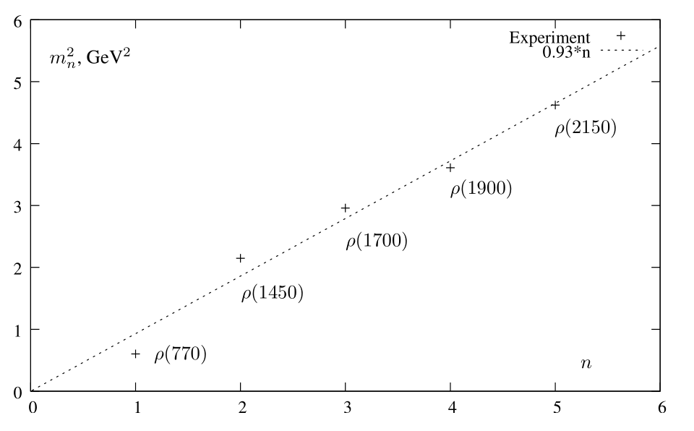
KKSS model (soft-wall model)
Karch et al., arXiv: 0602229[hep-ph]
5D action
Dilaton profile
Conformal AdS₅
e.o.m

Slide 15
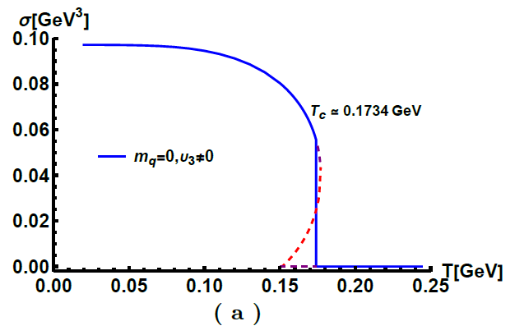
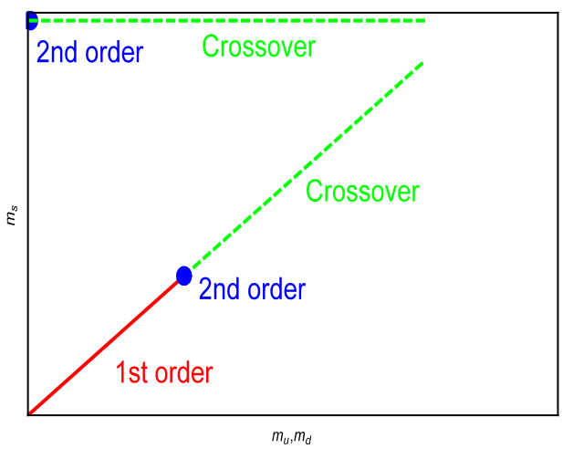
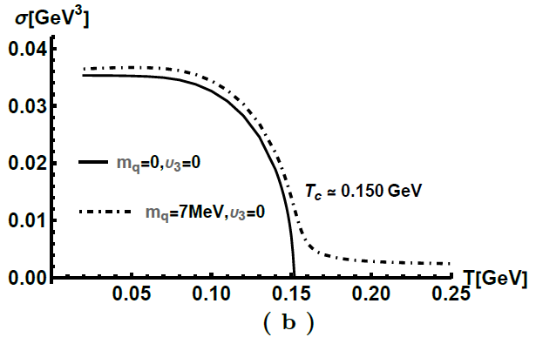
Chiral condensate
Chelabi et al., PRD(2016), arXiv: 1511.02721
Chelabi et al., JHEP(2016), arXiv: 1512.06493
5D action

Slide 16
II. 5D Setup, bounce solution and thin-wall approximation

Slide 17
5D Model
Y. Chen, Danning Li and M. Huang arXiv: 2212.06591
Φ denotes the dilaton field and the complex scalar field X corresponds to the quark condensation or fermionic condensate of BSMs.
$$X=\frac{χ}{\sqrt{2N_{f}}}I_{N_{f}}⇔⟨\overline{Q}Q⟩$$
5D action
Dilaton profile
Metric
Potential

Slide 18
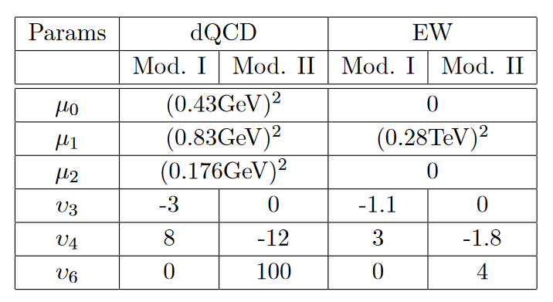
5D Model
Y. Chen, Danning Li and M. Huang arXiv: 2212.06591
5D action
The symmetry of the model is spontaneously broken by the non-zero vacuum expectation value of the scalar field X =$\frac{χ}{\sqrt{2N_{f}}}I_{N_{f}}$. For the fifth dimensional direction, the expansion of the scalar field $χ$ at the conformal boundary has the following form
Potential
Model I: $υ_{3}≠0,υ_{6}=0$
Model II: $υ_{3}=0,υ_{6}≠0$

Slide 19
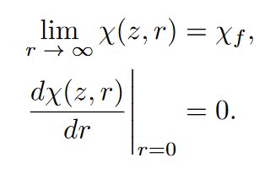
Bounce Solution
Y. Chen, Danning Li and M. Huang arXiv: 2212.06591
the equations of motion of the scalar field X can be obtained from action
The solution requires the following boundary conditions

Slide 20
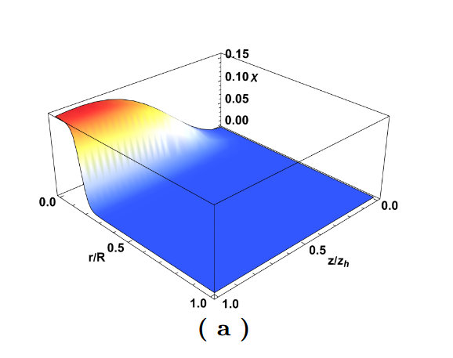
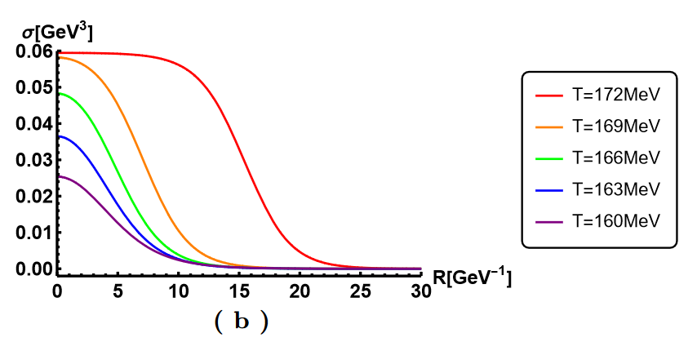
Bounce Solution
Y. Chen, Danning Li and M. Huang arXiv: 2212.06591
the condensate σ as a function of the radial coordinate r at different temperatures.
the bounce solution of the scalar field χ as a function of the fifth dimensional coordinate z and the radial coordinate r

Slide 21
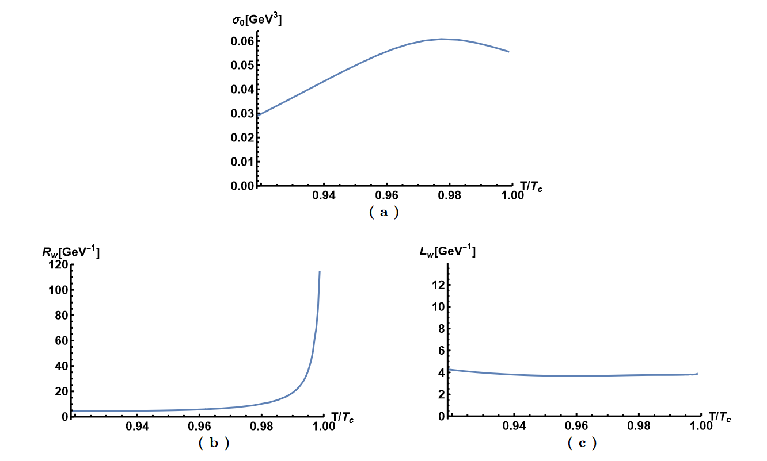
Thin-Wall Approximation
Y. Chen, Danning Li and M. Huang arXiv: 2212.06591
we use hyperbolic tangent function interpolation condensation as a function of the radial r, shown following
where σ0 is the condensation value at the center, Rw denotes the radius of the bubble, and Lw represents the thickness of the bubble wall.

Slide 22
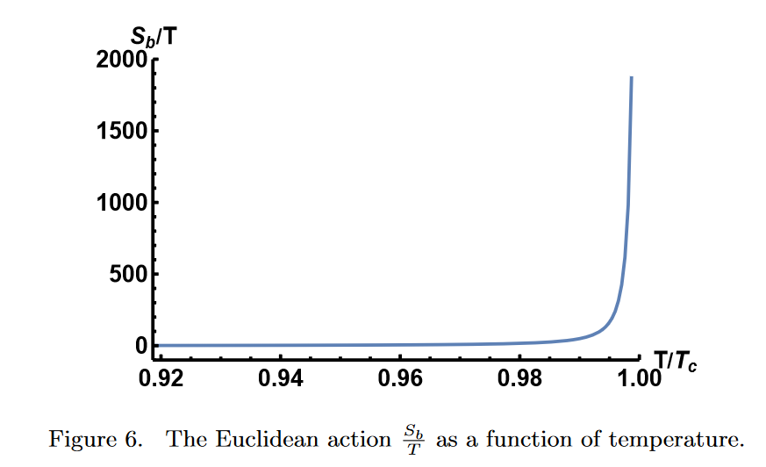
Thin-wall approximation
Y. Chen, Danning Li and M. Huang arXiv: 2212.06591
the tunneling rate of the stochastically generated bubbles is
$$T_{n}≃T_{c}$$
where Sb is the Euclidean action evaluated on the bounce solution and the factor is $A\left(T\right)=T^{4}{\left(\frac{S_{b}}{2πT}\right)}^{3/2}$. The nucleation temperature Tn can be given by relation $\frac{S_{b}\left(T_{n}\right)}{T_{n}}∼180$for QCDPT ($\frac{S_{b}\left(T_{n}\right)}{T_{n}}∼140$for EWPT).
$$T_{p}≃T_{n}?$$

Slide 23
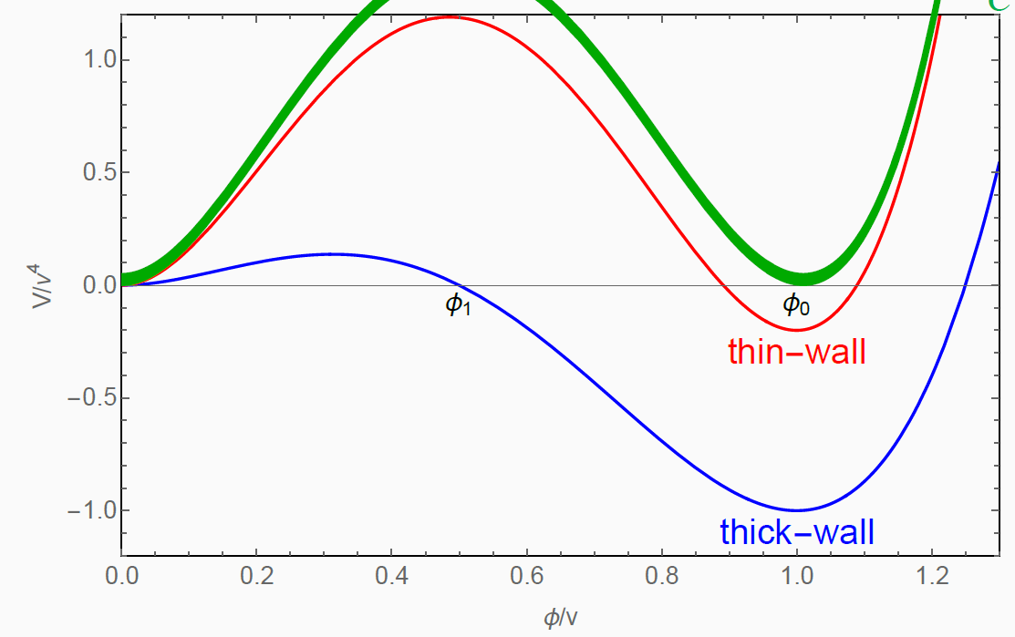
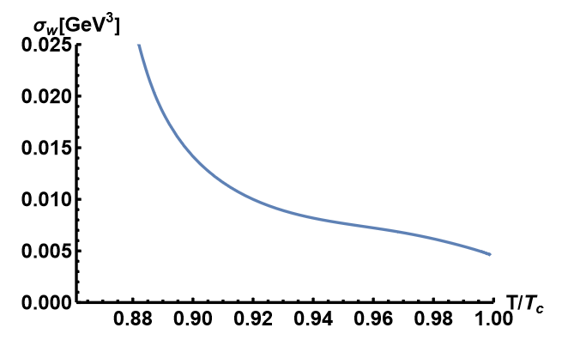
Thin-wall approximation
Y. Chen, Danning Li and M. Huang arXiv: 2212.06591
As in Ref. [A. Eichhorn, et al., JCAP (2021)], for Lw ≪Rw (thin-wall approximation), we can estimate the surface tension and the parameters α and β/H using the Euclidean action.

Slide 24
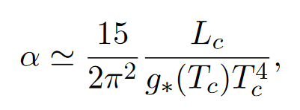
Thin-wall approximation
Y. Chen, Danning Li and M. Huang arXiv: 2212.06591
We estimate the parameters α and β/H using the Euclidean action obtained previously. The parameters α and β/H are very important for the GW power spectrum.
strength parameter α
transition rate parameter β/H

Slide 25
III. Bubble expansion and bubble wall velocity

Slide 26
Real-time evolution
Y. Chen, Danning Li and M. Huang arXiv: 2212.06591
To investigate the real-time evolution, we transform the framework to the ingoing Eddington-Finkelstein coordinate, then the metric becomes
Under the coordinate transformation, the scalar field χ is invariant, and its equation of motion becomes as follows
We choose the following boundary conditions

Slide 27
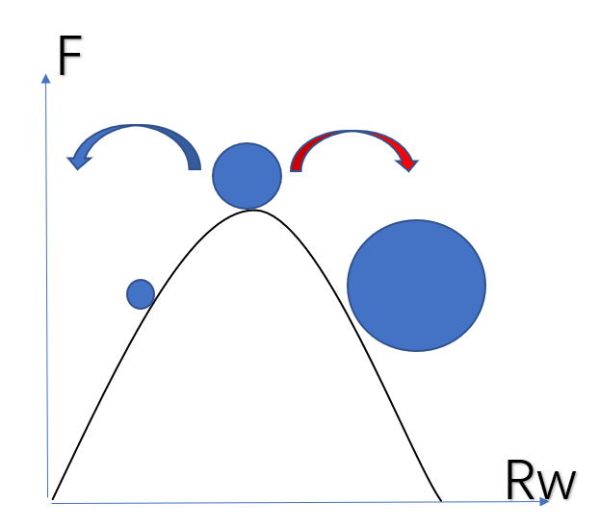
Bubble velocity
Y. Chen, Danning Li and M. Huang arXiv: 2212.06591
bounce solution=critical bubble solution

Slide 28
Bubble velocity
Y. Chen, Danning Li and M. Huang arXiv: 2212.06591

Slide 29
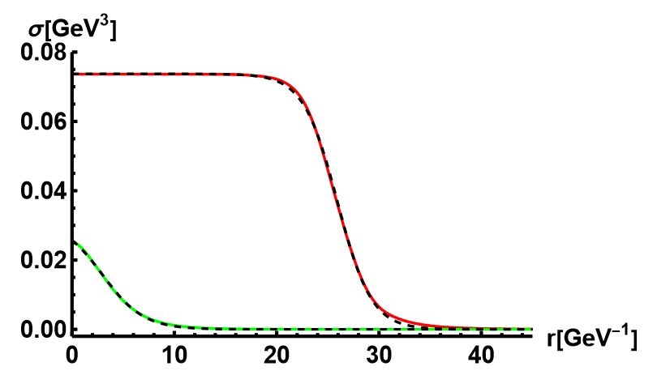
Bubble velocity
Y. Chen, Danning Li and M. Huang arXiv: 2212.06591
To obtain the bubble wall velocity, we used the function
we can define the velocity of the bubble wall by
the solid line is the numerical solution and the dashed line represents the fitting results of the hyperbolic tangent function.

Slide 30
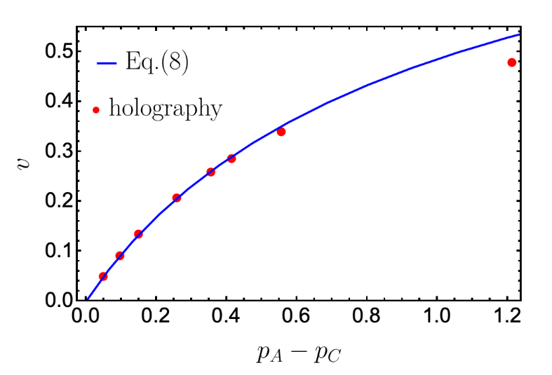
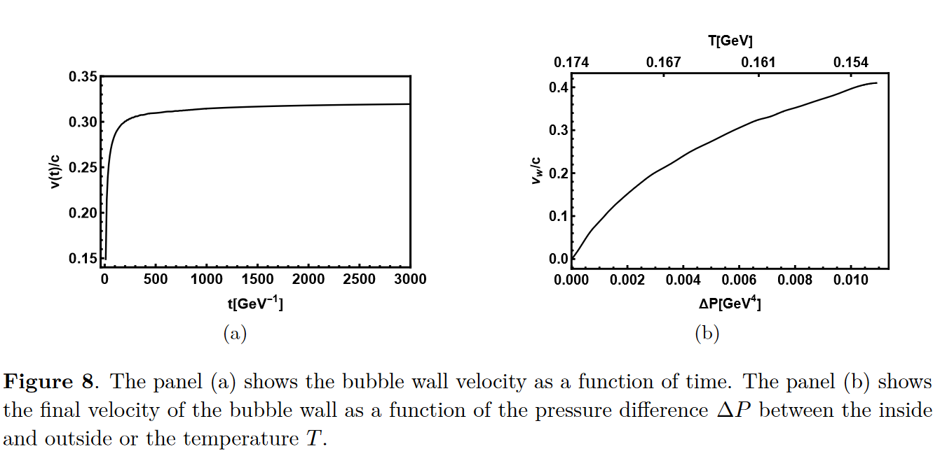
Bubble velocity
Y. Chen, Danning Li and M. Huang arXiv: 2212.06591
The final velocity of the bubble wall $v_{w}$ is defined as
$$c_{s}=\frac{1}{\sqrt{3}}$$
R. A. Janik et al., Phys Rev Lett(2022)

Slide 31
IV. Gravitational waves

Slide 32
GW power spectra
Y. Chen, Danning Li and M. Huang arXiv: 2212.06591
Within the linear approximation, the total GW power spectra can be written as
we have found that for the holographic model, the final velocity of the bubble wall is less than the speed of sound, i.e., the non-runaway case. According to Ref. [C. Caprini et al., JCAP(2016)], the GWs generated by collisions in the non-runaway case can be neglected with respect to acoustic waves and magnetohydrodynamic turbulence. Therefore, the total power spectrum is approximated to
Due to the complexity of turbulence, the contribution from the turbulence is dropped in this paper to make a conservative estimate.

Slide 33
GW power spectra
Y. Chen, Danning Li and M. Huang arXiv: 2212.06591
The key quantities which determine these power spectra are the following:
The percolation temperature Tp is defined as the temperature at which the probability to have the false vacuum is about 0.7.
The phase transition strength parameter α, which is related to the scalar potential energy released during the phase transition
The bubble wall speed vw
The transition rate parameter β, which can be thought of as the inverse phase transition duration

Slide 34
GW power spectra
Y. Chen, Danning Li and M. Huang arXiv: 2212.06591
The nucleation temperature is defined as one bubble per unit Hubble volume and is written as
the probability of a false vacuum is defined as
The percolation temperature is defined as $I\left(T_{p}\right)≃0.34$, which is the temperature when the probability of false vacuum is about $P\left(T_{p}\right)≃0.7$.

Slide 35
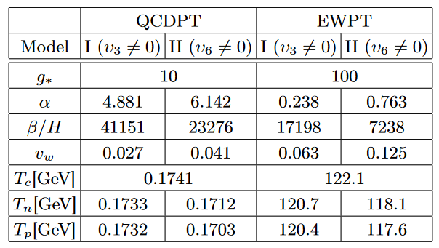
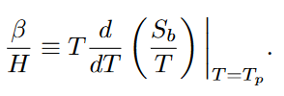
GW power spectra
Y. Chen, Danning Li and M. Huang arXiv: 2212.06591
The parameter α is defined as
Near-conformal model α~O(1)
The inverse of the duration time is defined as
Strongly coupled theory β~10000 ?
F.R. Ares et al., Phys.Rev.Lett.(2022);
J. Shao, Mei Huang, Phys.Rev.D(2023)

Slide 36
GW power spectra
Y. Chen, Danning Li and M. Huang arXiv: 2212.06591
From numerical simulations, the power spectrum from sound waves has the form of
The specific form of the factor κv depends on the bubble wall velocity and has the following form in the limits of large and small velocities

Slide 37
GW power spectra
Y. Chen, Danning Li and M. Huang arXiv: 2212.06591
the suppression factor is
It should be noted that the power spectrum from sound waves in Ref. [Guo et al., JCAP(2021)] contains a suppression factor $Υ$. Although it is not known whether this suppression factor is applicable with α∼O(1) it provides a strong suppression compared to previous estimates
The GW signal can be suppressed by a factor of ${10}^{−3}$ if the kinetic suppression effect from Ref. [Cutting et al. PRL(2020)] is also included.

Slide 38
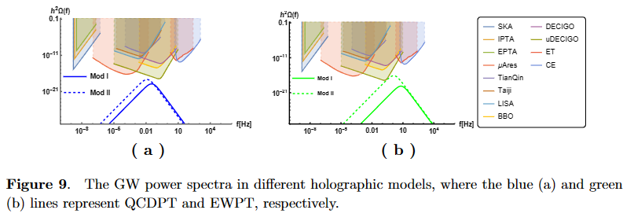
GW power spectra
Y. Chen, Danning Li and M. Huang arXiv: 2212.06591
NANOGrav-15
β ⇧
α ⇧

Slide 39
V. Summary

Slide 40
Summary
Y. Chen, Danning Li and M. Huang arXiv: 2212.06591
We investigate the bounce solution in the holographic QCD and electroweak models with first-order phase transition. The strength parameter α, inverse duration time β/H and bubble wall velocity vw are calculated by holographic bounce solution.
We find the parameter α is about O(1) and β/H is about 10000. The critical, nucleation and percolation temperatures of the phase transition are close to each other in the holographic model. In addition, the velocity vw is found to be less than the sound speed.

Slide 41
Summary
Y. Chen, Danning Li and M. Huang arXiv: 2212.06591
3) The GW signal is strongly suppressed due to the presence of the factor $Υ$, making it difficult to be detected by the experiment. The signal may be detected by Ultimate-DECIGO only when the appropriate parameters are selected in Model II for EWPT.
4) The primordial black hole is not favorable for formation due to the large parameter β/H and small velocity vw.

Slide 42
Progress: Collision

Slide 43
Progress: Spinodal Decomposition

Slide 44
Thanks！

