Slide 1

Chiral phase transition in the soft-wall AdS/QCD model
Danning Li (李丹凝)
Department of Physics, Jinan University
Based on:
Phys.Rev.D107(2023)8,086001, JHEP12(2022)113, Phys.Rev.D 102 (2020) 126014, JHEP08(2021)005,
JHEP01(2019)165, JHEP04(2016)036, Phys.Rev.D93(2016)10,101901
@USTC-PNP-Nuclear Physics Mini Workshop Series, November 25, 2023

Slide 2
Outlines
Introduction
Chiral phase transition from holography
Thermal spectra in the soft-wall models
Thermalization and prethermalization
Summary

Slide 3



QCD vacuum
Confinement:
Polyakov Loop: $L≡Tr[T(e^{i\int{A_{t}dt}})]$
$$\left\langle L\right\rangle \sim e^{−a E_{∞}}$$
Chiral symmetry breaking:
Global symmetry in Lagrangian level in chiral limit:
Spontaneously broken in vacuum:
Described by
non-vanishing chiral condensate
$m_{u}≈m_{d}=3−5MeV$, $m_{P(uud)}≈1GeV$

Slide 4
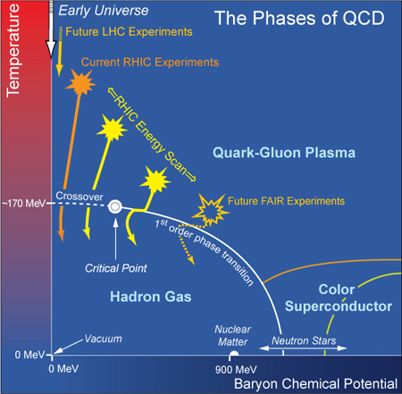
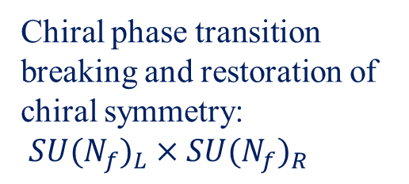
QCD phase transitions
Chiral phase transition
breaking and restoration of
chiral symmetry:
${SU(N_{f})}_{L}×{SU(N_{f})}_{R}$
Deconfinement phase transition

Slide 5
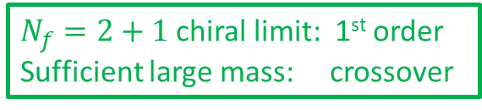


Mass Diagram: Columbia Plot
Upper right:
1st order phase transition
Left part:
chiral symmetry as good approximation
Two flavor chiral limit: 2nd order
Any finite quark mass: crossover
$N_{f}=2+1$chiral limit: 1st order
Sufficient large mass: crossover
Universality classes:
$$O\left(4\right),Z\left(2\right)$$
H.-T. Ding et.al, Int. J. Mod. Phys. E 24 (2015) 1530007
$$m_{s}^{tric}>\left(or<\right)m_{s}^{phys}$$

Slide 6
Mass Diagram: Columbia Plot
P.D.Forcrandab and O.Philipsenc, JHEP11(2008)012
H.-T. Ding et.al, Int. J. Mod. Phys. E 24 (2015) 1530007

Slide 7
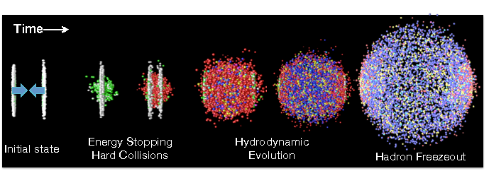
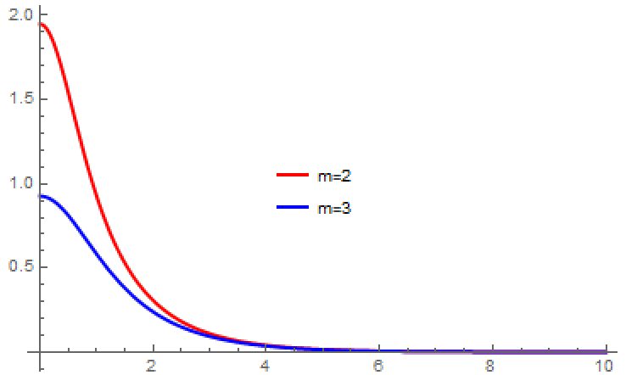
Hadron Spectrum and Phase Transition
Sketch plot
m_{pole}↓, towards low p
D.T.Son and M.A.Stephanov, Phys.Rev.Lett. 88 (2002) 202302

Slide 8
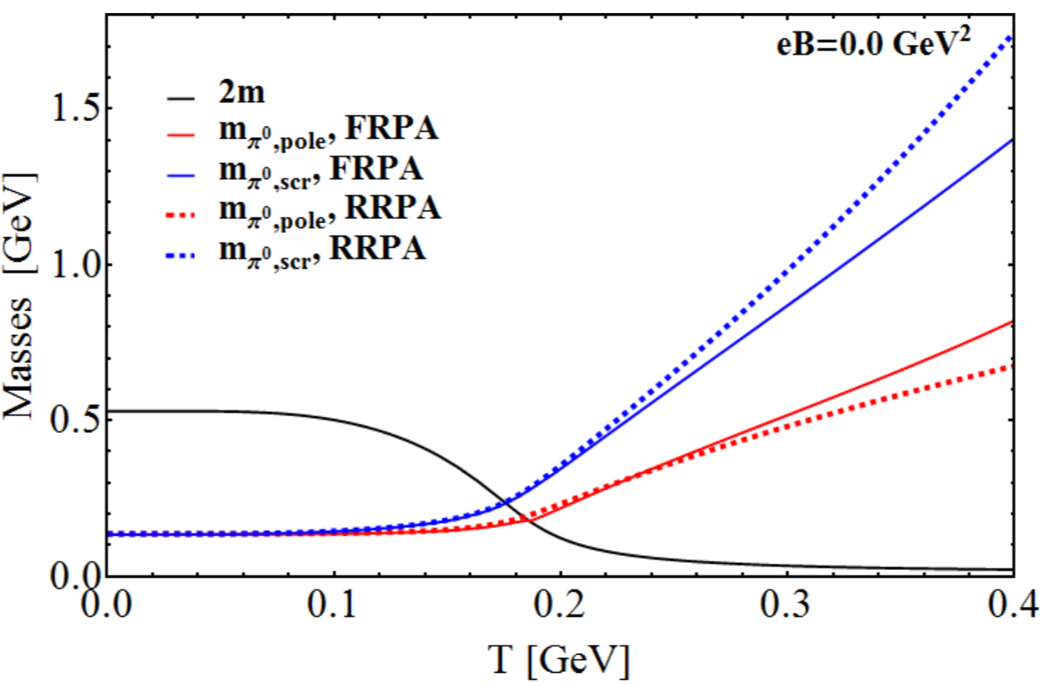
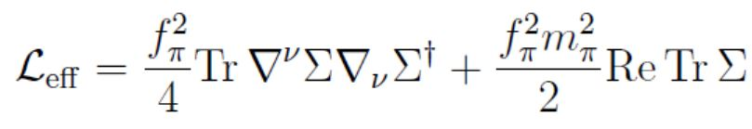

Hadron Spectrum and Phase Transition
DSE, Chiral limit
NJL
C.S.Fischer, Prog.Part.Nucl.Phys. 105 (2019) 1-60
B.Sheng, Y.Wang, X.Wang, L.Yu, Phys. Rev. D 103 (2021) 094011
LQCD
finite T CPT
B.B. Brandt, A.Francis, H.B. Meyer, D.Robaina, Phys.Rev.D 92 (2015) 9, 094510
D.T.Son and M.A.Stephanov, Phys.Rev.Lett. 88 (2002) 202302

Slide 9
Thermal width and meson dissociation
Meson dissociation
R: ratio of width to mass
Y.-Z. Xu, S.Qin, H.Zong, arXiv:2106.13592
Thermal properties of light mesons and their relations with chiral phase transition.

Slide 10
Nonequilibrium stage in HIC
(1)
(2)
(3)
From S.A.Bass’s talk slides
fluid dynamics: initial conditions, EOS, transport coefficients
local equilibrium: τ~0.1-1fm/c, fast thermalization?
transport models: hadronic cascade model, UrQMD models
nonequilibrium stage:
Kinetic theory: f(x, p), relativistic Boltzman equation
Color glasma: gluon saturation
weakly coupled picture
( but: η/s~0.2, which indicating a strongly coupled QGP in
hydrodynamics.
At least, at the end of the non-equilibrium period. )

Slide 11
Non-perturbative Method
Non-pertubative Method:
Lattice Simulation, DSE, FRG,
Effective models: NJL, PNJL, QM…
Lattice: sign problem @ finite chemical potential
Holography: finite baryon number density, non-equilibrium dynamics…
Near transition Point:
perturbative methods become invalid

Slide 12
Holographic Method
Closed strings in AdS background
SYM in Minkovski Space Time
J.Maldacena,Adv.Theor.Math.Phys.2:231-252,1998
application to QCD:
try to break the conformal symmetry
stage: model study
Holography: 5th dimension(r)
plays as energy scale
Correspondence:
Mapped the flow equation of FRG to the wave equation of HQCD:
F.Gao, M.Yamada, Phys.Rev.D 106.126003(2022)

Slide 13
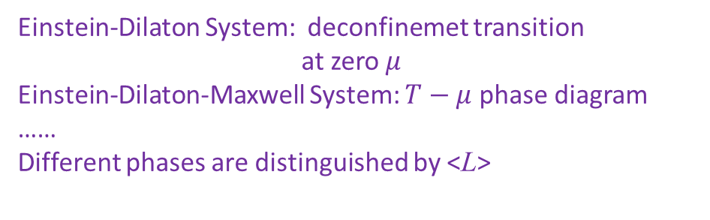
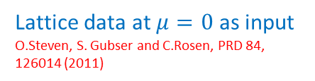
Phase Transitions from Holographic
bottom-up models:
Lattice data at $μ=0$ as input
O.Steven, S. Gubser and C.Rosen, PRD 84, 126014 (2011)
Mainly on confinement/deconfinement phase transition
Einstein-Dilaton System: deconfinemet transition
at zero $μ$
Einstein-Dilaton-Maxwell System: $T−μ$ phase diagram
……
Different phases are distinguished by <L>
top-down models:
More convenient for chiral phase transition,
different way of embedding to realize symmetry breaking and restoration
N.Horigome and Y. Tanii,JHEP01(2007)072

Slide 14
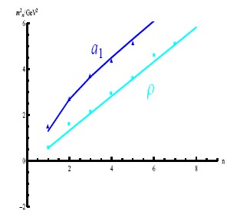



Soft-Wall Model
A.Karch, E.Katz, D.T.Son, M.A.Stephonov, Phys.Rev.D74:015005,2006
Promote 4D global chiral symmetry to 5D:
Field and Operator Correspondence:
$A_{L,μ}^{a}\left(z\right)=j_{L,μ}^{a}(x)+J_{L,μ}^{a}\left(x\right)z^{2}$+…
$A_{R,μ}^{a}\left(z\right)=j_{R,μ}^{a}(x)+J_{R,μ}^{a}\left(x\right)z^{2}$+…
$$X\left(z\right)=m_{q}z+\left\langle \overline{q}q\right\rangle z^{3}+…$$
Extensions:
T. Gherghetta, J. I. Kapusta and T. M. Kelley,Phys. Rev. D 79 (2009) 076003
T. M. Kelley, S. P. Bartz and J. I. Kapusta, Phys. Rev. D 83 (2011) 016002
Y. -Q. Sui, Y. -L. Wu, Z. -F. Xie and Y. -B. Yang, Phys. Rev. D 81(2010) 014024
Y.Q.Sui, Y.L.Wu, Y.B.Yang, Phys.Rev. D83 (2011), 065030
DL, M.Huang, Q.S.Yan, Eur.Phys.J. C73 (2013) 2615
S.He, S.Y.Wu, Y.Yang and P.H.Yuan,JHEP 1304 (2013) 093
Y.Chen, M. Huang, Phys.Rev. D105 (2022), 026021
………..
DL, M.Huang, JHEP11(2013)088

Slide 15
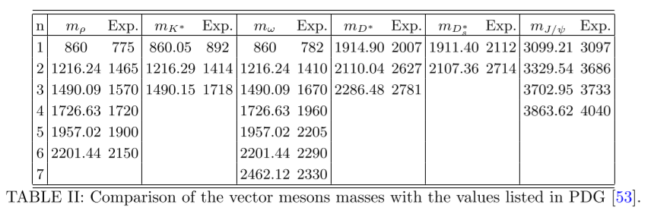
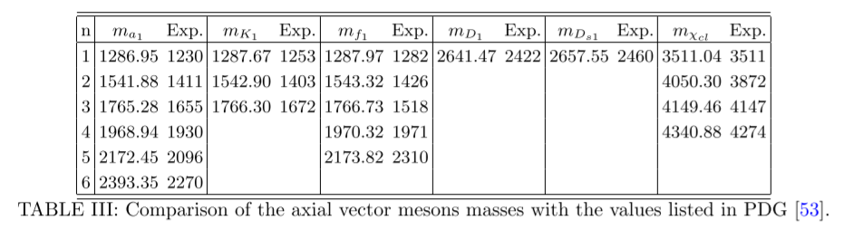
Including strange and charm quarks
Y.Q.Sui, Y.L.Wu, Y.B.Yang, Phys.Rev. D83 (2011), 065030
Y.Chen, M.Huang Phys.Rev.D 105 (2022) 2, 026021
SU(3)：including strange quark
SU(4)：including charm quark

Slide 16
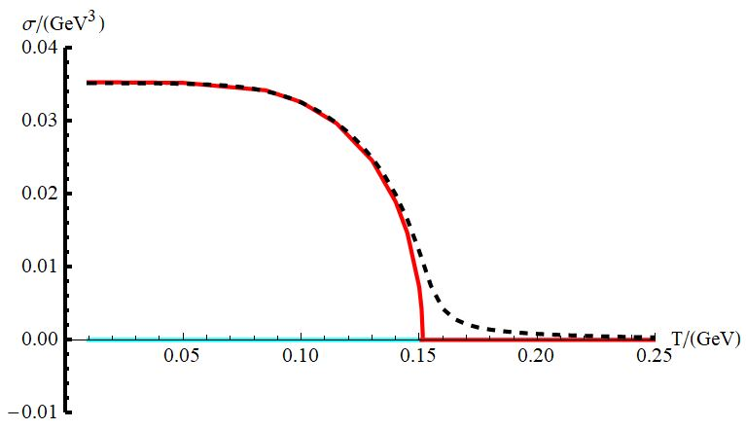
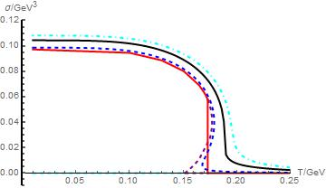
Finite temperature
Introduce T through black hole solutions
N_{f}=2: 2nd order(m=0), crossover(any m≠0)
T_{c}~150MeV
N_{f}=3:
1st order(m<37MeV), crossover(m>37MeV)
T_{c} ~170MeV
K.Chelabi, Z.Fang, M.Huang, DL, Y.L.Wu, JHEP04(2016)046

Slide 17
m_{u}= m_{d} ≠ m_{s}

Slide 18
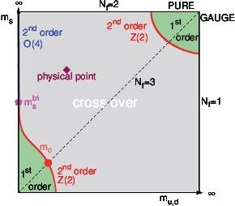
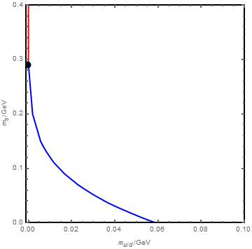
Phase Diagram
crossover
1st order
H.-T. Ding et.al, Int. J. Mod. Phys. E 24 (2015) 1530007
J.Chen, S.He, M.Huang, DL, JHEP01(2019)165
Finite T chiral phase transition can be well described in the soft-wall AdS/QCD model.

Slide 19
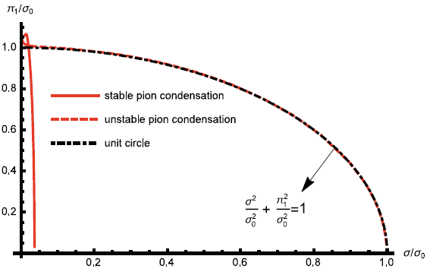
Density effect
A⁽⁰⁾₀=μ_{B}+O(z²)
A⁽³⁾₀=μ_{I}+O(z²)
Chiral PT

Slide 20
Density effect
A⁽¹⁾₀=μ_{B}+O(z²)
A⁽³⁾₀=μ_{I}+O(z²)
Chiral PT

Slide 21
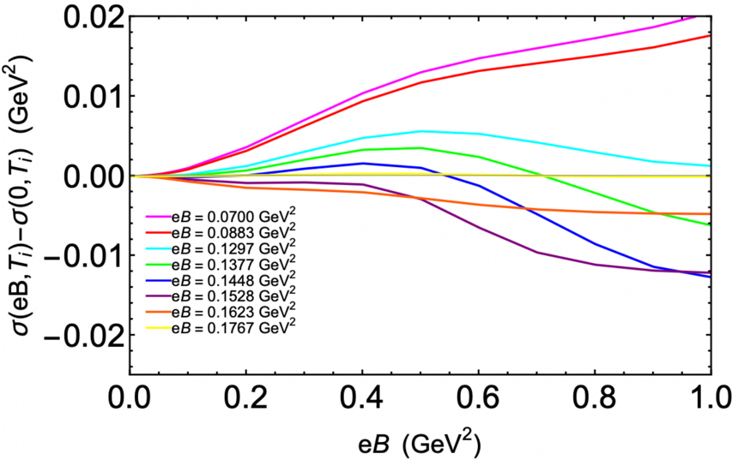
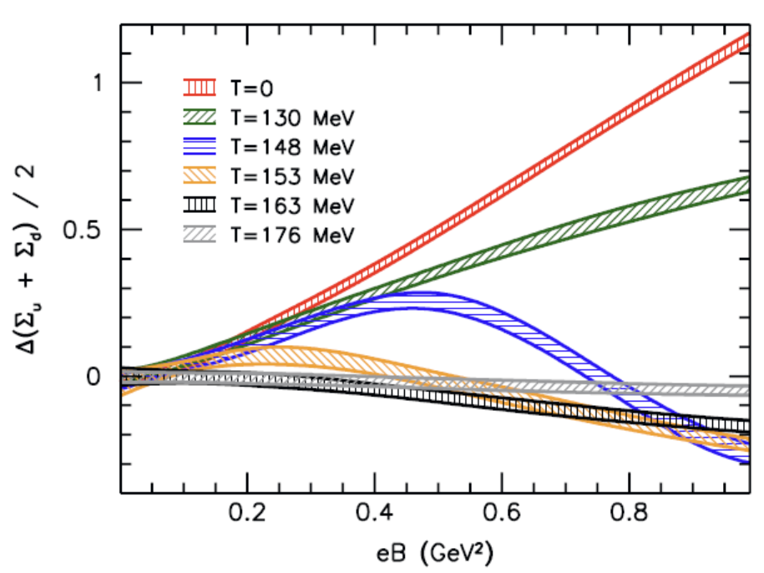
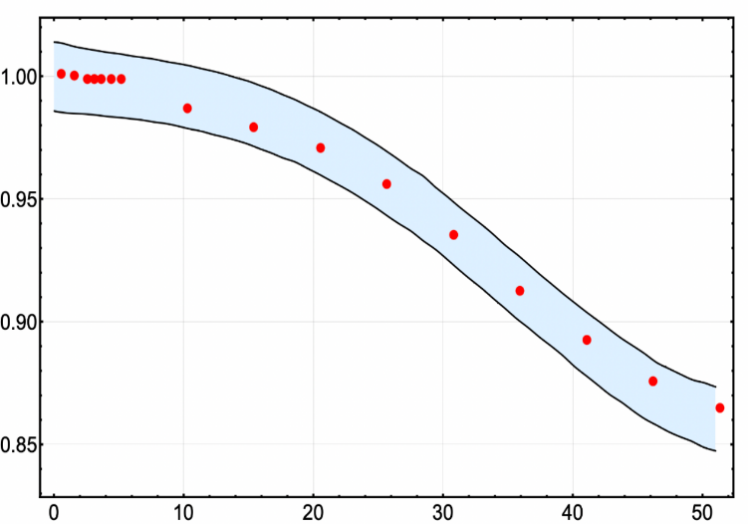
Magnetic effect(preliminary results)
T_{c}(B)/T_{c}(0)
Introduce magnetic field from EM current
(A_{μ}J^{μ,EM})
B/m_{π}²
Chiral phase transition can be well described in the soft-wall AdS/QCD model: from order parameter

Slide 22
Finite Temperature Spectral Function
Two equivalent way: spectral function(from Green function) or from quasi-normal modes

Slide 23
Pole mass and quasi-normal modes

Slide 24
Decay widths and meson dissociations
Closed to the pseudo critical temperature

Slide 25

Thermal spectra and phase transition
PCAC can be obtained directly from 5D eom
Scaling law near the critical point:
D.T.Son and M.A.Stephanov, Phys.Rev.Lett. 88 (2002) 202302
J.M. Torres-Rincon, and D.Teaney, Phys.Rev.D 106 (2022) 5, 056012
Also seen in finite temperature CPT

Slide 26
Finite μ_{I} spectra
B. B. Brandt, G. Endrődi, and S. Schmalzbauer, Phys.Rev. D97 (2018), 054514

Slide 27
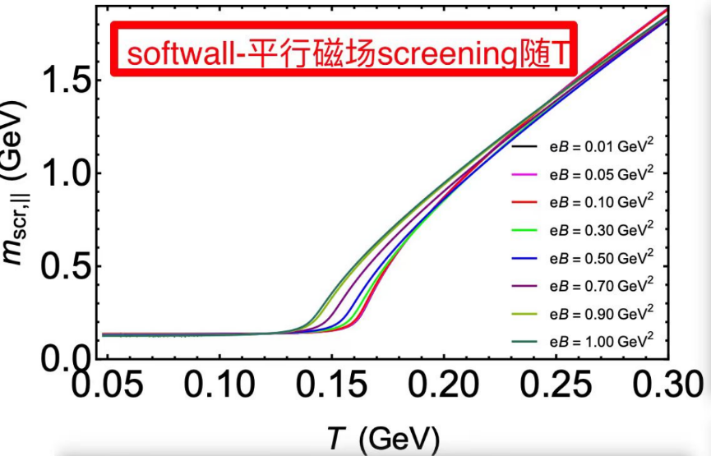
Magnetic effect(preliminary results)

Slide 28
Holographic thermalization
T_{ab}←→g_{ab} (appear in its expanding coefficients)
Time evolution: Einstein equations
g_{ab}(t)→T_{ab}(t)
Hard to deal with in traditional field tools, but easy(relatively) in HQCD:
Early studies: linearize Einstein equations
G.T.Horowitz et al., Phys.Rev.D62,024027(2000)
K.Murata et al. JHEP 0808,027(2008)
R.A.Janik et al., Phys.Rev.D73,045013(2006)
Direct mimicking: full dynamics in SYM(R+Λ)
P.M.Chesler et al., Phys.Rev.Lett.106,021601(2011)
M.P.Heller et al., Phys.Rev.Lett.108,201602(2012)
M.P.Heller et al., Phys.Rev.D85,126002(2012)
Describing the experimental data:
W.V.Schee et al., Phys.Rev.Lett.111,222302(2013)
W.V.Schee et al., Phys.Rev.C92,064907(2015)
K.Rajagopal et al., Phys.Rev.Lett.116,211603(2016)
P.M.Chesler et al., Phys.Rev.Lett.106,021601(2011)

Slide 29
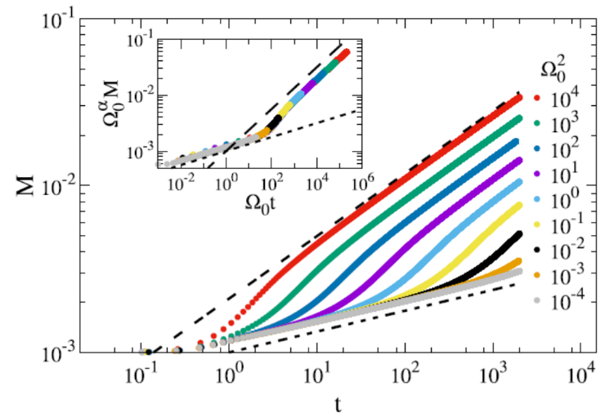
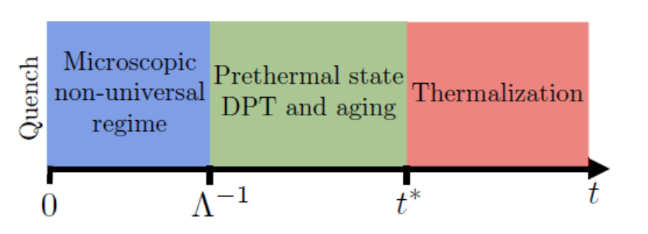
Prethermalization: short time
Originally, the term “prethermalization” was introduced by Berges, Borsányi, and Wetterich for matter under extreme conditions in a quasisteady state far from equilibrium.
Now widely used in many fields:
cold atom(theoretical + experiments)
condensed matter physics,
statistical physics
Integrable system: generalized Gibbs ensembles
RG point of view: non-thermal fixed point
J. Berges, Sz. Borsanyi, and C.Wetterich, Phys.Rev.Lett. 93 (2004) 142002
Near critical point: strong correlation
N. Tsuji, M. Eckstein, P. Werner, Phys.Rev.Lett.110(2013).136404
A. Chiocchetta, A. Gambassi, S.Diehl, and J.Marino, Phys.Rev.Lett. 118 (2017) 13, 135701
A. Chiocchetta, M.Tavora, A.Gambassi and A.Mitra, Phys.Rev.B91, 220302(2015)

Slide 30
Real-time dynamics in soft-wall model
Extension to nonequilibrium case:
Time dependent chiral condensate:
Evolve from nonequilibrium state to equilibrium state:

Slide 31
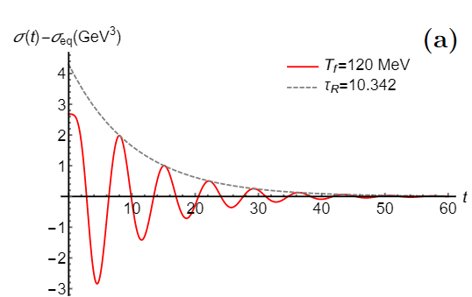
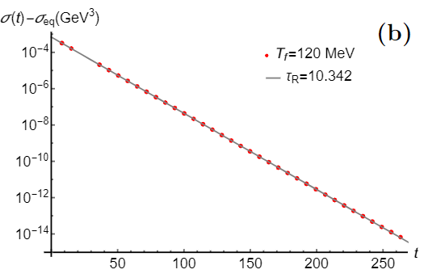
Thermalization

Slide 32
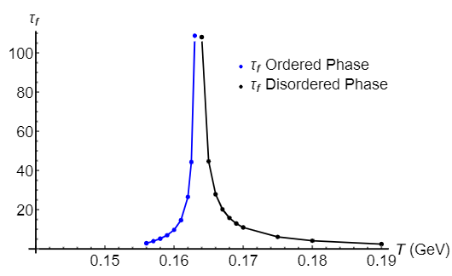
Relaxation time and critical slowing down

Slide 33
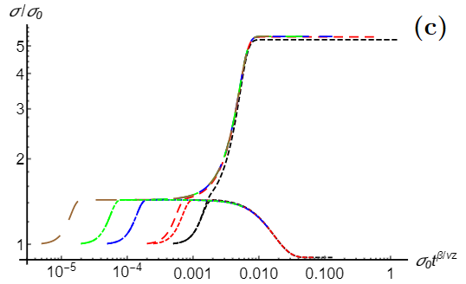
Prethermalization

Slide 34
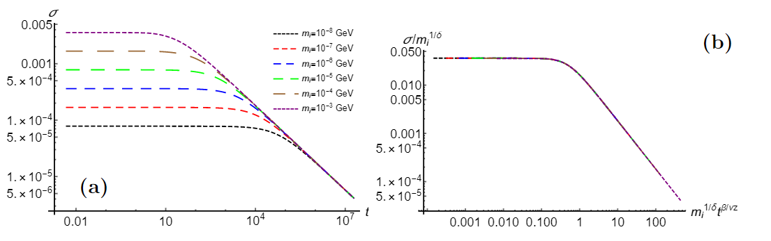
Dynamic critical scaling
However, the initial-slip exponent θ=0, again mean field!
But qualitatively they have similar patterns

Slide 35
Bubble nucleation(1st order PT)

Slide 36
Summary
Soft-wall AdS/QCD model provides a good start point to consider chiral phase transition in holographic framework.
The phase diagram is in agreement with the Columbia plot.
The thermal spectra can be well described in the soft-wall model. It is very like a 5D finite temperature CPT.
The real-time dynamics of chiral phase transition show non-trivial behavior in the intermediate time. This might be related with the so called “prethermalization” phenomena.
In the future: beyond the mean field, beyond the probe limit, close to the CEP in T-μ plane, ……

Slide 37
Thanks for your attentions!

