Slide 1

Measurement of the electric dipole moment (EDM) of ¹⁷¹Yb atoms in an optical dipole trap (ODT)
Zheng-Tian Lu
University of Science and Technology of China (USTC)
Hefei National Laboratory
October, 2026

Slide 2

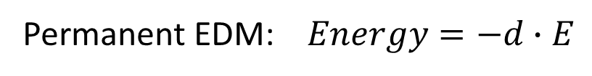
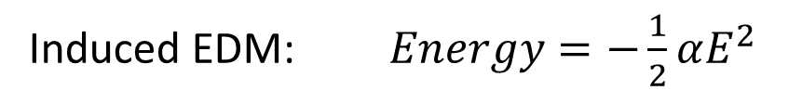
Permanent EDM violates P-, T- symmetry
Induced EDM: $Energy=−\frac{1}{2}αE^{2}$
Permanent EDM: $Energy=−d∙E$
_
_
_
T
P
+
+
+
EDM
spin
EDM
spin
EDM
spin
CP problem in strong interaction: θ term
SUSY:
New elementary particles→ new CP phase
Origins of matter – antimatter asymmetry:
New physical CP mechanism

Slide 3
Searching for EDM in three different categories
Electron
Paramagnetic
Yb-F, Th-O, Hf-F⁺
Electron-EDM,
electron-quark force
ACME, JILA Imperial
New physics beyond SM: SUSY et al.
PSI, KEK
Neutron, proton
Quark EDM
UWash, PTB Argonne, USTC
CENTREX, JHU
Nuclear Schiff moment Diamagnetic Hg, Yb, Ra
Tl-F, Yb(OH), Ag-Fr
Quark chromo-EDM
4 fermions, 3 gluons
Engel, Ramsey-Musolf, van Kolck, Prog. Part. Nucl. Phys. 71, 21 (2013)
System | Upper limit (e-cm) | Method | Value in Standard model (e-cm)
Electron | 4 x 10⁻³⁰ | Hf-F⁺ trap, Th-O beam | 10⁻³⁵
Neutron | 2 x 10⁻²⁶ | Neutrons – bottle | 10⁻³²
¹⁹⁹Hg | 7 x 10⁻³⁰ | Atoms – vapor cell | 10⁻³⁴
¹⁷¹Yb | This work | Atoms – trap | 10⁻³⁴

Slide 4
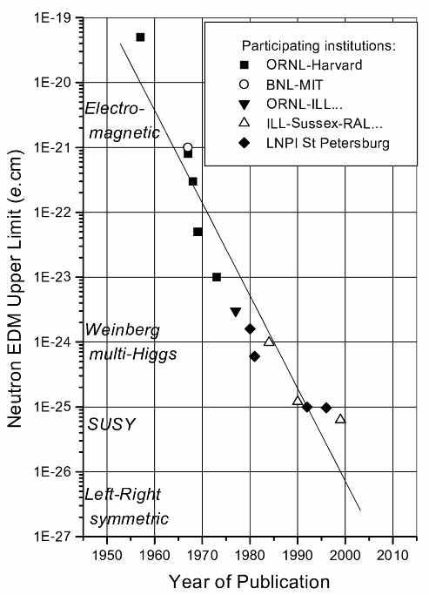

EDM of the Neutron
Beam
Limiting factor: δB ≈ v x E / c²
$ω=μ∙B±d∙E$
Ultra-cold neutron Storage
Cryo-storage
Notes:
Just tear through

Slide 5
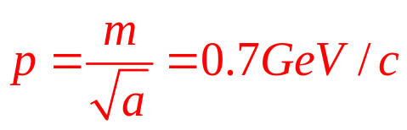
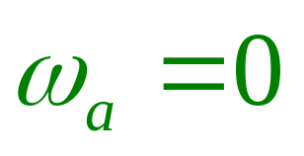
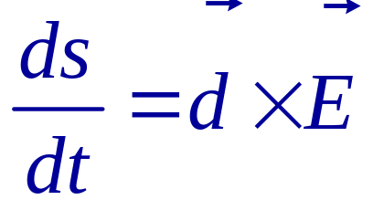
Proposal: an ALL-ELECTRIC ring for proton-EDM
Y. Semertzidis et al.
At the magic momentum
spin and momentum
vectors precess at the same rate in an E-field
E
Momentum
Spin
E
E
Diameter: 80 m
E
Notes:
Yannis Semertzidis, BNL
5

Slide 6
Searching for EDM in three different categories
Electron
Paramagnetic
Yb-F, Th-O, Hf-F⁺
Electron-EDM,
electron-quark force
ACME, JILA Imperial
New physics beyond SM: SUSY et al.
PSI, KEK
Neutron, proton
Quark EDM
UWash, PTB Argonne, USTC
CENTREX, JHU
Nuclear Schiff moment Diamagnetic Hg, Yb, Ra
Tl-F, Yb(OH), Ag-Fr
Quark chromo-EDM
4 fermions, 3 gluons
Engel, Ramsey-Musolf, van Kolck, Prog. Part. Nucl. Phys. 71, 21 (2013)
System | Upper limit (e-cm) | Method | Value in Standard model (e-cm)
Electron | 4 x 10⁻³⁰ | Hf-F⁺ trap, Th-O beam | 10⁻³⁵
Neutron | 2 x 10⁻²⁶ | Neutrons – bottle | 10⁻³²
¹⁹⁹Hg | 7 x 10⁻³⁰ | Atoms – vapor cell | 10⁻³⁴
¹⁷¹Yb | This work | Atoms – trap | 10⁻³⁴

Slide 7
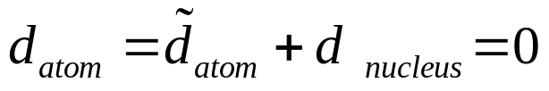
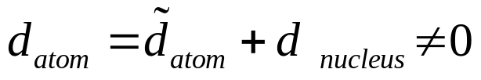

Measurability of Nuclear EDM
L.I. Schiff, Phys. Rev. 132, 2194 (1963)
Schiff shielding
However
since nuclear charge distribution differs from EDM distribution.
$$d_{atom}∝d_{nucleus}∙\left(r_{d}^{2}−r_{c}^{2}\right)∙r_{atom}^{−1}∙r_{c}^{−1}$$
simplified
rigorous
Schiff moment

Slide 8
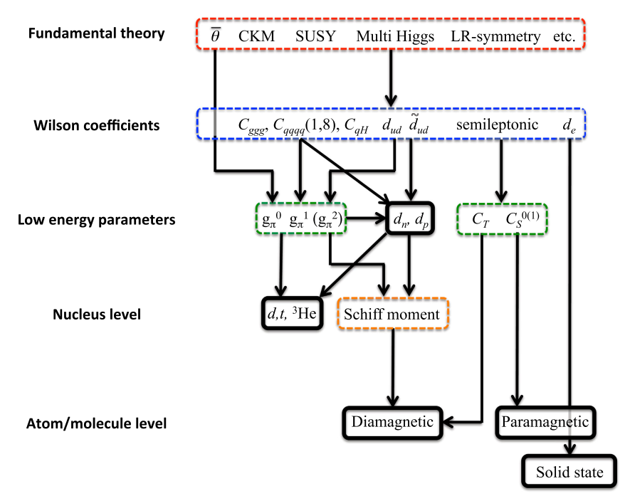
Theories from CP violation to EDM
Chupp et al.,
RMP 91, 015001 (2019)
Calculation of Schiff moments
¹⁹⁹Hg: J. H. de Jesus and J. Engel, PRC 72, 045503 (2005)
²²⁵Ra: J. Dobaczewski and J. Engel, PRL 94, 232502 (2005)
¹⁷¹Yb: Jiangming Yao (尧江明) S. Wang et al., arXiv 2610.22739

Slide 9
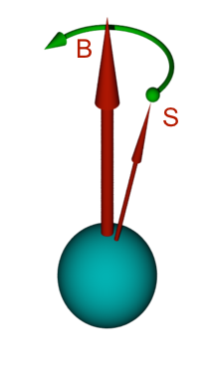
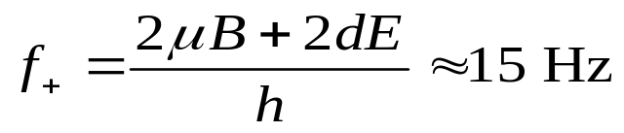


The Seattle EDM Measurement
Spin
precession
¹⁹⁹Hg: high Z, groundstate ¹S₀, I = ½, high vapor pressure
E
E
$$\left|f_{+}−f_{−}\right|<25 pHz$$
Courtesy of Michael Romalis
The best limit on atomic EDM
EDM (¹⁹⁹Hg) < 7 x 10⁻³⁰ e-cm
Graner et al., Phys Rev Lett (2016)
Unit
EDM
+e
-e
cm

Slide 10
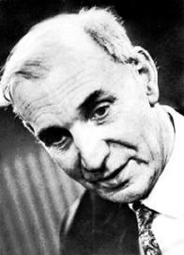
Optical Pumping
m_{F} = +1/2
m_{F} = -1/2
Alfred Kastler
1966 Nobel
Optical pumping
7p ³P₁
F = 1/2
Fluorescence
σ₊
Excitation
7s² ¹S₀
F = 1/2
m_{F} = -1/2
m_{F} = +1/2

Slide 11
AC Stark Shift (Light Shift)
m_{F} = +1/2
m_{F} = +1/2
σ₊
σ₊
On resonance
Red detuned
m_{F} = -1/2
m_{F} = -1/2
Light Shift → Optical Traping

Slide 12
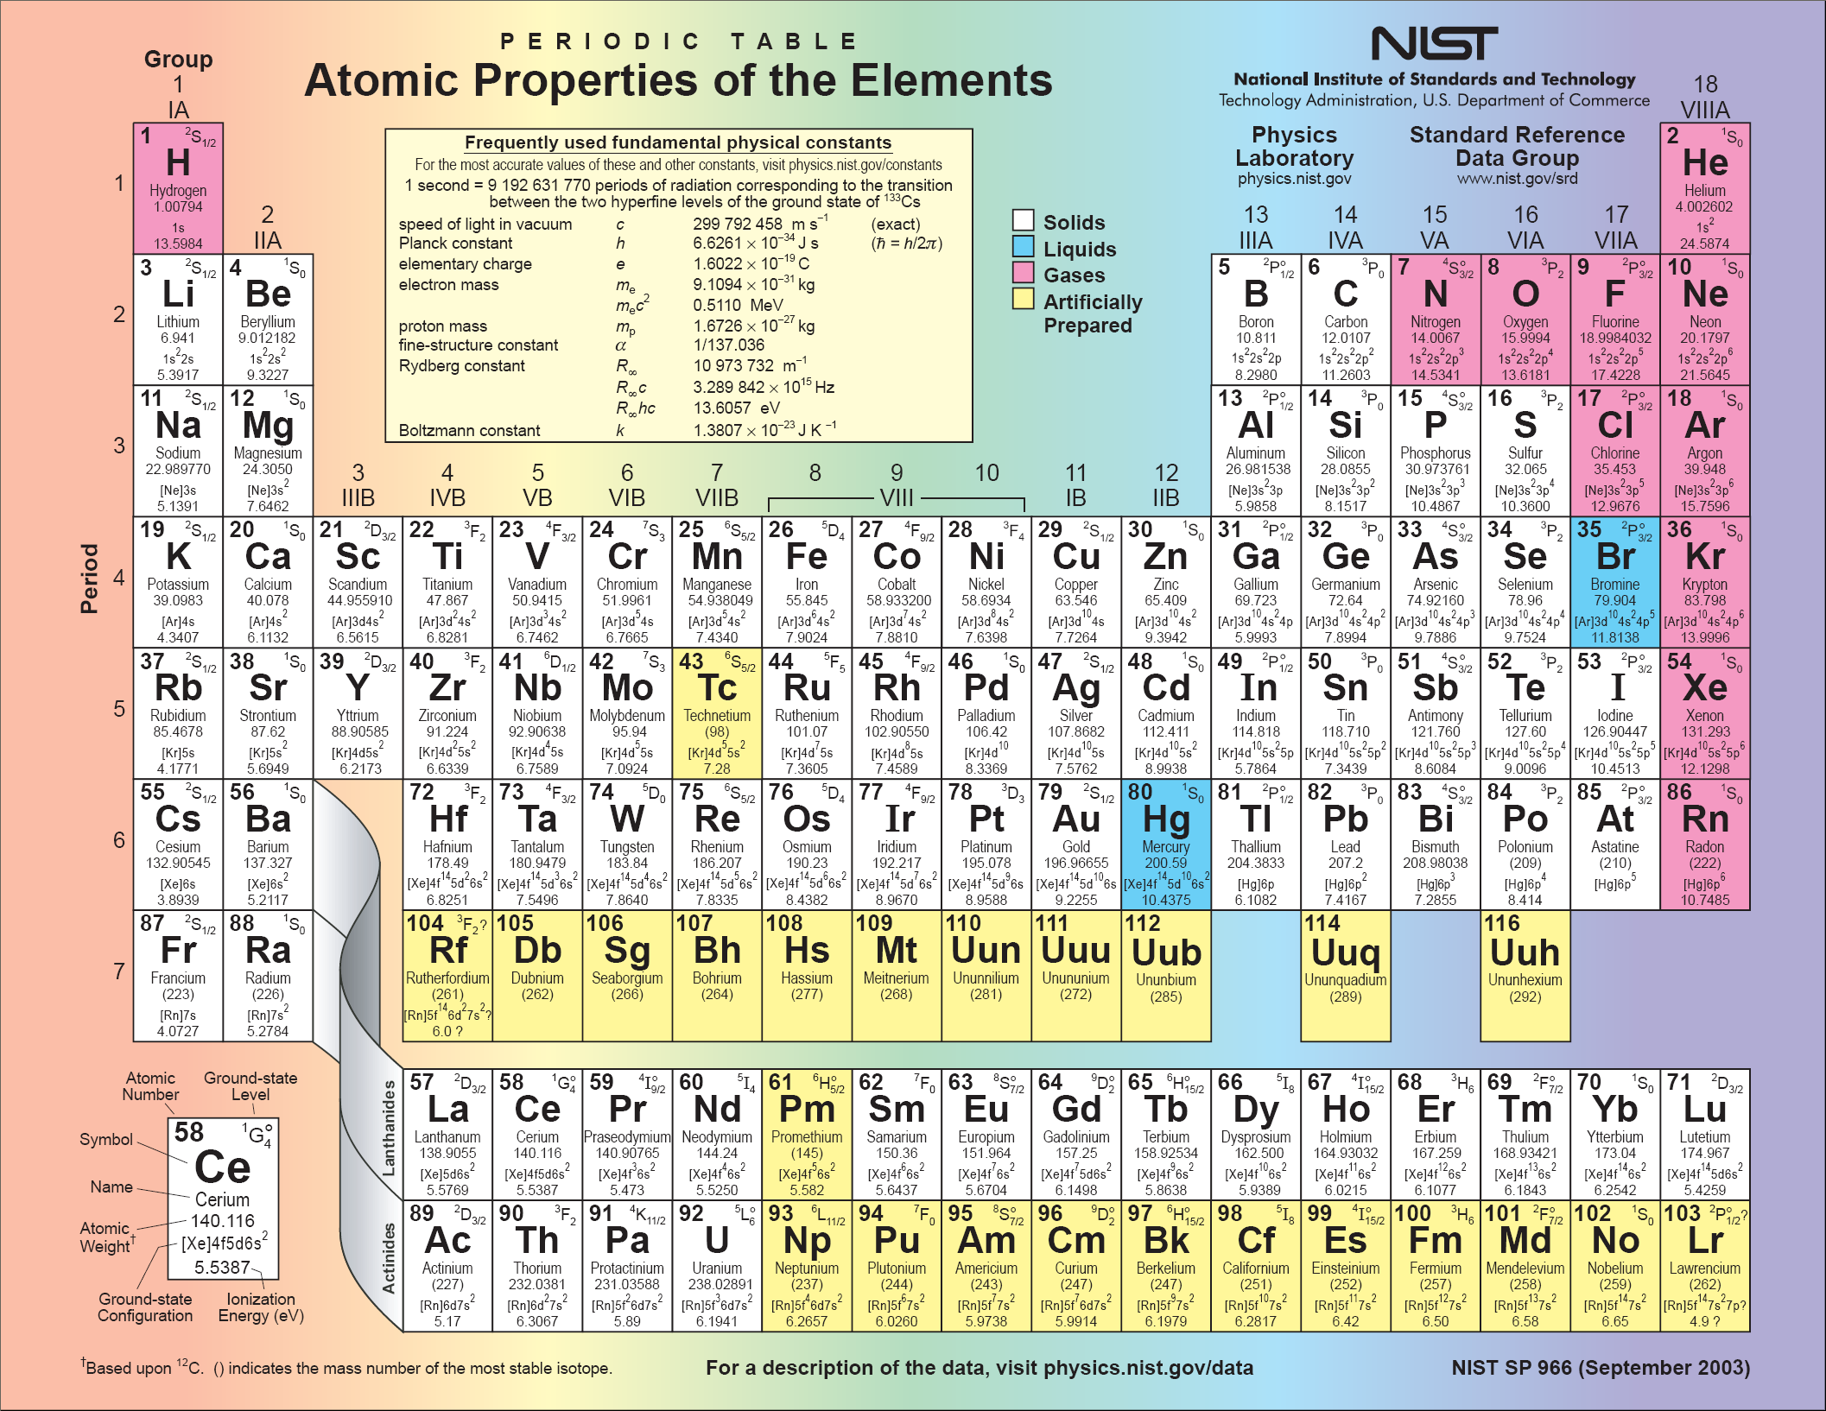
Ds
Rg
Cn
Uut
Fl
Uup
Lv
Uus
Uuo
¹S₀
¹S₀
_{I = 1/2}

Slide 13
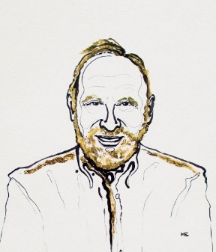
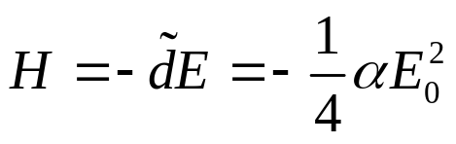
Measure EDM in an Optical Dipole Trap (ODT)
M.V. Romalis and E.N. Fortson, Phys. Rev. A 59, 4547 (1999)
Arthur Ashkin
2018 Nobel
Optical tweezer
Fiber laser: λ = 1036 nm, Power = 10 Watts
Focused to 50 μm → trap depth 60 μK
EDM in an optical dipole trap
v x E , Berry’s phase effects suppressed
Cold scattering suppressed between cold Fermionic atoms
Rayleigh scat. rate ~ 10⁻¹ s⁻¹ ; Raman scat. rate ~ 10⁻¹² s⁻¹
Vector light shift ~ μHz
Parity mixing induced shift under control
Conclusion: possible to reach 10⁻³⁰ e cm for ¹⁹⁹Hg

Slide 14
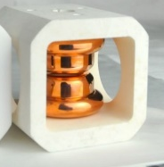
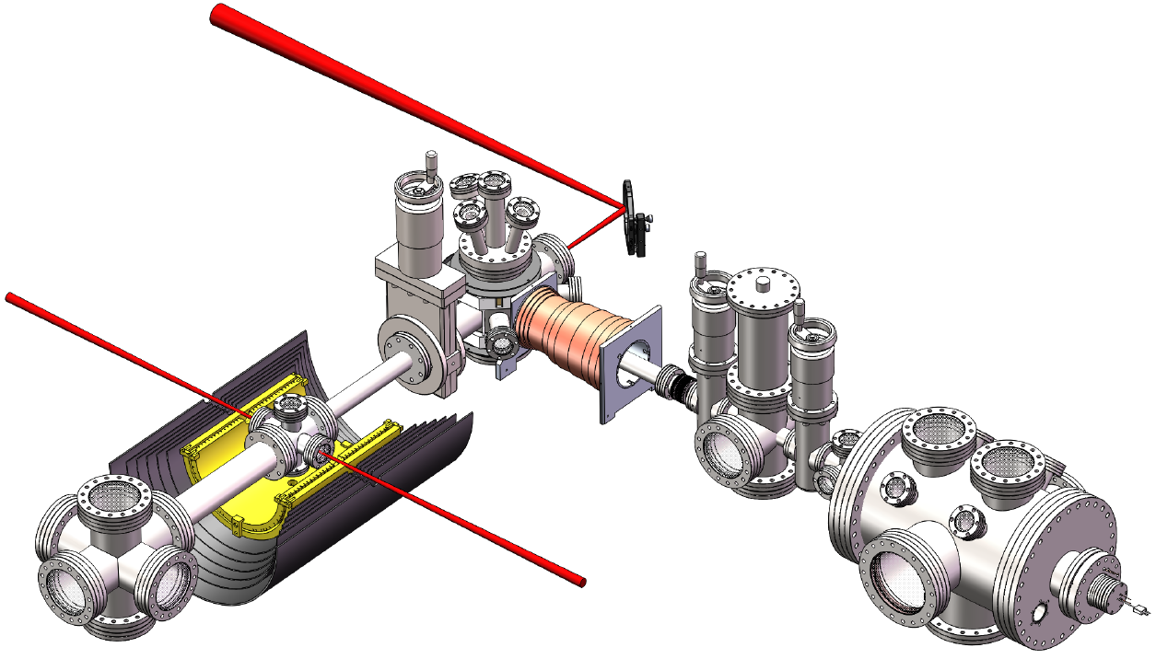
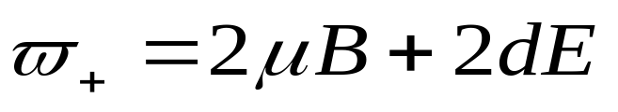
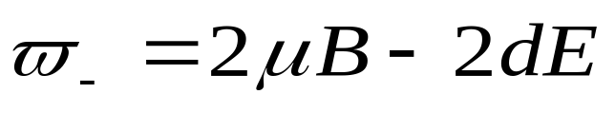

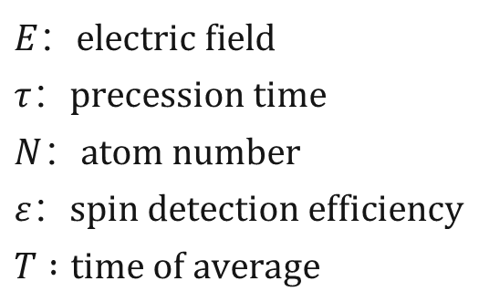
¹⁷¹Yb EDM Apparatus: Trapping + Science
Movable ODT (the “bus”)
Atom beam and trap
Electrodes
$$E：electric field$$
$$τ：precession time$$
$$N：atom number$$
$$ε：spin detection efficiency$$
$$T :time of average$$

Slide 15
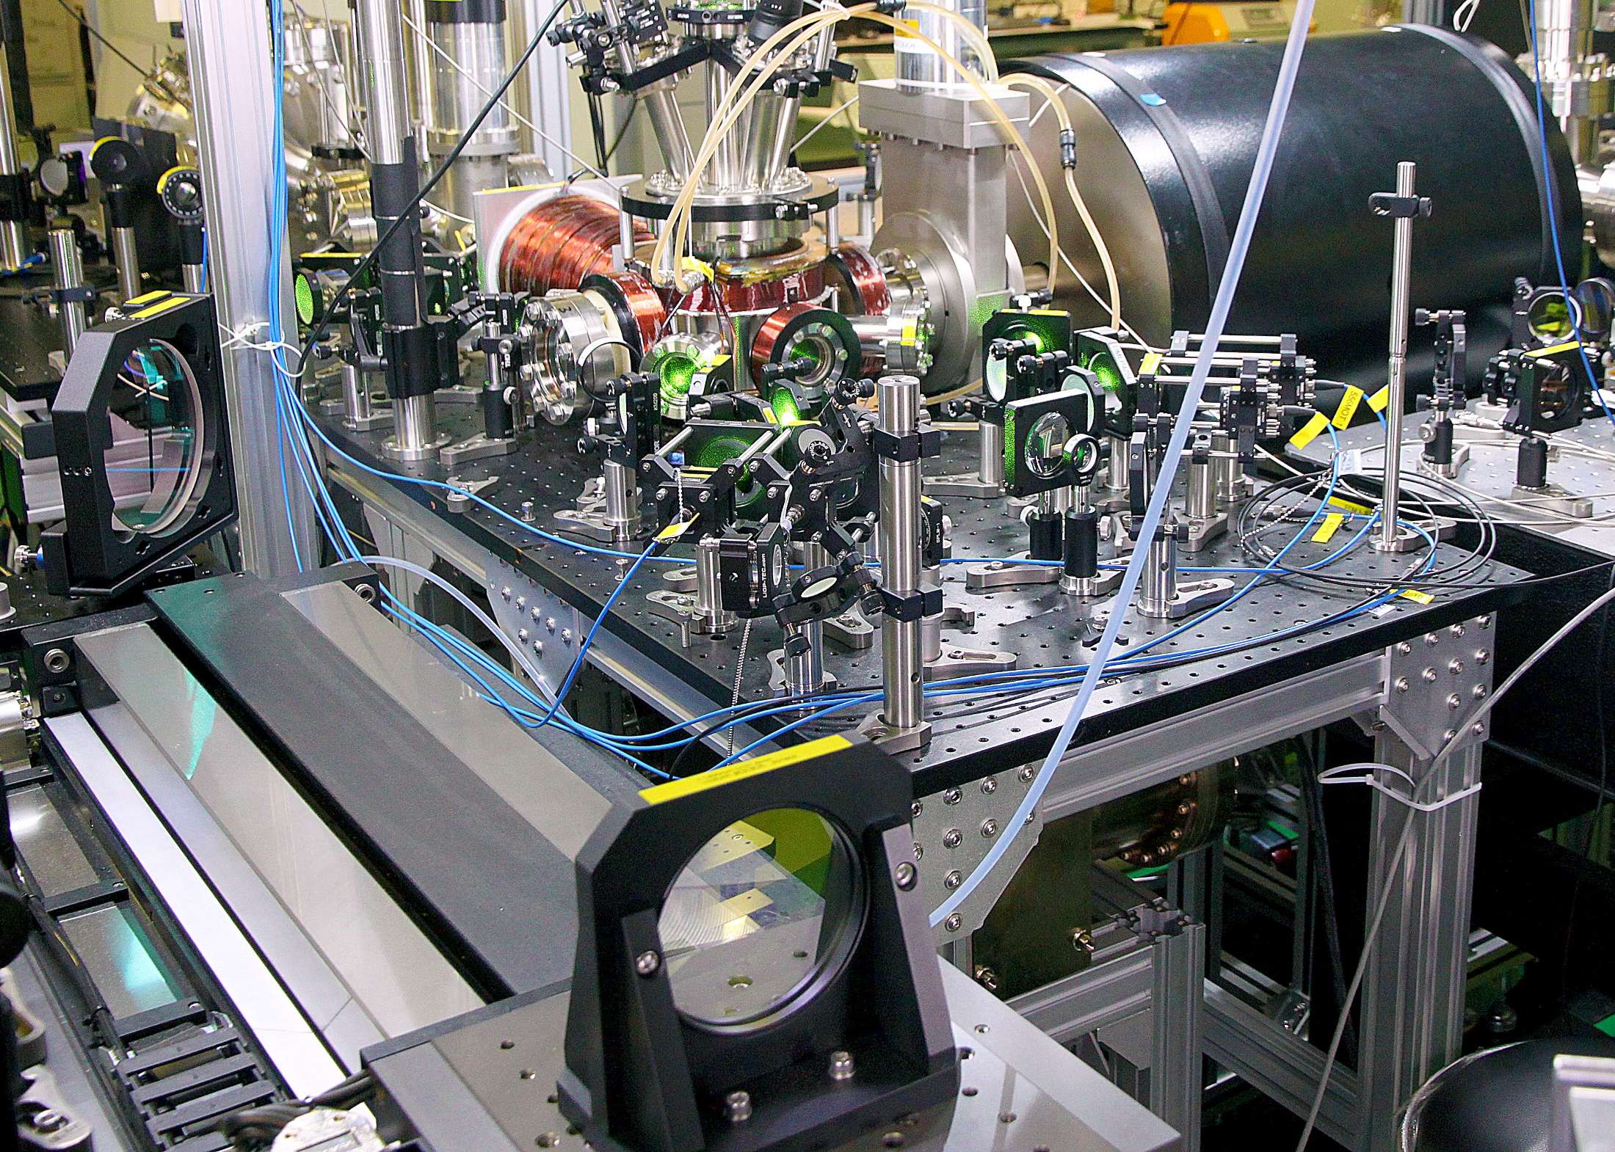
Magnetic shields
Air bearing stage

Slide 16
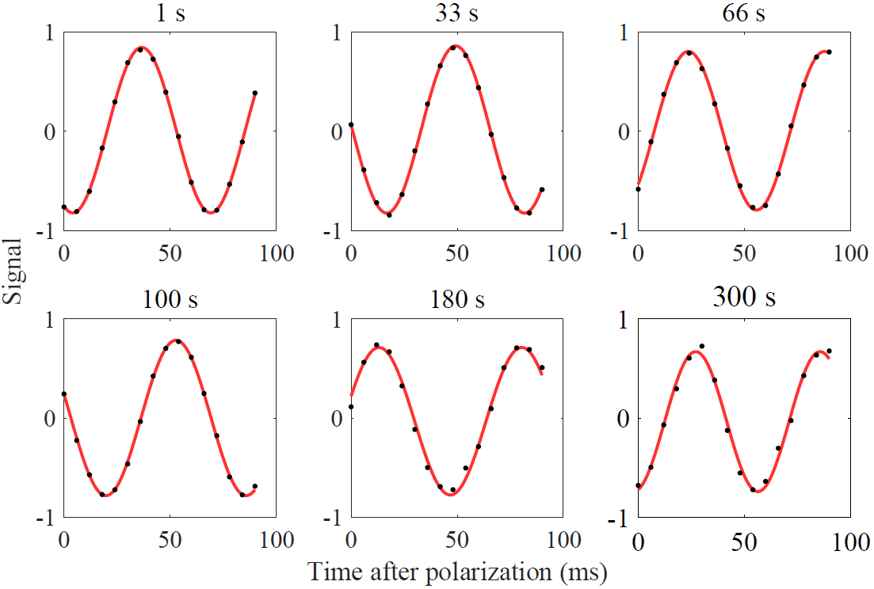
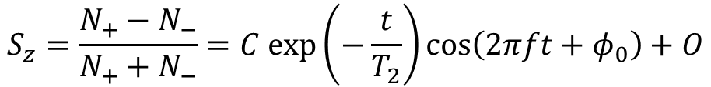
Long spin coherence time (T₂)
$$S_{z}=\frac{N_{+}−N_{−}}{N_{+}+N_{−}}=C exp\left(−\frac{t}{T_{2}}\right)\cos\left(2πft+φ_{0}\right)+O$$
Vacuum-limited trap lifetime: 75 s
EDM measurement precession time: 96 s
Observed precession to: 300 s
T₂ : (9 ± 4) x 10³ s (2.5±1.1 hr)

Slide 17
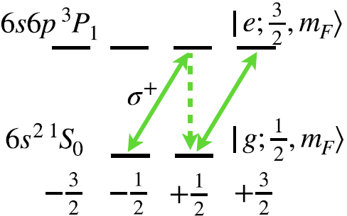
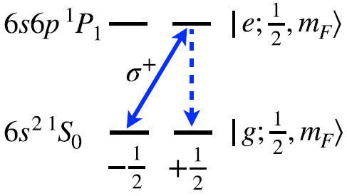
Spin-state detection – conventional method
Bright state：~ 3 photons before state “demolished”
Dark state：no photons,
state preserved
Bright state：state
“demolished”
Brighter state:
cycling,
state preserved

Slide 18
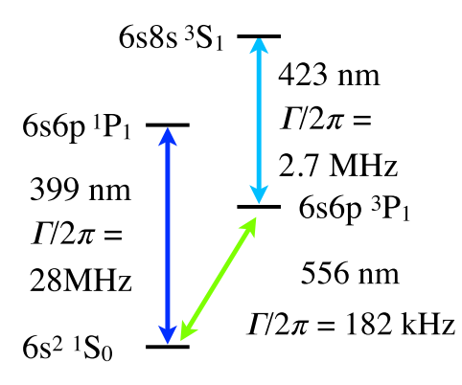
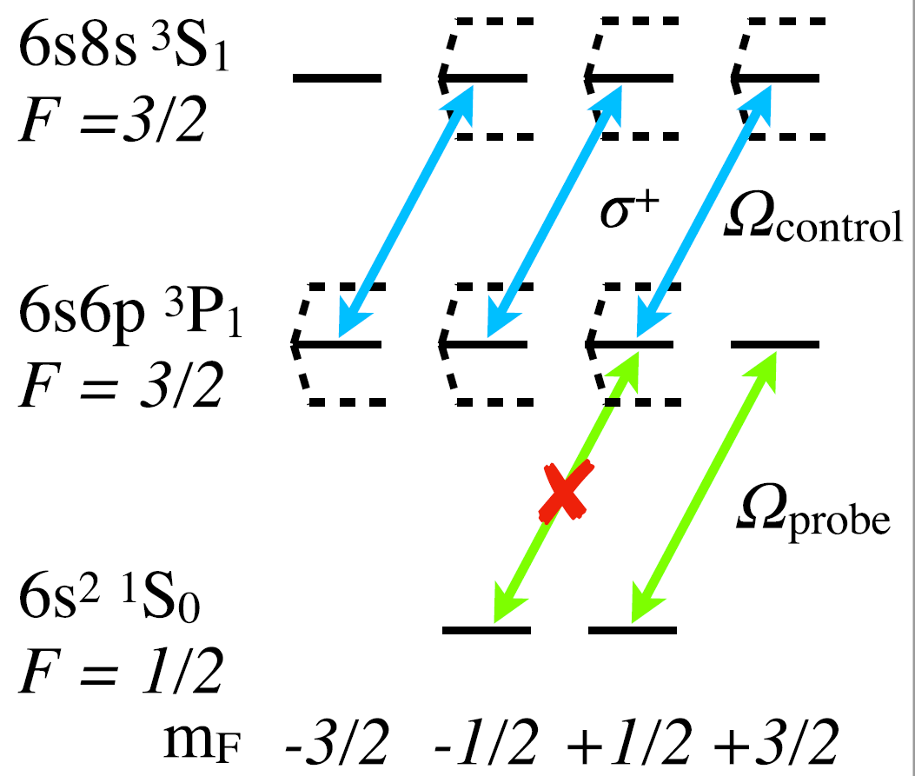
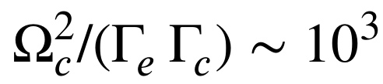


Spin-state detection by a QND method
Yang et al., PRApplied 19, 054015 (2023)
$Ω_{control }\sim 2π×40MHz$
Dark state：
no photons,
state preserved
Bright state:
cycling,
state preserved
$Ω_{probe }\sim 2π×70kHz$
Spin flip suppressed by:
Need ODT to be at magic wavelength
-- T. Zheng, M.S. Safronova et al., PRA (2020)

Slide 19
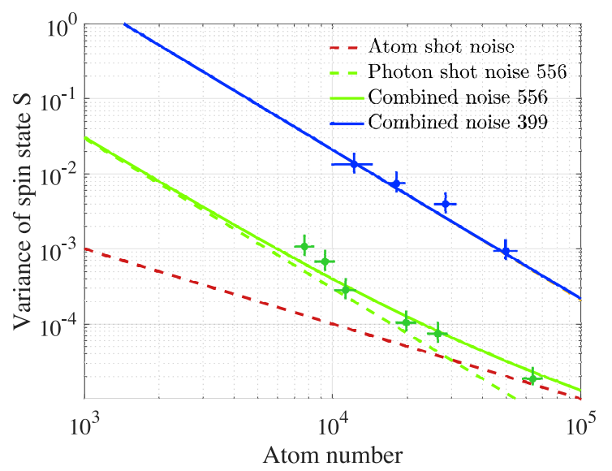
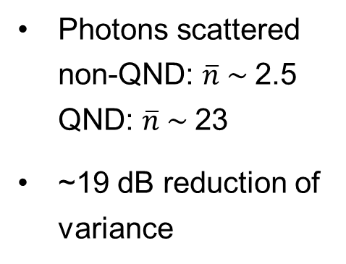
Spin-state detection by a QND method
Yang et al., PRApplied 19, 054015 (2023)
Non QND
Photons scattered non-QND: $\overline{n} \sim$2.5 QND: $\overline{n} \sim$23
~19 dB reduction of variance
Photon shot
QND
Atom shot

Slide 20
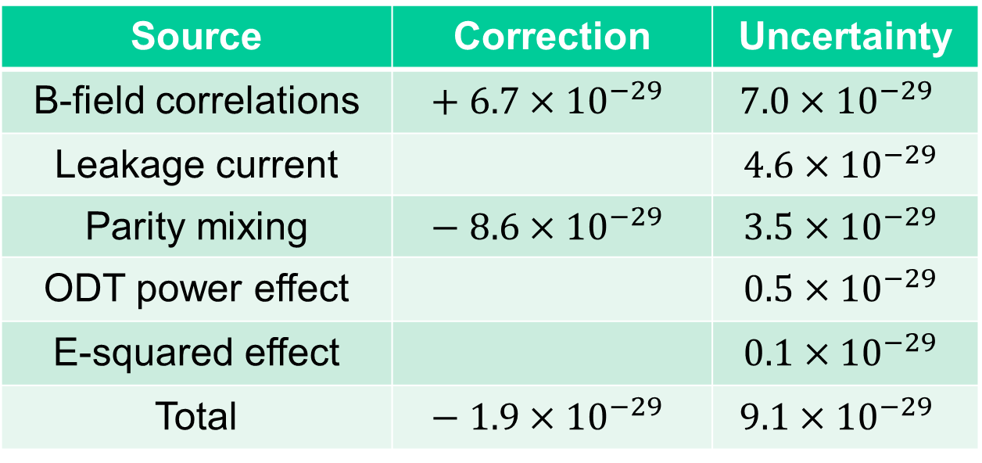
Systematic uncertainties
- effects correlated with E-field flipping
Source | Correction | Uncertainty
B-field correlations | $$+ 6.7×{10}^{−29}$$ | $$7.0×{10}^{−29}$$
Leakage current |  | $$4.6×{10}^{−29}$$
Parity mixing | $$− 8.6×{10}^{−29}$$ | $$3.5×{10}^{−29}$$
ODT power effect |  | $$0.5×{10}^{−29}$$
E-squared effect |  | $$0.1×{10}^{−29}$$
Total | $$− 1.9×{10}^{−29}$$ | $$9.1×{10}^{−29}$$

Slide 21
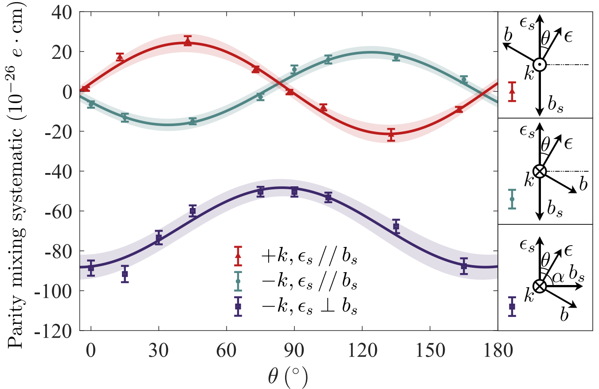
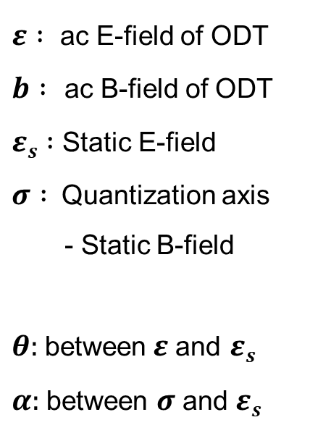
Parity mixing
Romalis and Fortson, PRA 59, 4547 (1999)
T-even, P-even, False EDM: $\tilde{d}={\tilde{d}}_{1}sin\left(2θ−α\right)+{\tilde{d}}_{2}sin⁡(α)$
$ε :$ ac E-field of ODT
$b :$ac B-field of ODT
$εs :$ Static E-field
$σ :$Quantization axis
- Static B-field
$θ:$between$ε$and $εs$
$α:$between $σ$ and $εs$

Slide 22
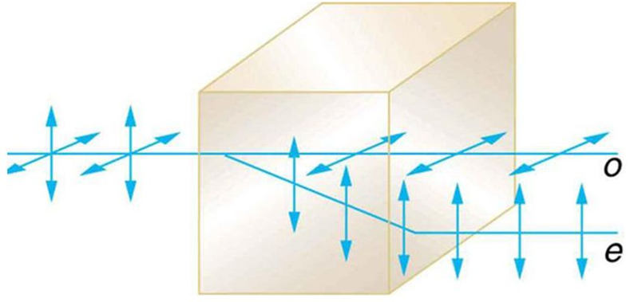
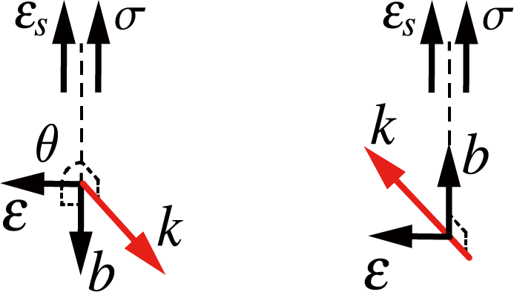
Parity mixing
Romalis and Fortson, PRA 59, 4547 (1999)
T-even, P-even, False EDM: $\tilde{d}={\tilde{d}}_{1}sin\left(2θ−α\right)+{\tilde{d}}_{2}sin⁡(α)$
ODT_{+k,H} + ODT_{+k,V} = 2 x ODT_{+k}
ODT_{+k} + ODT_{-k} = 0
Calcite crystal
$$\text{Residual} \text{parity}\text{−}\text{mixing} \text{effect} :3.5×{10}^{−29} e⋅cm$$

Slide 23
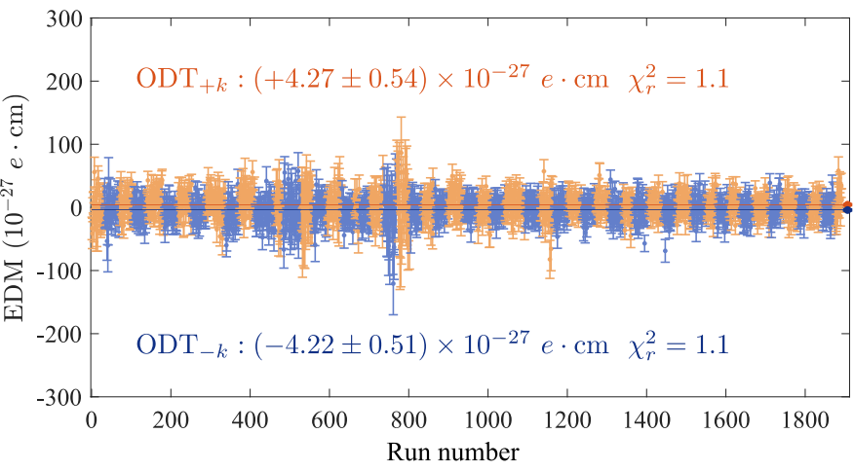
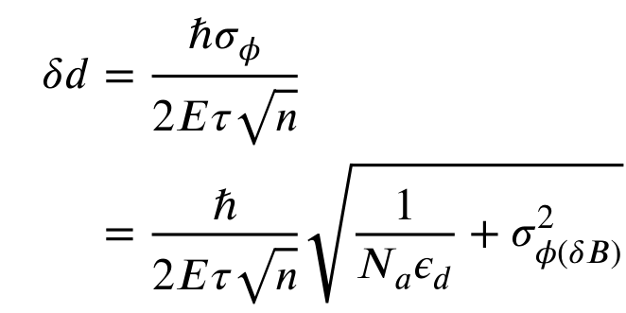
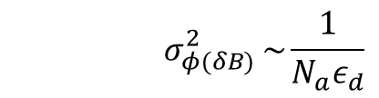
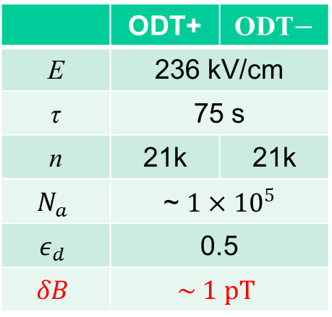
¹⁷¹Yb EDM measurement results
 | ODT+ | ODT$−$
E | 236 kV/cm
τ | 75 s
n | 21k | 21k
$$N_{a}$$ | ~ $1×{10}^{5}$
$$ε_{d}$$ | 0.5
$$δB$$ | $$\sim 1 pT$$
$$d\left(171Yb\right)=\left(0.1±{3.7}_{stat}±{0.9}_{syst}\right)×{10}^{−28} e cm$$
Upper limit (95%) ：$\left|d\left(171Yb\right)\right|<7.5×{10}^{−28} e cm$
$$σ_{φ(δB) }^{2}\sim \frac{1}{N_{a}ε_{d}}$$
Measurement of the EDM of ¹⁷¹Yb atoms in an ODT. Zheng et al., PRL 129, 083001 (2022)
New limit on ¹⁷¹Yb EDM. Wang et al., c(20x improved over PRL 2022)
Notes:
This figure shows all the data, orange and blue are for +k and –k. Besides the atomic projection noise and optical noise, there is some random B-field noise contributing to EDM uncertainty, it is mainly the Johnson noise from the copper electrodes. Currently, we are limited by the statistical error. This tables shows how we get the measurement done. The electric field, the interrogation time for single cycle, the repetition times for each direction of trap, the number of atoms, the spin state detection efficiency. Here the additional phase noise is characterized by the B-field fluctuation in 75s. Roughly, the 95% confidence upper limit is expected to improve by a factor of 16 or so compared with 2022.

Slide 24
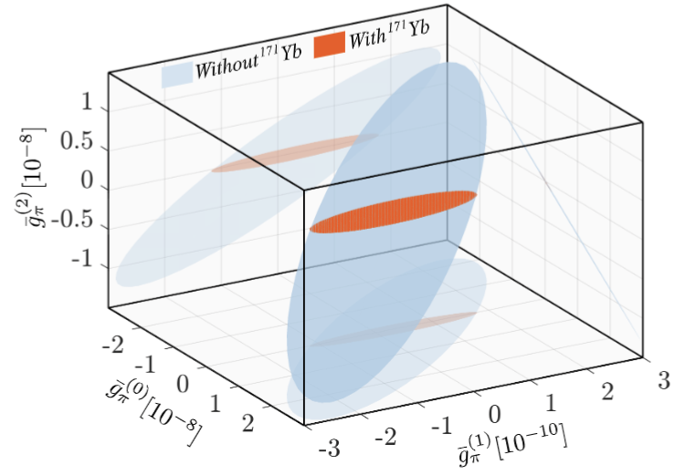

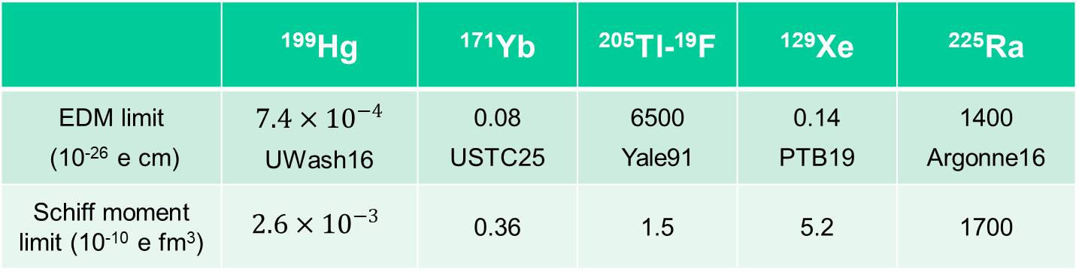
Global analysis
Chupp and Ramsey-Musolf, PRC (2015); Chupp et al., RMP (2019)
 | ¹⁹⁹Hg | ¹⁷¹Yb | ²⁰⁵Tl-¹⁹F | ¹²⁹Xe | ²²⁵Ra
EDM limit (10⁻²⁶ e cm) | $$7.4×{10}^{−4}$$ UWash16 | 0.08 USTC25 | 6500 Yale91 | 0.14 PTB19 | 1400 Argonne16
Schiff moment limit (10⁻¹⁰ e fm³) | $$2.6×{10}^{−3}$$ | 0.36 | 1.5 | 5.2 | 1700
Schiff moment
g: CP-violating coupling constants
(0) scalar (1) vector (2) tensor
a: nuclear structure parameters
New limit on ¹⁷¹Yb EDM.
Wang et al., arXiv 2610.22739
Notes:
This slide lists all the results of EDM upper limits due to Schiff moments. The first row is the EDM upper limits from the experiments. For each species of atom and molecule, there is a conversion factor for the Schiff moments. So the second row is the upper limits of the Schiff moment, and particle and nuclear physicists calculate the Schiff moments in terms of CP violating parameters, \etas are the interactions between nucleons that violate CP symmetry. You can see that 199Hg measurement limit is much better than all the others. Schiff moments’ sensitivities to the eta numbers are different, 225Ra is the most sensitive than all the others, the coefficients are three orders of magnitude bigger than the others. What it matters here is the how strong we can constrain the etas, it actually the ratio of the second row numbers and the coefficients in the third row.
Since there are multiple etas, limits from multiple systems make it possible to globally constrain these etas, rather than 199Hg alone.

Slide 25
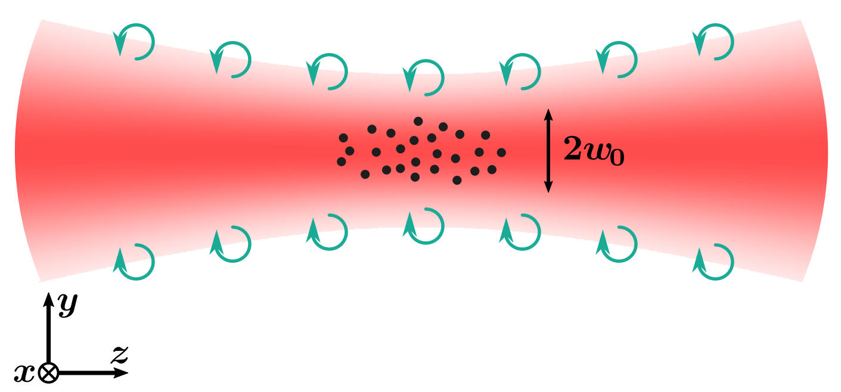
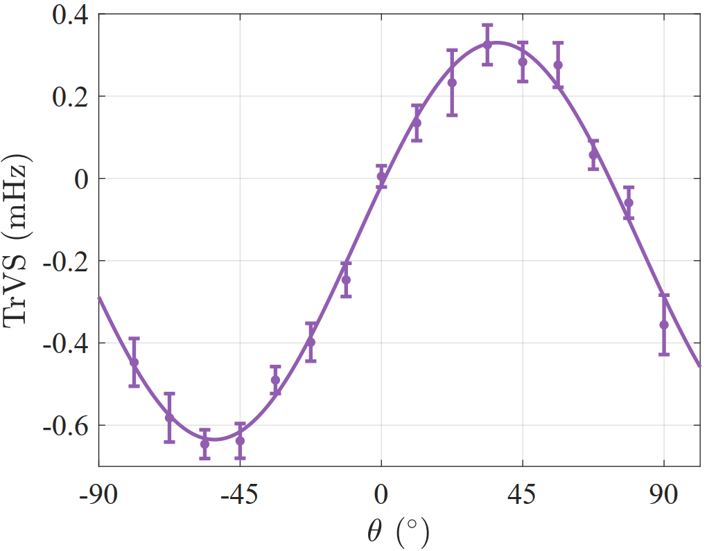
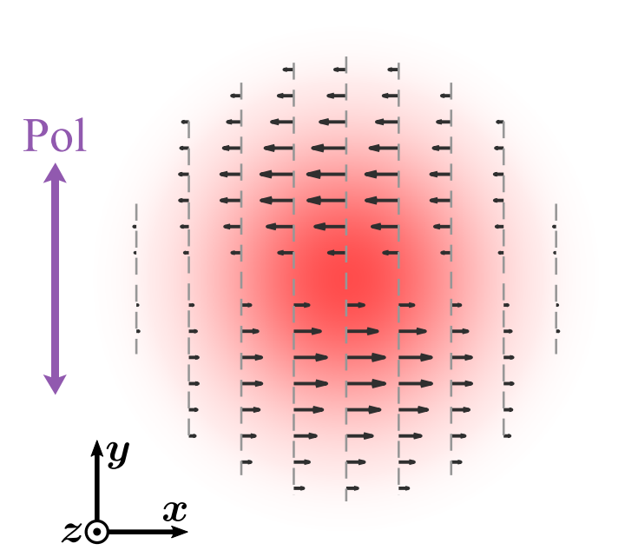
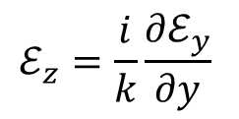
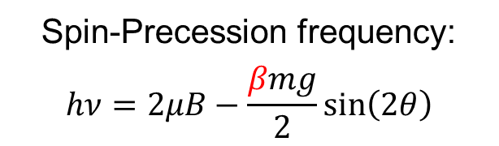


Gravity-Induced Transverse Vector Light Shift
At force equilibrium, force-to-frequency conversion is robust
Sensing weak force at μm-range (10⁻¹⁴ pN)
General systematic effect in precision measurement and quantum computing
Spin-Precession frequency:
$$hν=2μB−\frac{βmg}{2}sin\left(2θ\right)$$
$$ℰ_{z}=\frac{i}{k}\frac{∂ℰ_{y}}{∂y}$$
$$Δν (mHz)$$
$$g=9.8\left(5\right) m/s^{2}$$
Vector structure of a light beam
Wang et al., submitted

Slide 26
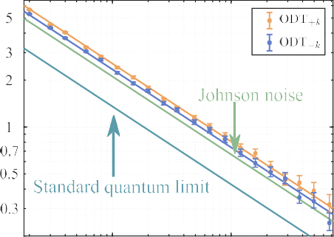
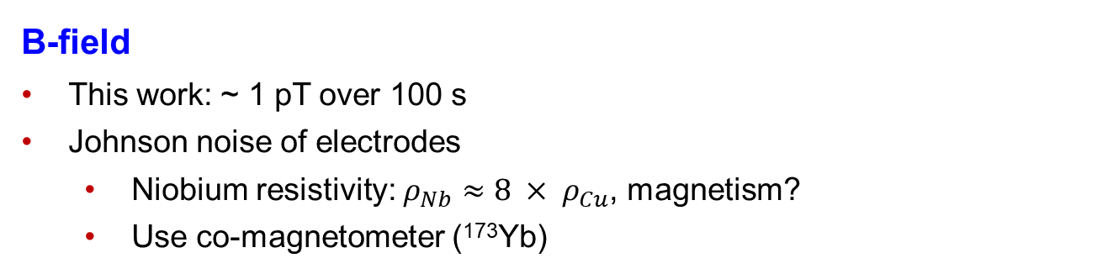
Outlook #1
Upgrade: ¹⁷¹Yb EDM precision improves into E-29 e-cm
  Larger E-field
  Longer trap lifetime
  Less B-field noise
  Optical cavity
E-field
Realized: 300 kV/cm, copper
Other works: 500 kV/cm, niobium
  - Ready et al. NIM A (2021)
B-field
This work: ~ 1 pT over 100 s
Johnson noise of electrodes
  Niobium resistivity: $ρ_{Nb}≈8 × ρ_{Cu}$, magnetism?
  Use co-magnetometer (¹⁷³Yb)

Slide 27
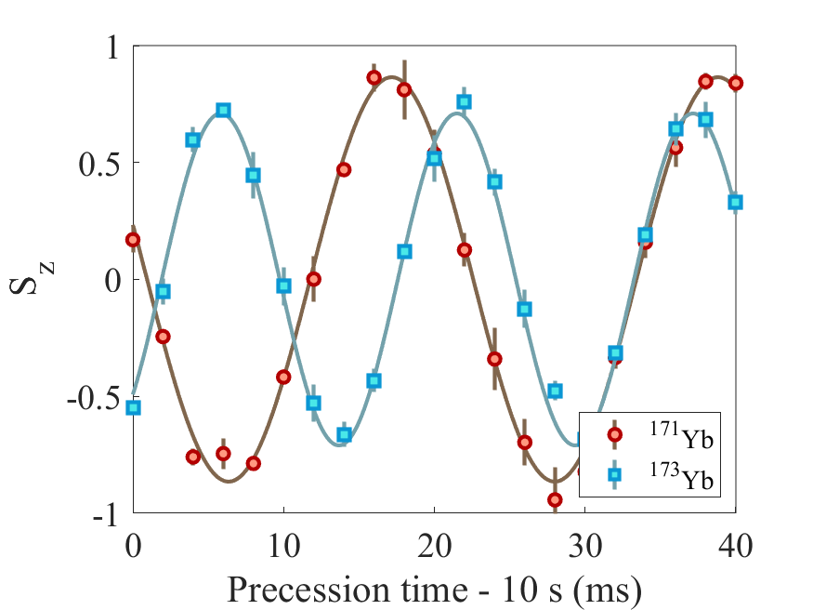
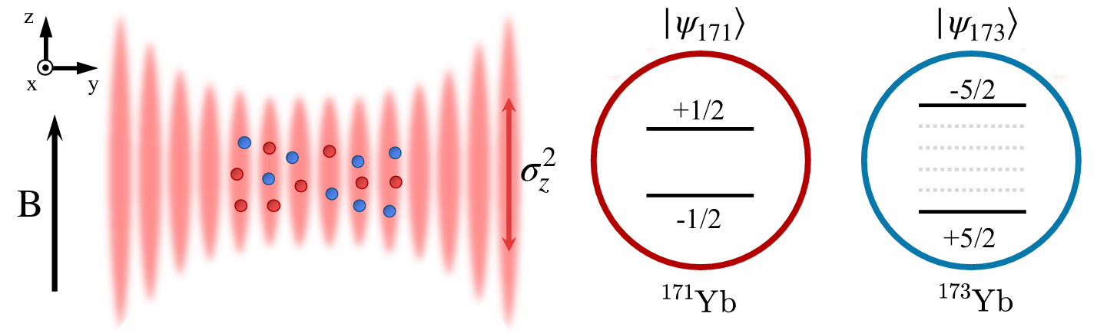

Cold-atom comagnetometry
via optical control of spin states
Zhang, Luo et al. Nat. Photonics, online (2026)
B-field noise suppression factor: 30,000
Ratio of nuclear magnetic moments R_171/173 = - 0.726076(3)
¹⁷¹Yb & ¹⁷³Yb co-trapped
$$R=\frac{ω_{171}}{ω_{173}}=\frac{γ_{171}B}{γ_{173}B}$$
Notes:
Experimentally, we use a control laser beam, which is about 1GHz detuned from resonance, so the tensor shift and vector shift is large enough, and the spin rotation will be fast enough. As I said, if the ratio of the vector and the tensor shift is 1:1, it generates the cat state, if it is 1:2, it generates coherent spin-state.

Slide 28





¹⁷³Yb (I = 5/2) decoherence in ODT
Prepare initial state:
$${|\left.+5/2\right\rangle }_{x}$$
Zeeman shift F_{z}
Problem: decoherence due to spatially varying ODT light shift
Stark shift (F_{z})²
$$ODT tensor shift: H_{t}=Ω(r)F_{z}^{2}$$

Slide 29






Minute-scale Schrödinger–cat state of spin-5/2 atoms
Yang et al., Nat. Photonics 19, 89 (2025)
$$π/2$$
$$\left|+5/2\right\rangle \left|Cat\right\rangle =\frac{1}{\sqrt{2}} \left( \left|+5/2\right\rangle + \left|−5/2\right\rangle \right)$$
$$High−spin π/2 pulse$$
Zeeman shift I_{z}
$$H=Ω\left(F_{x}−F_{x}^{2}\right)$$
$$t=\frac{π}{2Ω}$$
$$Ω=2π∙0.5 kHz$$
Stark shift I_{z}²
Coherence time ~ 1400 s

Slide 30




Search for Monopole-Dipole Interaction
or spin – mass coupling
$$\text{V}\text{(}\text{r}\text{)} \text{=}{ ℏ}^{2}g_{s}^{a}g_{p}^{b}\frac{σ_{b}⋅\hat{r}}{8πm_{b}}\left(\frac{1}{rλ}+\frac{1}{r^{2}}\right)e^{−\frac{r}{λ}}$$
$$R=\frac{ω_{171}}{ω_{173}}=\frac{γ_{171}B+V_{171}}{γ_{173}B+V_{173}}$$
Moody and Wilczek, PRD 30, 130 (1984)
spins
near
Pt
far
1: ${}_{}^{3}{He}$ depolarization. PRD (2015)
2: ${}_{}^{129}{Xe}$-${}_{}^{131}{Xe}$-Rb comag. PRL (2022)
Estimated sensitivities of ${}_{}^{171}{Yb}$-${}_{}^{173}{Yb}$ comag:
5: 70 um - version @ 100 h
6: Single-atom, 1 um - version @ 100 d

Slide 31
Outlook #2
¹⁷¹Yb
2-electron system
Nuclear spin I = ½
Stable and abundant
²²⁵Ra:
Group II
Nuclear spin I = ½
Radioactive t_{1/2} = 15 d
6s8s ³S₁
7s8s ³S₁
423 nm
Γ/2π =
2.7 MHz
784 nm
Γ/2π =
8.8 MHz
6s6p ¹P₁
7s7p ¹P₁
399 nm
Γ/2π =
28 MHz
483 nm
Γ/2π =
29 MHz
6s6p ³P₁
7s7p ³P₁
556 nm
Γ/2π = 182 kHz
714 nm
Γ/2π = 442 kHz
6s² ¹S₀
7s² ¹S₀
¹⁷¹Yb
E-28 e-cm
²²⁵Ra
E-28 e-cm
¹⁹⁹Hg
E-31 e-cm
$$\sim$$

Slide 32


EDM of ²²⁵Ra enhanced and more reliably calculated
Closely spaced parity doublet – Haxton & Henley, PRL (1983)
Large Schiff moment due to octupole deformation – Auerbach, Flambaum & Spevak, PRL (1996)
Relativistic atomic structure (²²⁵Ra / ¹⁹⁹Hg ~ 3) – Dzuba, Flambaum, Ginges, Kozlov, PRA (2002)
Parity doublet
|α⟩
|β⟩
Enhancement Factor: EDM (²²⁵Ra) / EDM (¹⁹⁹Hg)
 | Isoscalar | Isovector
Skyrme SIII | 300 | 4000
Skyrme SkM* | 300 | 2000
Skyrme SLy4 | 700 | 8000
Ψ⁻ = (|α⟩ − |β⟩)/√2
Ψ⁺ = (|α⟩ + |β⟩)/√2
55 keV
Schiff moment of ²²⁵Ra, Dobaczewski, Engel, PRL (2005)
Schiff moment of ¹⁹⁹Hg, Dobaczewski, Engel et al., PRC (2010)
“[Nuclear structure] calculations in Ra are almost certainly more reliable than those in Hg.”
– Engel, Ramsey-Musolf, van Kolck, Prog. Part. Nucl. Phys. (2013)
Constraining parameters in a global EDM analysis.
– Chupp, Ramsey-Musolf, PRC 91, 035502 (2015)

Slide 33


国际合作团队
Collaboration and Support
USTC
Xin-Peng Lin 林鑫鹏
Z.-T. Lu 卢征天
Wei-Tao Luo 罗炜涛
Zhi-Jin Tao 陶知进
Shou-Bo Wang 王守博
Shao-Zhen Wang 王绍政
Yu-Qi Wang 王雨琦
Tian Xia 夏添
Yang Yang 杨洋
Jie-Ling Zhang 张洁琳
Tao Zheng 郑涛
张洁琳 罗炜涛
We acknowledge support by:
Ministry of Science and Technology
National Natural Science Foundation
Chinese Academy of Sciences
林鑫鹏、王守博、王绍政
陶知进
夏添

