Slide 1
eBins = {0.0925, 0.095, 0.0975, 0.1, 0.105, 0.11, 0.115, 0.12, 0.125, 0.13, 0.135, 0.14};
thetaBins = {0, 0.04, 0.08, 0.12, 0.16, 0.2, 0.24, 0.28, 0.32, 0.36, 0.4, 0.44, 0.48, 0.52, 0.56, 0.6, 0.64, 0.68, 0.72, 0.76, 0.8, 0.8025, 0.805, 0.8075, 0.81, 0.8125, 0.815, 0.8175, 0.82, 0.8225, 0.825, 0.8275, 0.83, 0.8325, 0.835, 0.8375, 0.84, 0.8425, 0.845, 0.8475, 0.85, 0.855, 0.86, 0.865, 0.87, 0.875, 0.88, 0.885, 0.89, 0.895, 0.9, 0.905, 0.91, 0.915, 0.92, 0.925, 0.93, 0.935, 0.94, 0.942, 0.944, 0.945};

Slide 2
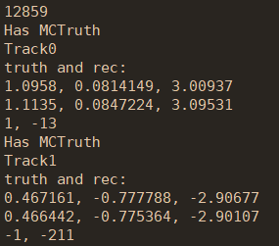

Fast sim with 3D sampling vs. Full sim
Selection criteria | Full sim |  |  | Fast sim (3D sampling)
 | Events | Absolute eff. | Relative eff. | Events | Absolute eff. | Relative eff.
Generated | 20000 | - | - | 20000 | - | -
Reconstructed | 20000 | 100% | 100% | 20000 | 100% | 100%
nGood = 2 | 14852 | 74.3% | 74.3% | 15458 | 77.3% | 77.3%
Truth matched | 14851 | 74.3% | 99.99% | 15458 | 77.3% | 100%
全模拟truth match效率不等于100%，
检查truth信息发现存在$μ^{+}$

Slide 3
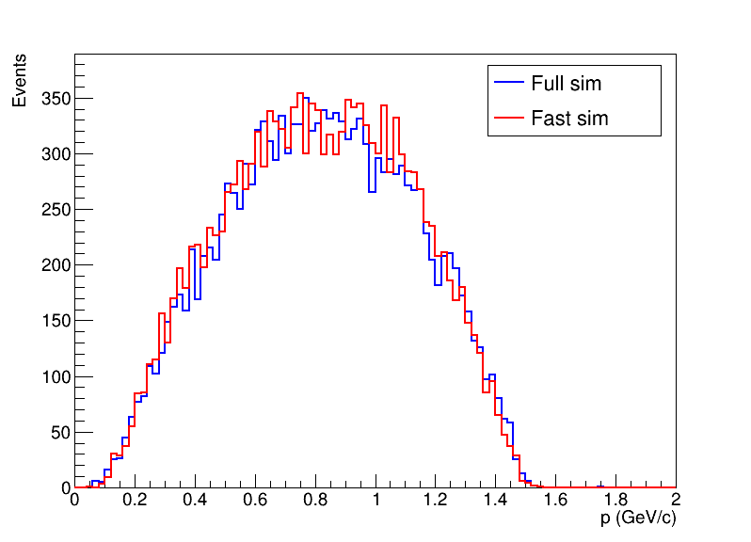
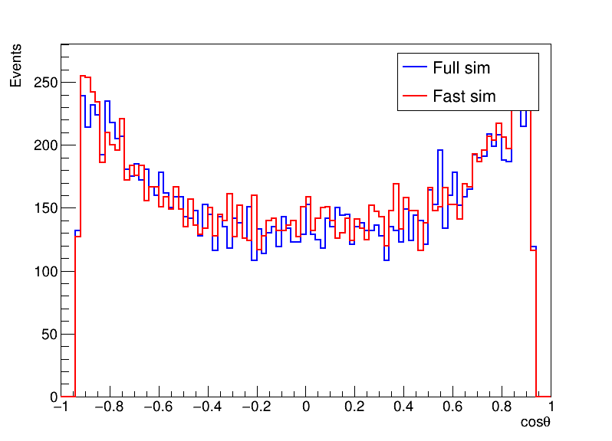
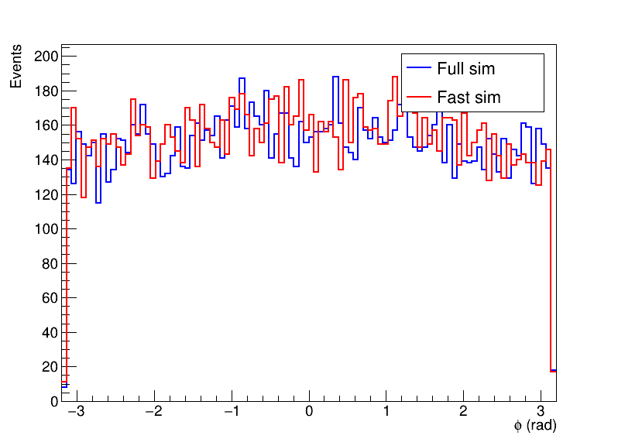
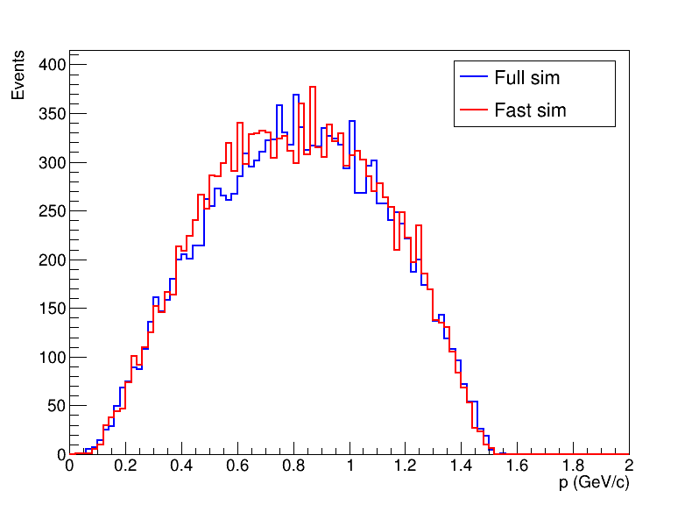
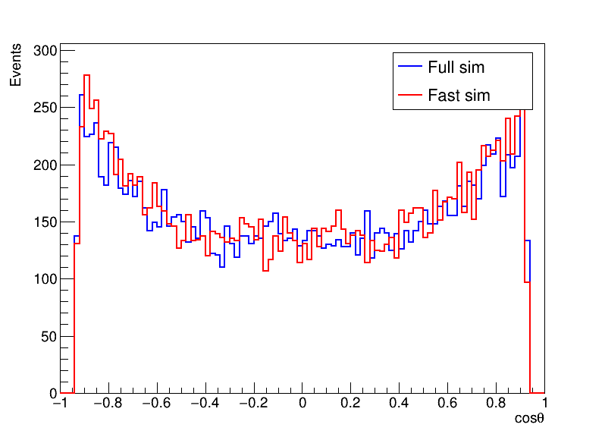
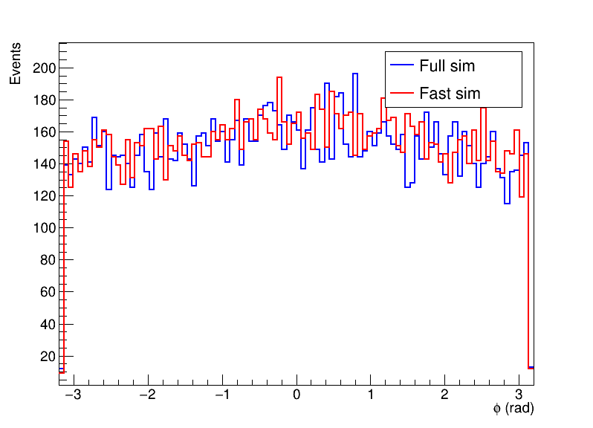
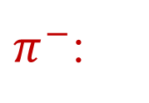
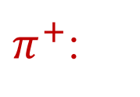
Fast sim with 3D sampling vs. Full sim
$π^{+}$:
$π^{−}$:

Slide 4
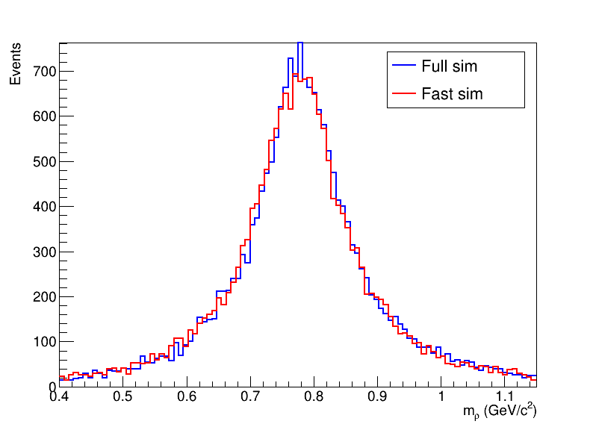
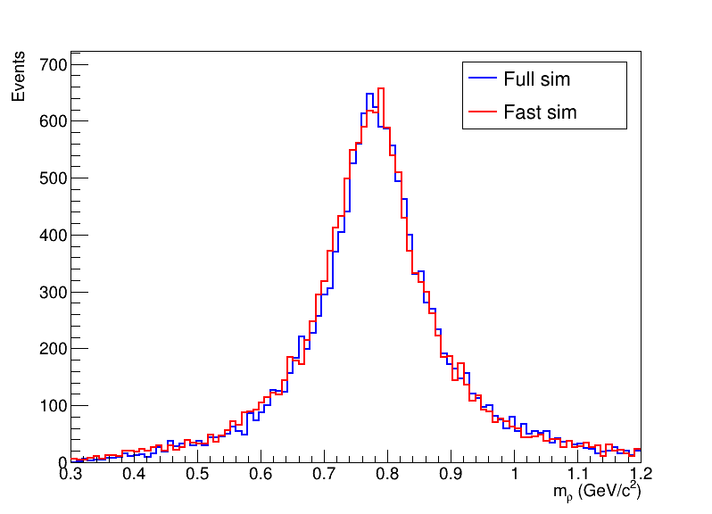

Fast sim with 3D sampling vs. Full sim
$ρ$ mass:
truth
reconstructed

Slide 5
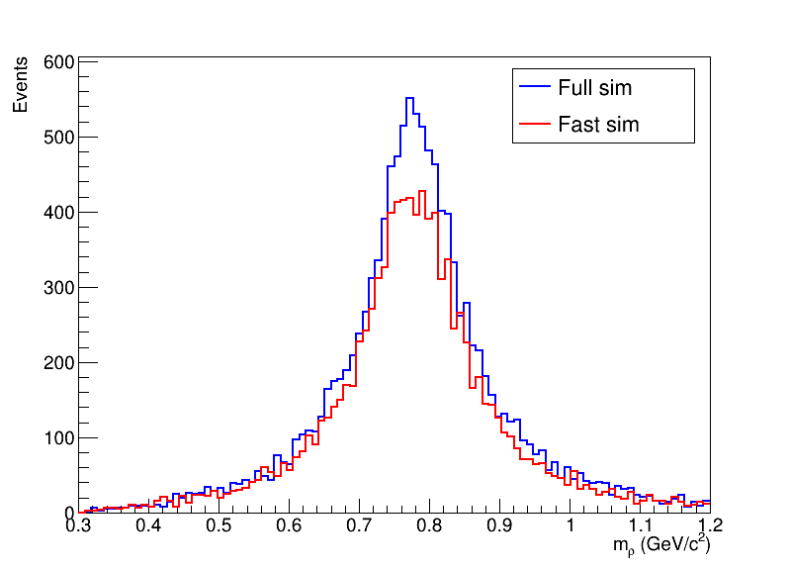
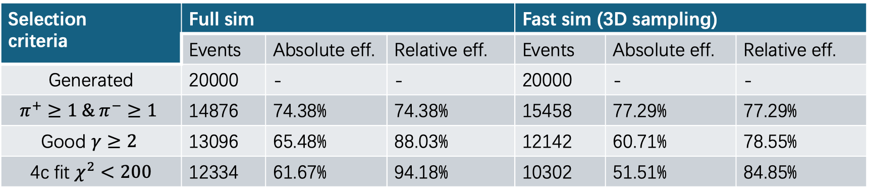

Fast sim with 3D sampling vs. Full sim
Selection criteria | Full sim |  |  | Fast sim (3D sampling)
 | Events | Absolute eff. | Relative eff. | Events | Absolute eff. | Relative eff.
Generated | 20000 | - | - | 20000 | - | -
$$π^{+}≥1 \& π^{−}≥1$$ | 14876 | 74.38% | 74.38% | 15458 | 77.29% | 77.29%
Good $γ≥2$ | 13096 | 65.48% | 88.03% | 12142 | 60.71% | 78.55%
4c fit $χ^{2}<200$ | 12334 | 61.67% | 94.18% | 10302 | 51.51% | 84.85%
$$J/ψ→ρ^{0}π^{0} ρ^{0}→π^{+}π^{−} π^{0}→γγ$$

Slide 6
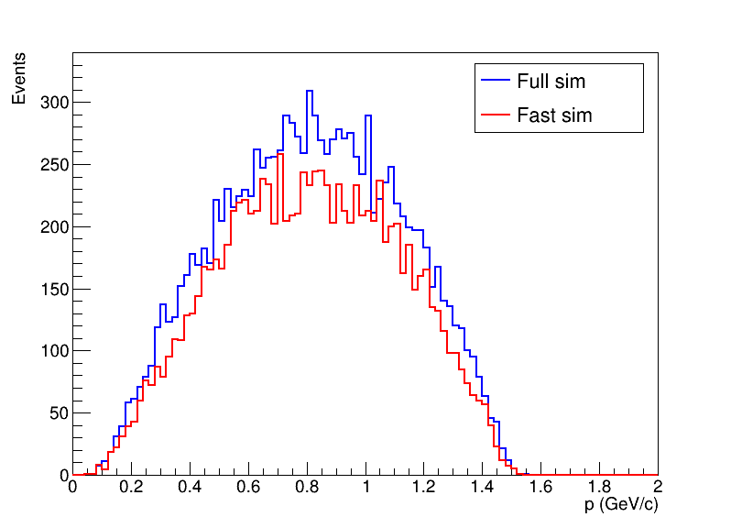
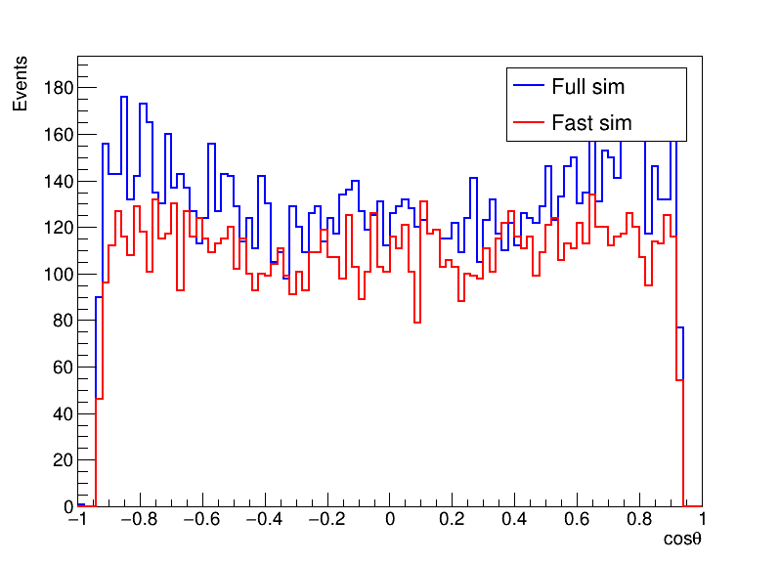
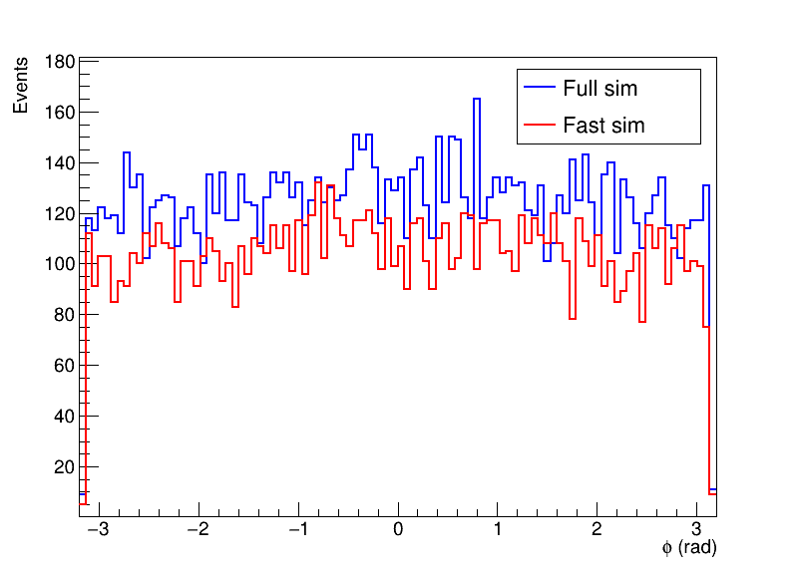

$π^{−}$:

Slide 7
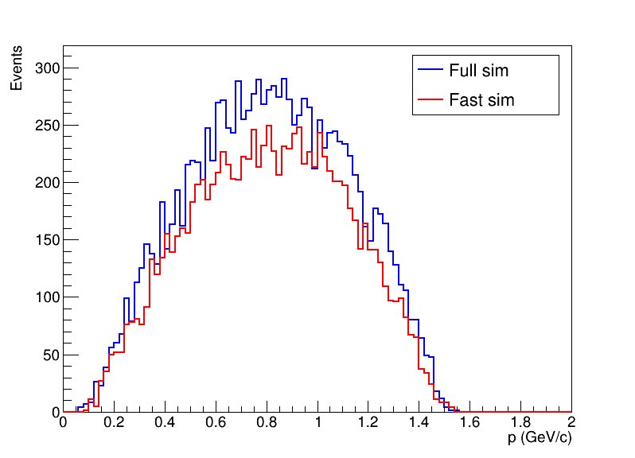
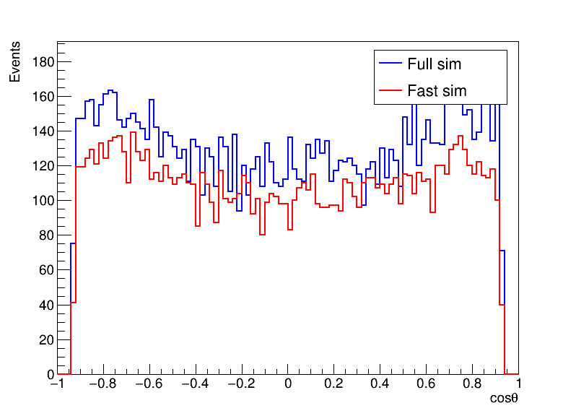
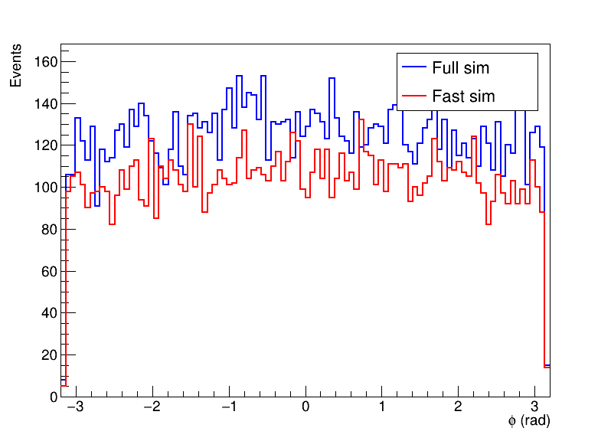
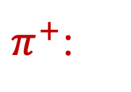
$π^{+}$:

Slide 8
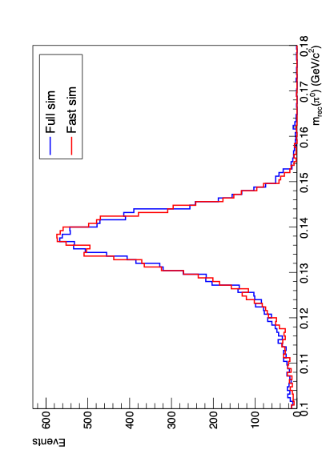
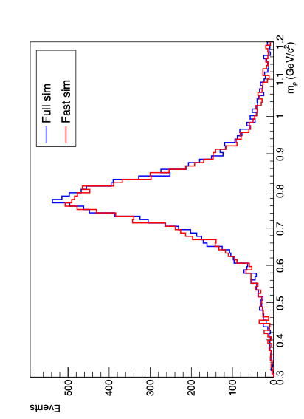
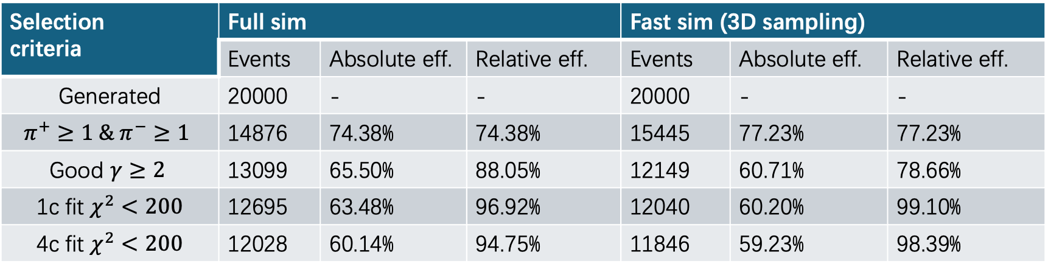

Fast sim with 3D sampling vs. Full sim
Selection criteria | Full sim |  |  | Fast sim (3D sampling)
 | Events | Absolute eff. | Relative eff. | Events | Absolute eff. | Relative eff.
Generated | 20000 | - | - | 20000 | - | -
$$π^{+}≥1 \& π^{−}≥1$$ | 14876 | 74.38% | 74.38% | 15445 | 77.23% | 77.23%
Good $γ≥2$ | 13099 | 65.50% | 88.05% | 12149 | 60.71% | 78.66%
1c fit $χ^{2}<200$ | 12695 | 63.48% | 96.92% | 12040 | 60.20% | 99.10%
4c fit $χ^{2}<200$ | 12028 | 60.14% | 94.75% | 11846 | 59.23% | 98.39%
$$J/ψ→ρ^{0}π^{0} ρ^{0}→π^{+}π^{−} π^{0}→γγ$$

Slide 9
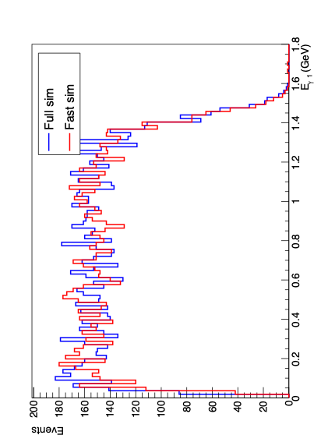
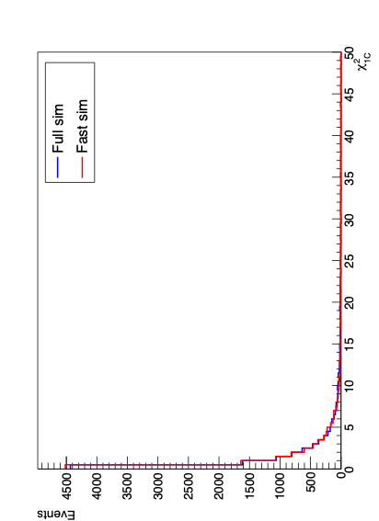
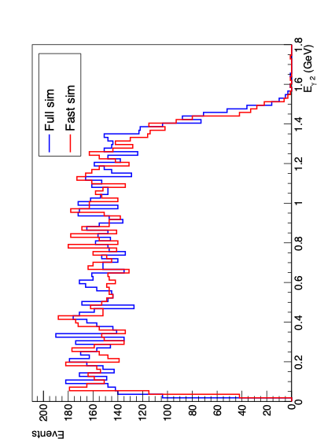
1c fit

Slide 10
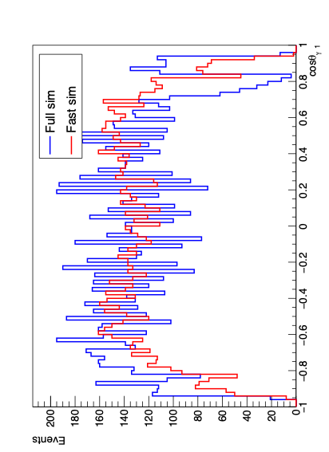
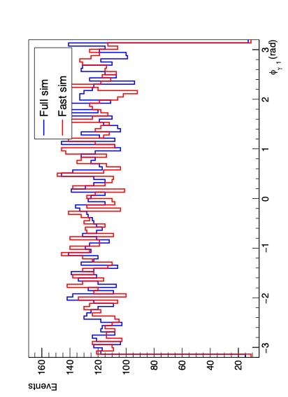
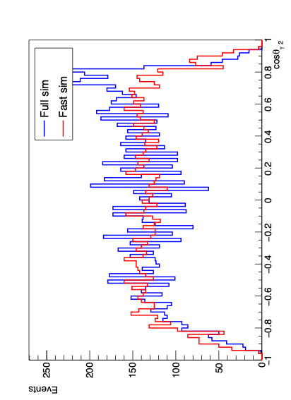
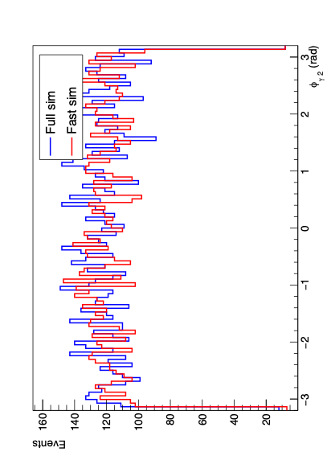
gam1
gam2

Slide 11
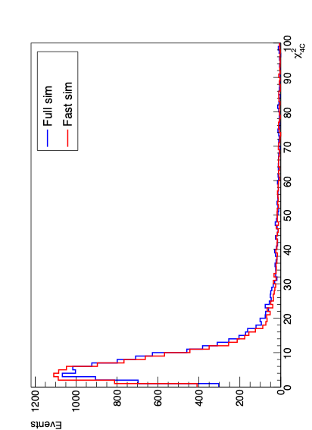
4c fit

Slide 12
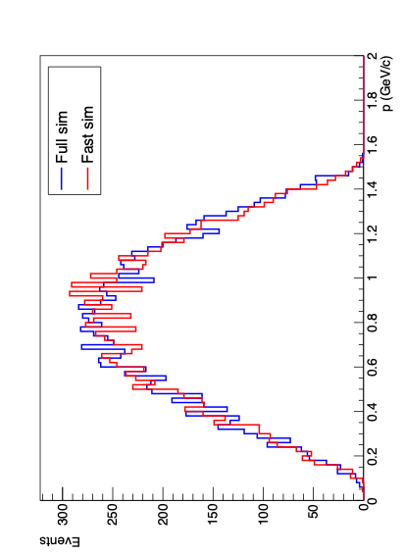
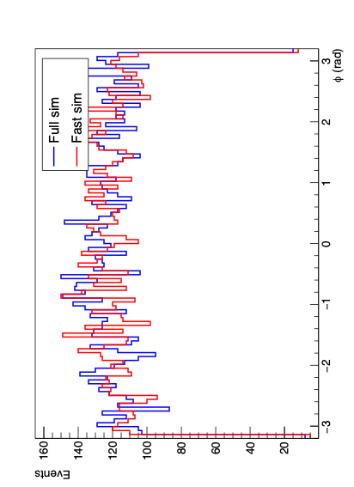
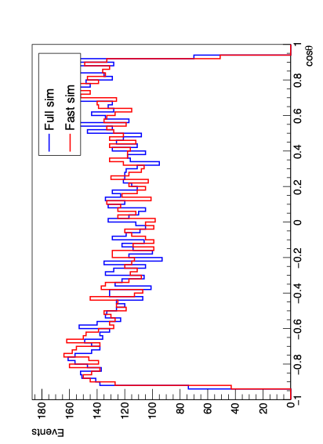
pip

Slide 13
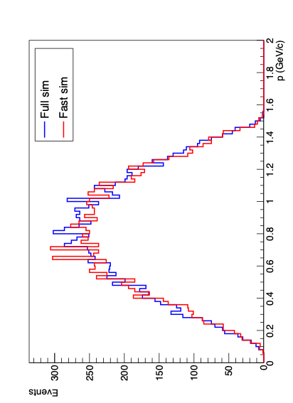
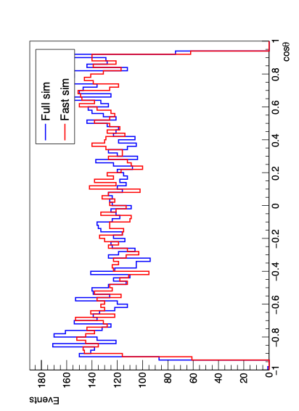
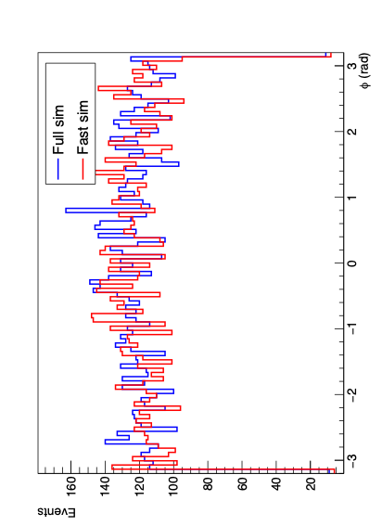
pim

Slide 14
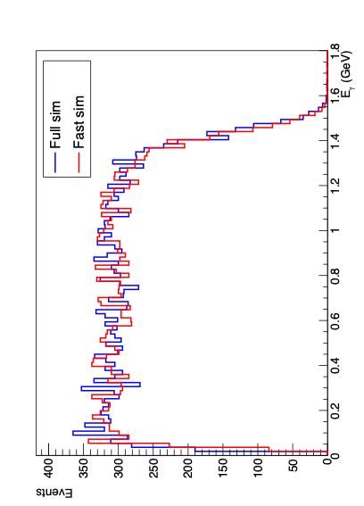
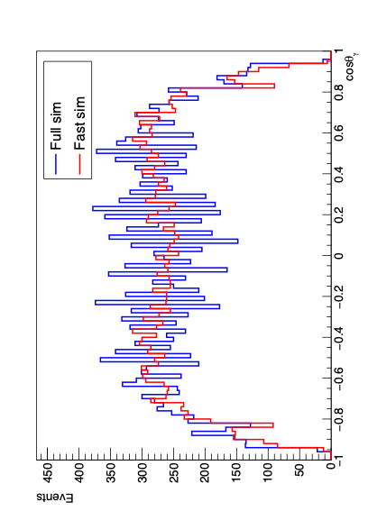
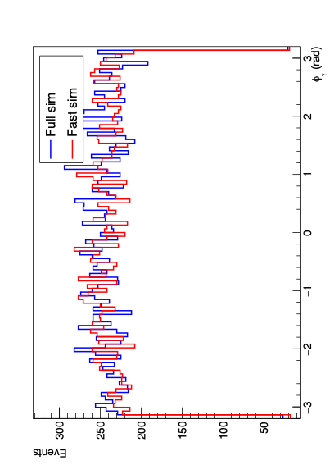
Update gamma

Slide 15


Slide 16
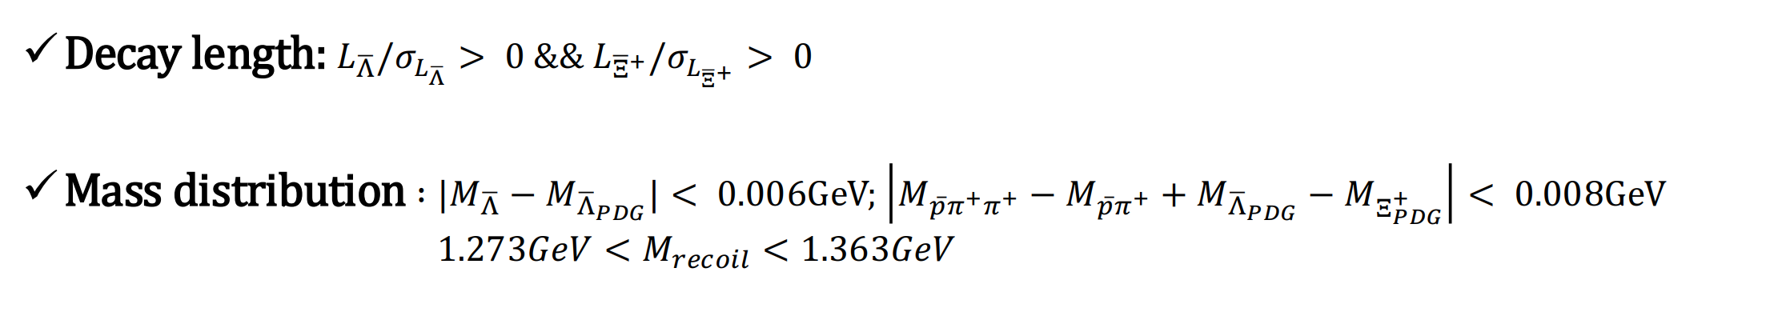
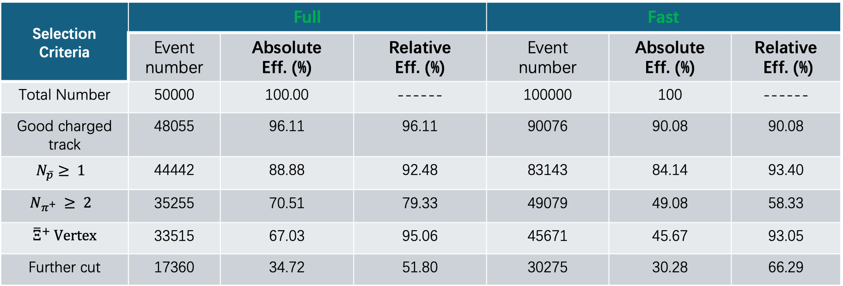
Single tag analysis
Cut flow
Selection Criteria | Full |  |  | Fast
 | Event number | Absolute Eff. (%) | Relative Eff. (%) | Event number | Absolute Eff. (%) | Relative Eff. (%)
Total Number | 50000 | 100.00 | ------ | 100000 | 100 | ------
Good charged track | 48055 | 96.11 | 96.11 | 90076 | 90.08 | 90.08
$$N_{\overline{p}}≥ 1$$ | 44442 | 88.88 | 92.48 | 83143 | 84.14 | 93.40
$$N_{π^{+}} ≥ 2$$ | 35255 | 70.51 | 79.33 | 49079 | 49.08 | 58.33
${\overline{Ξ}}^{+}$ Vertex | 33515 | 67.03 | 95.06 | 45671 | 45.67 | 93.05
Further cut | 17360 | 34.72 | 51.80 | 30275 | 30.28 | 66.29

Slide 17
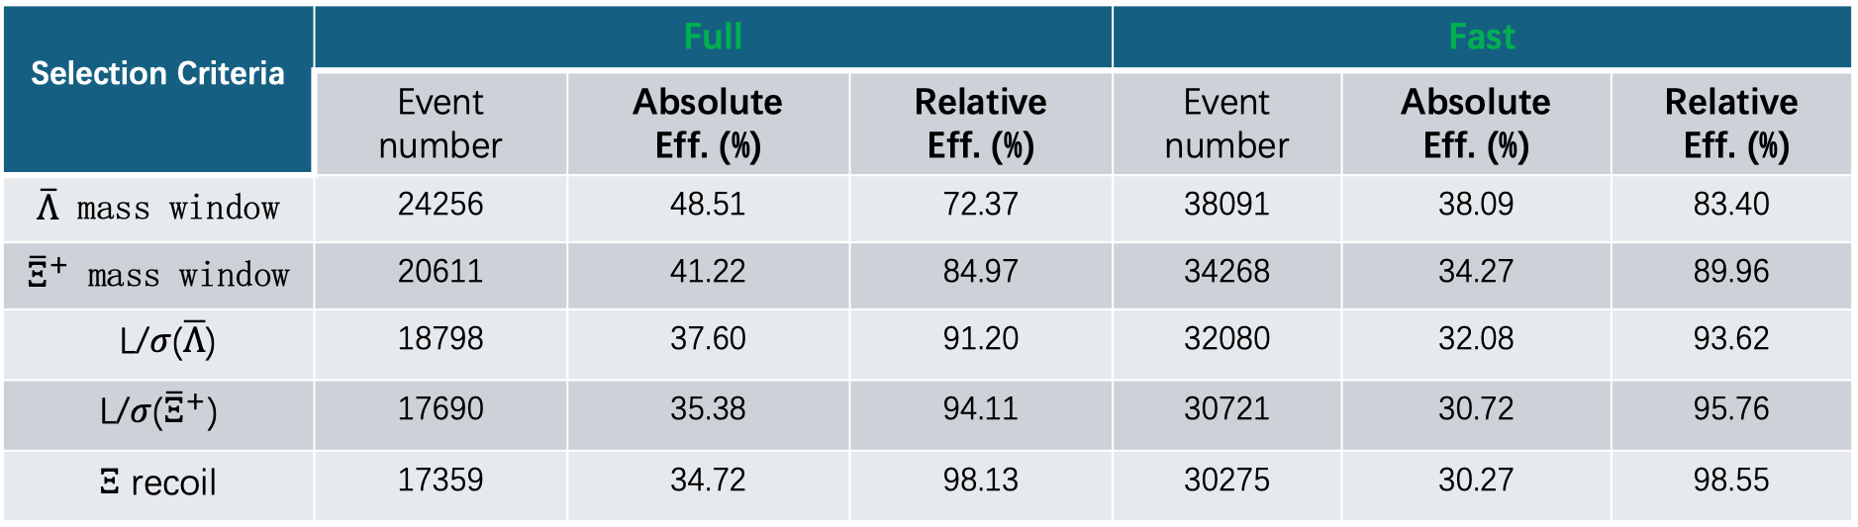
Single tag analysis
Cut flow
Selection Criteria | Full |  |  | Fast
 | Event number | Absolute Eff. (%) | Relative Eff. (%) | Event number | Absolute Eff. (%) | Relative Eff. (%)
$\overline{Λ}$ mass window | 24256 | 48.51 | 72.37 | 38091 | 38.09 | 83.40
${\overline{Ξ}}^{+}$ mass window | 20611 | 41.22 | 84.97 | 34268 | 34.27 | 89.96
L/$σ$($\overline{Λ}$) | 18798 | 37.60 | 91.20 | 32080 | 32.08 | 93.62
L/$σ$(${\overline{Ξ}}^{+}$) | 17690 | 35.38 | 94.11 | 30721 | 30.72 | 95.76
$Ξ$ recoil | 17359 | 34.72 | 98.13 | 30275 | 30.27 | 98.55

Slide 18
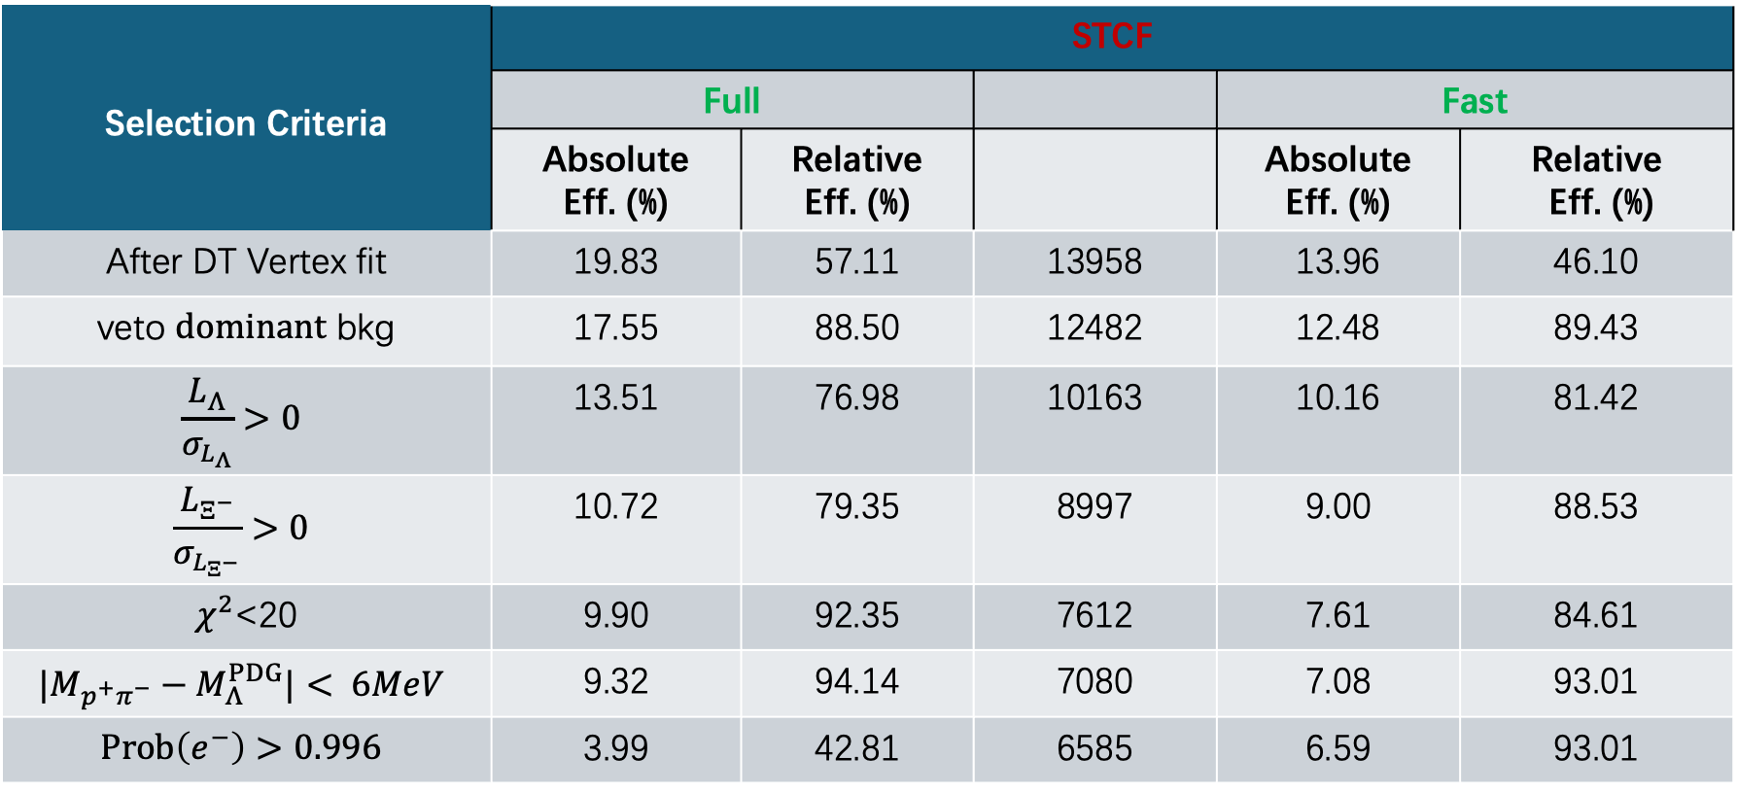
Double tag analysis
Cut flow
Selection Criteria | STCF
 | Full |  |  | Fast
 | Absolute Eff. (%) | Relative Eff. (%) |  | Absolute Eff. (%) | Relative Eff. (%)
After DT Vertex fit | 19.83 | 57.11 | 13958 | 13.96 | 46.10
veto $dominant$ bkg | 17.55 | 88.50 | 12482 | 12.48 | 89.43
$$\frac{L_{Λ}}{σ_{L_{Λ}}}>0$$ | 13.51 | 76.98 | 10163 | 10.16 | 81.42
$$\frac{L_{Ξ^{−}}}{σ_{L_{Ξ^{−}}}}>0$$ | 10.72 | 79.35 | 8997 | 9.00 | 88.53
$χ^{2}$<20 | 9.90 | 92.35 | 7612 | 7.61 | 84.61
$$|M_{p^{+}π^{−}}−M_{Λ}^{PDG}|< 6MeV$$ | 9.32 | 94.14 | 7080 | 7.08 | 93.01
$$Prob\left(e^{−}\right)>0.996$$ | 3.99 | 42.81 | 6585 | 6.59 | 93.01

Slide 19
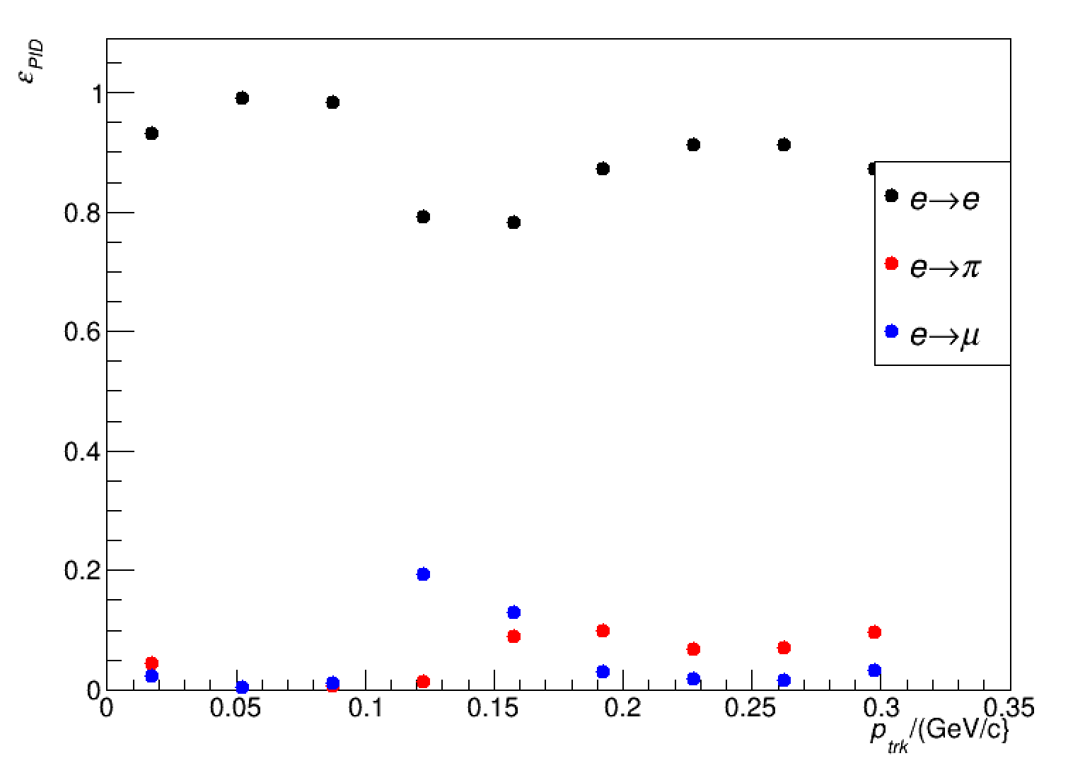
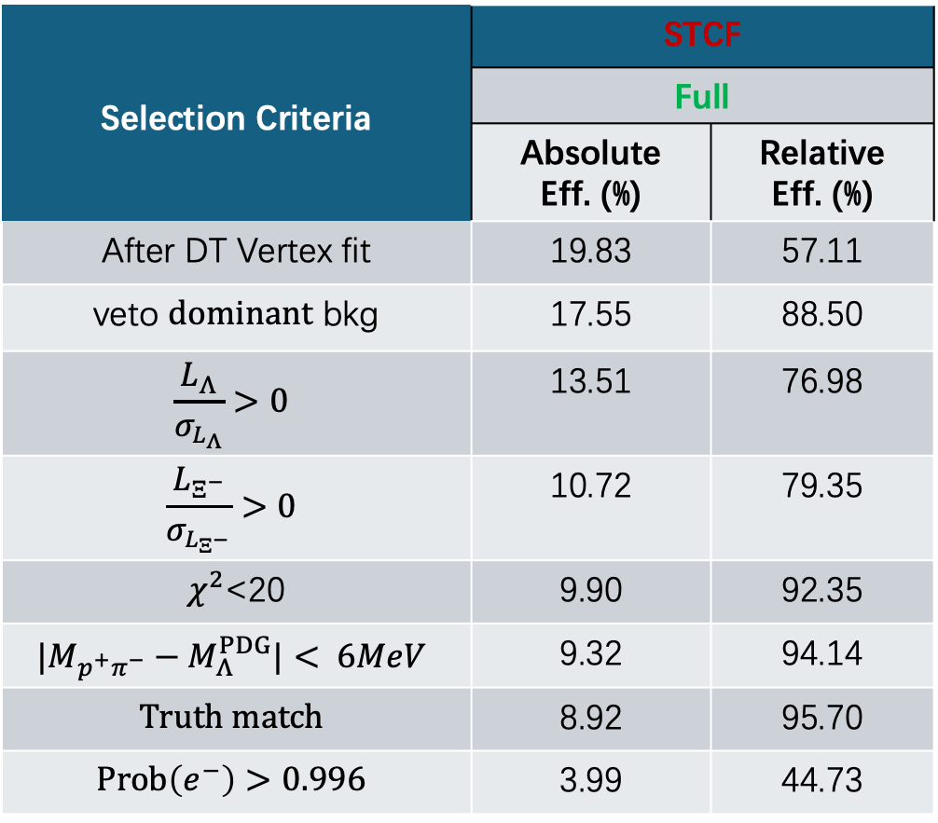
Double tag analysis
Cut flow
Selection Criteria | STCF
 | Full
 | Absolute Eff. (%) | Relative Eff. (%)
After DT Vertex fit | 19.83 | 57.11
veto $dominant$ bkg | 17.55 | 88.50
$$\frac{L_{Λ}}{σ_{L_{Λ}}}>0$$ | 13.51 | 76.98
$$\frac{L_{Ξ^{−}}}{σ_{L_{Ξ^{−}}}}>0$$ | 10.72 | 79.35
$χ^{2}$<20 | 9.90 | 92.35
$$|M_{p^{+}π^{−}}−M_{Λ}^{PDG}|< 6MeV$$ | 9.32 | 94.14
$$Truth match$$ | 8.92 | 95.70
$$Prob\left(e^{−}\right)>0.996$$ | 3.99 | 44.73

Slide 20
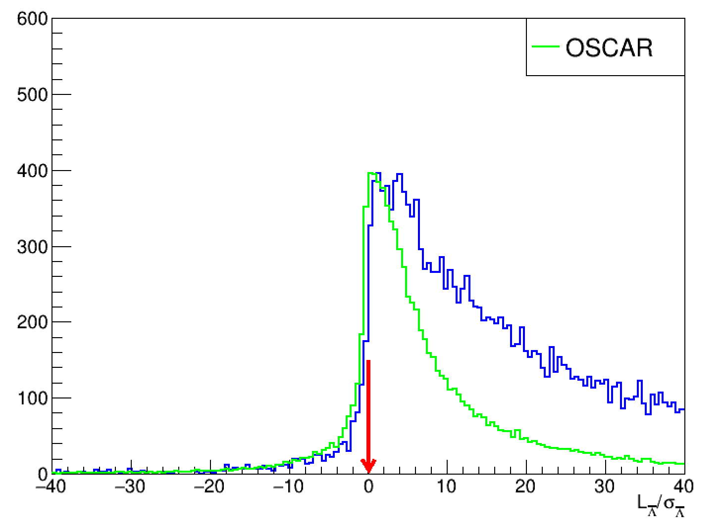
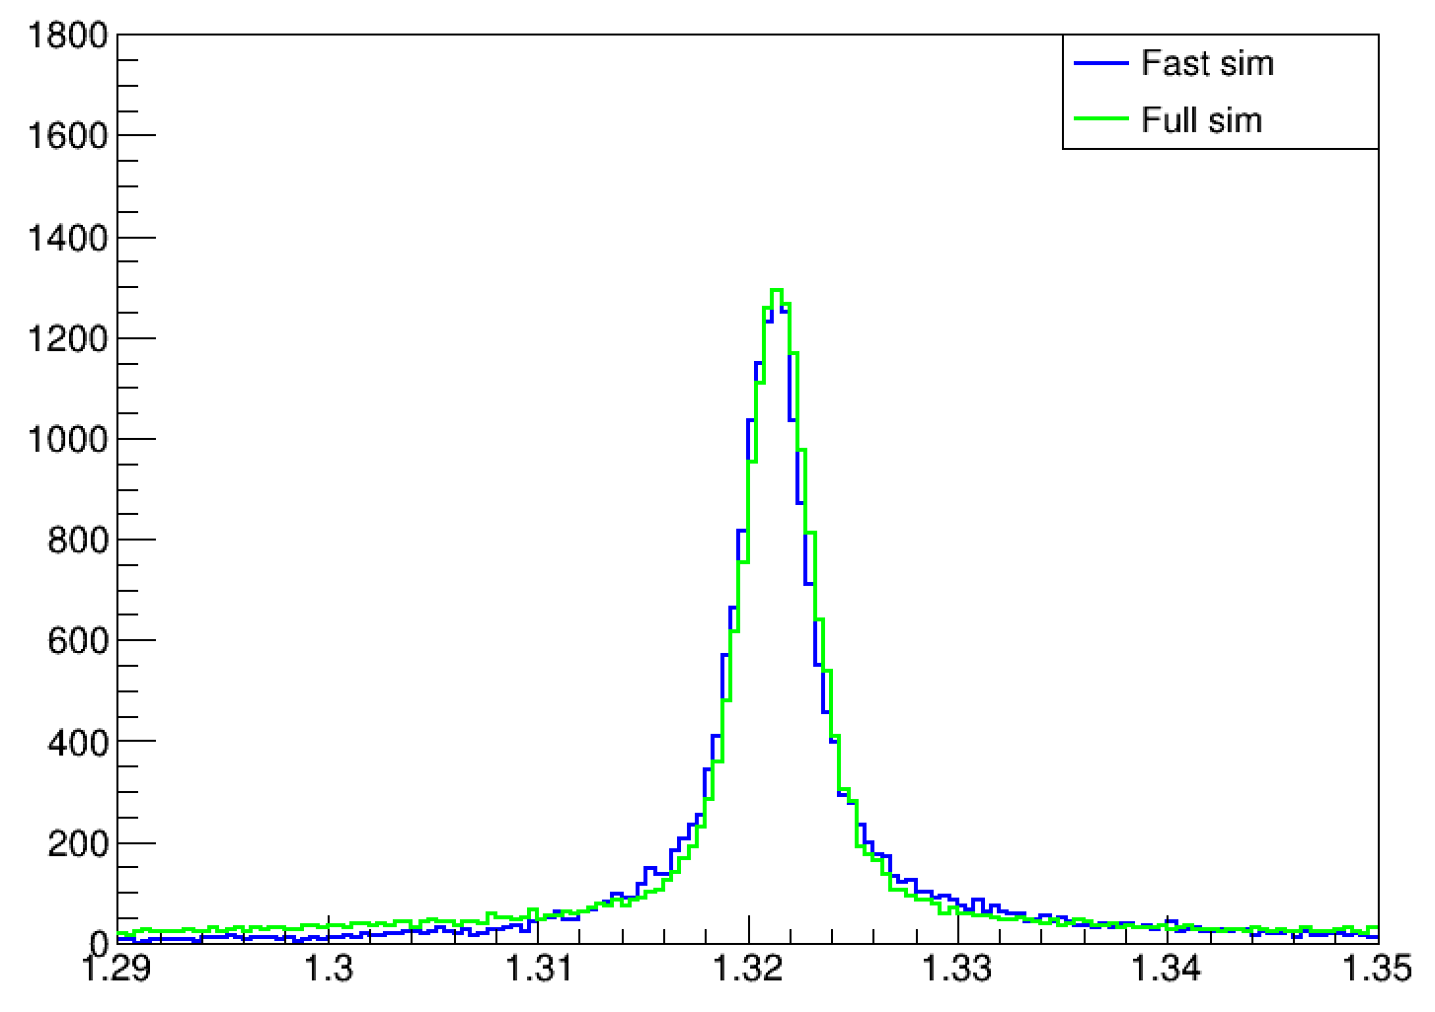
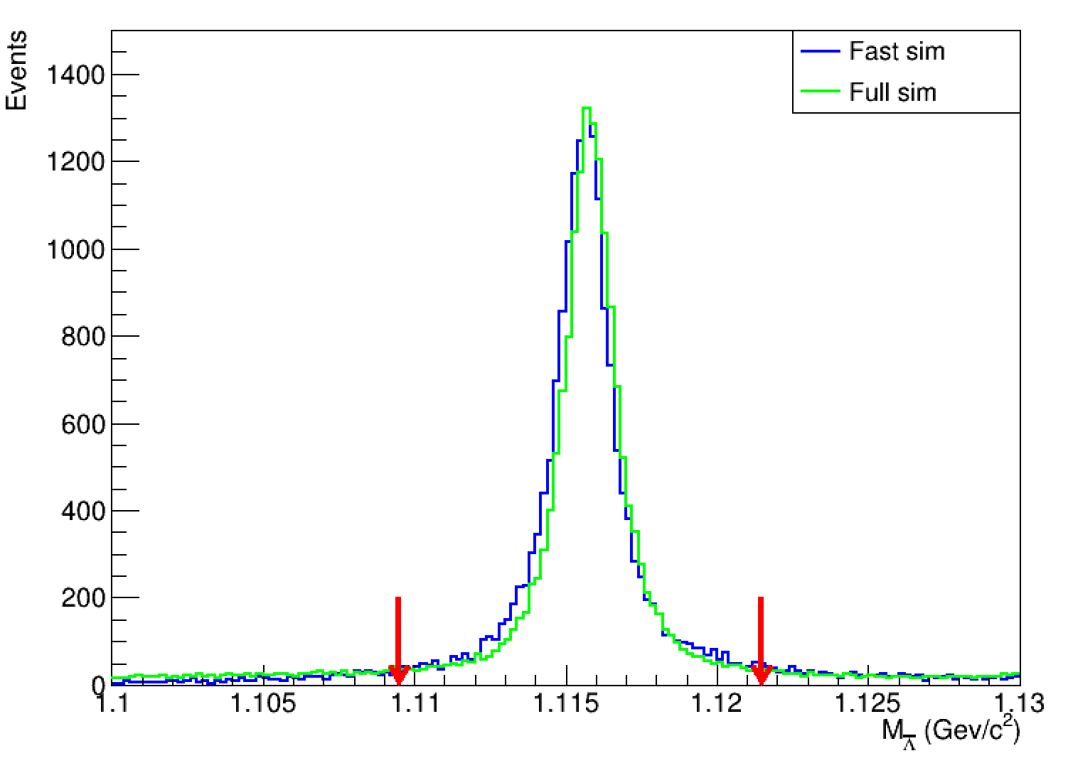
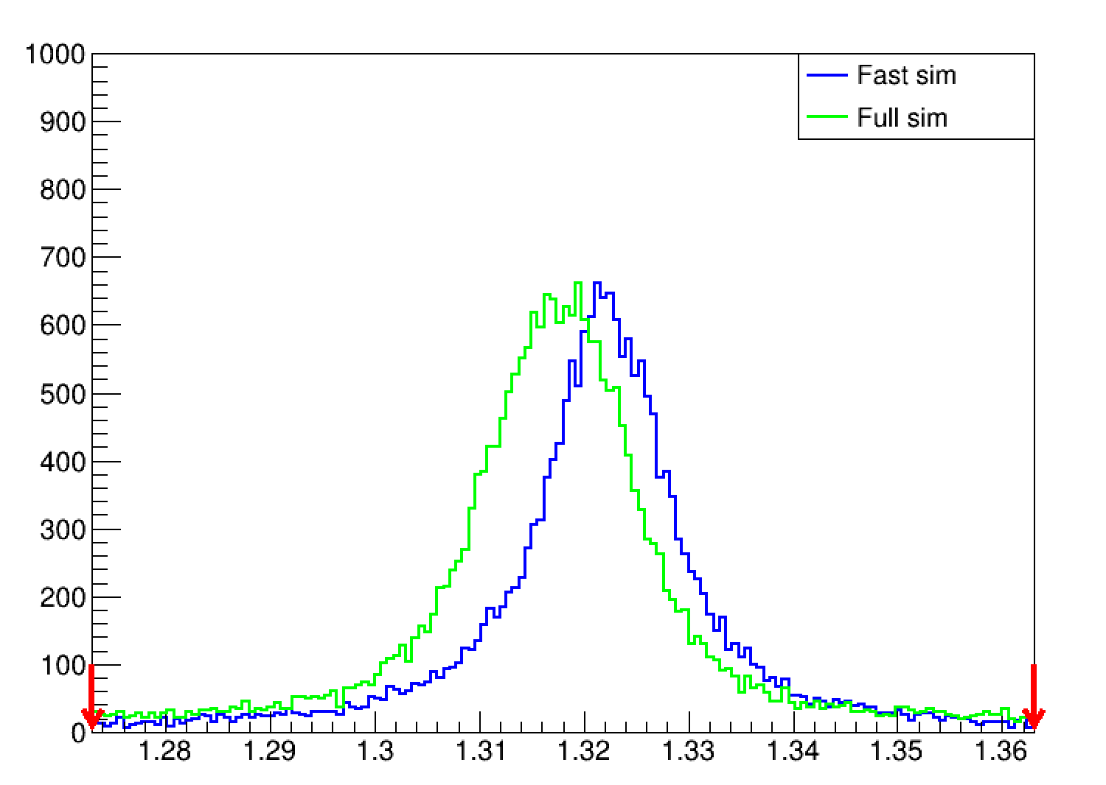
Xibar
Lambar
反冲Xi

Slide 21



