Slide 1
Bayesian Hyperparameter Optimization and Electronics Saturation Correction
Xiang Li
University of Science and Technology of China
2026.9.18

Slide 2
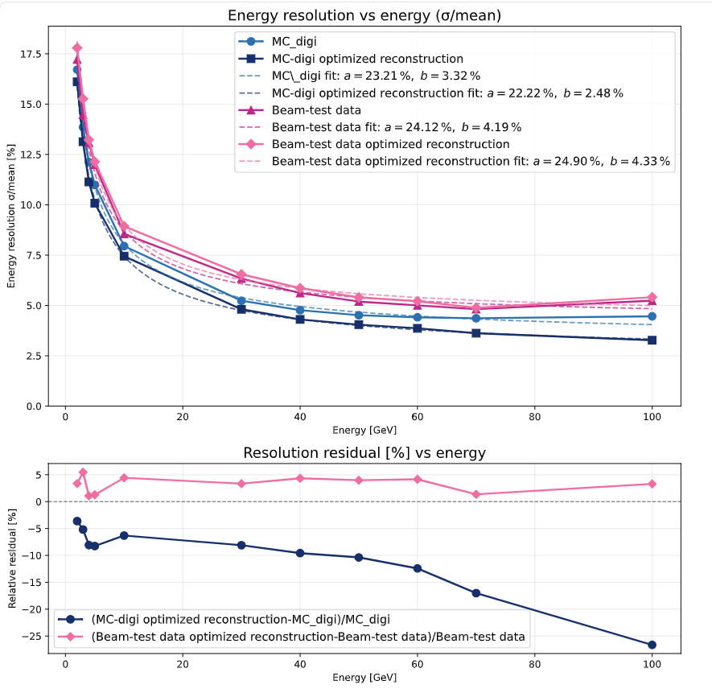
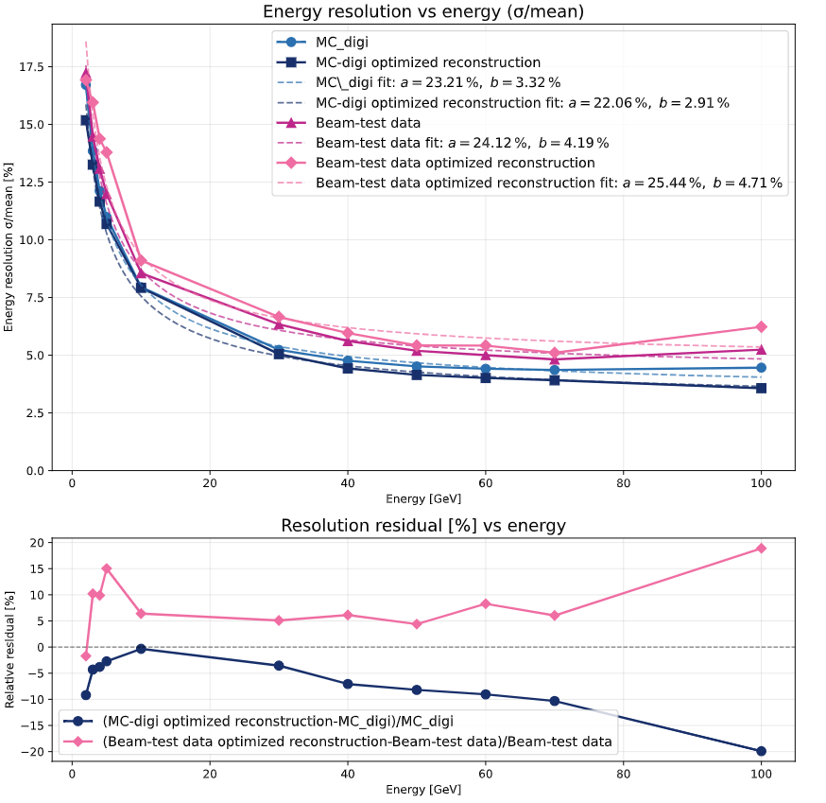
Motivation
Why Bayesian optimization?
  • Multiple strongly coupled hyperparameters
  • Full grid search is computationally expensive
  • Guided search finds competitive configurations with fewer trials
Same model architecture
Same training samples
Different hyperparameter configurations.
trial_3
trial_1

Slide 3
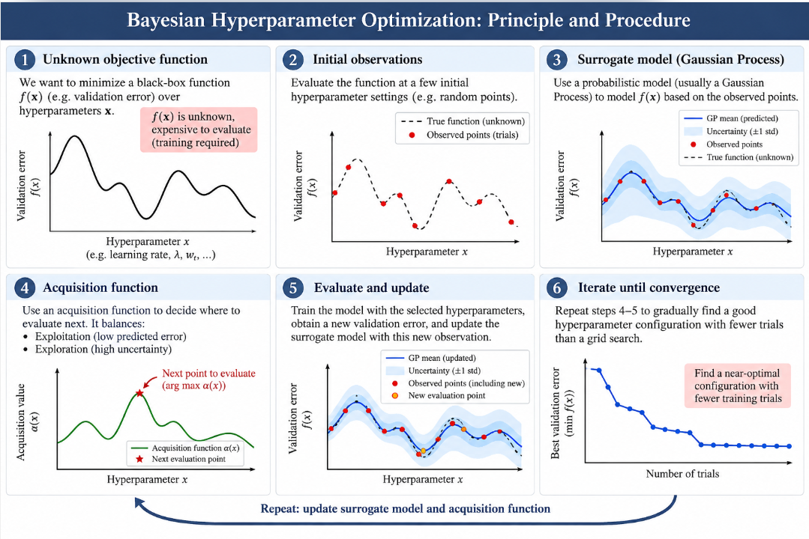

Bayesian Hyperparameter Optimization
Surrogate model
Gaussian Process（GP）
probability distribution over functions
Kernel function
measures similarity between hyperparameter configurations
Acquisition function：
next promising hyperparameter configuration

Slide 4
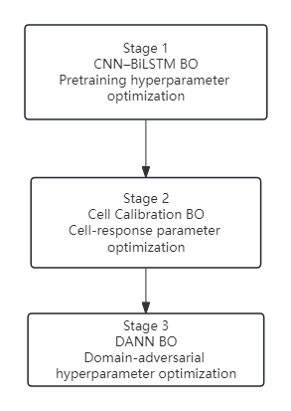
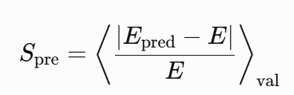
Bayesian Hyperparameter Optimization
Stage 1 — CNN–BiLSTM BO
Goal: optimize the energy-reconstruction backbone
Objective:
Key idea: minimize the validation relative energy error
Stage 2 — Cell Calibration BO
Goal: optimize hierarchical cell-response parameters a,b
Objective:
Key idea: simultaneously preserve energy regression and improve MC–Data response closure
Stage 3 — DANN BO
Goal: optimize domain-adversarial fine-tuning
Objective:
Key idea: improve data resolution while preserving energy scale and MC regression performance

Slide 5
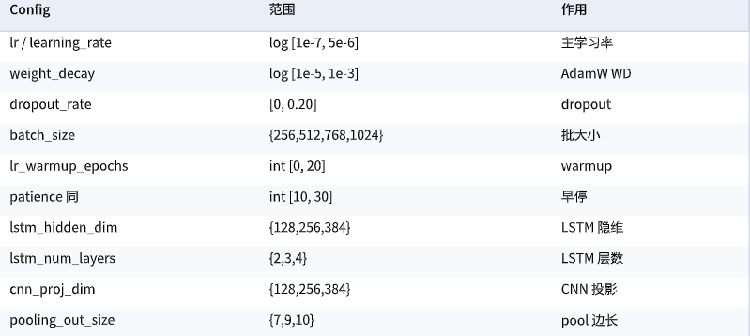
Step 1: Stabel CNN+LSTM model
Hyperparameter

Slide 6
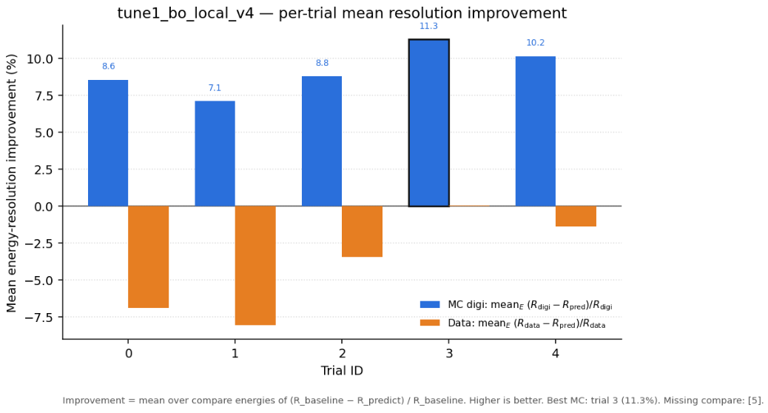
Step 1: Stabel CNN+LSTM model

Slide 7

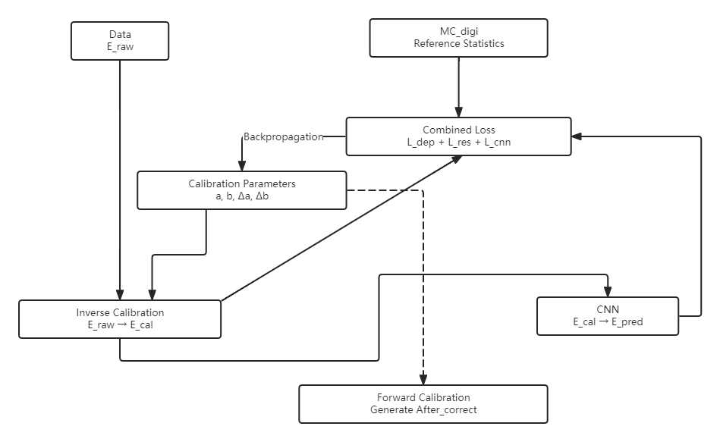




Calib cell level parameter a,b
Step 2: Using Inverse function to make data approch MC_digi.
SPS e- data 80,100,120 GeV
MC_digi 80,100,120 GeV
Total Loss：
Reference Loss：
Minimize the discrepancy with the MC_digi distribution.
CNN Energy Prediction Loss ：
Evaluates the accuracy of the network's macroscopic physical prediction.
Cell-level Deposition Loss：
Constrains the energy deposition distribution at the microscopic (per-cell) level.
Notes:
Let me briefly review the procedure we use to correct the electronics saturation effect.
First, we train a stable CNN–LSTM model using the MC-digi samples. After the model is pretrained, all network parameters are frozen.
Then, for the beam-test data, we apply the inverse response inverse function, to correct the electronics saturation at the cell level. During this calibration step, the CNN–LSTM remains fixed, and only the two response parameters, \(a\) and \(b\), are optimized for each cell.

Slide 8
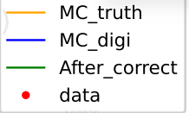
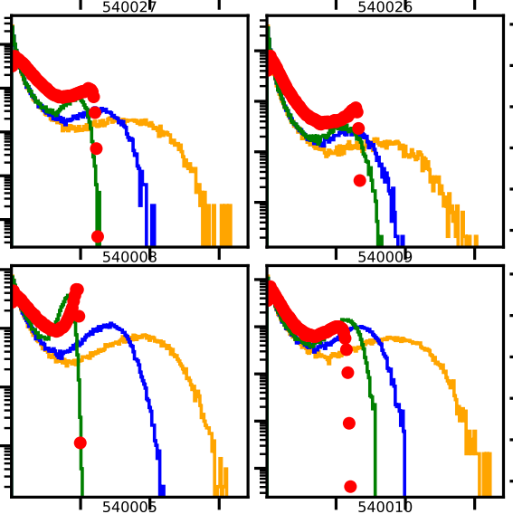
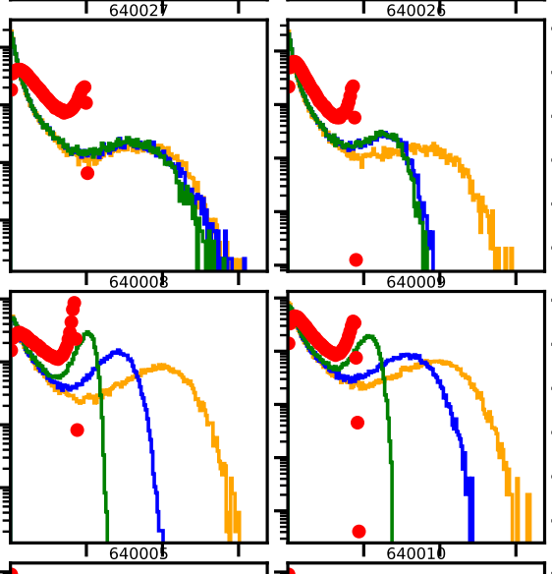
Calib cell level parameter a,b

Slide 9
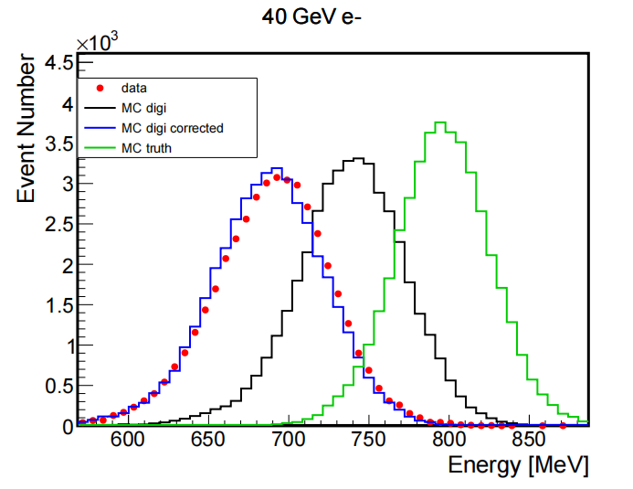
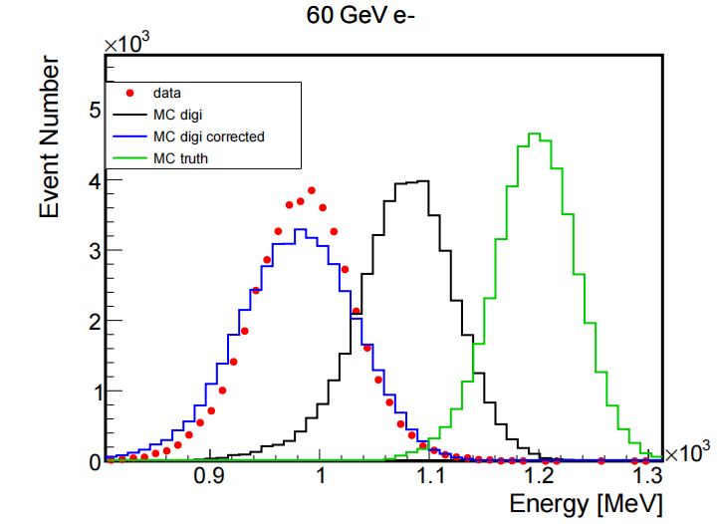
Energy spectrum
The saturation-effect model brings MC-digi into better agreement with beam-test data, especially at high energies.
Differences in beam center and beam size prevent a perfect match between MC_digi_correct and data

Slide 10
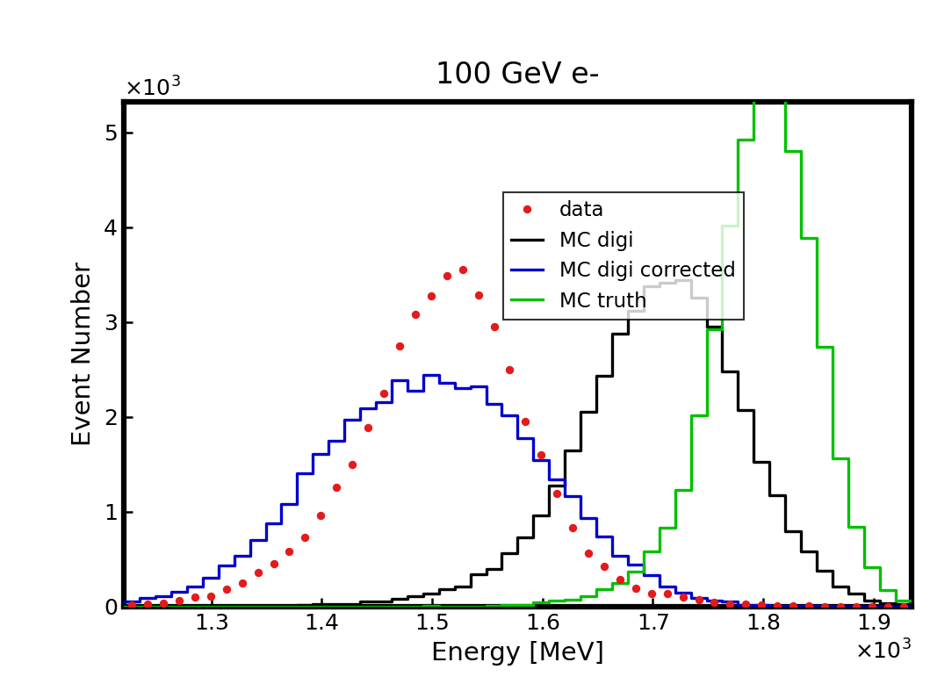
Energy spectrum
Mean response: Response-modeled MC-digi agrees well with data.
Distribution width: The modeled MC-digi still shows a larger sigma.

Slide 11
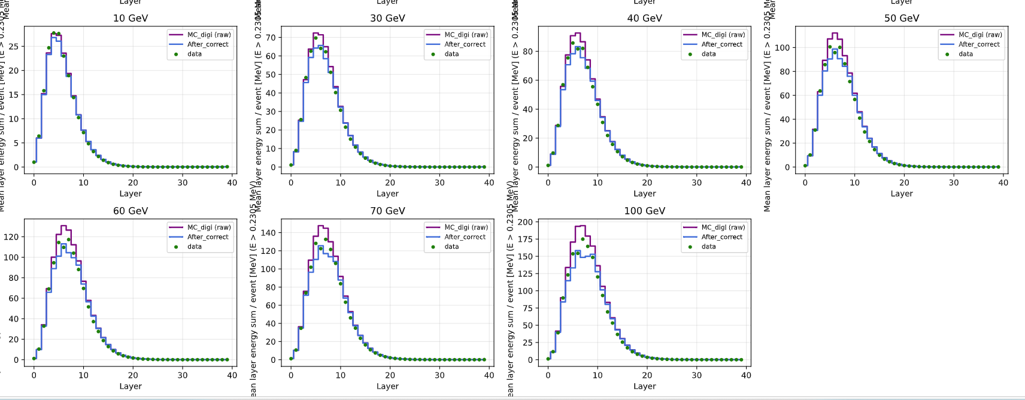
Layer energy spectrum

Slide 12
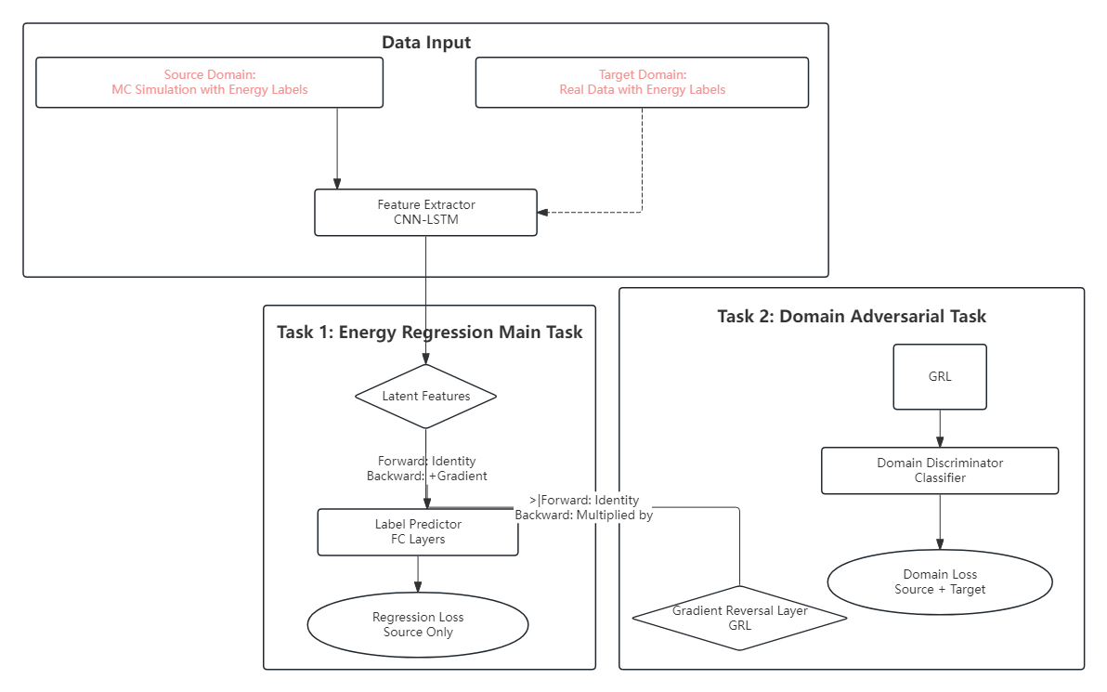

Retrain CNN+LSTM
Result：Retrain CNN+LSTM to improve energy resolution for data
    DANN（Domain-Adversarial Neural Network）
Samples: MC_digi_corrected: 1-120GeV (400000) Continuous e-
    Data: PS and SPS [ 1-120] GeV Descret energy
Preserves Core Physics: Retains essential information for accurate energy prediction (satisfies Label Predictor).
Acts as an "Eraser": Wipes away both MC "simulation fingerprints" and Data "real noise."

Slide 13
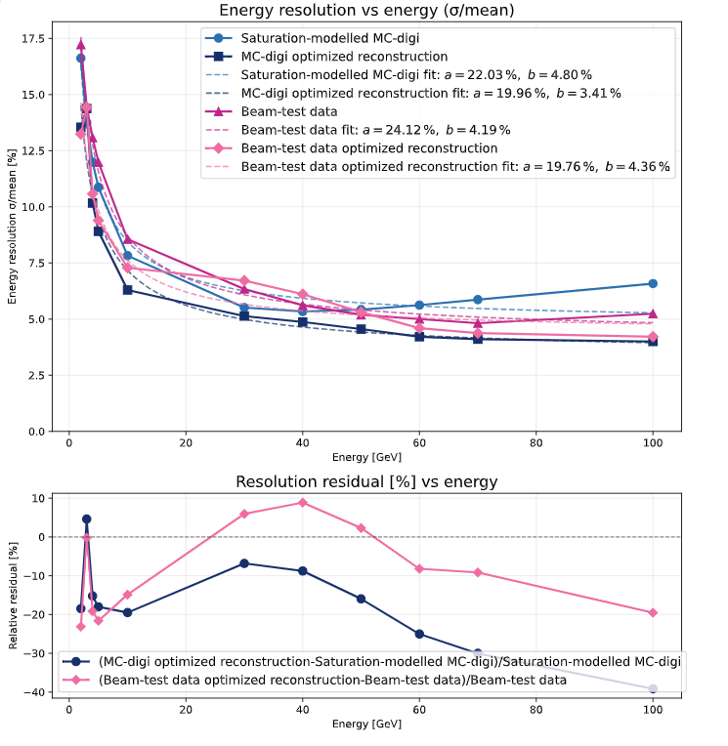
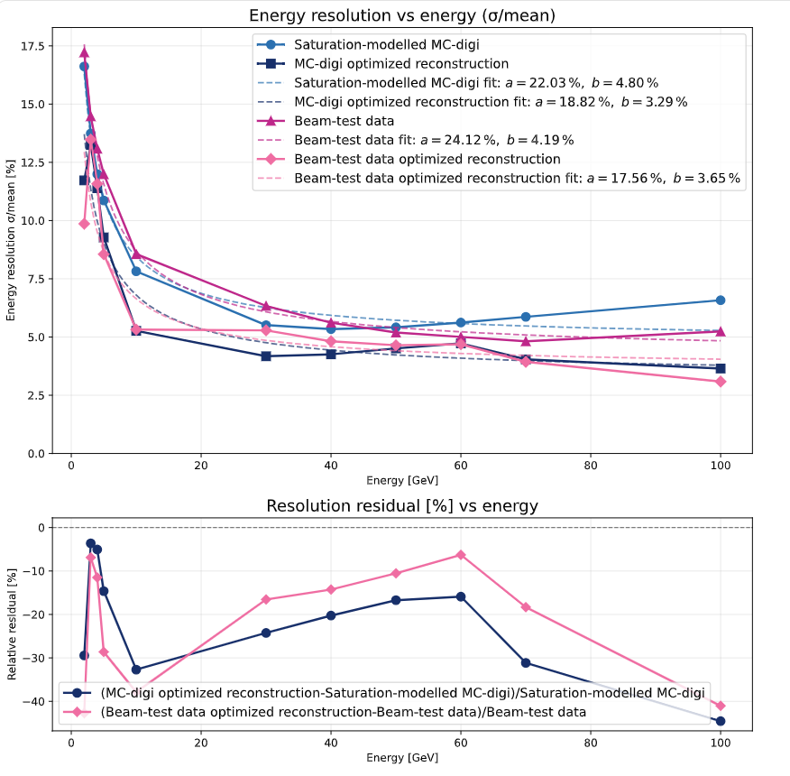
Target regression weight
"finetune_two_stage_dann_tgt_reg_weight": 0.38704931647041524,
"finetune_two_stage_dann_tgt_reg_weight": 0.609,

Slide 14
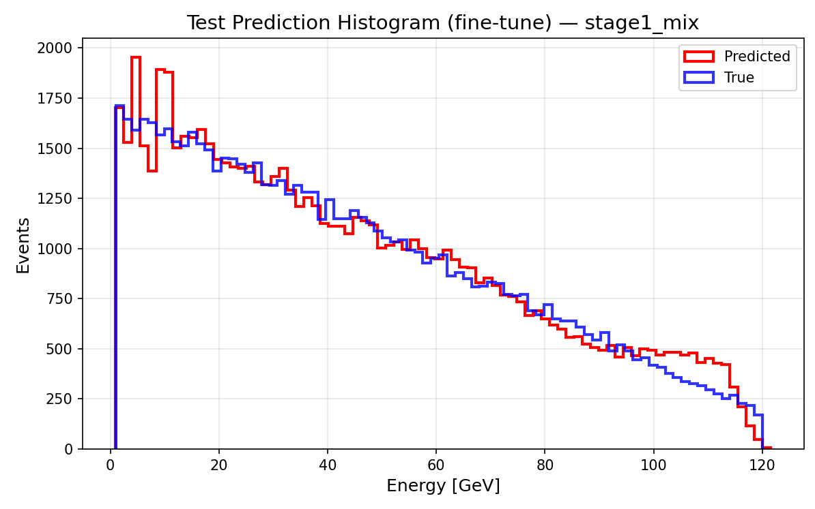
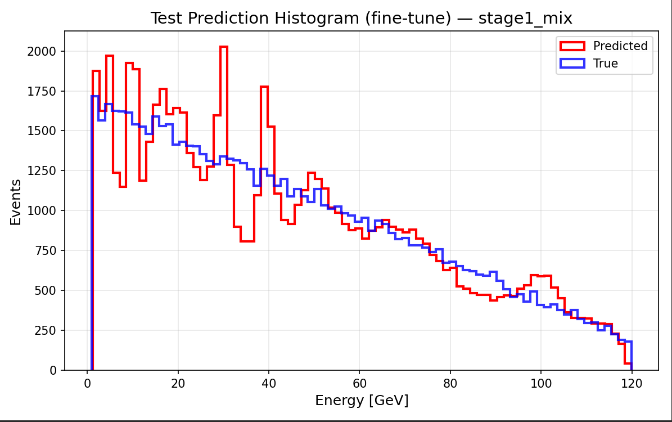
Target regression weight
"finetune_two_stage_dann_tgt_reg_weight": 0.38704931647041524,
"finetune_two_stage_dann_tgt_reg_weight": 0.609,

Slide 15
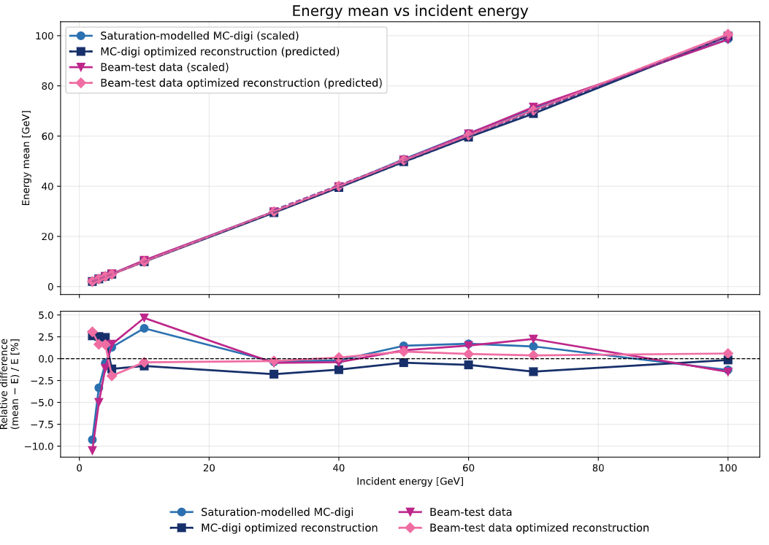
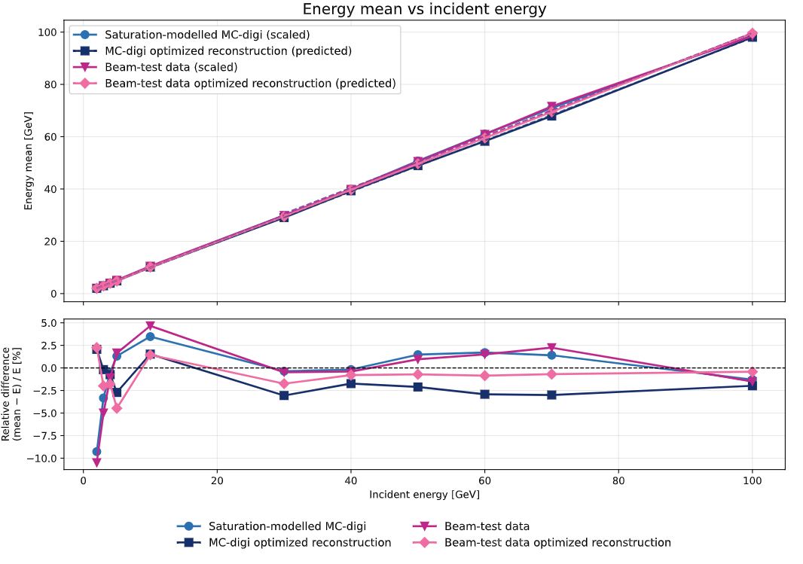
Target regression weight
"finetune_two_stage_dann_tgt_reg_weight": 0.38704931647041524,
"finetune_two_stage_dann_tgt_reg_weight": 0.609,

Slide 16
Summery
Bayesian optimization has replaced empirical hyperparameter tuning, providing a systematic and reproducible procedure for model selection.
Front-end electronics saturation modelling improves the agreement between MC-digi and beam-test data, but does not fully remove the simulation-to-data discrepancy, indicating additional residual detector-response effects.
The current DANN provides only limited improvement and increases the bias in continuous-energy MC predictions.
Next step: refine the domain-adaptation/model architecture to better preserve energy-dependent features while reducing the residual domain discrepancy.
Strategy：
Mean-pooling enhancement in CNN–LSTM to provide additional global shower information.
Energy-conditioned DANN to preserve energy-dependent features during domain alignment.
If residual discrepancies remain, their impact will be quantified and discussed as a limitation of the current approach.

Slide 17
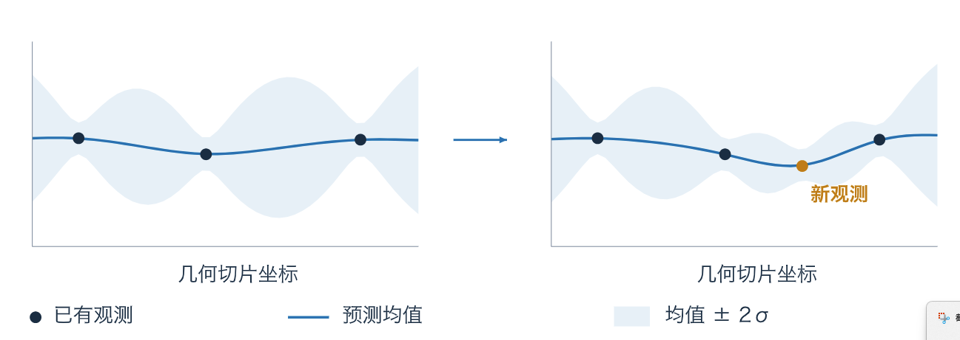
back up

