Slide 1

Study of Energy Reconstruction with Machine Learning
Speaker：Peng Borong
University of Science and Technology of China
2026.10.9

Slide 2
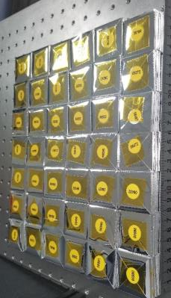
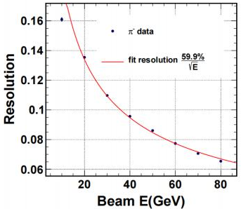
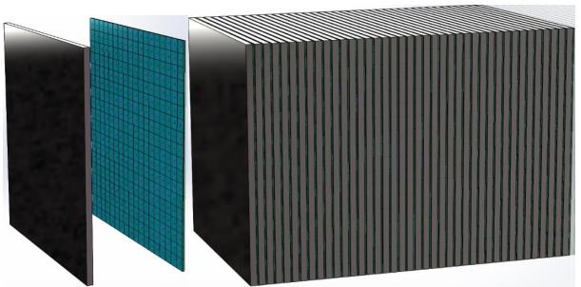
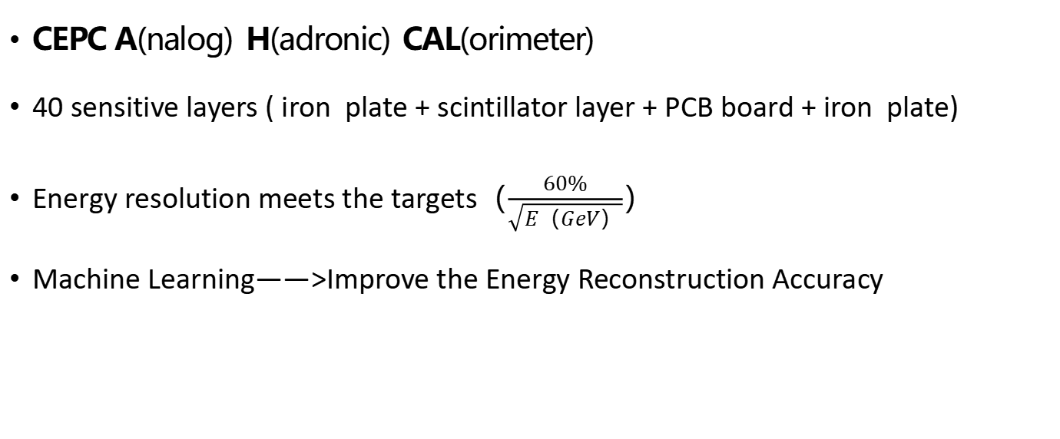
Background
CEPC A(nalog) H(adronic) CAL(orimeter)
40 sensitive layers ( iron plate + scintillator layer + PCB board + iron plate)
Energy resolution meets the targets（$\frac{60\%}{\sqrt{E（GeV）}}$）
Machine Learning——>Improve the Energy Reconstruction Accuracy
plastic scintillator
AHCAL
scintillator +PCB board
Fe
Fe
40 [layers] x 18 x 18 [cells/layer]

Slide 3
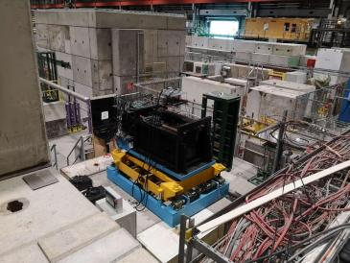
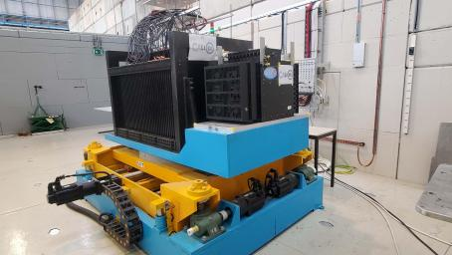
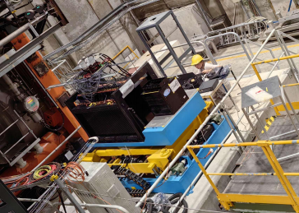
Beam Tests
3 beam tests have been done at CERN
muon position scan( 100GeV/c )
pion ( 1-120 GeV/c )
electron ( 1-120 GeV/c )
2022 SPS H8
2023 PS T9
2023 SPS H2

Slide 4
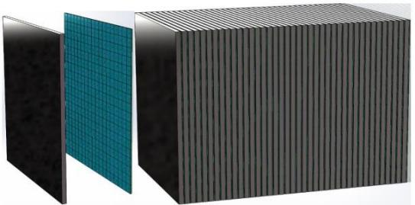
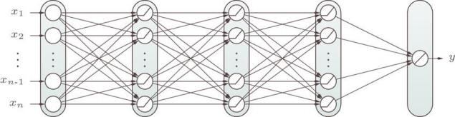
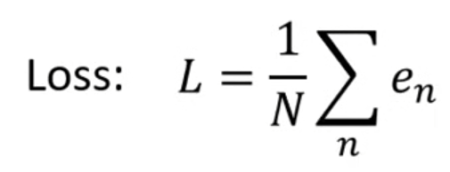

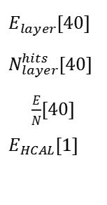
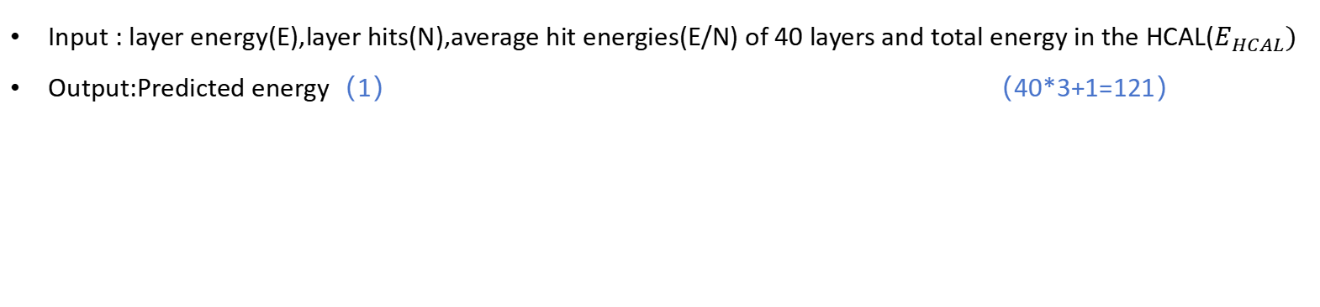
MLP Model
Input : layer energy(E),layer hits(N),average hit energies(E/N) of 40 layers and total energy in the HCAL($E_{HCAL})$
Output:Predicted energy（1） （40*3+1=121）
Dropout: 0.30 0.25 0.20 0.15
121 512 256 128 64 1
$E_{layer}$[40]
$N_{layer}^{hits}$[40]
$\frac{E}{N}$[40]
$E_{HCAL}$[1]
40 [layers] x 18 x 18 [cells/layer]
Predicted
Energy
Batch_Size | 64
Learning Rate | 1e-4
Epochs | 200
e = $\frac{{(y_{true}−y_{pred})}^{2}}{{y_{true}}^{2}}$
Mean Squared Relative Error
(MSRE)

Slide 5
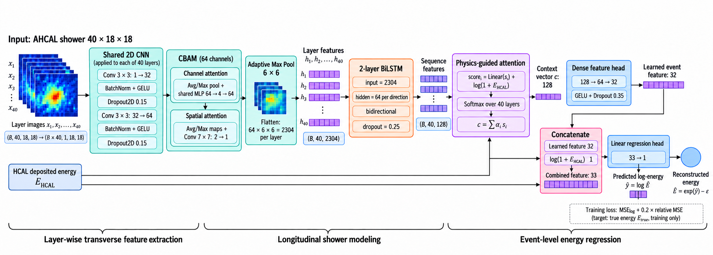
CNN Model
X ∈ $R^{40×18×18}$→Reconstructed energy E
2D CNN + CBAM + LSTM + Physics-Guided Attention
Notes:
整个网络由四个模块串联：
2D CNN：对每一层做共享权重的二维卷积，提取横向（层内）的簇射特征。
CBAM：卷积块注意力，先在通道维度、再在空间维度加权，让网络关注重要的通道和位置。
LSTM：把 40 层的特征按层序输入双向 LSTM，建模纵向（沿簇射发展方向）的时序信息。
Physics-Guided Attention：物理引导注意力。打分函数里额外加入了 log(1+E_HCAL)，也就是把 HCAL 沉积能量作为先验信息引导注意力权重。
最后把注意力上下文和 log(1+E_HCAL) 拼接，经过全连接回归头，输出 log 空间的预测能量，再指数还原成重建能量

Slide 6

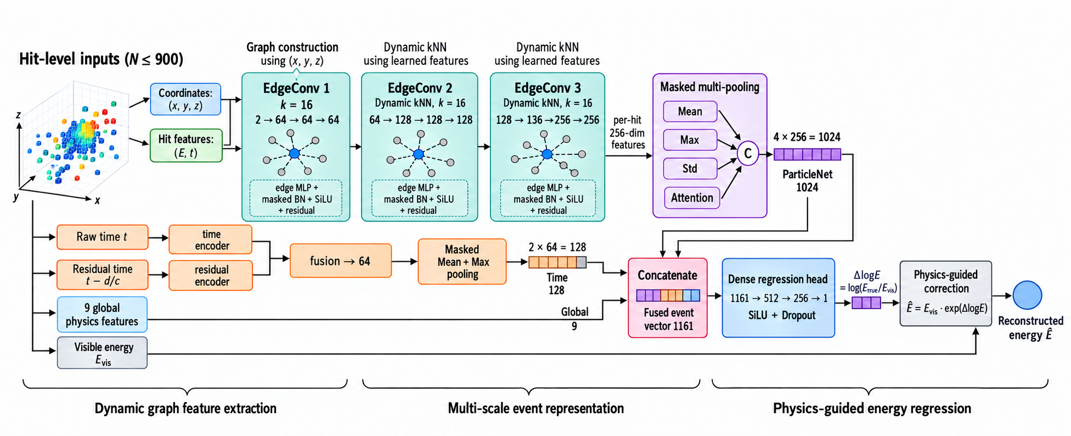

ParticleNet Model
EdgeConv + T-MLP→Fully Connected→Reconstructed energy E
$$L_{corr}(x=\log{\frac{E_{pred}}{E_{true}}},β=0.08) =\left\{\begin{aligned}0.5x^{2}, \left|x\right|≤β \\ β(\left|x\right|−0.5β), \left|x\right|>β\end{aligned}\right.$$
particle types : π+
loss:
$$L_{energy}(r=\frac{E_{pred}−E_{true}}{E_{true}},δ=0.05) =\left\{\begin{aligned}0.5r^{2}, \left|r\right|≤δ \\ δ(\left|r\right|−0.5δ), \left|r\right|>δ\end{aligned}\right.$$
Notes:
输入是 (x, y, z, E, t) 五维信息。
网络分三部分：
EdgeConv 主干：三层动态 EdgeConv。每层先用 kNN（k=16）在特征空间找近邻，构建边特征 (中心点, 邻居−中心)，再经过 edge MLP + masked BN + SiLU + 残差。三次下来通道从 64 → 128 → 256。
Masked multi-pooling：对每个 hit 的 256 维特征做 Mean / Max / Std / Attention 四种池化，拼成 1024 维。
时间与全局特征分支：原始时间 t 和时间残差 t − d/c 分别编码后融合、池化；再加 9 个全局物理特征（可见能量、hit 数、能量加权 z/r/time 的均值与标准差、晚期能量占比等）。
三路特征拼成 1161 维，经全连接回归头输出 ΔlogE = log(E_true/E_vis)，最后用 物理引导修正 得到重建能量 Ê = E_vis · exp(ΔlogE)。

Slide 7
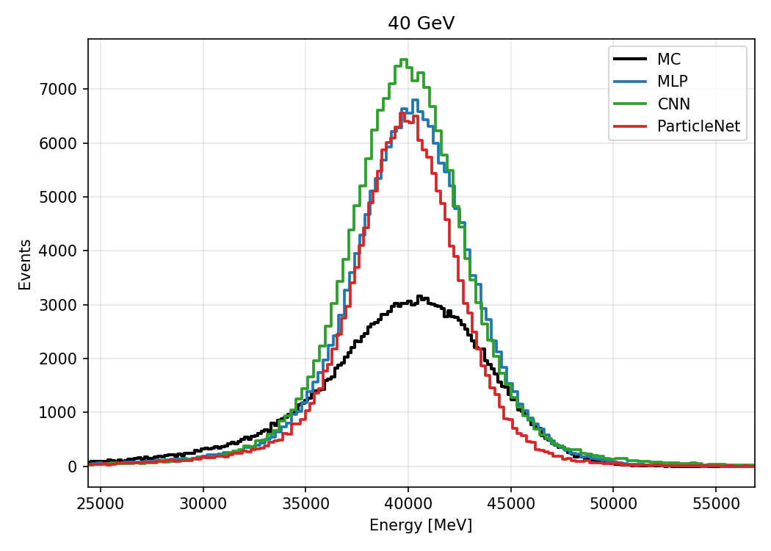
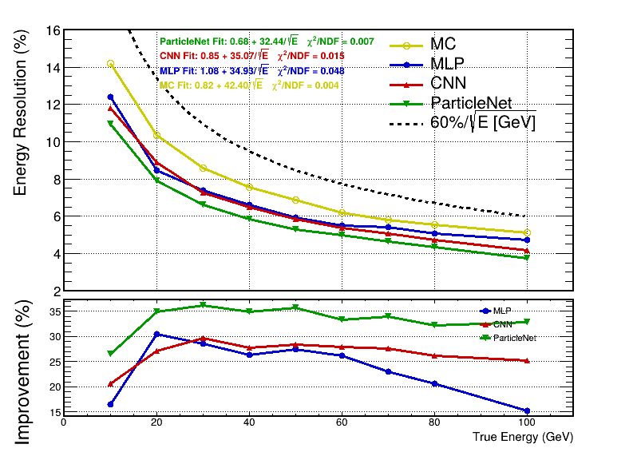
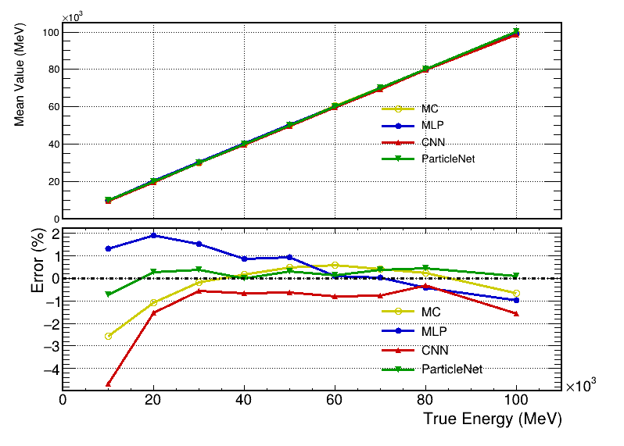
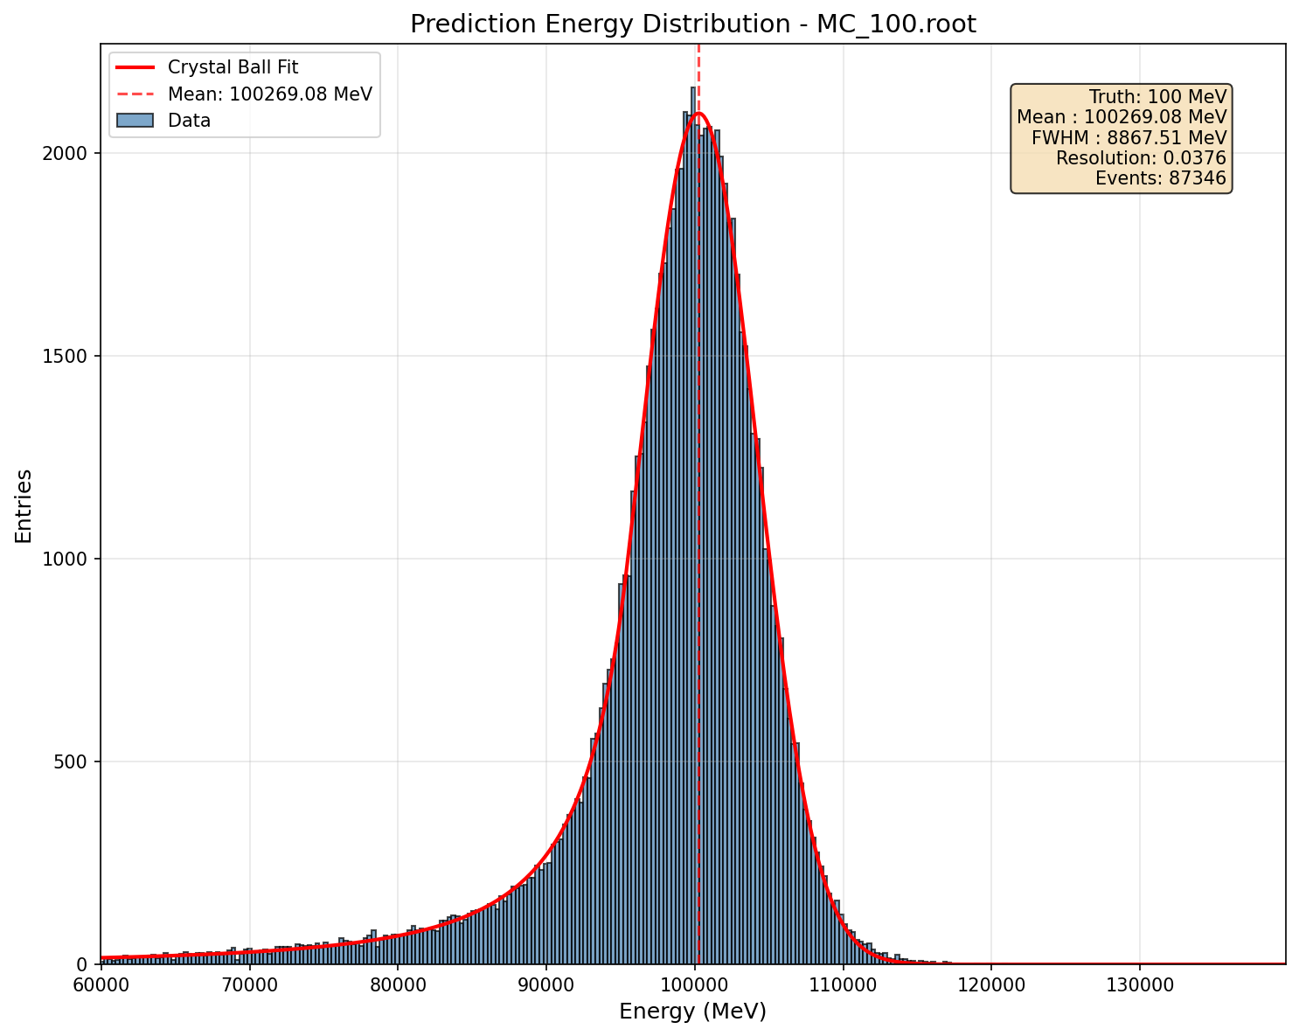


Results on MC
Resolution
Linearity
Resolution
MLP & CNN: both ~25% improvement (avg)
ParticleNet: 33.4% improvement (avg) — best
Energy Linearity
MLP: 0.88% (avg)
CNN: 1.28% (avg) — limited
ParticleNet: 0.29% (avg, all within ±1%)
MLP: solid, stable performance
CNN: no clear advantage over MLP on MC
ParticleNet clearly outperforms MLP & CNN
training sample
source：pion
range：1-120GeV
Event：train = 70.3e4
test = 12.4e4
$$Imp=\frac{\left|R_{MC}−R_{Model}\right|}{R_{MC}}$$
$$Error=\frac{\left|Mean−True\right|}{True}$$

Slide 8
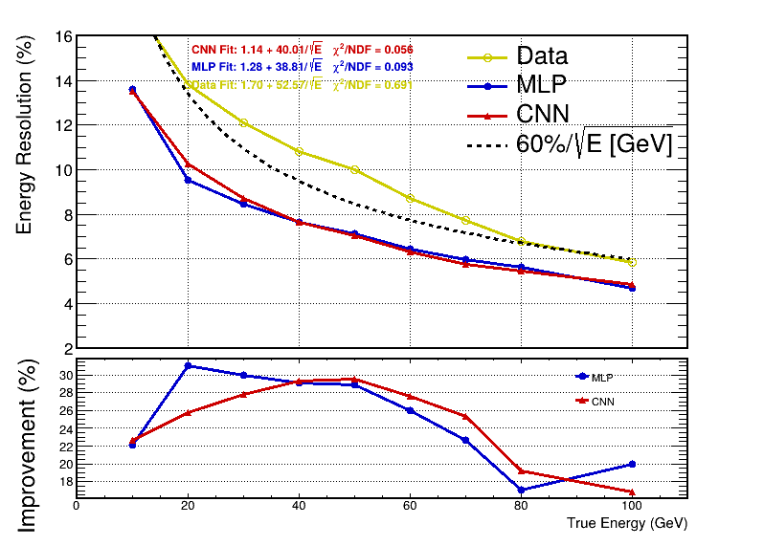
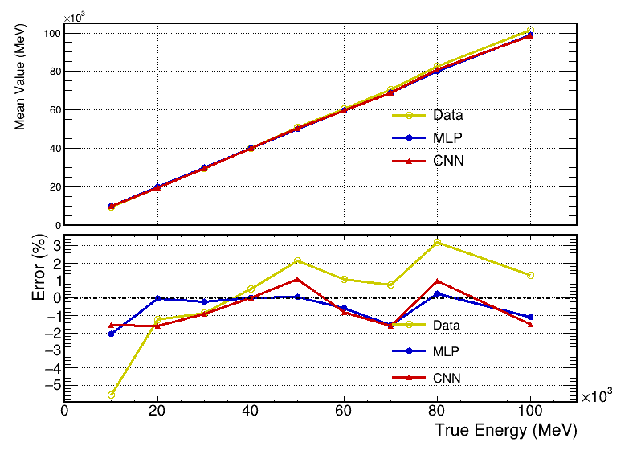
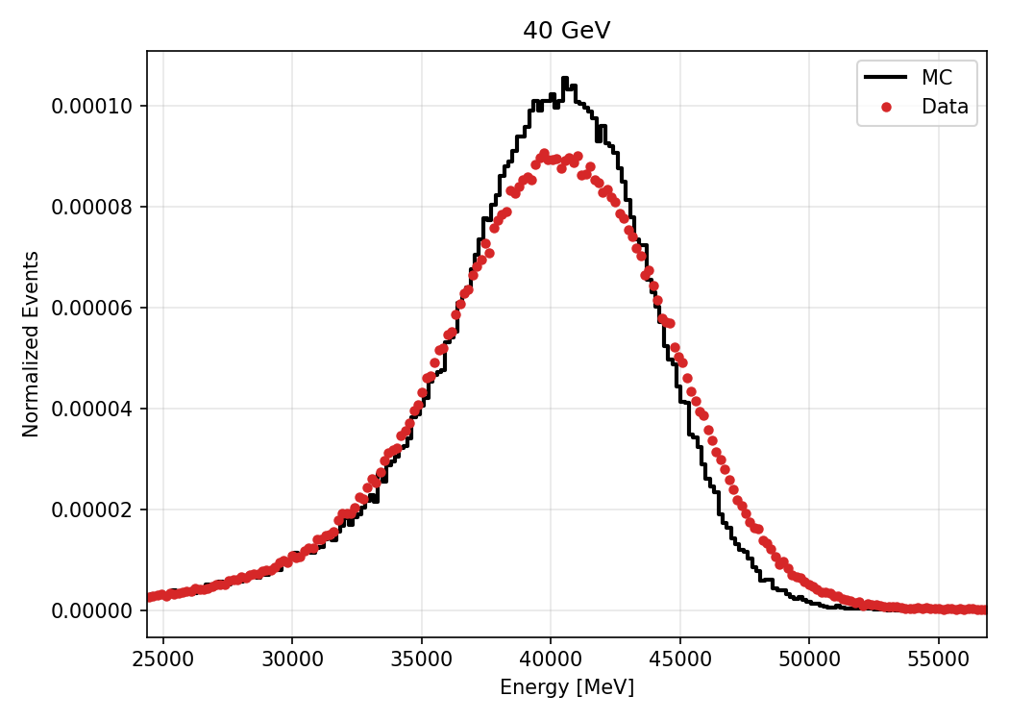
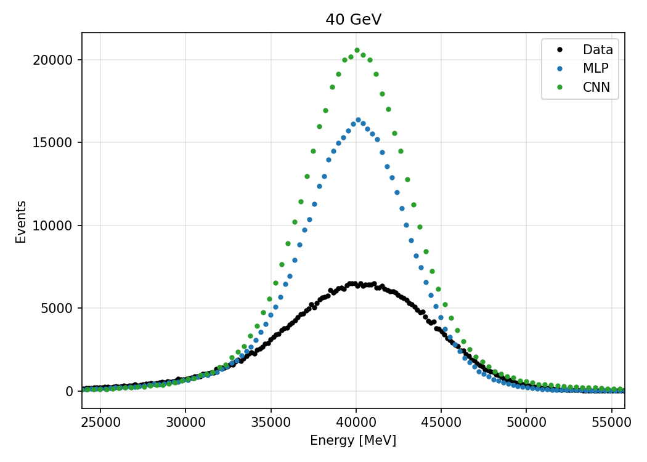
Results on Data
Resolution
Linearity
Data are slightly inferior to MC （0.83% on average）
Resolution
MLP & CNN:both ~25% improvement (avg)
Energy Linearity
MLP: 0.64% (avg)
CNN: 1.11% (avg) — limited

Slide 9
Summary
AHCAL : 40 layers × 18 × 18 cells/layer
Model : MLP CNN ParticleNet
MC results:
Improvement in resolution: ParticleNet(33.4% ,avg)>CNN(26.7% ,avg)≈MLP(23.8% ,avg)
Error in linearity:ParticleNet(0.29% ,avg)<MLP(0.88% ,avg)<CNN(1.28% ,avg)
Beam data(pion,1-120 GeV/c) results:
Improvement in resolution: CNN(24.8% ,avg)≈MLP(25.2% ,avg)
Error in linearity:MLP(0.64% ,avg)<CNN(1.11% ,avg)
ParticleNet: Major Advantage on AHCAL ！
Thanks for your attention!

Slide 10
back up

Slide 11
back up
event | energy(GeV) |  | 10 | 20 | 30 |  | 40 | 50 | 60 | 70 | 80 | 100
Data |  | Pre-cut | 1,027,814 | 749,791 | 1,081,725 |  | 1,038,984 | 1,258,699 | 1,034,938 | 1,058,822 | 1,073,061 | 1,286,608
 |  | Post-cut | 83,860 | 302,303 | 486,653 |  | 458,874 | 498,094 | 369,281 | 327,979 | 283,120 | 253,900
 |  | Fraction（%） | 8.16 | 40.32 | 44.99 |  | 44.17 | 39.57 | 35.68 | 30.98 | 26.38 | 19.73
MC |  | Pre-cut | 400,000 | 400,000 | 400,000 |  | 400,000 | 400,000 | 400,000 | 400,000 | 400,000 | 394,000
 |  | Post-cut | 201,676 | 211,115 | 199,497 |  | 186,119 | 169,367 | 152,117 | 133,628 | 116,822 | 87,346
 |  | Fraction（%） | 50.42 | 52.78 | 49.87 |  | 46.53 | 42.34 | 38.03 | 33.41 | 29.21 | 22.17
Train : 703,747 |  |  |  |  |  | Test : 124,035

Slide 12
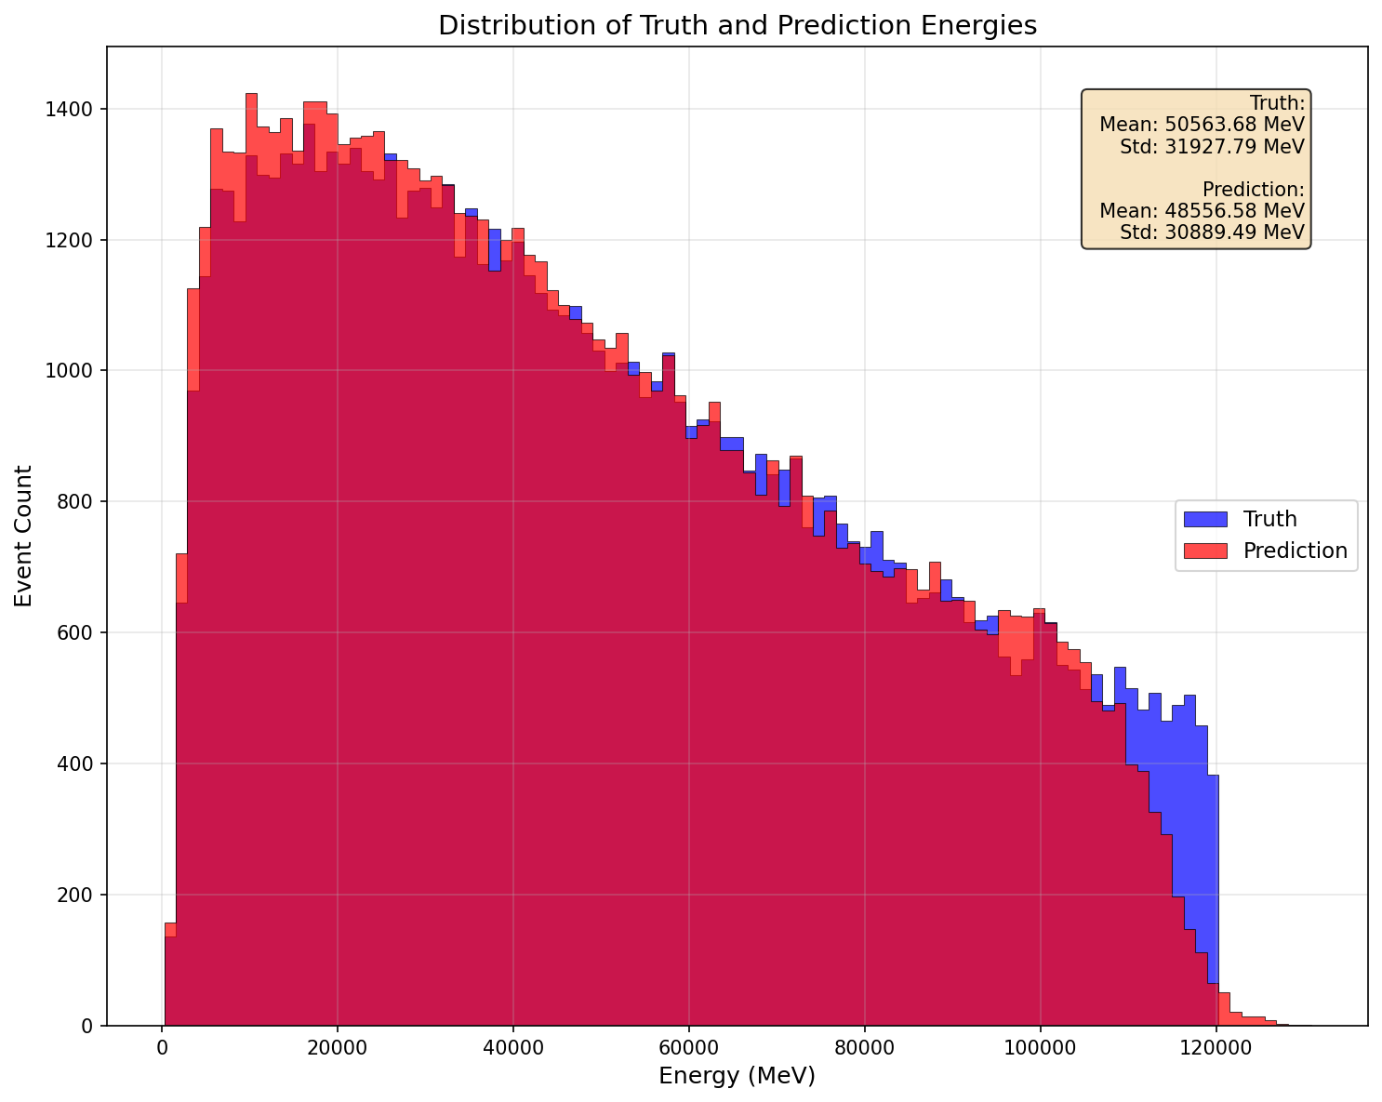
back up

Slide 13
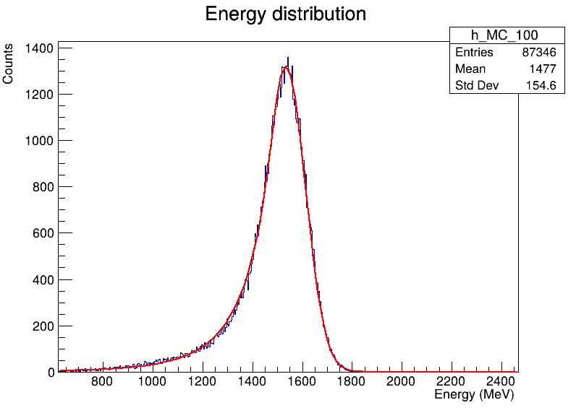
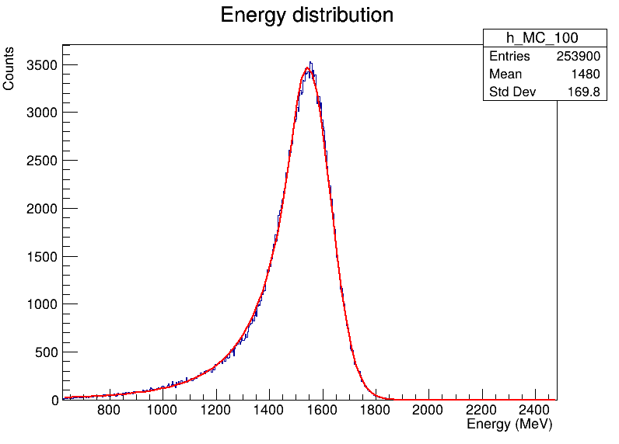
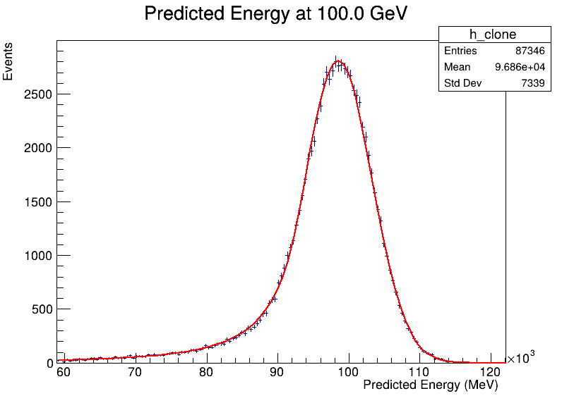
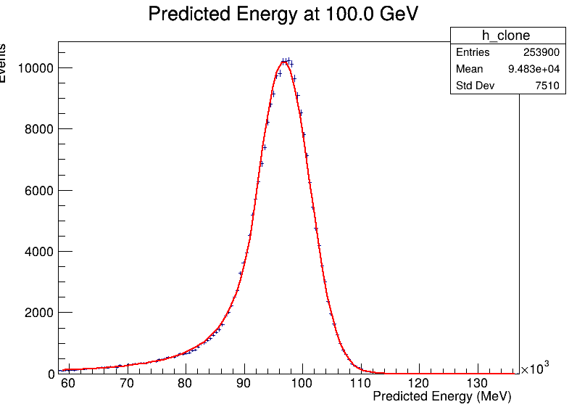
Energy Spectrum@100GeV
MC
Raw
Data
Raw
MLP
MLP
Resolution: Data overall worse than MC
（Larger σ）

Slide 14
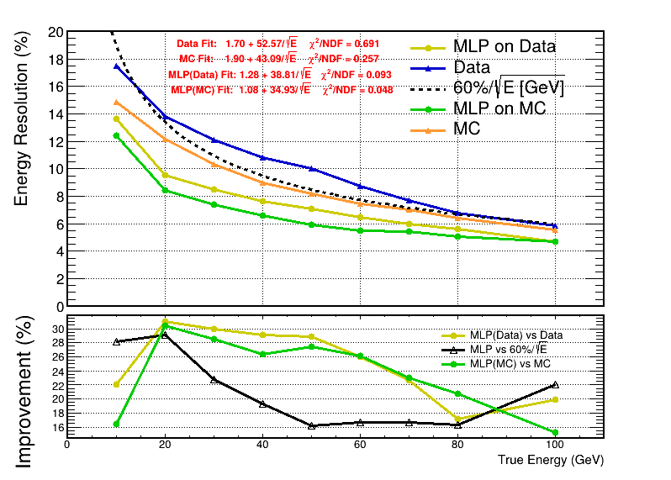
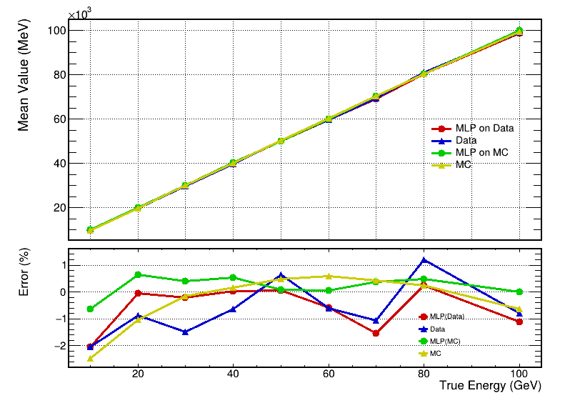
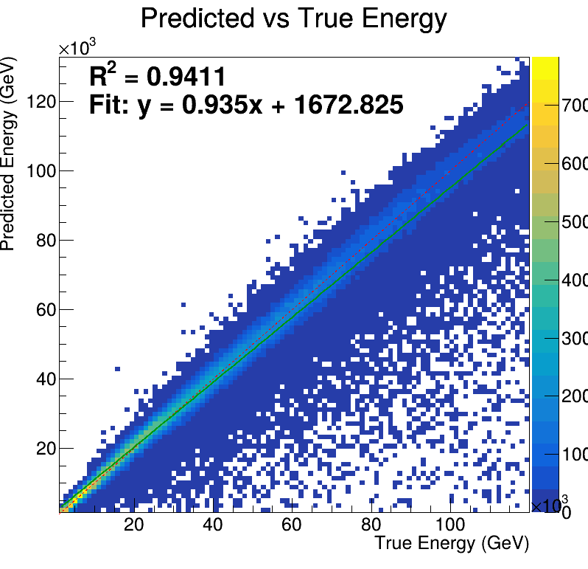


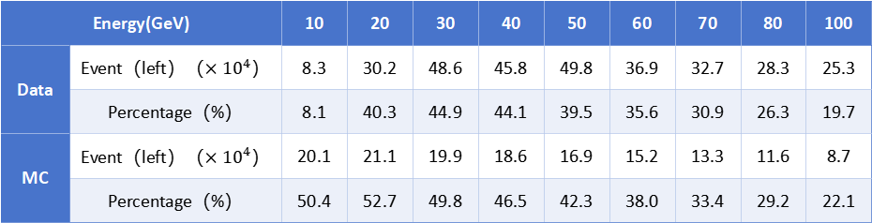
MLP Results
Resolution
Linearity
training sample
source：pion
range：1-120GeV
Event：train = 70.3e4
test = 12.4e4
Data are slightly inferior to MC
（0.83% on average）
Fewer leakage events
Resolution:25% improvement in both MC and Data
linearity:Data shows notable improvement
(-0.58% on average)
MC remains good(0.21% on average)
Energy(GeV) |  | 10 | 20 | 30 | 40 | 50 | 60 | 70 | 80 | 100
Data | Event（left）（$×{10}^{4}$） | 8.3 | 30.2 | 48.6 | 45.8 | 49.8 | 36.9 | 32.7 | 28.3 | 25.3
 | Percentage（%） | 8.1 | 40.3 | 44.9 | 44.1 | 39.5 | 35.6 | 30.9 | 26.3 | 19.7
MC | Event（left）（$×{10}^{4}$） | 20.1 | 21.1 | 19.9 | 18.6 | 16.9 | 15.2 | 13.3 | 11.6 | 8.7
 | Percentage（%） | 50.4 | 52.7 | 49.8 | 46.5 | 42.3 | 38.0 | 33.4 | 29.2 | 22.1
$$Imp=\frac{\left|R_{MC}−R_{MLP}\right|}{R_{MC}}$$
$$Error=\frac{\left|Mean−True\right|}{True}$$

Slide 15
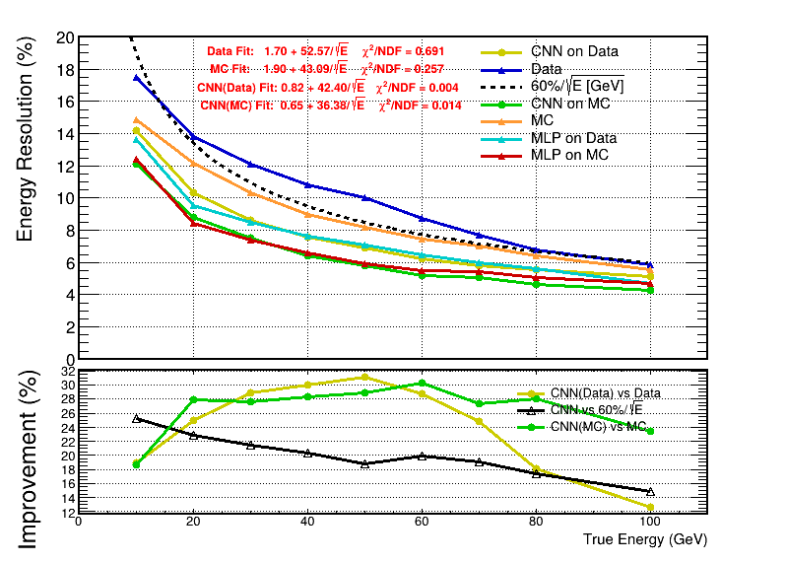
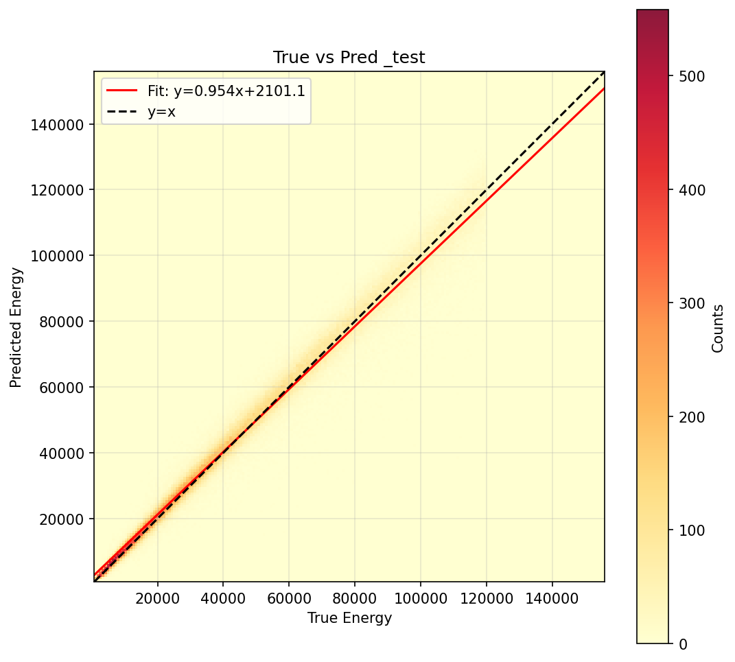
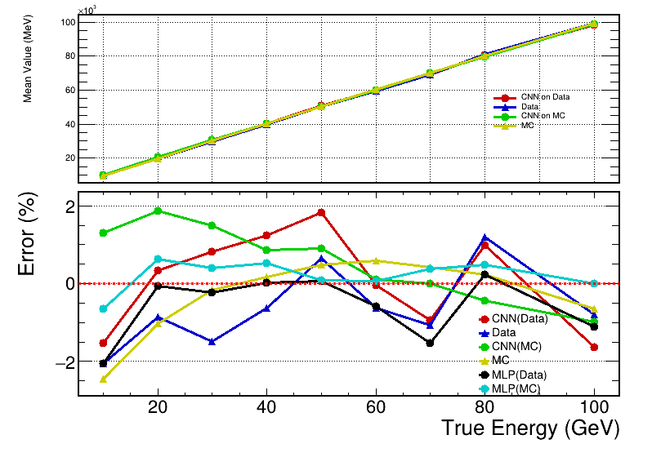
CNN Results
Resolution
Linearity
Resolution
MLP & CNN: ~25% improvement (both)
Energy Linearity
MLP: notable improvement — 0.51% (avg)
CNN: limited improvement — 0.96% (avg)
vs. MLP
CNN: no clear advantage on AHCAL yet
$$Imp=\frac{\left|R_{MC}−R_{MLP}\right|}{R_{MC}}$$
$$Error=\frac{\left|Mean−True\right|}{True}$$

