Slide 1
eBins = {0.0925, 0.095, 0.0975, 0.1, 0.105, 0.11, 0.115, 0.12, 0.125, 0.13, 0.135, 0.14};
thetaBins = {0, 0.04, 0.08, 0.12, 0.16, 0.2, 0.24, 0.28, 0.32, 0.36, 0.4, 0.44, 0.48, 0.52, 0.56, 0.6, 0.64, 0.68, 0.72, 0.76, 0.8, 0.8025, 0.805, 0.8075, 0.81, 0.8125, 0.815, 0.8175, 0.82, 0.8225, 0.825, 0.8275, 0.83, 0.8325, 0.835, 0.8375, 0.84, 0.8425, 0.845, 0.8475, 0.85, 0.855, 0.86, 0.865, 0.87, 0.875, 0.88, 0.885, 0.89, 0.895, 0.9, 0.905, 0.91, 0.915, 0.92, 0.925, 0.93, 0.935, 0.94, 0.942, 0.944, 0.945};

Slide 2
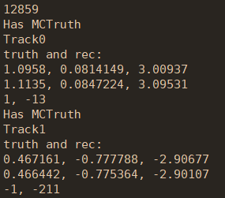

Fast sim with 3D sampling vs. Full sim
Selection criteria | Full sim |  |  | Fast sim (3D sampling)
 | Events | Absolute eff. | Relative eff. | Events | Absolute eff. | Relative eff.
Generated | 20000 | - | - | 20000 | - | -
Reconstructed | 20000 | 100% | 100% | 20000 | 100% | 100%
nGood = 2 | 14852 | 74.3% | 74.3% | 15458 | 77.3% | 77.3%
Truth matched | 14851 | 74.3% | 99.99% | 15458 | 77.3% | 100%
全模拟truth match效率不等于100%，
检查truth信息发现存在$μ^{+}$

Slide 3
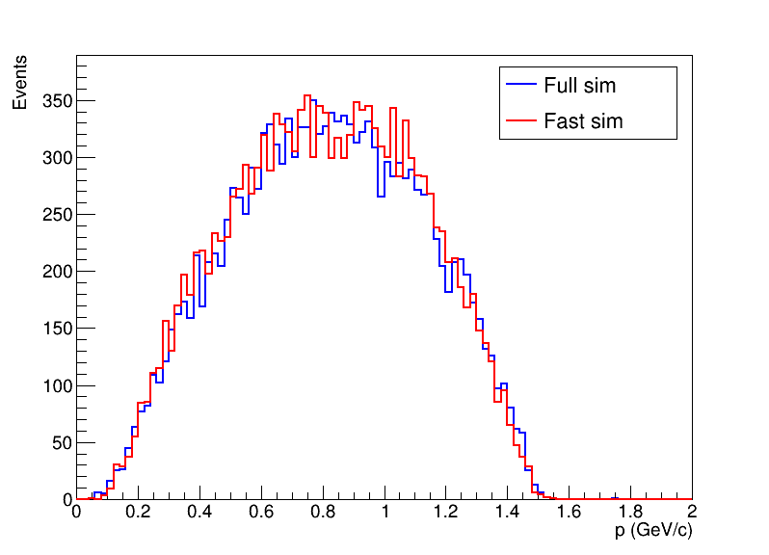
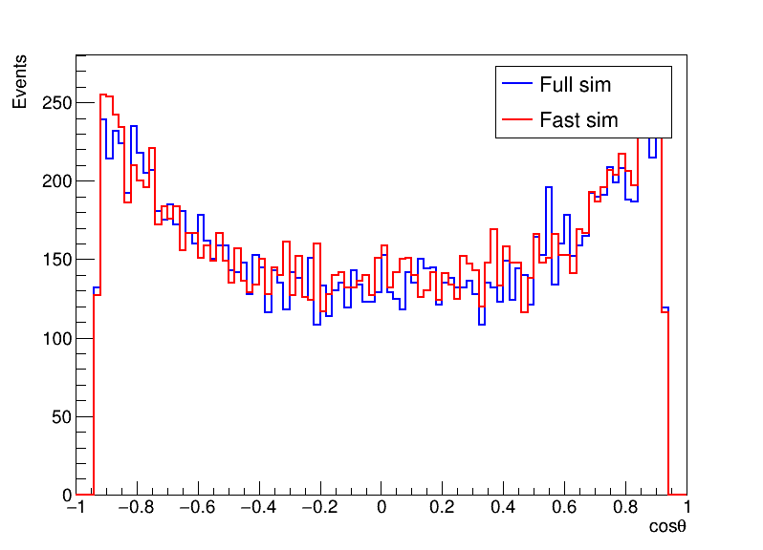
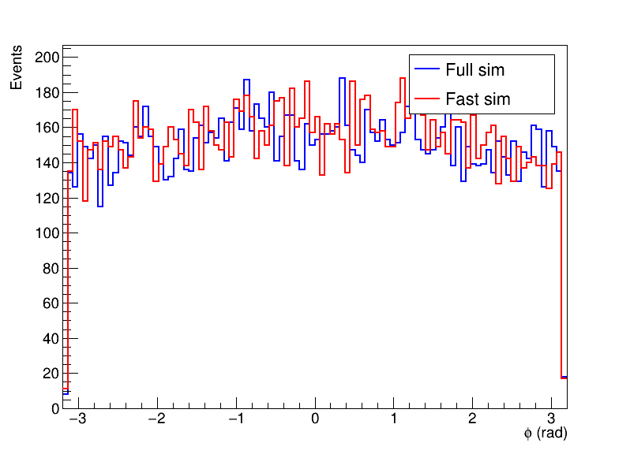
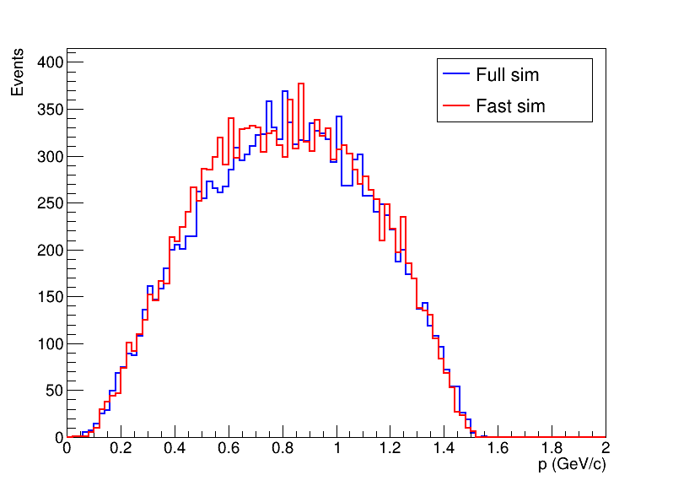
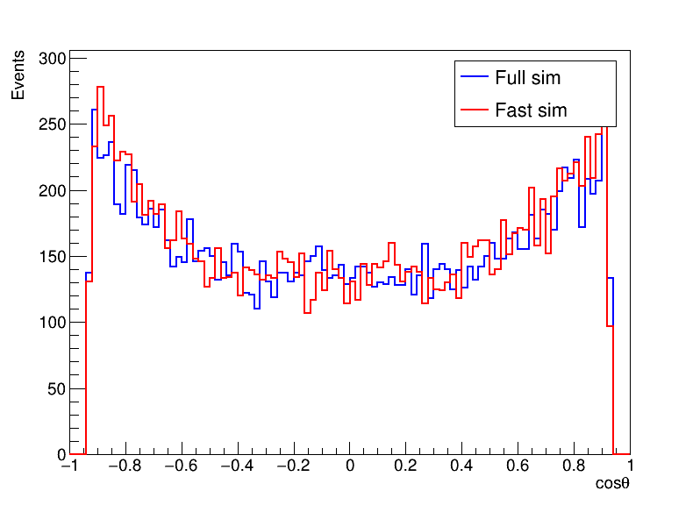
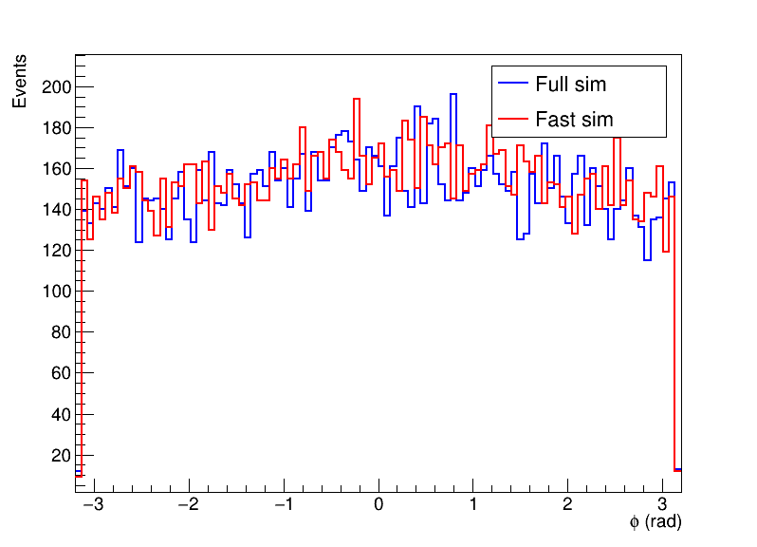
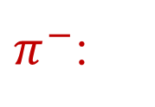
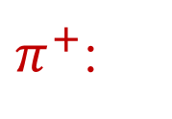
Fast sim with 3D sampling vs. Full sim
$π^{+}$:
$π^{−}$:

Slide 4
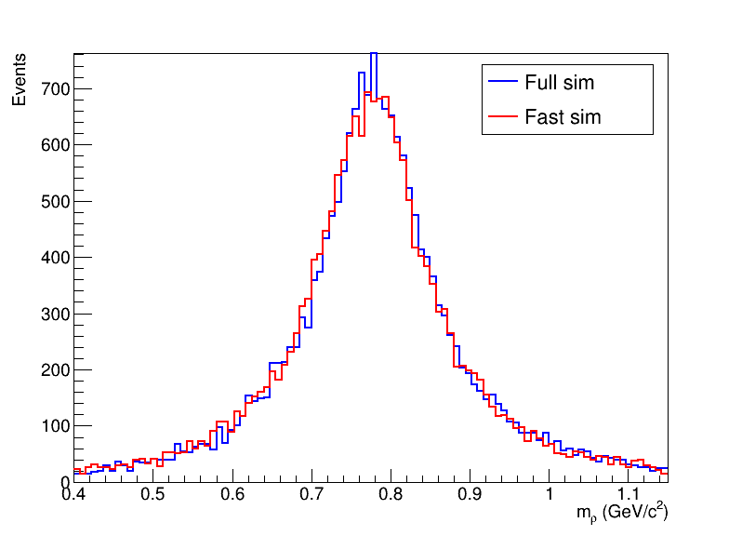
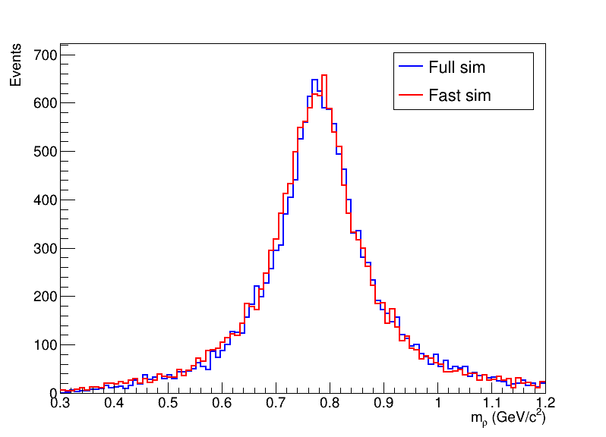

Fast sim with 3D sampling vs. Full sim
$ρ$ mass:
truth
reconstructed

Slide 5
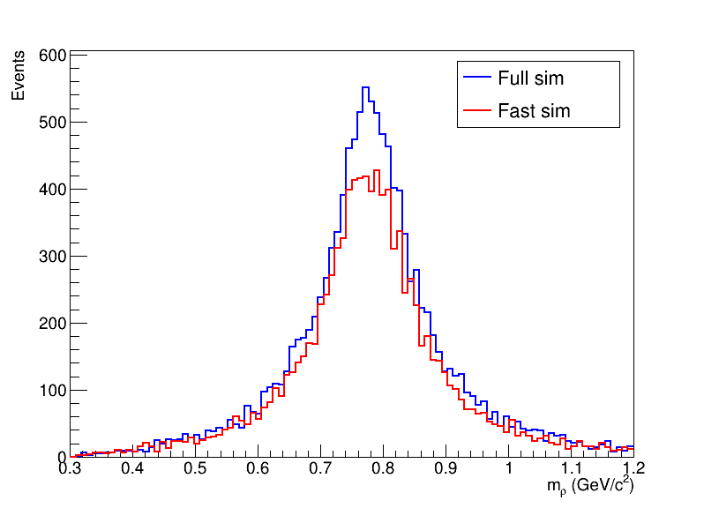
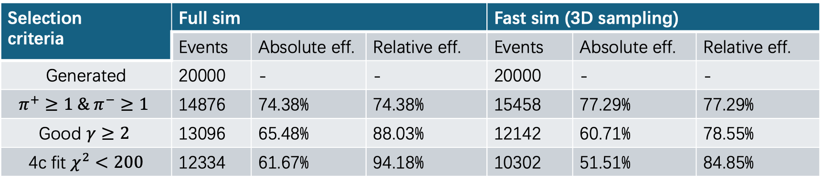

Fast sim with 3D sampling vs. Full sim
Selection criteria | Full sim |  |  | Fast sim (3D sampling)
 | Events | Absolute eff. | Relative eff. | Events | Absolute eff. | Relative eff.
Generated | 20000 | - | - | 20000 | - | -
$$π^{+}≥1 \& π^{−}≥1$$ | 14876 | 74.38% | 74.38% | 15458 | 77.29% | 77.29%
Good $γ≥2$ | 13096 | 65.48% | 88.03% | 12142 | 60.71% | 78.55%
4c fit $χ^{2}<200$ | 12334 | 61.67% | 94.18% | 10302 | 51.51% | 84.85%
$$J/ψ→ρ^{0}π^{0} ρ^{0}→π^{+}π^{−} π^{0}→γγ$$

Slide 6
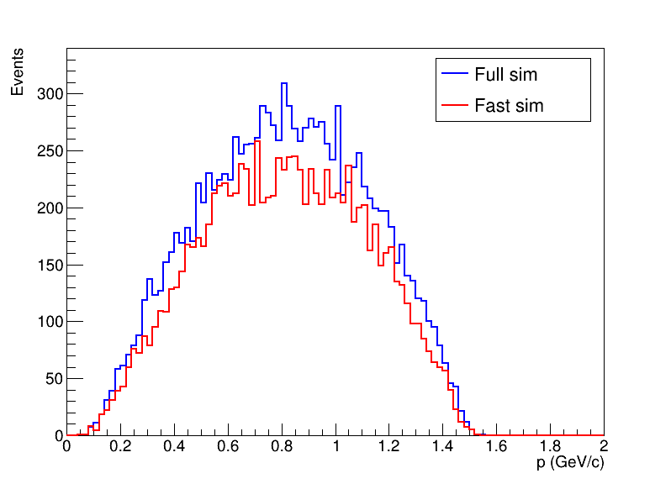
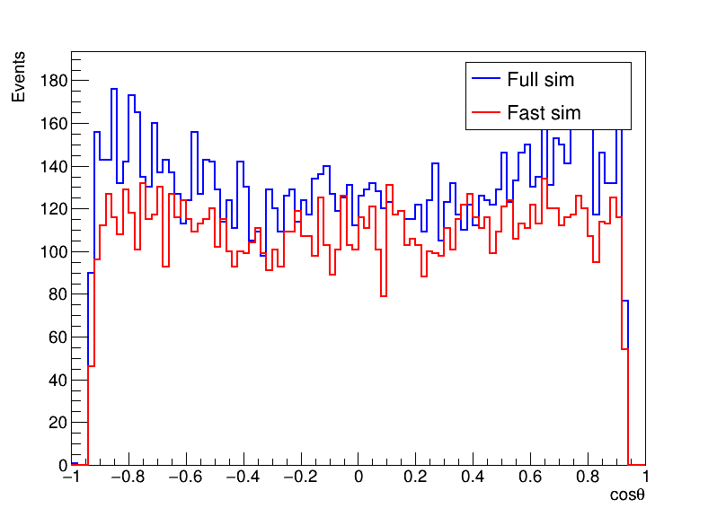
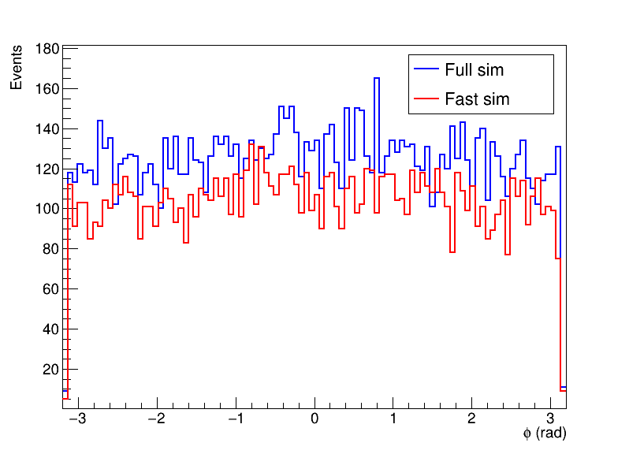

$π^{−}$:

Slide 7
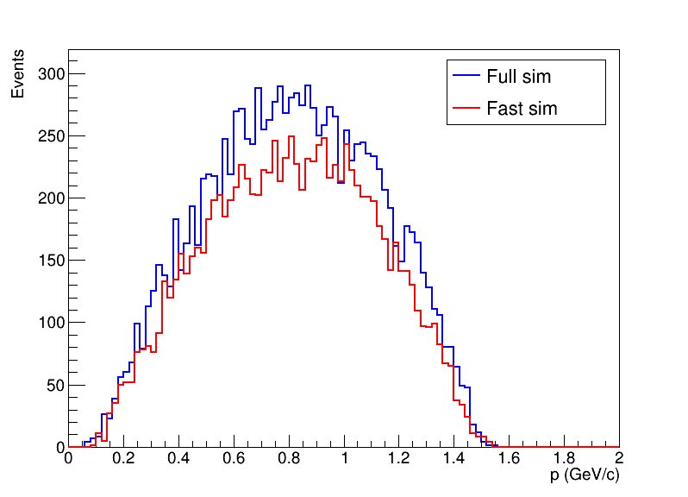
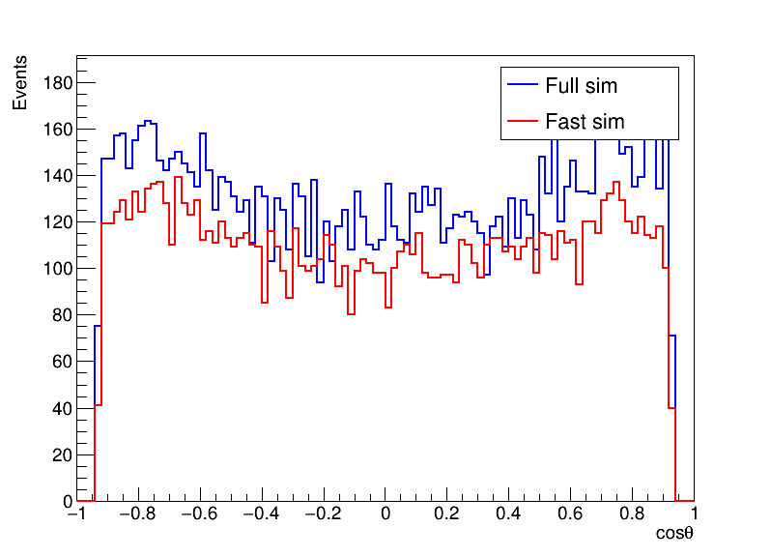
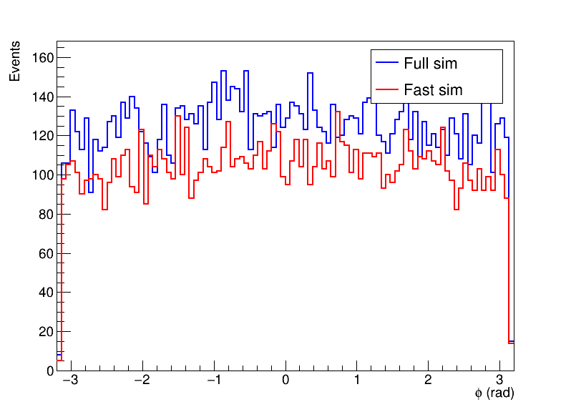

$π^{+}$:

Slide 8
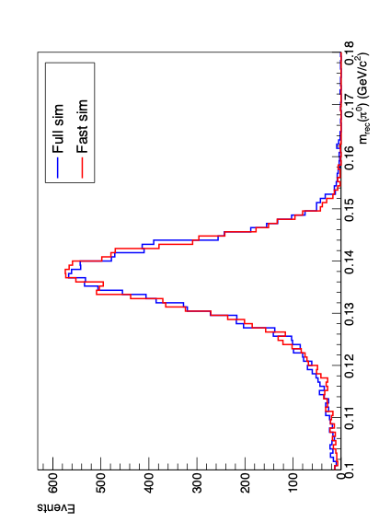
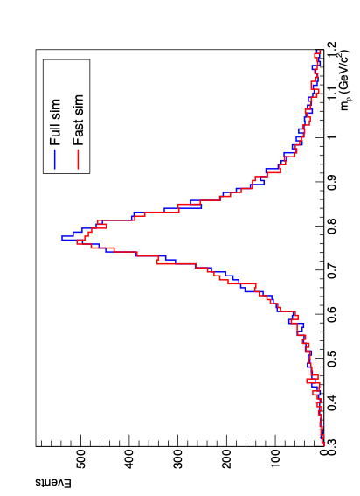
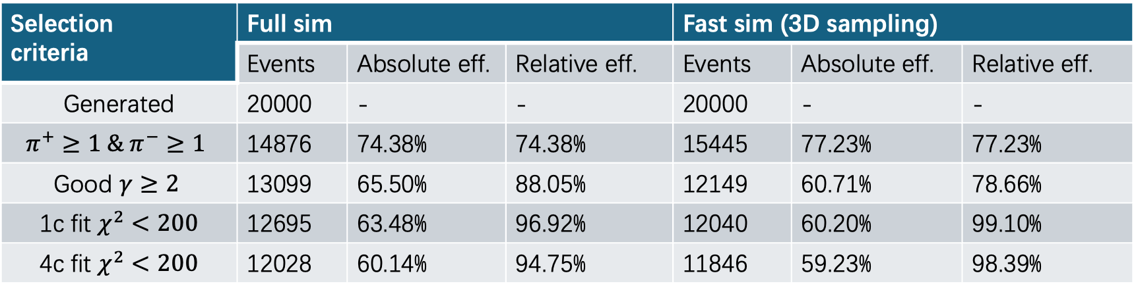

Fast sim with 3D sampling vs. Full sim
Selection criteria | Full sim |  |  | Fast sim (3D sampling)
 | Events | Absolute eff. | Relative eff. | Events | Absolute eff. | Relative eff.
Generated | 20000 | - | - | 20000 | - | -
$$π^{+}≥1 \& π^{−}≥1$$ | 14876 | 74.38% | 74.38% | 15445 | 77.23% | 77.23%
Good $γ≥2$ | 13099 | 65.50% | 88.05% | 12149 | 60.71% | 78.66%
1c fit $χ^{2}<200$ | 12695 | 63.48% | 96.92% | 12040 | 60.20% | 99.10%
4c fit $χ^{2}<200$ | 12028 | 60.14% | 94.75% | 11846 | 59.23% | 98.39%
$$J/ψ→ρ^{0}π^{0} ρ^{0}→π^{+}π^{−} π^{0}→γγ$$

Slide 9
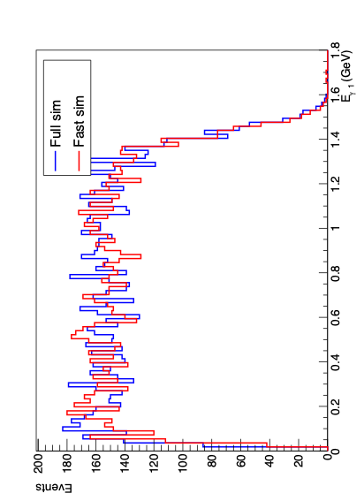
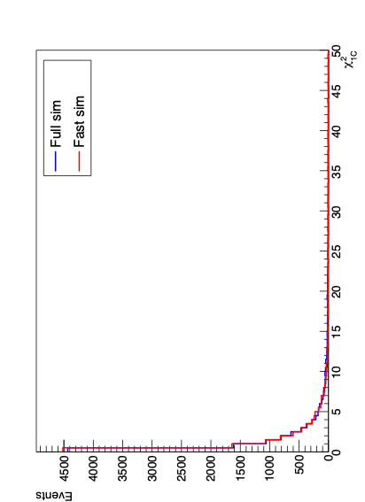
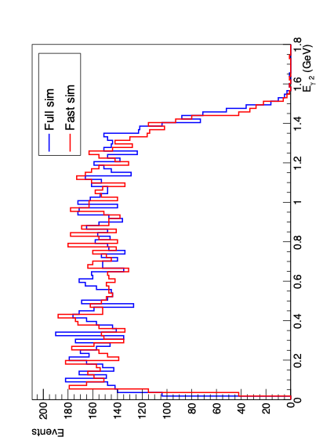
1c fit

Slide 10
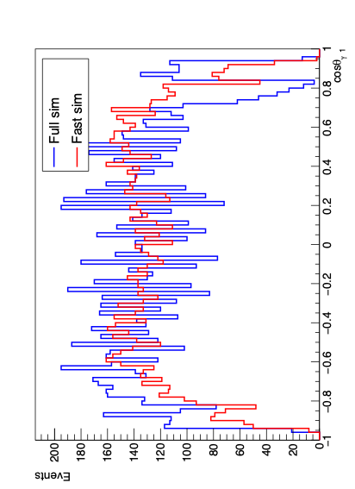
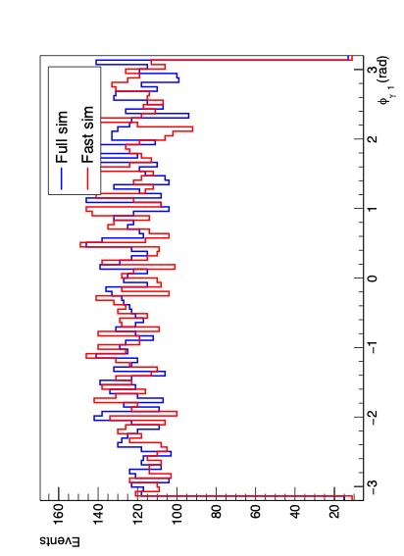
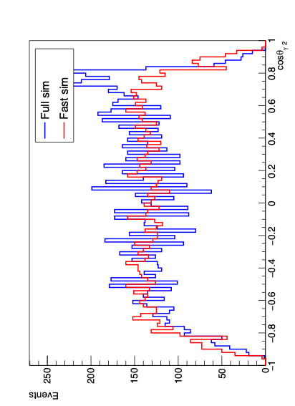
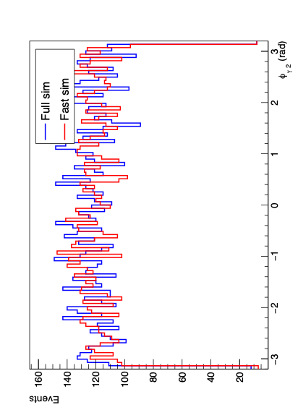
gam1
gam2

Slide 11
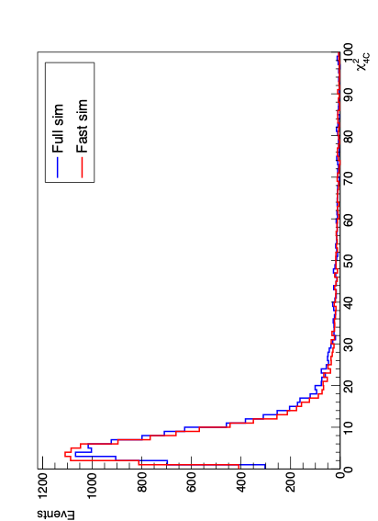
4c fit

Slide 12
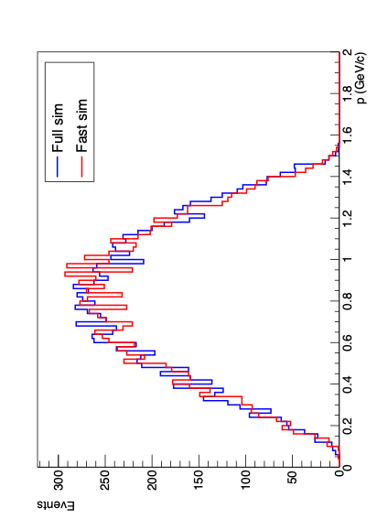
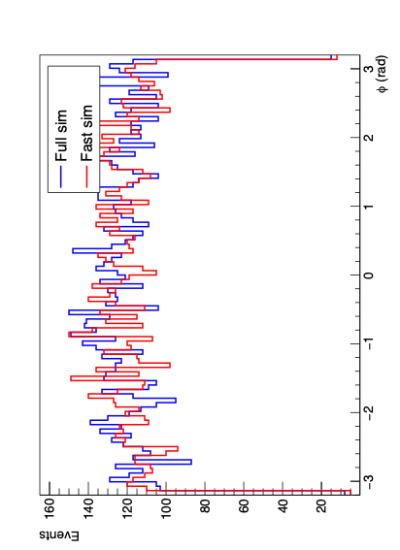
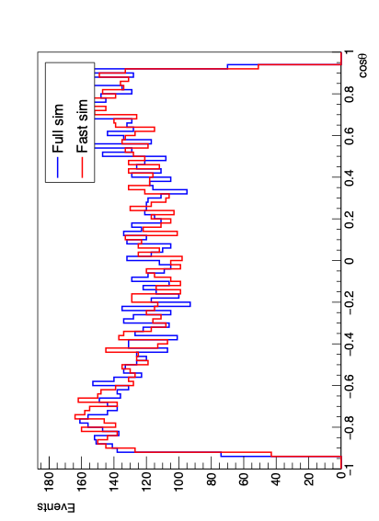
pip

Slide 13
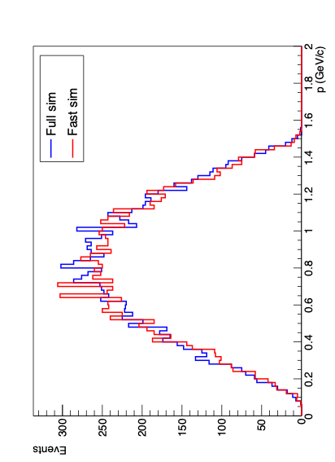
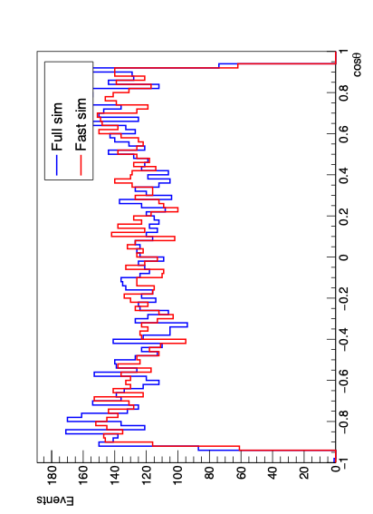
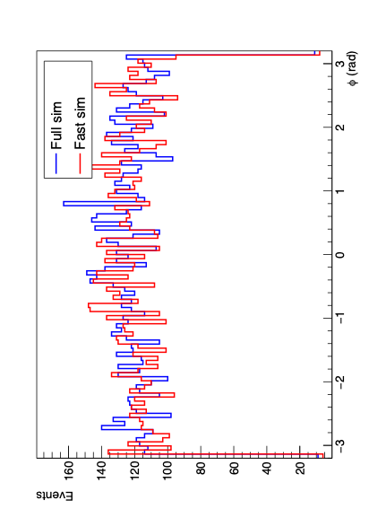
pim

Slide 14
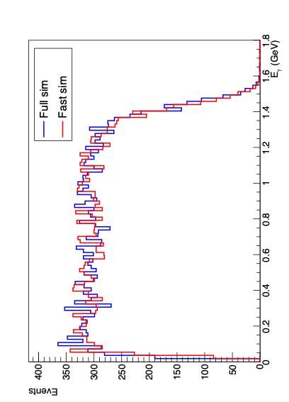
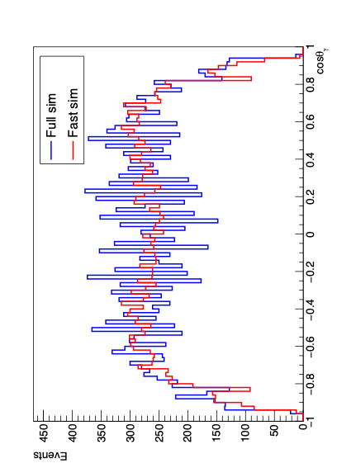
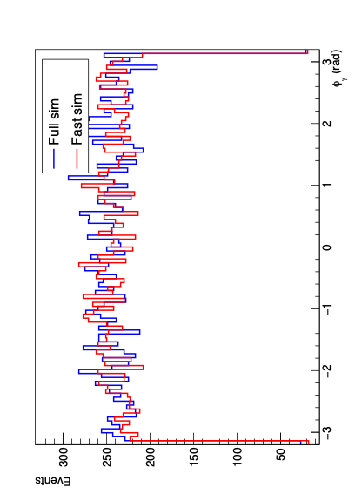
Update gamma

Slide 15


Slide 16
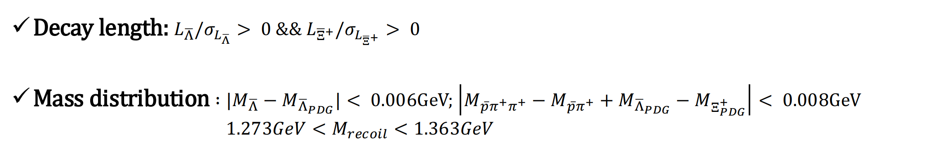
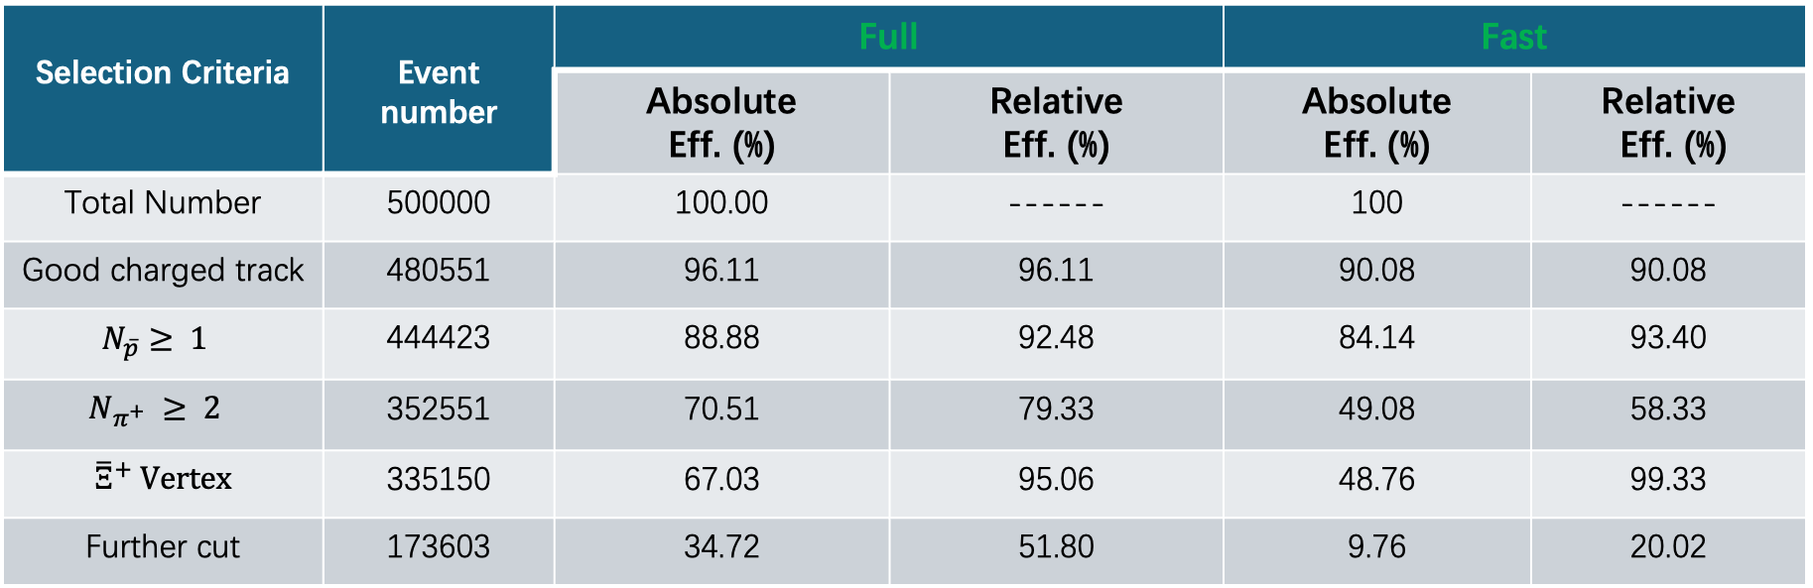
Single tag analysis
Cut flow
Selection Criteria | Event number | Full |  | Fast
 |  | Absolute Eff. (%) | Relative Eff. (%) | Absolute Eff. (%) | Relative Eff. (%)
Total Number | 500000 | 100.00 | ------ | 100 | ------
Good charged track | 480551 | 96.11 | 96.11 | 90.08 | 90.08
$$N_{\overline{p}}≥ 1$$ | 444423 | 88.88 | 92.48 | 84.14 | 93.40
$$N_{π^{+}} ≥ 2$$ | 352551 | 70.51 | 79.33 | 49.08 | 58.33
${\overline{Ξ}}^{+}$ Vertex | 335150 | 67.03 | 95.06 | 48.76 | 99.33
Further cut | 173603 | 34.72 | 51.80 | 9.76 | 20.02

Slide 17
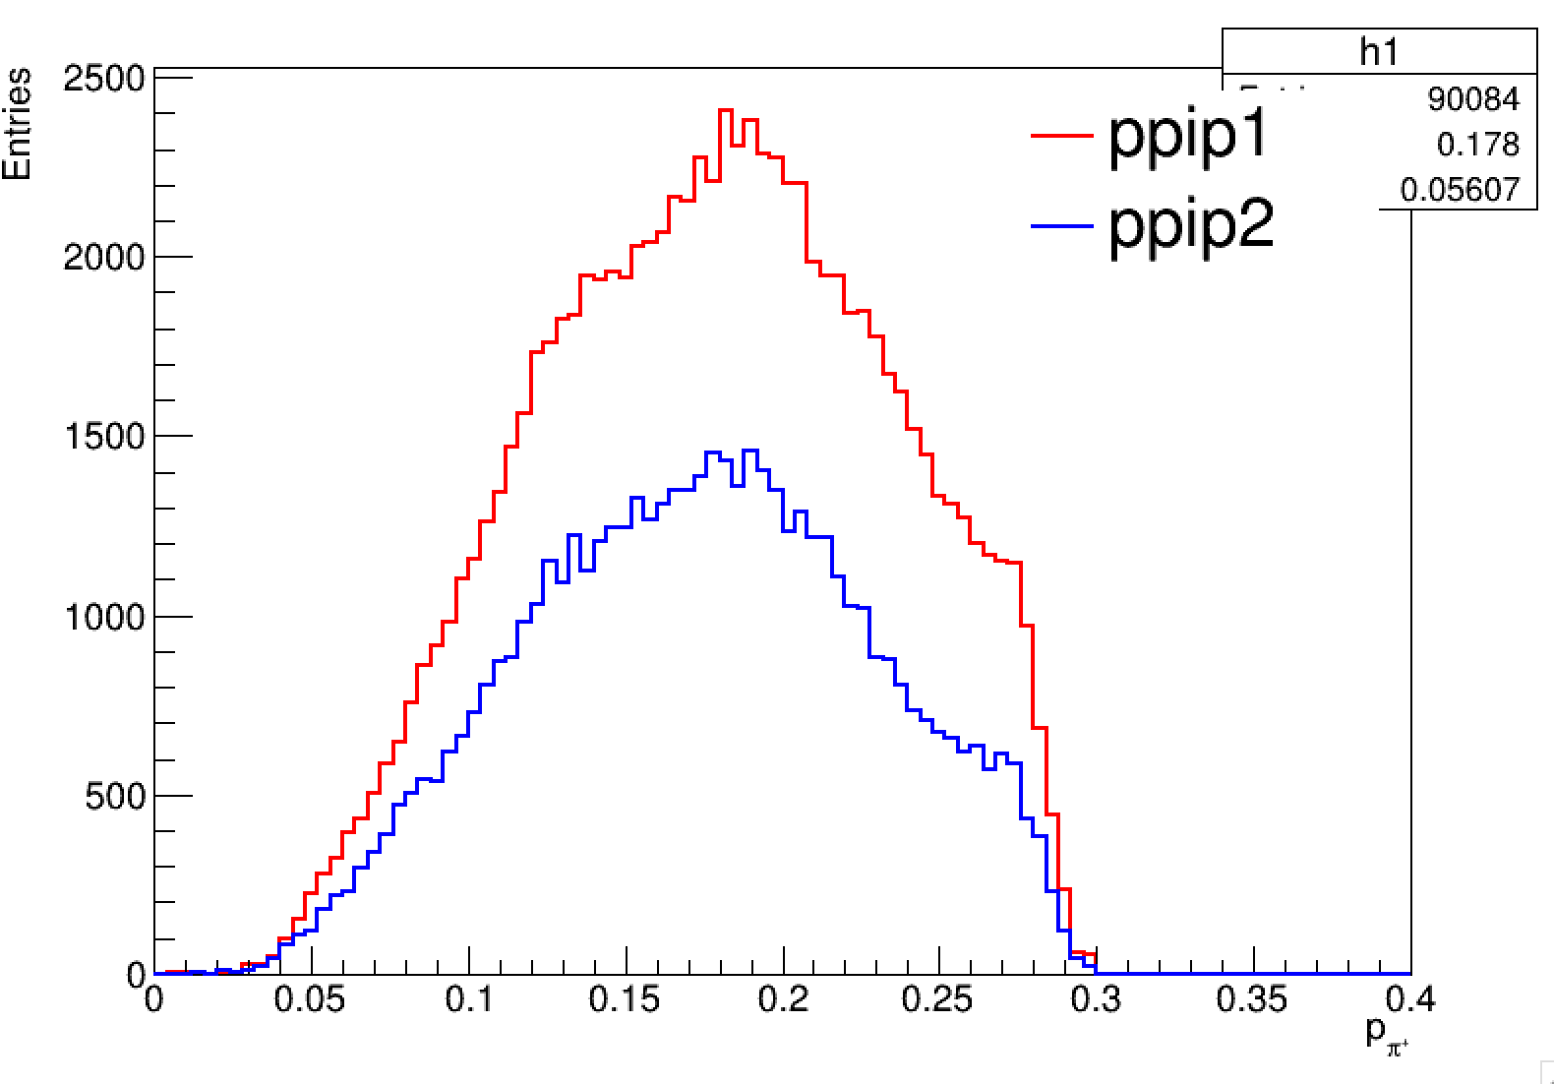
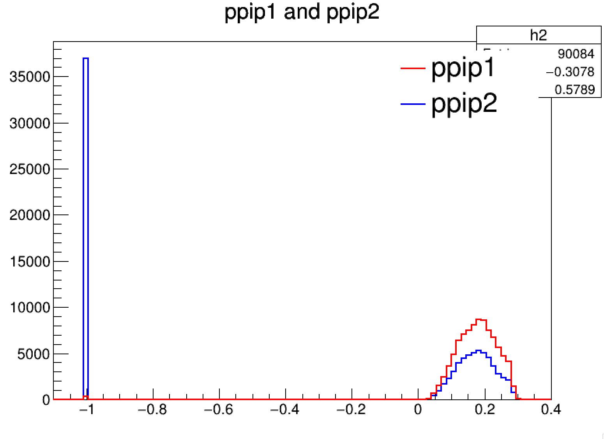

Slide 18
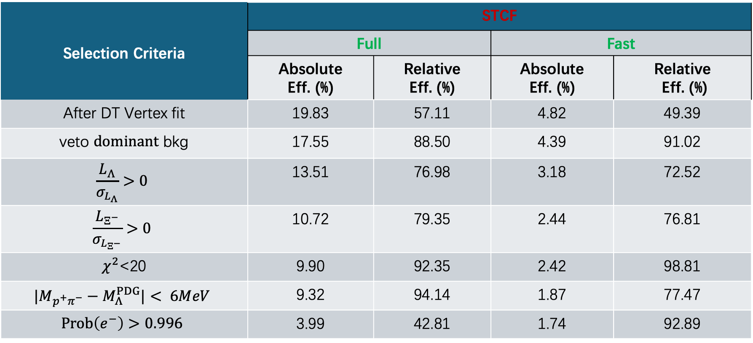
Double tag analysis
Cut flow
Selection Criteria | STCF
 | Full |  | Fast
 | Absolute Eff. (%) | Relative Eff. (%) | Absolute Eff. (%) | Relative Eff. (%)
After DT Vertex fit | 19.83 | 57.11 | 4.82 | 49.39
veto $dominant$ bkg | 17.55 | 88.50 | 4.39 | 91.02
$$\frac{L_{Λ}}{σ_{L_{Λ}}}>0$$ | 13.51 | 76.98 | 3.18 | 72.52
$$\frac{L_{Ξ^{−}}}{σ_{L_{Ξ^{−}}}}>0$$ | 10.72 | 79.35 | 2.44 | 76.81
$χ^{2}$<20 | 9.90 | 92.35 | 2.42 | 98.81
$$|M_{p^{+}π^{−}}−M_{Λ}^{PDG}|< 6MeV$$ | 9.32 | 94.14 | 1.87 | 77.47
$$Prob\left(e^{−}\right)>0.996$$ | 3.99 | 42.81 | 1.74 | 92.89

