Slide 1

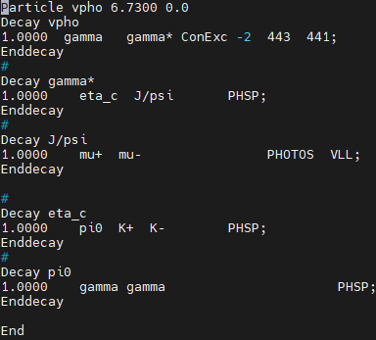
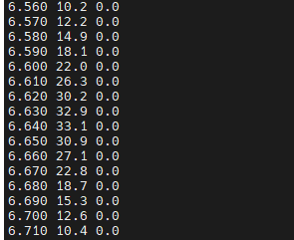

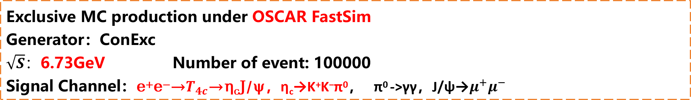
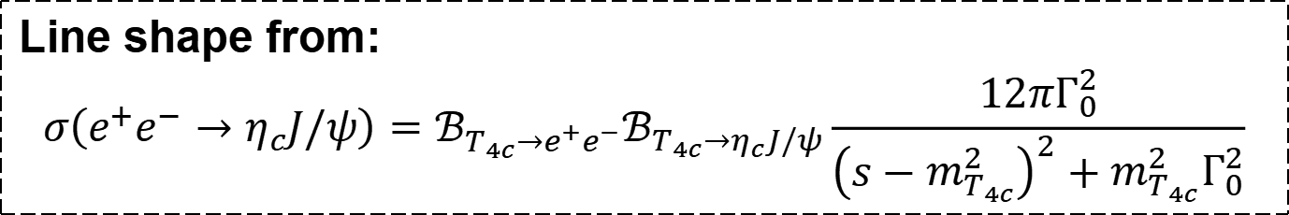
My study for $\text{the} \text{double}\text{−}\text{charmonia} η_{c}\text{J}\text{/}ψ \text{production}$
Exclusive MC production under OSCAR FastSim
Generator：ConExc
$\sqrt{S}：$6.73GeV Number of event: 100000
Signal Channel：e⁺e⁻→$T_{4c}$→η_{c}J/ψ，η_{c}→K⁺K⁻π⁰， π⁰ ->γγ，J/ψ→$μ^{+}μ^{−}$
By Zhuojuan Dong
Line shape from:
$$σ\left(e^{+}e^{−}→η_{c}J/ψ\right)=ℬ_{T_{4c}→e^{+}e^{−}}ℬ_{T_{4c}→η_{c}J/ψ}\frac{12πΓ_{0}^{2}}{{\left(s−m_{T_{4c}}^{2}\right)}^{2}+m_{T_{4c}}^{2}Γ_{0}^{2}}$$

Slide 2
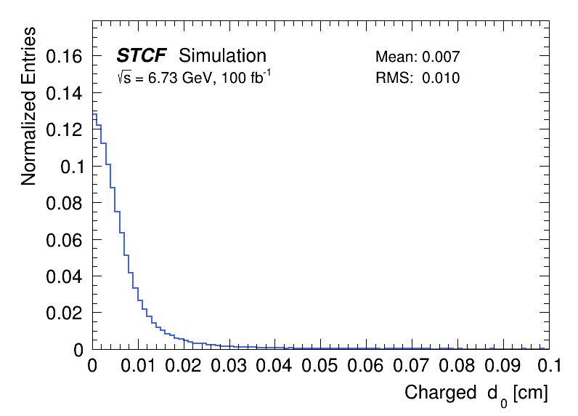
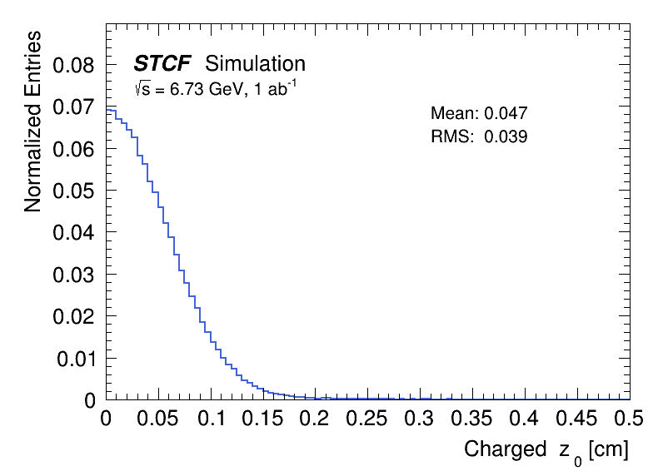
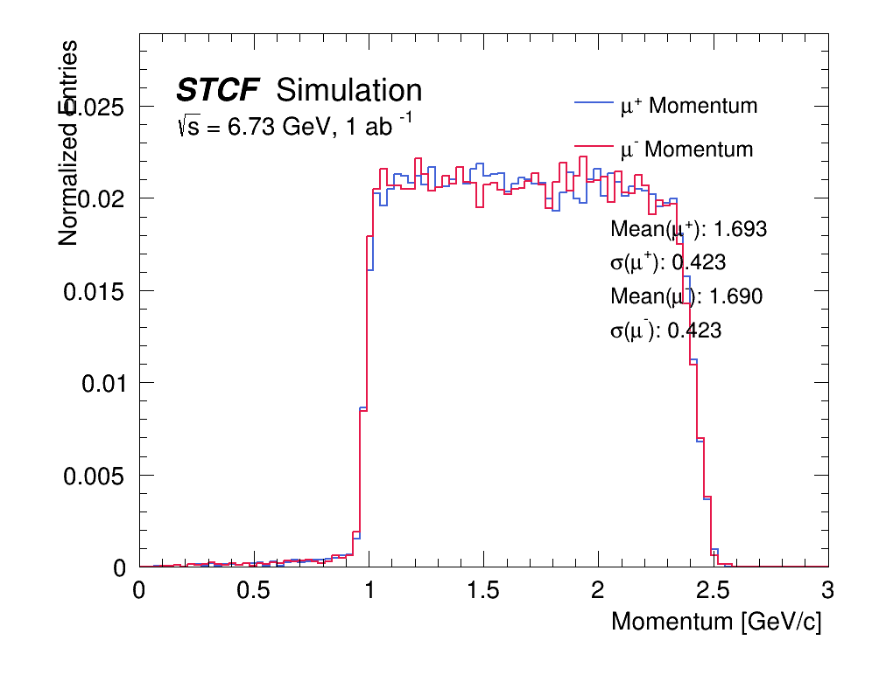
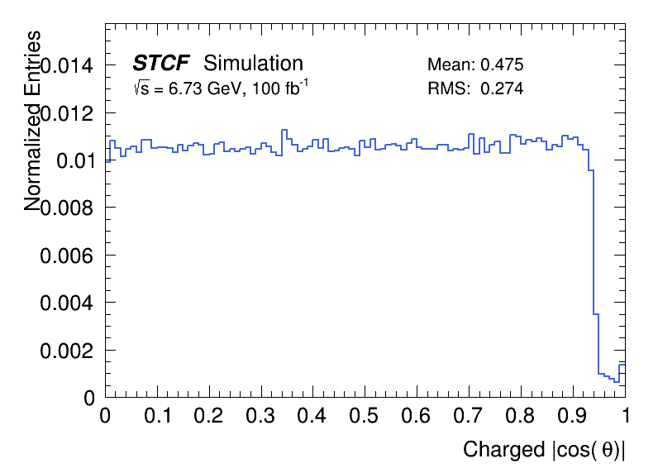



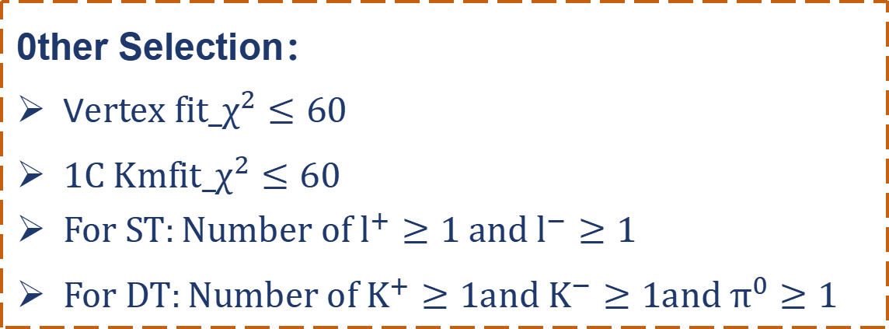

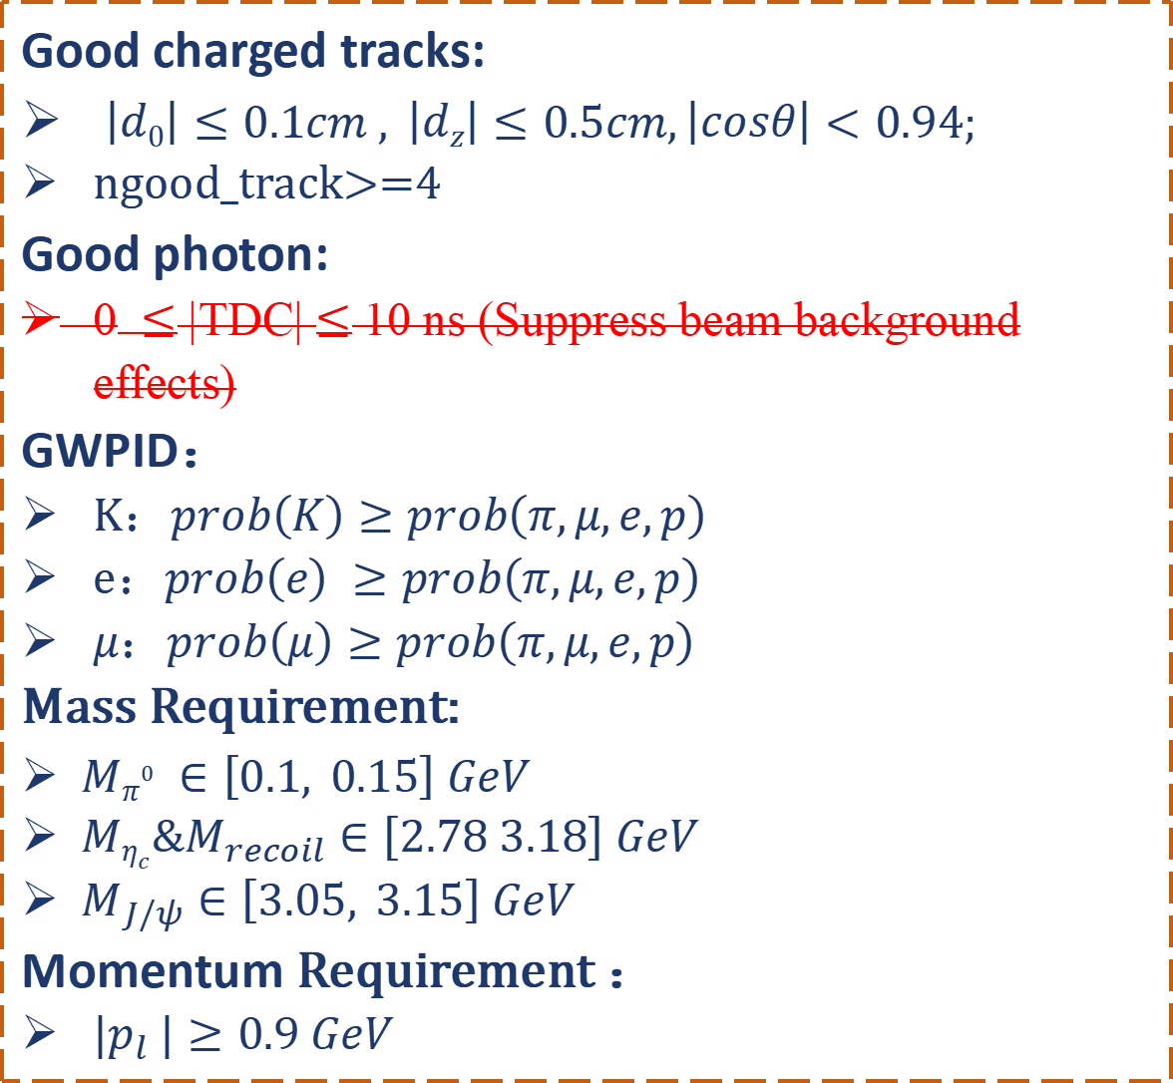
Event selection
Event selection
Good charged tracks:
$\left|d0\right|≤0.1cm , \left|dz\right|≤0.5cm,\left|cosθ\right|<0.94;$
ngood_track>=4
Good photon:
0$≤$ |TDC| $≤$ 10 ns (Suppress beam background effects)
GWPID：
K：$prob\left(K\right)≥prob\left(π,μ,e,p\right)$
e：$prob\left(e\right) ≥prob\left(π,μ,e,p\right)$
$μ$：$prob\left(μ\right)≥prob\left(π,μ,e,p\right)$
Mass Requirement:
$Mπ^{0} ∈\left[0.1, 0.15\right] GeV$
$Mη_{c}\&M_{recoil}∈\left[2.78 3.18\right] GeV$
$M_{J/ψ}$ $∈\left[3.05, 3.15\right] GeV$
Momentum Requirement ：
$|p_{l} |≥0.9 GeV$
0ther Selection：
V$ertex fit_χ^{2}≤60$
$1C Kmfit_χ^{2}≤60$
$For ST:Number of l^{+}≥1 and l^{−}≥1$
$For DT:Number of K^{+}≥1{and K}^{−}≥1and π^{0}≥1$
$$\left|d0\right|$$
$$\left|d0\right|$$
$$\left|dz\right|$$
$$\left|dz\right|$$
$$\left|cosθ\right|$$
$$\left|cosθ\right|$$
$$|p_{l} |$$
$$|p_{l} |$$

Slide 3
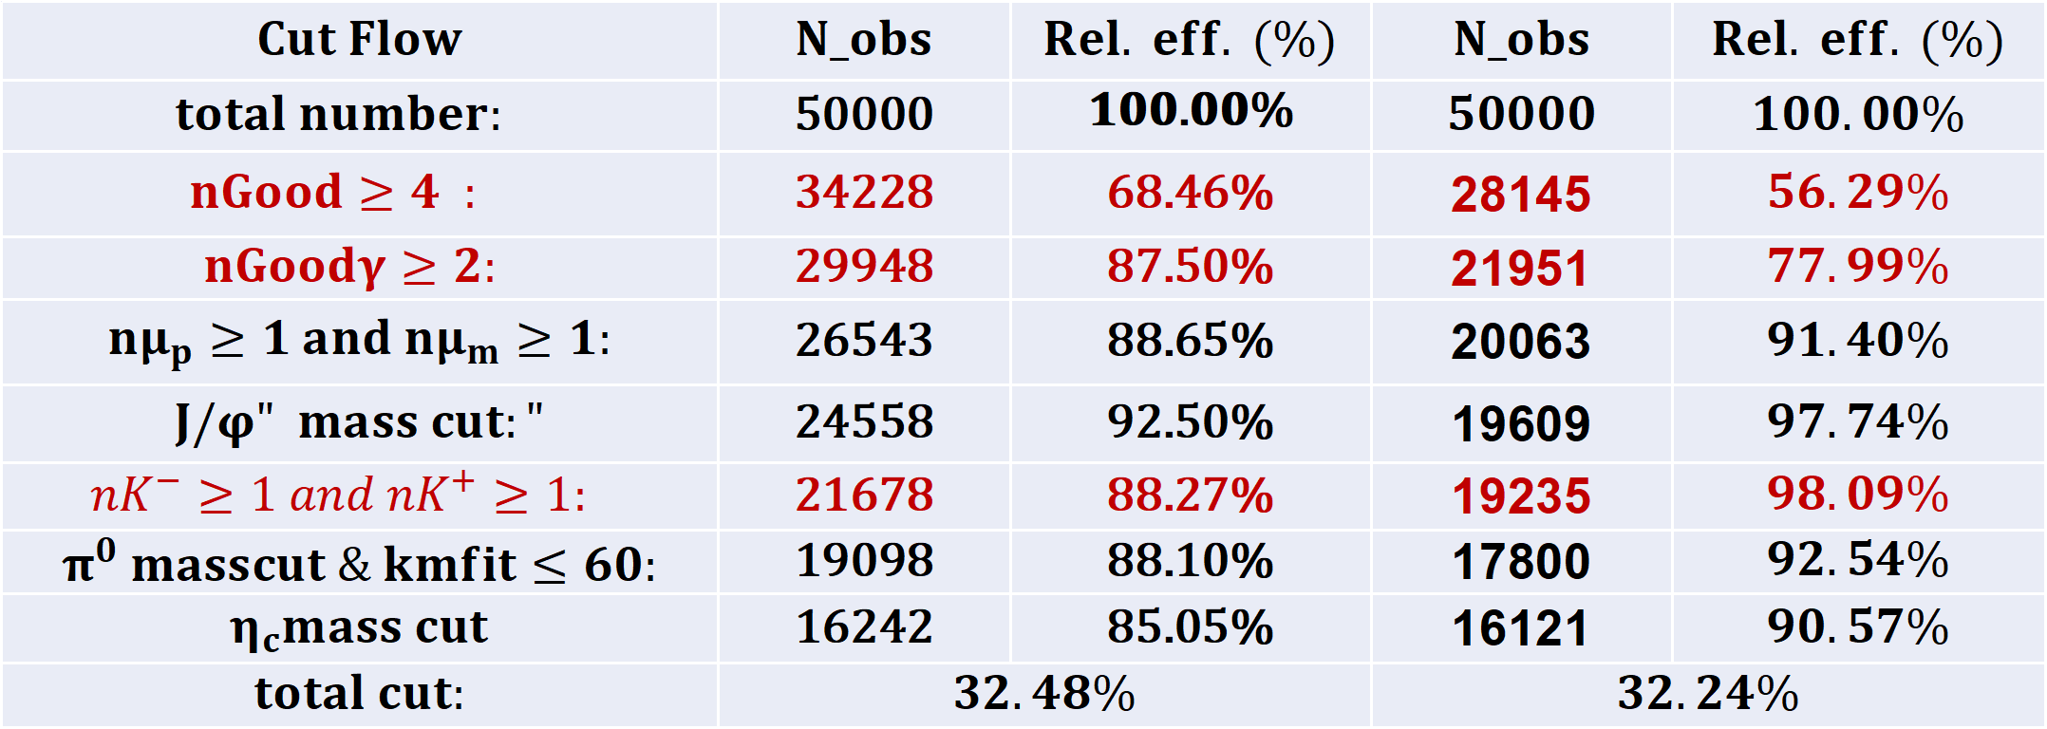
J/ψ→$μ^{+}μ^{−}$
$oscar 全模拟 VS 快模拟$@2.6.2
cut flow
$$Cut Flow$$ | $$N_obs$$ | $$Rel. eff. (\%)$$ | $$N_obs$$ | $$Rel. eff. (\%)$$
$$total number:$$ | 50000 | 𝟏𝟎𝟎.𝟎𝟎% | $$50000$$ | $$100.00\%$$
$$nGood≥4 :$$ | 34228 | 68.46% | 28145 | $$56.29\%$$
$$nGoodγ≥2:$$ | 29948 | 87.50% | 21951 | $$77.99\%$$
$$nμ_{p}≥1 and nμ_{m}≥1:$$ | 26543 | 88.65% | 20063 | $$91.40\%$$
$$J/φ" mass cut:"$$ | 24558 | 92.50% | 19609 | $$97.74\%$$
$$nK^{−}≥1 and nK^{+}≥1:$$ | 21678 | 88.27% | 19235 | $$98.09\%$$
$$π^{0} masscut \& kmfit≤60:$$ | 19098 | 88.10% | 17800 | $$92.54\%$$
$$η_{c}mass cut$$ | 16242 | 85.05% | 16121 | $$90.57\%$$
$$total cut:$$ | $$32.48\%$$ |  | $$32.24\%$$
gwpid
全模拟
快模拟

Slide 4
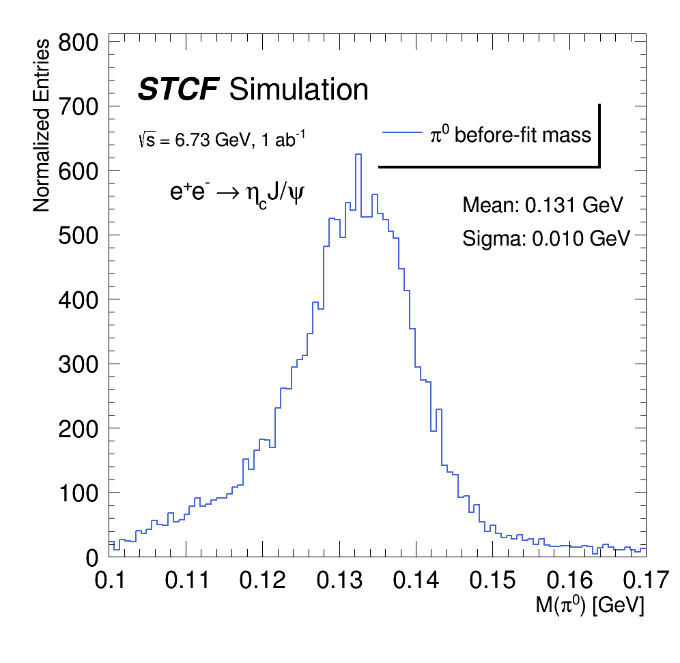
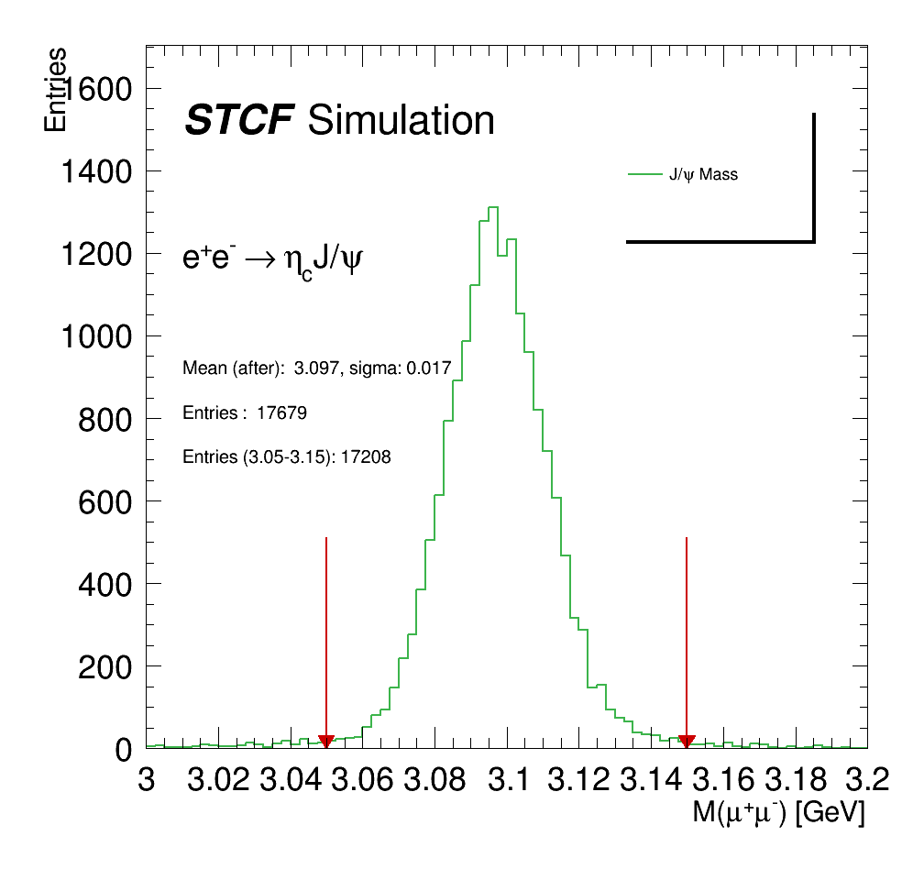
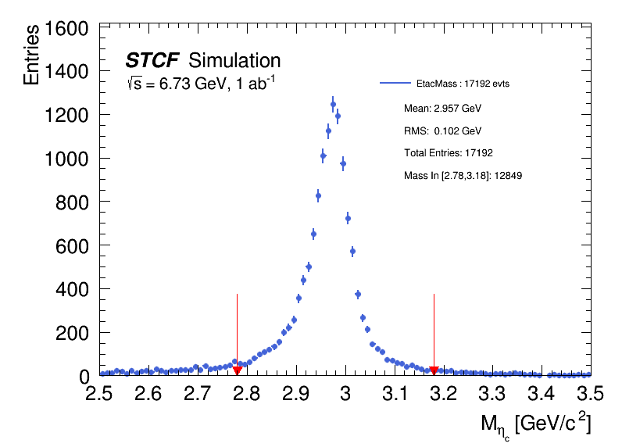


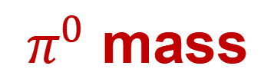
J/ψ→$μ^{+}μ^{−}$
$π^{0}$ mass
$J/ψ$ mass
$η_{c}$ mass

Slide 5
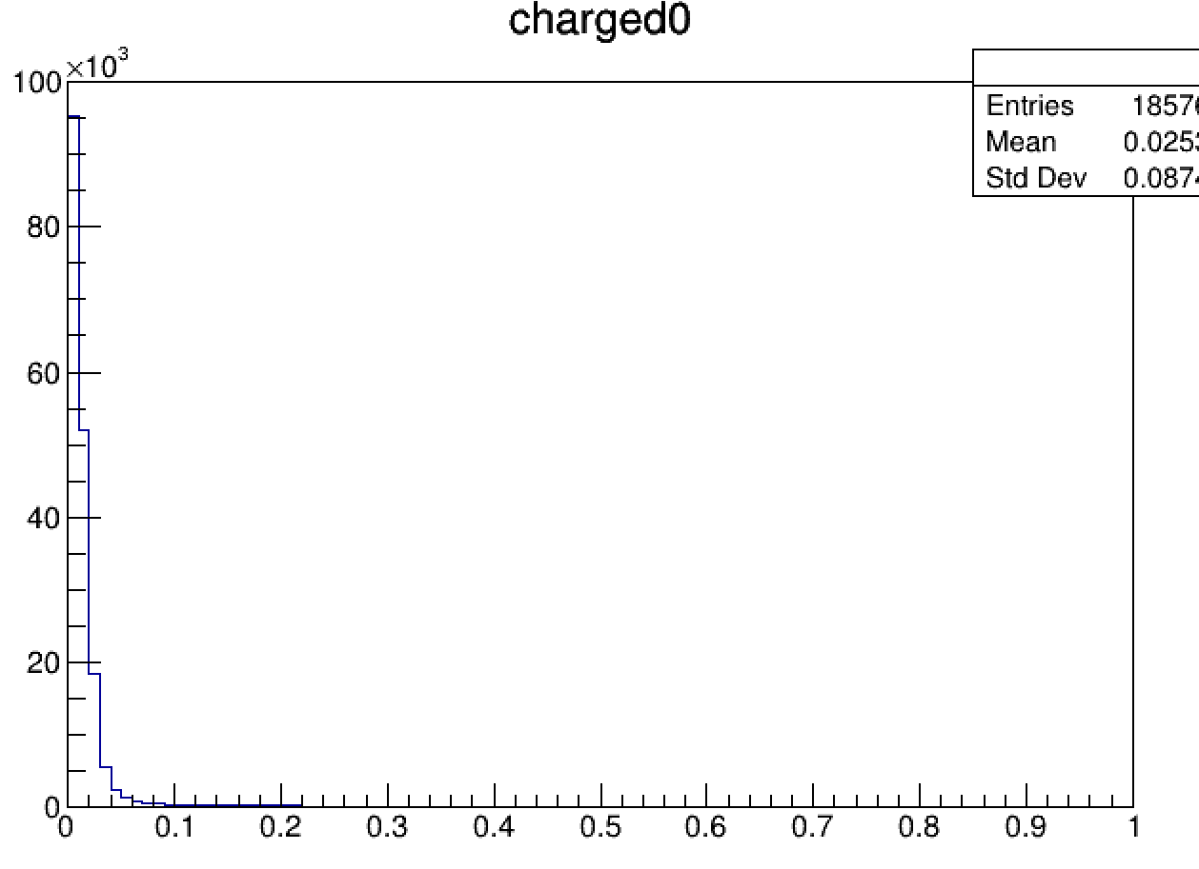
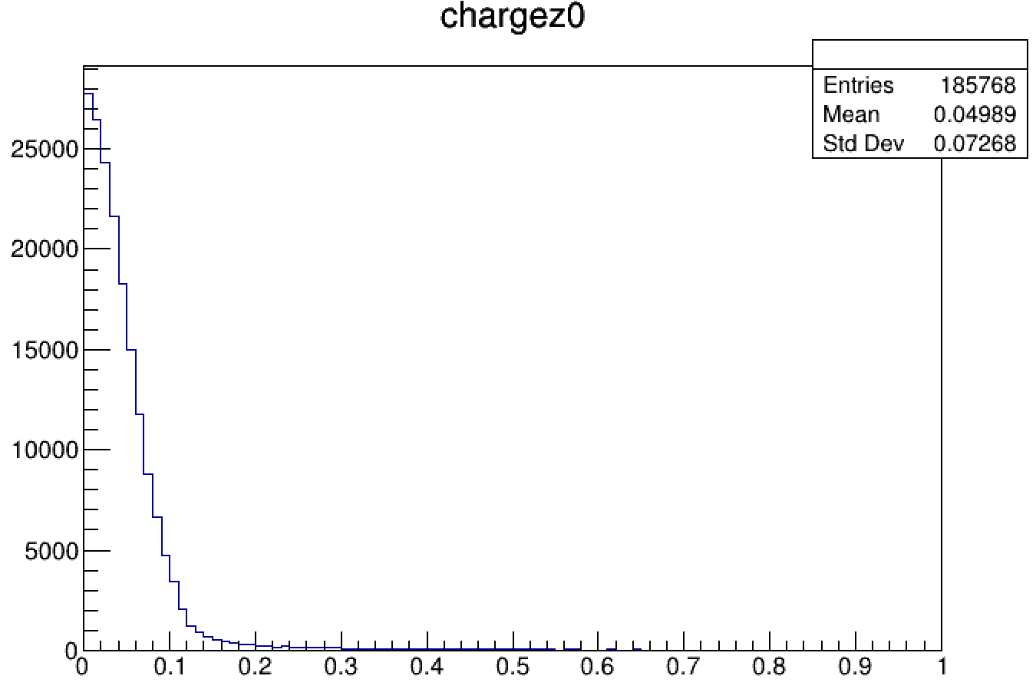
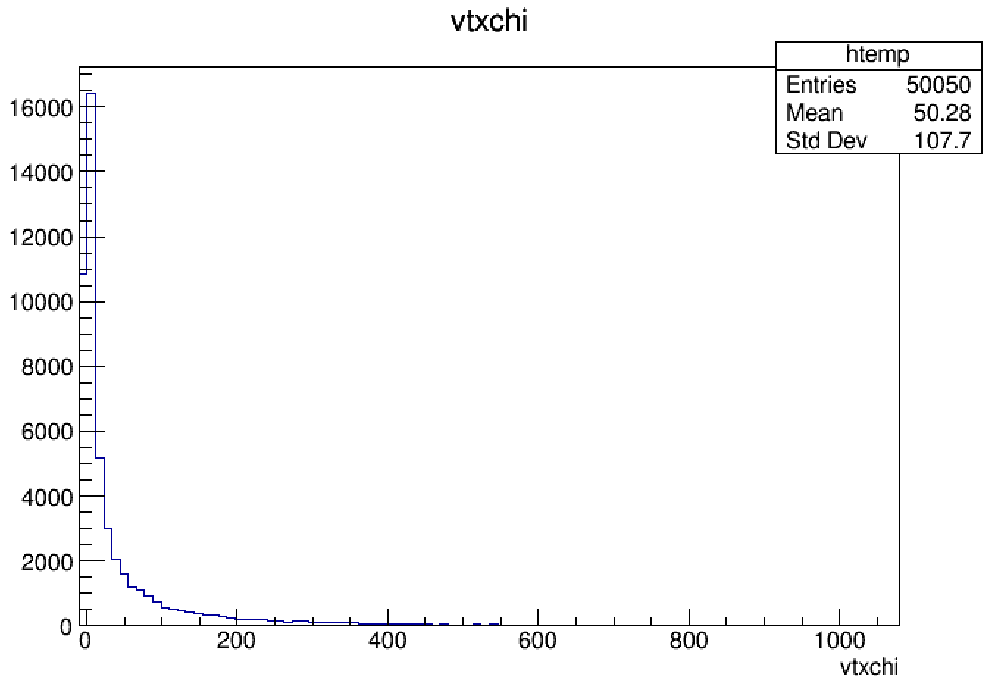
J/ψ→$μ^{+}μ^{−}$
$$nGood≥4 :$$ | 34228 | 68.46% | 28145 | $$56.29\%$$
$$nGoodγ≥2:$$ | 29948 | 87.50% | 21951 | $$77.99\%$$
1、
2、
auto ecalshower = m_EcalShowerCol->at(i);
int a = ecalshower.getTrackID();
if(a>0) continue;

