Slide 1
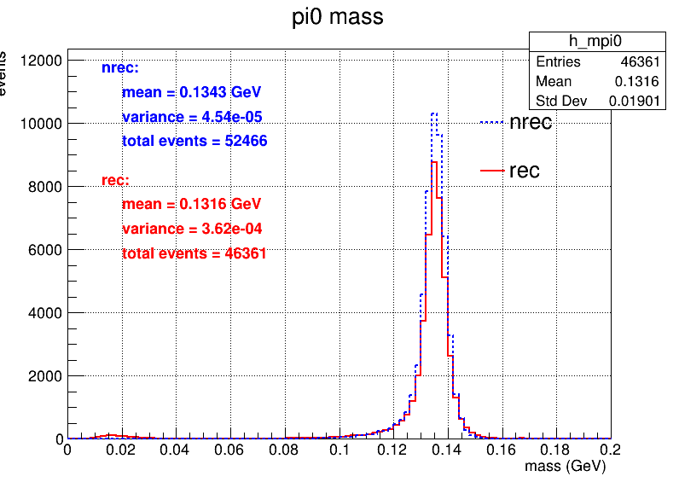
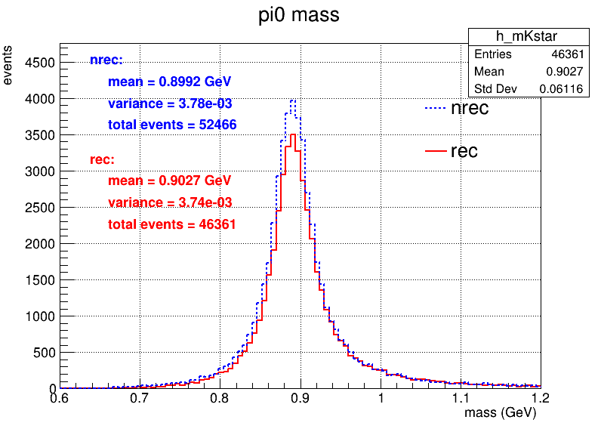
J/psi --> K*+ K-
K*+ --> K+ pi0
 | 多维抽样 | 全重建 | 相对效率 | 绝对效率
初始 | 100000 | 100000 | 多维抽样 vs 全重建 | 多维抽样 vs 全重建
K+ K- cutd0<=10,cutz0<=20 | 81962 | 83898 | 81.96% vs 83.90% | 81.96% vs 83.90%
cut角度和能量,ngama>=2 | 54533 | 62288 | 66.53% vs 74.24% | 54.53% vs 62.29%
4c运动学拟合chi2最小 | 52466 | 46361 | 96.21% vs 74.43% | 52.47% ±0.16%vs46.36%±0.16%

Slide 2
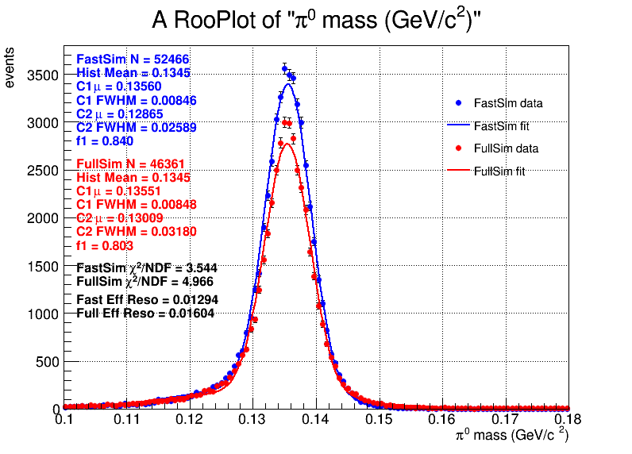
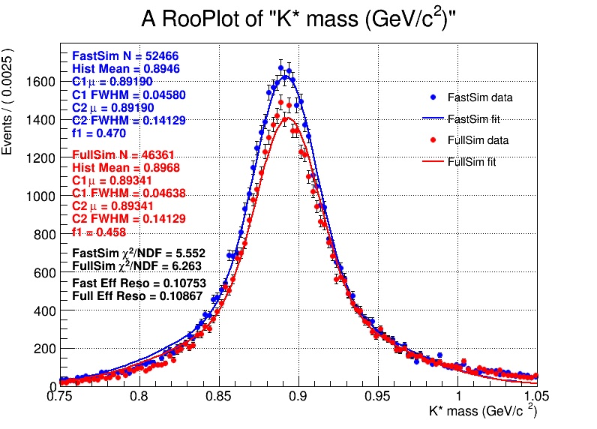

Slide 3
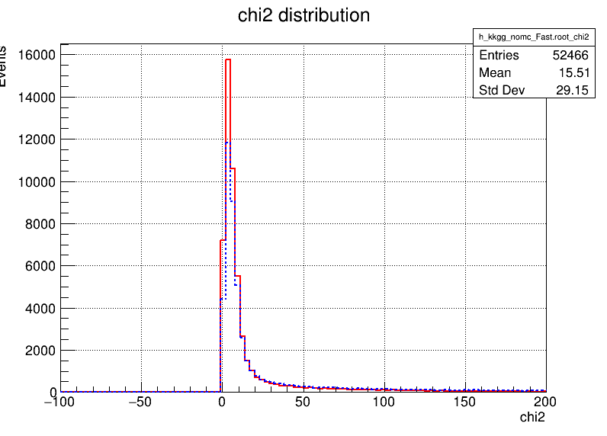
多维抽样

Slide 4
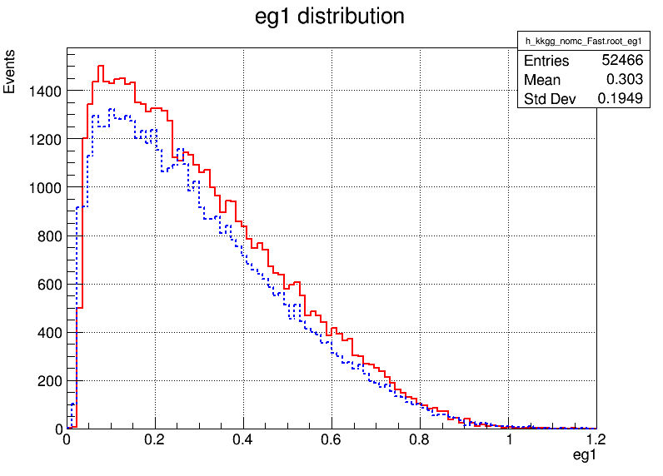
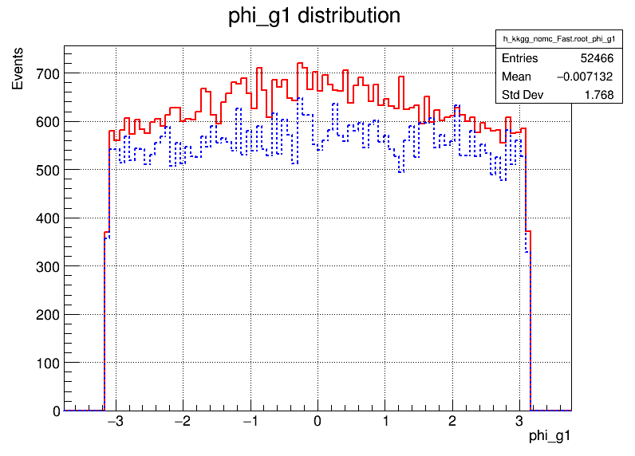
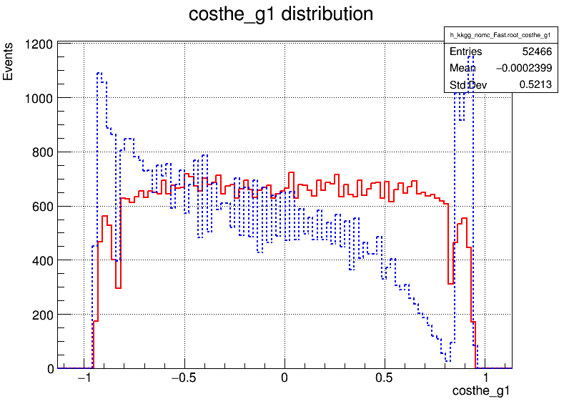
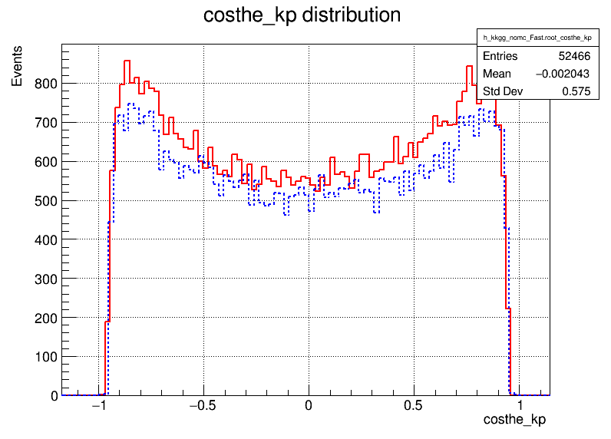
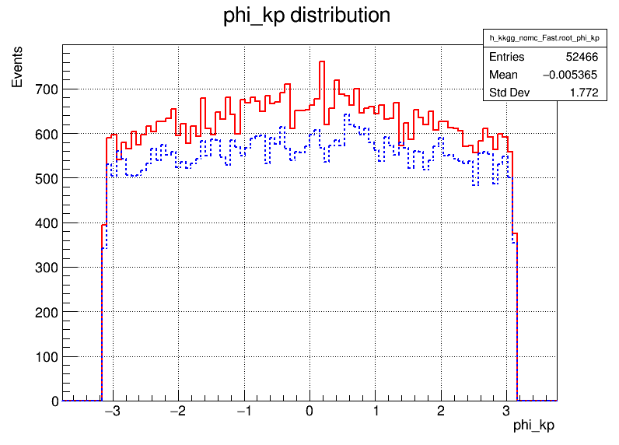
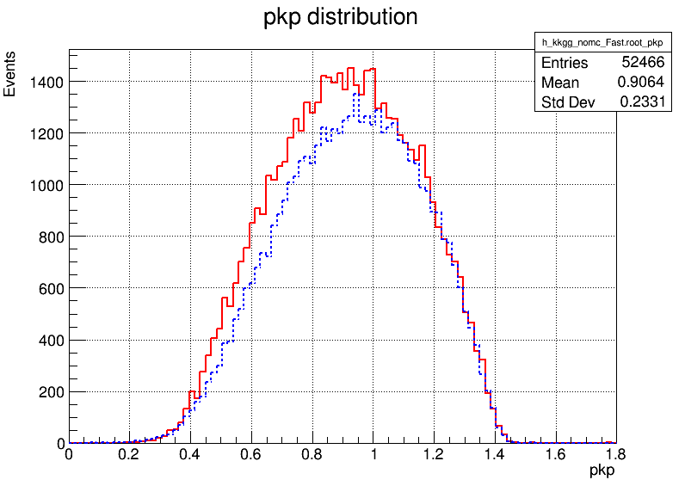

Slide 5
