Slide 1
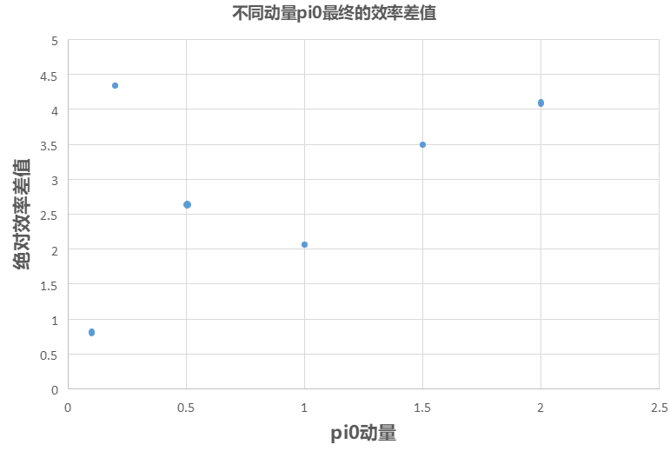
动量（GeV） | 全重建后绝对效率(%) | 多维抽样后的绝对效率(%) | 差值（%）
0.1 | 61.37±0.3443 | 60.55±0.3456 | 0.82±0.6899
0.2 | 60.50±0.3457 | 56.16±0.3509 | 4.335±6966
0.5 | 66.60±0.3335 | 63.95±0.3395 | 2.65±0.6730
1.0 | 73.98±0.3102 | 71.92±0.3178 | 2.06±0.6280
1.5 | 77.17±0.2968 | 73.68±0.3114 | 3.49±0.6082
2.0 | 78.92±0.2884 | 74.82±0.3069 | 4.105±0.5953

Slide 2
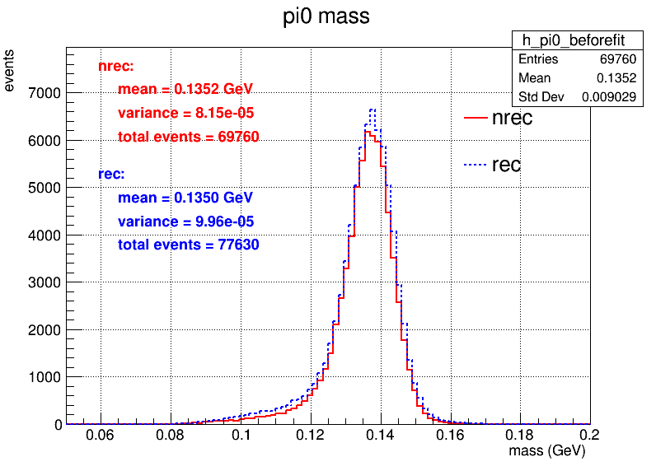
$$J/Ψ−>γπ^{0}(γγ)$$
 | 多维抽样 | 全重建 | 相对效率 | 绝对效率
初始 | 100,000 | 100,000 | 多维抽样 vs 全重建 | 多维抽样 vs 全重建
trackID<0 的数量大于等于3 | 72185 | 90162 | 72.185%vs90.162% | 72.185%vs90.162%
cut角度和能量 | 71839 | 84313 | 99.52% vs 93.51% | 71.839%vs84.313%
运动学拟合 | 69760 | 77630 | 97.1% vs 92.07% | 69.760%vs77.63%

Slide 3
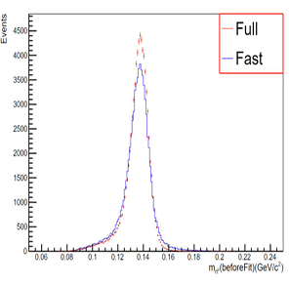
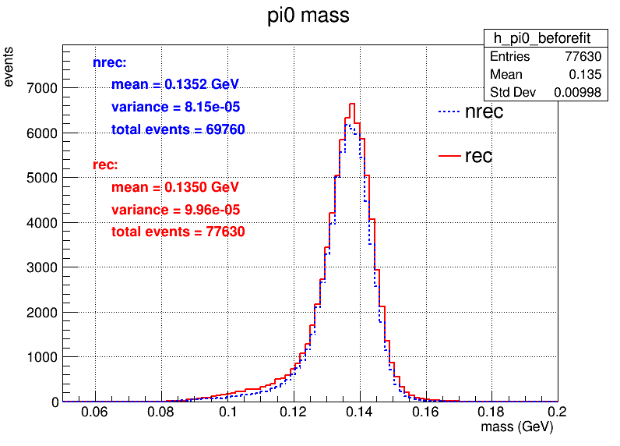
性能对比：峰的差距减少

Slide 4
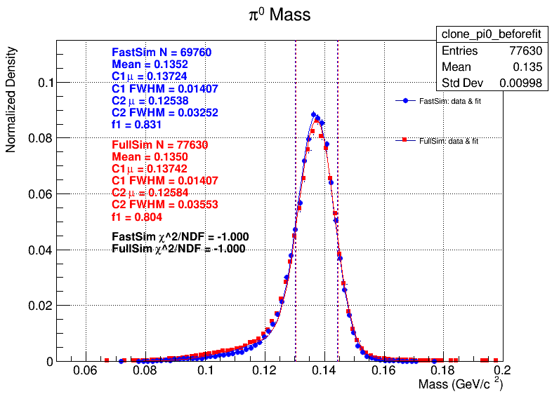
归一化频率直方图：使用双高斯拟合
加权分辨

Slide 5
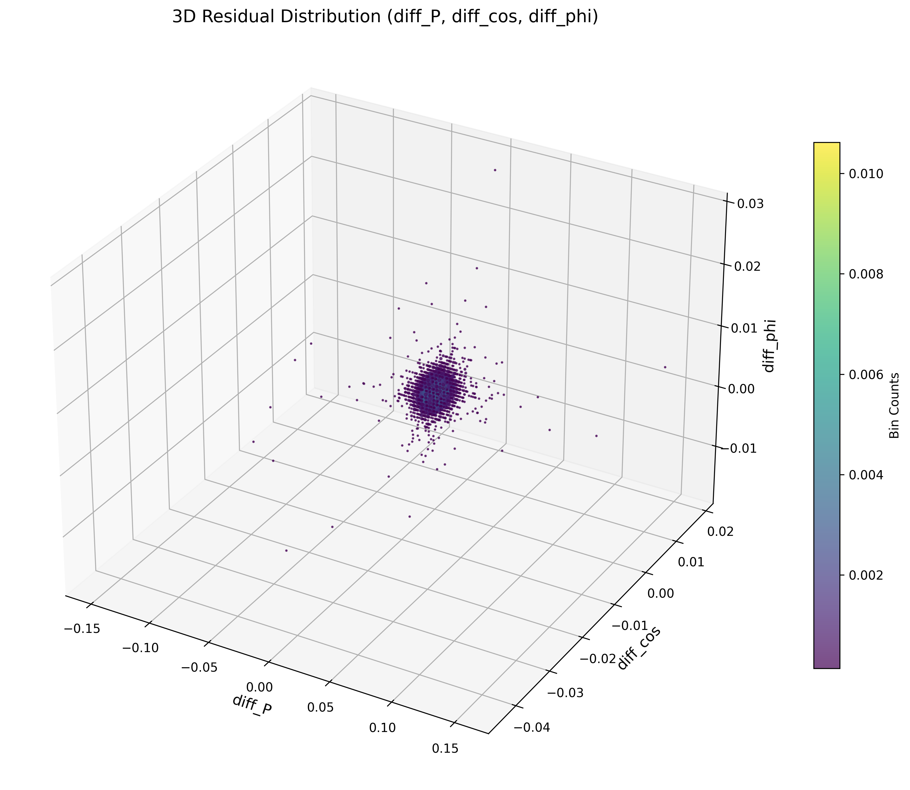
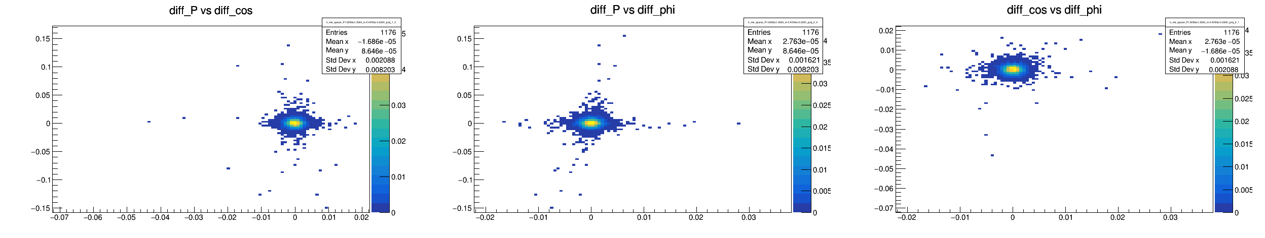
K单粒子数据获取直方图
K-: P:[1.0,1.2) GeV ;cos theta :[-0.4 ,-0.2)
残差范围较大：删除前后0.5%的数据

Slide 6
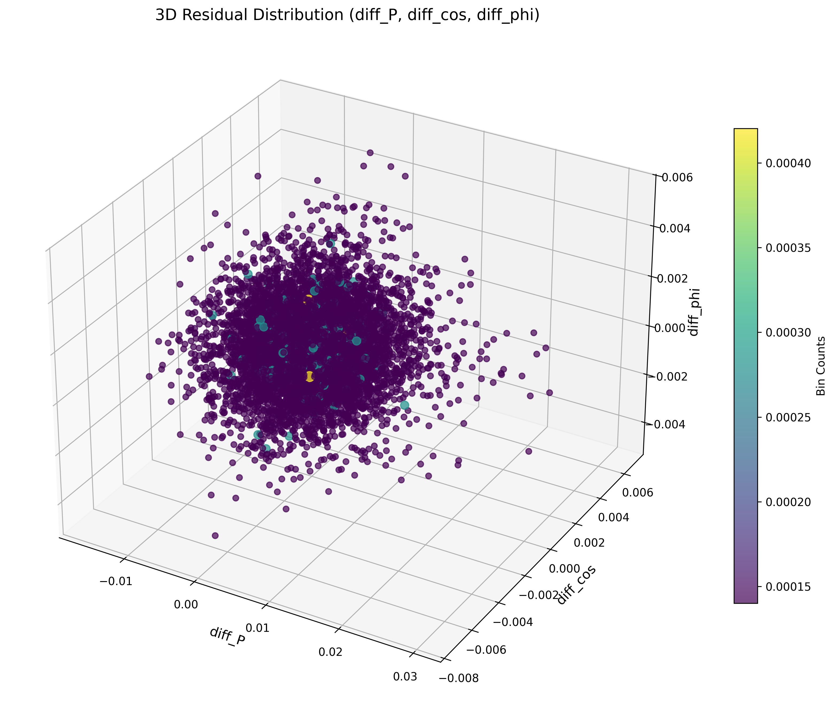
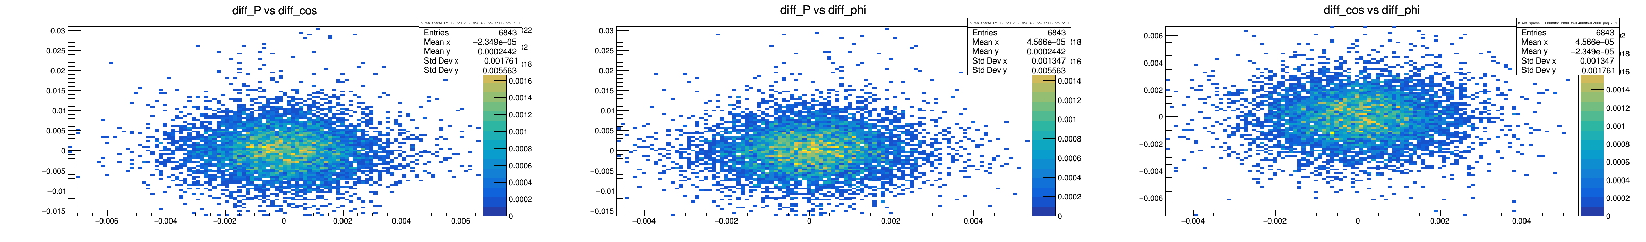
删除前后1%

Slide 7
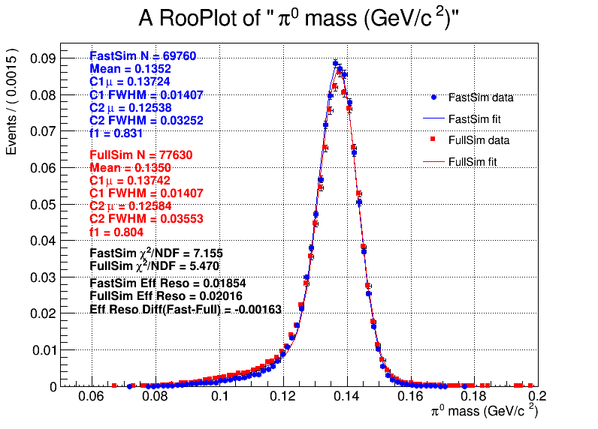
σ_eff = sqrt(f1·σ1² + f2·σ2²)

Slide 8
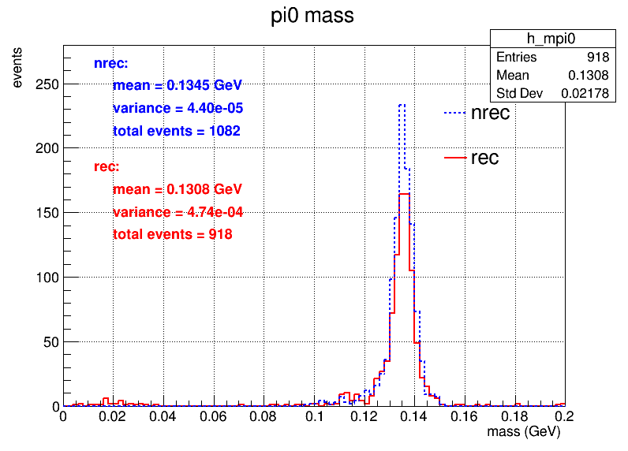
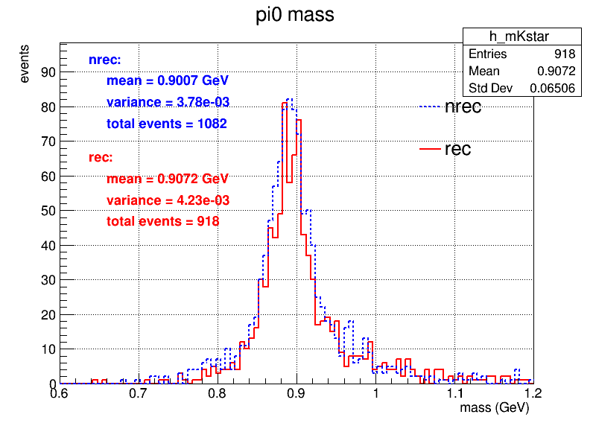
J/psi --> K*+ K-
K*+ --> K+ pi0
 | 多维抽样 | 全重建 | 相对效率 | 绝对效率
初始 | 2000 | 2000 | 多维抽样 vs 全重建 | 多维抽样 vs 全重建
MCmatch K+ K- | 1664 | 1596 | 83.2%vs79.8% | 83.2%vs79.8%
cut角度和能量,ngama>=2 | 1111 | 1179 | 66.77% vs 73.87% | 55.55%vs58.95%
运动学拟合chi2最小 | 1082 | 918 | 97.39% vs 77.82% | 54.1% ±1.11%vs45.9%±1.11%

Slide 9
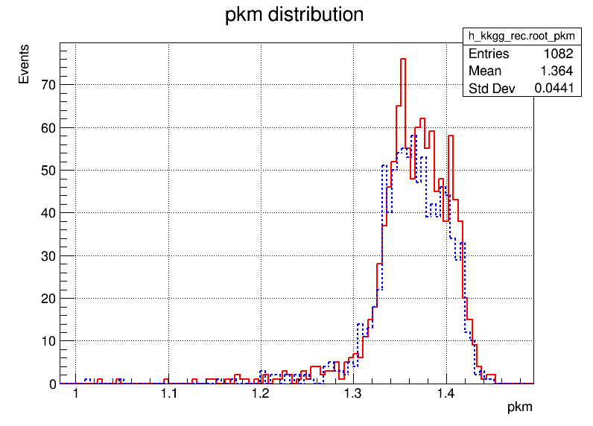
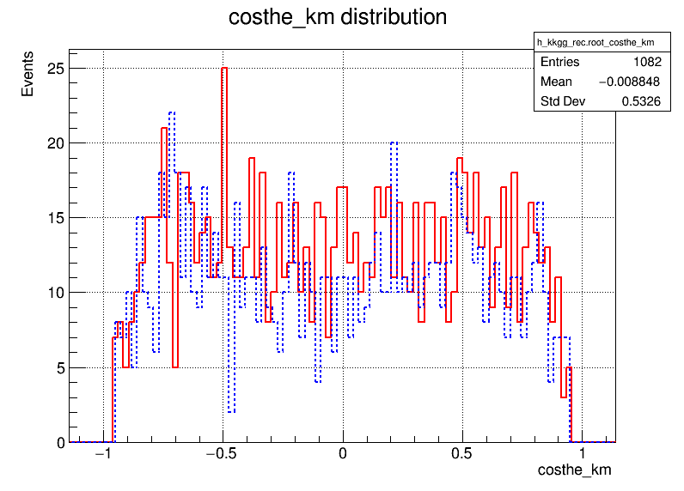
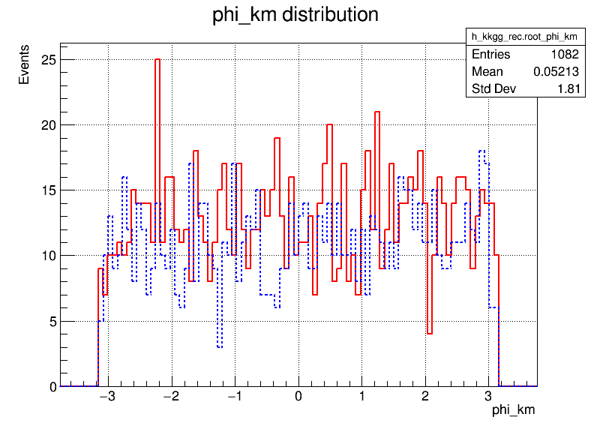
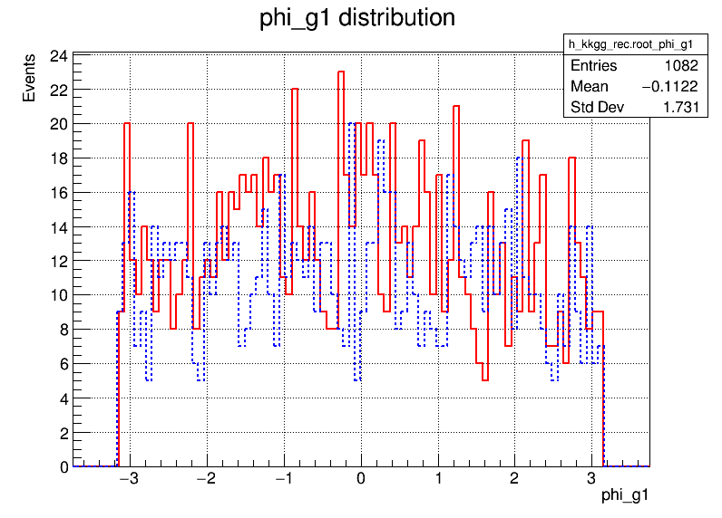
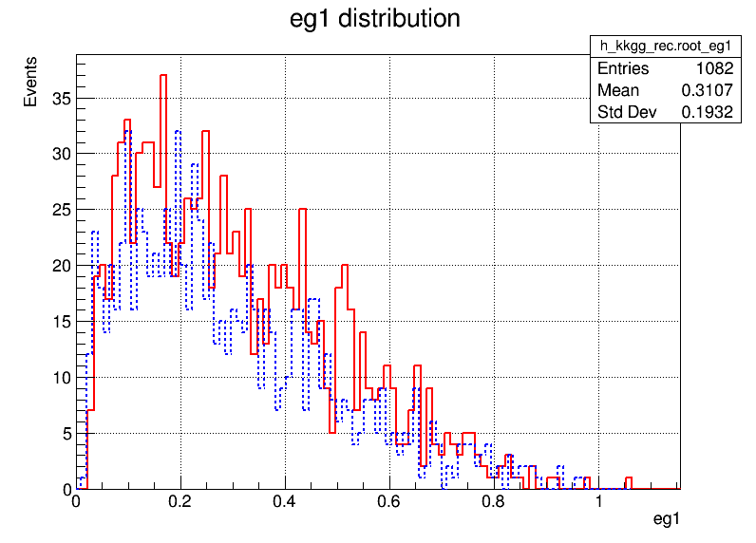
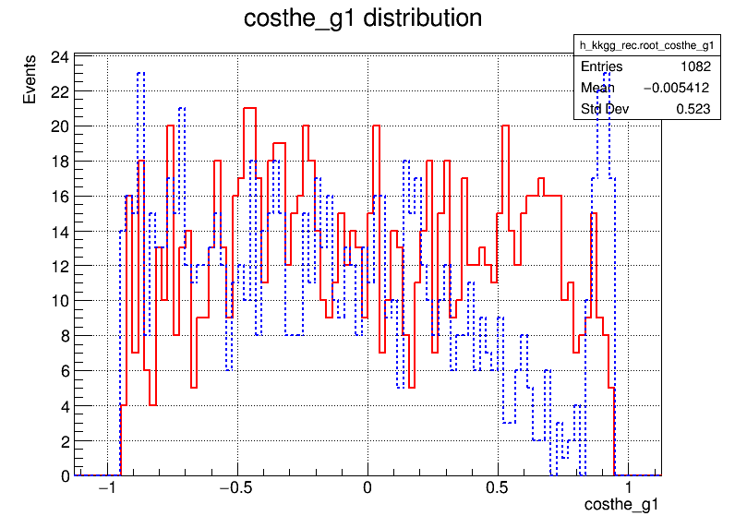

Slide 10
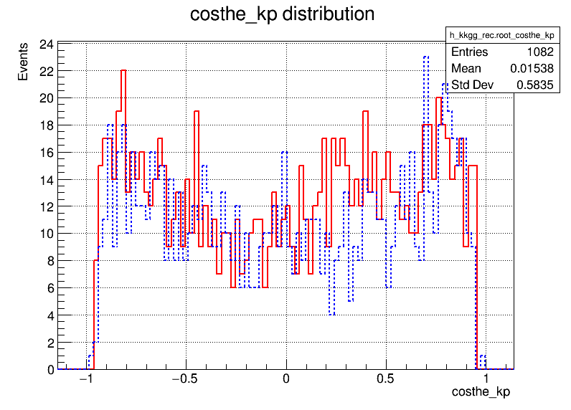
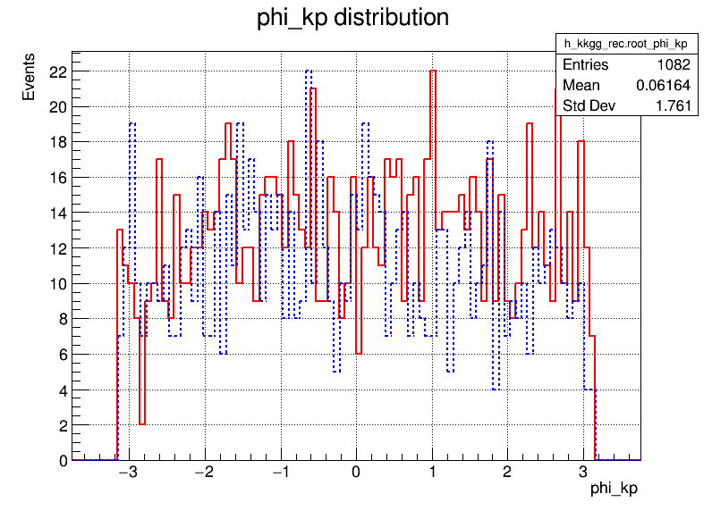
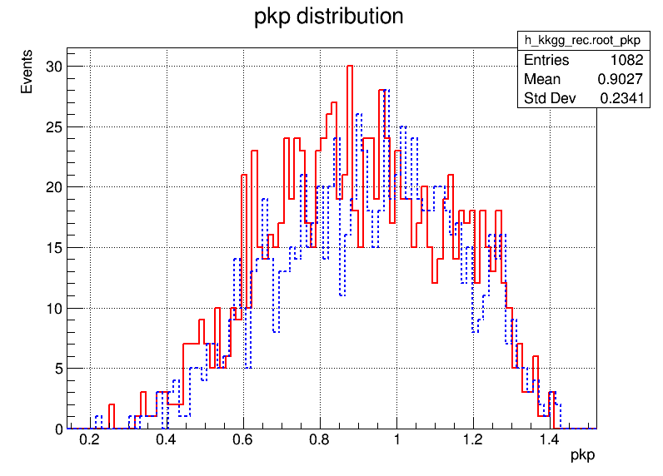

Slide 11
const double g_moms[] ={0.03,0.1,0.13,0.16,0.2,0.25,0.3,0.35,0.4,0.45,0.5,0.6,0.8,1.,1.2,1.4,1.6,2,2.5,3,3.5};
const double g_coss[] = {-0.93,-0.9,-0.85,-0.75,-0.6,-0.4,-0.2,0,0.2,0.4,0.6,0.75,0.85,0.9,0.93};

Slide 12
