Slide 1
CEPCSW
Hongbin Diao
University of Science and Technology of China

Slide 2
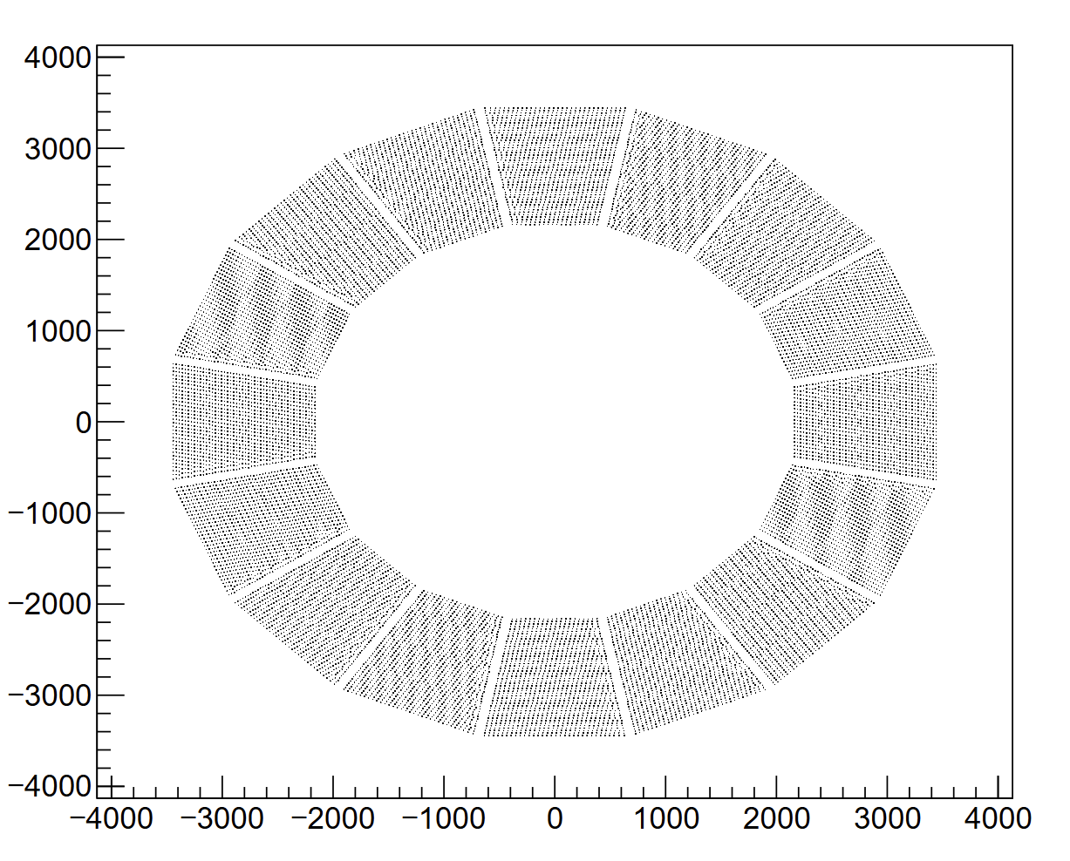
CEPCSW
HCAL barrel

Slide 3
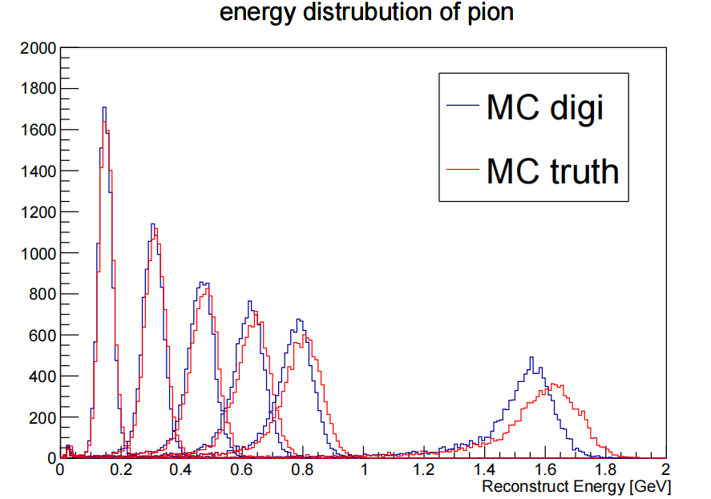
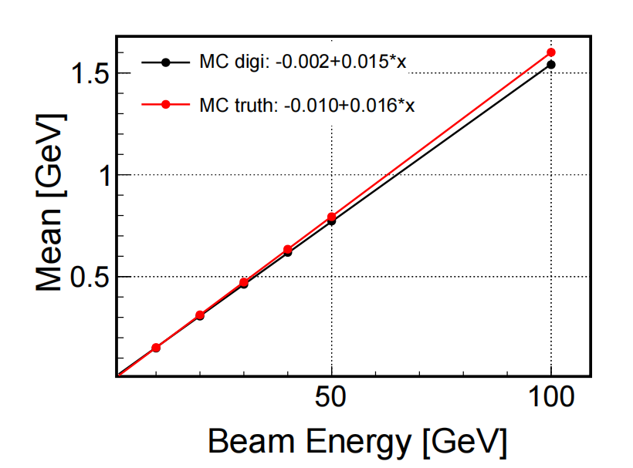
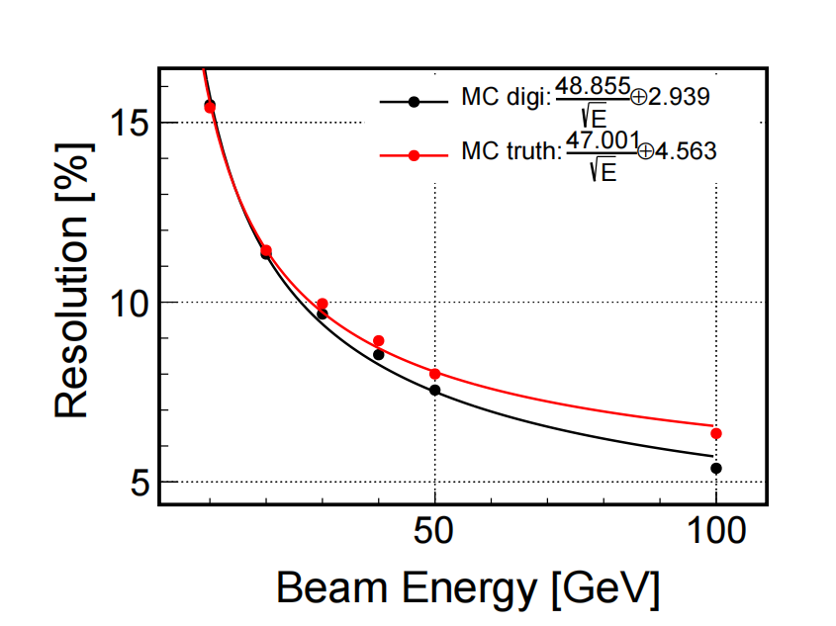
single particel -- pion
only PS-HCAL in detector

Slide 4
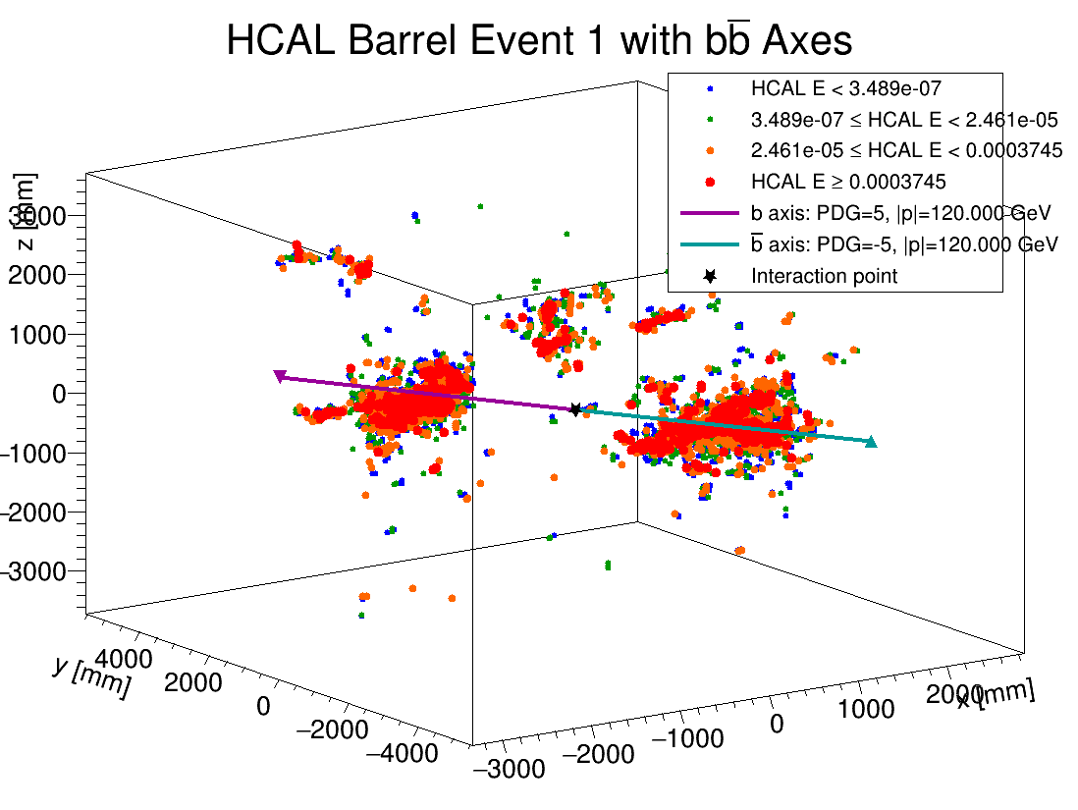
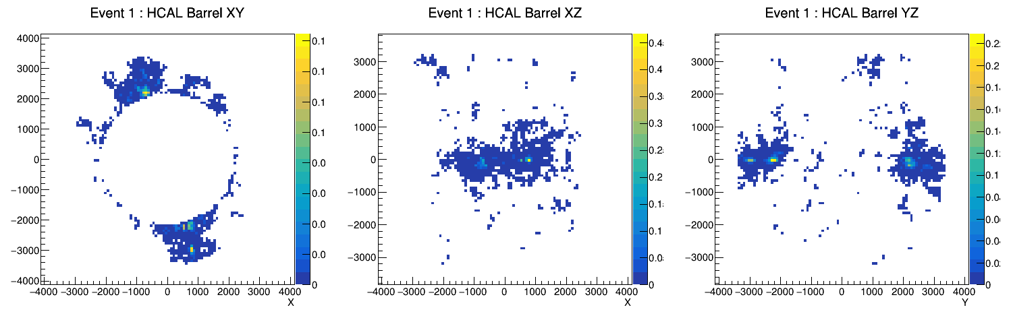
e+e->b bbar
only PS-HCAL in detector

