Slide 1
eBins = {0.0925, 0.095, 0.0975, 0.1, 0.105, 0.11, 0.115, 0.12, 0.125, 0.13, 0.135, 0.14};
thetaBins = {0, 0.04, 0.08, 0.12, 0.16, 0.2, 0.24, 0.28, 0.32, 0.36, 0.4, 0.44, 0.48, 0.52, 0.56, 0.6, 0.64, 0.68, 0.72, 0.76, 0.8, 0.8025, 0.805, 0.8075, 0.81, 0.8125, 0.815, 0.8175, 0.82, 0.8225, 0.825, 0.8275, 0.83, 0.8325, 0.835, 0.8375, 0.84, 0.8425, 0.845, 0.8475, 0.85, 0.855, 0.86, 0.865, 0.87, 0.875, 0.88, 0.885, 0.89, 0.895, 0.9, 0.905, 0.91, 0.915, 0.92, 0.925, 0.93, 0.935, 0.94, 0.942, 0.944, 0.945};

Slide 2
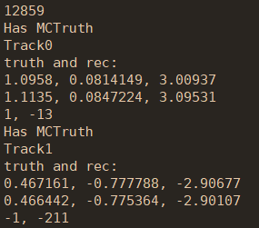

Fast sim with 3D sampling vs. Full sim
Selection criteria | Full sim |  |  | Fast sim (3D sampling)
 | Events | Absolute eff. | Relative eff. | Events | Absolute eff. | Relative eff.
Generated | 20000 | - | - | 20000 | - | -
Reconstructed | 20000 | 100% | 100% | 20000 | 100% | 100%
nGood = 2 | 14852 | 74.3% | 74.3% | 15458 | 77.3% | 77.3%
Truth matched | 14851 | 74.3% | 99.99% | 15458 | 77.3% | 100%
全模拟truth match效率不等于100%，
检查truth信息发现存在$μ^{+}$

Slide 3
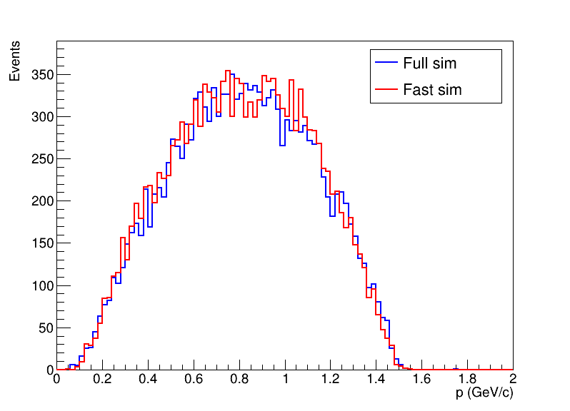
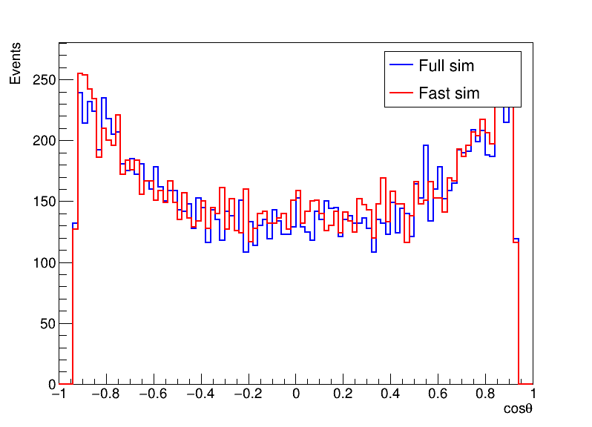
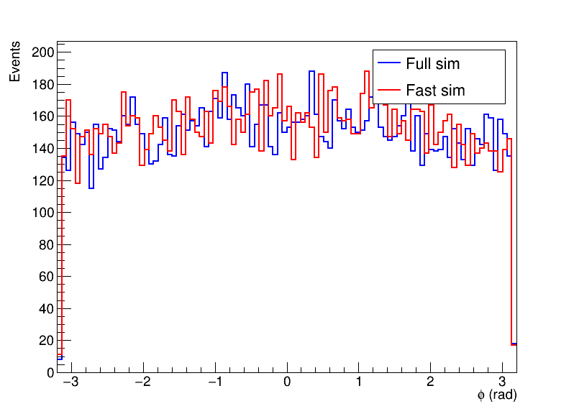
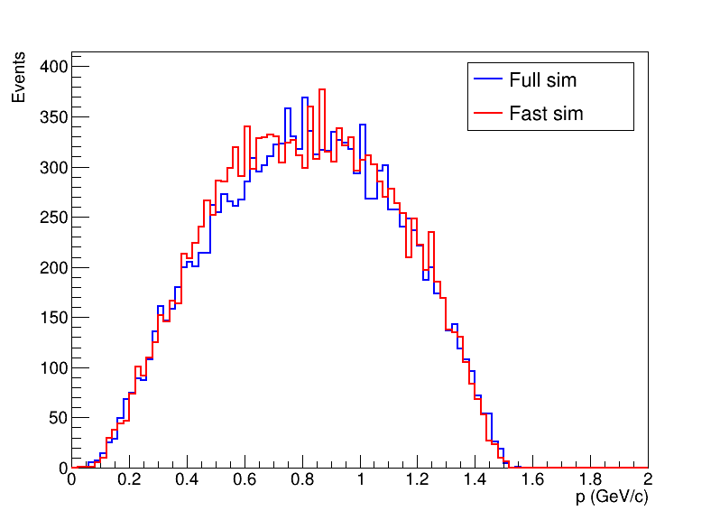
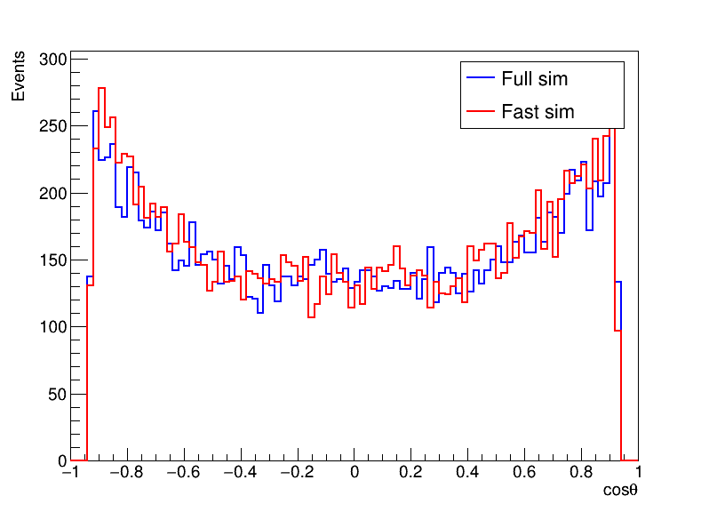
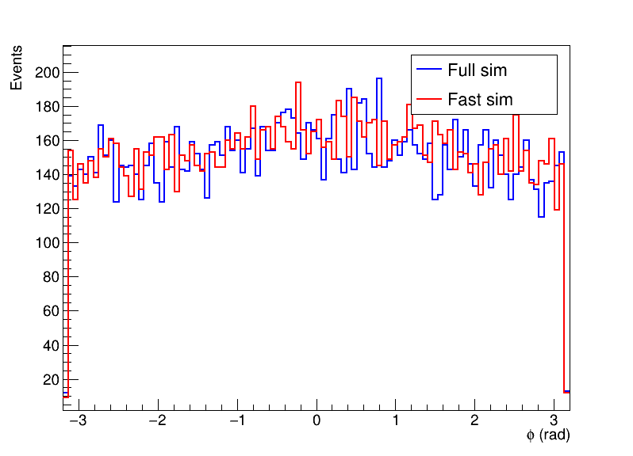
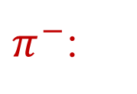
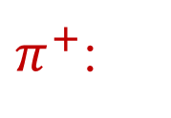
Fast sim with 3D sampling vs. Full sim
$π^{+}$:
$π^{−}$:

Slide 4
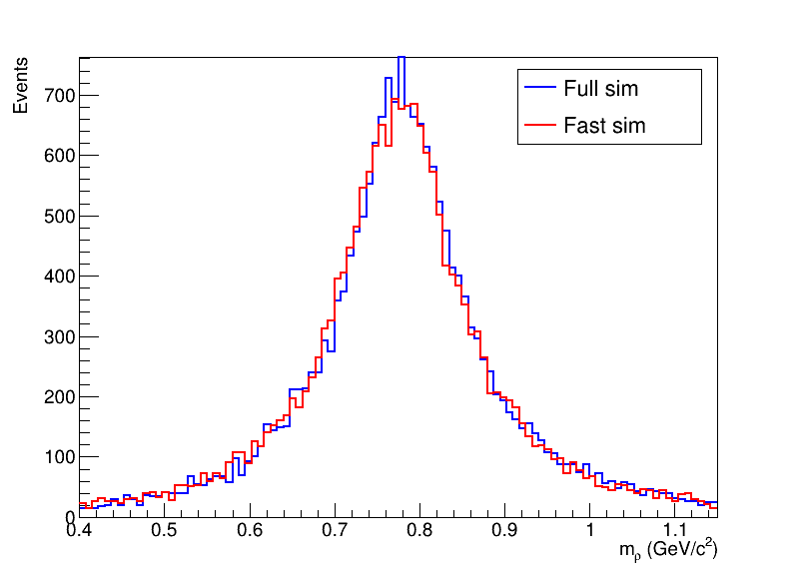
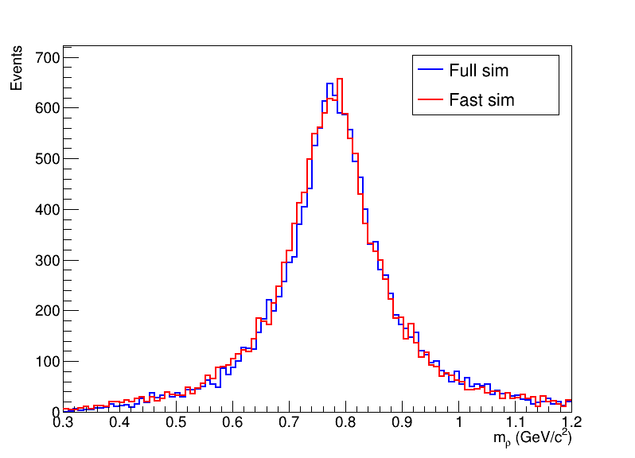
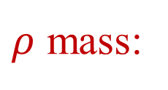
Fast sim with 3D sampling vs. Full sim
$ρ$ mass:
truth
reconstructed

