Slide 1
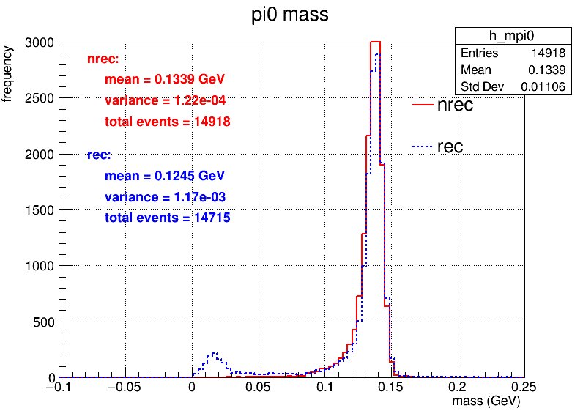
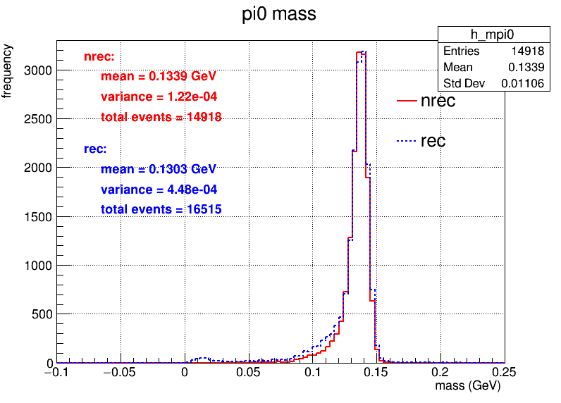
使用MC match, 重新生成全重建数据，使用matchMCParticleViaMomentum()
未使用MC match
MC match

Slide 2
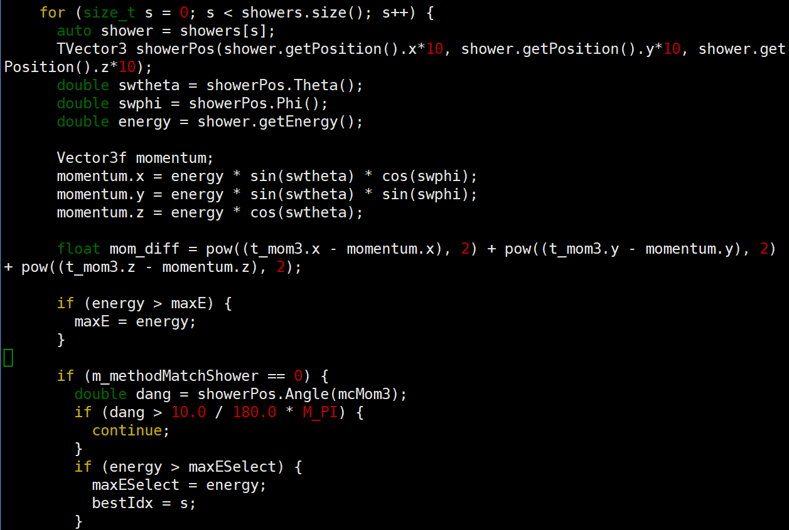
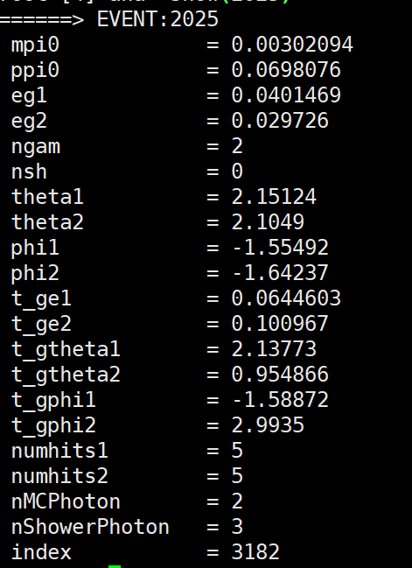
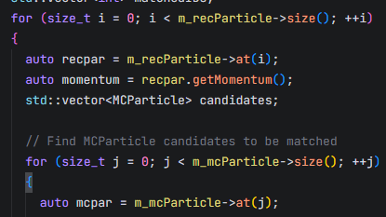
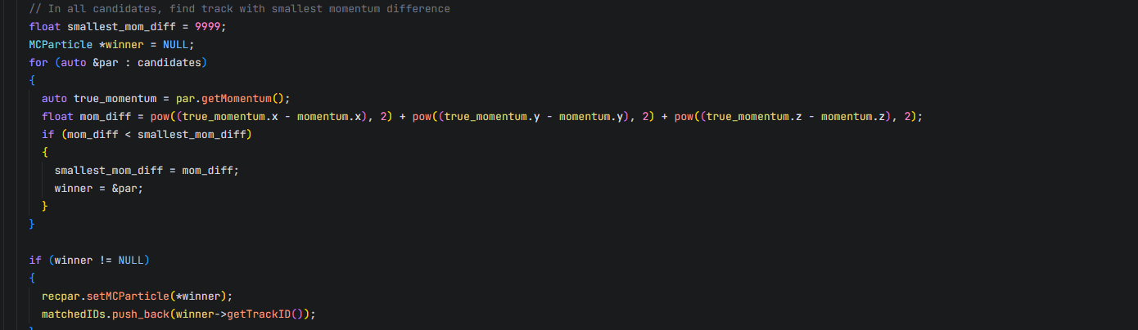
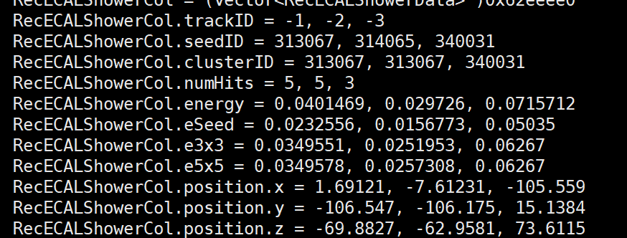
修复bug
在分析代码中匹配MC，选择10°角内的能量最大的Shower
OSCAR内对光子MC匹配的代码存在问题EventAssembler::matchMCParticleViaMomentum()：
基于recParticle 挑选动量最相近的MCParticle
MC匹配依赖径迹顺序

Slide 3
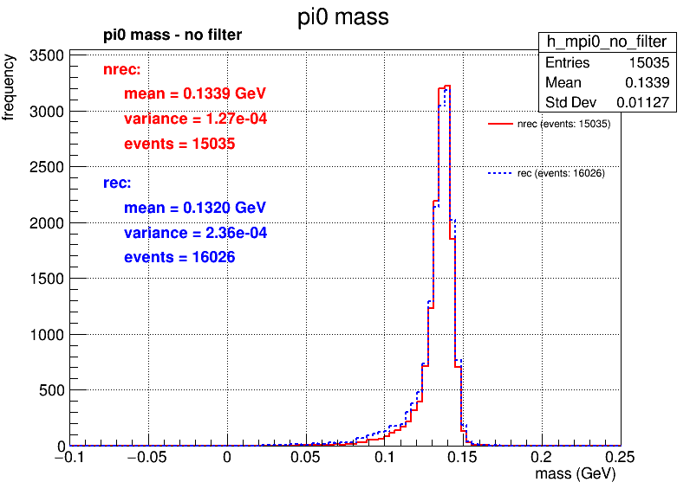
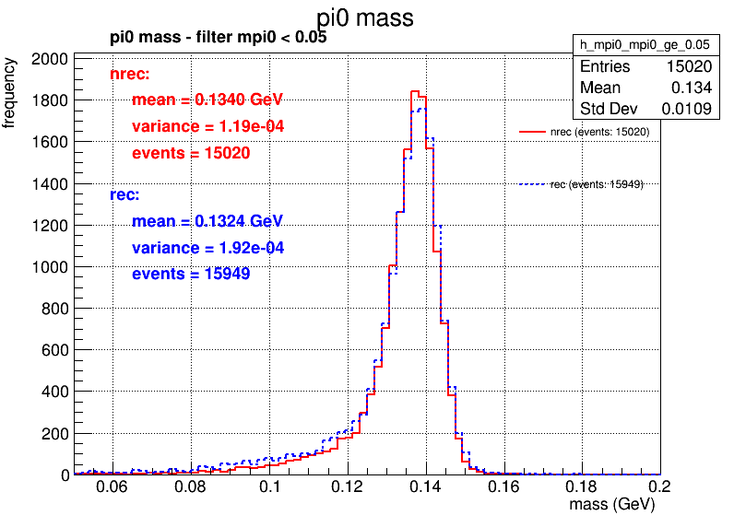
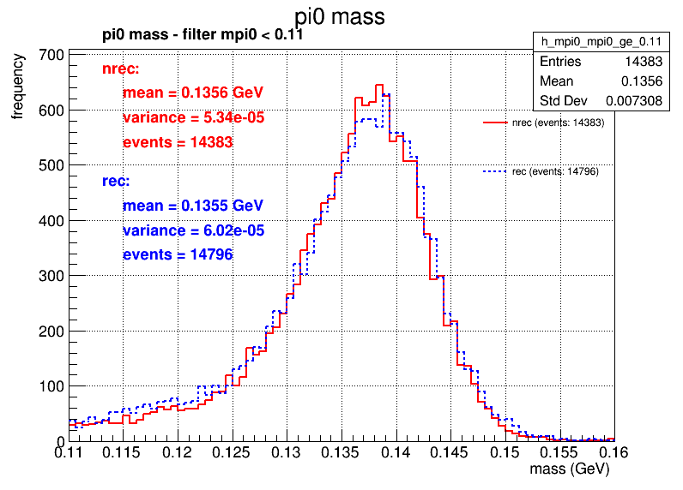
1GeV
 | 多维抽样 | 全重建 | 相对效率 | 绝对效率
初始 | 20,000 | 20,000 | 多维抽样 vs 全重建 | 多维抽样 vs 全重建
trackID<0 的数量大于等于2 | 15056 | 17687 | 75.28%vs88.44% | 75.28%vs88.44%
MC match cut角度和能量 | 15035 | 16026 | 99.86% vs 90.61% | 75.18%vs80.13%
pi0>0.05 | 15020 | 15949 | 99.9%vs 99.52% | 75.1%vs79.75%
pi0>0.11 | 14383 | 14796 | 95.76% vs 92.77% | 71.92% vs 73.98%

Slide 4
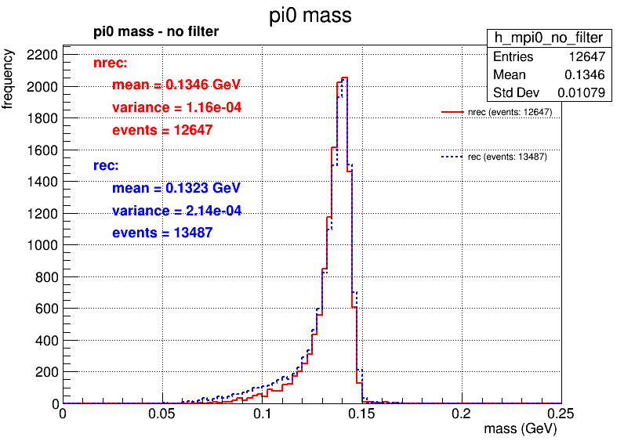
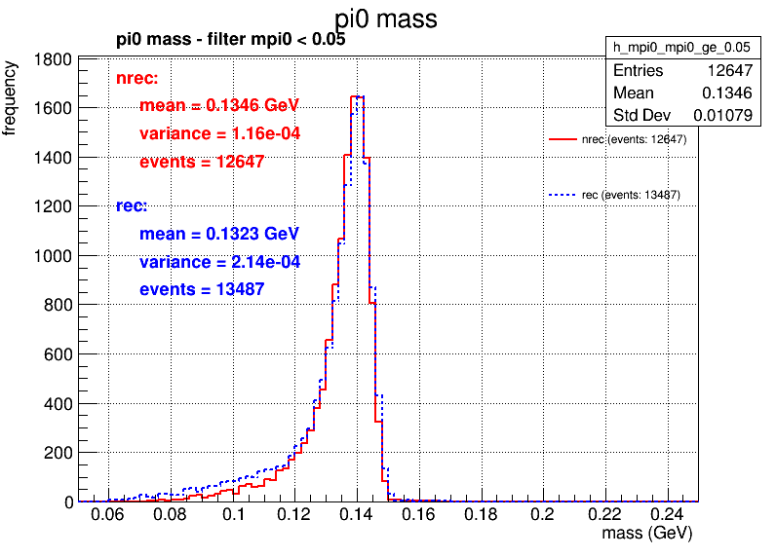
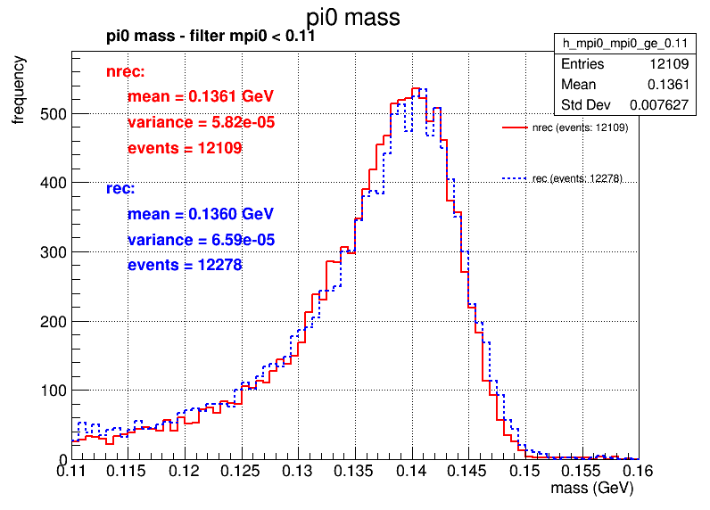
0.1GeV
 | 多维抽样 | 全重建 | 相对效率 | 绝对效率
初始 | 20,000 | 20,000 | 多维抽样 vs 全重建 | 多维抽样 vs 全重建
trackID<0 的数量大于等于2 | 12675 | 15518 | 63.37%vs77.59% | 63.37%vs77.59%
MC match cut角度和能量 | 12647 | 13487 | 99.78%vs86.91% | 63.23% vs 67.44%
pi0>0.05 | 12647 | 13487 | 100% vs 100% | 63.23% vs 67.44%
pi0>0.11 | 12109 | 12278 | 95.75% vs 91.04% | 60.55% vs 61.39%

Slide 5
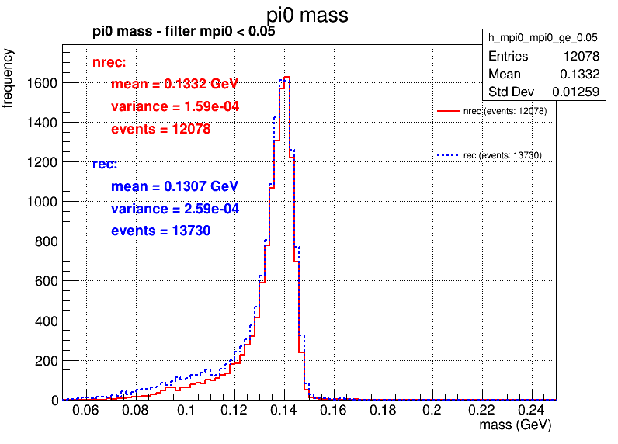
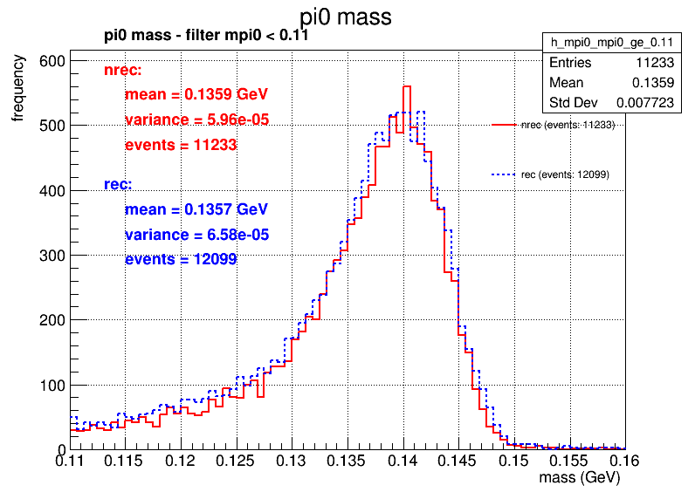
0.2GeV
 | 多维抽样 | 全重建 | 相对效率 | 绝对效率
初始 | 20,000 | 20,000 | 多维抽样 vs 全重建 | 多维抽样 vs 全重建
trackID<0 的数量大于等于2 | 12098 | 16123 | 60.49% vs 80.62% | 60.49% vs 80.62%
MC match cut角度和能量 | 12078 | 13735 | 99.83% vs 85.19% | 60.39% vs 68.68%
pi0>0.05 | 12078 | 13730 | 100% vs 99.96% | 60.39% vs 68.65%
pi0>0.11 | 11233 | 12099 | 93% vs 88.12% | 56.165% vs 60.5%

Slide 6
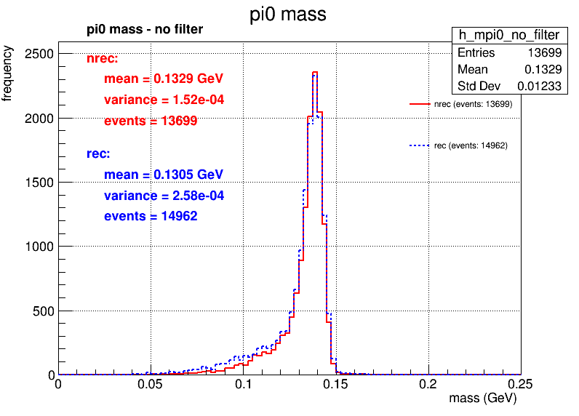
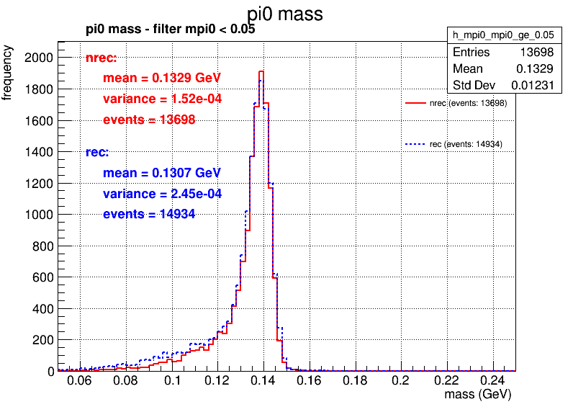

0.5GeV
 | 多维抽样 | 全重建 | 相对效率 | 绝对效率
初始 | 20,000 | 20,000 | 多维抽样 vs 全重建 | 多维抽样 vs 全重建
trackID<0 的数量大于等于2 | 13715 | 17090 | 68.58% vs 85.45% | 68.58% vs 85.45%
MC match cut角度和能量 | 13699 | 14962 | 99.88% vs 90.61% | 68.5%vs74.18%
pi0>0.05 | 13698 | 14934 | 99.99%vs 99.81% | 68.49% vs 74.67%
pi0>0.11 | 12789 | 13321 | 93.36% vs 89.2% | 63.95% vs 66.6%

Slide 7
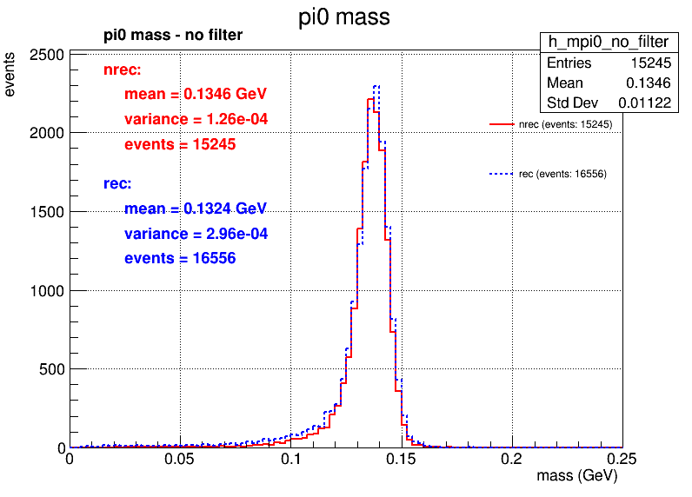
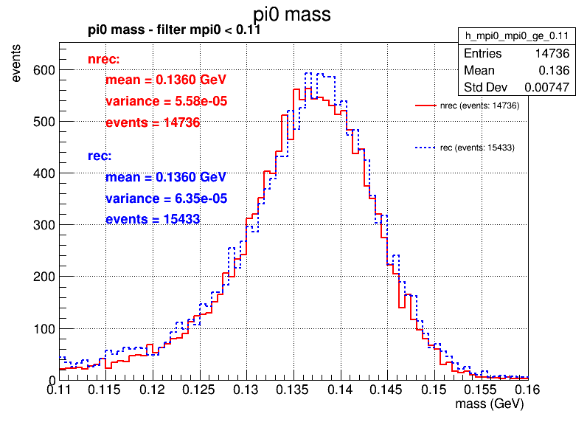
1.5GeV
 | 多维抽样 | 全重建 | 相对效率 | 绝对效率
初始 | 20,000 | 20,000 | 多维抽样 vs 全重建 | 多维抽样 vs 全重建
trackID<0 的数量大于等于2 | 15472 | 17996 | 77.36% vs 89.98% | 77.36% vs 89.98%
MC match cut角度和能量 | 15245 | 16556 | 98.53% vs 92% | 76.23% vs 82.78%
pi0>0.05 | 15218 | 16376 | 99.82% vs 98.91% | 76.09% vs 81.88%
pi0>0.11 | 14736 | 15433 | 96.83% vs 94.24% | 73.68% vs 77.17%

Slide 8
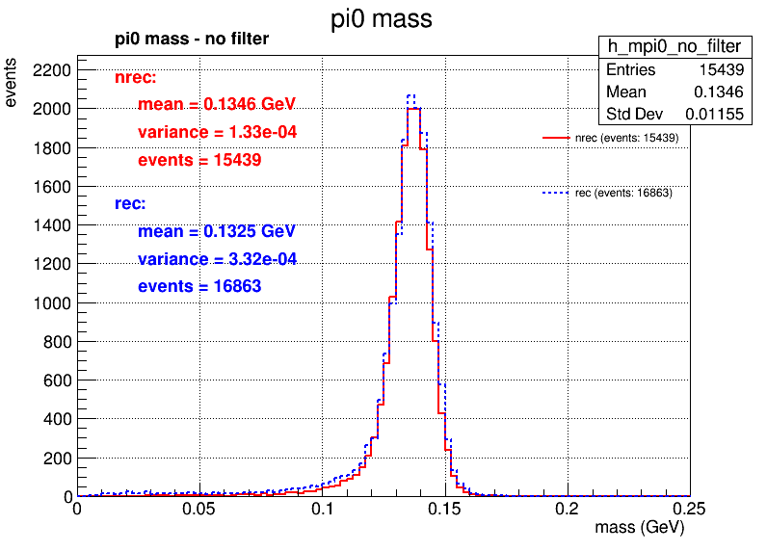
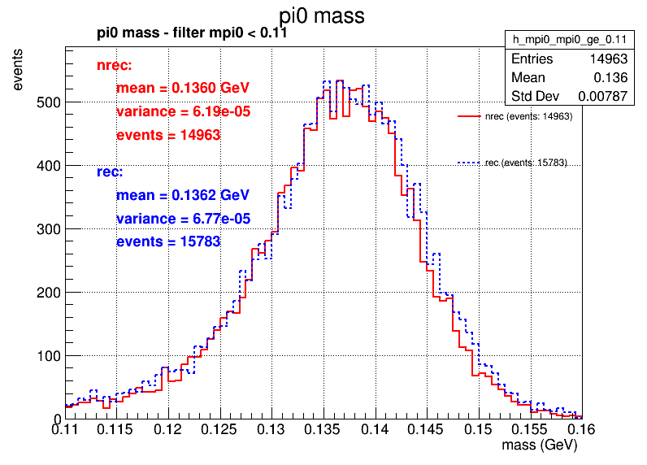
2GeV
 | 多维抽样 | 全重建 | 相对效率 | 绝对效率
初始 | 20,000 | 20,000 | 多维抽样 vs 全重建 | 多维抽样 vs 全重建
trackID<0 的数量大于等于2 | 15625 | 18092 | 78.13% vs 90.46% | 78.13% vs 90.46%
MC match cut角度和能量 | 15439 | 16863 | 98.81% vs 93.21% | 77.2% vs 84.32%
pi0>0.05 | 15405 | 16621 | 99.78% vs 98.56% | 77.03% vs 83.11%
pi0>0.11 | 14963 | 15783 | 97.13% vs 94.96% | 74.815% vs 78.92%

