Slide 1

超子-核子谱仪研讨会2026
Quark and Gluon Spin Contribution
in Baryon Spin determined by LQCD
Peng Sun
Institute of Modern Physics, Chinese Academy of Sciences

Slide 2
Outline
1) Background
2) Quark and Gluon spin in baryon
3) Summary

Slide 3
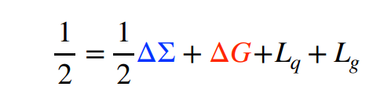
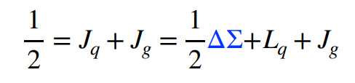
Baryon spin sum rule
Baryon is a composite particle with spin 1/2
Jaffe-Manohar sum rule Jaffe and Manohar, NPB 90’
• Complete decomposition into quark and gluon spin & orbital AM
• Gauge-dependent, but with clear partonic interpretation
Ji sum rule Ji, PRL 97’
• Frame- and gauge-independent
• Quark and gluon contributions related to the moments of GPDs

Slide 4




Ji sum rule Ji, PRL 97’
Quark helicity PDF 0th moment
Quark GPD 1th moment
Gluon GPD 1th moment
Jaffe-Manohar sum rule Jaffe and Manohar, NPB 90’
Gluon helicity PDF 0th moment

Slide 5
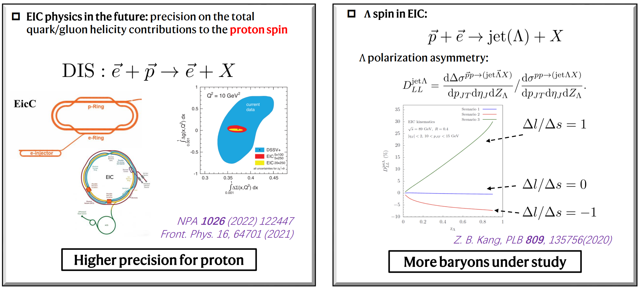

Slide 6
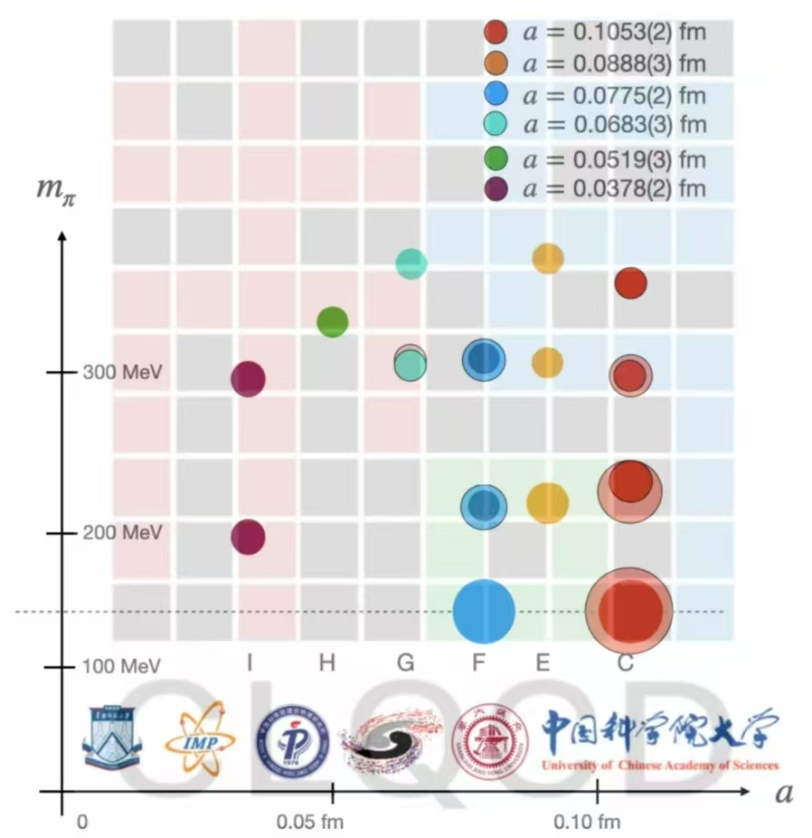

CLQCD ensembles
We have 6 lattice spacings from 0.105fm to 0.038fm.
Each case has several pion masses from 300MeV to 140MeV.
We have two ensembles with around physical points (pion mass is about 140MeV) at lattice spacing 0.105fm and 0.077fm.
With such ensembles, we can control the systematic uncertainty.

Slide 7
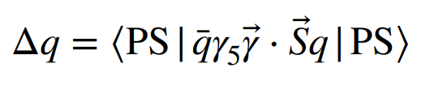
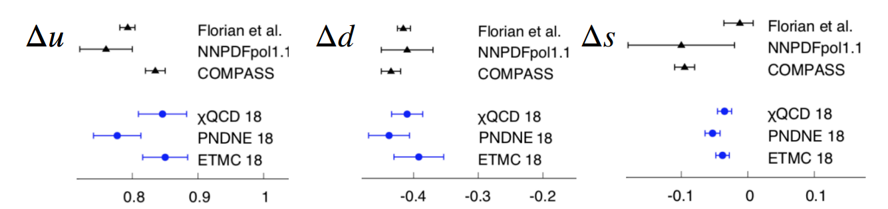
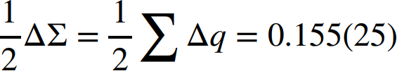
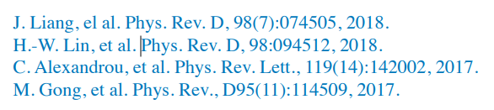
Quark spin in proton

Slide 8
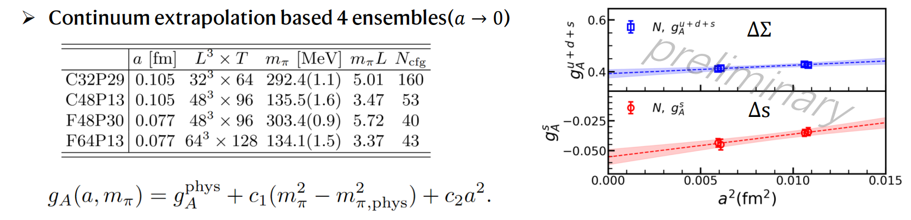
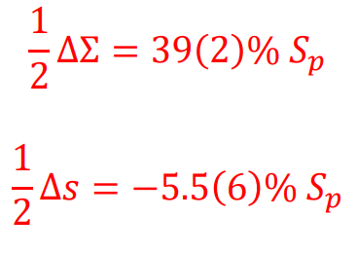
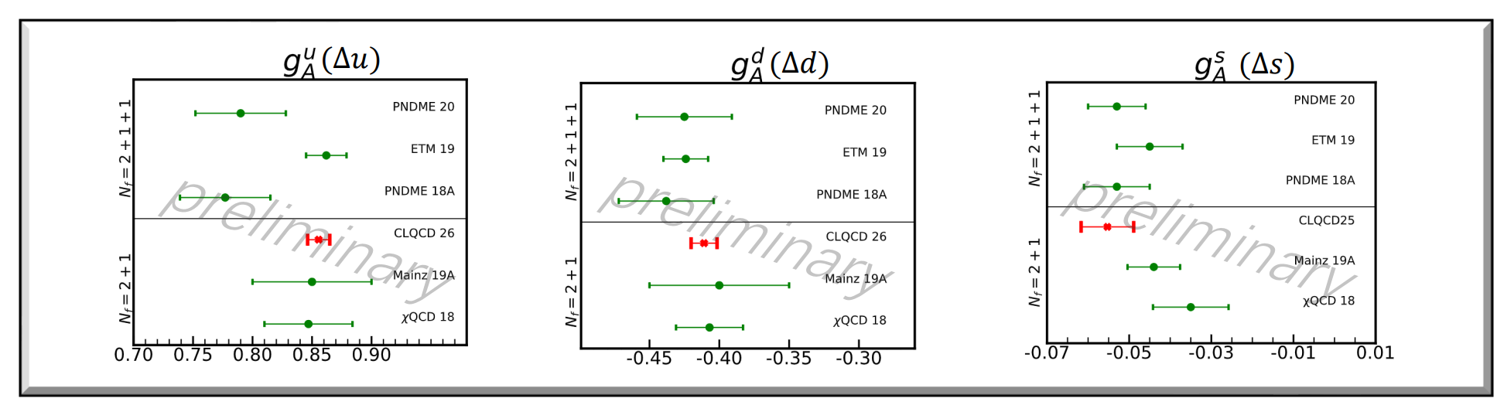
Quark spin in proton

Slide 9
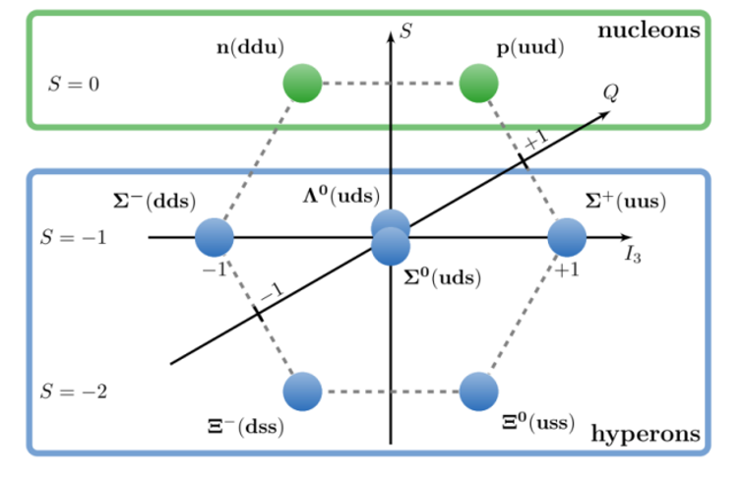
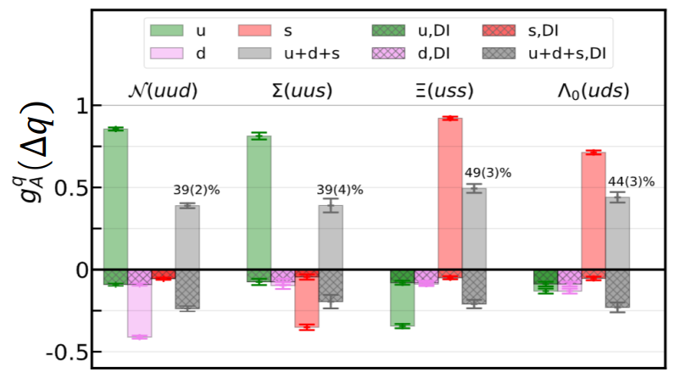
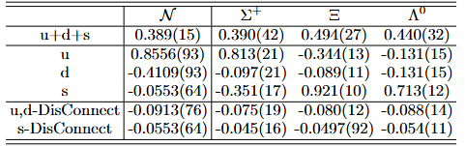
Quark spin on Octet baryons

Slide 10
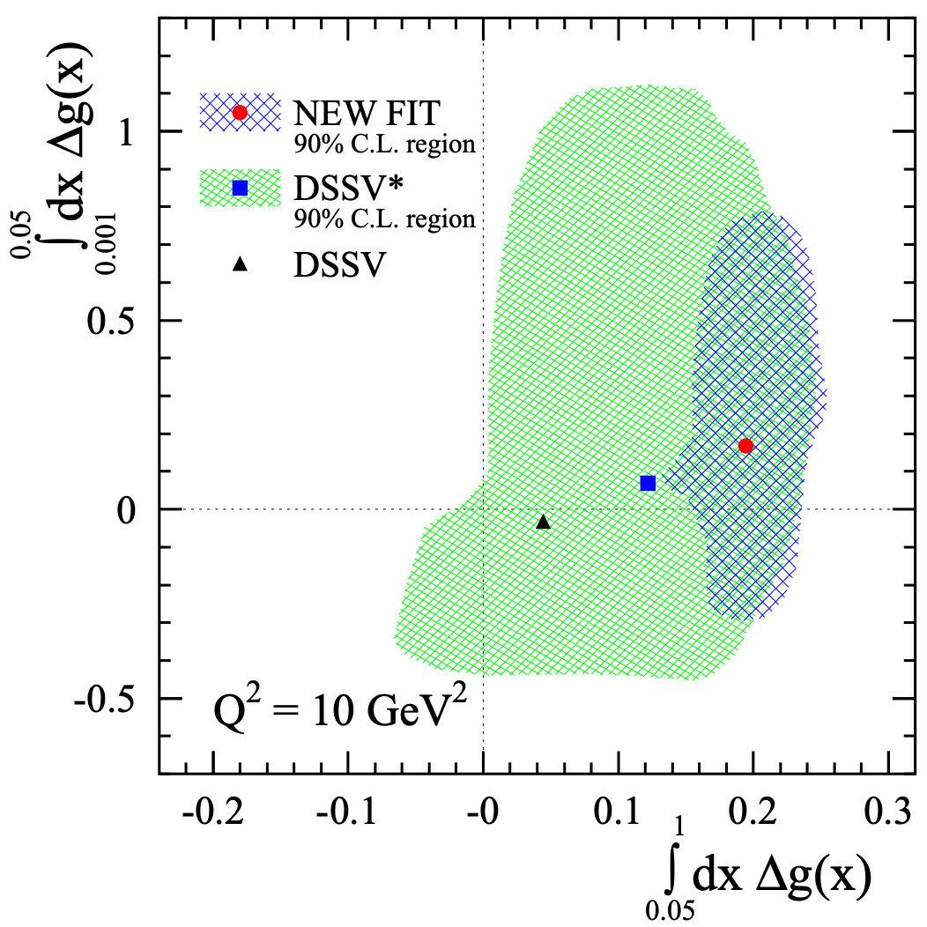
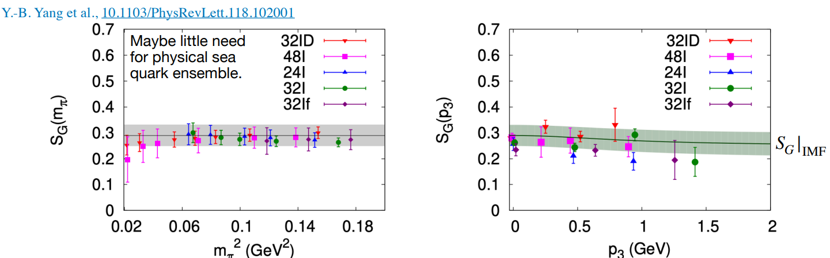
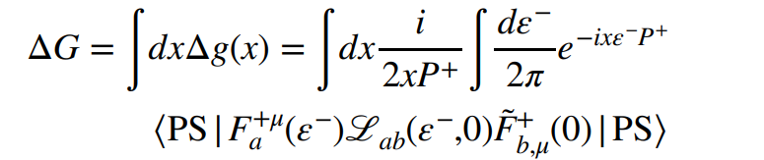

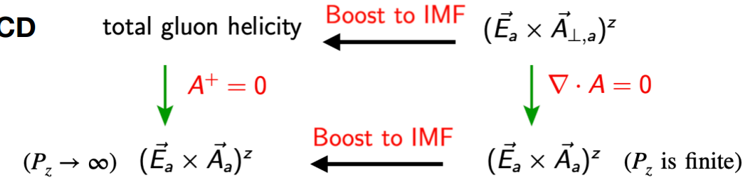
Gluon spin in proton

Slide 11
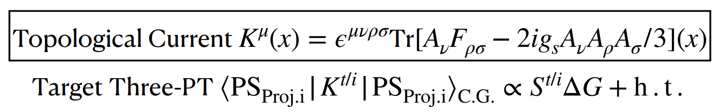
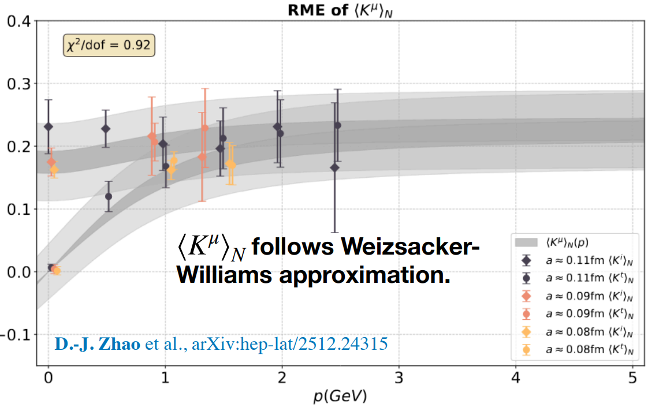
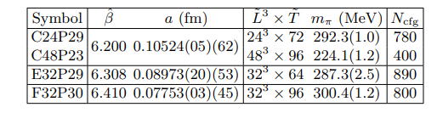
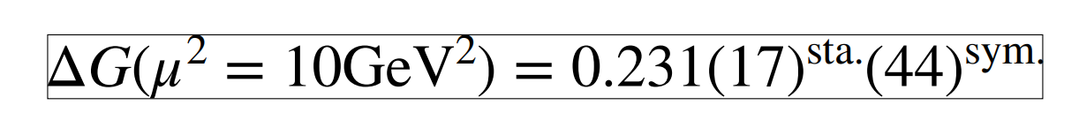
Gluon spin in proton

Slide 12
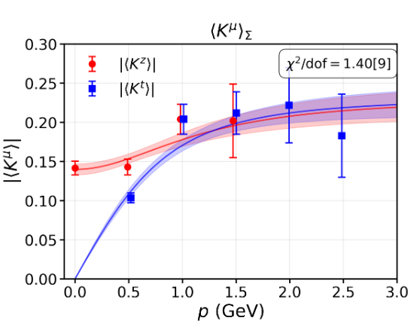
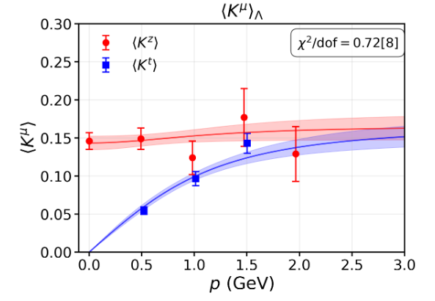
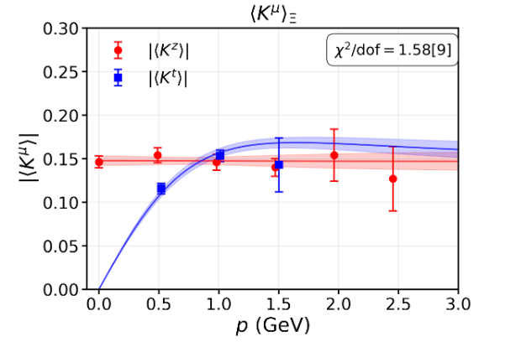

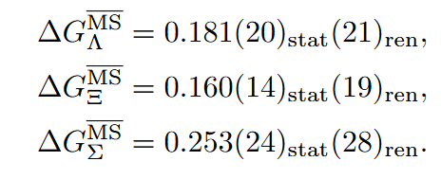


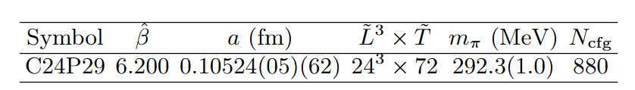
Gluon spin on Octet baryons

Slide 13
summary
Quark and gluon spin contribute about 40%~50% and 30%~50% respectively in baryon spin budget according to LQCD calculation.
In terms of our current calculation , the strange quark contributes a lot for the spin of lambda particle.

Slide 14
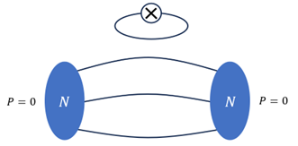
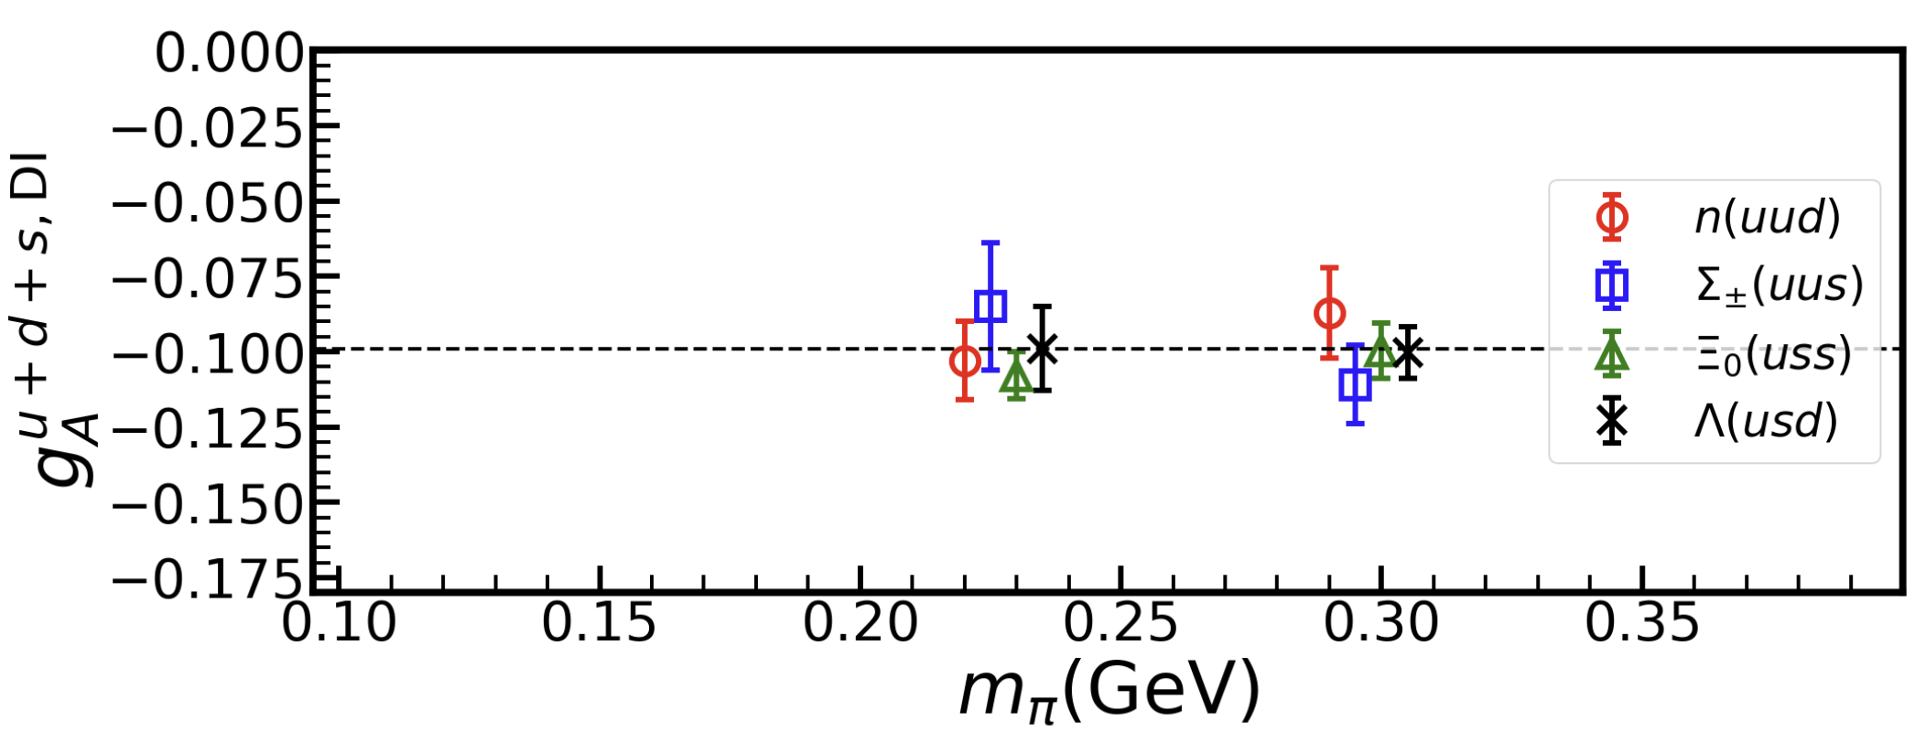
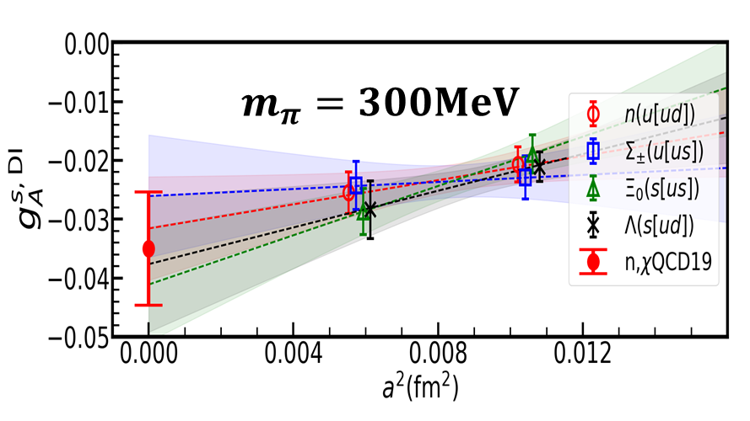
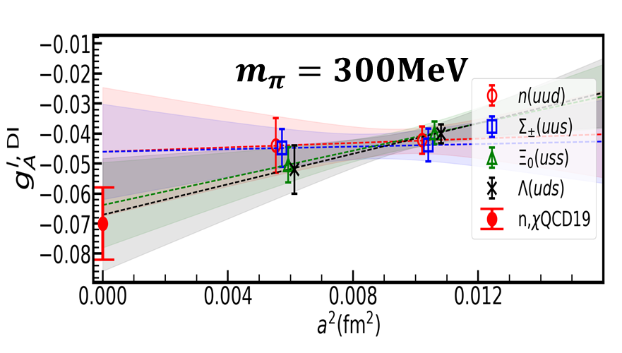


The sea quark contribution
$$u+d+s$$
$$a=0.105fm$$

Slide 15
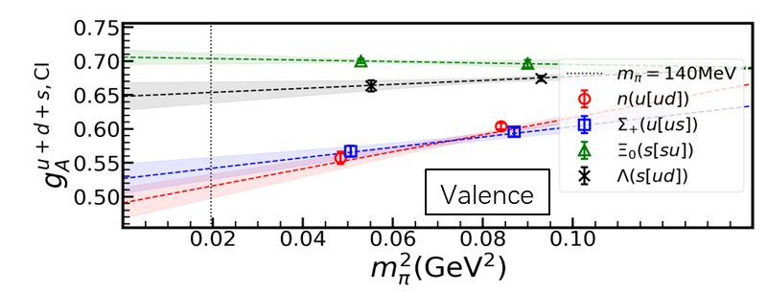
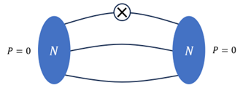
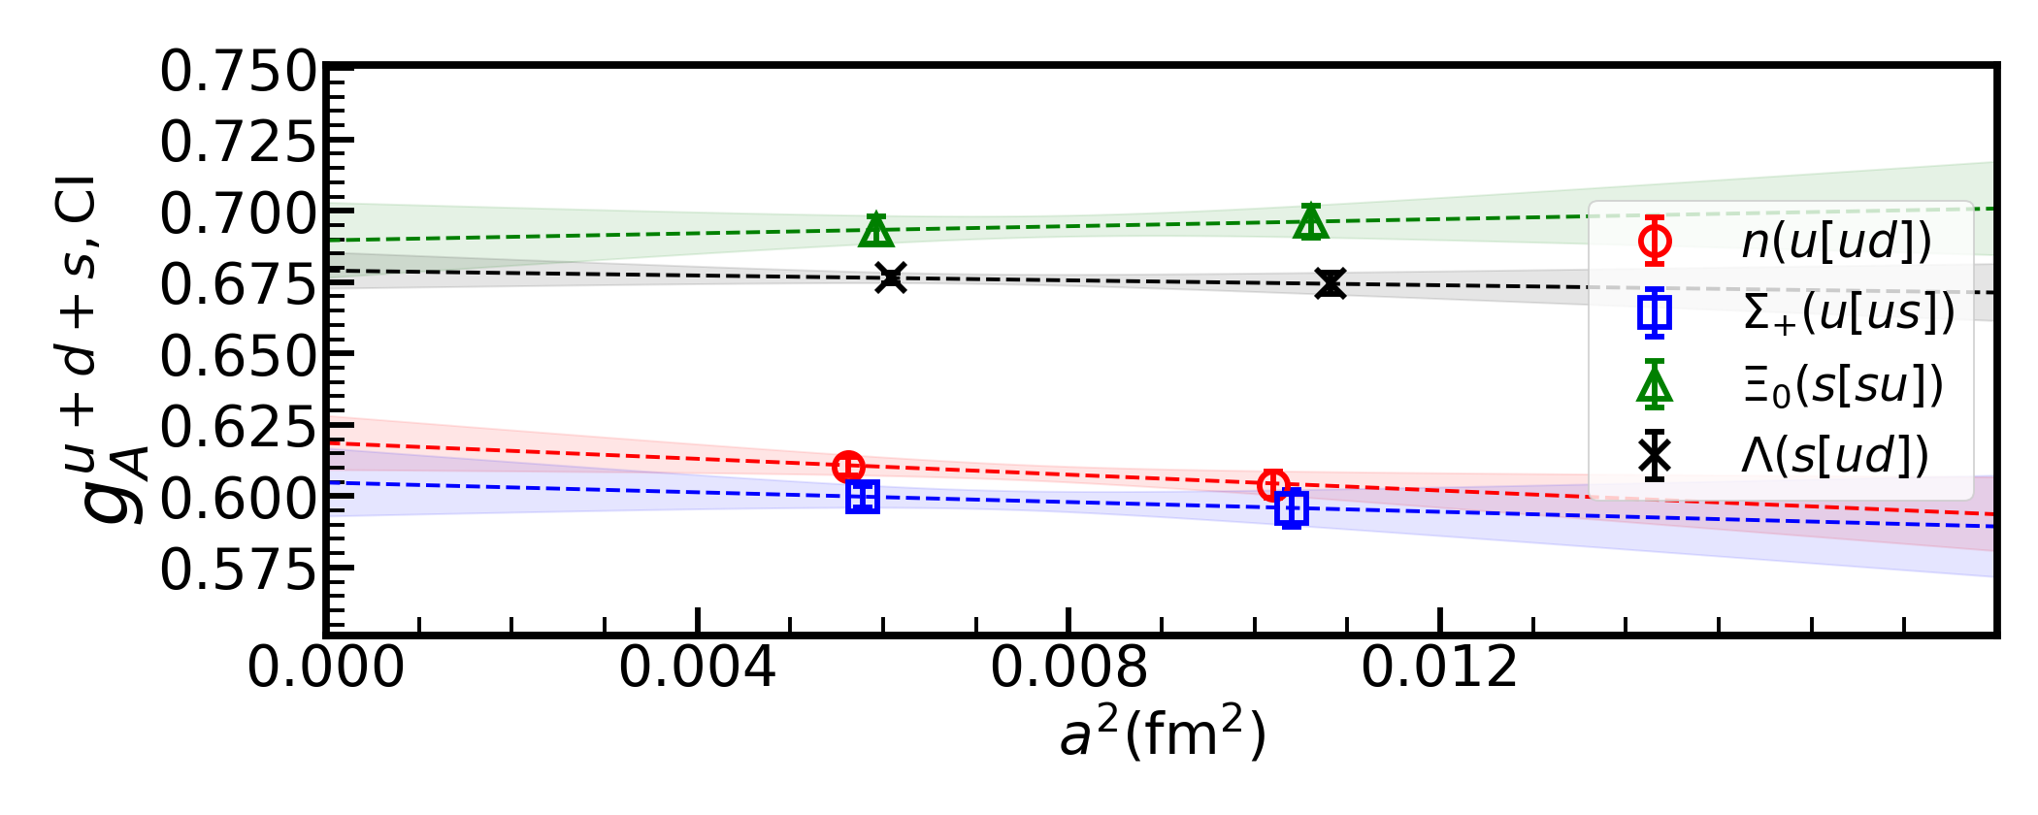

The valence quark contribution
$$a=0.105fm$$

Slide 16

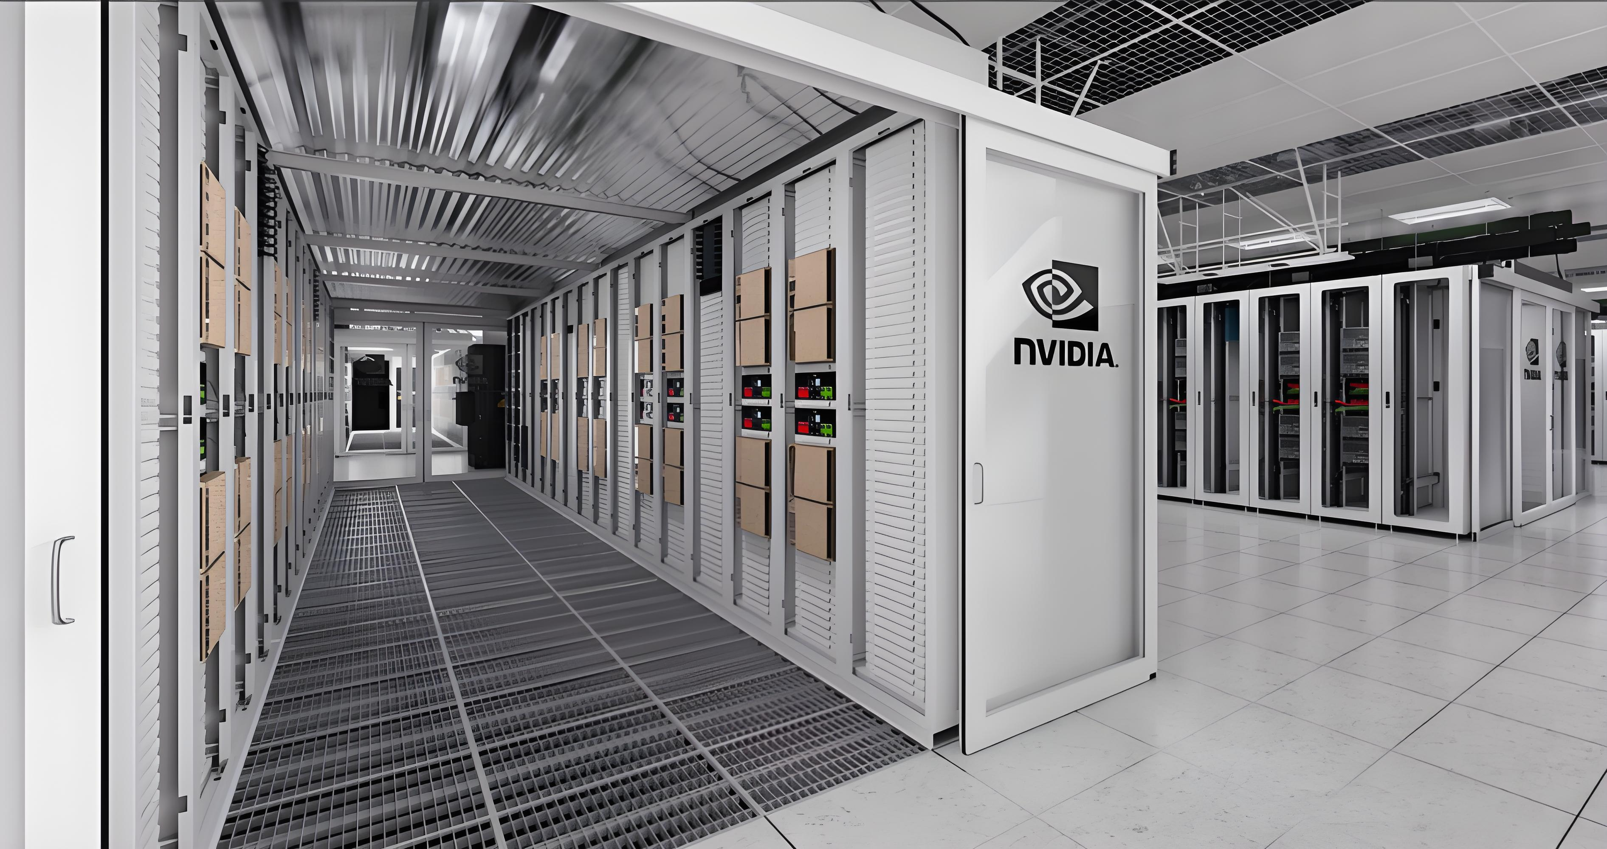
LQCD is expensive, but we can reduce the cost.
Good compute resource
Good strategy or idea

Slide 17
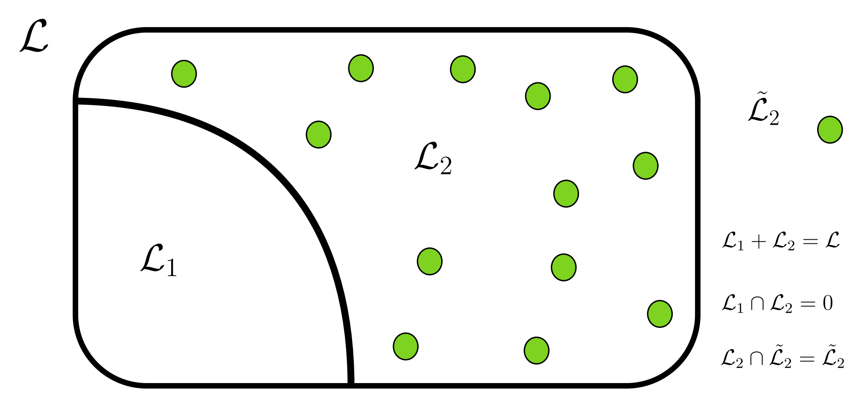
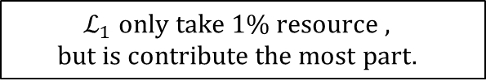
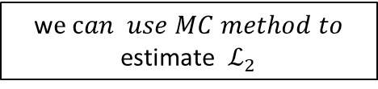
A Method to reduce the cost
Distillation method has been broadly used in lattice calculation of two-point functions
P.R.D. 80, 054506 (2009)
w$e can use MC method to$
estimate $ℒ_{2}$
~1%
$$ℒ_{1} only take 1\% resource ,$$
$$but is contribute the most part.$$

Slide 18




The blending Method to reduce the cost
ArXiv:2505.01719
All-to-All propagator will be
Unacceptable!
All-to-all propagator size: ${ \left(4N_{c}N_{T}N_{V}^{ }\right)}^{2}$
1. Vectors
2.Perambulator
+
$$\frac{N_{e}+N_{st}}{[ℒ]}≈1\%$$
$${\left(N_{c}N_{T}N_{V}^{ }\right)(N_{e}+N_{st})}^{ }$$
$${\left[4N_{T}\left(N_{e}+N_{st}\right)\right]}^{2}$$
Acceptable!

Slide 19

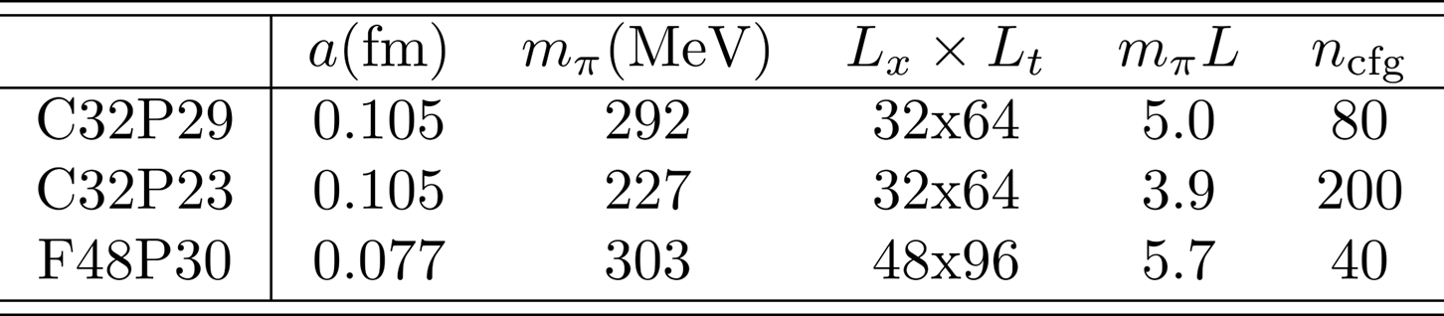
2+1 flavor tadpole-improved Clover Fermion with Symanzik gauge action

Slide 20
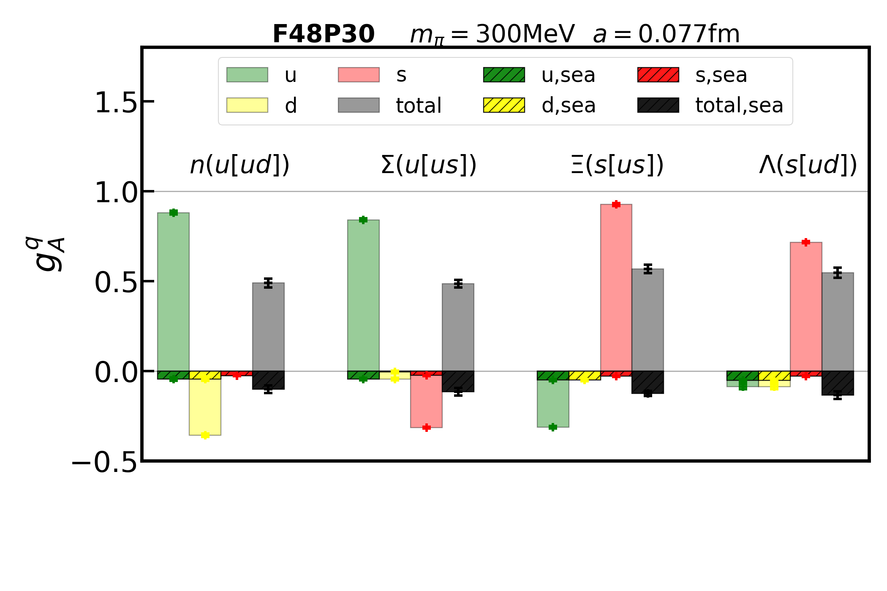
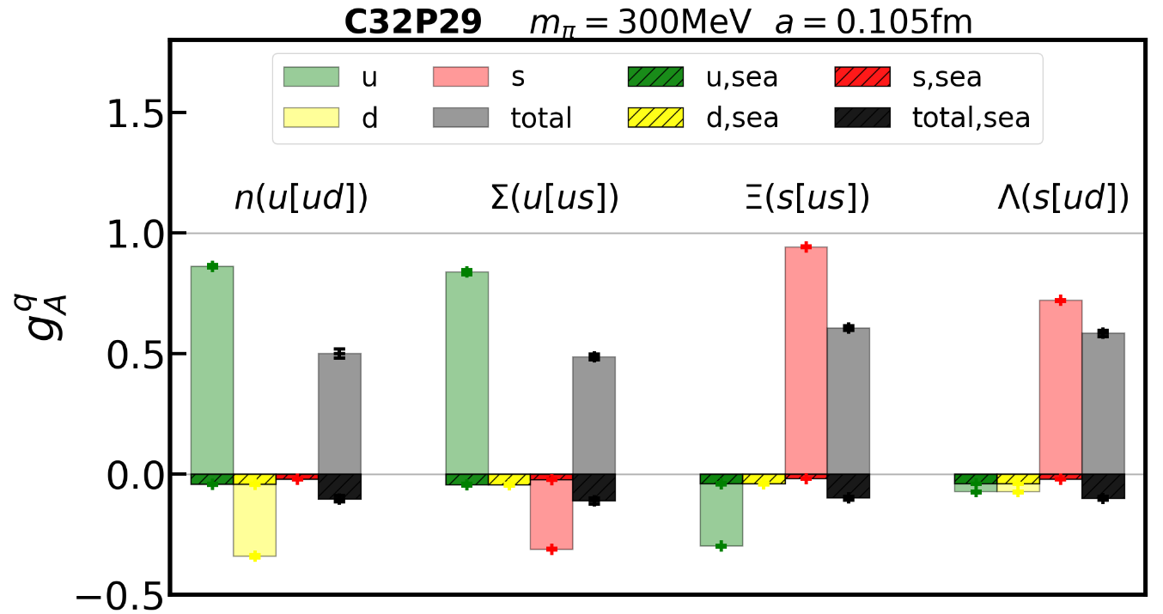
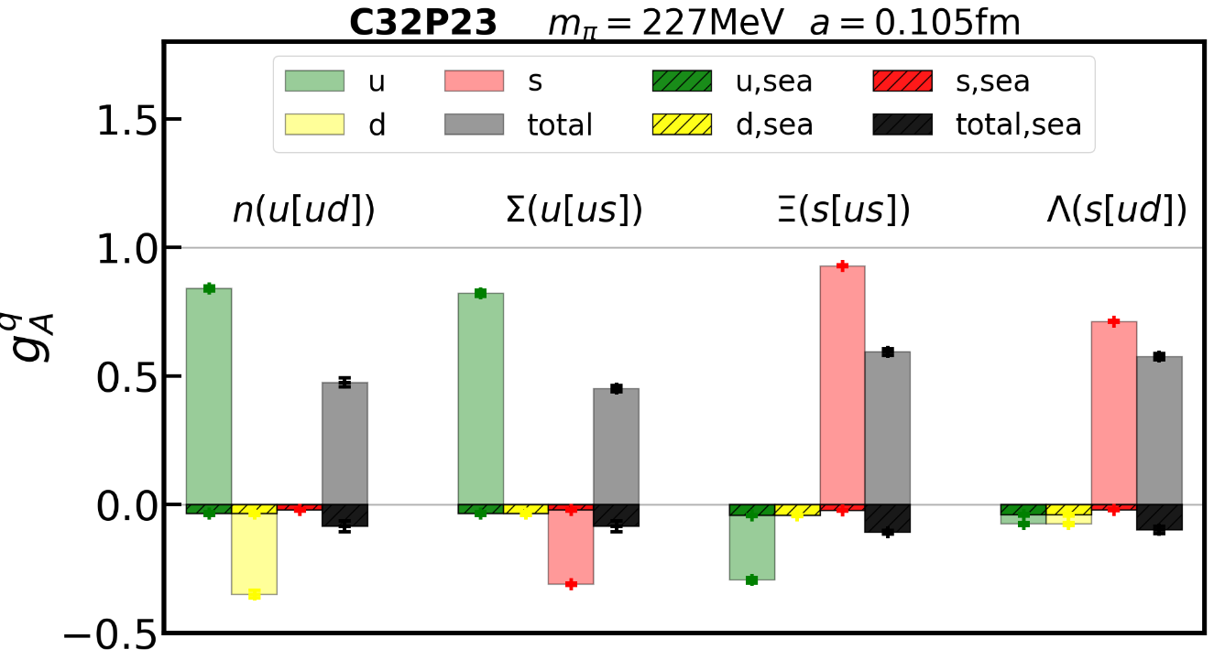
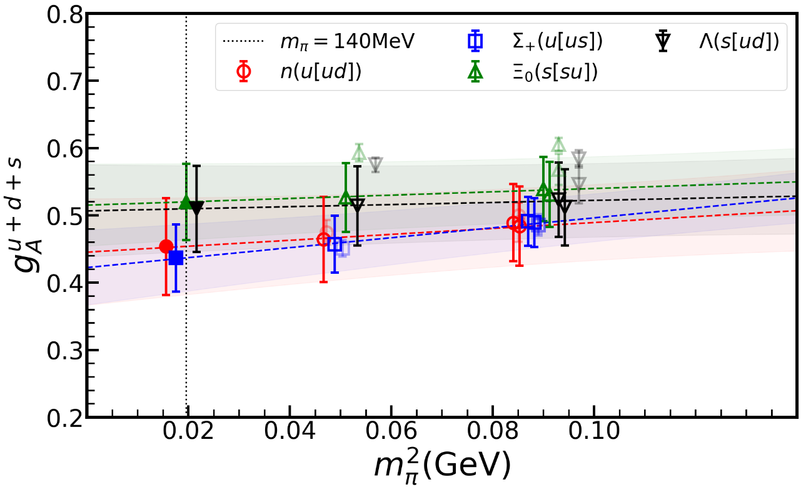
Our result

Slide 21


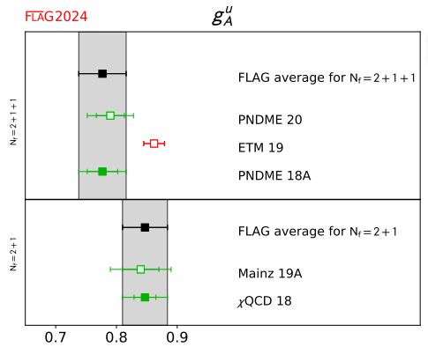
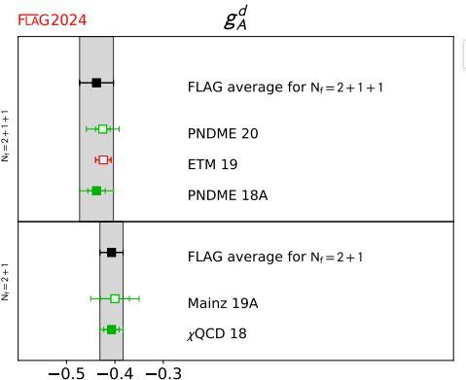
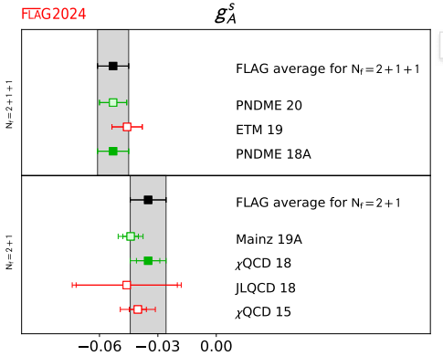
Lattice calculation
（ ）
in proton

Slide 22
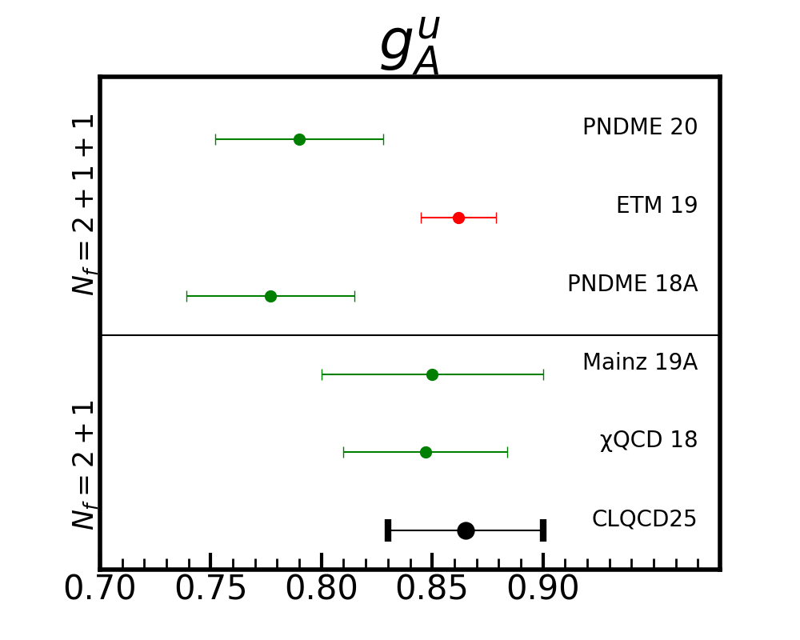
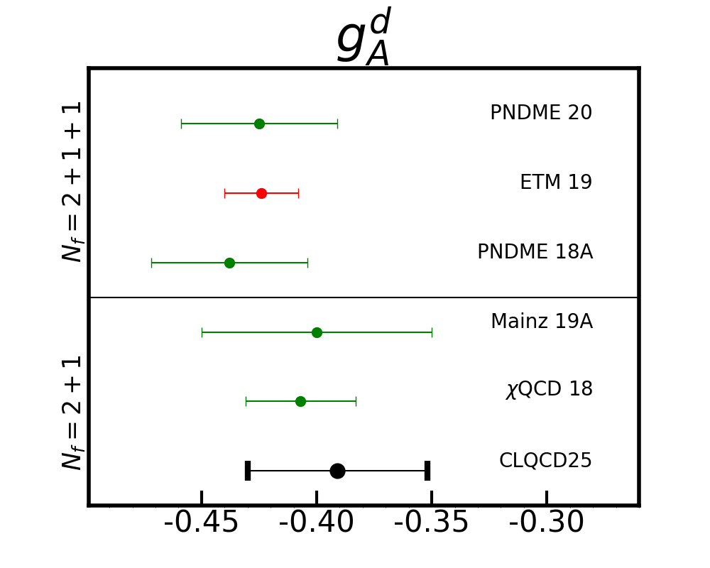
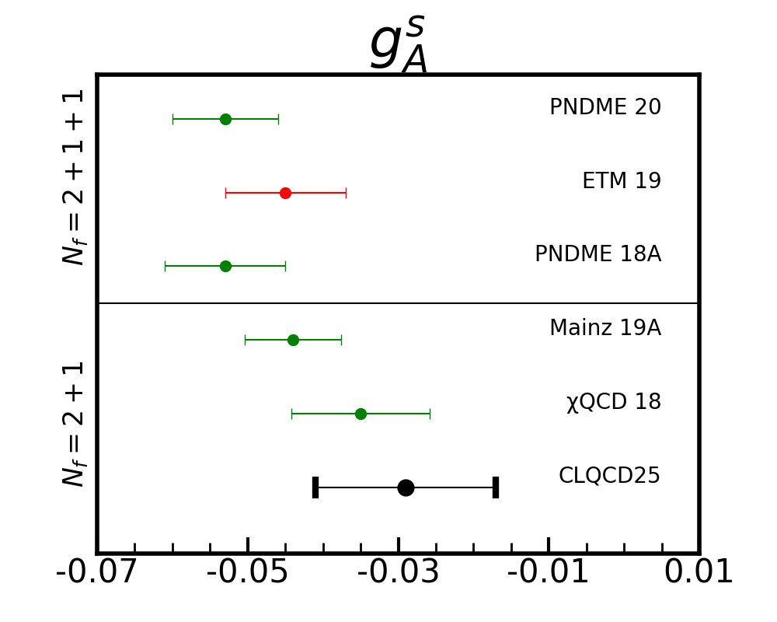
Quark spin in proton comparing to other groups

Slide 23
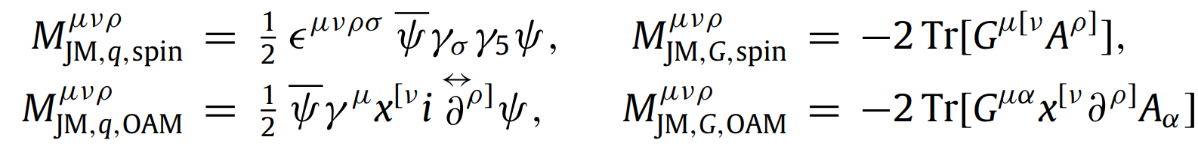

The Jaffe–Manohar decomposition：
The Ji decomposition：
The Belinfante decomposition…
The gauge-invariant kinetic decomposition…
The gauge-invariant canonical decomposition…

Slide 24










Lattice calculation

