Slide 1
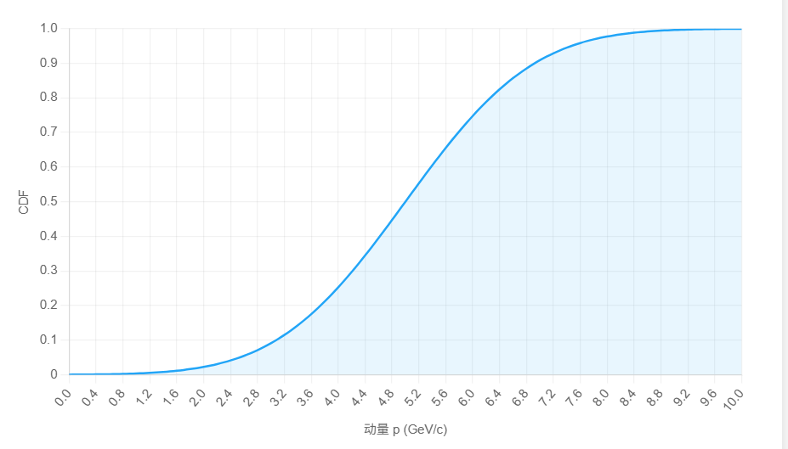
多维抽样
数据获取为误差值：Error: Δx , Δy , Δθ_p , Δϕ_p , Δ|p|
MCTruth+smear
由五维直方图（pdf）体现权重（对于特定的E,theta,phi bin每个有一张五维直方图）
使用权重大于0的bin相加，获得CDF
用两组数组分别储存bin的坐标和对应的0-1的数值
[Δx , Δy , Δθ_p , Δϕ_p , Δ|p|]

Slide 2
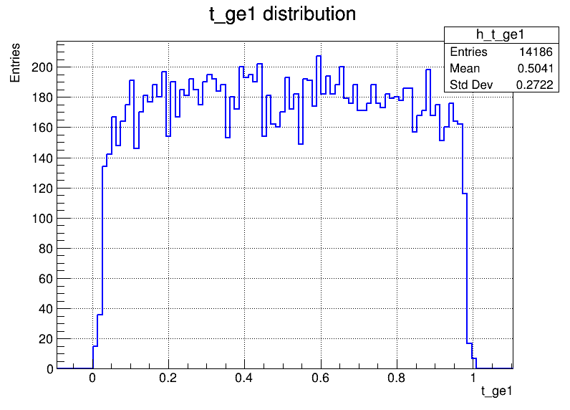
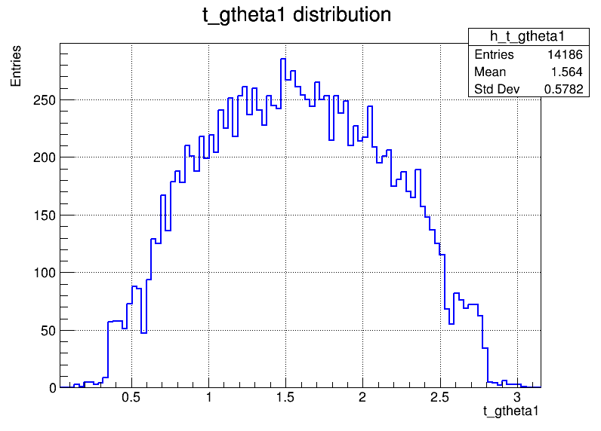
获取1GeVpi0中的光子的能量和角度分布
E=[0，1.01)GeV
theta=[0,pi]rad

Slide 3
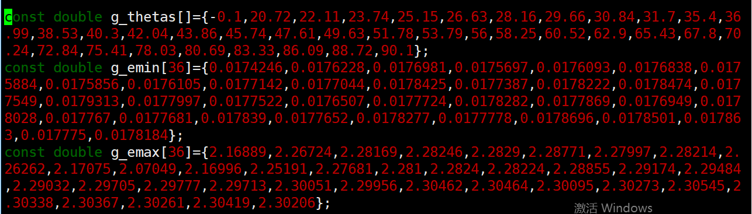
目前的抽样：
根据角度分bin选择角度
根据角度选择能量bin
能量和角度分bin：
使用带电粒子的动量分bin:
m_eBins = {0.025, 0.1, 0.13, 0.16, 0.2, 0.25, 0.3, 0.35, 0.4, 0.45, 0.5, 0.6, 0.8, 1.01};GeV
m_thetaBins = {-0.1, 20.72, 22.11, 23.74, 25.15, 26.63, 28.16, 29.66, 30.84, 31.7,
35.4, 36.99, 38.53, 40.3, 42.04, 43.86, 45.74, 47.61, 49.63, 51.78,
53.79, 56, 58.25, 60.52, 62.9, 65.43, 67.8, 70.24, 72.84, 75.41,
78.03, 80.69, 83.33, 86.09, 88.72, 90.1};degree

Slide 4
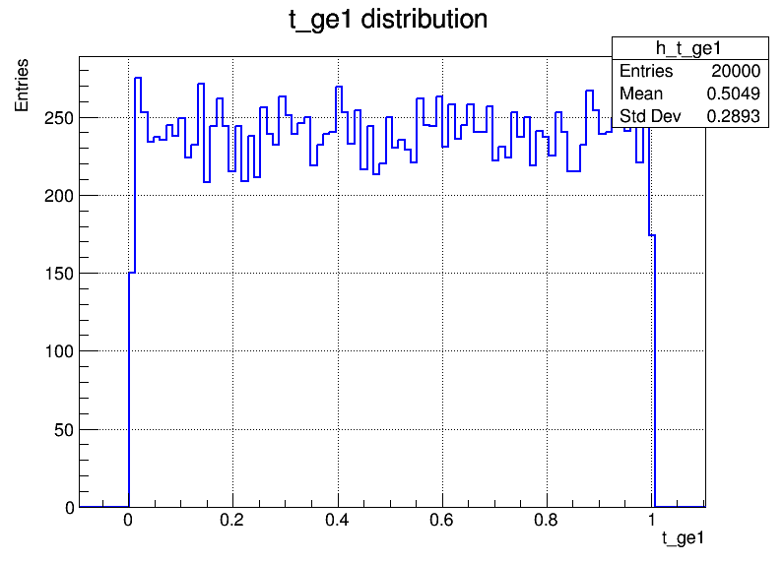
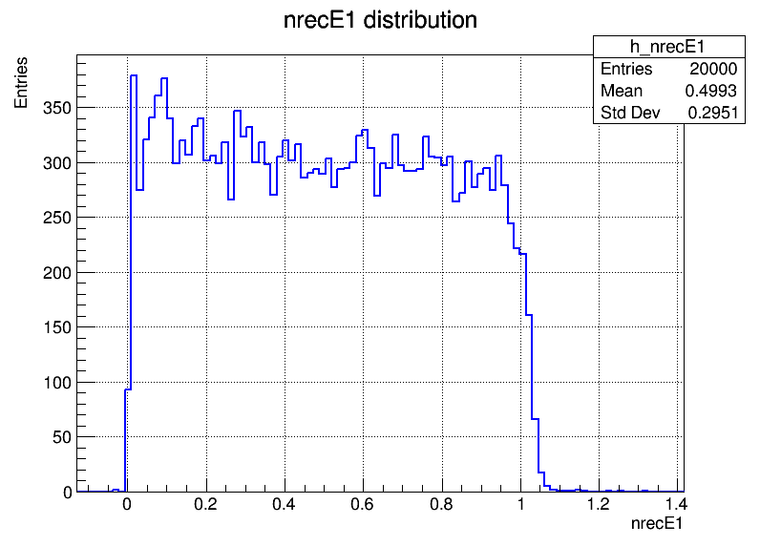
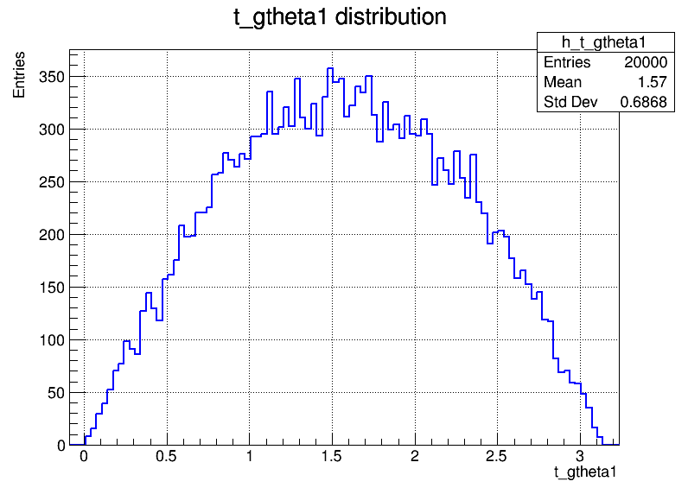
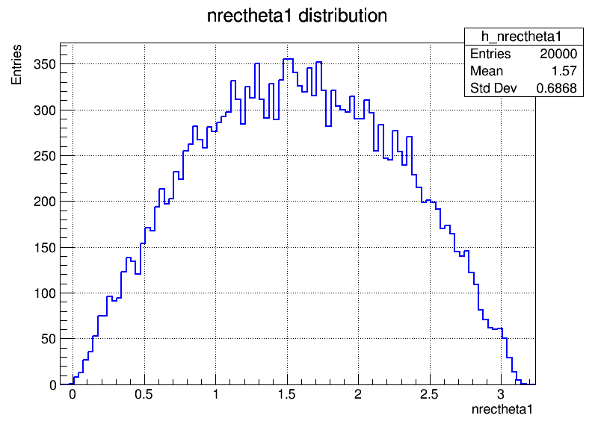
对光子进行抽样

Slide 5
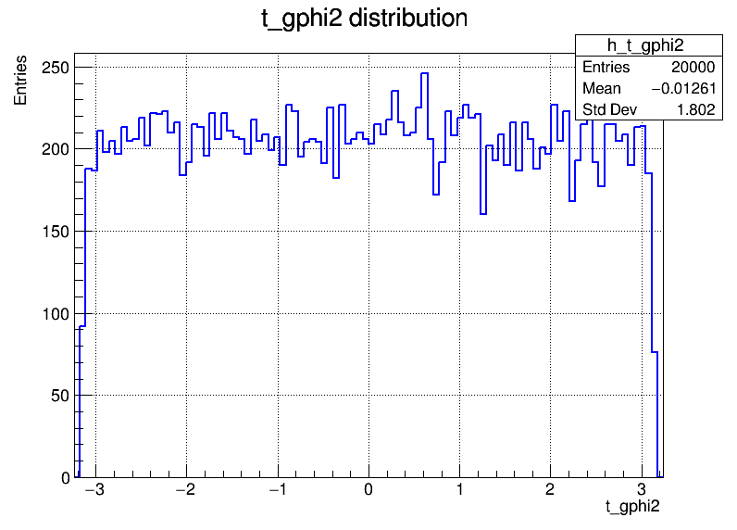
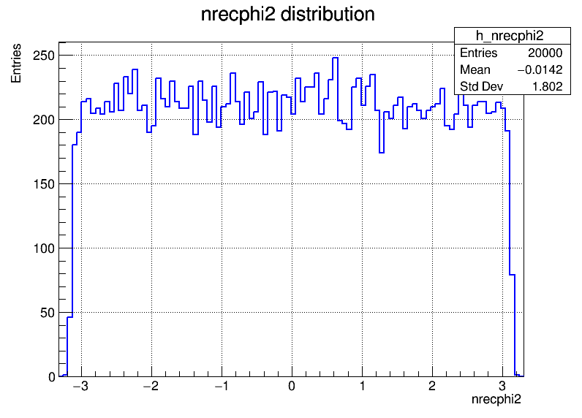

Slide 6
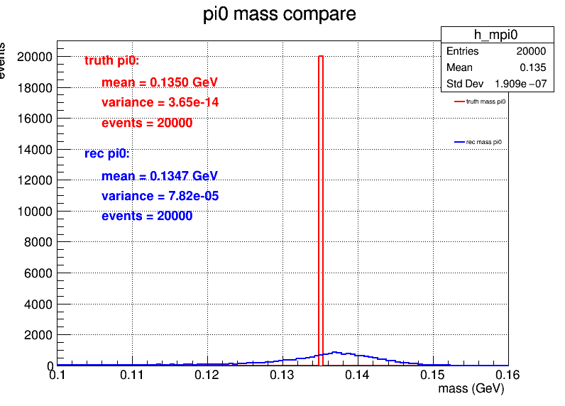
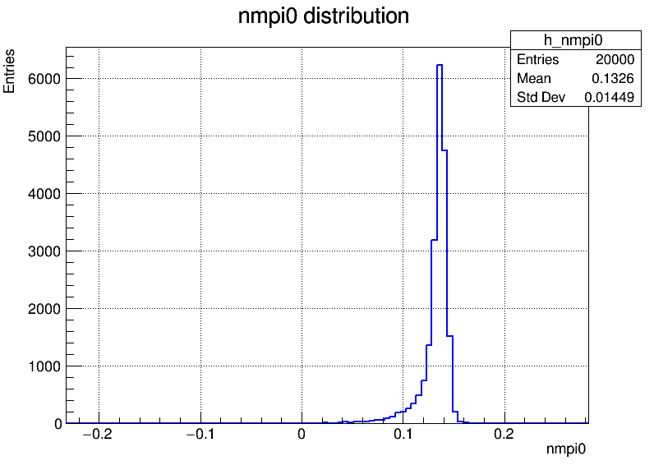
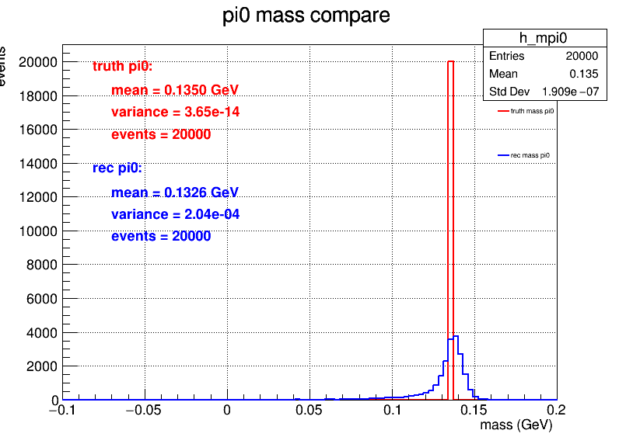
pi0 mass
考虑只是抽样，没有加入重建效率，目前重建结果全部通过筛选
不带电粒子粒子数量>=2
动量和角度 限制，在桶部能量> 0.025GeV,在端盖>0.05GeV
选出与mass_pi0差别最小的两个光子

Slide 7
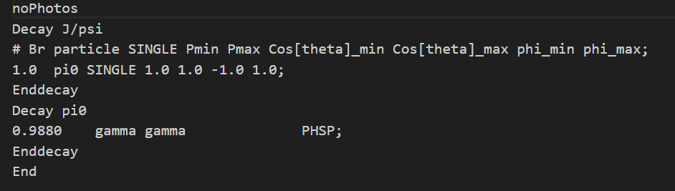
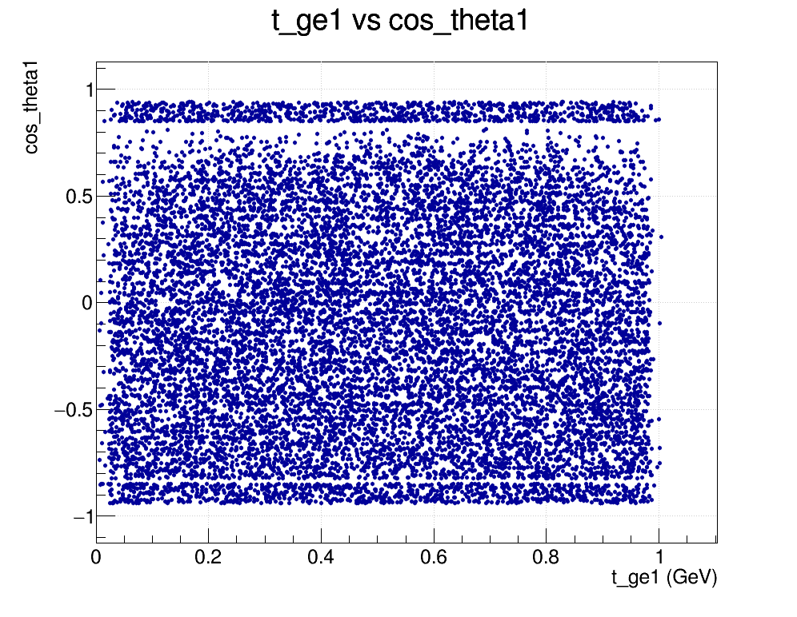
pi0->gamma gamma 中truth信息
不带电粒子粒子树>=2
动量和角度 限制，在桶部能量> 0.025GeV,在端盖>0.05GeV，0.83-0.833的光子剔除
选出与mass_pi0差别最小的两个光子

Slide 8
3.38MB 416
8.32KB
xBins[]={0,0.04,0.08,0.12,0.16,0.2,0.24,0.28,0.32,0.36,0.4,0.44,0.48,0.52,0.56,0.6,0.64,0.68,0.72,0.76,0.8,0.8025,0.805,0.8075,0.81,0.8125,0.815,0.8175,0.82,0.8225,0.825,0.8275,0.83,0.8325,0.835,0.8375,0.84,0.8425,0.845,0.8475,0.85,0.855,0.86,0.865,0.87,0.875,0.88,0.885,0.89,0.895,0.9,0.905,0.91,0.915,0.92,0.925,0.93,0.935,0.94,0.942,0.944,0.945};
yBins[]={0.03,0.0325,0.035,0.0375,0.04,0.0425,0.045,0.0475,0.05,0.0525,0.055,0.0575,0.06,0.0625,0.065,0.0675,0.07,0.0725,0.075,0.0775,0.08,0.0825,0.085,0.0875,0.09,0.0925,0.095,0.0975,0.1,0.105,0.11,0.115,0.12,0.125,0.13,0.135,0.14,0.145,0.15,0.16,0.17,0.18,0.19,0.2,0.21,0.22,0.23,0.24,0.25,0.27,0.29,0.31,0.33,0.35,0.37,0.39,0.41,0.43,0.45,0.47,0.49,0.51,0.53,0.55,0.57,0.59,0.61,0.63,0.65,0.67,0.69,0.71,0.73,0.75,0.77,0.79,0.81,0.83,0.85,0.9,0.95,1,1.05,1.1,1.15,1.2,1.25,1.3,1.35,1.4,1.45,1.5,1.55,1.6,1.65,1.7,1.75,1.8,1.85,1.9,1.95,2,2.05,2.1,2.15,2.2,2.25,2.3,2.35,2.4,2.45,2.5,2.55,2.6,2.65,2.7,2.75,2.8,2.85,2.9,2.95,3.0,3.05,3.1,3.15,3.2,3.25,3.3,3.35,3.4,3.45,3.5};

Slide 9
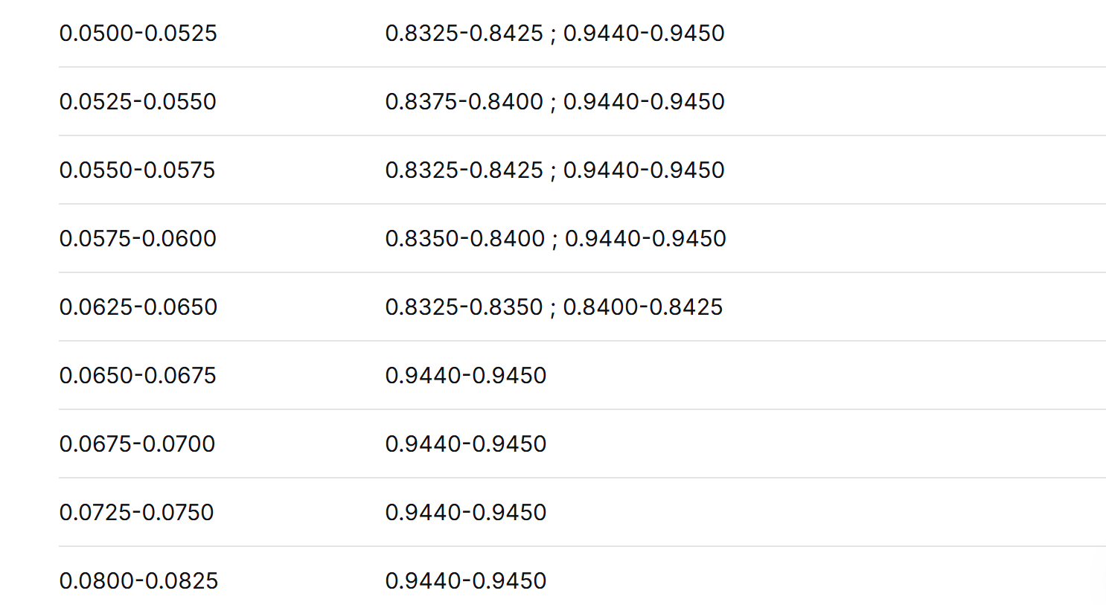
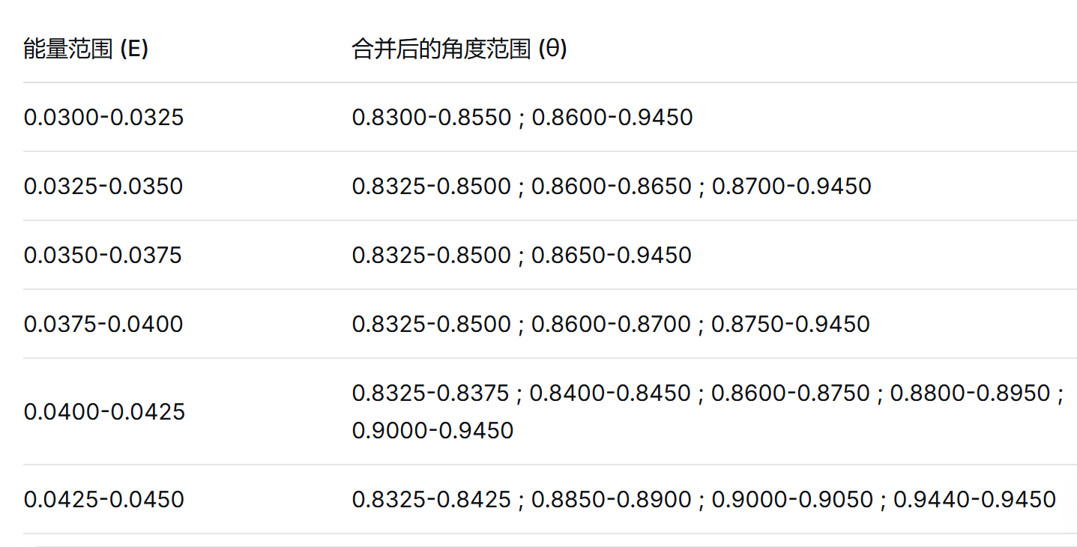
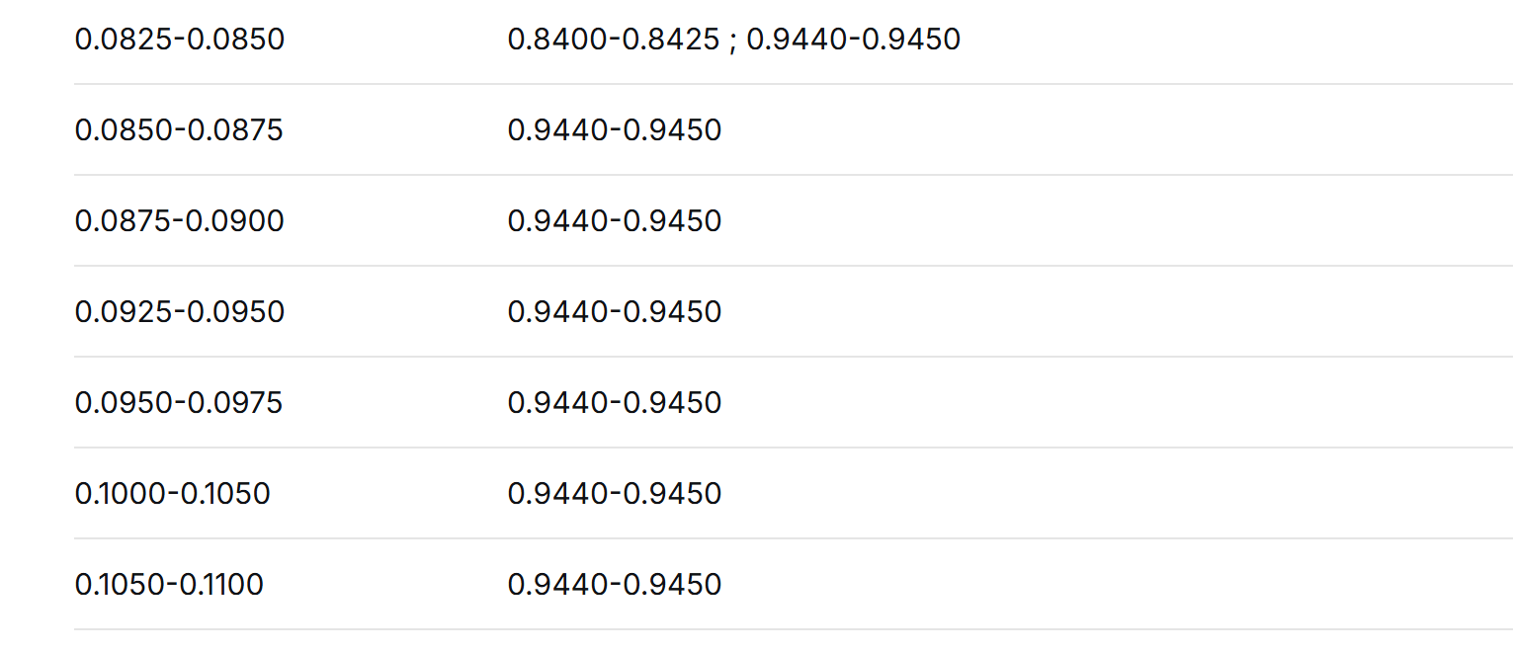
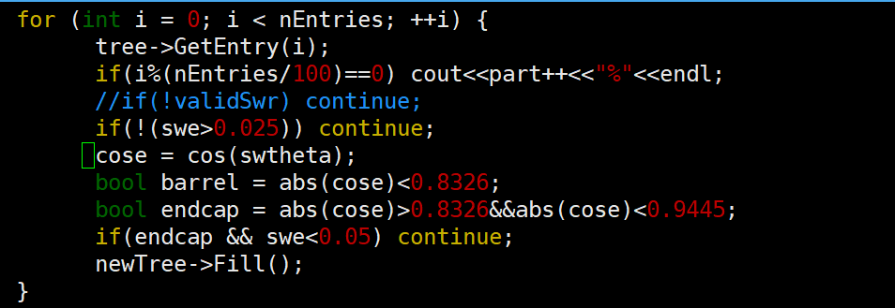
使用新的分bin方案
存在空bin事例
0.82-0.944 端盖 能量低于0.05GeV
能量大于0.05GeV 0.944以上数据缺失

Slide 10
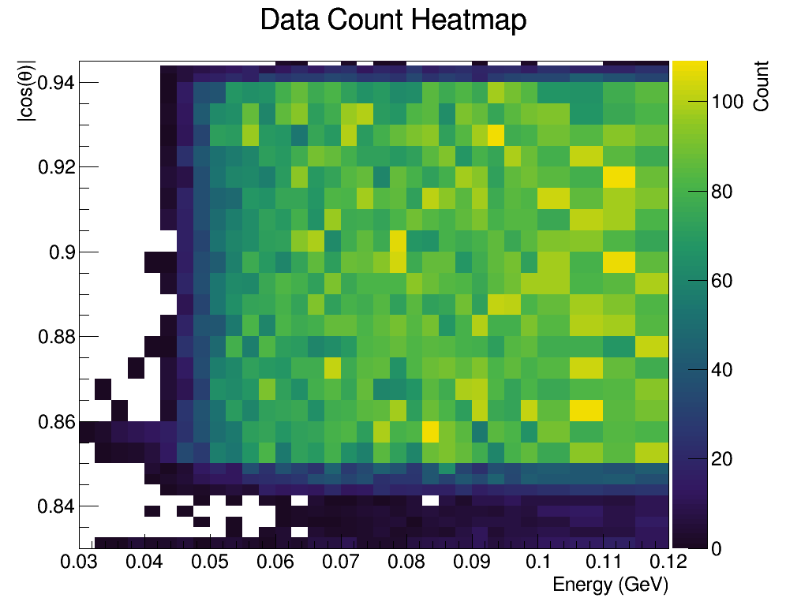
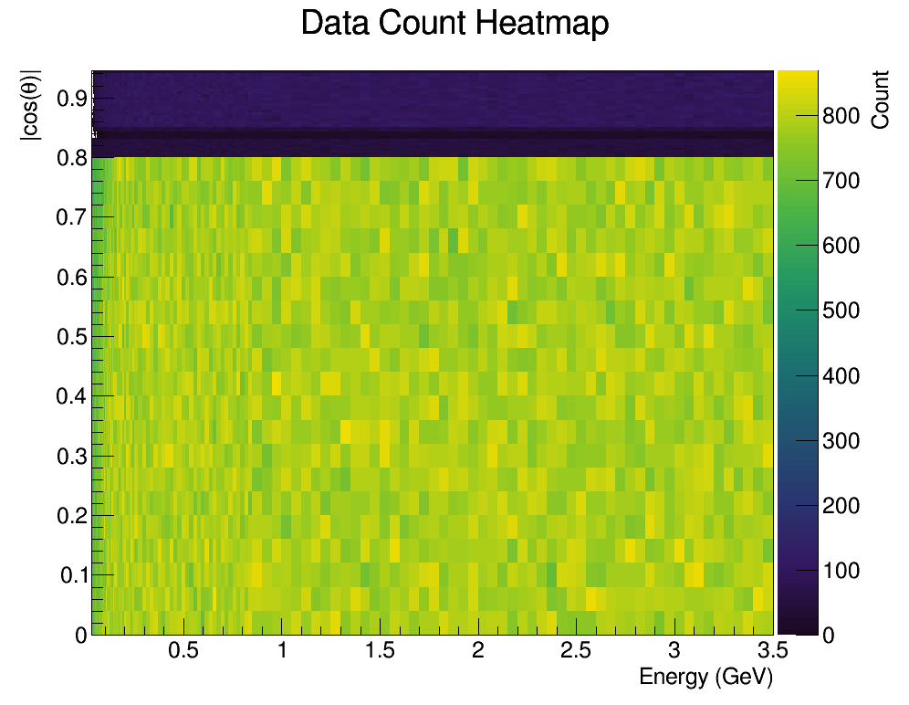
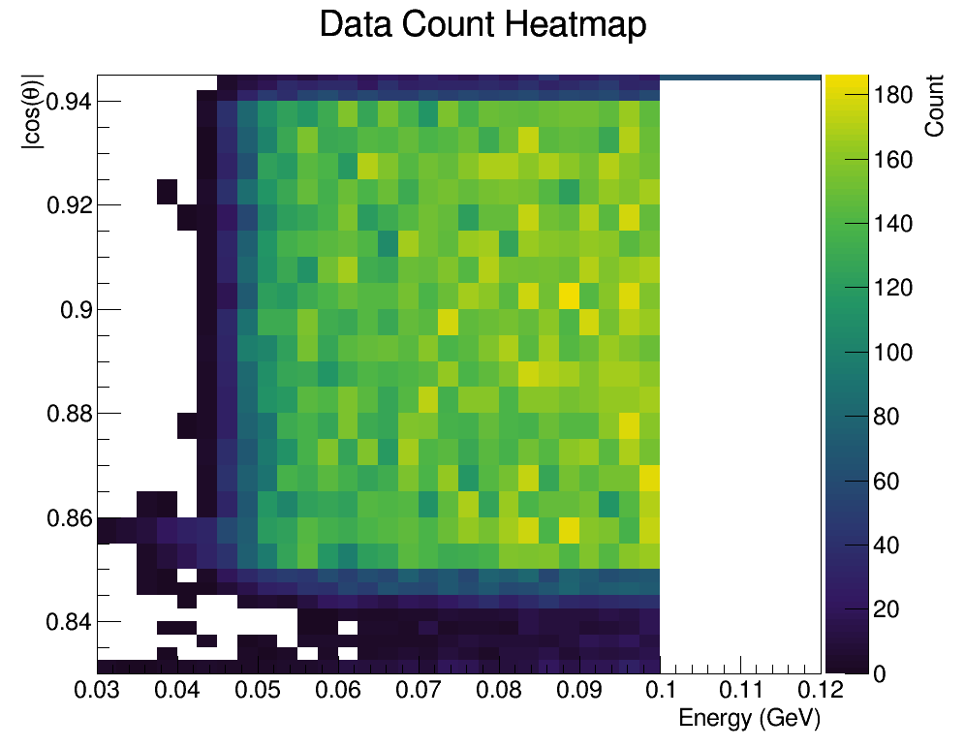
添加数据14w

Slide 11
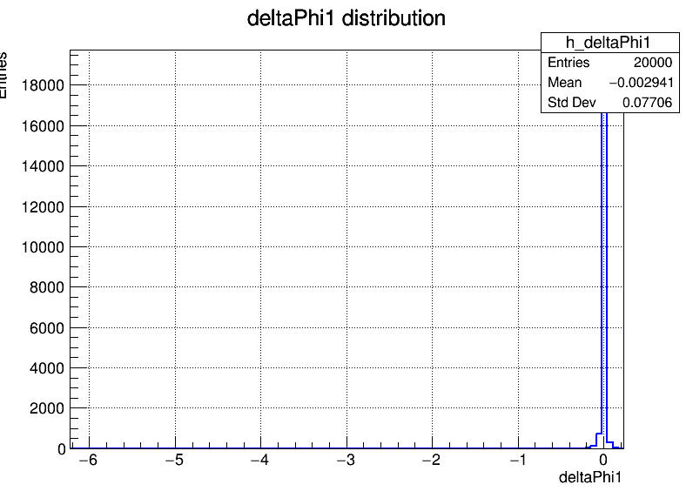
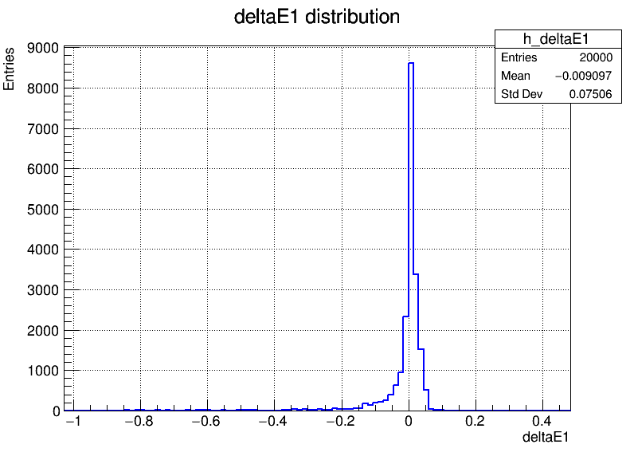
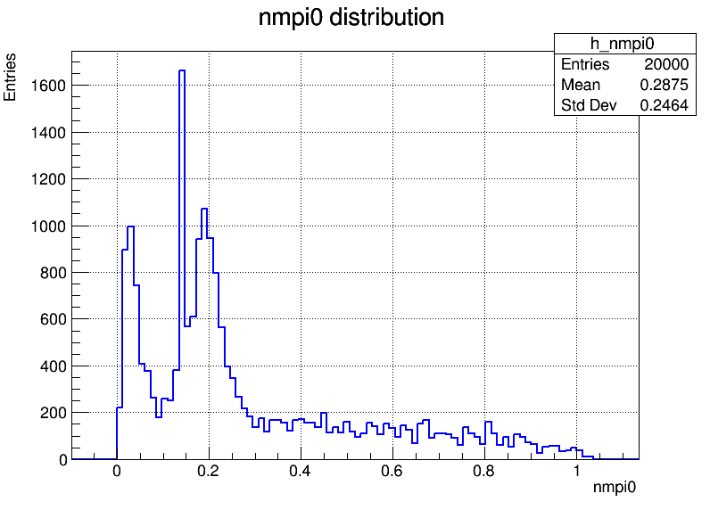
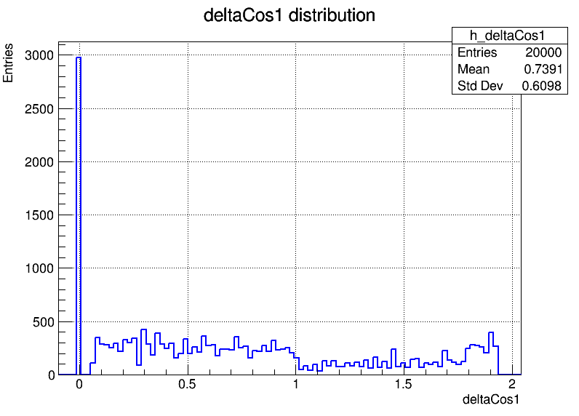
占据存储15.52MB
抽取数据的delta的值时，角度的单位存在问题，phi有极大值未剔除需要debug

Slide 12
设计加入FastSim
预存储CDF
查找分bin
抽取delta值
存入信息

Slide 13
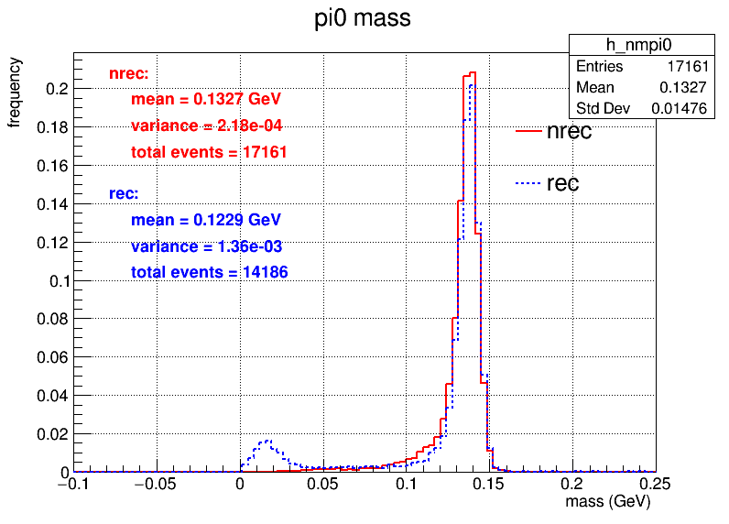
pi0质量谱：nrec：n维抽样的值
rec:重建的值
不带电粒子粒子数量>=2
动量和角度 限制，在桶部能量> 0.025GeV,在端盖>0.05GeV
选出与mass_pi0差别最小的两个光子

Slide 14
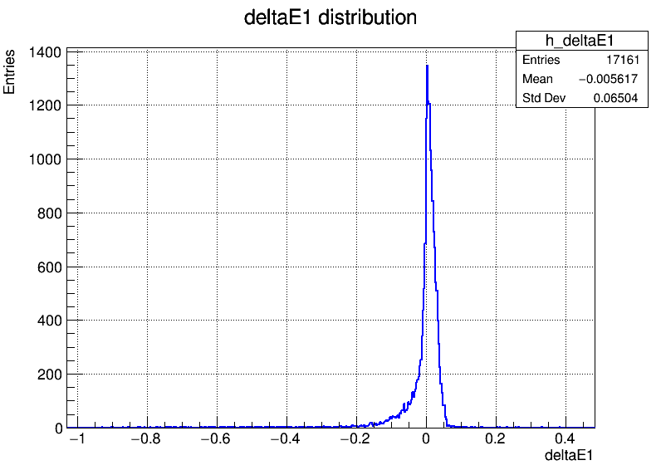
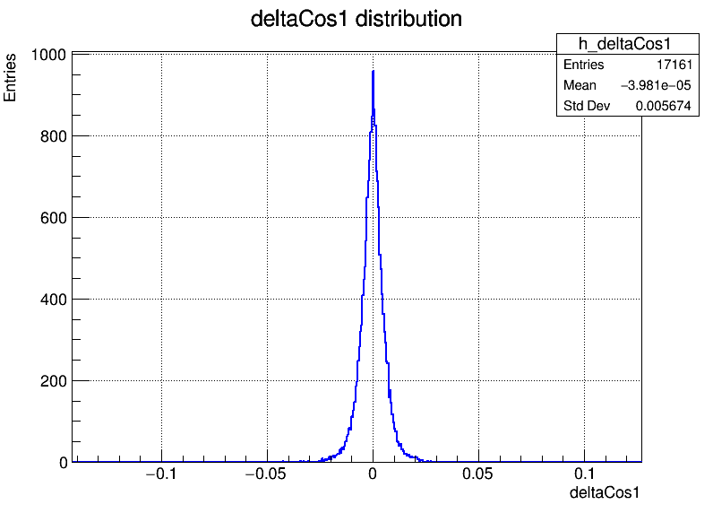
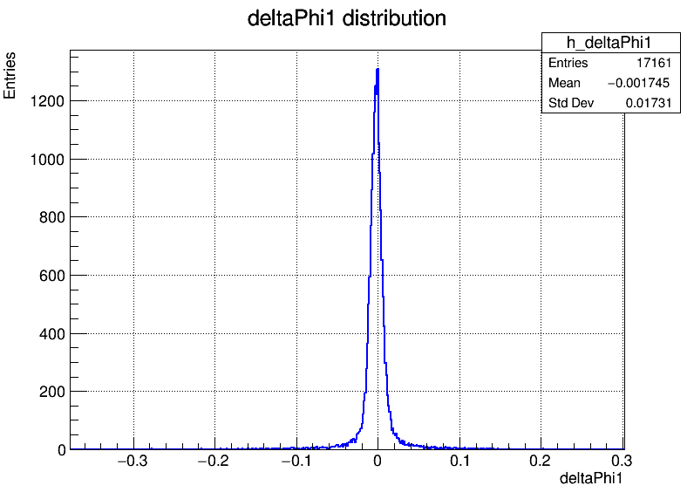

光子的rec-truth的值
抽样为0的数量，文件总事例数2w

Slide 15
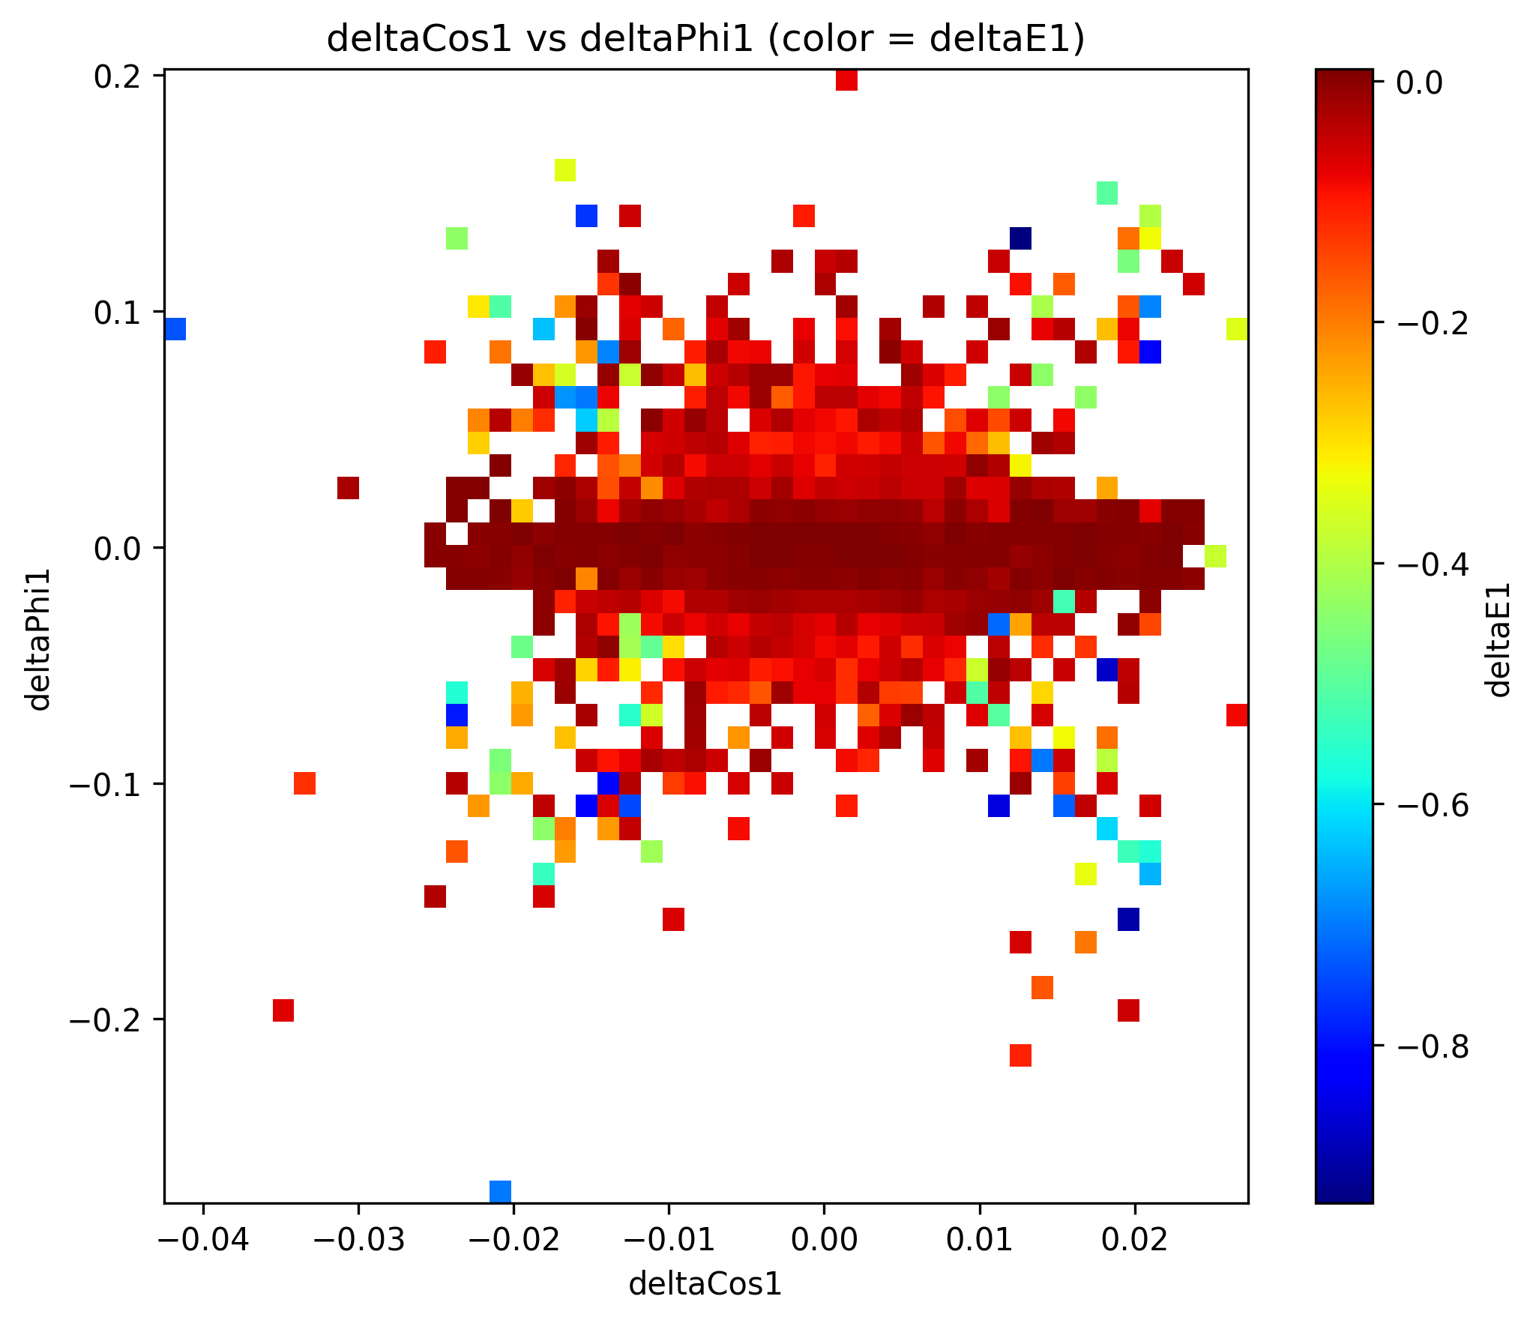
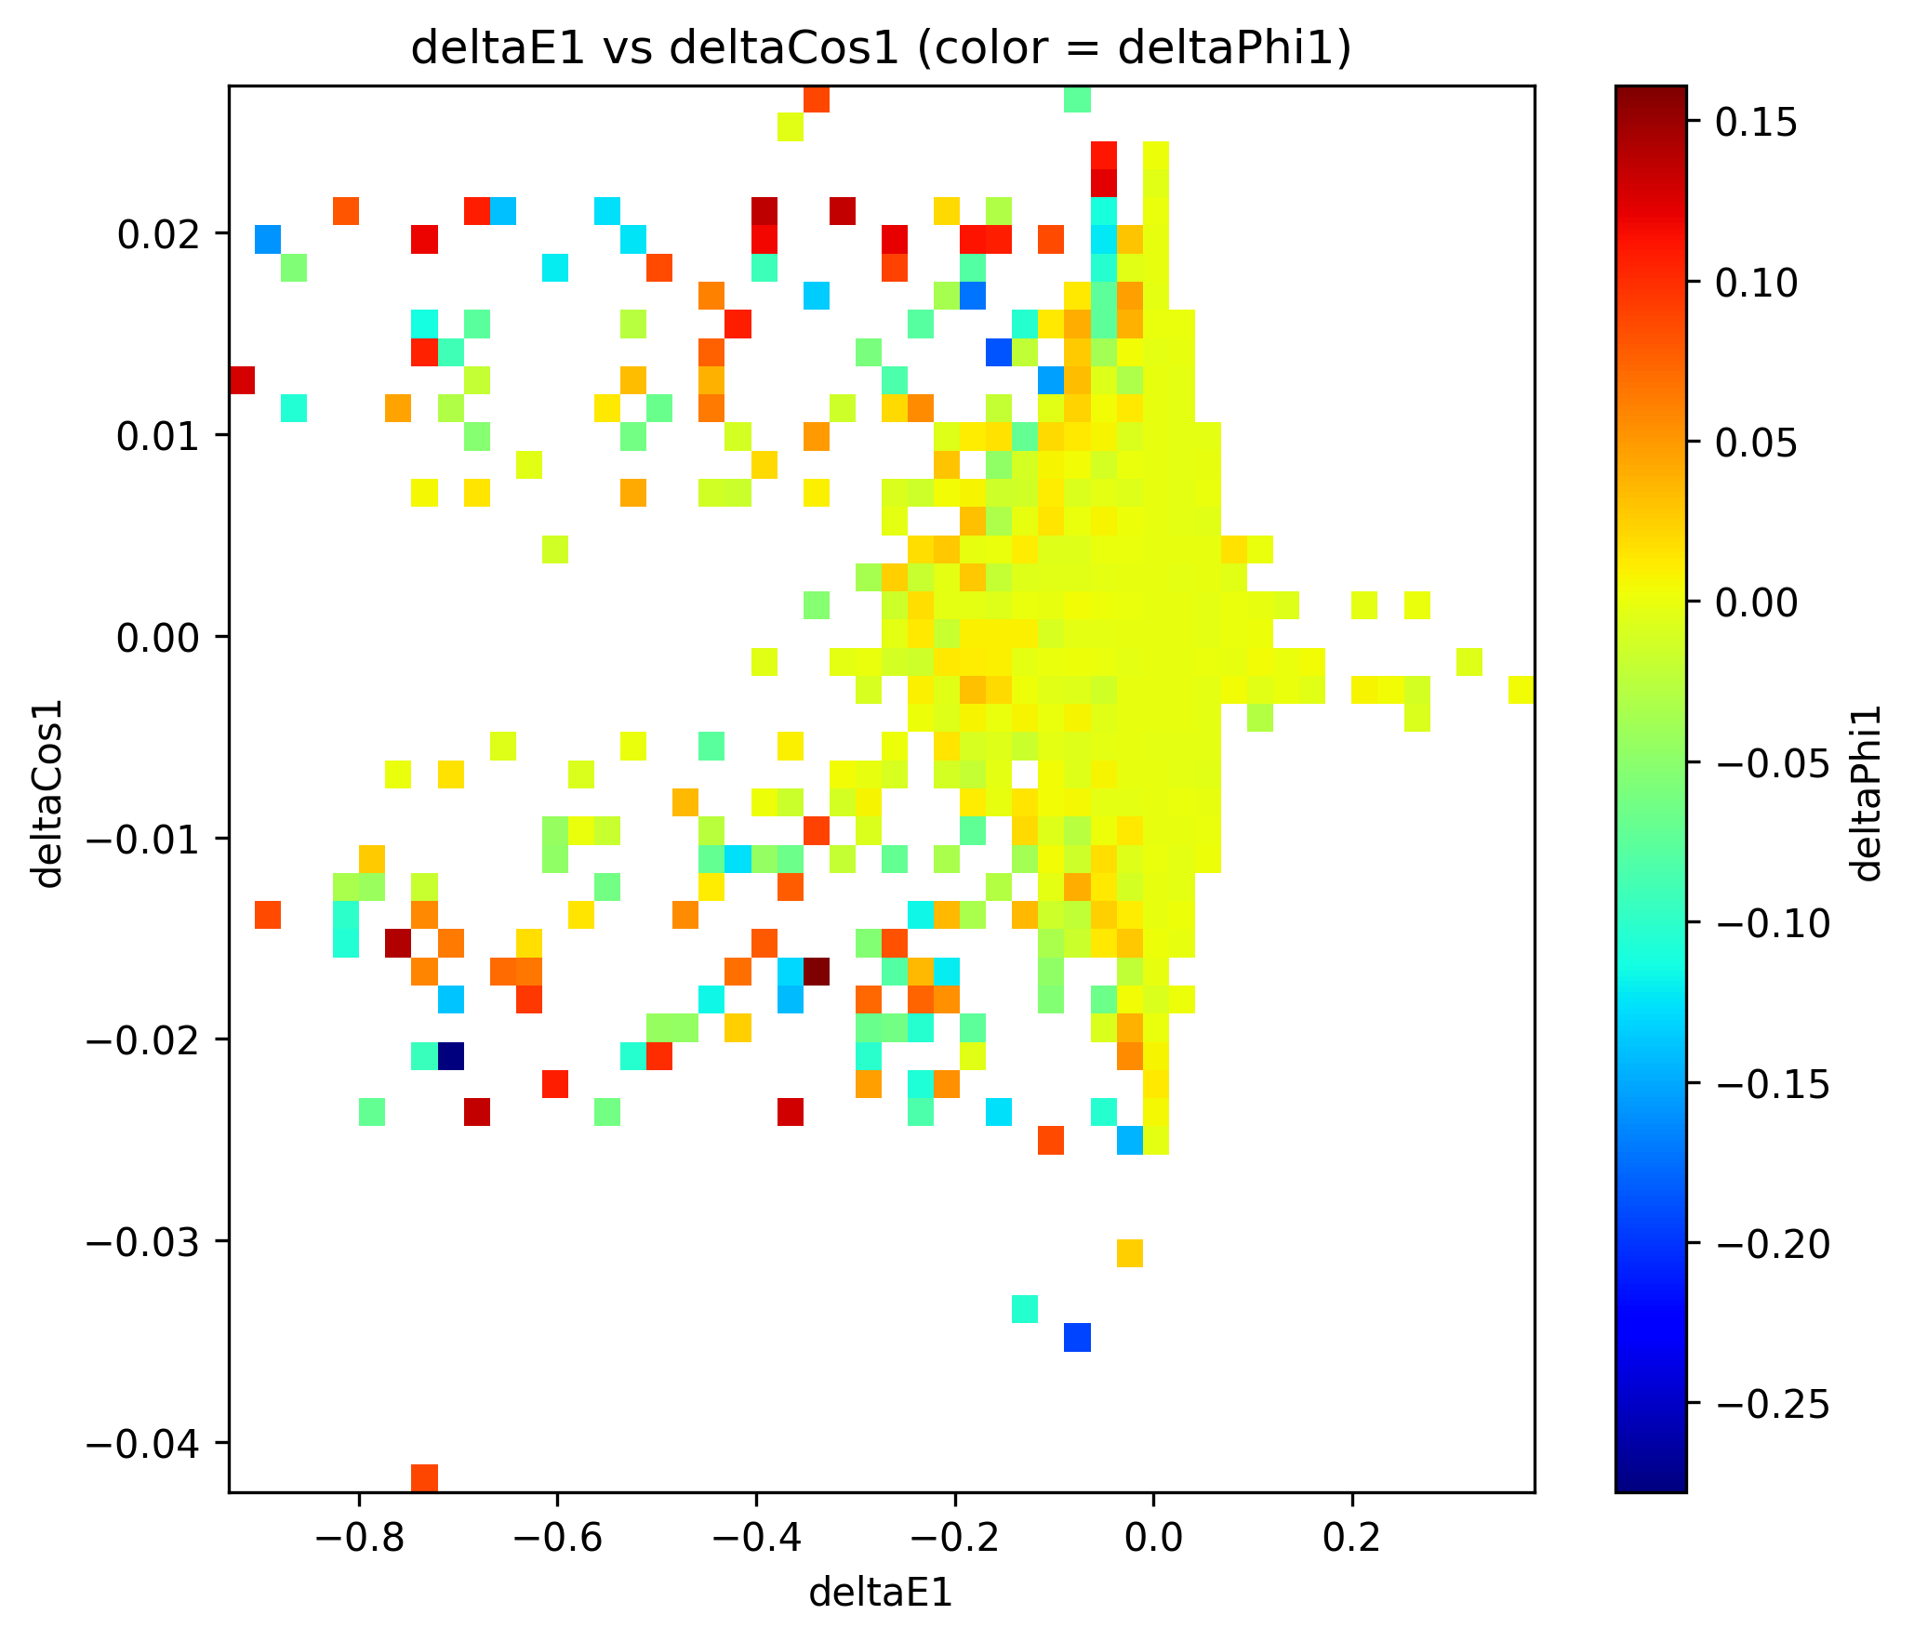
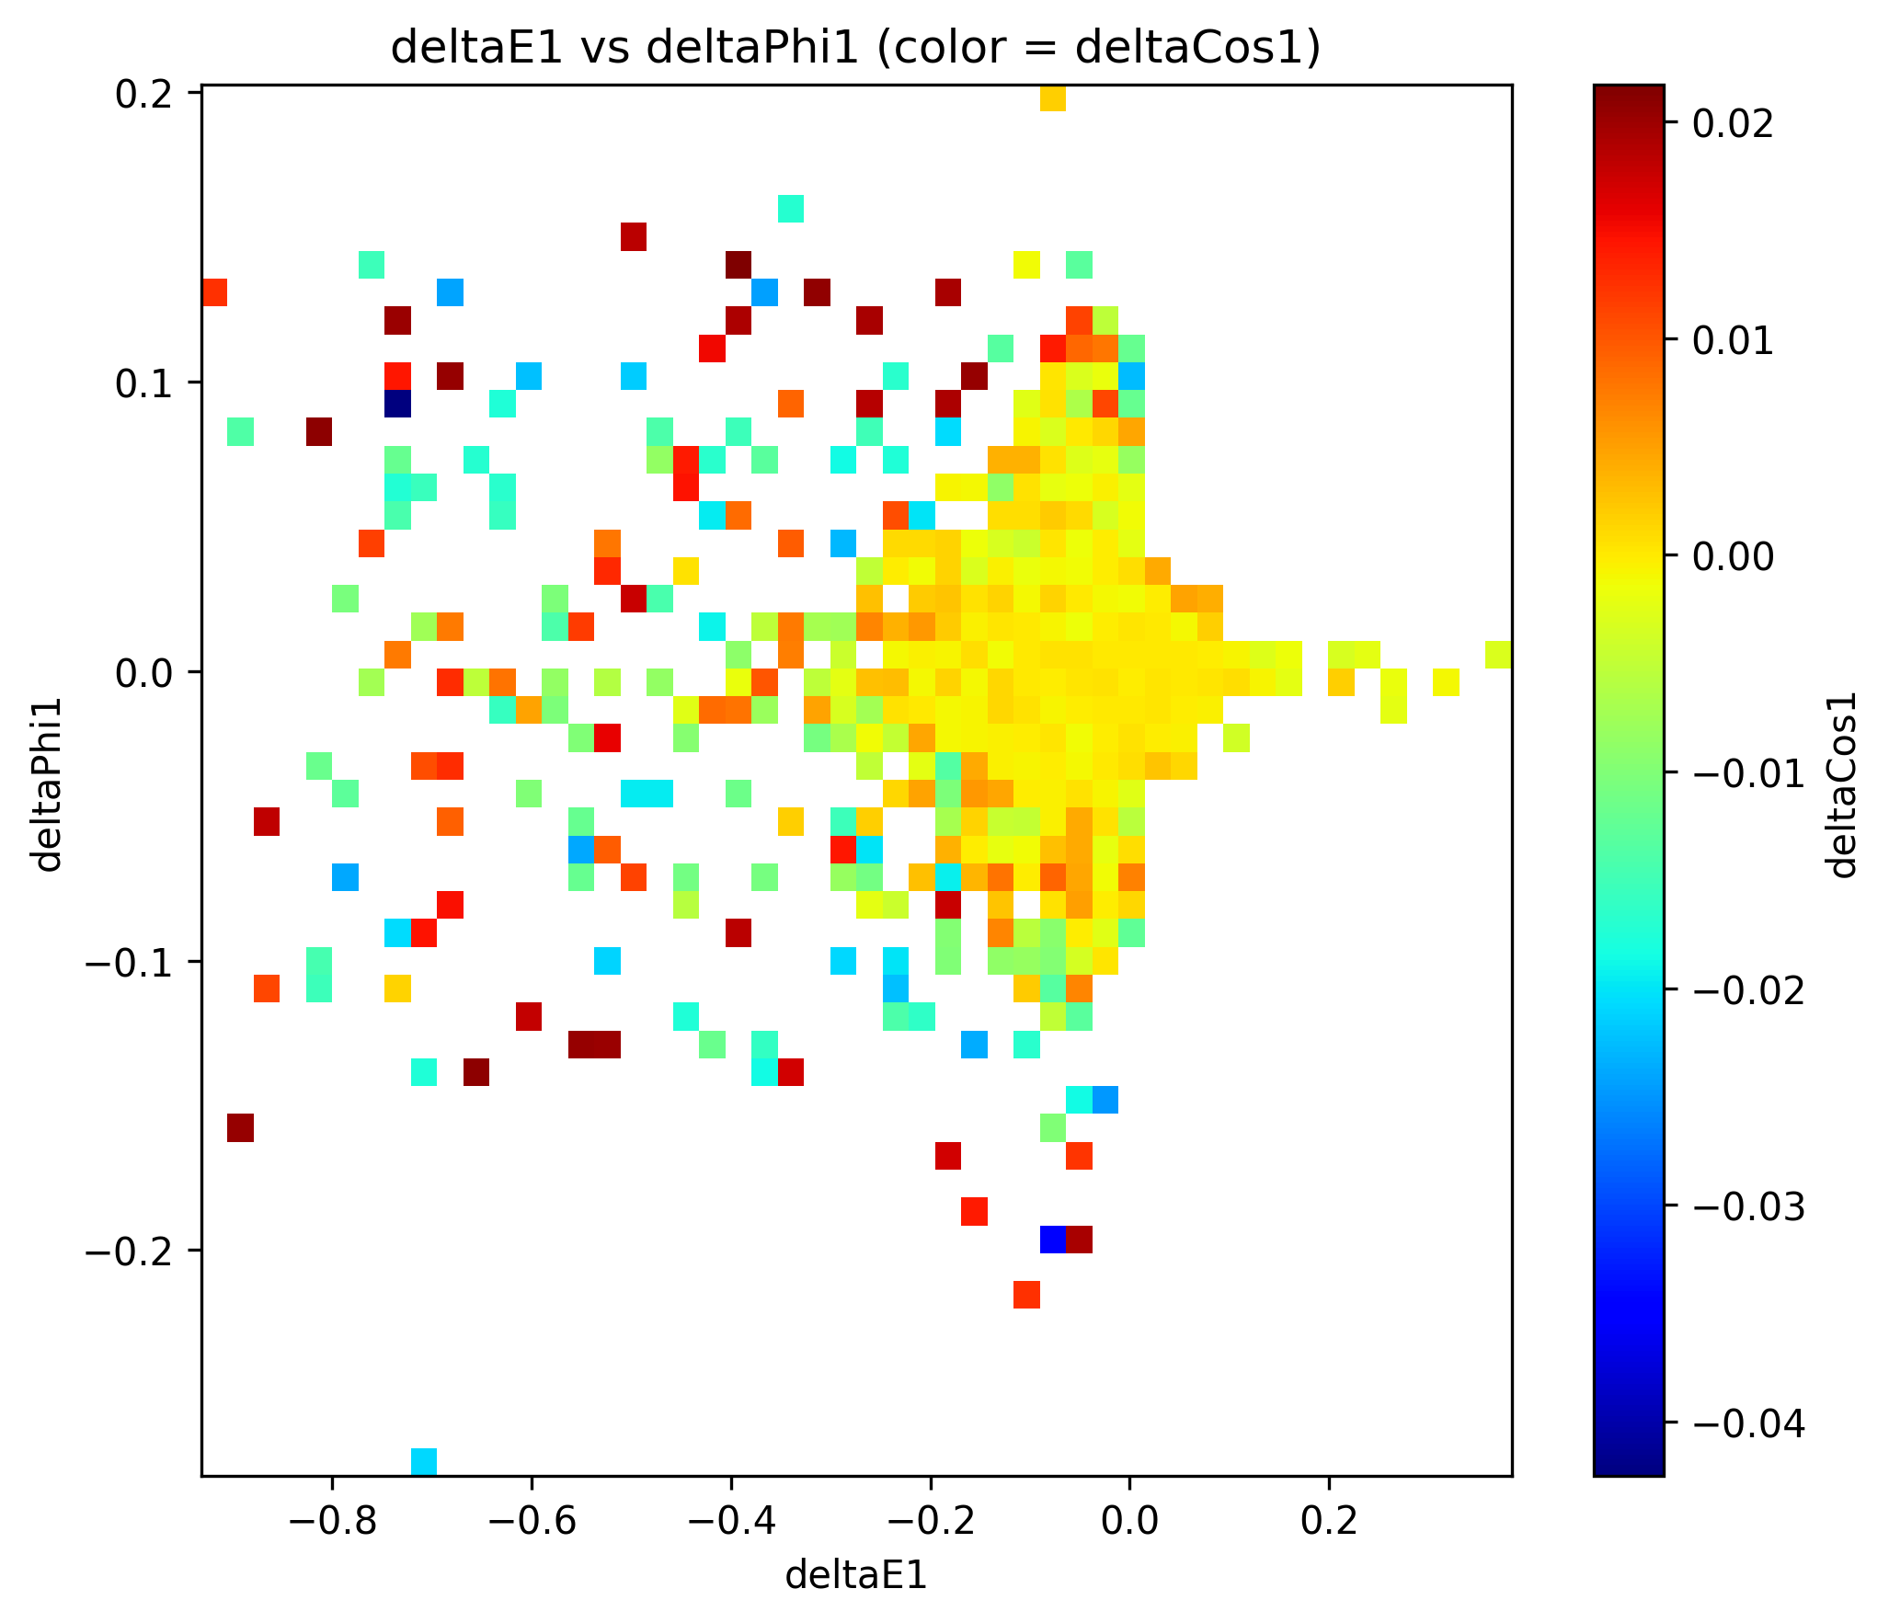
关联关系
deltaPhi，deltaCos的绝对值低的区域，deltaE1也低

Slide 16
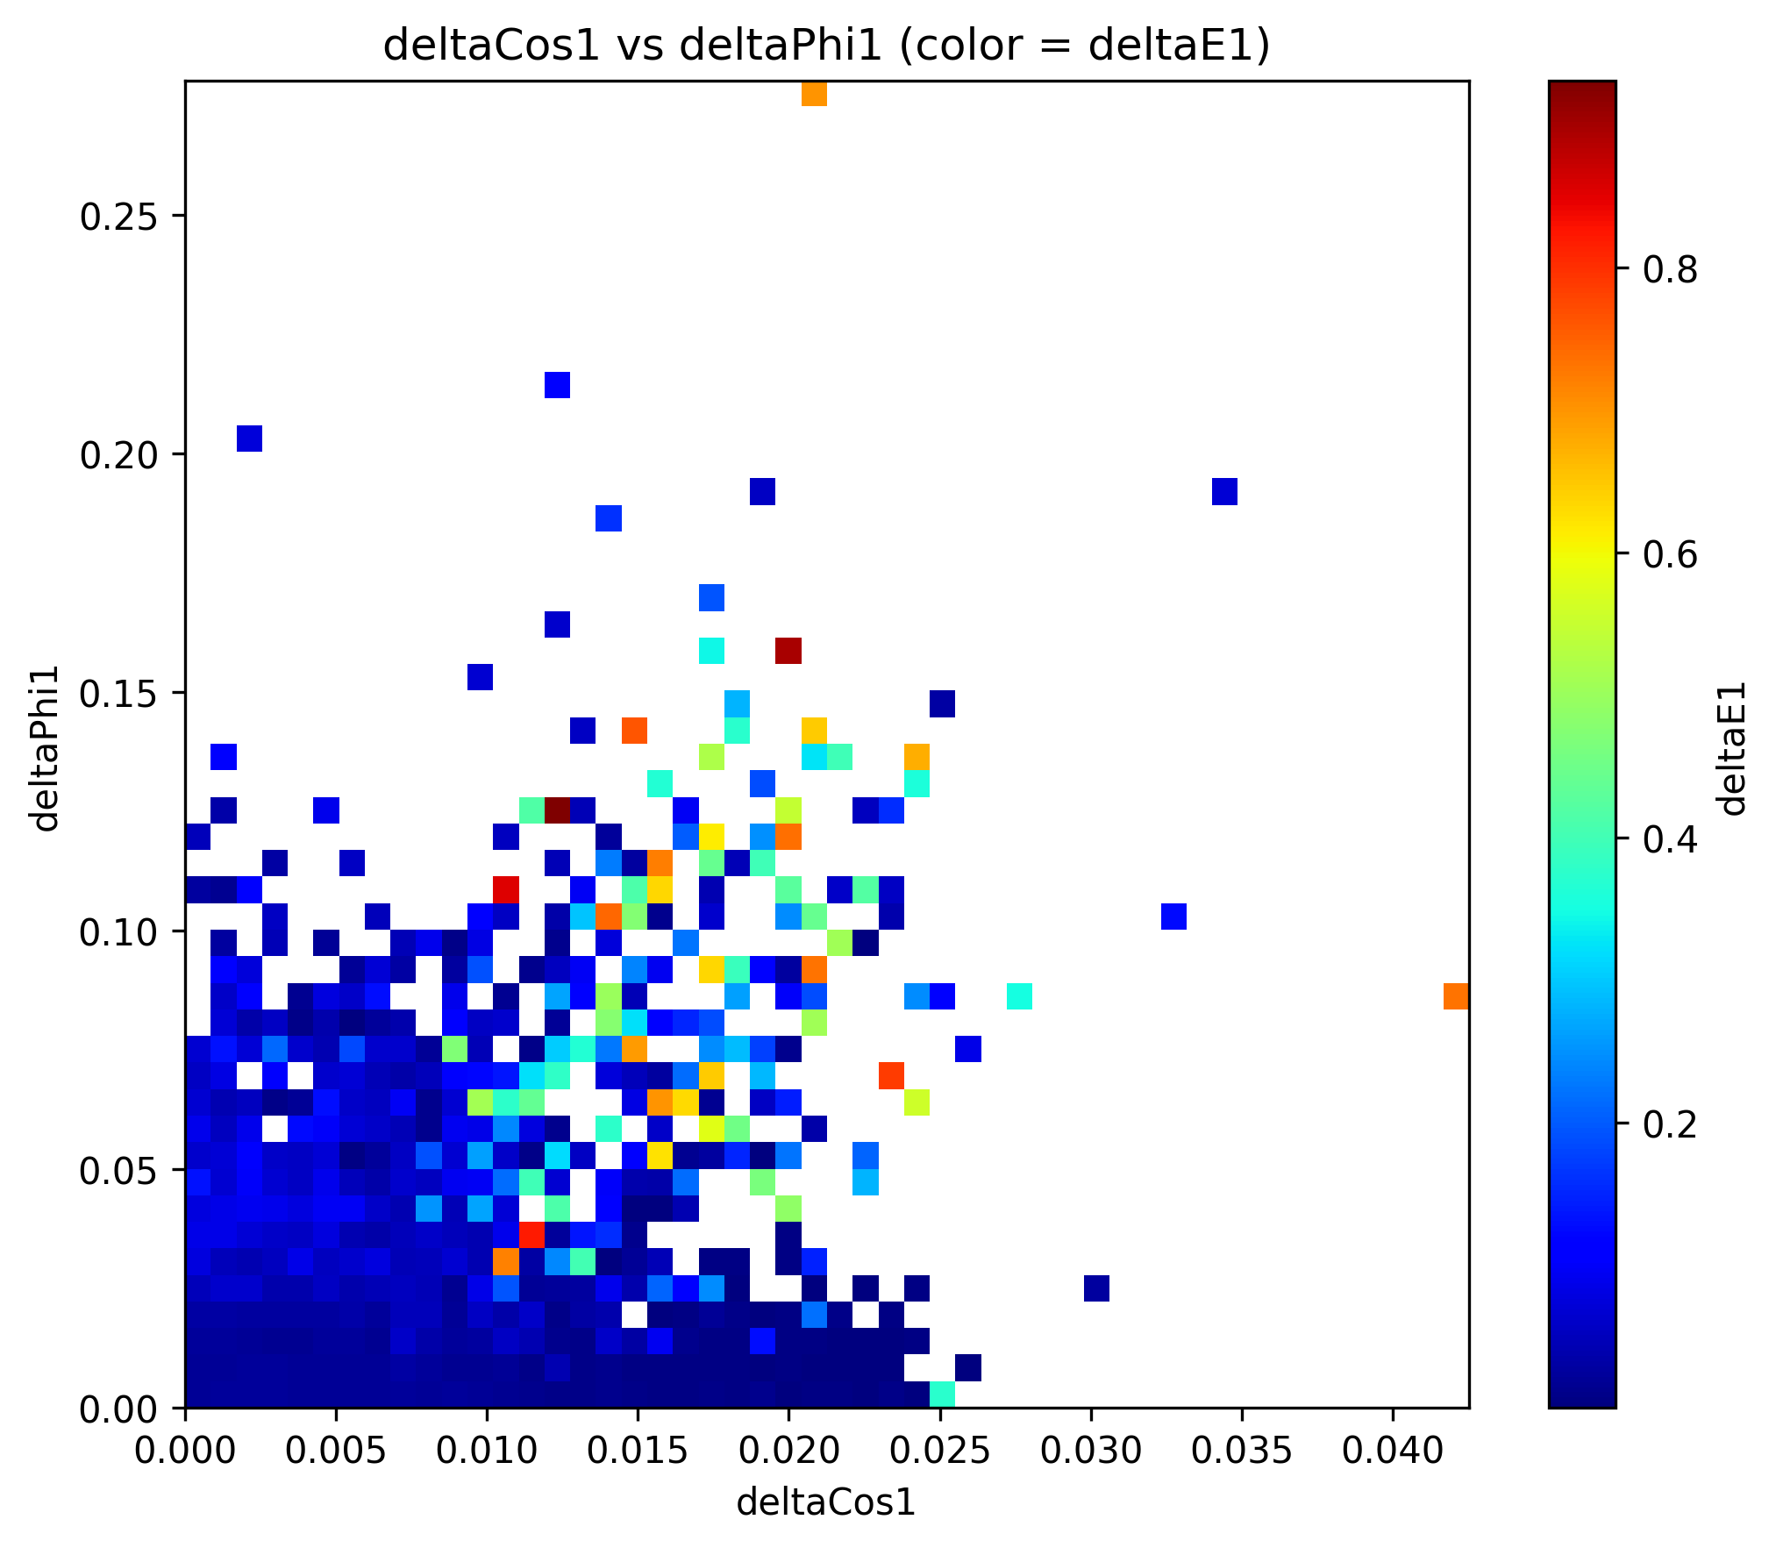
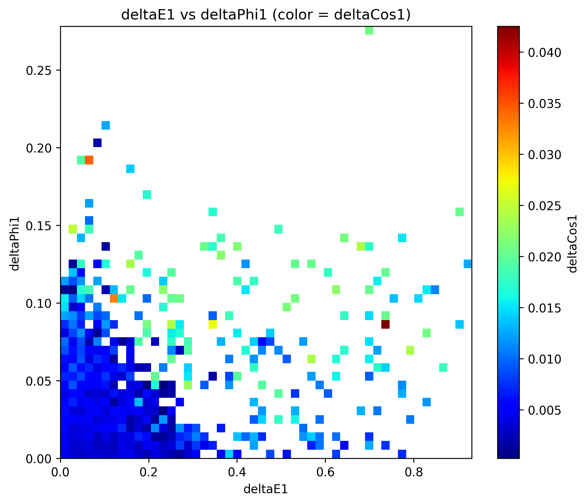
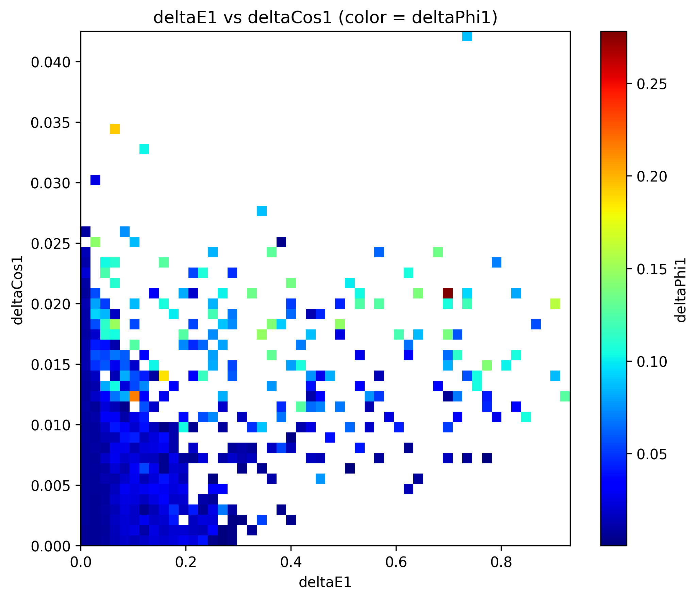
|nrec-truth|

Slide 17
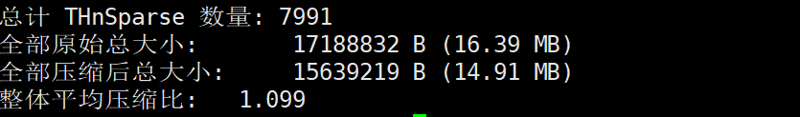
压缩比：1.099
计数量低的bin，存储时坐标轴信息的存储>bin的存储

Slide 18
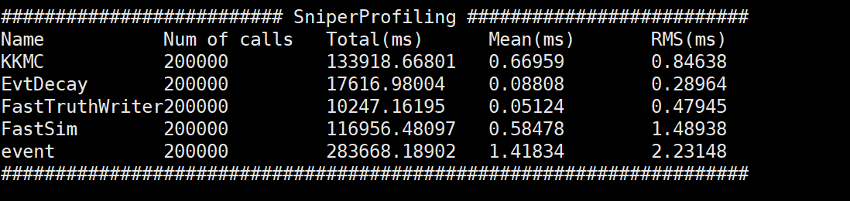
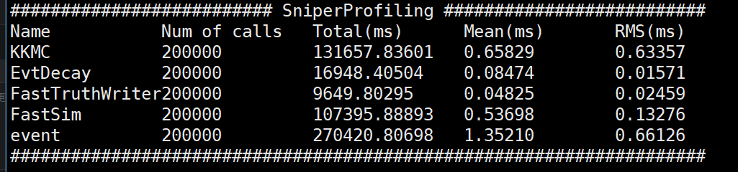
将多维抽样加入FastSim流程中，得到2w rhopi0
无多维抽样
多维抽样
时间反而减少
考虑一次性读取所有bin进入缓存，减少了反复提取的时间

Slide 19
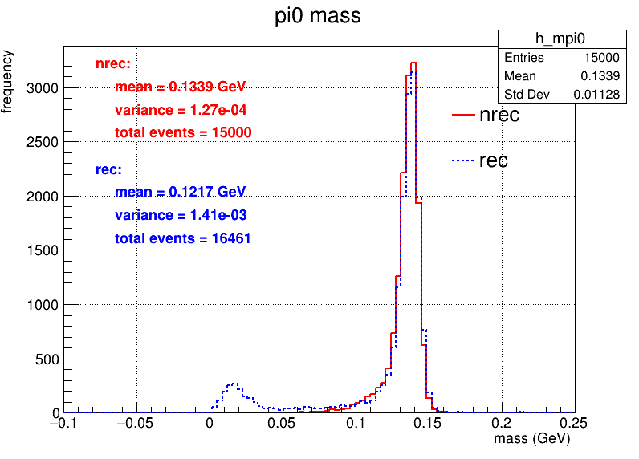
对比1GeV pi->gamma gamma的数据

Slide 20
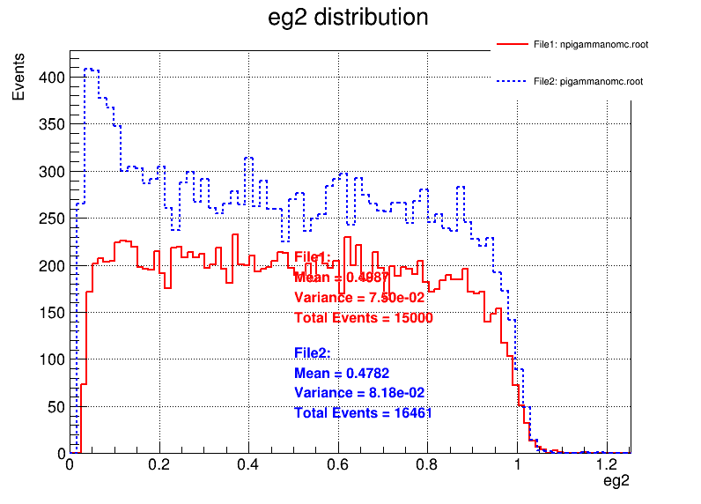
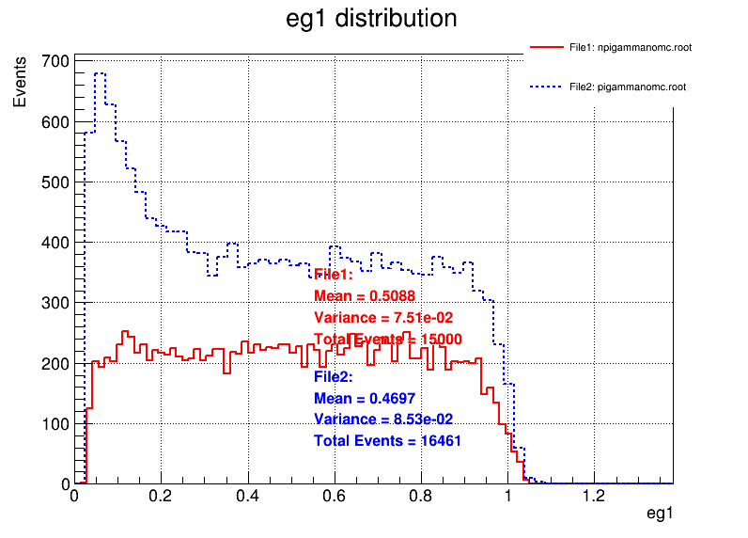
 | 多维抽样 | 相对效率 | 全重建
初始 | 20,000 | 多维抽样 vs 全重建 | 20,000
trackID<0 的数量大于等于2 | 15056 | 75.28% vs 88.43% | 17687
cut角度和能量 | 15000 | 99.6% vs 93% | 16461
低动量和大角度的光子n维抽样
红色：多维抽样
蓝色：全重建

Slide 21
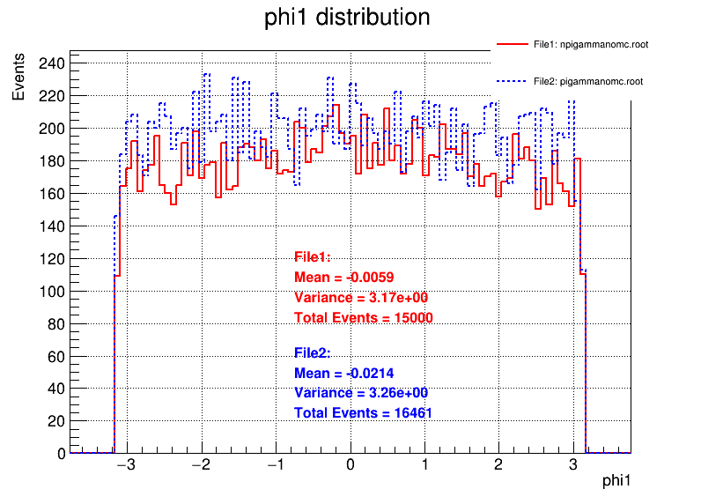
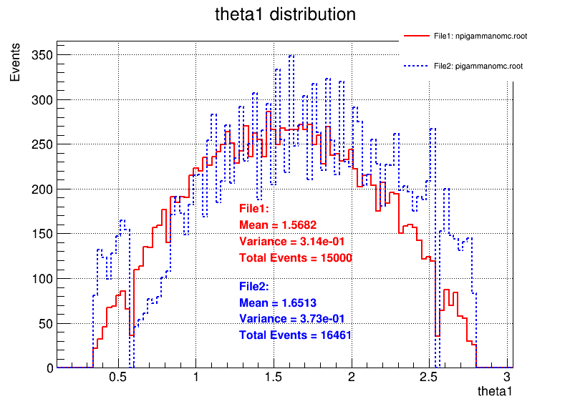

Slide 22
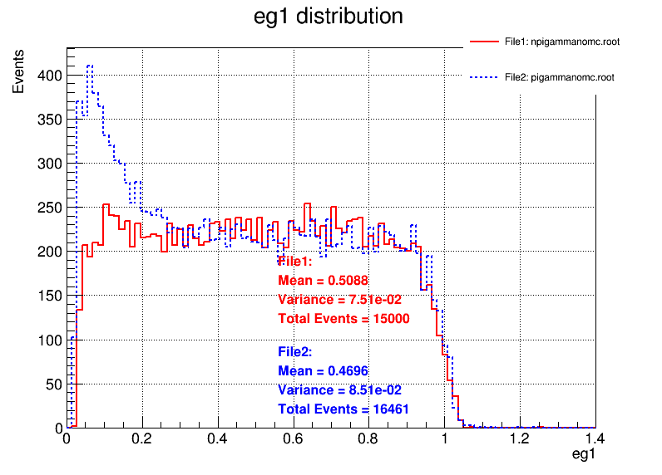
重建光子：全重建比多维抽样多一部分低能量光子

Slide 23
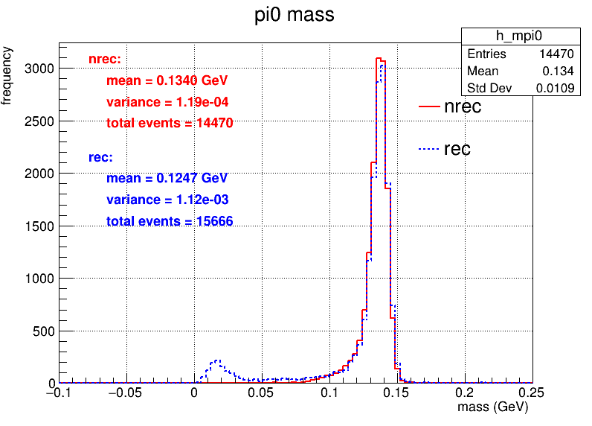
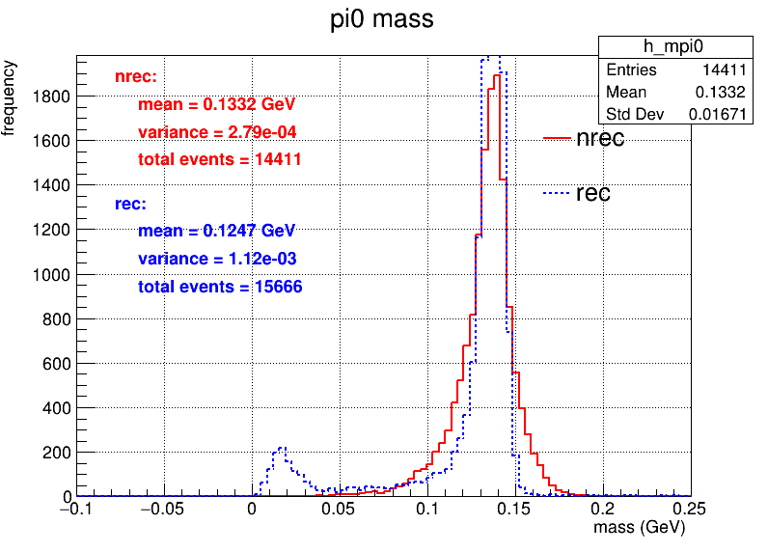
对于mpi0<0.05GeV
pdf绘制时出现的极端值过滤，去除前1%和后1%的数据
无去除
多维抽样中的数据
添加cut 光子能量>0.05GeV

Slide 24
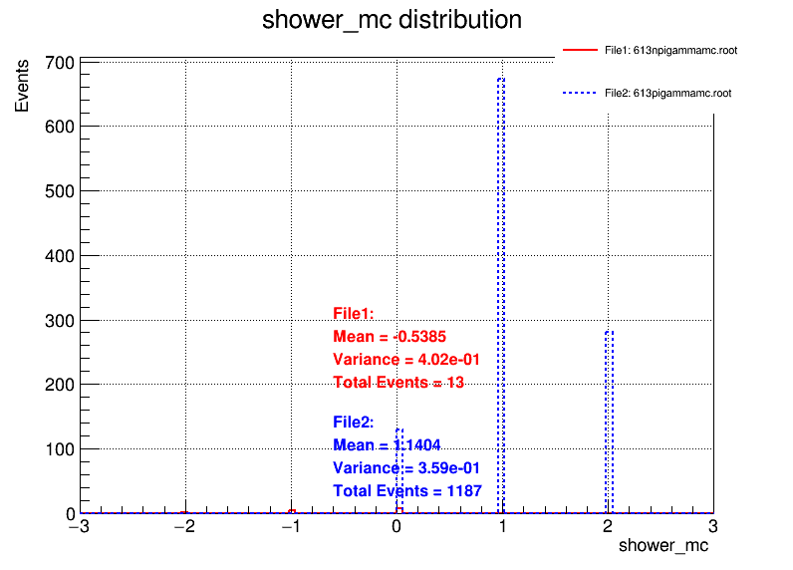
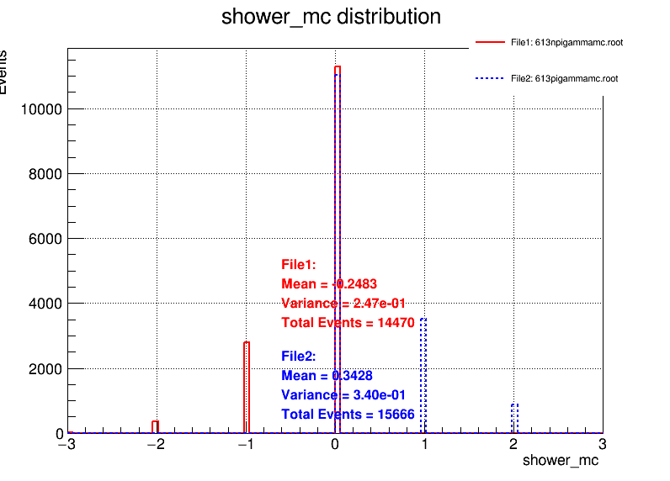
考虑是否是一个光子重建出来两个Shower
统计事例中MCParticle中光子数量，和ECALShower中光子的数量，用 shower-MC
全部事例
mpi0<0.05

Slide 25
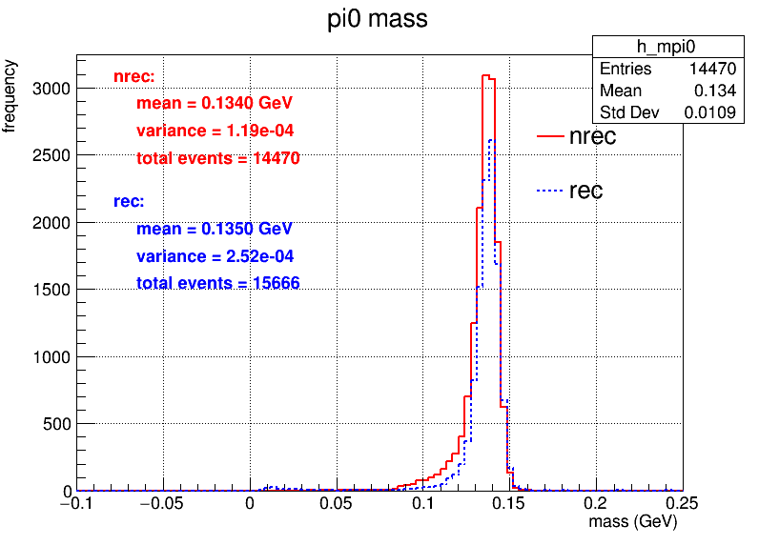
剔除show-MC>0的事例
m_pi0<0.05GeV->全重建过程中hit聚类导致一个光子重建出低能量光子，和一个高能光子

Slide 26

重新统计和绘制多维抽样pi0的直方图
 | 多维抽样 | 全重建 | 相对效率 | 绝对效率
初始 | 20,000 | 20,000 | 多维抽样 vs 全重建 | 多维抽样 vs 全重建
trackID<0 的数量大于等于2 | 14972 | 17687 | 74.86%vs88.43% | 74.86%vs88.43%
cut角度和能量 | 14918 | 16461 | 99.63% vs 93% | 74.59%vs82.3%
pi0>0.05 | 14902 | 14782 | 99.89%vs 89.8% | 74.51%vs 73.91%

Slide 27



Slide 28
6.23

Slide 29

0.1GeV
 | 多维抽样 | 全重建 | 相对效率 | 绝对效率
初始 | 20,000 | 20,000 | 多维抽样 vs 全重建 | 多维抽样 vs 全重建
trackID<0 的数量大于等于2 | 12588 | 15518 | 62.94%vs77.59% | 62.94%vs77.59%
cut角度和能量 | 12542 | 13544 | 99.63% vs 87.27% | 62.71%vs67.72%
pi0>0.05 | 12542 | 13371 | 99.89%vs 98% | 62.71%vs 66.85%

Slide 30

0.2GeV
 | 多维抽样 | 全重建 | 相对效率 | 绝对效率
初始 | 20,000 | 20,000 | 多维抽样 vs 全重建 | 多维抽样 vs 全重建
trackID<0 的数量大于等于2 | 12151 | 16123 | 60.75%vs80.62% | 60.75%vs80.62%
cut角度和能量 | 12094 | 14060 | 99.53% vs 87.2% | 60.47%vs70.3%
pi0>0.05 | 12093 | 13399 | 99.99%vs 95.3% | 60.47%vs 67%

Slide 31

0.5GeV
 | 多维抽样 | 全重建 | 相对效率 | 绝对效率
初始 | 20,000 | 20,000 | 多维抽样 vs 全重建 | 多维抽样 vs 全重建
trackID<0 的数量大于等于2 | 13688 | 17090 | 68.44%vs85.45% | 68.44%vs85.45%
cut角度和能量 | 13624 | 15474 | 99.53% vs 90.54% | 68.12%vs77.37%
pi0>0.05 | 13623 | 14081 | 99.99%vs 91% | 68.11%vs70.41%

Slide 32

1.5GeV
 | 多维抽样 | 全重建 | 相对效率 | 绝对效率
初始 | 20,000 | 20,000 | 多维抽样 vs 全重建 | 多维抽样 vs 全重建
trackID<0 的数量大于等于2 | 15488 | 17996 | 77.44%vs89.98% | 77.44%vs89.98%
cut角度和能量 | 15434 | 17010 | 99.65% vs 85.05% | 77.17%vs85.05%
pi0>0.05 | 15400 | 15308 | 99.78%vs 90% | 77%vs 76.54%

Slide 33

2GeV
 | 多维抽样 | 全重建 | 相对效率 | 绝对效率
初始 | 20,000 | 20,000 | 多维抽样 vs 全重建 | 多维抽样 vs 全重建
trackID<0 的数量大于等于2 | 15689 | 18092 | 78.45%vs90.46% | 78.45%vs90.46%
cut角度和能量 | 15621 | 17230 | 99.57% vs 95.23% | 78.11%vs86.15%
pi0>0.05 | 15583 | 15576 | 99.75%vs 90.4% | 77.92%vs 77.88%

