Slide 1
Magnetic Flux Concentrator Strengthened Magnetometer
Beige Liu
Academician Research Station Monthly meeting
2026/07/06

Slide 2
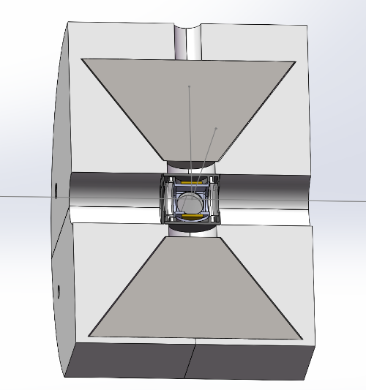
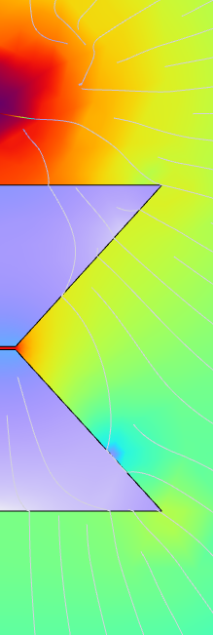
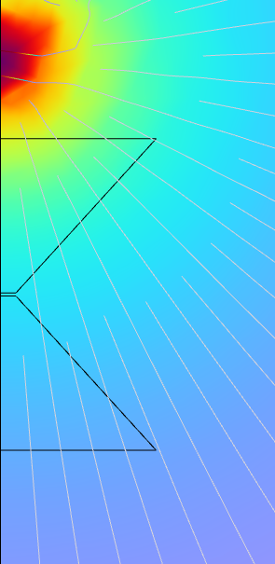


Magnetic Flux Concentrator (MFC)
Air-Core Coil coupling Magnetometer
Iron-Core Coil coupling Magnetometer
Magnetometer Direct Detection
MM
MM
Design
Iron Core
MM
$$I$$
Rb chamber
$$I$$
Rb chamber
Rb chamber
Limitations
Thermal noise of the coils
No net magnetic flux strengthen
Tiny sensing volume (r~1cm)
MFC strengthened Magnetometer
High-permeability materials can gather magnetic flux from magnetic monopoles and amplify their magnetic field at the magnetometer.
Proposal
Where we put the magnetometer

Slide 3
Outline of the report
Simulation of the MFC & magnetometer
Signal & Noise Tests of MFC & magnetometers
Miniaturized heating chamber
MFC & magnetometer sensitivity monitoring
Gain measurement

Slide 4
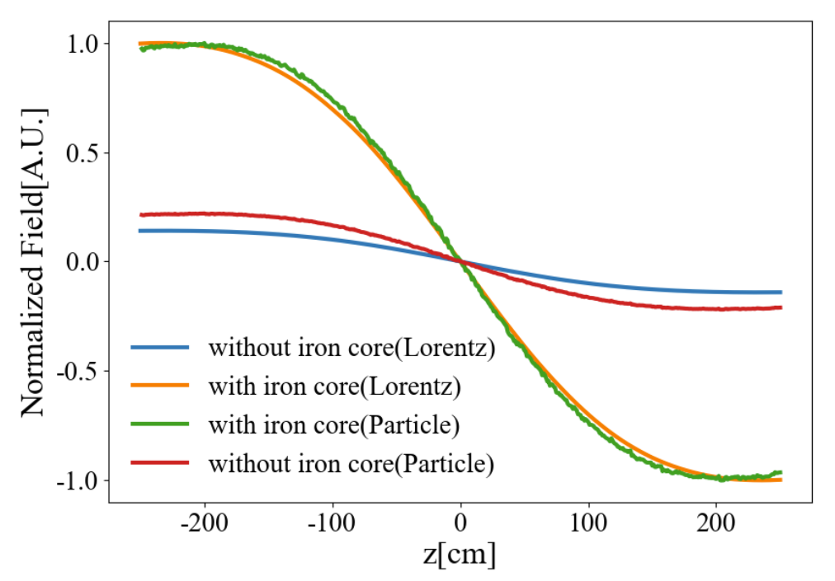
MFC simulation
Simulation Framework
COMSOL
H-map
Simulated typical magnetic field waveform. Incident $r\sim 1m$
Direct Simulation
Lorentz reciprocity theorem
Faraday’s law
B field
Induction
Magnetometer Simulation
Optimal filter

Slide 5
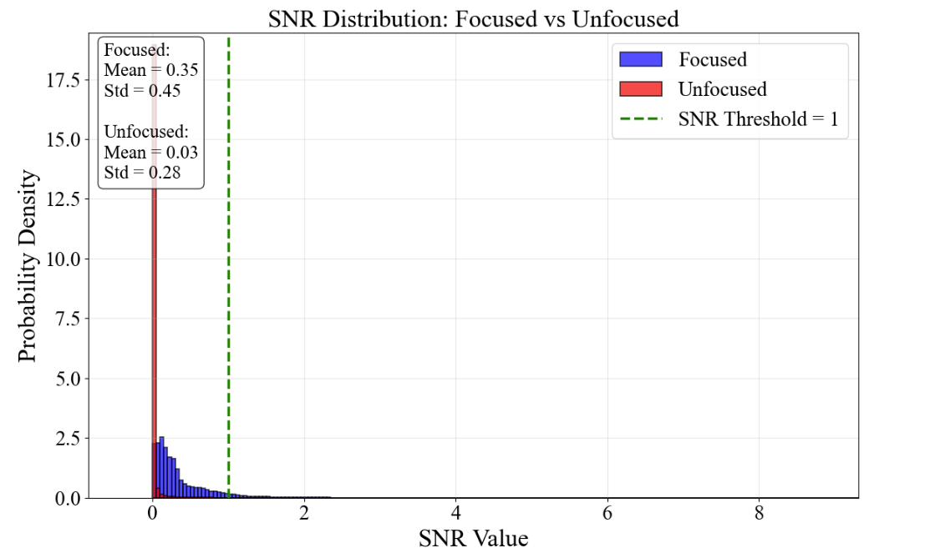
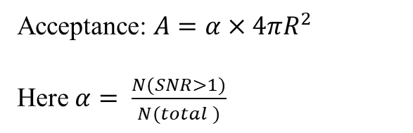
Acceptance strengthen of MFC
Isotropic toy Monte Carlo
Isotropic source
Detector
R
Acceptance: $A=α×4πR^{2}$
Here $α= \frac{N(SNR>1)}{N(total )}$
Without MFCs, $A\sim {\text{15.9}\text{cm}}^{2}sr$, For a benchmark MFC, $A\sim {\text{280.0 }\text{cm}}^{2}sr$ ( $β\sim 1e^{−6}$)

Slide 6
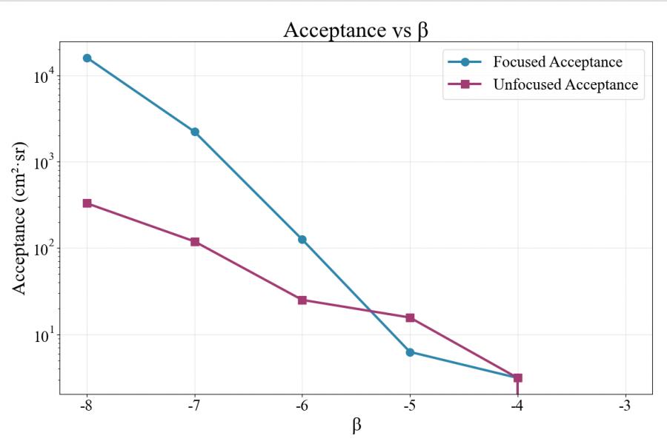
MFC simulation
Acceptance for different speed of MM： cover low β regime
The lower the velocity of magnetic monopoles, the greater the energy they accumulate at the magnetometer.
Ignored the decrease in magnetometer sensitivity at low frequencies .
Relaxation effect of MFC are not taken into account.

Slide 7
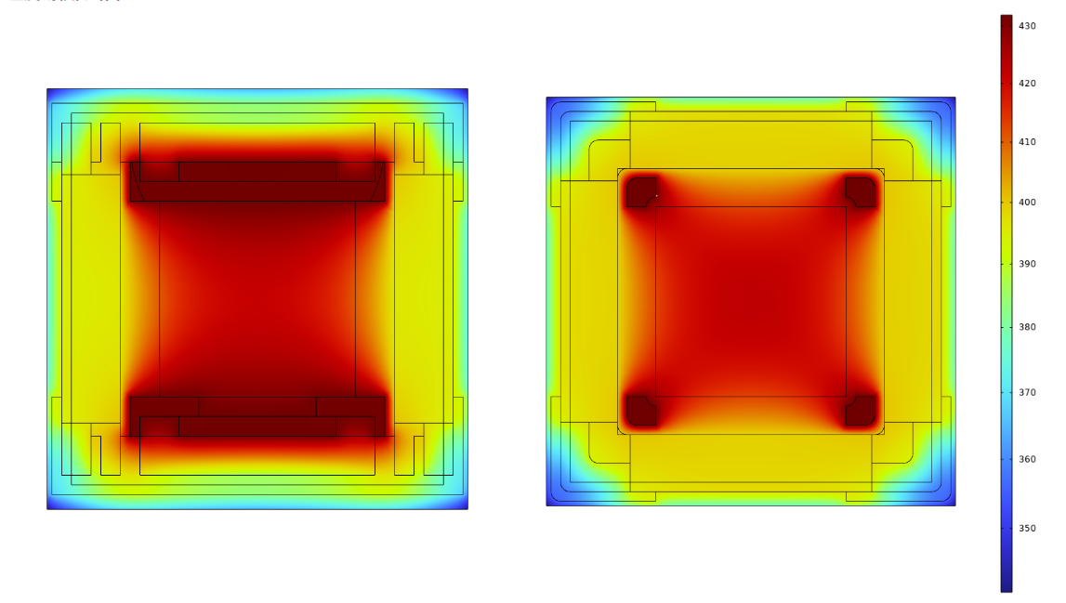
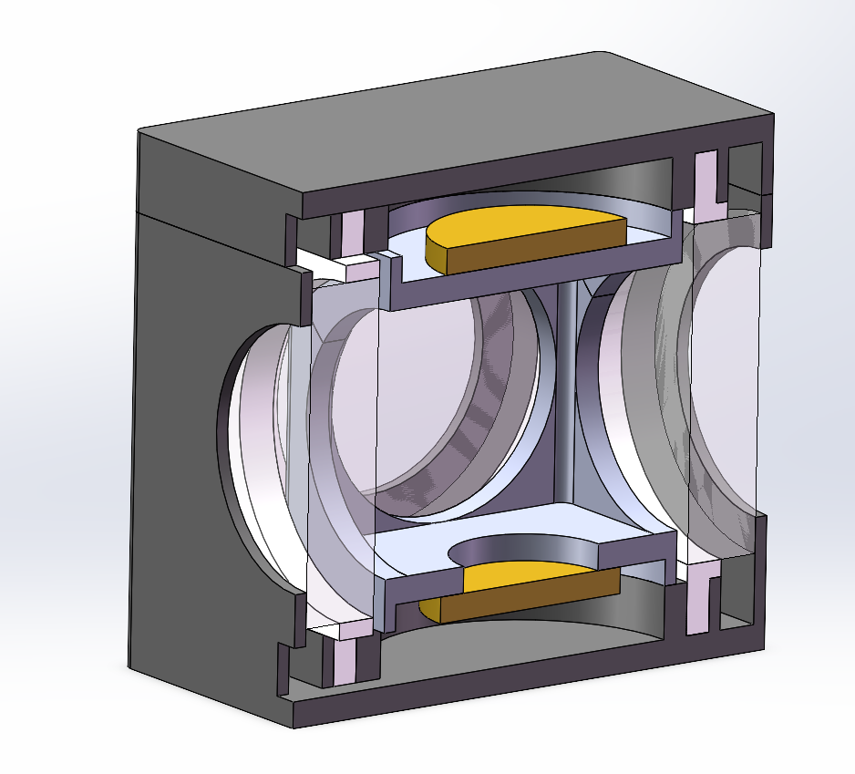
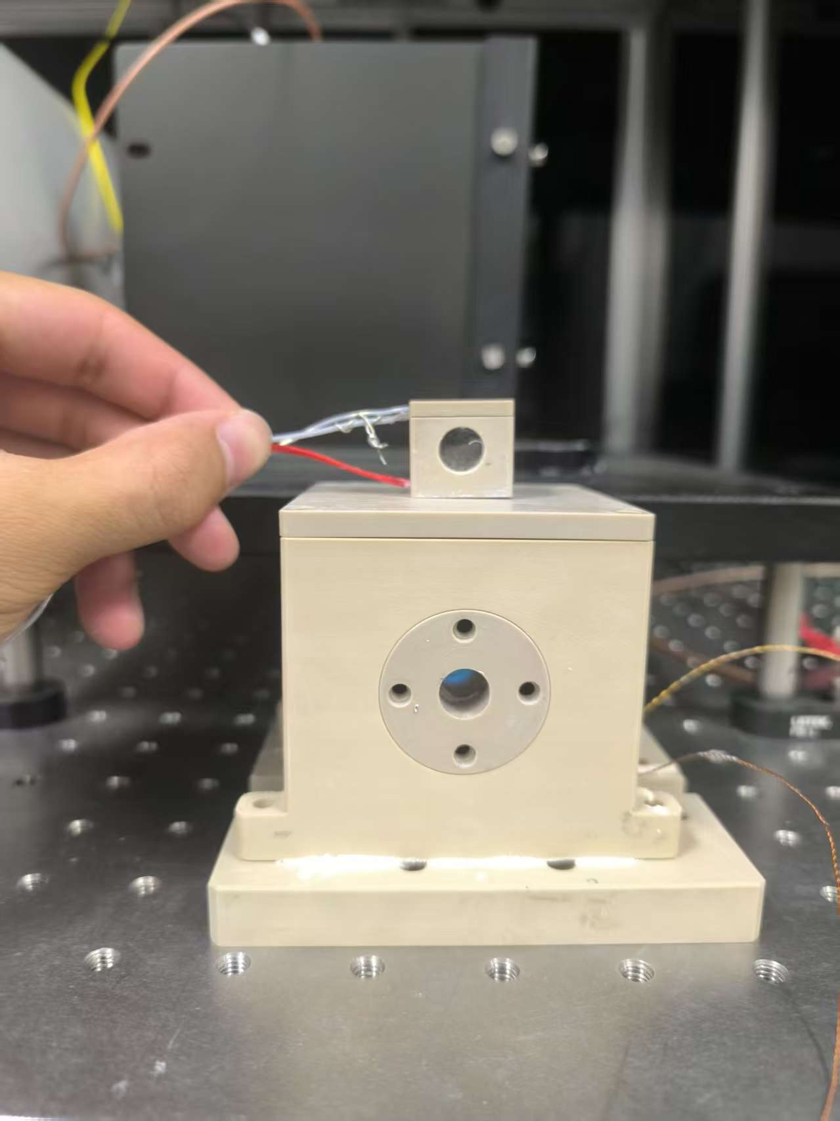
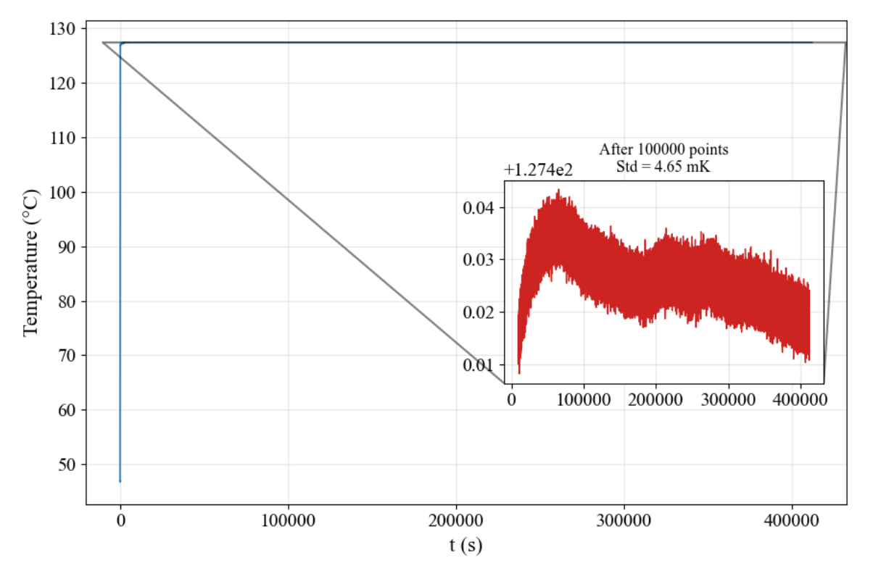
Miniaturized heating chamber
Design of miniaturized heating chamber
Simulated temperature gradient ~5%,$T_{2}$ decline ~1%
2cm
Heating test: temperature control stability ~5mK @ 127°C
Inner core: boron nitride thermal conductive
outer layer: PEEK thermal insulation
dual-terminal resistance heating

Slide 8
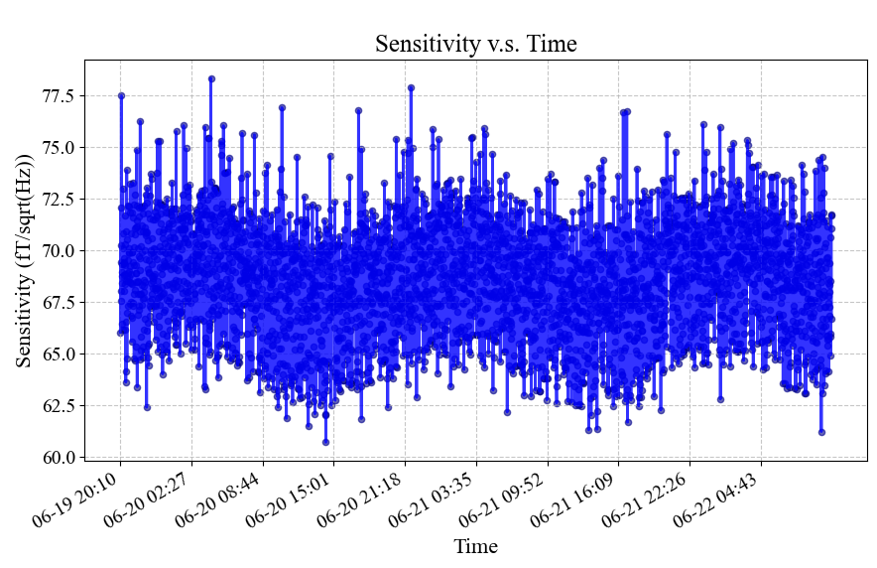
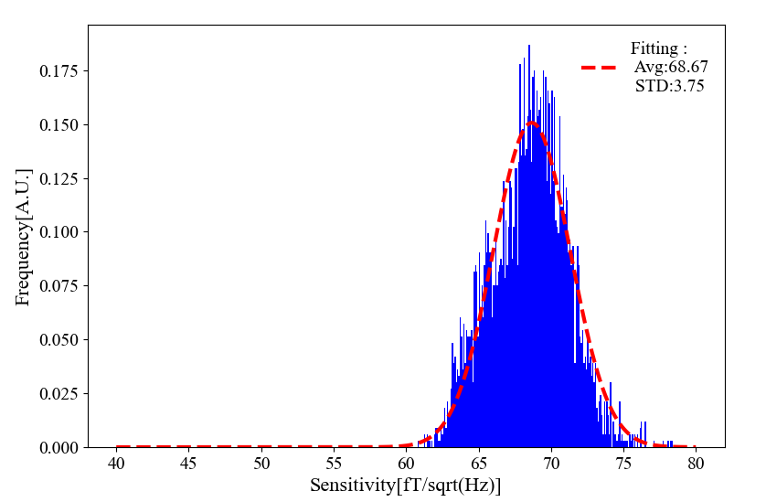
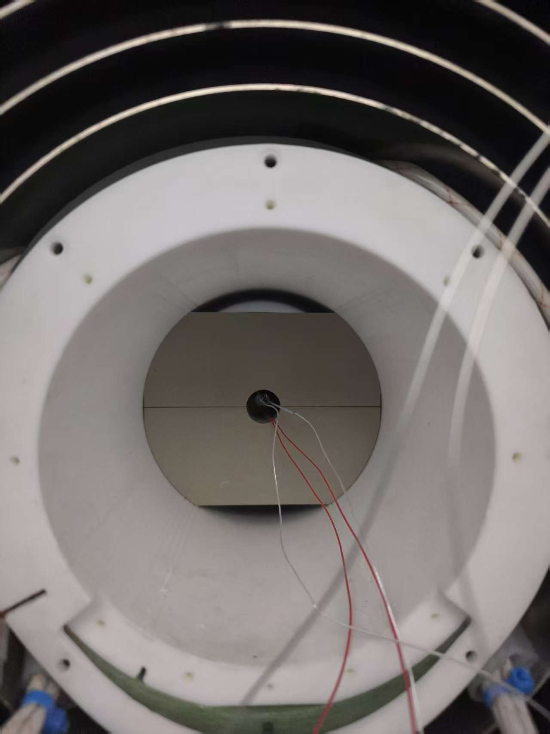
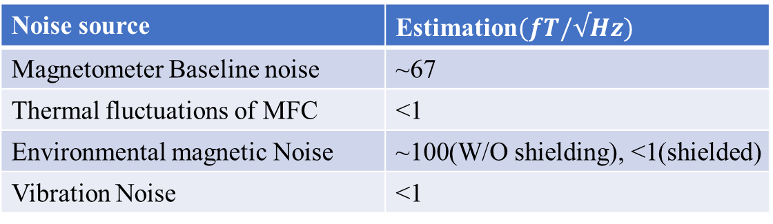

Magnetometer sensitivity estimation & Tests
Estimated Sensitivity ~ 67$\left(\frac{fT}{\sqrt{Hz}}\right)$
Noise source | Estimation$(fT/√Hz)$
Magnetometer Baseline noise | ~67
Thermal fluctuations of MFC | <1
Environmental magnetic Noise | ~100(W/O shielding), <1(shielded)
Vibration Noise | <1
Tested Sensitivity ~ 68.67$\left(\frac{fT}{\sqrt{Hz}}\right)±3.75$ (3-day continuous monitoring)

Slide 9
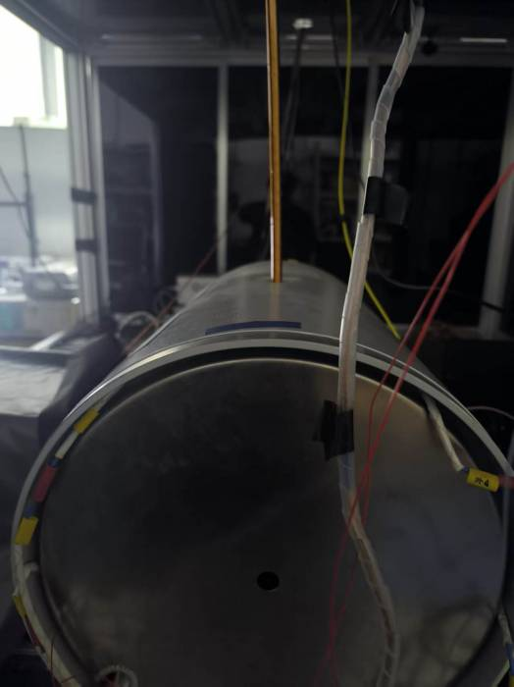
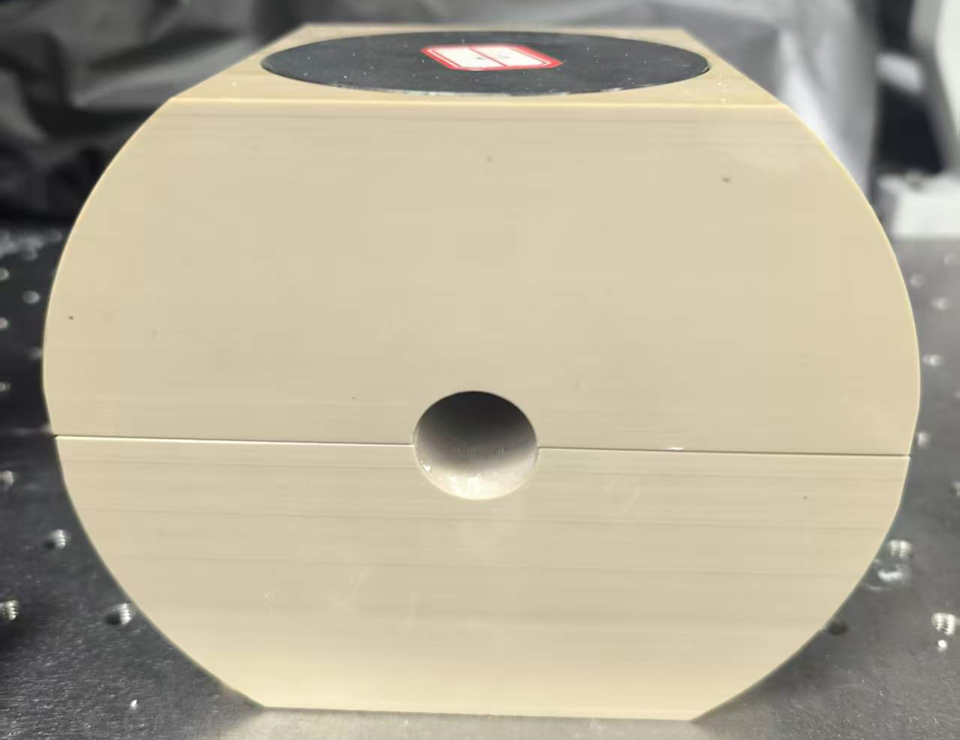
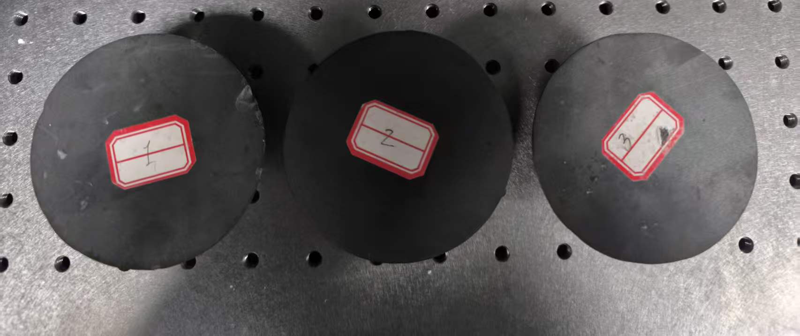
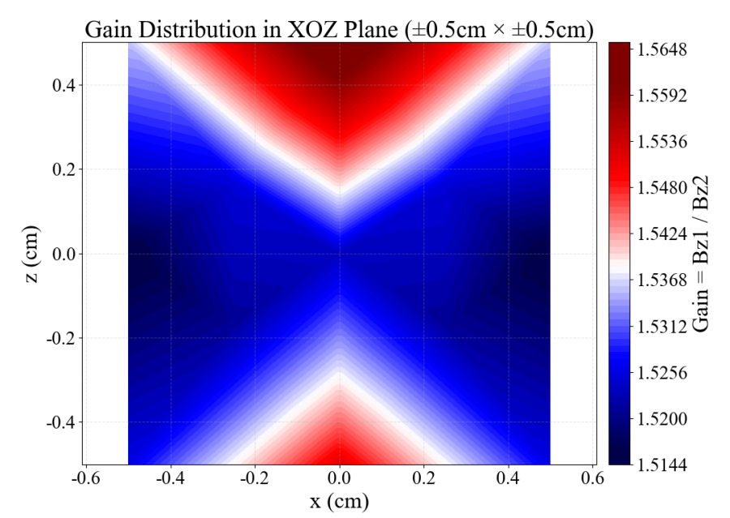
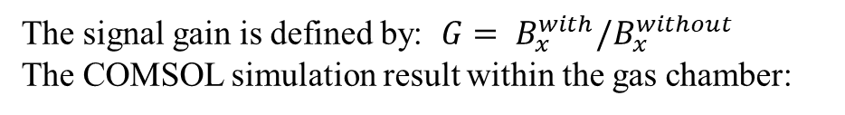
Simulated MM signal Tests
Case | Sample 1&2 | Sample 2&3 | Sample 1&3
Simulation | 1.54 | 1.54 | 1.54
Measurement | 1.42±0.24 | 0.84±0.21 | 0.91±0.23
The signal gain is defined by: ${G= B}_{x}^{with}/B_{x}^{without}$
The COMSOL simulation result within the gas chamber:

Slide 10
Conclusions
Conclusions:
MFC efficiently collects magnetic monopole magnetic induction lines, greatly expanding the sensitive volume range of magnetometers
Preliminary noise and signal tests verify the rationality of this model, which is worthy of in-depth research.
Todo：
Establish a comprehensive model incorporating low-frequency sensitivity degradation of magnetometers and MFC relaxation effects to improve model reliability
Propose optimization strategies based on current models to further enlarge sensitive volume.
Integrate schemes and add square-meter prototype test modules.

