Slide 1


阻尼扭摆磁铁的同步辐射分布
李航洲
2026.06.18

Slide 2

提纲
DW基本参数与布局
单个DW功率分布
一对DW功率分布
DW直线段功率分布
总结

Slide 3
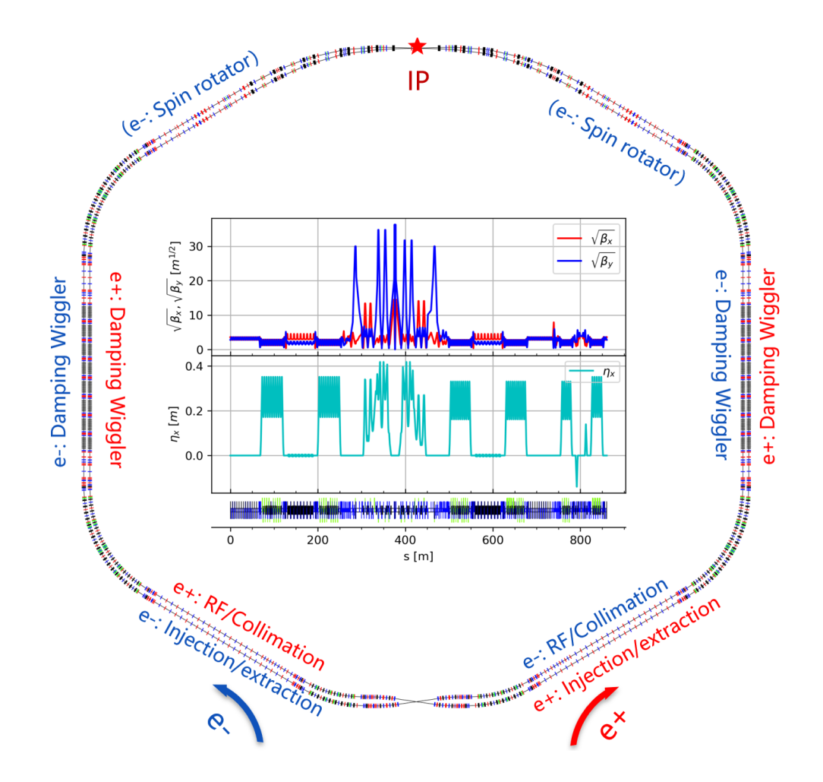
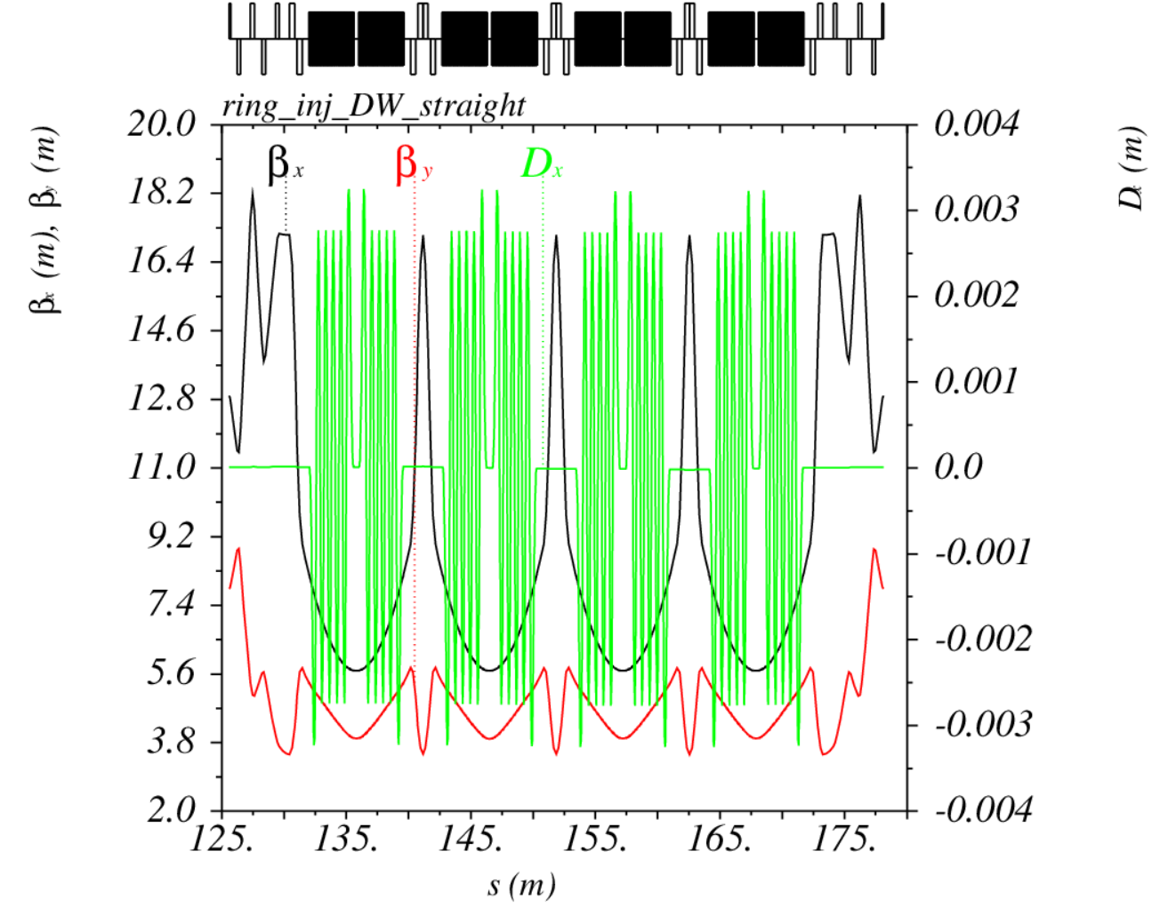
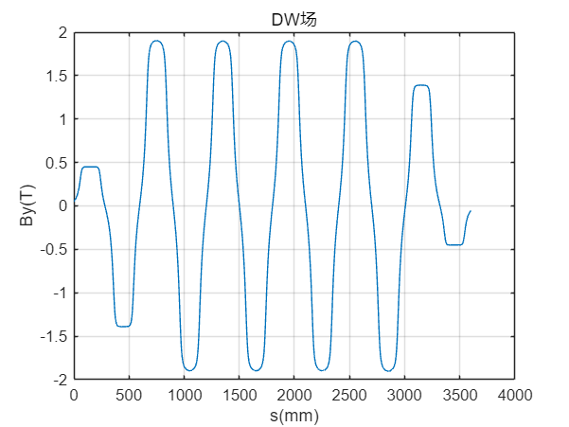
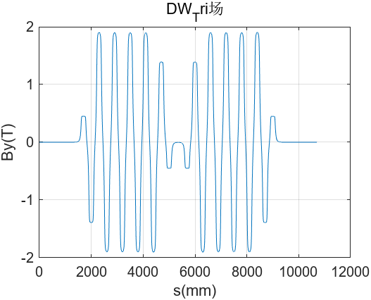
DW基本参数与布局
单个DW磁铁参数
峰值磁场1.9T
周期长度600mm
周期个数6
长度3.6m
STCF对撞环的布局和光学函数
单个DW磁场分布
一对DW磁场分布

Slide 4
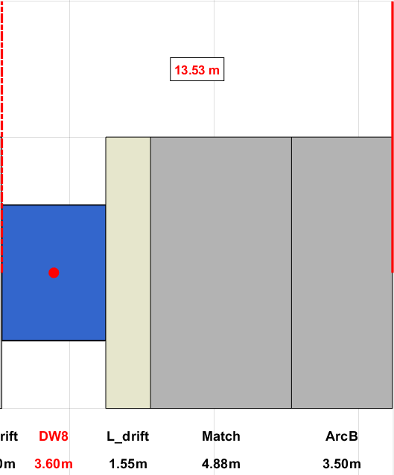
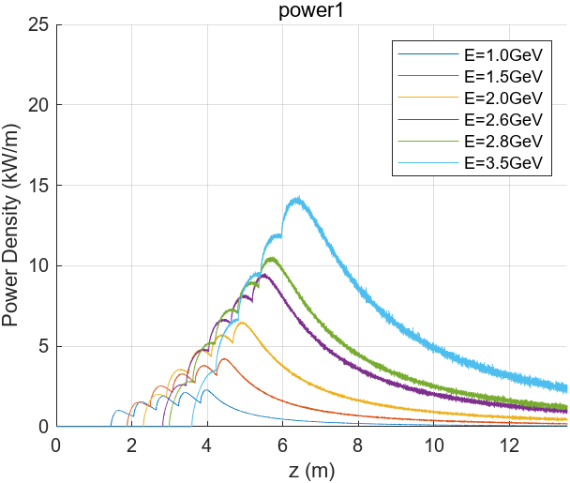
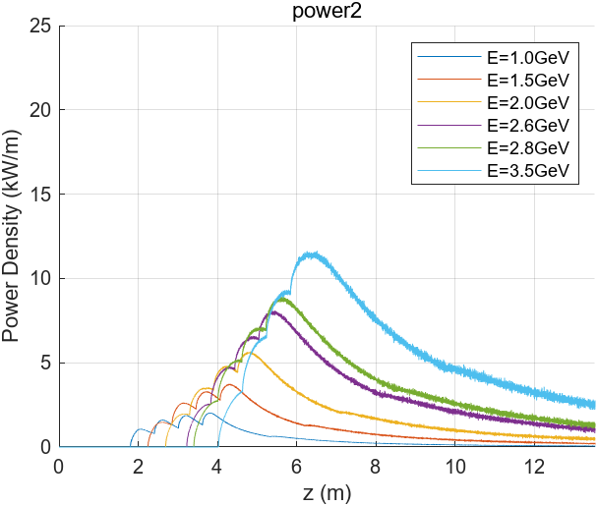
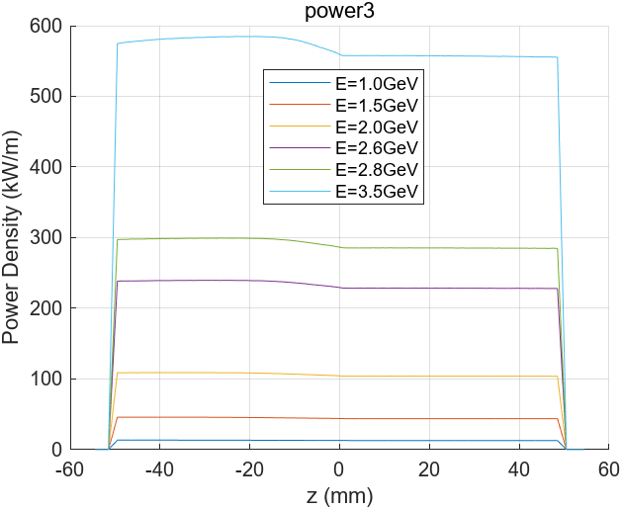
单个DW功率线密度
power1
power3
power2
考虑最后一块DW
DW入口到ARC第一块B铁前（ power3 面）13.53m
power1、2面距离光轴50mm
 | 1GeV | 1.5GeV | 2GeV | 2.6GeV | 2.8GeV | 3.5GeV
power1(kW) | 7.00 | 15.03 | 25.42 | 40.32 | 45.74 | 65.91
power2(kW) | 6.22 | 13.23 | 22.16 | 34.69 | 39.17 | 55.43
power3(kW) | 1.32 | 4.47 | 10.61 | 23.32 | 29.12 | 56.84
power_all(kW) | 14.55 | 32.73 | 58.18 | 98.33 | 114.03 | 178.18
power_3/power_all | 9.08% | 13.66% | 18.23% | 23.72% | 25.54% | 31.90%

Slide 5
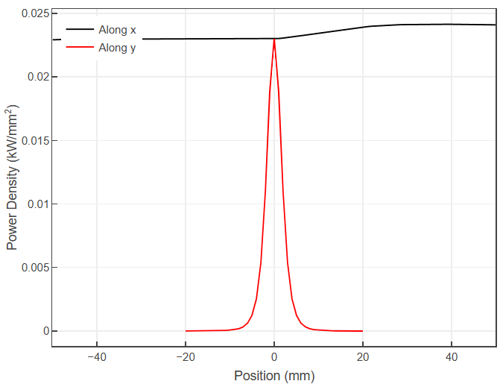
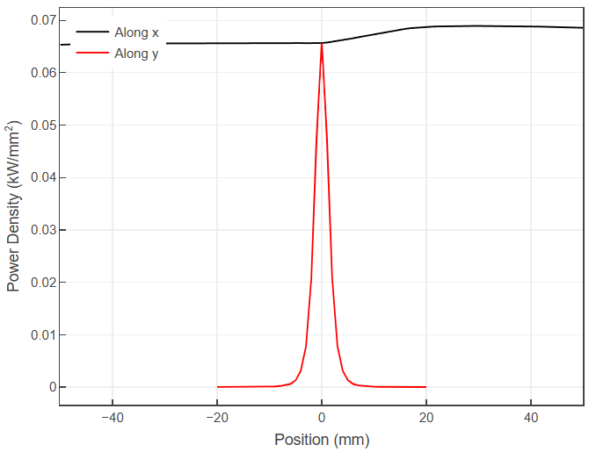
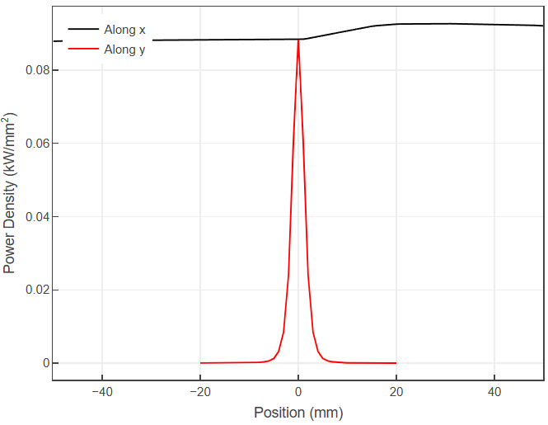
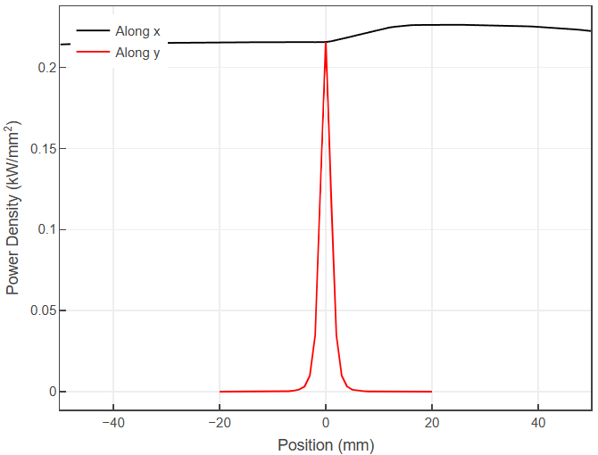
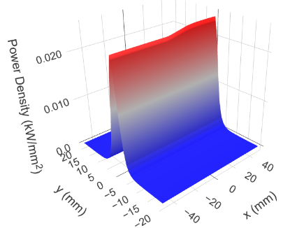
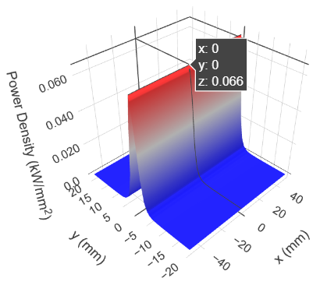
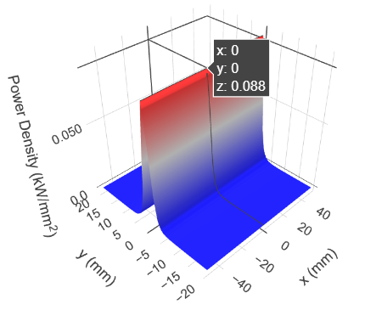

最后一块DW出口接收面功率分布
接收面取管道孔径水平[-50,50]mm，垂直[-20,20]mm
2GeV
2.6GeV
2.8GeV
3.5GeV

Slide 6
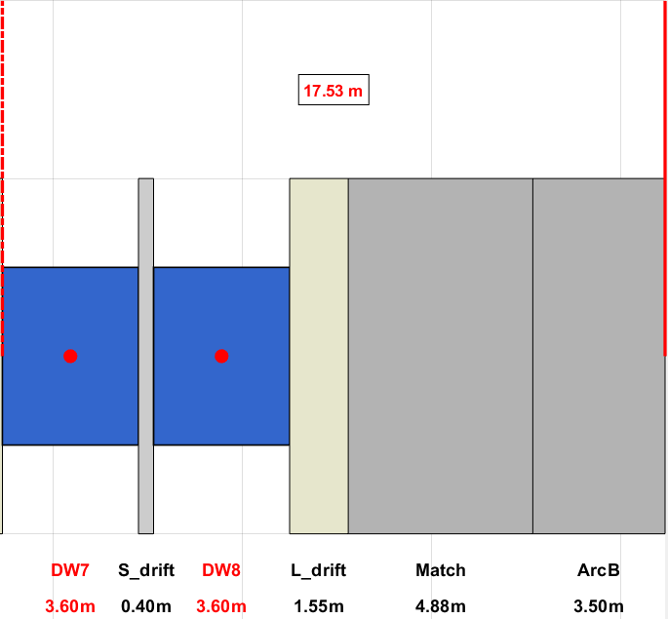
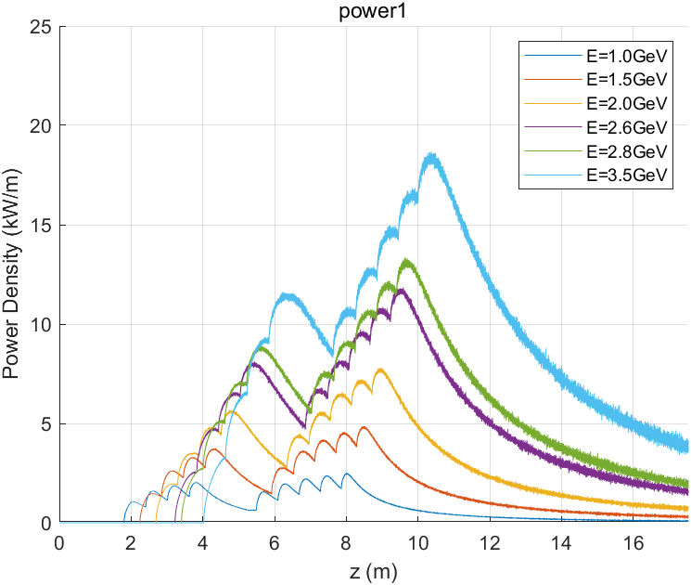
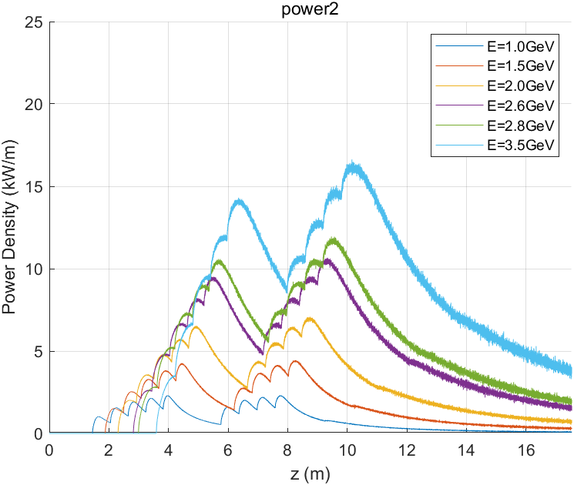
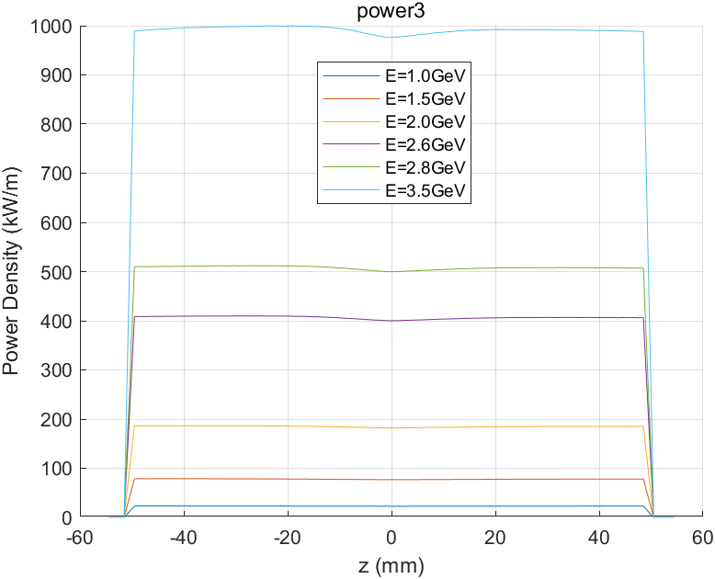
一对DW功率线密度
power1
power3
power2
考虑最后一对DW
DW入口到ARC第一块B铁前（ power3 面）17.53m
power1、2面距离光轴50mm
 | 1GeV | 1.5GeV | 2GeV | 2.6GeV | 2.8GeV | 3.5GeV
power1(kW) | 13.38 | 28.81 | 48.90 | 77.95 | 88.59 | 128.53
power2(kW) | 13.41 | 28.86 | 48.98 | 78.05 | 88.70 | 128.68
power3(kW) | 2.30 | 7.79 | 18.48 | 40.65 | 50.77 | 99.14
power_all(kW) | 29.09 | 65.45 | 116.36 | 196.65 | 228.07 | 356.35
power_3/power_all | 7.91% | 11.89% | 15.89% | 20.67% | 22.26% | 31.90%

Slide 7
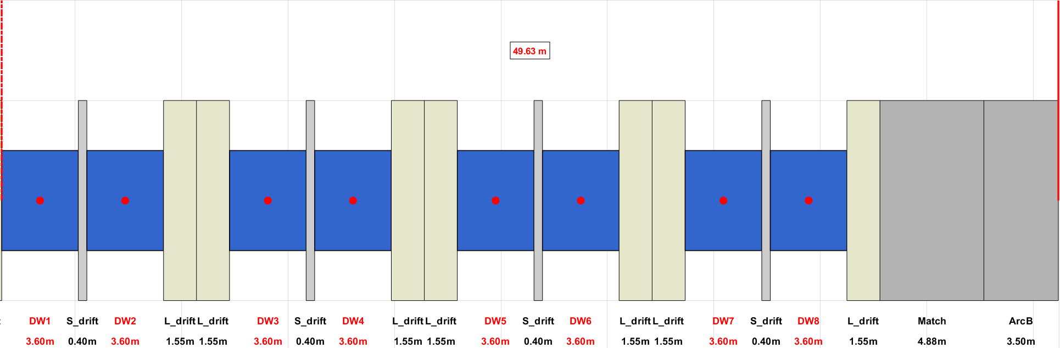
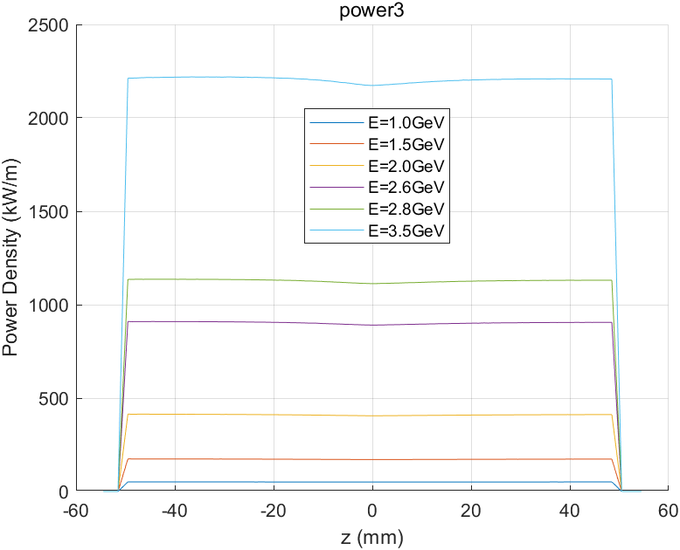
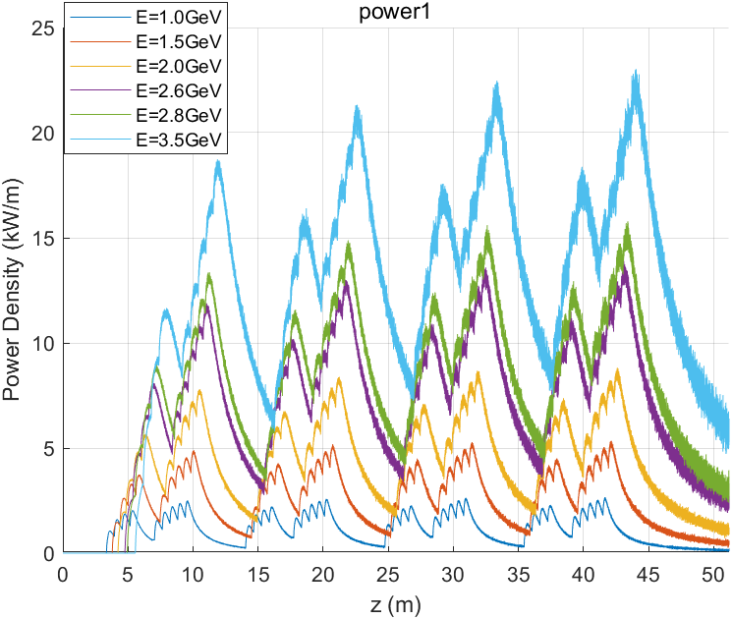
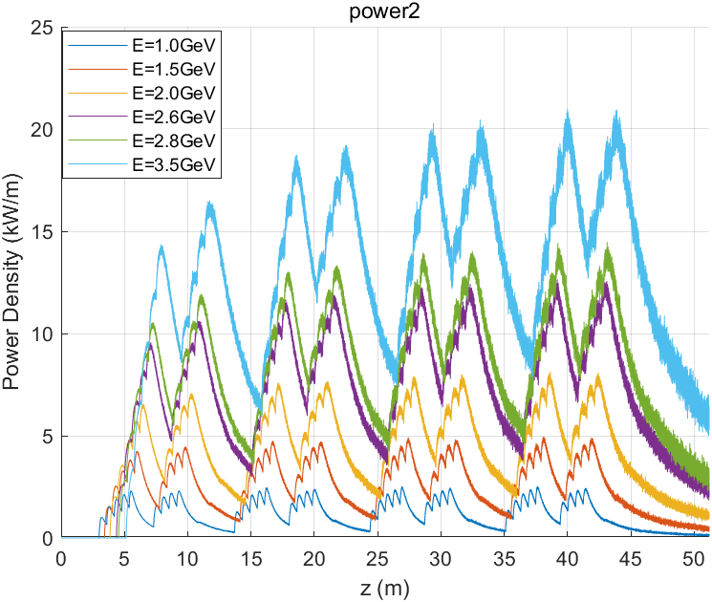
DW直线段功率线密度
power1
power3
power2
考虑DW直线段入口到ARC第一块B铁前（ power3 面）49.63m
power1、2面距离光轴50mm
 | 1GeV | 1.5GeV | 2GeV | 2.6GeV | 2.8GeV | 3.5GeV
power1(kW) | 55.63 | 122.27 | 212.23 | 348.23 | 399.83 | 602.65
power2(kW) | 55.62 | 122.25 | 212.17 | 348.07 | 399.63 | 602.27
power3(kW) | 5.10 | 17.27 | 41.02 | 90.26 | 112.78 | 220.45
power_all(kW) | 116.369 | 261.80 | 465.42 | 786.57 | 912.23 | 1425.36
power_3/power_all | 4.39% | 6.60% | 8.81% | 11.48% | 12.36% | 31.90%

Slide 8
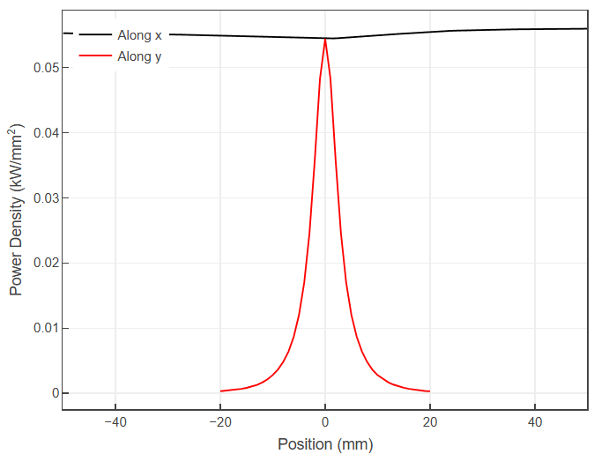
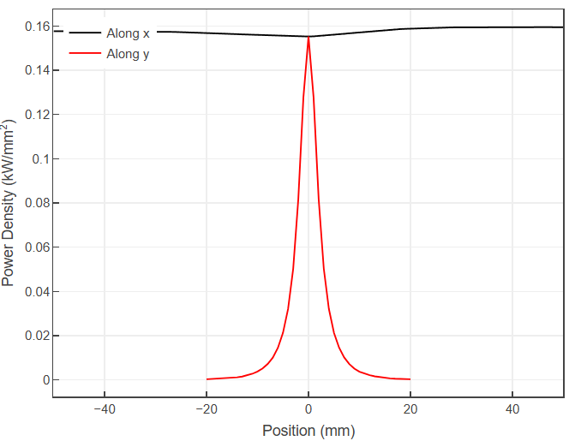
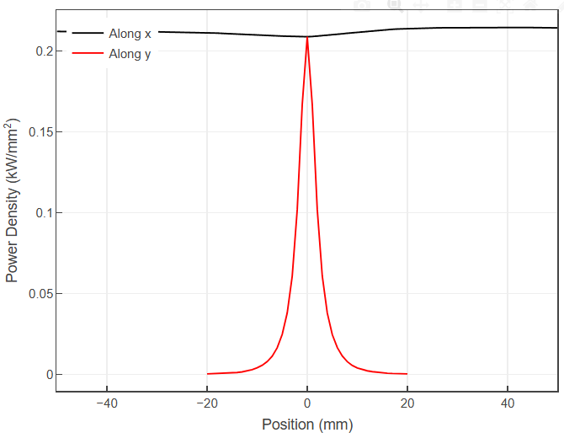
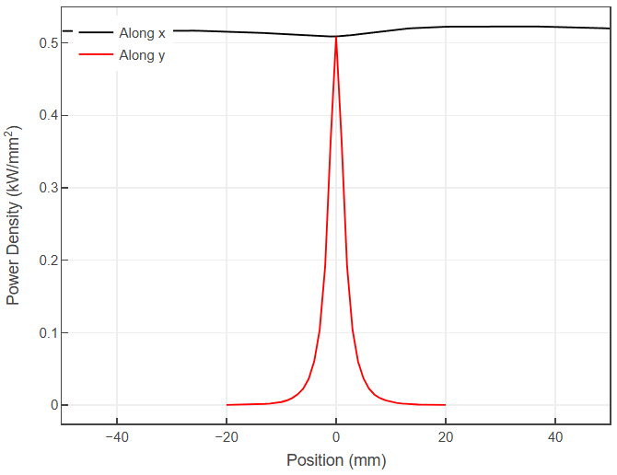
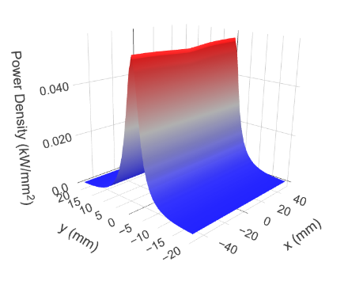
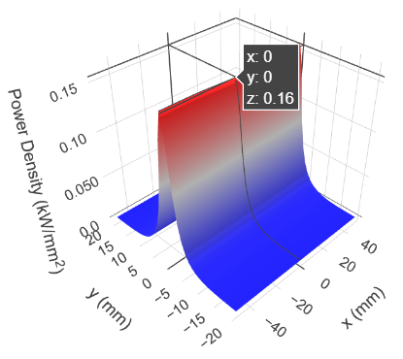
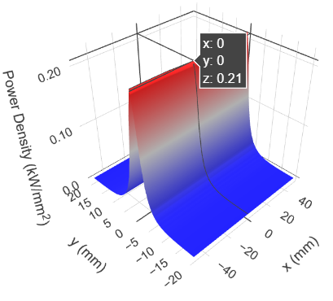
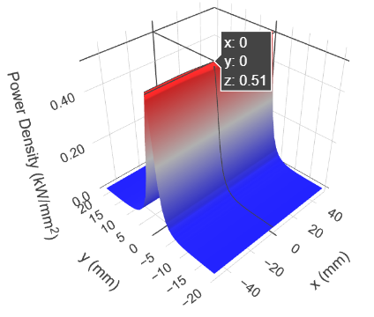
DW直线节出口接收面功率分布
接收面取管道孔径水平[-50,50]mm，垂直[-20,20]mm
2GeV
2.6GeV
2.8GeV
3.5GeV

Slide 9
总结
基于STCFV5版lattice，在 1、2、2.6、2.8、3.5GeV能量下，
考虑1.9T，3.6mDW，管道孔径水平[-50,50]mm，垂直[-20,20]mm
计算了的单个DW、一对DW、DW直线节，沿管道的线功率密度、端面二维功率分布
对于DW直线节，不同能量下，沿管道的功率线密度峰值如下表
 | 1GeV | 1.5GeV | 2GeV | 2.6GeV | 2.8GeV | 3.5GeV
power1(kW/m) | 2.66 | 5.35 | 8.79 | 13.73 | 15.78 | 23.02
power2(kW/m) | 2.45 | 4.91 | 8.10 | 12.57 | 14.47 | 20.93
真空管道设计需要考虑那个能量下进行设计

Slide 10
请各位老师批评指正 !
Notes:
Thank you for your attention!

Slide 11
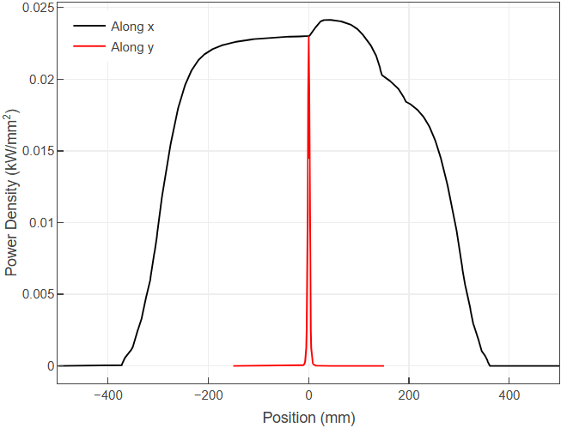
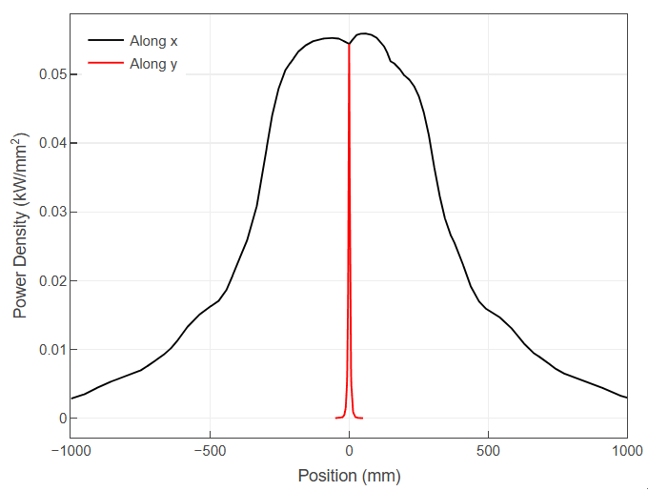
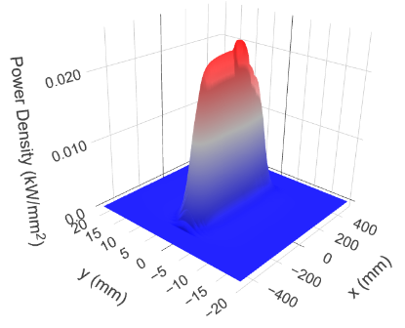
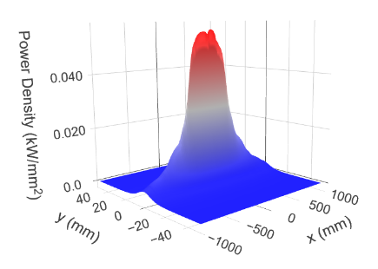
最后一块DW出口接收面功率分布
接收面取管道孔径水平[-50,50]mm，垂直[-20,20]mm
2GeV

