Slide 1

磁单极子感应探测 level-1触发算法研究
中国科学技术大学
University of Science and Technology of China
叶昌庆
2026-06

Slide 2
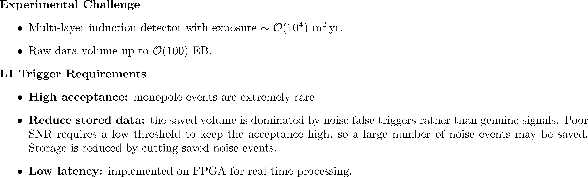
提出问题

Slide 3
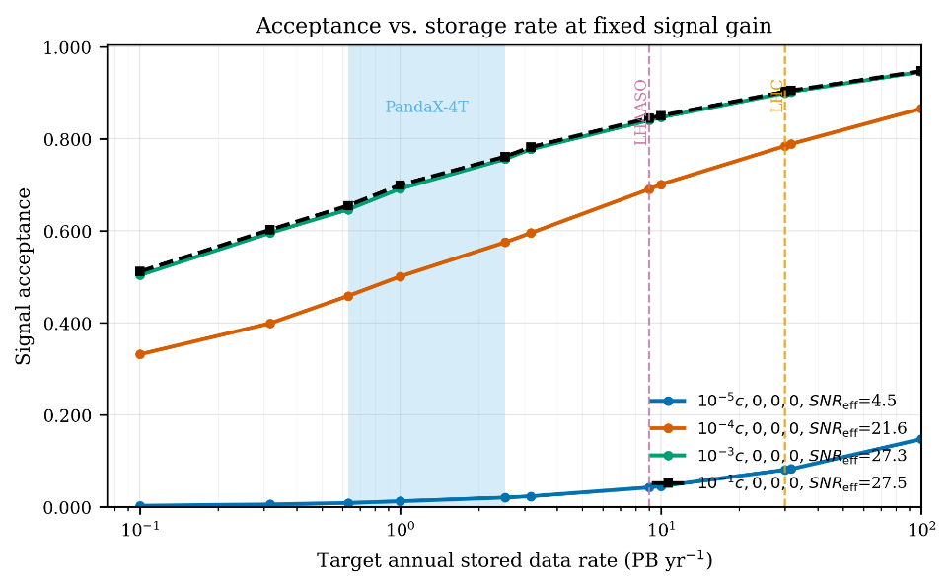
分析问题
Storage constraint
• Lower false-triggered saved fraction → lower acceptance; trade off to a manageable level.
• Target 10⁻³ → ~10 PB/yr over a 10-year run (manageable).
Objective
• Maximize acceptance at a fixed 10⁻³ saved-data fraction.
Acceptance–storage trade-off
• Acceptance rises with the stored-data rate; differs by velocity (intrinsic SNR).

Slide 4
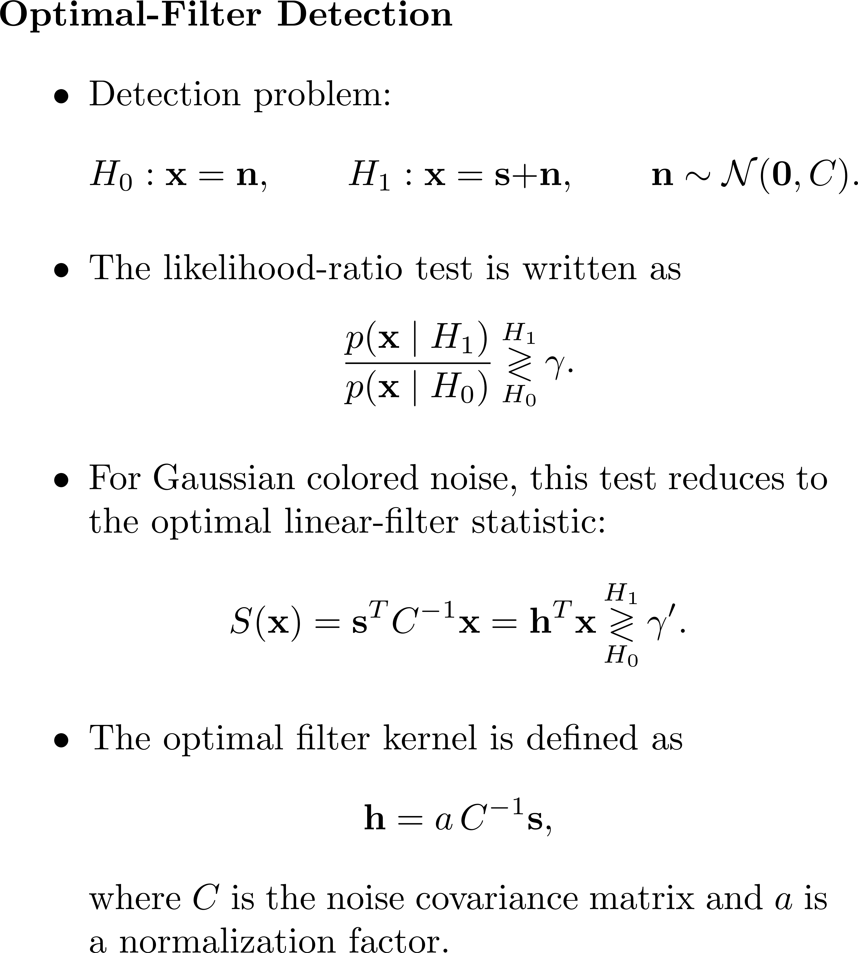
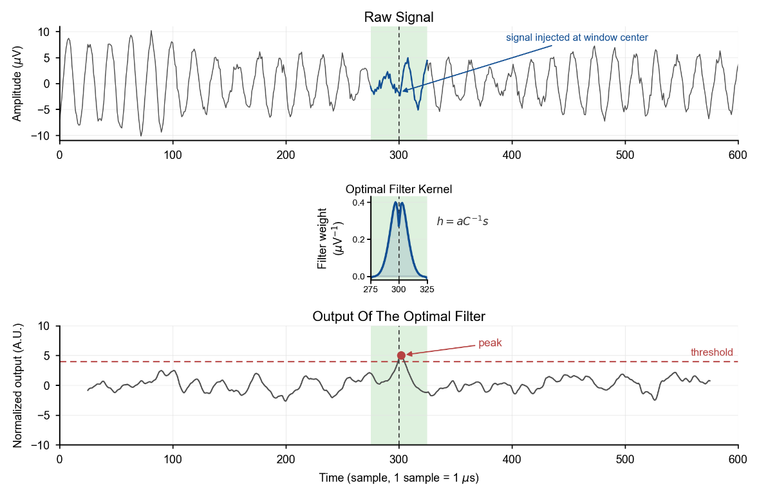
最优滤波

Slide 5
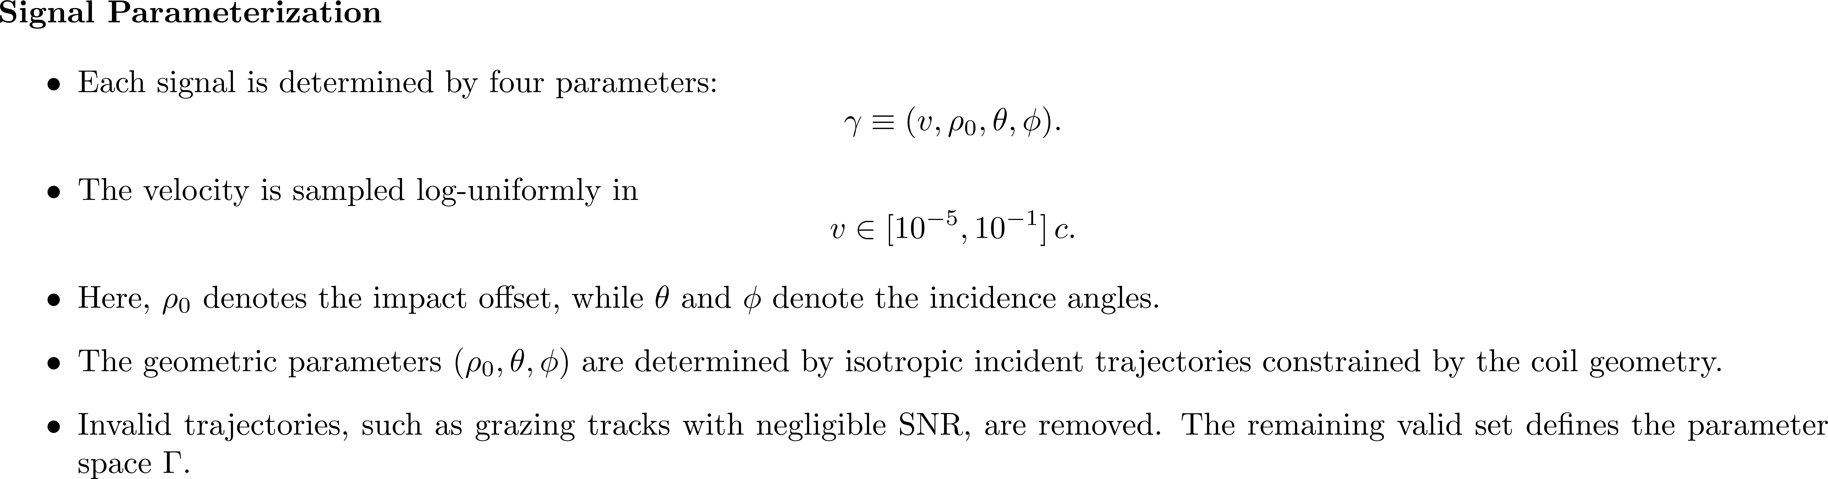
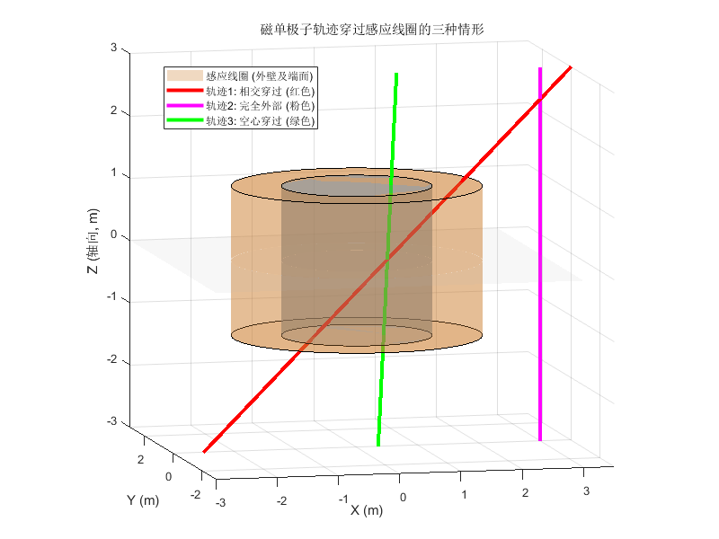
参数空间 Γ

Slide 6
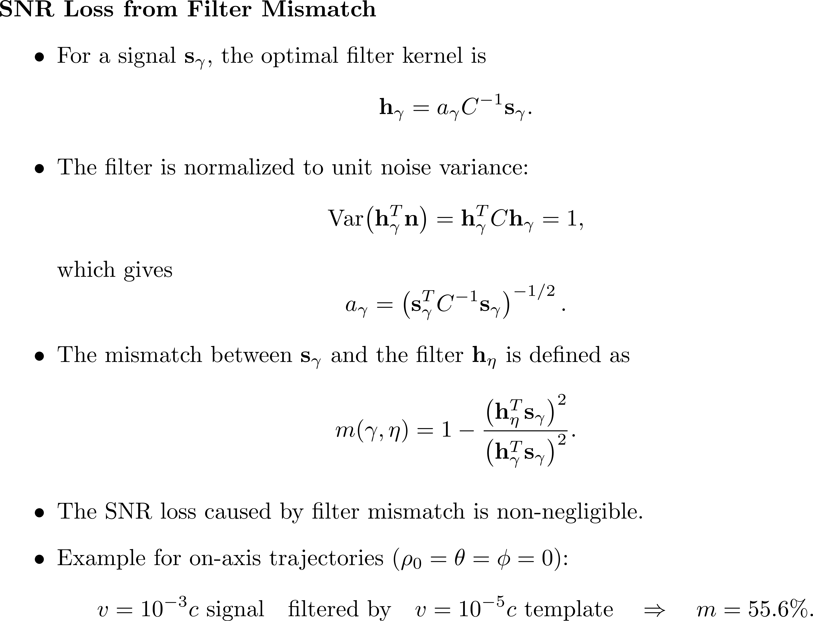
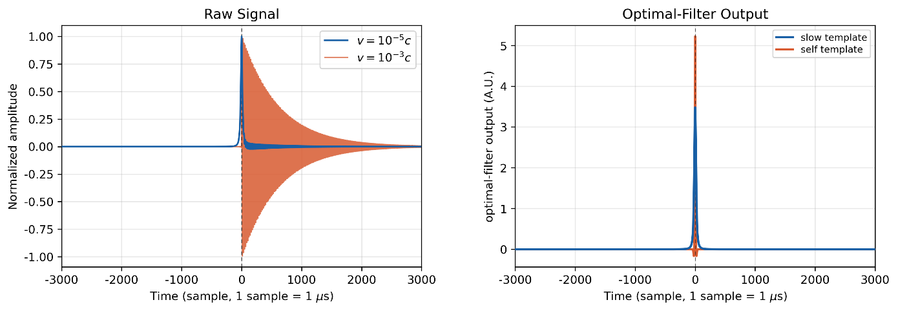
Mismatch

Slide 7
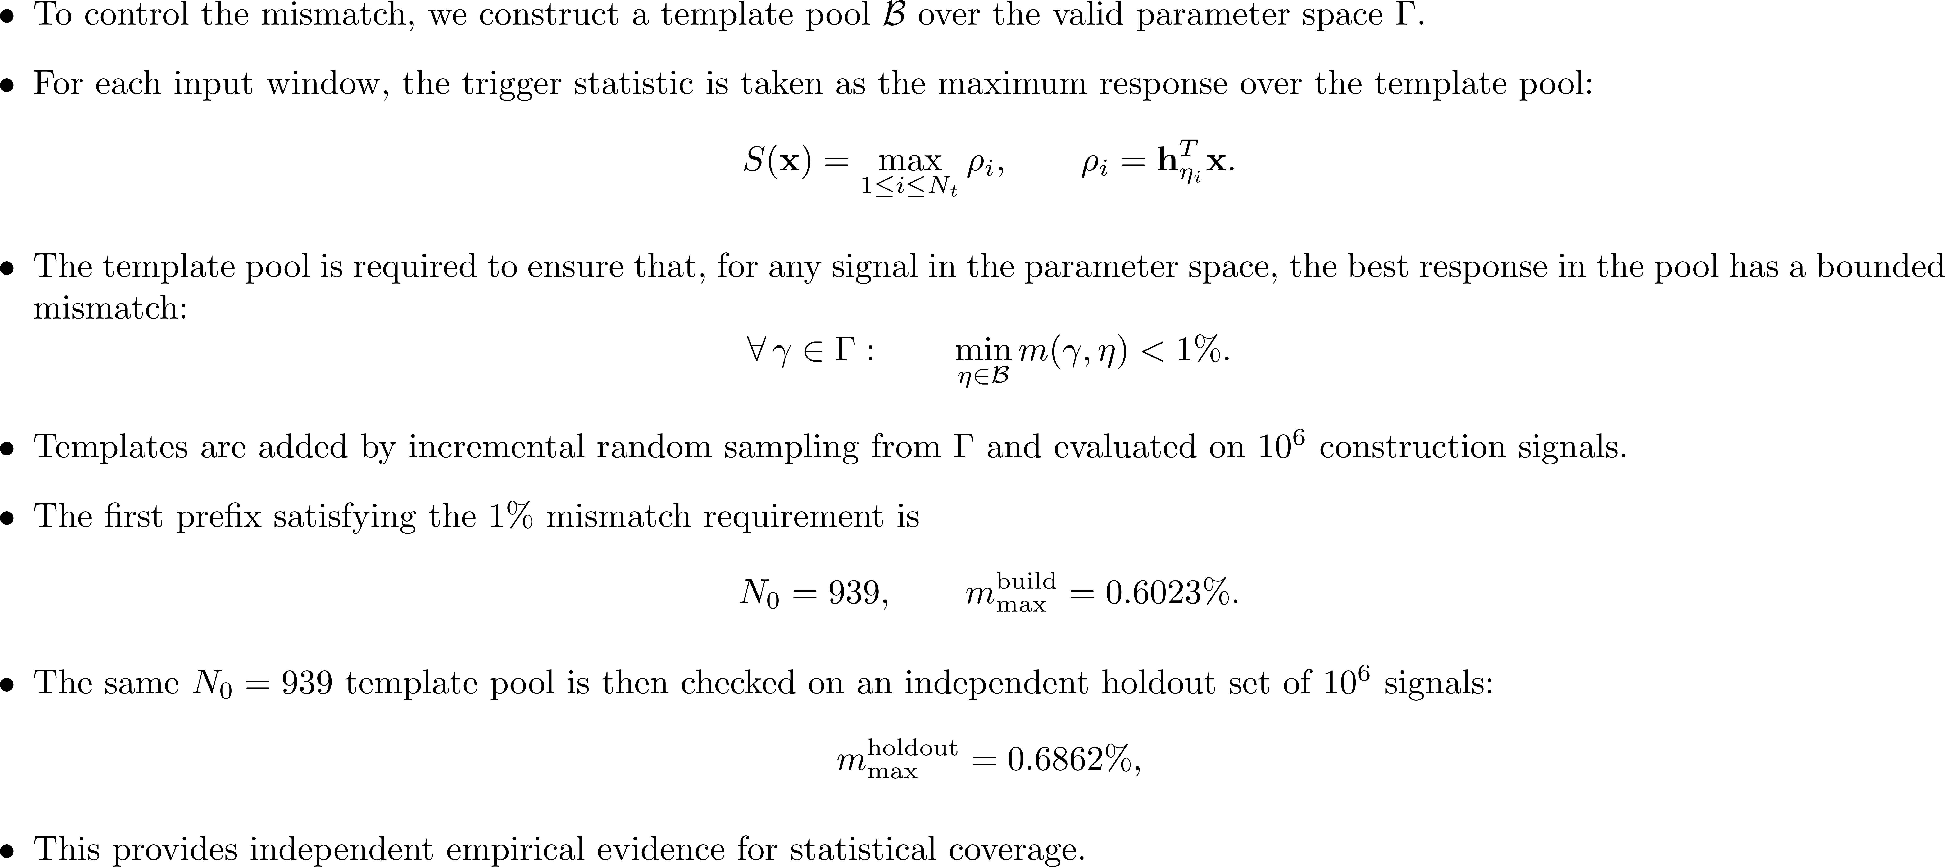
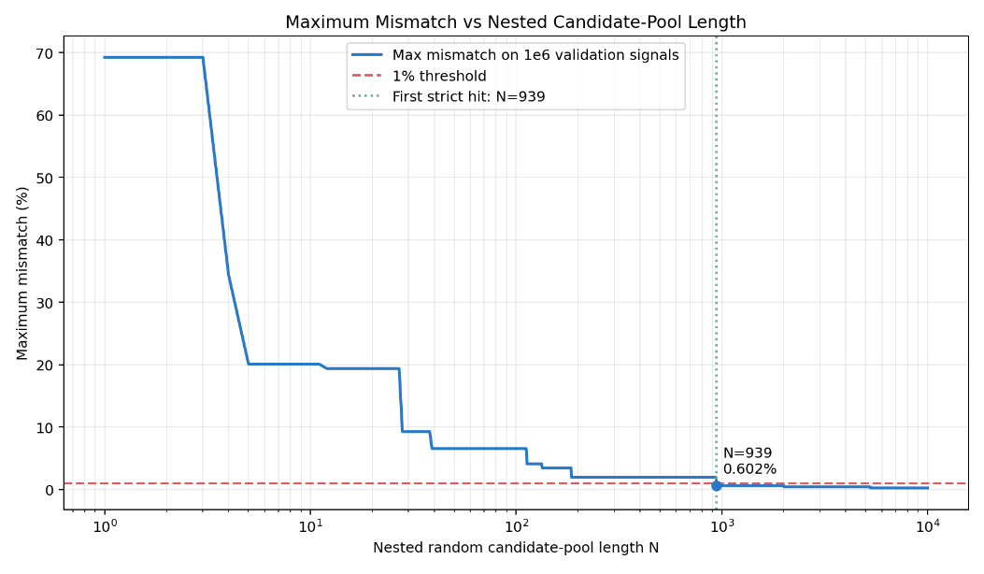
Template Pool — Coverage

Slide 8
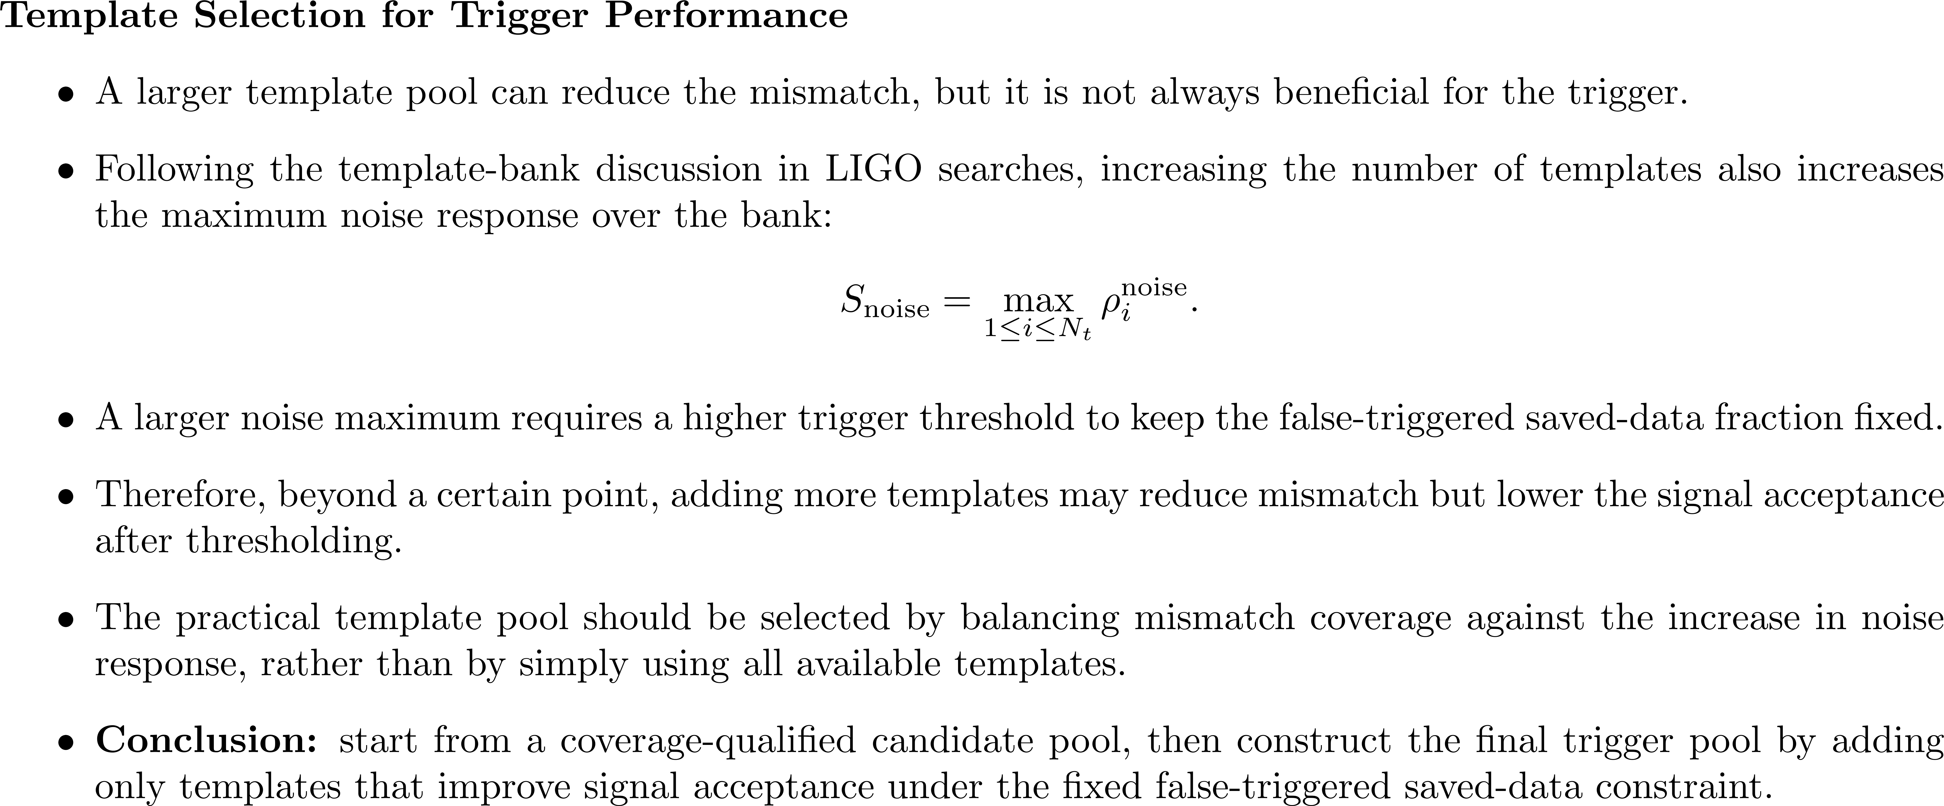
Practical Template Pool — FNR-Greedy

Slide 9
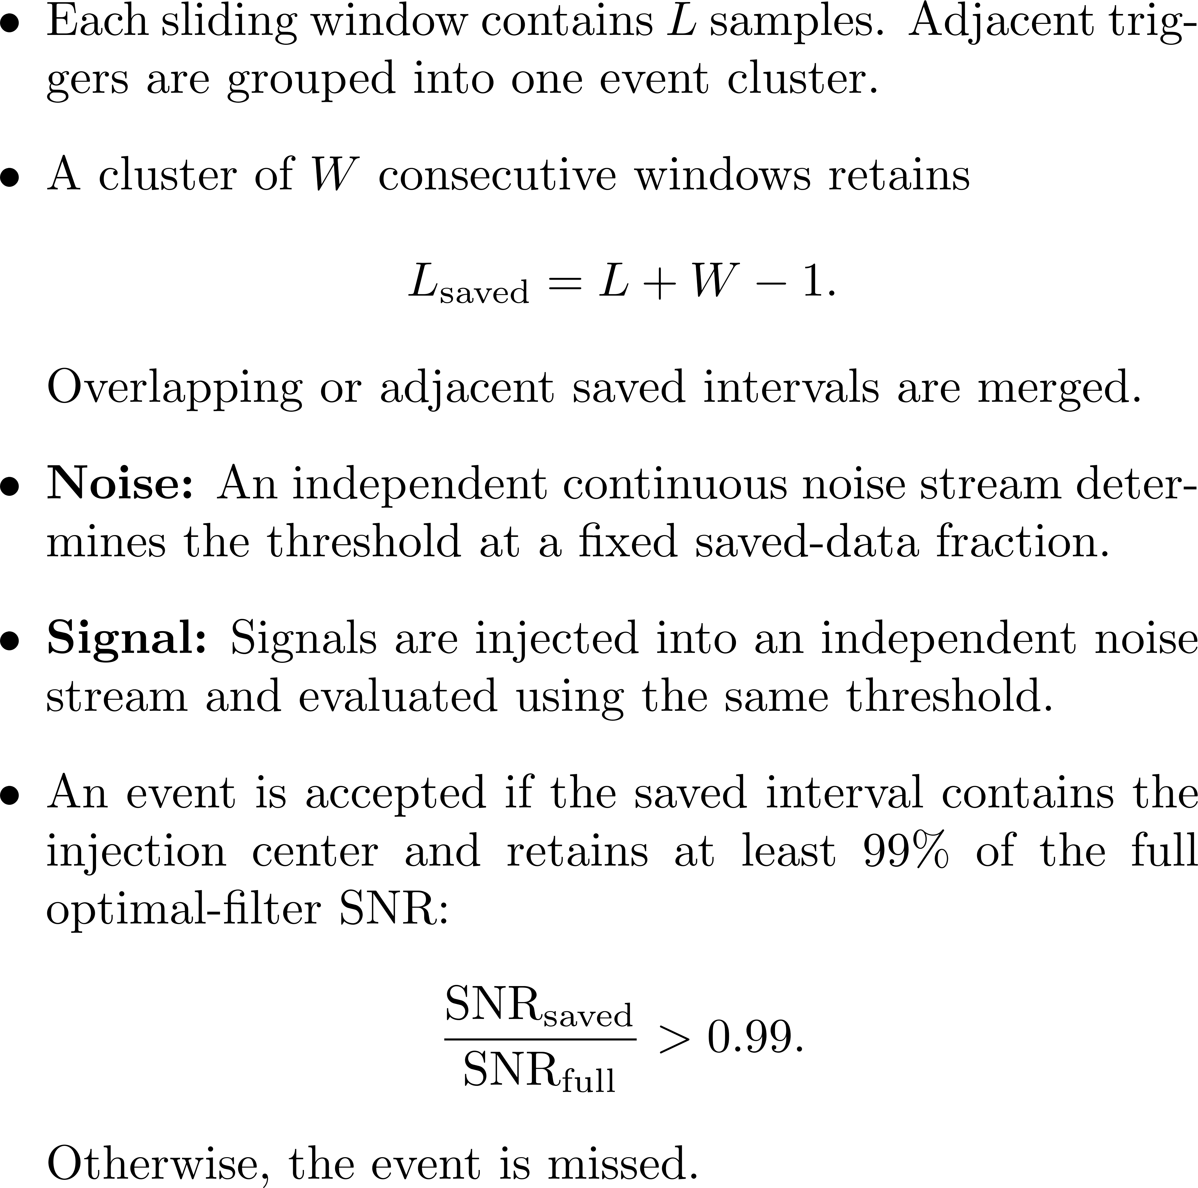
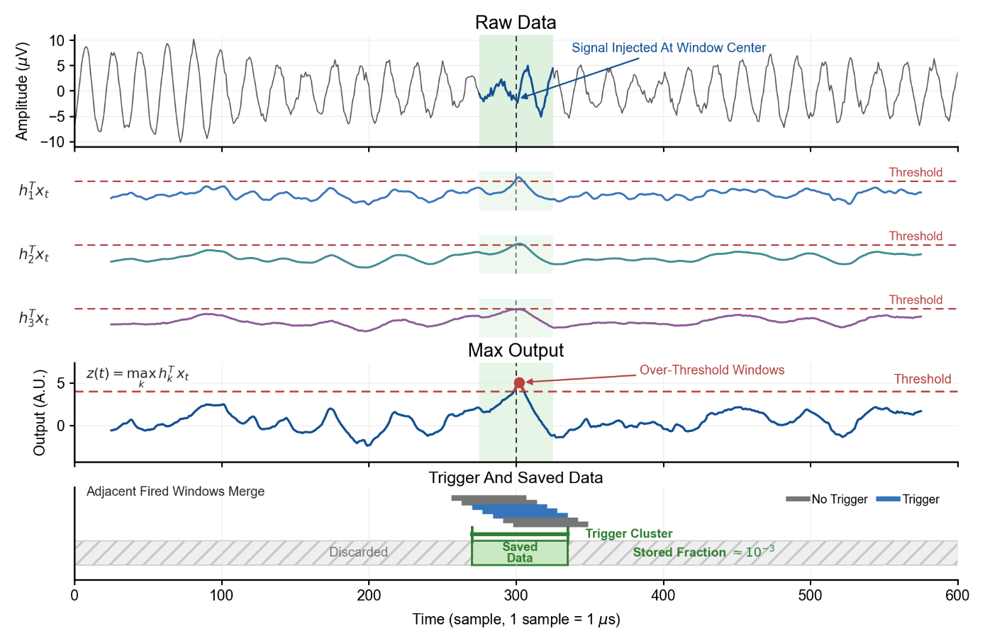
Practical Template Pool — Stream Evaluation

Slide 10
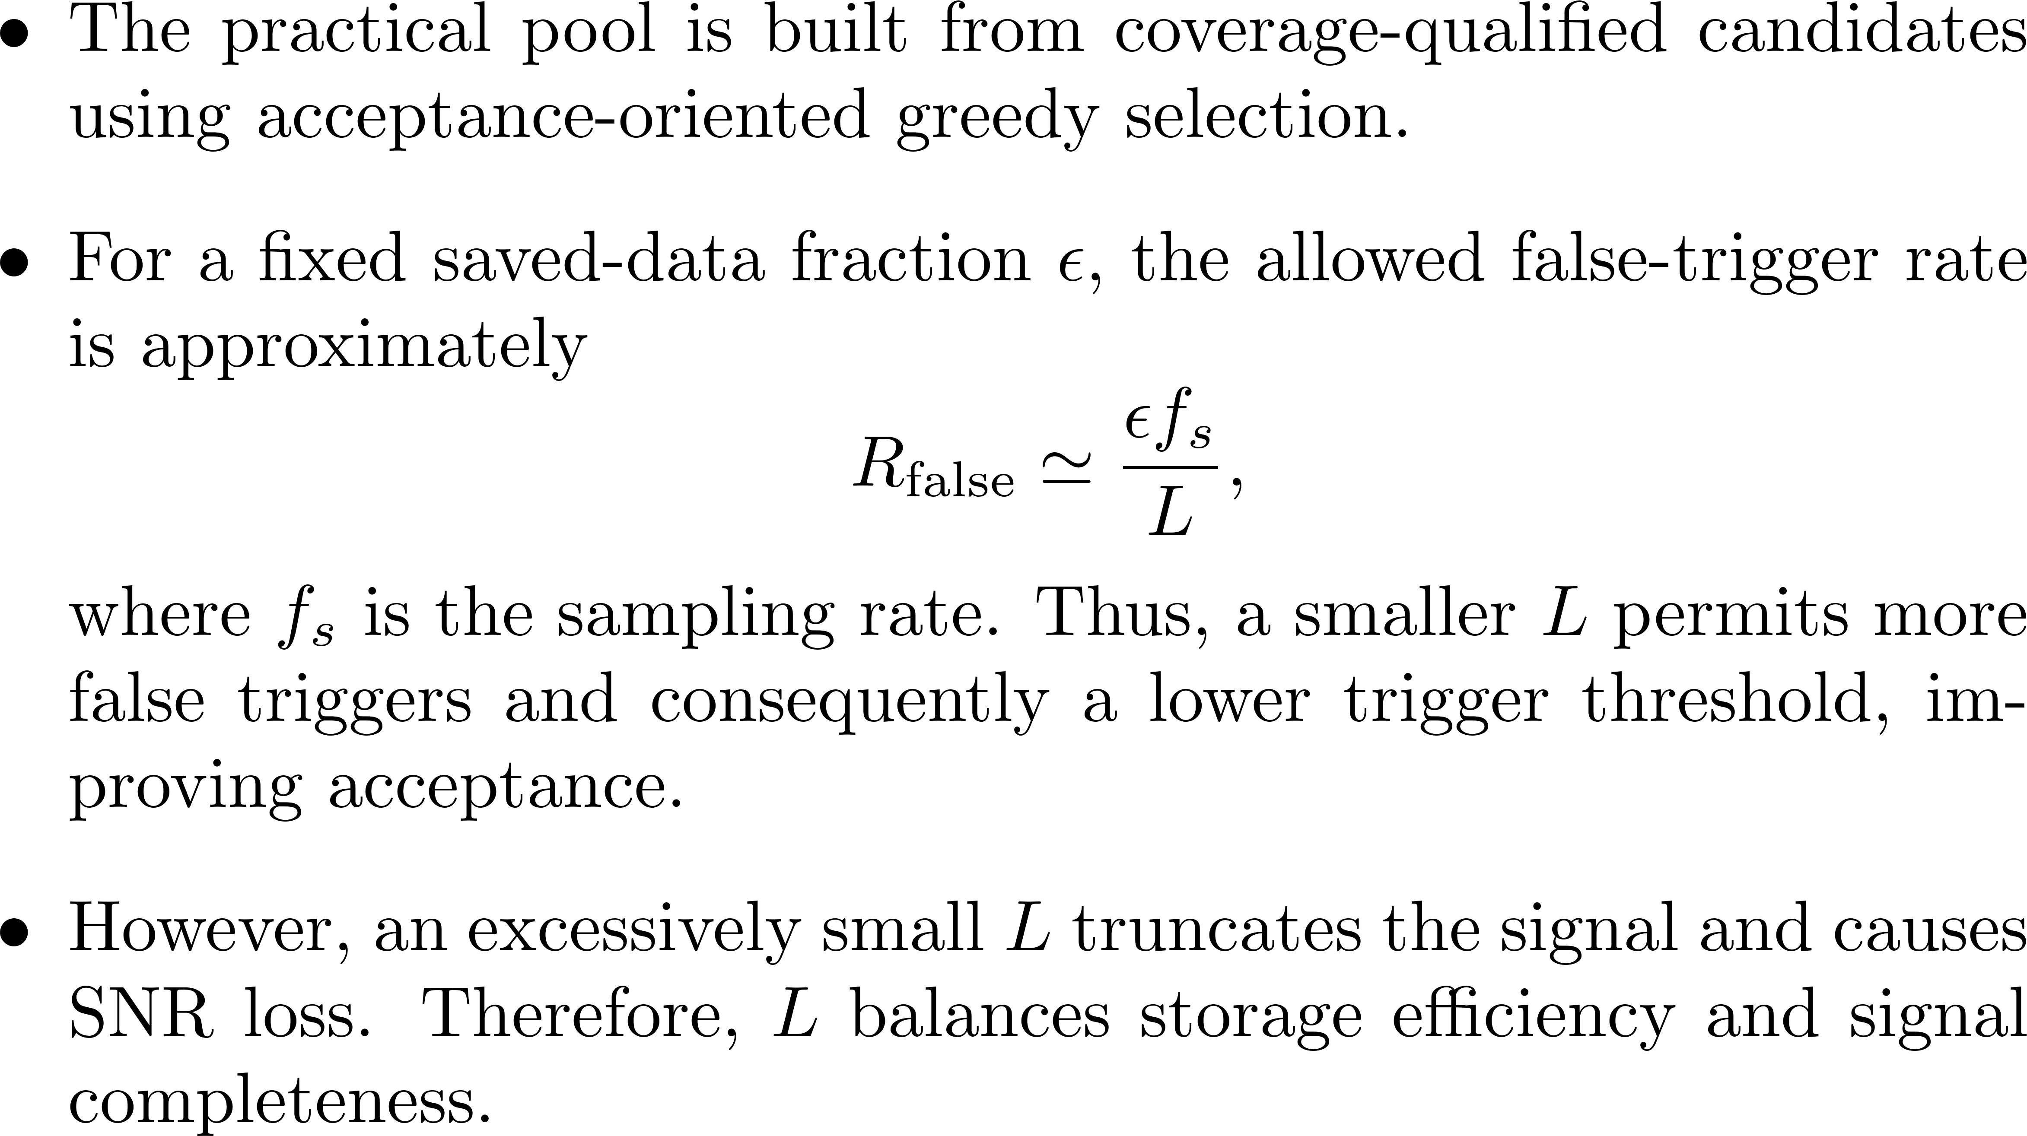
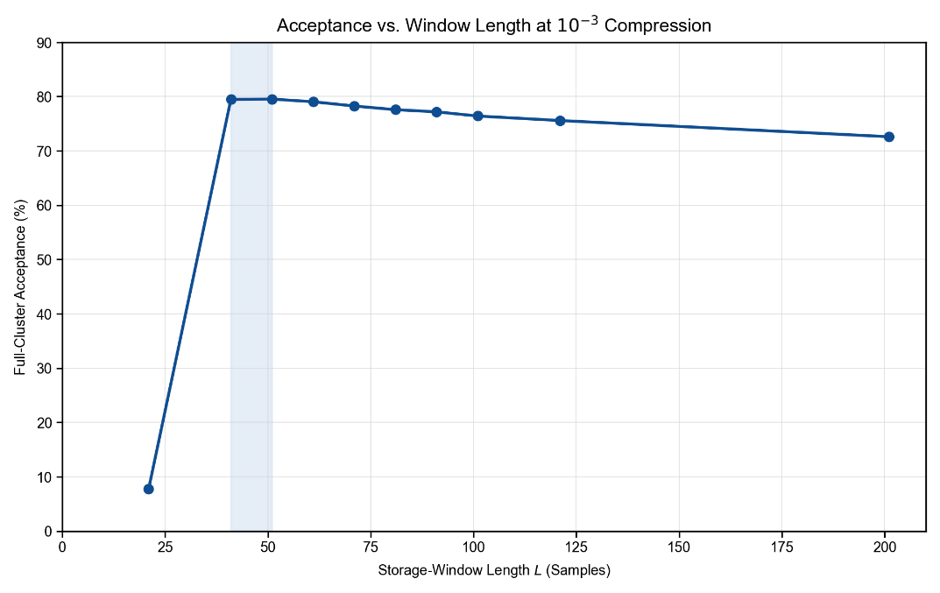
Practical Template Pool

Slide 11

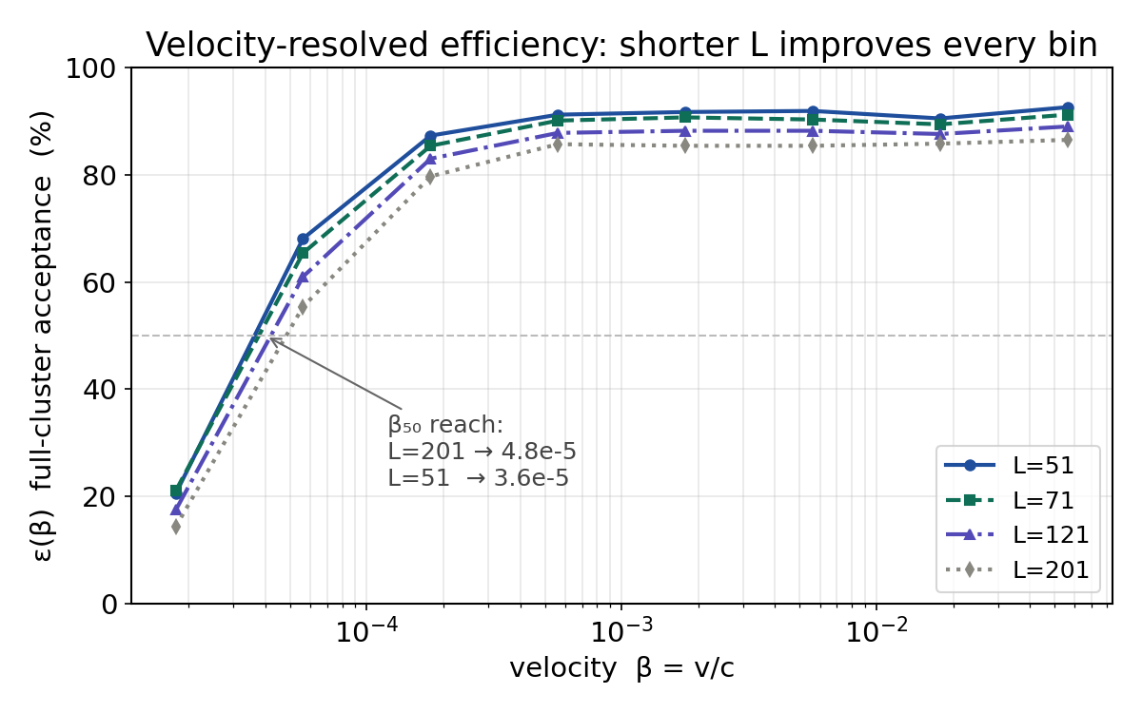
Practical Template Pool

Slide 12
中国科学技术大学
University of Science and Technology of China
Thanks for listening!
Email: ycq@mail.ustc.edu.cn

