Slide 1

CEPC AHCAL Energy Resolution
李想
2025.6.10
Notes:
Today, I will present my work on improving the ECAL energy resolution using machine learning.

Slide 2
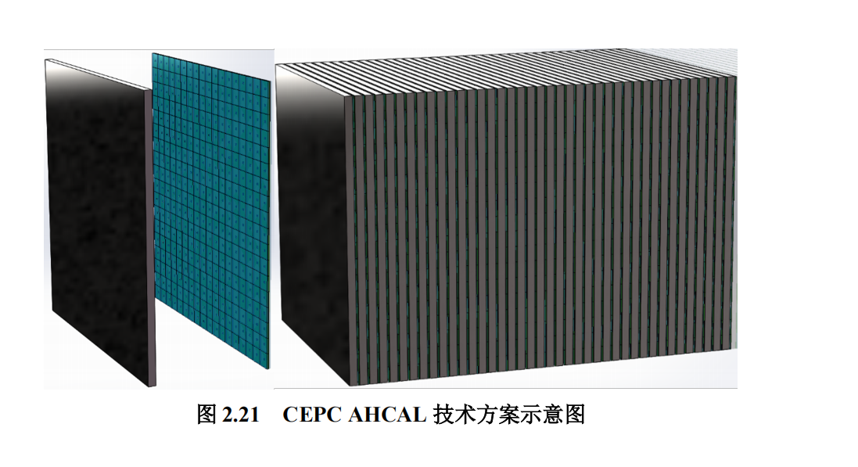
AHCAL：
AHCAL Standalone Geometry Model:
Total Layers: 40 sampling layers.
Layer Components: Absorber, plastic scintillator tiles, and PCB.
Sensitive Area:720 × 720 mm² (populated by 324 scintillator tiles, each 40 × 40 × 3 mm³).
Absorber:20-mm-thick iron plate.
PCB:2-mm-thick G4_KAPTON.
Note: The absorber and PCB have the exact same area as the sensitive region.
Depth of the prototype ：5 λ
Notes:
Our primary objective is to enhance the ECAL energy resolution using machine learning techniques. We evaluate two parallel strategies: a layer-level Multi-Layer Perceptron (MLP) and a hit-level CNN+LSTM architecture. We then compare their performance against the standard energy-sum method

Slide 3
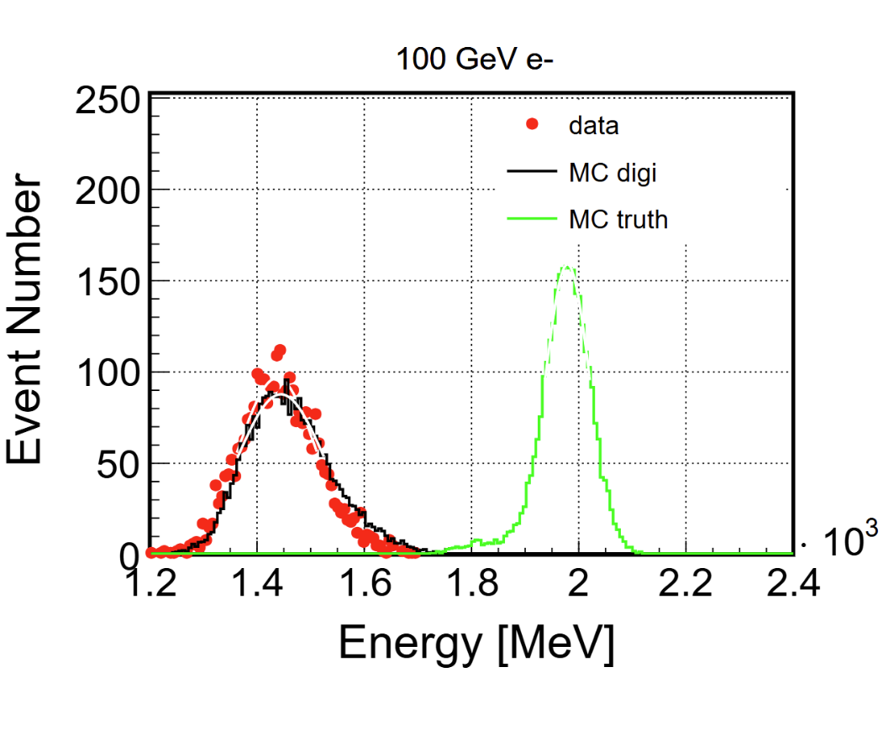
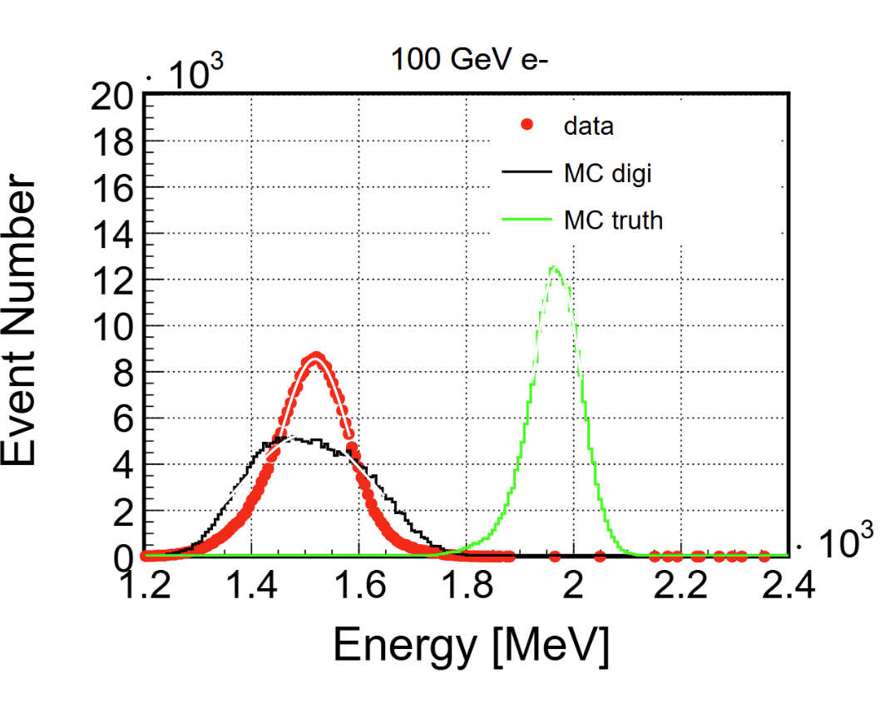
motivation：
Attempt to improve the HCAL
e- energy resolution using ML
Sim-to-Real Gap
strategy:
Layer level data:Train an MLP;
Hit level data: Train a CNN+LSTM,CNN+Transformer;
Using Transfer Learning
Option One for Data with position selecting
  Good match with MC_digi but small data volume
Option two for Data without position selecting
  Poor match with MC_digi but large data volume
cite Hong Bin's work
Data with position selecting
Data without position selecting
Notes:
Our primary objective is to enhance the ECAL energy resolution using machine learning techniques. We evaluate two parallel strategies: a layer-level Multi-Layer Perceptron (MLP) and a hit-level CNN+LSTM architecture. We then compare their performance against the standard energy-sum method

Slide 4
Data Sample size
Data with position selecting
Data without position selecting
energy_folder | n_total | n_tag1 | rate
1GeV | 344409 | 3090 | 0.008971891
2GeV | 536821 | 23792 | 0.044320174
3GeV | 483472 | 43364 | 0.089692888
4GeV | 536197 | 91033 | 0.169775288
5GeV | 517351 | 79864 | 0.154371017
10GeV | 238139 | 13111 | 0.055056081
20GeV | 573677 | 100590 | 0.175342571
30GeV | 556570 | 92099 | 0.165476041
40GeV | 421484 | 38672 | 0.091752
50GeV | 743810 | 55265 | 0.074299888
60GeV | 377014 | 11306 | 0.029988276
70GeV | 580935 | 7940 | 0.013667622
80GeV | 273278 | 2979 | 0.010900987
100GeV | 289511 | 2942 | 0.010161963
120GeV | 242049 | 1453 | 0.006002917
TOTAL | 6714717 | 567500
energy_folder | n_total | n_tag1 | rate
1GeV | 344409 | 39559 | 0.114860529
2GeV | 536821 | 201654 | 0.375644768
3GeV | 483472 | 256005 | 0.529513602
4GeV | 536197 | 294630 | 0.549480881
5GeV | 517351 | 213018 | 0.411747537
10GeV | 238139 | 151471 | 0.636061292
20GeV | 573677 | 507401 | 0.884471575
30GeV | 556570 | 486346 | 0.873827192
40GeV | 421484 | 364786 | 0.865480066
50GeV | 743810 | 640892 | 0.861634019
60GeV | 377014 | 326884 | 0.867034115
70GeV | 580935 | 507052 | 0.872820539
80GeV | 273278 | 222710 | 0.814957662
100GeV | 289511 | 250737 | 0.866070719
120GeV | 242049 | 207874 | 0.85880958
TOTAL | 6714717 | 4671019
Notes:
In contrast to the resolution, no comparable enhancement was observed in the energy linearity.

Slide 5
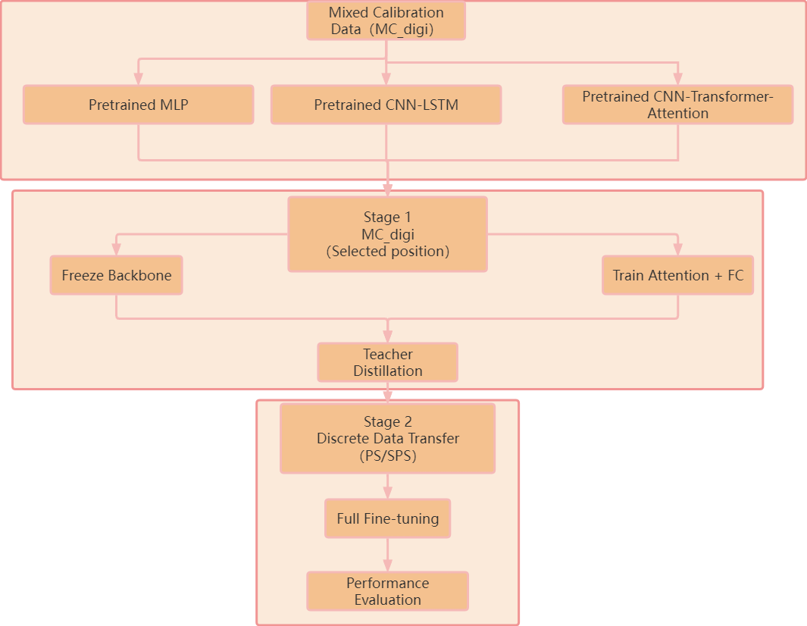
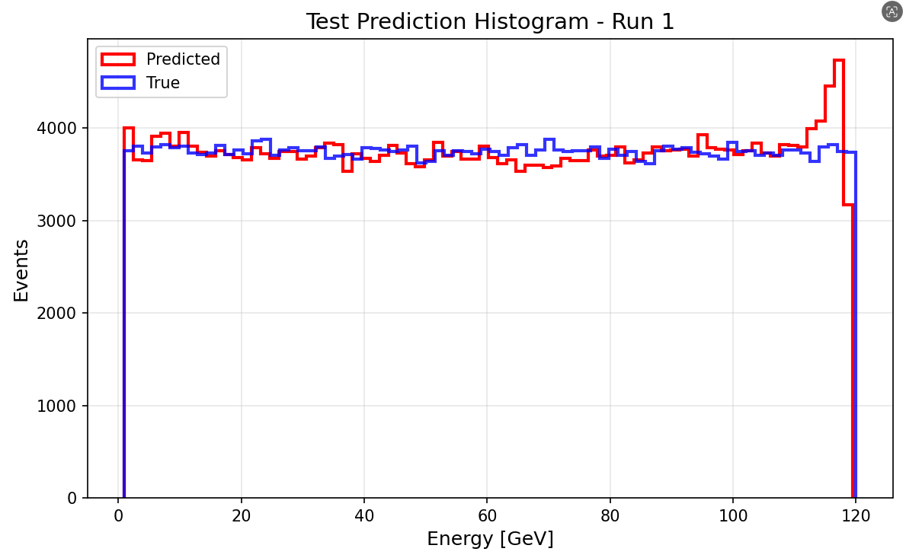
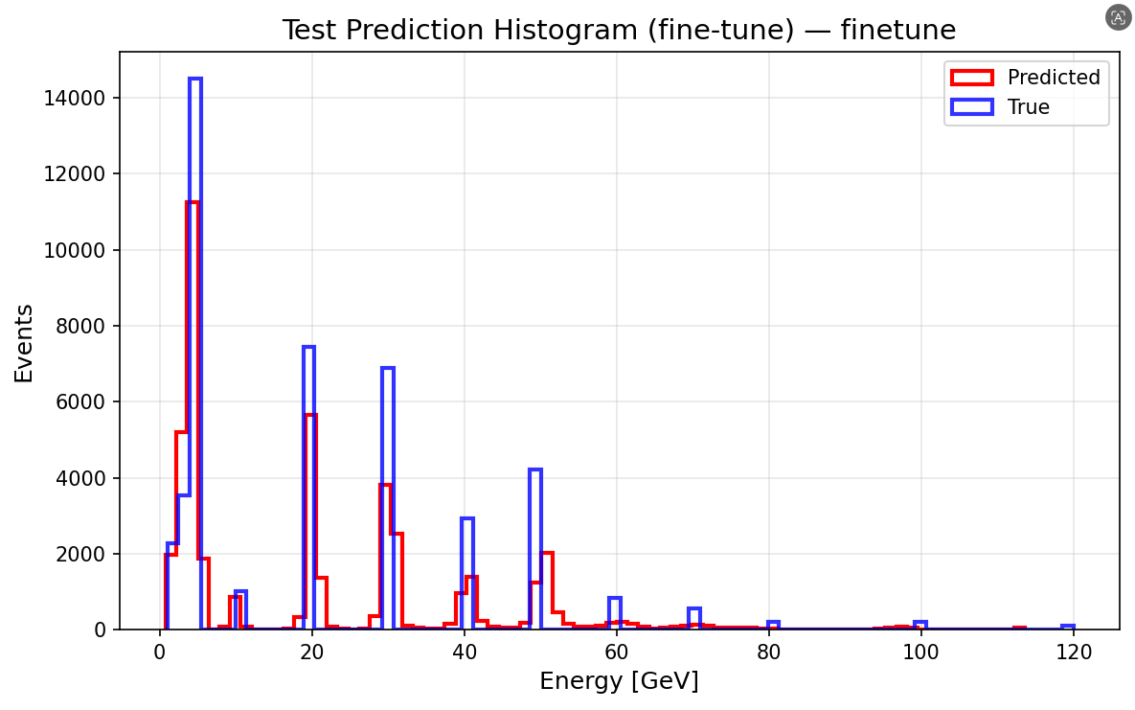
Transfer Learning Option One
Samples:
MC (After digilization) : 1-120GeV e-(20000000) Continuous
Data with position selecting: from PS and SPS [ 1.0,2.0,3.0,4.0,5.0,10.0, 20.0, 30.0, 40.0, 50.0, 60.0, 70.0, 80.0, 100.0, 120]GeV Uniformly mixed
Pre-trained model
Transfer Learning
Notes:
In contrast to the resolution, no comparable enhancement was observed in the energy linearity.

Slide 6
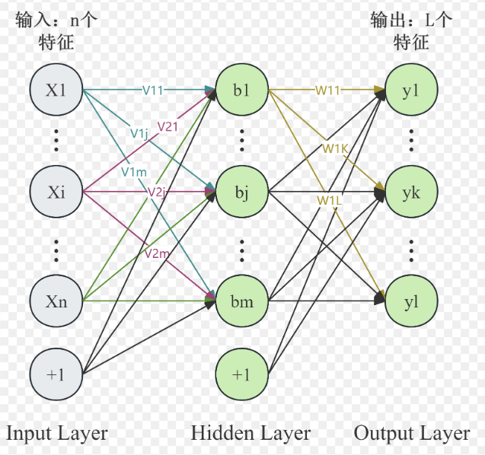
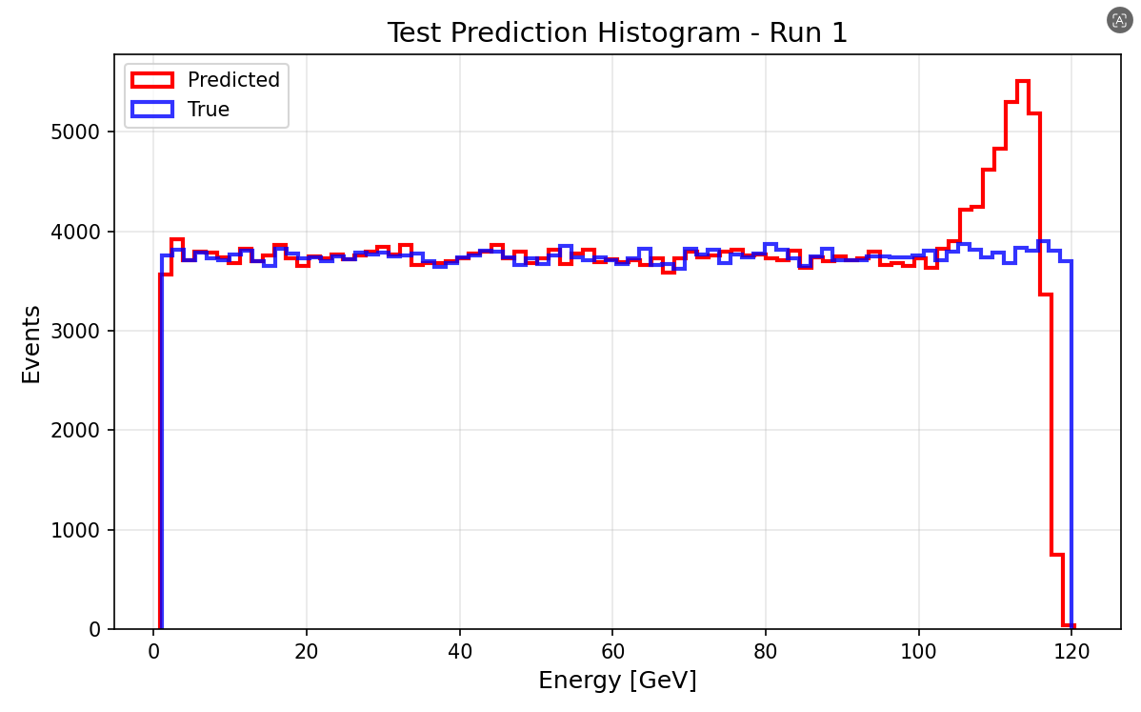
M(ulti) L(ayer) P(erceptron) Trian
Input(Layer level data):
  Energy(E) of per layer(40)
  Hit_no(N) of per layer(40)
  E/N of perlayer(40)
  Total_deposited_energy(1)
Output:
  Predicted Partical Energy
Samples:
MC: 1-120GeV e-(20000000) Continuous
Data split
train_frac = 0.7
val_frac = 0.15
test_frac = 0.15
[1024,512,256,128]
lr =0.5e-4
batch_size =64
epochs =100
weight_decay =1e-4
optimizer ="adamw"
Input and Output（relative error <2%）
Notes:
When comparing both models trained on the same restricted 12,000-sample dataset, the CNN+LSTM architecture demonstrates a clear advantage over the standard MLP. Despite the limitations of data starvation, the CNN+LSTM model achieves better energy resolution and more stable linearity. This suggests a potentially superior capability in extracting complex spatial and longitudinal shower features directly from the raw hit data.

Slide 7
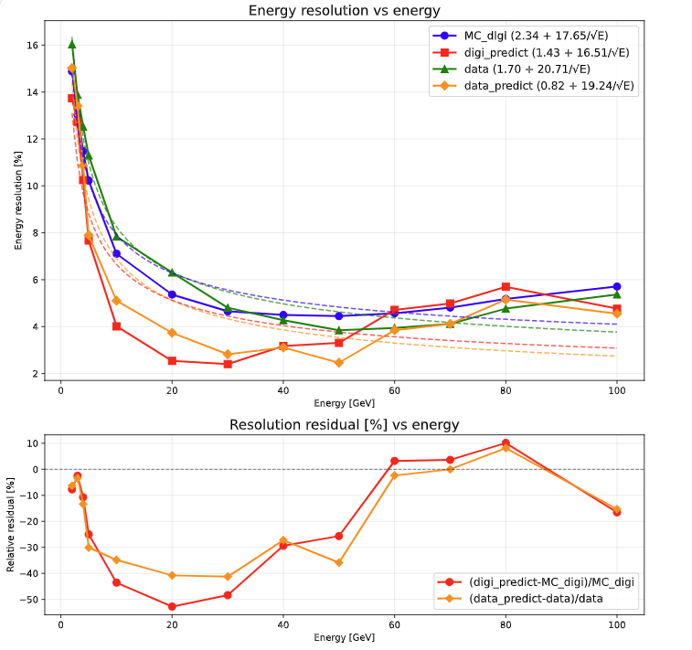
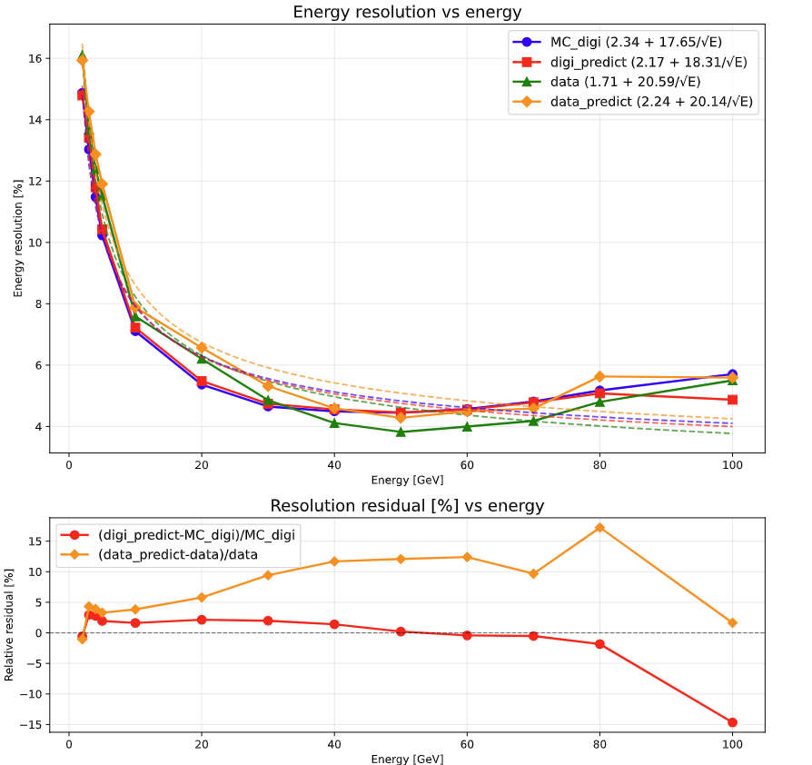
MLP Result_Energy Resolution
Transfer Learning
Pre-trained model
Notes:
When comparing both models trained on the same restricted 12,000-sample dataset, the CNN+LSTM architecture demonstrates a clear advantage over the standard MLP. Despite the limitations of data starvation, the CNN+LSTM model achieves better energy resolution and more stable linearity. This suggests a potentially superior capability in extracting complex spatial and longitudinal shower features directly from the raw hit data.

Slide 8
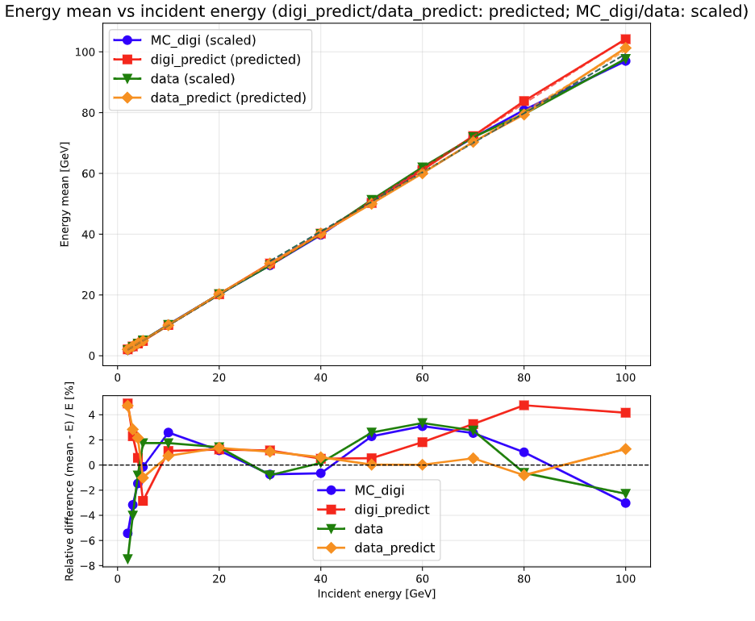
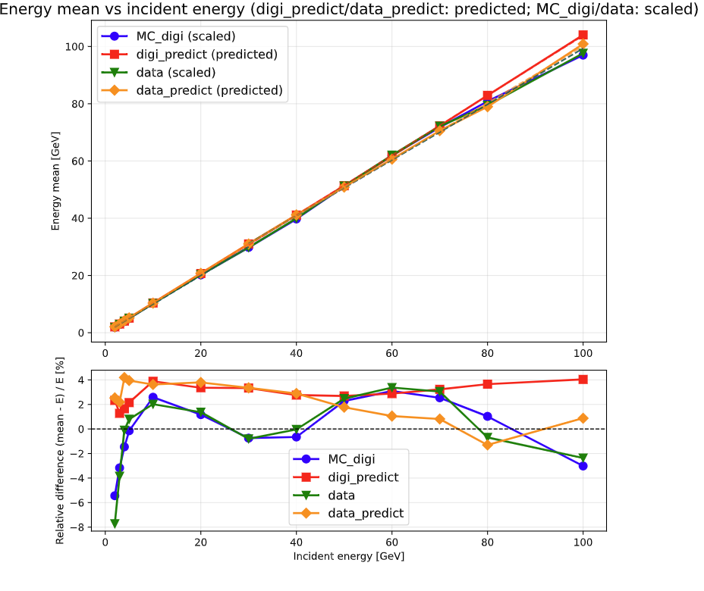
MLP Result_Linearity
Transfer Learning
Pre-trained model
Notes:
When comparing both models trained on the same restricted 12,000-sample dataset, the CNN+LSTM architecture demonstrates a clear advantage over the standard MLP. Despite the limitations of data starvation, the CNN+LSTM model achieves better energy resolution and more stable linearity. This suggests a potentially superior capability in extracting complex spatial and longitudinal shower features directly from the raw hit data.

Slide 9
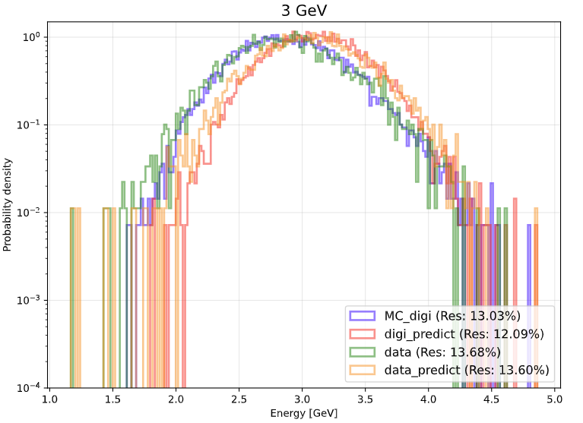
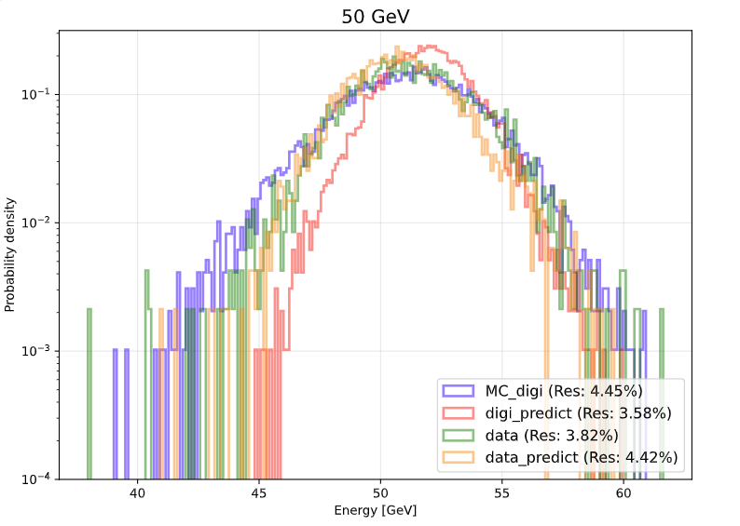
MLP Result HCAL Transfer Learning
3GeV
50GeV
Notes:
In contrast to the resolution, no comparable enhancement was observed in the energy linearity.

Slide 10
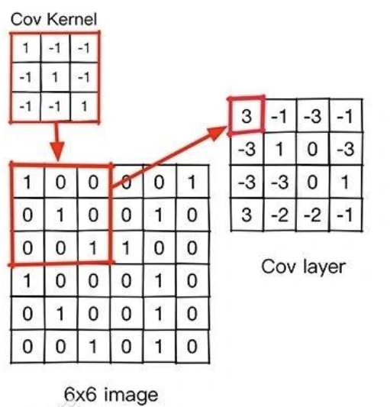
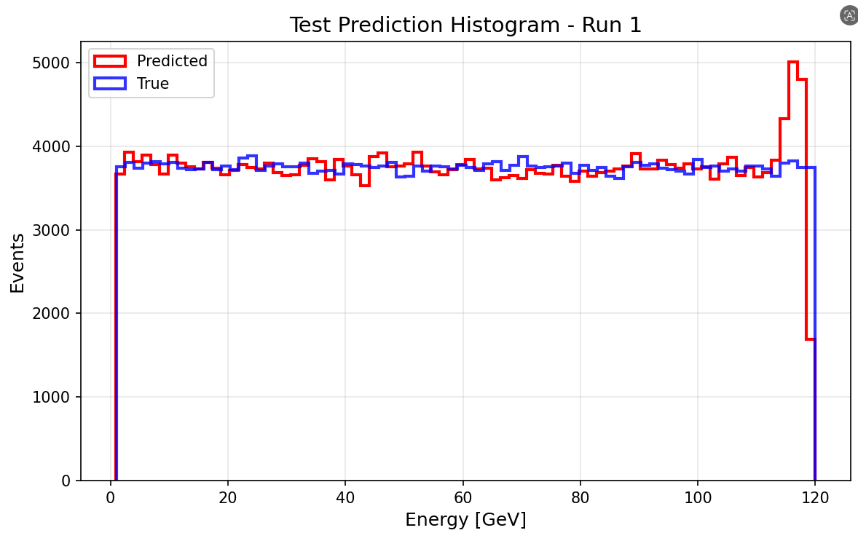
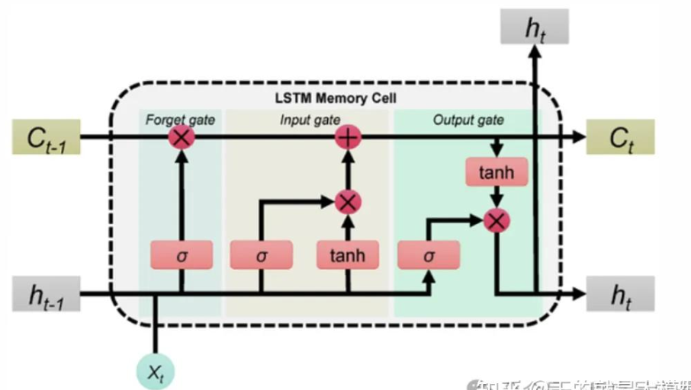
CNN+LSTM Trian (12000)
Input(hit level data):
HIt_ENERGY
Output:
  Predicted Energy
CNN (Convolutional Neural Network)
Samples:
MC: 1-120GeV (12000) Continuous e-
Data split
train_frac = 0.7
val_frac = 0.15
test_frac = 0.15
Read the hit image of the super layer
LSTM (Long Short-Term Memory)
Learn the development of shower at different levels
lr =1e-4
batch_size =256
epochs =150
weight_decay =1e-4
optimizer ="adamw"
Input and Output（rellative error <2%）
Notes:
When comparing both models trained on the same restricted 12,000-sample dataset, the CNN+LSTM architecture demonstrates a clear advantage over the standard MLP. Despite the limitations of data starvation, the CNN+LSTM model achieves better energy resolution and more stable linearity. This suggests a potentially superior capability in extracting complex spatial and longitudinal shower features directly from the raw hit data.

Slide 11
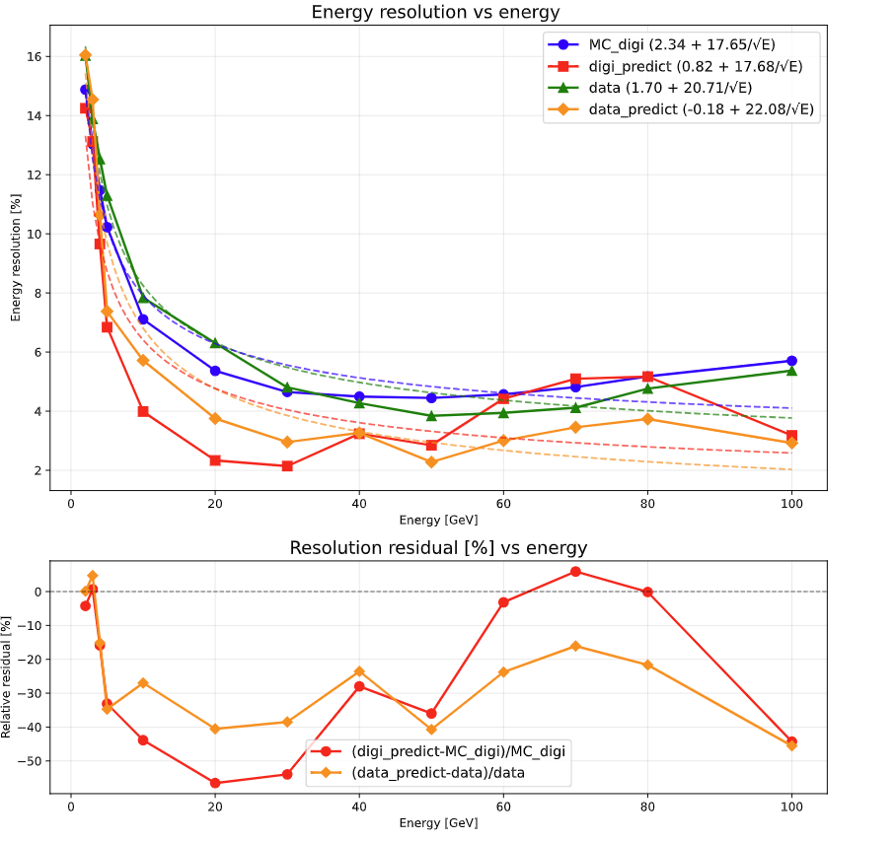
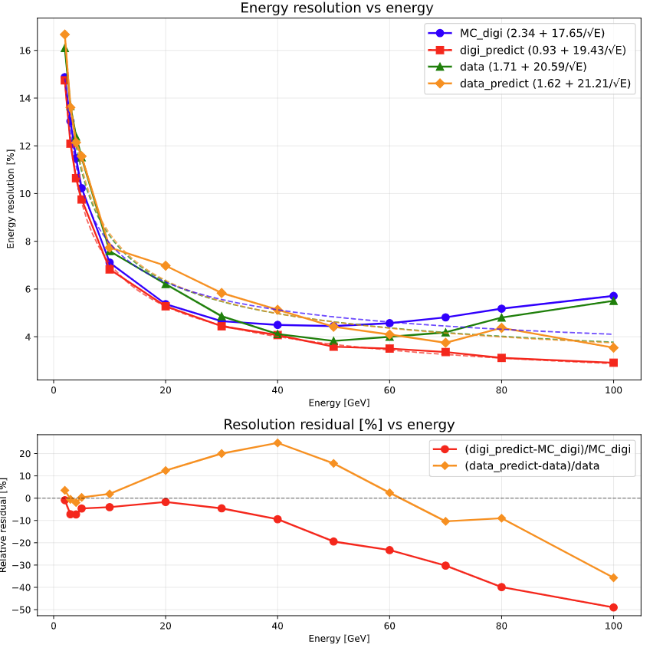
CNN+LSTM Result_Energy Resolution
Transfer Learning
Pre-trained model
Notes:
When comparing both models trained on the same restricted 12,000-sample dataset, the CNN+LSTM architecture demonstrates a clear advantage over the standard MLP. Despite the limitations of data starvation, the CNN+LSTM model achieves better energy resolution and more stable linearity. This suggests a potentially superior capability in extracting complex spatial and longitudinal shower features directly from the raw hit data.

Slide 12
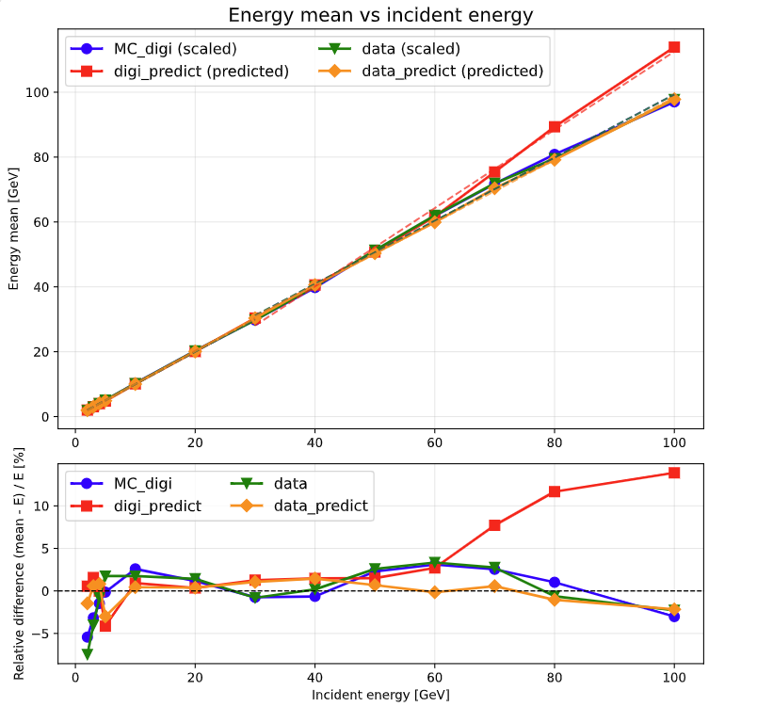
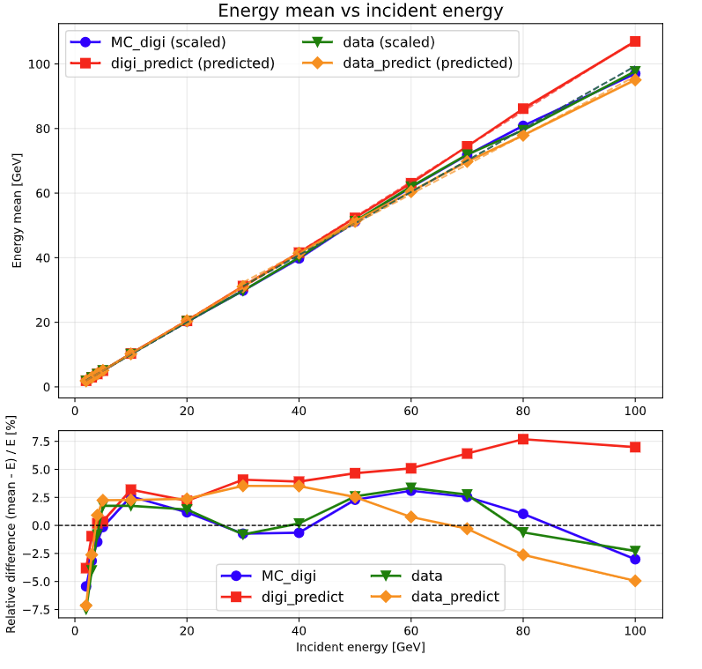
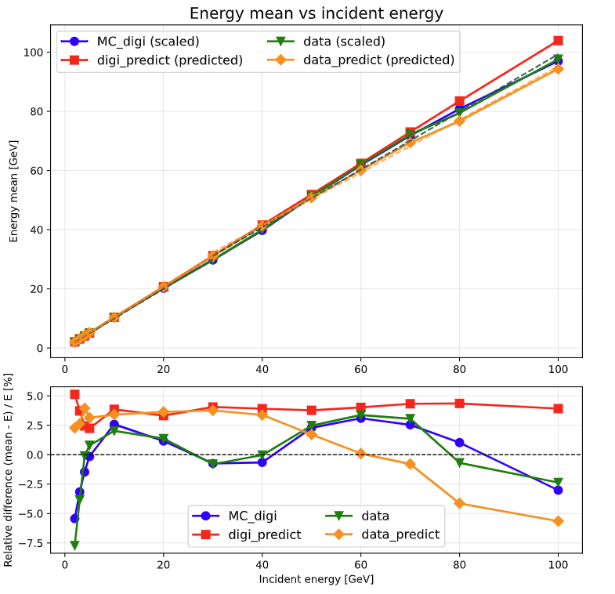
CNN+LSTM Result_Linearity
stage 2
stage 1
Pre-trained model
Notes:
When comparing both models trained on the same restricted 12,000-sample dataset, the CNN+LSTM architecture demonstrates a clear advantage over the standard MLP. Despite the limitations of data starvation, the CNN+LSTM model achieves better energy resolution and more stable linearity. This suggests a potentially superior capability in extracting complex spatial and longitudinal shower features directly from the raw hit data.

Slide 13
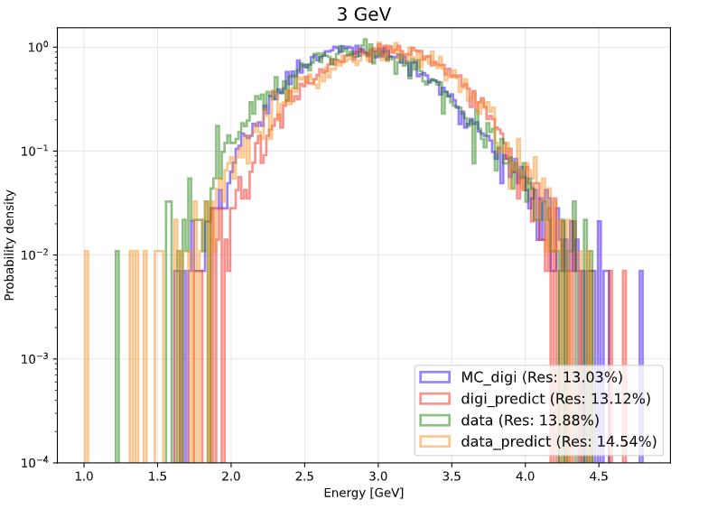
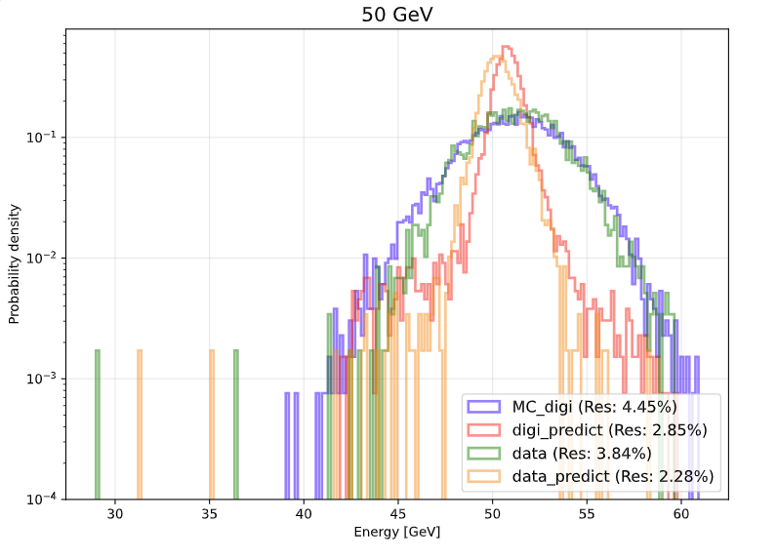
CNN+LSTM Result HCAL Transfer Learning
3GeV
50GeV
Notes:
In contrast to the resolution, no comparable enhancement was observed in the energy linearity.

Slide 14
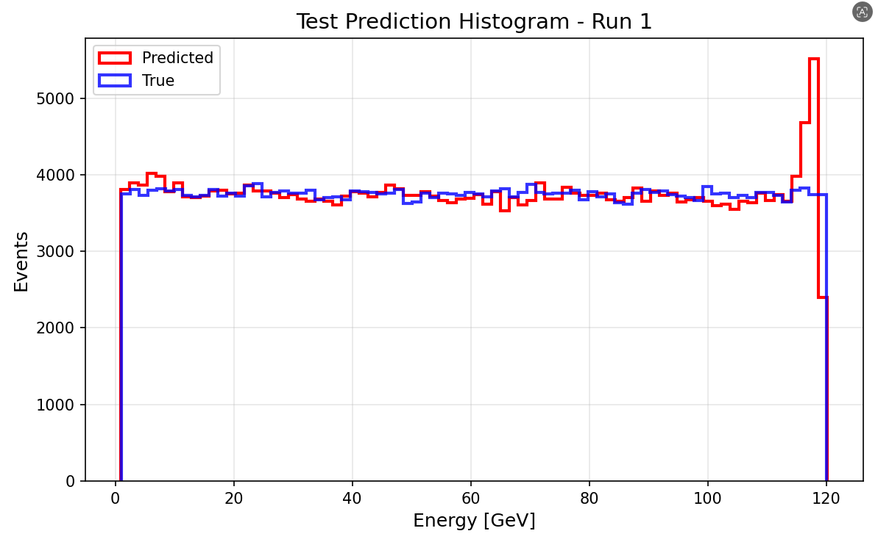
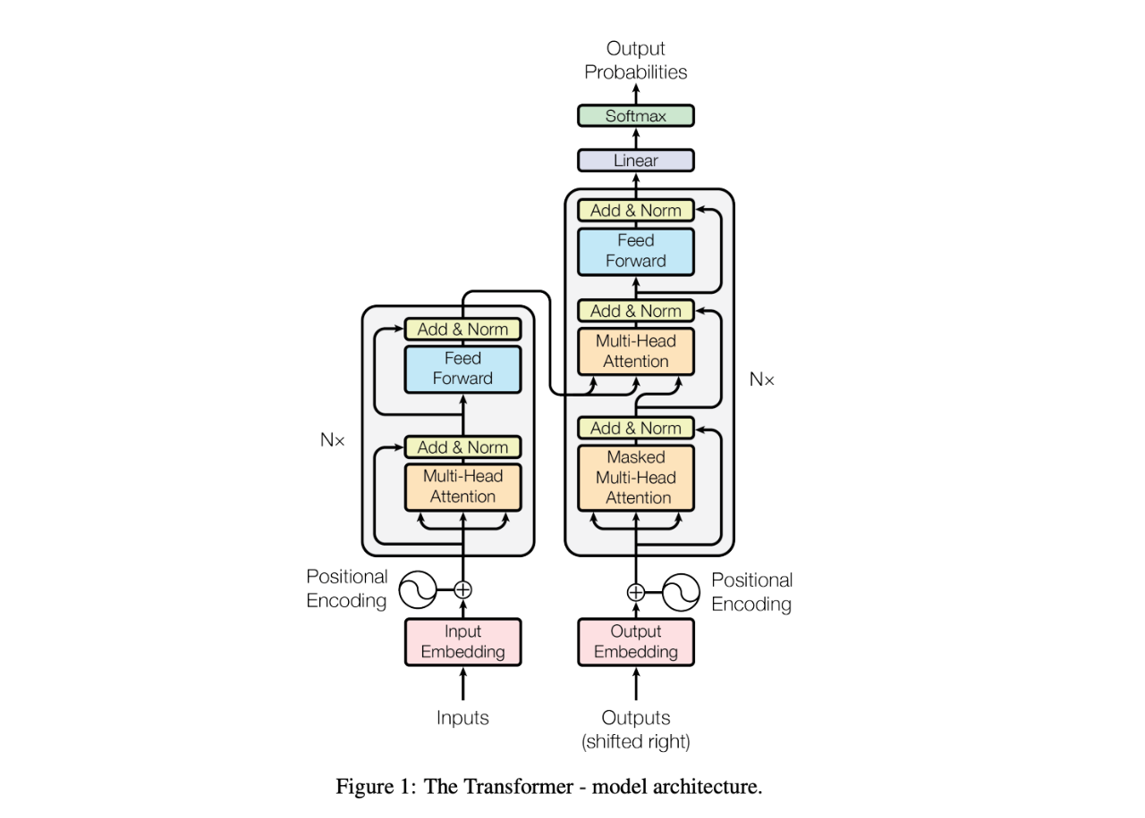
CNN+Transformer Trian (2000000)
Input(hit level data):
HIt_ENERGY
Output:
  Predicted Energy
CNN (Convolutional Neural Network)
Samples:
MC: 1-120GeV (2000000) Continuous e-
Data split
train_frac = 0.7
val_frac = 0.15
test_frac = 0.15
Read the hit image of the super layer
Transformer
Learn the development of shower at different levels
lr =1e-4
batch_size =256
epochs =150
weight_decay =1e-4
optimizer ="adamw"
Input and Output（rellative error <1%）
Notes:
When comparing both models trained on the same restricted 12,000-sample dataset, the CNN+LSTM architecture demonstrates a clear advantage over the standard MLP. Despite the limitations of data starvation, the CNN+LSTM model achieves better energy resolution and more stable linearity. This suggests a potentially superior capability in extracting complex spatial and longitudinal shower features directly from the raw hit data.

Slide 15
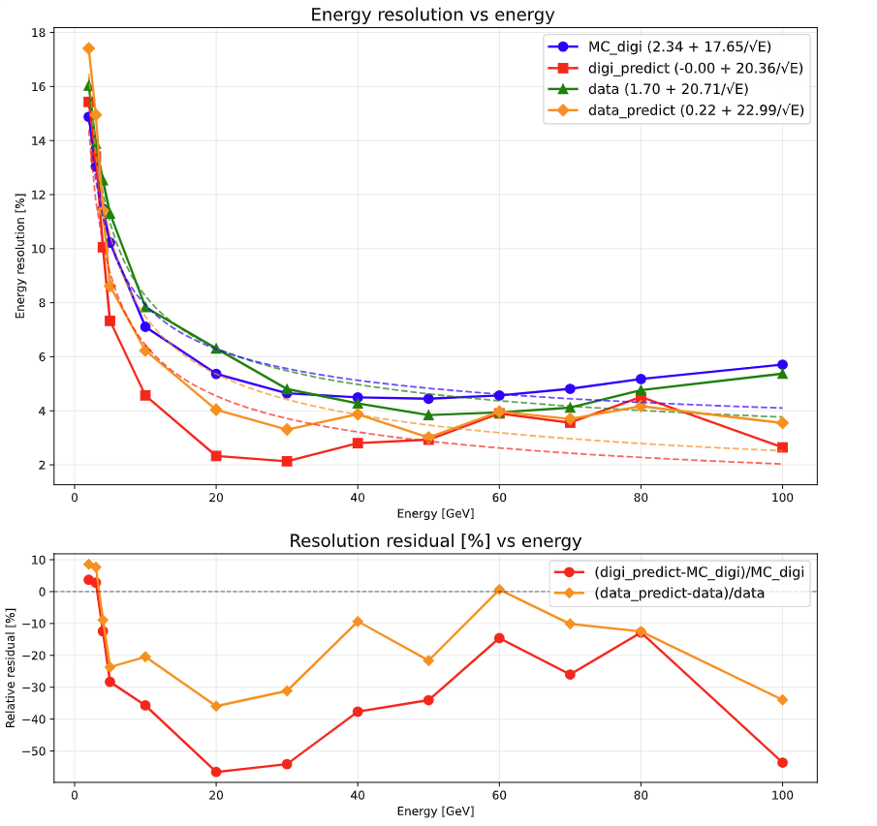
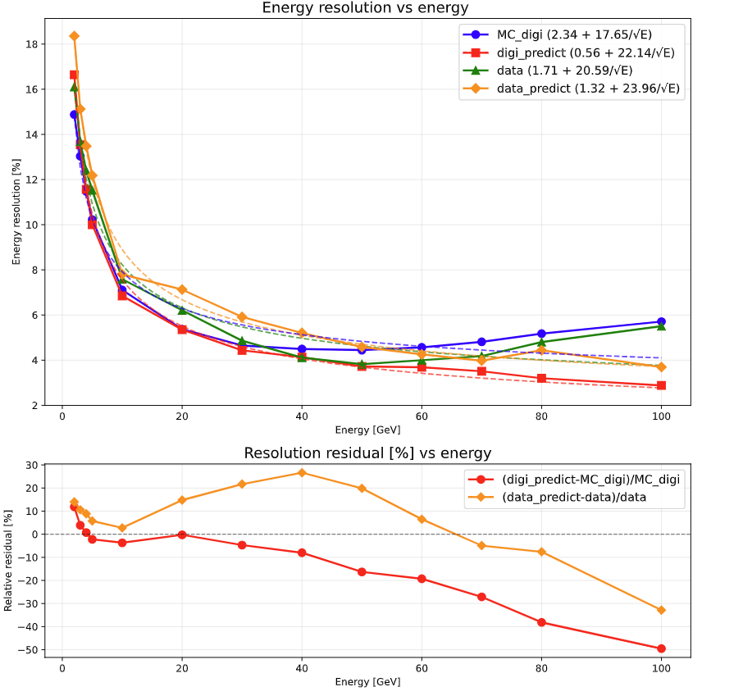
CNN+Transformer Result_Energy Resolution
Transfer Learning
Pre-trained model
Notes:
When comparing both models trained on the same restricted 12,000-sample dataset, the CNN+LSTM architecture demonstrates a clear advantage over the standard MLP. Despite the limitations of data starvation, the CNN+LSTM model achieves better energy resolution and more stable linearity. This suggests a potentially superior capability in extracting complex spatial and longitudinal shower features directly from the raw hit data.

Slide 16
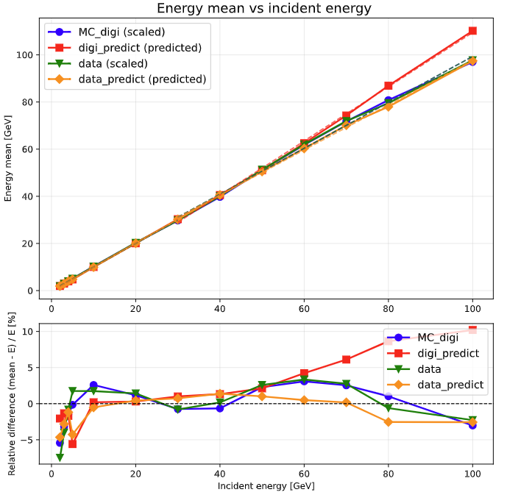
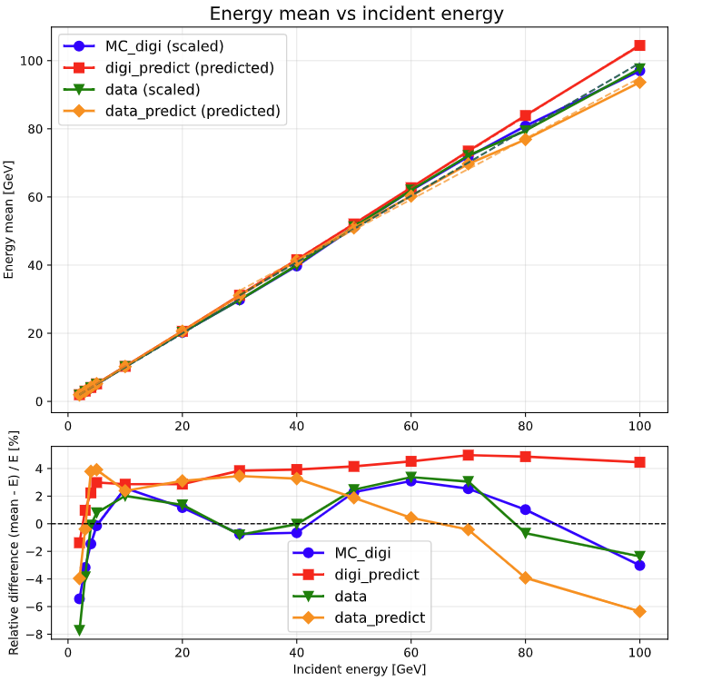
CNN+Transformer Result_Linearity
Transfer Learning
Pre-trained model
Notes:
When comparing both models trained on the same restricted 12,000-sample dataset, the CNN+LSTM architecture demonstrates a clear advantage over the standard MLP. Despite the limitations of data starvation, the CNN+LSTM model achieves better energy resolution and more stable linearity. This suggests a potentially superior capability in extracting complex spatial and longitudinal shower features directly from the raw hit data.

Slide 17
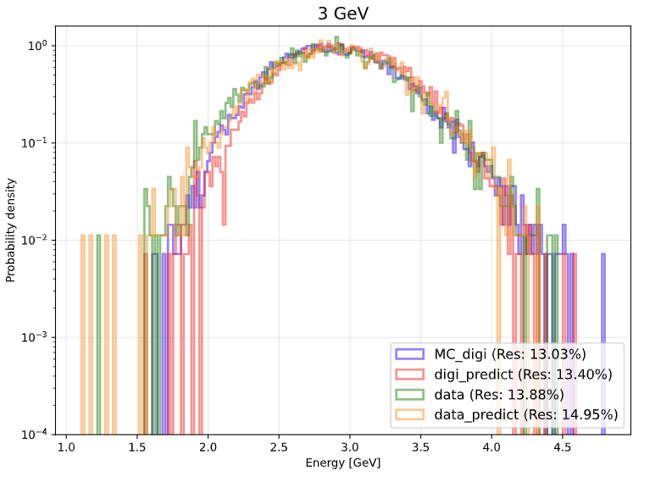
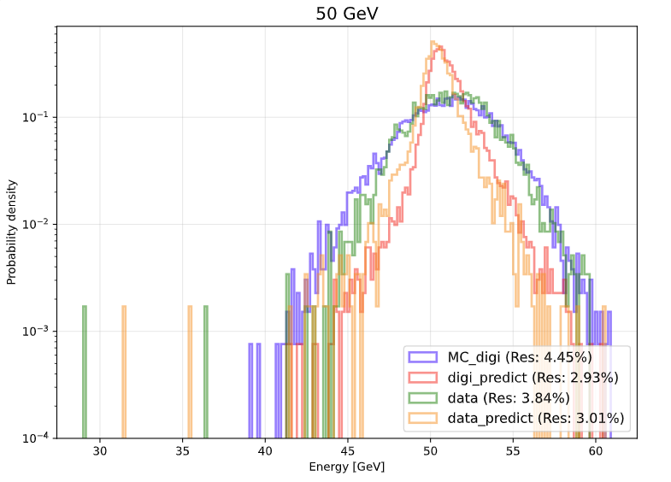
CNN+Transformer Result HCAL Transfer Learning
3GeV
50GeV
Notes:
In contrast to the resolution, no comparable enhancement was observed in the energy linearity.

Slide 18
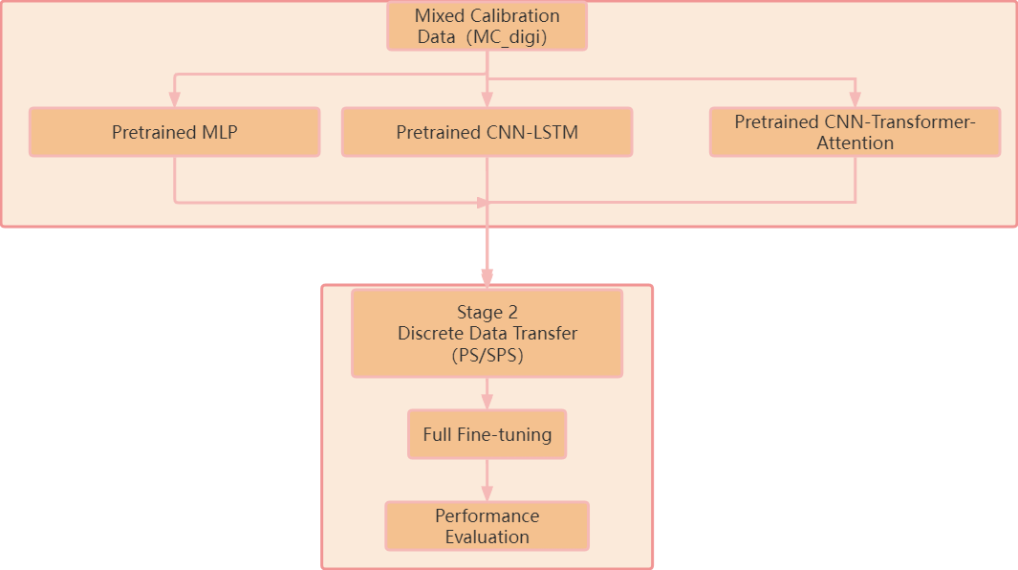
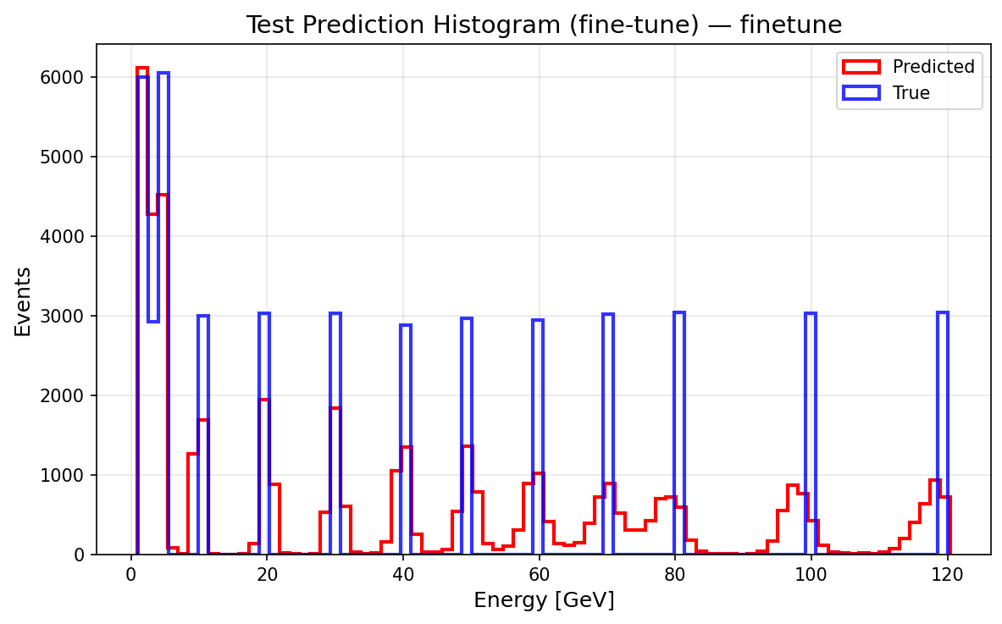
Transfer Learning Option two
Samples:
MC (After digilization) : 1-120GeV e-(20000000) Continuous
Data without position selecting: from PS and SPS [ 1.0,2.0,3.0,4.0,5.0,10.0, 20.0, 30.0, 40.0, 50.0, 60.0, 70.0, 80.0, 100.0, 120]GeV Uniformly mixed
Pre-trained model
Transfer Learning
Notes:
In contrast to the resolution, no comparable enhancement was observed in the energy linearity.

Slide 19
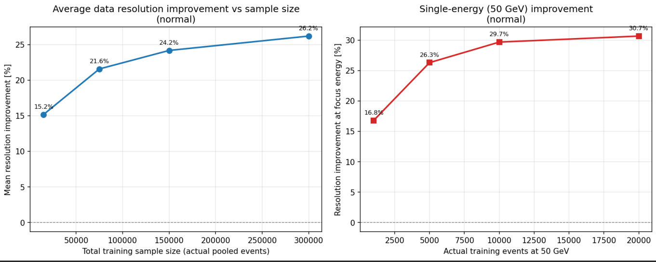
Scaling without position seleing skip stage 1
CNN+LSTM 50GeV
Scaling up the data volume consistently improves both the average and single-point energy resolutions
Notes:
In contrast to the resolution, no comparable enhancement was observed in the energy linearity.

Slide 20
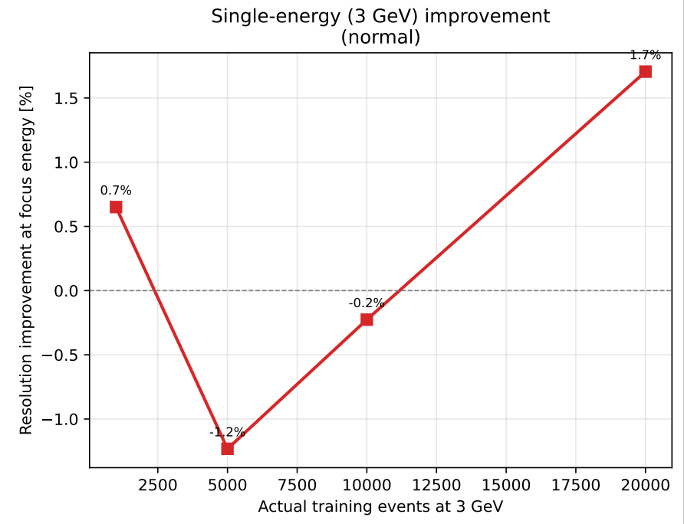
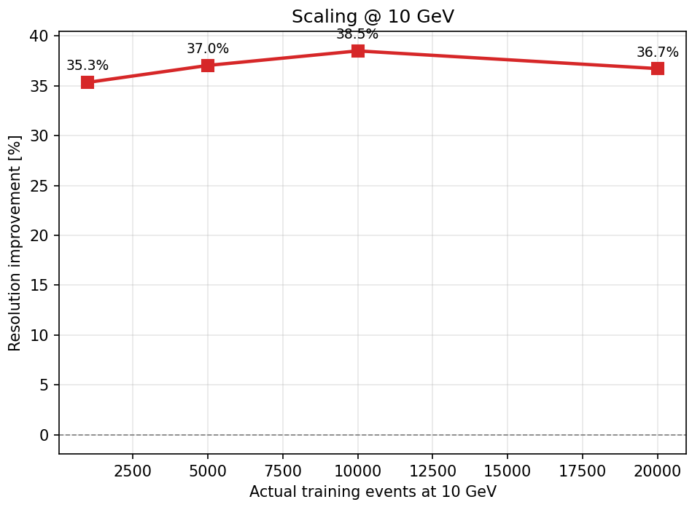
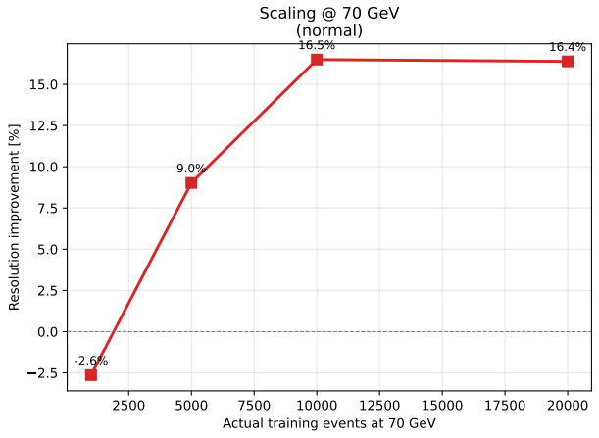
Scaling without position seleing skip stage 1
CNN+LSTM 3GeV
CNN+LSTM 10GeV
CNN+LSTM 70GeV
The amount of data required to improve energy resolution varies at different energy points
Notes:
In contrast to the resolution, no comparable enhancement was observed in the energy linearity.

Slide 21
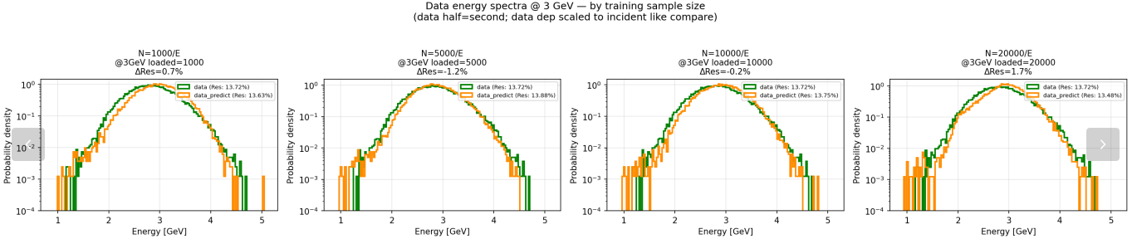
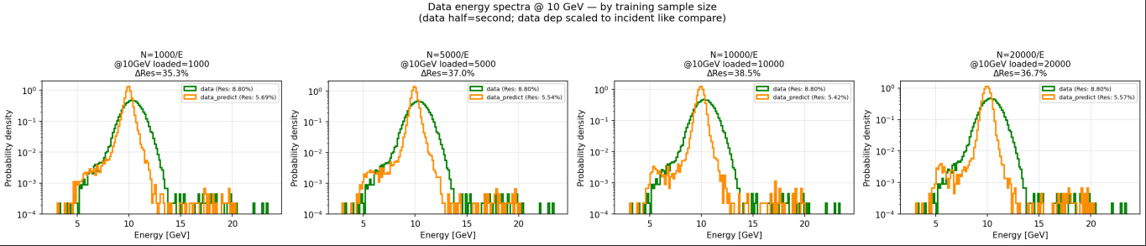
Scaling without position seleing skip stage 1
CNN+LSTM
3GeV
10GeV
Notes:
In contrast to the resolution, no comparable enhancement was observed in the energy linearity.

Slide 22
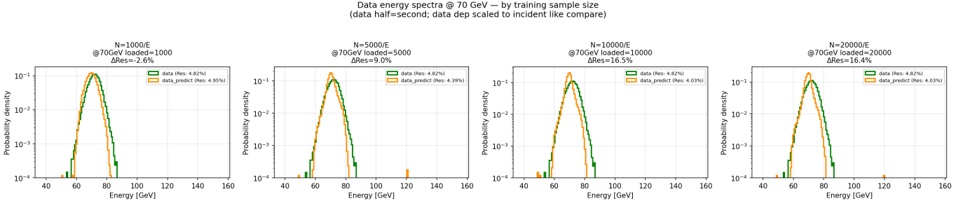
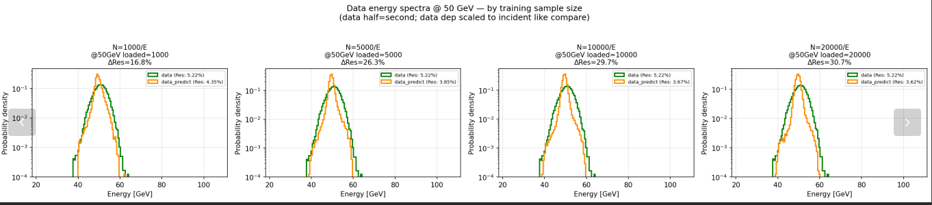
Scaling without position seleing skip stage 1
CNN+LSTM
70GeV
50GeV
Notes:
In contrast to the resolution, no comparable enhancement was observed in the energy linearity.

Slide 23
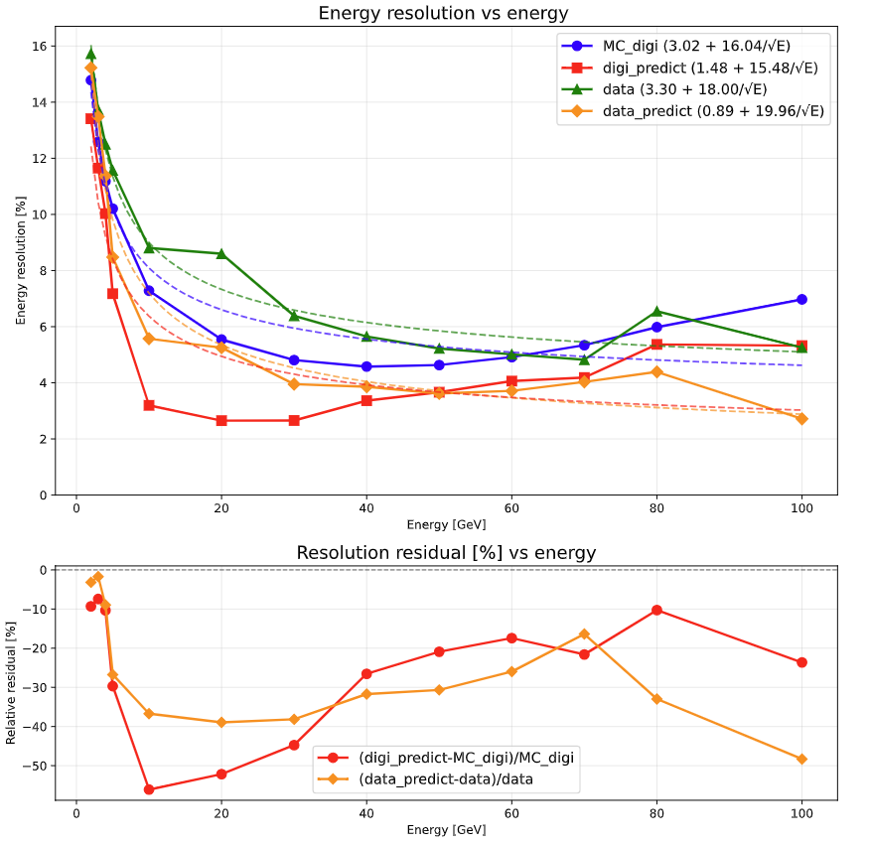
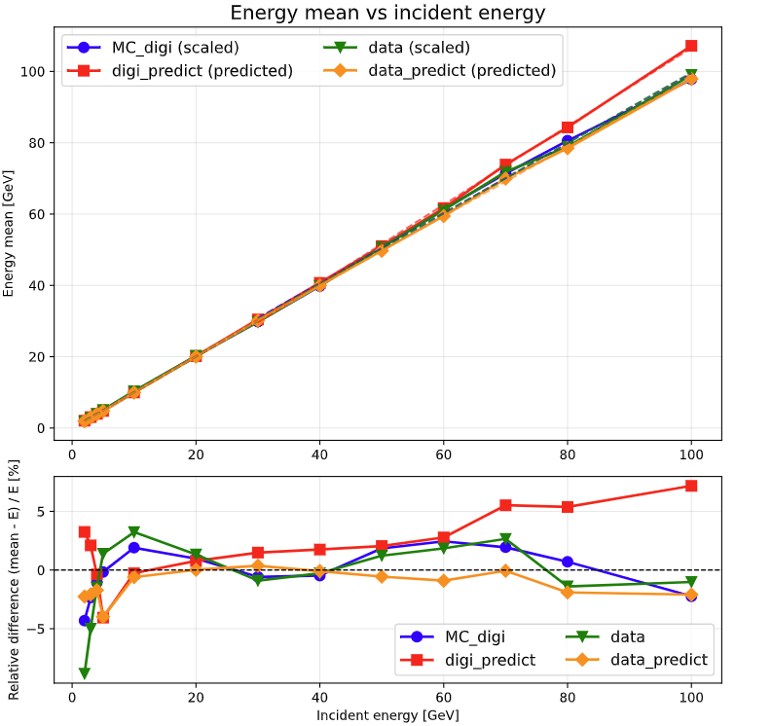
Scaling without position seleing skip stage 1
CNN+LSTM Per energy data sample 20000
Energy Resolution
Energy Linearity
Notes:
In contrast to the resolution, no comparable enhancement was observed in the energy linearity.

Slide 24
Summary
Model Performance: Both CNN+LSTM and CNN+Transformer outperform MLP, demonstrating that hit-level data contains richer information. CNN+LSTM also better than CNN+Transformer, likely because shower development exhibits a distinct sequential order across layers. This structural characteristic favors the recurrent nature of LSTMs over the multi-head attention mechanism of Transformers.
Transfer learning: Following the application of transfer learning, both the linearity and energy resolution of the data exhibited significant improvements.
Concern: Risk of Overfitting: May over-optimize on isolated energy points.
      Generalization Concern: Risk of non-physical "hallucinations" at unseen energies.
Next step
Update CNN+Tramsformer CNN+LSTM and Transfer learning.
Notes:
In conclusion, while the hit-level CNN+LSTM architecture demonstrates significant theoretical potential, sample size remains the absolute decisive factor for performance. Moving forward, we plan to scale our CNN+LSTM training to 1.2 million samples and explore Transformer-based architectures

Slide 25
Transfer Learning Option One
Samples:
MC (After digilization) : 1-120GeV e-(20000000) Continuous
Data with position selecting: from PS and SPS [ 1.0,2.0,3.0,4.0,5.0,10.0, 20.0, 30.0, 40.0, 50.0, 60.0, 70.0, 80.0, 100.0, 120]GeV Uniformly mixed
E [GeV] loaded key
1 1610 1GeV
2 12989 2GeV
3 23634 3GeV
4 49636 4GeV
5 46817 5GeV
10 6686 10GeV
20 50000 20GeV
30 46188 30GeV
40 19523 40GeV
50 27840 50GeV
60 5623 60GeV
70 3911 70GeV
80 1486 80GeV
100 1482 100GeV
120 700 120GeV
Pre-trained model
Transfer Learning
Notes:
In contrast to the resolution, no comparable enhancement was observed in the energy linearity.

Slide 26
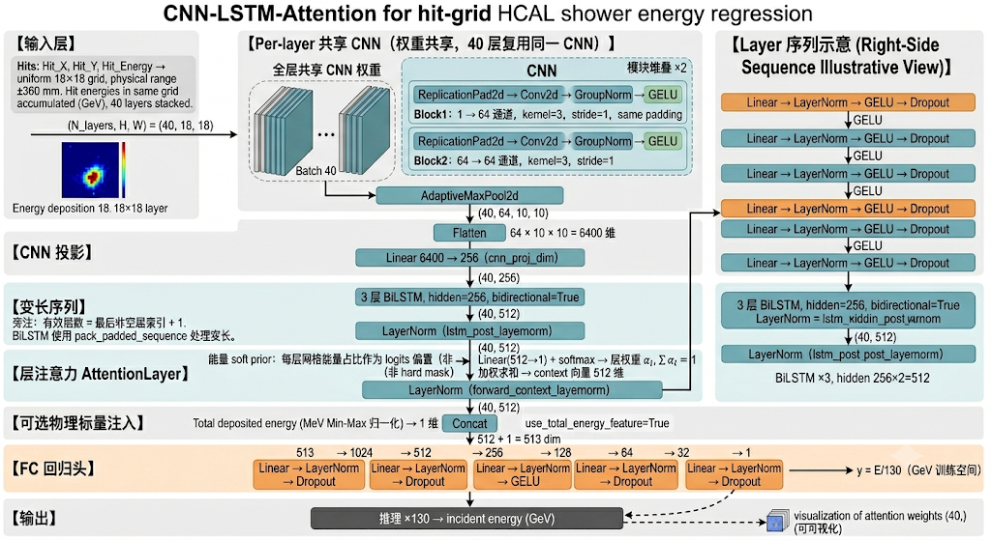
CNN+LSTM Trian (2000000)
Notes:
We also explored a deep learning approach using a CNN+LSTM network to directly process hit energy images. The goal is to learn the spatial and longitudinal development of the clusters. However, due to computational constraints, this initial test was limited to a dataset of 12,000 samples.

Slide 27
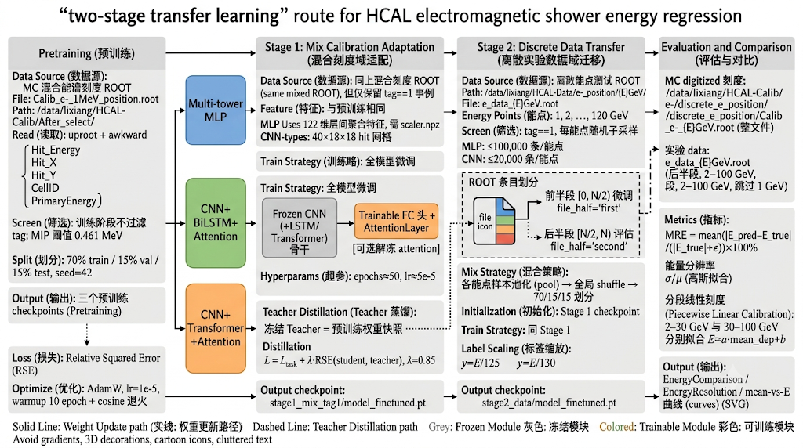
Transfer Learning
Notes:
In contrast to the resolution, no comparable enhancement was observed in the energy linearity.

Slide 28
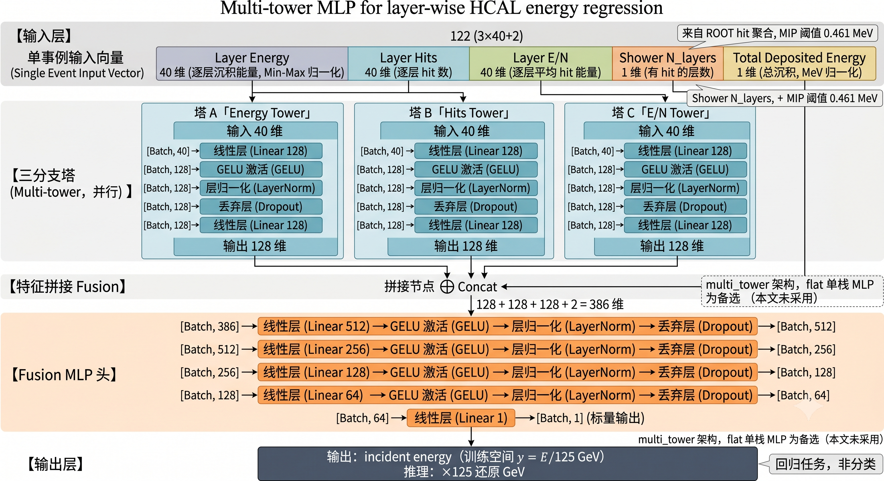
M(ulti) L(ayer) P(erceptron) Trian
Notes:
For the layer-wise MLP model, the inputs consist of 97 features: energy, hit counts, and energy-to-hit ratios for each of the 32 layers, plus the total deposited energy. To ensure robust learning, the model is trained on a comprehensive dataset of 12 million continuous Monte Carlo samples ranging from 1 to 120 GeV.

Slide 29
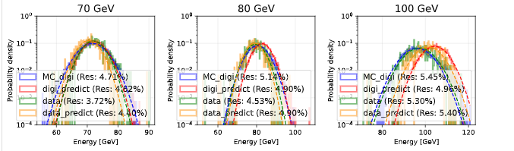
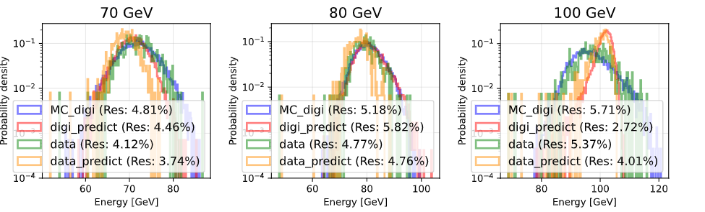
MLP Result HCAL Transfer Learning
Pre-trained model
Transfer Learning
Notes:
In contrast to the resolution, no comparable enhancement was observed in the energy linearity.

Slide 30
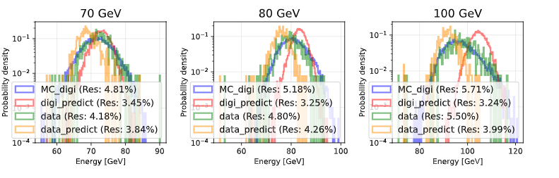

CNN+Transformer Result HCAL Transfer Learning
Pre-trained model
Transfer Learning
Notes:
In contrast to the resolution, no comparable enhancement was observed in the energy linearity.

Slide 31

MLP
Notes:
When comparing both models trained on the same restricted 12,000-sample dataset, the CNN+LSTM architecture demonstrates a clear advantage over the standard MLP. Despite the limitations of data starvation, the CNN+LSTM model achieves better energy resolution and more stable linearity. This suggests a potentially superior capability in extracting complex spatial and longitudinal shower features directly from the raw hit data.

Slide 32

CNN+LSTM
Notes:
When comparing both models trained on the same restricted 12,000-sample dataset, the CNN+LSTM architecture demonstrates a clear advantage over the standard MLP. Despite the limitations of data starvation, the CNN+LSTM model achieves better energy resolution and more stable linearity. This suggests a potentially superior capability in extracting complex spatial and longitudinal shower features directly from the raw hit data.

Slide 33
离散数据按入射能：载入迁移池 | 参与迁移训练(train) | 验证(val) | 测试(test)
每能点请求采样 ≤ 100000; ROOT half=first; 划分比例 train/val/test = 0.7/0.15/0.15
池合计 298463 条（全能量合并后打乱，再按比例切分）
============================================================
E [GeV] pooled train val test
1 1610 1104 259 247
2 12989 9019 1980 1990
3 23634 16487 3621 3526
4 49636 34707 7495 7434
5 46817 32820 7041 6956
10 6686 4694 979 1013
20 50338 35202 7494 7642
30 46188 32540 6787 6861
40 19523 13676 2934 2913
50 27840 19496 4182 4162
60 5623 3922 843 858
70 3911 2737 581 593
80 1486 1039 237 210
100 1482 987 226 269
120 700 494 110 96
------------------------------------------------------------
TOTAL 298463 208924 44769 44770
============================================================
Notes:
In contrast to the resolution, no comparable enhancement was observed in the energy linearity.

