Slide 1
From Geant4 to FastCaloGAN: Fast Simulation in HEP
Group8:杨家齐

Slide 2
Content
ATLAS
Geant4
Fast Simulation
FastCaloGAN
Comparison
Summary

Slide 3
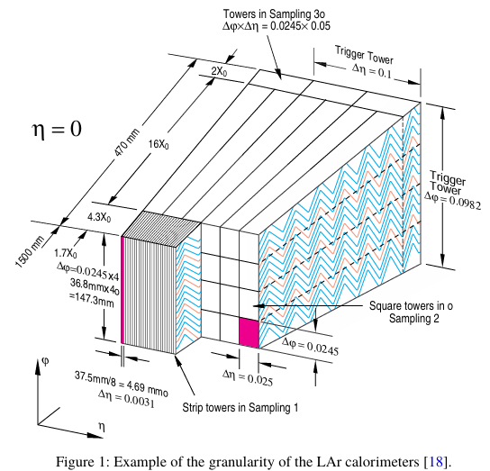
ATLAS
The ATLAS calorimeter system is divided into three main regions: the barrel, the end-cap, and the forward region.
η = -ln tan(θ/2)
The electromagnetic calorimeter has three active layers in the precision-measurement region (|η| < 2.5) and two layers in the higher-|η| region (2.5 < |η| < 3.2). In addition, the forward calorimeter (FCal) provides coverage in the range 3.1 < |η| < 4.9, and presamplers are used in the region |η| < 1.8.
The barrel hadronic calorimeter (TileCal) covers |η| < 1.7, while the hadronic end-cap calorimeter (HEC) and FCal extend the hadronic coverage to |η| < 4.9.

Slide 4
Geant4
Geant4 is one of the standard tools for detector simulation in high-energy physics. It uses Monte Carlo methods to model how particles pass through matter, including their interactions, energy deposition, and secondary particle production.
By combining detector geometry, material properties, and physical processes in a step-by-step simulation, Geant4 provides high-precision full simulation and serves as an important benchmark for later fast simulation methods.

Slide 5
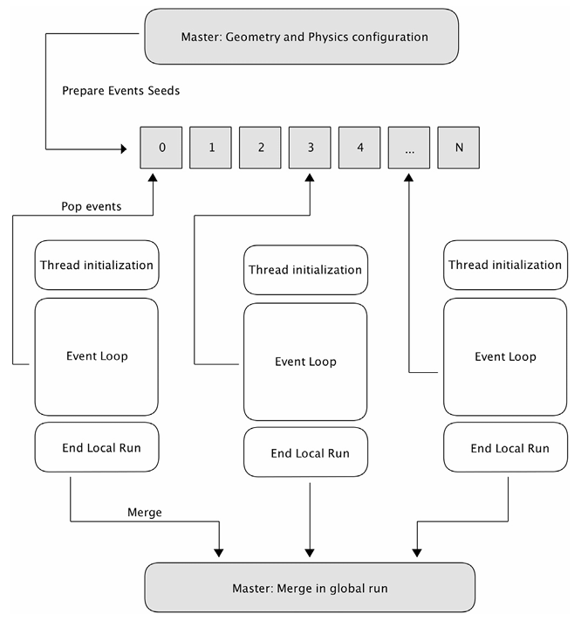
Geant4
In multithreaded Geant4, the master thread prepares the geometry and physics setup, while worker threads simulate one or more events independently. This event-level parallelism allows Geant4 to use many-core machines more efficiently and to share constant data, such as geometry and physics tables, across threads. At the end of the run, thread outputs can be merged into the global result

Slide 6
Fast Simulation
Full detector simulation based on Geant4 provides high precision, but it is computationally very expensive. In large experiments such as ATLAS, calorimeter shower simulation is one of the main CPU bottlenecks. Therefore, fast simulation methods are developed to replace the most expensive parts of full simulation while preserving the key detector response as accurately as possible.

Slide 7
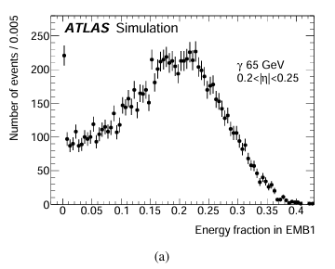
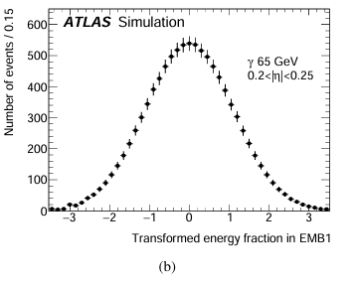
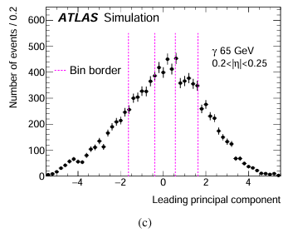
FastCaloSim V2 parameterizes longitudinal shower development in three steps:
(a) the energy fraction in each calorimeter layer is extracted from Geant4 samples;
(b) each distribution is transformed into an approximately Gaussian variable;
(c) PCA is then applied to decorrelate the layer energies and classify showers into bins.
During simulation, this chain is reversed to generate fast calorimeter responses.

Slide 8
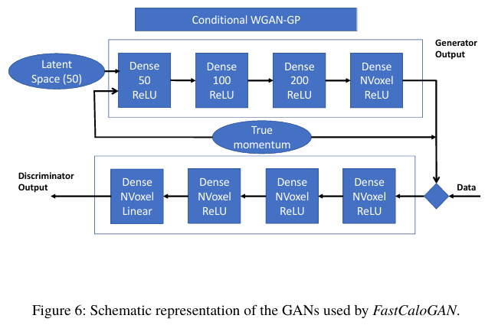
FastCaloGAN
FastCaloGAN is implemented as a conditional WGAN-GP.
The generator takes latent noise and the true particle momentum as input, and outputs the voxelized energy deposition in the calorimeter. The discriminator compares generated showers with Geant4 showers, so that the model learns the calorimeter response distribution directly.

Slide 9
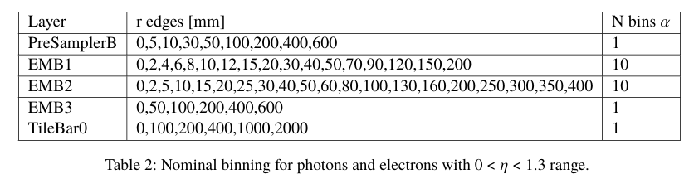
FastCaloGAN
- Split the calorimeter into 100 eta slices
- Train separate GANs for photons, electrons and pions
- Convert Geant4 hits into voxelized showers
- Optimize the representation for particle type and detector region
- Reduce sparsity while preserving the main shower structure

Slide 10
FastCaloGAN
After training, FastCaloGAN is not used as a standalone TensorFlow model. The selected generator checkpoints are converted into a format that can be loaded inside the ATLAS Athena framework via LWTNN. The generator first produces energy deposits at the voxel level, and these voxel energies are then mapped back to ATLAS calorimeter cells.
In this way, the FastCaloGAN output can be processed by the standard ATLAS reconstruction chain and compared at the level of reconstructed physics objects.

Slide 11
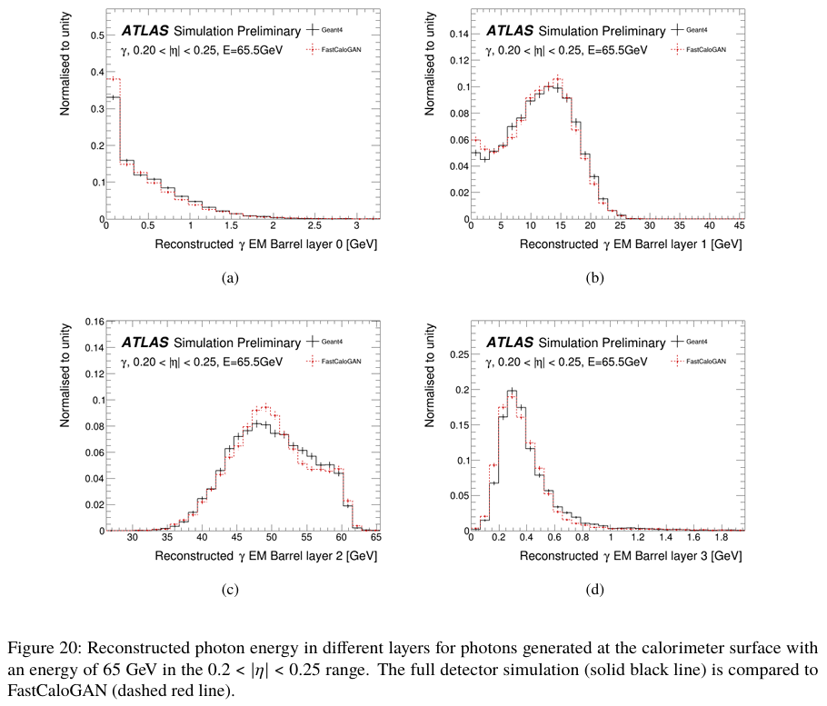
FastCaloGAN
In AtlFast3, FastCaloGAN is used as part of a hybrid fast-simulation system rather than as a universal replacement.
FastCaloSim V2 is kept for electromagnetic showers and for low- and high-energy hadrons, while FastCaloGAN is mainly used for medium-energy hadronic showers, where correlated fluctuations are more difficult to capture with traditional parameterization.

Slide 12
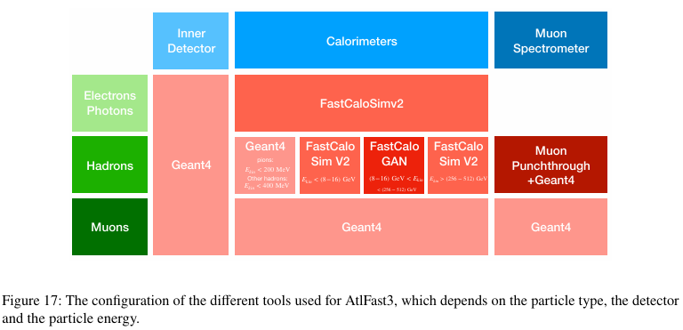
FastCaloGAN
In AtlFast3, FastCaloGAN is used within a larger hybrid simulation workflow rather than as a standalone replacement.
The choice of tool depends on the particle type, the detector region, and the particle energy. Electromagnetic showers are handled by FastCaloSim V2, medium-energy hadronic showers are assigned to FastCaloGAN, and the remaining parts are covered by Geant4 or other dedicated components. This system-level configuration is what makes fast simulation both practical and reliable in real ATLAS production.

Slide 13
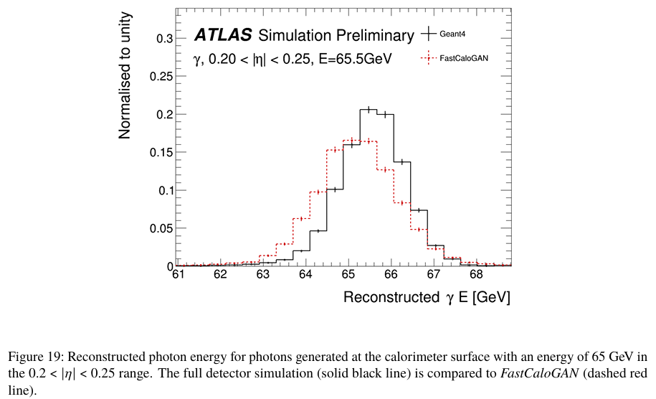
Comparison
Figure 19 compares the reconstructed photon-energy distribution for 65 GeV photons in the range 0.2 < |η| < 0.25.
The black curve is the Geant4 result, and the red dashed curve is the FastCaloGAN result after standard ATLAS reconstruction.

Slide 14
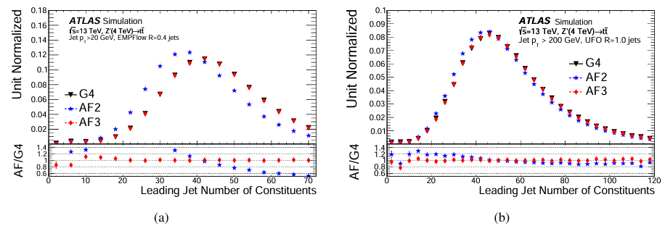
Comparison
Compares the number of jet constituents in Geant4, AtlFastII, and AtlFast3. In both EMPFlow jets and UFO jets, AtlFastII tends to underestimate the constituent multiplicity, while AtlFast3 follows the Geant4 distribution more closely. This indicates that the newer hybrid fast-simulation scheme gives a better description of jet internal structure.

Slide 15
Summary
Full detector simulation with Geant4 is accurate, but too computationally expensive for large-scale ATLAS event production.
This motivates fast simulation, first with parameterized methods such as FastCaloSim.
Generative approaches such as FastCaloGAN are better suited to modelling complex, correlated shower fluctuations.
The key strategy is to target the main simulation bottleneck and balance physics fidelity, computing cost, and integration into the analysis workflow.

Slide 16
References
Course Chapter 6: Calibration and Simulation
Agostinelli et al., Geant4-a simulation toolkit, NIM A 506 (2003) 250-303
ATLAS Collaboration, AtlFast3: the next generation of fast simulation in ATLAS, arXiv:2109.02551
Paganini et al., CaloGAN: Simulating 3D High Energy Particle Showers in Multi-Layer Electromagnetic Calorimeters with Generative Adversarial Networks, arXiv:1712.10321
ATLAS Collaboration, Fast simulation of the ATLAS calorimeter system with GANs, ATL-SOFT-PUB-2020-006

Slide 17
Thanks

