Slide 1
Performance of the LHCb muon detector in Run 3
汇报人：马博 胡涌泉 聂雨

Slide 2
upgrade
The LHCb Experiment and Run 3 Upgrade
LHCb is a dedicated heavy flavor physics experiment at the LHC, covering the rapidity range 2<η<5, mainly studying particles containing c and b quarks.
Run 2 (2015–2018): Instant brightness L = 4 × 10^32 cm⁻² s⁻¹
Run 3 (2022–2026): The instantaneous luminosity increases 5 times, reaching L = 2 × 10^33 cm⁻² s⁻¹.

Slide 3
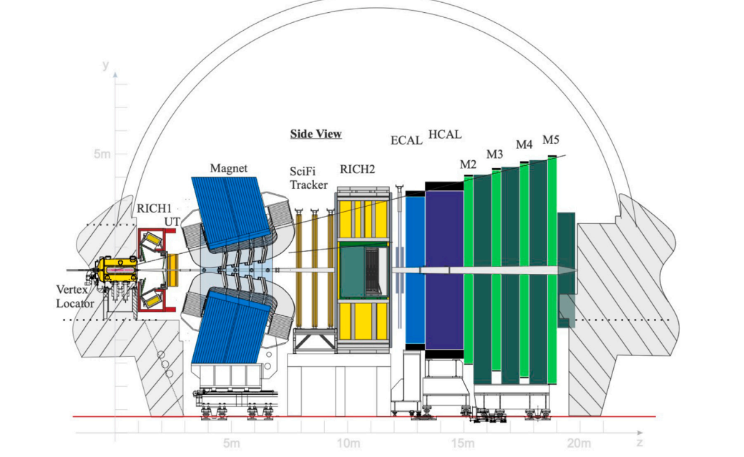
upgrade
The μ detector is located at the very end of the spectrometer
and consists of four rectangular stations, M2–M5, with 80 cm thick iron absorbers between the stations.
Main function: muon identification,
providing triggering and offline selection
for physics analyses
with a large number of muon final states.

Slide 4
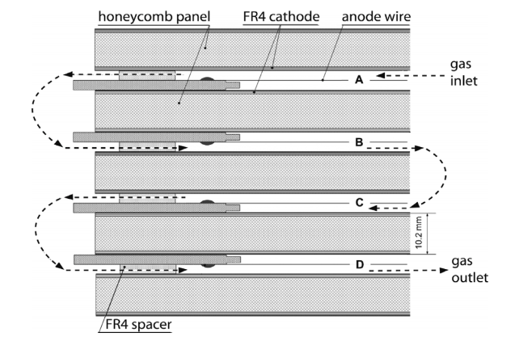
upgrade
1、Particle traversal
2、Gas ionization
3、Electron drift
4、Avalanche multiplication
5、Signal generation
MWPC

Slide 5
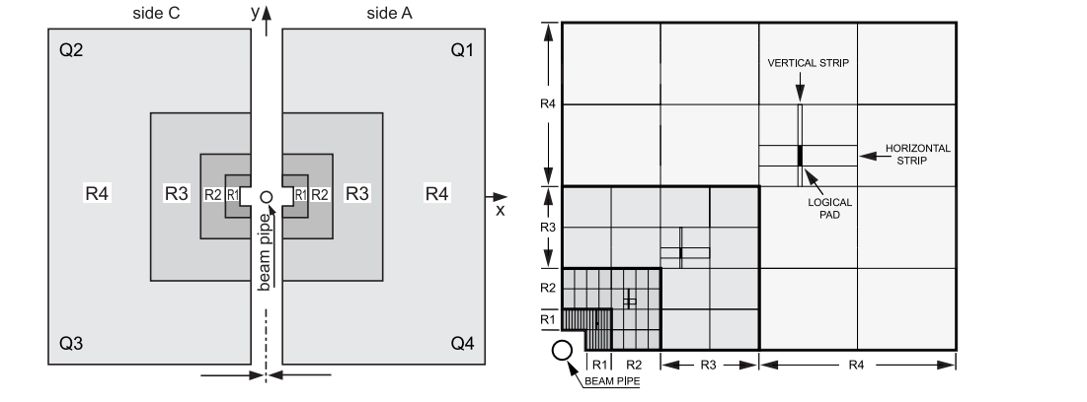
upgrade
A front view of a detector station
Horizontal strip: Sections from the cathodic pads
Vertical strip: Groups from the anode wires
x
y

Slide 6
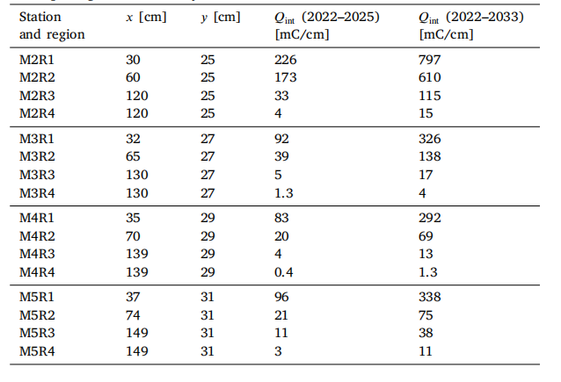
upgrade
Aging Assessment
The R2/R3/R4 of M2 and R4 of M5 removed the logic merge layer, which increased granularity and reduced dead time.
goal：Maintain or even improve the μ particle identification performance of Run 2：
  muon efficiency >90%
  Hadron misidentification rate <1%

Slide 7
Calibration (Time & Space)
Time calibration
指标 | 校准前 | 校准后
信号峰与 BXID 窗口中心偏差 | 可达 ±10 ns 以上 | < 1 ns
单站 hit 效率 | 可能低于 90% | > 99%
误归束团的比例 | 不可接受 | 可忽略

Slide 8
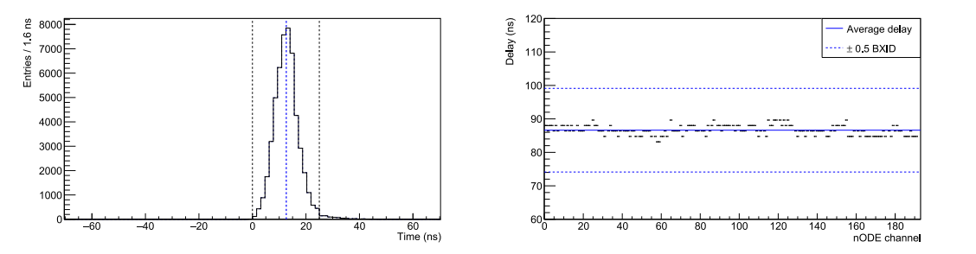
Calibration (Time & Space)
Time distribution of the nODE channel .
The blue vertical line marks the center of the target BXID (25 ns window).
There's a tail near the signal peak.
Delay settings for all 32 channels on the node

Slide 9
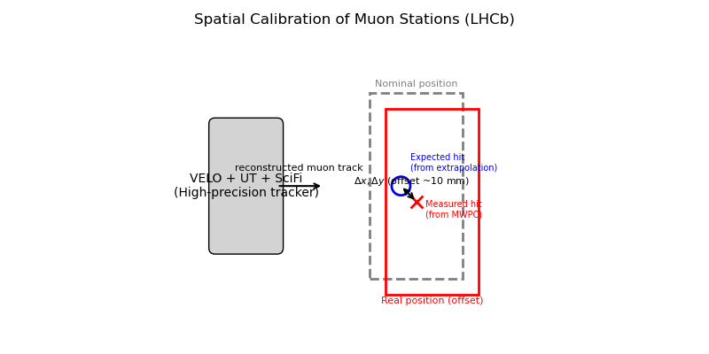
Calibration (Time & Space)
Space calibration
虚线框：μ 子站标称位置
实线框：μ 子站真实位置（带偏移）
：Expected hitting point
： Actual hit point
由于维护后探测器站的实际位置会偏离设计值，需要精确测量每个 μ 子站的偏移量

Slide 10
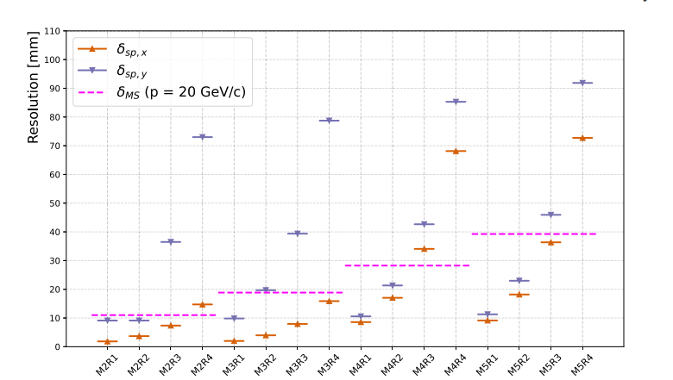
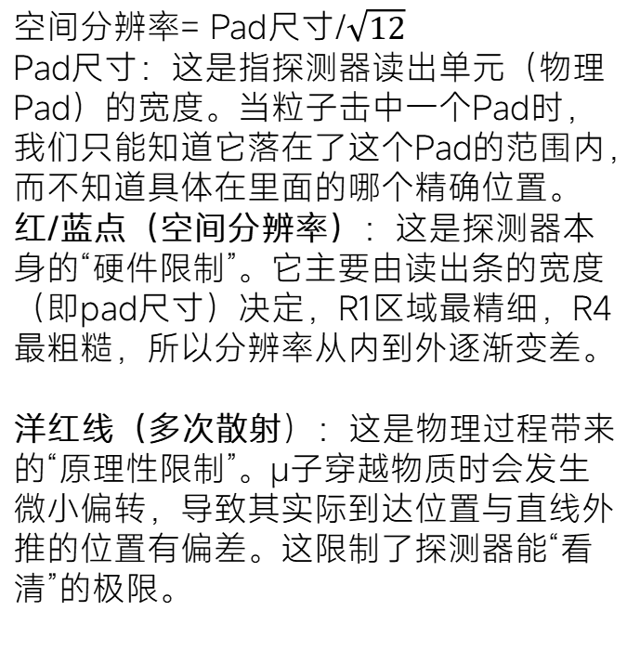
Calibration (Time & Space)
空间分辨率= Pad尺寸/$\sqrt{12}$
​Pad尺寸：这是指探测器读出单元（物理Pad）的宽度。当粒子击中一个Pad时，我们只能知道它落在了这个Pad的范围内，而不知道具体在里面的哪个精确位置。
红/蓝点（空间分辨率）：这是探测器本身的“硬件限制”。它主要由读出条的宽度（即pad尺寸）决定，R1区域最精细，R4最粗糙，所以分辨率从内到外逐渐变差。
洋红线（多次散射）：这是物理过程带来的“原理性限制”。μ子穿越物质时会发生微小偏转，导致其实际到达位置与直线外推的位置有偏差。这限制了探测器能“看清”的极限。

Slide 11
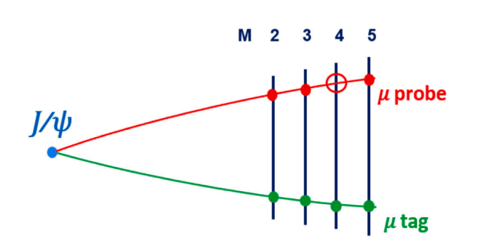


Testing (Performance Measurement)
Standard Methods for Measuring Efficiency
Side view diagram of four stations

Slide 12
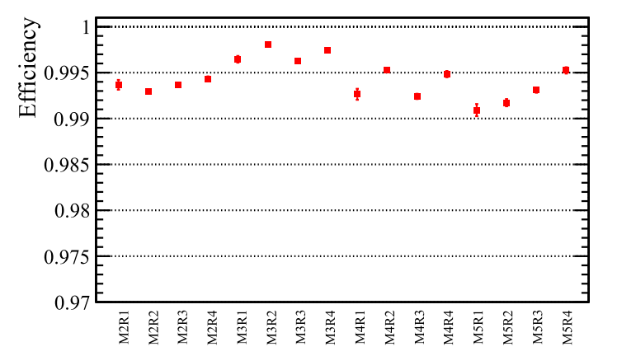
Testing (Performance Measurement)
The four areas (R1-R4) of each station (M2-M5) are all operating at nearly 100% efficiency.
All areas have an efficiency of over 99%, meeting the design goal.

Slide 13
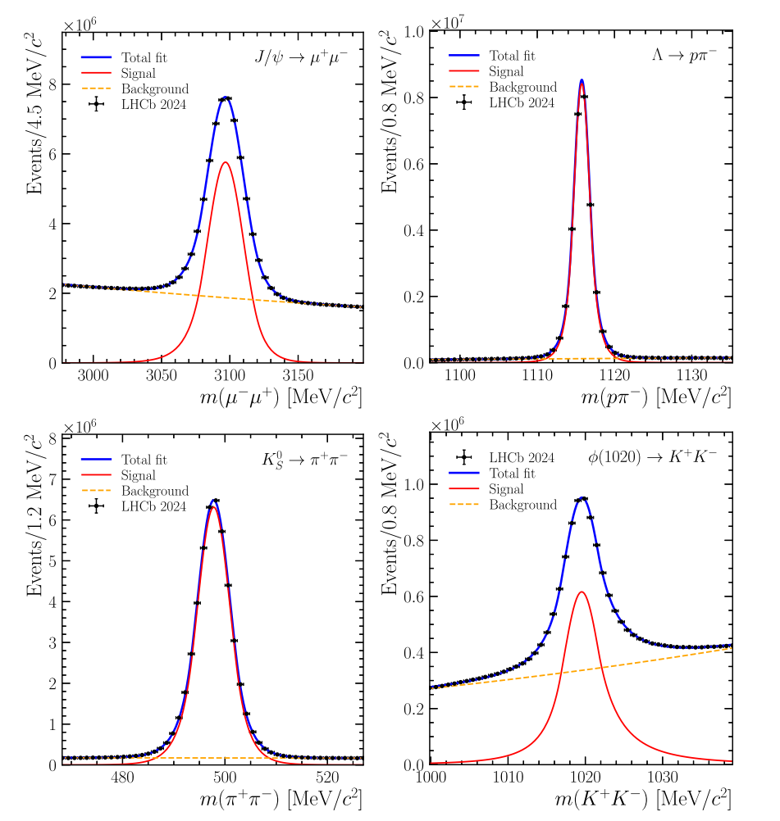
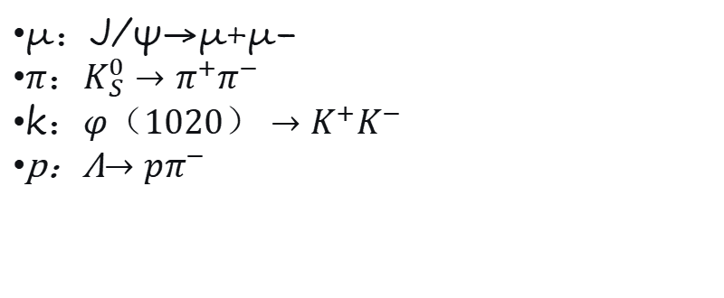
Testing (Performance Measurement)
μ：J/ψ→μ+μ−
$π：K_{S}^{0}→π^{+}π^{−}$
k$：φ（1020）→K^{+}K^{−}$
p：Λ$→pπ^{−}$
The fitting results are used to calculate the sPlot weight for each event, so that the background can be subtracted in later analysis.

Slide 14
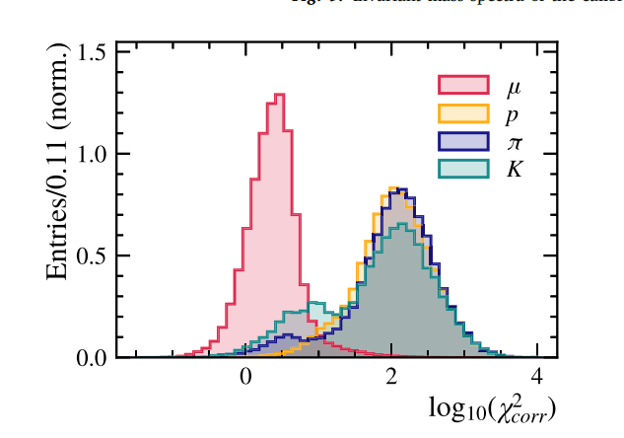
Testing (Performance Measurement)
单击此处编辑母版文本样式
第二级
第三级
第四级
第五级
μ 集中在低值区，说明其 hit 与径迹预测匹配。
π/K 有更长的尾部，但低值区的小峰来自衰变-in-flight。
p 分布最靠右，误判率最低
Use the sPlot technique on each sample to remove the combined background and get the pure signal distribution.

Slide 15
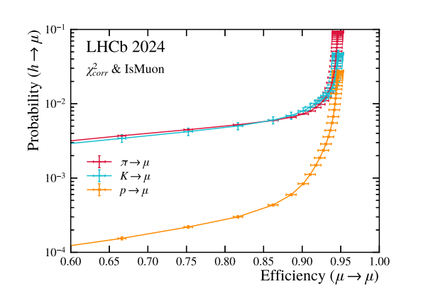
Testing (Performance Measurement)
在 μ 效率 90% 处：
π 误判率 ≈ 0.4%（千分之四）
K 误判率 ≈ 0.6%（千分之六）
p 误判率 ≈ 0.05%（万分之五）
Performance is comparable to Run 2, meeting the Upgrade I target.
ROC 曲线（μ 效率 vs. 强子误判率）

Slide 16
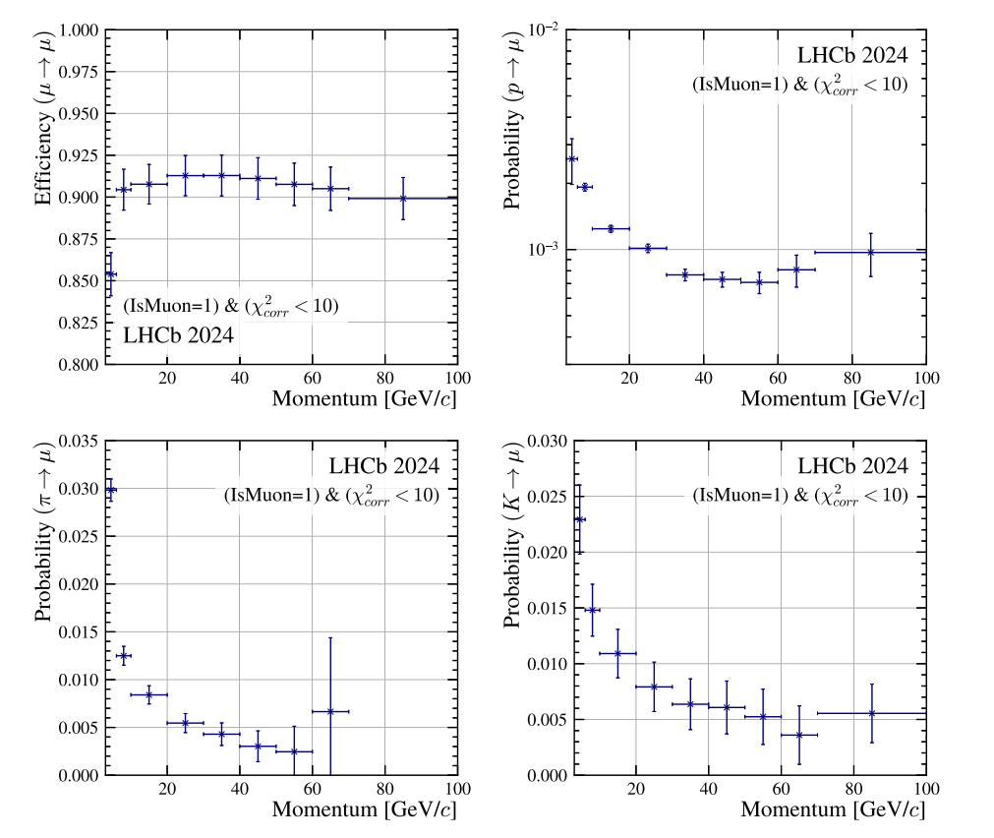
Testing (Performance Measurement)
单击此处编辑母版文本样式
第二级
第三级
第四级
第五级
The dependence of muon efficiency and hadron misidentification rate on track momentum.
低动量 (p < 20 GeV/c)：
误判率较高（π ~2%）。
原因：多次散射严重。
高动量 (p > 50 GeV/c)：误判率降至 ‰ 级别。
μ 效率稳定在 >90%。
μ 效率在所有动量下均平稳（~90–95%）。

Slide 17
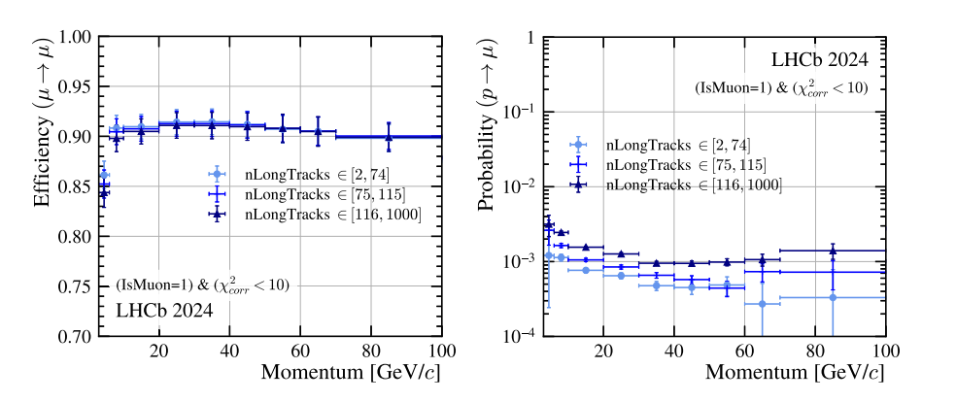
Testing (Performance Measurement)
随着堆积增加（nLongTracks 从 0 到 >200），μ 效率几乎不变。
质子误判率有所上升（组合误判增加），但仍处于可接受水平。
证明了算法在高亮度环境下的稳定性。
Test the effect of event pile-up (number of tracks per event) on μ identification performance at high brightness.

Slide 18
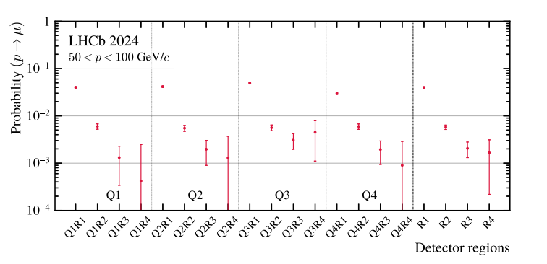
Testing (Performance Measurement)
R1（最内层，靠近束流）：误判率最高（~1.5%）。
R2 显著下降，R3/R4 接近 0%。
没有明显的上‑下或左‑右不对称（四个象限一致）。
Calculate the false alarm rate separately by region (R1–R4) and quadrant (Q1–Q4).

Slide 19
Thank you

