Slide 1
Jet classification and tagging
报告人:周洋洋

Slide 2
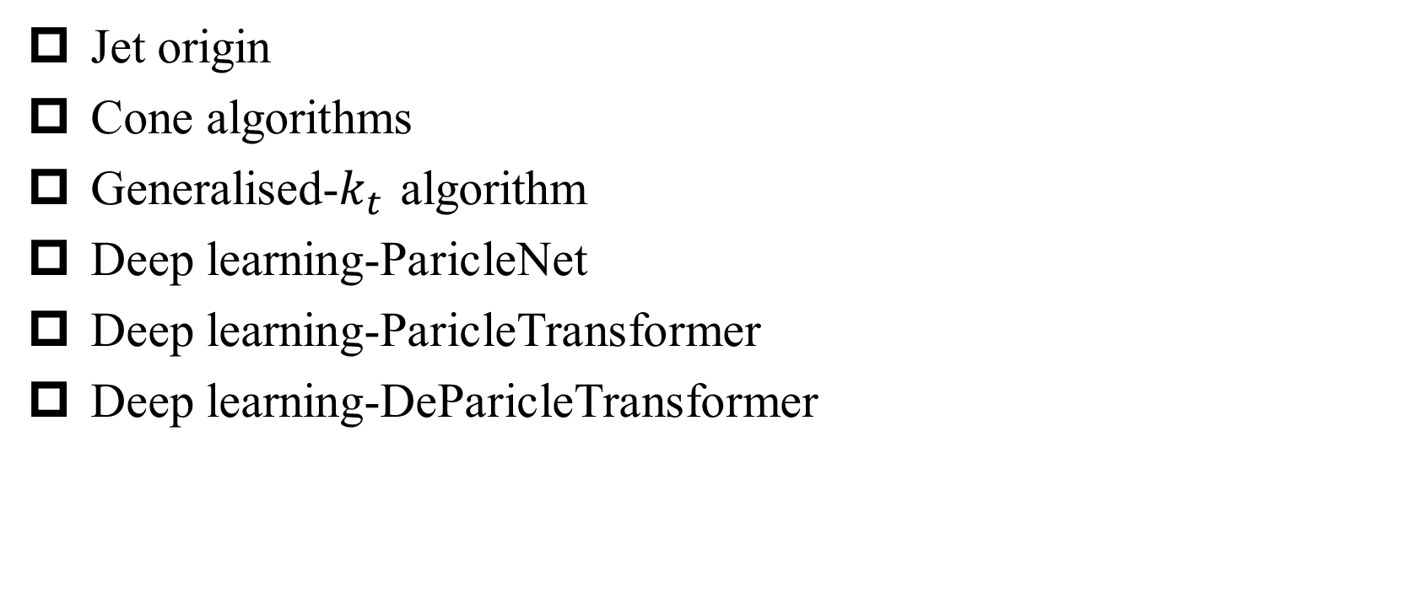
Content
Jet origin
Cone algorithms
Generalised-$k_{t}$ algorithm
Deep learning-ParicleNet
Deep learning-ParicleTransformer
Deep learning-DeParicleTransformer

Slide 3
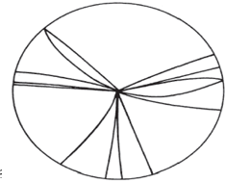
Jet origin
Quarks and gluons are never visible in their own right. Almost immediately after being produced, a quark or gluon fragments and hadronises, leading to a collimated spray of energetic hadrons — a jet.
  By measuring their energy and direction one can get close to the idea of the original “parton”.
  Jets also need to be defined — this is generally done through a jet definition, a set of rules for how to group particles into jets.

Slide 4
Jet origin
At hadron colliders
  high-momentum-transfer 2 → 2 scattering of partons inside the colliding (anti)protons
  contains information on the distributions of partons inside the proton
Hadronic decay of a heavy particle
  top quark, a Higgs boson, or some other yet-to-be discovered resonance
Radiatively- emission of a gluon
  one of the main backgrounds to multi-jet signals of new physics
  The rate of production of such jets provides information on the value of strong coupling and is related also to the color structure of events

Slide 5
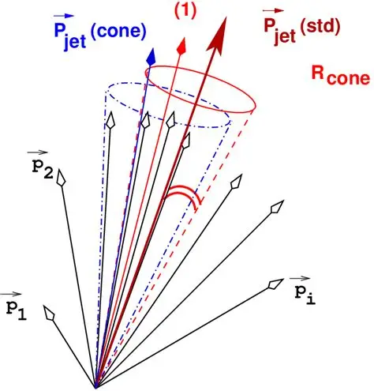
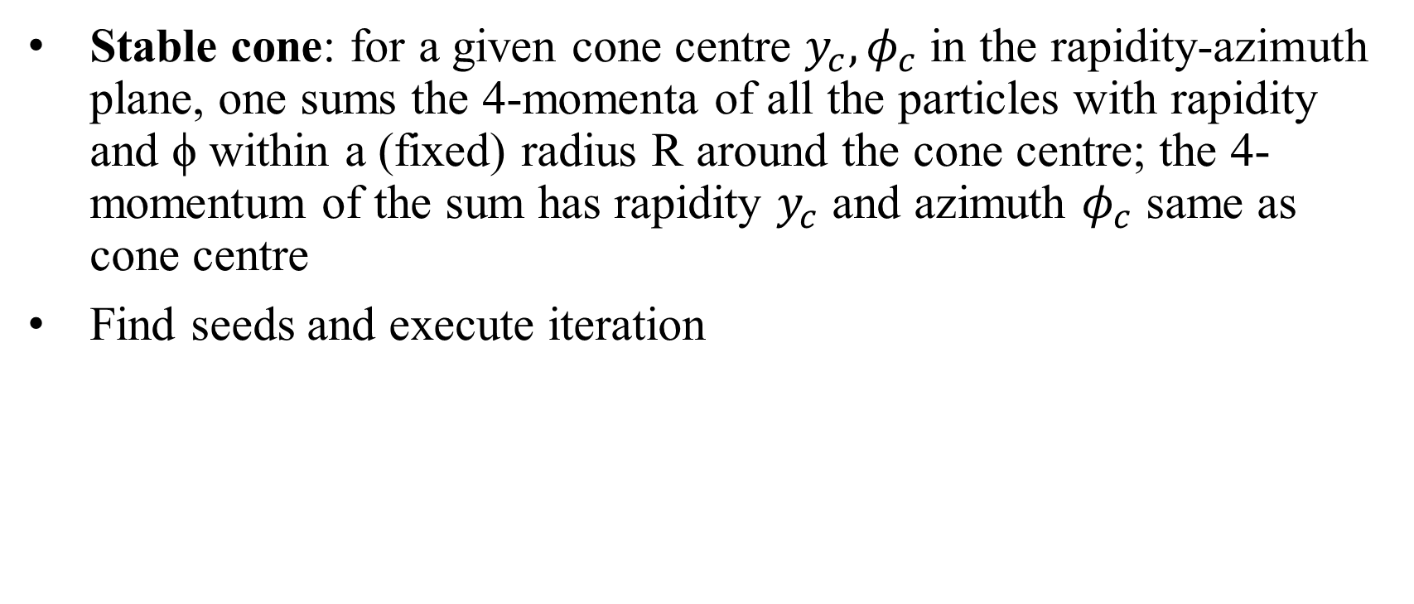
Cone algorithms
Stable cone: for a given cone centre $y_{c},φ_{c}$ in the rapidity-azimuth plane, one sums the 4-momenta of all the particles with rapidity and ϕ within a (fixed) radius R around the cone centre; the 4-momentum of the sum has rapidity $y_{c}$ and azimuth $φ_{c}$ same as cone centre
Find seeds and execute iteration

Slide 6
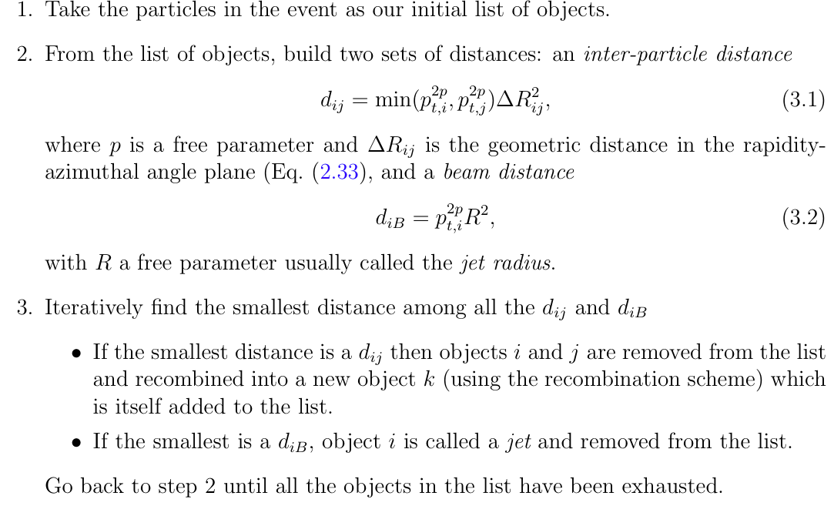


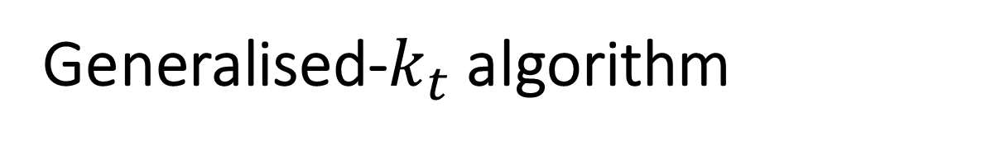
Generalised-$k_{t}$ algorithm

Slide 7
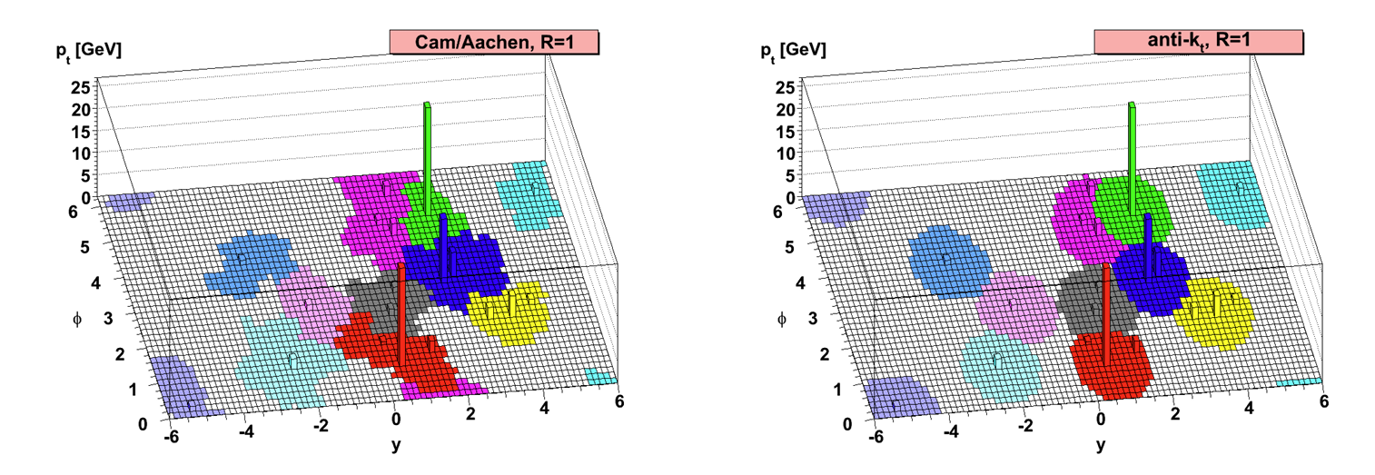

Slide 8
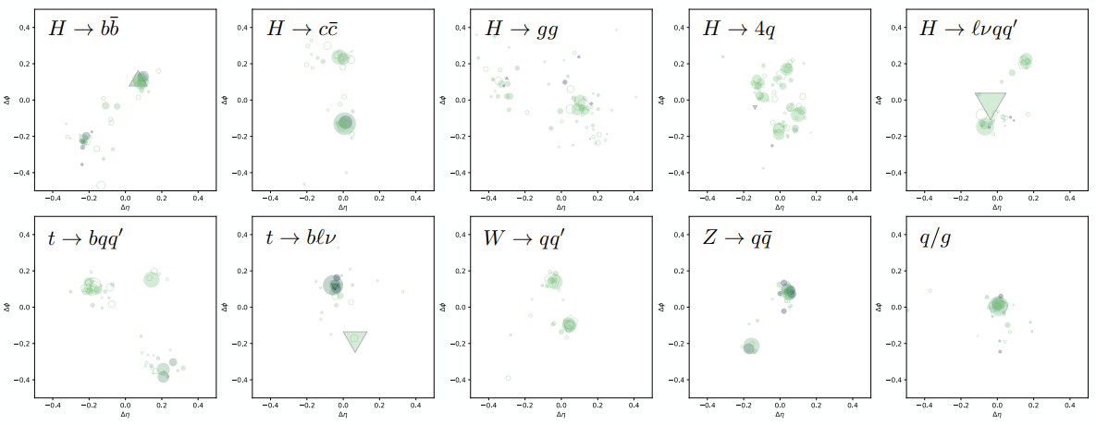
Deep learning
Deep learning has transformed how jet tagging, a critical classification task at high-energy particle colliders such as the CERN LHC, is performed, leading to a drastic improvement in its performance

Slide 9
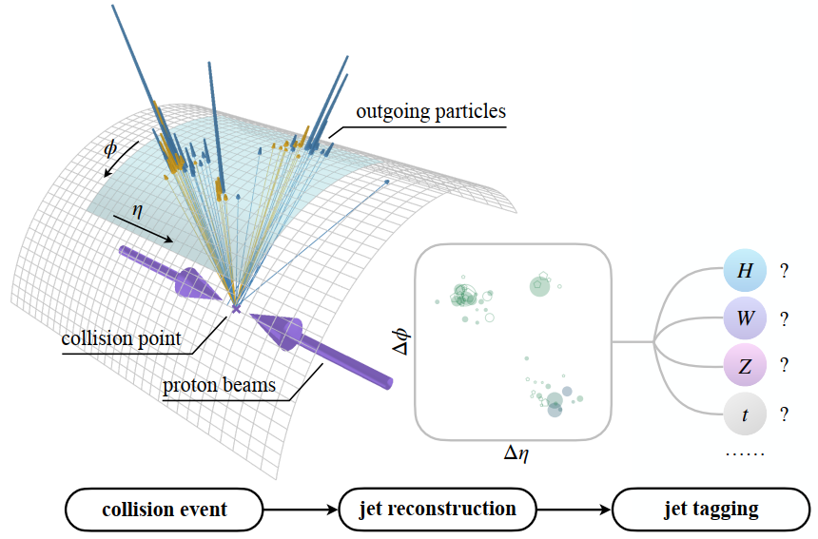
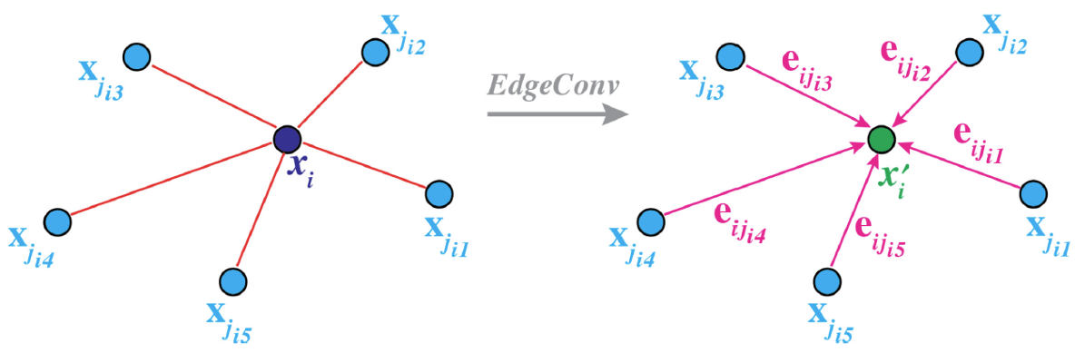

Deep learning-ParicleNet
Treat a jet as an unordered set of particles.
A event contains $O(1000)$ particles, which can be taken as a point cloud.
The ParticleNet architecture is introduced to tag jets.
The key algorithm - kNN

Slide 10
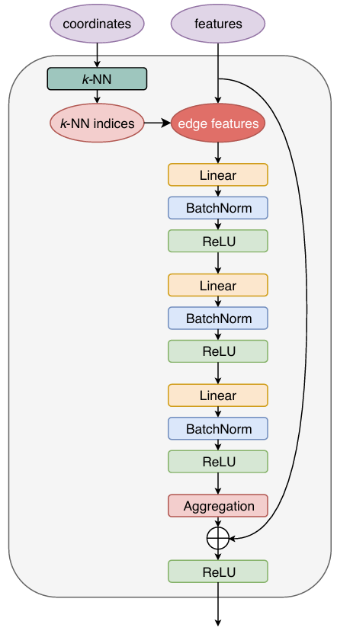
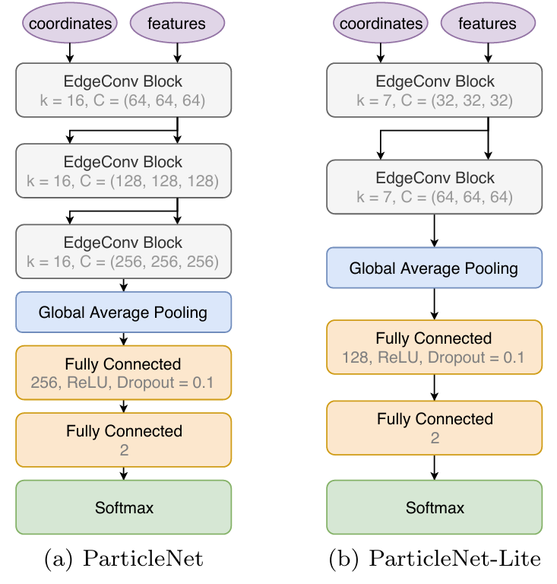
Deep learning-ParticleNet

Slide 11
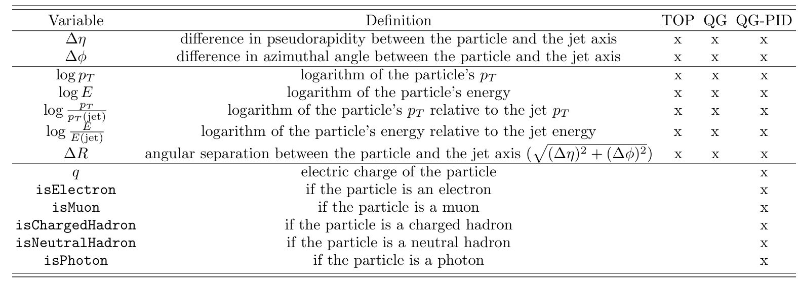
Deep learning-ParticleNet

Slide 12
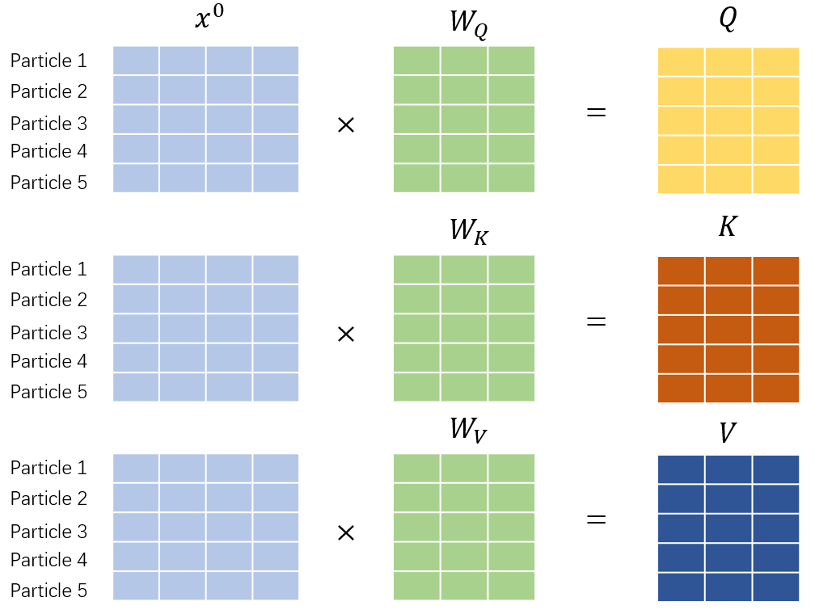

Deep learning-ParticleTransformer
The attention between two particle can be extracted by features.
Compared to kNN, attention is more flexible.

Slide 13
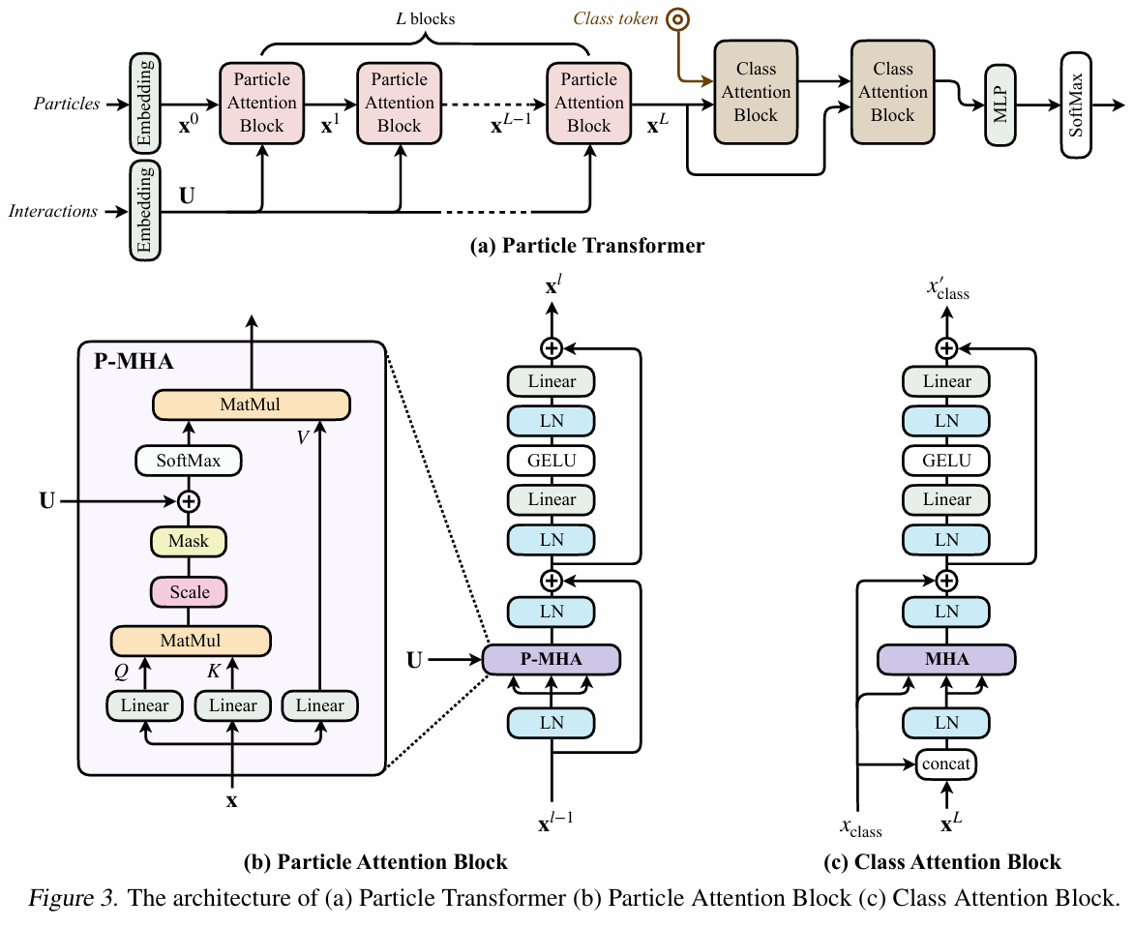
Deep learning-ParticleTransformer

Slide 14
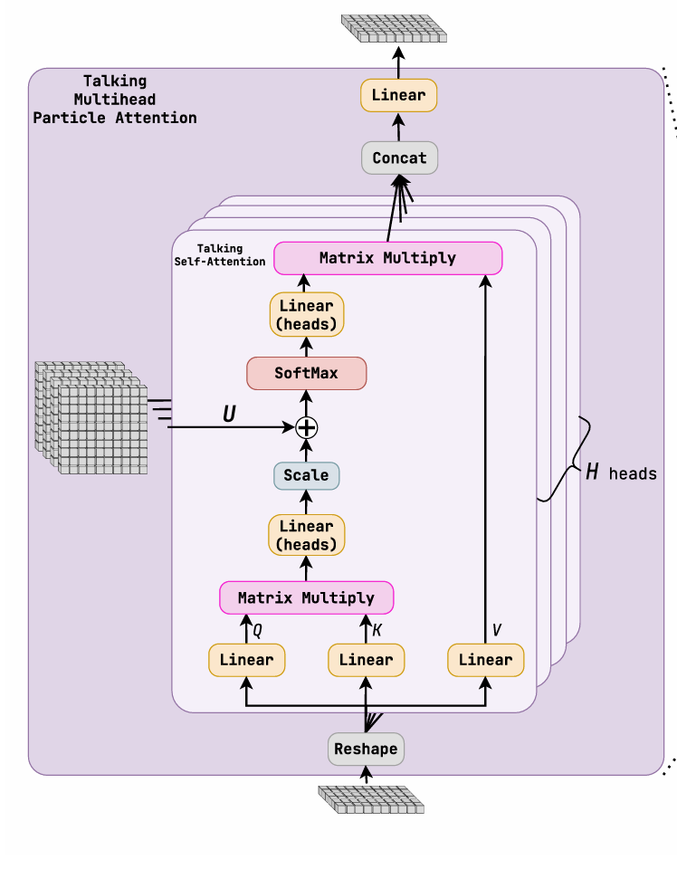
Deep learning-DeParicleTransformer
The Talking Multihead Self-Attention, utilizes the interaction variables by allowing the heads to exchange information about a given feature each head possesses.

Slide 15
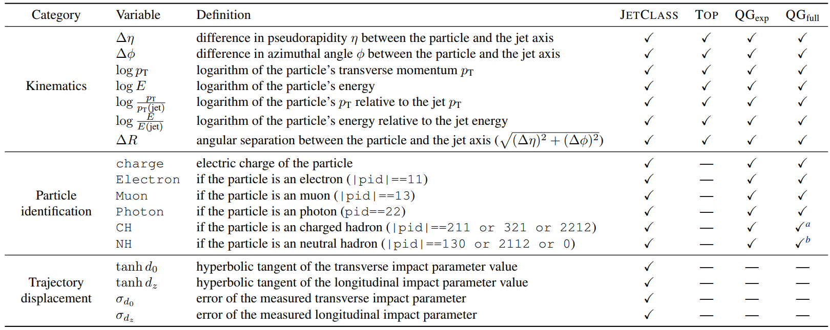
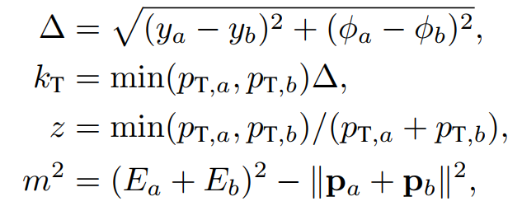

Slide 16
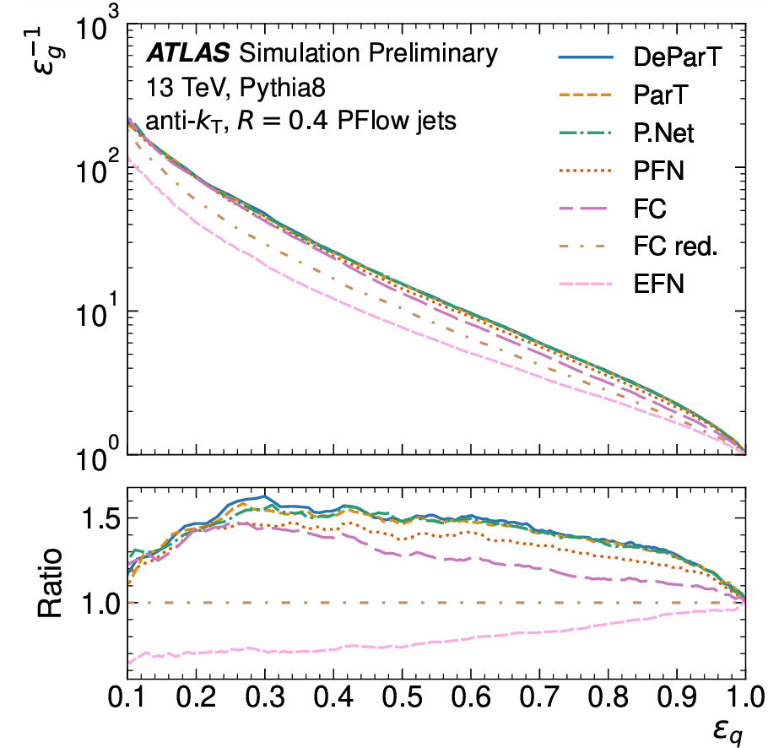
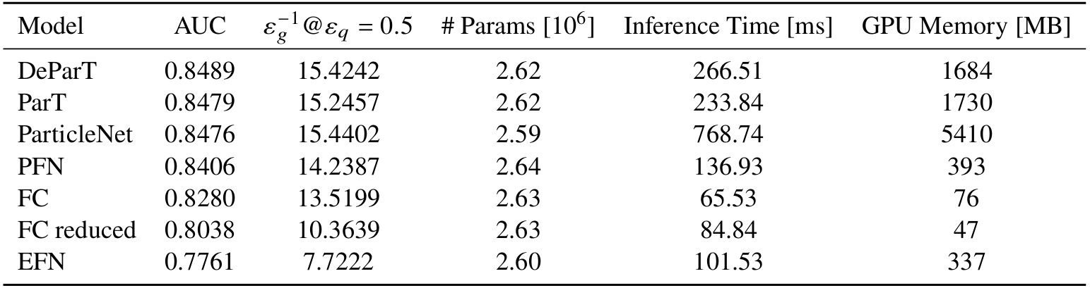
Performance between various models

Slide 17
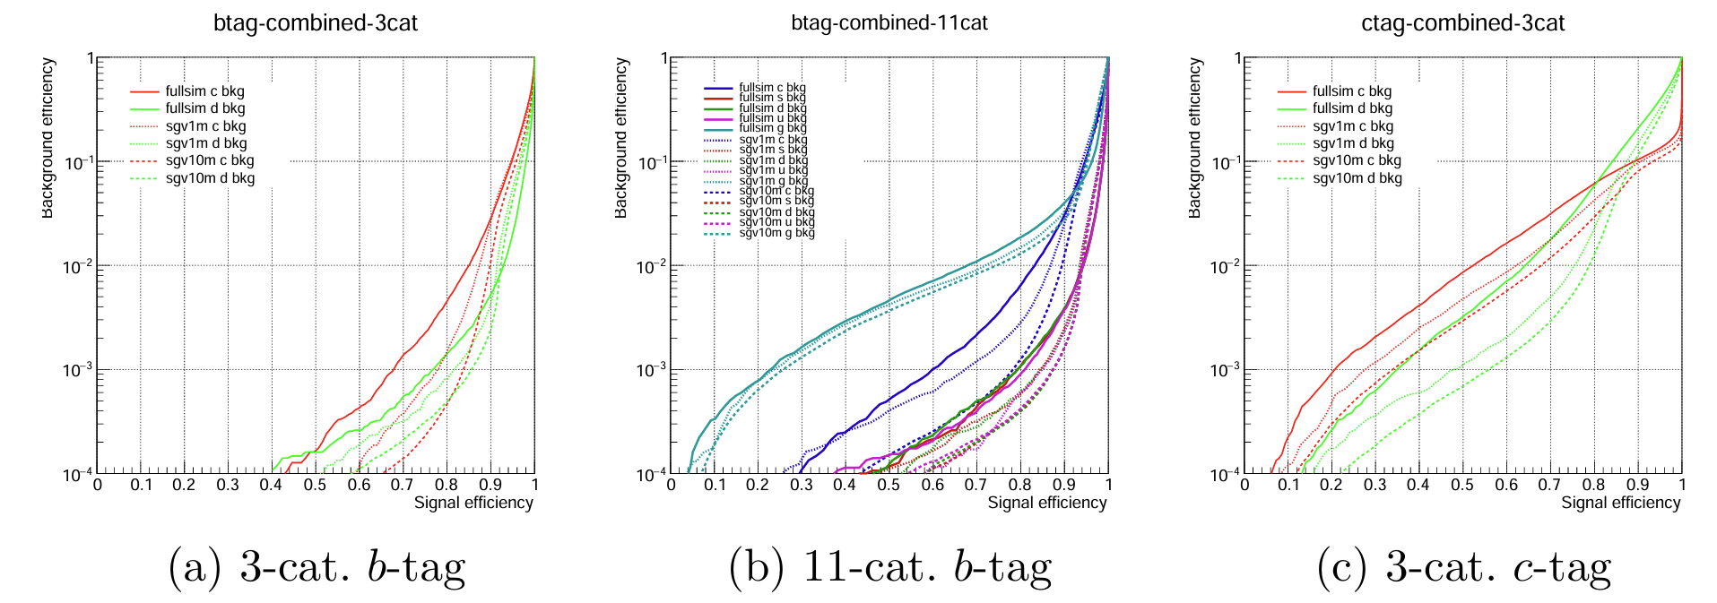
The performance of the Particle Transformer (ParT) for jet flavor tag ging using ILD full simulation events (1M jets) as well as fast simulation samples (10M and 1M jets)

Slide 18
References
ATLAS Collaboration, Constituent-Based Quark Gluon Tagging using Transformers with the ATLAS detector, ATL-PHYS-PUB-2023-032, 2023, url: https://cds.cern.ch/record/2878932.
[1901.10342] Looking inside jets: an introduction to jet substructure and boosted-object phenomenology
[1902.08570] ParticleNet: Jet Tagging via Particle Clouds
[2202.03772] Particle Transformer for Jet Tagging

Slide 19
Thanks

