Slide 1
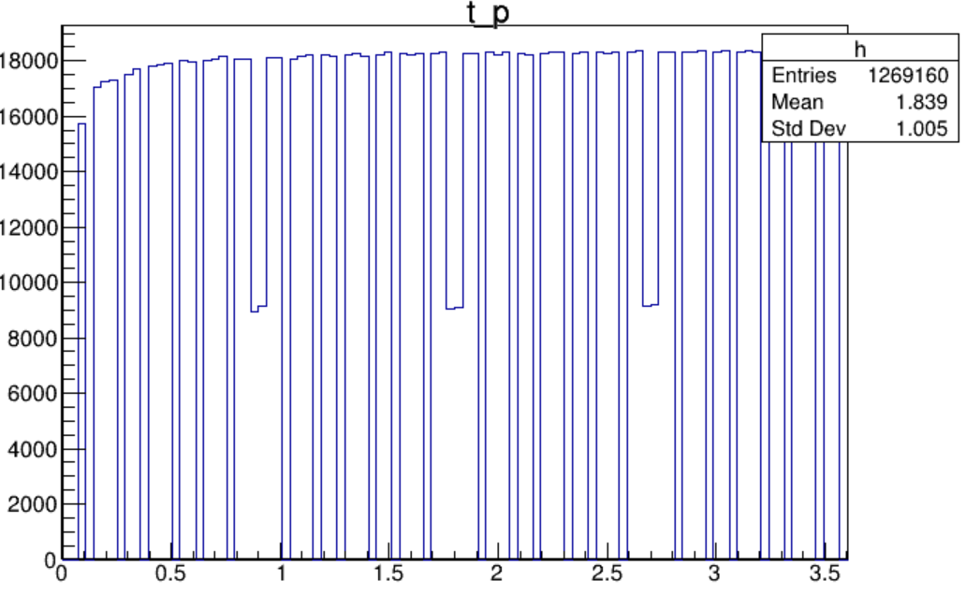
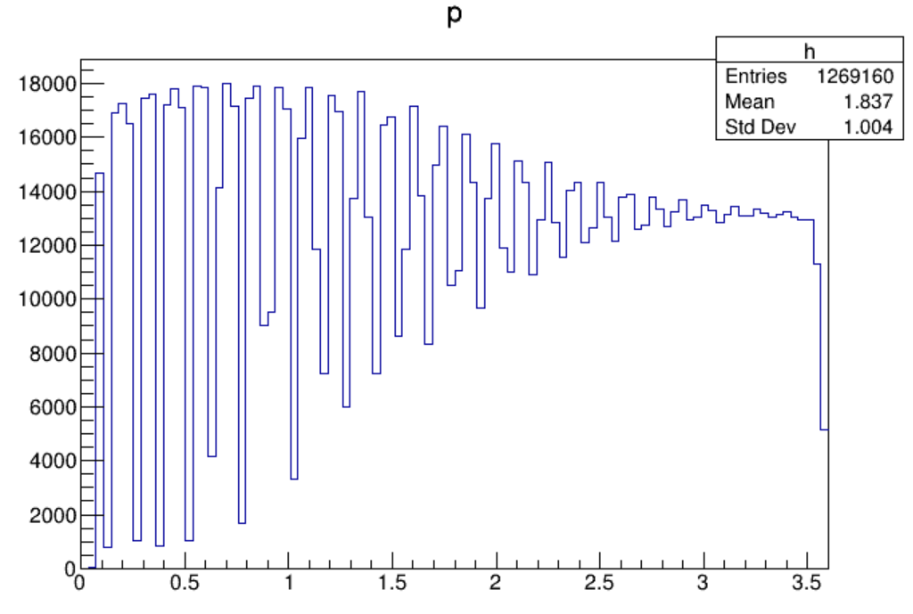
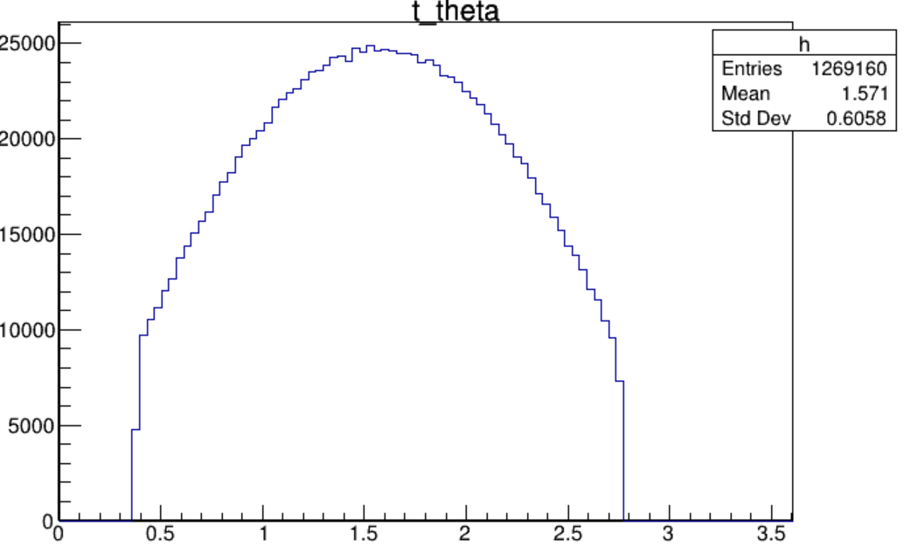
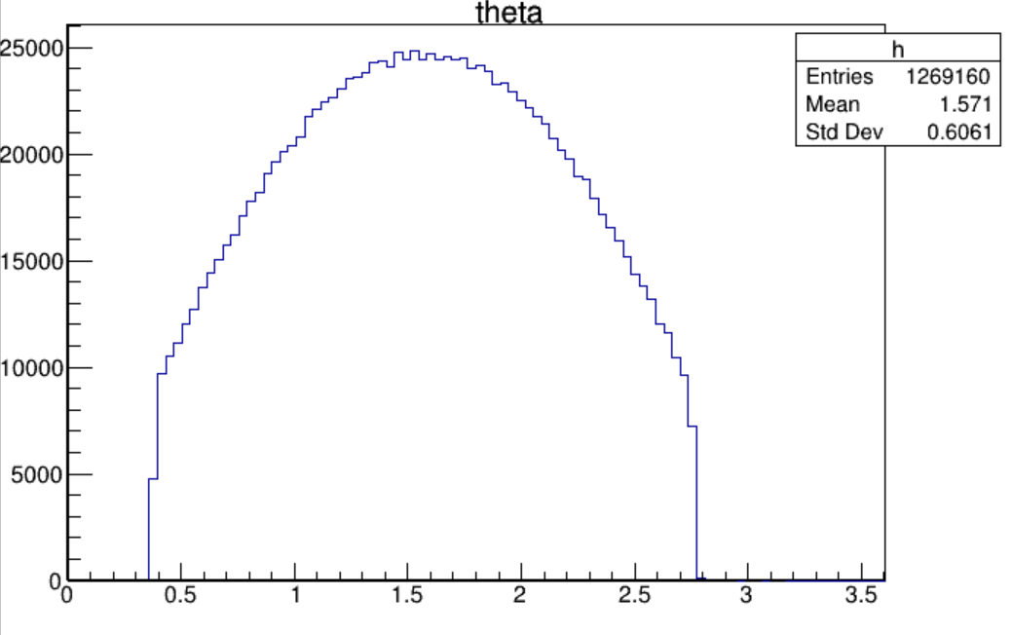
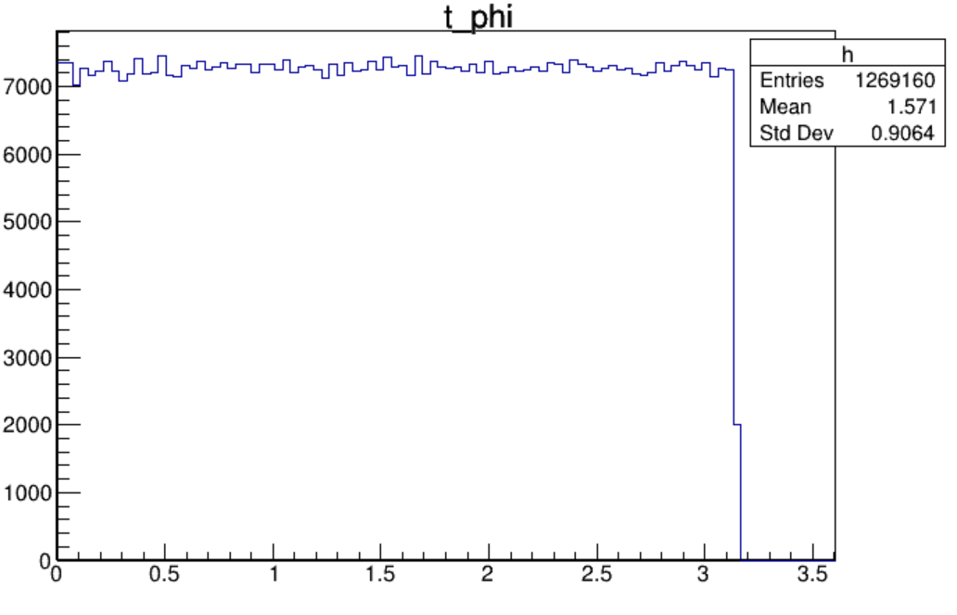
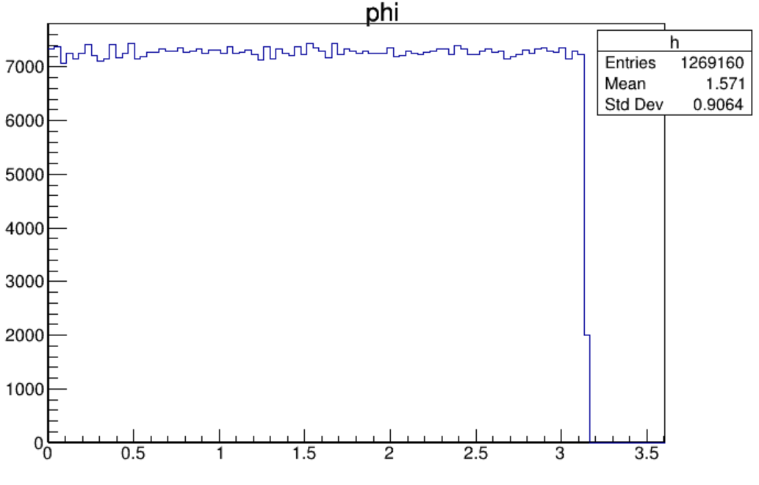
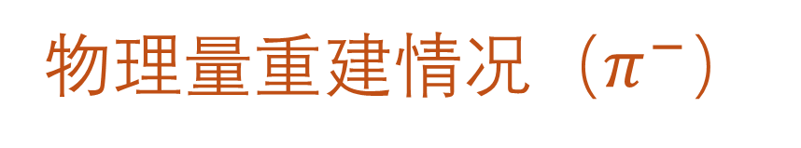
物理量重建情况（$π^{−}$）
Reconstruction

Slide 2
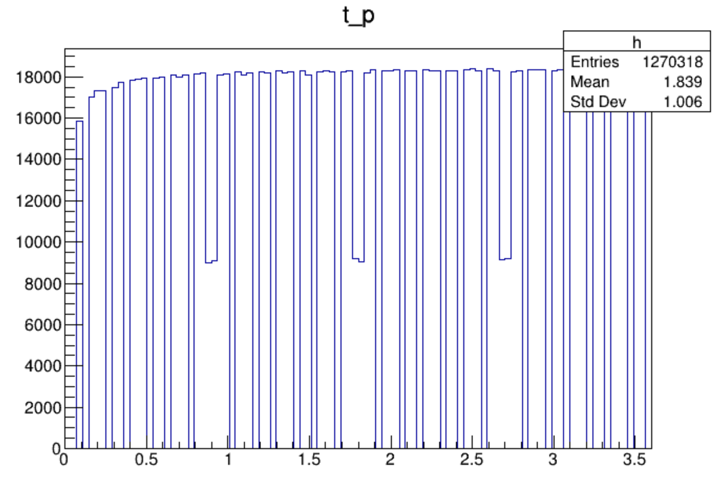
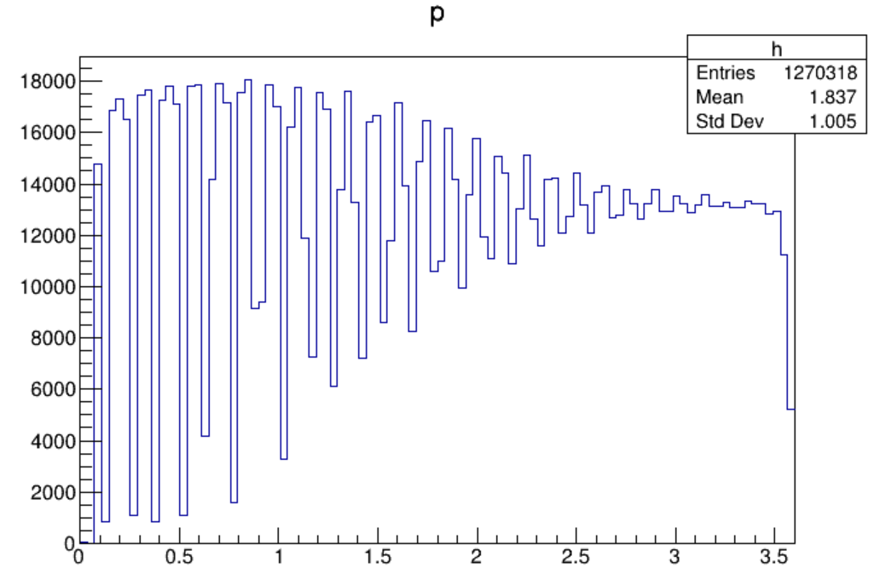
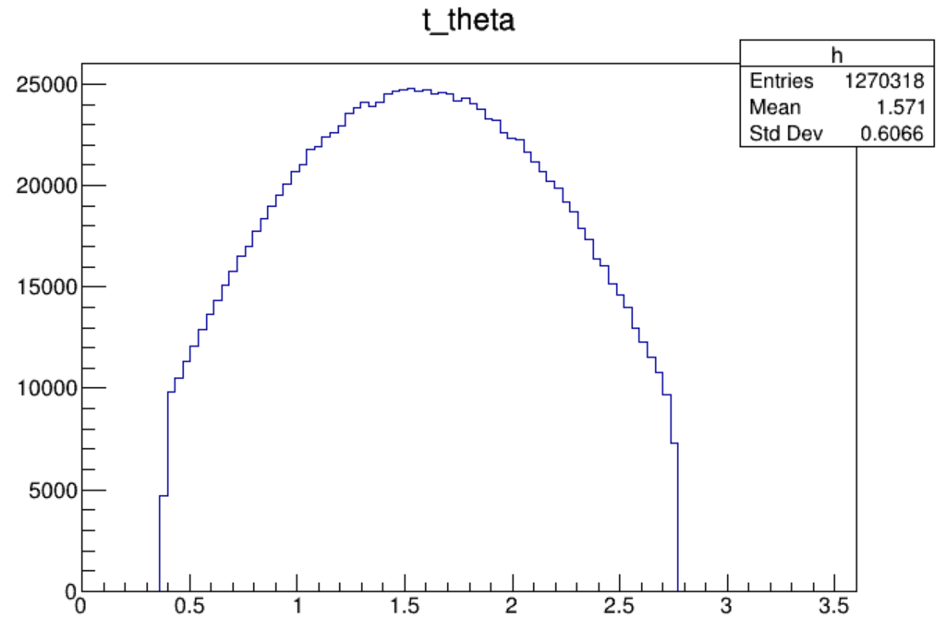
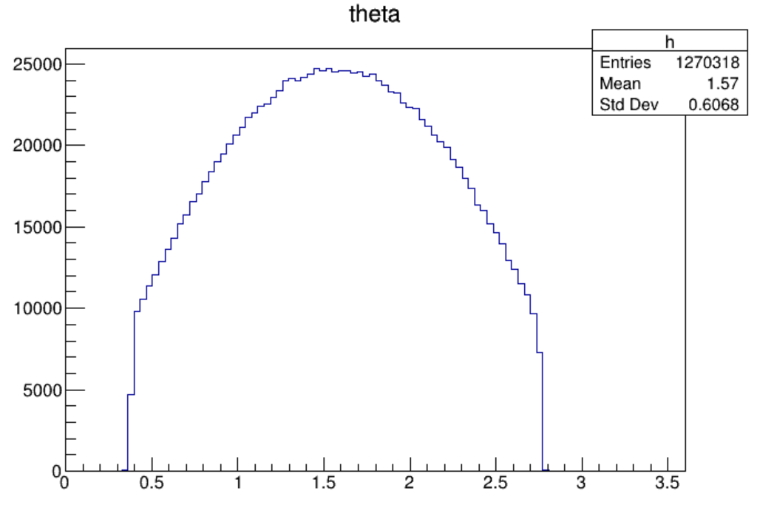
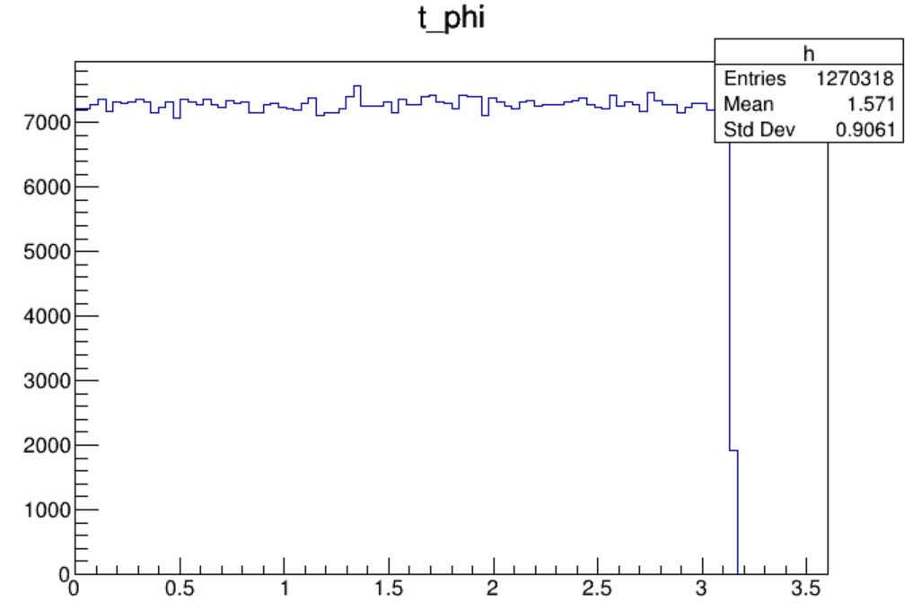
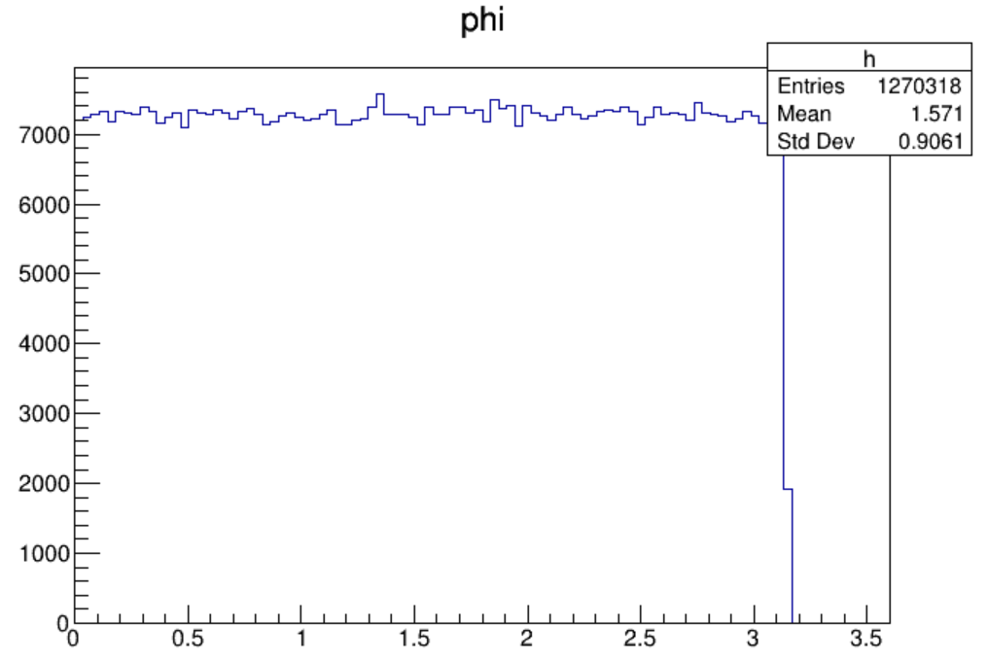
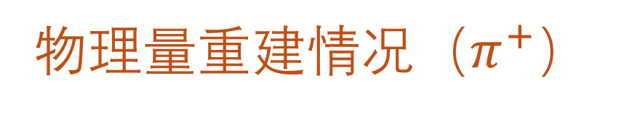
物理量重建情况（$π^{+}$）
Reconstruction

Slide 3

P, $θ$ 分bin
P_bins = {0., 0.275, 0.475, 0.675, 0.875,
1.075, 1.275, 1.475, 1.675, 1.875,
2.075, 2.275, 2.475, 2.675, 2.875,
3.075, 3.275, 3.475, 3.675}
Theta_bins = {0, 0.04, 0.08, 0.12, 0.16, 0.2, 0.24, 0.28, 0.32, 0.36,
0.4, 0.44, 0.48, 0.52, 0.56, 0.6, 0.64, 0.68, 0.72, 0.76,
0.8, 0.8025, 0.805, 0.8075, 0.81, 0.8125, 0.815, 0.8175,
0.82, 0.8225, 0.825, 0.8275, 0.83, 0.8325, 0.835, 0.8375,
0.84, 0.8425, 0.845, 0.8475, 0.85, 0.855, 0.86, 0.865,
0.87, 0.875, 0.88, 0.885, 0.89, 0.895, 0.9, 0.905, 0.91,
0.915, 0.92, 0.925, 0.93, 0.935, 0.94, 0.942, 0.944, 0.945};

Slide 4
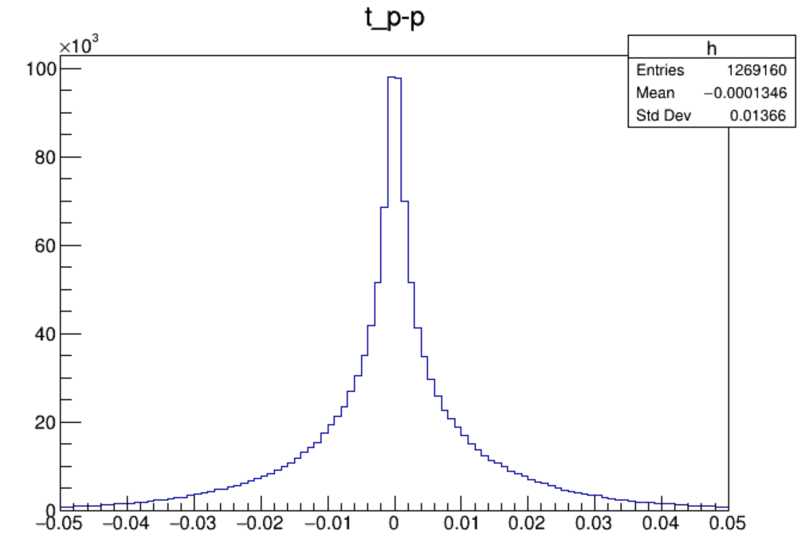
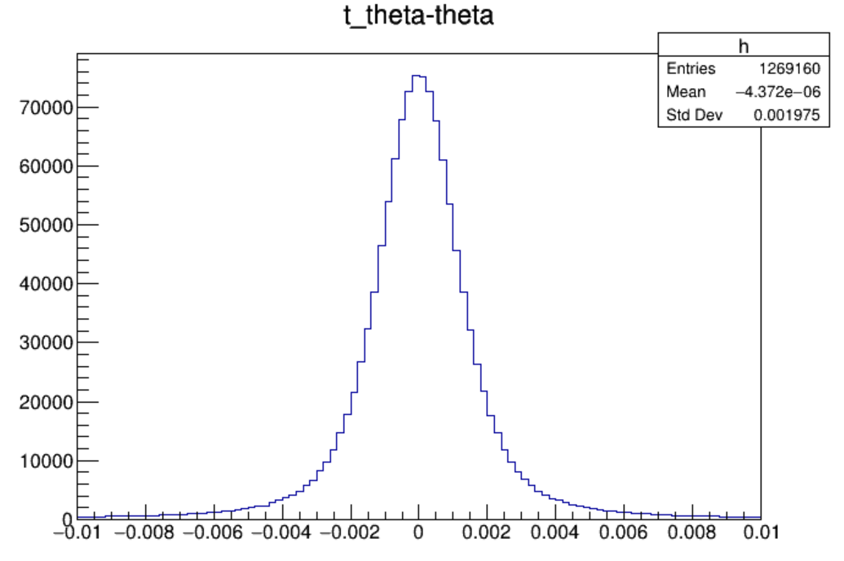
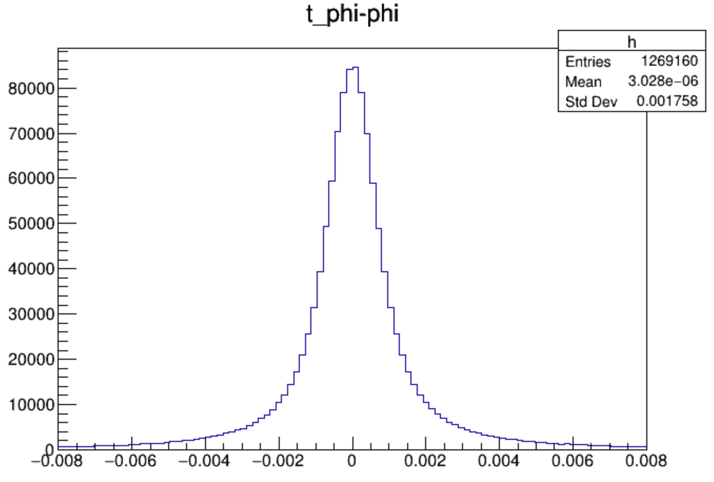
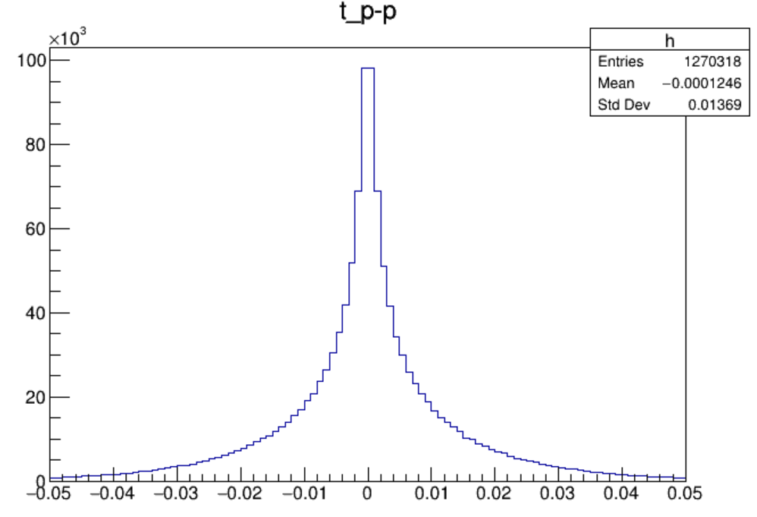
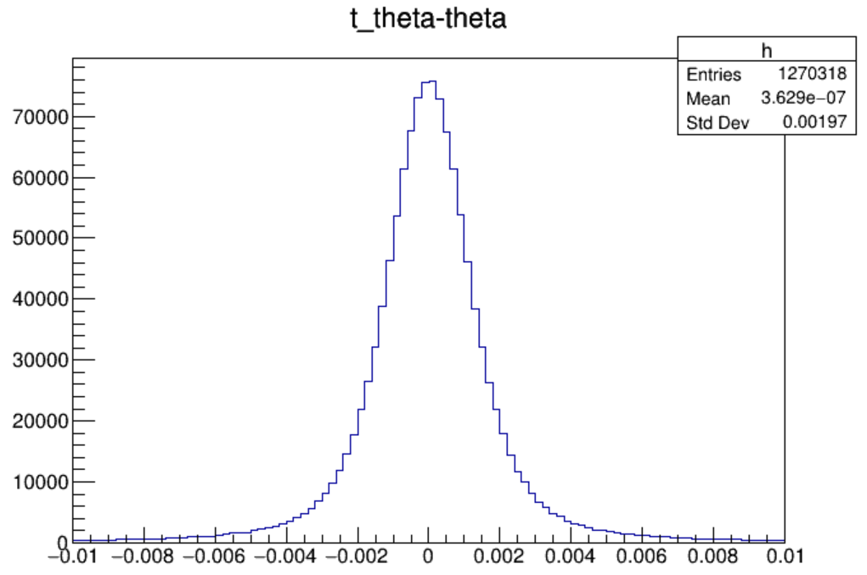
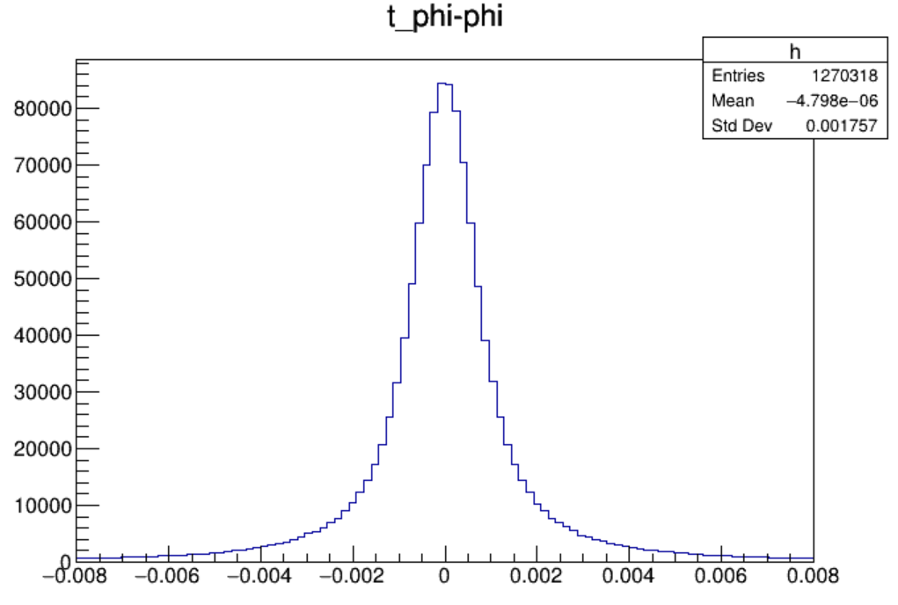


残差分布
$$π^{−}$$
$$π^{+}$$

Slide 5
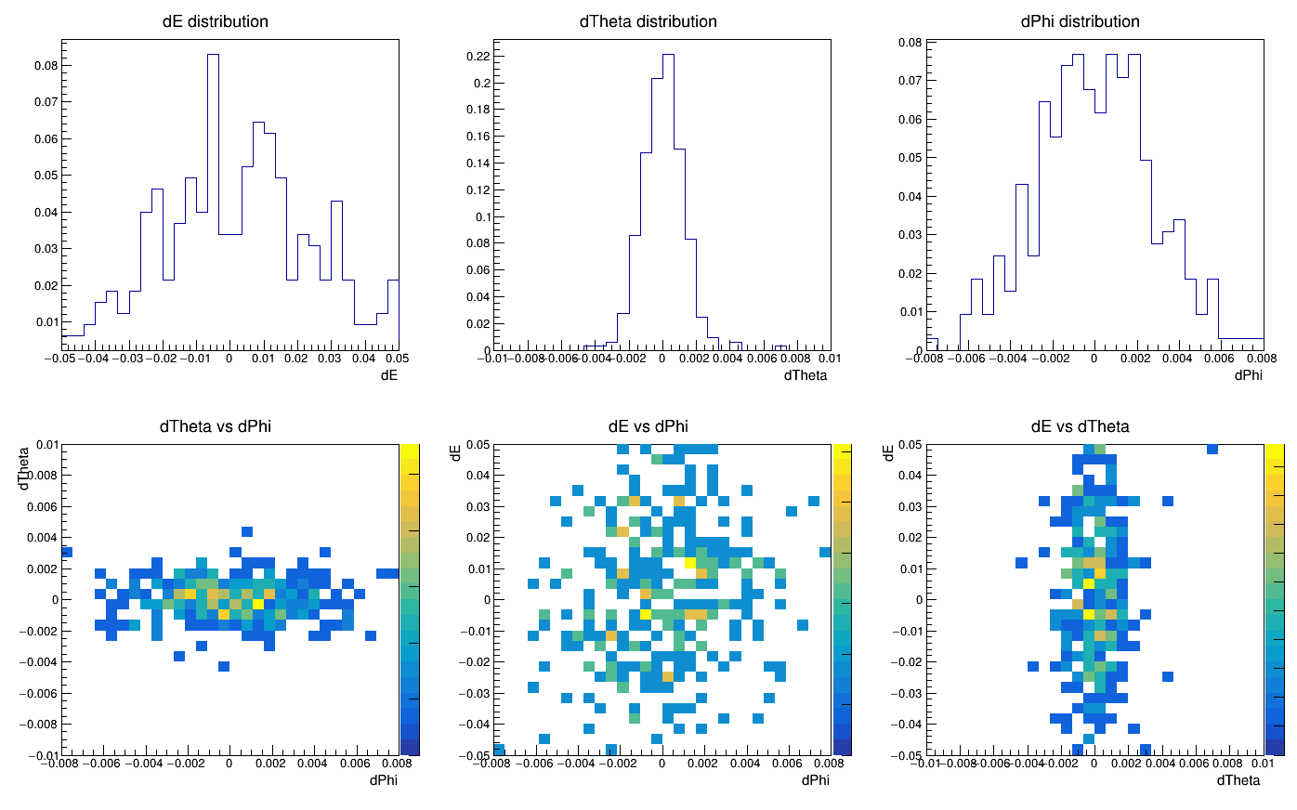
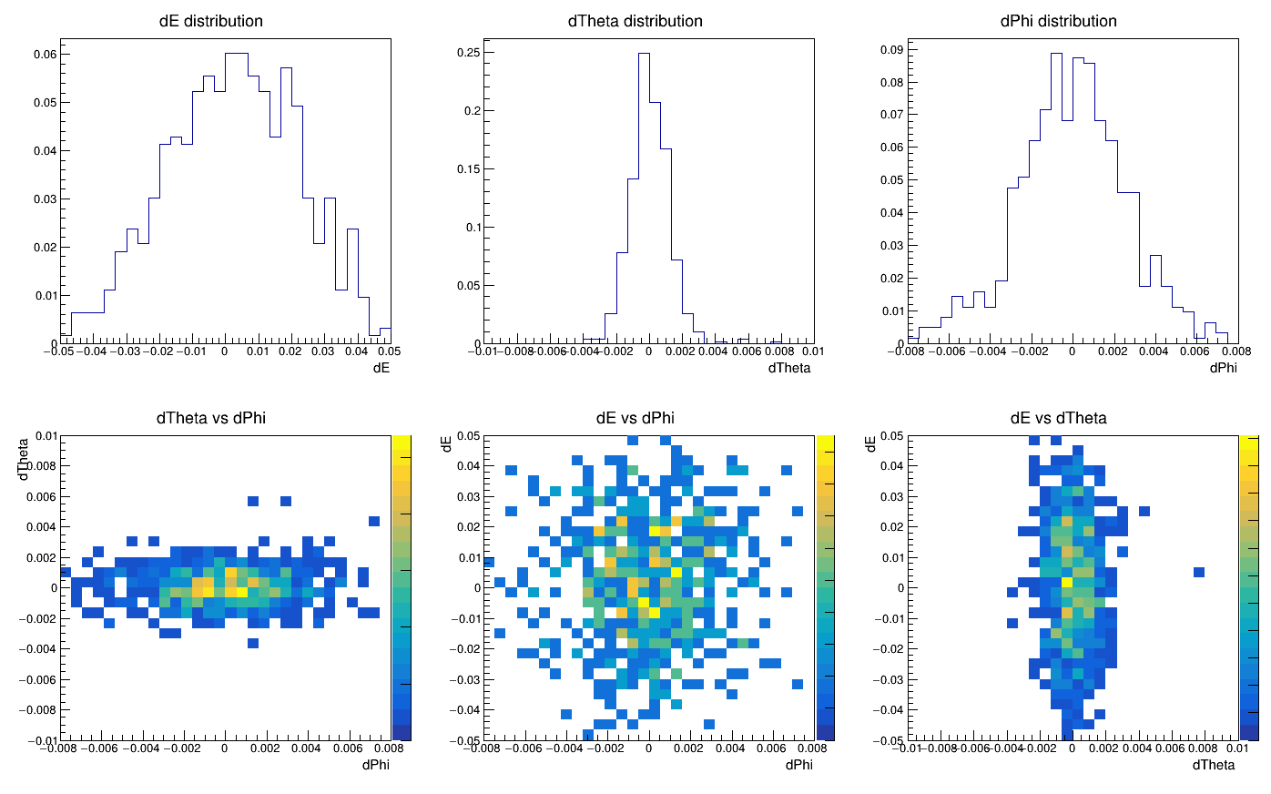
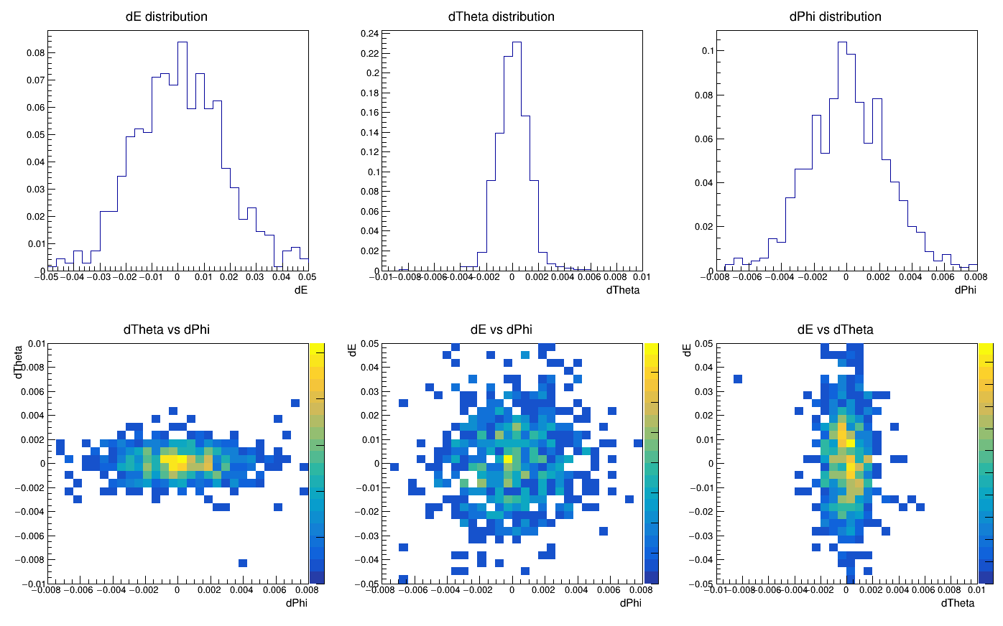
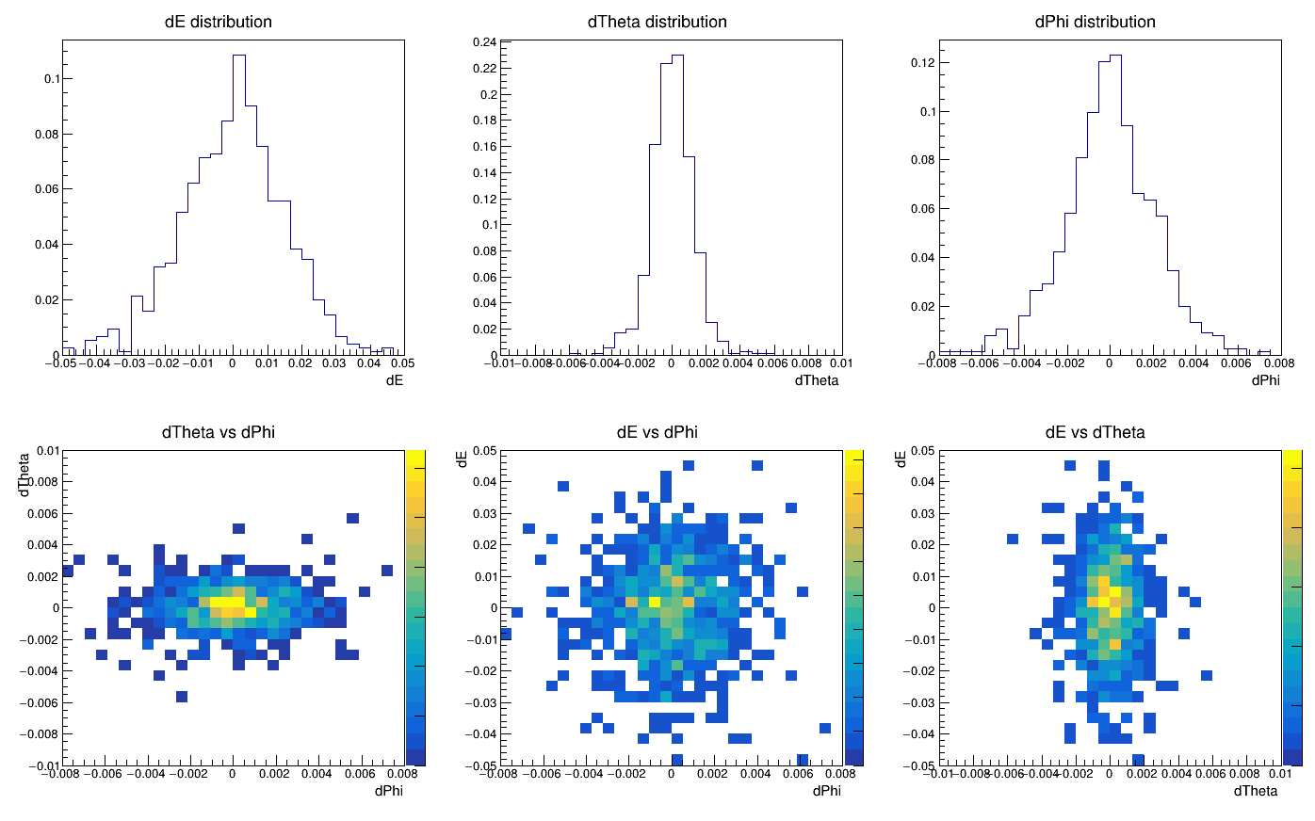
三维残差分布
binP=8, binTheta=9,10,11,12

Slide 6
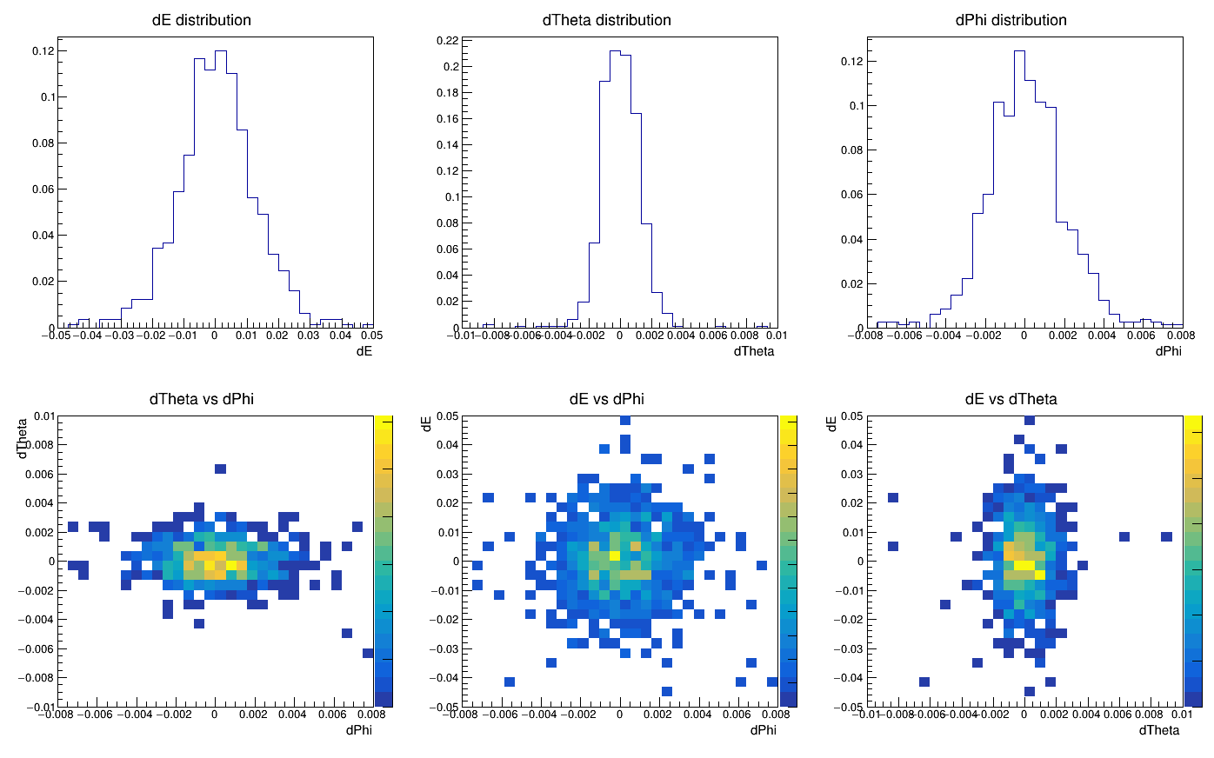
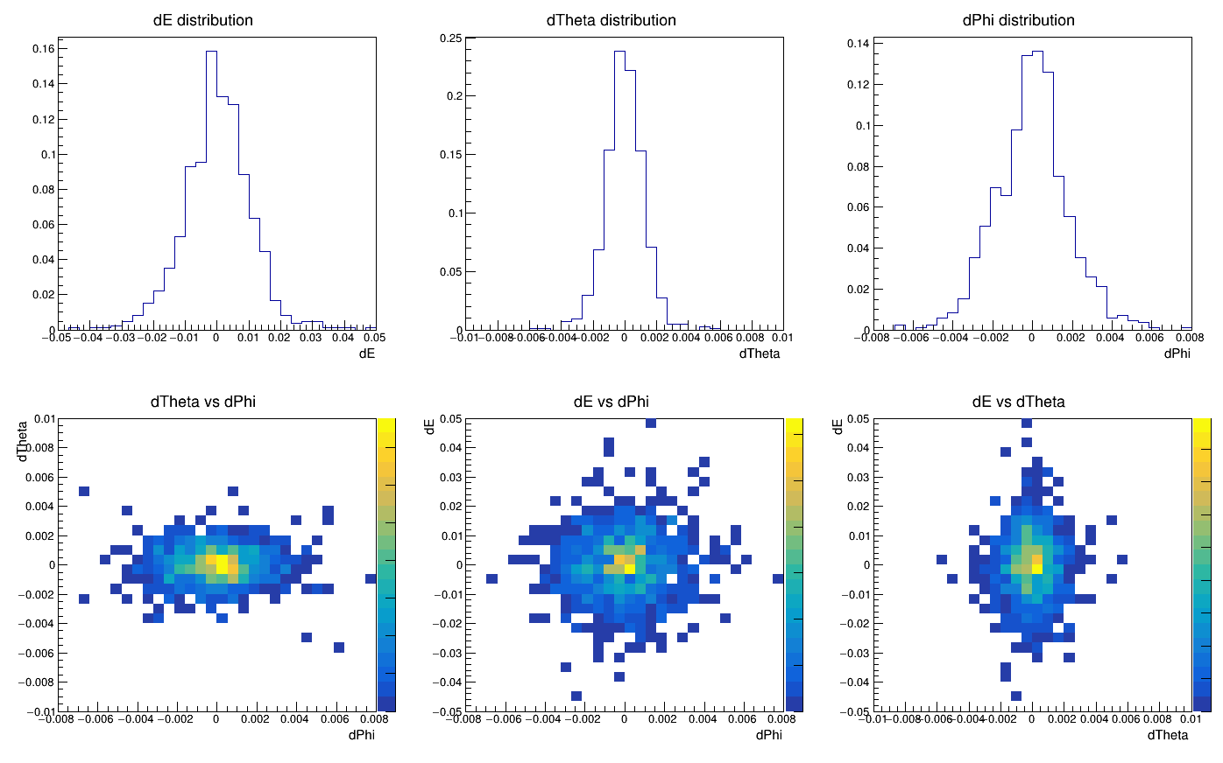
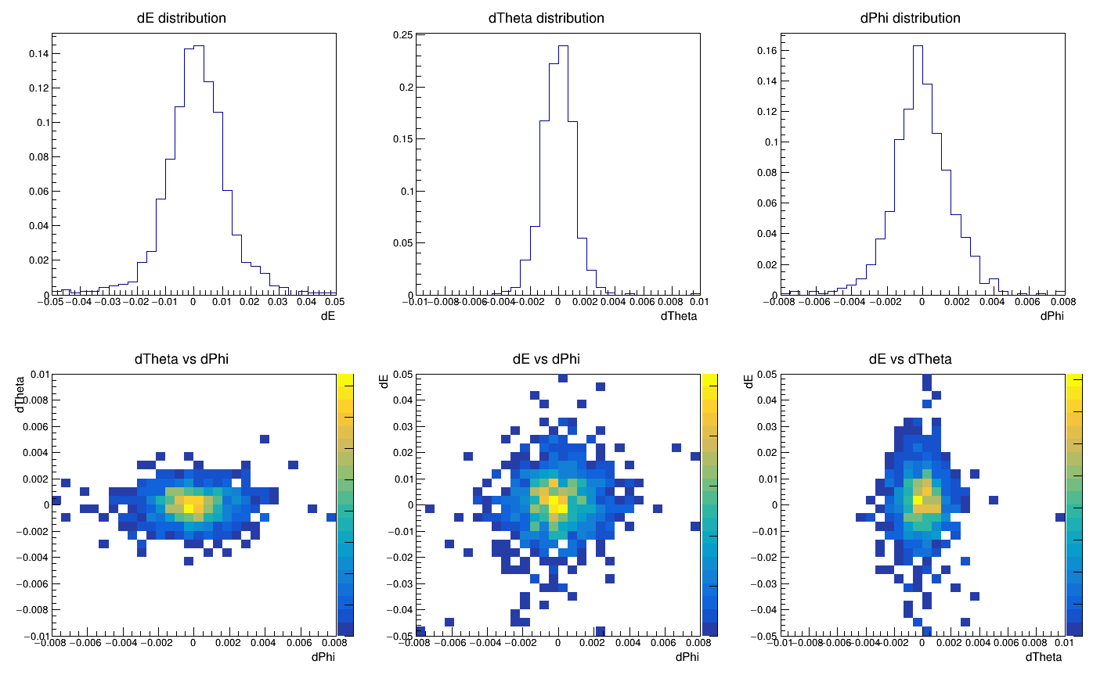
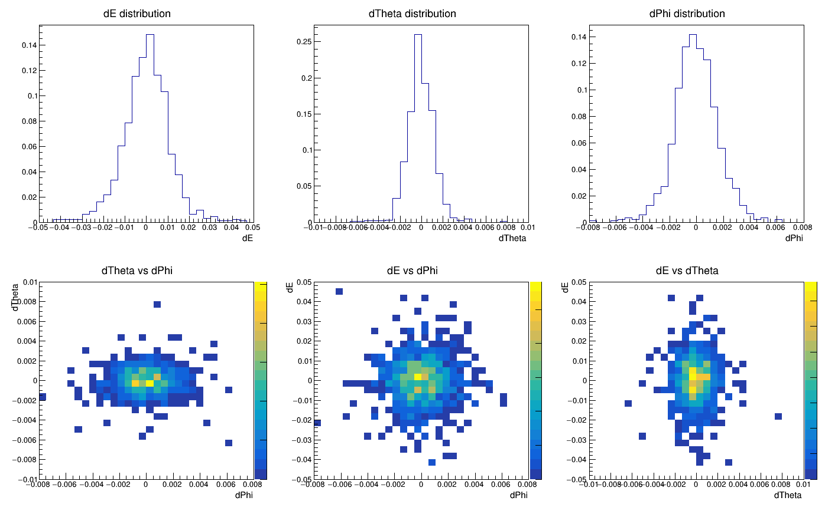
三维残差分布
binP=8, binTheta=13,14,15,16

Slide 7
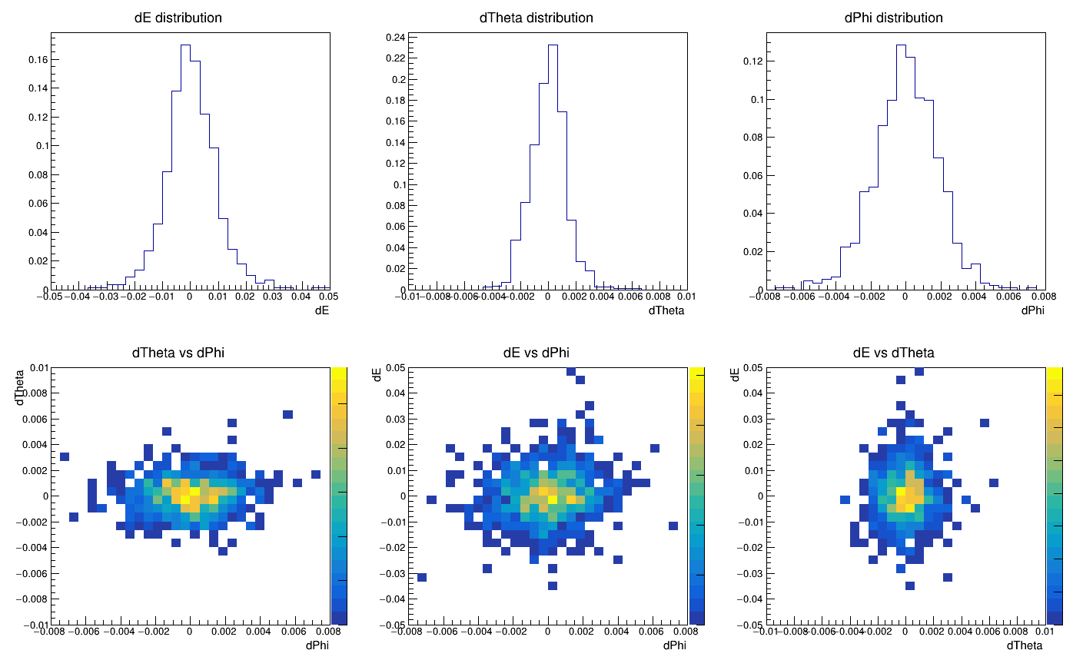
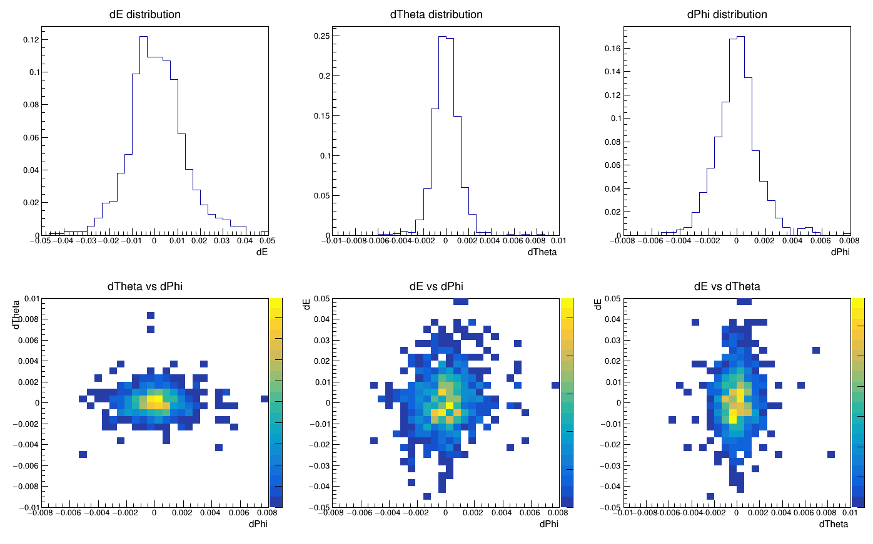
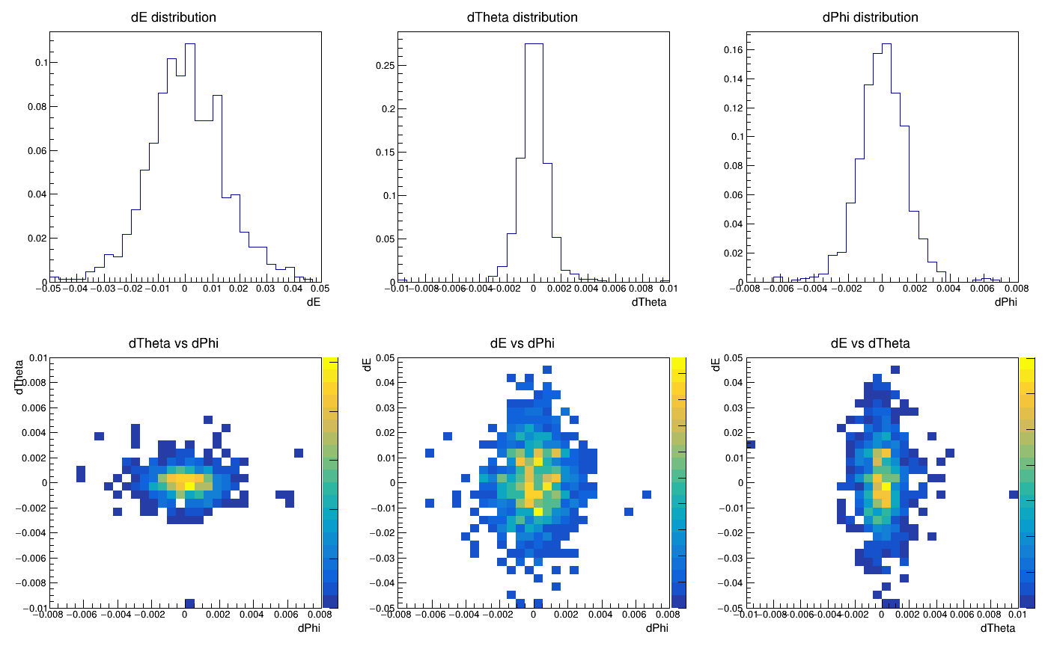
三维残差分布
binP=7,8,9,10, binTheta=15

