Slide 1

CEPC AHCAL Energy Resolution
李想
2025.5.14
Notes:
Today, I will present my work on improving the ECAL energy resolution using machine learning.

Slide 2
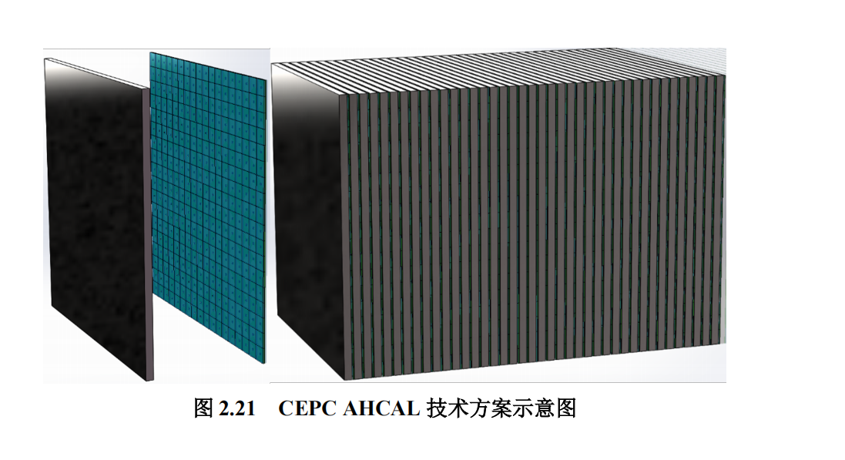
AHCAL：
AHCAL Standalone Geometry Model:
Total Layers: 40 sampling layers.
Layer Components: Absorber, plastic scintillator tiles, and PCB.
Sensitive Area:720 × 720 mm² (populated by 324 scintillator tiles, each 40 × 40 × 3 mm³).
Absorber:20-mm-thick iron plate.
PCB:2-mm-thick G4_KAPTON.
Note: The absorber and PCB have the exact same area as the sensitive region.
Notes:
Our primary objective is to enhance the ECAL energy resolution using machine learning techniques. We evaluate two parallel strategies: a layer-level Multi-Layer Perceptron (MLP) and a hit-level CNN+LSTM architecture. We then compare their performance against the standard energy-sum method

Slide 3
motivation：
Attempt to improve the HCAL e- energy resolution using ML
strategy:
Layer level data:Train an MLP;
Hit level data: Train a CNN+LSTM,CNN+Transformer;
Evaluate the performance in terms of energy resolution and linearity
Notes:
Our primary objective is to enhance the ECAL energy resolution using machine learning techniques. We evaluate two parallel strategies: a layer-level Multi-Layer Perceptron (MLP) and a hit-level CNN+LSTM architecture. We then compare their performance against the standard energy-sum method

Slide 4
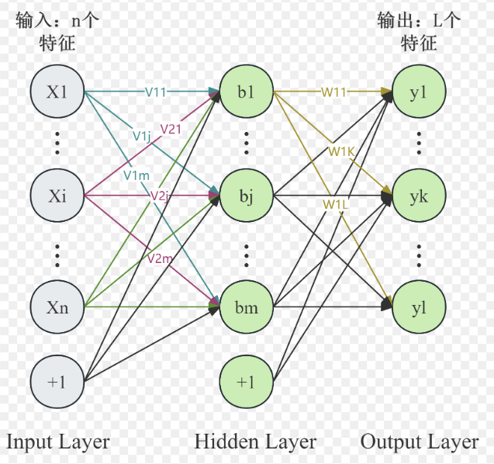
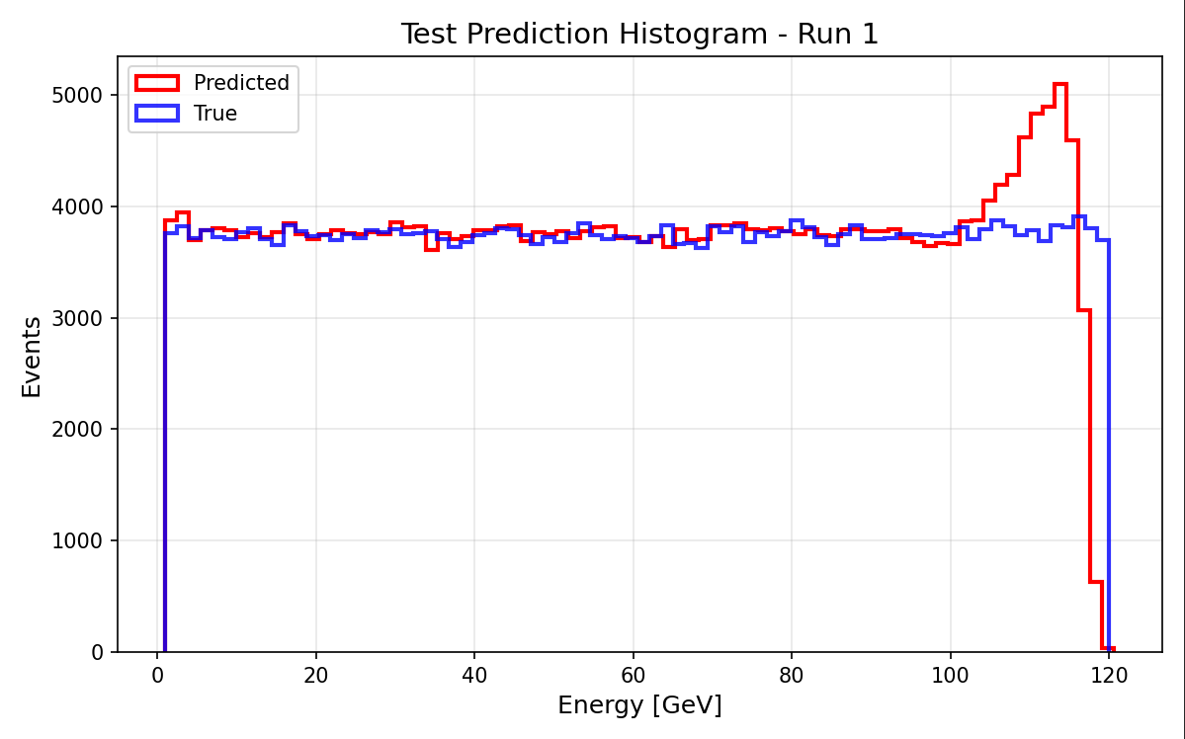
M(ulti) L(ayer) P(erceptron) Trian
Input(Layer level data):
  Energy(E) of per layer(40)
  Hit_no(N) of per layer(40)
  E/N of perlayer(40)
  Total_deposited_energy(1)
Output:
  Predicted Partical Energy
Samples:
MC: 1-120GeV e-(20000000) Continuous
Data split
train_frac = 0.7
val_frac = 0.15
test_frac = 0.15
[1024,512,256,128]
lr =0.5e-4
batch_size =64
epochs =100
weight_decay =1e-4
optimizer ="adamw"
Input and Output（relative error <2%）
Notes:
For the layer-wise MLP model, the inputs consist of 97 features: energy, hit counts, and energy-to-hit ratios for each of the 32 layers, plus the total deposited energy. To ensure robust learning, the model is trained on a comprehensive dataset of 12 million continuous Monte Carlo samples ranging from 1 to 120 GeV.

Slide 5
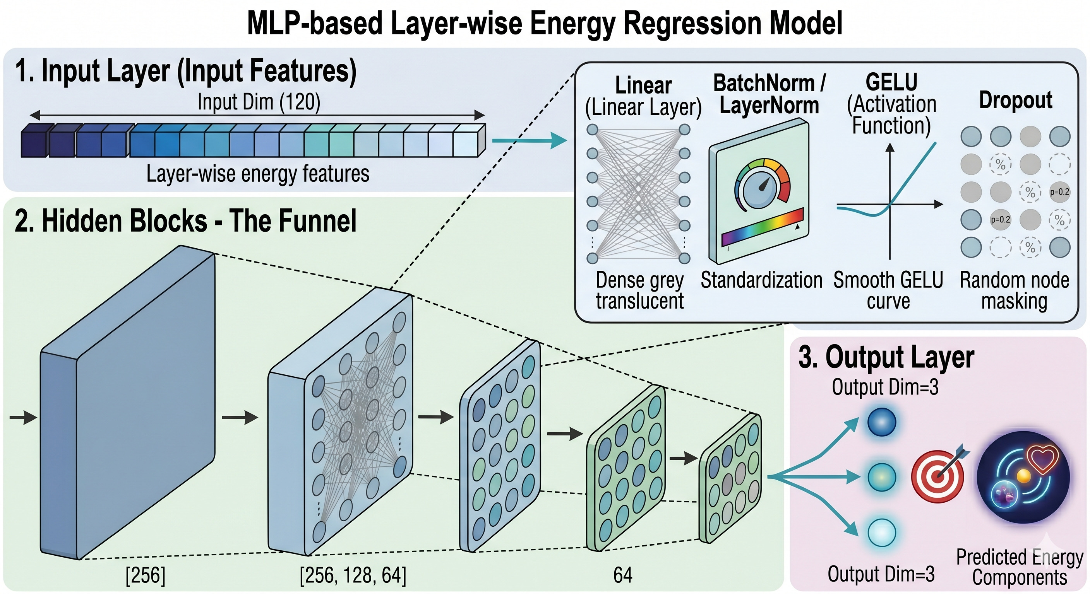
MLP Trian (2000000)
Notes:
We also explored a deep learning approach using a CNN+LSTM network to directly process hit energy images. The goal is to learn the spatial and longitudinal development of the clusters. However, due to computational constraints, this initial test was limited to a dataset of 12,000 samples.

Slide 6
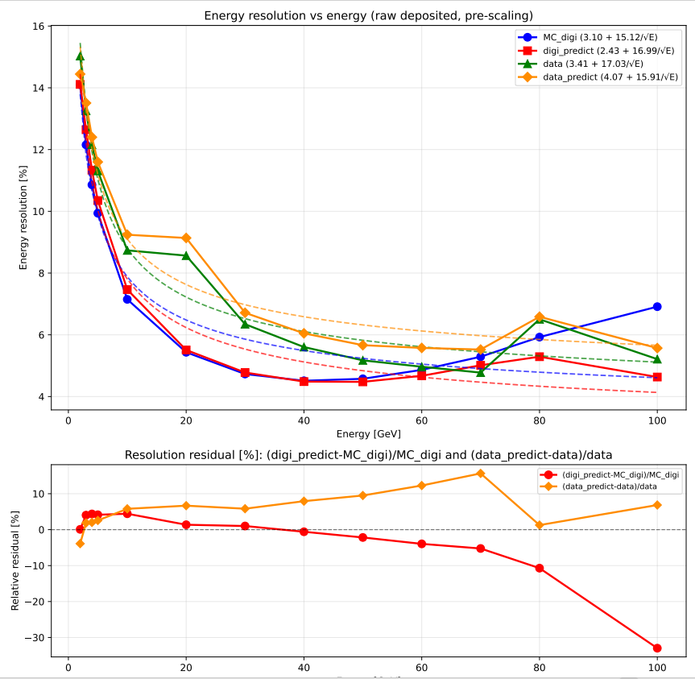
MLP Result
Energy Resolution MLP
Discrete energy points：
[ 2.0,3.0,4.0,5.0,10.0, 20.0, 30.0, 40.0, 50.0, 60.0, 70.0, 80.0, 100.0, ]GeV
MC_digi = Total deposited energy (MC_digi)
Data = Total deposited energy (SPS:10-100GeV)
            (PS:2-5GeV)
Improvement:
Max resolution boost (MC_digi): 30%
No improvement (data)
Notes:
When comparing both models trained on the same restricted 12,000-sample dataset, the CNN+LSTM architecture demonstrates a clear advantage over the standard MLP. Despite the limitations of data starvation, the CNN+LSTM model achieves better energy resolution and more stable linearity. This suggests a potentially superior capability in extracting complex spatial and longitudinal shower features directly from the raw hit data.

Slide 7
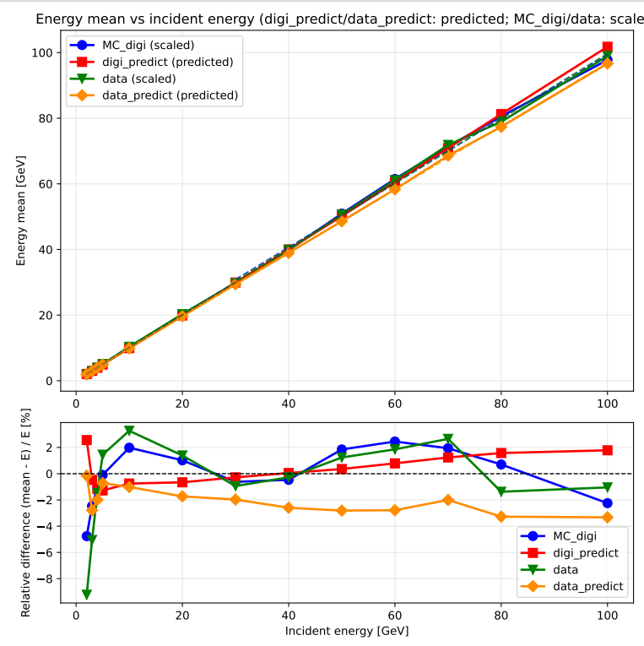
MLP Result Result HCAL
Linearity MLP
Discrete energy points：
[ 2.0,3.0,4.0,5.0,10.0, 20.0, 30.0, 40.0, 50.0, 60.0, 70.0, 80.0, 100.0, ]GeV
MC_digi = Total deposited energy (MC_digi)
Data = Total deposited energy (SPS:10-100GeV)
            (PS:2-5GeV)
Linearity fit Seprate: low_energy(2-30GeV)
        high_energy(30-100GeV)
No Improvement:
Notes:
Turning to the linearity evaluation on the same 12,000-sample dataset, the CNN+LSTM model once again outperforms the standard MLP. While both models exhibit some residual fluctuations due to the limited data volume, the CNN+LSTM maintains a noticeably more stable and accurate linear response across the energy spectrum. This further confirms its superior capability to capture complex physical correlations directly from the raw hit-level data

Slide 8
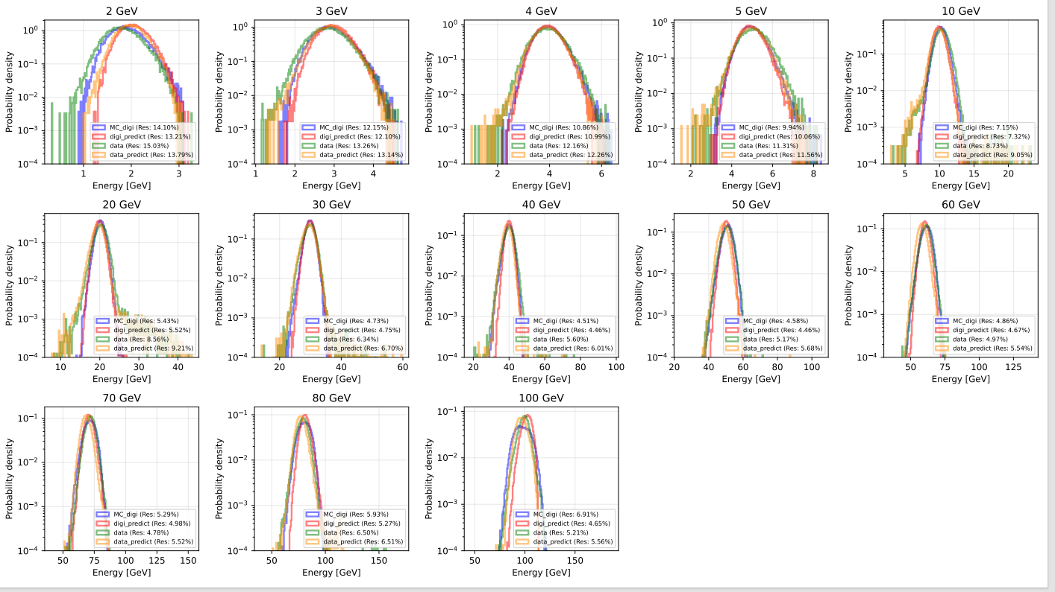
MLP Result HCAL
Notes:
In contrast to the resolution, no comparable enhancement was observed in the energy linearity.

Slide 9
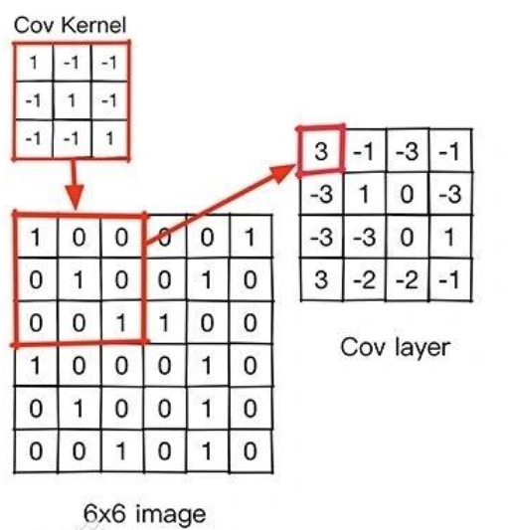
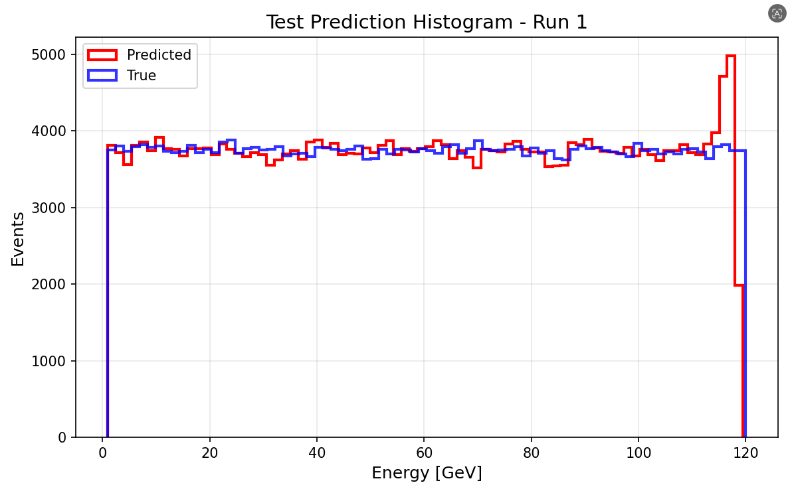
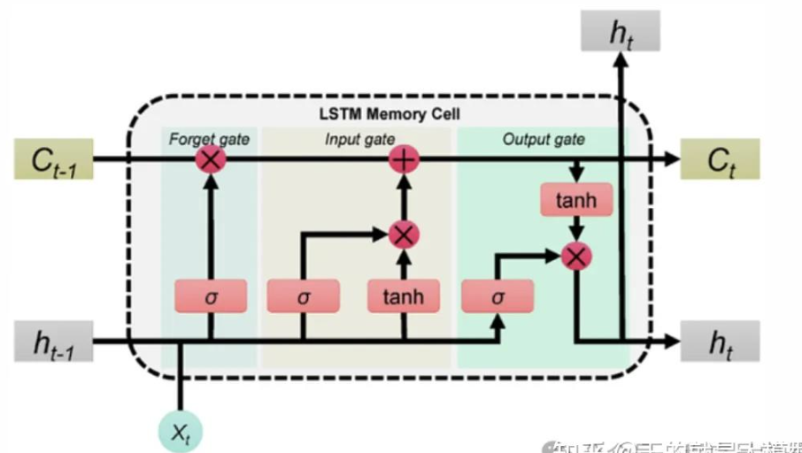
CNN+LSTM Trian (2000000)
Input(hit level data):
HIt_ENERGY
Output:
  Predicted Energy
CNN (Convolutional Neural Network)
Samples:
MC: 1-120GeV (2000000) Continuous e-
Data split
train_frac = 0.7
val_frac = 0.15
test_frac = 0.15
Read the hit image of the super layer
LSTM (Long Short-Term Memory)
Learn the development of shower at different levels
lr =1e-4
batch_size =256
epochs =150
weight_decay =1e-4
optimizer ="adamw"
Input and Output（rellative error <2%）
Notes:
We also explored a deep learning approach using a CNN+LSTM network to directly process hit energy images. The goal is to learn the spatial and longitudinal development of the clusters. However, due to computational constraints, this initial test was limited to a dataset of 12,000 samples.

Slide 10
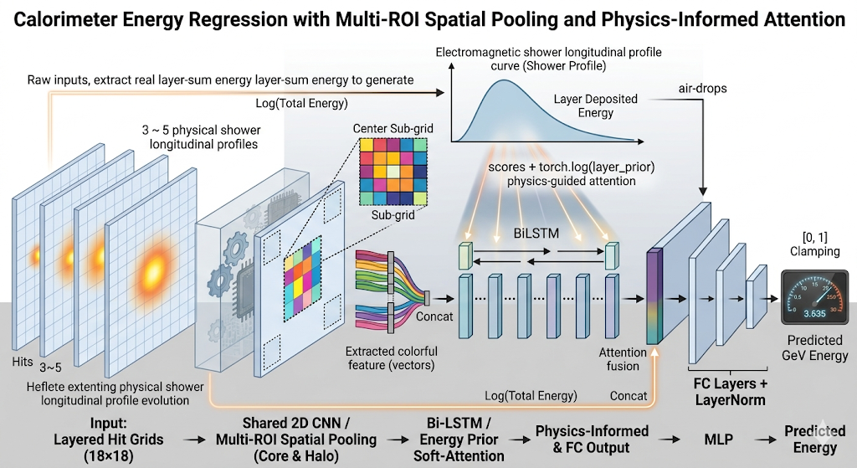
CNN+LSTM Trian (2000000)
Notes:
We also explored a deep learning approach using a CNN+LSTM network to directly process hit energy images. The goal is to learn the spatial and longitudinal development of the clusters. However, due to computational constraints, this initial test was limited to a dataset of 12,000 samples.

Slide 11
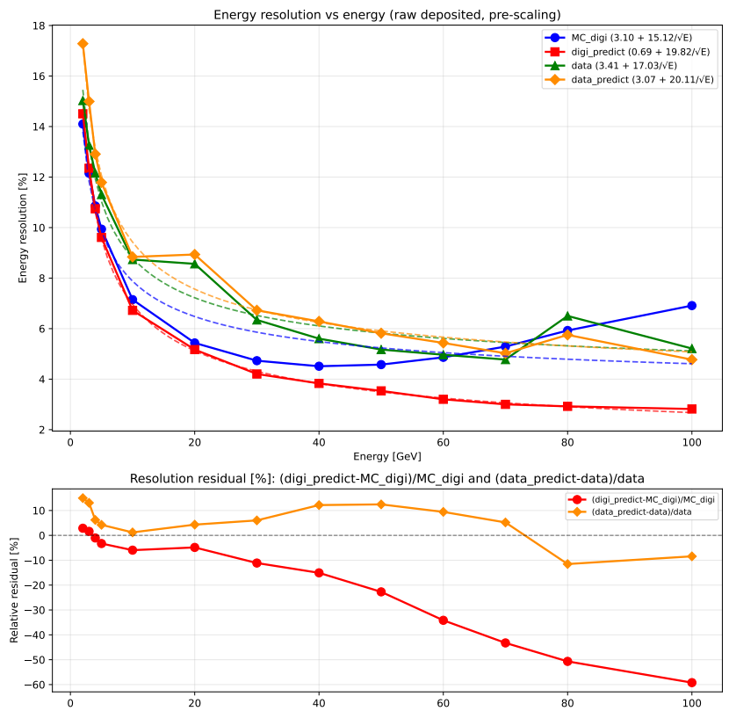
CNN+LSTM Result Result HCAL
Energy Resolution CNN+LSTM
Discrete energy points：
[ 2.0,3.0,4.0,5.0,10.0, 20.0, 30.0, 40.0, 50.0, 60.0, 70.0, 80.0, 100.0, ]GeV
MC_digi = Total deposited energy (MC_digi)
Data = Total deposited energy (SPS:10-100GeV)
            (PS:2-5GeV)
Improvement:
Max resolution boost (MC_digi): ~60%
No improvement (data)
Large difference between data and MC_digi
Notes:
When comparing both models trained on the same restricted 12,000-sample dataset, the CNN+LSTM architecture demonstrates a clear advantage over the standard MLP. Despite the limitations of data starvation, the CNN+LSTM model achieves better energy resolution and more stable linearity. This suggests a potentially superior capability in extracting complex spatial and longitudinal shower features directly from the raw hit data.

Slide 12
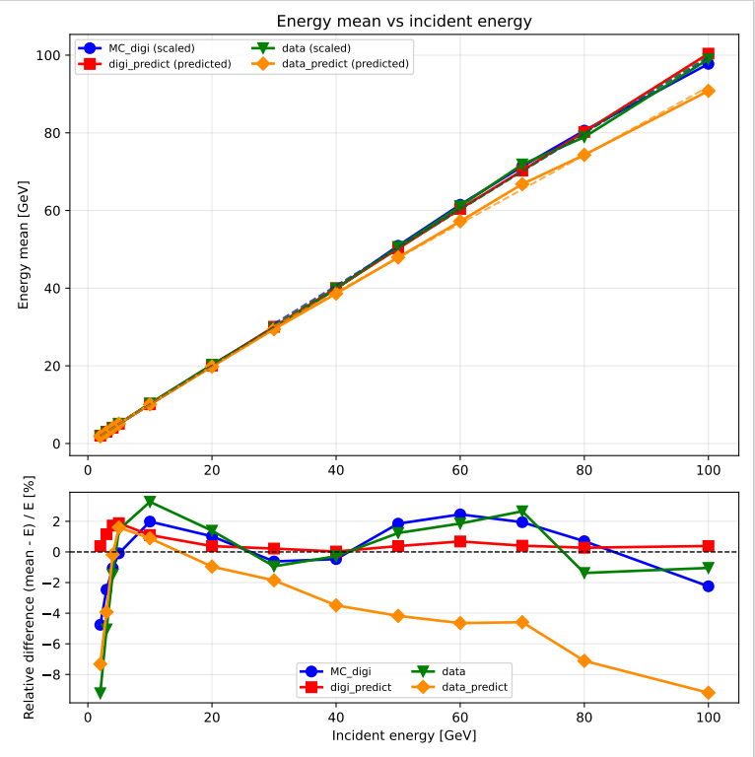
CNN+LSTM Result Result HCAL
Linearity CNN+LSTM
Discrete energy points：
[ 2.0,3.0,4.0,5.0,10.0, 20.0, 30.0, 40.0, 50.0, 60.0, 70.0, 80.0, 100.0, ]GeV
MC_digi = Total deposited energy (MC_digi)
Data = Total deposited energy (SPS:10-100GeV)
            (PS:2-5GeV)
No Improvement:
Large difference between data and MC_digi
Notes:
Turning to the linearity evaluation on the same 12,000-sample dataset, the CNN+LSTM model once again outperforms the standard MLP. While both models exhibit some residual fluctuations due to the limited data volume, the CNN+LSTM maintains a noticeably more stable and accurate linear response across the energy spectrum. This further confirms its superior capability to capture complex physical correlations directly from the raw hit-level data

Slide 13
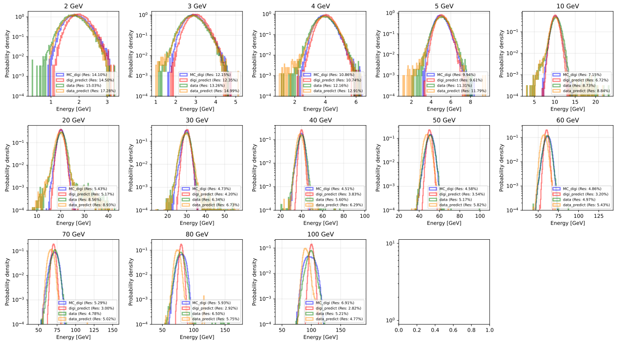
CNN+LSTM Result HCAL
Notes:
In contrast to the resolution, no comparable enhancement was observed in the energy linearity.

Slide 14
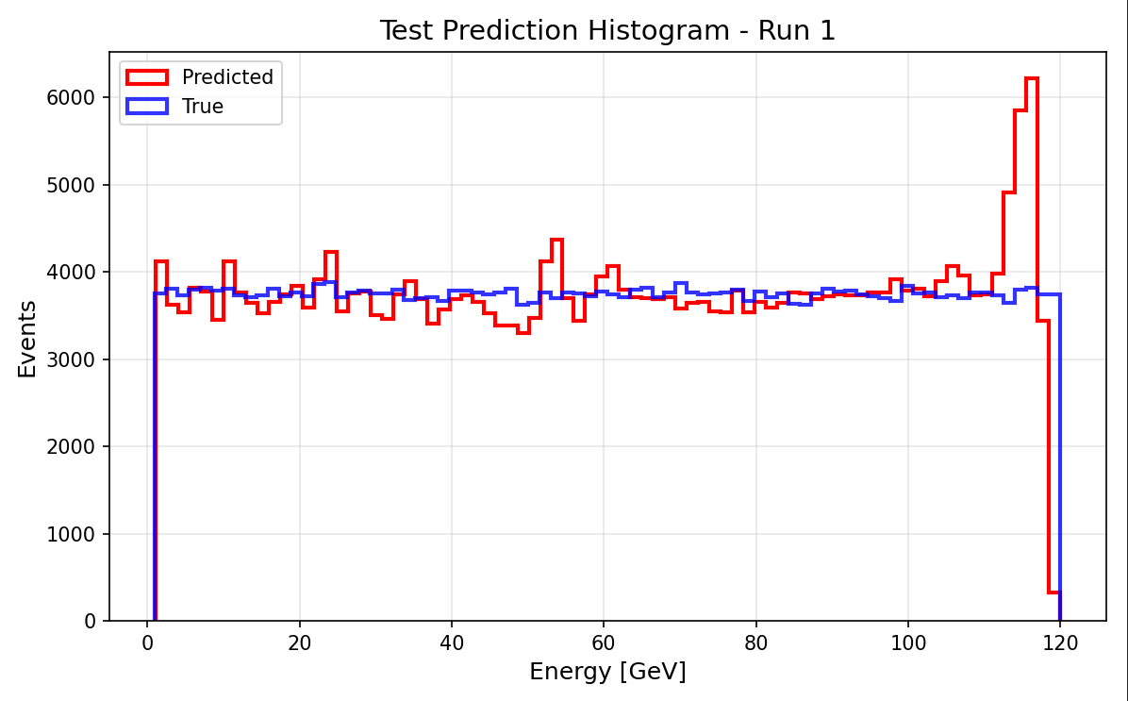
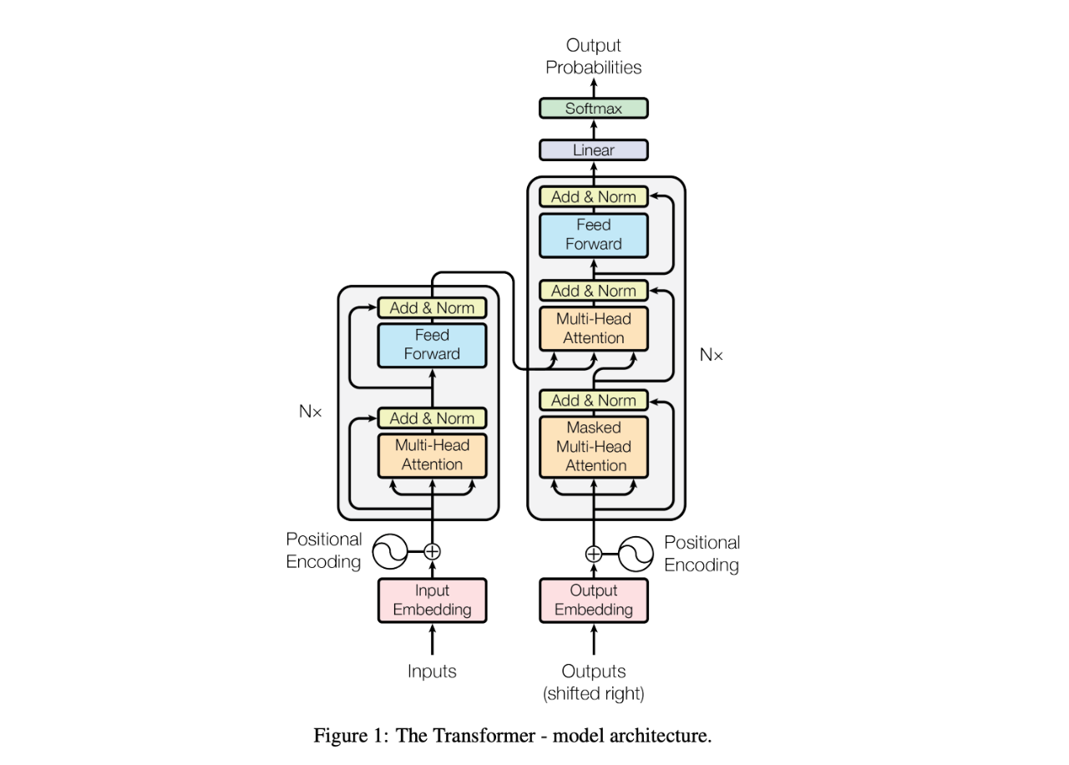
CNN+Transformer Trian (2000000)
Input(hit level data):
HIt_ENERGY
Output:
  Predicted Energy
CNN (Convolutional Neural Network)
Samples:
MC: 1-120GeV (2000000) Continuous e-
Data split
train_frac = 0.7
val_frac = 0.15
test_frac = 0.15
Read the hit image of the super layer
Transformer
Learn the development of shower at different levels
lr =1e-4
batch_size =256
epochs =150
weight_decay =1e-4
optimizer ="adamw"
Input and Output（rellative error <1%）
Notes:
We also explored a deep learning approach using a CNN+LSTM network to directly process hit energy images. The goal is to learn the spatial and longitudinal development of the clusters. However, due to computational constraints, this initial test was limited to a dataset of 12,000 samples.

Slide 15
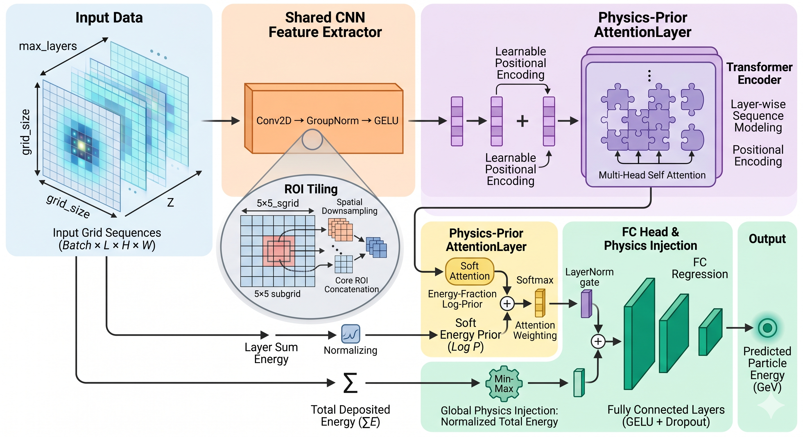
CNN+Transformer Trian (2000000)
Notes:
We also explored a deep learning approach using a CNN+LSTM network to directly process hit energy images. The goal is to learn the spatial and longitudinal development of the clusters. However, due to computational constraints, this initial test was limited to a dataset of 12,000 samples.

Slide 16
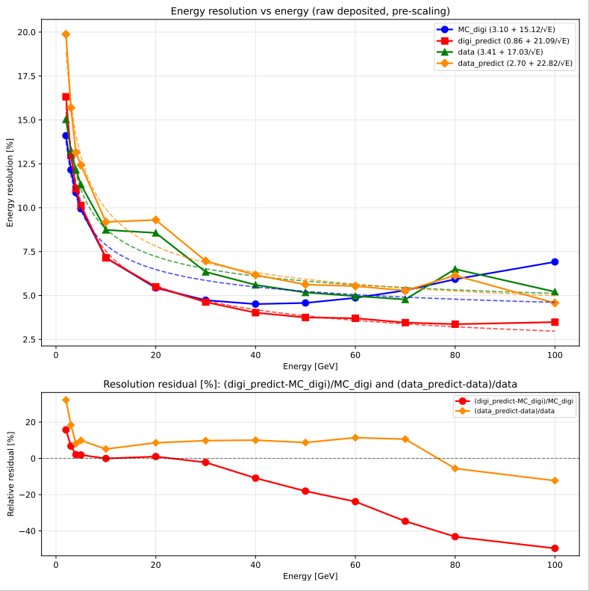
CNN+Transformer Result HCAL
Energy Resolution
Discrete energy points：
[ 2.0,3.0,4.0,5.0,10.0, 20.0, 30.0, 40.0, 50.0, 60.0, 70.0, 80.0, 100.0, ]GeV
MC_digi = Total deposited energy (MC_digi)
Data = Total deposited energy (SPS:10-100GeV)
            (PS:2-5GeV)
Improvement:
Max resolution boost (MC_digi): ~50%
No improvement (data)
Large difference between data and MC_digi
Notes:
As you can see here, the MLP model gives much better energy resolution than the baseline, which I labeled as 'truth'. If you look at the bottom panel,we see a consistent improvement of about 5% across discrete energy points. Overall, this gives us a total resolution boost of 9%.

Slide 17
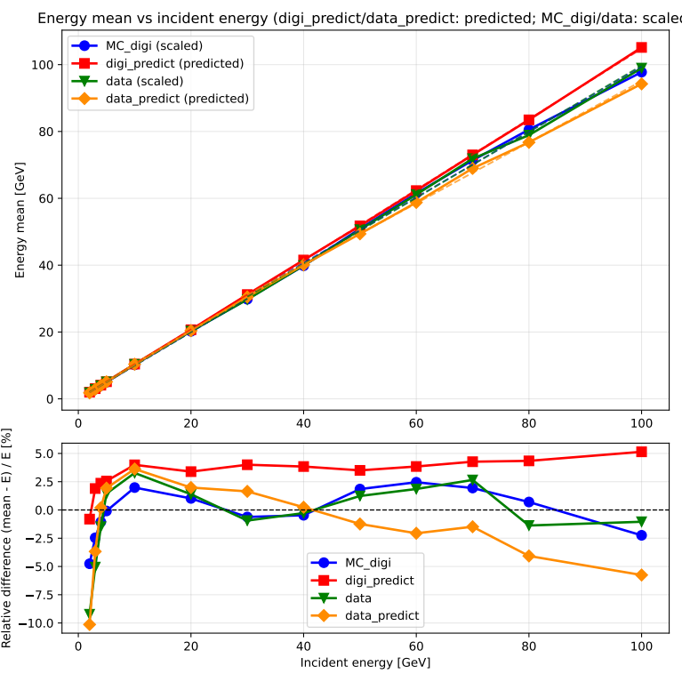
CNN+Transformer Result HCAL
Linearity
Discrete energy points：
[ 2.0,3.0,4.0,5.0,10.0, 20.0, 30.0, 40.0, 50.0, 60.0, 70.0, 80.0, 100.0, ]GeV
MC_digi = Total deposited energy (MC_digi)
Data = Total deposited energy (SPS:10-100GeV)
            (PS:2-5GeV)
Large difference between data and MC_digi
Notes:
In contrast to the resolution, no comparable enhancement was observed in the energy linearity.

Slide 18
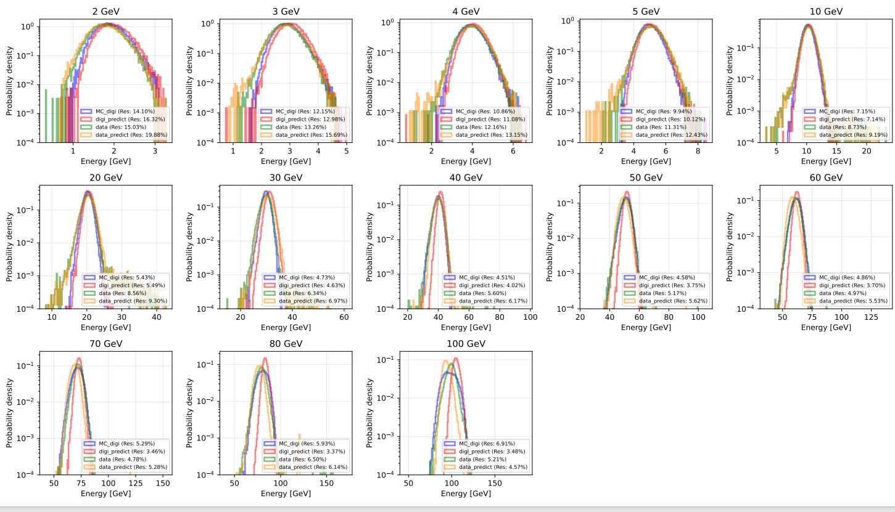
CNN+Transformer Result HCAL
Notes:
In contrast to the resolution, no comparable enhancement was observed in the energy linearity.

Slide 19
Summary
Boundary Effects: HCAL's boundary effect is significantly larger than ECAL's, likely attributed to HCAL's structural design.
Model Performance: Both CNN+LSTM and CNN+Transformer outperform MLP, demonstrating that hit-level data contains richer information.
Future Comparison: It remains unclear which is better between CNN+LSTM and CNN + Transformer, as the results are highly sensitive to hyperparameter tuning.
Problem: The predictions on real data are much worse than those on simulation.
Notes:
In conclusion, while the hit-level CNN+LSTM architecture demonstrates significant theoretical potential, sample size remains the absolute decisive factor for performance. Moving forward, we plan to scale our CNN+LSTM training to 1.2 million samples and explore Transformer-based architectures

Slide 20
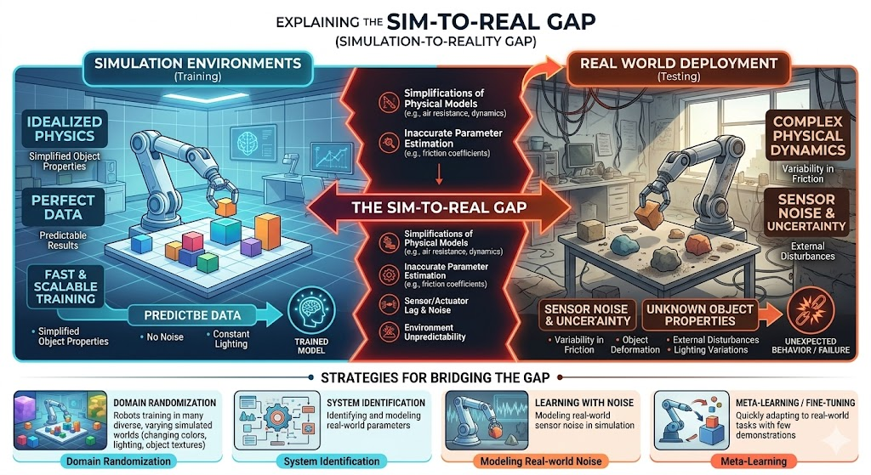
Sim-to-Real Gap
Notes:
In contrast to the resolution, no comparable enhancement was observed in the energy linearity.

Slide 21
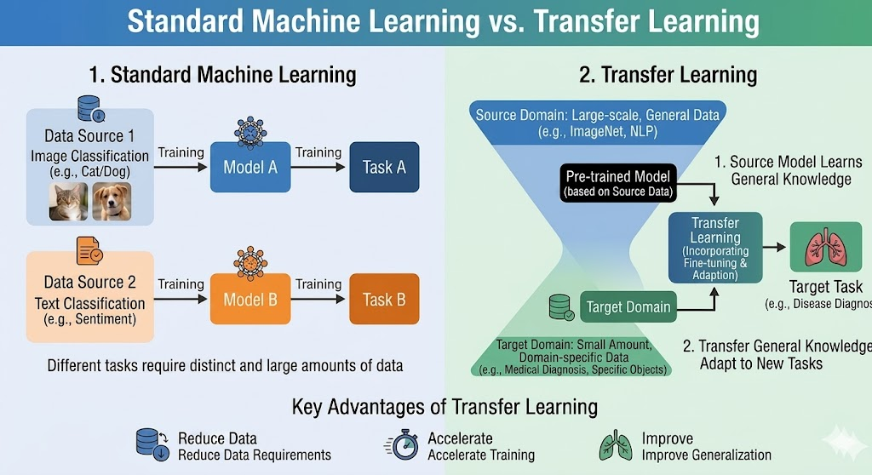
Transfer Learning
Notes:
In contrast to the resolution, no comparable enhancement was observed in the energy linearity.

Slide 22
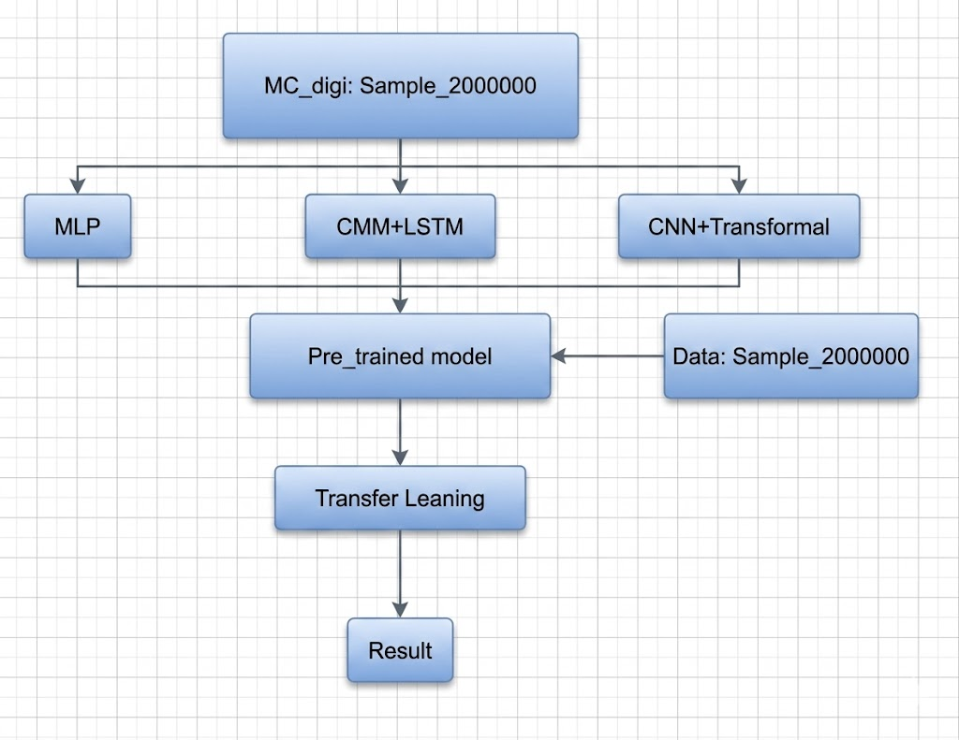
Transfer Learning
Transfer Leaning: Only changed Fully Conneted Layer.
Data：Sample_200000 from PS and SPS
[ 2.0,3.0,4.0,5.0,10.0, 20.0, 30.0, 40.0, 50.0, 60.0, 70.0, 80.0, 100.0, ]GeV Uniformly mixed
Notes:
In contrast to the resolution, no comparable enhancement was observed in the energy linearity.

Slide 23
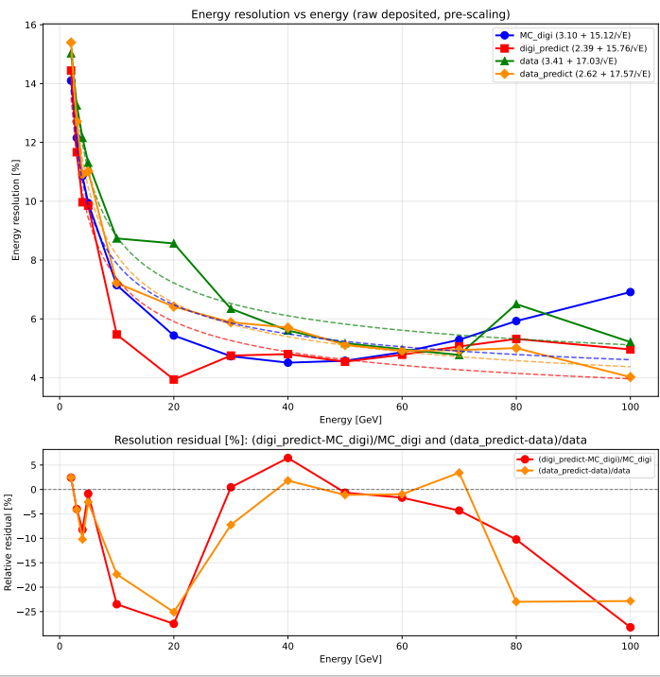
MLP Result_Energy Resolution
Transfer Learning
Pre-trained model
Notes:
When comparing both models trained on the same restricted 12,000-sample dataset, the CNN+LSTM architecture demonstrates a clear advantage over the standard MLP. Despite the limitations of data starvation, the CNN+LSTM model achieves better energy resolution and more stable linearity. This suggests a potentially superior capability in extracting complex spatial and longitudinal shower features directly from the raw hit data.

Slide 24
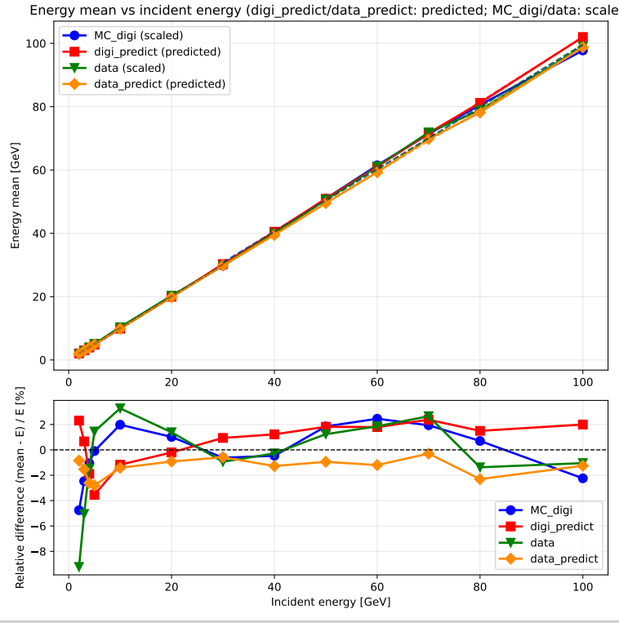
MLP Result_Linearity
Transfer Learning
Pre-trained model
Notes:
When comparing both models trained on the same restricted 12,000-sample dataset, the CNN+LSTM architecture demonstrates a clear advantage over the standard MLP. Despite the limitations of data starvation, the CNN+LSTM model achieves better energy resolution and more stable linearity. This suggests a potentially superior capability in extracting complex spatial and longitudinal shower features directly from the raw hit data.

Slide 25
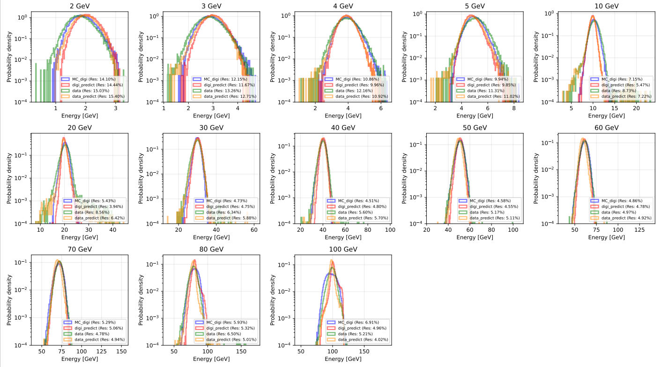
MLP Result HCAL Transfer Learning
Notes:
In contrast to the resolution, no comparable enhancement was observed in the energy linearity.

Slide 26
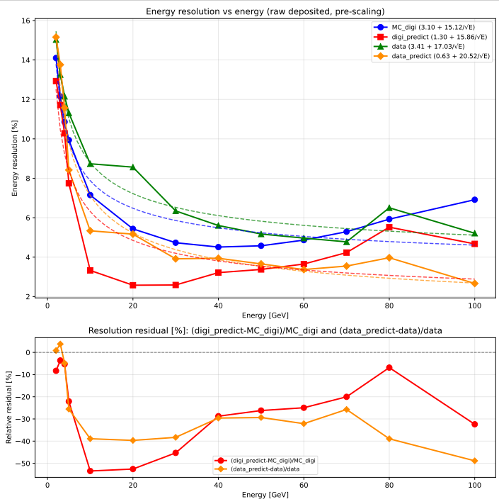
CNN+LSTM Result_Energy Resolution
Transfer Learning
Pre-trained model
Notes:
When comparing both models trained on the same restricted 12,000-sample dataset, the CNN+LSTM architecture demonstrates a clear advantage over the standard MLP. Despite the limitations of data starvation, the CNN+LSTM model achieves better energy resolution and more stable linearity. This suggests a potentially superior capability in extracting complex spatial and longitudinal shower features directly from the raw hit data.

Slide 27
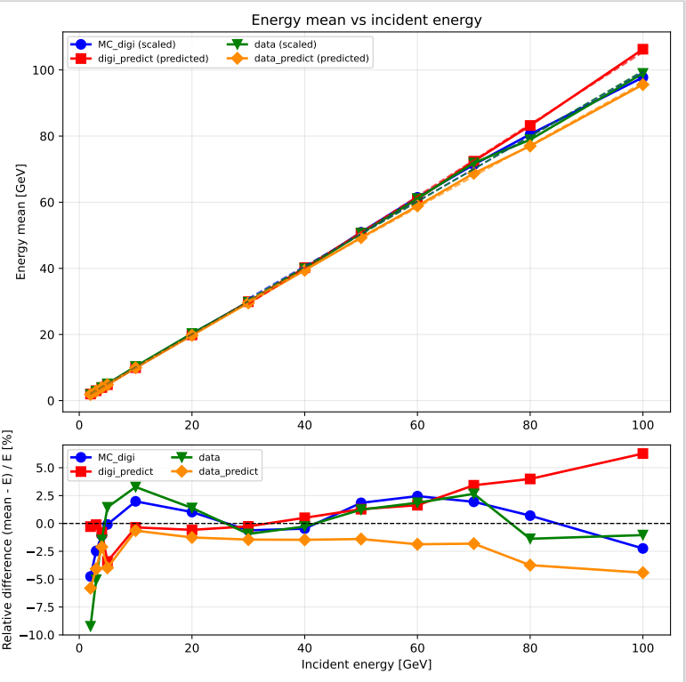
CNN+LSTM Result_Linearity
Transfer Learning
Pre-trained model
Notes:
When comparing both models trained on the same restricted 12,000-sample dataset, the CNN+LSTM architecture demonstrates a clear advantage over the standard MLP. Despite the limitations of data starvation, the CNN+LSTM model achieves better energy resolution and more stable linearity. This suggests a potentially superior capability in extracting complex spatial and longitudinal shower features directly from the raw hit data.

Slide 28
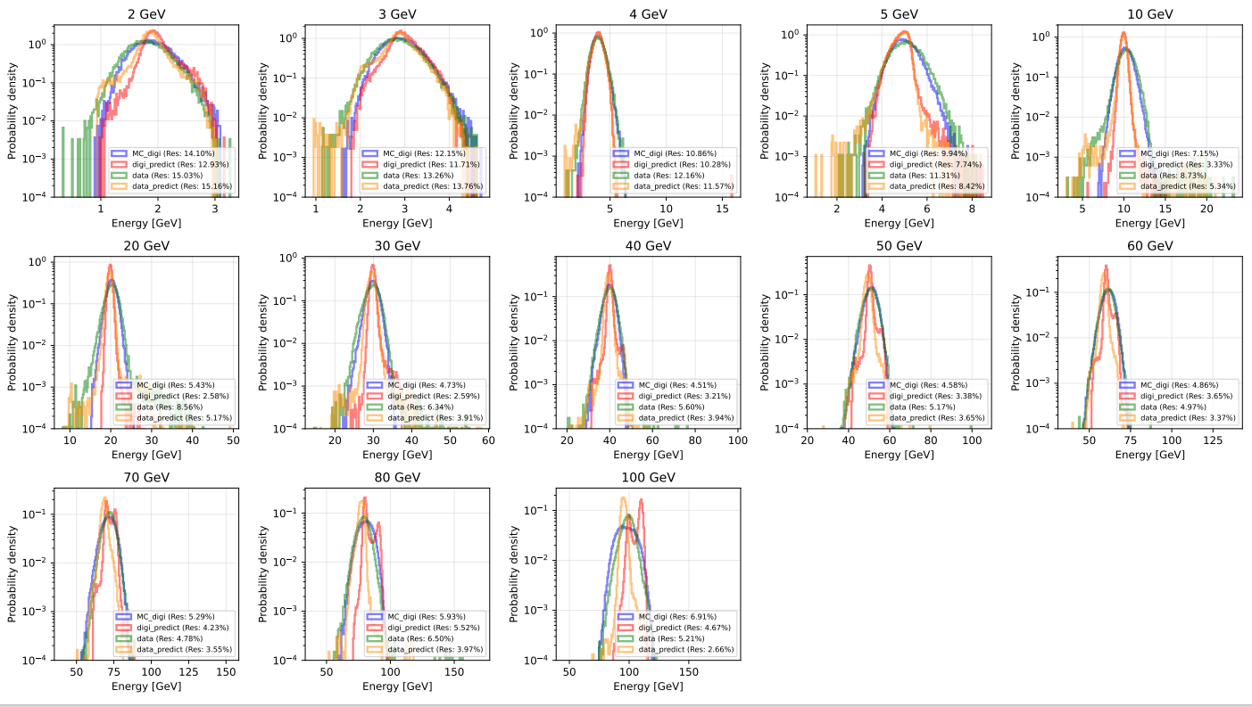
CNN+LSTM Result HCAL Transfer Learning
Notes:
In contrast to the resolution, no comparable enhancement was observed in the energy linearity.

Slide 29
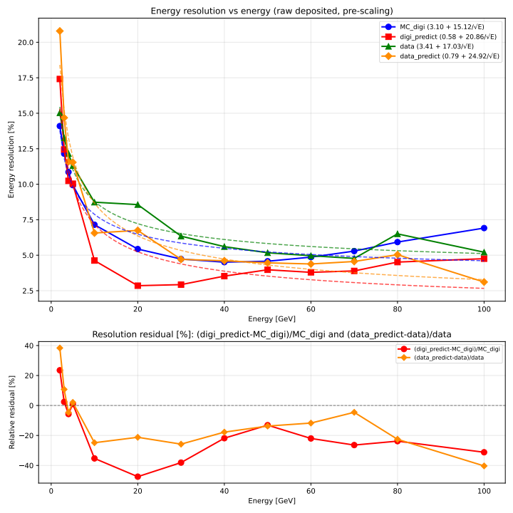
CNN+Transformer Result_Energy Resolution
Transfer Learning
Pre-trained model
Notes:
When comparing both models trained on the same restricted 12,000-sample dataset, the CNN+LSTM architecture demonstrates a clear advantage over the standard MLP. Despite the limitations of data starvation, the CNN+LSTM model achieves better energy resolution and more stable linearity. This suggests a potentially superior capability in extracting complex spatial and longitudinal shower features directly from the raw hit data.

Slide 30
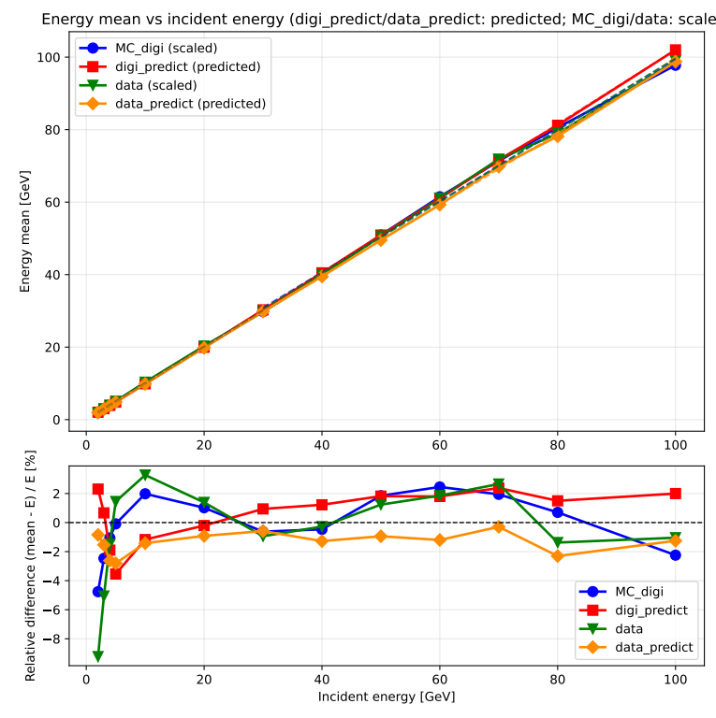
CNN+Transformer Result_Linearity
Transfer Learning
Pre-trained model
Notes:
When comparing both models trained on the same restricted 12,000-sample dataset, the CNN+LSTM architecture demonstrates a clear advantage over the standard MLP. Despite the limitations of data starvation, the CNN+LSTM model achieves better energy resolution and more stable linearity. This suggests a potentially superior capability in extracting complex spatial and longitudinal shower features directly from the raw hit data.

Slide 31
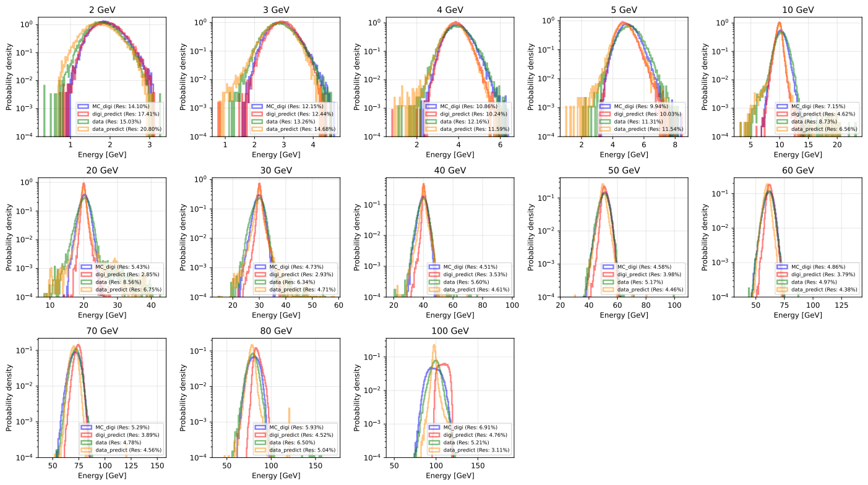
CNN+Transformer Result HCAL Transfer Learning
Notes:
In contrast to the resolution, no comparable enhancement was observed in the energy linearity.

Slide 32
Summary
Model Performance: Both CNN+LSTM and CNN+Transformer outperform MLP, demonstrating that hit-level data contains richer information. CNN+LSTM also better than CNN+Transformer, likely because shower development exhibits a distinct sequential order across layers. This structural characteristic favors the recurrent nature of LSTMs over the multi-head attention mechanism of Transformers.
Transfer learning: Following the application of transfer learning, both the linearity and energy resolution of the data exhibited significant improvements.
Concern: Risk of Overfitting: May over-optimize on isolated energy points.
      Generalization Concern: Risk of non-physical "hallucinations" at unseen energies.
Next step
Update CNN+Tramsformer CNN+LSTM and Transfer learning.
Notes:
In conclusion, while the hit-level CNN+LSTM architecture demonstrates significant theoretical potential, sample size remains the absolute decisive factor for performance. Moving forward, we plan to scale our CNN+LSTM training to 1.2 million samples and explore Transformer-based architectures

Slide 33
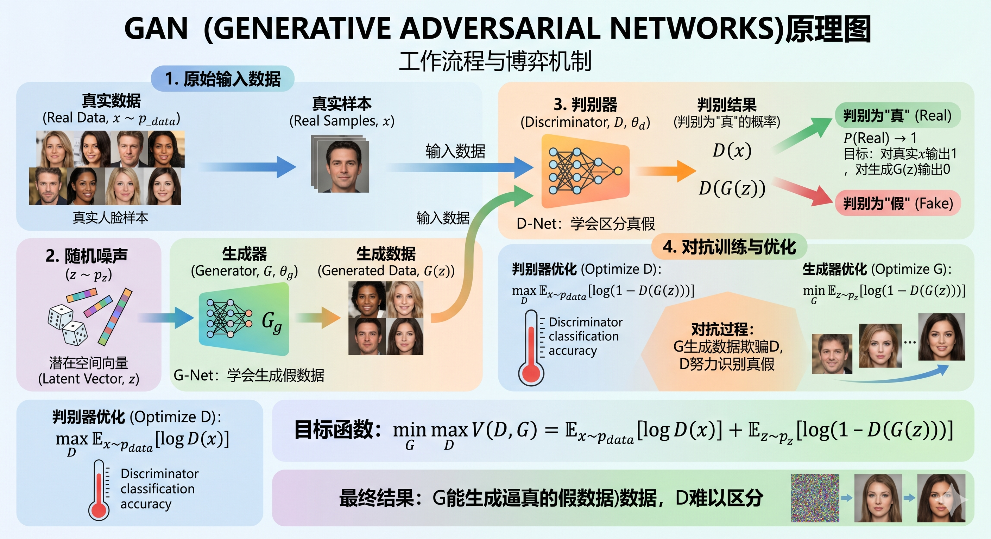
Generative Adversarial Network
Notes:
In contrast to the resolution, no comparable enhancement was observed in the energy linearity.

