Slide 1
Group Meeting
Jianjie Peng
2026/4/21

Slide 2
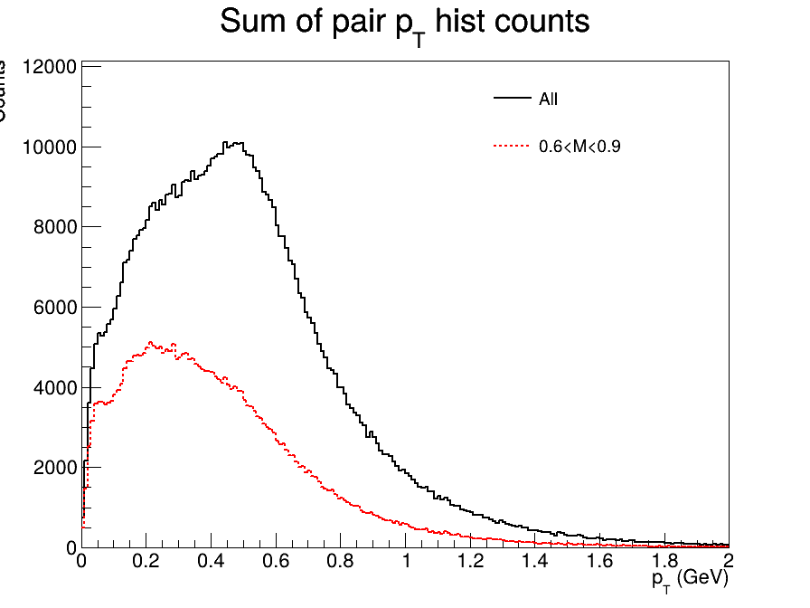
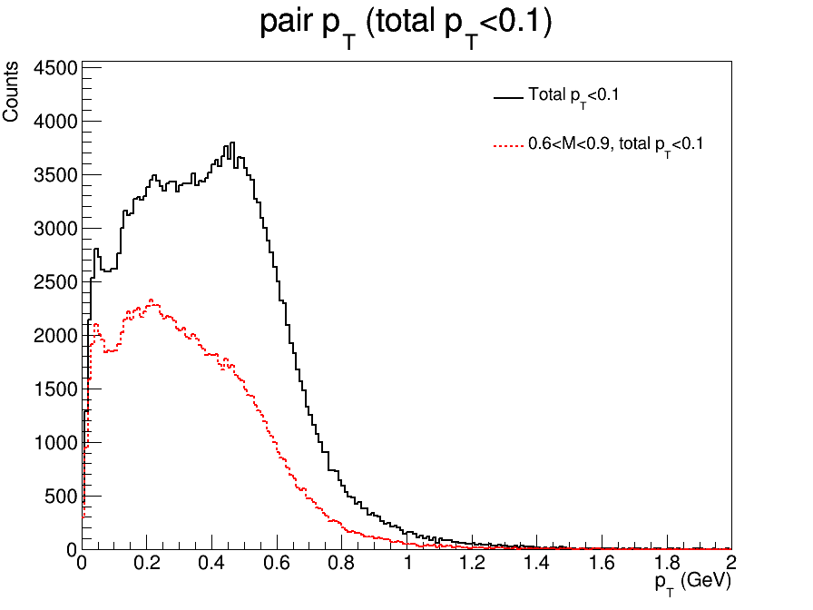
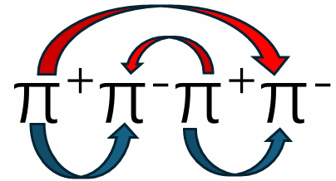
Pairing up & Pair $p_{T}$
A1
A2
B1
B2
A low-𝑝_{𝑇} peak below 0.1 GeV is observed

Slide 3
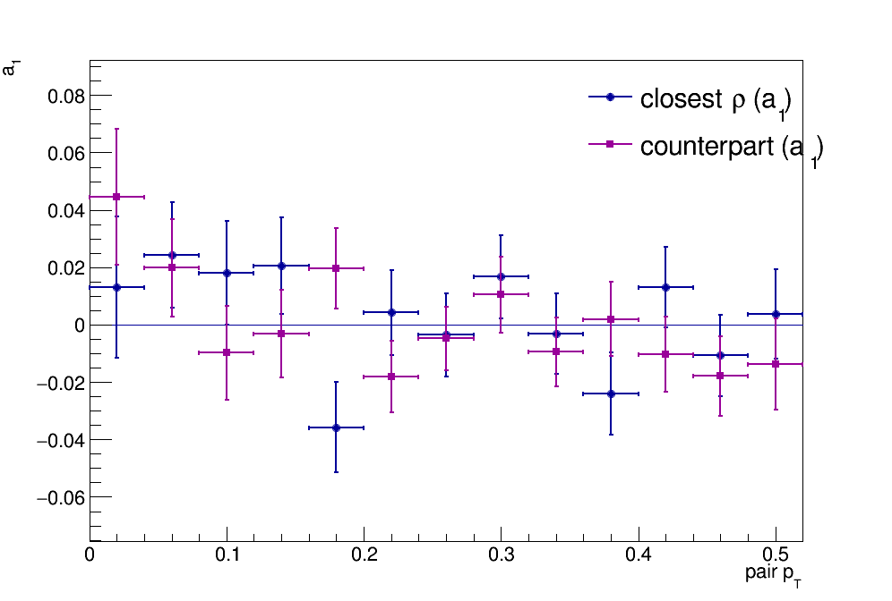
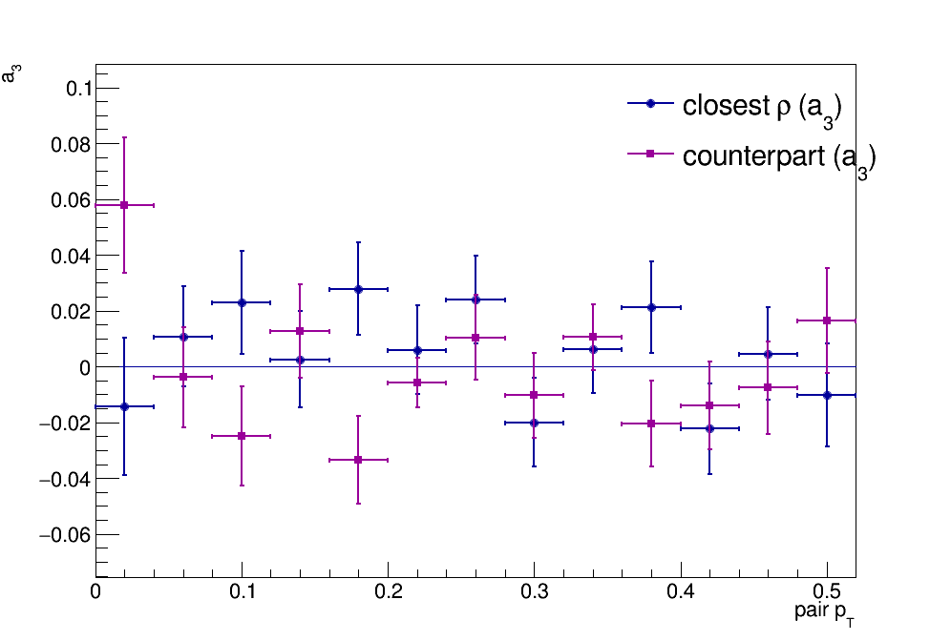
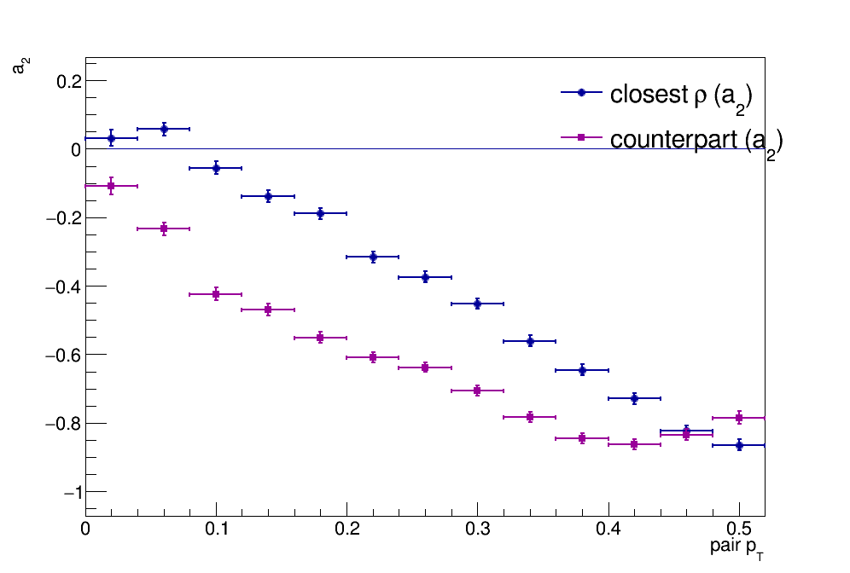
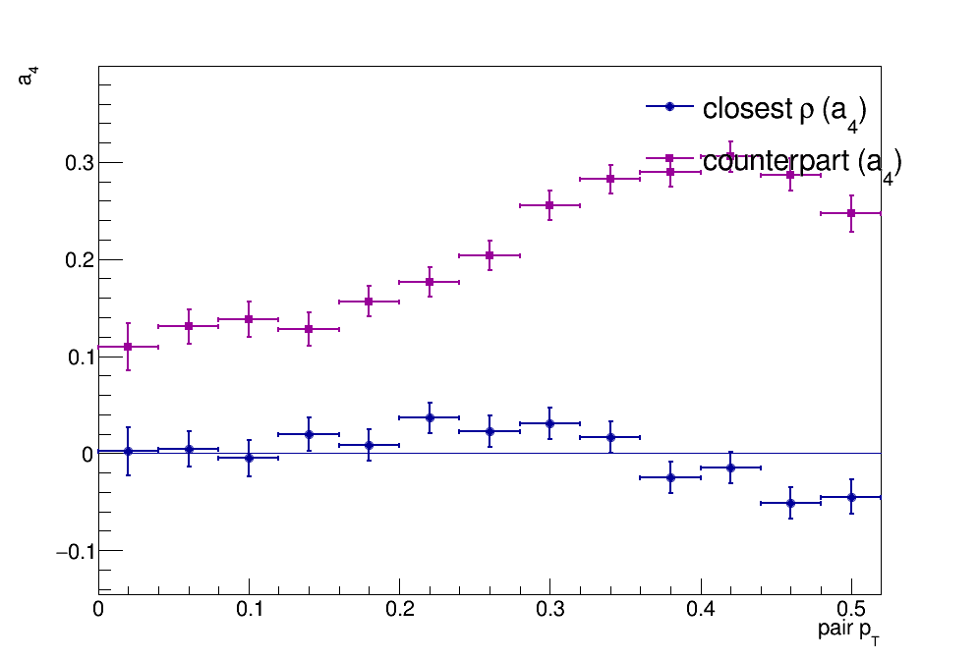

Fitting Parameters v.s. Pair $p_{T}$
$$Fit:f\left(φ\right)=A_{0}\left(1+\sum{A_{n}\cos\left(nφ\right)}\right)$$

Slide 4

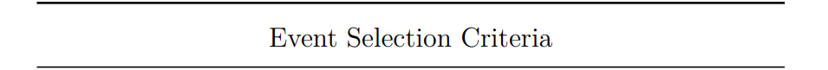
Dataset and Event Selection
@2025 Pb-Pb 5.36 TeV
Era (OMS): HIRun2025A
DAS: /HIEmptyBX/HIRun2025A-PromptReco-v1/AOD
Counts After Selection
HIRun2025A：24059541
Flag_primaryVertexFilter && Flag_hiClusterCompatibility
HLT_HIL1NotBptxOR_v*
HLT_HIL1UnpairedBunchBptxMinus_v*
HLT_HIL1UnpairedBunchBptxPlus_v*

Slide 5
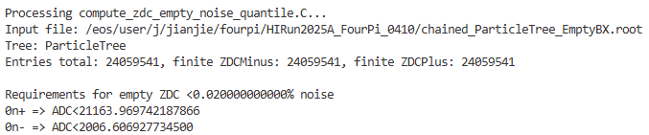
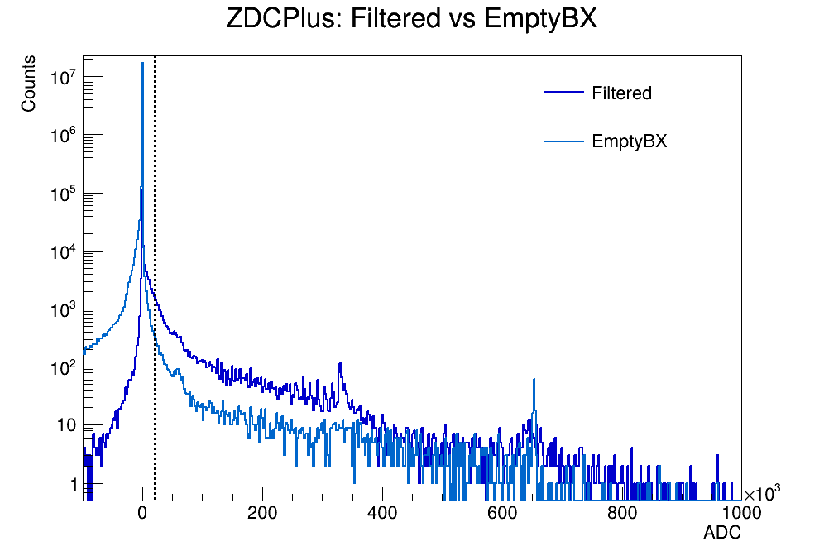
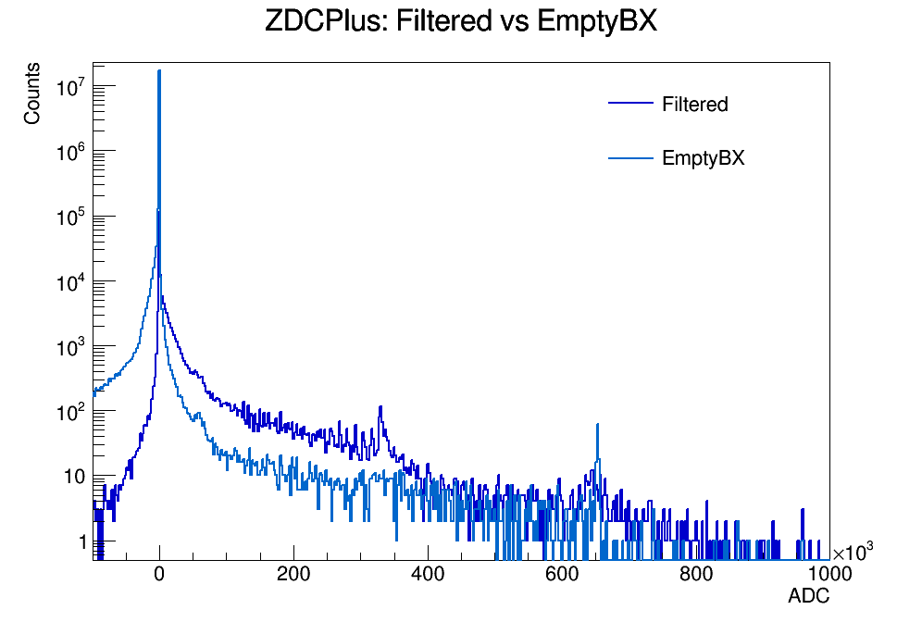
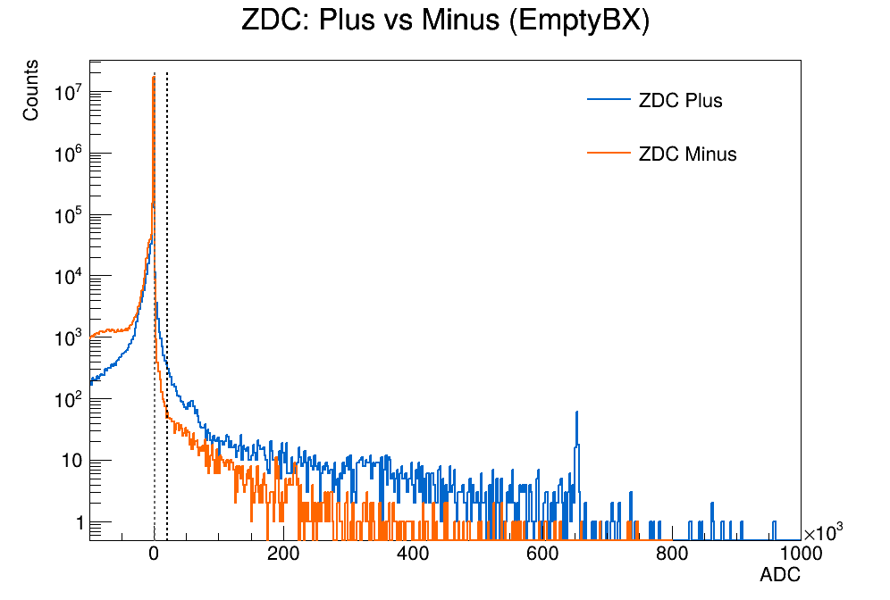
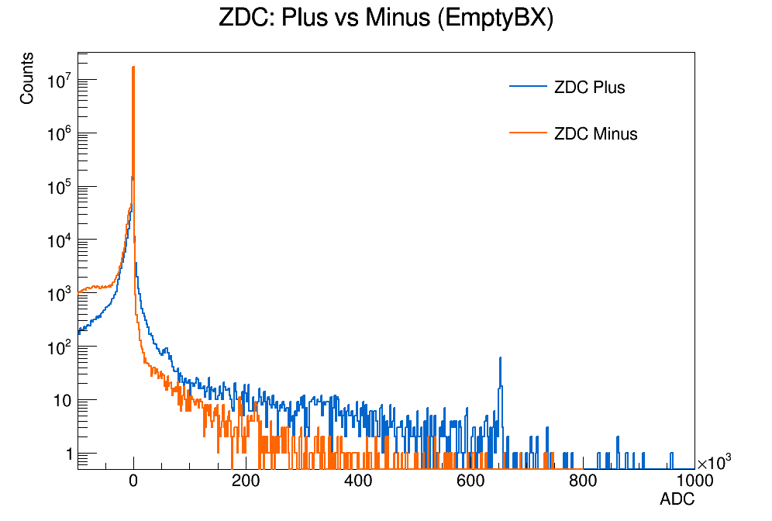
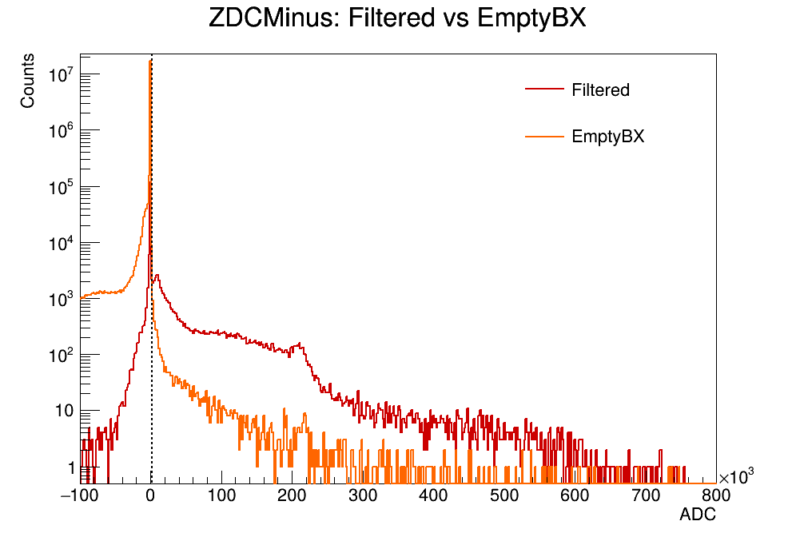
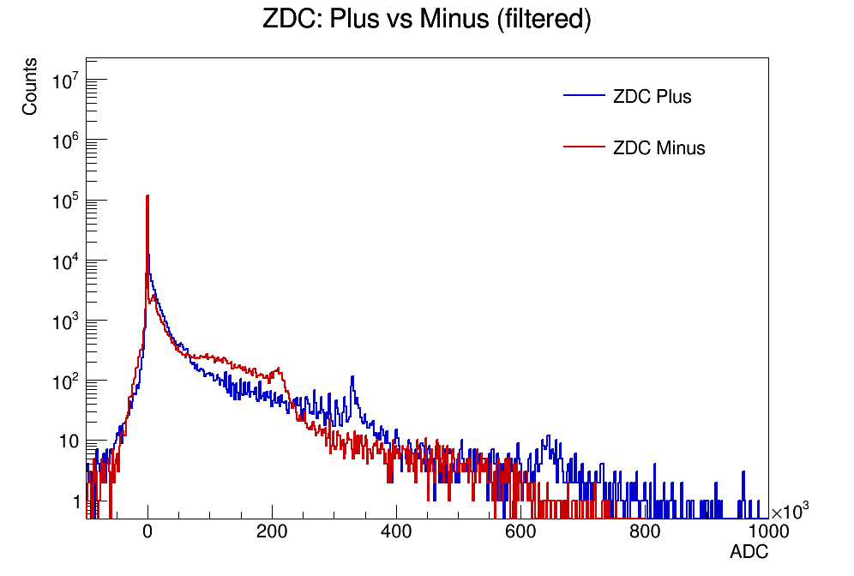
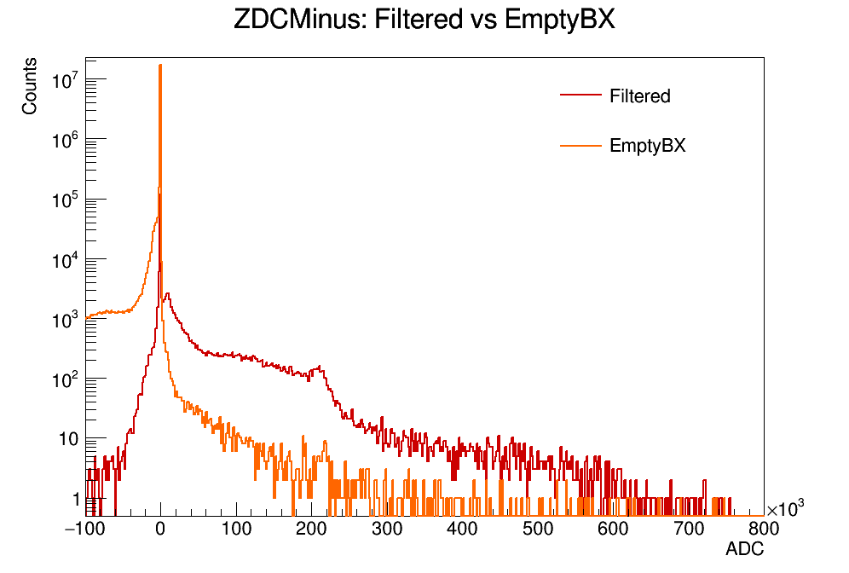
ZDC threshold

Slide 6
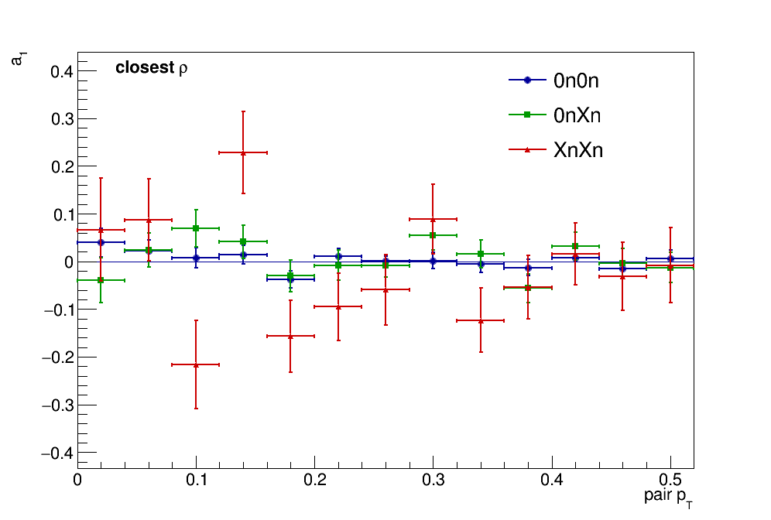
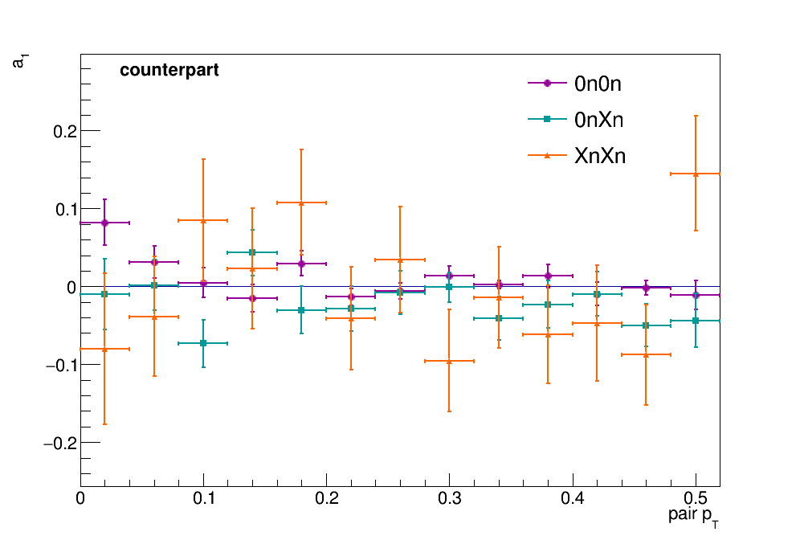
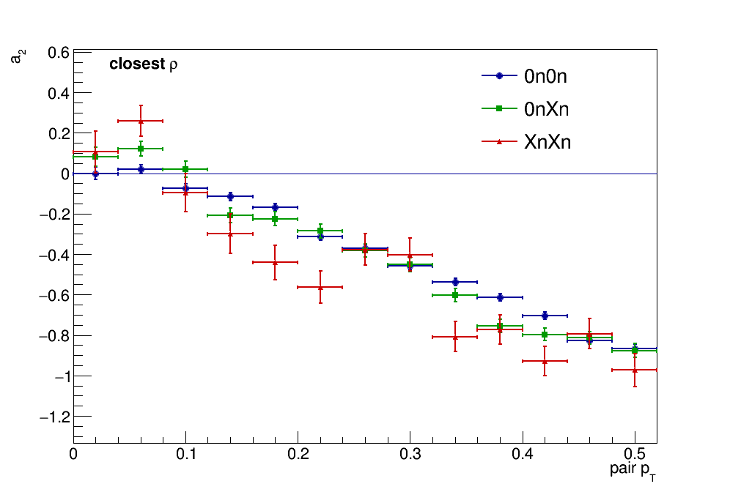
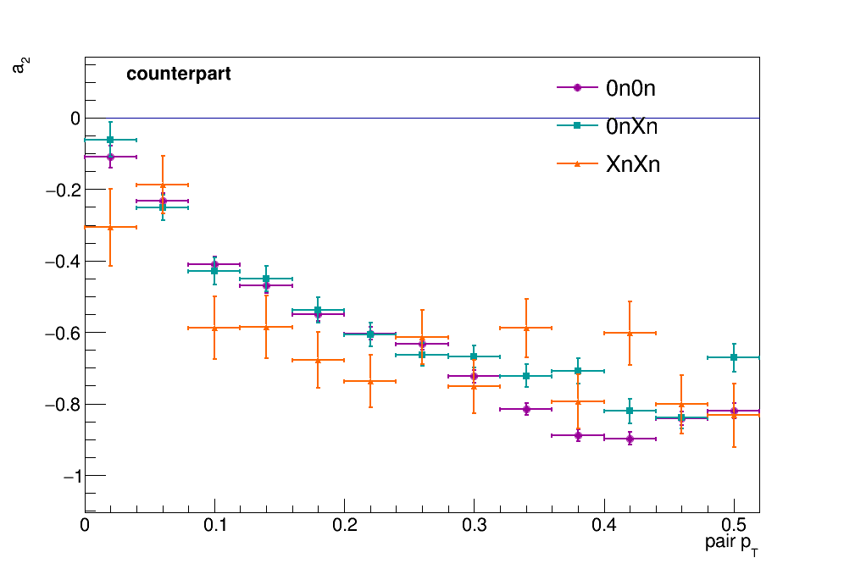
Different Neutron Classes: $a_{1}$ & $a_{2}$

Slide 7
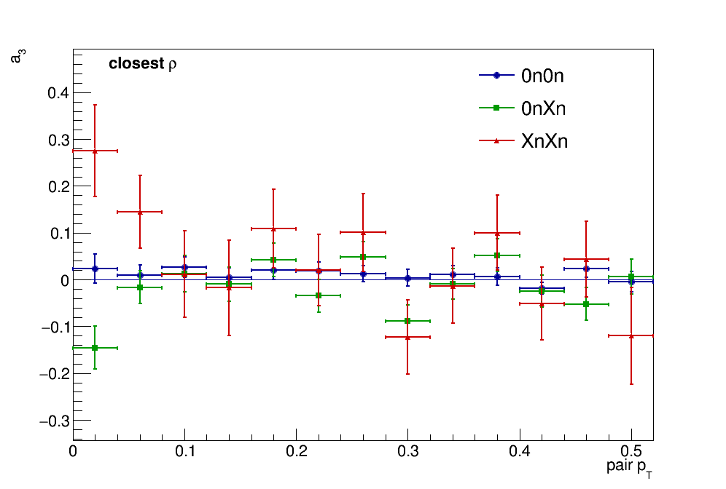
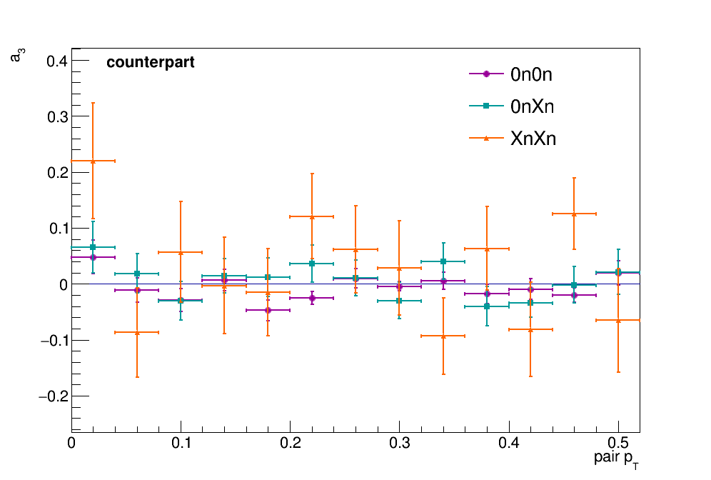
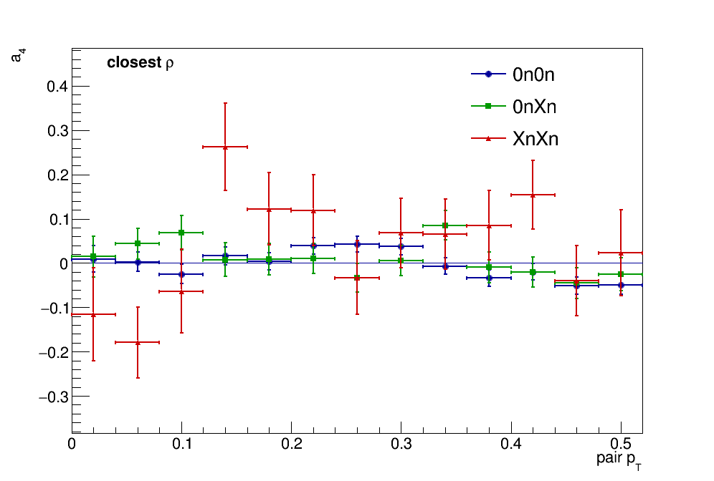
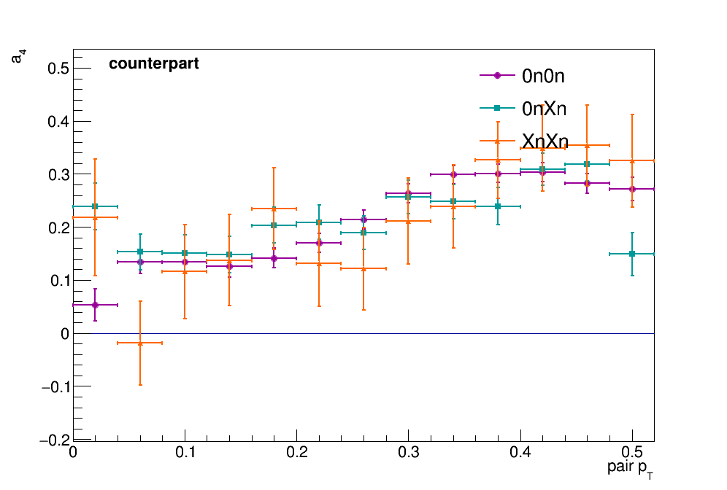
Different Neutron Classes : $a_{3}$ & $a_{4}$

Slide 8
Thanks for Listening!
Thanks for Listening!

