Slide 1

Research Proposal and Preliminary Plan for LGAD Detector Readout
Presenter: Yi Qian
Department: Nuclear Electronics Laboratory / Institute of Modern Physics, CAS
April 23, 2026, Qingdao, Shandong

Slide 2
Outline
1. Introduction of ALTIROC
2. Research Proposal and the preliminary plan
3. work foundation

Slide 3
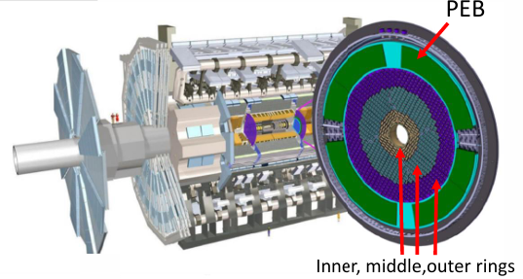
1. Introduction of ALTIROC
Background events: The increase in collision frequency leads to pile-up effects, making events difficult to distinguish.
Solution: Utilize high-precision temporal and spatial information to enhance particle discrimination capability, enabling more accurate event reconstruction.
Particle detection technology based on LGAD (Low Gain Avalanche Detector） has been proposed.
High-Granularity Timing Detector (HGTD)
Timing resolution: 30 ps/track (or 50 ps/hit) at the beginning, 50 ps/track (or 70 ps/hit) after 4000 /fb
8032 modules，totally 3.6 M channels
Module consist of two units（2x4 cm², 450 pixels）
2 ASICs bump bonded onto two 15x15 LGAD
Tolerance：Inner (4.5 MGy, 4.5x10¹⁵n_{eq}/cm²)
Outer (2.1 MGy, 4.0x10¹⁵n_{eq}/cm²)
Temperature：-30℃
Power: < 1.2 W; < 300 mW/cm²

Slide 4

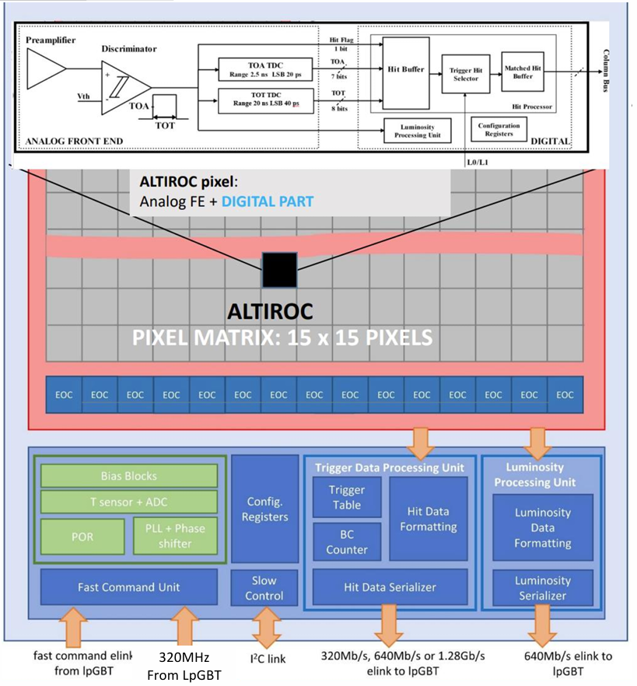
ALTIROC
ATLAS LGAD Timing Integrated Read-Out Chip
Technology: TSMC 130 nm 1.2 V CMOS
ASIC size:
Pixel area: 19.5 x 19.5 mm²
Total area: 22 x 20 mm²
Pixel area:
15 x 15 pixel matrix
Pixel size: 1.3 x 1.3 mm²
On-pixel electronics:
Analog: Preamplifer + DIS. + TDC
Digital: SRAM + CONF. + Luminosity unit
EOC (End of Column): Readout & transfer
Periphery: PLL, SC, Data Processing & Formatting, etc.
4
Notes:
Purple 紫色

Slide 5
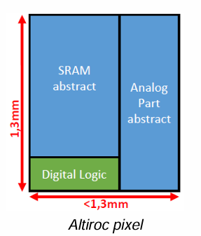
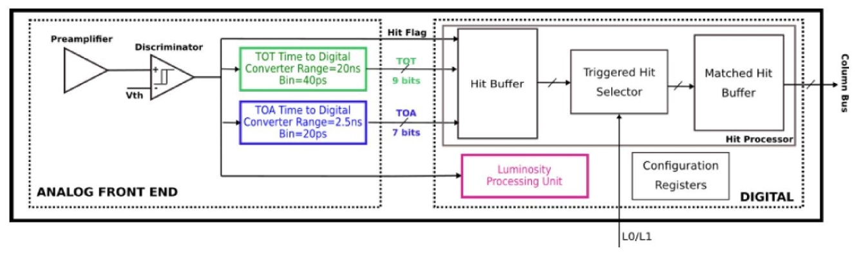
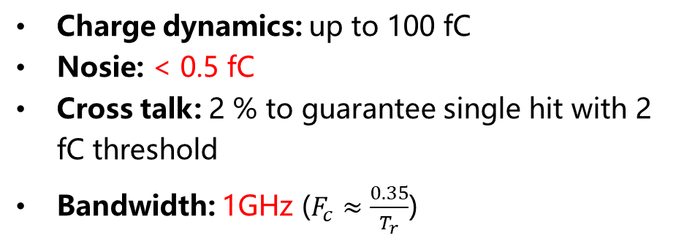
ALTIROC
On-pixel electronics Architecture
preamplifier
Discriminator
Charge dynamics: up to 100 fC
Nosie: < 0.5 fC
Cross talk: 2 % to guarantee single hit with 2 fC threshold
Bandwidth: 1GHz ($F_{c}≈\frac{0.35}{T_{r}}$)
10 bits DAC for the threshold of all; 8 bits DAC correction for threshold of each
The range from 650 mV ~ 1.2 V, with a LSB of 0.55 mV
External discriminator signal delivered by periphery for debug & TDC characterization
5

Slide 6
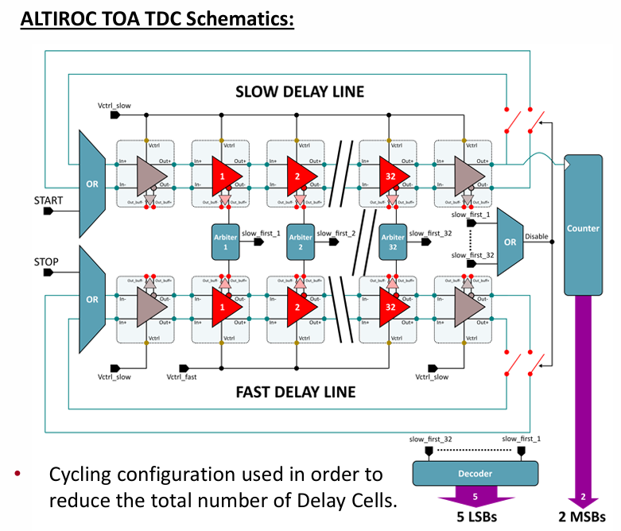
TDC in Altiroc
TOA (Time of Arrival)
Vernier delay line (Differential shunt capacitor voltage controlled delay cells)
Range: 2.56 ns (Hits only happens around 40 MHz)
LSB: 20 ps; 7 bits
Conversion time: < 20 ns
Start: Rising edge from discriminator
Stop: First rising edge from 40 MHz clk
40 MHz clk of TDC
Jitter: < 10 ps
Clocks skew in ASIC: +/- 150 ps
The global clock routing requirement is crucial
6

Slide 7
Pixel-digital
Hit Buffer
1536 x 19 bits DP-SRAM
1 bit for hit flag, 7 bits for TOA, 9 bits for TOT and 2 bits for CRC
Latency: up to 38.4 μs (Waiting for L0/L1 trigger)
Trigger Hit Selector
When L0/L1 arrives, select the data from Hit Buffer to Matched Hit Buffer
Zero suppression
Tagged a 5-bits identifier provided by Trigger Data Processing
Matched Hit Buffer
8 x 22 bits FIFO
1 bit for hit flag, 7 bits for TOA, 9 bits for TOT, 2 bits for CRC, 5 bits for identifier
Transfer to EOC
7

Slide 8
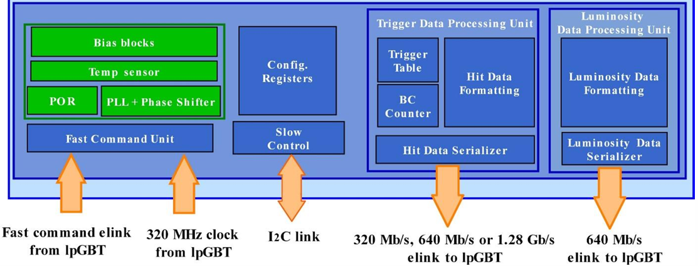
Periphery
Bias blocks—bandgap
PLL
Phase Shifter
Reference clock: 40 MHz from clock divider (320 MHz differential input)
Ensure the phase alignment of the internal clocks
Integrated two fine delay lines with a resolution of 97 ps to phase shift
Trigger data processing
SC parameters
VCO up to 1.28 GHz, then divided into 40, 80, 160, 640 MHz
Triggered and programmable-latency readout with zero suppression
A single serializer to send out data at rates 320, 640 Mbp or 1.28 Gbps (CERN Low Power Signal, CLPS)
8b10b encoding
Command Pulse generator
I2C interface
Fast Control
Monitoring
Threshold, Bias, Temperature, etc.
8

Slide 9
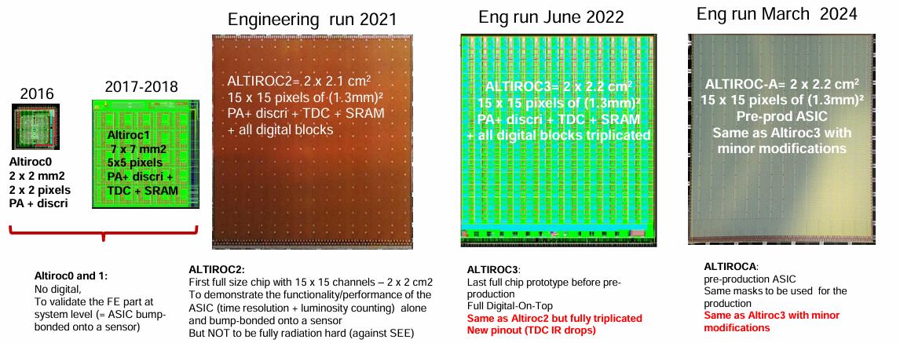
Design Approaches
ALTIROC Development
Chip size 2.2 x 2 cm²
Analog 30% of the chip
- To guarantee analog performance at system level
Digital 70% of the chip
- 5 clock domains
- Assembly done Full Digital on Top + UVM verification
- Top level assembled with INNOVUS
- Verilog models and lib files to be done for all analog/mixed blocks
- Analog periphery treated as a macro block
IR drops
- Power supplies only from one side, IR drop control is a key issue in particular for
the TDC
9

Slide 10
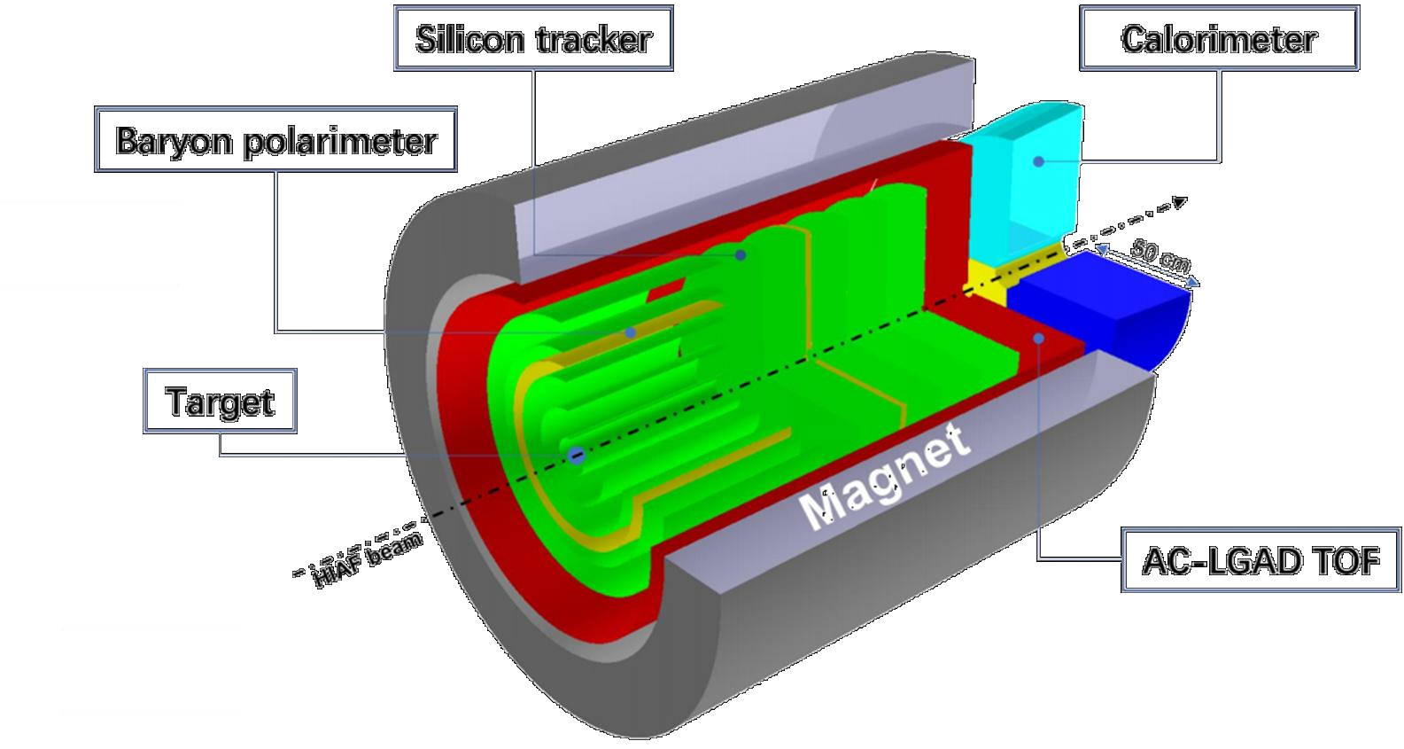
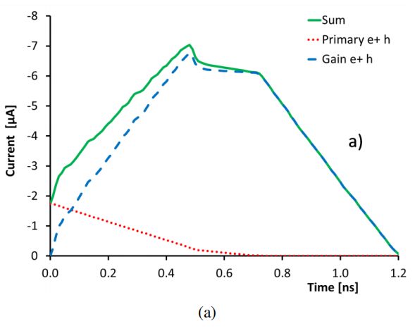
2. Research Proposal and the preliminary plan
Research Background for H-NS
The LGAD, with its core advantages of high temporal resolution, high positional resolution and radiation resistance, has become a key sensor device for the Huizhou Super Nuclear Spectrometer (H-NS) on the HIAF .
The LGAD readout chip (ASIC) is the core component that determines the performance of LGAD.
Electronics requirements: ASIC, high bandwidth, fast response
Electrical characteristics:
Output signal: current pulse, pulse width 0.6 - 1.2 ns,
typical charge quantity approximately: 10 fC;
Detector capacitance (Cd): 4 pF
Layout diagram of the internal detection system of H-NS
Typical signal
10

Slide 11
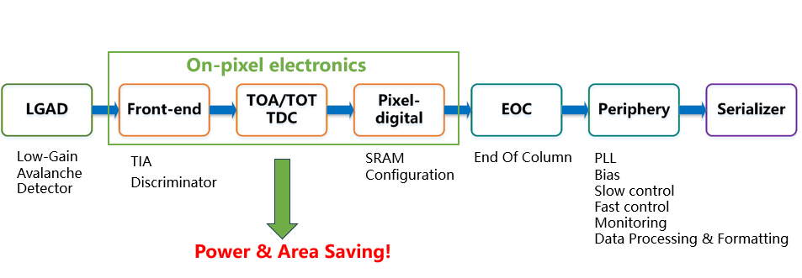
ASIC Structure Design
Readout Architecture
Based on ALTIROC-A
Improvement Thoughts
Design Guidelines
Adopt the latest storage and readout architectures to reduce the area, power consumption and dead time of on-pixel electronics
Perform more processing in the periphery,（ data preprocessing, nonlinearity correction, calibration, event rejection, etc)
Adopt more efficient data compression algorithms.
On pixel electronics
Minimize area
Minimize power consumption
Simplify the structure
Digital on top
Improve radiation resistance
11

Slide 12
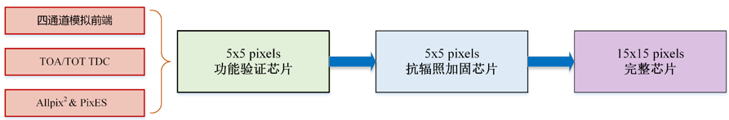
Research Proposal
Research Proposal
Preliminary Personnel Task Allocation
Total 7 person
Front-end: Yuan Song
TDC: Tianlei Pu
Pixel-digital: Weijian Lu, Hongyun Zhao
EOC: Weijian Lu, Hongyun Zhao
Periphery: Hongyun Zhao, Weijian Lu,
Tianlei Pu, Xiaofeng Fu
Serializer: ?
Responsibility
Leader of chip: Yi Qian
Architecture & Top: Tianlei Pu, Weijian Lu, Hongyun Zhao
Readout System: Junwei Yan
12

Slide 13
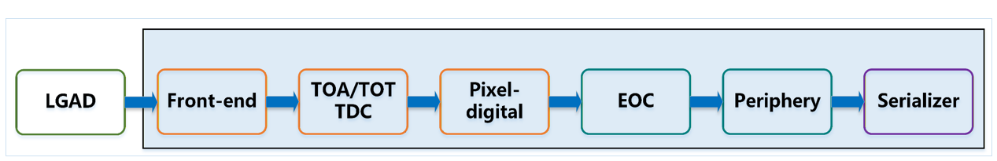
Key Technologies & Design Challenges for Engineering-Grade Chips
Clocks skew in ASIC: +/- 150 ps
Radiation Hardening (TID, SEE)
Analog IP Extraction, Digital on Top
PixES Platform Construction
Timing Constraint I of Special Digital Circuits
IR drop analysis (Redhawk)
20 ps TDC
PLL + Phase shift
Serializer
Allpix²
Power on Reset
13

Slide 14
Preliminary Design and Simulation of ASIC
1. Preliminary design of the front-end circuit
Implementation method: Adpopt a 130nm process and design a 5✕5 pixel (with 25 channels) configuration
Temporarily designed by 180 nm process
single-channel structur
CMOS input stage , enhance the transconductance gain, improving the signal-to-noise ratio
Additional open-loop common-source amplifier, increase the gain;
Input impedance is 50Ω, work as Transconductor
Pre-amplifier circuit structure

Slide 15
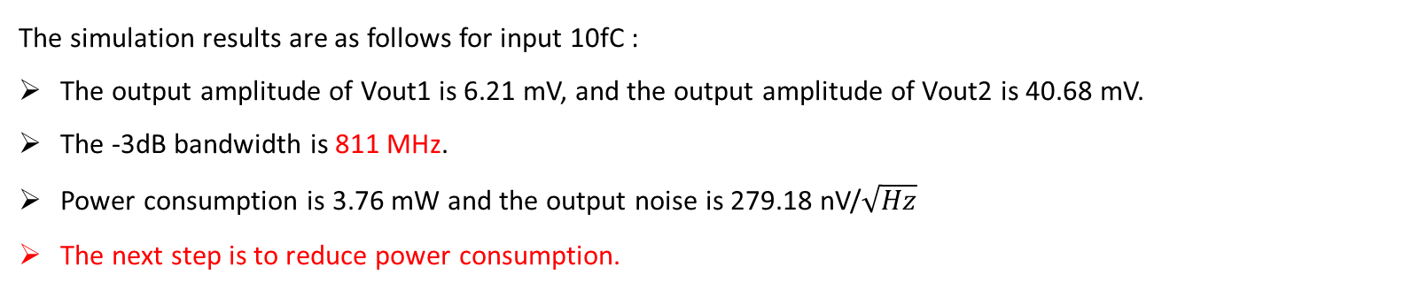
Front-end circuit simulation results
The simulation results are as follows for input 10fC :
The output amplitude of Vout1 is 6.21 mV, and the output amplitude of Vout2 is 40.68 mV.
The -3dB bandwidth is 811 MHz.
Power consumption is 3.76 mW and the output noise is 279.18 nV/$\sqrt{Hz}$
The next step is to reduce power consumption.
PeakingTime 789.6ps
PeakingTime 790.4ps
The transient waveforms of Vout1 and Vout2

Slide 16
2. TDC Design and Simulation
TDC Structure
High Resolution TDC Structure
Vernier TDC as the core
Start signal trans and loops in Slow Delay Line
Stop signal trans in Fast Delay Line and Chase the Start signal in Slow Delay line
When Stop catch the Start, Convert temp Code to 5bit binary
Dynamic Range 32*15ps *16=7.68 ns
TDC Structre

Slide 17
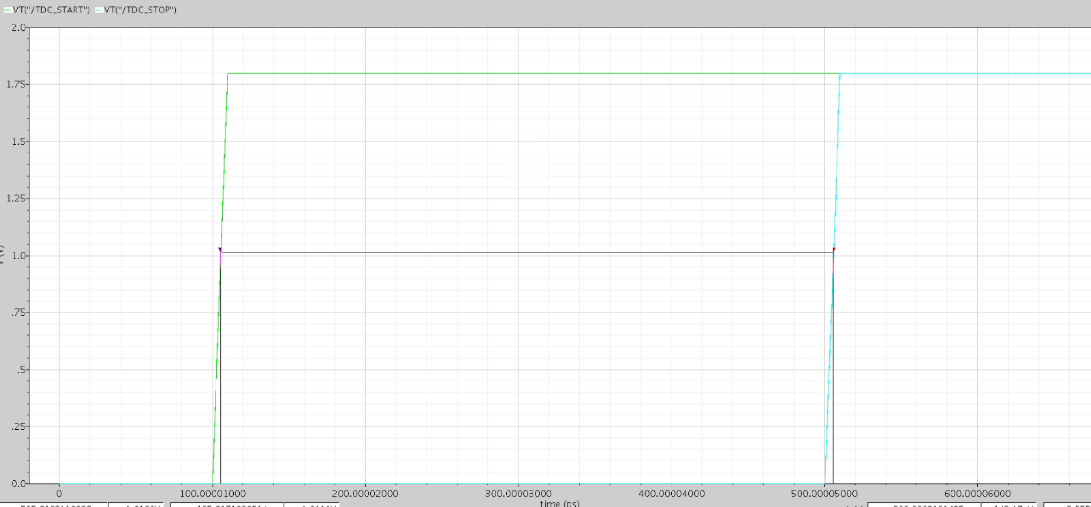
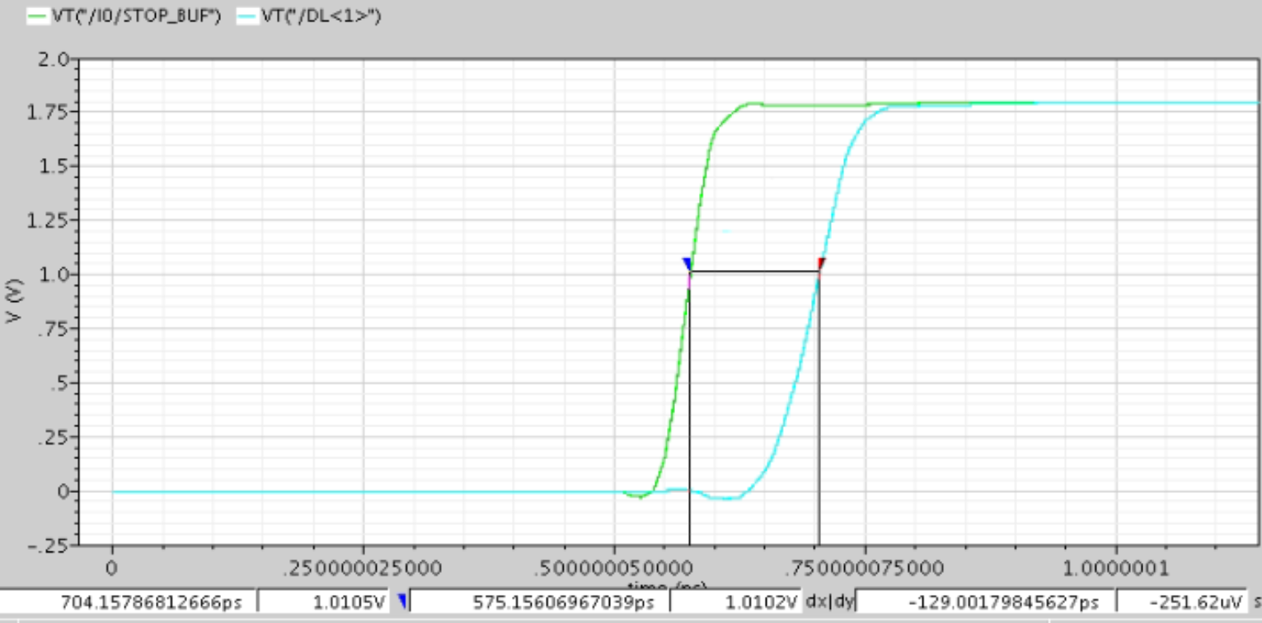
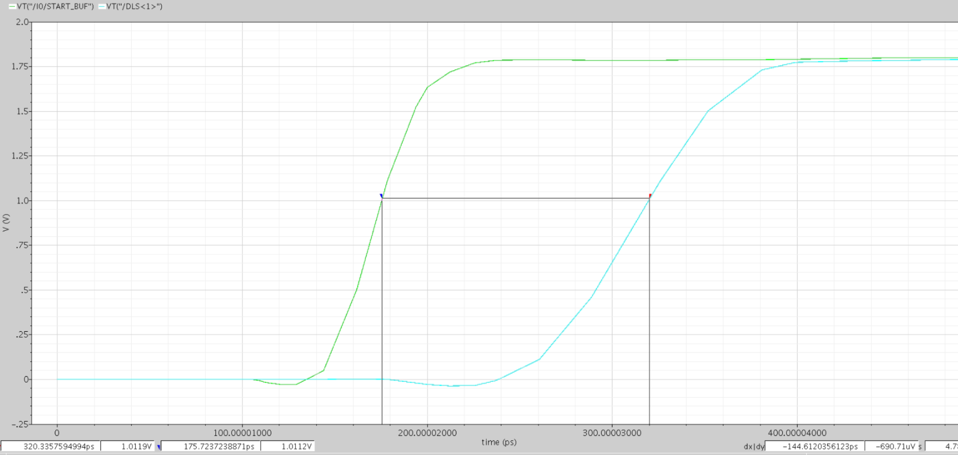
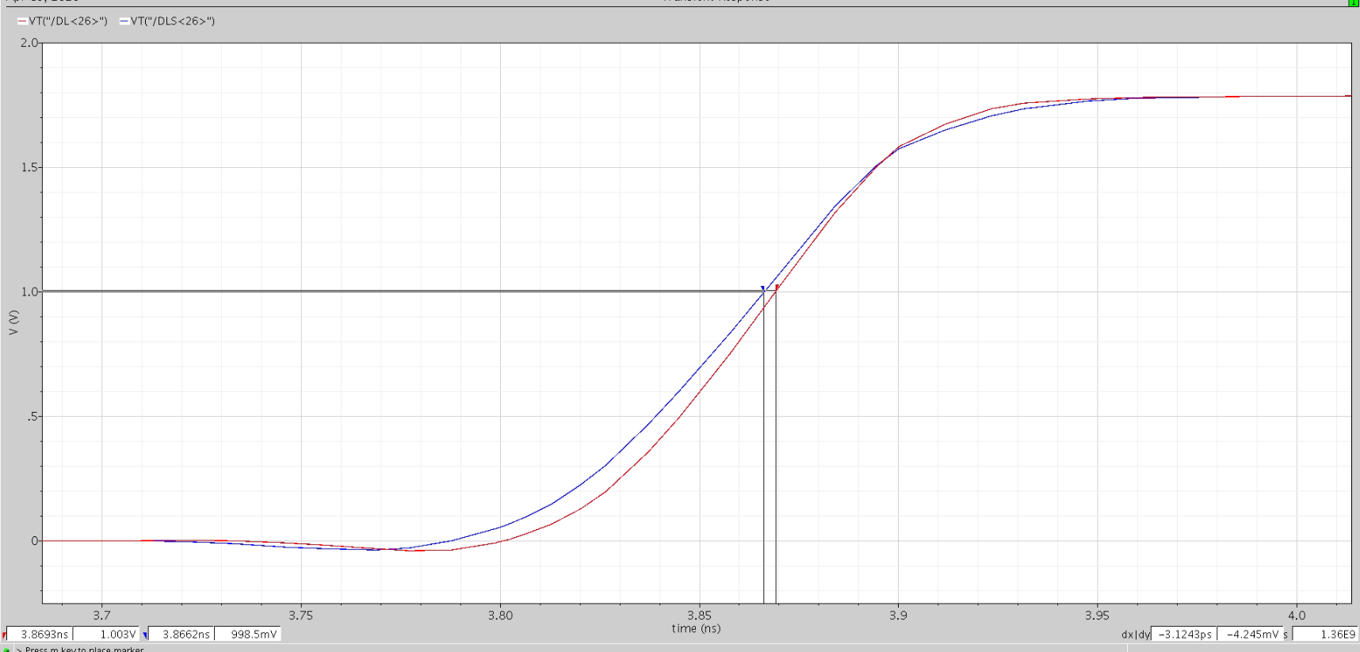
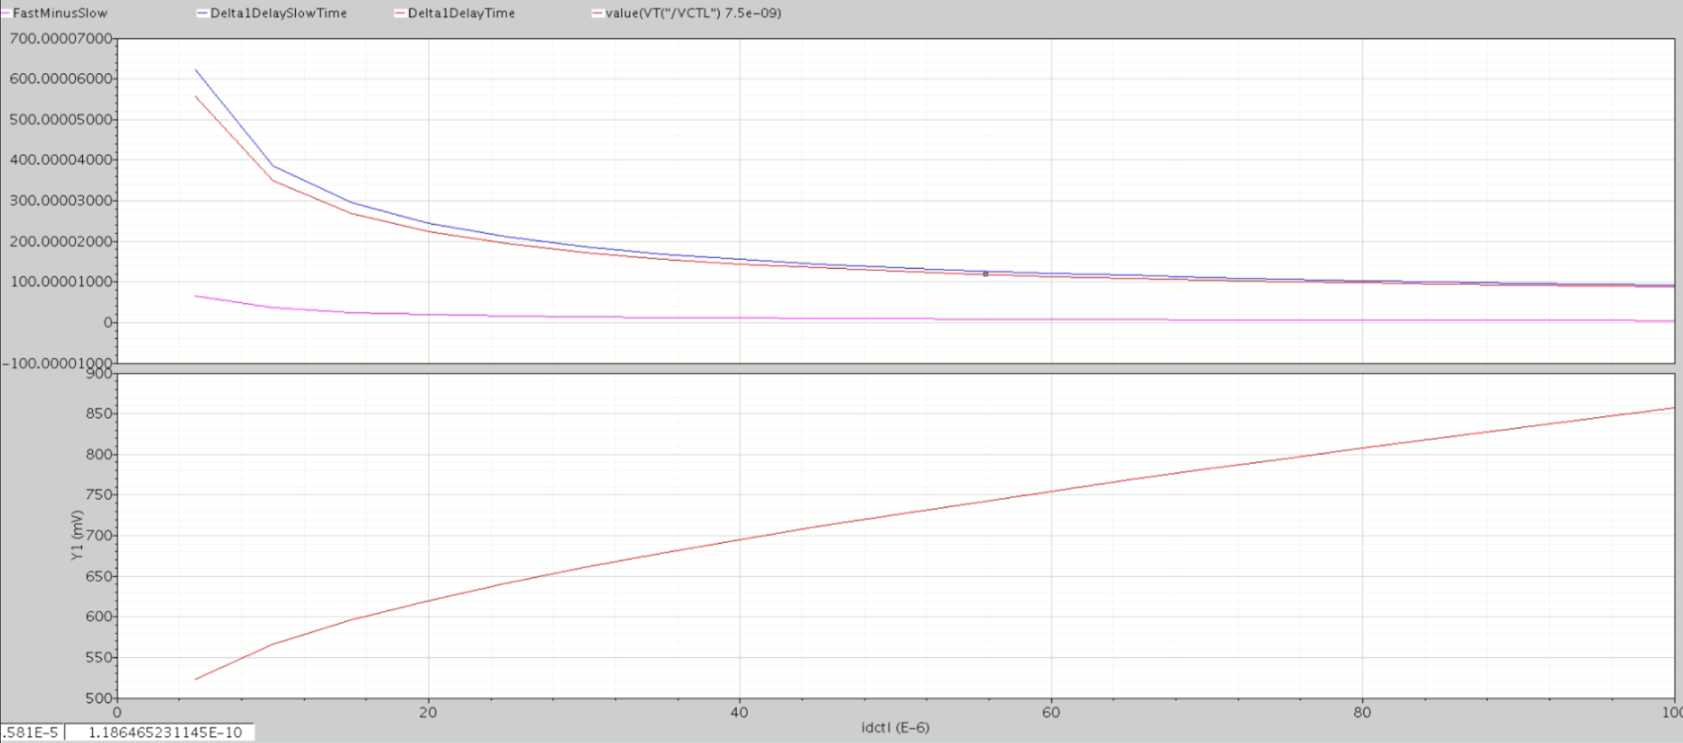
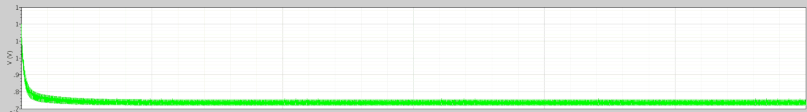
TDC Simulation
Design and Implementation
Voltage-Controlled Delay Units
Delay-Locked Loops (DLL)
Delay Chain Design
80 MHz clock generating DLL of 144 ps and 129 ps
5-bit cyclic delay chain (fast chain, slow chain)
Implementation of Time-to-Digital Converter (TDC)
Problems to Be Solved
Logic Parts in Slow Delay Line when Start loops
Improve the Noise performance
Signal Under Test Δt=400ps
The Slow Delay Line Δts=144ps
The Fast Delay Line Δtf=129ps
Stop Catch Start at bit 26
26*15ps=390 ps
TDC Simulation
Bin width 15ps, measure a 400ps signal
TDC principle works properly
DLL Phase Locked
Locking state

Slide 18
4. Work Foundation of NEISyG
research team(Nuclear Electronics Instruments and System Group )
Personnel of the Nuclear Electronics Team: 9 members (7 Senior Engineers , 2 Engineers)
15 graduate students currently studying
One doctoral student majoring in ASIC design study at CERN Alice by November,2026
research interests
(1) Front-End Readout Electronics: Specializing in the design of application-specific integrated circuits (ASICs) for nuclear physics experiments and the development of precision measurement front-end electronics.
(2) High-Speed Data Acquisition and Processing: Conducting research on real-time data acquisition systems based on high-speed analog-to-digital conversion and large-scale FPGAs.
(3) Radiation-Hardened Electronics: Investigating electronic reinforcement technologies for high-radiation environments to ensure the long-term stable operation of systems in scenarios such as heavy-ion accelerators and spaceborne payloads.
Notes:
组织策划实施

Slide 19
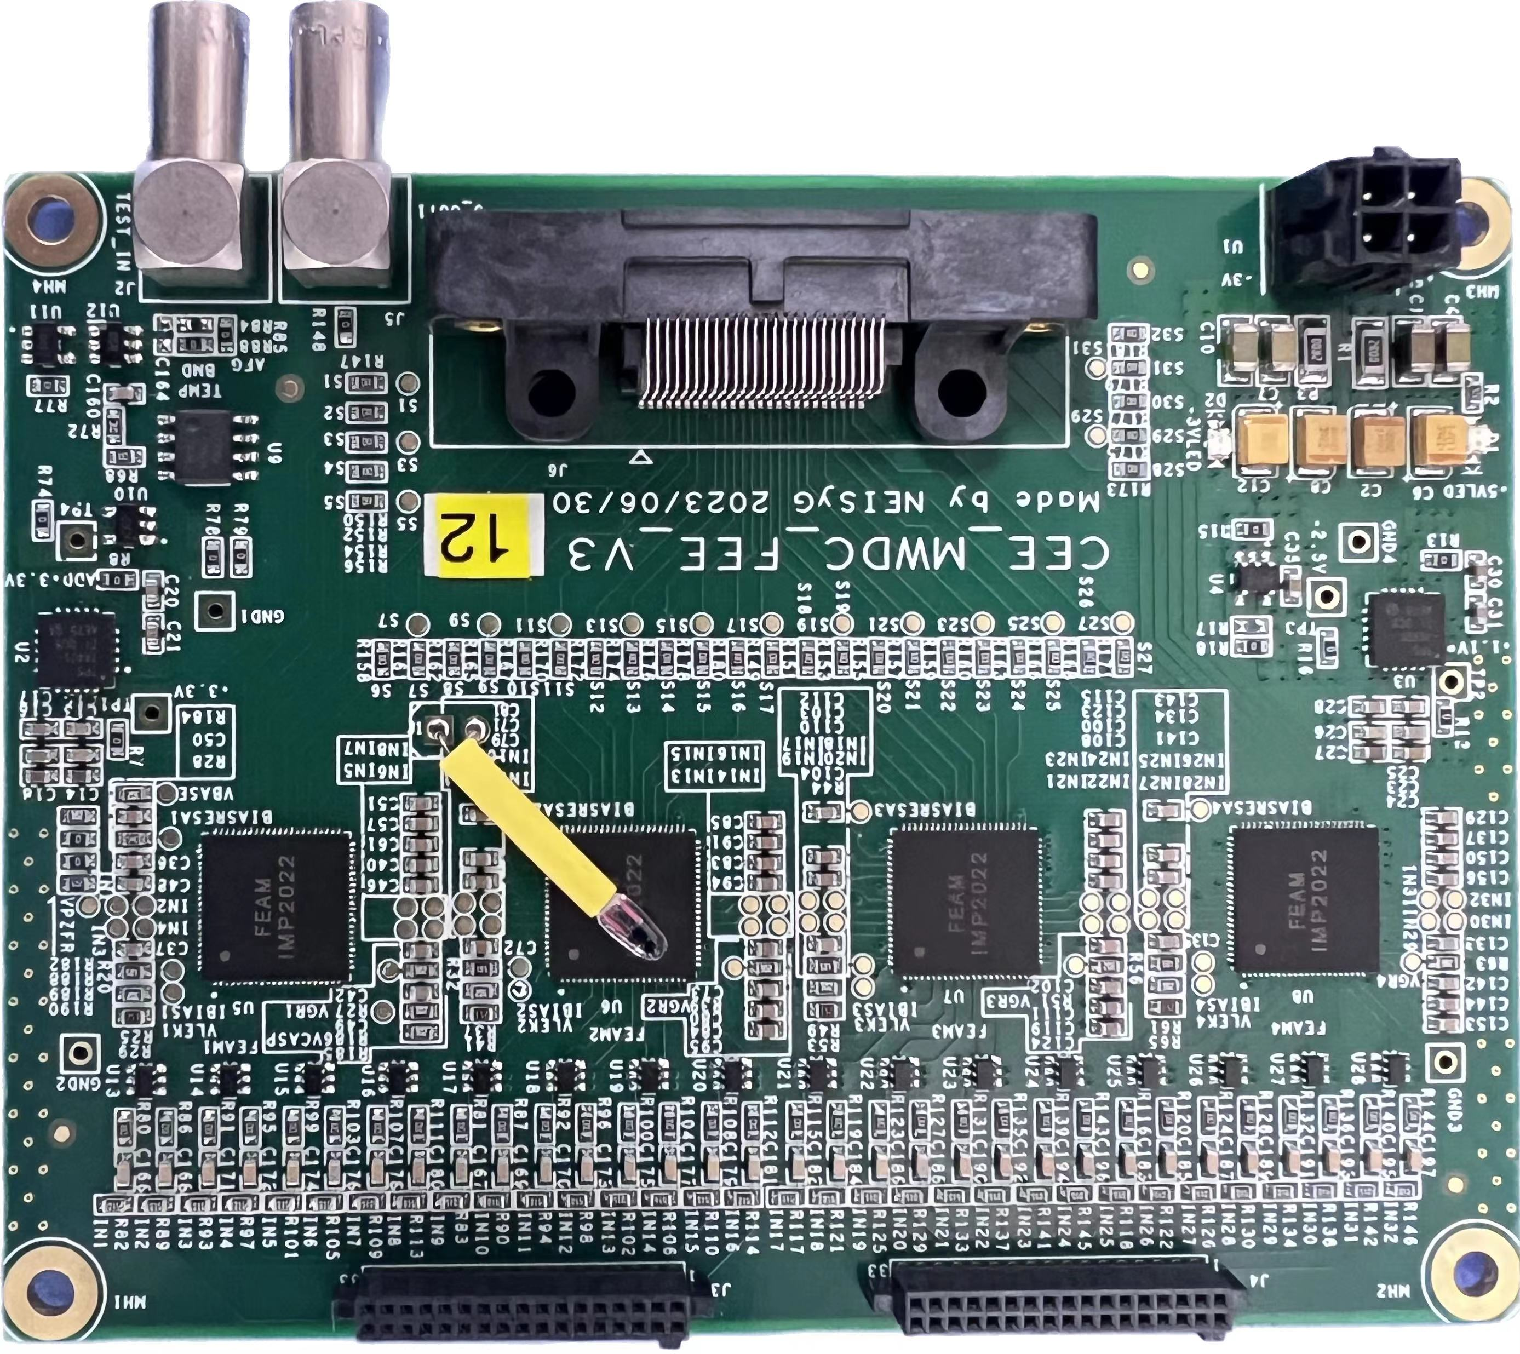
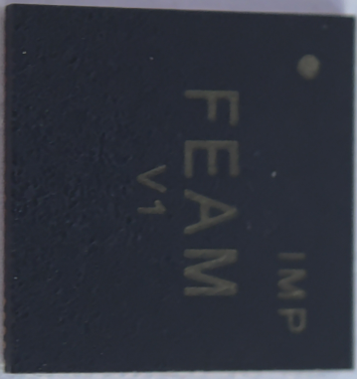
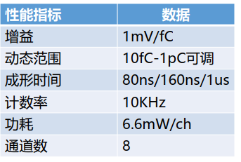
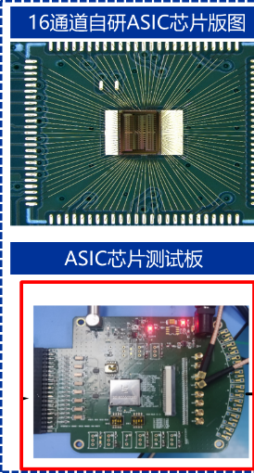
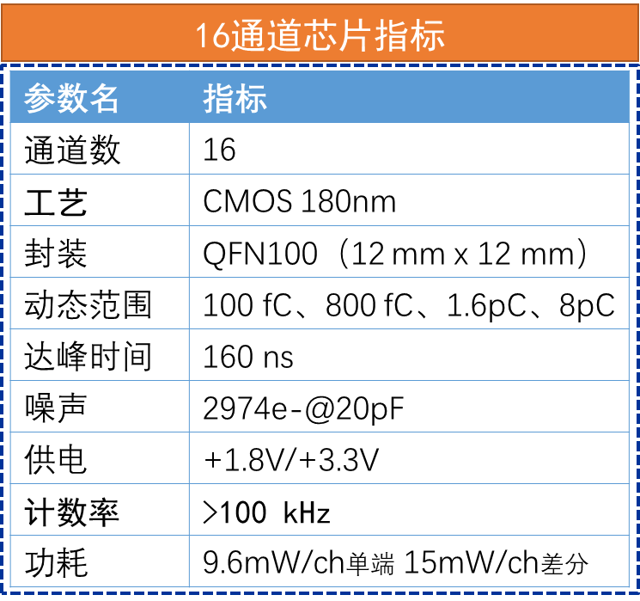
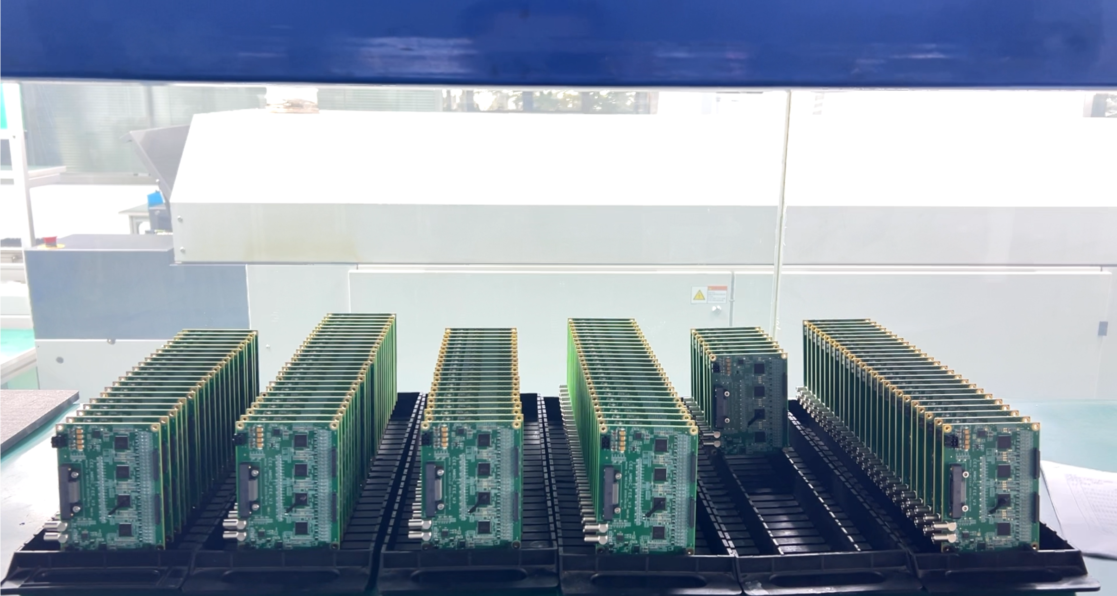
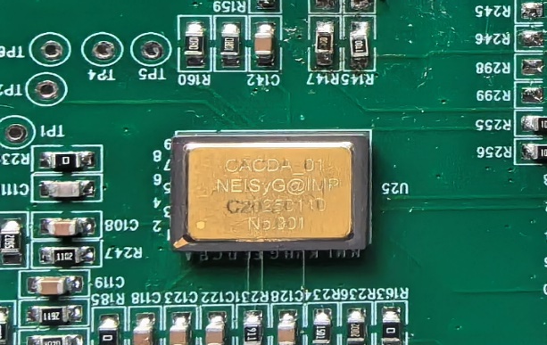
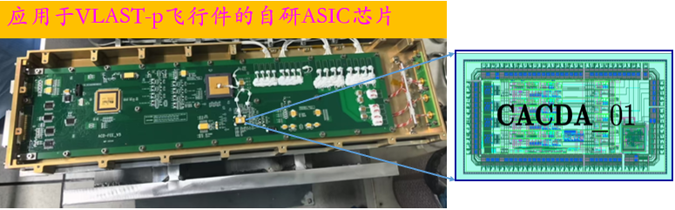
Research and Development of Special Front-end Readout ASIC Chips
FEAM：Front-end Readout Chip for CEE-MWDC
FEAT：16ch Front-end Chip for TPC
Mass production (3300 channels in total)
CACDA_01： PMT front-end readout chip for VLAST-p anti-coincidence detector
CSA+ Shaper+ PDH + Discrimination
Self-trigger output Dynamic range: 10 pC
Slow control interface
Radiation-hardened design
TID ＞75krad
The flight unit of “VLAST-p"

Slide 20
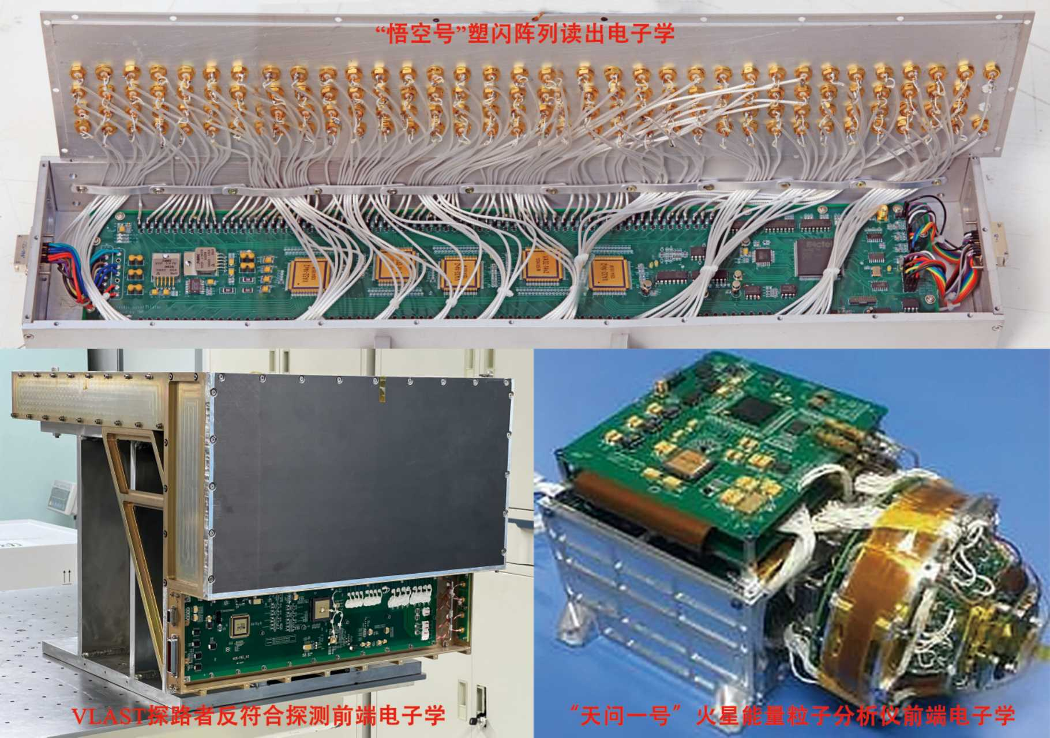
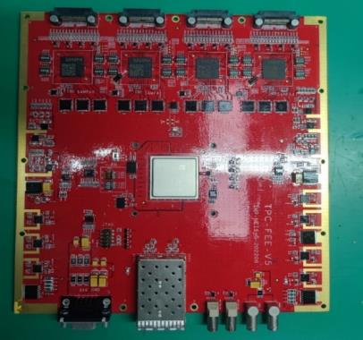
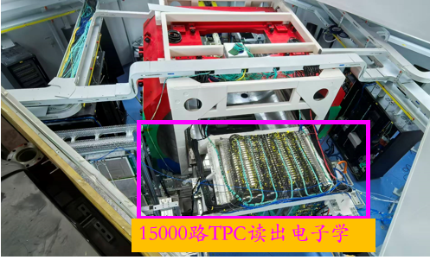
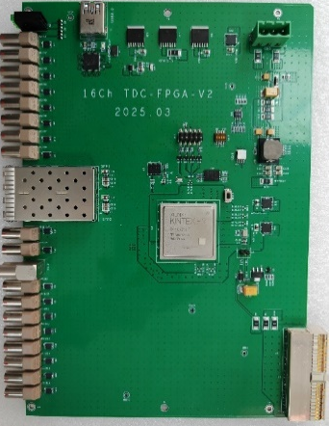
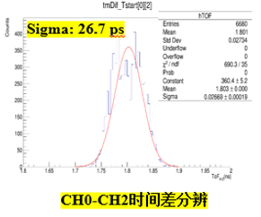
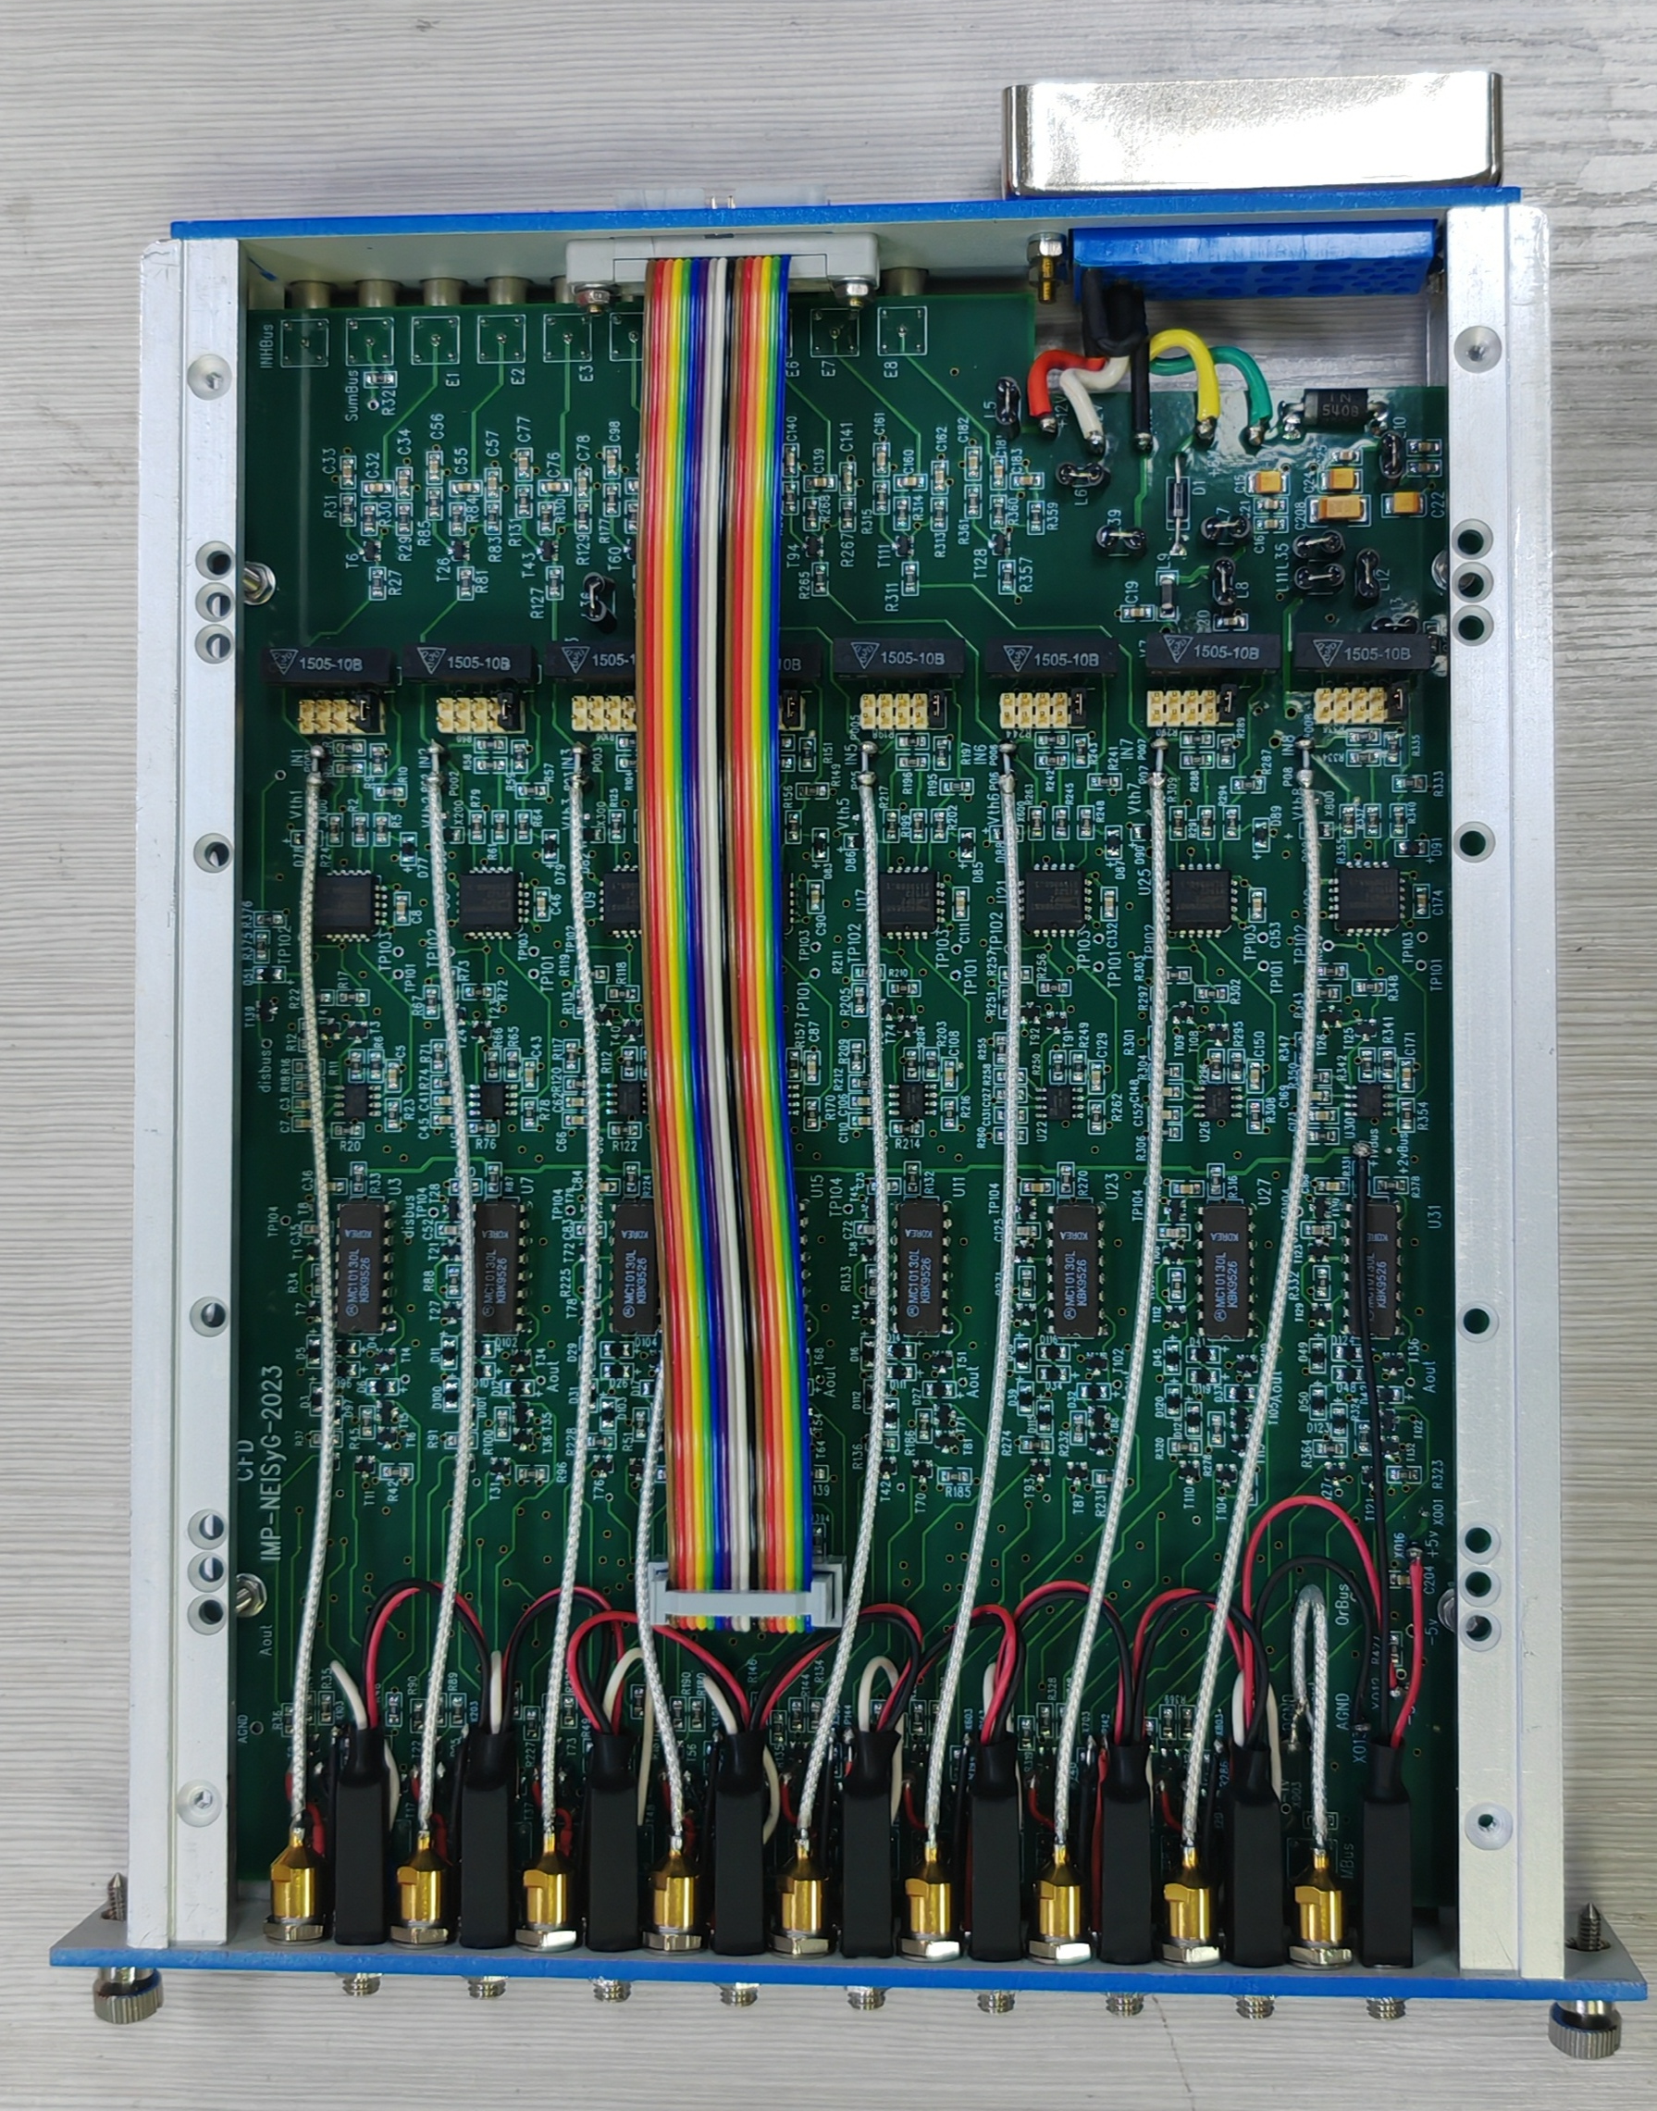
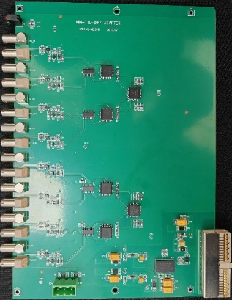
Research and Development of Front-End Readout Electronics
CEE-TPC front-end electronics(with SAMPA chip)
HIRIBL-TOF front-end electronics
Front-end electronics for space detection
Tianwen-1(天问一号), Mars Energetic Particle Analyzer
VLAST-p, ACD Electronics
DAMPE (Wukong悟空号), PMT Readout Electronics
Constant Fraction Discriminator
Level conversion board
time digitization board
Notes:
75.4MeV·cm2mg-1

Slide 21
Summary
The technologies involved in LGAD readout chips can be applied to various experimental scenarios, so their development is urgently needed.
Readout chips for future engineering applications involve highly challenging, long development cycles and large investments. There is an urgent need for joint efforts across the industry, and we look forward to cooperating with all of you.
Thank you to all the Professors for your support of our previous work.
Thank you!

