Slide 1
Unlocking the Deepest Mysteries of the Universe with a Deep Underground Liquid Xenon Observatory
Jianglai Liu 刘江来
Tsung-Dao Lee Institute• School of Physics & Astronomy
Shanghai Jiao tong university
USTC “见微”学术沙龙

Slide 2

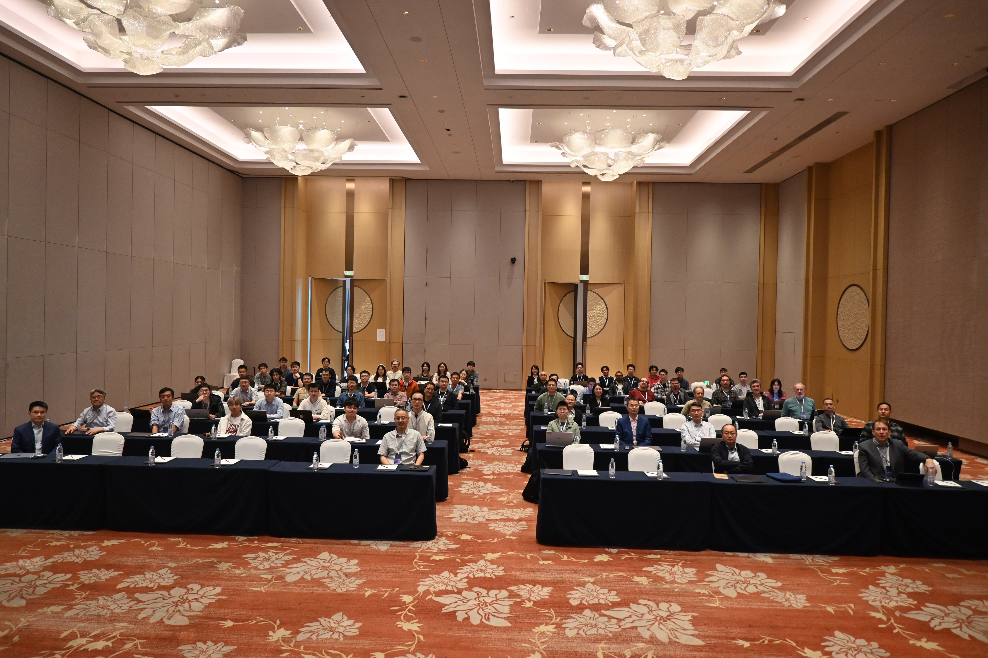

Slide 3
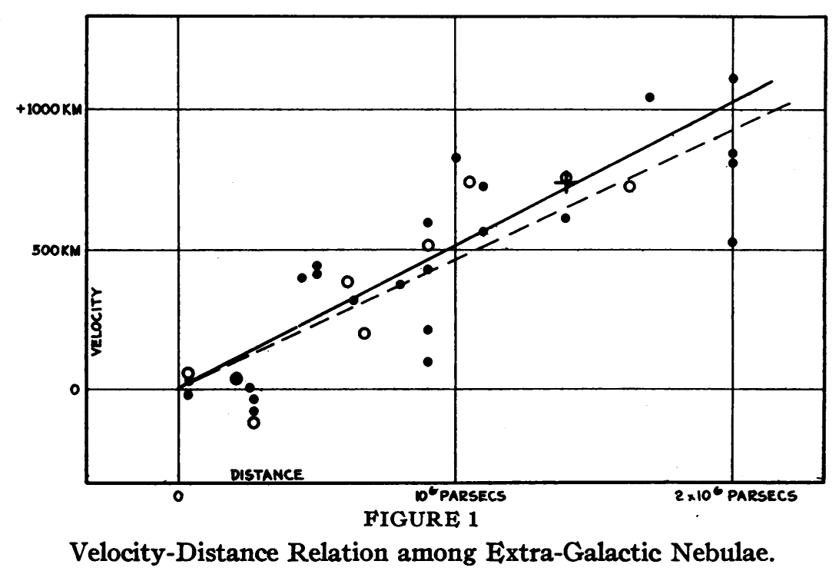
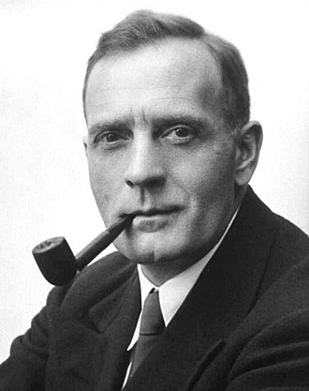
Mount Wilson, 1929

Slide 4

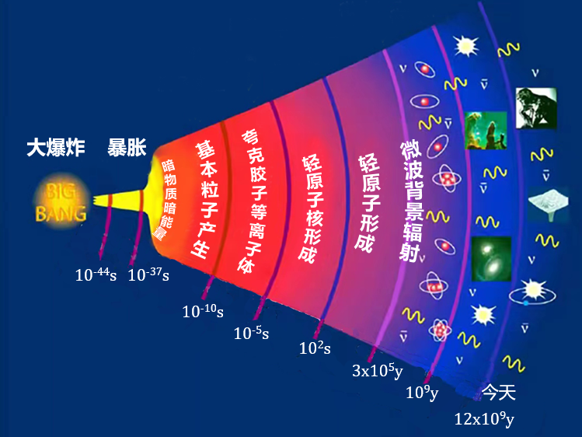
1948 Gamow’s “Big Bang”

Slide 5
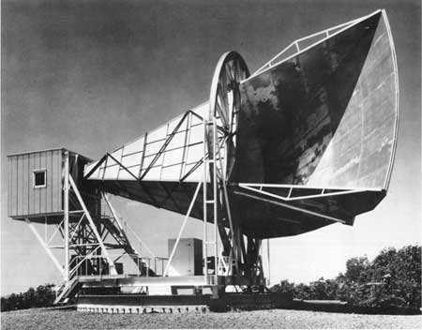

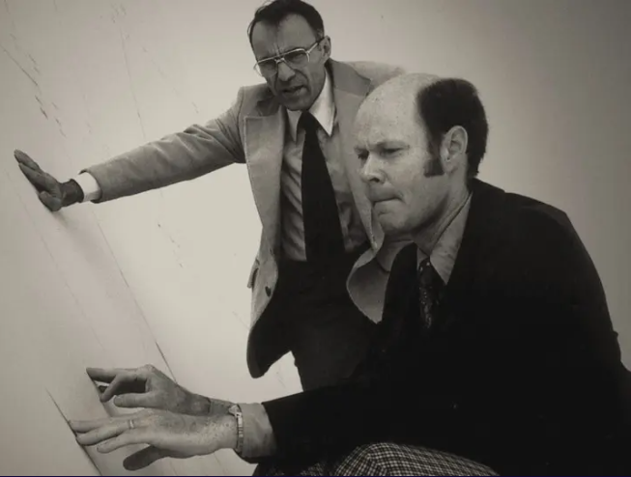
New Jersey, 1964

Slide 6
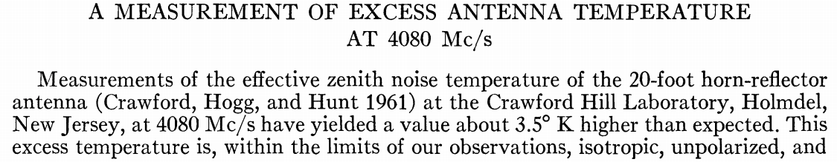
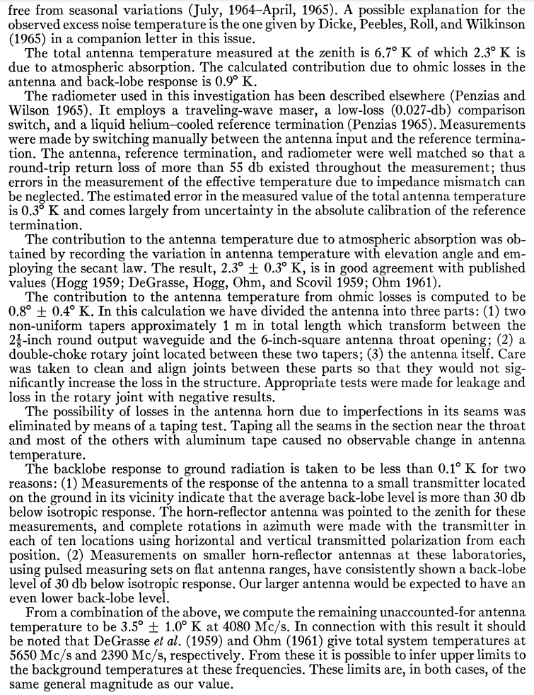
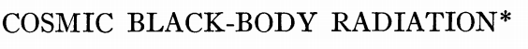
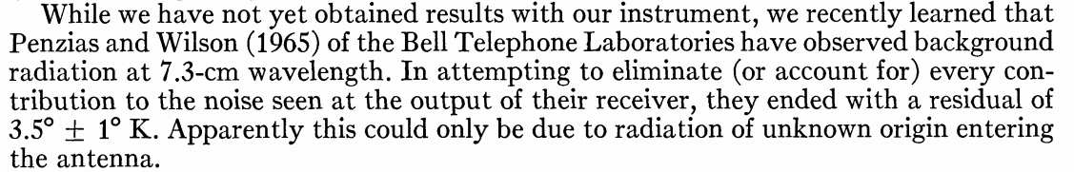
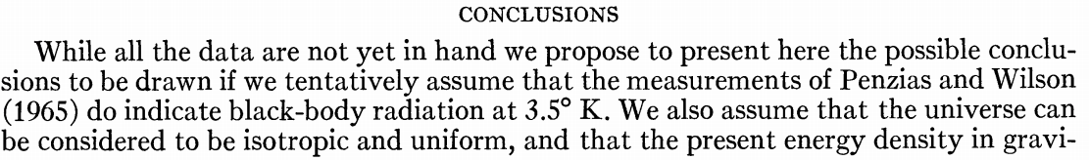
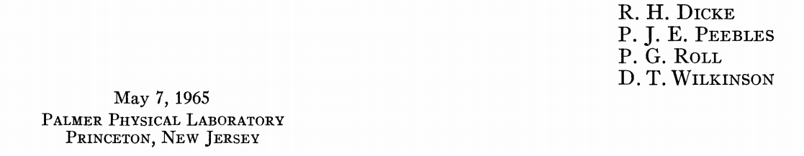

Slide 7
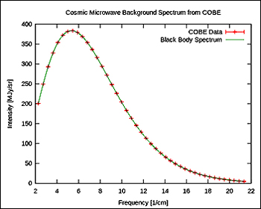
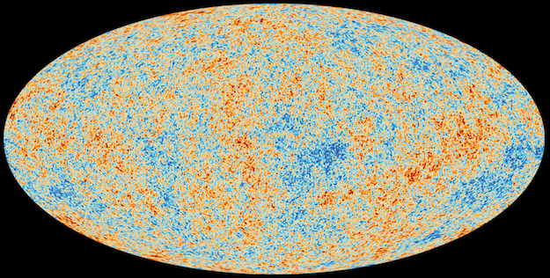
Today: Precision Cosmology

Slide 8
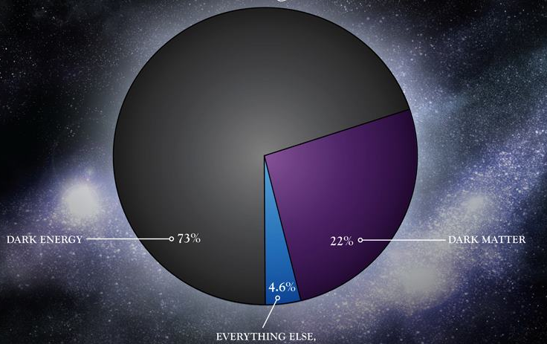
Standard Cosmology: ΛCDM
？
？
Dark Energy 68.3%
Dark Matter 26.8%
4.9%
Normal matter

Slide 9
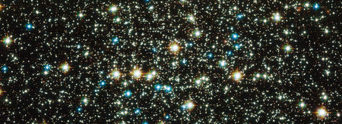
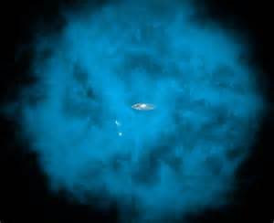
1/3 proton mass/cm³, v ~1/1000c

Slide 10
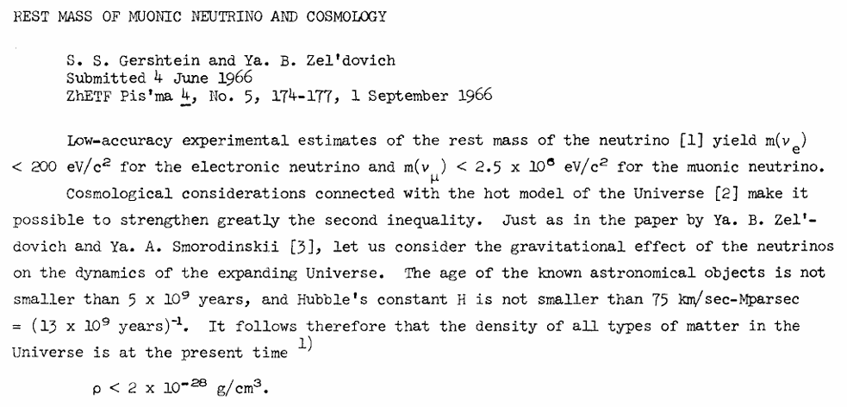
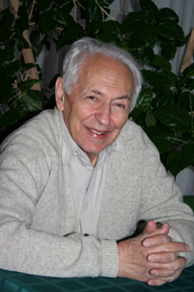
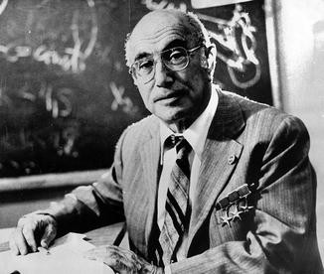
What are these invisible matter?

Slide 11
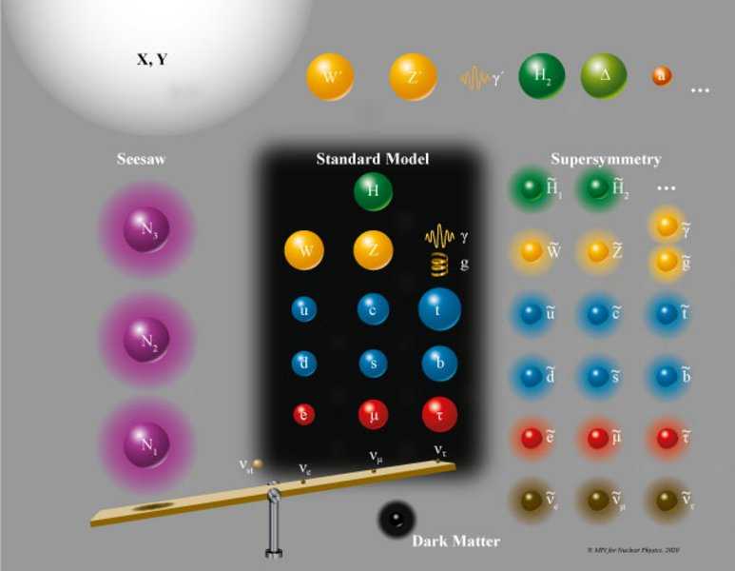
Elementary particles?

Slide 12

Particle scattering

Slide 13
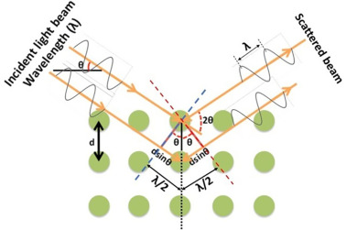
Quantum coherence in scattering

Slide 14
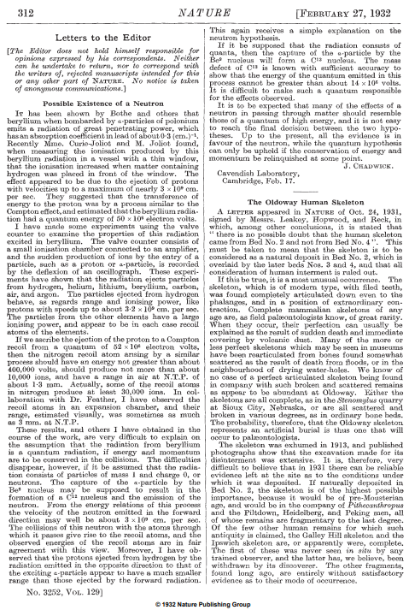
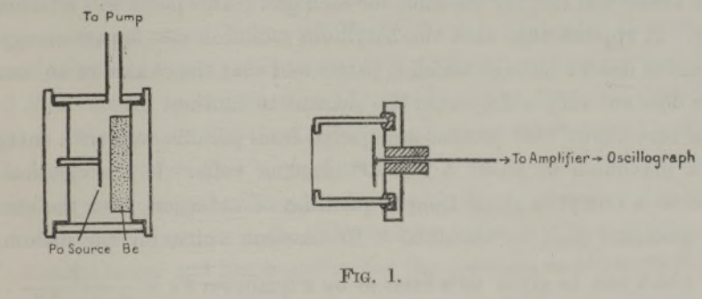
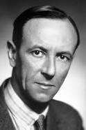
Chadwick 1932: discovery of neutron
alpha + Be9 -> C + x (production)
x + A -> x + A (detection)
Ionization chamber: detection of particles
Nobel prize 1935
1GeV/c² * 0.1 c ~ 10 fm
and (coherent) strong interaction!

Slide 15
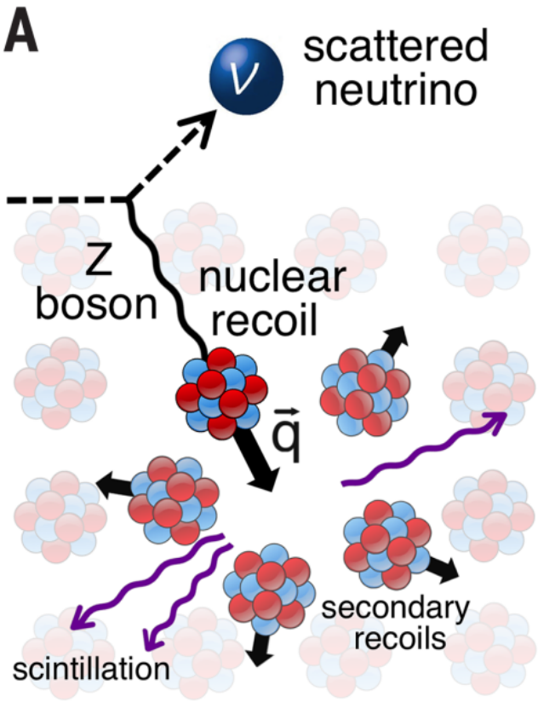
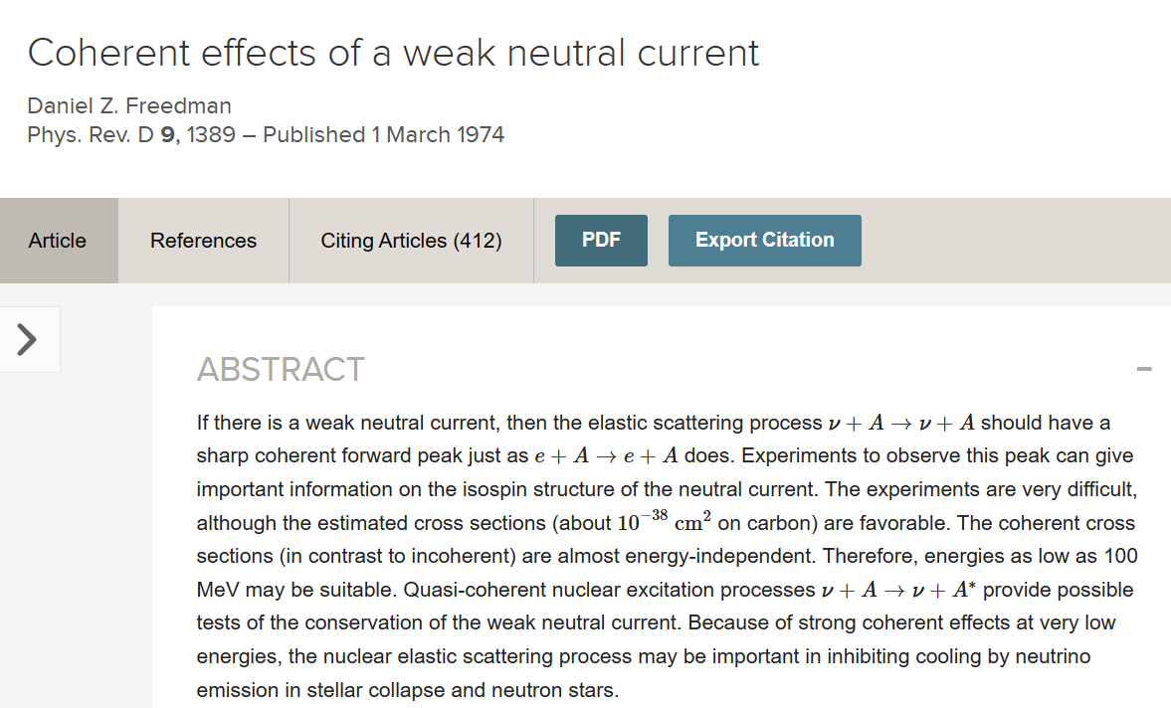
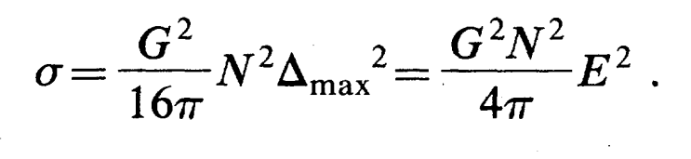
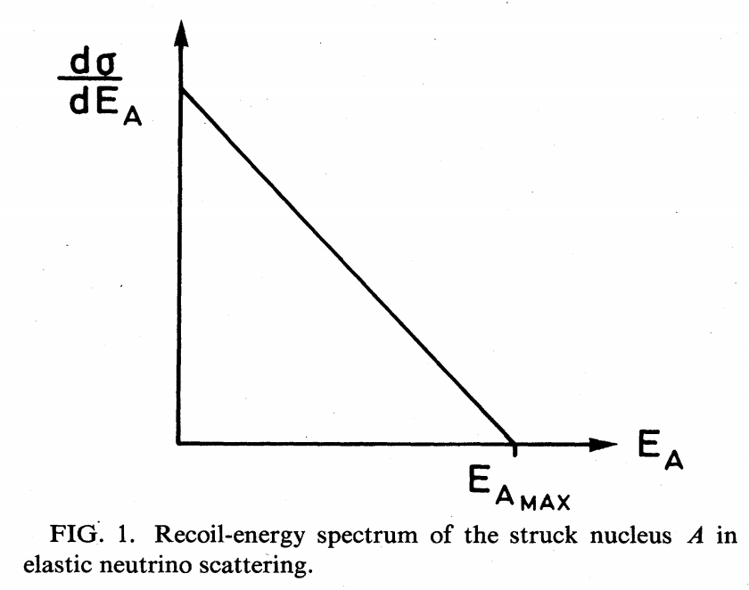

Coherent elastic neutrino-nucleus scattering (CEvNS)
Quantum mechanics: 200 MeV ~ 1 fm
So MeV neutrino cannot resolve nucleons in nucleus
N=num neutrons

Slide 16
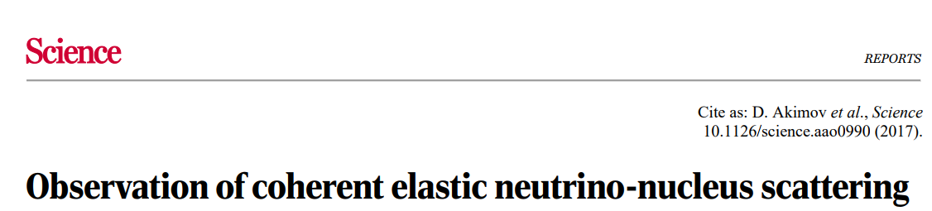
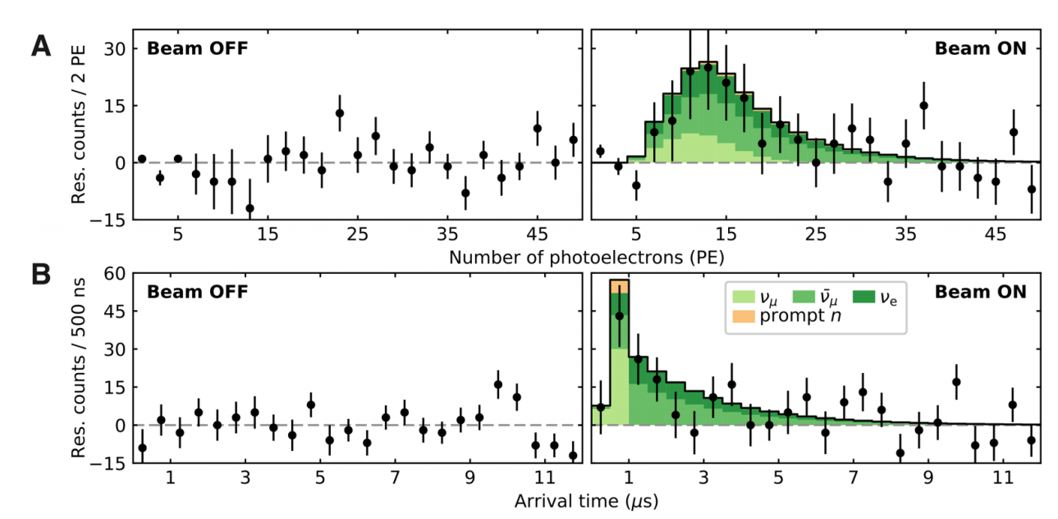
Oak Ridge, 2017

Slide 17
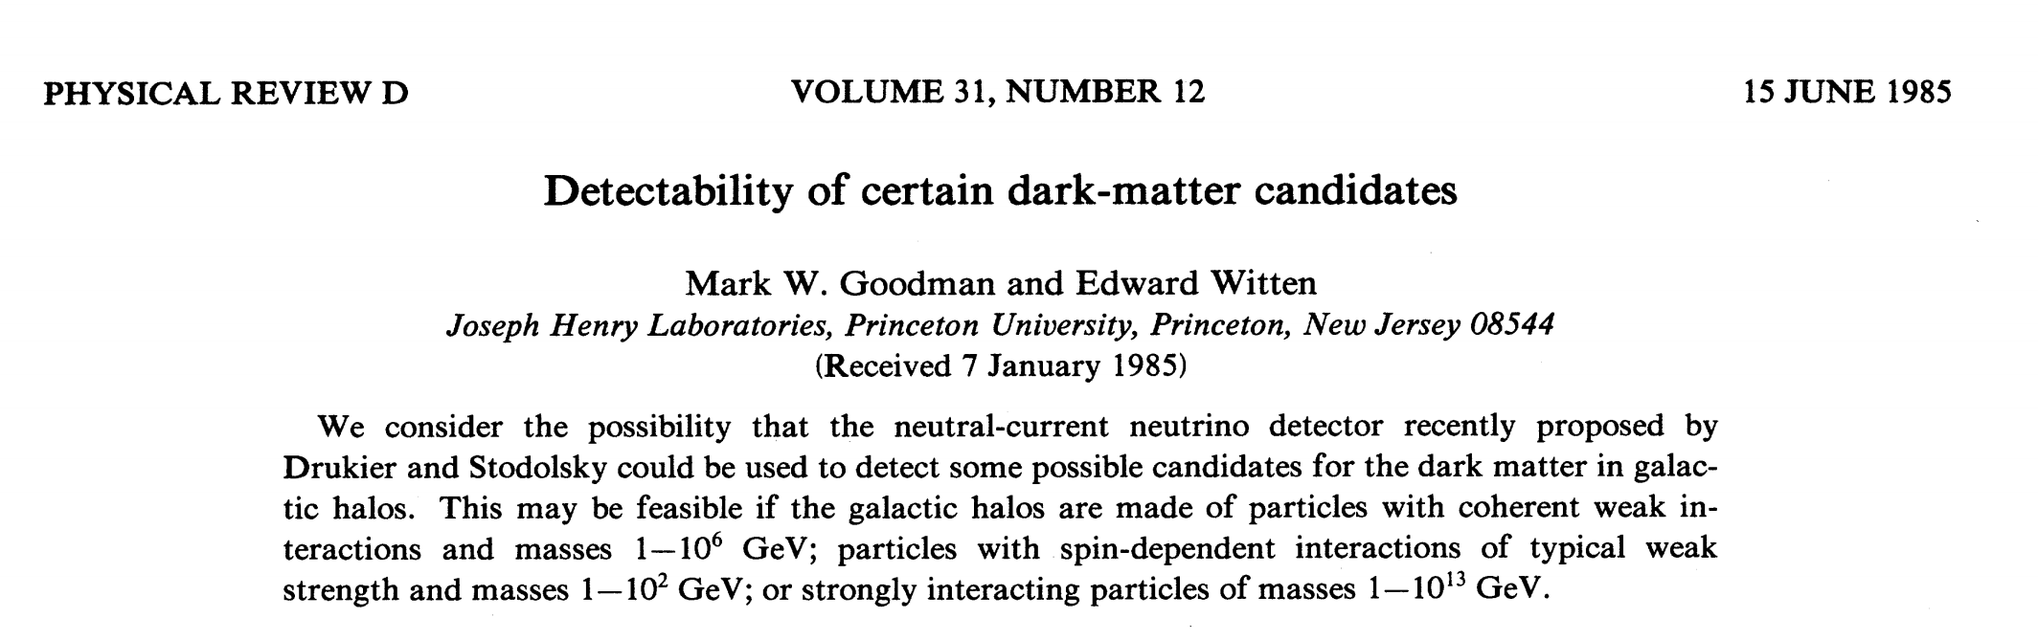
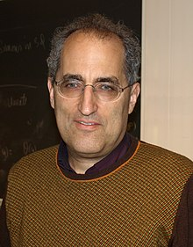
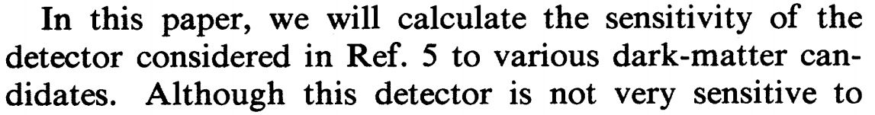
“Application”
For a 100 GeV dark matter, v=1/1000c, p=100 MeV/c, λ~10 fm
So coherent scattering with nucleons inside nucleus!

Slide 18

SNOLab (加拿大)
SuperCDMS, PICO，
SENSEI, DAMIC
BOULBY(英国)
ZEPLINE, DRIFT
Y2L(韩国)
COSINE
Modane(法国)
EDELWEISS
中国锦屏
CDEX, PandaX
SURF(美国)
LUX/LZ
Canfranc(西班牙)
ANAIS
Gran Sasso(意大利)
XENON, DarkSide
Soudan(美国)
CDMS
Stawell(澳大利亚)
SABRE South

Slide 19
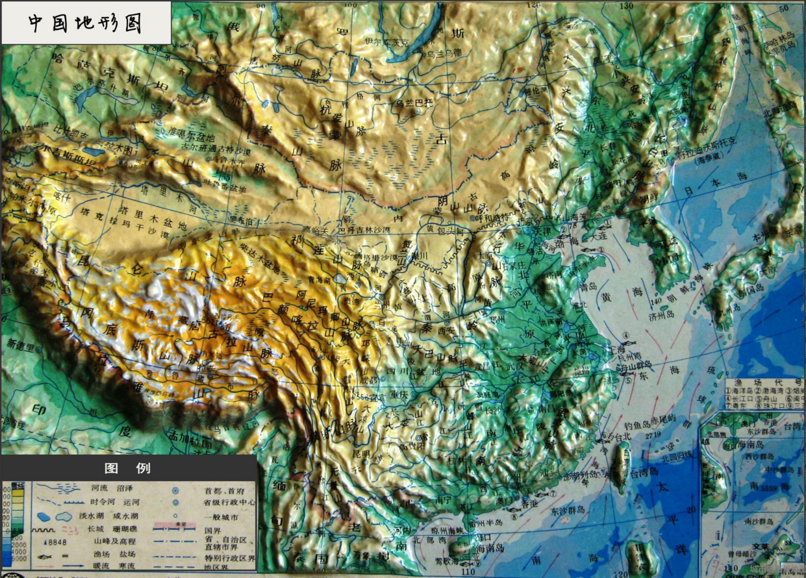
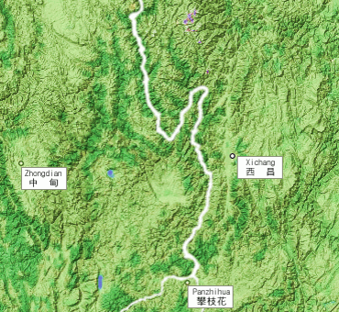
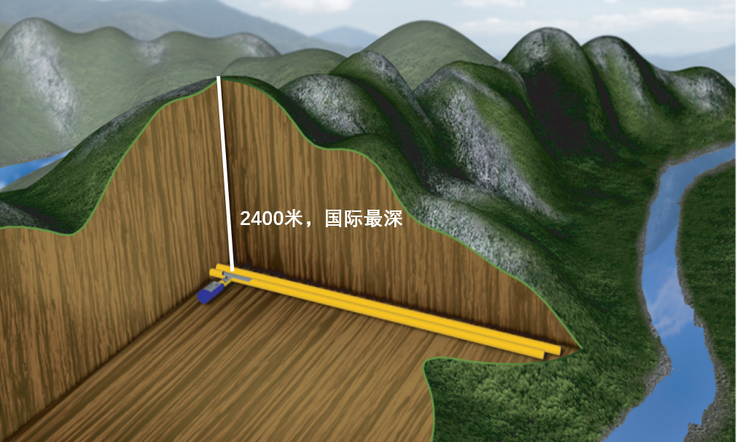
中国地形图

Slide 20
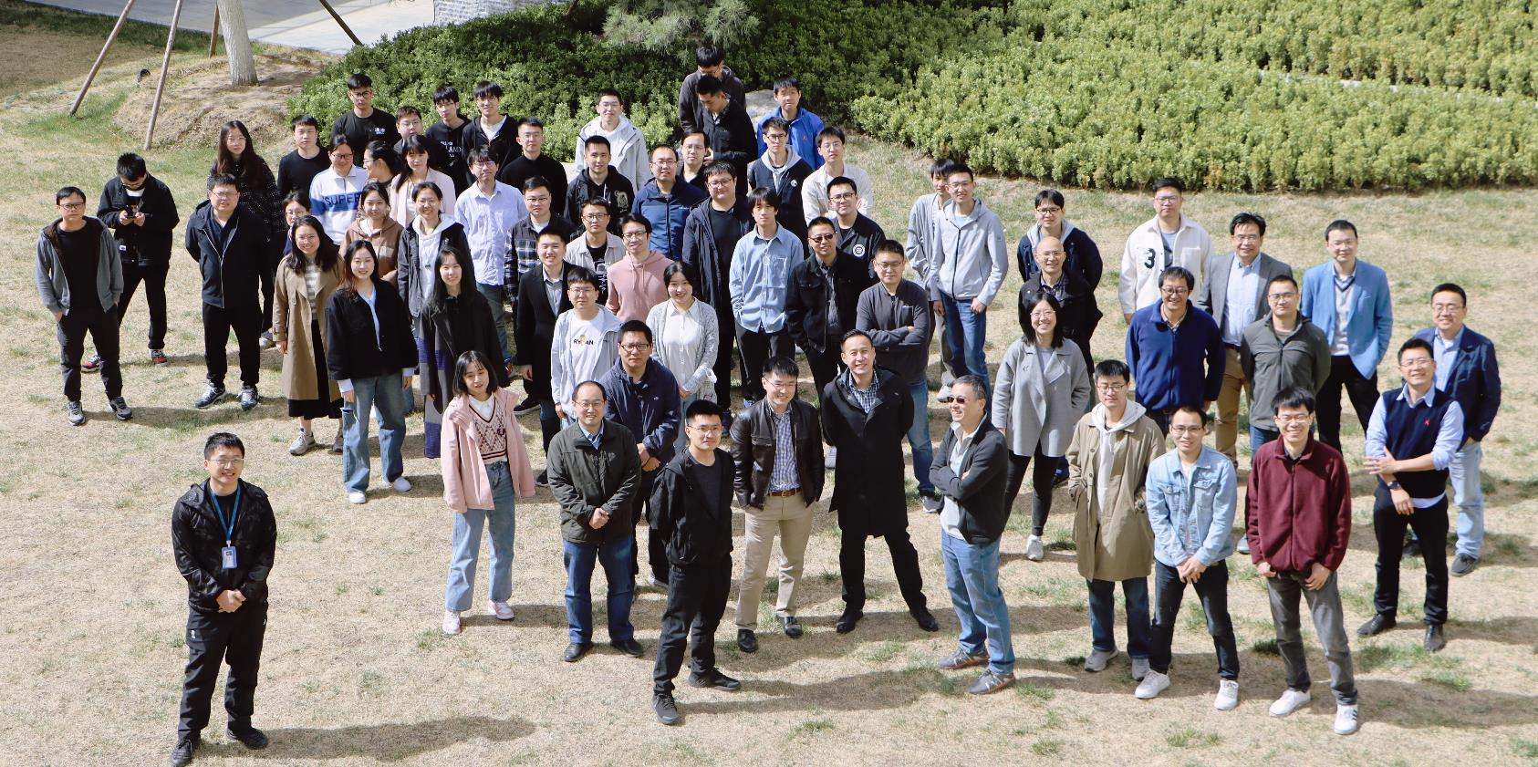
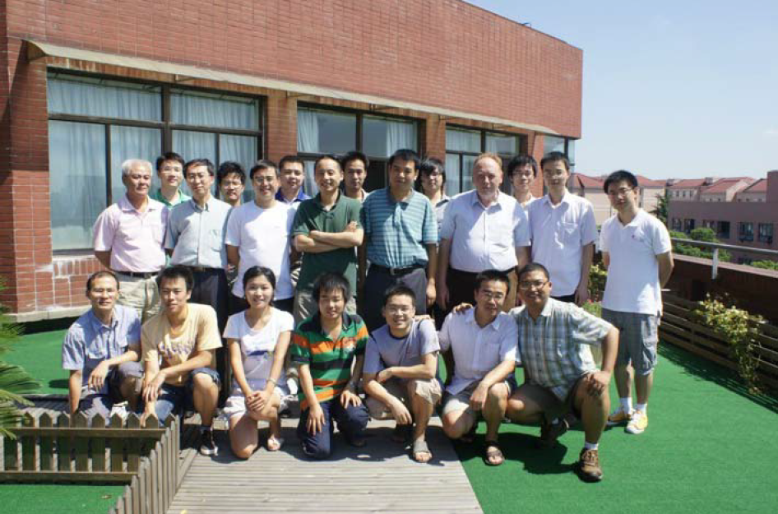

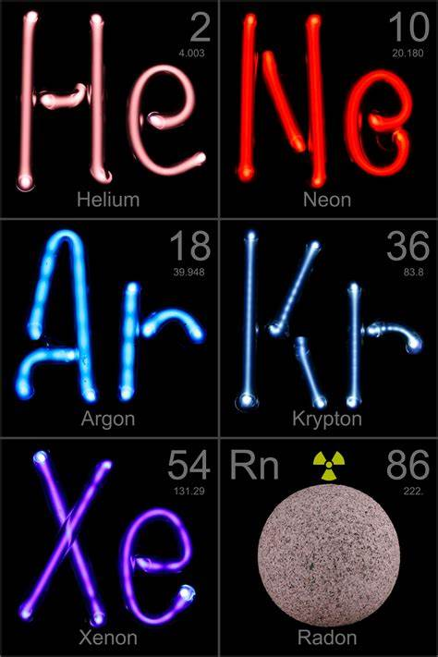
Particle and Astrophysical Xenon Experiment

Slide 21
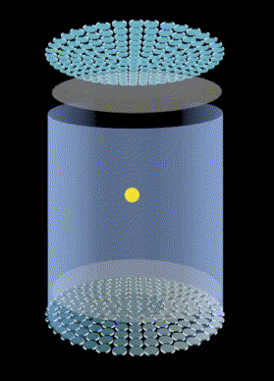

Slide 22
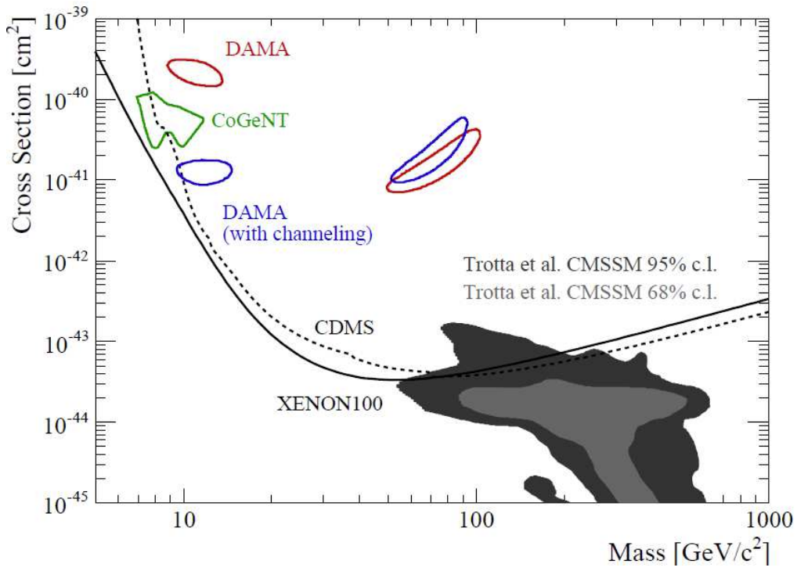
Low Hanging Fruit?
2010

Slide 23
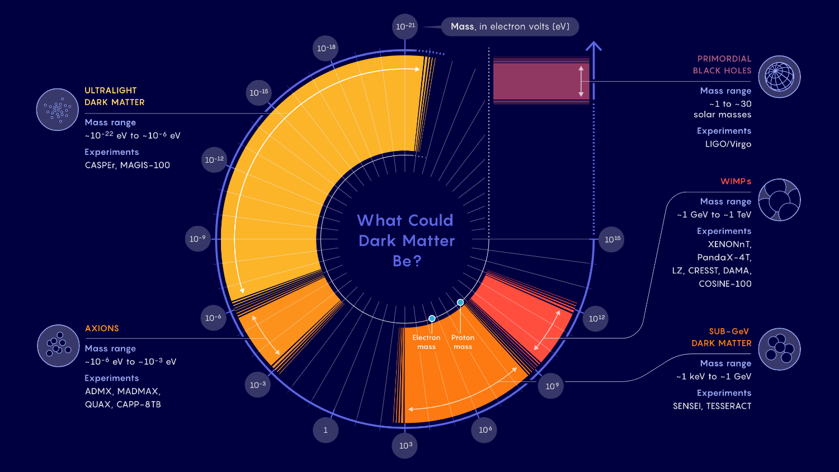
Total Solution/Confusion?

Slide 24
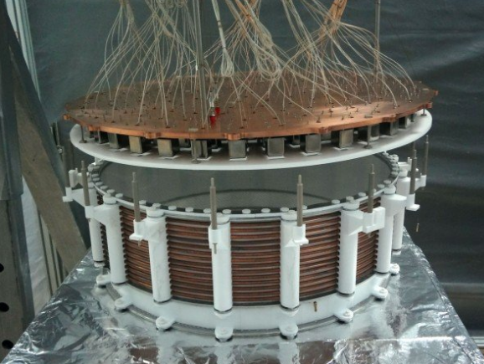
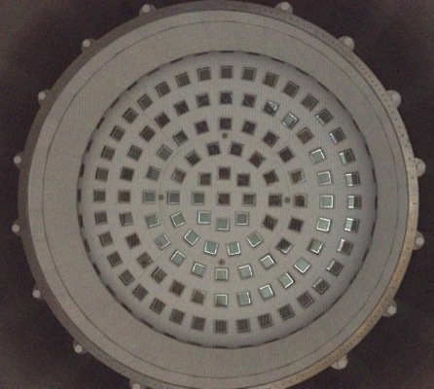
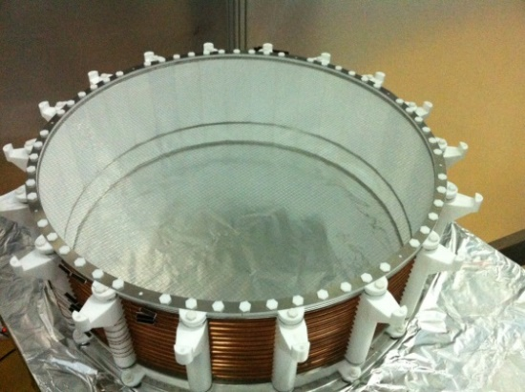
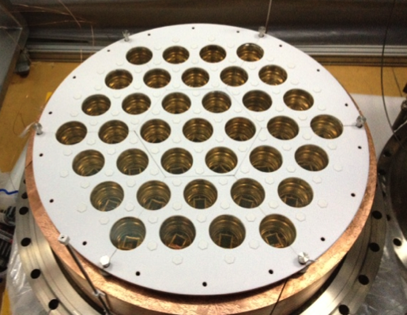
PandaX-I（2009-2014），120 kg

Slide 25
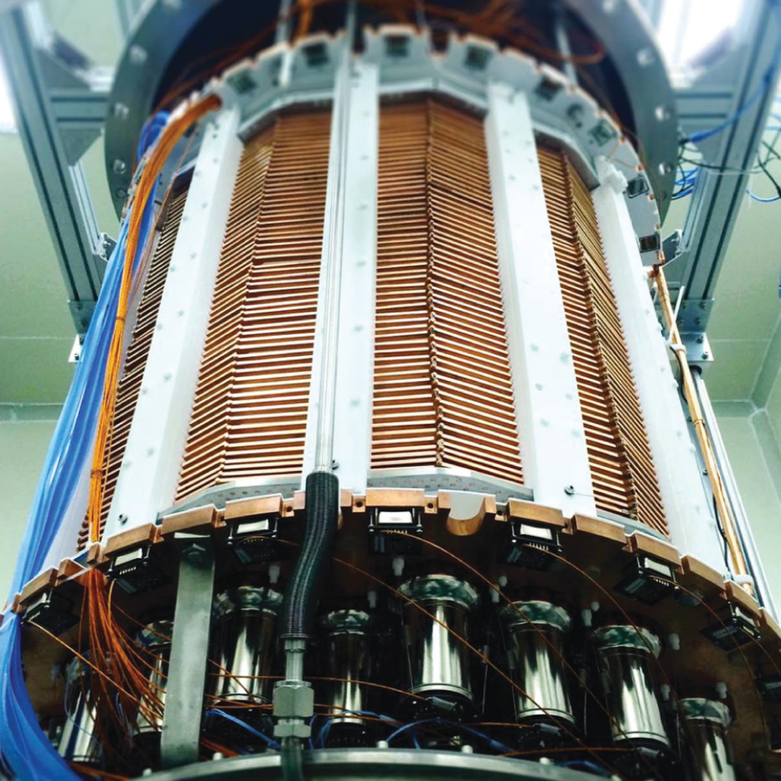
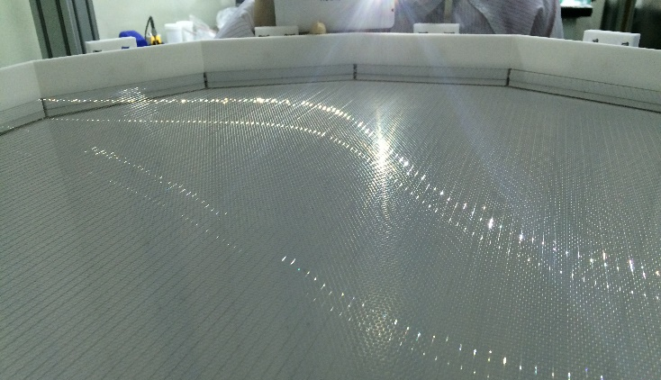
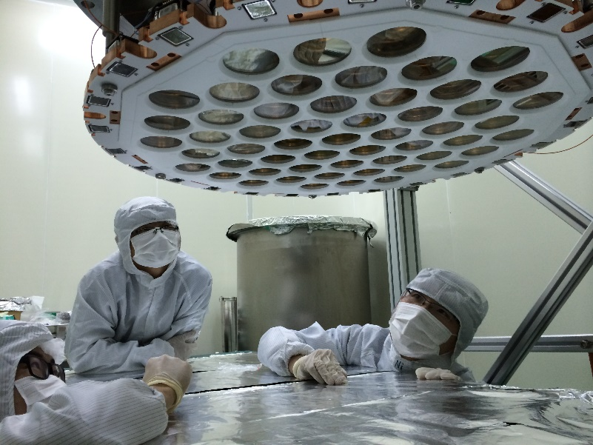
PandaX-II (2015-2019)
580kg
120kg

Slide 26


Slide 27












2018.4 water tank construction
2019.8 PandaX-4T instllation
2020.5 liquid xenon filling
2020/6-2020/11 integration tests

Slide 28

First recorded event in PandaX-4T（2020/6/3 17:19:35）

Slide 29



Background: toughest battle
20 atom/kg => 2 atom/kg of xenon
氚：³H，5trillion/kg of water
Similarly: ⁸⁵Kr ~ 10 atom/kg, ²²²Rn ~ 1 atom/kg in xenon

Slide 30
Background: toughest battle
20 atom/kg => 2 atom/kg of xenon
氚：³H，5trillion/kg of water
Similarly: ⁸⁵Kr ~ 10 atom/kg, ²²²Rn ~ 1 atom/kg in xenon

Slide 31


Slide 32



Kr85 essay – an “endless” pursue
Old method: RGA-based
New method with optical spectrometer

Slide 33


1.5 ton*year Exposure

Slide 34




How dark is dark matter?

Slide 35


Slide 36



Low mass DM detection techniques
2203.08297 US Snowmass
DM’
DM
e’
Atomic inelastic scattering: accessing full DM KE-binding. Essig, Mardon, Volansky, PRD 85, 076007 (2012)

Slide 37





S2-only approach
PRL 130, 261001 (2023)
PRL 135, 211001 (2025)

Slide 38


Slide 39


Slide 40


Slide 41





𝛎

Slide 42




Slide 43
APS highlights of the year 2024
Miniature astrophysical neutrino observatories!

Slide 44


LZ/XENON latest results
LZ: 2512.08065
XENON: 2604.06002
A platform to study neutrino interactions + astrophysical neutrino observatory

Slide 45



“Bigger fish”: Majorana neutrinos
1937, Majorana

Slide 46

Dirac, 1928
Negative energy solution ⇔ positron (e⁺)

Slide 47

Matter⇔Energy

Slide 48



1/Billion Asymmetry?
Early Universe
Today Universe

Slide 49


Neutrino Connection?
Leptogenesis: Fukugita and Yanagida
Neutrino is majorana
Neutrino violate CP
Neutrino mass is produced by seesaw mechanism

Slide 50


How to Tell a Majorana Neutrino?

Slide 51


Particle Experiments vs Cosmology
DESI 2025：
Σm_{v}<0.064 eV

Slide 52



¹³⁰Te/¹⁰⁰Mo
⁷⁶Ge
¹³⁶Xe (8.9% natural abd.)
CUORE/CUPID
Bolometer
LEGEND family
HPGe
KamLAND-ZEN
Doped LS
EXO/nEXO
LXe TPC

Slide 53

Magical Xenon
0.1%
ECEC
DBD
DBD

Slide 54

Most accurate Xe136 2vbb
arXiv:2512.04849
PRL

Slide 55


Xe136 0vbb：Best Results in Natural Xenon
Science Bulletin 2025
arXiv:2412.13979
Lifetime
$>2.1×{10}^{24}$year 90% CL
Median sensitivity
2.7 $×{10}^{24}$year

Slide 56

Race of Majorana neutrino mass
???

Slide 57

What are we doing now?
April 17,2026
Bye bye PandaX-4T!

Slide 58


Next future
20T
43T

Slide 59



PandaX-20/40T @ CJPL

Slide 60

Baseline scientific potential
FV 13 ton, ROI 1-10 keVee, 99.7% ER rejection

Slide 61

Baseline scientific potential
FV 2.4 ton natural, 1% resolution

Slide 62


Unique advantage of natural xenon detector: Xe136->Ba136*
60t
100t
arXiv:2508.17413, Ke Han, Shaobo Wang, Jiangmin Yao et al.

Slide 63

Baseline scientific potential

Slide 64



10 Years from Now？
Isotopic separation according to scientific findings
AMIA1
AMIA2
Discovery smoking gun！

Slide 65






A symphony without finale …
1887
2015

