Slide 1
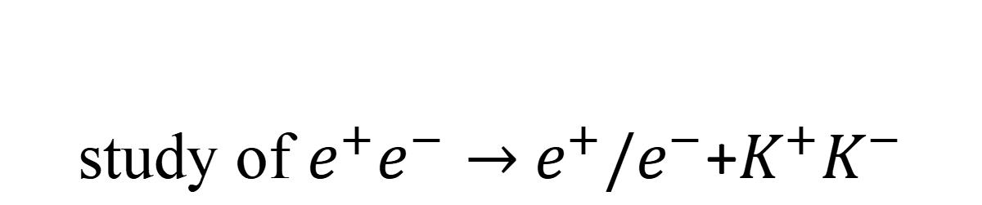
study of $e^{+}e^{−}→$ $e^{+}{/e}^{−}$+$K^{+}K^{−}$
2026.6.17

Slide 2
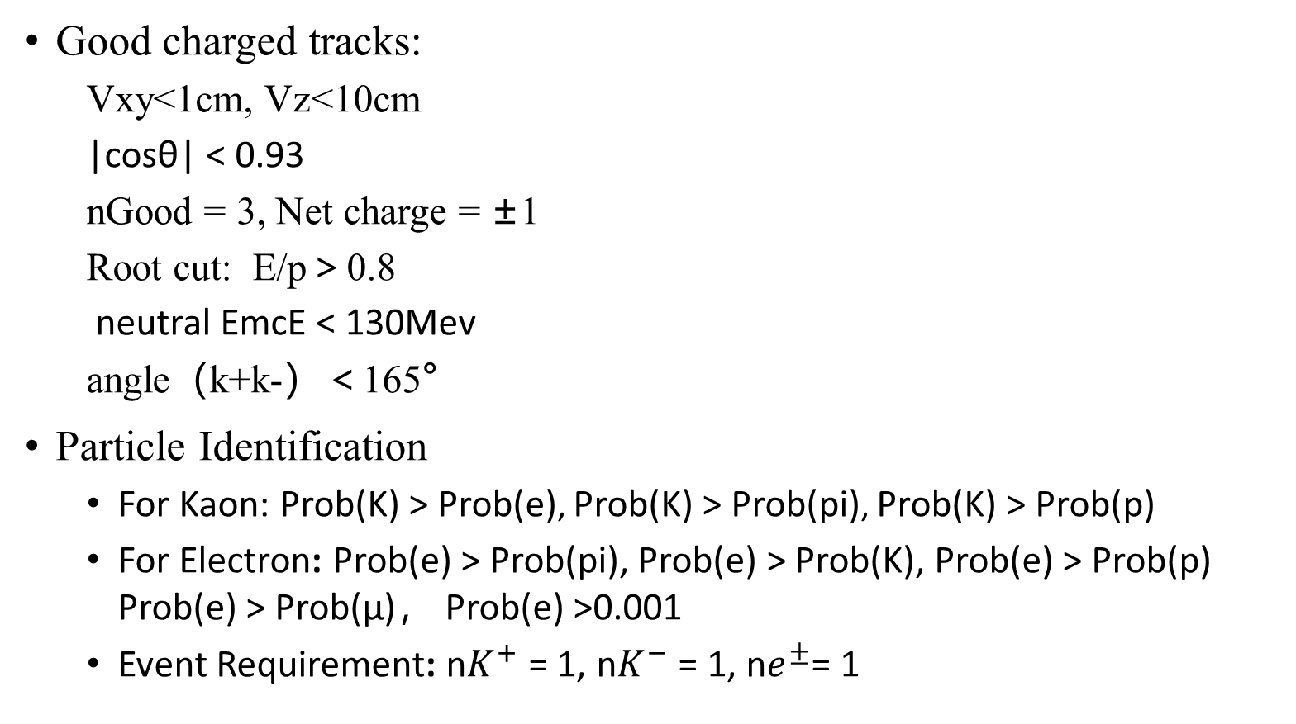
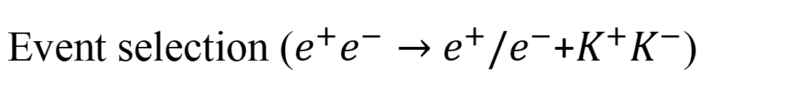
Event selection ($e^{+}e^{−}→$ $e^{+}{/e}^{−}$+$K^{+}K^{−}$)
Good charged tracks:
  Vxy<1cm, Vz<10cm
  |cosθ| < 0.93
  nGood = 3, Net charge = ±1
  Root cut: E/p＞0.8
  neutral EmcE < 130Mev
  angle（k+k-）＜165°
Particle Identification
  For Kaon: Prob(K) > Prob(e), Prob(K) > Prob(pi), Prob(K) > Prob(p)
  For Electron: Prob(e) > Prob(pi), Prob(e) > Prob(K), Prob(e) > Prob(p) Prob(e) > Prob(μ)， Prob(e) >0.001
  Event Requirement: n$K^{+}$ = 1, n$K^{−}$= 1, n$e^{±}$= 1

Slide 3
Event selection ($e^{+}e^{−}→$ $e^{+}{/e}^{−}$+$K^{+}K^{−}$)
蒙特卡洛模拟器产生子:cppGamgam
数据样本
  data：/bes3fs/offline/data/712-1/psipp/round15-17/
  inclusivemc ： /besfs5/offline/data/tauqcd/bes3gen/712/psipp/round17/Hadron_Hybrid

Slide 4
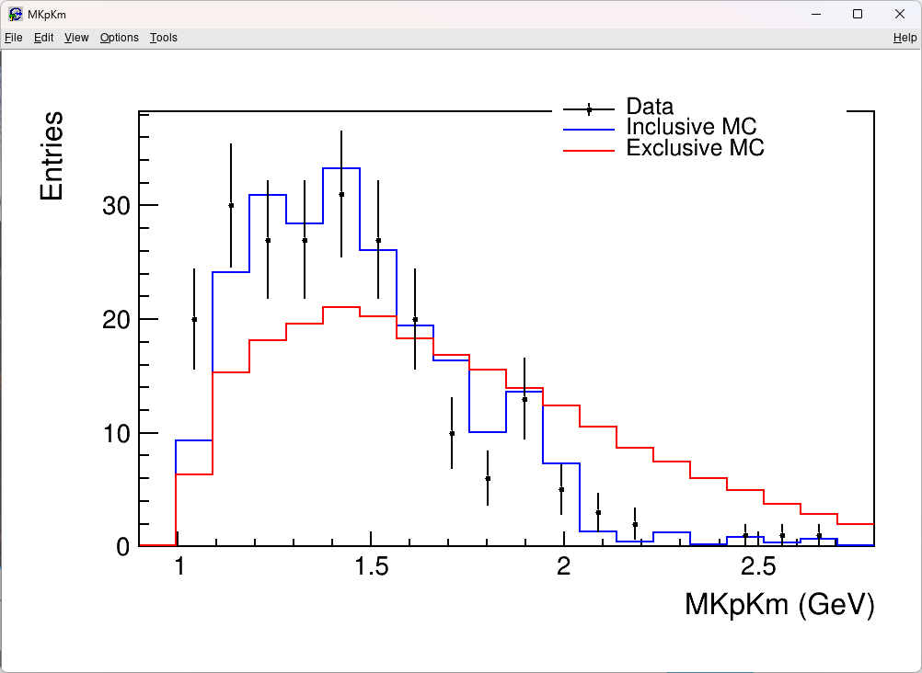
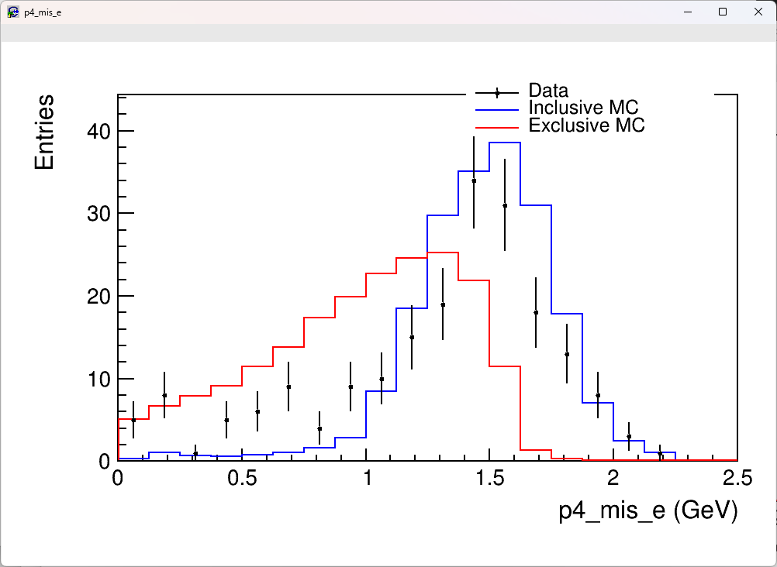

Event selection ($e^{+}e^{−}→$ $e^{+}{/e}^{−}$+$K^{+}K^{−}$)

Slide 5
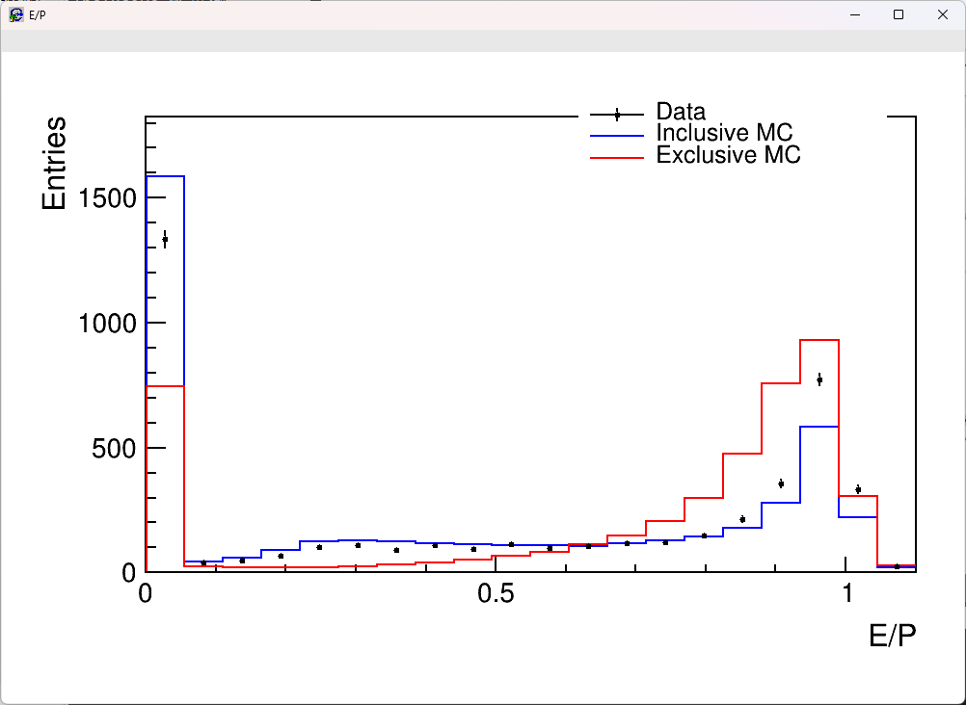
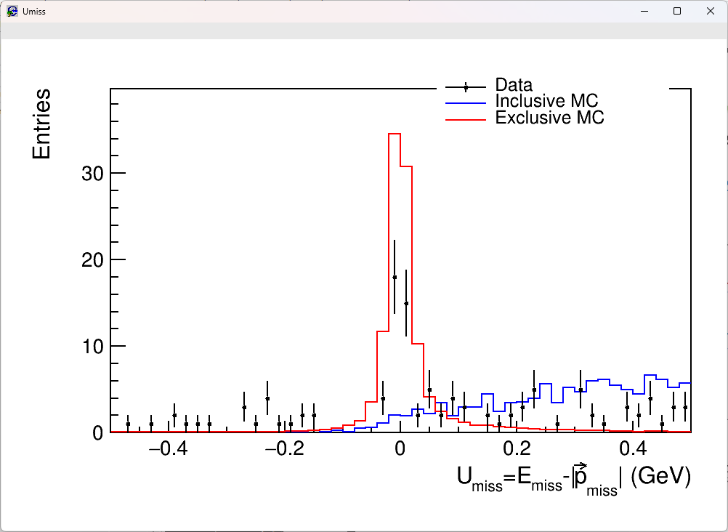
Event selection ($e^{+}e^{−}→$ $e^{+}{/e}^{−}$+$K^{+}K^{−}$)

Slide 6
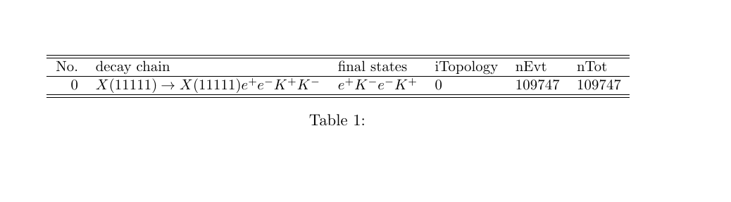

Event selection ($e^{+}e^{−}→$ $e^{+}{/e}^{−}$+$K^{+}K^{−}$)
信号mc topo

Slide 7
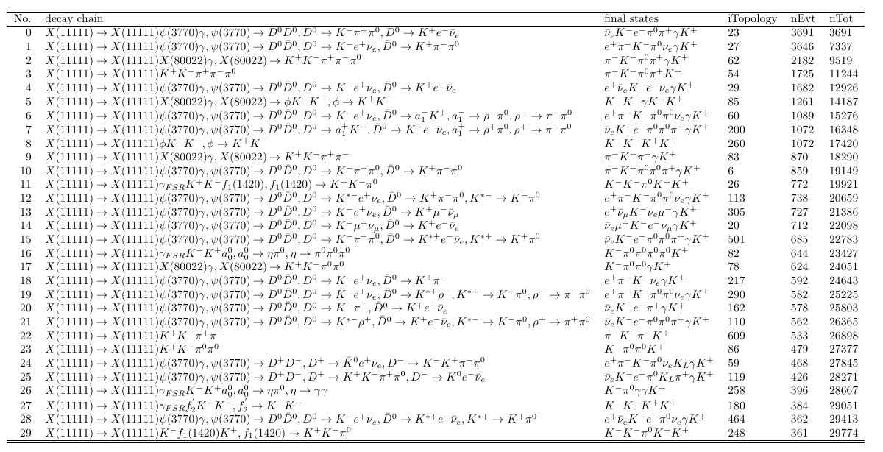
Event selection ($e^{+}e^{−}→$ $e^{+}{/e}^{−}$+$K^{+}K^{−}$)
信号mc topo
Inclmc topo (before cut)

Slide 8
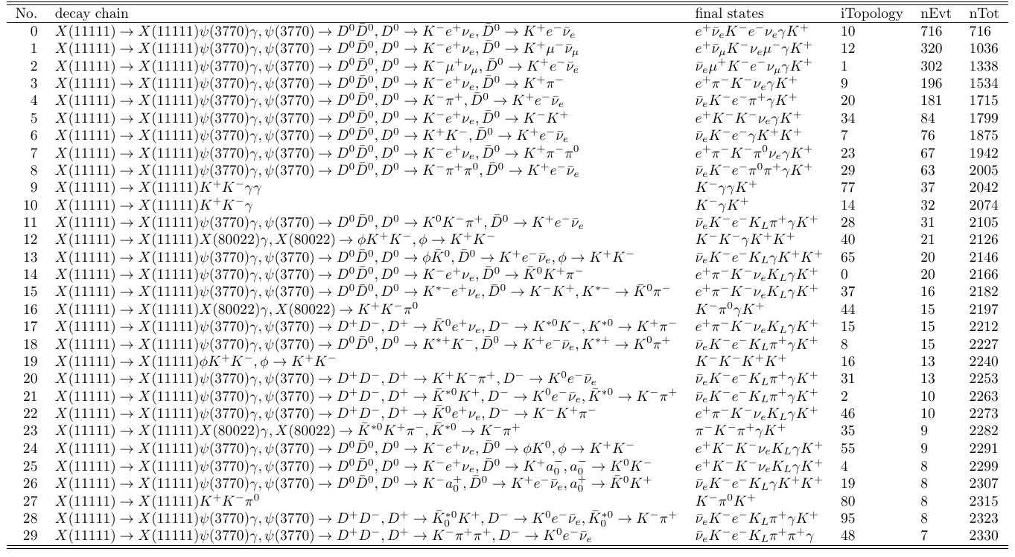
Event selection ($e^{+}e^{−}→$ $e^{+}{/e}^{−}$+$K^{+}K^{−}$)
信号mc topo
Inclmc topo (with eop emc angle cut)

Slide 9
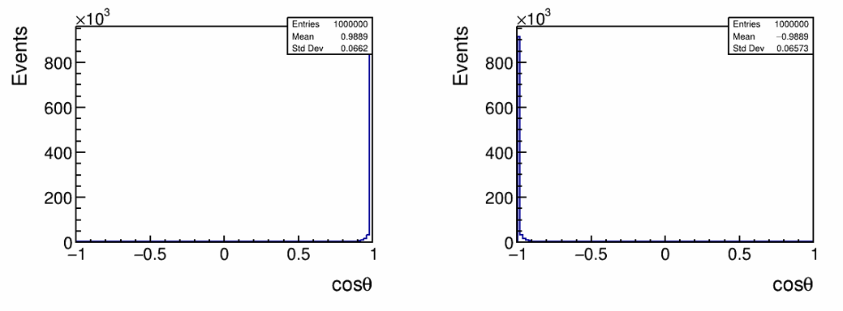
Event selection ($e^{+}e^{−}→$ $e^{+}{/e}^{−}$+$K^{+}K^{−}$)
e+ e-

Slide 10
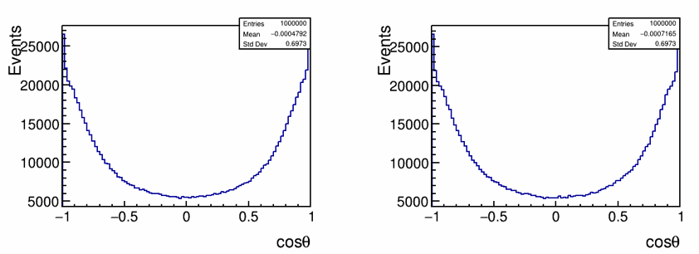
Event selection ($e^{+}e^{−}→$ $e^{+}{/e}^{−}$+$K^{+}K^{−}$)
K+ k-

Slide 11
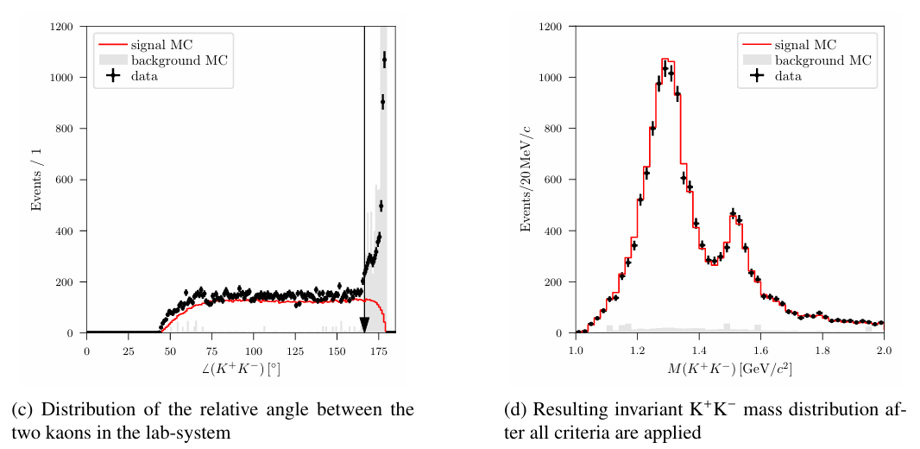
Event selection ($e^{+}e^{−}→$ $e^{+}{/e}^{−}$+$K^{+}K^{−}$)
Event selection by Meike Küßner

Slide 12
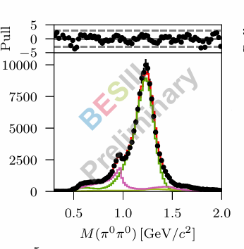
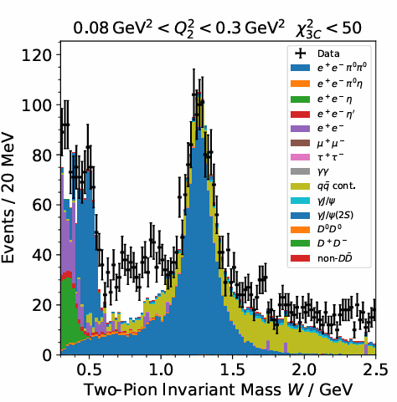
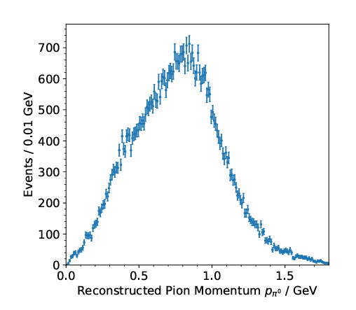

Study of ($e^{+}e^{−}→$ $e^{+}{/e}^{−}$+$K^{+}K^{−}$)
M(pi0pi0) by Meike Küßner
M(pi0pi0) by Max Lellmann
Pion Momentum by Max Lellmann

Slide 13
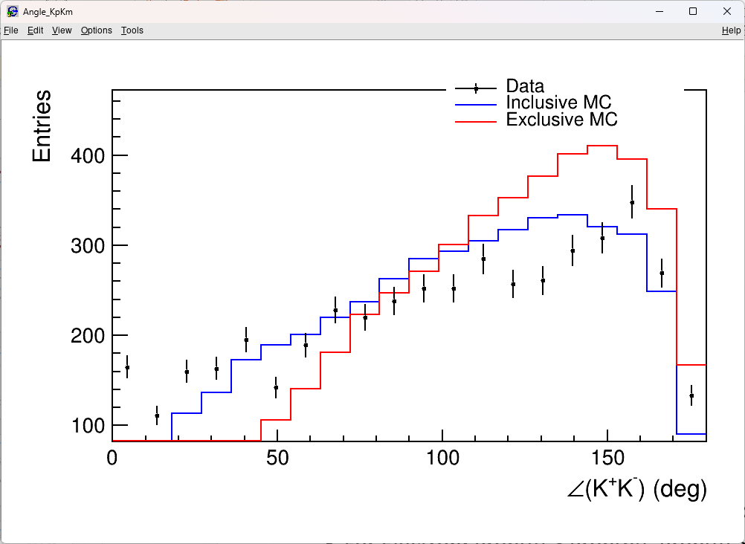
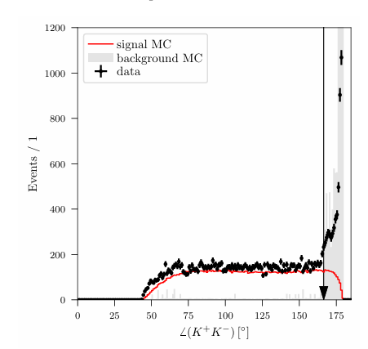
Event selection ($e^{+}e^{−}→$ $e^{+}{/e}^{−}$+$K^{+}K^{−}$)

Slide 14
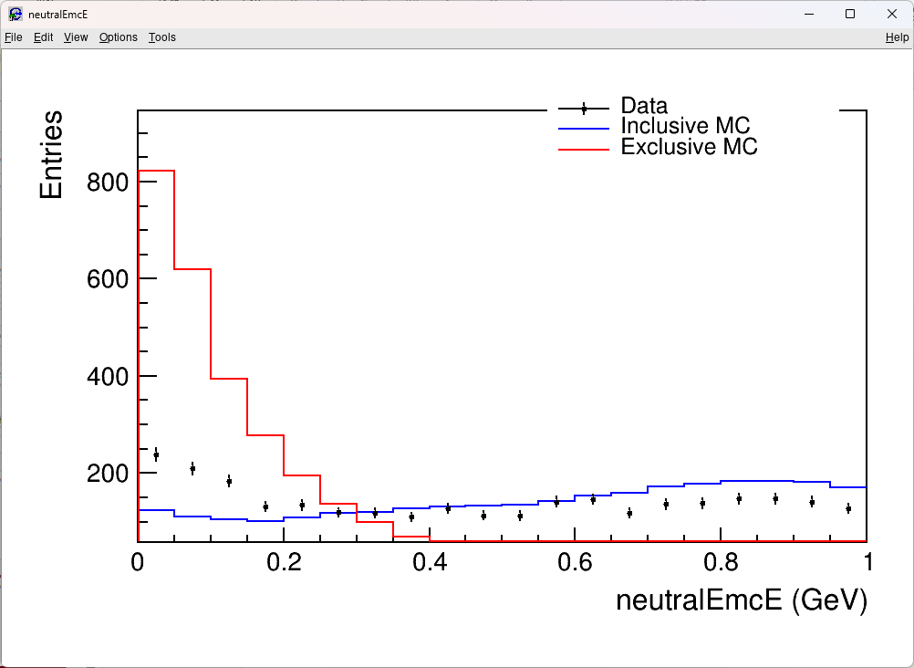
Event selection ($e^{+}e^{−}→$ $e^{+}{/e}^{−}$+$K^{+}K^{−}$)

Slide 15
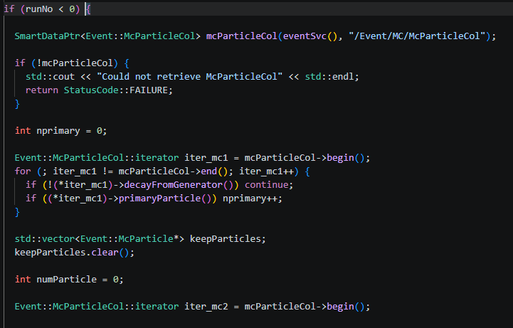
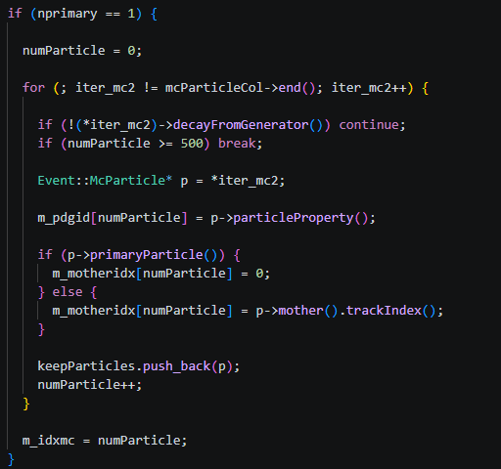
Event selection ($e^{+}e^{−}→$ $e^{+}{/e}^{−}$+$K^{+}K^{−}$)

Slide 16
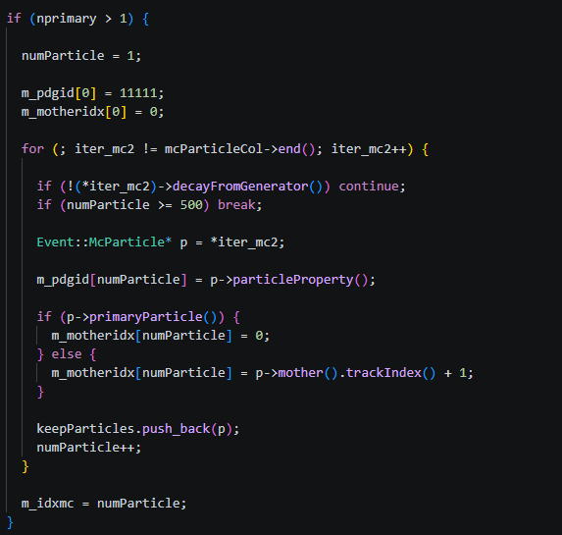
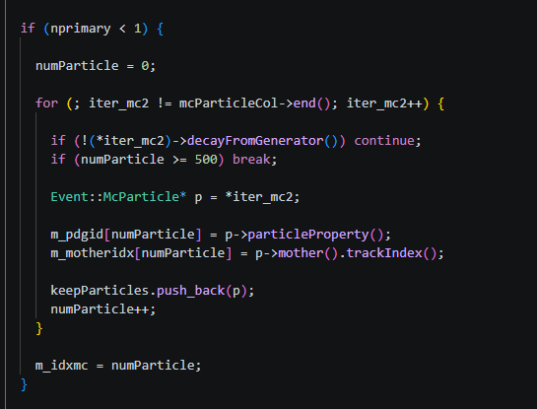
Event selection ($e^{+}e^{−}→$ $e^{+}{/e}^{−}$+$K^{+}K^{−}$)

Slide 17
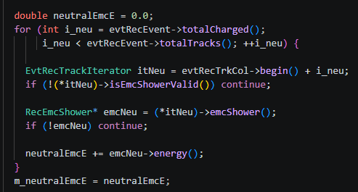
Event selection ($e^{+}e^{−}→$ $e^{+}{/e}^{−}$+$K^{+}K^{−}$)

